Slide 1
Analyzing Floodplain Reconnection as a Restoration Method
Dr. Natalie Kruse Daniels
Jen Bowman, Nora Sullivan, Dr. Kelly Johnson, Annika Gurrola, Jordan Pazol, Ashley Widener, Jacob South

Slide 2
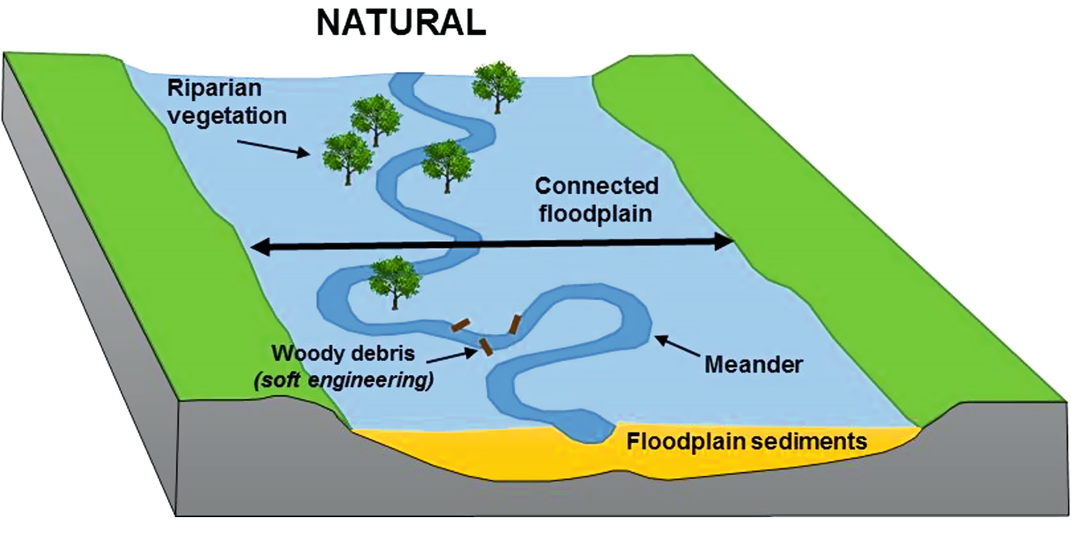
Floodplain Reconnection and Restoration
Purpose:
To establish a connection between stream channel and the surrounding terrestrial environment
Why use this method:
Increased water storage
Increased nutrient storage
Increased resilience to flooding
Reduced erosion
Historically, streams in this area behaved this way.
Cooper, Hiscock, & Lovett, 2019

Slide 4
Erosion
High water velocity post rainfall

Slide 5
Increased water storage
Reduced sediment flux into channel
Less SW nutrient export DS
Less sediment export DS

Slide 11
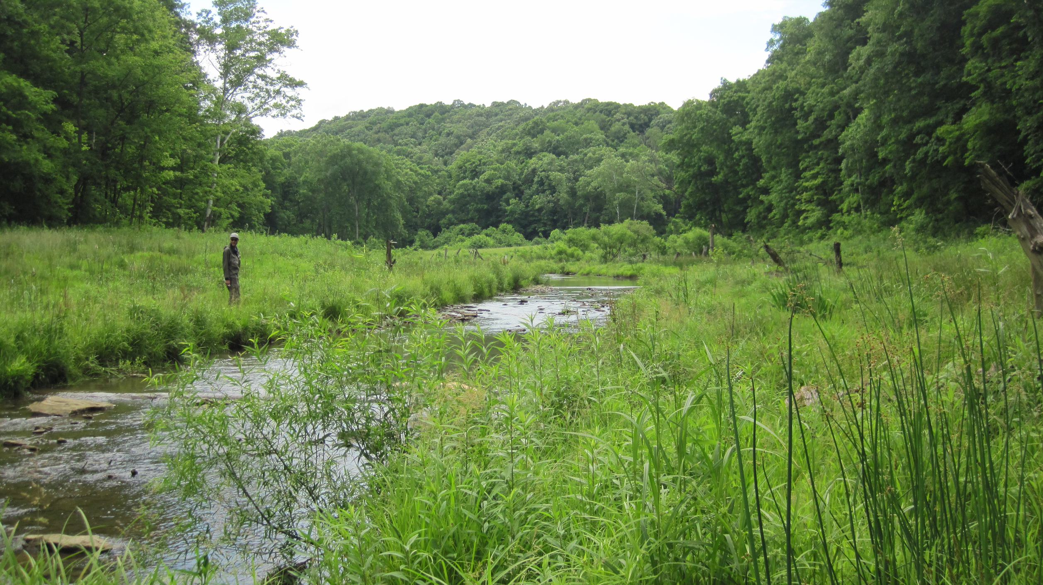

Slide 17
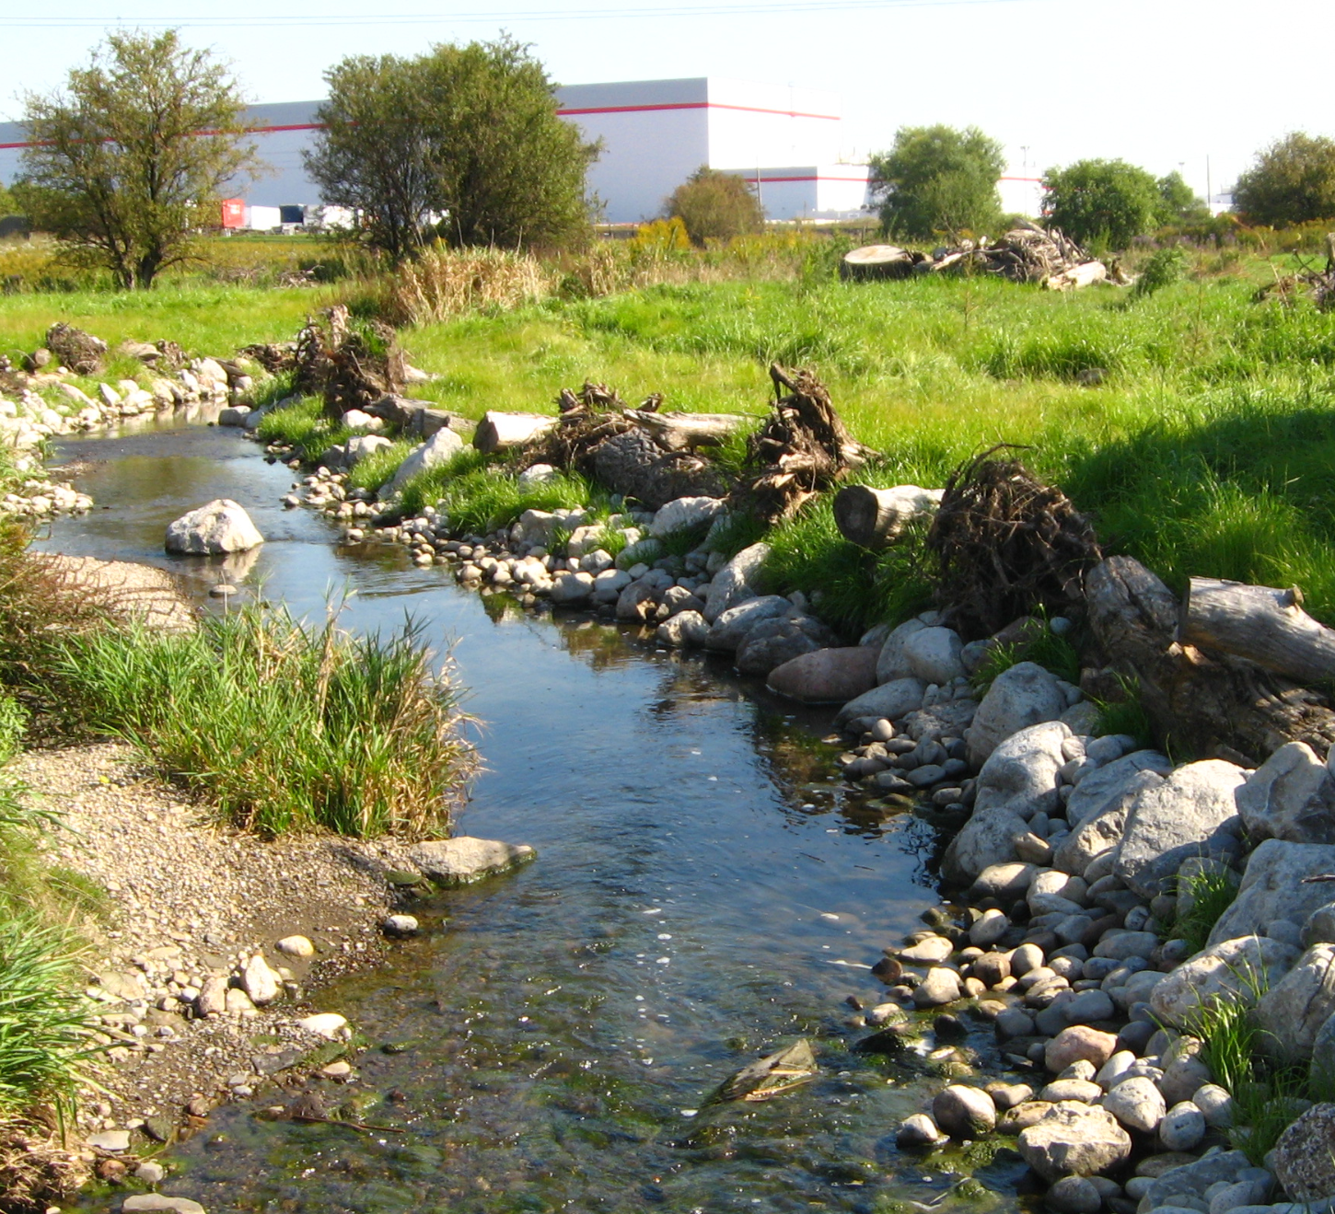
Problems with Form Focused Restoration
Overlooks dynamic nature of streams’ chemical and biological processes
Ignores need for open systems that adjust to changing inputs of energy and material
Won't encourage return of previously established species (Walter & Merritts, 2008)
https://sustainabletechnologies.ca/home/urban-runoff-green-infrastructure/natural-features-and-systems/natural-channel-design/

Slide 18
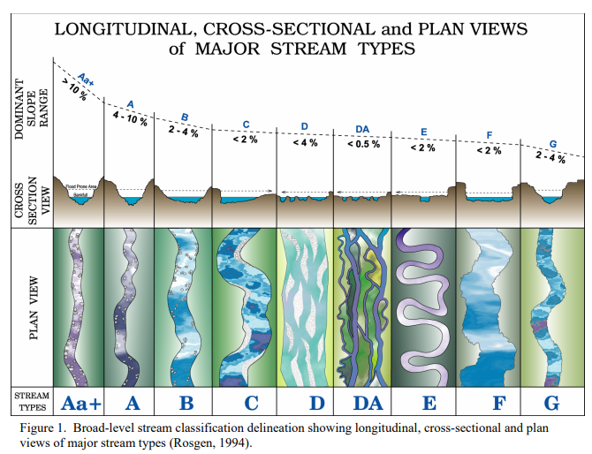
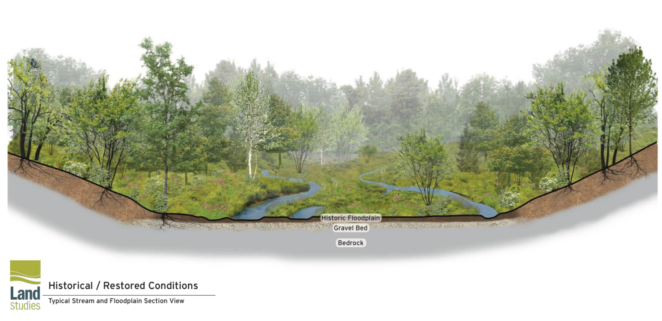
Stream Restoration
Form Based versus Function Based

Slide 19
Sediment Dynamics
Excess sediment can cause: turbid water, habitat destruction, lower biodiversity
Sediment can harbor excess nutrients
Velocity and volume of water moves sediment at different rates

Slide 20
Nutrient Cycling
Nutrients are vital for ecosystem health, but too much or too little can be harmful to biodiversity
Many different biotic and hydrologic factors control rates of nutrient retention, removal, and release
McMillan and Noe note that nutrient processing rates were primarily controlled by physical channel features
Simplified channel structure does not lead to a connected system like varied, natural streams do

Slide 21
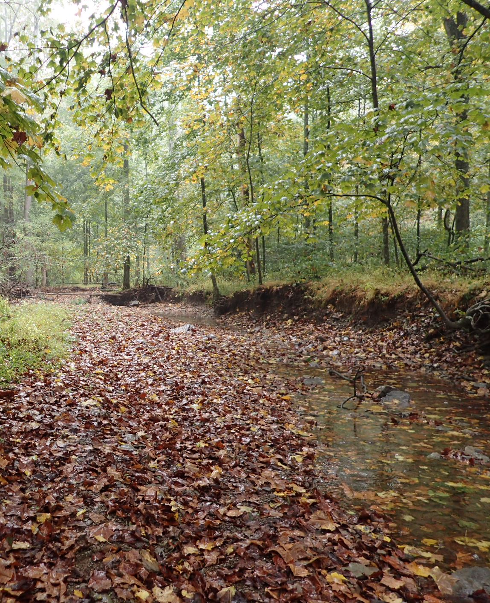
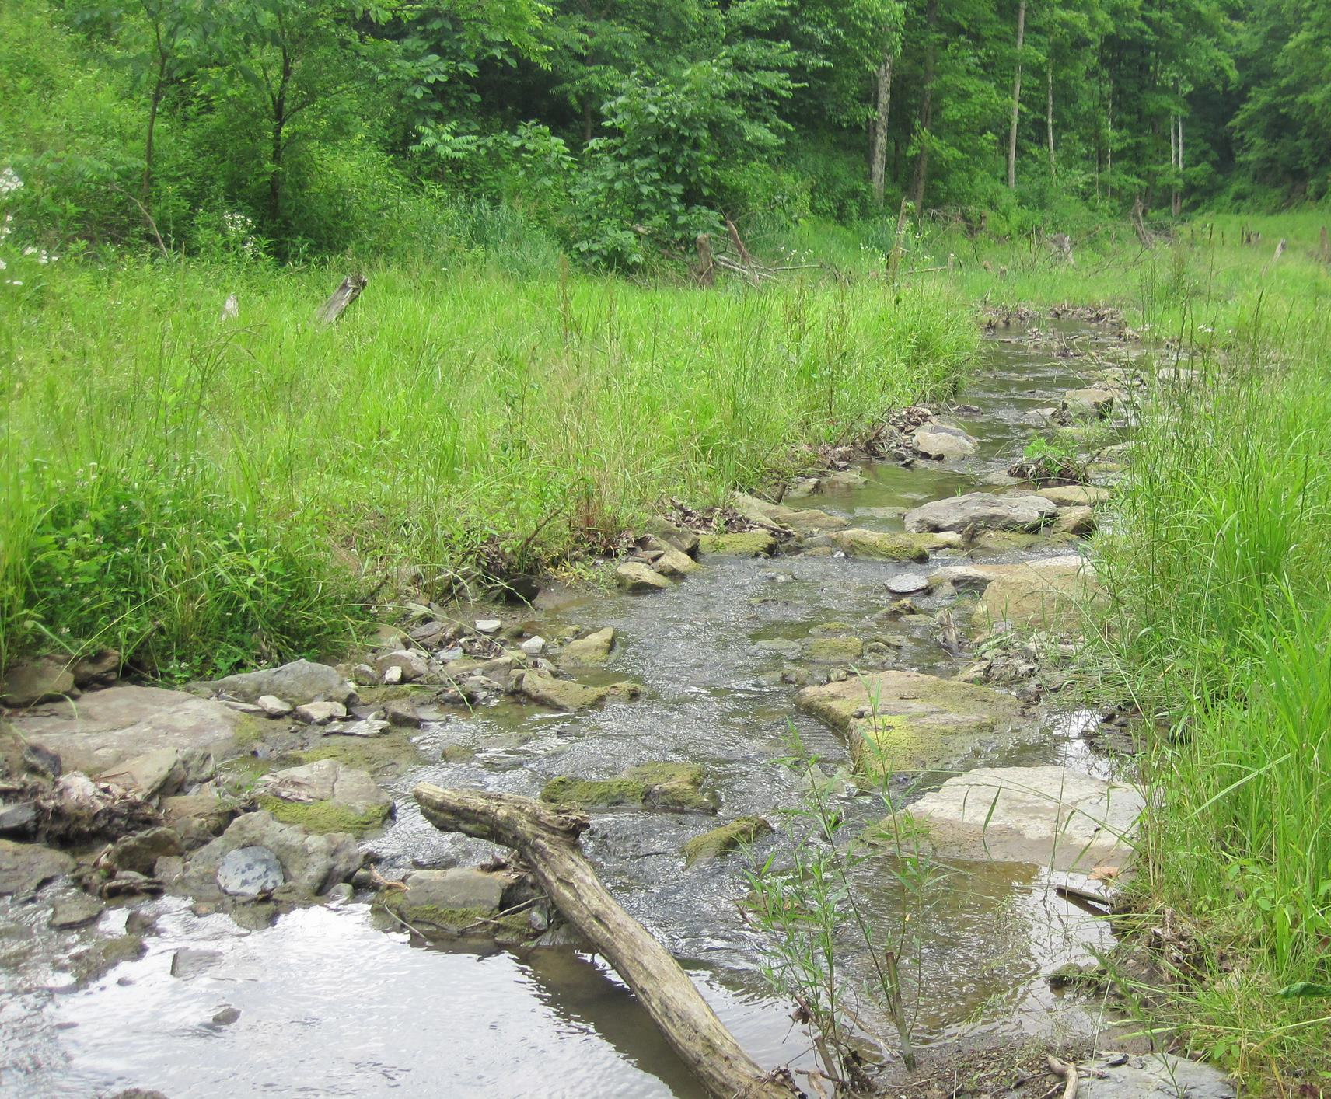
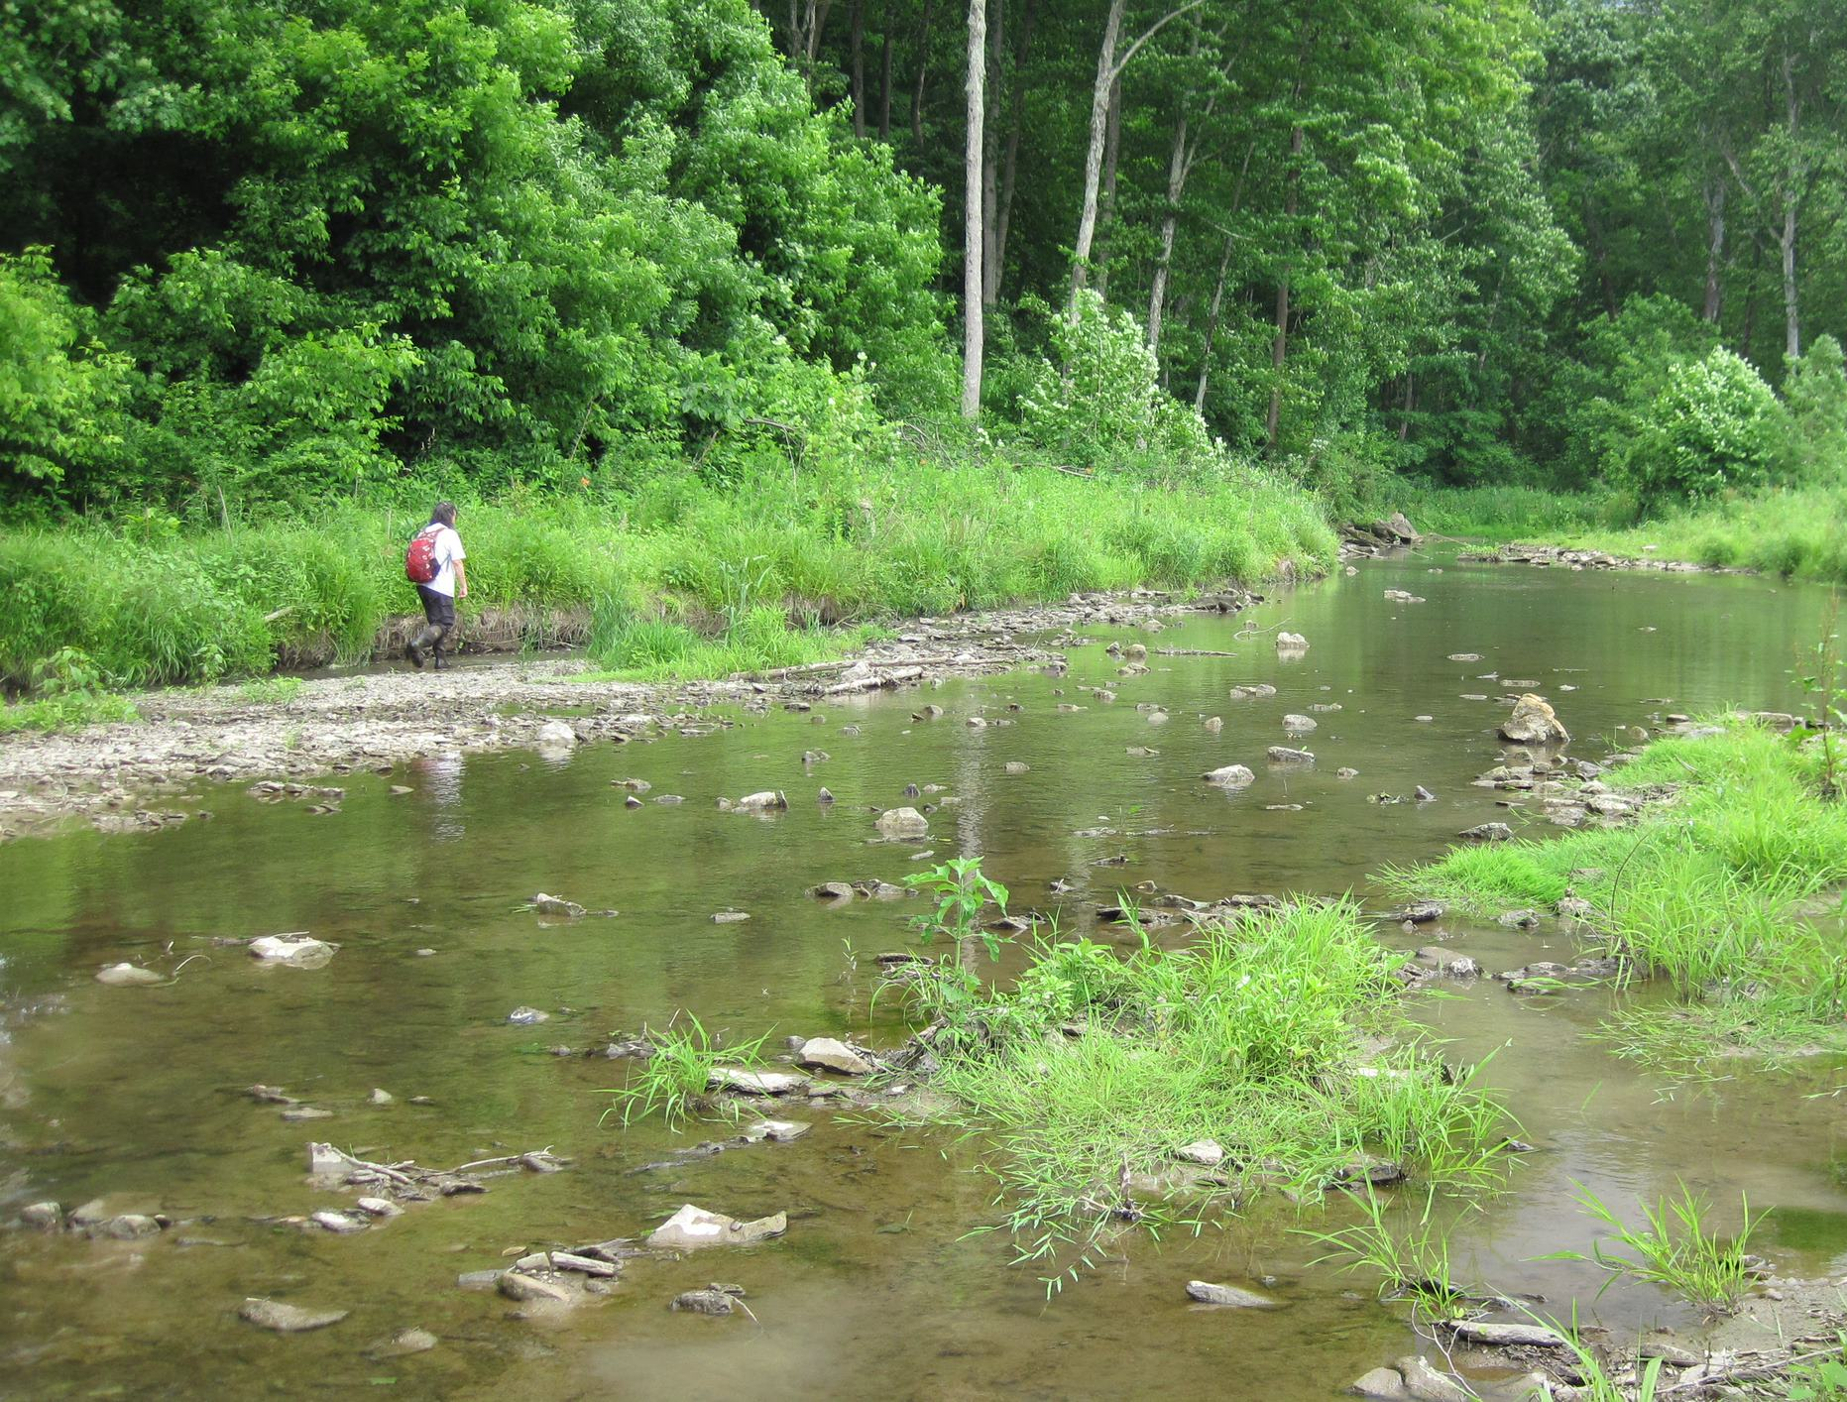
Study Sites
Primary headwaters
Headwaters
Wadeable

Slide 22
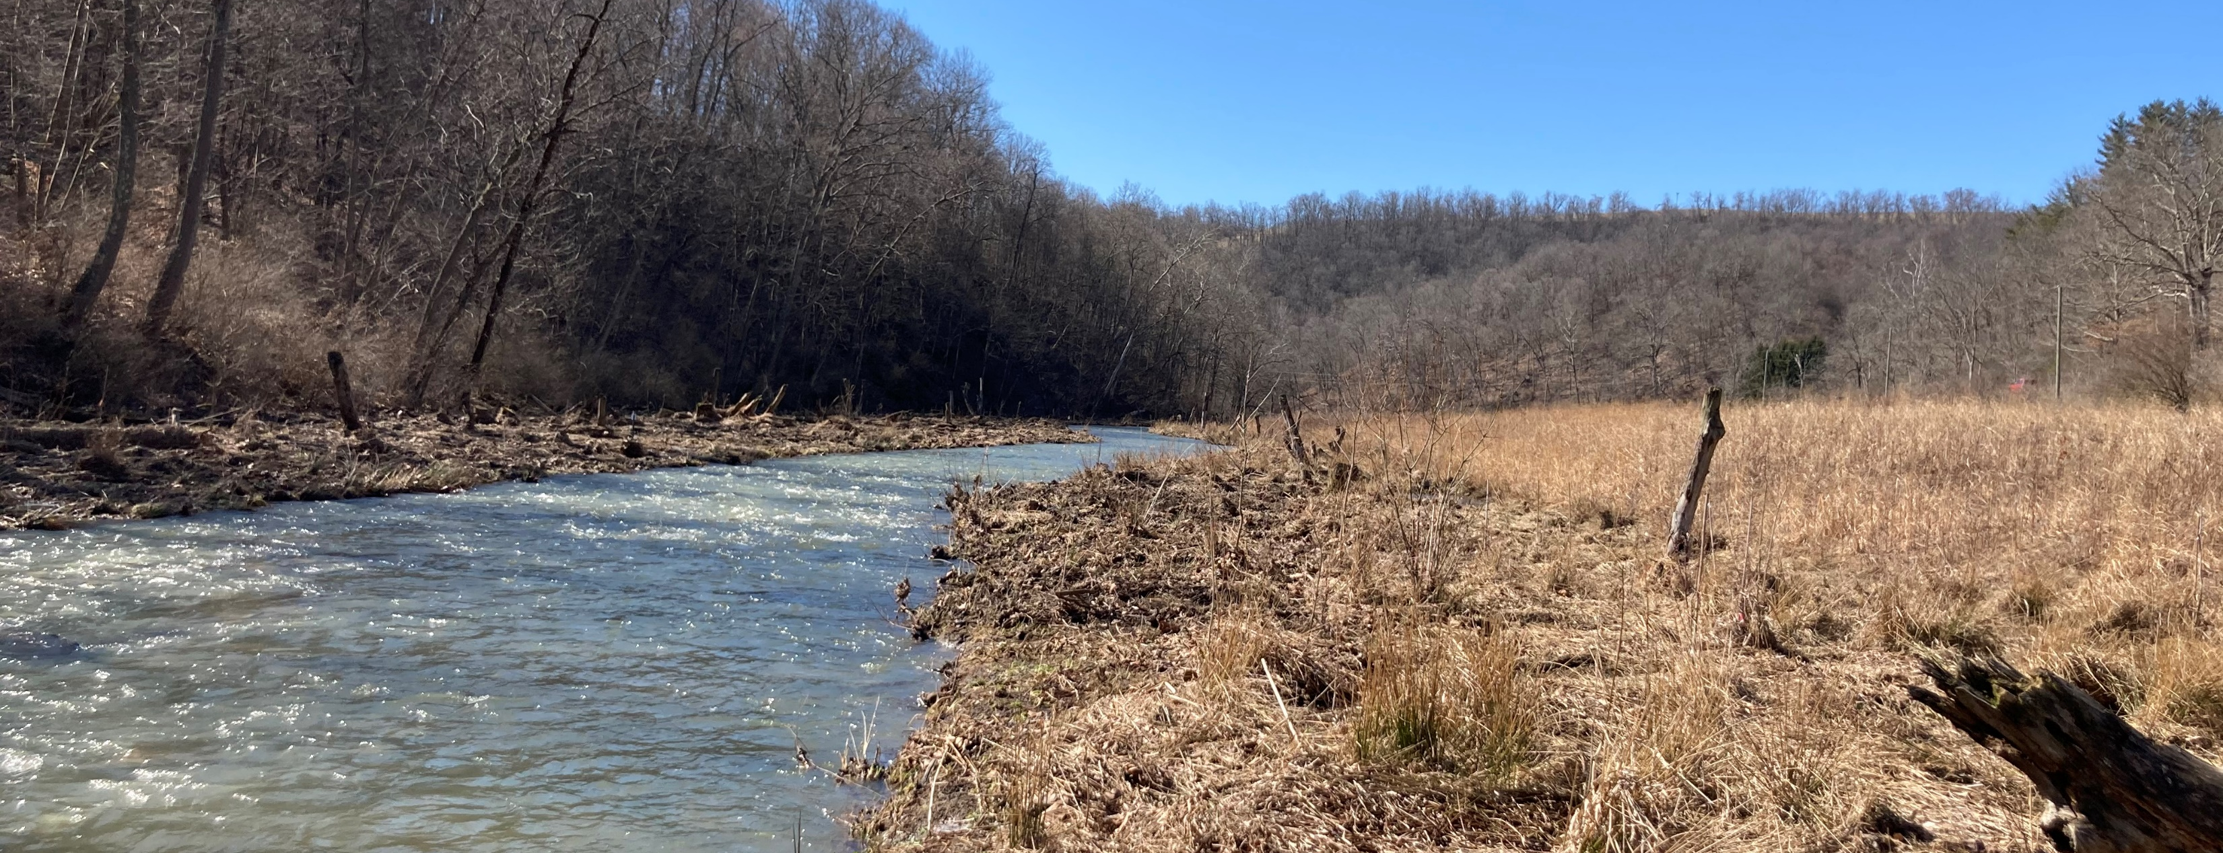
Hydrologic Change

Slide 23
Daily Precipitation Data

Slide 24
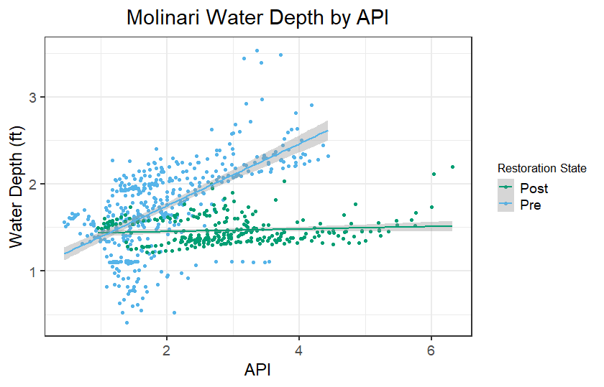
Wadeable streams
Molinari – Slope decreased post-restoration. This means that water level stays fairly consistent over a wide range of wetness and is not influenced by periods of high precipitation nearly as much as it was pre-restoration.
Lebanik – Water level was lower post-restoration. Contrary to the hypothesis, behaves oppositely Molinari and the slope increases post-restoration, meaning that the water level was more influences by periods of high precipitation.

Slide 25
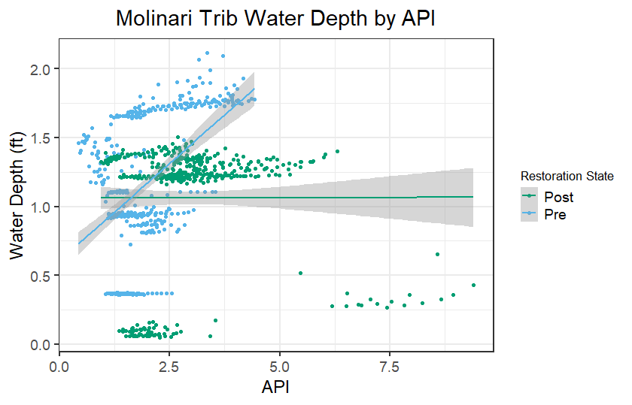
Headwater streams
Beham – Water level was higher post-restoration. Slope increased post-restoration.
Molinari Trib - Slope decreased post-restoration

Slide 26
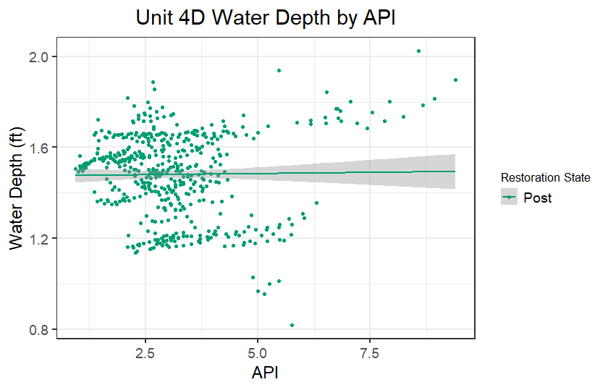
Primary headwaters
McCulley – Slope decreased post-restoration
Unit 4D – no pre-restoration data, but the trendline is flat like most of the other sites post-restoration, so likely a decrease

Slide 27
Sediments

Slide 28
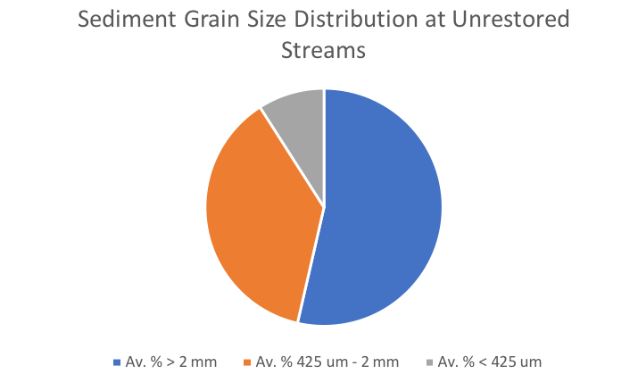
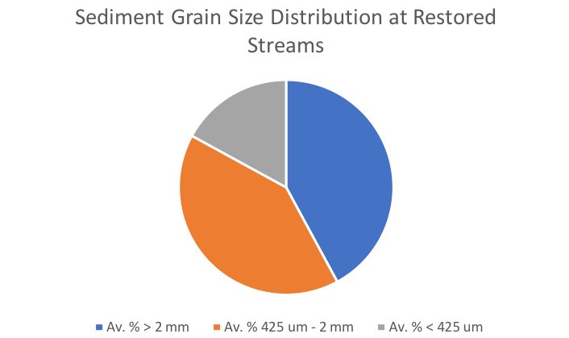
Sediment Dynamics
More fine grained sediment in restored sites

Slide 29
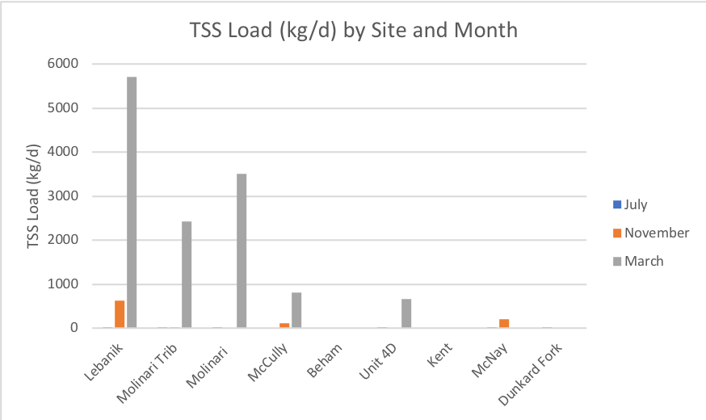
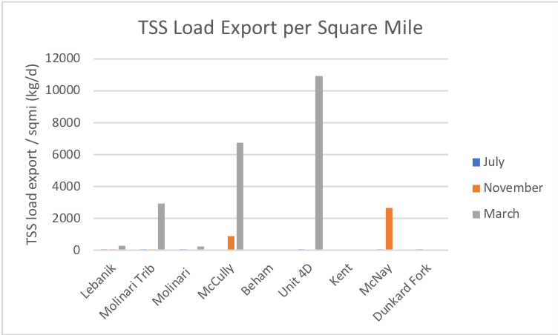
Sediment Dynamics
TSS load export/mi² was highest in high flow, lowest during low flow

Slide 30
Nutrients

Slide 31
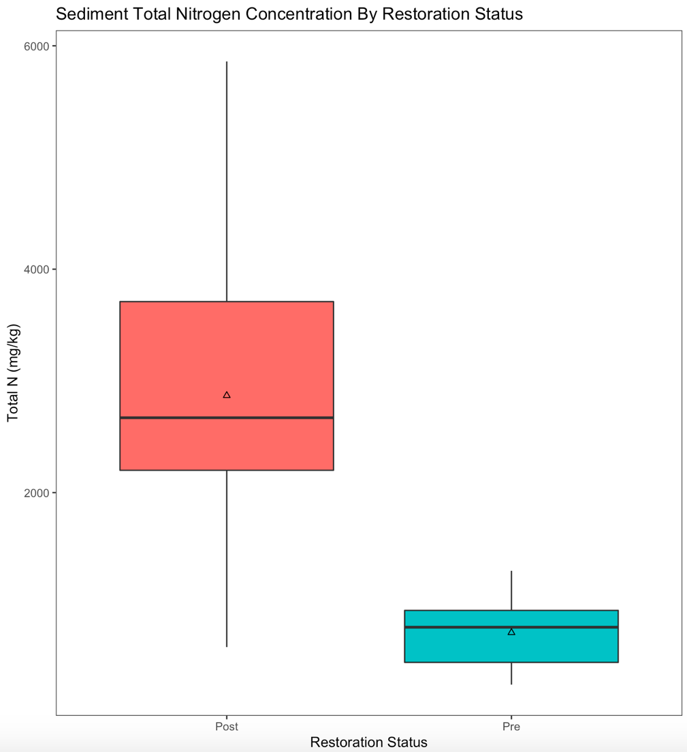
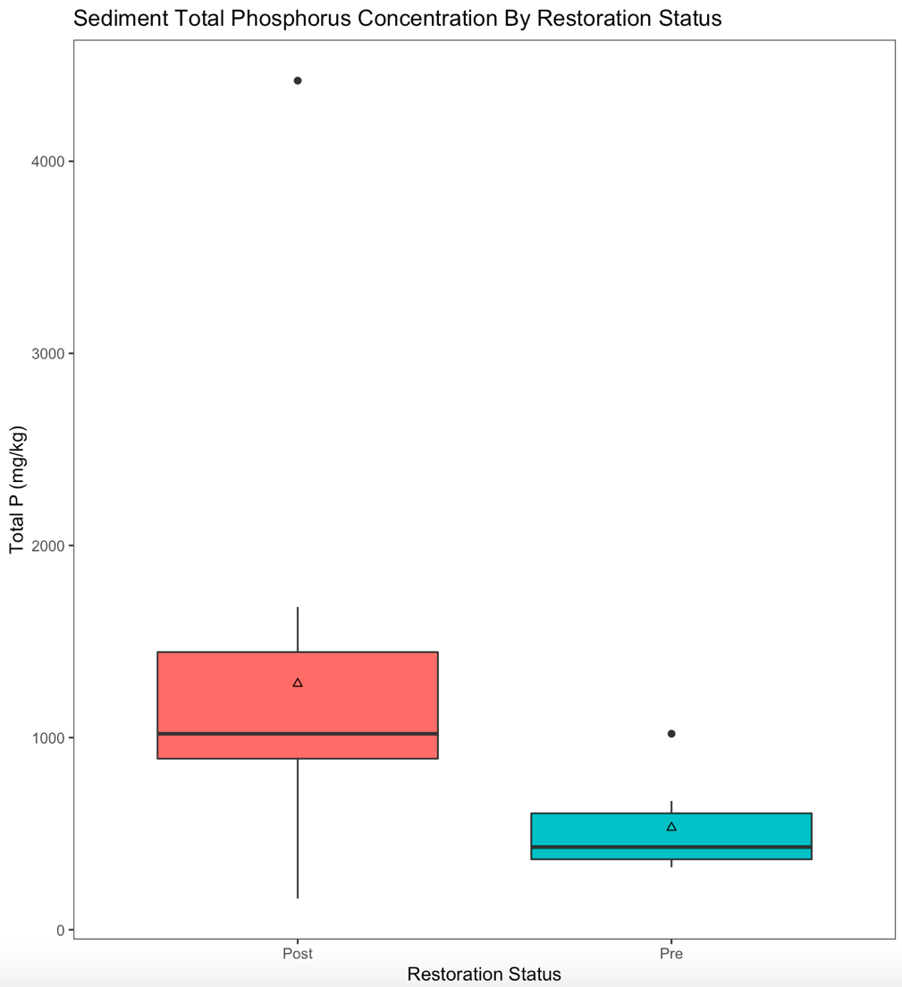
Sediment Nutrients
More N and P in restored sites
P = 0.014
P = 0.008

Slide 32
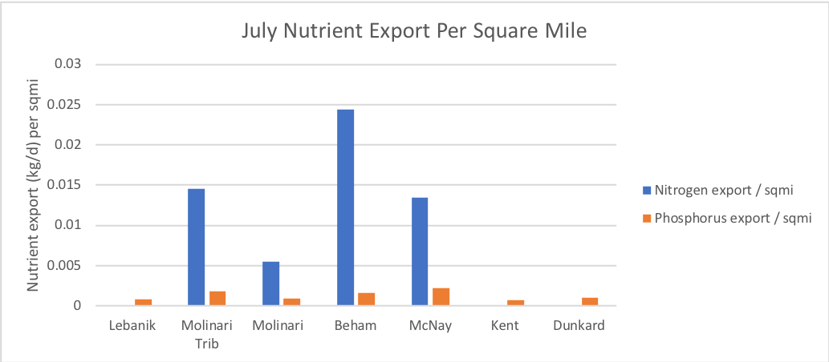
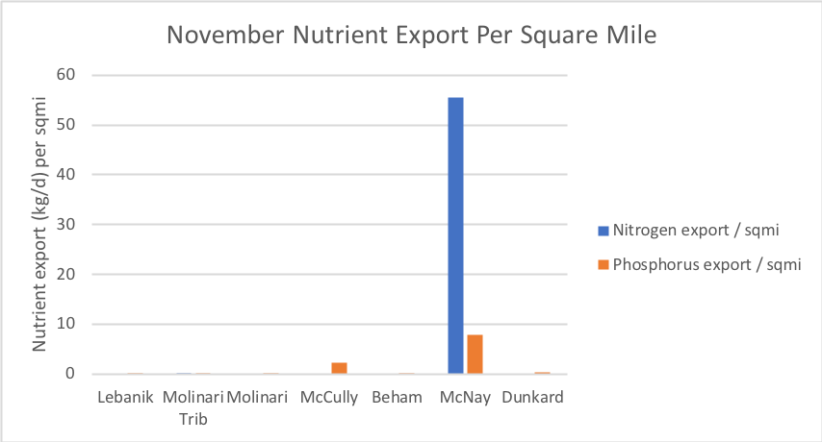
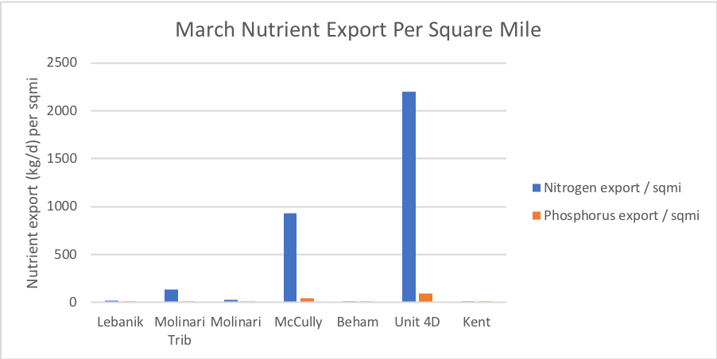

Slide 33
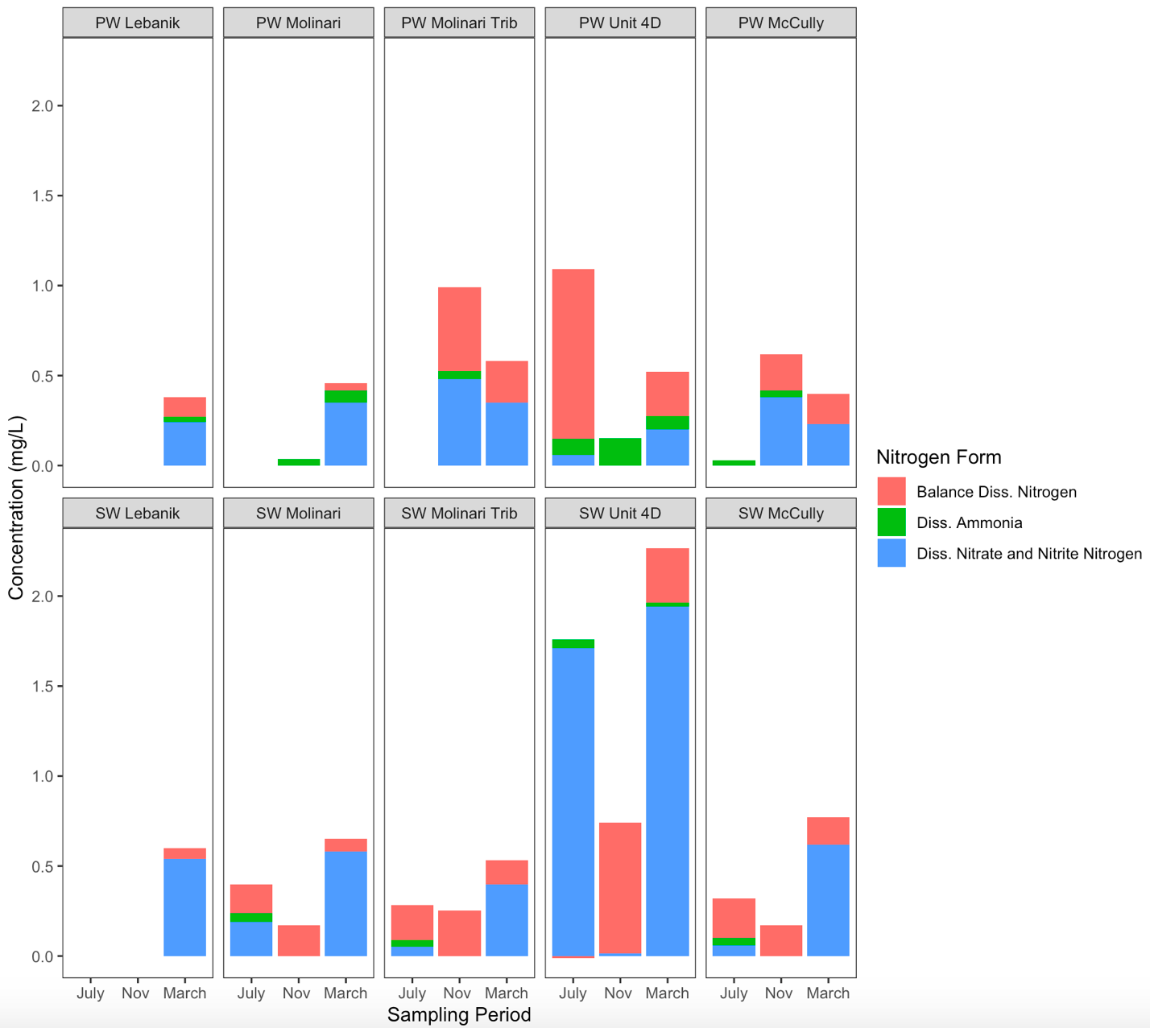
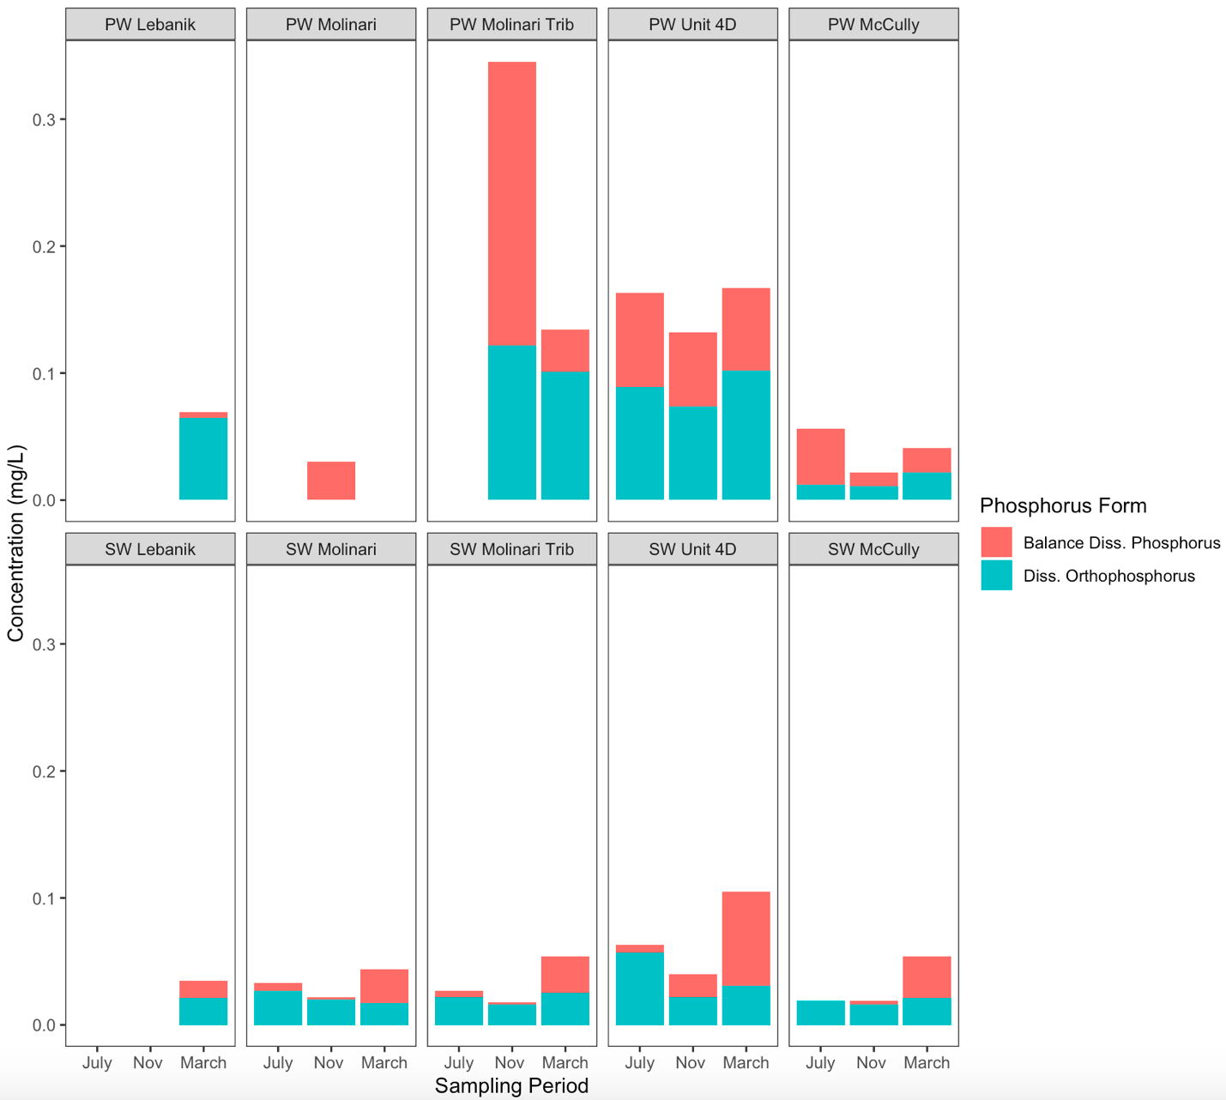
Floodplain Nutrient Interactions: PW and SW
P = 0.017

Slide 34
Summary
Floodplain Reconnection:
Tends to have less “flashy” storm response, limiting erosion
Retains fine grained sediments
Retains sediment-bound nutrients
Retains phosphorus in floodplain wetlands

Slide 35
Thank you!
Dr. Natalie Kruse Daniels
Master of Sustainability, Security, and Resilience (online)
Master of Science in Environmental Studies (in person)
Ohio University
krusen@ohio.edu

