Slide 1
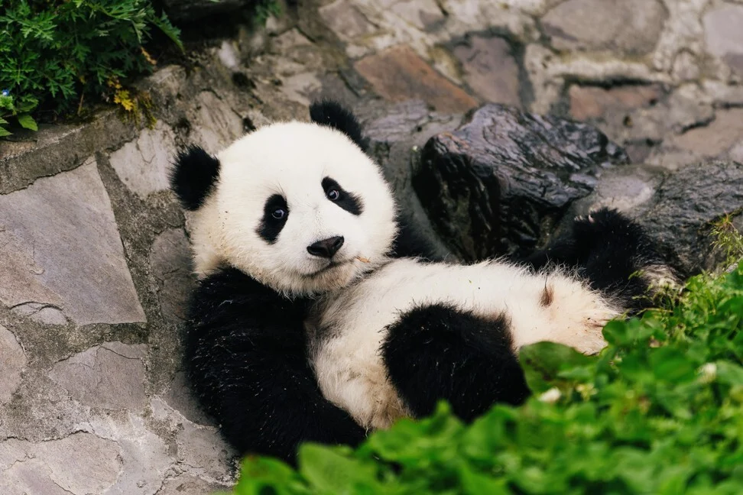
Hi!! Do you know me??
My favorite food??

Slide 2
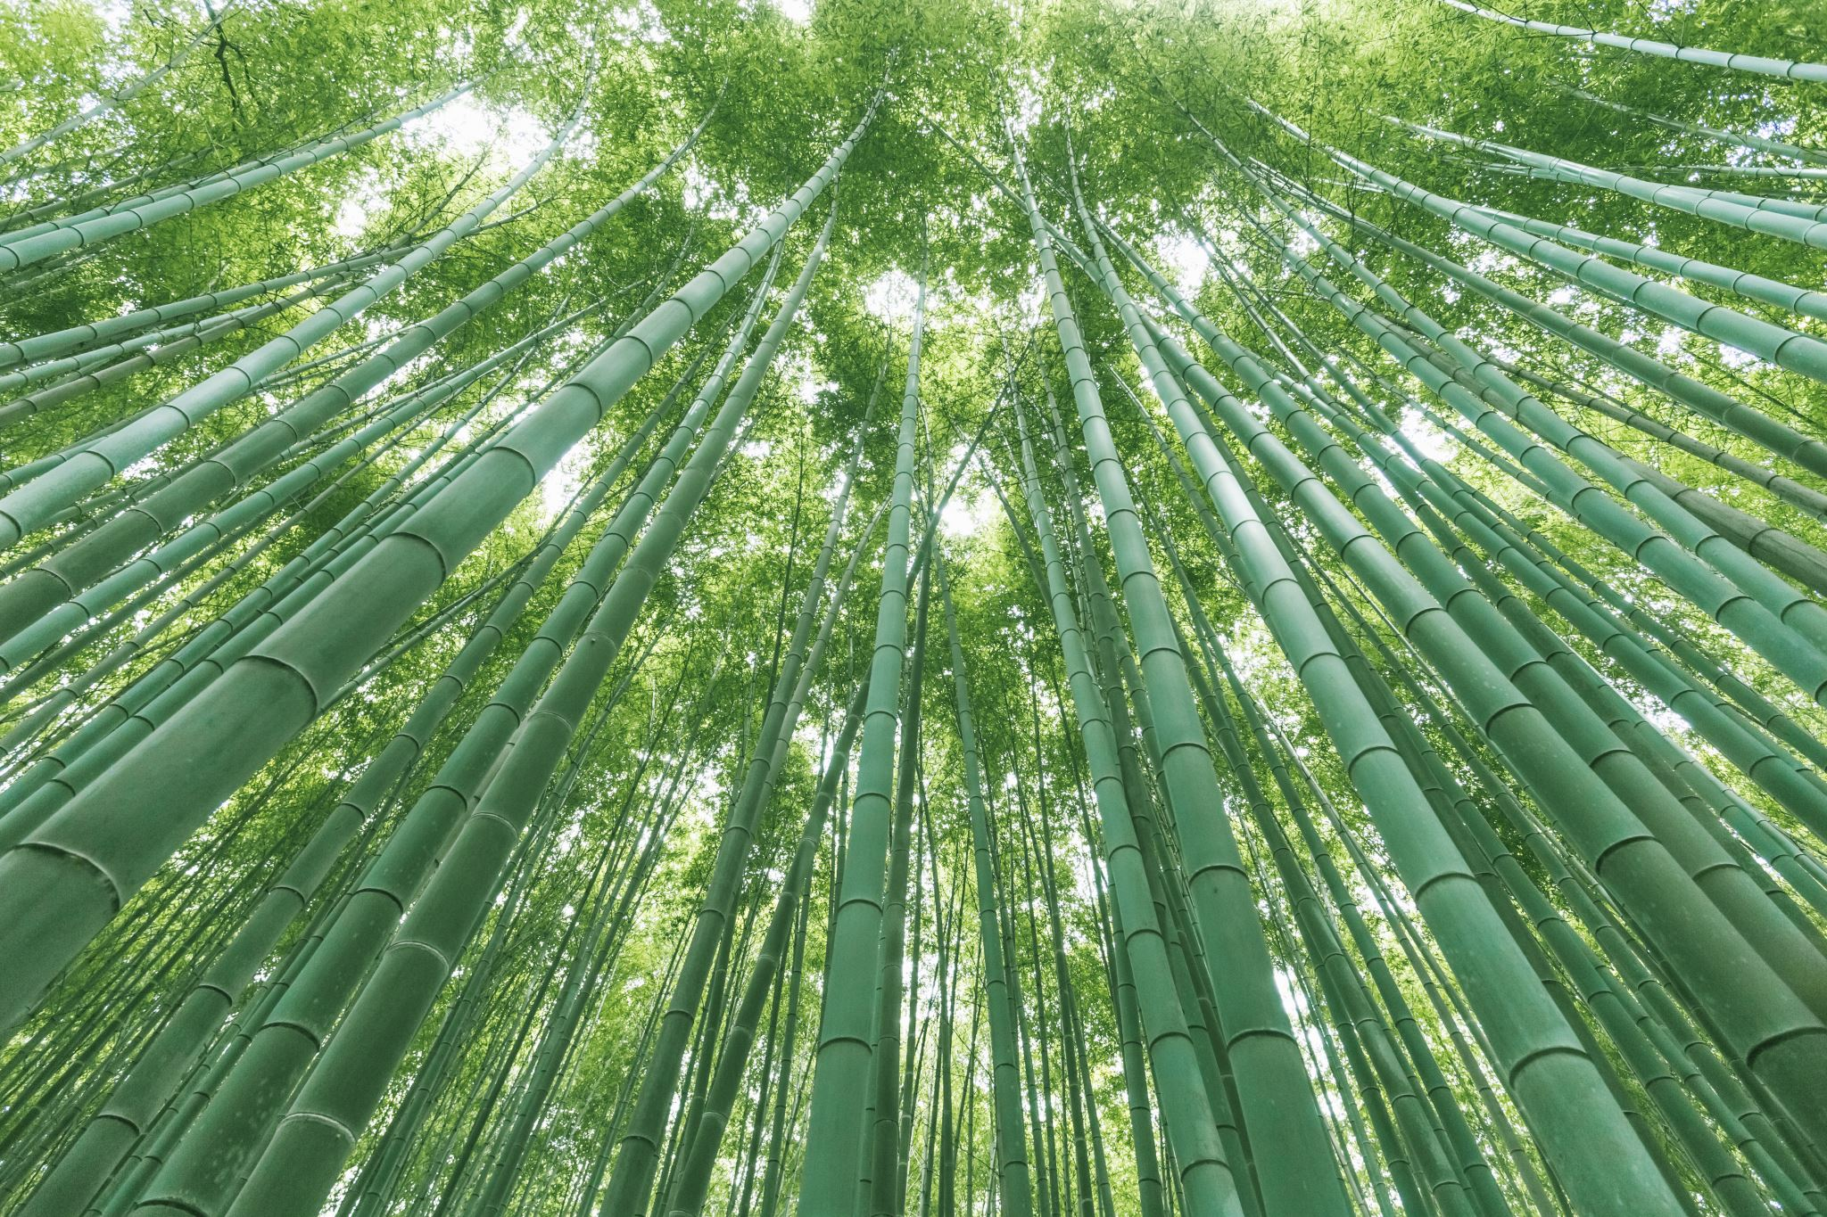
Bamboo as a potential option for land reclamation and restoration
Apsana Kafle^{1,2} and Kwabena Akodwaa-Boadi²
Department of Renewable Resources, University of Alberta, Canada
World Bamboo Organization, USA

Slide 3
Table of Contents
Bamboo
Uses and benefits
Why bamboo for landscape restoration and reclamation?
Successful case studies
Translating these experiences to North America?
Some considerations
This Photo by Unknown Author is licensed under CC BY-NC-ND

Slide 4
Bamboo
Umbrella term used to describe a species of related grass
Perennial flowering plant
Commonly dubbed as “poor mans’ timber” to “green gold”
Notes:
Living in regions from sea level to high elevation Himalayas

Slide 5
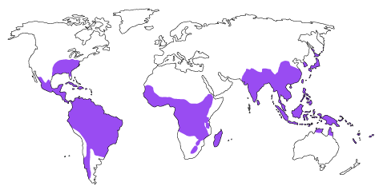
A Glimpse of bamboo in the world
Covers 35 million hectares in the world
1663 species of 123 genera
Total coverage, 1% of the world forest area
Native to all continents except Europe and Antarctica
China has the highest bamboo diversity

Slide 6
Uses of bamboo

Slide 7
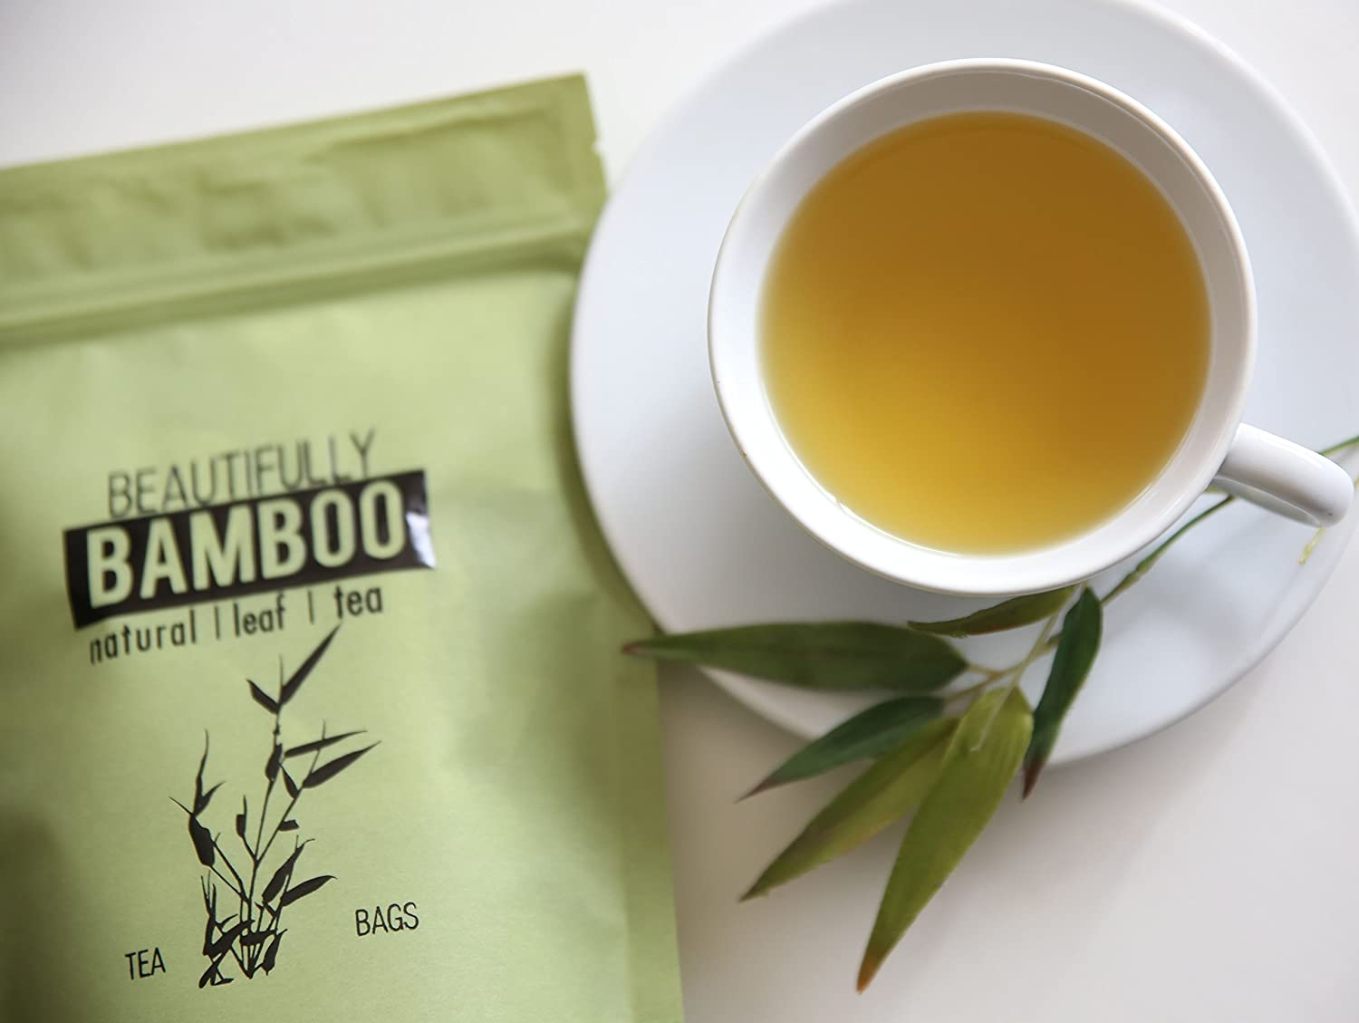
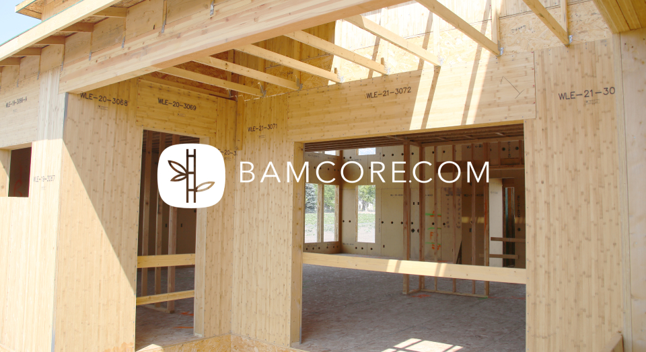
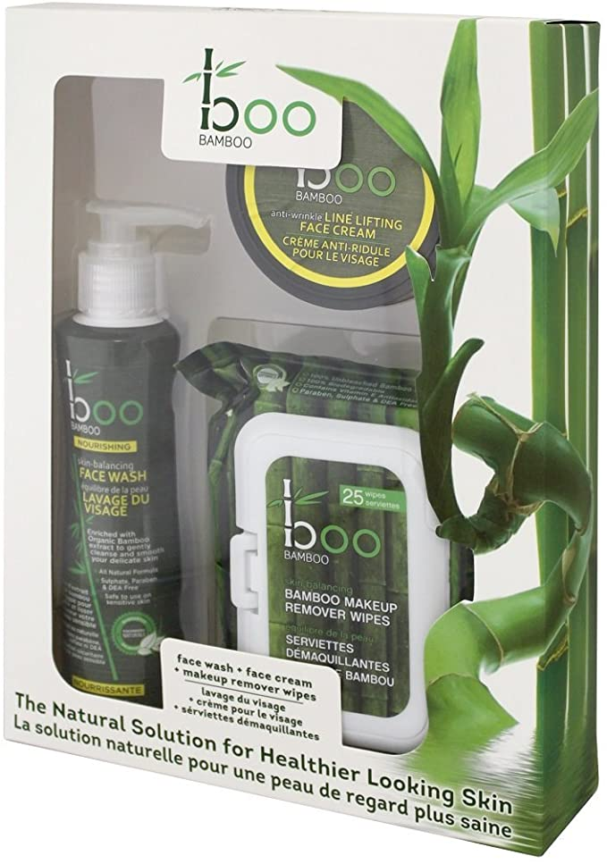
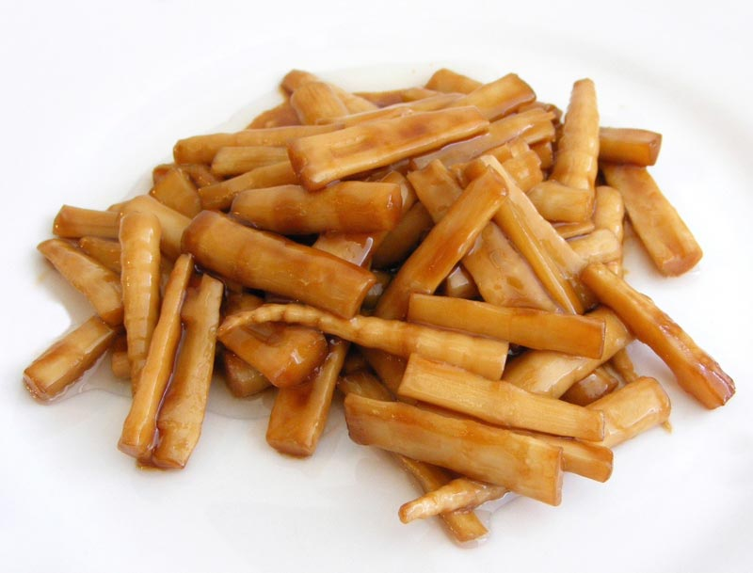
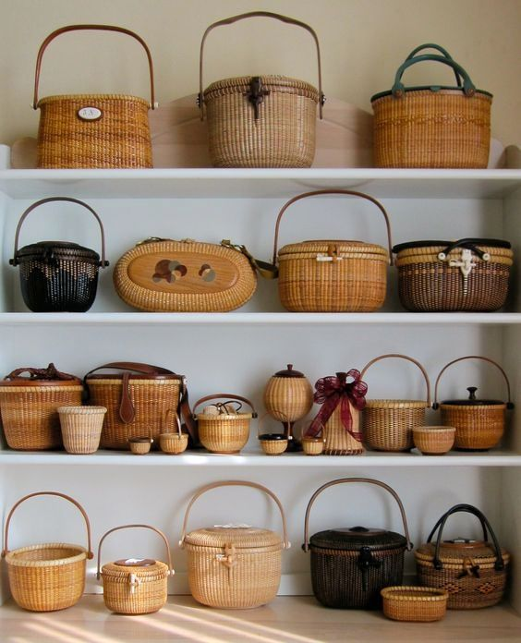
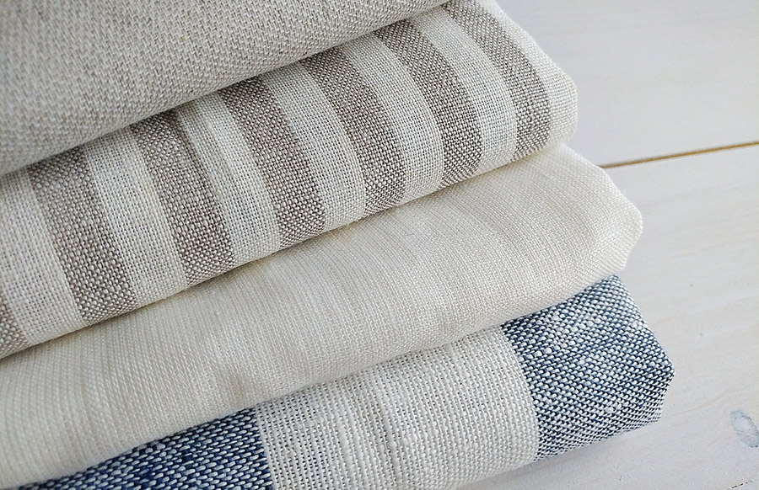

Slide 8
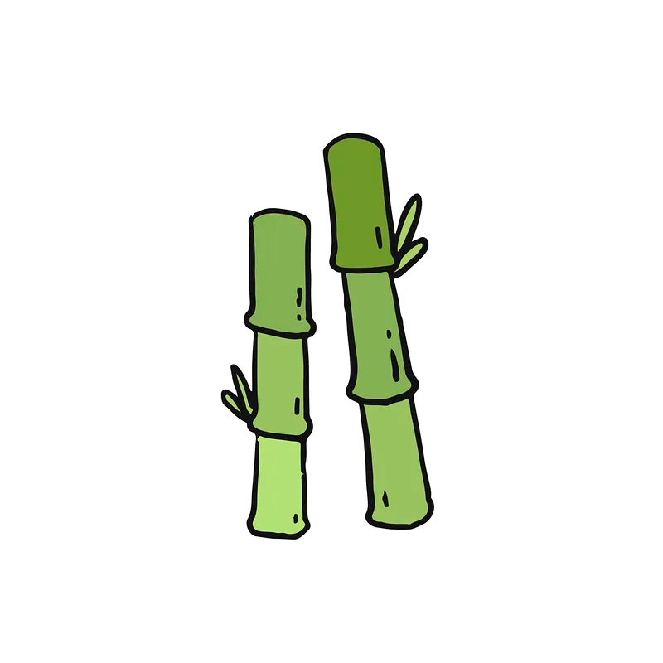
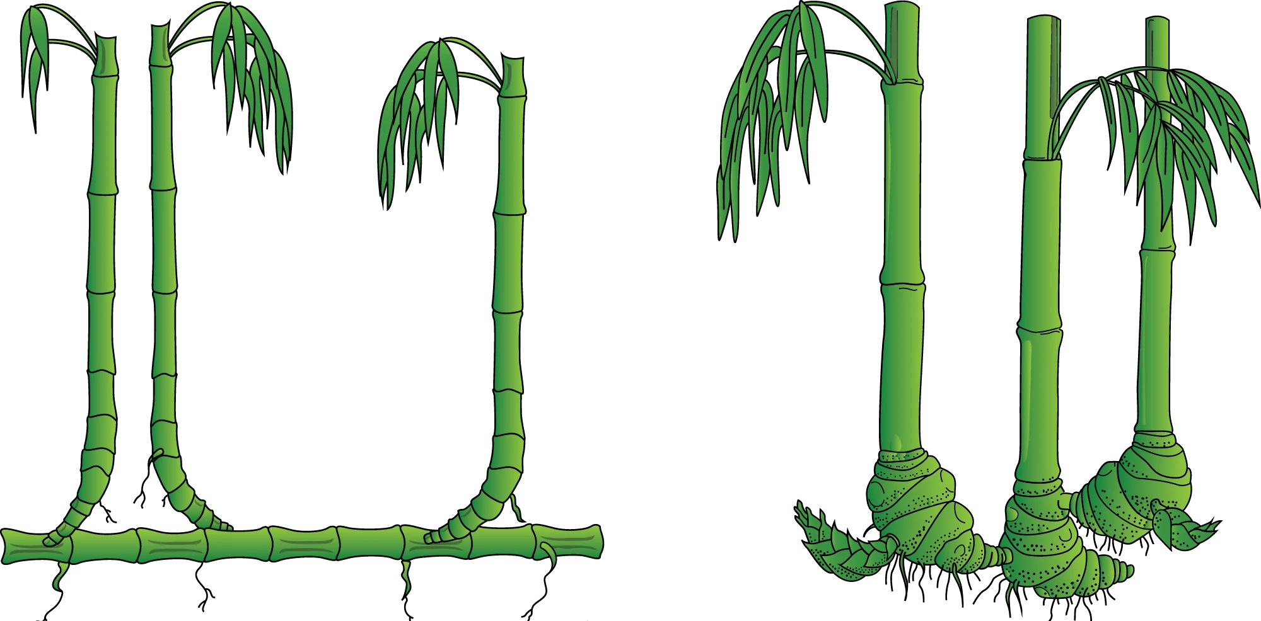
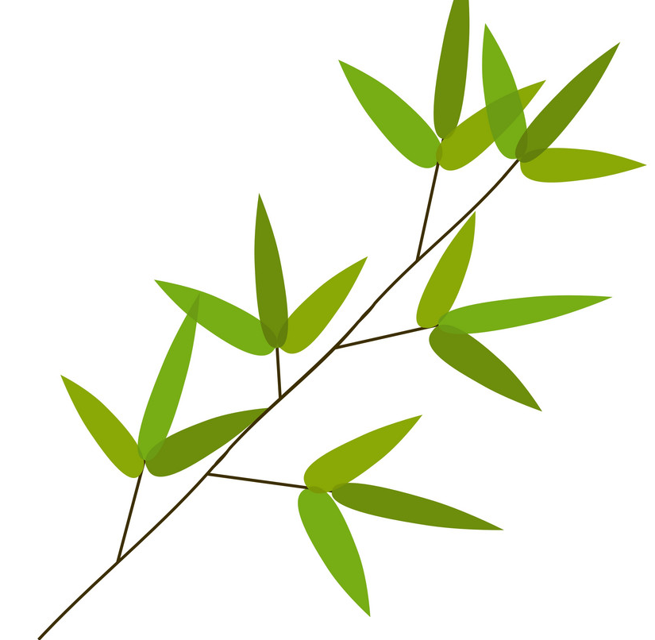
Characteristics of bamboo for restoration and reclamation
Long and extensive root system
Self Regeneration
Perennial
One of fastest growing plant
Quick cover on land
Returns organic matter to the soil
Quick recovery after damage
Notes:
Bamboo possess qualities that make it ideal for restoration and rehabilitation of degraded landscape
2. Rhizome: can reach deep down, draw nutrients that other plant would struggle specially on steep and poor sites
Underground rhizome can measure upto 100km/ha, grow upto a length of 60 cm and live for century. Most bamboo rhizome are present on the layer of soil 0-30 cm which enables it to be effective for soil conservation.
3. The underground rhizome can survive and regenerate even when the biomass above ground have been destroyed
4. Bamboo is among the fastest growing plants that can grow upto 1 m in a day, therefore it can revegetate and restore quickly over a bare land on a short period of time
5. Once the plant establish it provides good cover and helps to prevent run-off help yo keep moisture in the soil and replenishing groundwater. Single bamboo can bind six cubic meters of dirt.
6. Leaf drop begins to return organic matter in the soil, rebuilding fertility. Due to the fast growing nature, it is capable of accumulating high litter that can be used again to rehabilitate the soil.
7.

Slide 9
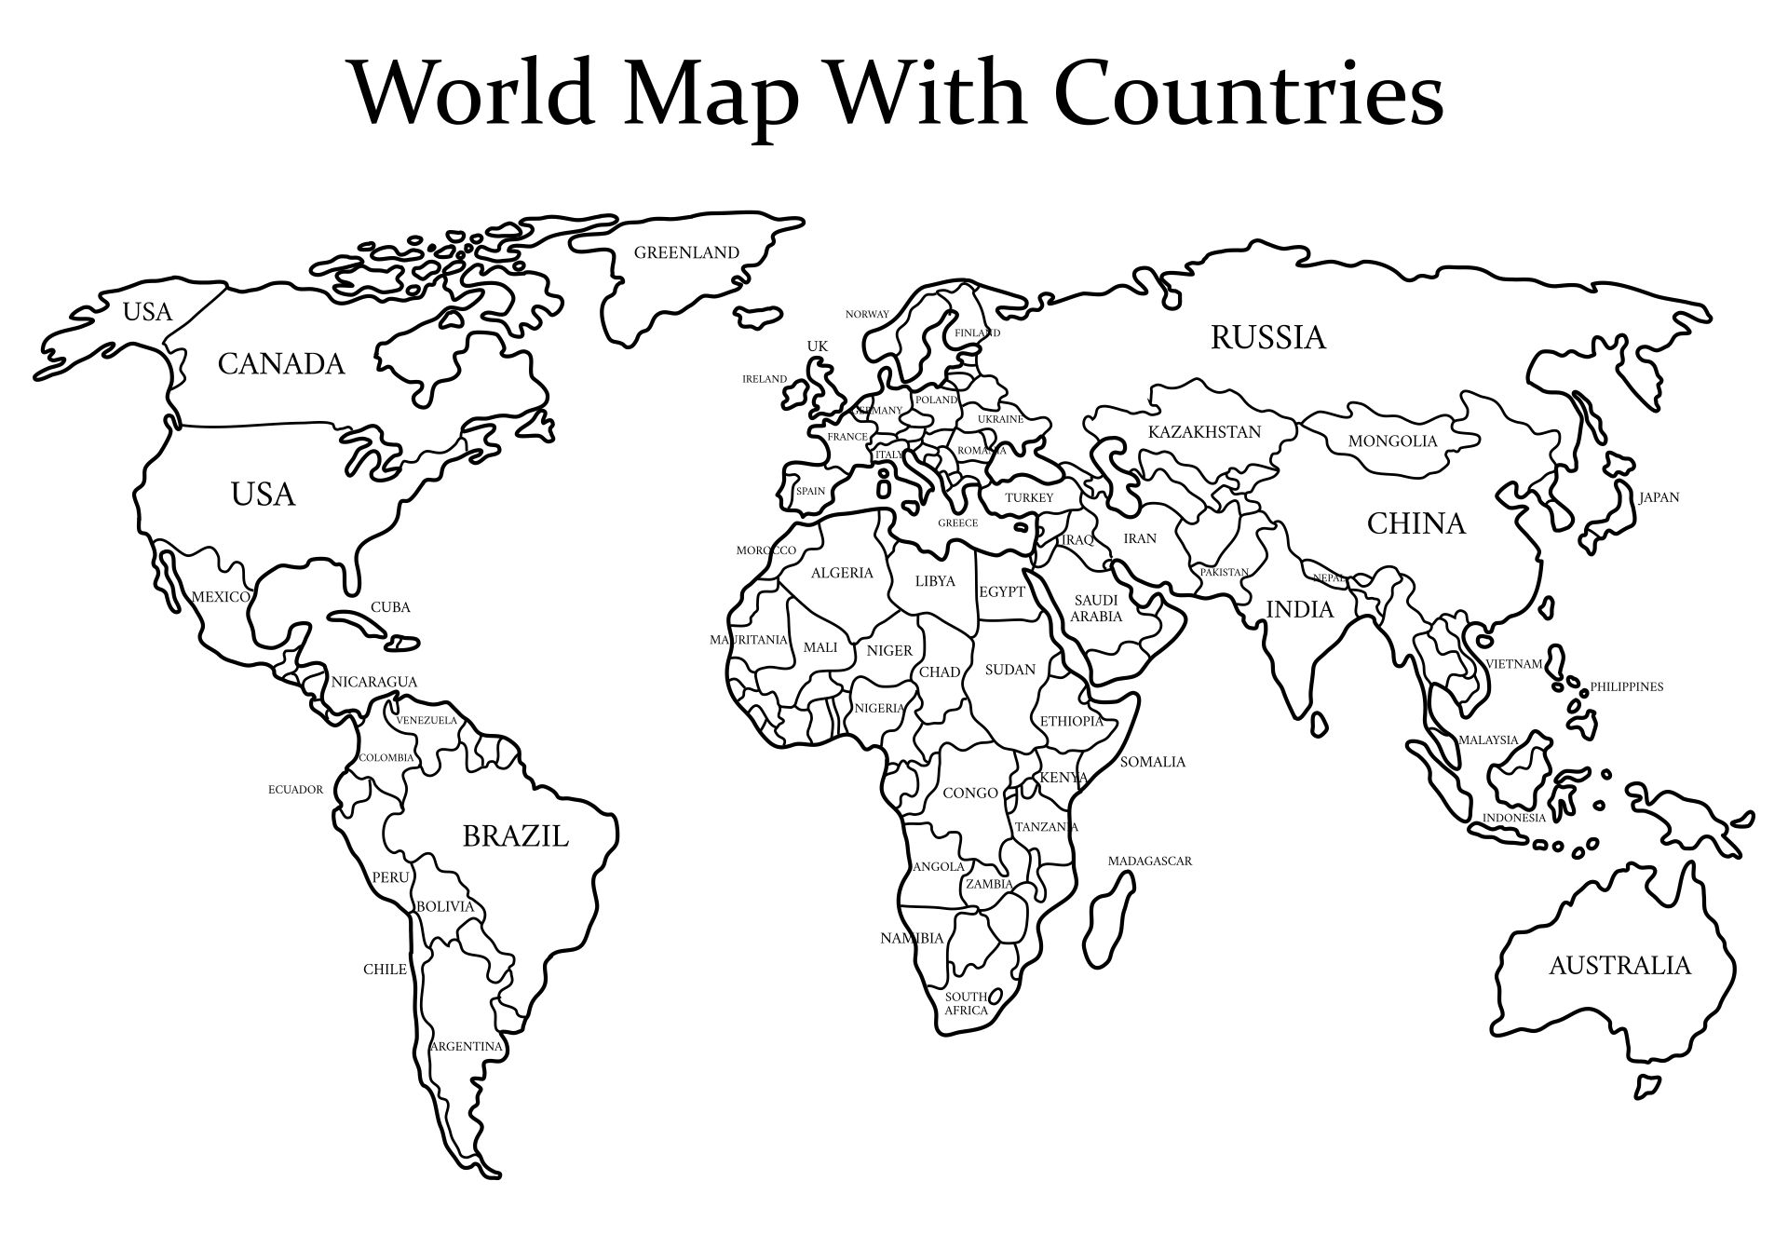
Case Studies across countries
Notes:
The Case Studies on bamboo for restoration and reclmataion remains relatively a small scale but have shown promising results

Slide 10
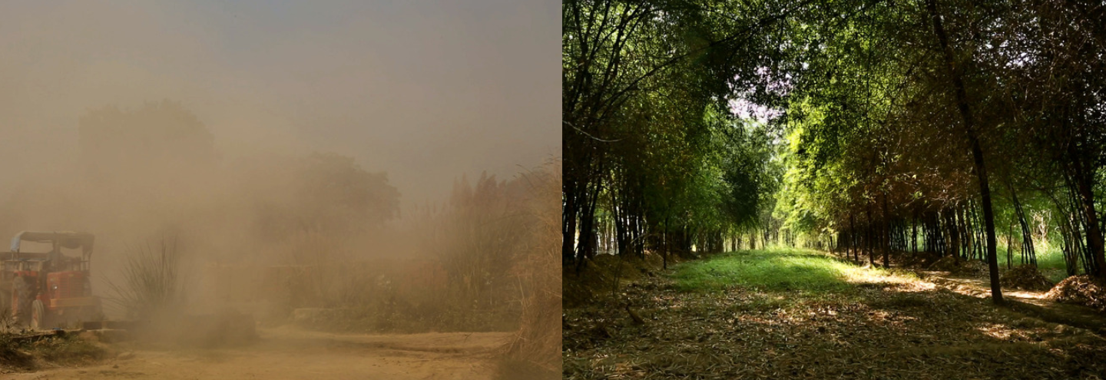
Bamboo for brick mine reclamation in India

Slide 11
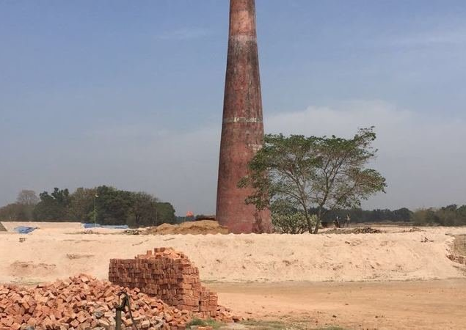
Allahabad, Uttar Pradesh in India
Clay soil for red brick
45 brick kilns in 4000 ha land
Topsoil dripped up to 3 m depth
Pilot initiative, 106 ha land bamboo
Native species
Bamboo plantation expansion
Establishment local propagation nurseries
Notes:
The brick klins started in 1960s in Allahabad UP, India
The land was chosen where cyclones hit most severely
In less than 10 years, after the soil had been stripped, the land was barren
In hot summer with no vegetation, the temperature reached upto 54 degress
Local typhoons due to heavy wind blowing
Increased poverty in the local area

Slide 12
Two Decades Results
Large scale land rehabilitation, 4000 ha and 96 villages
Total 10% of annual income to local farmers
Adds 6-8 inches of humus to the soil
Water table rise; 40m below in 1996, 33 m below in 2003, ~15 m below now
Carbon content of soil increased from 0-0.9t/ha due to leaf fall
Over 200 spp of birds and 60 spp mammal recorded
Notes:
1. Bamboo is a part of large scale land rehabilitation

Slide 13
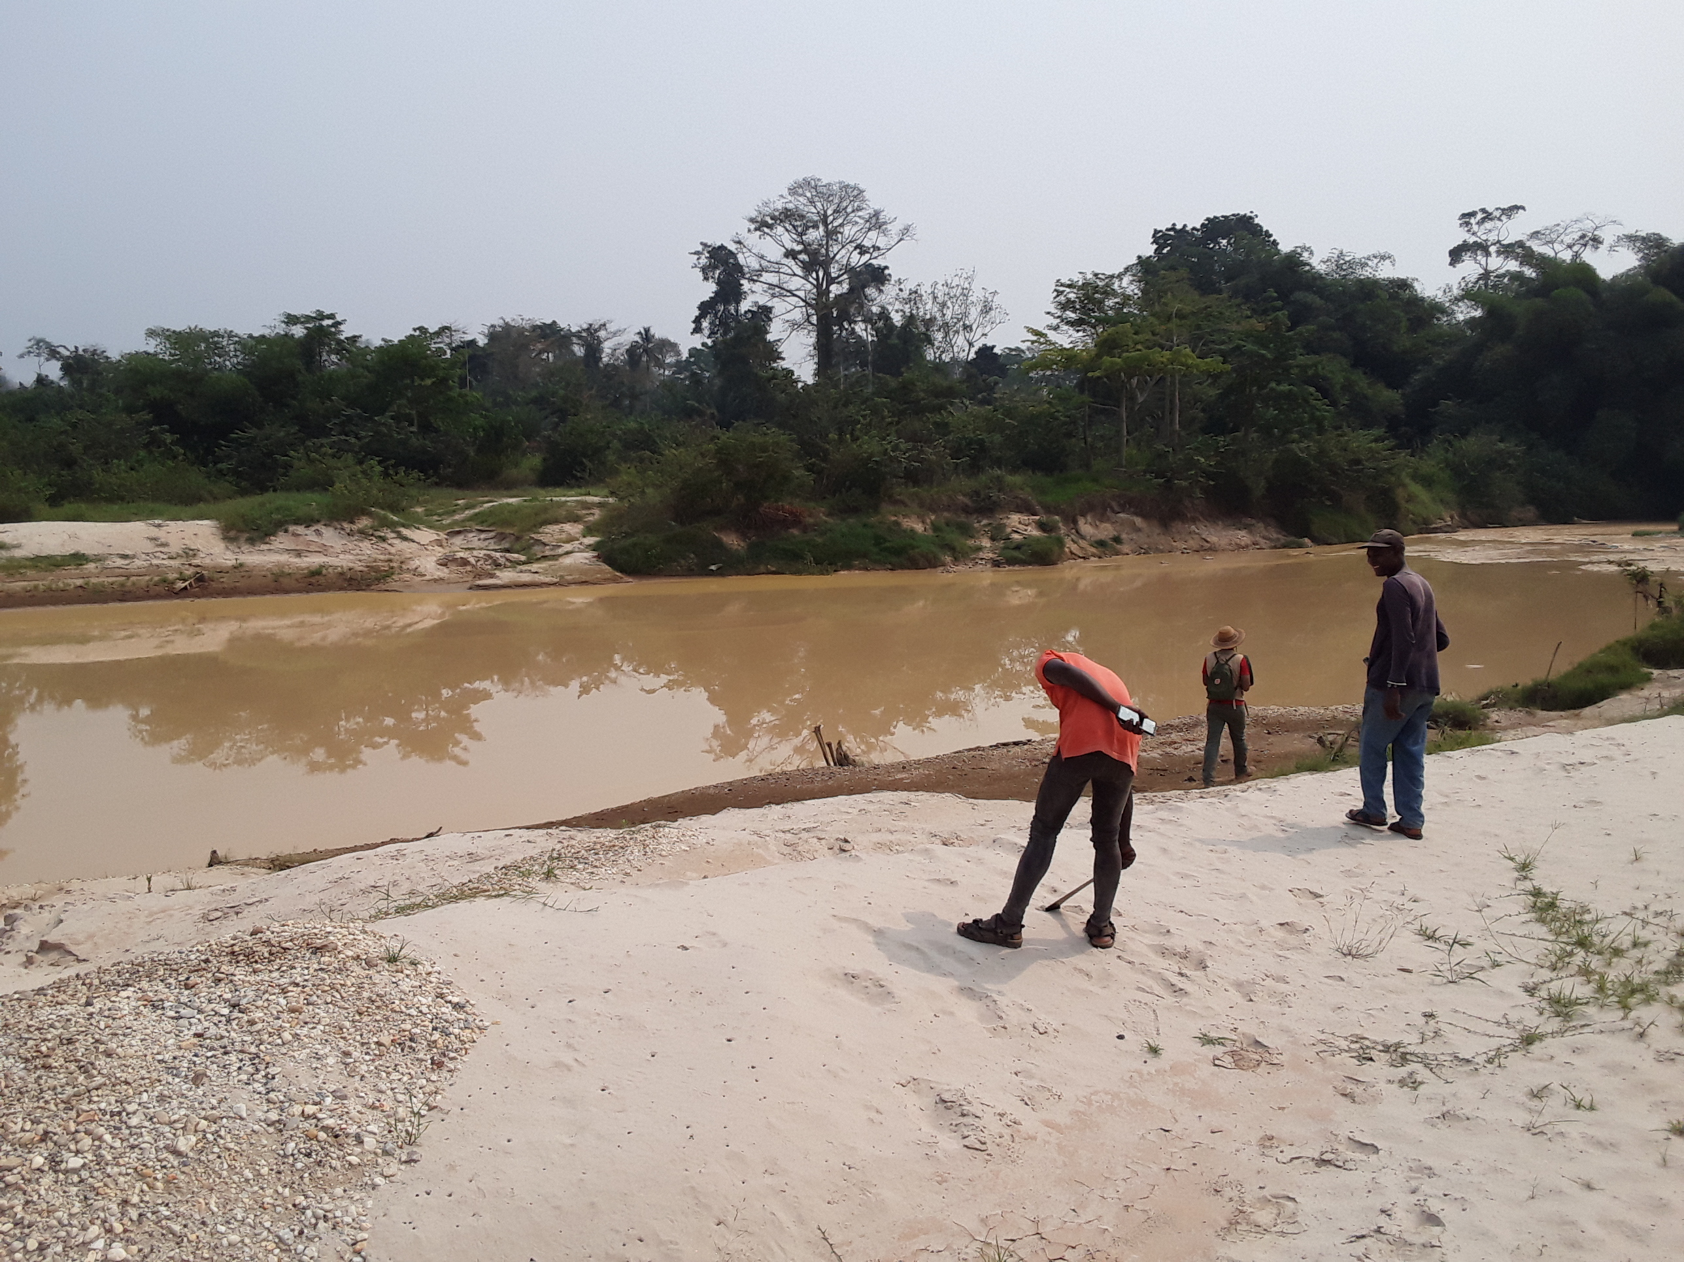
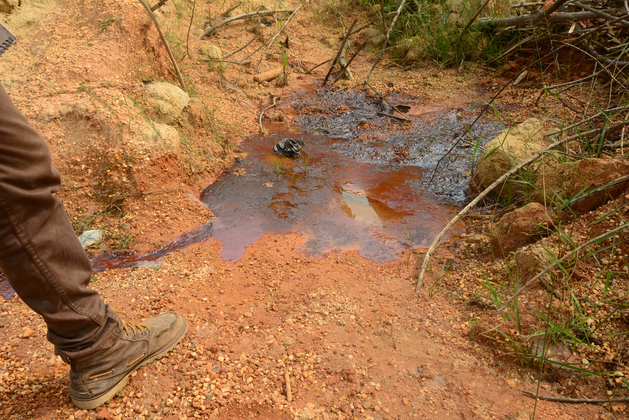
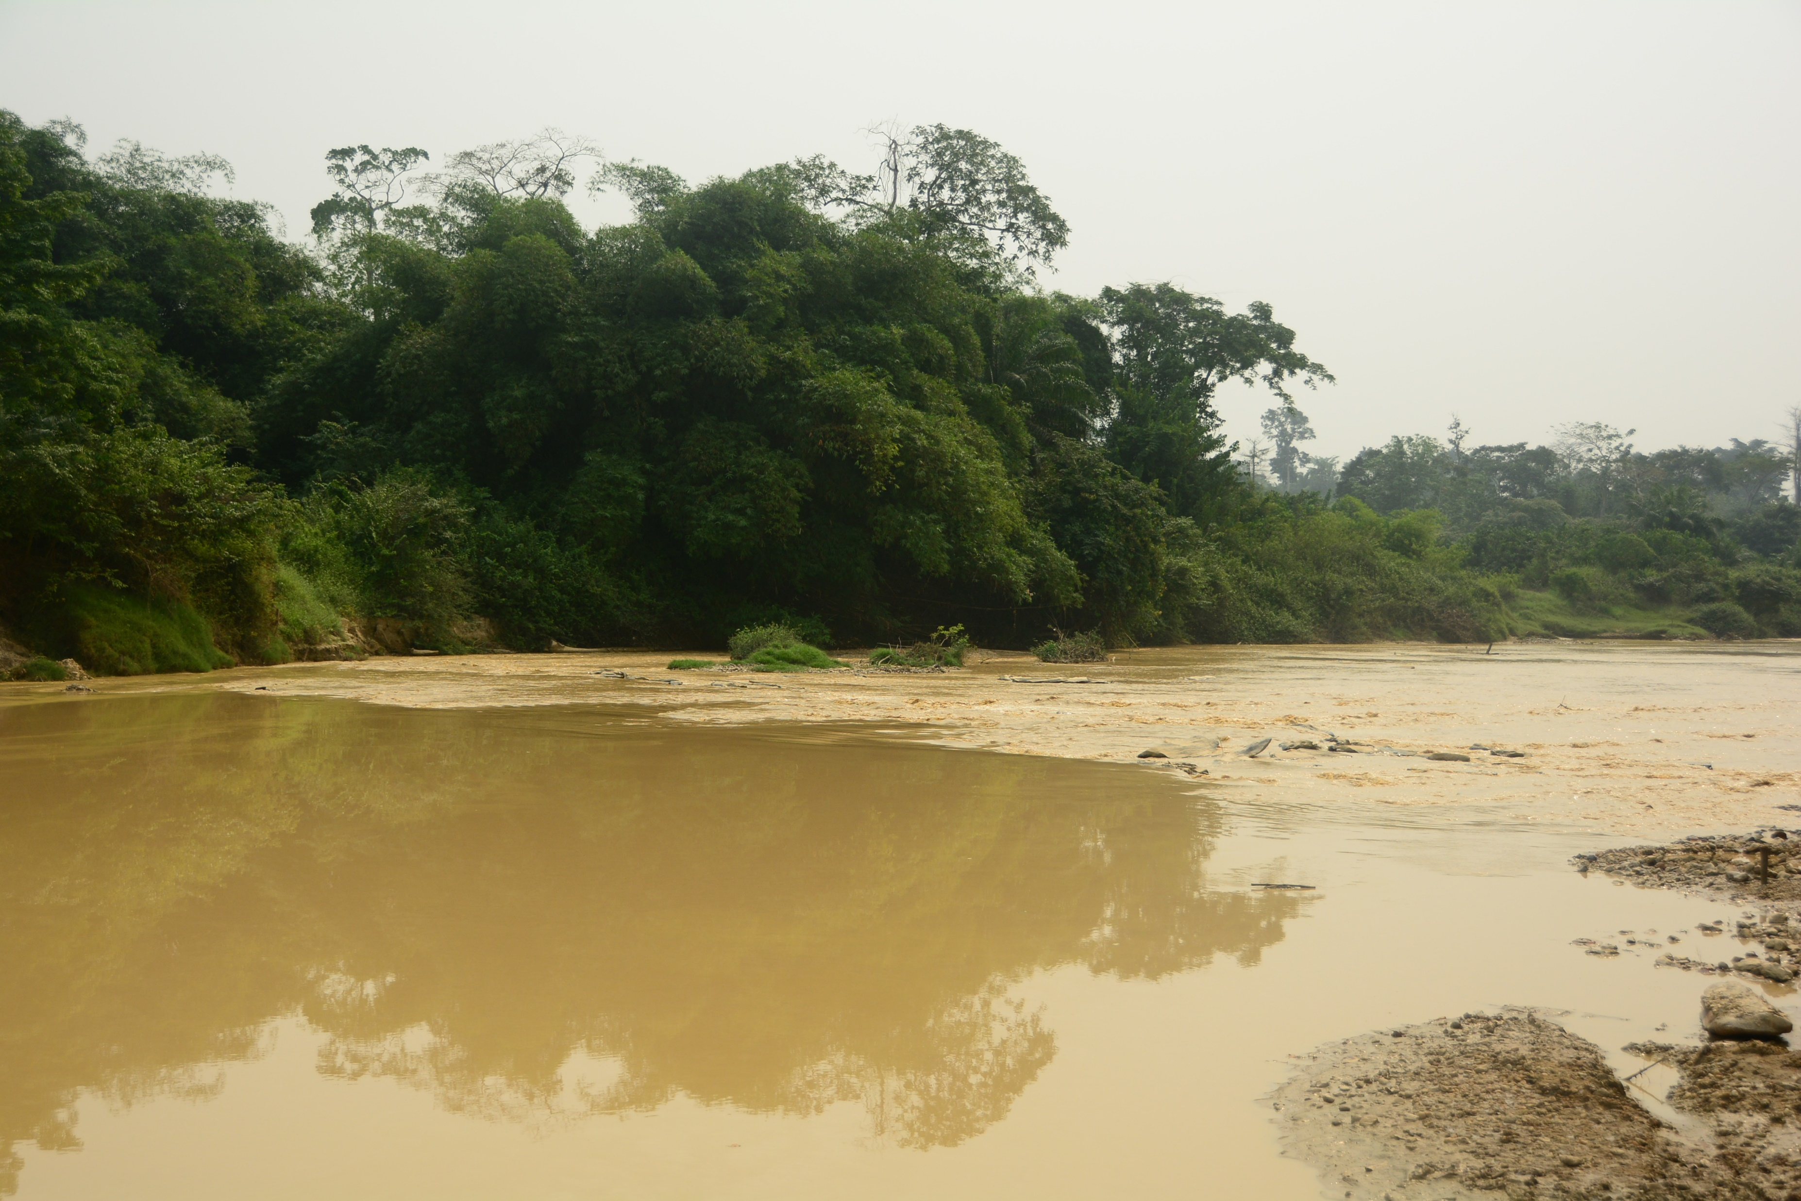
Bamboo for illegal mining reclamation in Ghana
The Ashanti Land Reclamation Project
22 villages and 110,000 people
4,500 ha to be restored
Total plantation 3,000,000
Notes:
Illegal mining for gold and other minerals also known as galamsy is a major cause for soil degradation in Ghana
This cause annual degradation of 3000 ha of land in Ghana
Trial plots of bamboo in south east Ashanti gold mine projects
Exploratory plots of 825 m2 were demarcated in unmined, reclaimed mined and unmuned

Slide 14
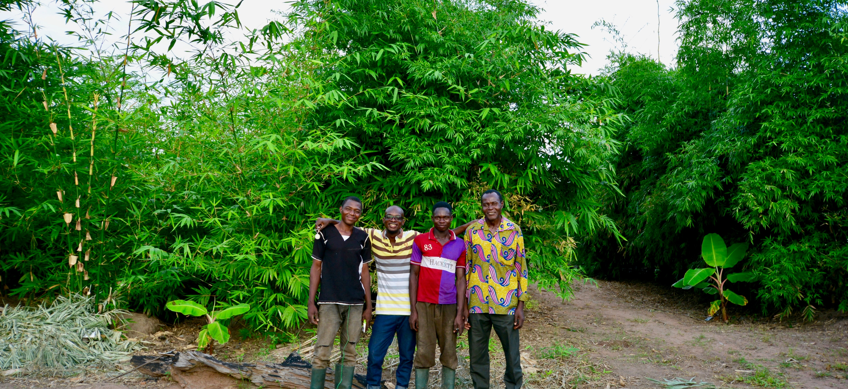
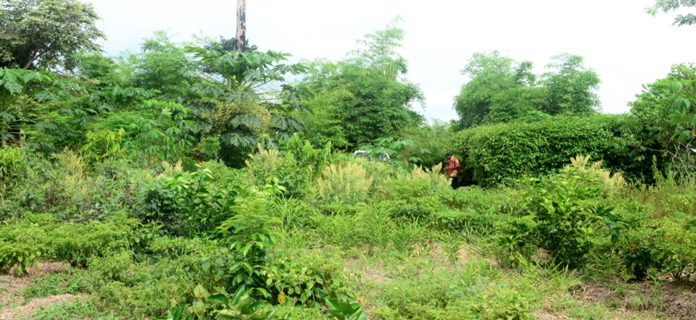
Trial Project
7 spp of bamboo planted in Unmined, Mined-reclaimed, Mined-non reclaimed
Survival 97% in unmined & reclaimed., 70% in mined and non-reclaimed
Mean shoot production mined reclaimed> unmined> mined and non-reclaimed
Height growth in 3 months 173 cm mined reclaimed, 113 cm unmined and 63 cm

Slide 15
Bamboo for Landscape Restoration

Slide 16
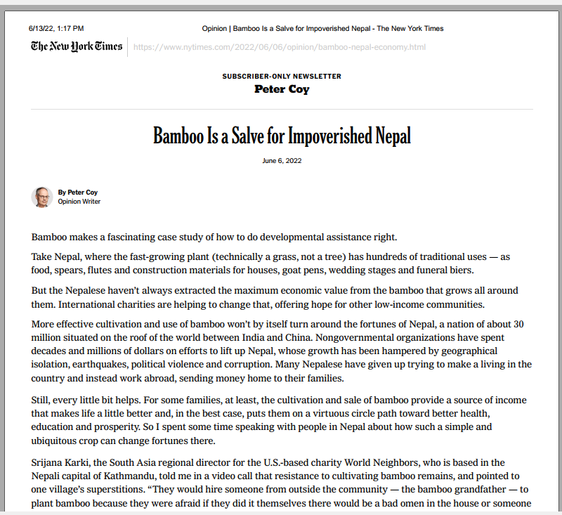

Slide 17
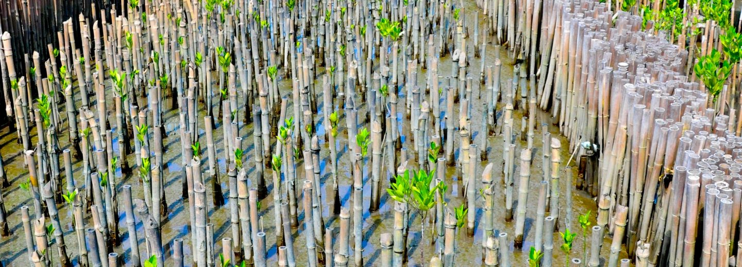
Bamboo for Coastal Restoration in Thailand

Slide 18
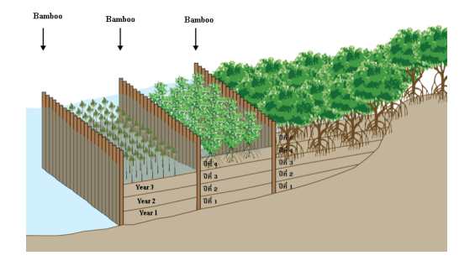
Project Implementation
Bamboo poles barriers within 50m from the coastline
Aged bamboo >3 inches
2 m below sea belt and 3 m above
Atleast 35 poles per meter of bamboo
Project Impact
Wave strength reduced by 5-70%
Wave height reduced by 15.2-86.6 %
Coastline stabilization
Recovery of aquatic animals like clams, oysters, crabs
Notes:
Samut Songkhram is a central Thai province that can show how bamboo can decelerate erosion and increase sediment in coastal areas.
The province is highly vulnerable to erosion and landslide, the major cause is the loss of the coastal mangrove forests.

Slide 19
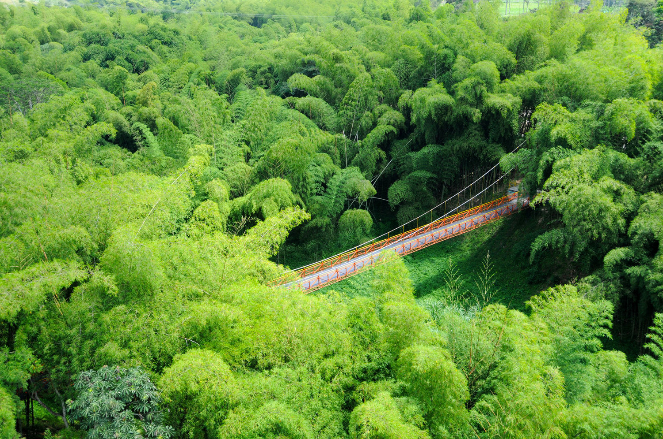
Restoring Fragmented Forest Patches in Columbia
Coffee farming and cattle grazing, driving factors for land degradation
Guadua experimental plantation to improve connectivity
15 years results
Total porosity of soil increased
Decrease in bulk density
Improvement in chemical properties and overall socio-economic benefits

Slide 20
Success factors
Local participation and Indigenous techniques
Small Scale Nurseries/Tissue Culture
Value Chain Development
Use of native species
Notes:
AS we saw, bamboo can grow in diverse environments, poor soil, degraded landscape, windy areas etc,

Slide 21
Opportunities for Bamboo in North America
Native genus Arundinaria
American Bamboo Society Reports more than 490 spp. of bamboo in US and Canada
World Bamboo Organization, American Bamboo Society
UBC Bamboo Application and Manufacturing Research Group
Alternative species considerations like willow?
Notes:
South central and south eastern US

Slide 22
Key Considerations
Notes:
Even the native bamboo is running bamboo so consideration is need

Slide 23
Acknowledgements

Slide 24
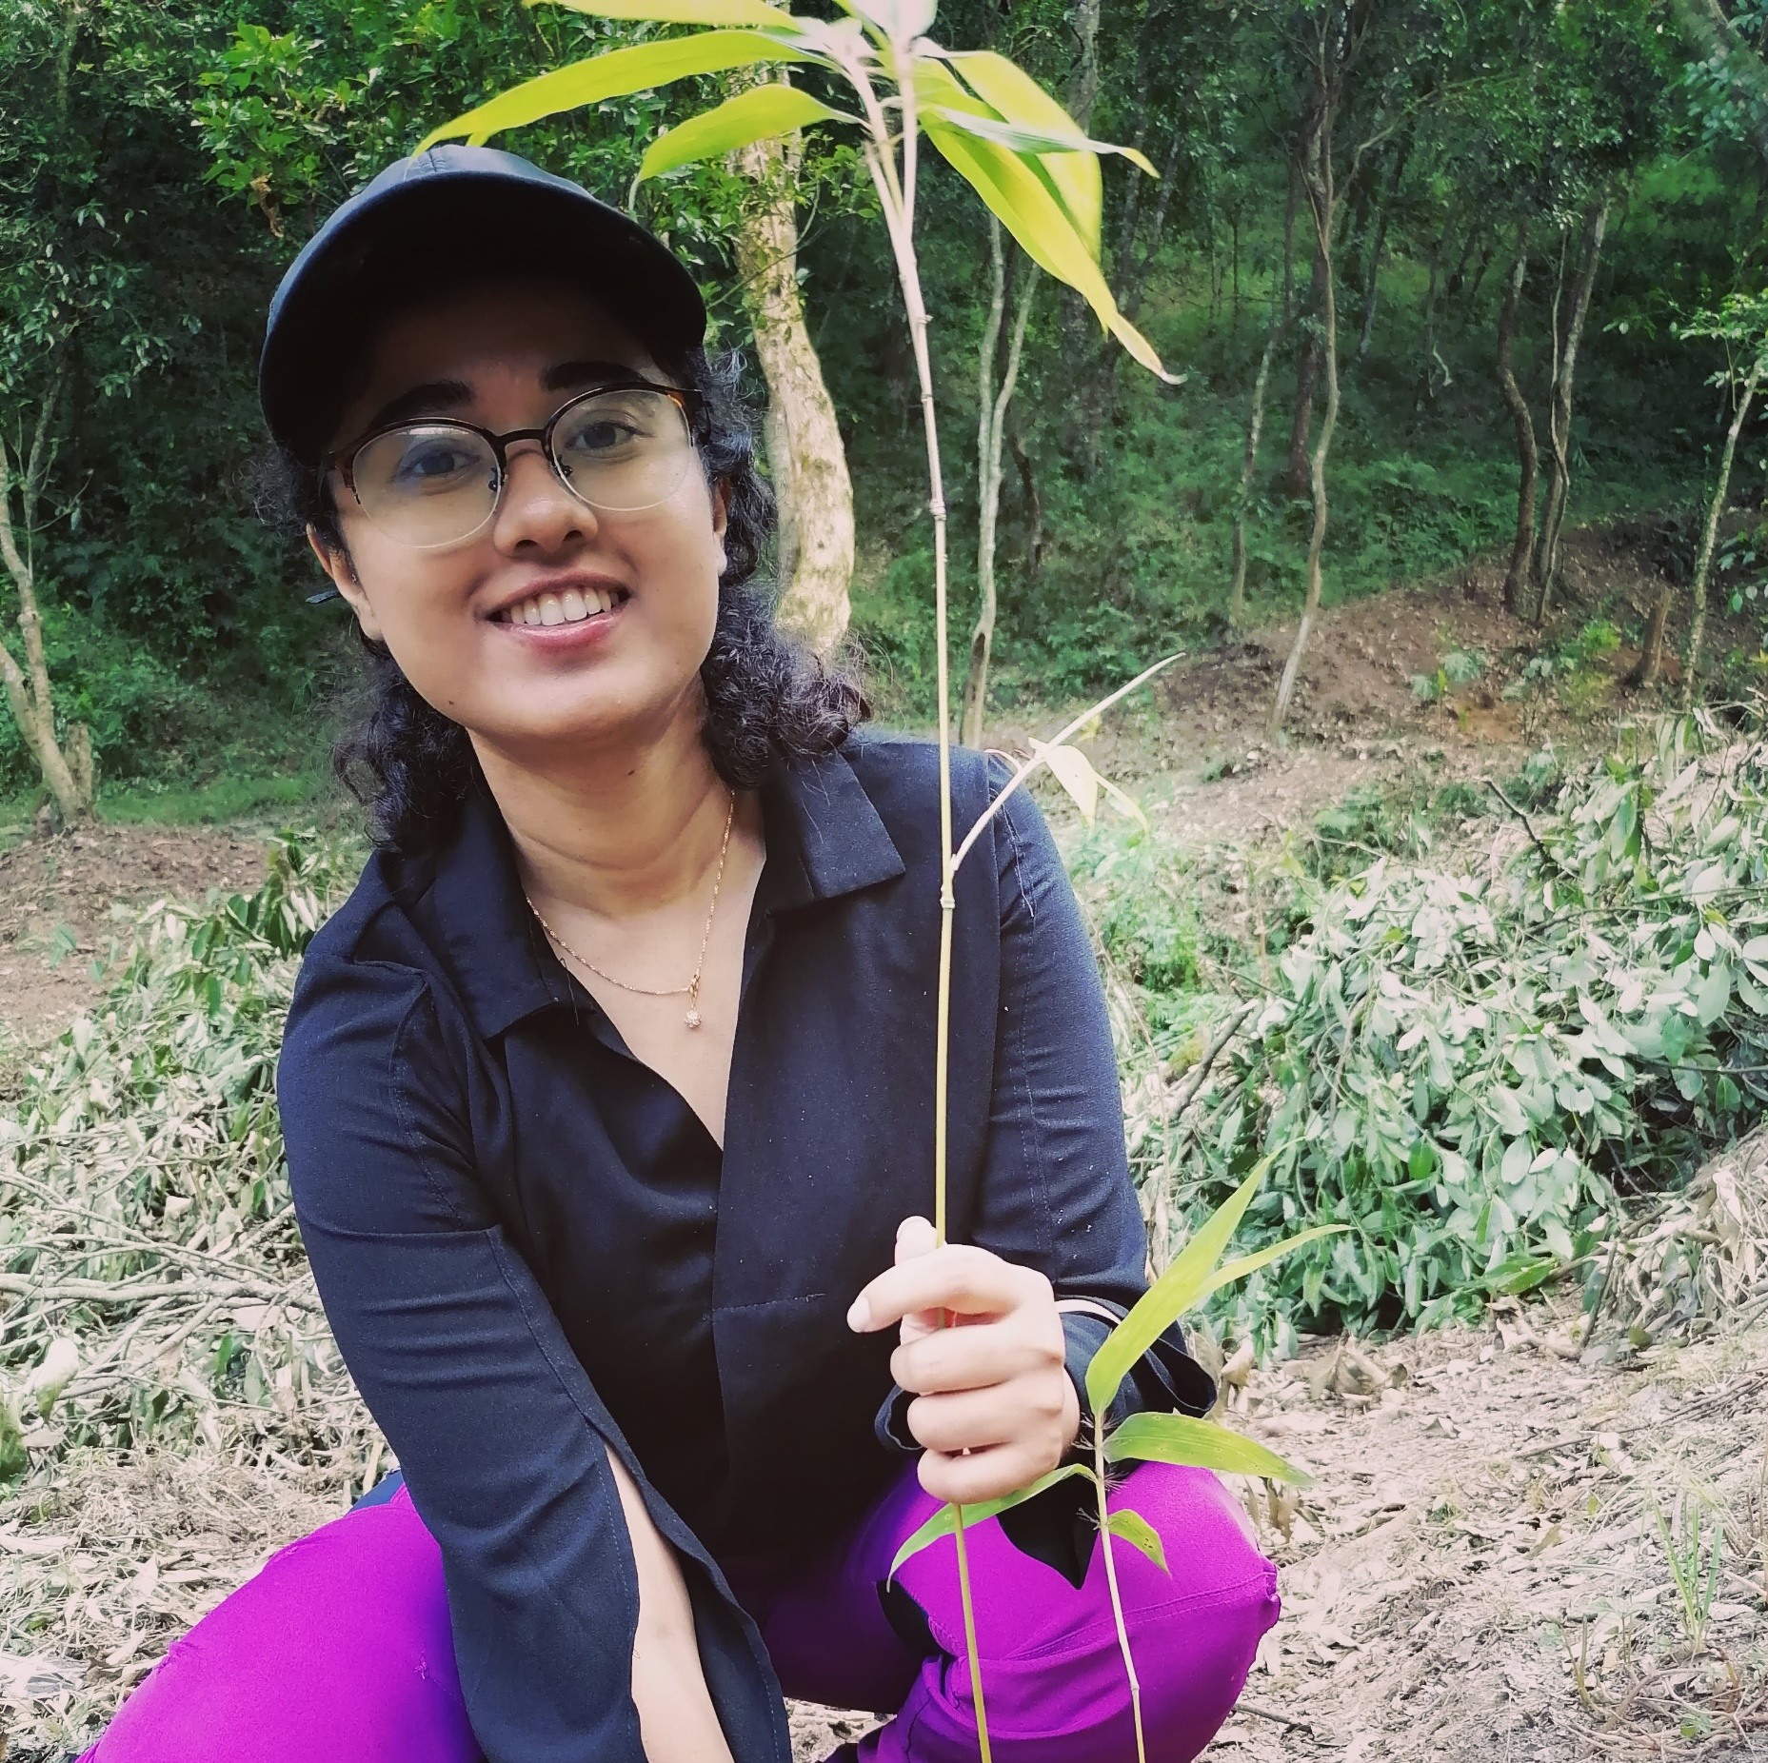
It’s time to #thinkBAMBOO
APSANA KAFLE
apsana@ualberta.ca kafleapsana@gmail.com

