Slide 1
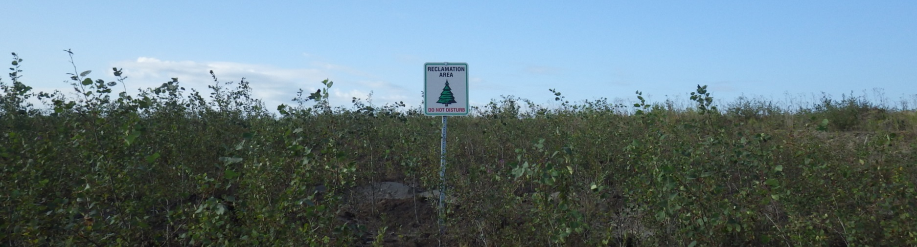


Buried wood in reclamation soils
Brad Pinno, Laura Manchola Rojas, and Kaitlyn Trepanier
bpinno@ualberta.ca

Slide 2
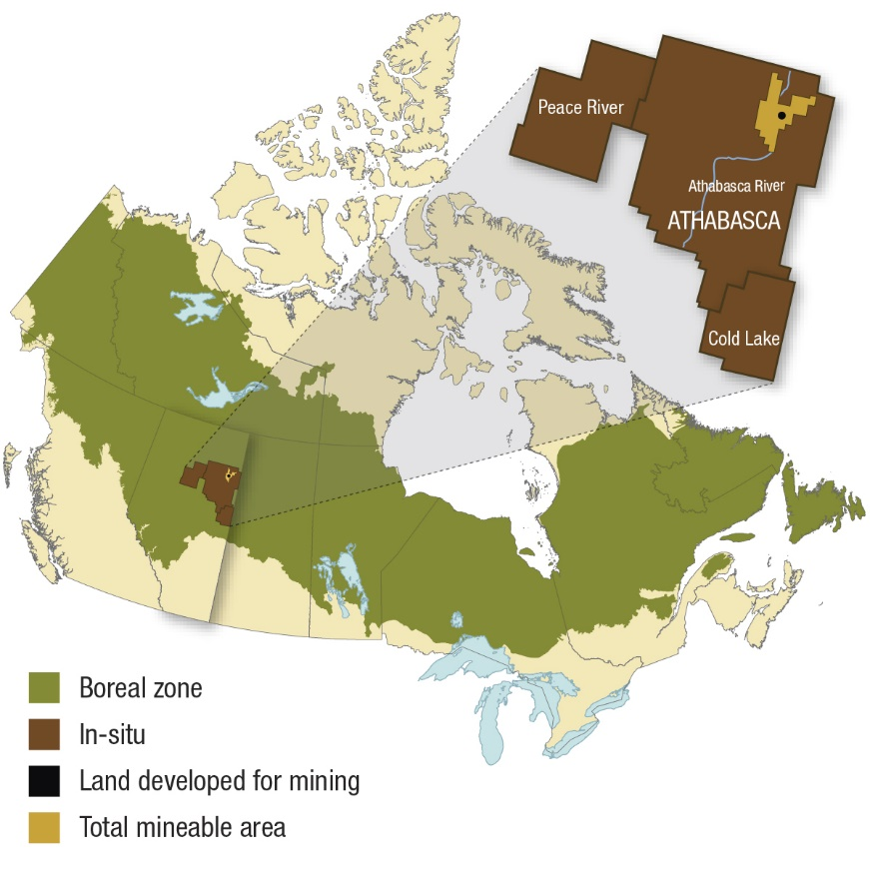
Oil Sands in Alberta
Oil sands deposits in northern Alberta in the boreal forest
Most of the rest of Alberta is underlain by conventional oil and gas deposits
Oil sands mining has directly disturbed over 80,000 ha of boreal forest so far; 8,200 ha are under active reclamation
Goal of upland reclamation is to create self-sustaining forest ecosystems
Natural Resources Canada

Slide 3
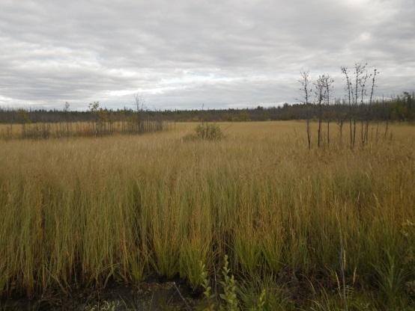
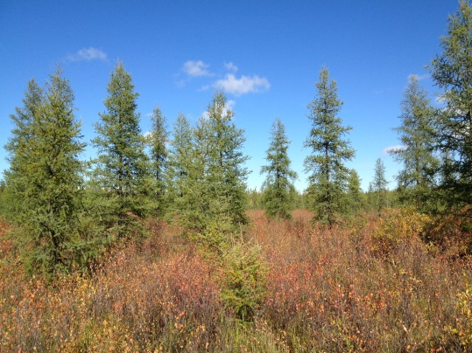
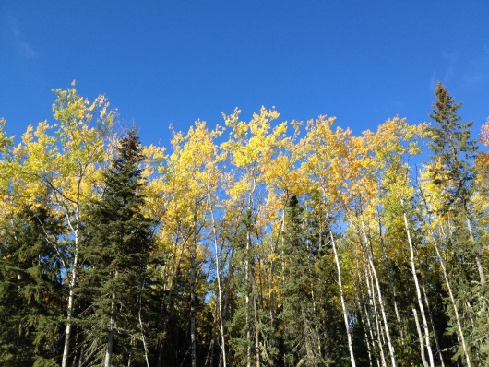
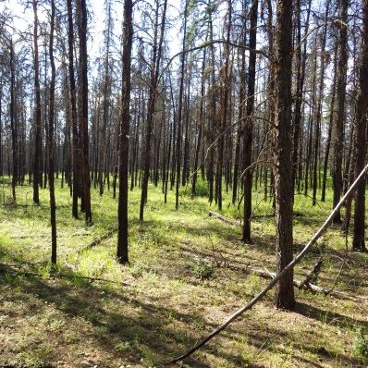
Natural landscape
Half uplands, half wetland bogs and fens
Upland soils mainly finer textured Luvisols (Alfisols) on mesic sites and sandy Brunisols (Inceptisols) on drier sites
Borderline sub-arctic climate
Moisture limited environment (455 mm precipitation annually)
Sedge dominated fen
Tamarack and black spruce wetland
Aspen-spruce mixedwood on mesic sites
Jack pine on xeric sites

Slide 4
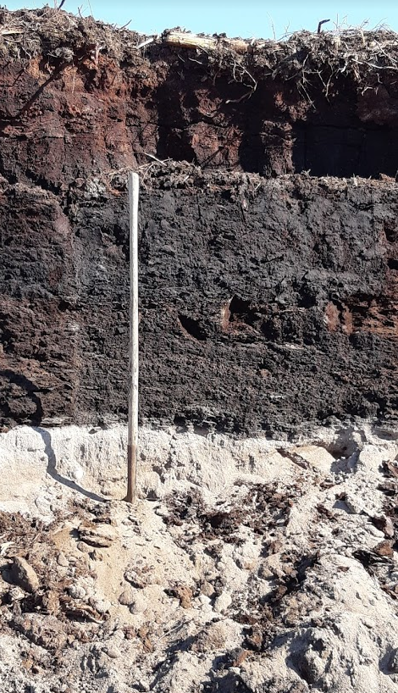
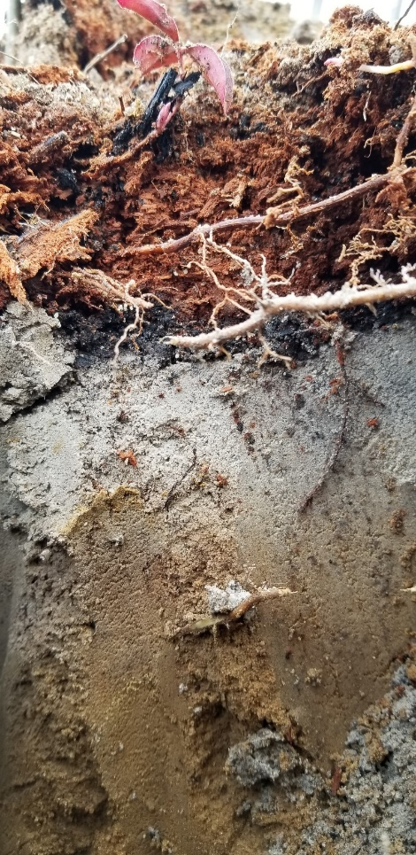
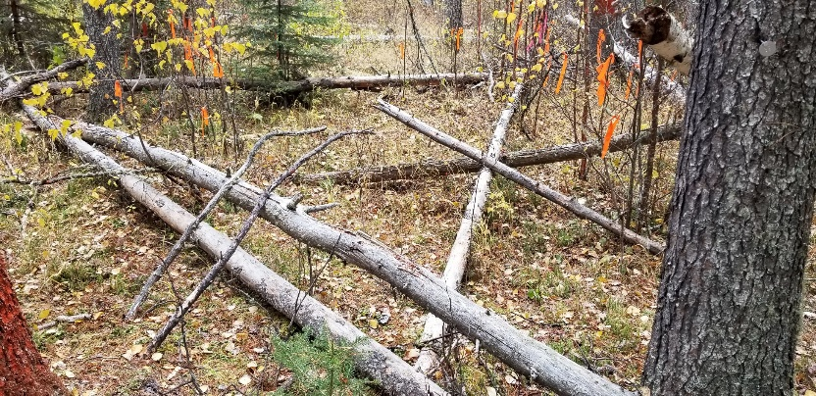
Buried wood in natural forests
Standing dead
On the surface
In the soil in varying stages of decomposition
Many roles for buried wood and woody debris in forests

Slide 5
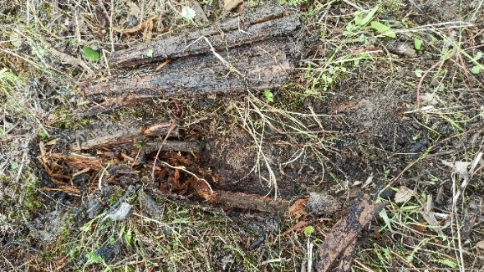
Current practice
Photos: CEMA, CNRL and Manchola Rojas
Merchantable timber and soil is salvaged
Excess woody debris may be burnt, mulched or incorporated into recl soil
Reclamation soil is stockpiled for future use or used immediately
Buried wood is a part of reclamation soil

Slide 6
Research questions
Wood addition (high C:N) may reduce nutrient availability for plants.
What is the impact of buried wood in reclamation soils on nutrient supply rates and tree growth?
How much buried wood is there?
Study 1: Lab incubation → nutrients
Study 2: Greenhouse → trees
Study 3: Field → how much

Slide 7
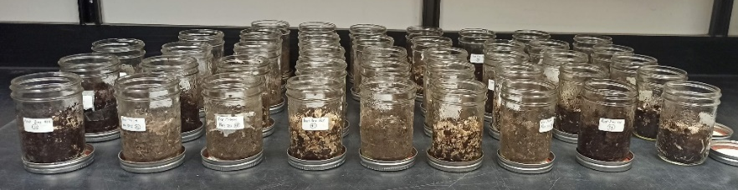
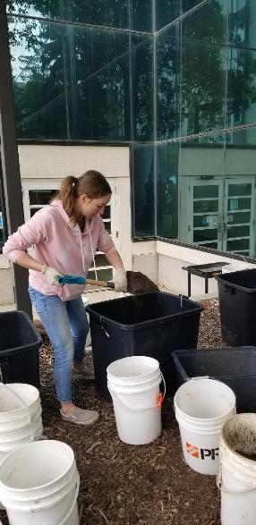
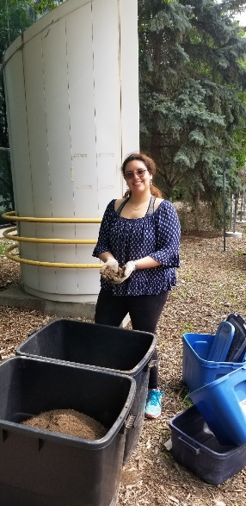
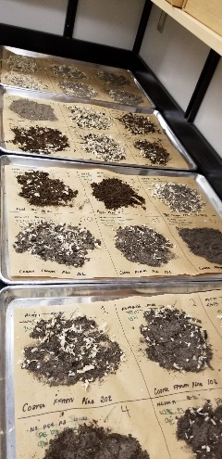
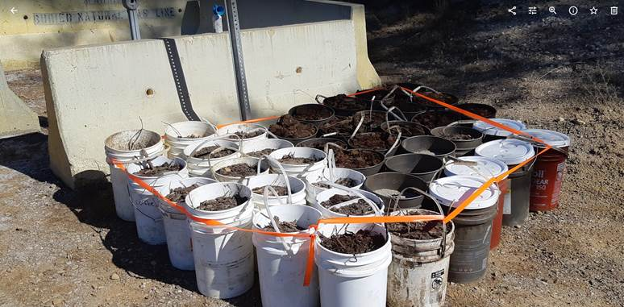
1. Lab Incubation
4 soils
  Peat, PMM, fine FFMM, coarse FFMM
  PMM = peat – mineral mix
  FFMM = forest floor – mineral mix
4 wood additions
  0, 10, 20, 50% volume
Lab incubation
Nutrient supply rates

Slide 8
Lab incubation results
Total inorganic nitrogen
0
10
20
50
Wood decreased nitrogen supply in most fertile soils
  Immobilization of N
No impact on poorer soils
Phosphorus and potassium more influenced by soil type
Longer term impacts?
Nutrient release in the future?
Microbes, invertebrates, other critters?
Fine PMM Peat Coarse
FFMM FFMM
Phosphates
Potassium
Fine PMM Peat Coarse
FFMM FFMM
Fine PMM Peat Coarse
FFMM FFMM
Manchola Rojas MSc thesis

Slide 9
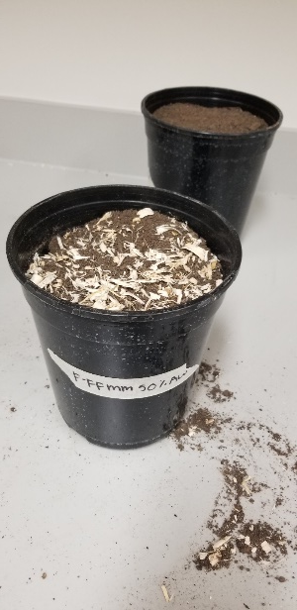
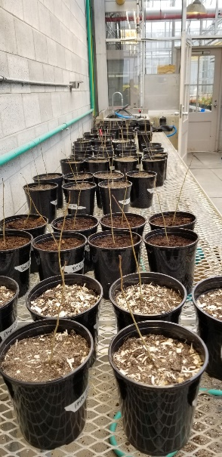
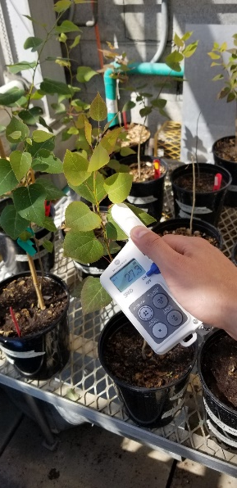
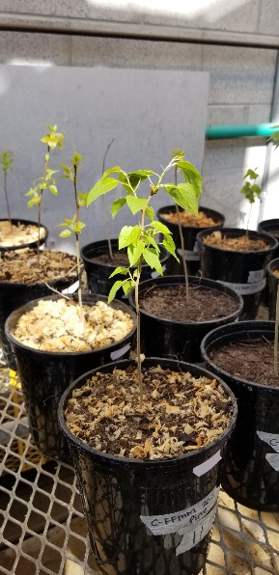
2. Greenhouse study
Same 4 soil x 4 wood combinations
Grew trembling aspen seedlings for 4 months
Height, diameter, foliar chlorophyll every two weeks

Slide 10
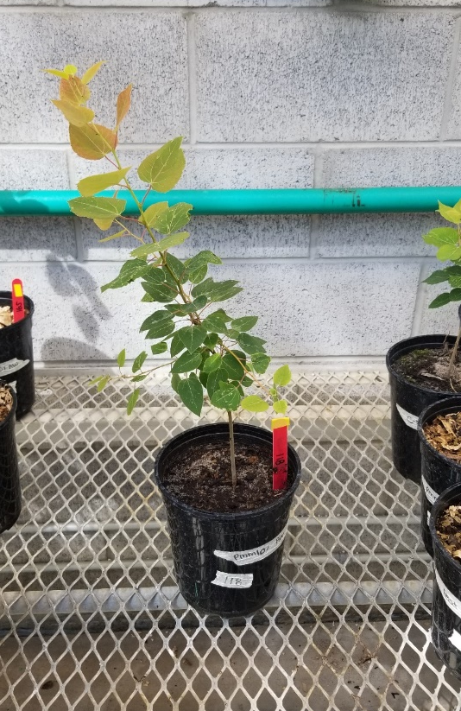
Greenhouse results
Aspen grew the most with no wood but the impact varied by soil type
Greatest growth in fine FFMM, poorest growth in coarse FFMM
Aspen growth correlated with soil nitrogen supply rates
Biomass
Foliar chlorophyll
Height
Coarse Fine Peat PMM
FFMM FFMM
Coarse Fine Peat PMM
FFMM FFMM
Biomass
Trepanier et al. Forests. 2022

Slide 11
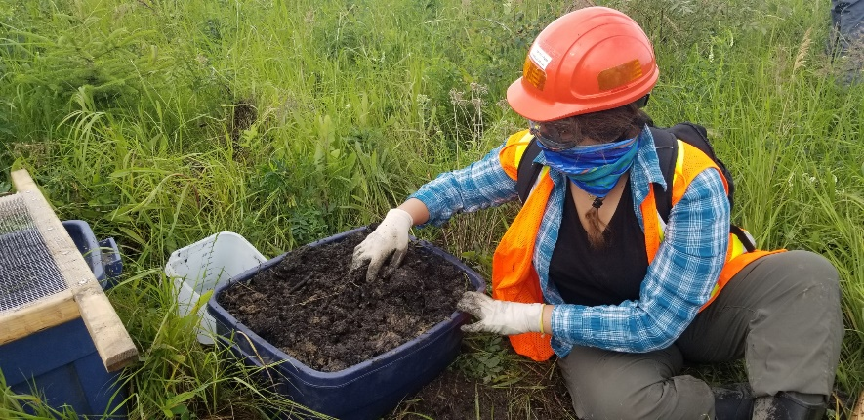
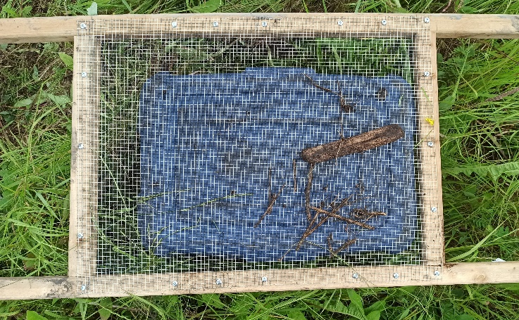
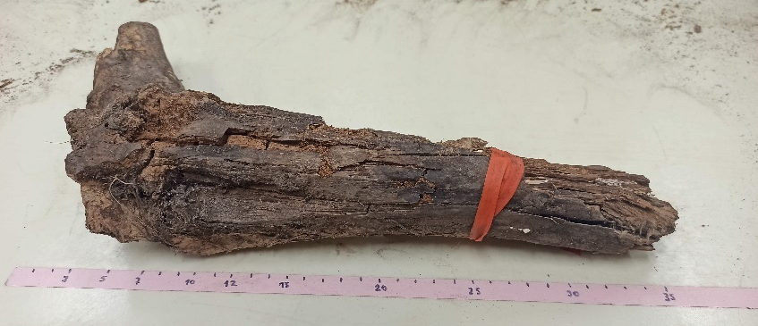
3. Field study
2 soil types → PMM and FFMM
Characterize actual amounts of buried wood in reclamation soils
Size classes and decay state
Nutrient supply rates

Slide 12
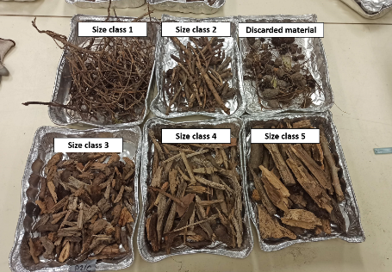
Field results
PMM | FFMM
4.8 m³/ha | 13.9 m³/ha
0.32% (max 2%) | 0.93% (max 6%)
More buried wood in FFMM than PMM
Way less buried wood than predicted from salvage piles (20%)
Size and decay classes similar
No correlation between buried wood and nutrient supply rates

Slide 13
Conclusions
Buried wood has the potential to reduce nutrient availability, especially in the most productive soils
This change in nutrients may influence tree growth
But this is very unlikely at the levels of buried wood found in operational reclamation sites

Slide 14
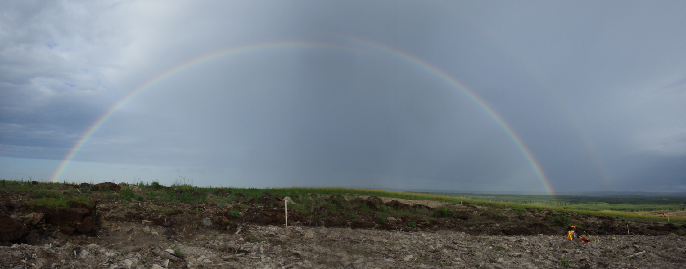
Thanks!

