Slide 1
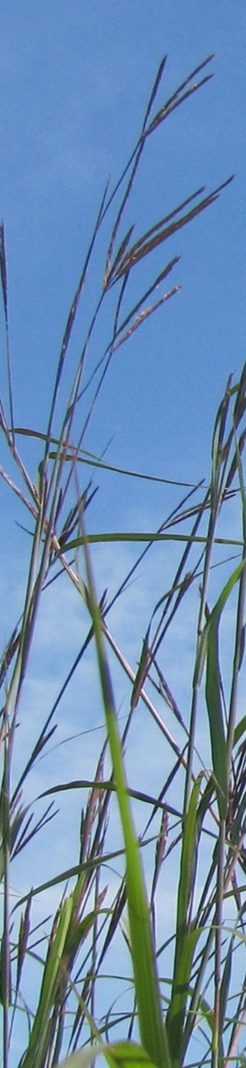
Reducing Seed Dormancy in
Southern-Adapted Native Forage Grasses
Brian S. Baldwin¹, Jesse I. Morrison¹, and J. Brett Rushing²
¹Dept. of Plant & Soil Sciences, Mississippi State, MS
²Dept. of Plant & Soil Sciences, Coastal Plains Res. & Ext. Center, Newton, MS
13 June 2022
American Society of Reclamation Science
Duluth, Minnestoa

Slide 2
Characteristics
Co-adapted with North American ecosystems and wildlife
  Especially ground-nesting birds
Very deep rooted
  Drought tolerant
  Marginal soils
Tall, medium and short bunch-type grasses
Long-lived perennial grasses
  >25 yrs
Notes:
These are all warm-season meaning they begin to grow vegetatively at the end of spring, when the temperatures are on the rise.
Because they are perennial we can compare our selected populations within any given year-when determining progress this allows us to reduce un-accountable variation due to the environment
They are difficult to establish in a field from seed for several reasons:
1)the growth rate is slow during the seedling stage, giving weeds the opportunity to shade-out and out-compete these grasses.
2)Also, these grasses have extensive seed dormancy which prevents uniform germination and this also allows weeds to get an upper-hand
Dormancy can be defined as viable seed that does not germinate under ideal conditions. Most crops have been domesticated and the dormancy is all but removed. However, this is not the case with these grasses. To break the dormancy the seed are typically stratified prior to planting. This involves subjecting moist seed to cold temperatures (around 4 degrees C) for 2 weeks. The alternative is storing the seed for about a year to reduce dormancy. Both options are an inconvenience to producers.

Slide 3
Uses
Reclamation
  Mining and other disturbed industrial sites
Livestock pasture and hay
  Gains of greater than1-2 lbs/day
Conservation and wildlife
Roadside vegetation
Notes:
These are all warm-season meaning they begin to grow vegetatively at the end of spring, when the temperatures are on the rise.
Because they are perennial we can compare our selected populations within any given year-when determining progress this allows us to reduce un-accountable variation due to the environment
They are difficult to establish in a field from seed for several reasons:
1)the growth rate is slow during the seedling stage, giving weeds the opportunity to shade-out and out-compete these grasses.
2)Also, these grasses have extensive seed dormancy which prevents uniform germination and this also allows weeds to get an upper-hand
Dormancy can be defined as viable seed that does not germinate under ideal conditions. Most crops have been domesticated and the dormancy is all but removed. However, this is not the case with these grasses. To break the dormancy the seed are typically stratified prior to planting. This involves subjecting moist seed to cold temperatures (around 4 degrees C) for 2 weeks. The alternative is storing the seed for about a year to reduce dormancy. Both options are an inconvenience to producers.

Slide 4
Deleterious characteristics
Not adapted to corralled livestock
  Rotational grazing alright
Difficult to establish in the field
  Extensive seed dormancy
    Failure of seed to germinate even though conditions are optimal
  Slow initial growth
    Attributed to crown development
  Weed competition
  Doak et al. ENGS 2002

Slide 5
Domestication of grasses
Old World grass species
  Human selection pressure on Old World grasses/forages for about 6,000 yrs

Slide 6
Domestication of grasses
Old World grass species
  Human selection pressure on Old World grasses/forages for about 6,000 yrs
New World grass species
  About 60 yrs, or so

Slide 7
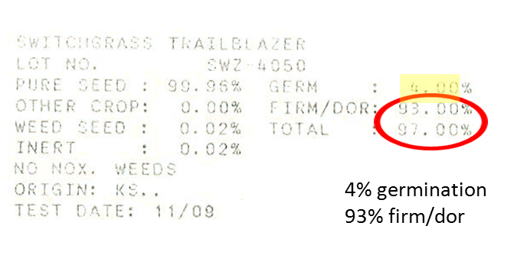
Native seed and percentage germination
Switchgrass Trailblazer
Lot No.: SWZ 4050
Pure Seed : 99.98% Germ: 4.00%
Other Crop : 0.00% Firm/Dor : 93.00%
Weed Seed : 0.02% Total : 97.00%
Inert %: 0.02%
NO NOX WEEDS
Origin: KS.
Test Date: 11/09
300 lbs/A

Slide 8
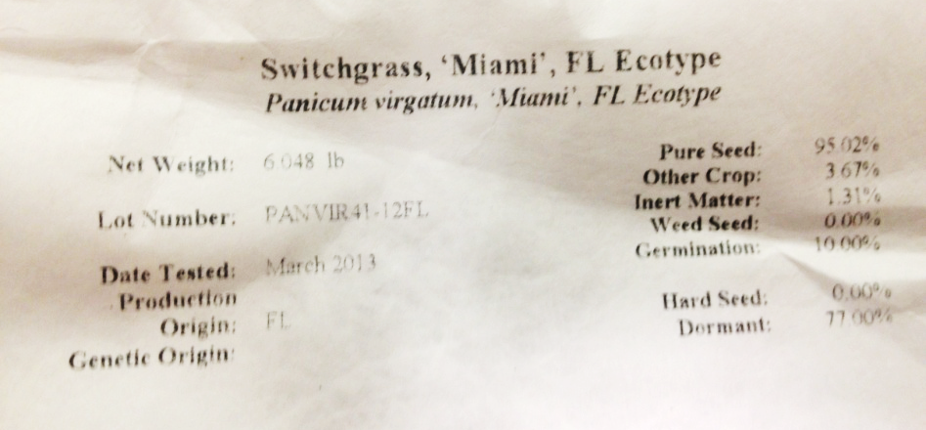


Examples
77% dormant
76% non-germinating
77% dormant

Slide 9
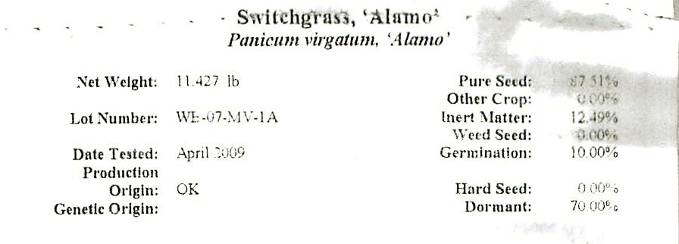

Seed dormancy
“Incorporation of native species into a breeding program for other traits [and the subsequent seed increases] reduces seed dormancy by eliminating seed that don’t germinate.”
‘Alamo’ released in 1978

Slide 10
Let’s do the Math $
If the seed lot is 77% dormant, then only 23% of the seed will germinate immediately after planting.
Planting rate of 8 lbs/A PLS for most native grasses = 1.84 lbs/A living seedlings.
Planting rate goes up 4.35 X to get equivalent of 8 lbs = 34.8 lbs/A for minimum recommended coverage

Slide 11
Let’s do the Math $
If the seed lot is 77% dormant, then only 23% of the seed will germinate immediately after planting.
Planting rate of 8 lbs/A PLS for most native grasses = 1.84 lbs/A living seedlings.
Planting rate goes up 4.35 X to get equivalent of 8 lbs = 34.8 lbs/A for minimum recommended coverage
At a price of $25/lb goes from $200 to $870/A

Slide 12
Let’s do the Math $
If the seed lot is 77% dormant, then only 23% of the seed will germinate immediately after planting.
Planting rate of 8 lbs/A PLS for most native grasses = 1.84 lbs/A living seedlings.
Planting rate goes up 4.35 X to get equivalent of 8 lbs = 34.8 lbs/A for minimum recommended coverage
At a price of $25/lb goes from $200 to $870/A
At a price of $30/lb goes from $240 to $1,044/A

Slide 13
Methods to overcome seed dormancy
Stratification – 8-10 wks
Scarification – acids or mechanical abrasion
Chemical treatments – K₂NO₃, H₂O₂, Na₂HClO₃
Hormones/PGRs - GA₃
Generally:
  Ineffective commercially
  Use caustic chemicals
  Reversible upon drying
Add cost and only circumvent the problem
In the South . . . . . .

Slide 14
Our objective
Select to reduce seed dormancy
  Develop native germplasm adapted to the southeastern U.S. that “germinates on demand” without stratification

Slide 15
Species
Switchgrass, UL & LL (Panicum virgatum)
Big bluestem (Andropogon gerardii)
Indiangrass (Sorghastrum nutans)
Little bluestem (Schizachyrium scoparium)
Beaked panicum (Panicum anceps)
Purpletop (Tridens flavus)
Eastern gamagrass (Tripsacum dactyloides)
Southeastern wildrye (Elymus glabriflorus)
Notes:
PART 2, Seed dormancy is an issue. Note that these two cultivars are 70 and 93% seed dormant seed. Stratification, a cold wet treatment, is used to overcome dormancy, but it is messy, and sometimes is ineffective. Occasionally the seed dormancy resumes after it is dried for planting. These are the seedlots purchased for planting in the field study (they were wet stratified for the field study.)

Slide 16
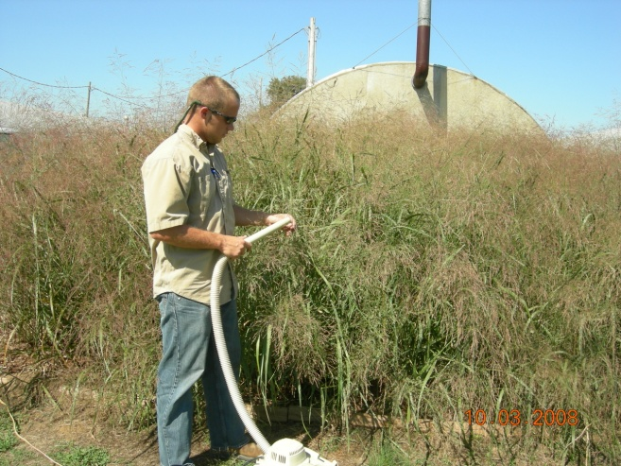
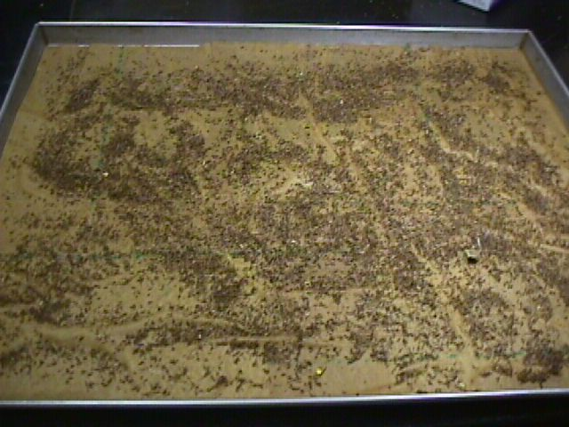
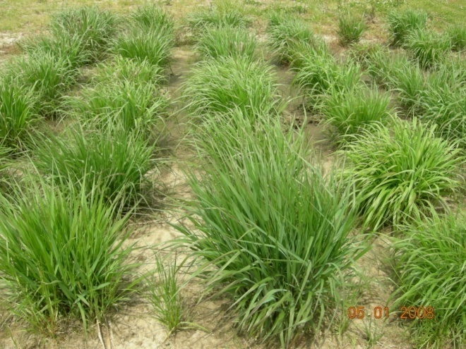
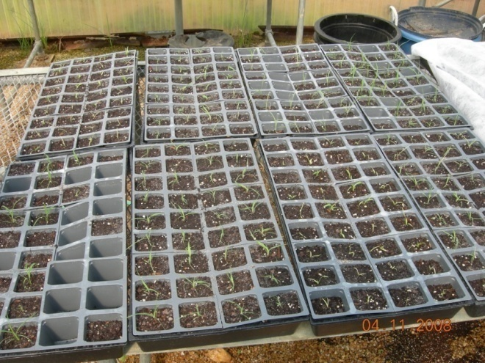
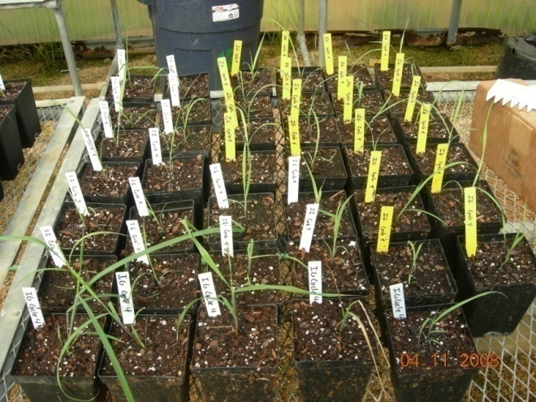
Phenotypic
Recurrent
Selection

Slide 17
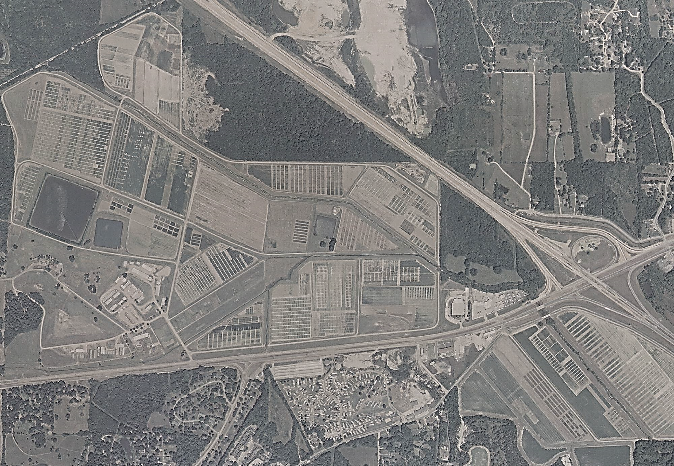
Cycle 4
R.R. Foil Plant Science Research Center
Mississippi State University
Cycle 5
Cycle 0
Cycle 3
Cycle 1
Cycle 6
Cycle 8
Cycle 7
Cycle 2

Slide 18
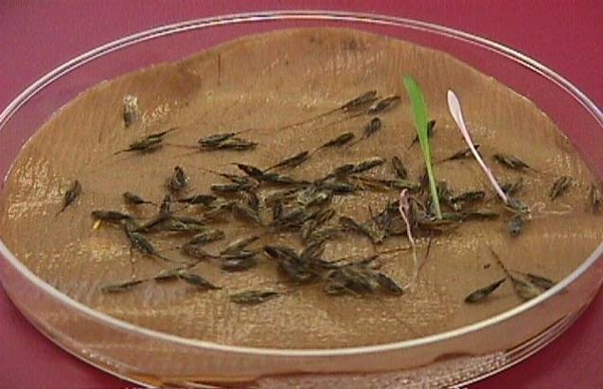
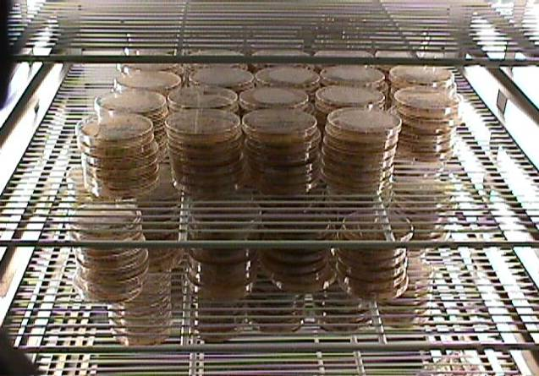
Materials and methods
Population evaluation (AOSA)
  Collected seed from established species blocks
  4 months storage (60% RH @ 70º F)
  6 reps of 100 seed/species/cycle placed in Petri dishes
  Captan®/water solution; germination paper

Slide 19
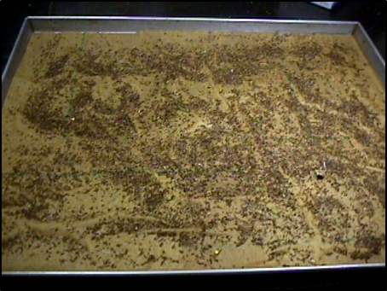
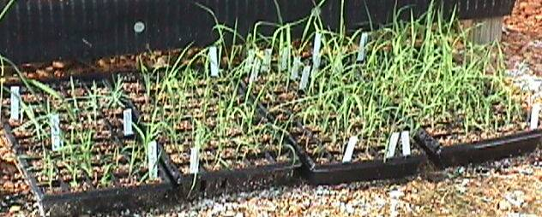
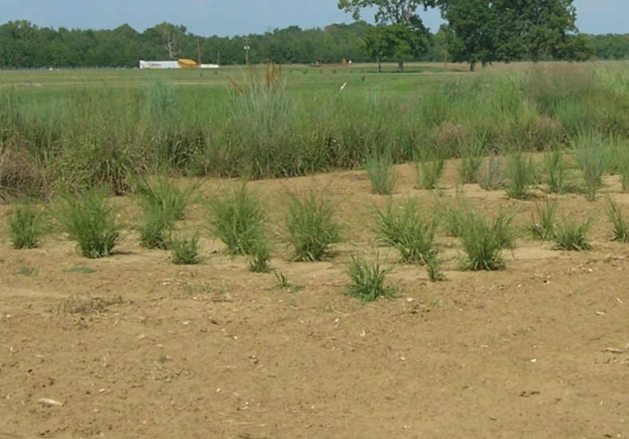
Materials and methods
Mass screening of populations
  Seedlings transplanted to six-packs.
  Surviving seedlings transferred to the greenhouse (transitional period)
  New cycles were established >¼ mile from other cycles.

Slide 20
‘Excelso’ Indiangrass: 14-day
Cycle | Evaluation/Screening Year |  |  |  |  |  |  |  |  |  | Mean (%) LSD=3.40
 | 2002 | 2003 | 2004 | 2005 | 2006 | 2007 | 2008 | 2009 | 2010 | 2018
 | Mean Germination Percentage by Year
0 | 0.20 | 1.70 | 0.30 | 0.33 | 0.83 | 0.33 | 2.33 | 0.00 | 0.00 | 11.6 | 0.64
1 | 0.30 | 2.70 | 2.20 | 2.17 | 2.67 | 11.83 | 4.00 | 0.34 | 0.34 | 11.7 | 2.82
2 |  | 1.00 | 7.50 | 7.50 | 11.67 | 7.17 | 31.67 | 6.00 | 5.66 | 47.3 | 9.54
3 |  |  | 17.00 | 17.00 | 18.50 | 1.00 | 25.83 | 6.00 | 4.66 | 60.1 | 12.54
4 |  |  |  | 1.67 | 0.53 | 18.67 | 19.50 | 11.00 | 19.34 | 48.3 | 17.39
5 |  |  |  |  |  |  | 10.83 | 14.34 | 11.00 | 65.8 | 25.5
6 |  |  |  |  |  |  |  |  | 9.34 | 84.6 | 46.5
7 |  |  |  |  |  |  |  |  |  | 74.0 | 64.0
14-day germination of ‘Americus’ = 0.0; ‘Holt’ = 0.0

Slide 21
Velocity of Germination
Sometimes called mean germination rate (MGR)
MGT = ΣFx/ ΣF; where F is the number of seed germinated on day x.
MGR =CV/100 =1/T; where T is mean germination time and CV; coefficient of velocity

Slide 22
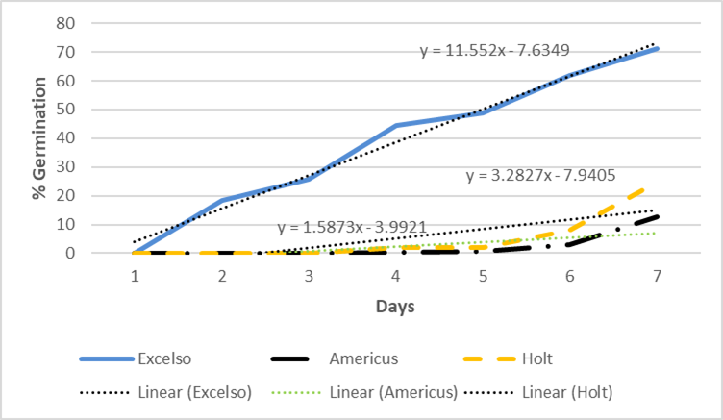
Velocity of Germination
‘Excelso’ Indiangrass

Slide 23
Results
Species at various levels of pre-stratification germination
Serendipitously increased VOG
    0.2% precocious germination in 28 days
    94 % precocious germination in 5 days
Five ready for commercial release

Slide 24
Results
Five ready for commercial release
  ‘Espresso’ (syn ‘Expresso’) LL switchgrass (64%)
  ‘Robusto’ UP switchgrass (42%)
  ‘Supremo’ big bluestem (42%)
  ‘Excelso’ Indiangrass (76%)
  ‘Cappuccino’ little bluestem (58%)
  ‘Copiah’ and ‘Cohoma’ southeastern wildrye (70%)

Slide 25
Prepping for Commercial Release
Research populations only generate a handful of seed
Requires four increase generations
  Breeder’s seed Foundation seed
  Foundation seed Registered seed
  Registered Certified seed (for sale)
Each generation represents a 300 to 10,000 fold increase in seed number.
8 yrs of selection + 4 yrs seed increase = 12 yrs

Slide 26


Prepping for Commercial Release
If you are developing new varieties, develop a relationship with a seed company.

Slide 27
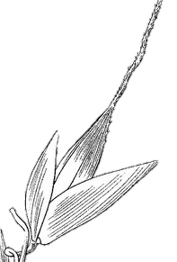
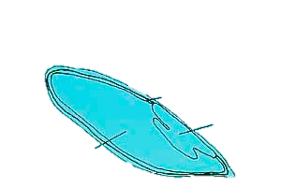
Pay attention to the changes you are making
Selection against dormant seed has caused two changes to the seed.
  Cracking of pericarp upon seed maturity
  Seed fall free of the glumes
pericarp
aleurone
palea &
lemma
embryo
endosperm
glumes
Notes:
g

Slide 28
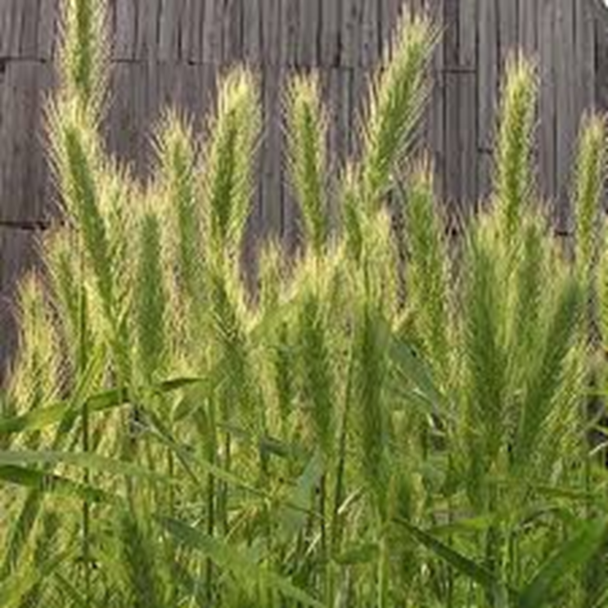

Questions?

