Slide 1
Teaching Reclamation through Applied Curricular and Co-Curricular Experiences
Dr. Natalie Kruse Daniels
Ohio University

Slide 2
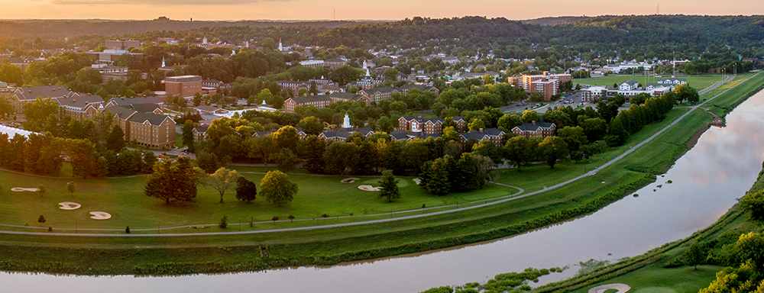
Ohio University – First University West of the Allegheny Mountains

Slide 3
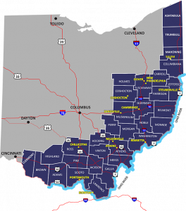
Regional Setting

Slide 4
Voinovich School of Leadership and Public Service

Slide 5
Voinovich School Academic Programs
Master of Public Administration (on campus, Executive, online)
Master of Science in Environmental Studies (on campus)
Master of Sustainability, Security, and Resilience (online)
Honors Tutorial Bachelor of Arts in Environmental Studies
4 graduate certificates
1 undergraduate certificate

Slide 6
Voinovich School Staffing Model
Integrated teams of faculty, staff, and students
8 Tenure Track Faculty
75 Professional Staff members
UG and GA students

Slide 7
Applied Learning in Reclamation
Coursework
Voinovich Scholars Program
Applied Thesis and Leadership Practicum Experiences

Slide 8
Applied Coursework
Watershed Management
Field Methods in Environmental Studies

Slide 9
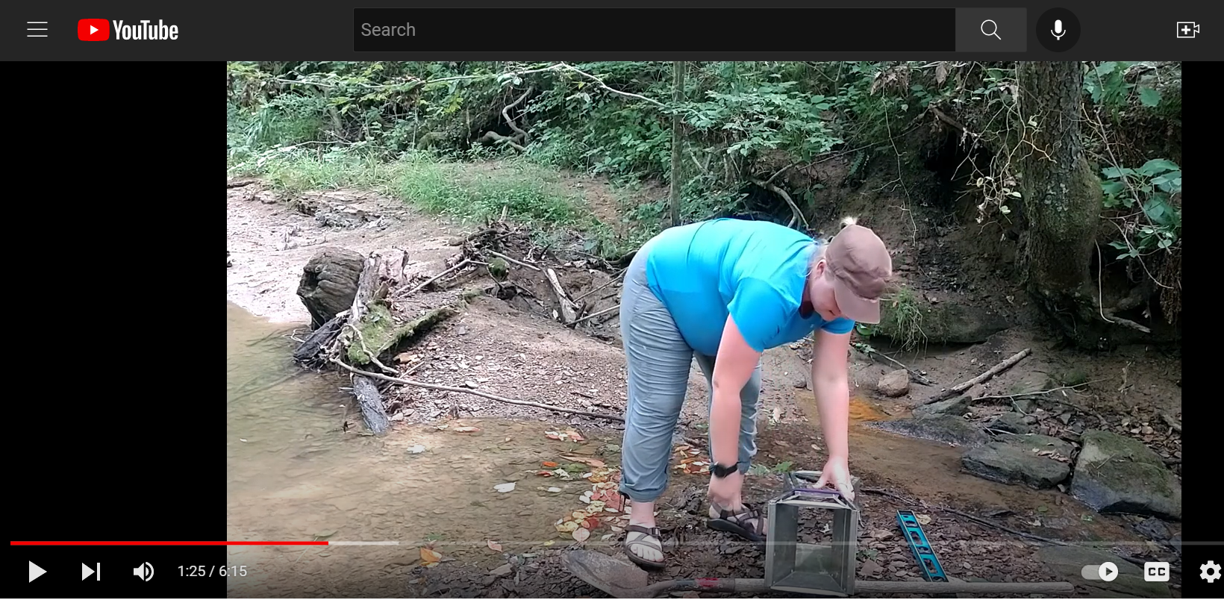
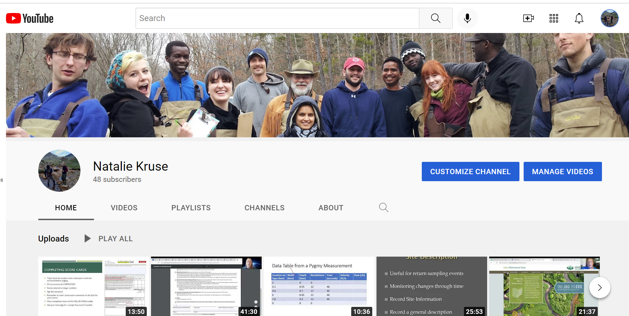
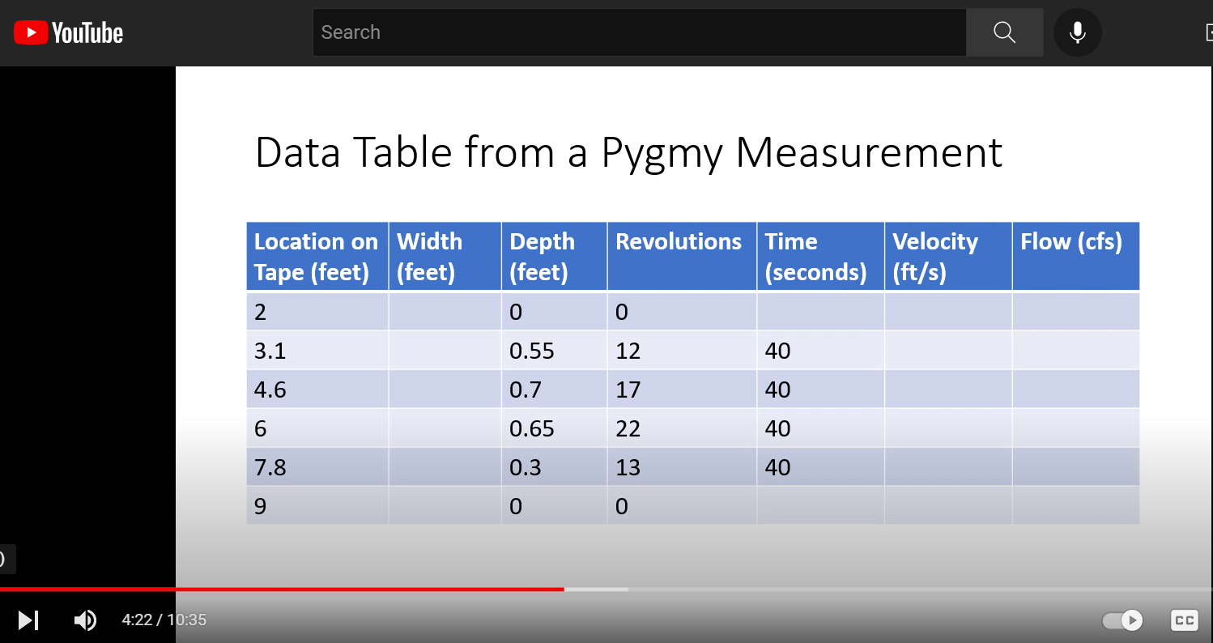
Flipped Classroom Model

Slide 10
Field Experiences
Water Quality Sampling
Fish Sampling
Macroinvertebrate Sampling
Habitat Assessment
Flow Measurement
Watershed Planning

Slide 11
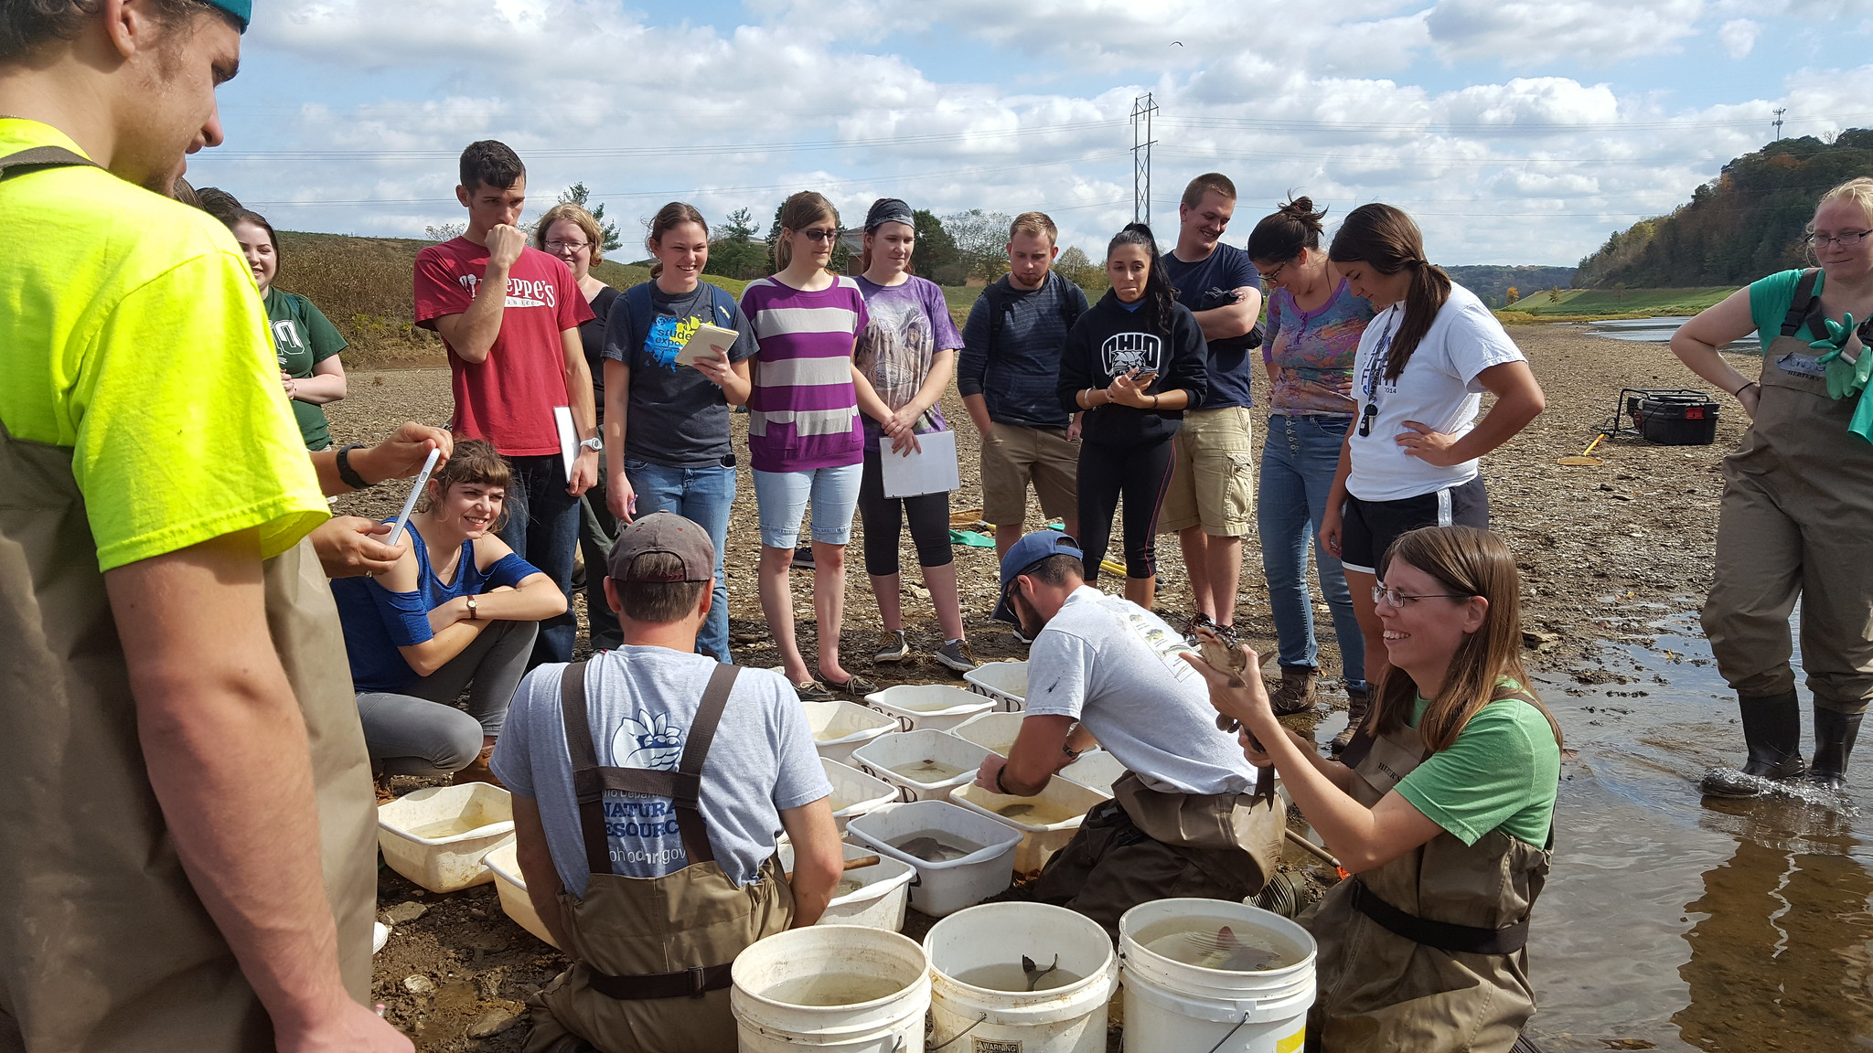
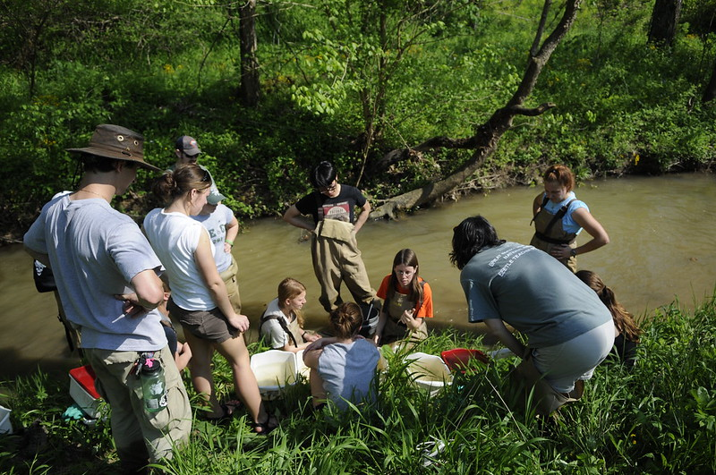

Slide 12
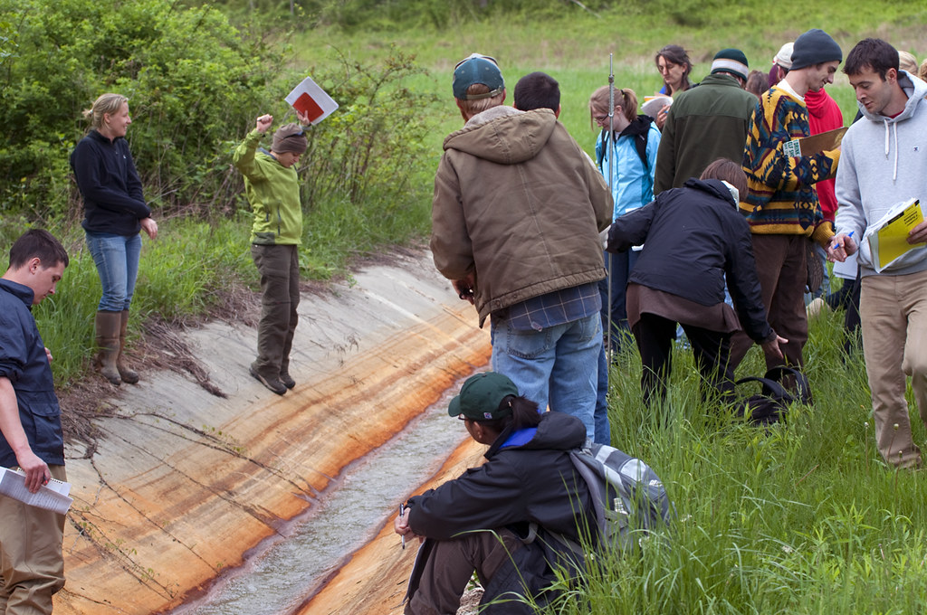

Slide 13
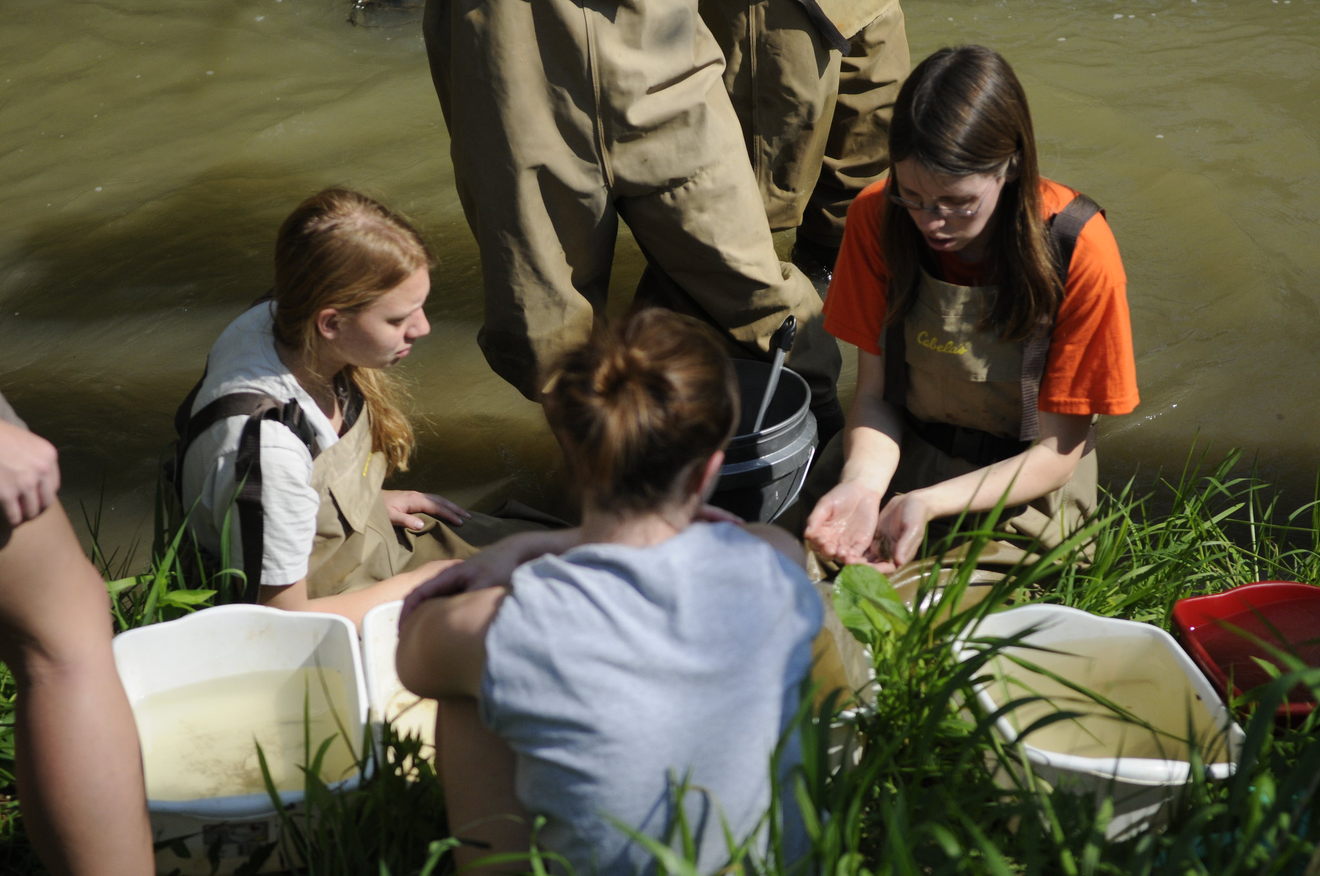

Slide 14
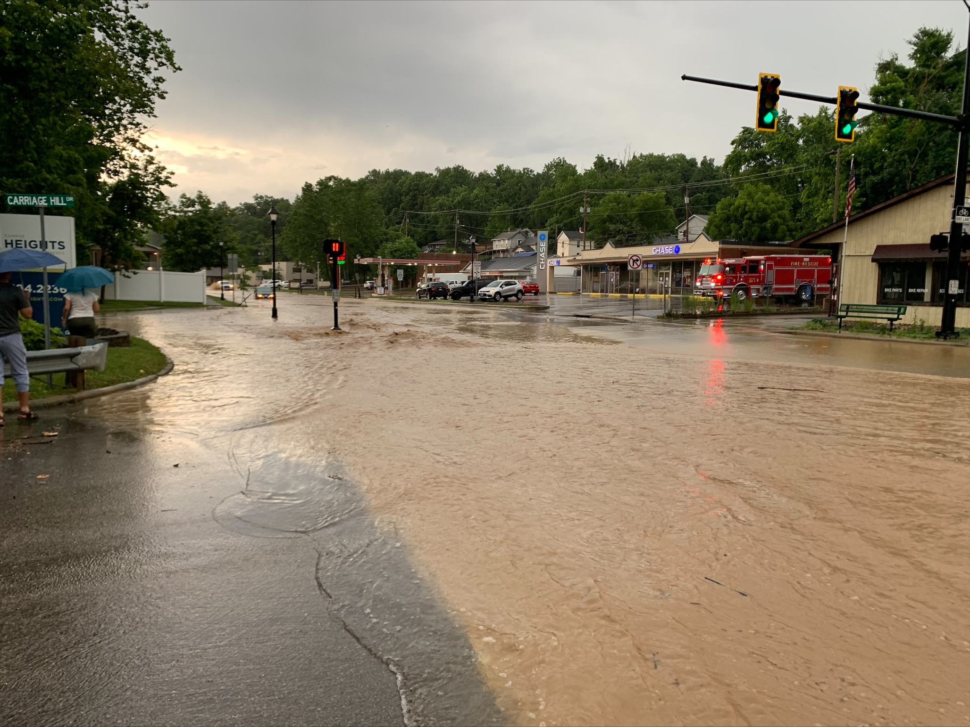
Class Assignments
Watershed Management Plan
9 Element Plan Development
Sampling Plan
Watershed Planning Exercise for Stormwater Management

Slide 15
Voinovich Undergraduate Research Scholars Program
Paid, undergraduate, academic year position
Students embedded in project teams
Newly paid $15/hour – desirable position

Slide 16
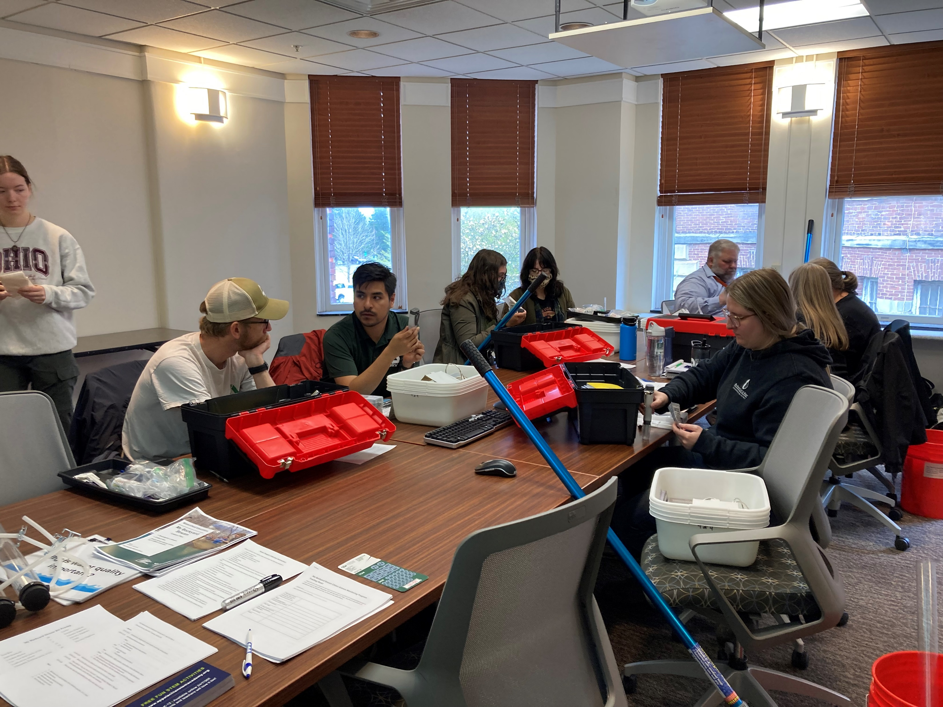
My Backyard Stream

Slide 17
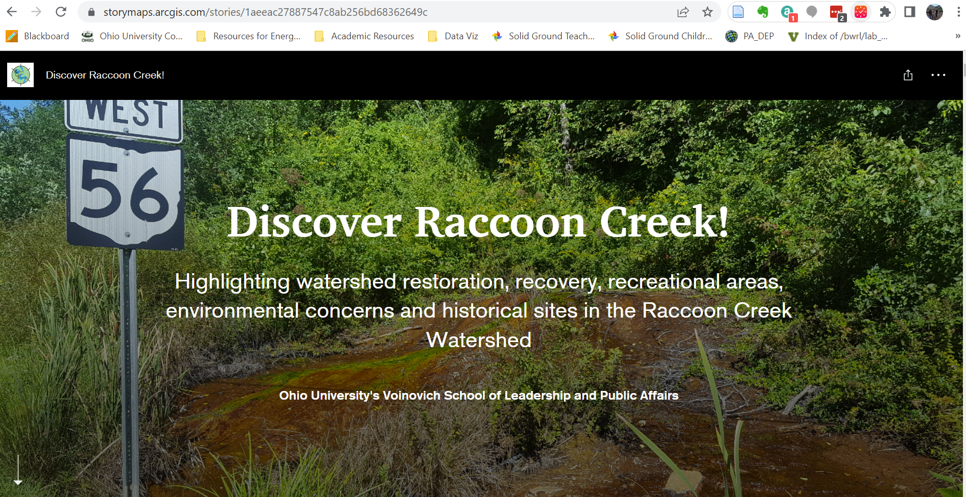
Science Communication

Slide 18
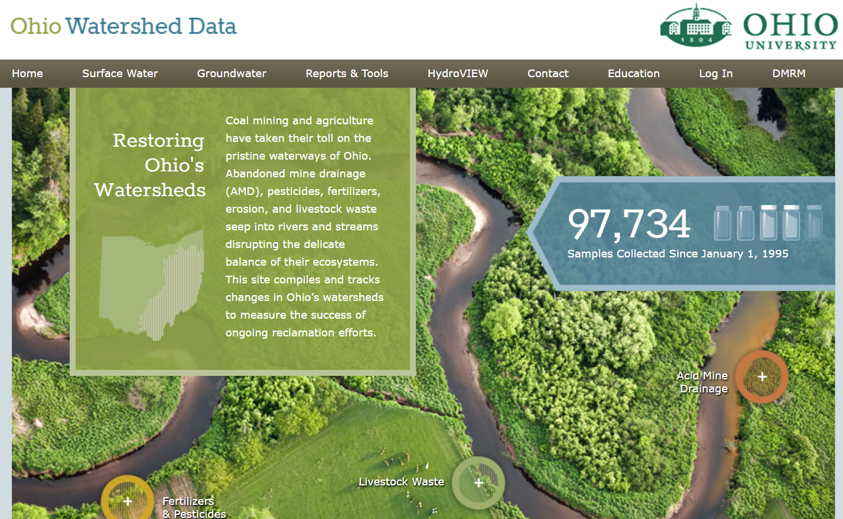
www.watersheddata.com

Slide 19
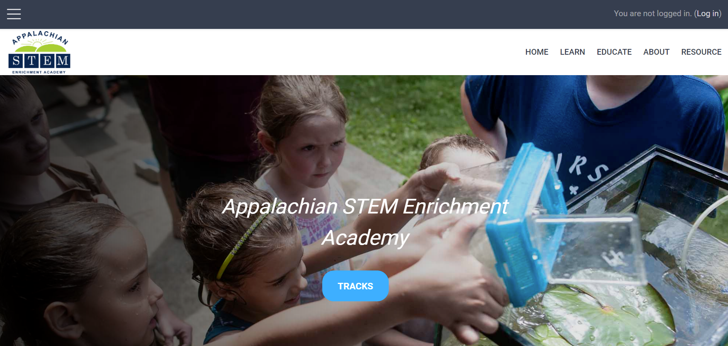
Appalachian STEM Enrichment Academy

Slide 20
Thesis and Leadership Practicums
Master of Science in Environmental Studies – 2 Capstone options
  Thesis
  Leadership Practicum
Practical, Applied, Often embedded in project/grant work

Slide 21
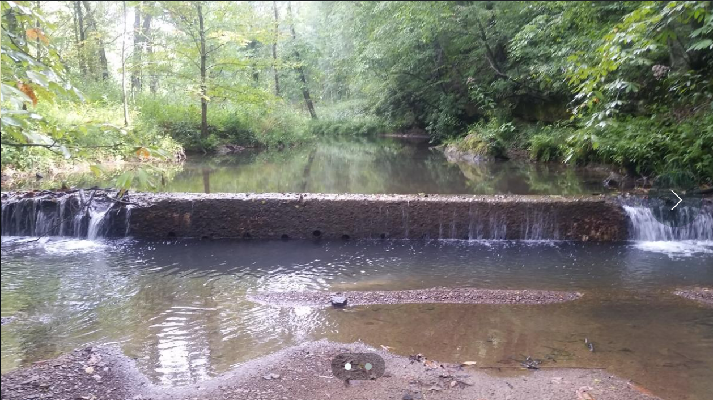
Sandy Run Low Head Dam

Slide 22
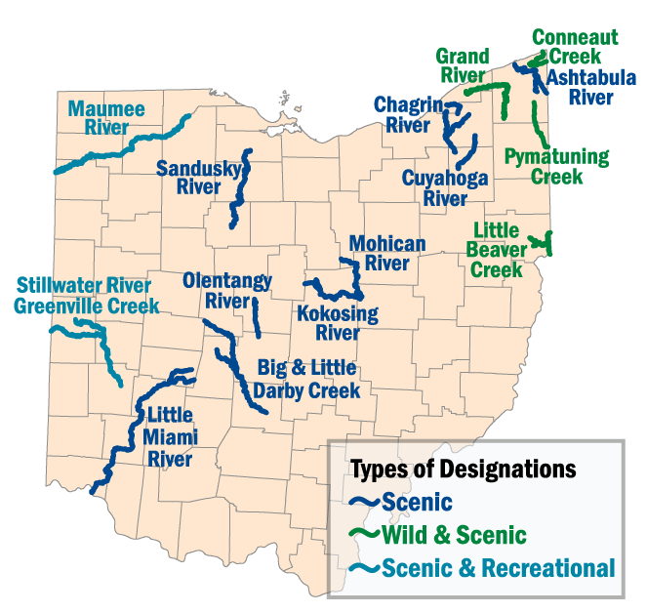
Scenic River Designation

Slide 23
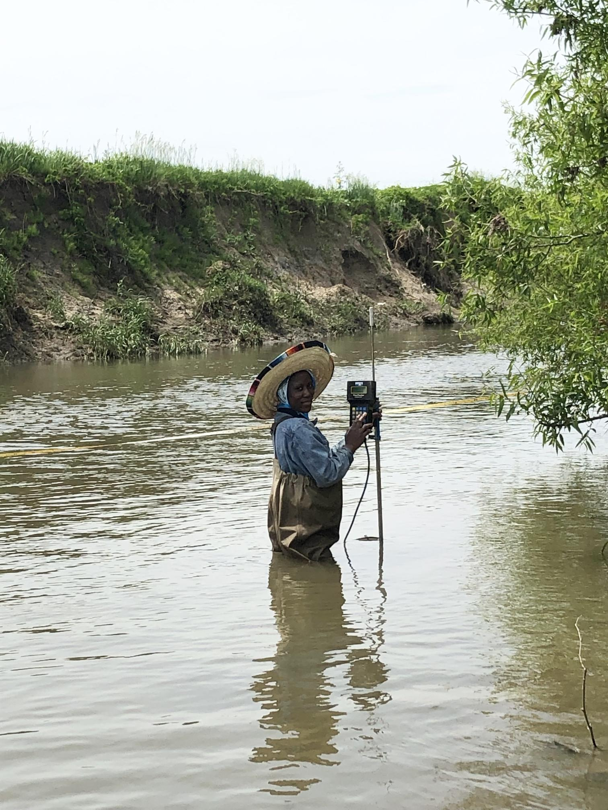
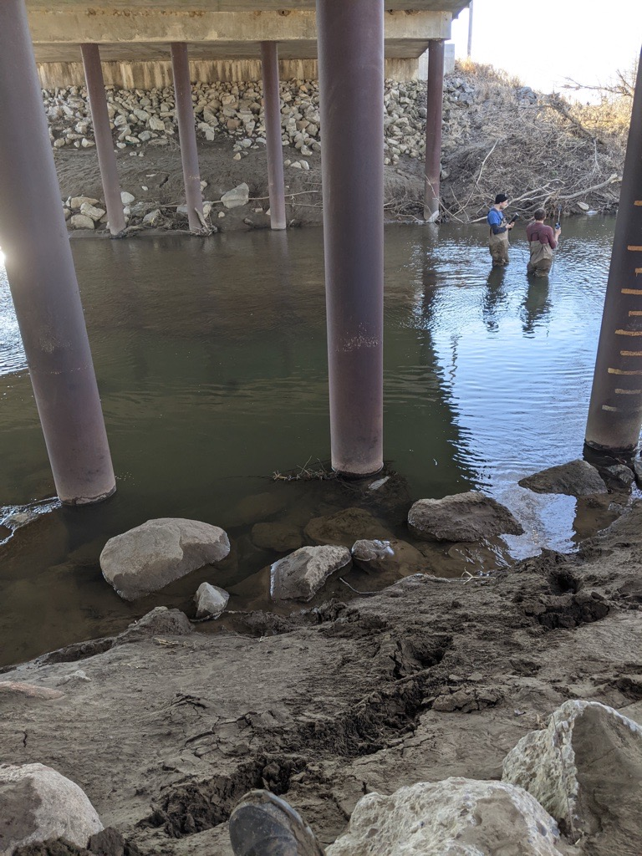
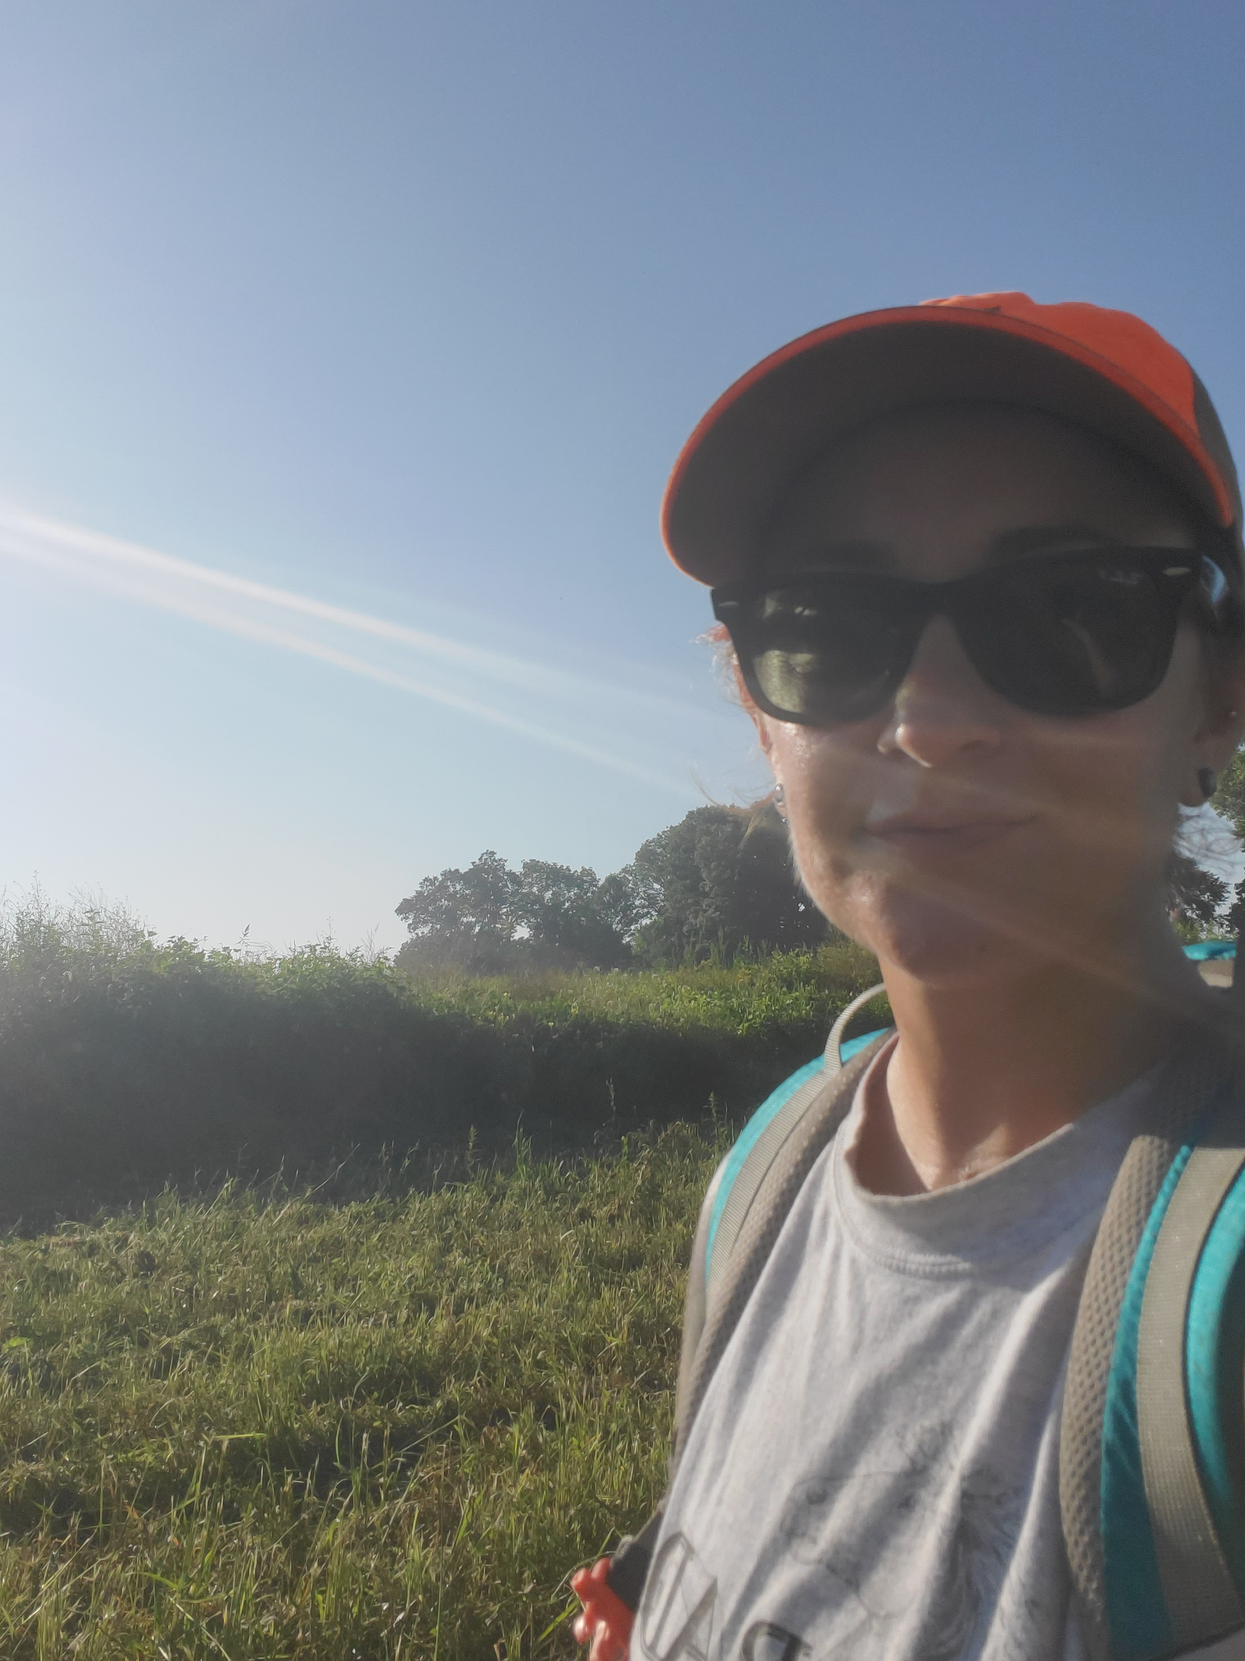
Bloody Run Swamp

Slide 24
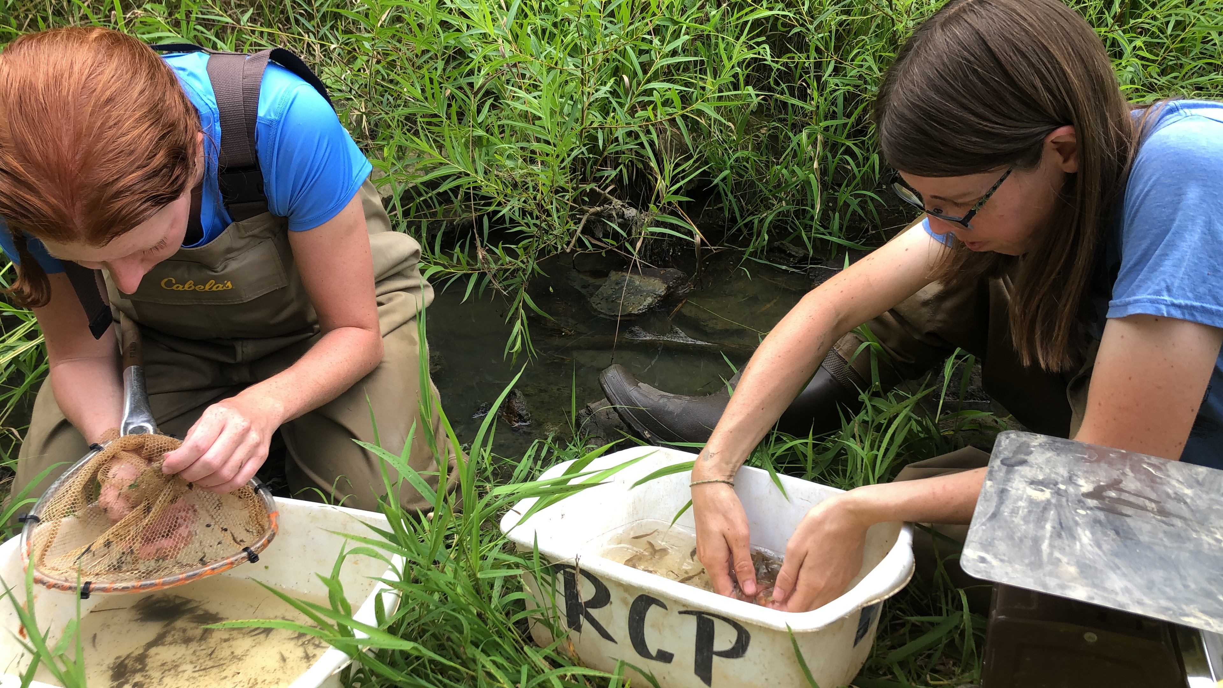
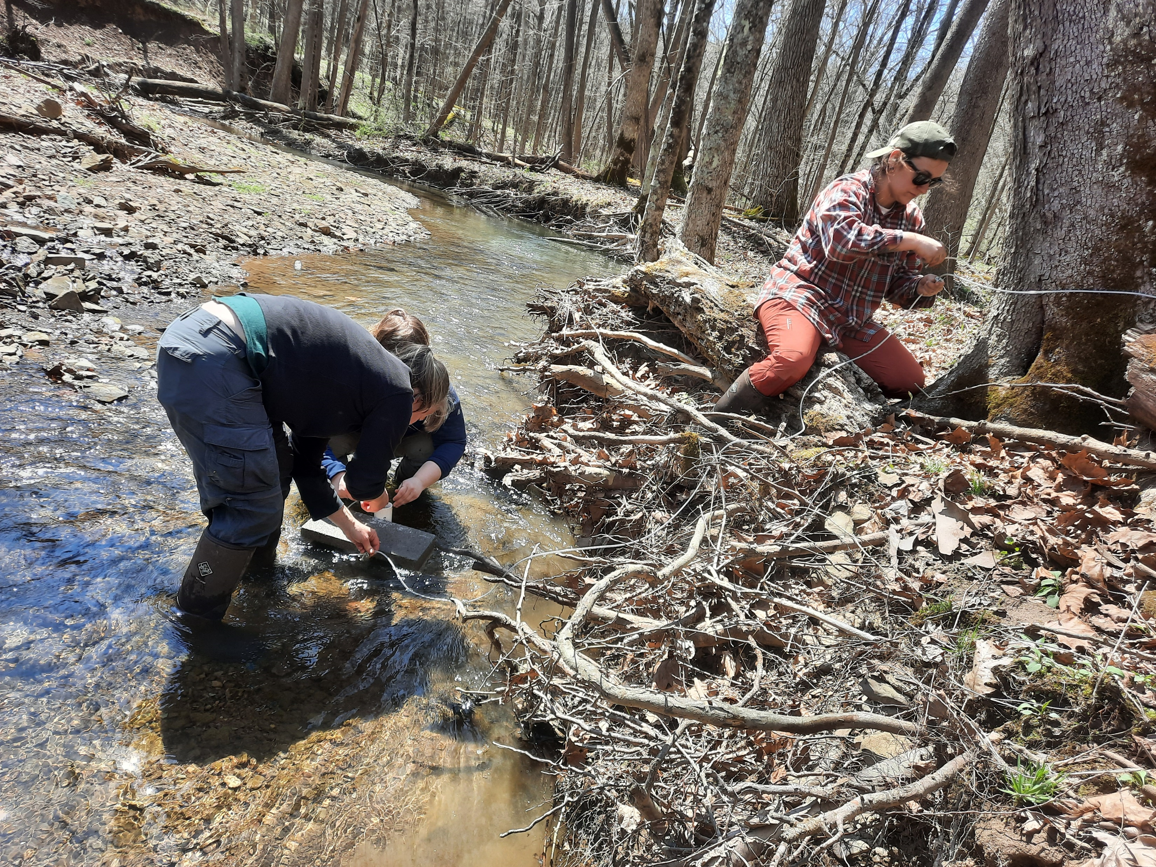
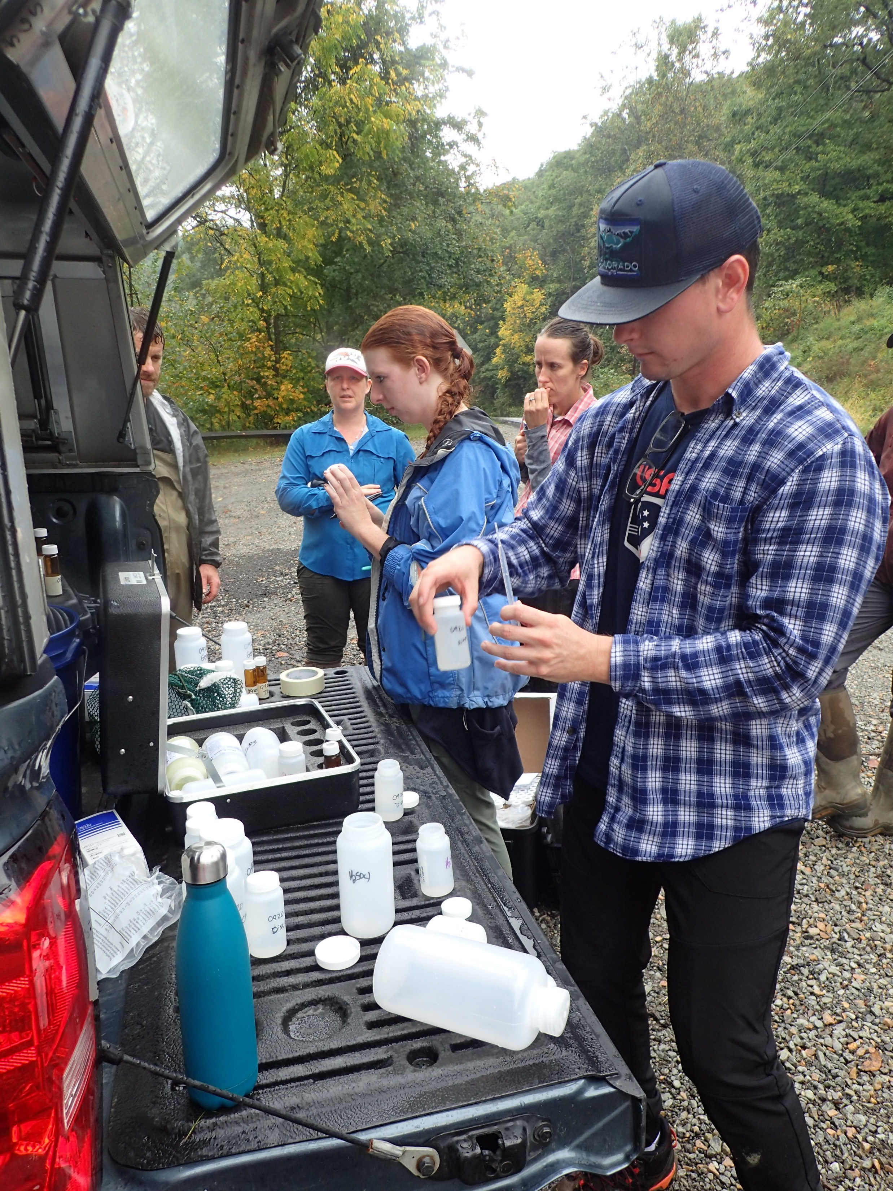
Stream Restoration Western PA

Slide 25
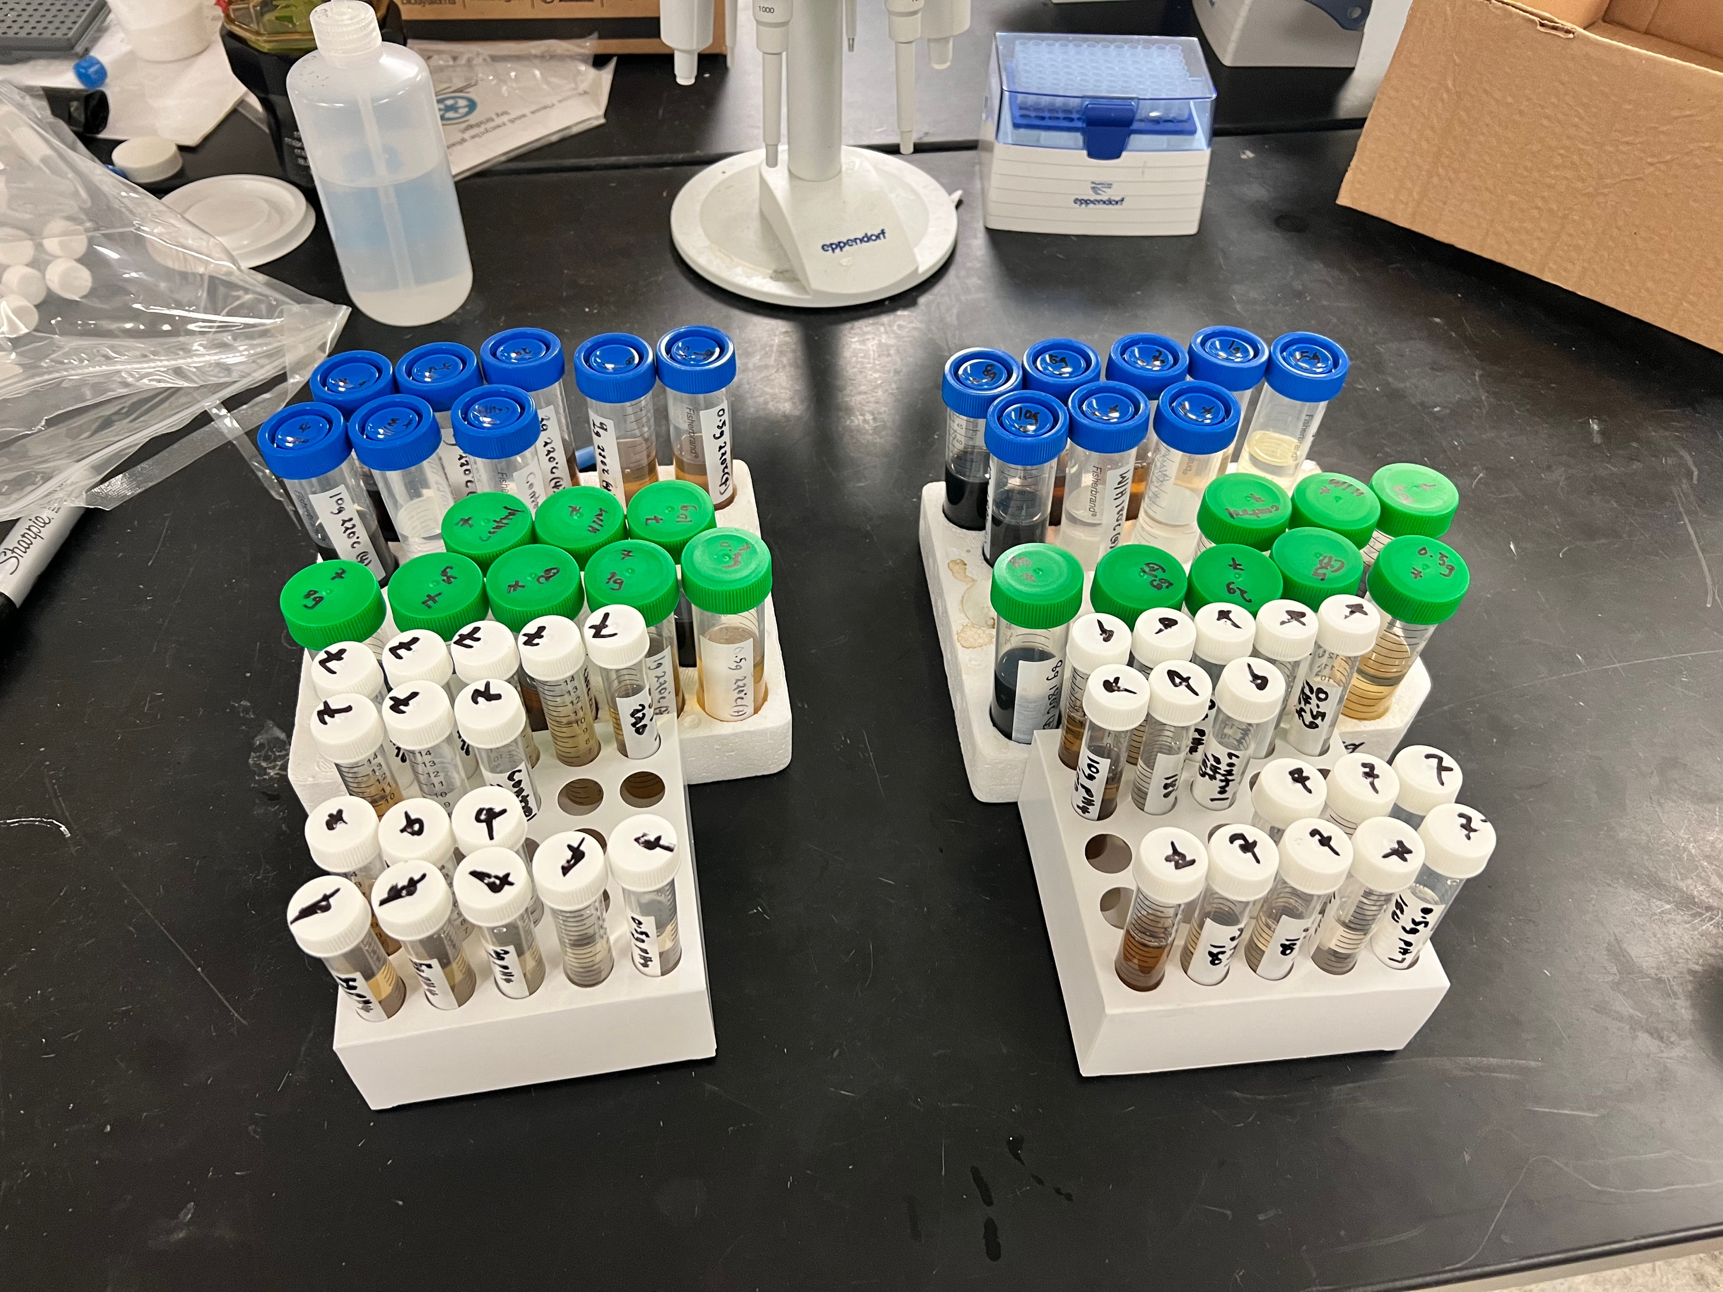
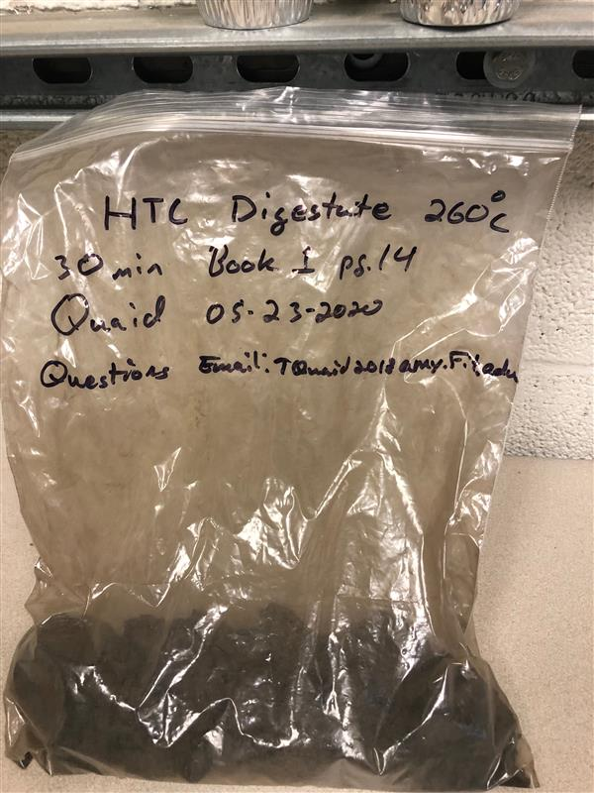
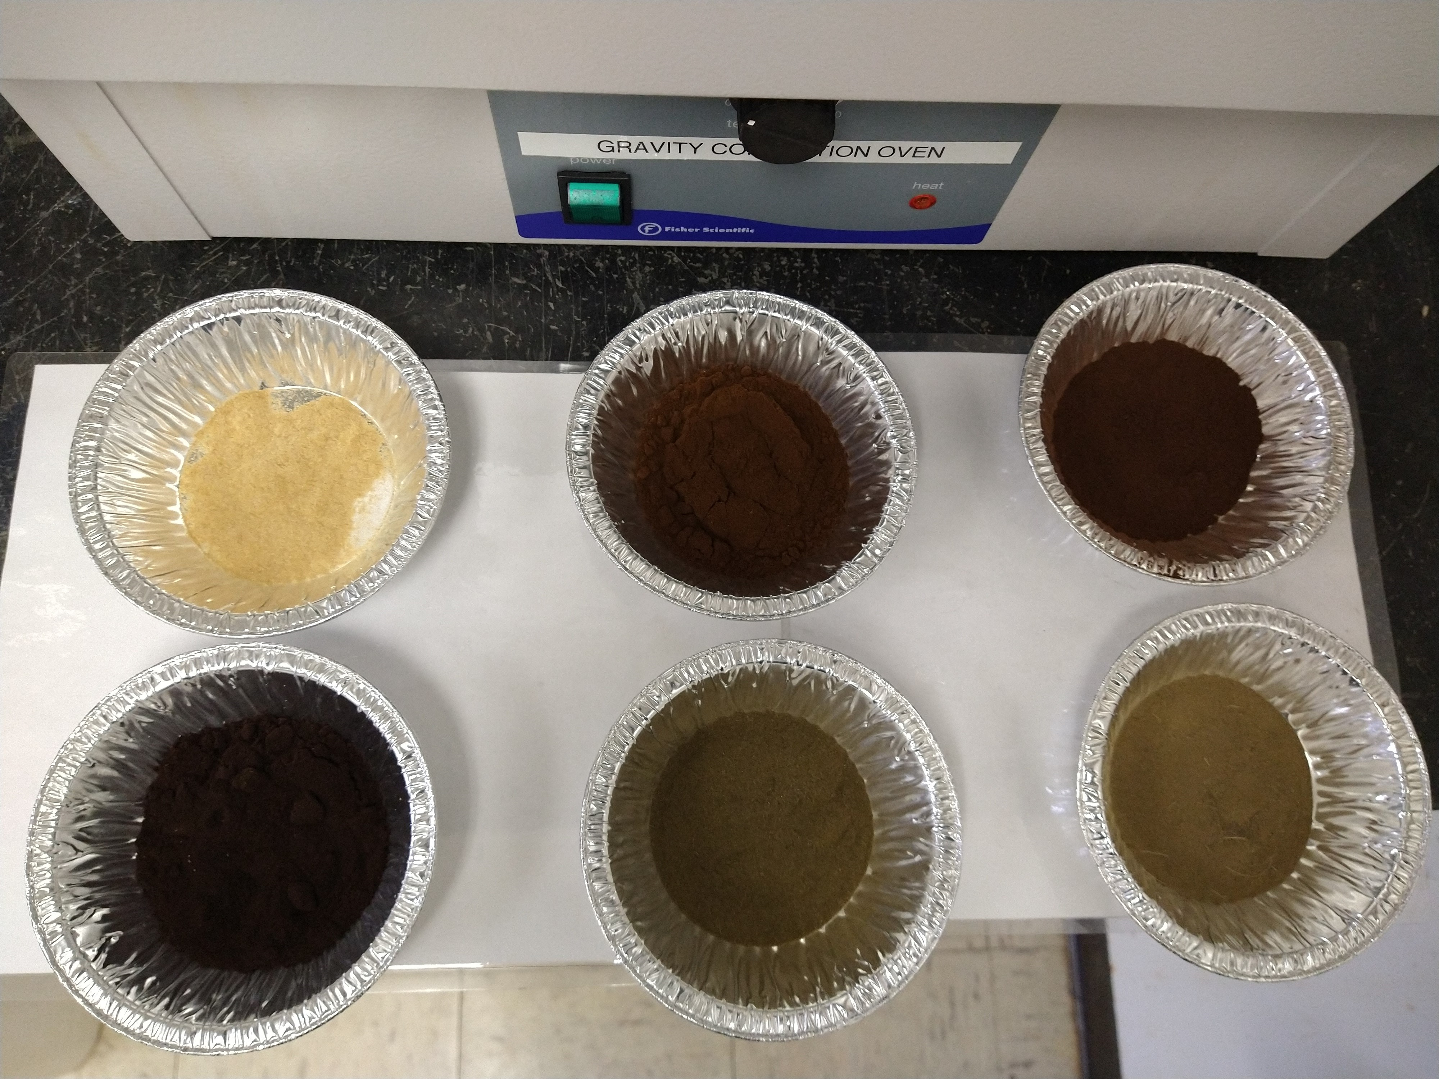
Novel Biosorbants

Slide 26
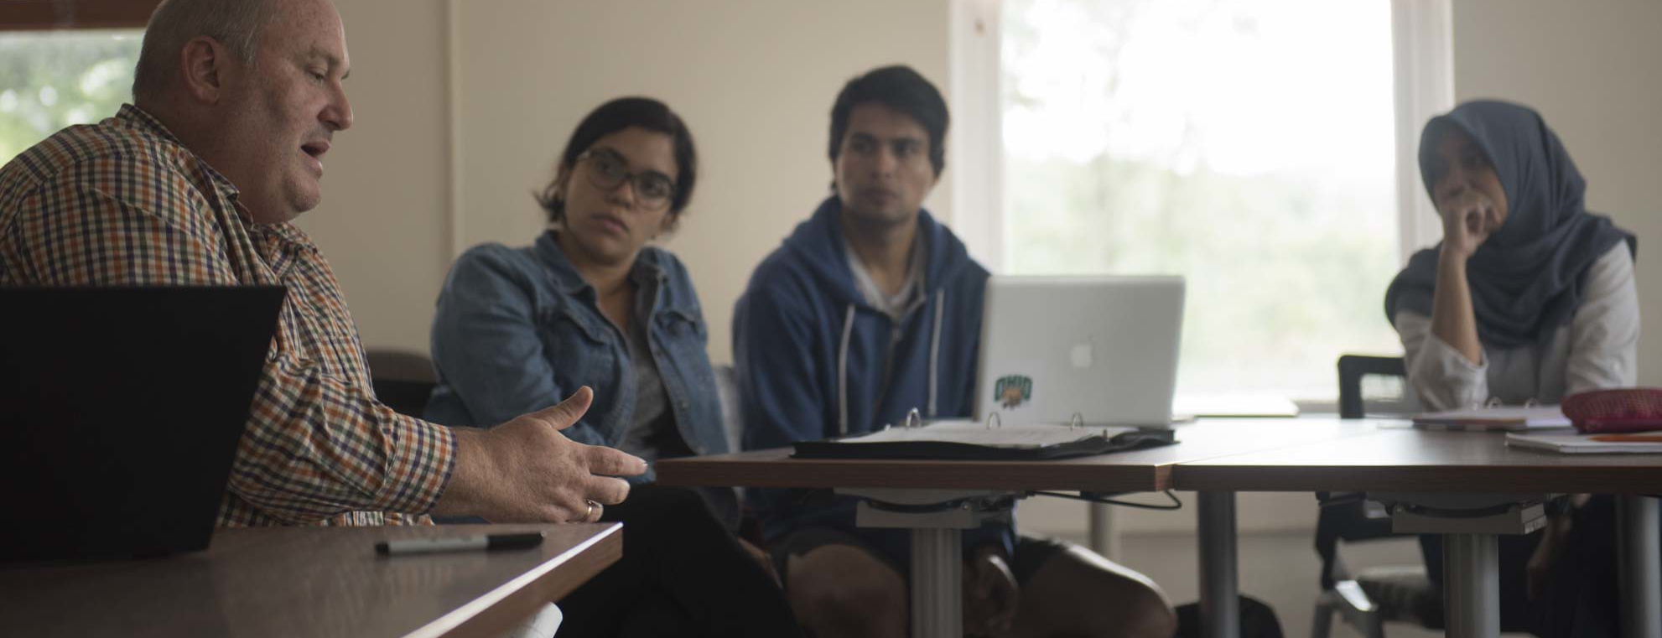
Master of Sustainability, Security, and Resilience Capstone

Slide 27

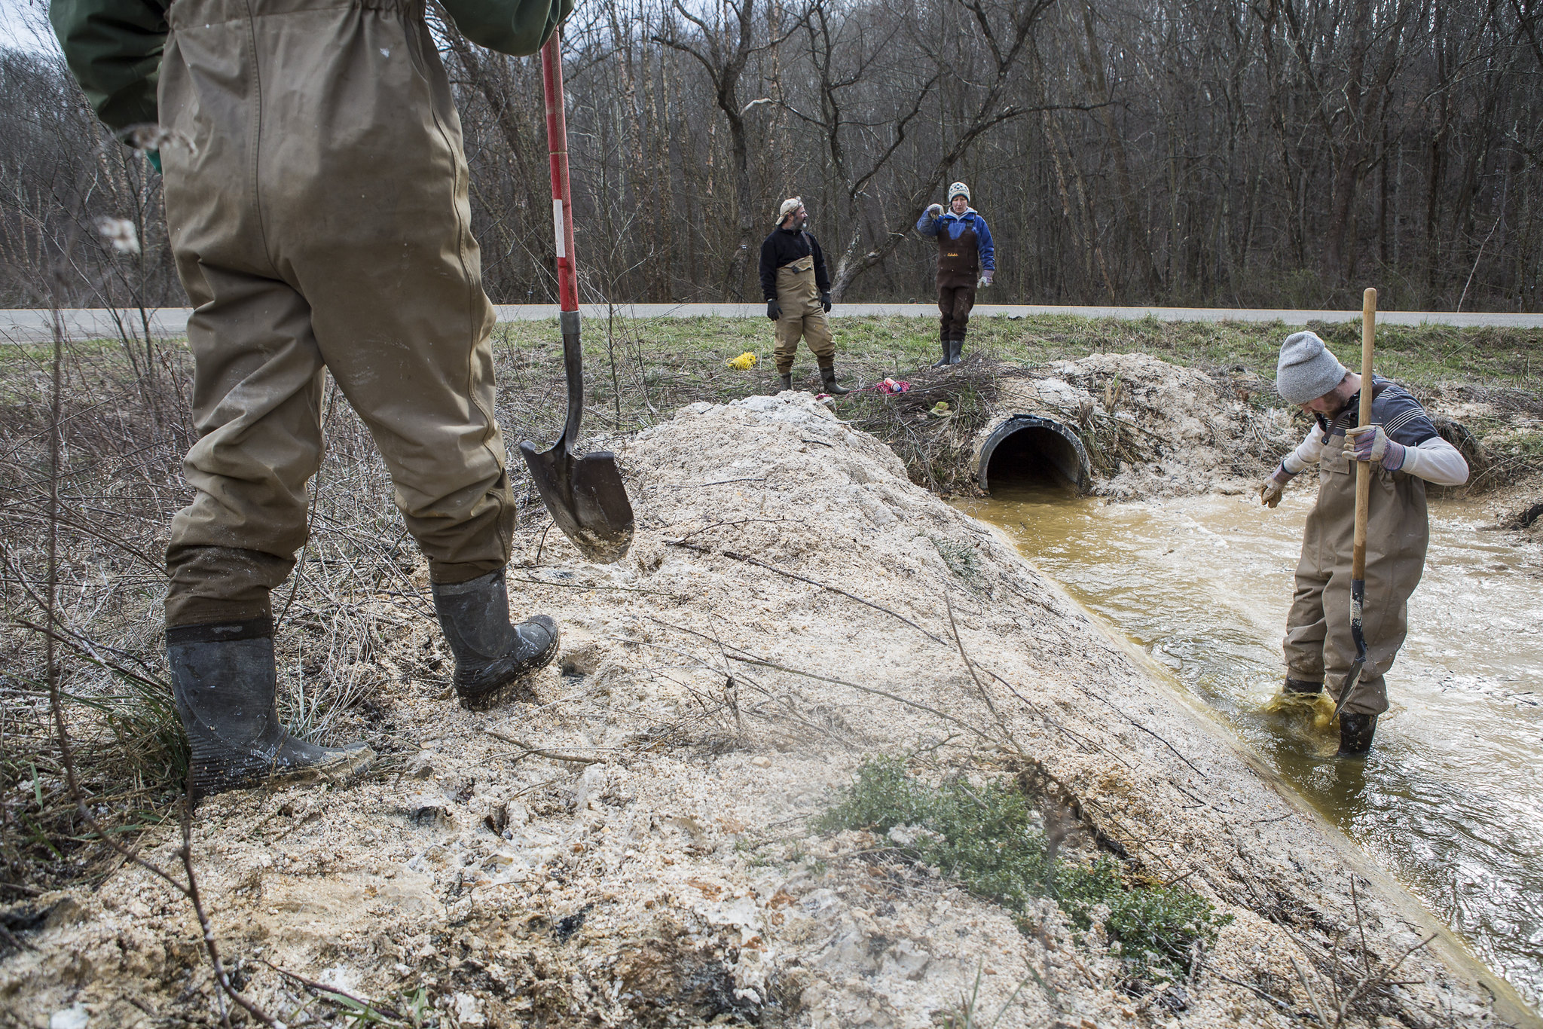
Student Involvement in Ongoing Work

Slide 28
Student Employment Outcomes
Alumni Serve Agencies at:
  Ohio and other state Departments of Natural Resources
  Ohio and other state Environmental Protection Agencies
  US EPA
  Regional water agencies
Alumni Serve as Americorps Members
Alumni lead in the non-profit sector:
  Watershed
  Climate resilience
  Social enterprise

Slide 29
Thank you!
Dr. Natalie Kruse Daniels
Master of Sustainability, Security, and Resilience (online)
Master of Science in Environmental Studies (in person)
Ohio University
krusen@ohio.edu

