Slide 1
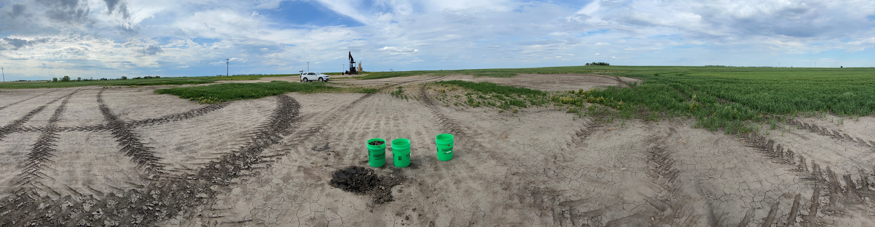

Calcium acetate: an alternative to gypsum for improving oilfield, brine impacted soils
Annalie Peterson, Thomas DeSutter, Nathan Derby, Miranda Meehan and Aaron Daigh
North Dakota State University, Fargo, ND

Slide 2
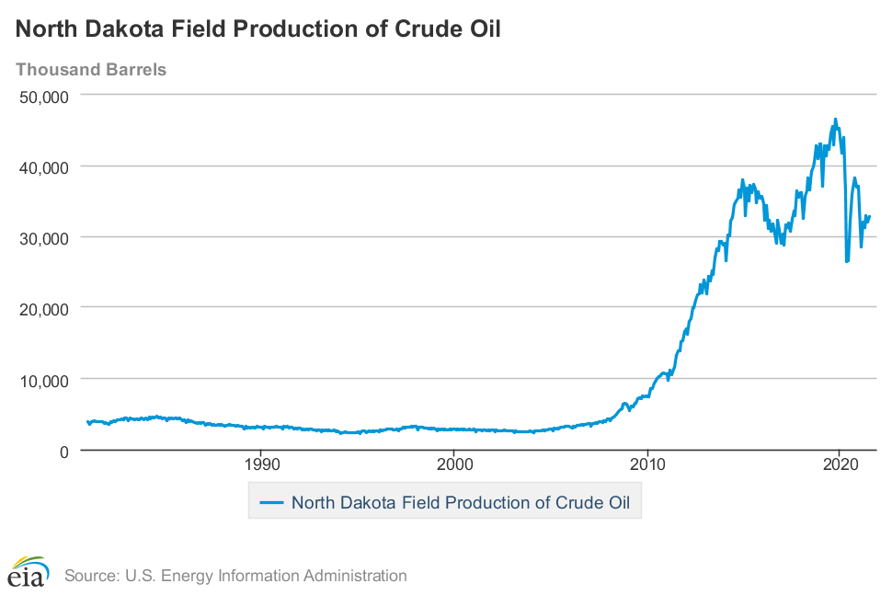
Oil Production in North Dakota
Notes:
-Graph of oil production in North Dakota over the last 40 years
-just before 2010, there is an abrupt increase in oil and natural gas production
-since 2012, North Dakota has been second leading producer of oil and natural gas only second the Texas

Slide 3
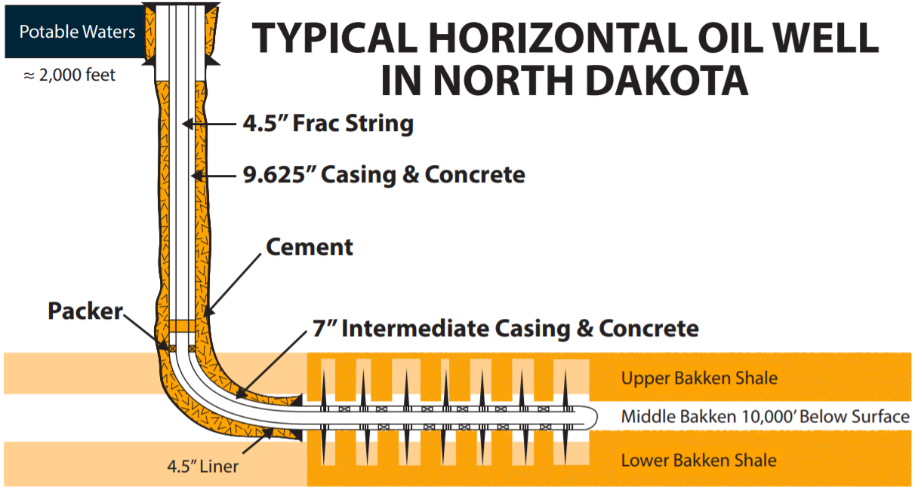
(ND water resources, 2019)
Notes:
-The reason oil and natural gas production increases is because of horizonal drilling efforts and fracking
-this image shows what horizonal drilling in the Bakken formation may look like in North Dakota
-2006 was the first successful horizontal drilling and fracking operation in North Dakota
-most wells in ND are just over 14000 ft deep, although can be shallower like the image shows
-horizontal drilling efforts seek to minimize above ground disturbances
-first, wellbore is drilled to kick off point (90 degree turn) and is lined with pipe and concrete and cement
Fracking then begins when perforated gun busts through pipe and casing into the productive rock
Then fracking fluid is pumped in with extends preexisting cracks and oil and natural gas

Slide 4
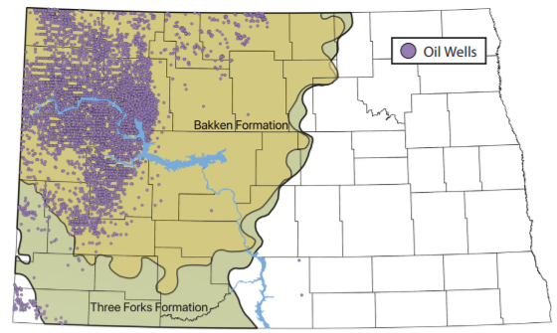
15,355 wells drilled from 2007-2018
(ND water resources, 2019)
Notes:
-This shows the location of the amount of more recent wells that have been drilled in North Dakota
-This image also shows the extent of the Bakken Formation and the Three Forks Formation
-These two rocks units are known as the two main rock units that hold most of the Oil and NG that ND produces

Slide 5
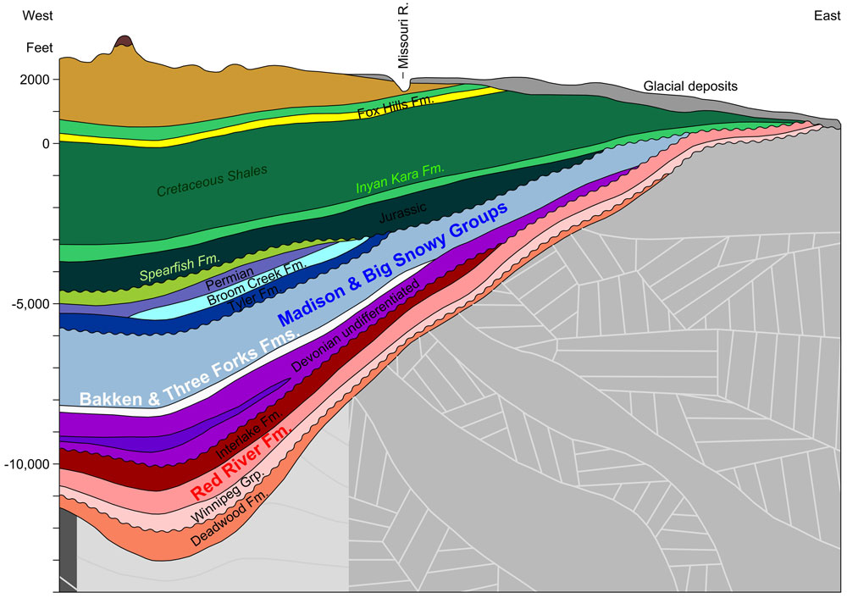
(North Dakota Geological Survey)
Notes:
-The image shows the series of rock units in the Williston Basin
-The far left side shows the western boarder of North Dakota and the Missouri rive for further context
-The Williston basin is one of few places were geologic history has been recorded so completely
-This image also shows the varying depths at which the Bakken and Three Forks Fm. Can be found

Slide 6
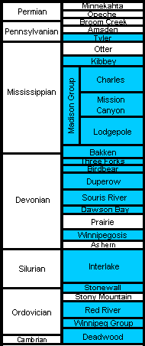
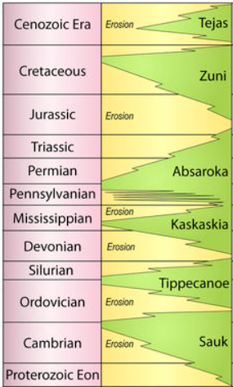
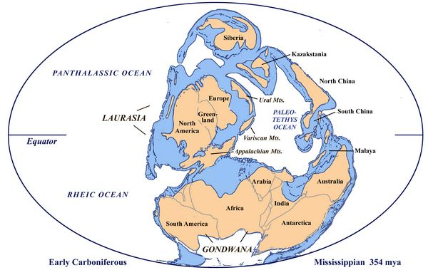
(Sloss, 1963)
(Clack, 2012)
(North Dakota Geological Survey)
Notes:
-This is a geologic timescale with rock units of Paleozoic age rocks in the Williston basin
-It shows that the Bakken and Three Forks Fm. Were deposited during the late Devonian and early Mississippian
-sediments deposited is rising sea levels during the Kaskaskia transgression… rising sea levels means less glaciers means warming earth means an abundance of marine plants and animals required for the development of oil and natural gas

Slide 7
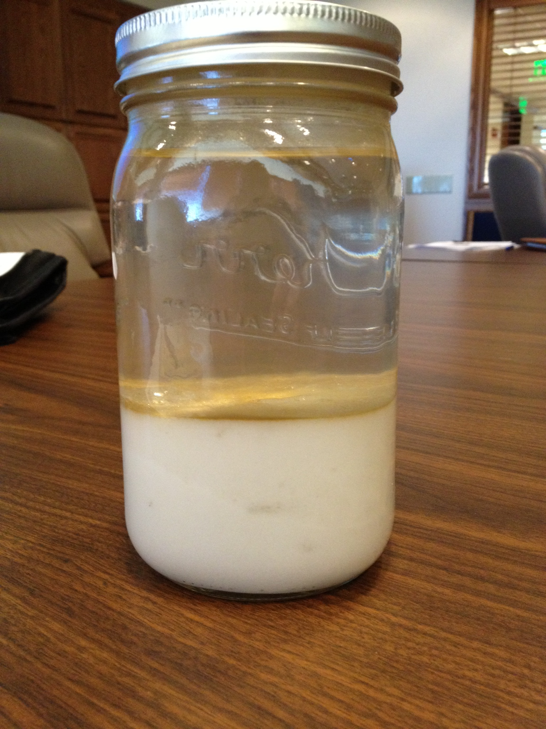
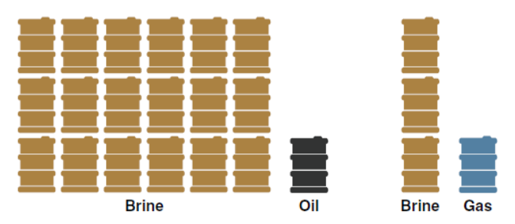
Brine is composed of primarily NaCl
EC often exceeds 200 dS/m
TDS are often greater than 250,000 mg/L
(Meehan et al., 2017)
(Green et al., 2019)
Notes:
Now that I’ve talked about some background, the purpose of this talk is to discuss the brine still remediation
So what is brine? Well…..
These are the constituents and measurements we see associated with brine solutions
This is typically the amount of brine we see produced in North Dakota
At first, it’s a 2:1 of oil to brine at the beginning of drilling operations
Through time, this ratio changes until on average, over the total longevity of the well, its 18:1 ratios of brine to oil

Slide 8
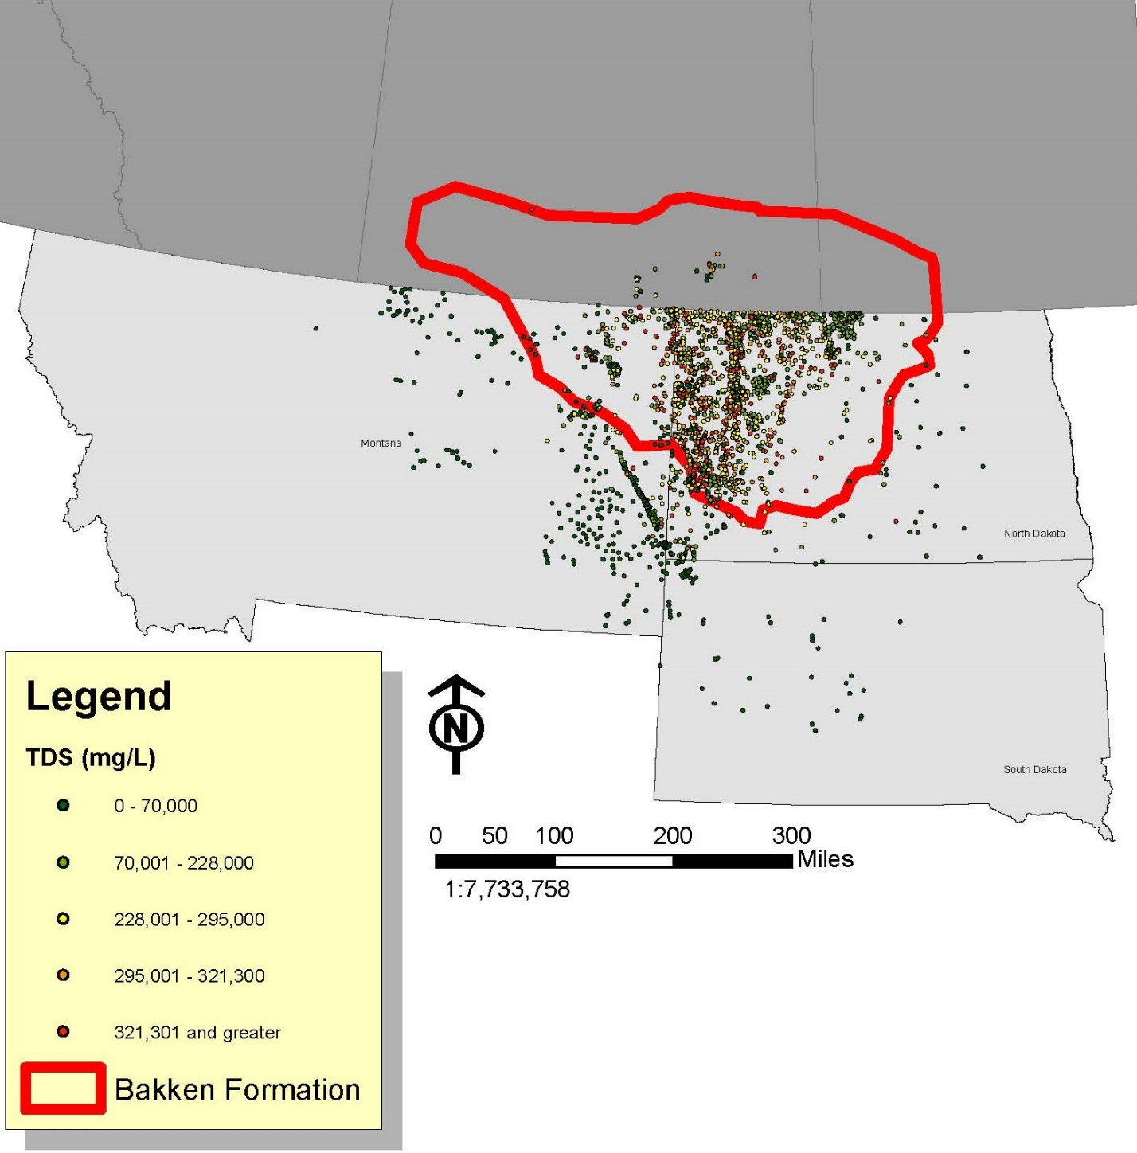
Total Dissolved Solids of brine samples in and around the Bakken Formation
(Figure from Megan Ostrand)
Notes:
-Map of Montana, ND and SD with the Bakken Fm and points represent the locations of samples of brine
-Color correlated with amount of total dissolved solids
-colors is hard to see so I enlarged the image to show the variability in Western ND
-samples especially concentrated on Nesson and Ceder creek anticlines

Slide 9
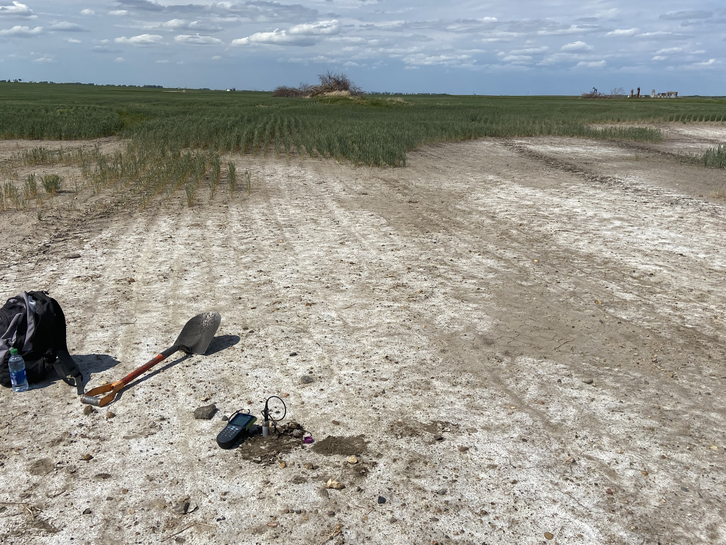
Why are we concerned about brine?
Ionic stress: disrupts enzyme activity and protein synthesis
Osmotic stress: induces drought like conditions
Oxidative stress: reactive oxygen species accumulate
Notes:
- Ionic stress Causes premature senescence
Osmotic stress draws water away from root zone
Oxidative stress causes excessive production the ROS which ultimately leads to plant death

Slide 10
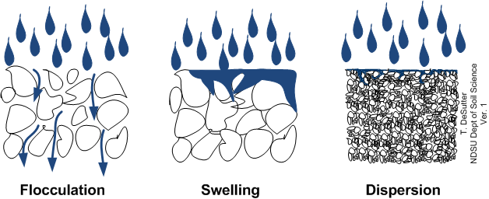
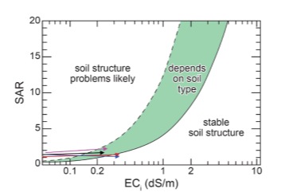
Na causes soil aggregates to swell and disperse
Less macro pores and clogged pores from dispersed clays
If SAR:EC too high
Ksat decreased
(Nnadi et al., 2013)
Notes:
-excess sodium from brine also has adverse effects on soil physical and chemical health
If too much sodium is on soil exchange sites, it could cause soil dispersion
High SAR alone won’t cause soils to disperse, only is EC drops below threshold required to maintain flocculation

Slide 11
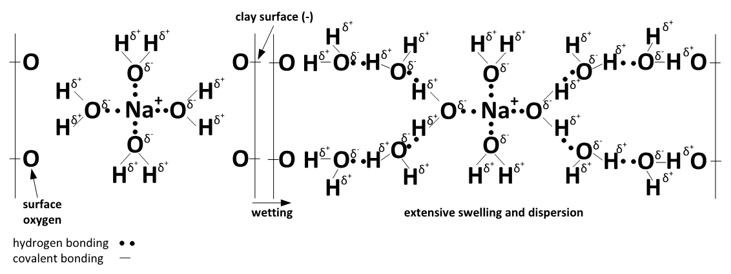
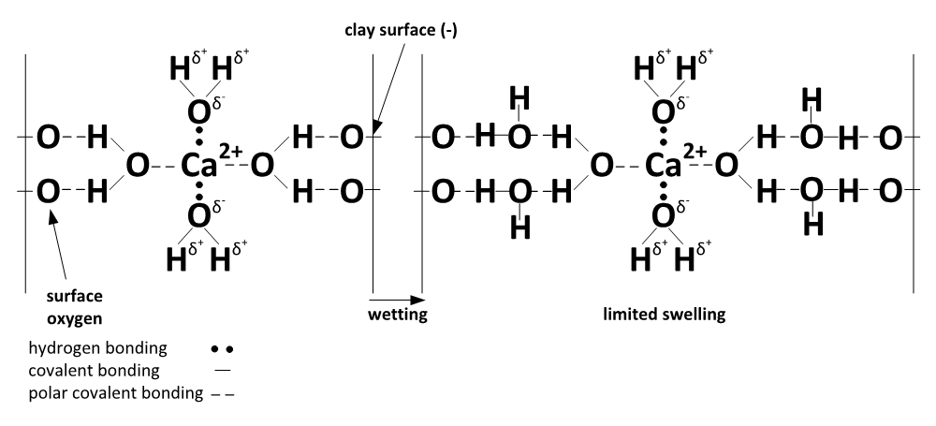
Notes:
-the reason sodium on soil exchange sites cause dispersion is because sodium has affinity to be hydrated
Sodium has a low charge density meaning that is has a low charge to comparatively large ionic radius
Calcium on the other hand has a charge density about twice that of sodium
This is was sodium and calcium looks like on soil exchange sites
First we have stable aggregates on the left
when they’re wetted we see that sodium swells and eventually disperses
The soil with calcium only exhibits limited swelling

Slide 12

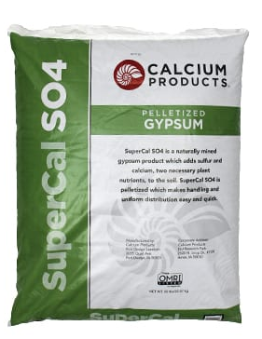
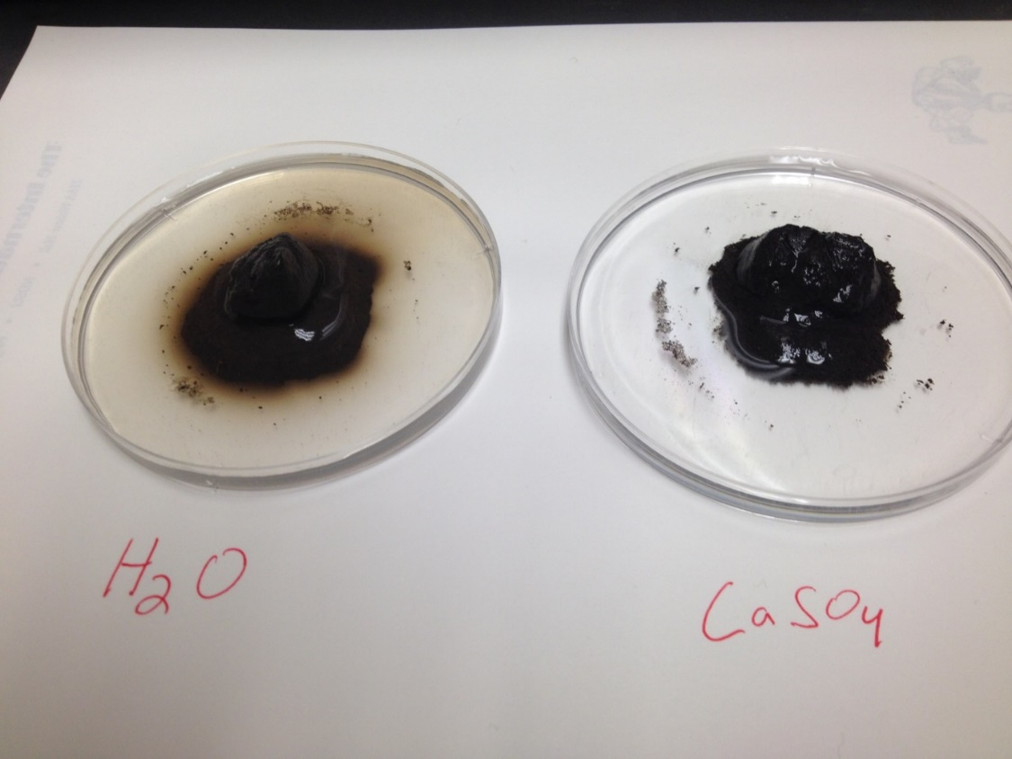
Gypsum (CaSO₄*2H₂O) is a common, in-situ amendment used for sodic soils
Improved aggregate stability
CaSO₄ Solubility: 2.0-2.5g/L at 25 °C
Pros:
Cons:
Easy to find in any garden section
Relatively inexpensive (~$200 per Ton)
Low surface area + low solubility
Notes:
-so in order to prevent soil dispersion, a calcium amendment needs to be applied to that calcium can replace sodium on soil exchange sites
-historically, gypsum has been the most common calcium amendment for sodic and brine impacted soils
-There are pelletized options; these are a couple we have on hand on campus
-it does work, but is relatively insoluble

Slide 13
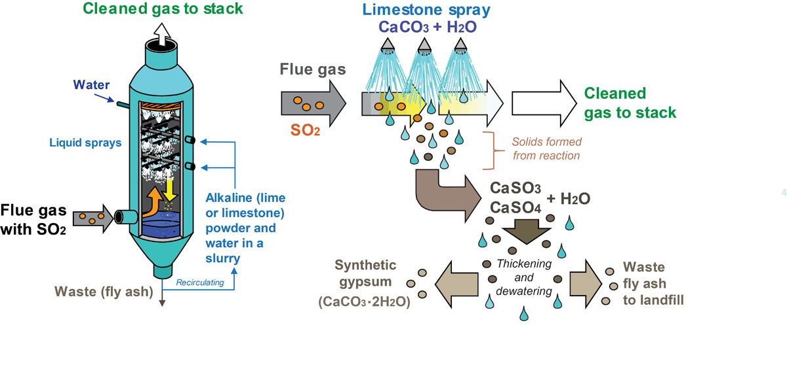
Flue Gas Desulphurization Gypsum – (FGD Gypsum)
Pros:
Cons:
Higher surface area than pelletized gypsum
Produced locally
Low cost (~$10 per Ton)
Still somewhat insoluble (2.0-2.5g / L)
(Kentucky Geological Survey)
Notes:
-There is also flue gas dusulphurization gypsum
-This is what a wet scrubber looks like
-coal lets off SO2 in refinery process
-to prevent SO2 emmisions which would eventually results in the formation of sulphuric acid, a lime slurry or solution is applied
-SO2 + CaCO3 yields CaSO3 (calcium sulfide)
-CaSO3 is forced oxidized with compressed air to produce CaSO4

Slide 14
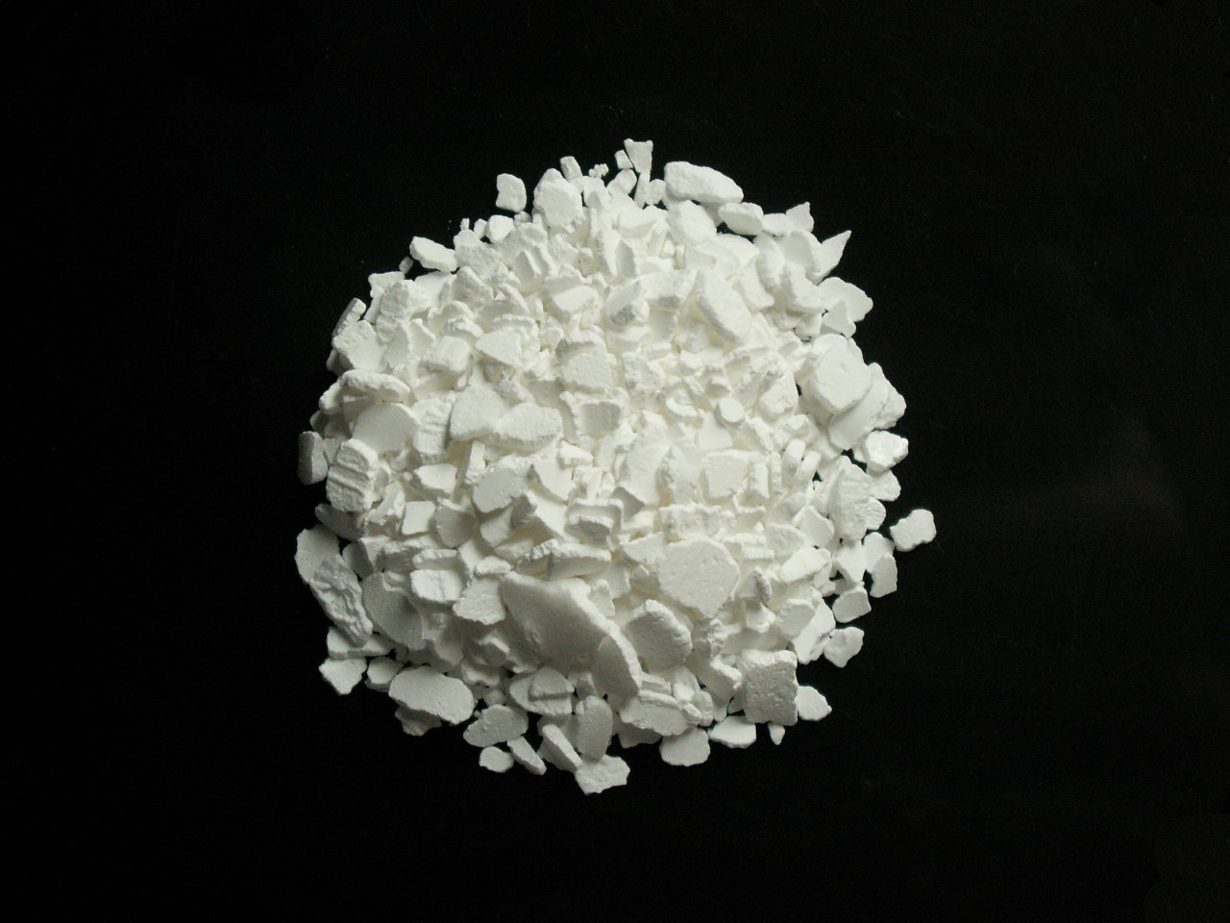
Calcium Chloride (CaCl₂)
Pros:
Highly soluble: 745 g/L at 20 °C
Easily accessible
Cons:
Chloride concentrations in surface and ground waters are often strictly regulated (North Dakota MCL of chloride is 250 mg/L)
Relatively expensive (~$1,100 per ton)
Notes:
-There are other more soluble calcium salts that may come to mind such as calcium chloride
-maximum contaminant level (MCL) in ND is 250 mg/L

Slide 15
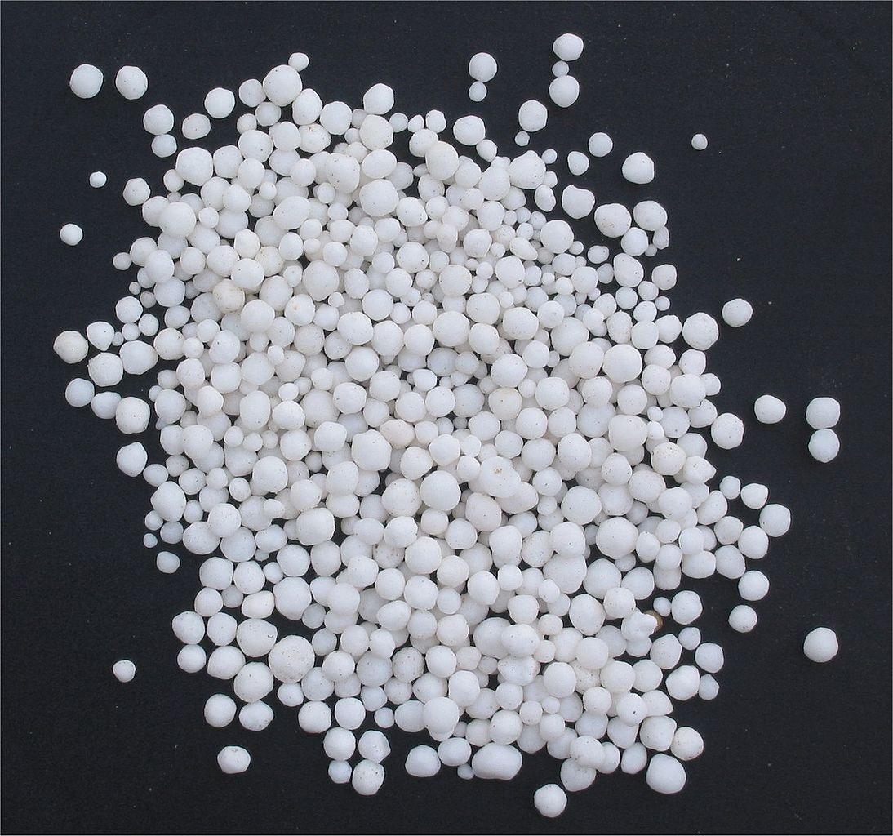
Calcium Nitrate (Ca(NO₃)₂)
Pros:
Highly soluble: 1,212 g/L at 20 °C
Easily accessible – produced for specialty crops
Cons:
Nitrate concentrations in surface and ground waters are often strictly regulated (North Dakota MCL of nitrate is 10mg/L)
Price is variable – dependent on cost of nitrogen

Slide 16
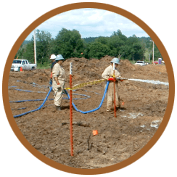
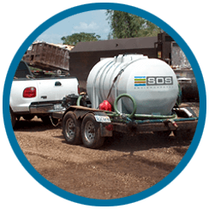

DeSalt Plus (Ca²⁺, K⁺, NH₄⁺) Produced by SOS Environmental
Pros:
Highly soluble: sold as solution
Cons:
Nitrate concentrations are still a concern (North Dakota MCL of nitrate is 10 mg/L)
K⁺ has about half the dispersive properties as Na⁺
Unclear Price
Unclear composition
Nitrification
NH₄⁺
NO₂⁻
NO₃⁻

Slide 17
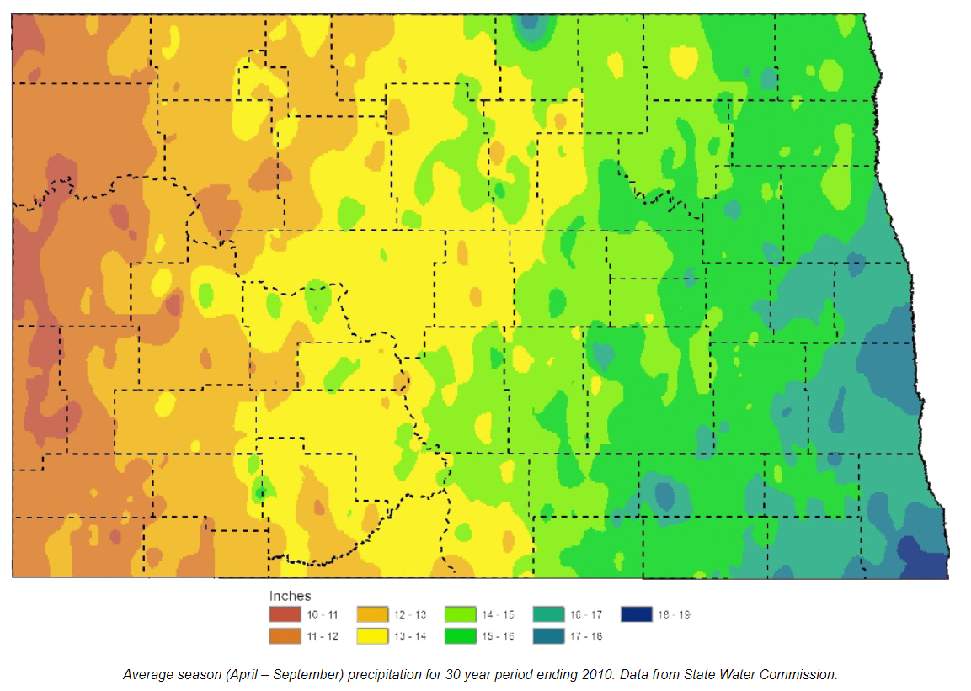
Ca-acetate as an alternative to Gypsum
Ca-acetate (Ca(C₂H₃O₂) ₂) | Gypsum (CaSO₄*2H₂O)
25% Ca | 23% Ca
347g/L at 20 °C | 2.0-2.5g/L at 25 °C
$1000/ Ton | $10/ Ton (Flue Gas) & $200/ Ton (Pellet)
Most oil and gas in ND is produced under semiarid conditions (MAP 10-20in)
Less water and time needed for Ca to replace Na on soil exchange sites and improve saturated hydraulic conductivity
Notes:
-So gypsum is most common amendment, but has it’s draw backs
-CaCl2 and CaNO3 aren’t realistic because of groundwater concerns
-Desalt plsu
-So this promted the idea of using calcium acetate as an alternative to gypsum

Slide 18
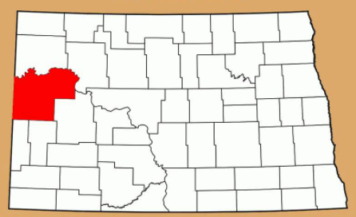
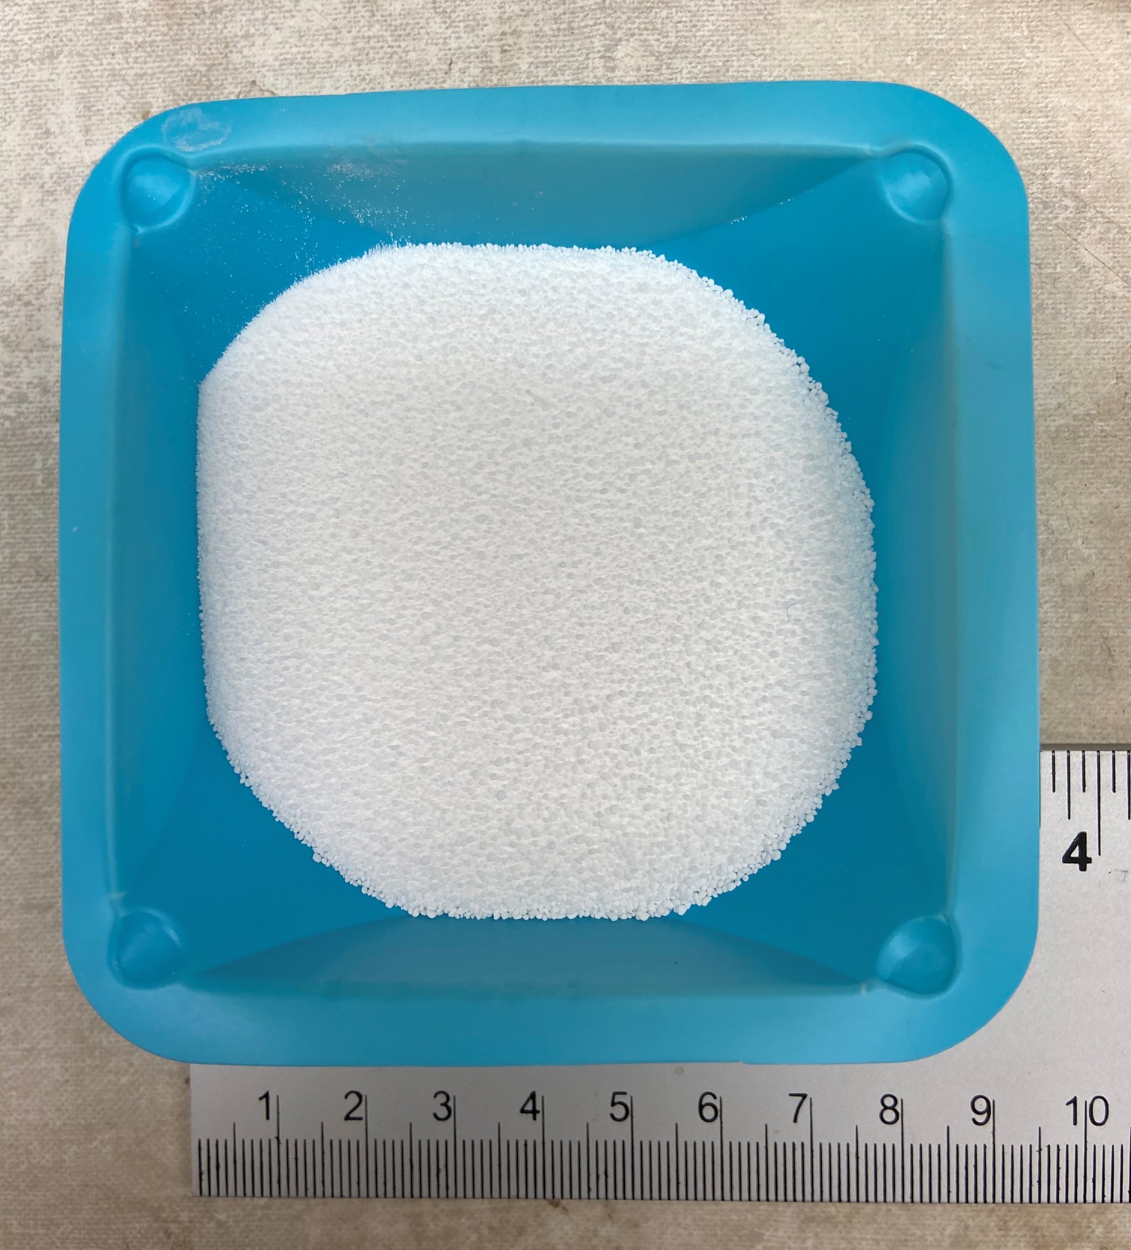
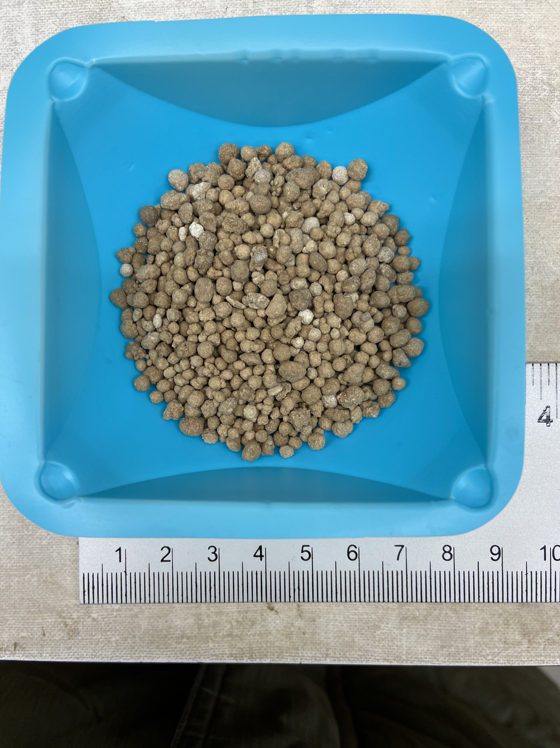
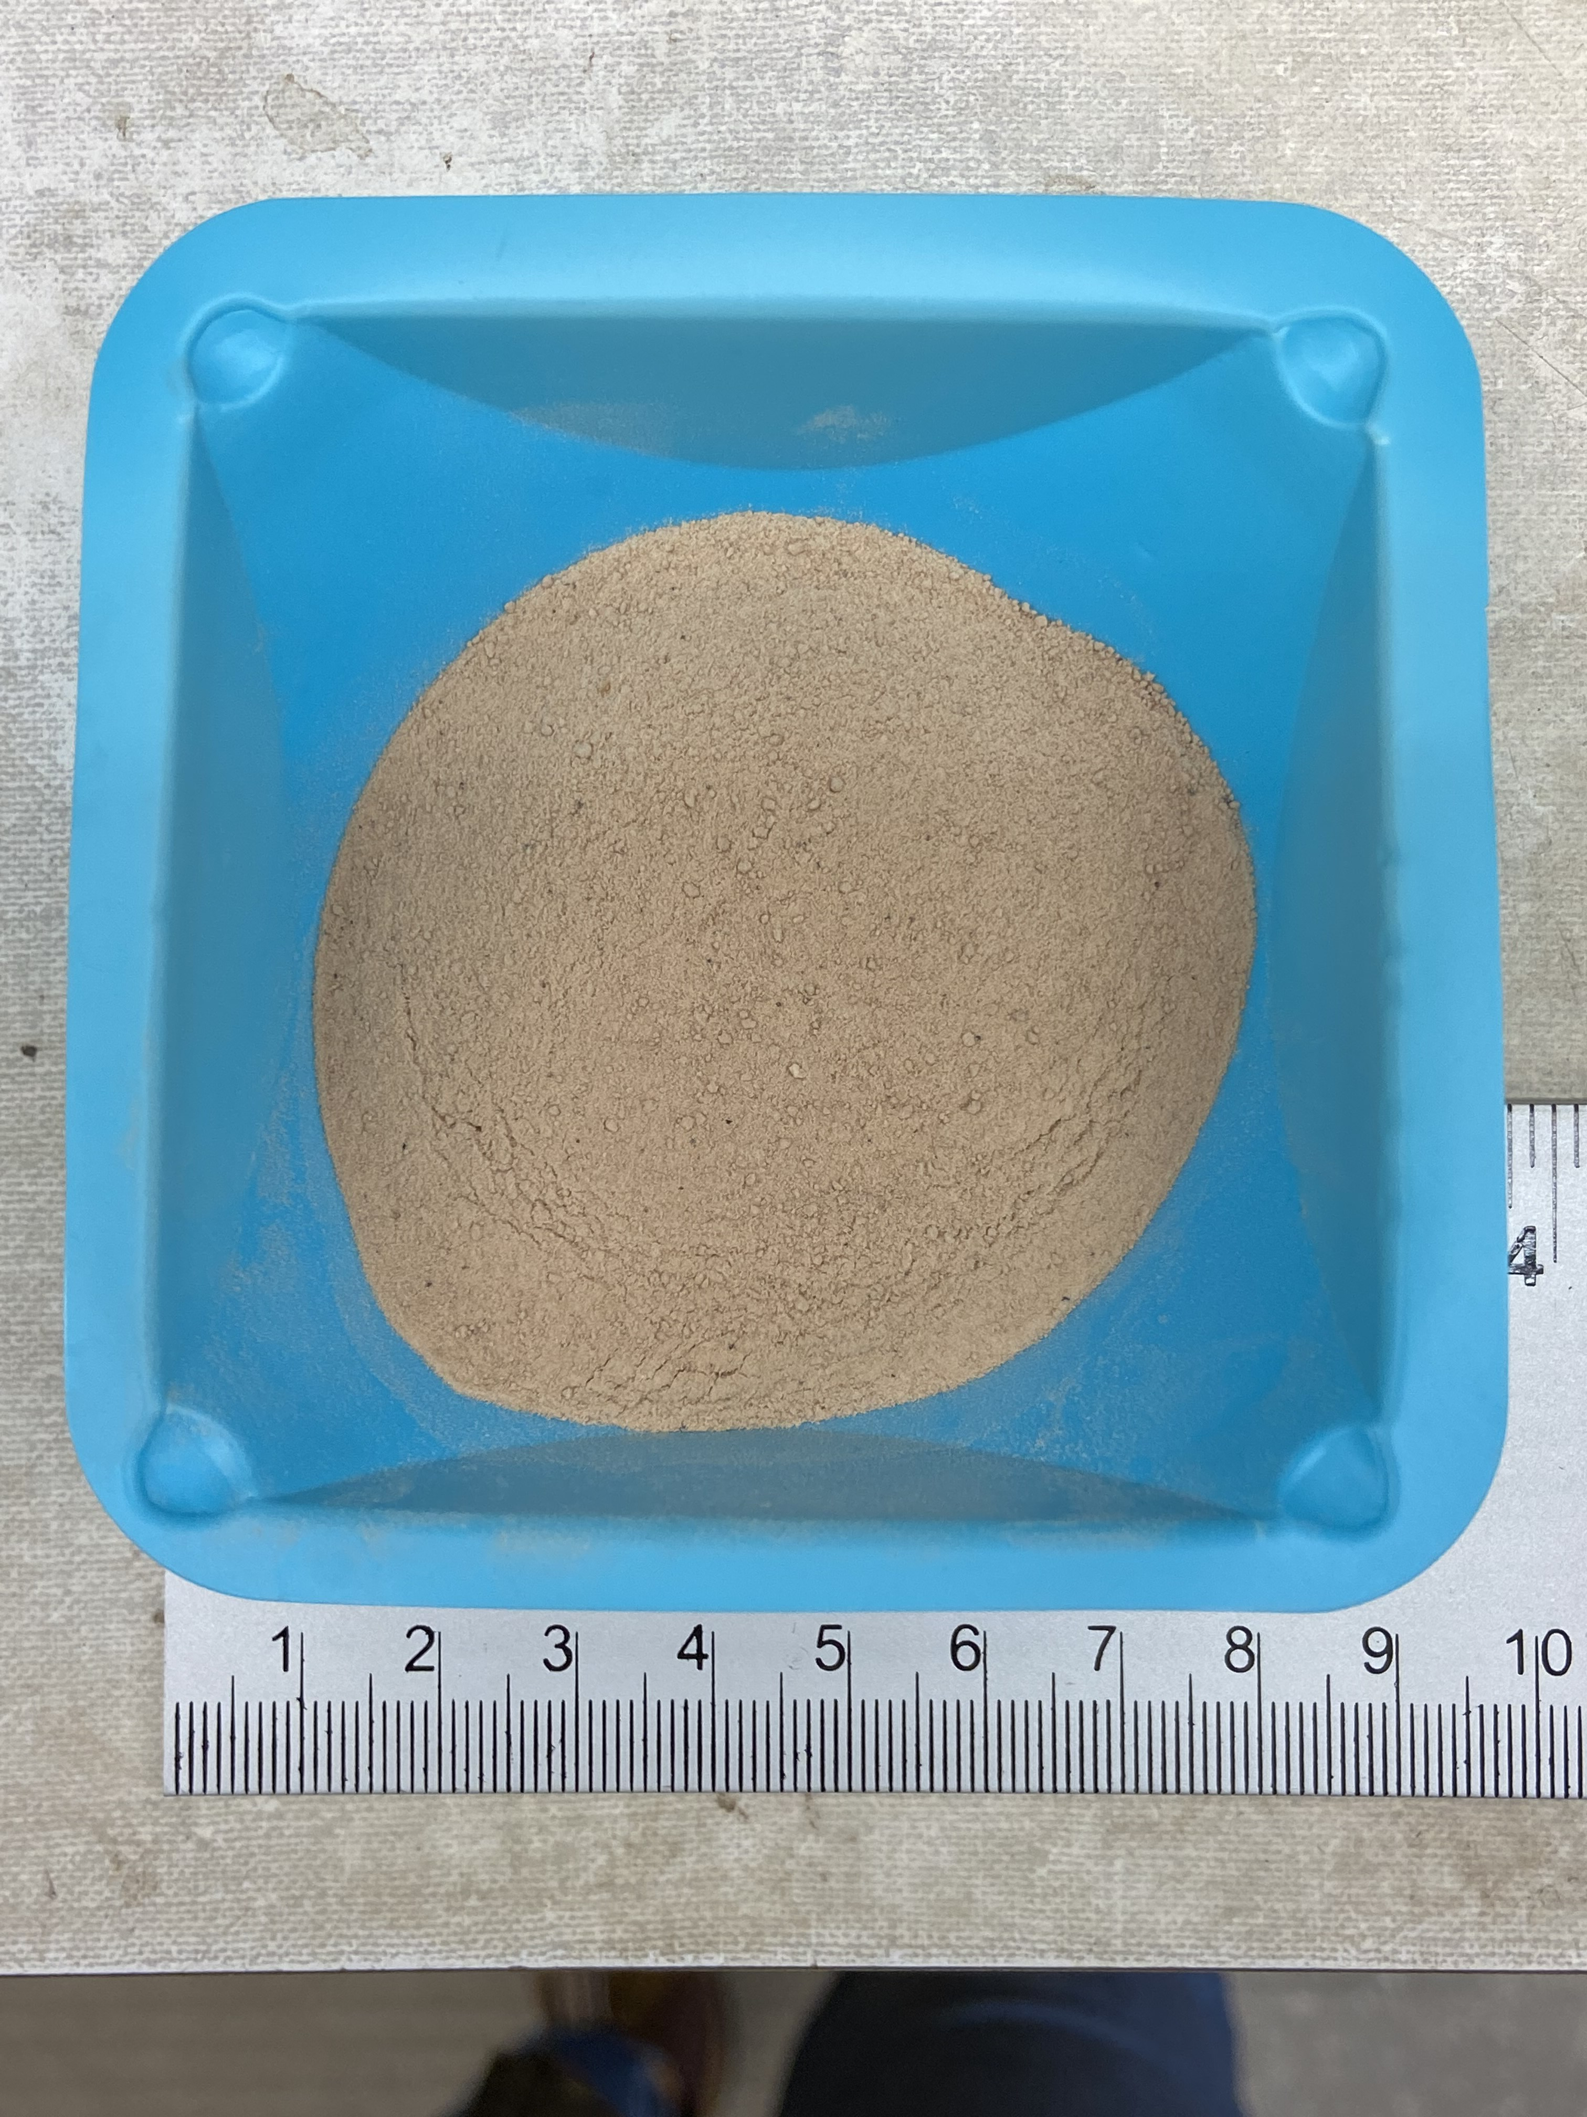
Soil Information
CEC = 20 cmol(+)/kg
EC₁:₁ = 17.5 mmho/cm
%Na (SAR) = 37.8
8% clay content
McKenzie County, North Dakota
Amendments mixed with soil at rates of:
0 T/acre
1 T/acre
5 T/acre
10 T/acre
20 T/acre
Ca-acetate
Pelletized Gypsum (2-4mm)
Flue Gas Gypsum
3 amendments at 4 rates for 4 reps plus 4 reps of a control equals 52 total runs

Slide 19
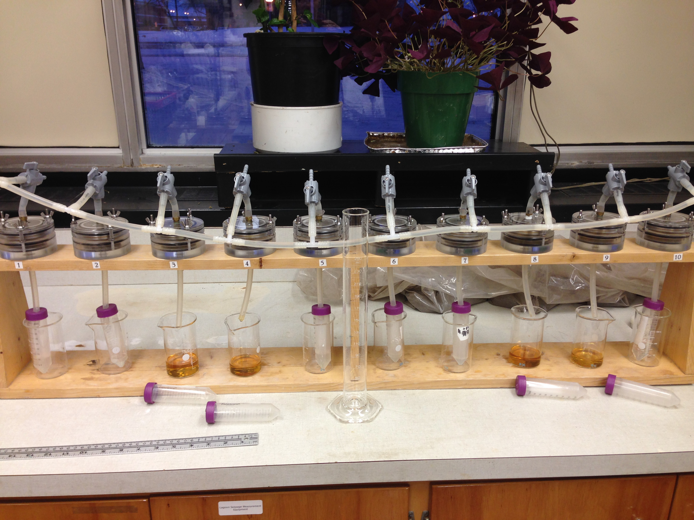
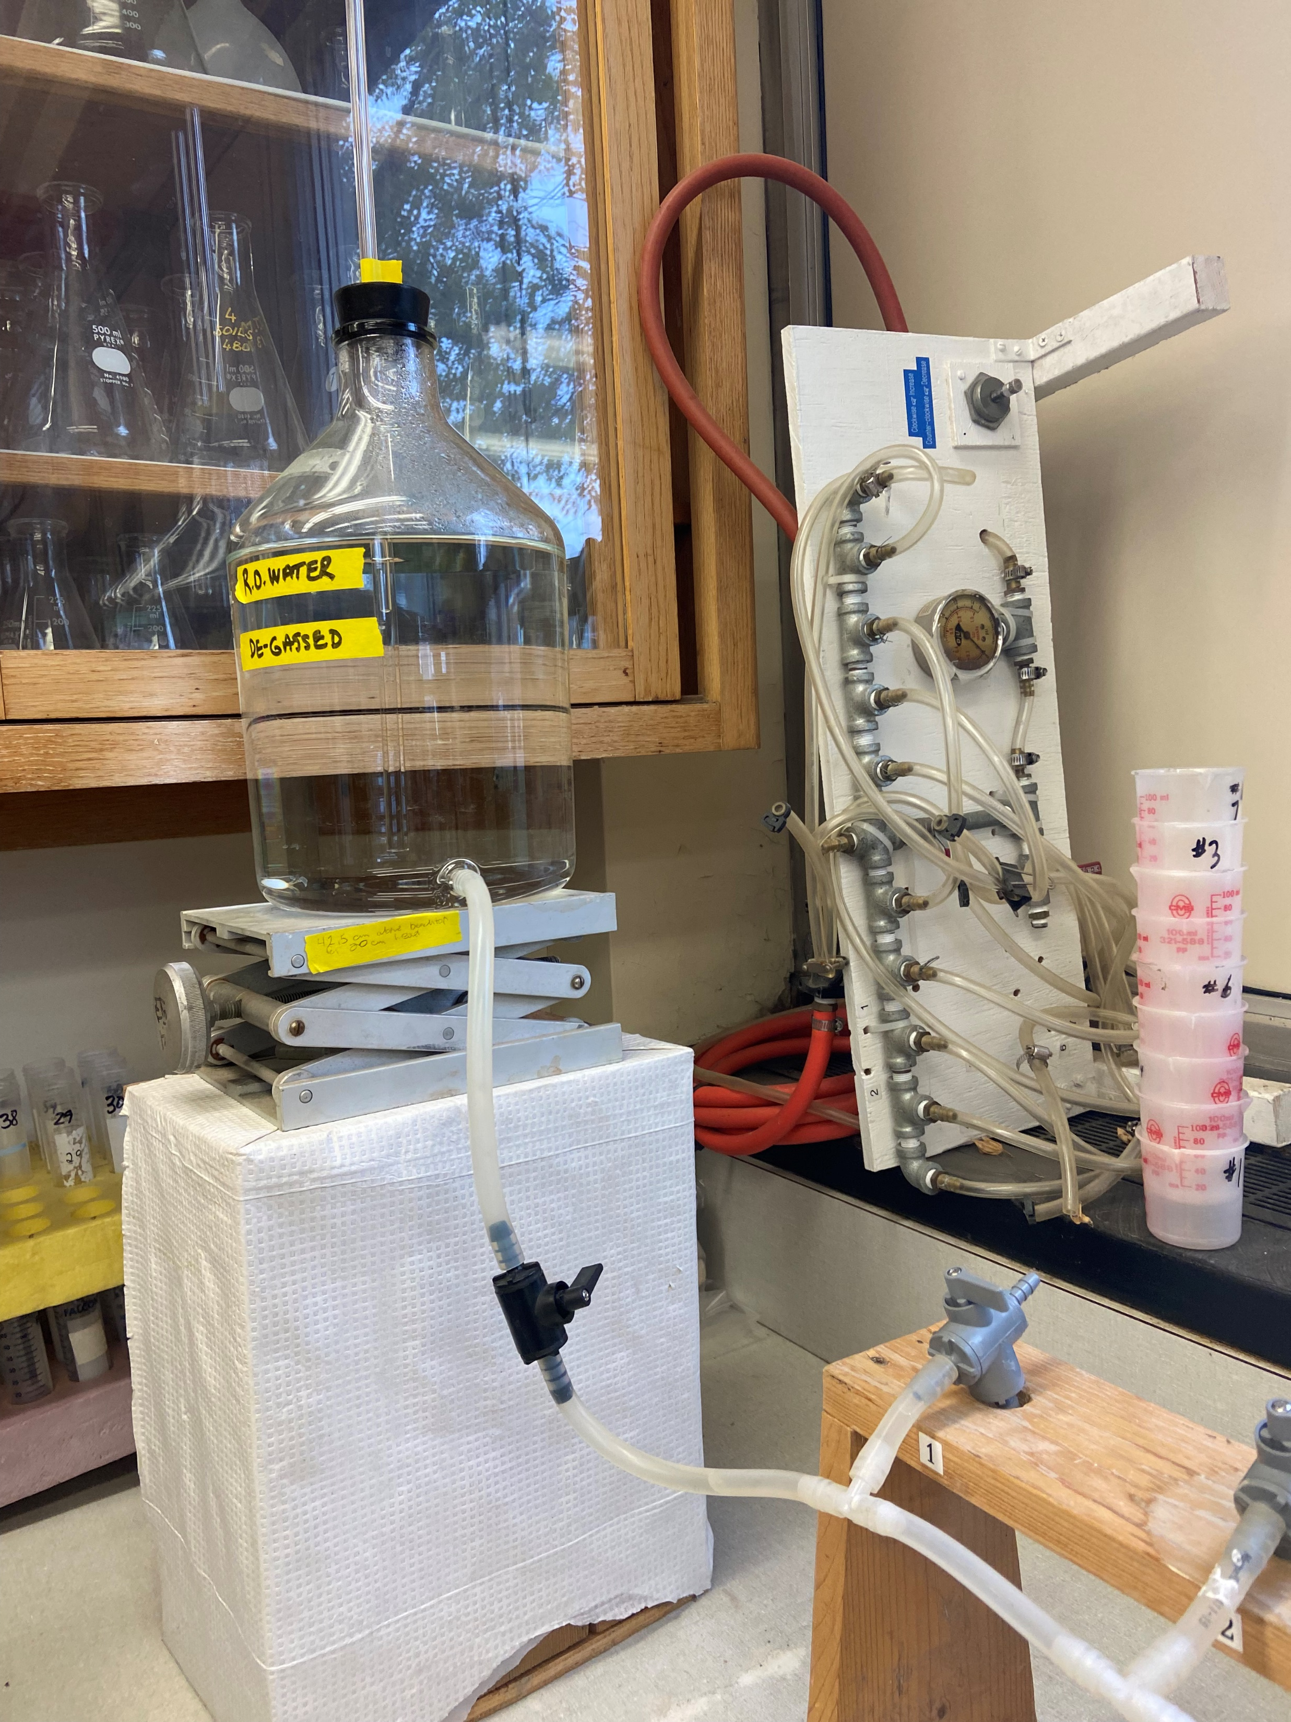

Ksat Methods
Amendments (Ca-as, FG, and Pel.) and rates were randomized
Soils were packed using methods similar to Sommerfeldt et al. 1984
  1cm soil added to cell at a time
  Edge of tempe cell is tapped for soil to settle and compacted
  Soil surface disturbed to prevent artificial boundary
Tempe cells attached to Mariotte bottle with 20cm head
Leachate collected in ~15-25 mL increments by centrifuge tubes
Ksat determined by time and leachate volume measurements
(Nathan Derby)
Tempe cell top
Stainless Steel Screens
68.2 cm³
Filter Paper to retain soil particles
Tempe cell bottom

Slide 20
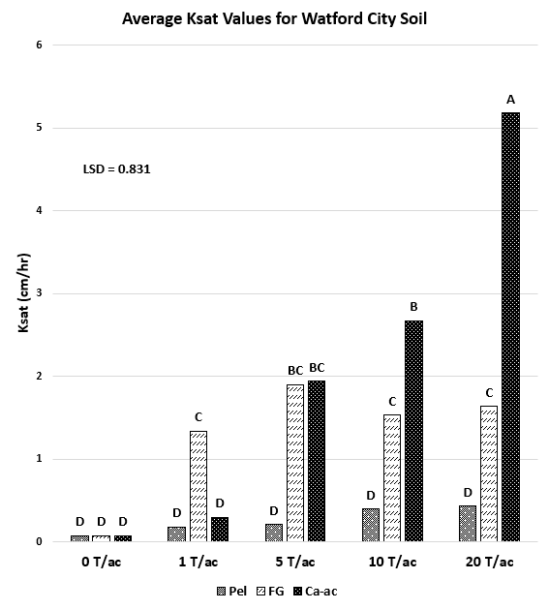

Slide 21
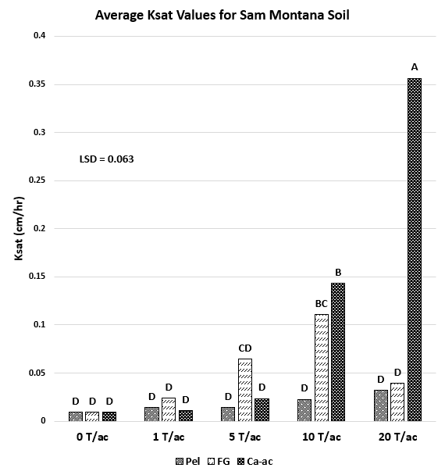

Slide 22
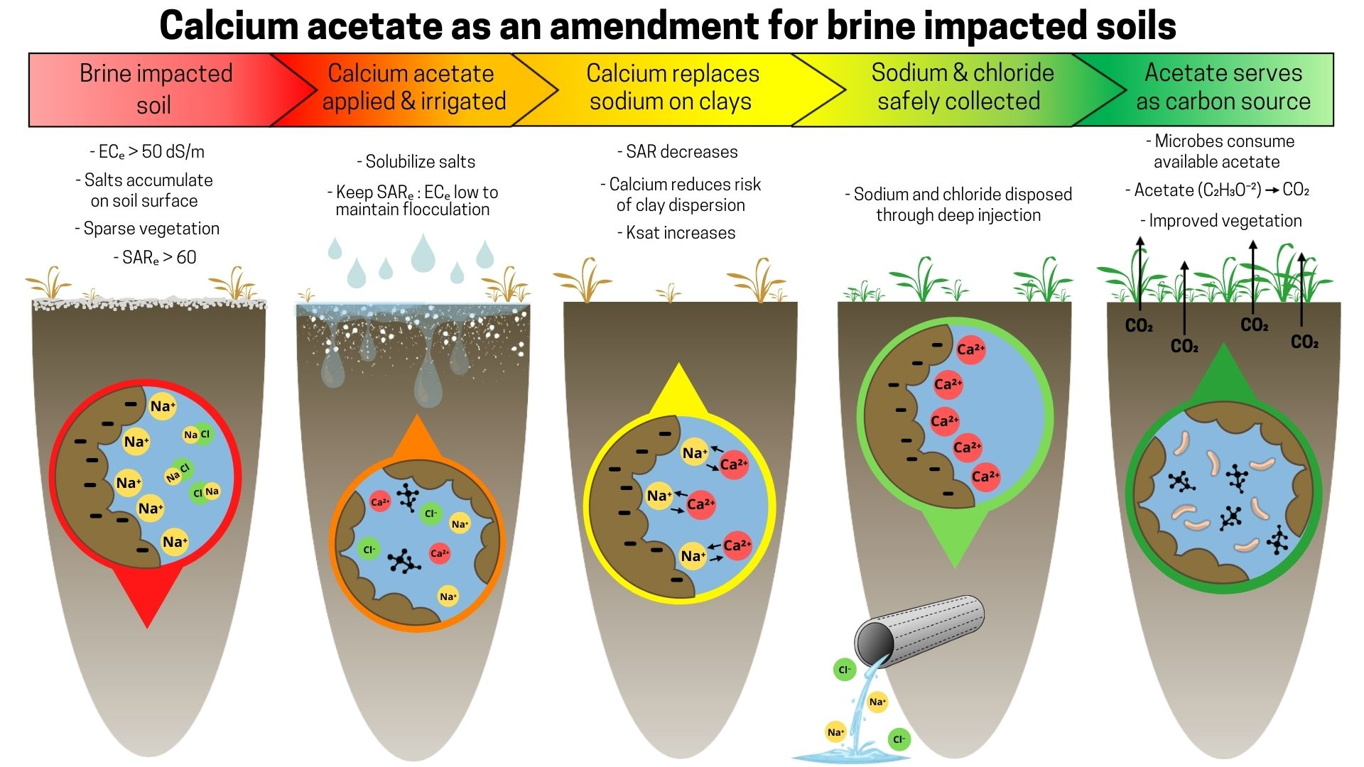

Slide 23
References cited:
Derby, N.E., Casey, F.X.M., and DeSutter, T.M., 2016, Effects of oil field brine wastewater on saturated hydraulic conductivity of smectitic loam soils: Canadian Journal of Soil Science, v. 96, p. 496- 503, doi: 10.1139/cjss-2016-0036.
Meehan, M.A., Sedivec, K., DeSutter, T.M., Augustin, C., and Daigh, A.L.M., 2017, Environmental Impacts of Brine (Produced Water): North Dakota State University Extension Service.
Green, A.W., DeSutter, T.M., Daigh, A.L.M., and Meehan, M.A., 2019, Wicking Salts from Brine- Contaminated Soils: A potential Method for In Situ Remediation: Agricultural & Environmental Letters, doi: 10.2134/ael2018.12.0069.
Green, A.W., DeSutter, T.M., Meehan, M.A., Daigh, A.L.M., and O’Brien, P.L., 2020, Produced water’s impact on soil properties: Remediation challenges and opportunities: Agrosystems, Geosciences & Environment, doi: 10.1002/agg2.20042.
Nnadi, E.O., Newman, A.P., and Coupe, S.J., 2013, Geotextile Incorporated Permeable Pavement System as Potential Source of Irrigation Water: Effects of Re-Used Water on the Soil, Plant Growth and Development: Clean Soil Air Water, v. 42, p. 125-132, doi: 10.1002/clen.201300165.
Sommerfeldt T.G., Schaalje G.B., and Hulstein W. 1984. Use of Tempe cell, modified to restrain swelling, for determination of hydraulic conductivity and soil water content. Can. J. Soil Sci. 64: 265– 272.

Slide 24
Calcium acetate: an alternative to gypsum for improving oilfield, brine impacted soils
Annalie Peterson, Thomas DeSutter, Nathan Derby, Miranda Meehan and Aaron Daigh
North Dakota State University, Fargo, ND

