Slide 1
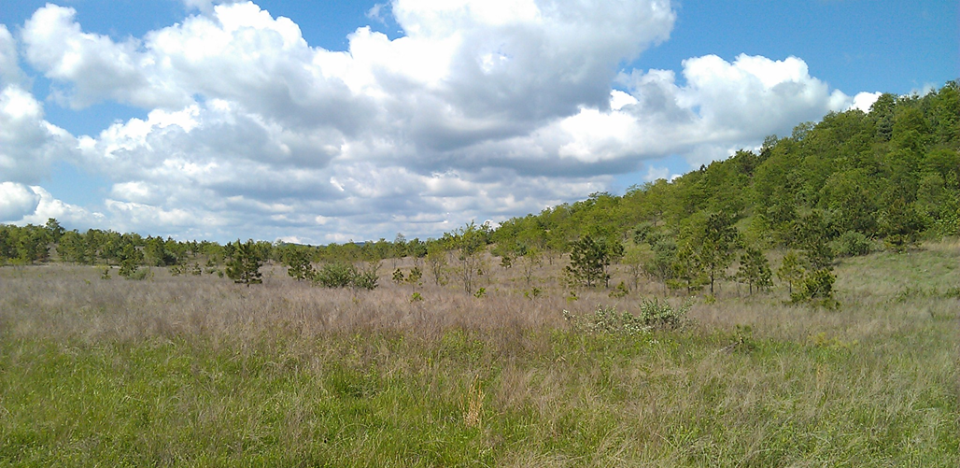
Overcoming arrested succession and invasive species on older reclaimed surface mines
Jennifer Franklin
University of Tennessee, Knoxville, TN, USA
ASRS, Duluth, MN June 14, 2022

Slide 2
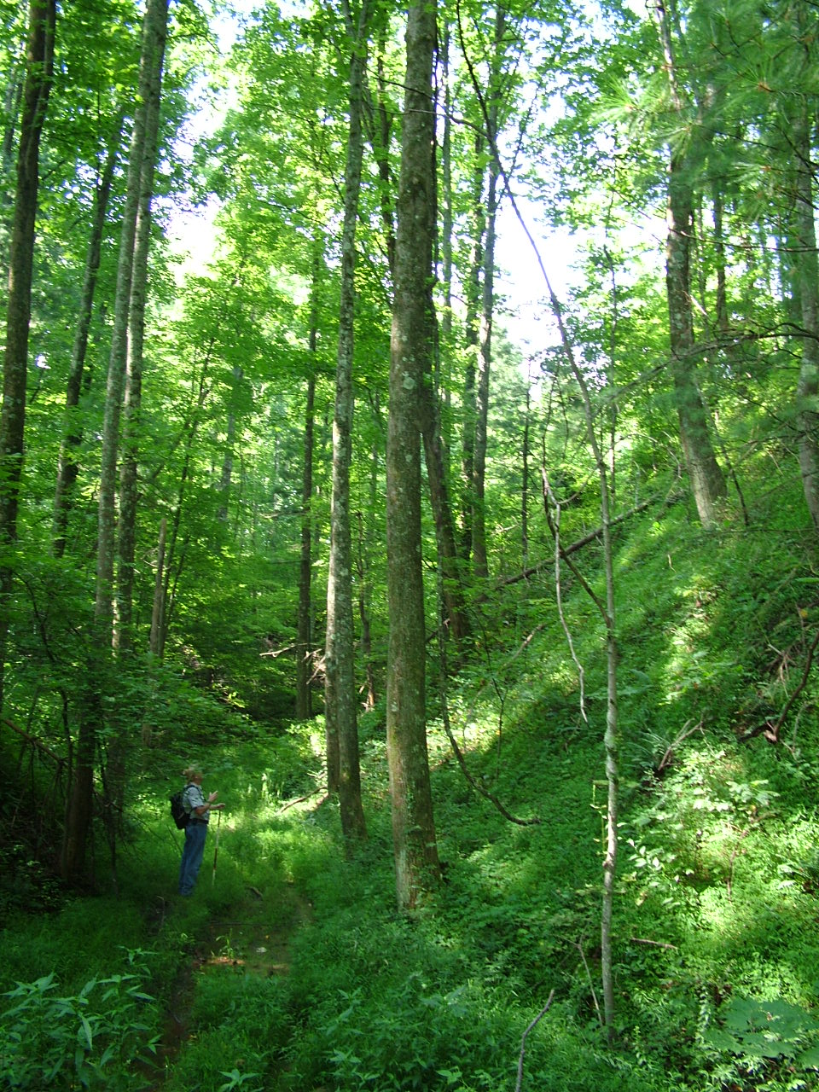
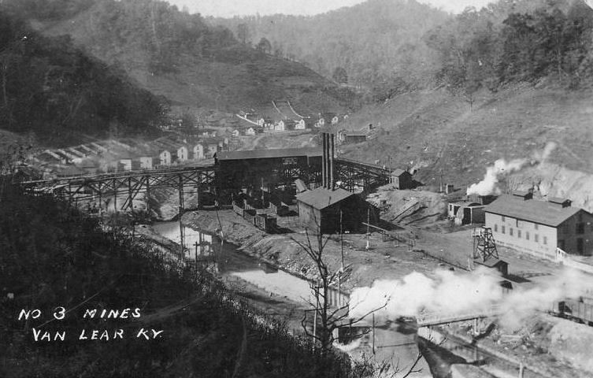
Reclamation history
Before 1960 there were few mining laws
Much environmental damage
But natural succession and long term recovery is very good

Slide 3
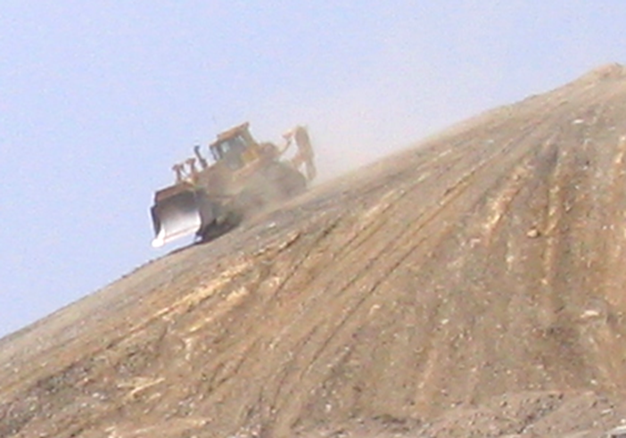
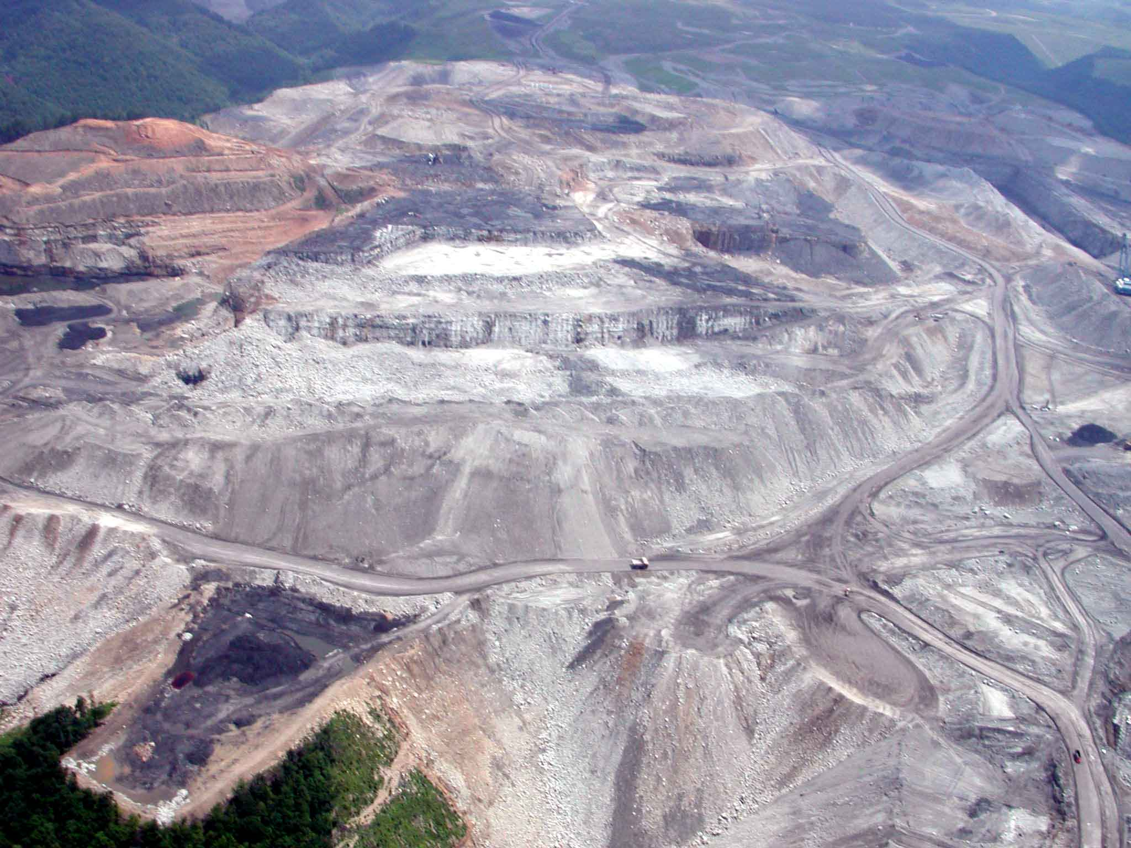
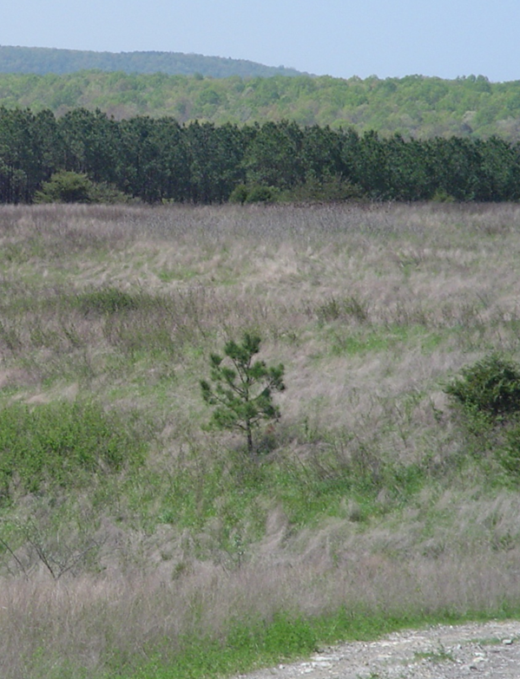
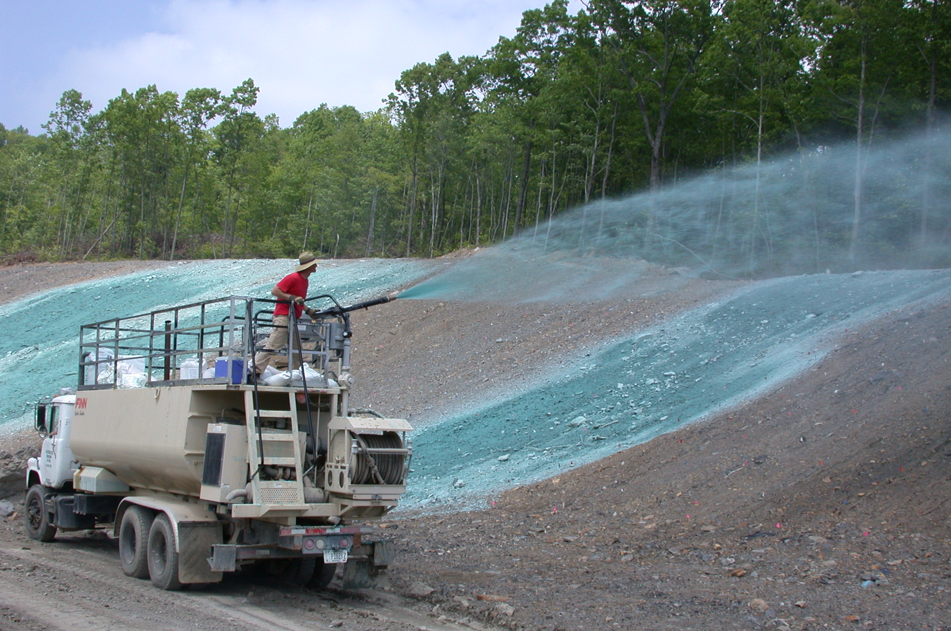
Reclamation 1977-2010 in Eastern US coalfields
Grading compacted soil
Aggressive non-native plants seeded

Slide 4
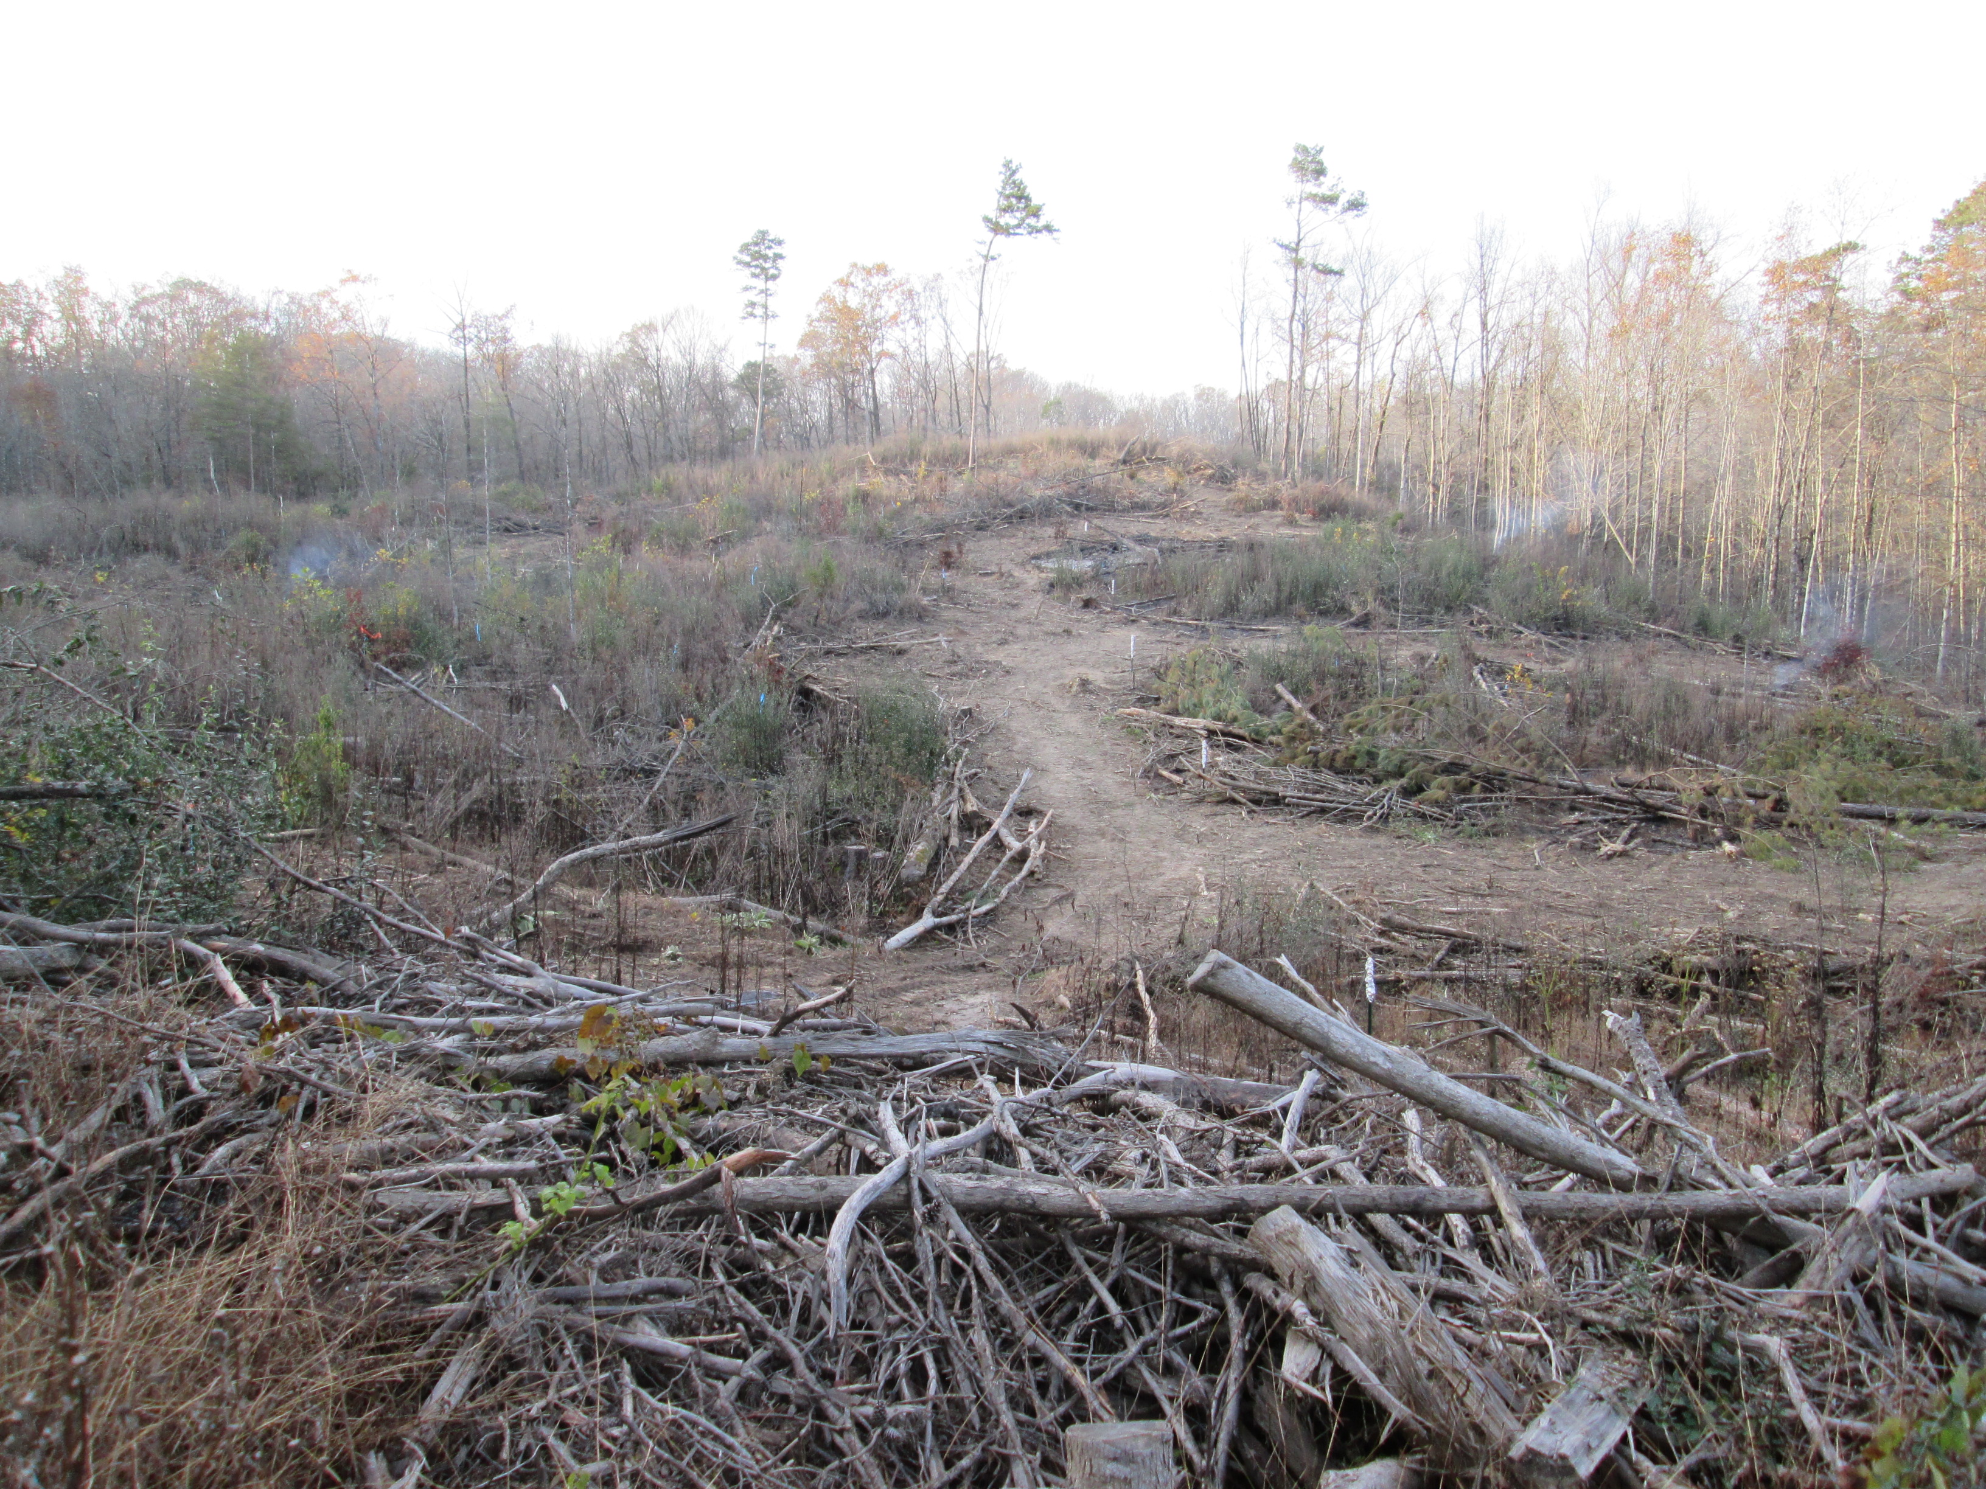
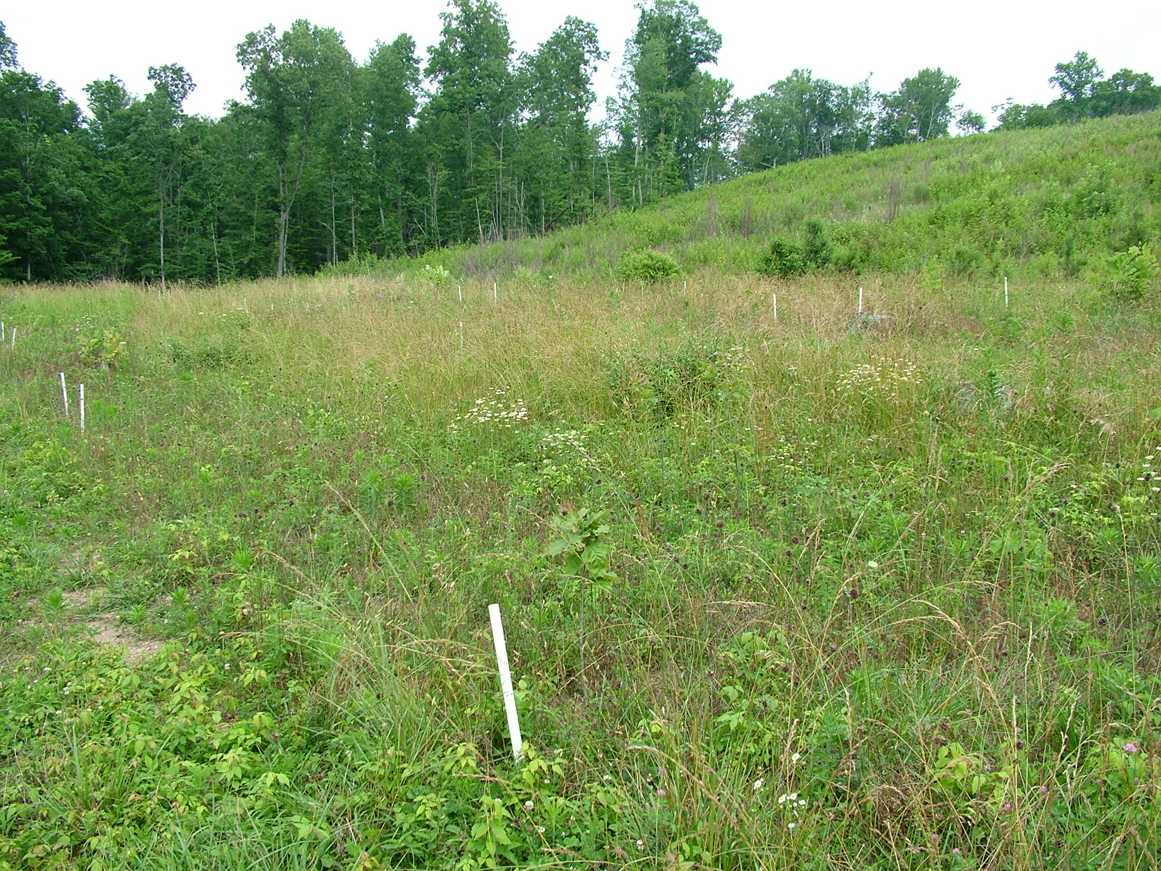
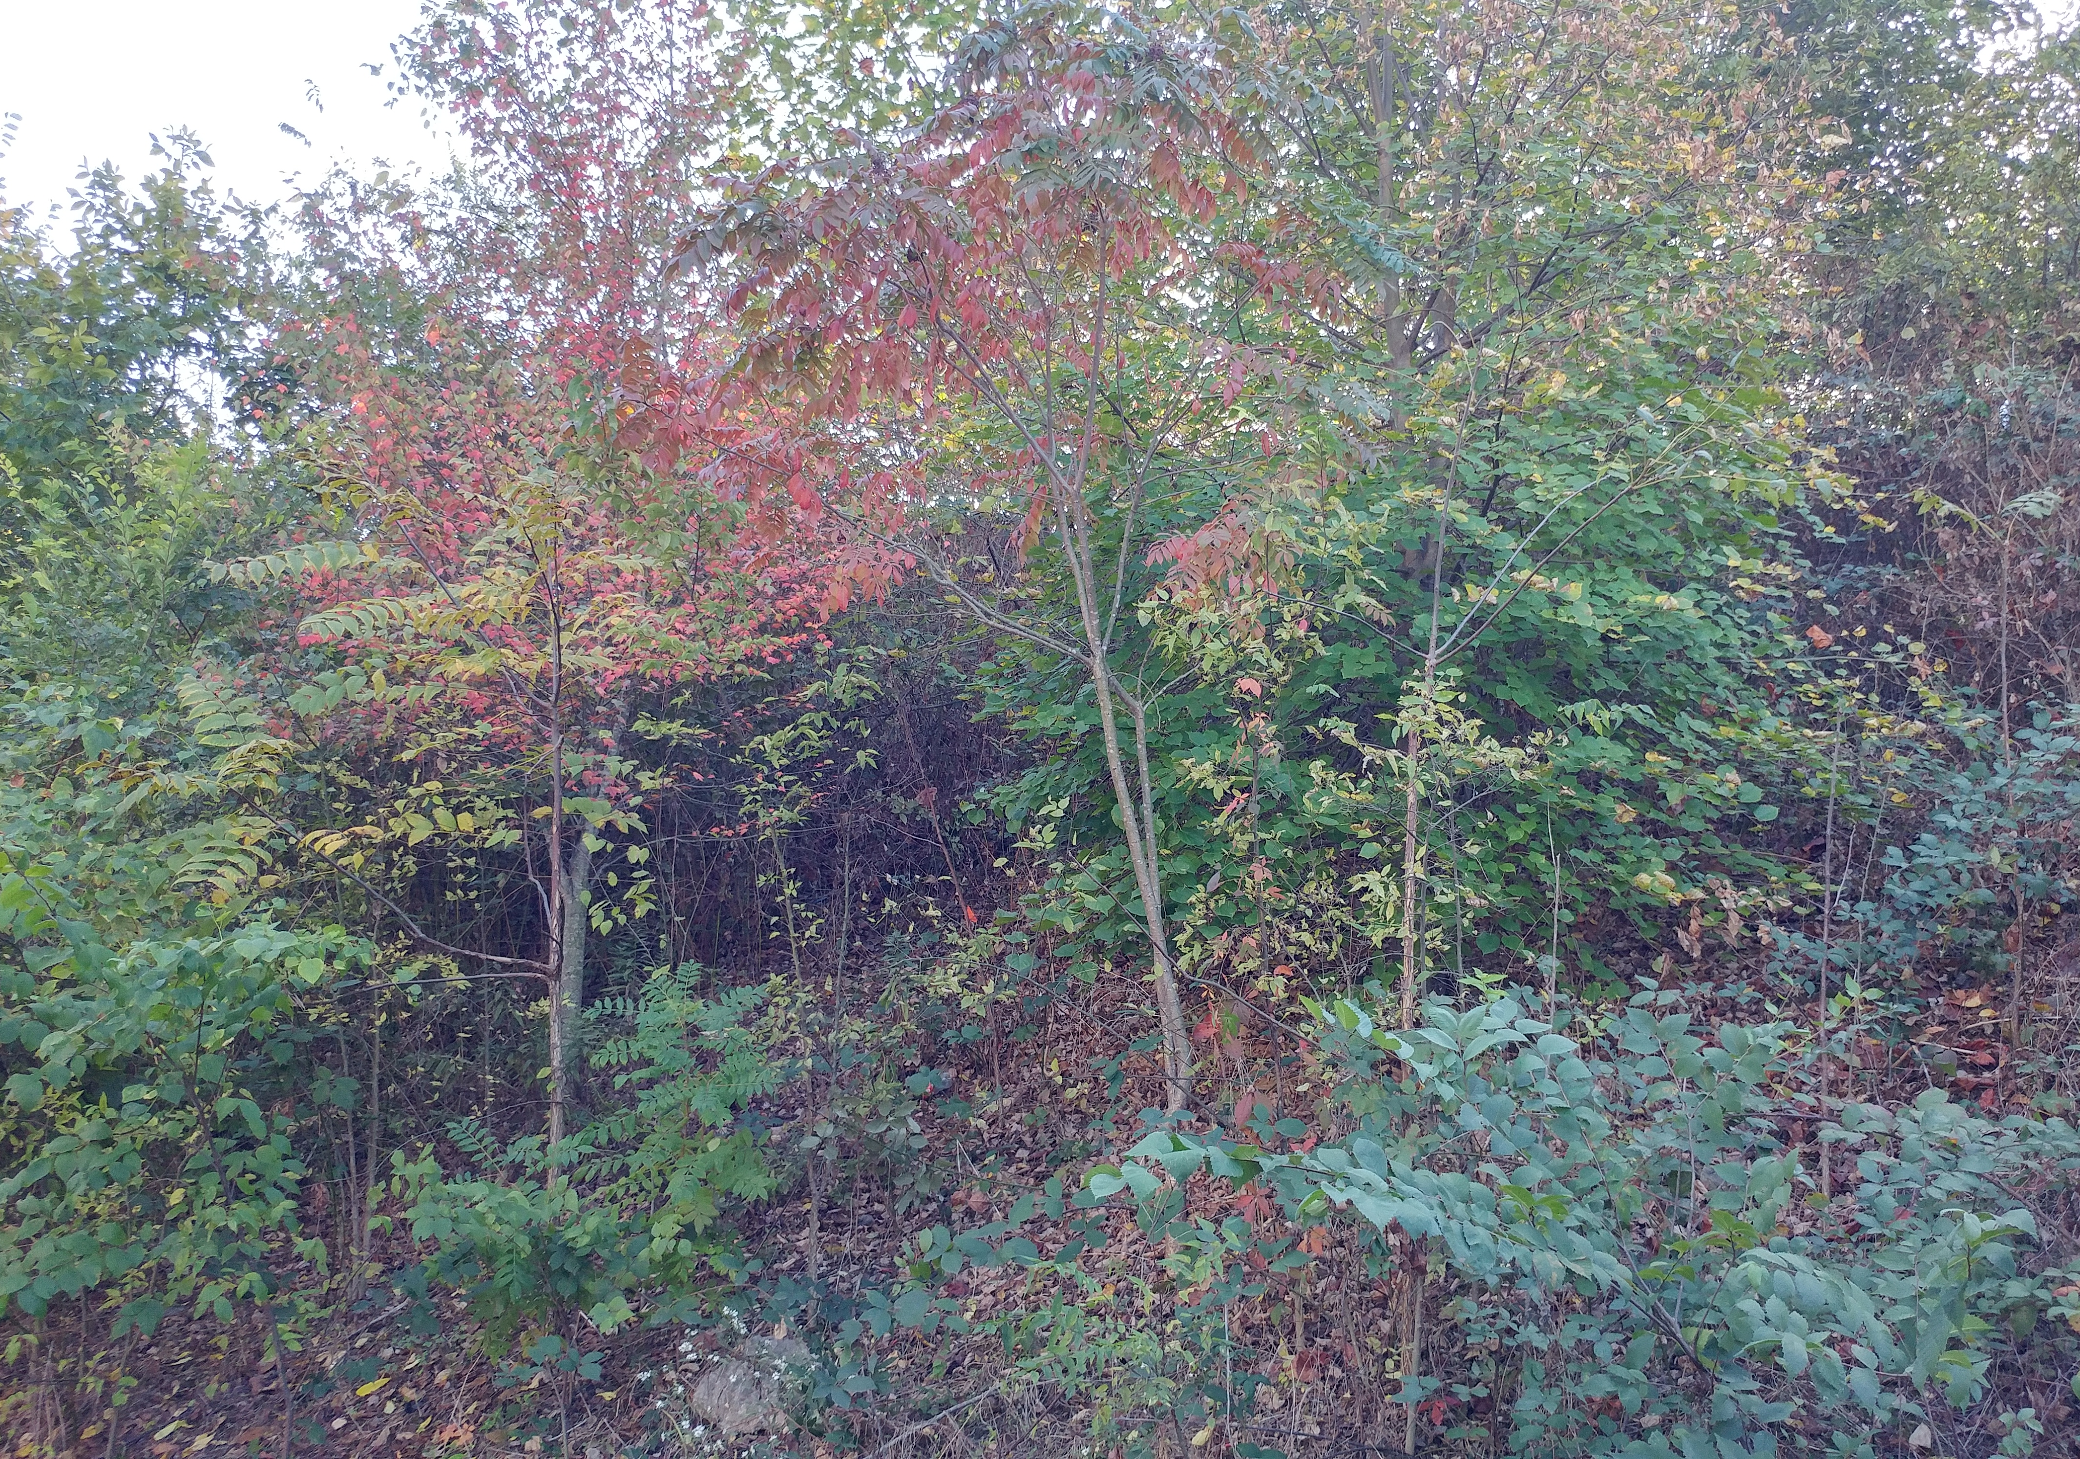
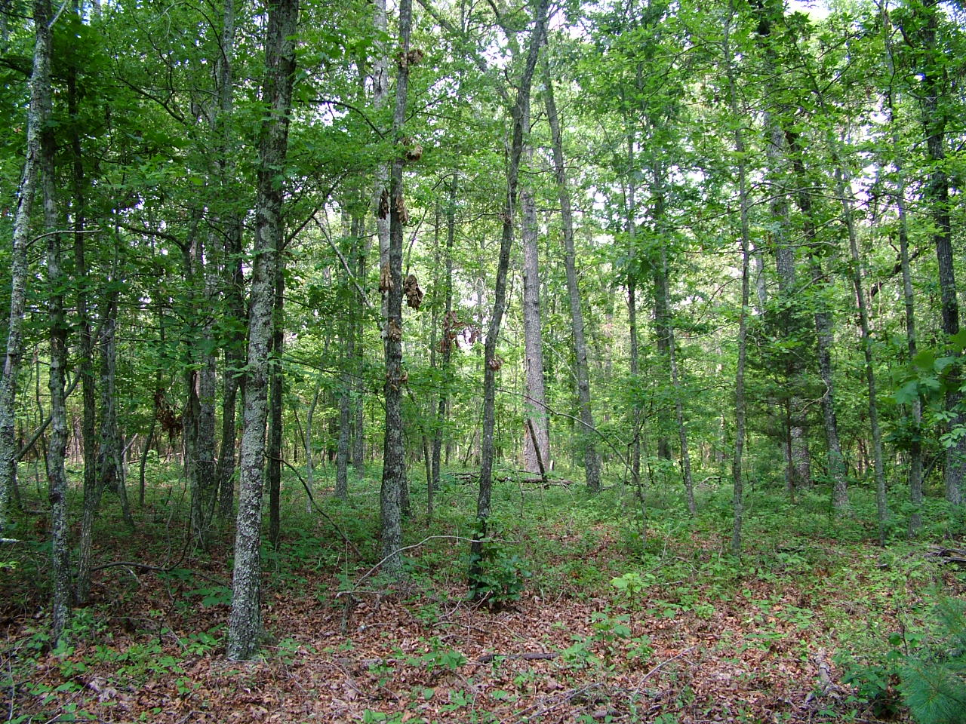
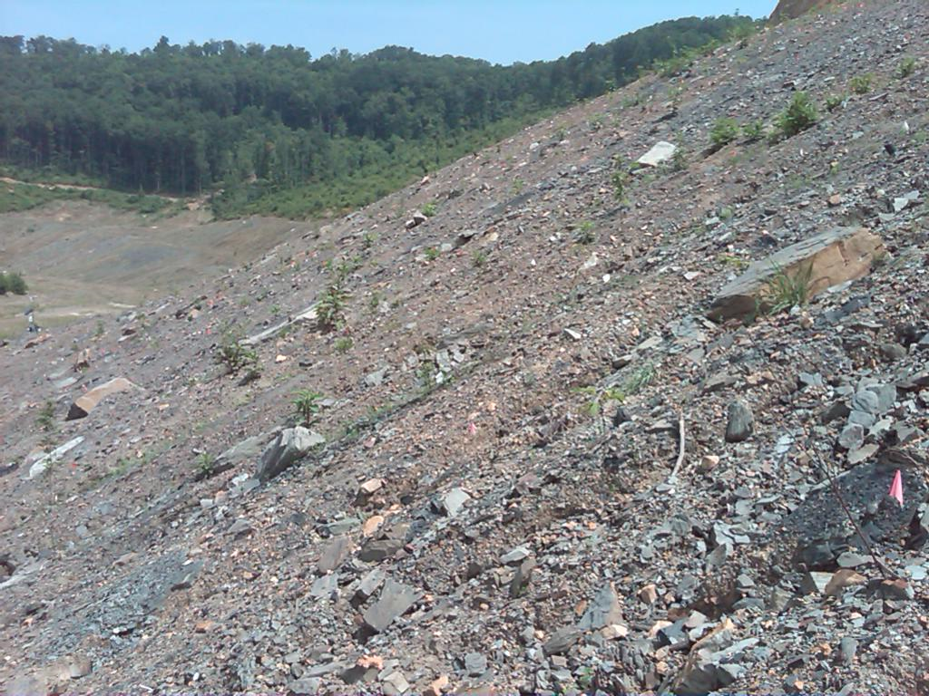
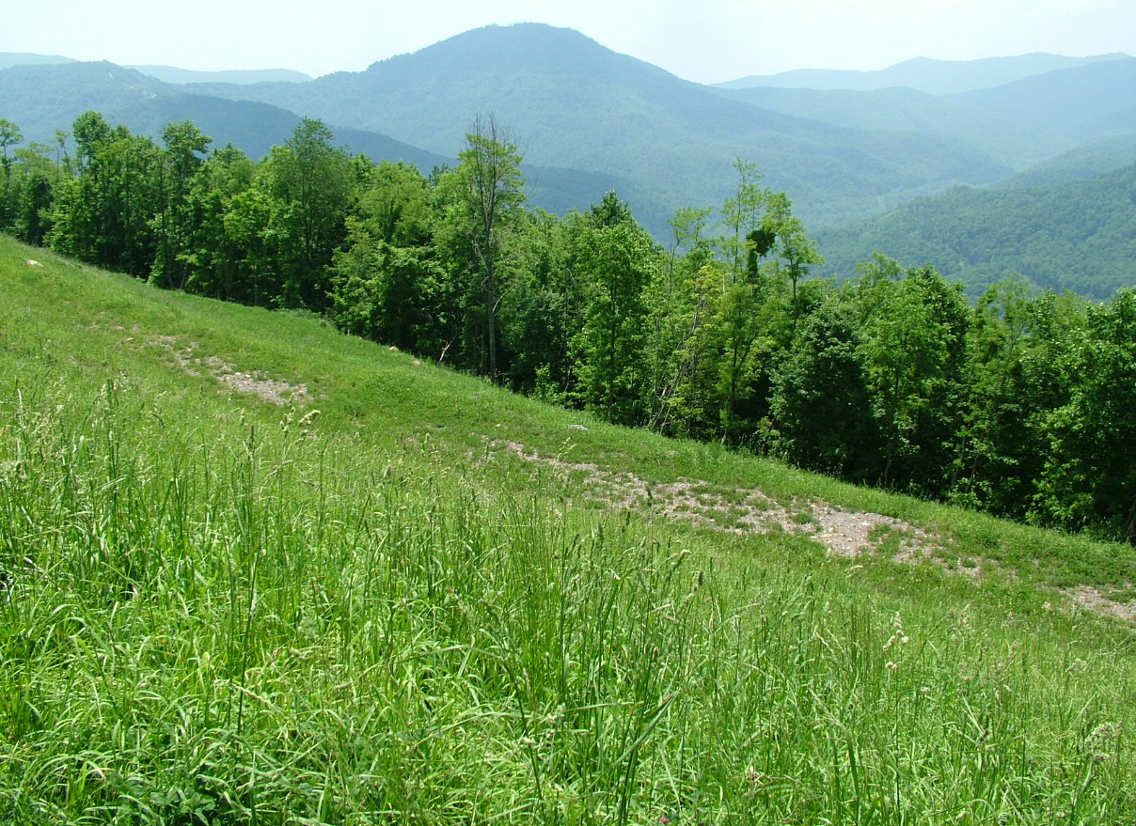
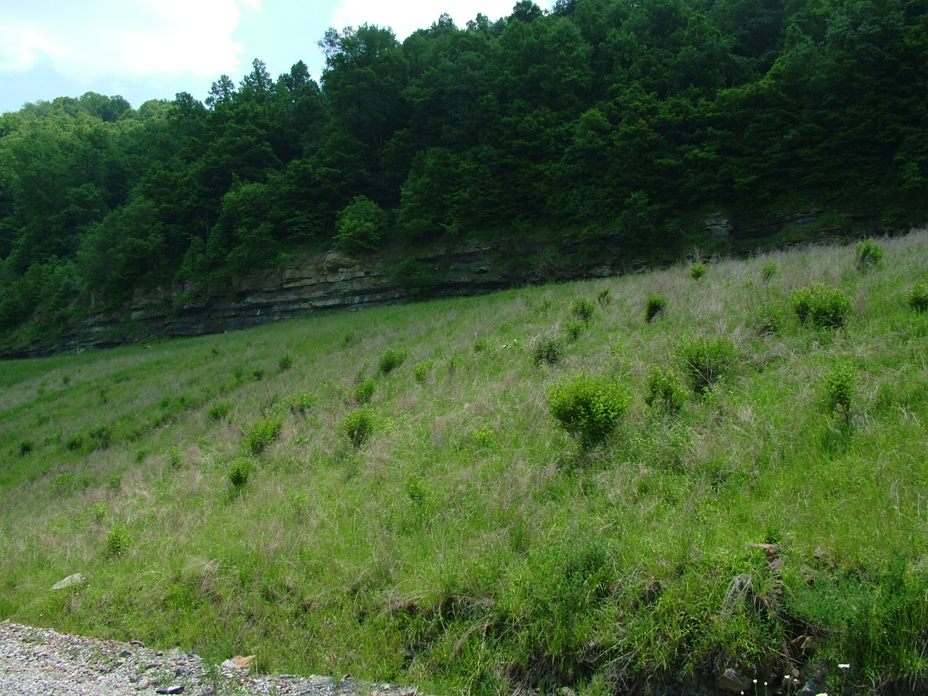
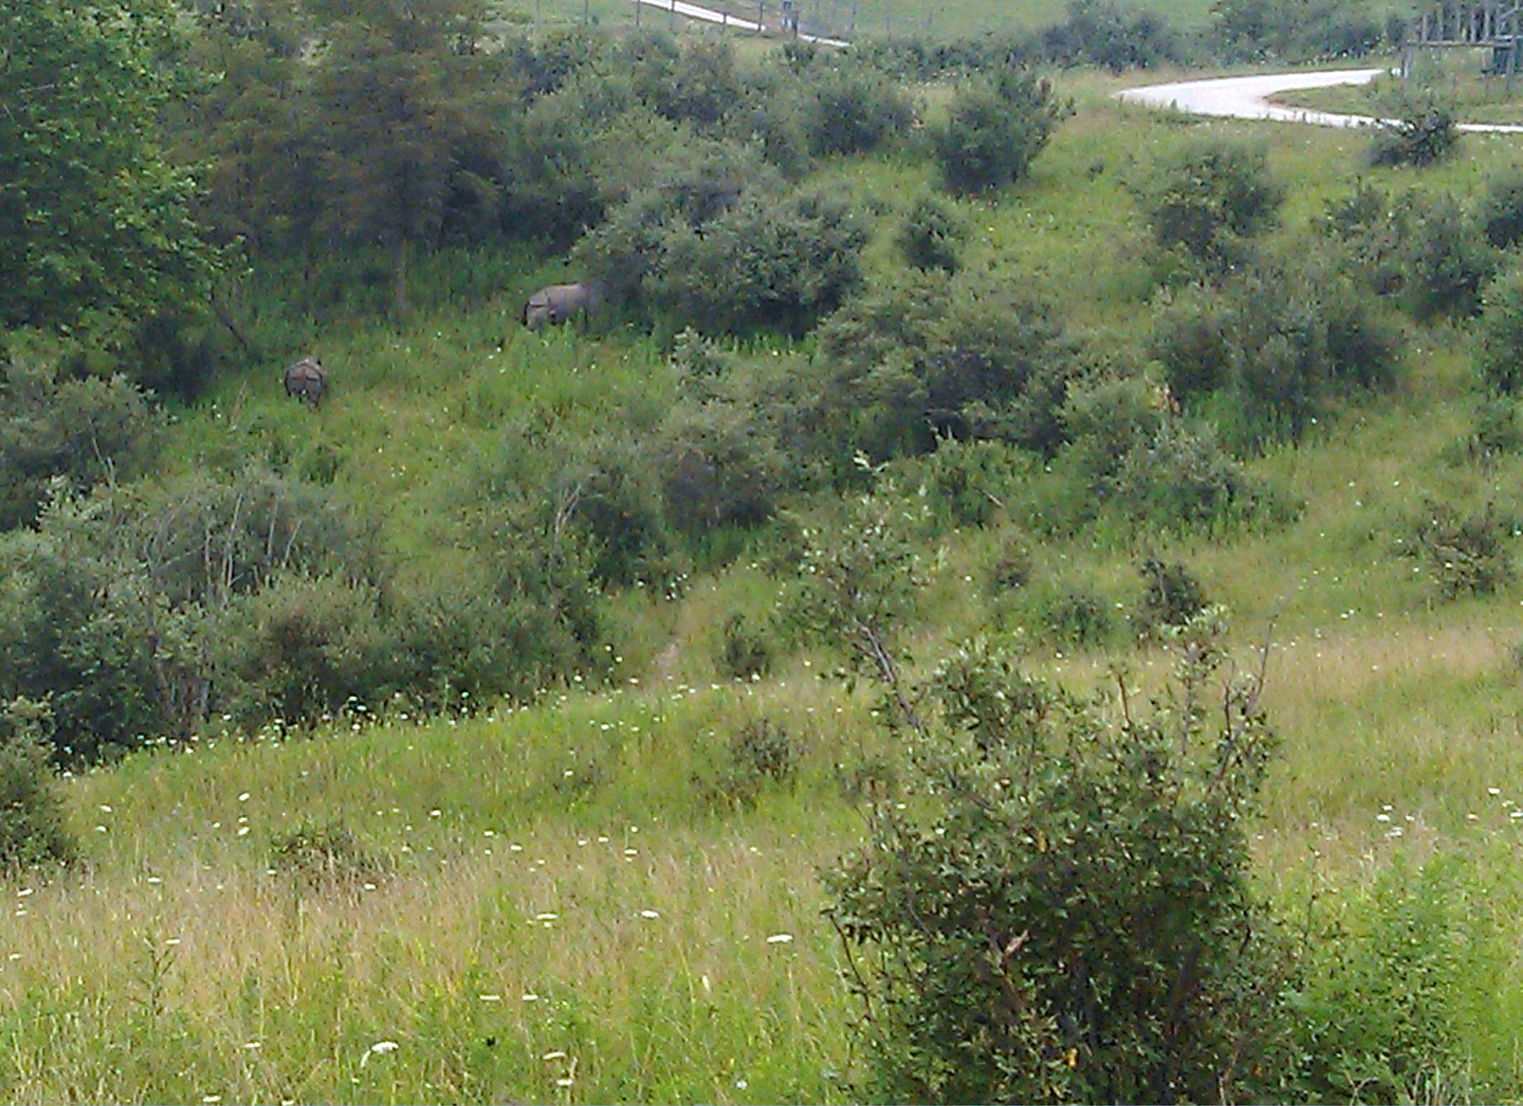
Succession Harvest 6 months 6 years 25 years
Mining “Arrested Succession” 25 years

Slide 5
Study site
Reclaimed ~10 years prior
10 ha total
Elev. 770 m (2500 ft.)
Soil sandstone/shale pH 6.5
3 blocks
4 treatment plots 0.81 ha each

Slide 6
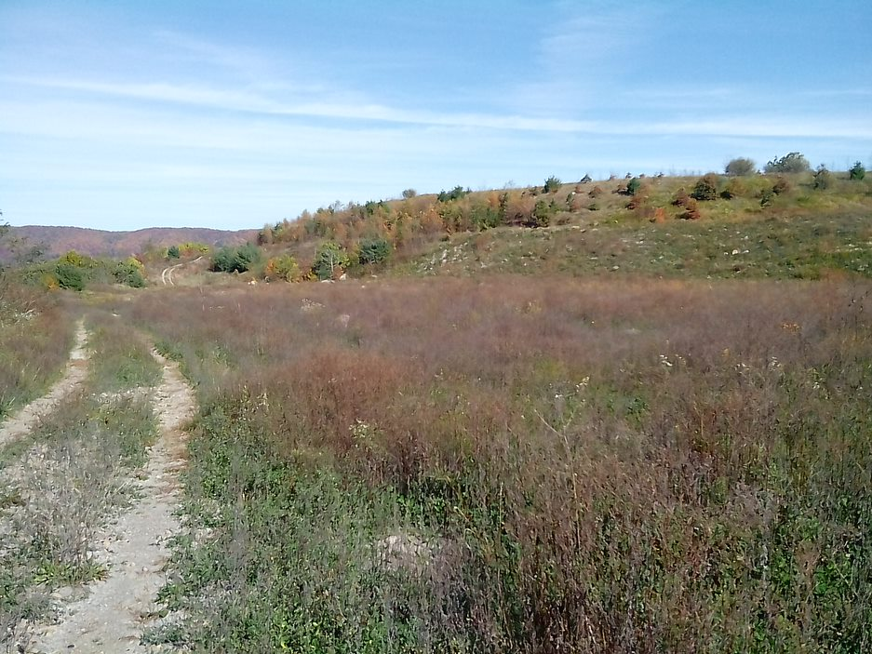
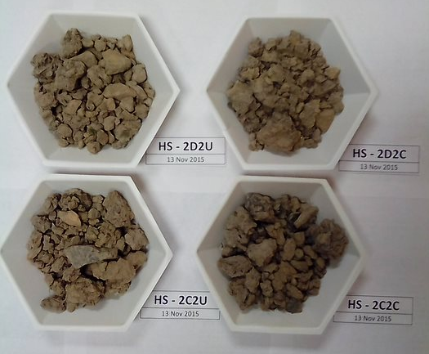
Vegetation
Average cover (including senescent) 93%
dominated by:
Red clover (Trifolium pratense)
Tall fescue (Schedonorus arundinaceus)
Lespedeza cunata
Birdsfoot trefoil (Lotus corniculatus)

Slide 7
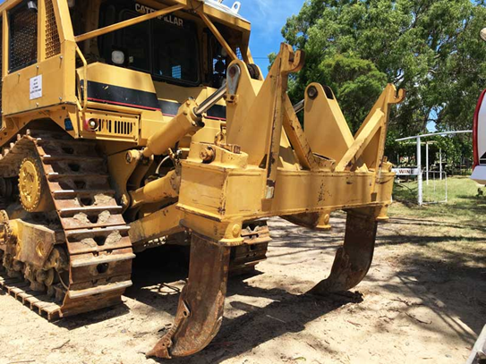
Treatments
Exotic invasive shrubs (Eleagnus umbellata) treated with herbicide
Subsoiled to 1.2 m depth to relieve compaction
Tree planting: 2240 trees/shrubs per ha
Recommended but not used:
Herbicide over entire site
Fencing or tree shelters to protect seedlings
Experimental tests of herbaceous seed mixtures
For recommended treatment see:
https://arri.osmre.gov/FRA/Advisories/FRA-11-LegacyLands-Nov2013.pdf

Slide 8
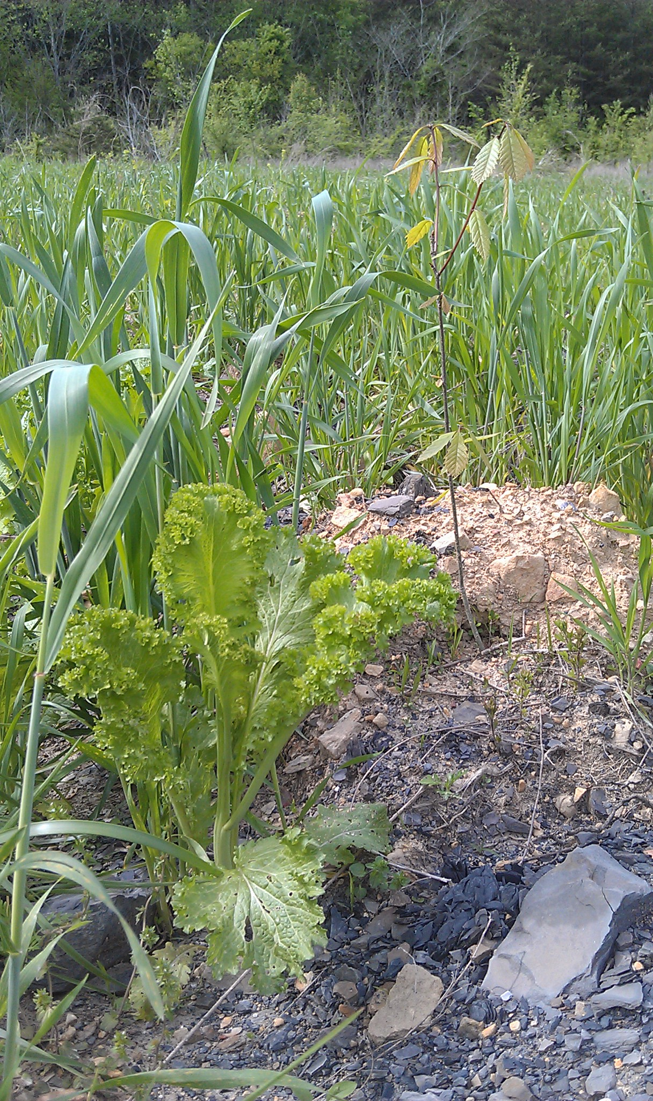
Sub-soiling temporarily reduced cover of vegetation
subsoiling
Rapid regrowth
Control May 2015
Seeded
Some seeded species were successful, but never accounted for more than 10% of vegetation
Seeded

Slide 9
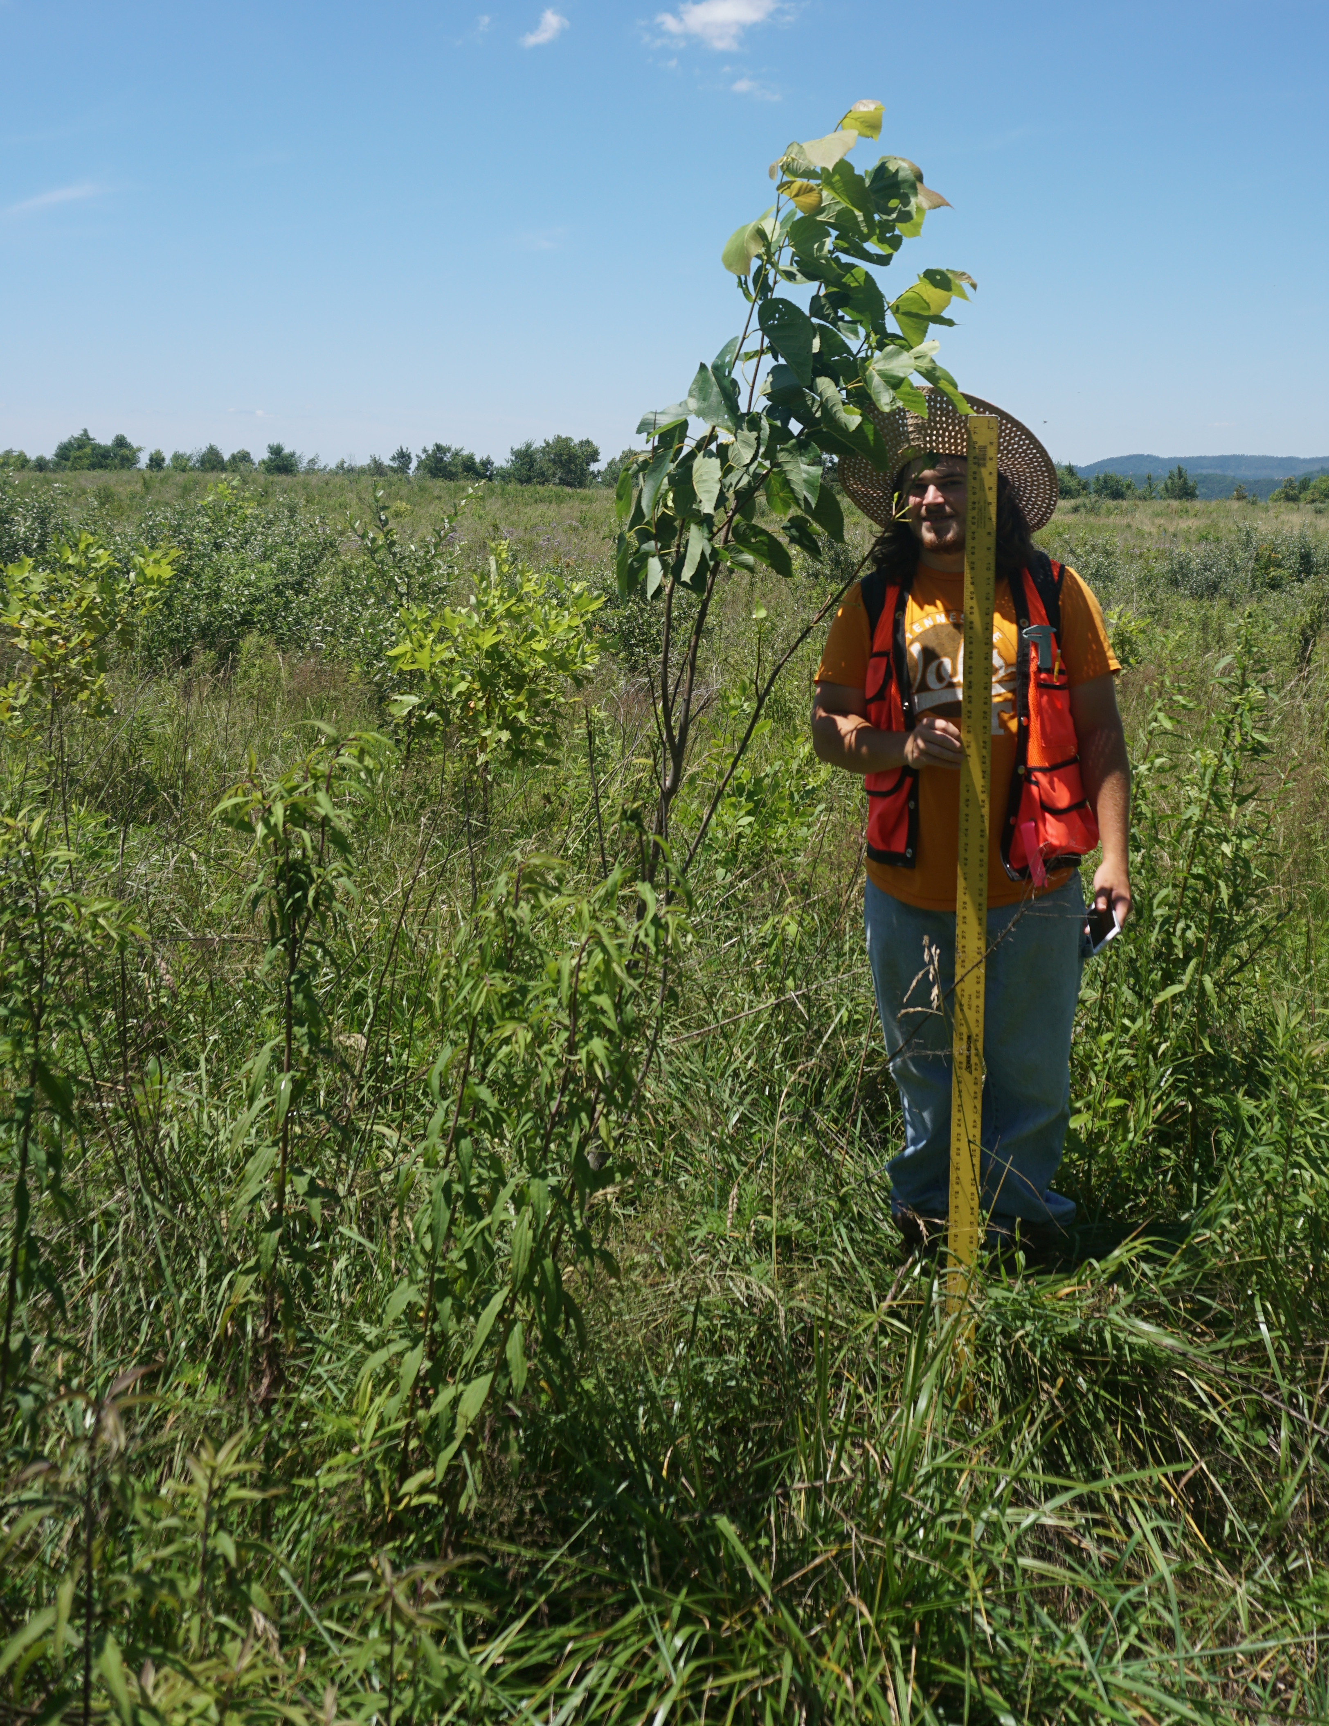
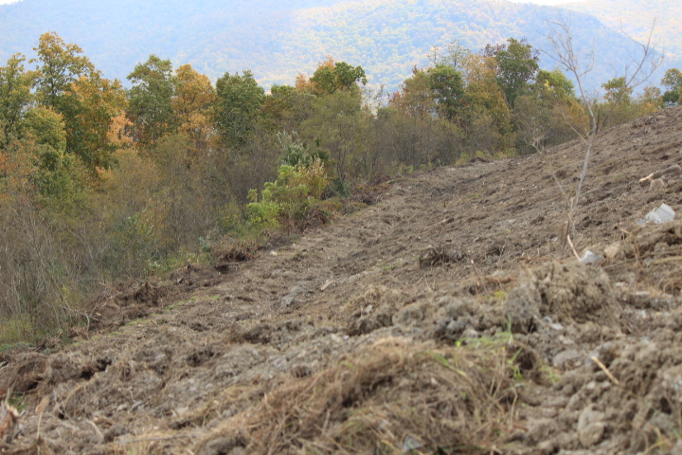
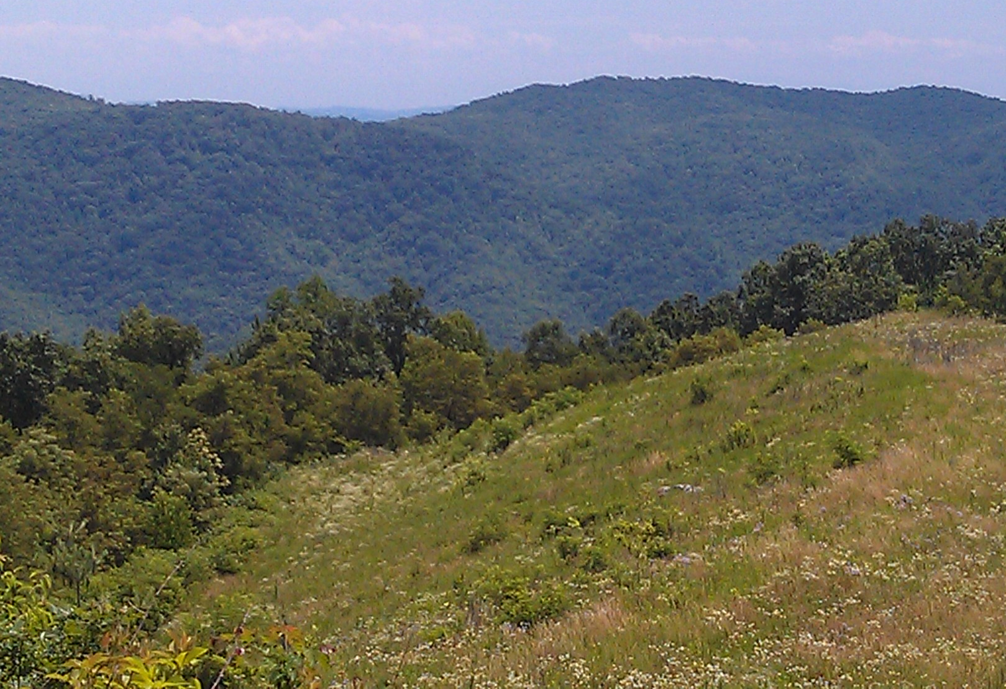
Change in vegetation over 2 years
Significant increase in 7 native, 5 non-native species
Significant decrease in 4 native, 4 non-native species
Rank abundance: (scale of 1 dominant to 6 absent)
Lespedeza cuneata (non-native legume) from 3.9 to 4.2
Festuca arundinacea (non-native grass) from 4.1 to 5.7
Tree survival at year 3 was 21%
52% had browsing damage

Slide 10
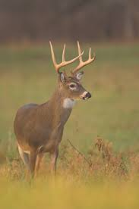
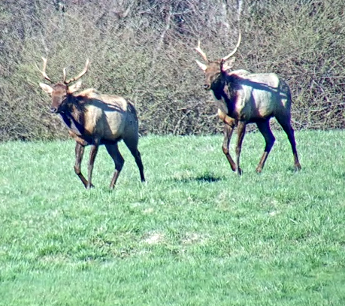
Browse damage
% of seedlings browsed
species |  | Apr-Jul 2015 | Aug 2017
northern red oak |  | 64 | 63
chinkapin oak |  | 39 | 54
yellow poplar |  | 9 | 8
white oak |  | 16 | 29
pin oak |  | 48 | 58
southern red oak |  | 35 | 38
eastern white pine |  | 4 | 0
tn.gov

Slide 11
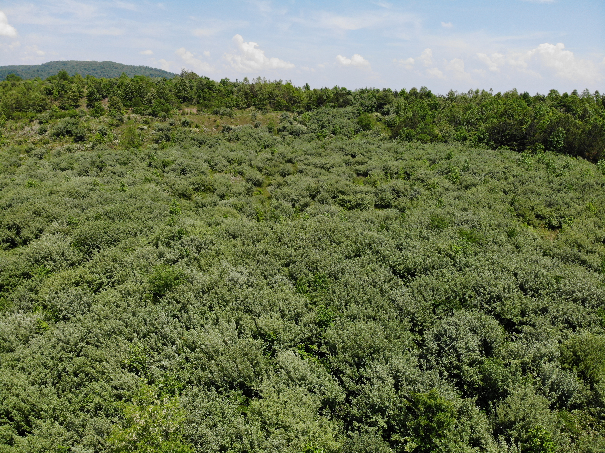
Year 4 - 2019 Year 6 - 2021
Invasive autumn olive controlled through year 3. Widespread in year 4.

Slide 12
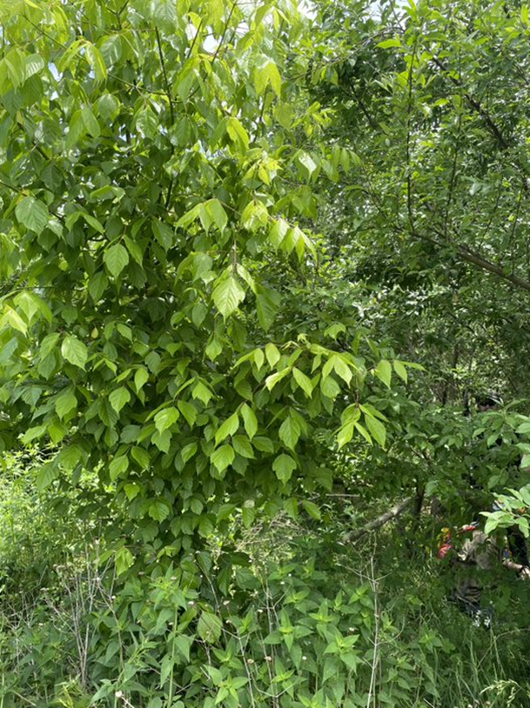
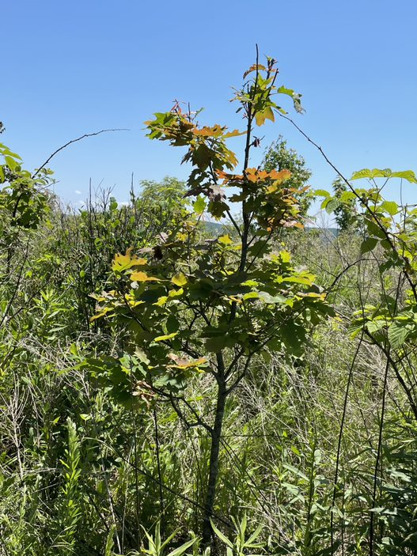
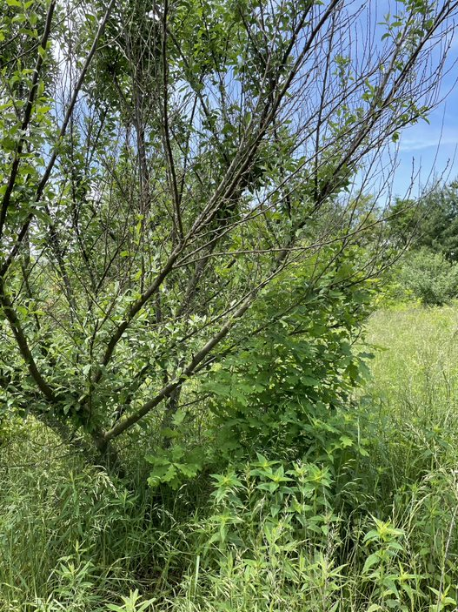
Open vs. shrubby
Are trees taller or more dense within shrubby plots?
NO

Slide 13
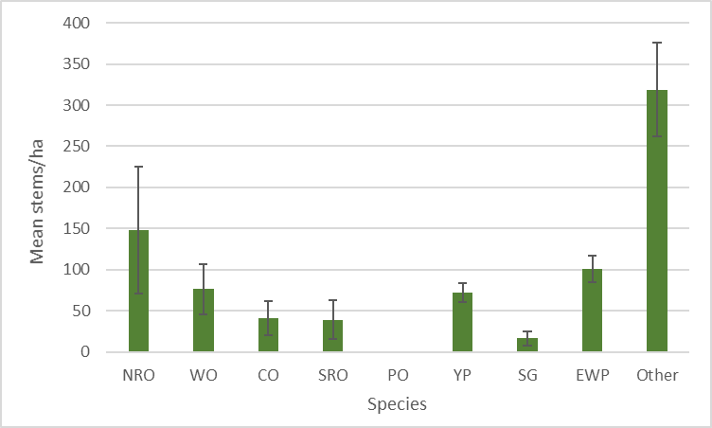
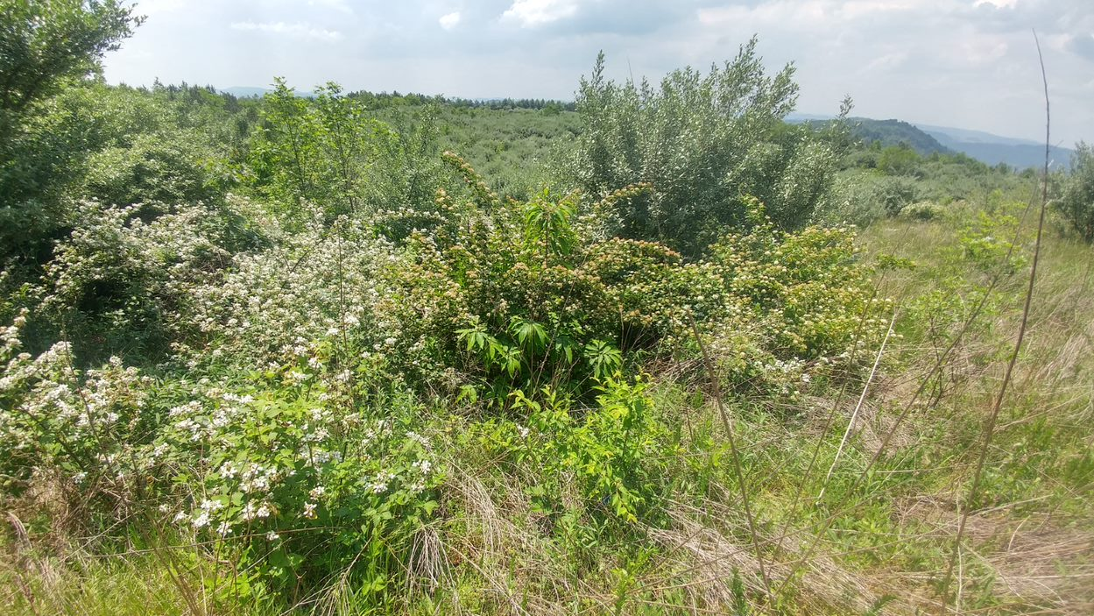
2022
Total stems of shrubs:
4.25 stems/m²
425,000 + 14,000 stems/ha
Autumn olive:
0.67 stems/m²
67,000 + 14,000 stems/ha
Trees:

Slide 14
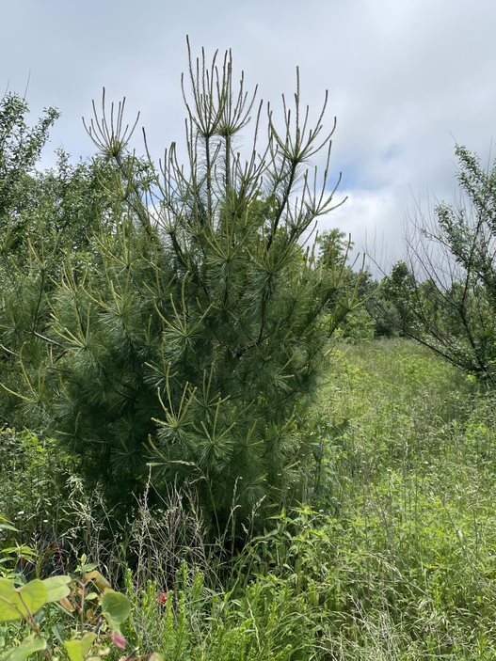
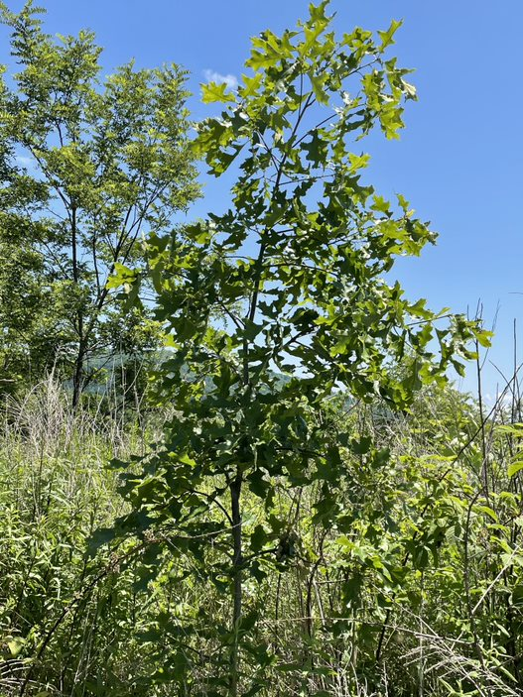
2022

Slide 15
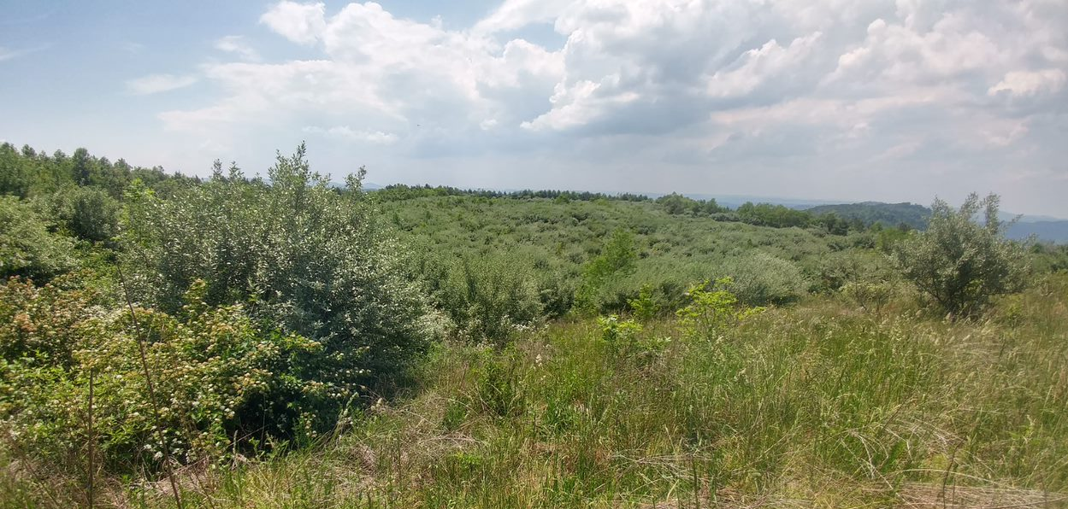
This project was funded by the National Fish and Wildlife Foundation
Thanks to:
Matt Aldrovandi, Ian Kennedy, Haley Cox, Kyle Hanners, Annie Miller, and Jack Wilkerson – field assistance
Chris Miller, OSMRE
Michael French, American Chestnut Foundation and Green Forests Work
This work is supported by McIntyre-Stennis gra nt no. TEN00MS-111 accession no1014114 from the USDA National Institute of Food and Agriculture
Thank you

