Slide 1


AN ARGUMENT
FOR
Long-Term
CARE and MAINTENACE
AT
RECLAIMED MINE SITES
Peter Werner, PE
USFS Mining Engineer
June 13, 2022
39th ASRS Annual Meeting
Duluth, MN, June 13-16, 2022
Notes:
Goal to keep you entertained and in your seats
Violate Cardinal Rule of PowerPoint
Will talk about mine reclamation plans and need for financial assurance for long term care and maintenance as part of permit approval
Will touch on the following 3 themes

Slide 2
The “How”, “What”, and “Why” of
Long-Term Care and Maintenance
How should you think about long-term care and maintenance? (… think geologically)
What should be included in long-term care and maintenance? (… it’s not just about the water)
Why is long-term care and maintenance important? (… the alternative is really, really, expensive)
Notes:
Recently the mining community has recognized that LTOM may be needed for certain reclaimed mine facilities, especially TSFs, but there are other facilities that also pose long term risks
Unfortunately there is not much guidance on what “long-term” means. What it looks like; how long it lasts.
Start with definition. Maybe mineral regulations offer some clues.

Slide 3
What Do the Regulations Say?
“…operator shall… reclaim the surface disturbed in operations by taking such measures as will prevent or control onsite and off-site damage to the environment and forest surface resources…” (36 CFR 228.8(g))
“…the operator shall reclaim the area disturbed… by taking reasonable measures to prevent or control on-site and off-site damage of the Federal lands.” (43 CFR 3809.420(b)(3)(i))
“The mining area shall be closed so that it is stable, free of hazards, minimizes hydrologic impacts, minimizes the release of substances that adversely impact other natural resources, and is maintenance free.” (MN Rule 6132.3200 Subpart 1)
Notes:
Not much help. More objectives rather than a “how to” or a “how long”.
Let’s see if mine plans can shed some light on what long-term means.

Slide 4
What Do Mine Plans Say?
“The TSF may be identified as a landform…when it reaches a condition that in the opinion of the agencies is considered to be physically, chemically, ecologically and socially stable and no longer poses a risk to life or the environment.” (in Stillwater Mining Company East Boulder Mine Detailed Design for Stage 6 TSF Expansion, 01/27/2020)
“Develop long-term landform that maintains stability and integrity of the TSF embankments.” (in Skunk Camp TSF Reclamation Plan Approach, Resolution Copper Project, November 2019)
Notes:
The old “I’ll know it when I see it” approach to reclamation.
These don’t move us any closer to a definition of long-term
Why is this important? Remember, a bond needs to be in place before mining can commence. The challenge for regulator is to calculate a reclamation cost for something that is yet to be defined in both scope and time.

Slide 5
Why is Long-Term
Care and Maintenance Necessary?
A New Landform on the Landscape
Operating Life vs. Functional Life
  Operating Life – meant to address a finite period of use (e.g., active operations)
  Functional Life – meant to address a period of time during which a system needs to function and meet or exceed performance requirements. (maybe even… forever?)
The Dynamic Environment
  Engineering time vs. Geologic time
  Geomorphological processes and landscape evolution
Notes:
Let’s try to back into a definition of “long-term” by looking at what happens to a reclaimed site over time. Consider the following.
Most important slide of the entire presentation because it captures the fundamentals of the argument for LTOM. First, we need to acknowledge that we have a new landform…., and what do we know about landforms? Given enough time, things that are tall and pointy become low and flat.
Highly recommend Nick Bugosh’s workshop on geomorphic reclamation on Wednesday
Operating vs. functional. Consider that a mine may be in operation for say an average of 30 yrs, yet the landforms it creates will be on the landscape for much, much longer than the time it was in operation.
Live in a changing world. And if our landforms need to remain functional forever, need to think in geologic time rather than in engineering time.
Add 4th reason: Optimism Bias, irrational optimism. Some in audience…

Slide 6
The Long-Term Care and Maintenance Conflict
Engineered Systems
A Dynamic Landscape
Underdrains
Water Balance Covers
Seepage Collection Systems
Surface Water Diversion Ditches
Sediment Ponds
Geosynthetics
Electronic Monitoring Systems
Rain Events
Flooding
Slope Creep (i.e., gravity)
Freeze-Thaw
Wind Erosion
Wildfire
Drought
Animal pertubations
Notes:
To further underscore the impacts from a dynamic landscape, consider the following.
By constructing these mining landforms, we immediately set-up a conflict between engineered systems and natural processes.
These systems will never perform as well as they do on the day they were constructed. Why? Because of the relentless assault on these systems by the natural processes listed on the right.
Not just about complex facilities like TSF as I will demonstrate later.

Slide 7
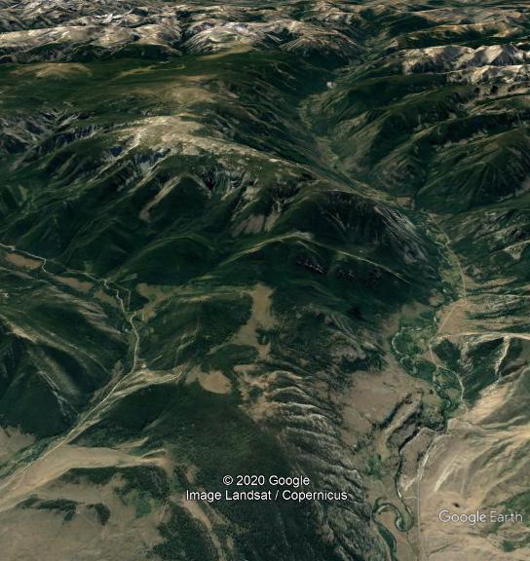
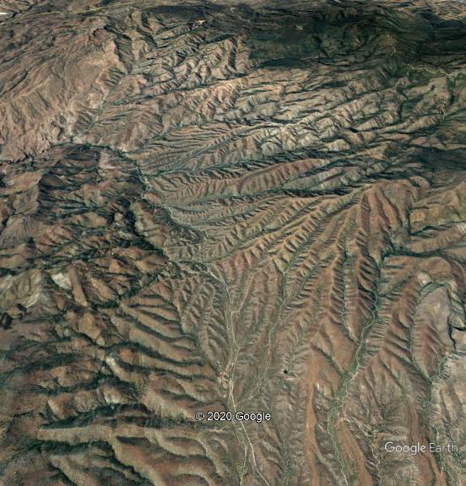
A Dynamic and Evolving Landscape
Notes:
Let me illustrate some of the previous points with 2 real-time examples
Image on LEFT: mountains, major rivers, snow, trees. Likely temperate climate, with alpine ecosystem. Snow means avalanche danger, freezing conditions. Short growing season. Maybe not a lot of soil development or depth.
Image on RIGHT: High stream density. Lots if 1st and 2nd order streams. Doesn’t look to be much veg development. Likely semi-arid to arid ecosystem, which means not a lot of soil development and soils likely coarse grained so not much water holding capacity, likely high run-off potential, flash flooding.

Slide 8
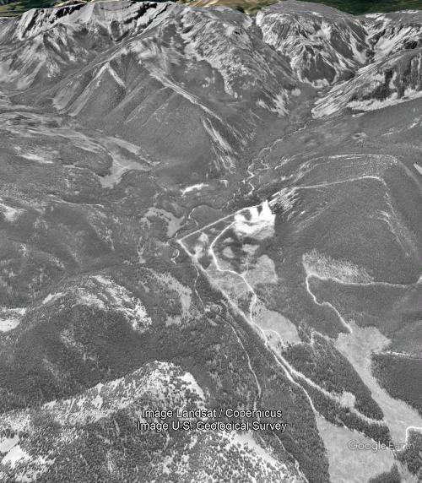
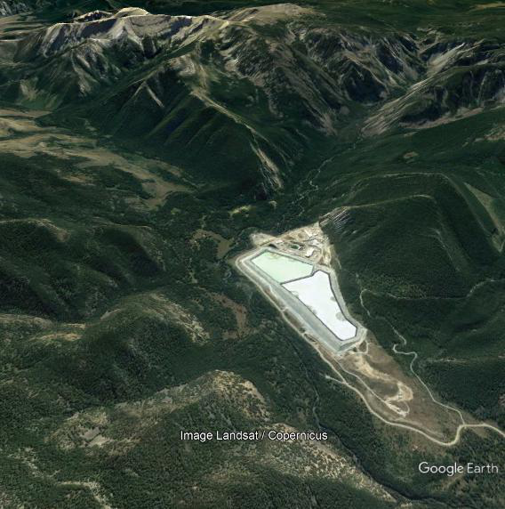
East Boulder Mine
Sweet Grass County, MT
Notes:
Photo on left from late 1990s.
Well defined river valley, trace of river, clear cuts
Today there is a mine

Slide 9
Proposed TSF
Expansion
Existing TSF
Notes:
Do you think perhaps there is some irrational optimism associated with this design?

Slide 10
Notes:
Historic trace of river migration over the years.
Over steepened slopes at the meanders.
Who’s to say there won’t be migration in the future that could encroach on toe of TSF?

Slide 11
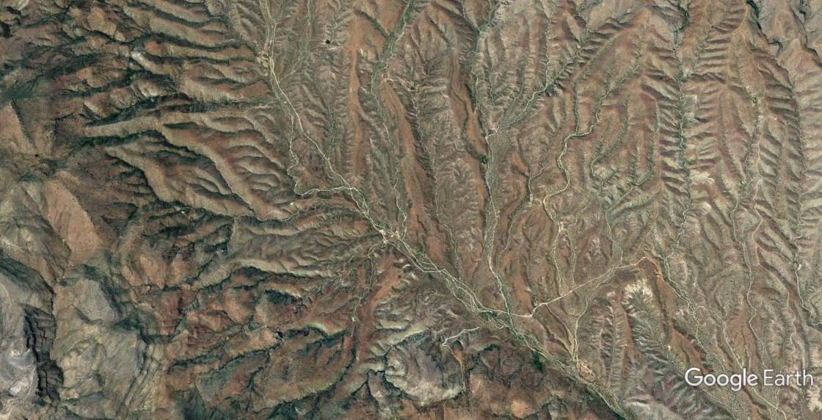
Resolution Cu Mine Tailings Site
Pinal County, AZ
1 in = 1 mi
Notes:
I show you these examples not to criticize the plans, but to underscore that some mines may have potential liabilities that persist long after closure simply due to dynamic and evolving landscapes.
So, how can we begin to quantify these liabilities so we can get closer to what “long-term” means? Risk Analysis.

Slide 12
Evaluating Long-Term Care and Maintenance Needs
Use Risk Assessment
  Identify what could go wrong
  Describe consequences of system failure
  Assign time frames
  Develop mitigations
  Transparent process
  Stakeholder participation
Notes:
To review common elements of Risk Analysis

Slide 13
Notes:
Performed a risk assessment for the post-closure period for the E. Boulder Mine I showed earlier. Here’s an excerpt from the risk register.
We’ve added columns for mitigations and the rationale for those mitigations, basing the rationale on past experience as much as possible. E.g., clean out culverts and ditches at certain intervals, replace inclinometer and piezometers based on what we know from other applications. And so forth.
MCE or PMF or other extreme events were not risk drivers, rather inter-dependence of multiple landform systems, often seemingly inconsequential systems such as diversion ditches or sed ponds It was the failure of these relatively simple systems that if left uncorrected led to more impactful consequences, that were perhaps years in the making.
For example, the diversion ditch fails which causes stormwater to discharge onto the TSF which erodes the cap which exposes the tailings which during subsequent storm events can erode into the river.
It’s like “Death by 1,000 cuts.”, or like the old proverb: For want of a nail…

Slide 14
How Mitigations Reduce Risk
No Mitigations
With Mitigations
Notes:
Able to move risk levels to lower levels with simple preventative care and maintenance measures.
Have we landed on a definition for “long-term” yet? Maybe not directly, but we can get at it through risk analysis by identifying those risks that may persist after closure, and for how long, maybe even forever.
FYI, for our exercise we determined that the identified risks would be present forever.

Slide 15
Financing Long-Term Care and Maintenance
1. Utilize Time Value of Money Concept
  Discounted Cash Flow Analysis (DCF)
  A means to establish the initial fund amount
  LTOM w/o DCF = $800 x 10³⁰ ($800 nonillion)
  LTOM w/ DCF = $39.7 x 10⁶
2. Shortcomings
  Initial assumptions are very important
  Account requires active management to meet financial goals
  The 100-yr fallacy (100 yrs. ≠ perpetuity)
Notes:
Answered first 2 questions about “How” (geologically), and “What” (not just the water or complex systems. Now let’s look at “Why” LTOM is important.
Paying for long-term care and maintenance, even if it’s relatively simple, low-cost activities like cleaning out diversion ditches periodically, can become very expensive when stretched out over, tens or hundreds or even thousands of years.
Only realistic way to pay for this is through establishing a care and maintenance fund in advance.
To do this, take advantage of the Time Value of Money
We did this for our E. Boulder example and compared the real cost (not discounted) to a discounted cost scenario. We took the calculation out to that year in the future where the Present Value of the future out-year cost was <$1.
Nonillion. More manageable 40 million. $40 million in hand today will pay for our LTOM plan vs. paying $800 nonillion over the entire term of the LTOM program.
Obvious shortcomings

Slide 16
Momentum is Building
BLM’s 43 CFR 3809 Regulations
USFS Authorized Trust Funds for Long-Term O&M
Biden-Harris Administration Fundamental Principles for Domestic Mining Reform (02/22/22)
International Council on Mining & Metals
World Bank
Alberta
Saskatchewan
British Columbia
Western Australia

Slide 17
Long-Term Care and Maintenance Recap
A permanent new landform on the landscape that will evolve over time. Who will take care of it?
Risk assessment tools to help identify long-term liabilities.
Use the time value of money to fund what otherwise can be a really, really, expensive undertaking.
Resist irrational optimism
Notes:
We have the tools to avoid or at least minimize future liabilities, but it requires a change in how we look at closed mines, and how we evaluate their potential liabilities. So, to recap…

Slide 18
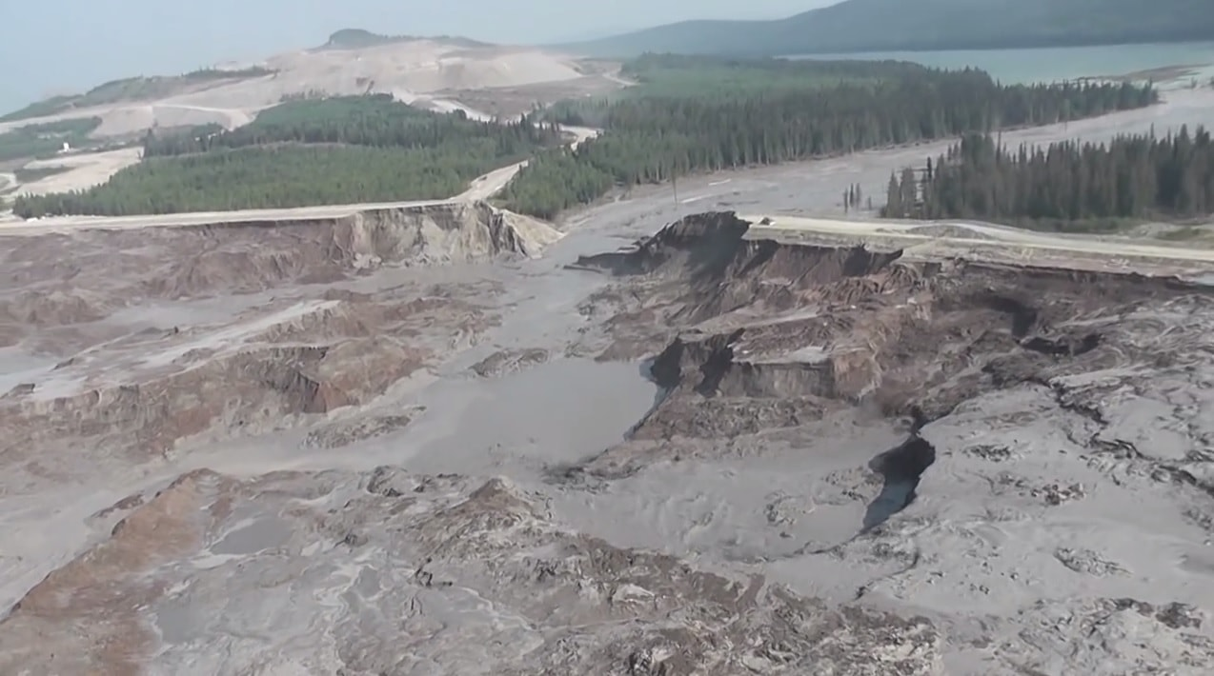
Comments?

Slide 19
Mine Closure Resources
Landform Design Institute (LDI) https://www.landformdesign.com
Closure Planning Practitioners Association (CPPA) https://www.cppa.asn.au
Australian Centre for Geomechanics (ACG) https://acg.uwa.edu.au

