Slide 1


Gladden AMD Treatment Plant
Chartiers Creek Watershed
South Fayette Township
Allegheny County
Pennsylvania

Slide 2

The Gladden AMD Treatment Facility
South Fayette Conservation Group (SFCG) received a $13,048,446 AML Economic Revitalization (AML Pilot) Grant from the PA DEP Bureau of Abandoned Mine Reclamation in 2019.
SFCG contracted with Tetra Tech to complete a Design-Build Project to design and build the Gladden AMD Treatment Facility.
The Gladden mine drainage treatment plant, located just west of Pittsburgh Pennsylvania in the Chartiers Creek watershed, South Fayette Township, Allegheny County, represents a mutli-decades effort to address and ameliorate the impacts of abandoned underground coal mine drainage in the local community.

Slide 3
South Fayette Conservation Group
The South Fayette Conservation Group (SFCG) is a non-profit conservation and watershed group located in southern Allegheny County about 12 miles southwest of Pittsburgh. Their mission is to conserve, protect and enhance our natural and recreational resources for the benefit of their families and neighbors.
The SFCG addresses conservation issues associated with urban growth and abandoned mine drainage (AMD), which impacts major tributaries in the region including Millers Run, Coal Run, Fishing Run, Robinson Run and Chartiers Creek. In addition, the group seeks to increase public awareness of these issues and to increase involvement among different sectors of their community.
SFCG is a volunteer organization that partners with private, local and state organizations to complete special projects including but are not limited to abandoned mine drainage reclamation, major stream remediation, riparian land restorations and several community and education outreach initiatives among many other achievements.

Slide 4
Gladden Project History
2003 PaDEP Growing Greener grant develop Lower Chartiers Creek Watershed Restoration Plan
2005 - Restoration Plan for Large Mine Discharges to Lower Chartiers Creek determines Gladden discharge to be largest point source in the watershed - Tom Gray, Engr. Mgr.
2006 Grant from Growing Greener II for the Fishing Run Restoration/Maude Mine Reclamation Project completed in 2007.
2009 Growing Greener Grant Recipient for the South Fayette Watershed Visual Assessment including Millers Run
2009 Clean Water Fund Grant Program Recipient sponsored by the Allegheny County Conservation District for our Fish Habitat Project for Millers Run completed in 2011

Slide 5
Gladden Project History (continued)
May 9, 2019 – South Fayette Conservation Group (SFCG) AML PILOT Grant Application Submitted
Sept 26, 2019 – PADEP BAMR Grant Awarded to SFCG
Oct 1, 2019 – Kick-off Meeting at BAMR Ebensburg Office
May 11, 2020 – Agencies/Stakeholders/Contractors On-site Pre-Construction Meeting
January 18, 2021 – Start-up and Commissioning Begins
February 1, 2021 – Continuous Treatment Commences

Slide 6
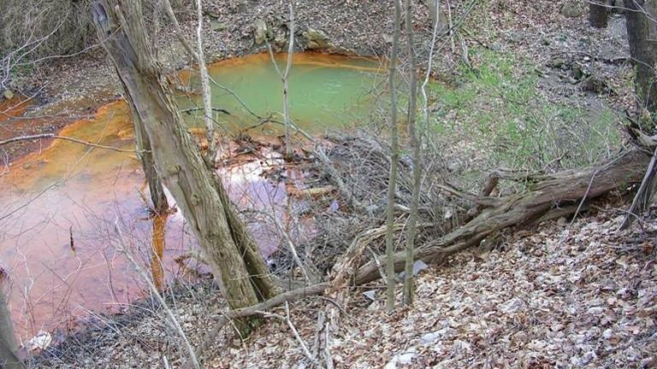
Gladden Discharge flowing from an open Mine Shaft

Slide 7
The Gladden AMD Discharge – Chartiers Creek Watershed
The Gladden Discharge flows from the abandoned Montour No. 2 underground coal mine operated by the former Pittsburgh Coal Company and abandoned circa 1920
The discharge dumps on average more than 900 gallons (750 – 1,500 gpm) of iron-laden (90 – 130 mg/liter) water into Millers Run every minute (1.3 million gallons per day)

Slide 8
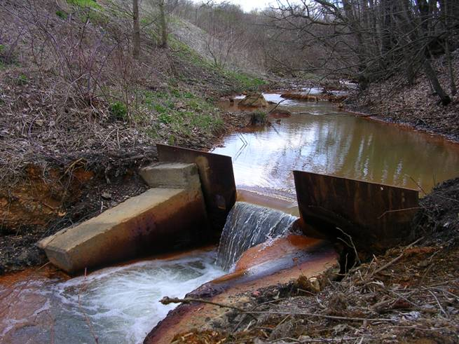
Gladden Discharge Channel and Flow Measuring Weir

Slide 9
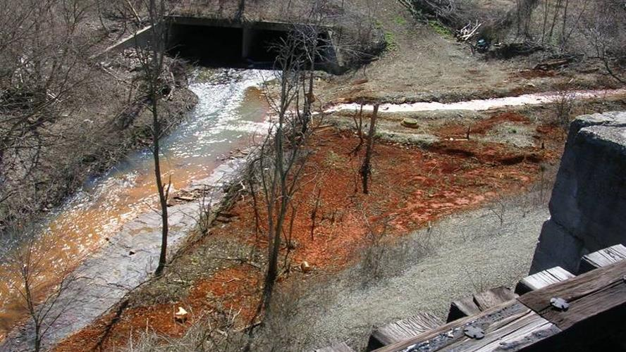
Gladden Discharge Flowing into Millers Run

Slide 10
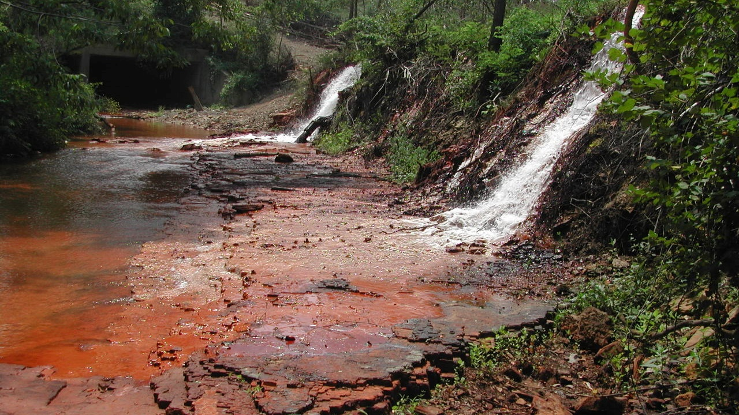
Gladden Discharge Flowing into Millers Run

Slide 11

The Gladden AMD Discharge – Chartiers Creek Watershed
According to watershed studies completed by the local conservation groups in conjunction with PA-DEP, the Gladden discharge is responsible for 40% of the iron loading and 50% of the acidity loading to Chartiers Creek
Within a half-mile from where the Gladden Discharge enters Millers Run, it changes from a clear stream with trout to an orange stream with virtually no life

Slide 12
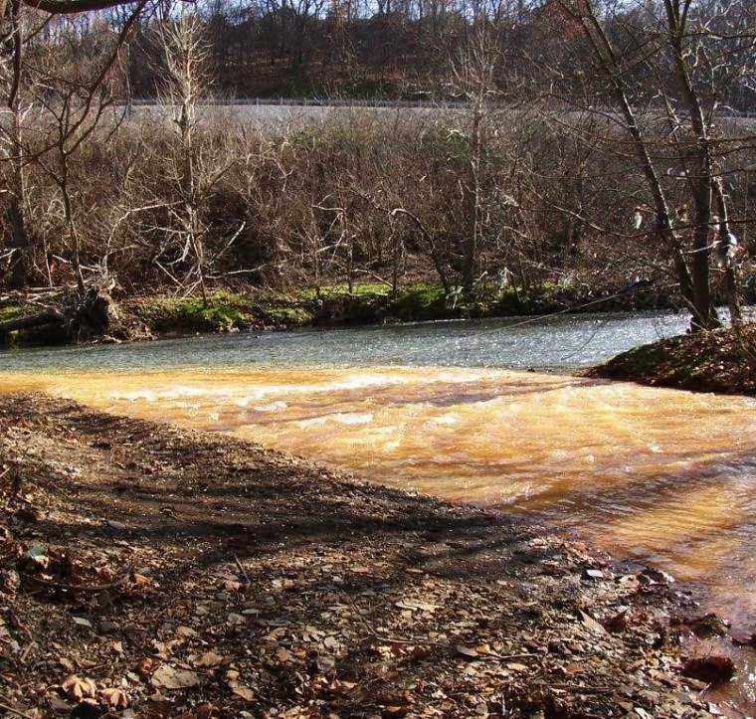
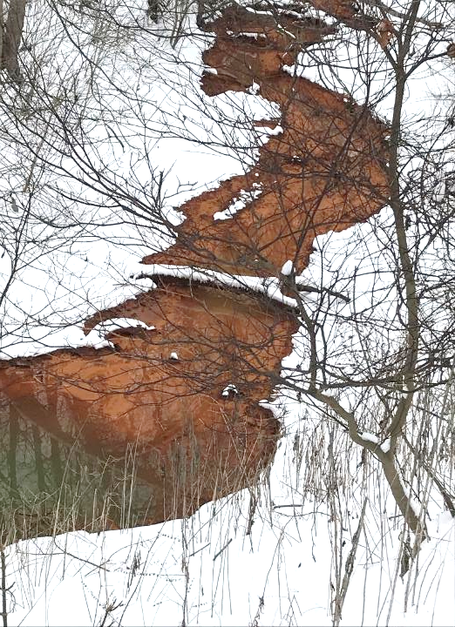
Gladden Discharge into Millers Run
and Millers Run into Chartiers Creek
Raw Discharge: pH=6, Fe 100 ppm
Flows: Avg=750 gpm, 1,470 gpm max
Draining 5,500 acres of Mine Workings
1,500 acres of Mine Pool

Slide 13
The Gladden AMD Discharge – Chartiers Creek Watershed
Millers Run then flows into Chartiers Creek degrading the stream quality to a point where it can support almost no aquatic life
Chartiers Creek, located partially in Washington and Allegheny Counties, flows into the Ohio River just a few miles downstream from the confluence of the Allegheny and Monongahela Rivers where the Ohio River begins in downtown Pittsburgh

Slide 14
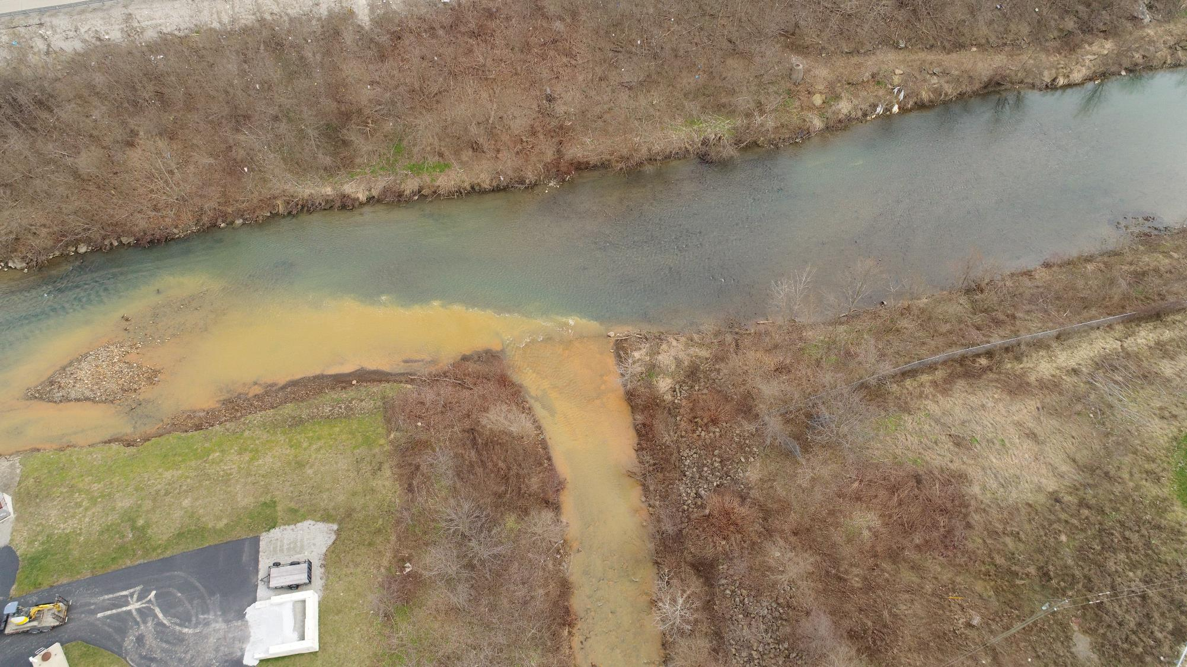
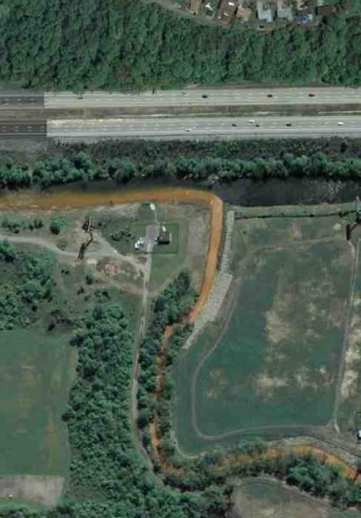
Aerial View of the Confluence of Millers Run and Chartiers Creek

Slide 15
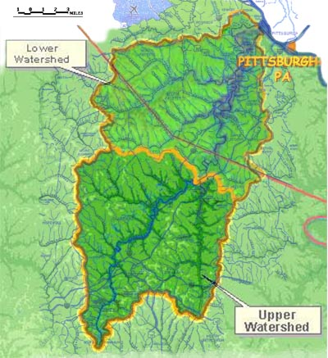
Chartiers Creek Watershed
Gladden Discharge

Slide 16
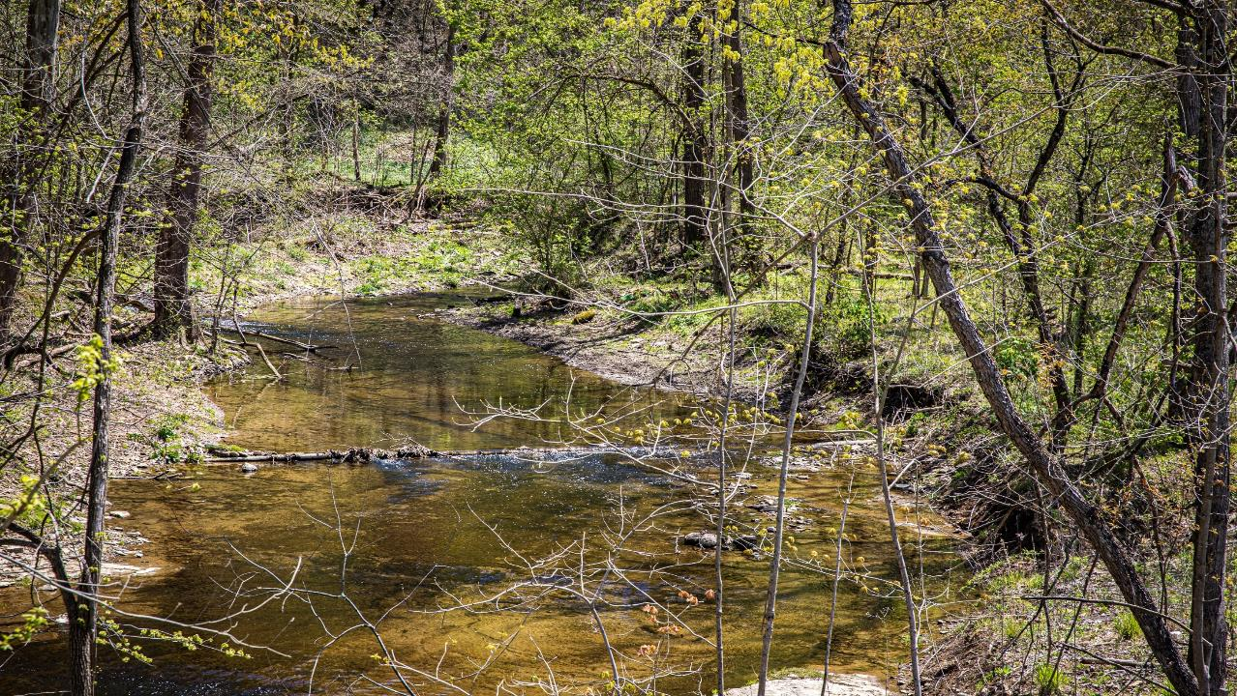
Millers Run above AMD Impacts

Slide 17
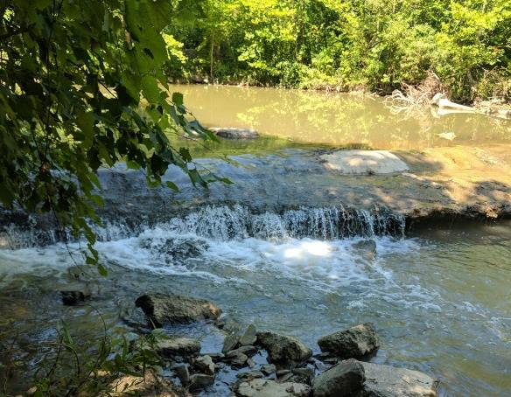
Millers Run above AMD Impacts

Slide 18
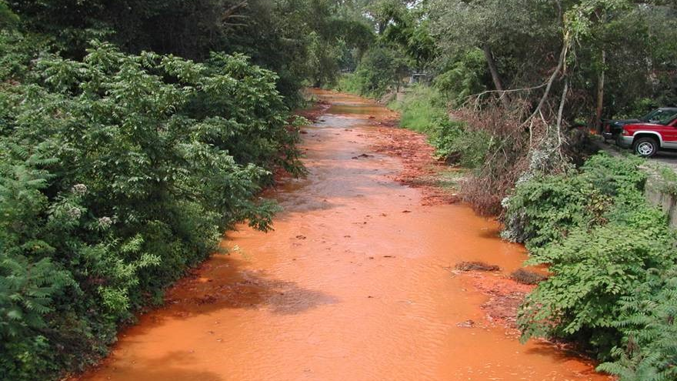
Millers Run below AMD Impacts

Slide 19
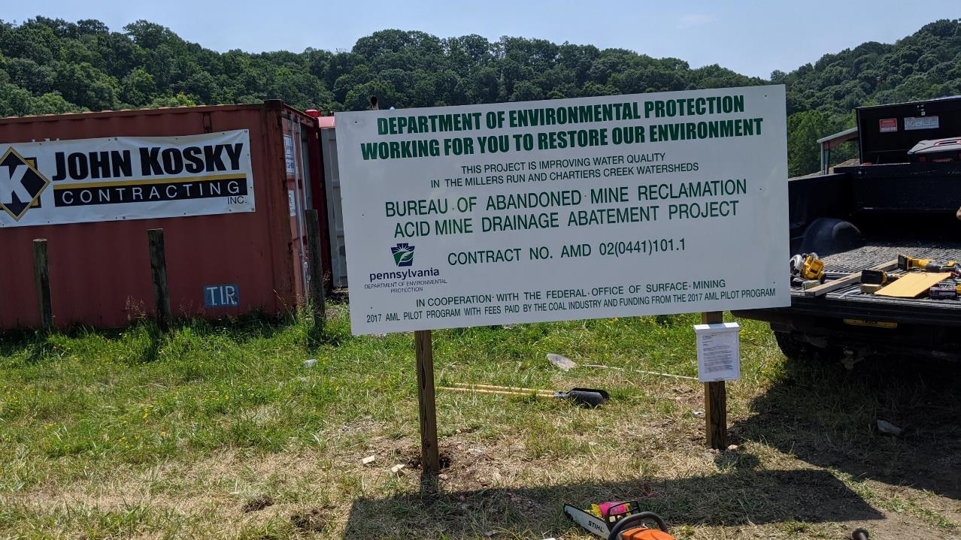
The Solution: Relocate and Treat the Mine Discharge at a New Mine Drainage Treatment Facility

Slide 20

Treatment Plant Design
A 2.2 million gallons per day (MGD) treatment plant was designed to treat the existing Gladden discharge.
The Gladden AMD Treatment Facility is the first facility in PA that was designed from inception to be a Hydrogen Peroxide treatment plant.
The plant includes two pumping stations to extract the AMD water from the mine pool and bring it to the surface for treatment.
The treatment includes oxidation using industrial grade (50%) hydrogen peroxide addition, polymer addition to form solid precipitates, solids recirculation for enhanced flocculation, and a clarifier and settling/polishing pond to remove the precipitated metals and solids from the water.
The treated water is discharged to Millers Run, and the sludge is pumped to a portion of the mine that is not hydrologically connected for disposal.

Slide 21

Treatment Plant Components
2 submersible turbine pumps rated at approximately 1,200 gpm located at a point in the mine to achieve a maximum drawdown elevation
A combination pre-aeration, reaction polymer slow mix tank with a design capacity of 1,600 gpm
A back-up NaOH chemical addition automated dosing system (only if needed)
A 5,600-gallon reserve capacity automated hydrogen peroxide dosing system
An emulsion polymer system
An 65-foot diameter clarifier, 1,600 gpm design capacity
A polishing pond with service water system
Redundant sludge boreholes and pumping systems
A main control building with an office, lab, and restroom

Slide 22
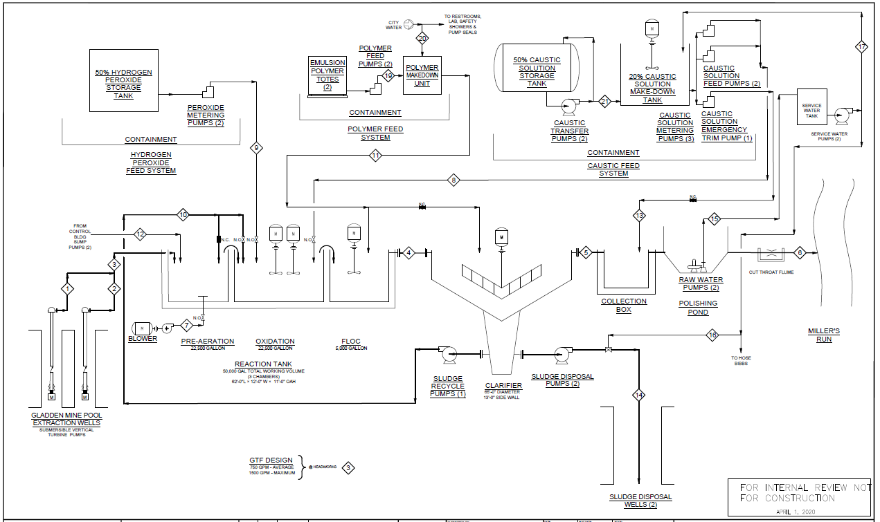

System Process Flow Diagram

Slide 23
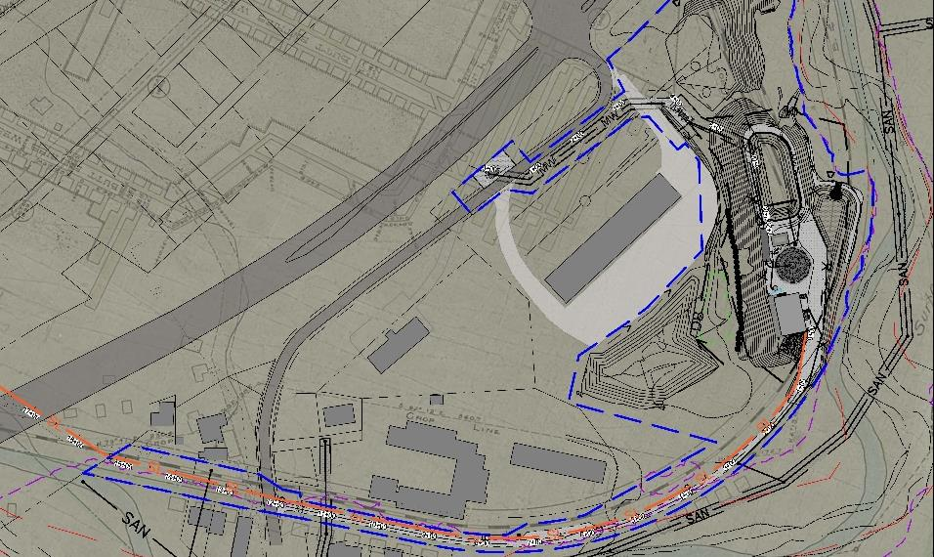




















Treatment Plant
AMD Extraction Wells
Farmers Market
Rt. 50
Sludge Disposal
Millers Run

Slide 24
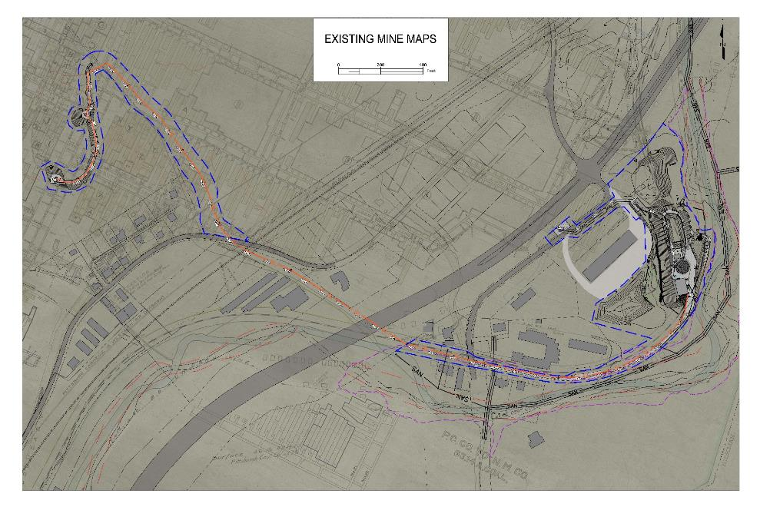
Treatment Plant and Sludge Disposal Line Layout over Mine Workings

Slide 25
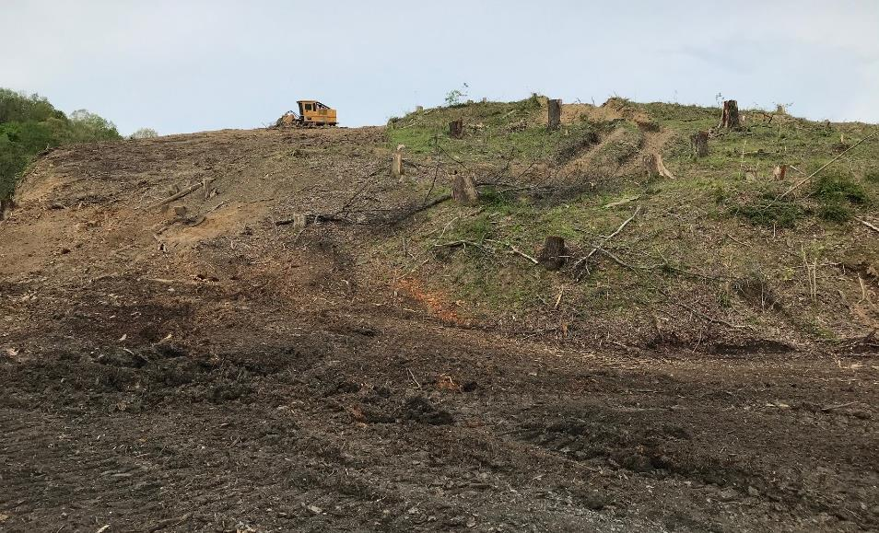
Initiation of Project Construction
Civil Site Development – May 18, 2020

Slide 26
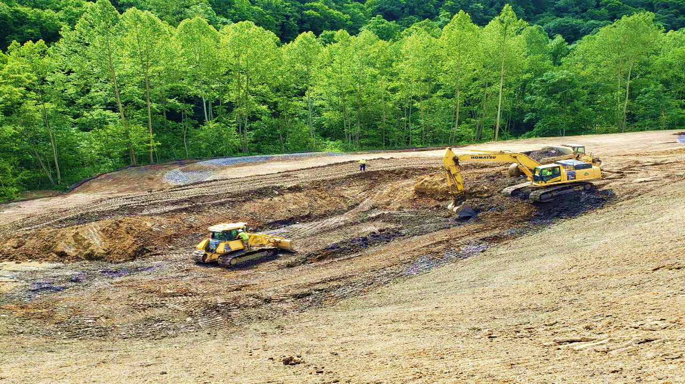
Civil Site Development – June 8, 2020

Slide 27
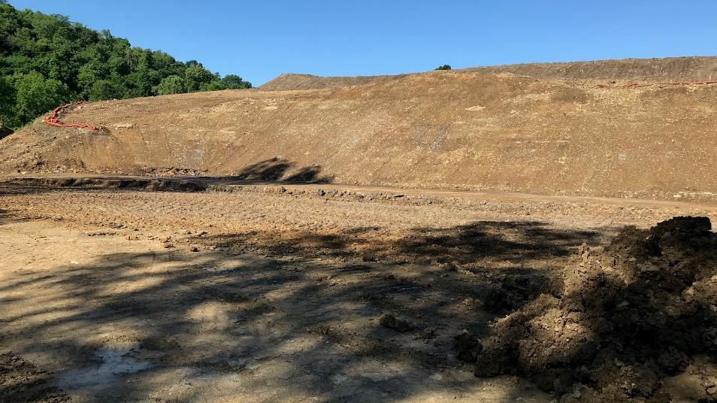
Civil Site Development – June 12, 2020

Slide 28
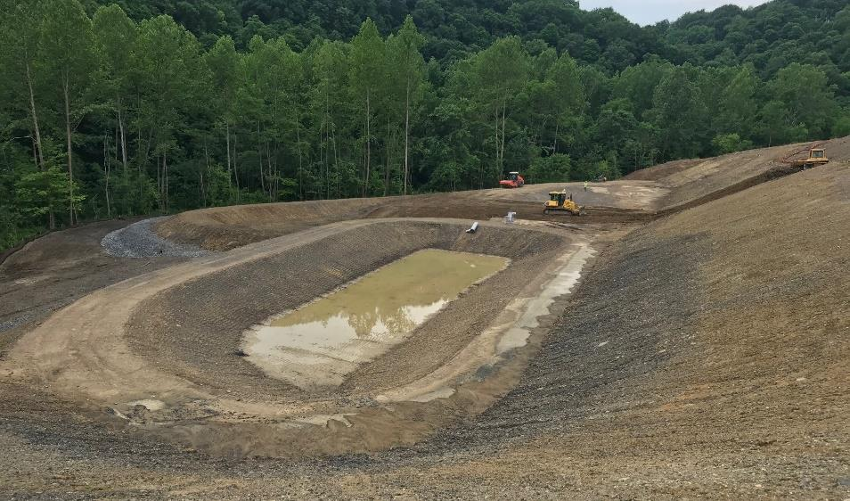
Civil Site Development – June 22, 2020

Slide 29
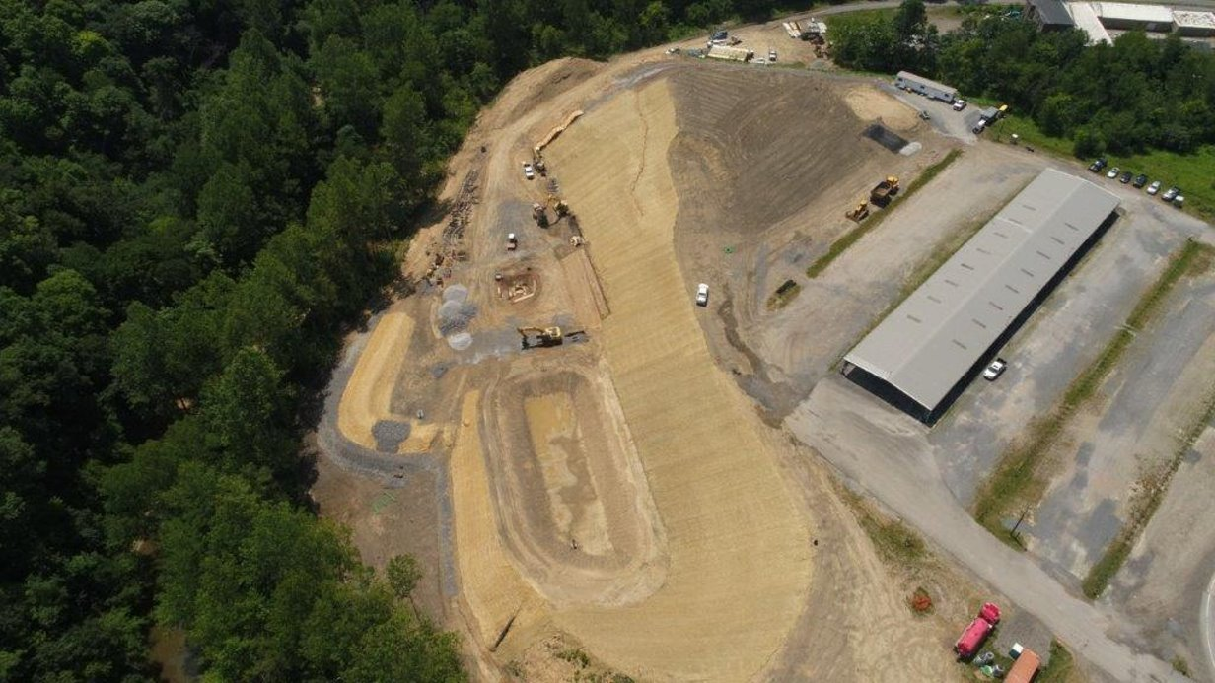
Foundation Work Started – July 10, 2020

Slide 30
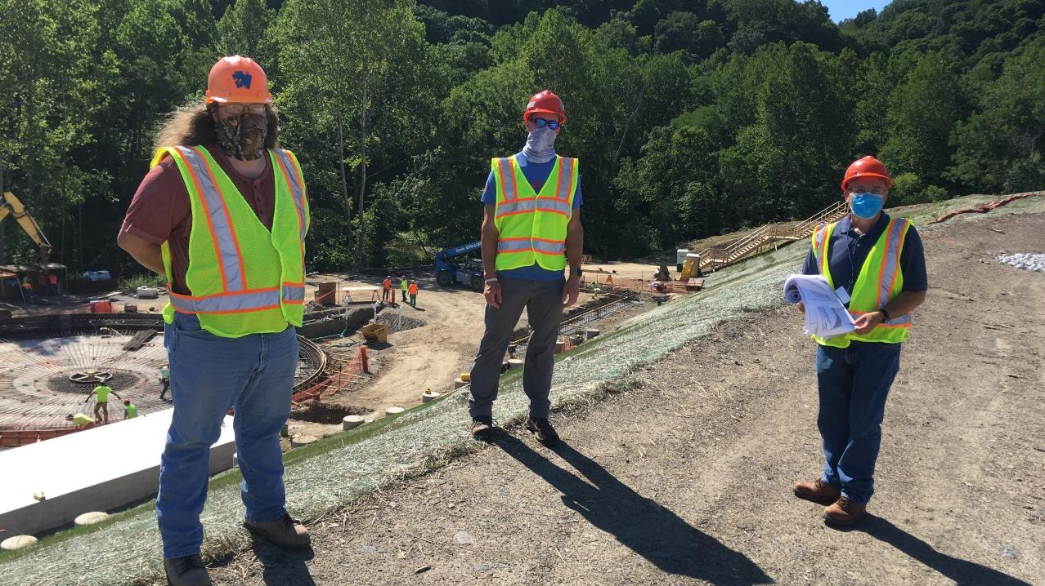
Masking and Social Distancing Safety Protocols were Necessary as a Result of the COVID-19 Pandemic

Slide 31
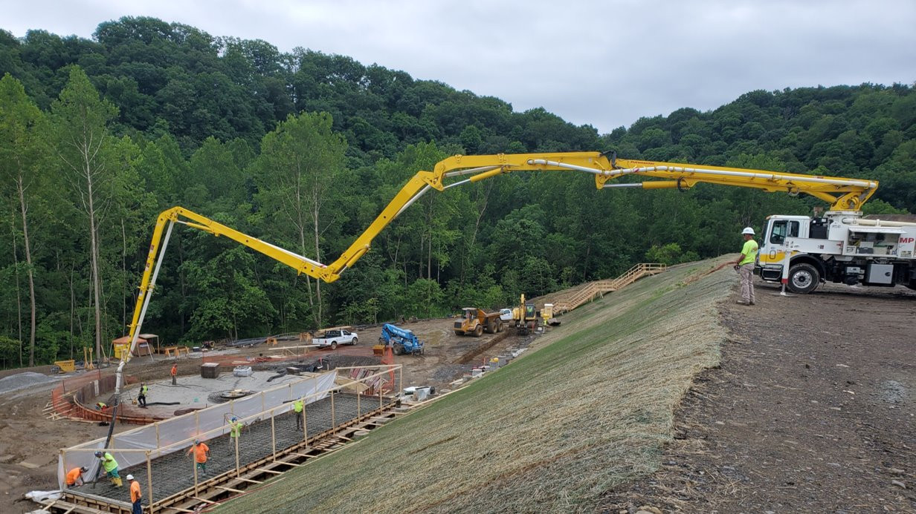
Foundation Work for Clarifier and Reaction Tank – July 23, 2020

Slide 32
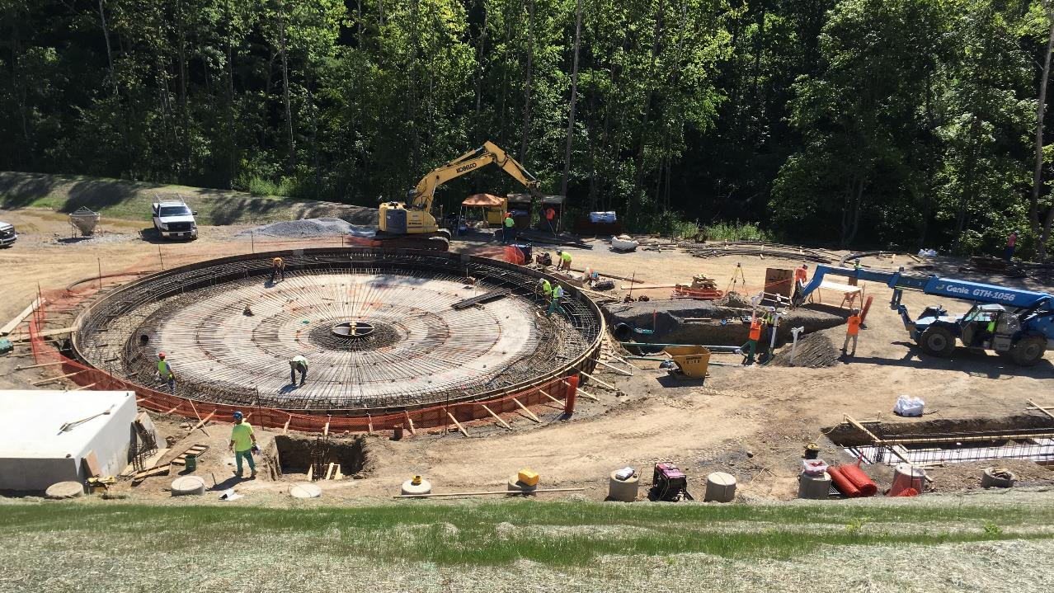

Site Construction – July 28, 2020

Slide 33

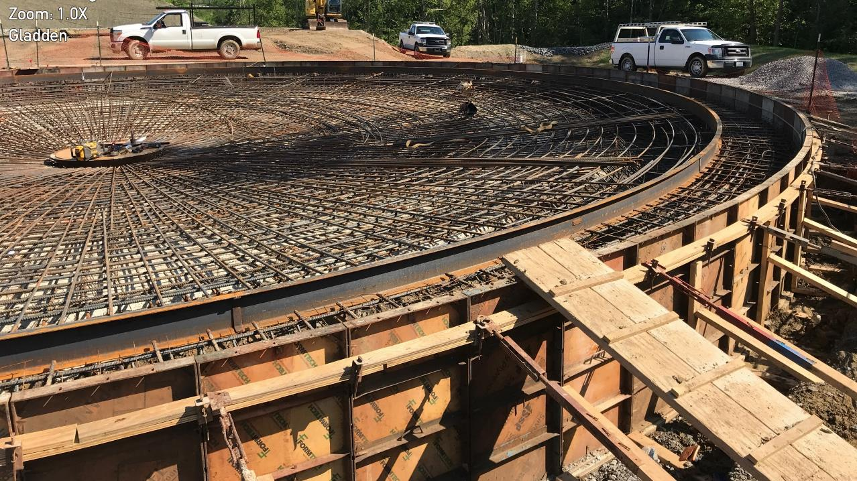
Steel Reinforcement for the Clarifier Base – August 3, 2020

Slide 34
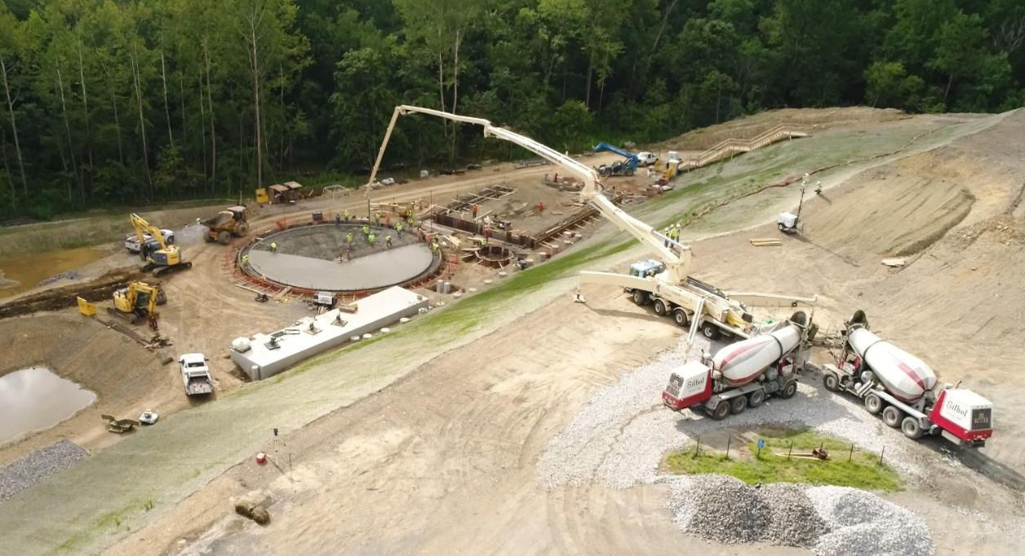

Concrete Pour for the Clarifier Base – August 5, 2020

Slide 35
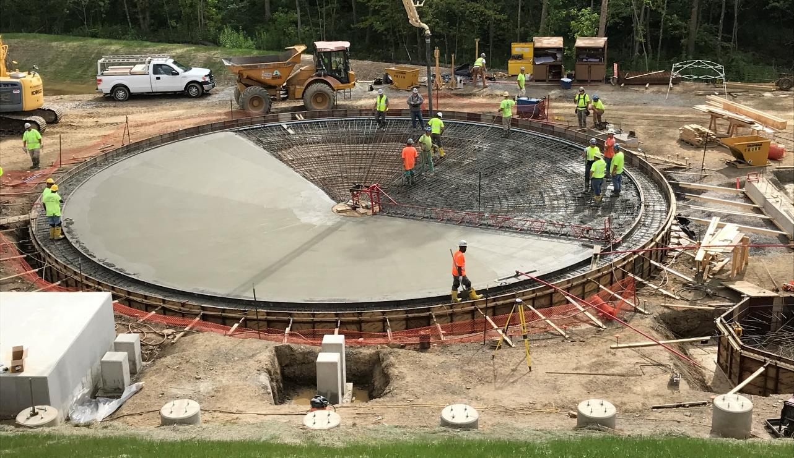
Pouring the Foundation for the Clarifier – August 5, 2020

Slide 36
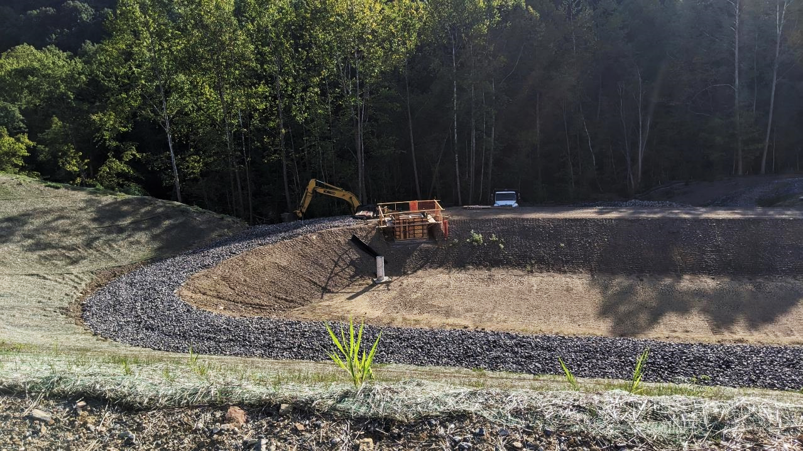
Polishing Pond and Outlet Flow Control Structure Construction

Slide 37
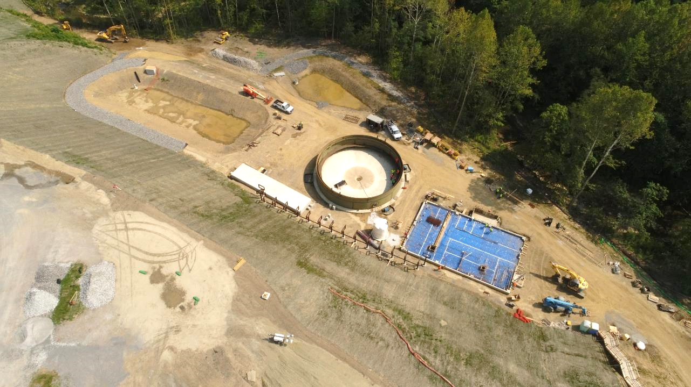
Clarifier Tank Walls and Control Building Foundation Progressing – August 19, 2020

Slide 38
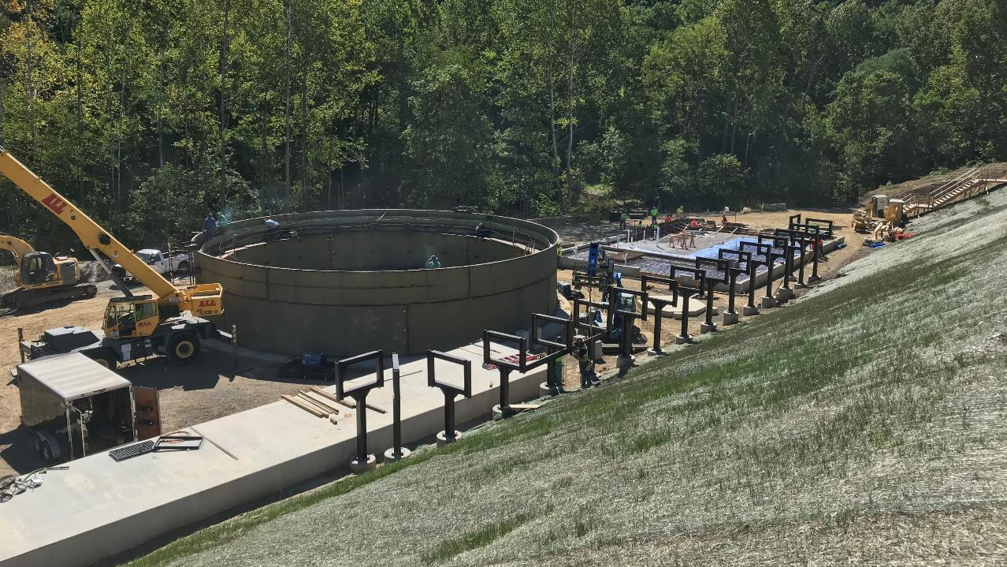

Clarifier:
WesTech Engineering LLC
65-ft. Diameter Conventional Clarifier with Sludge Recirculation

Slide 39
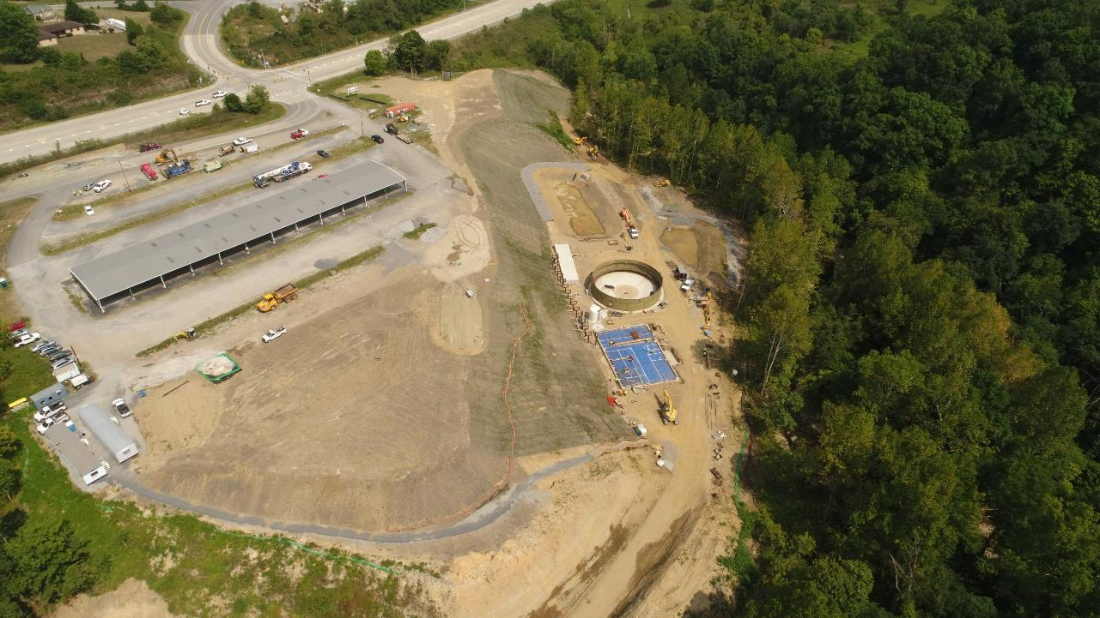
Aerial View of Site Under Construction – August 25, 2020

Slide 40
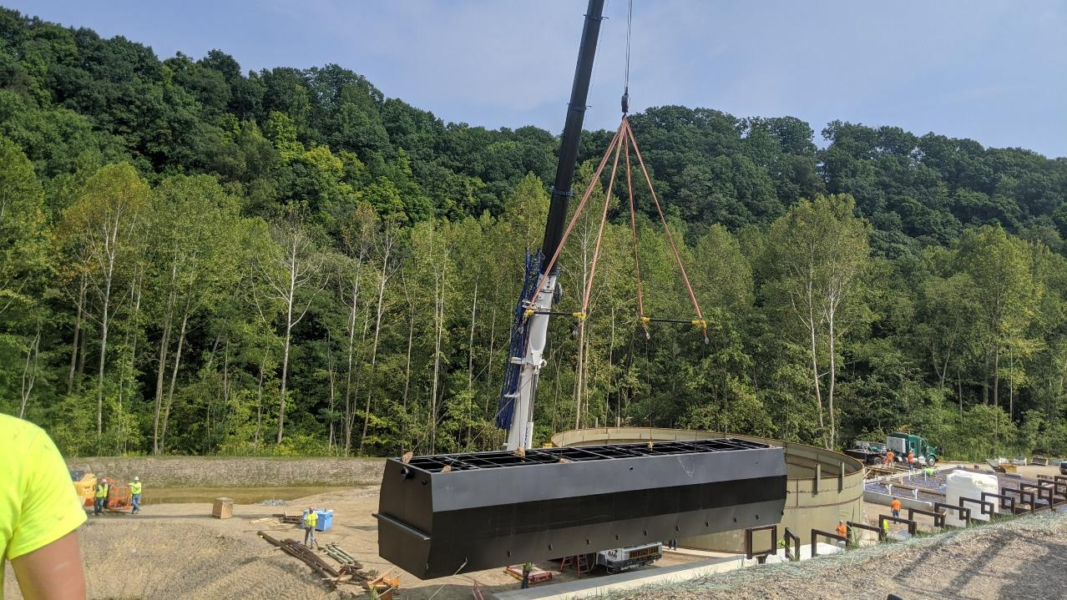
Installation of the Reaction Tank – August 26, 2020

Slide 41
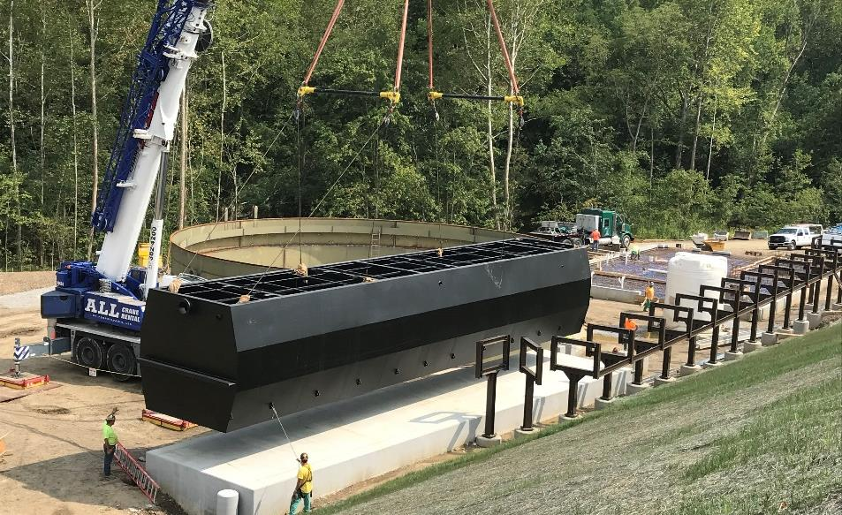
Reaction Tank:
Purestream Inc.
Dimensions: 62’ x 12’ with
3 Compartments

Slide 42
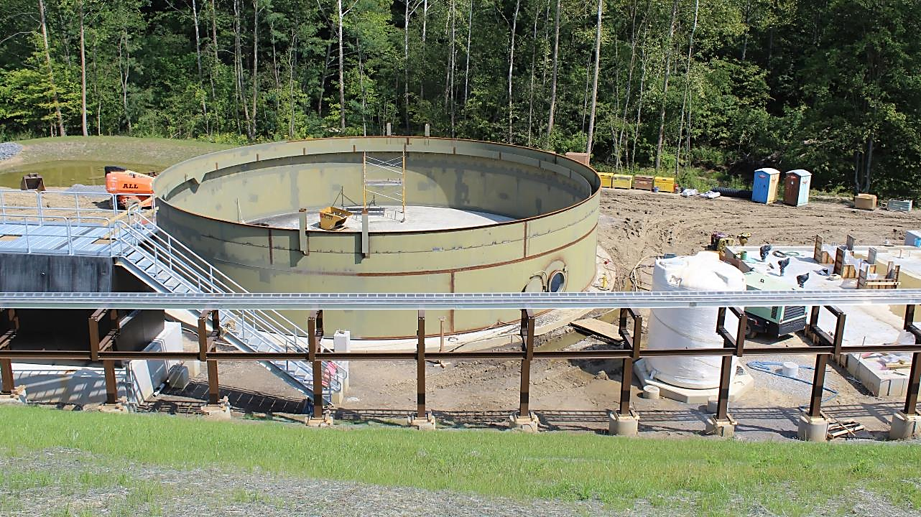
Clarifier Tank Shell Completed – September 6, 2020

Slide 43
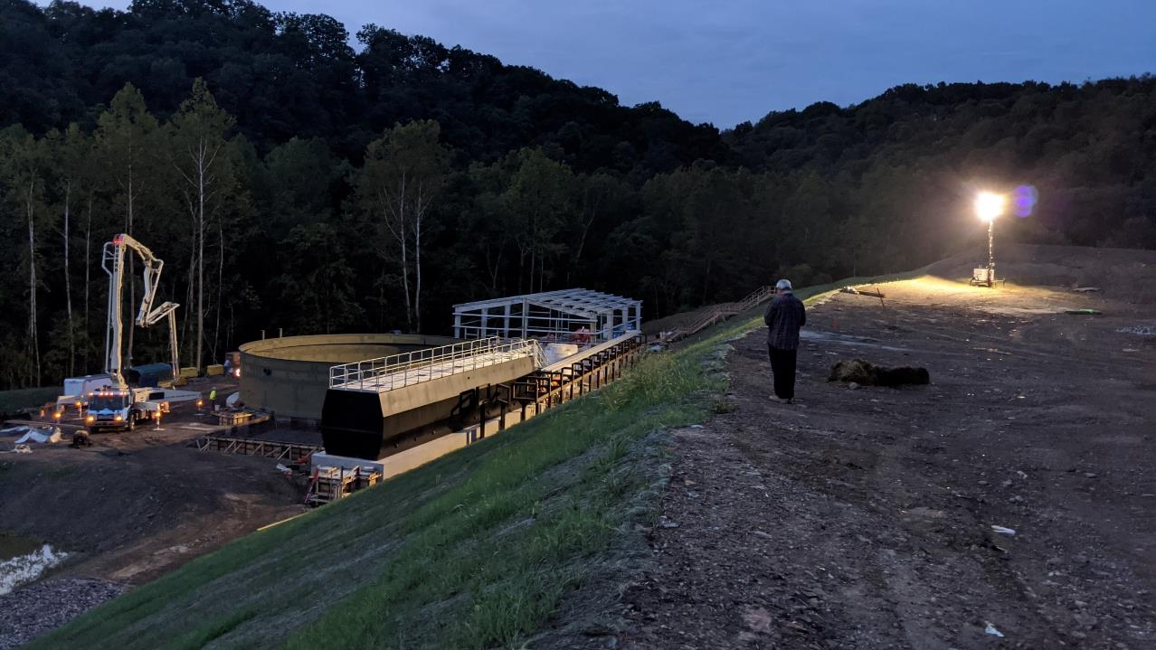

Property Owner and Contractor John Kosky Watches an Early Morning Concrete Pour – September 14, 2020

Slide 44
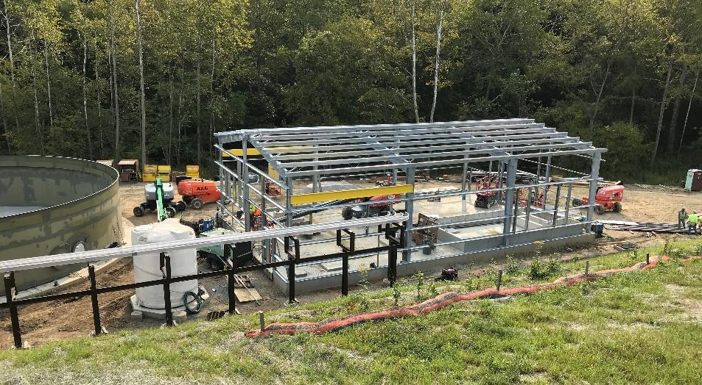
Control Building Construction – September 16, 2020

Slide 45
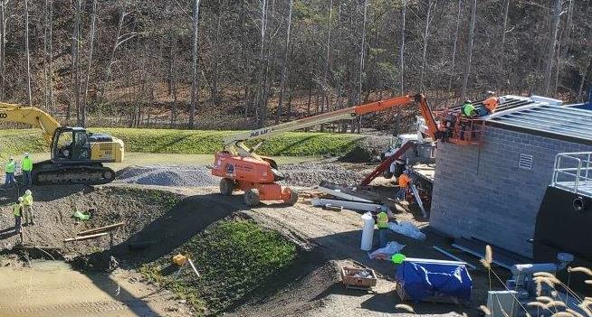

Peroxide Building Construction – November 4, 2020

Slide 46
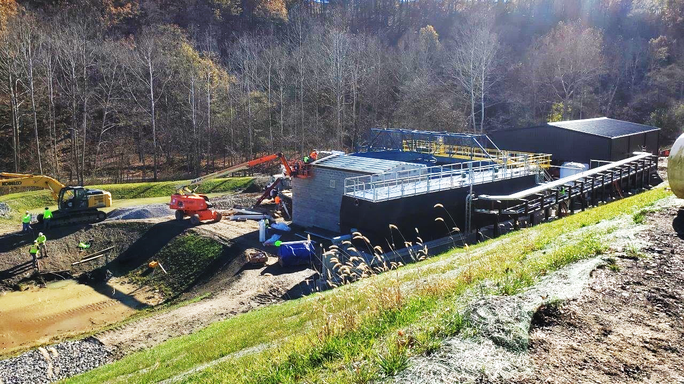
Plant Construction – November 4, 2020

Slide 47
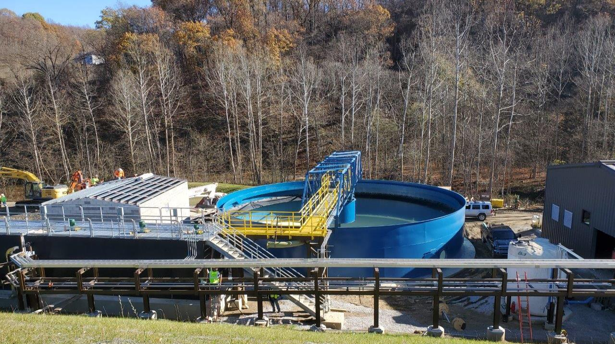
Plant Construction – November 4, 2020

Slide 48
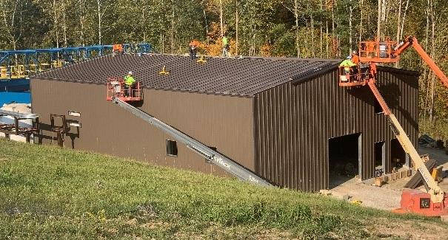
Control Building Construction – October 6, 2020
Rhino Steel Building (74’ 6” x 48’ 4” x 20’)
Electrical Controls and MCC
Lab/Office and Restroom
Caustic Tank and Mixing
Polymer System
Sludge Disposal and Re-Circulation Pumps
Service Water and Sump Pumps

Slide 49
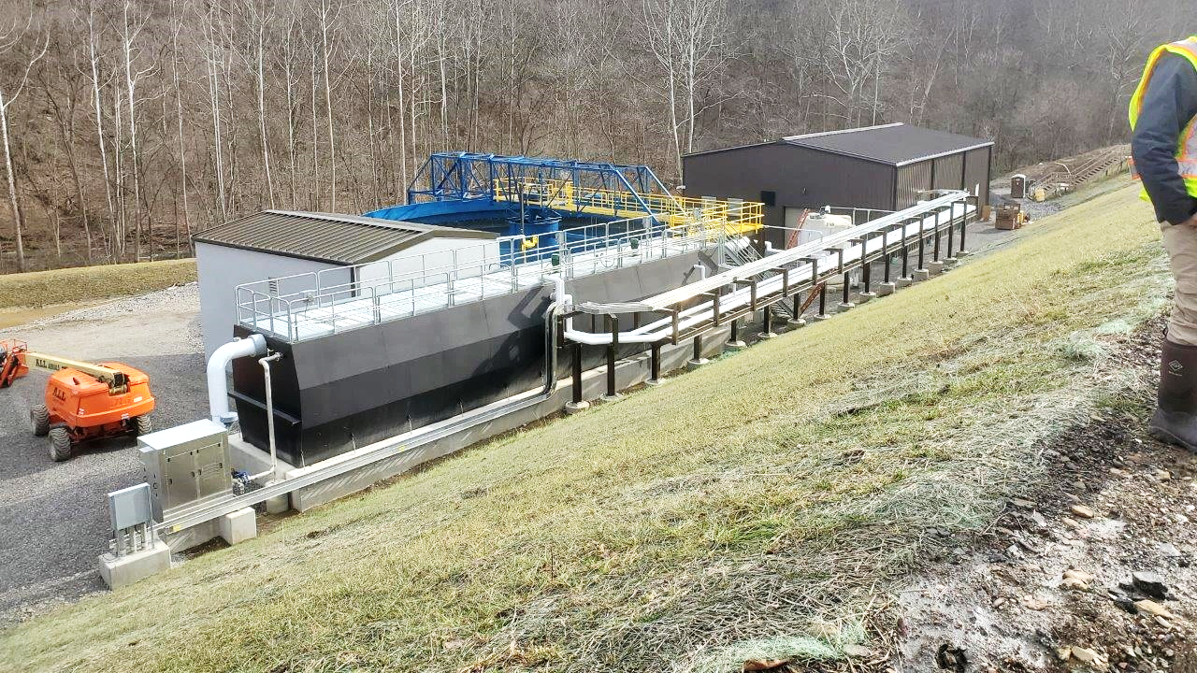
Treatment Facility – January 8, 2021

Slide 50
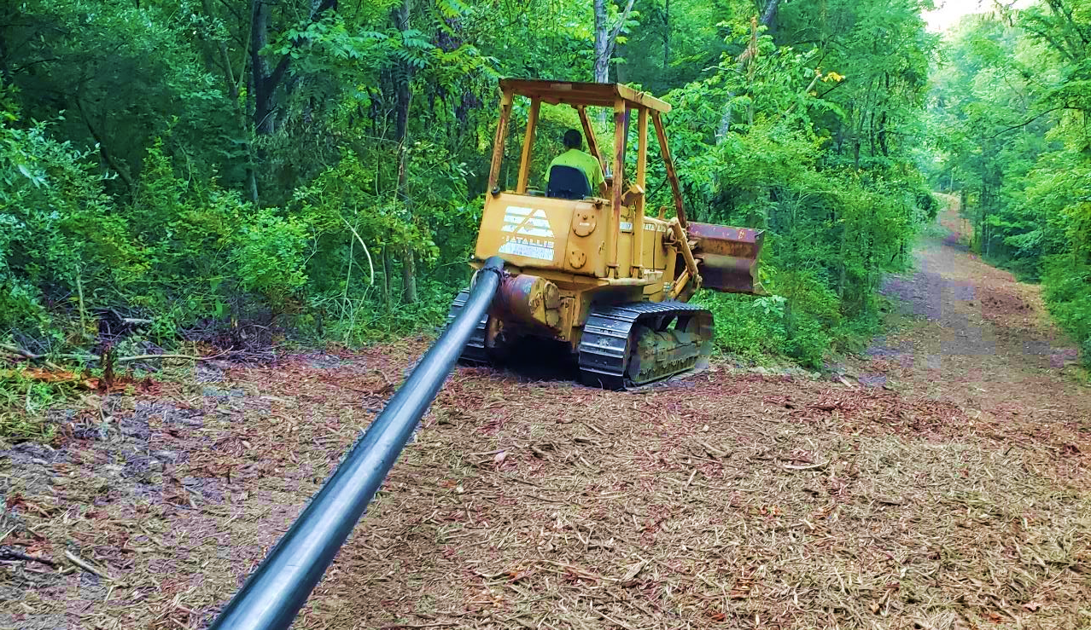
Installation of Sludge Line

Slide 51
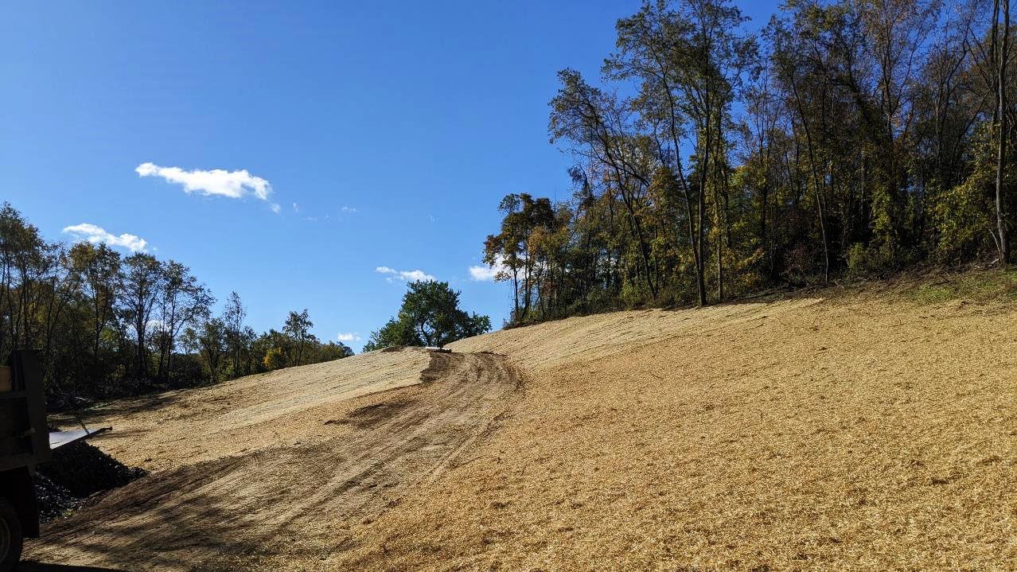
Sludge Line Corridor Seeded and Mulched

Slide 52
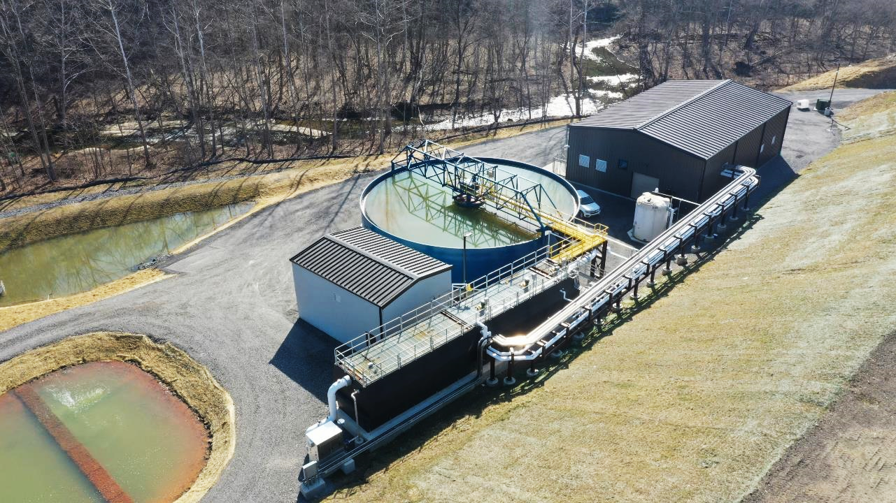

Gladden AMD Treatment Facility Completed and Operating – March 22, 2021

Slide 53
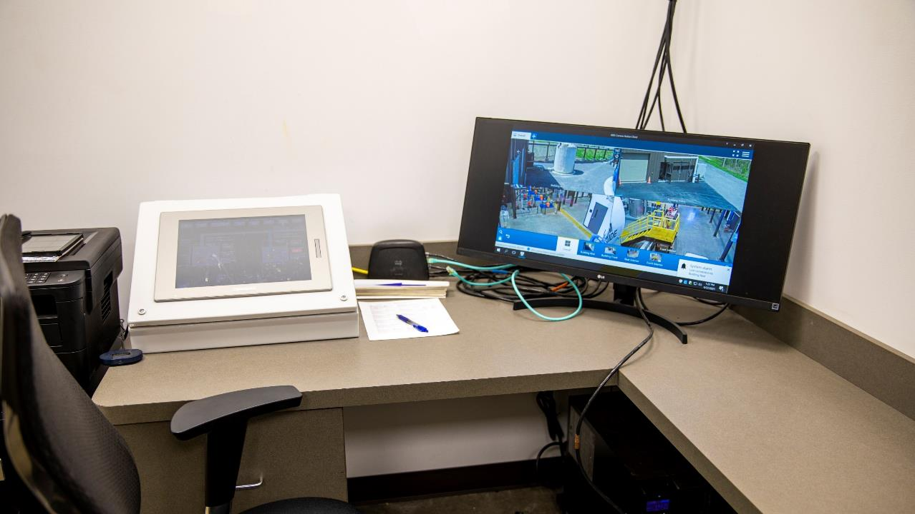
Treatment Plant Operations Center/ Office in the Control Building

Slide 54
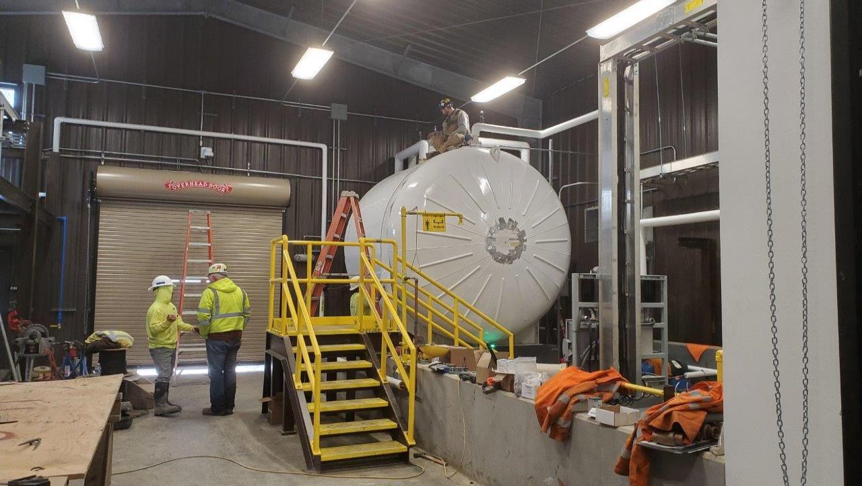
Caustic Soda Tank with Spill Containment in
Control Building – January 8, 2021

Slide 55
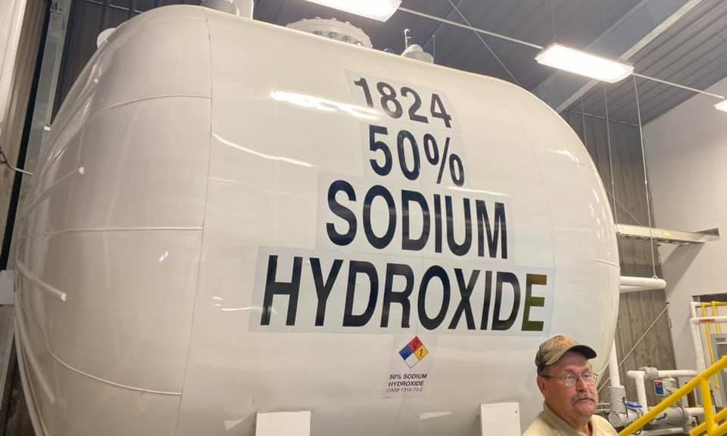
Sodium Hydroxide Tank with Spill Containment in
Control Building – August 13, 2021

Slide 56
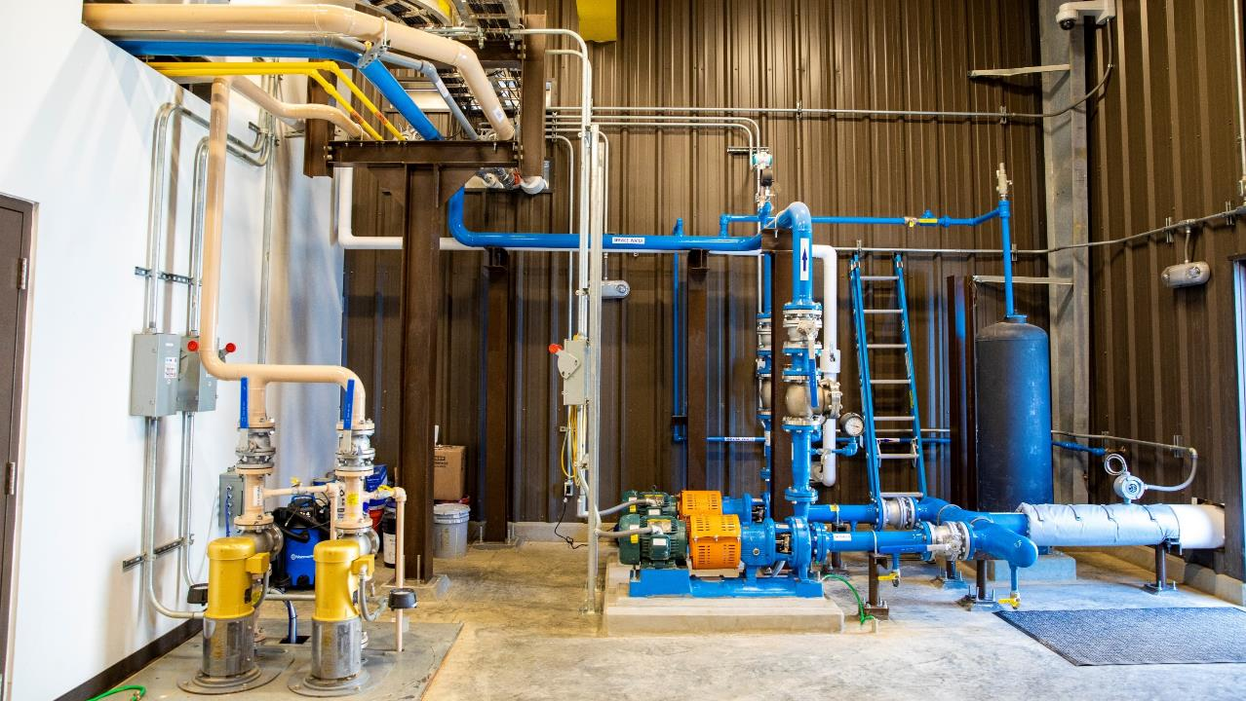
Polymer Feed Pumps

Slide 57
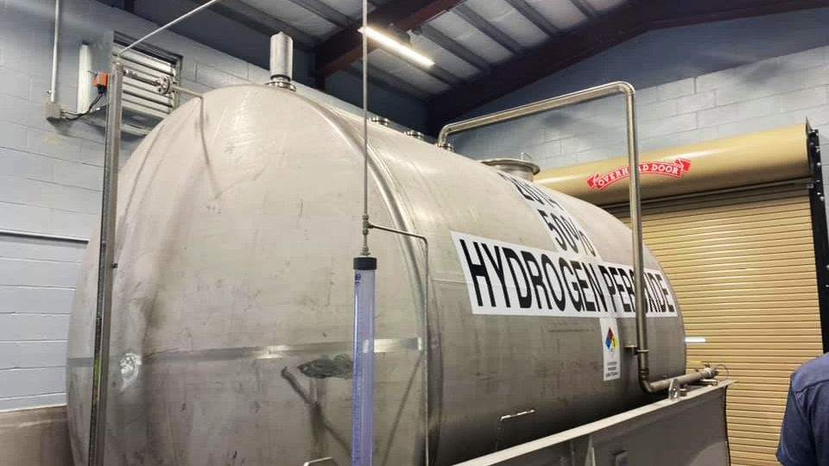
Hydrogen Peroxide Tank with Spill Containment in the Hydrogen Peroxide Building

Slide 58
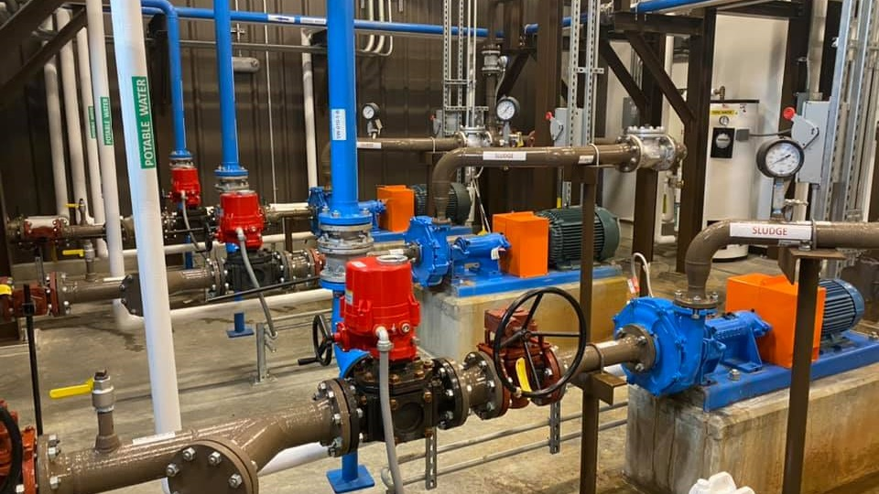

Sludge Pumps in Control Building

Slide 59

65-ft. Conventional Clarifier

Slide 60

Clarifier Rake Assemby

Slide 61

Clarifier Superstructure and Catwalk

Slide 62

Polymer Slow Mix Portion of the Reaction Tank

Slide 63

Mixers on Top of Reaction Tank

Slide 64

Mixer on Top of Reaction Tank

Slide 65


350,000 Gallon Clarification Tank

Slide 66


Slide 67

The Gladden AMD Treatment Facility has been removing ~1,050 lbs. of Iron every day which would have been discharging into Millers Run

Slide 68


Iron Settleability Test to Determine Sludge Settling Rate and Polymer Dosing Rate
Special Thanks to:
Rich Beam, OSMRE / Former PaDEP
Brent Means, OSMRE
Joe Pehur, AMD Industries

Slide 69



Slide 70

Completed and Operating Gladden AMD Treatment Facility – March 19, 2021

Slide 71

Gladden Discharge After Plant Start Up – March 23, 2021

Slide 72

Millers Run Near Cuddy PA 2/24/21 (4 Weeks after Startup)

Slide 73

Before Treatment
After Treatment

Slide 74


The Gladden Treatment Facility is Restoring 4 Miles of Millers Run and 4 Miles of Chartiers Creek
Aerial View Before Treatment
Aerial View After Treatment

Slide 75




April 27, 2021 – Gladden Project Dedication and Ribbon Cutting Ceremony

Slide 76


April 27, 2021 – Gladden Project Dedication and Ribbon Cutting Ceremony
Congressman Conor Lamb

Slide 77

April 27, 2021 – Gladden Project Dedication and Ribbon Cutting Ceremony
Tetra Tech’s Tom Gray

Slide 78

April 27, 2021 – Gladden Project Dedication and Ribbon Cutting Ceremony
SFCG’s Steve Frank and Tetra Tech’s Farley Wood

Slide 79

South Fayette Conservation Board Members
April 27, 2021 – Gladden Project Dedication and Ribbon Cutting Ceremony

Slide 80

April 27, 2021 – Gladden Project Dedication and Ribbon Cutting Ceremony
Project Partner Representatives from SFCG, Tetra Tech, PA DEP, OSMRE, and PFBC

Slide 81

The Final Product – The Gladden AMD Treatment Plant

Slide 82


The Final Product – Millers Run Near Cuddy Post Office

Slide 83


The Final Product – Millers Run at its Confluence with Chartiers Creek

Slide 84

Project Funding
The Gladden AMD Treatment Project cost just over $13 million.
The funding for the project came from two primary sources:
  The AMD abatement and treatment program (AMD Set-Aside Program) authorized in the Surface Mining Control and Reclamation Act (SMCRA).
  The federal Office of Surface Mining Reclamation and Enforcement’s (OSMRE’s) AML Pilot Program, now referred to as the federal Abandoned Mine Land Economic Revitalization (AMLER) Program.
The AMLER Program specifically targets abandoned mine cleanup projects that are linked to local community and economic development goals.
Additional funding through Growing Greener has been awarded to support long-term operation and maintenance of this treatment system by providing 2 years of additional O&M funding. Current annual cost is $300,000.

Slide 85
Project Grant and Contracting Mechanisms
The entire Gladden AMD Treatment Facility design and construction methodology was facilitated by a PA DEP BAMR grant and contracting process awarded to the local project sponsor, the South Fayette Conservation Group (SFCG).
SFCG, through a competitive bid process, retained design engineering services, construction contractors and plant operators through the PA DEP BAMR reimbursement grant process.
This methodology resulted in the treatment plant being designed, constructed, and placed into operation within only a 14-month time frame, despite the fact that construction occurred during the height of the global Covid-19 pandemic.

Slide 86
Economic and Community Benefits
The Gladden AMD Active Treatment Plant is restoring 4 miles of Millers Run and will be instrumental in restoring 14 miles of Chartiers Creek to the confluence with the Ohio River.
Millers Run is on the PA Fish Commission stocking list upstream of the Gladden Discharge. The plant will enable the fish to migrate down into the remaining 4 miles of Millers Run.
This section of stream flows past Morgan Park and through the Newberry Market development, both of which provide good access points for fishing.
The Newbury development is 300-acre site of which about 200 acres is being developed into two residential communities and the remaining 100 acres is being developed into a mixed-use commercial retail development to include a pedestrian friendly main street with shops, restaurants, outdoor plazas, a hotel, grocery store and retail tenants.

Slide 87
Economic and Community Benefits
The restoration of this section of Millers Run provides an aesthetically pleasing stream for this development and existing residential areas and also provides a stream with a high potential for recreational visitation.
Chartiers Creek flows past Meyer & Middleton Park, which also provides fishing/recreational access for the stream.
Chartiers Creek is also a common place for canoes and kayaks, with seven boat launches along its banks between Canonsburg Lake and the Ohio River. Individuals and organized groups travel the waters on a regular basis.
The Chartiers Creek watershed is experiencing an economic boom and having clean streams and a clean environment visible to the public are an essential part of a vibrant community.

Slide 88

The Gladden AMD Treatment Facility Project was the Recipient of a 2022 Pennsylvania Governor’s Award for Environmental Excellence
Staff from Tetra Tech and South Fayette Conservation Group at the April 26, 2022 Awards Ceremony

Slide 89




OUR PARTNERS
OSMRE
Pennsylvania DEP-BAMR
South Fayette Conservation Group
John Kosky Contacting

Slide 90




OUR PARTNERS
Chapman Corporation
Ligonier Construction
Infinity Drilling

Slide 91

CONTACTS:
  Heather Trexler, P.G.
    Email: Heather.Trexler@tetratech.com
    Cell: (412) 944-8106
  Eric Cavazza, P.E.
    Email: Eric.Cavazza@tetratech.com
    Cell: (412) 522-9764
  Tom Gray, P.E.
    Email: Thomas.Gray@tetratech.com
    Cell: (412) 526–5095

