Slide 1
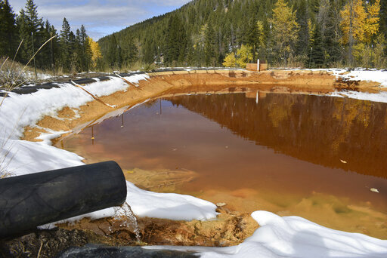
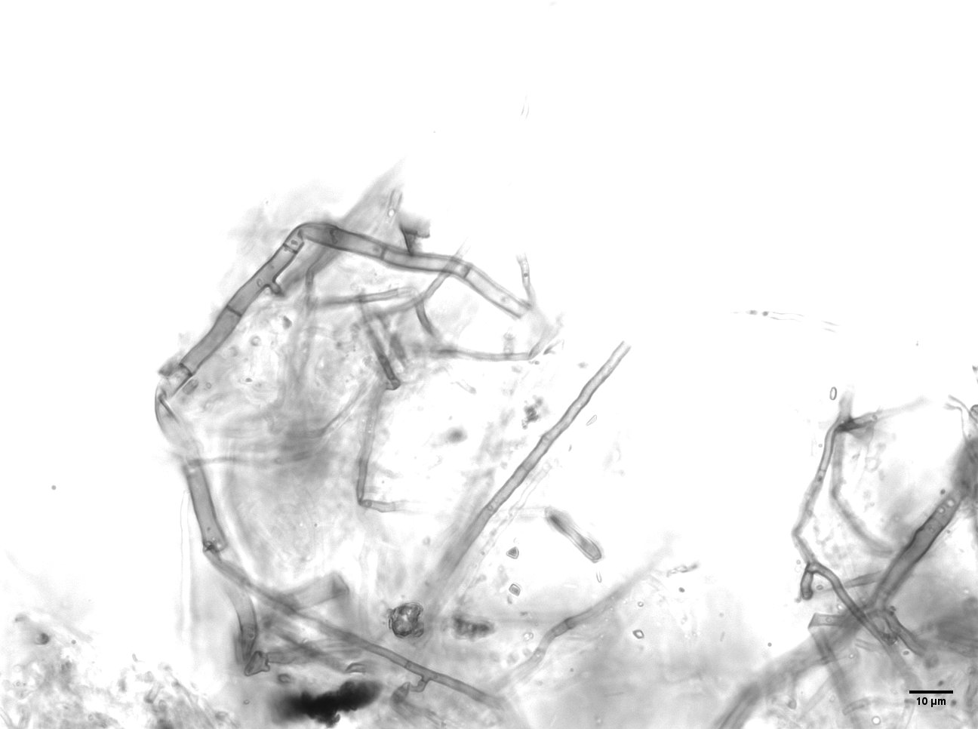
Heavy Metal Recovery Using Manganese-Oxidizing
Microbes and Recycled Carpet Fiber
Brandy Stewart, Sharon Bone, and Cara Santelli
University of Minnesota

Slide 2
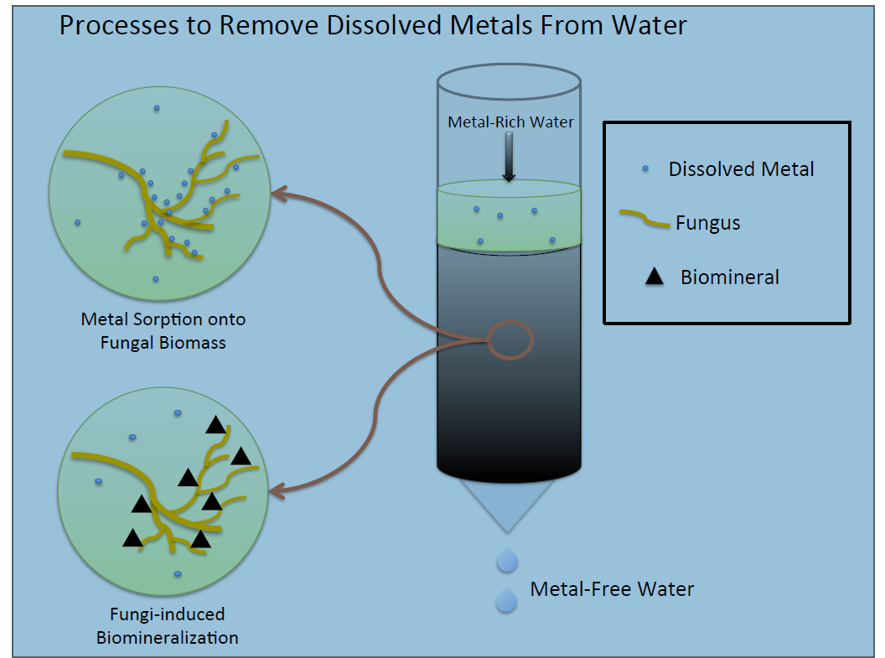
Project Objective-design bioreactor using Mn-oxidizing fungus
C. Santelli

Slide 3
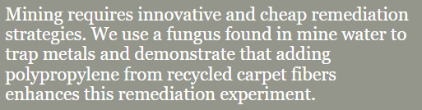

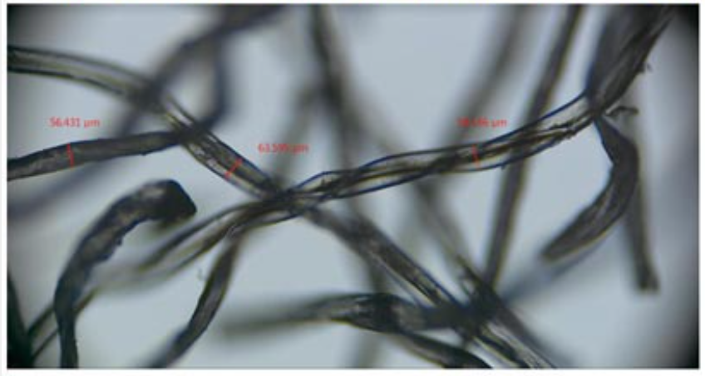
Project Objective-design bioreactor using Mn-oxidizing fungus
C. Santelli

Slide 4
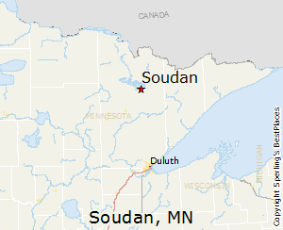
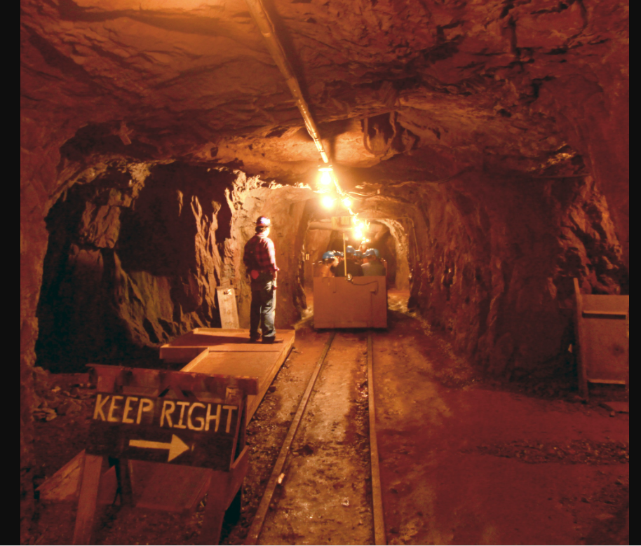
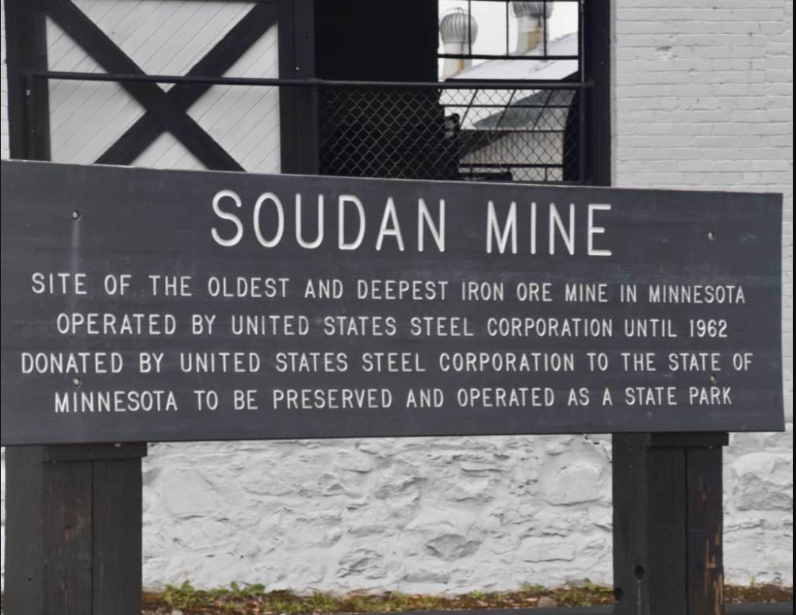
Project Background-Soudan Iron Mine

Slide 5
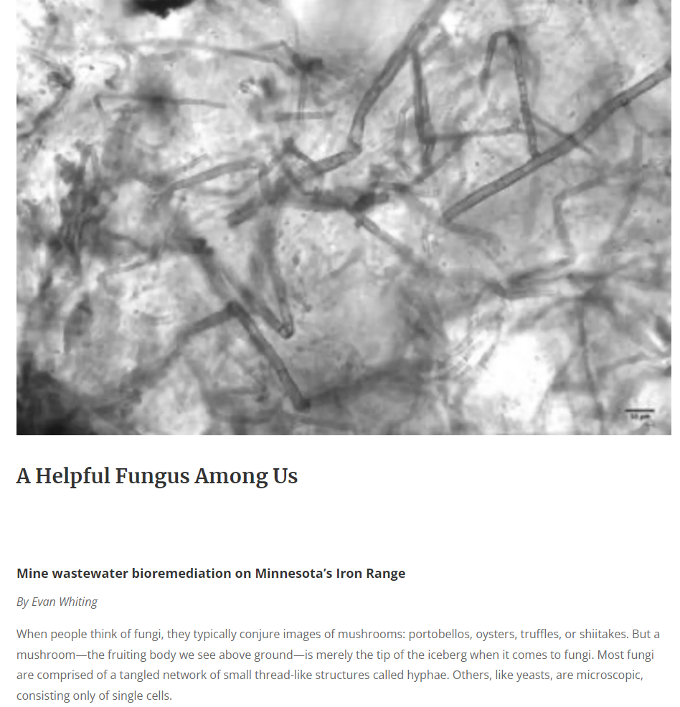
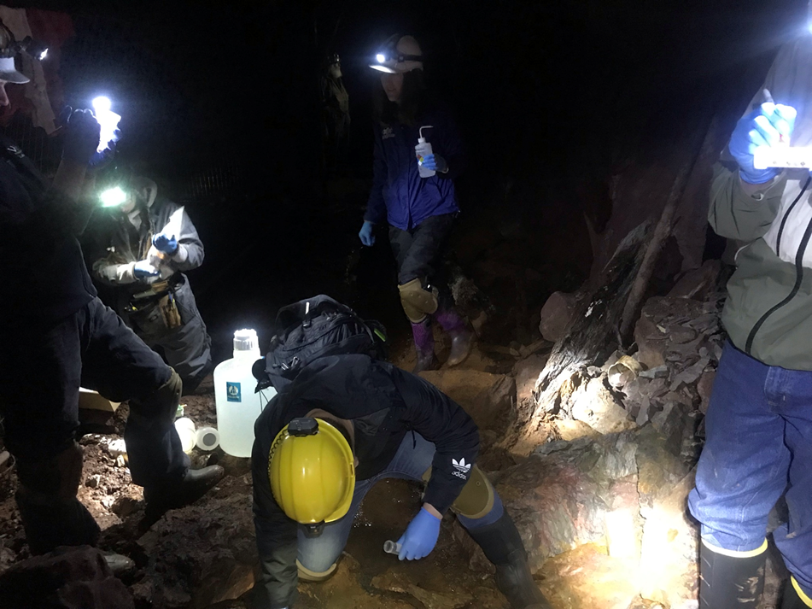
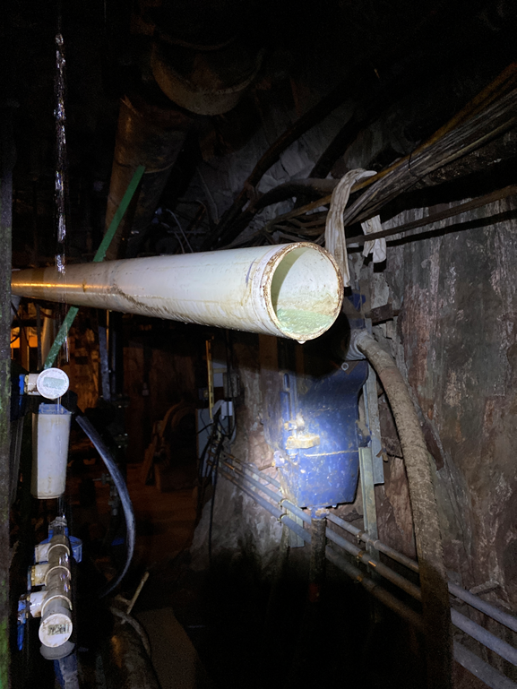
Periconia verrucosa

Slide 6
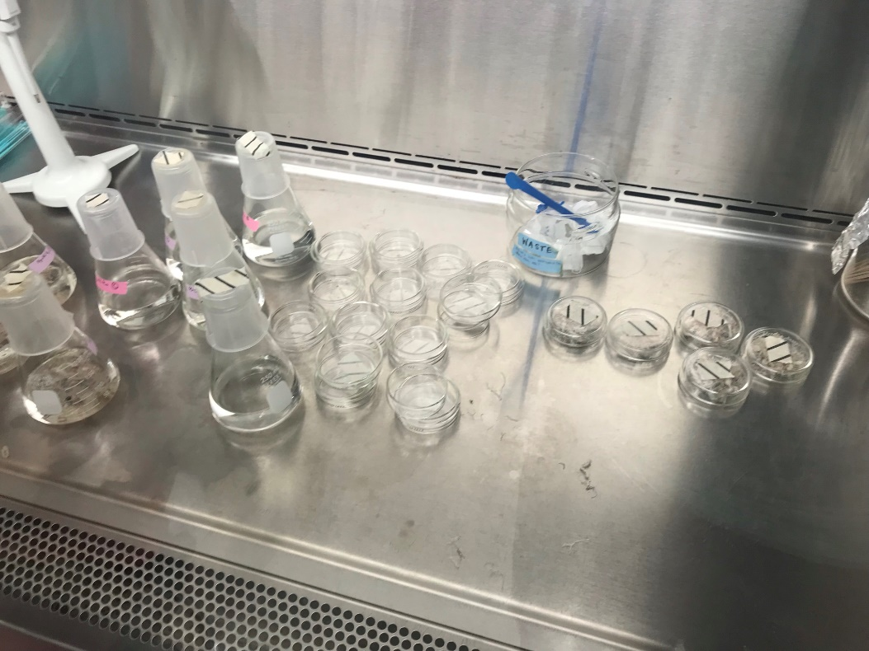
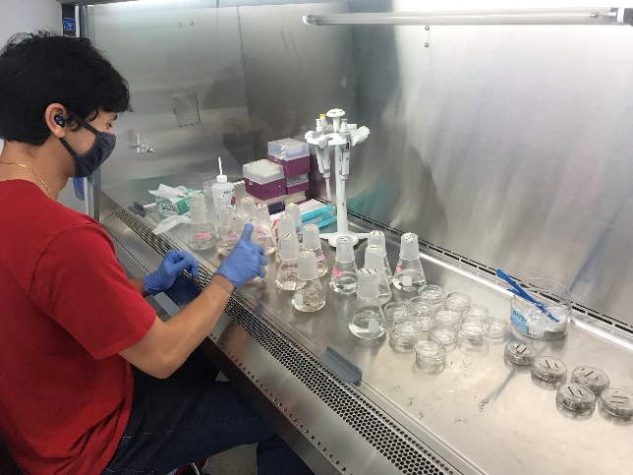
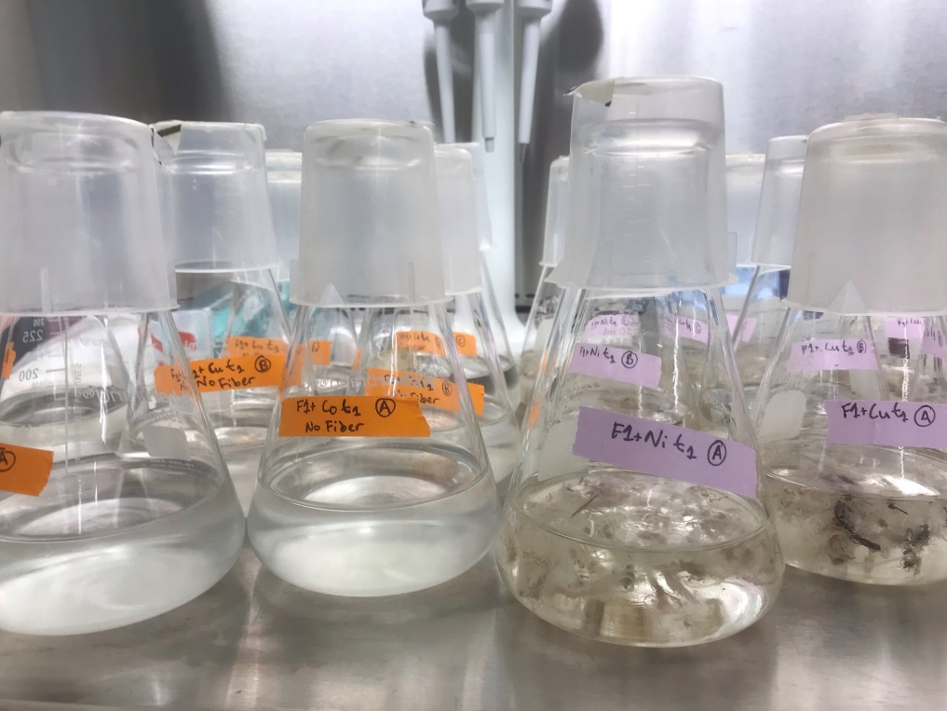
Experimental Setup
1g polypropylene fiber
100 mL synthetic brine media
500 µM Mn(II)
0.2 mL blended fungal culture
20 µM (Ni(II), Co(II), Cu(II))
Day 1-initial conditions
No fiber Carpet fiber

Slide 7
Experimental Setup
1g polypropylene fiber
100 mL synthetic brine media
500 µM Mn(II)
0.2 mL blended fungal culture
20 µM (Ni(II), Co(II), Cu(II))
Periconia verrucosa
Day 1-initial conditions
Mn(II) _{(aq)} Mn (III/IV) solid
No fiber Carpet fiber

Slide 8
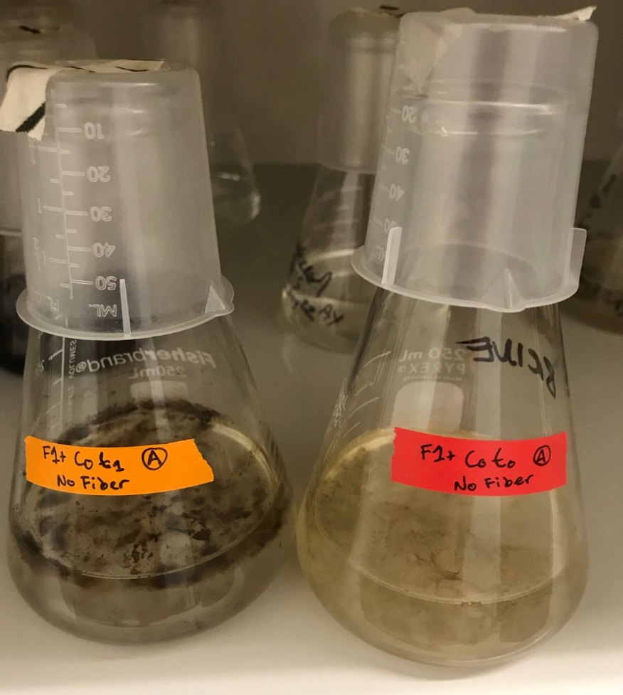
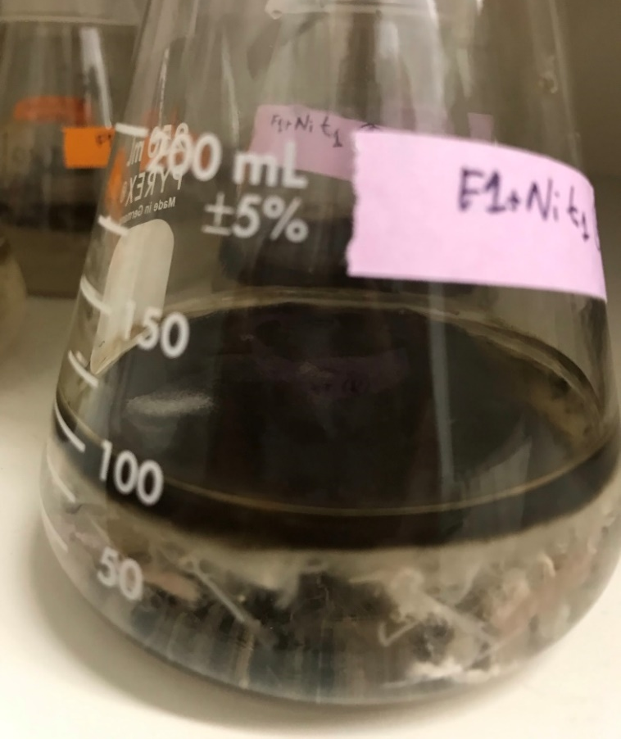
Results - Carpet Fiber Impact
Day 7 – Mnoxide/fungal biofilm with carpet fiber Day 7 – Mnoxide/fungal biofilm with no carpet fiber
Carpet fiber visibly increases biomass and Mnoxide amount

Slide 9
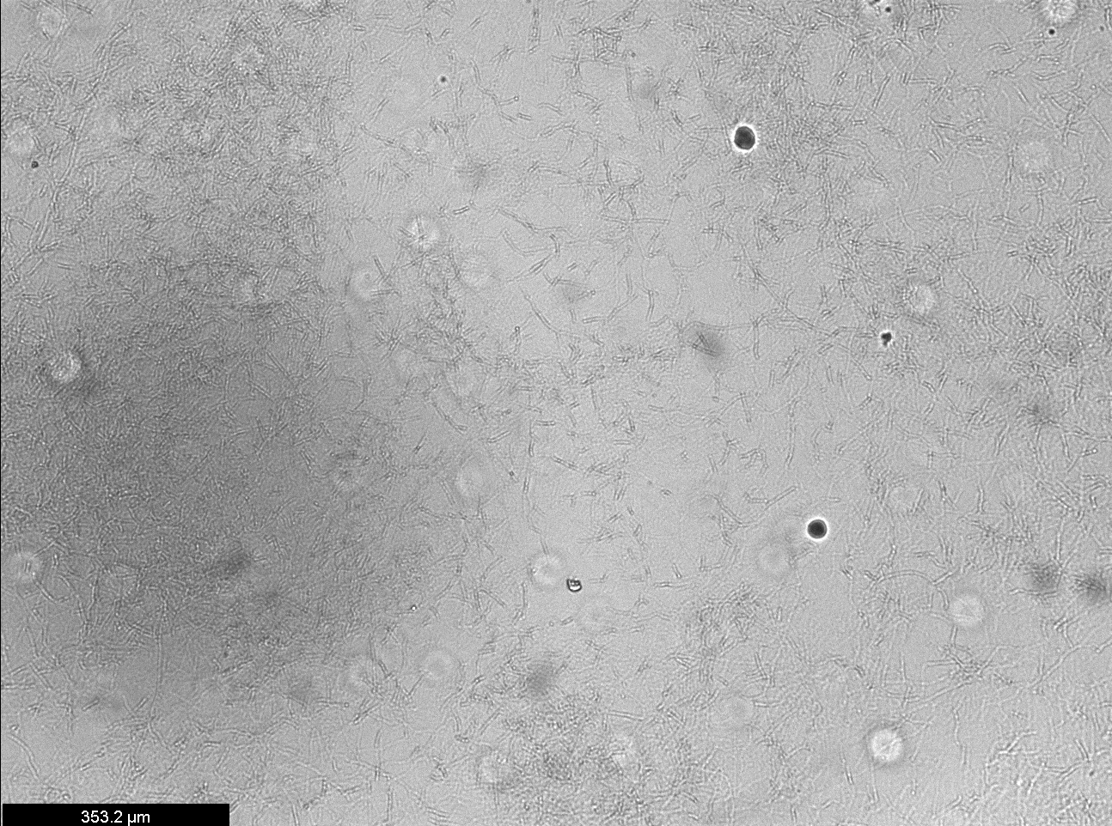
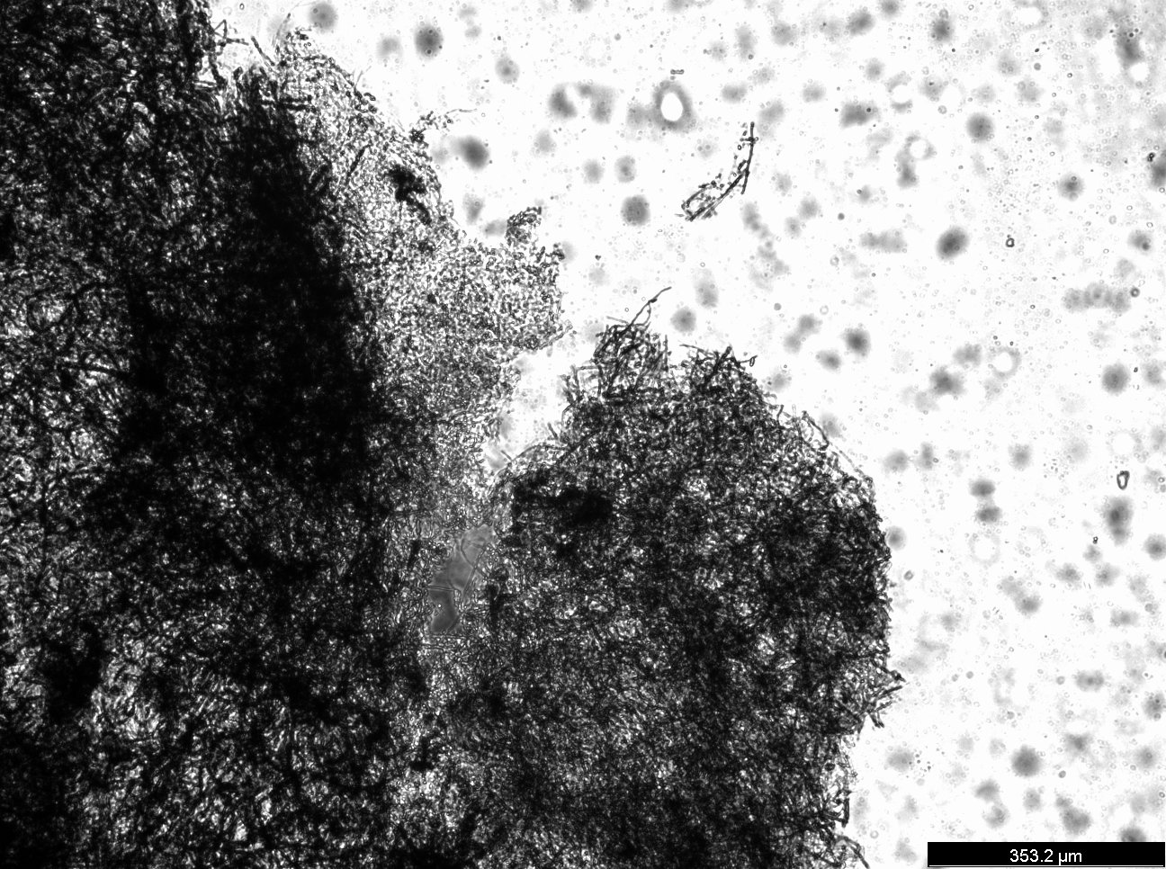
Fungal culture without Mn Fungal culture with Mn oxide precipitates

Slide 10
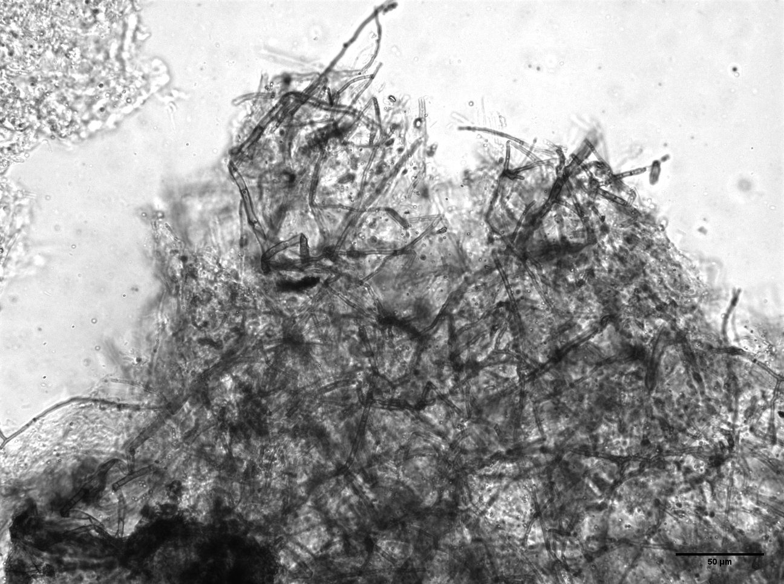
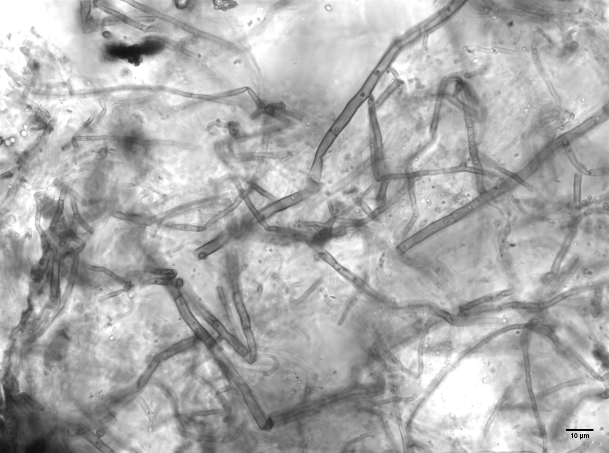
Fungal culture with Mn oxide precipitates

Slide 11
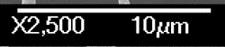

Slide 12
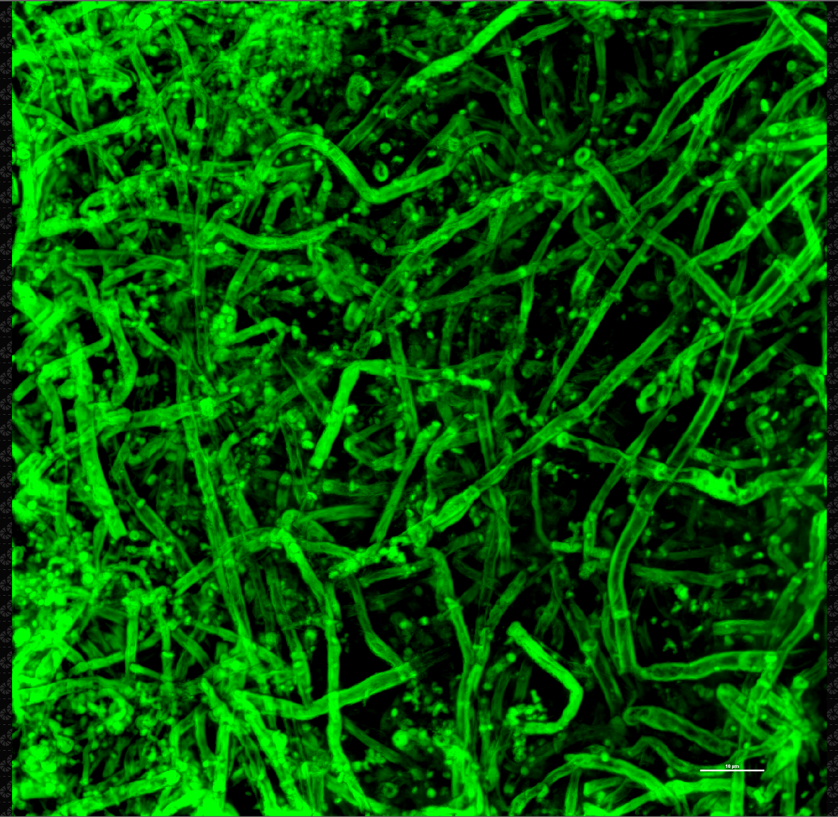
Complex, dense network of fungal material and biominerals
10 µm

Slide 13
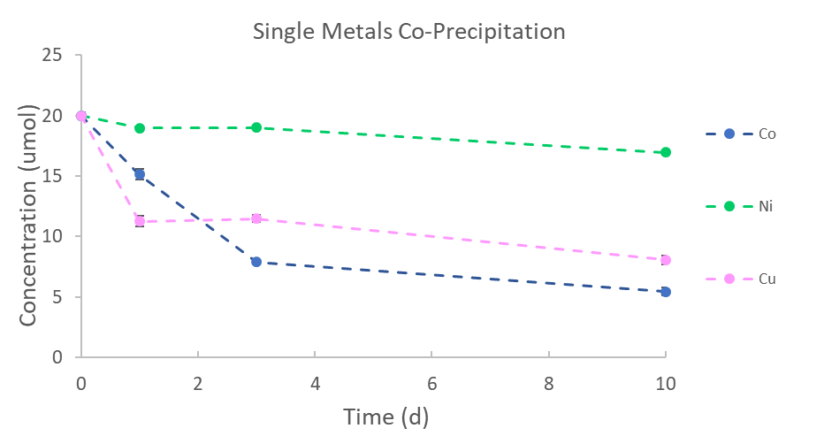


Slide 14
Soluble metal concentrations decrease over time

Slide 15
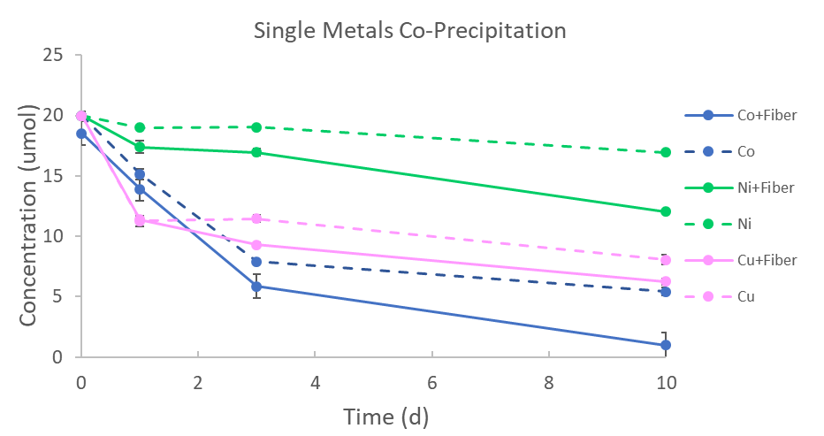
Presence of carpet fiber enhances metal removal

Slide 16
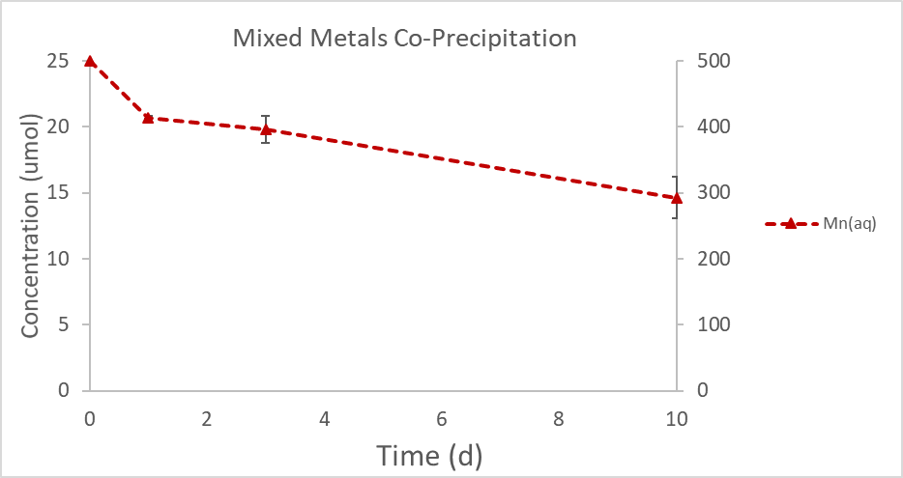
Soluble Mn concentration decreases over time

Slide 17
Soluble Mn concentration decreases over time

Slide 18
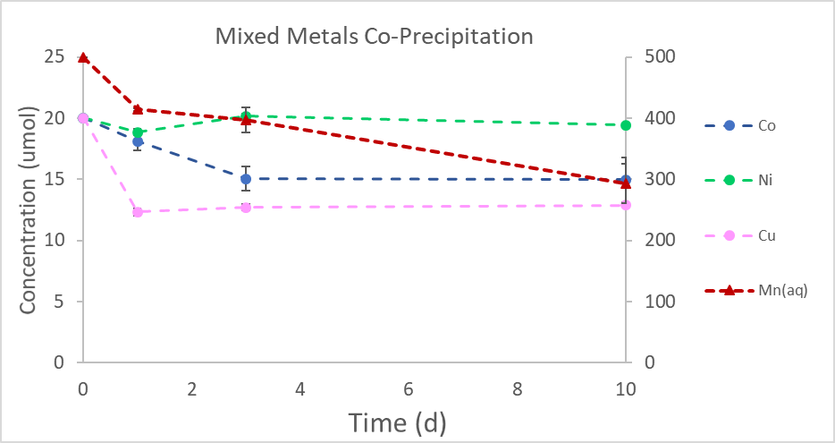
Soluble metals decrease over time

Slide 19
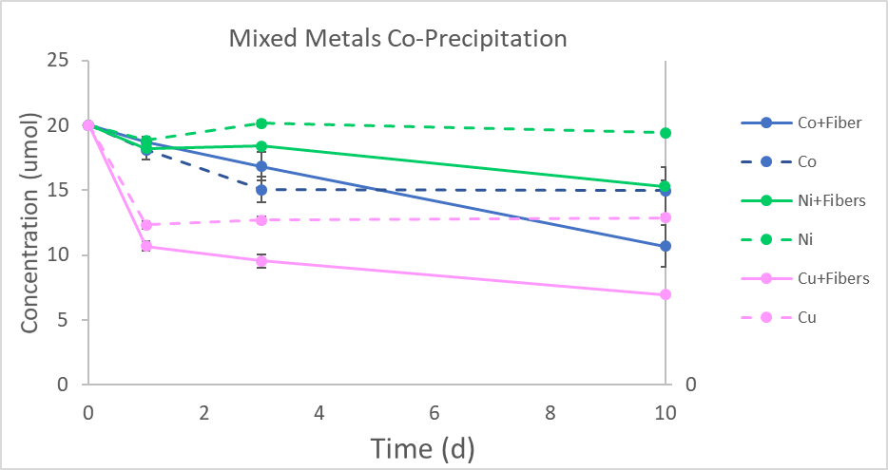
Carpet fibers enchance metal removal

Slide 20
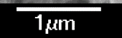
Fungi
Mnoxide
Carpet Fiber

Slide 21
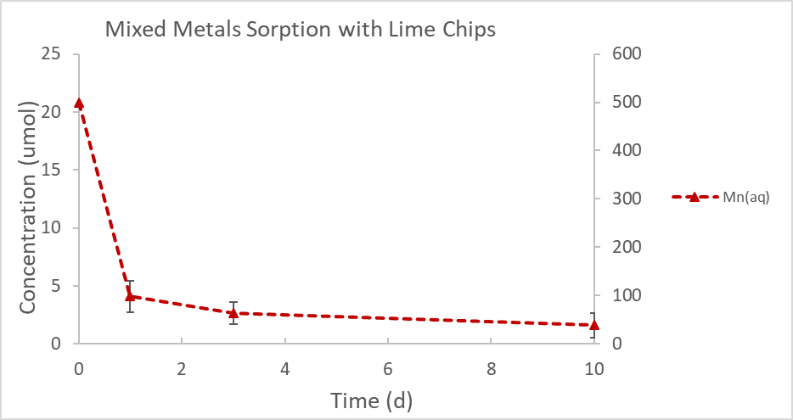
Soluble Mn concentration decreases over time

Slide 22
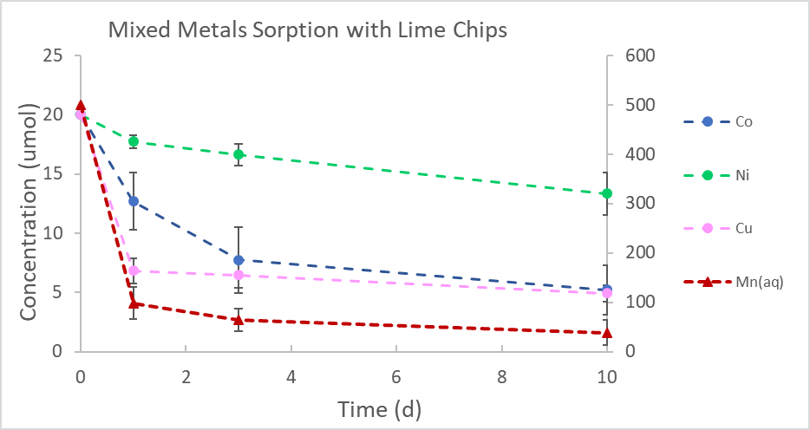
Soluble metals decrease

Slide 23
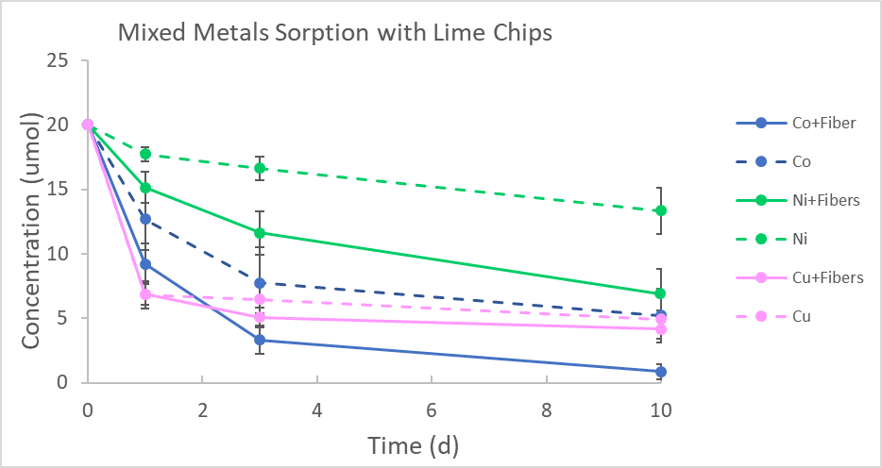
Carpet fibers enchance metal removal and pH buffering helps removal

Slide 24
Carpet Fiber
Fungal Biomass

Slide 25
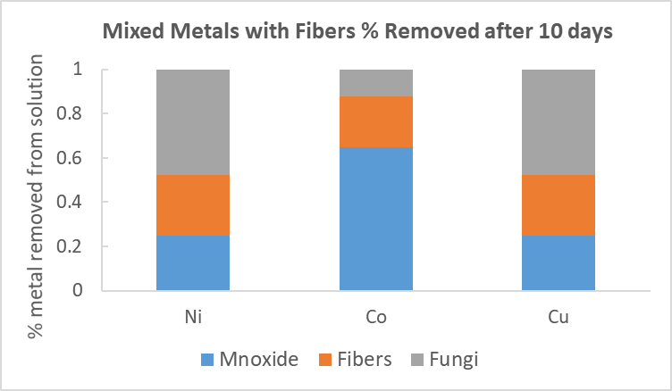
Proportion of metal associated with Mnoxide phase depends on metal

Slide 26
Results – Fungal biomineral interaction
Fungi
Mnoxide material

Slide 27
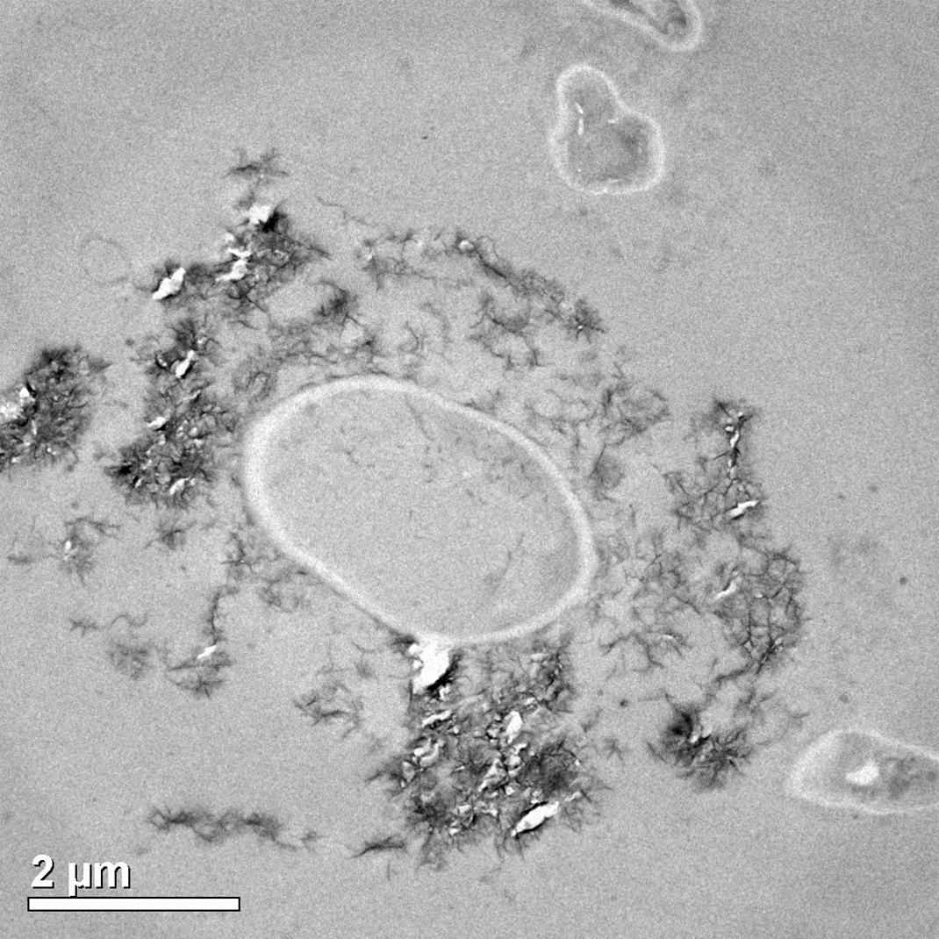



Slide 29
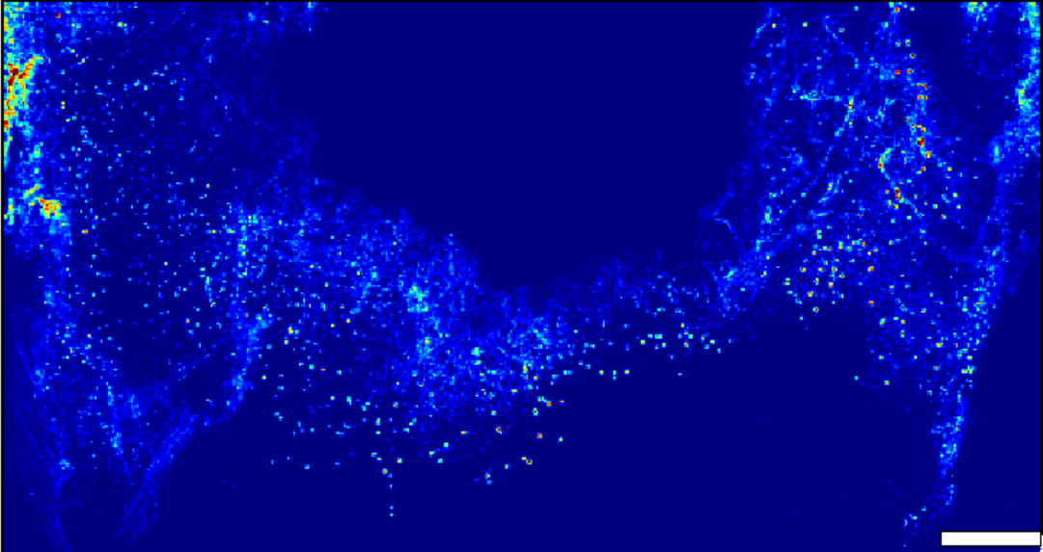
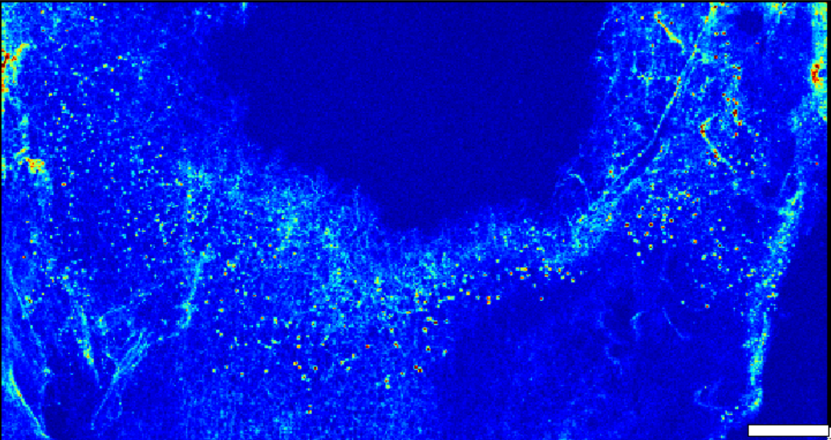
Mn
Results – Fungal metal association
Cu
500 um
Trace metals co-located with Mn oxides
500 um

Slide 30
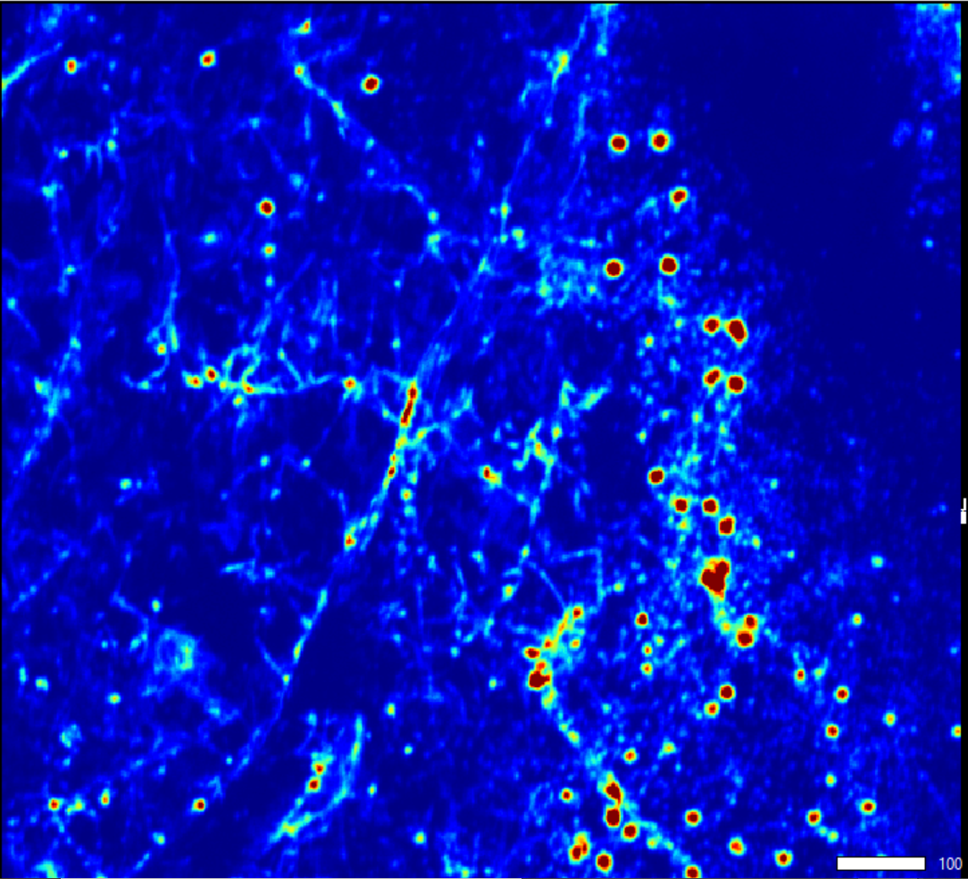
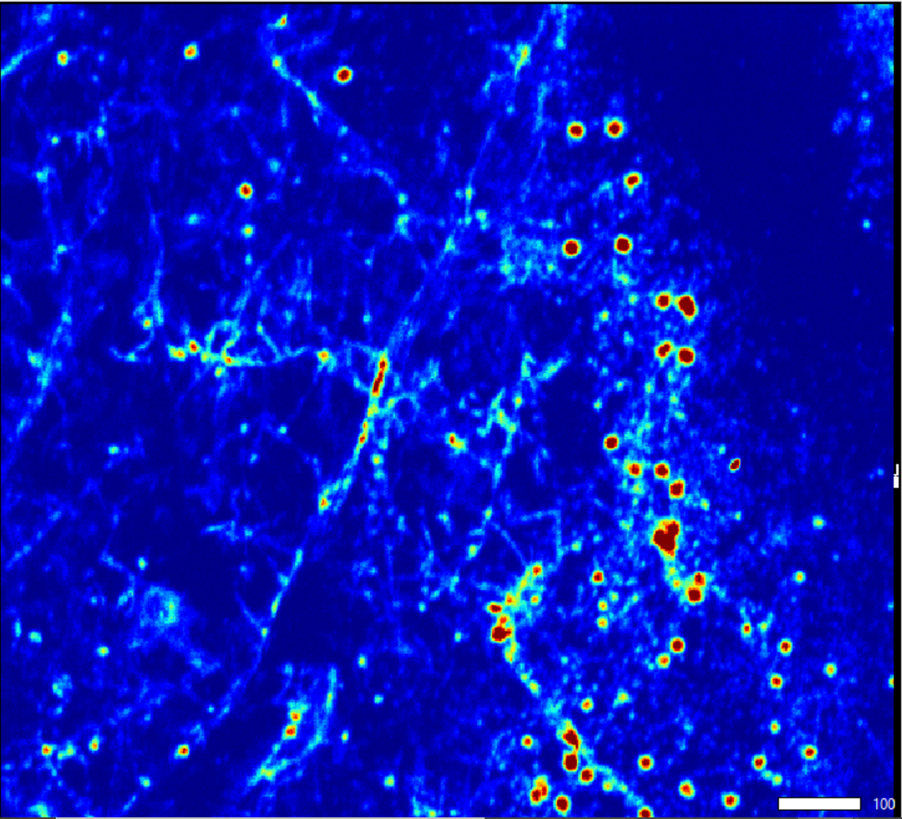
Mn
Co
Xray fluorescence map of fungal biomass and mixed metal
precipitation showing co-location of Mn with Cu, Co, Ni

Slide 31
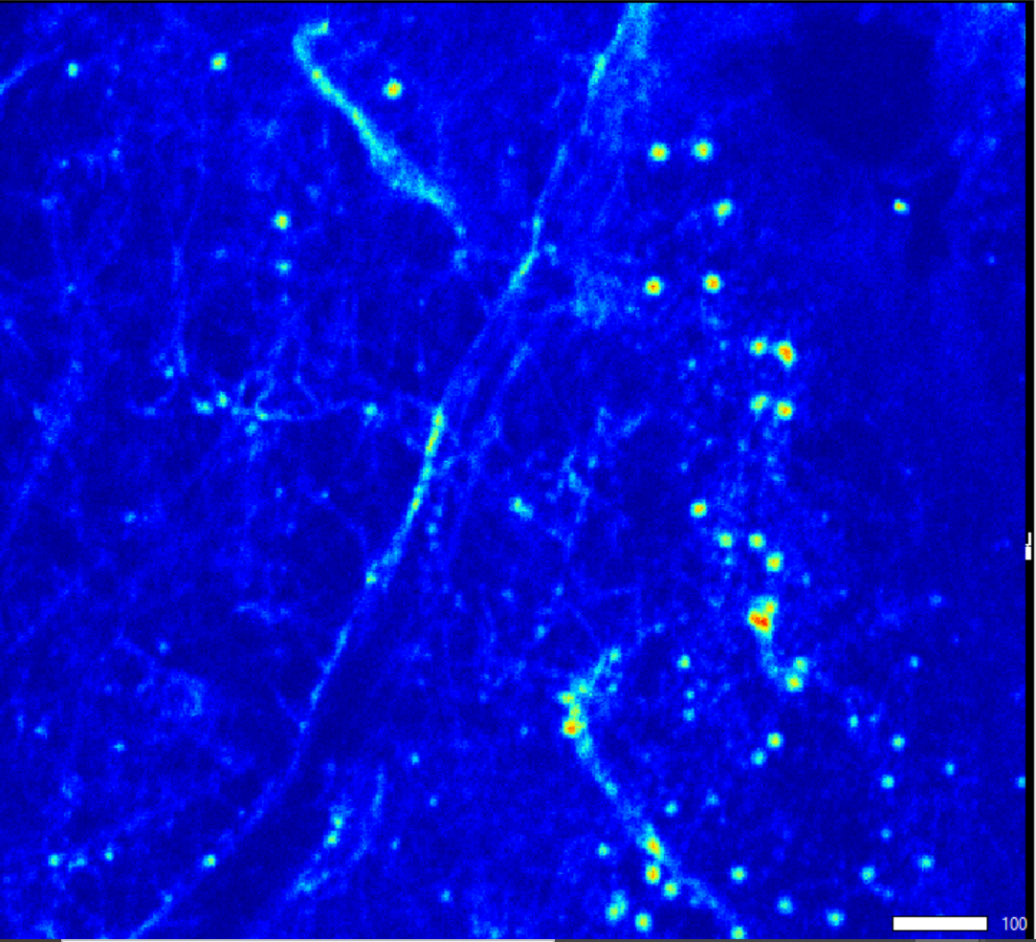
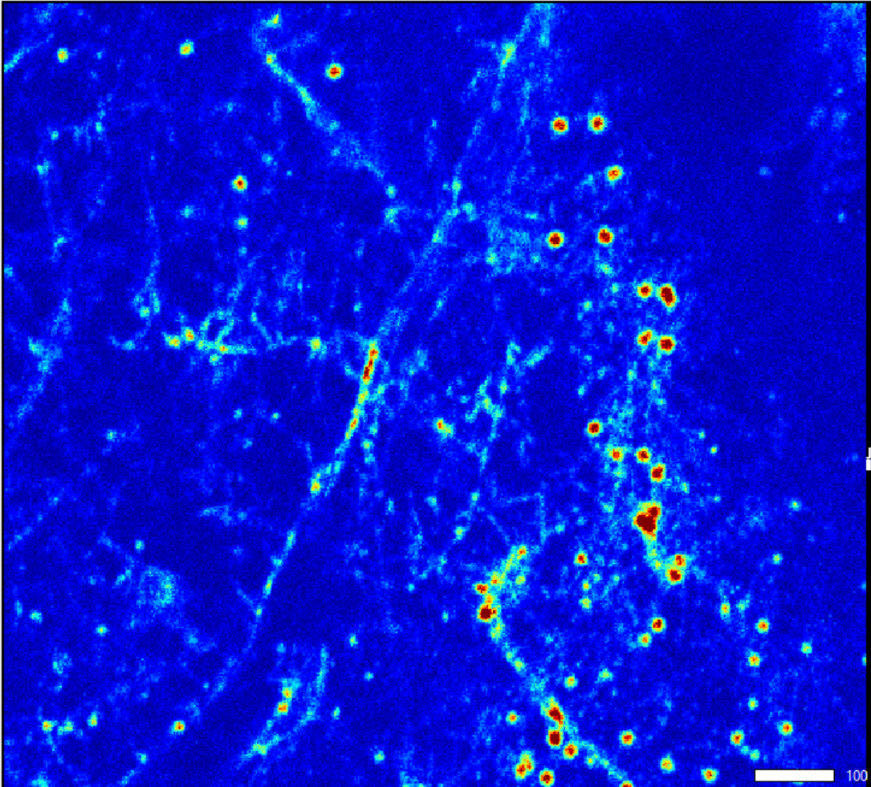
Mn
Co
Cu
Ni

Slide 32
Conclusions-what we know so far
Mn oxidizing fungi sequesters Co, Ni, Cu with Mn biomineral
Carpet fibers increase metal uptake
Fungus grows well in salty brine media

Slide 33
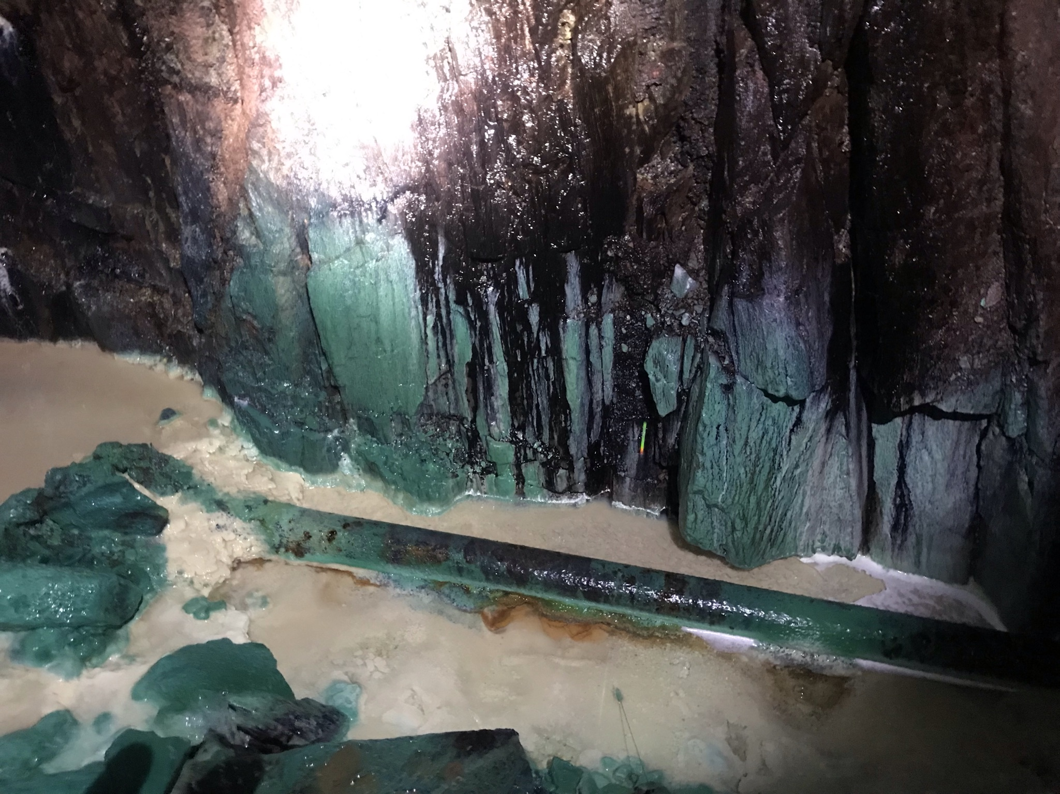
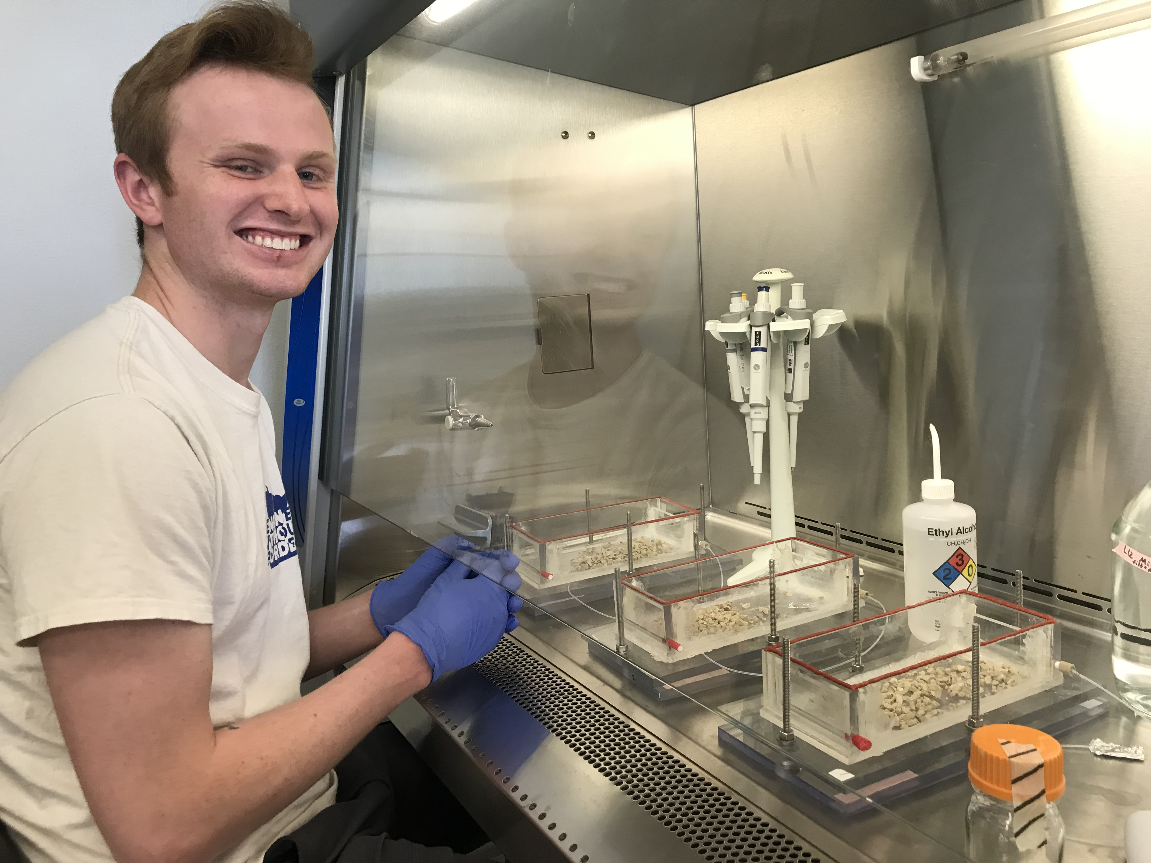
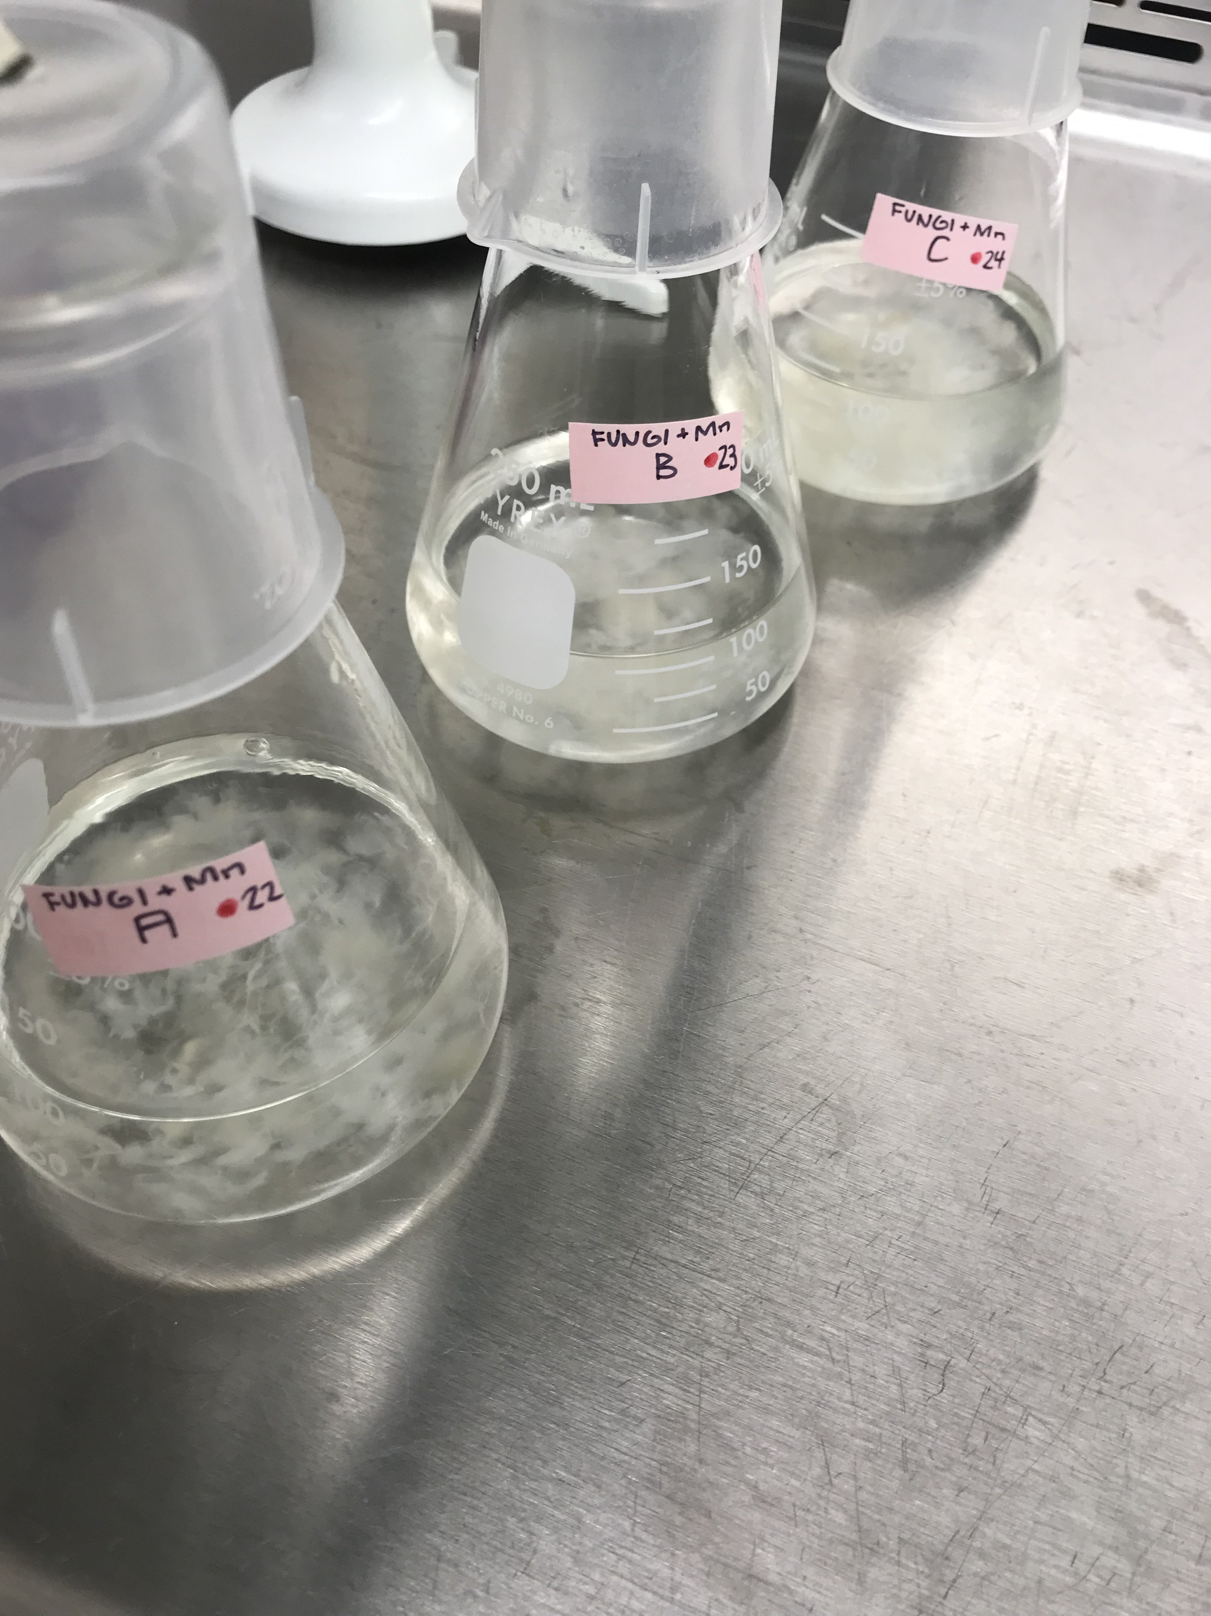
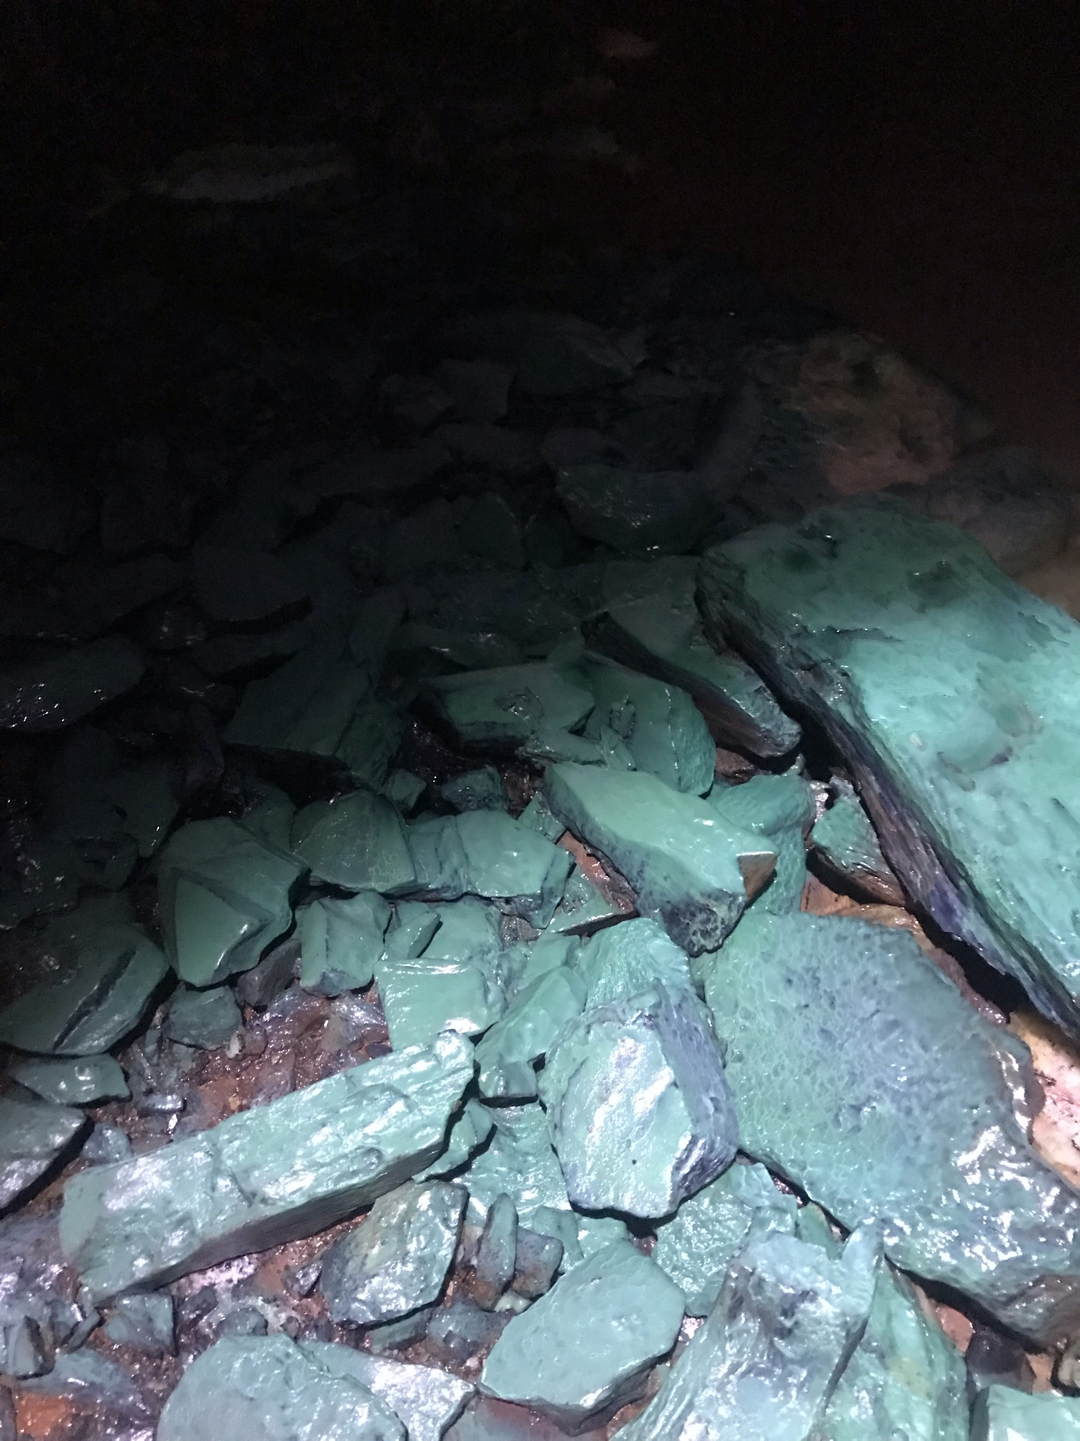
Ongoing work-Soudan Mine Water
Elevated levels of Cu and Ni
Can this be treated with fungal system?

Slide 34
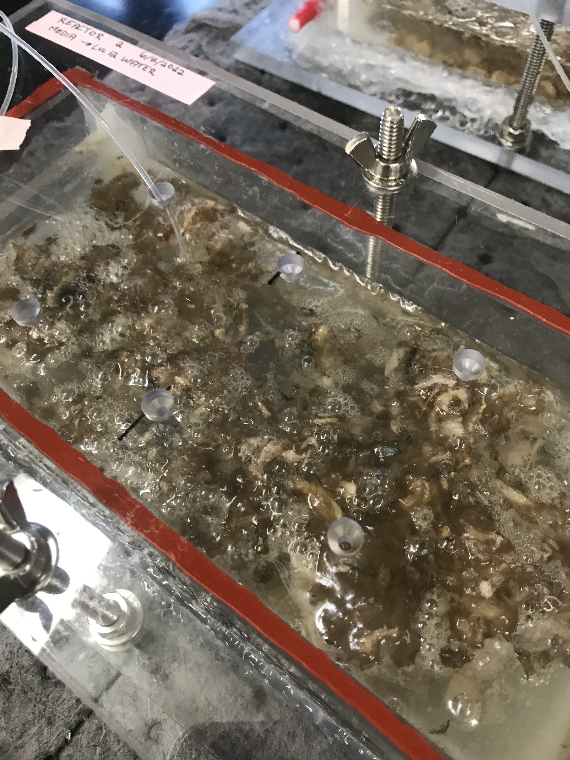
Ongoing work-Soudan Mine Water
Elevated levels of Cu and Ni
Can this be treated with fungal system?

Slide 35


Acknowledgements
Santelli Lab
Soudan Mine
Stanford Synchrotron Radiation Laboratory
Industrial Partners
  Clearwater Biologic
Funding Source
  MnDrive: Minnesota’s Discovery, Research, and InnoVation Economy

Slide 36
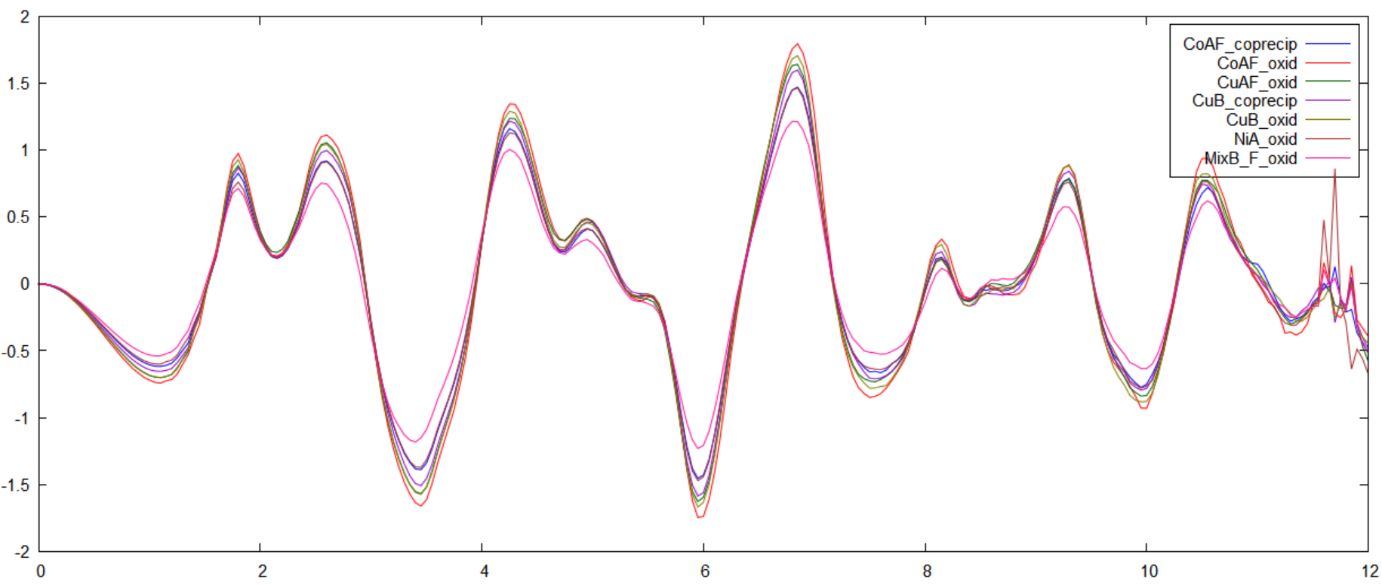
Mn K-edge EXAFS
Carpet Fiber is not impacting local manganese coordination chemistry

Slide 38
Soudan pics, new show copper
Mention industrial partner
Tem pictures
New graph results, include bar charts
Explain what we are looking at with SEM, maybe add an image
Explain Mn chemistry or exclude that slide
Add that we are including mine water now and working
Add pictures of that if we have

Slide 44


Slide 45
