Slide 1
Evaluation of Peat Sorption Media for Metal Removal from Stormwater from a Mineral Processing Facility
Candace Kairies-Beatty, Alex Vaslow,
Caleb Robb, Luke Zwiefelhofer
Winona State University
Paul Eger
Talon Metals
Peggy Jones, Doug Green
American Peat Technology

Slide 2
Overview
Peat based sorption media
The Site
Column Testing
  Column design
  Operational issues
  Results
Biochar Comparison
Conclusions

Slide 3
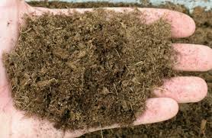
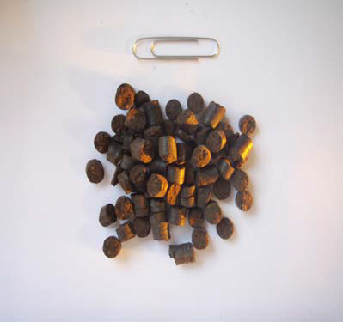
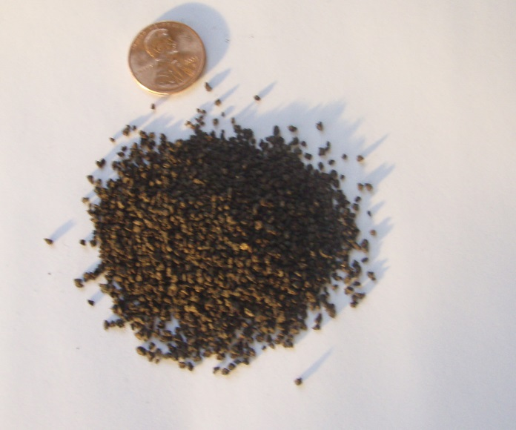
What is Peat based sorption media?
APTsorb /APTivator TM
  Patented peat based sorption media
  Hardened granule
APTsorb TM Granule

Slide 4
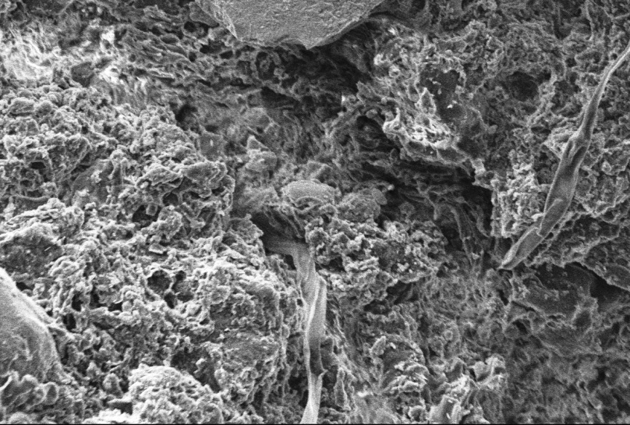
Why should I care?
  Large surface area
  High hydraulic conductivity (~0.5 cm/sec)
  High metal affinity (1-15% max dry wgt)
  Can remove particulates < 5-10 microns
APTsorb TM Granule 1500x

Slide 5
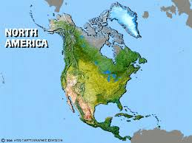
The Site
Metal processing facility
Industrial stormwater
pH ~ 7-8
Elevated Pb, Zn, Cd
 | Cadmium (ug/L) | Lead (ug/L) | Zinc (ug/L)
Stormwater | 112 | 615 | 8361
Permit Limit | 0.5 | 7.9 | 72.5
Flow 160 gpm

Slide 6
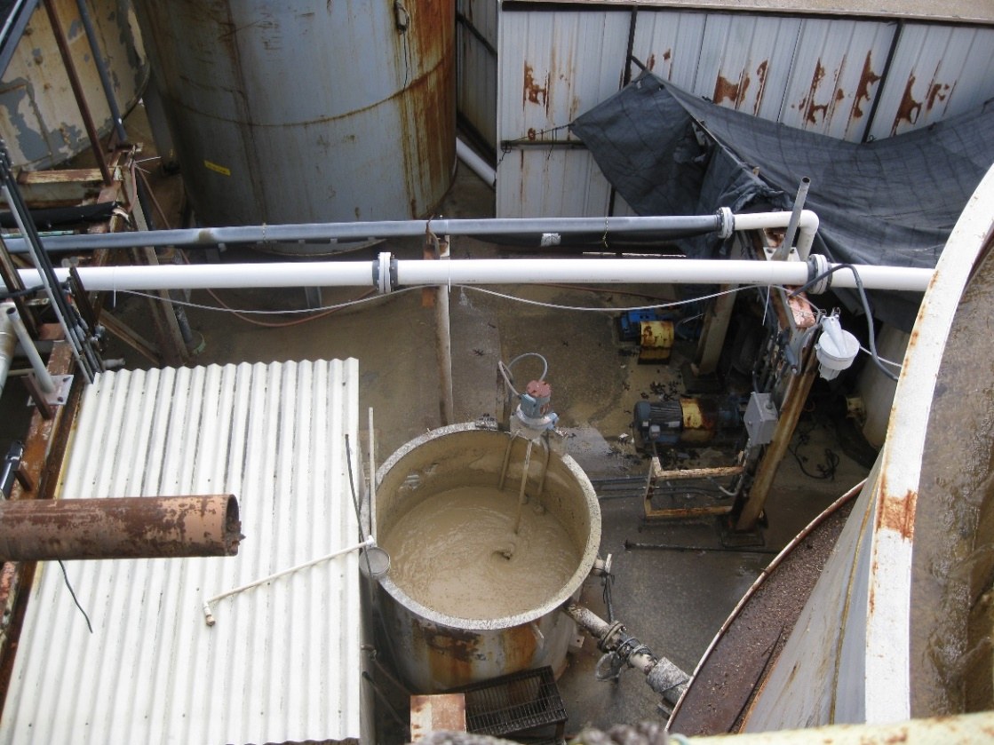
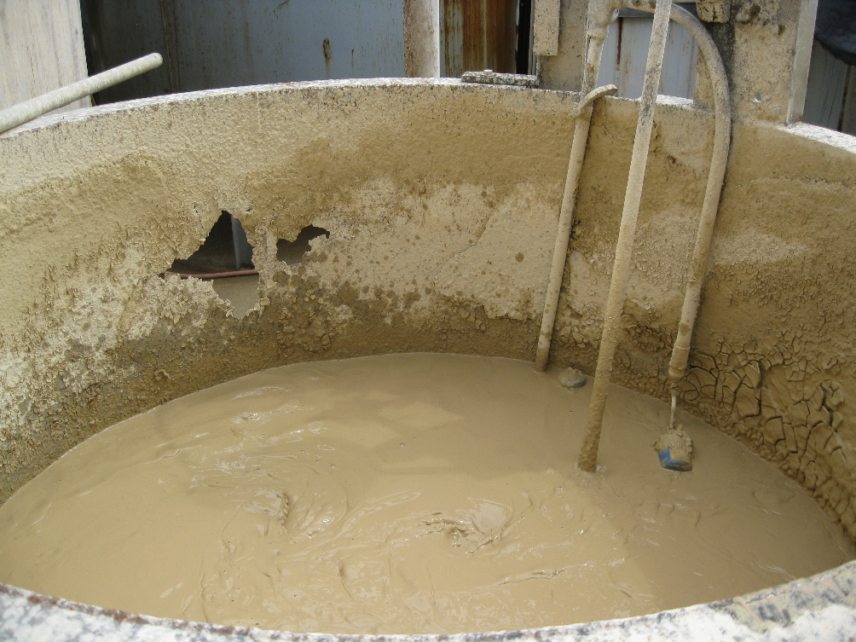
The Problem
Aging treatment system
Requiring 24/7 supervision

Slide 7
Objectives
Can peat sorption media treat this water?
Is there a difference between peat media?
Compare peat media to biochar

Slide 8
Approach
in
Frit
1/8
Glass wool
3/16
Media
2 5/8
72 grams peat media
Schematic not to scale
Frit
1/8
Glass beads
1/2
Frit
1/8
Flow 20 ml/min
Contact time 7.5 min

Slide 9
Column Test 1
APTsorb

Slide 10
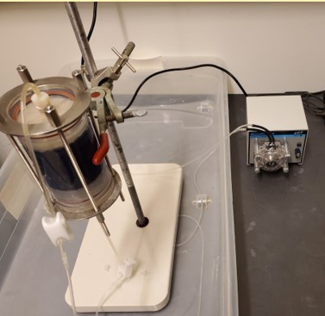

Slide 11
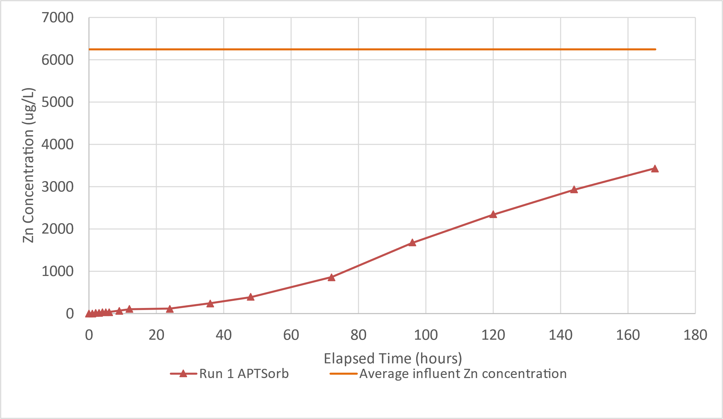
Zinc

Slide 12
Permit Limit

Slide 13
Cadmium

Slide 14
Pb

Slide 17
Media Digestion
Column section | Section | Zn ug | Cd ug | Pb ug
A | Top | 10905 | 168 | 13
B |  | 13668 | 287 | 55
C |  | 16179 | 463 | 274
D | Bottom | 19799 | 686 | 1302
Solids mg/kg | Average | 15138 | 401 | 411
Total mass |  | 1,089,926 | 28,858 | 29,597

Slide 18
Media Digestion
Column section | Section | Zn ug | Cd ug | Pb ug
A | Top | 10905 | 168 | 13
B |  | 13668 | 287 | 55
C |  | 16179 | 463 | 274
D | Bottom | 19799 | 686 | 1302
 |  | 15138 | 401 | 411
Total mass |  | 1,089,926 | 28,858 | 29,597
mass water |  | 1,037,431 | 32,167 | 25,416
% difference |  | 5% | -9% | 12%

Slide 19
Column Test 2
APTivator

Slide 20
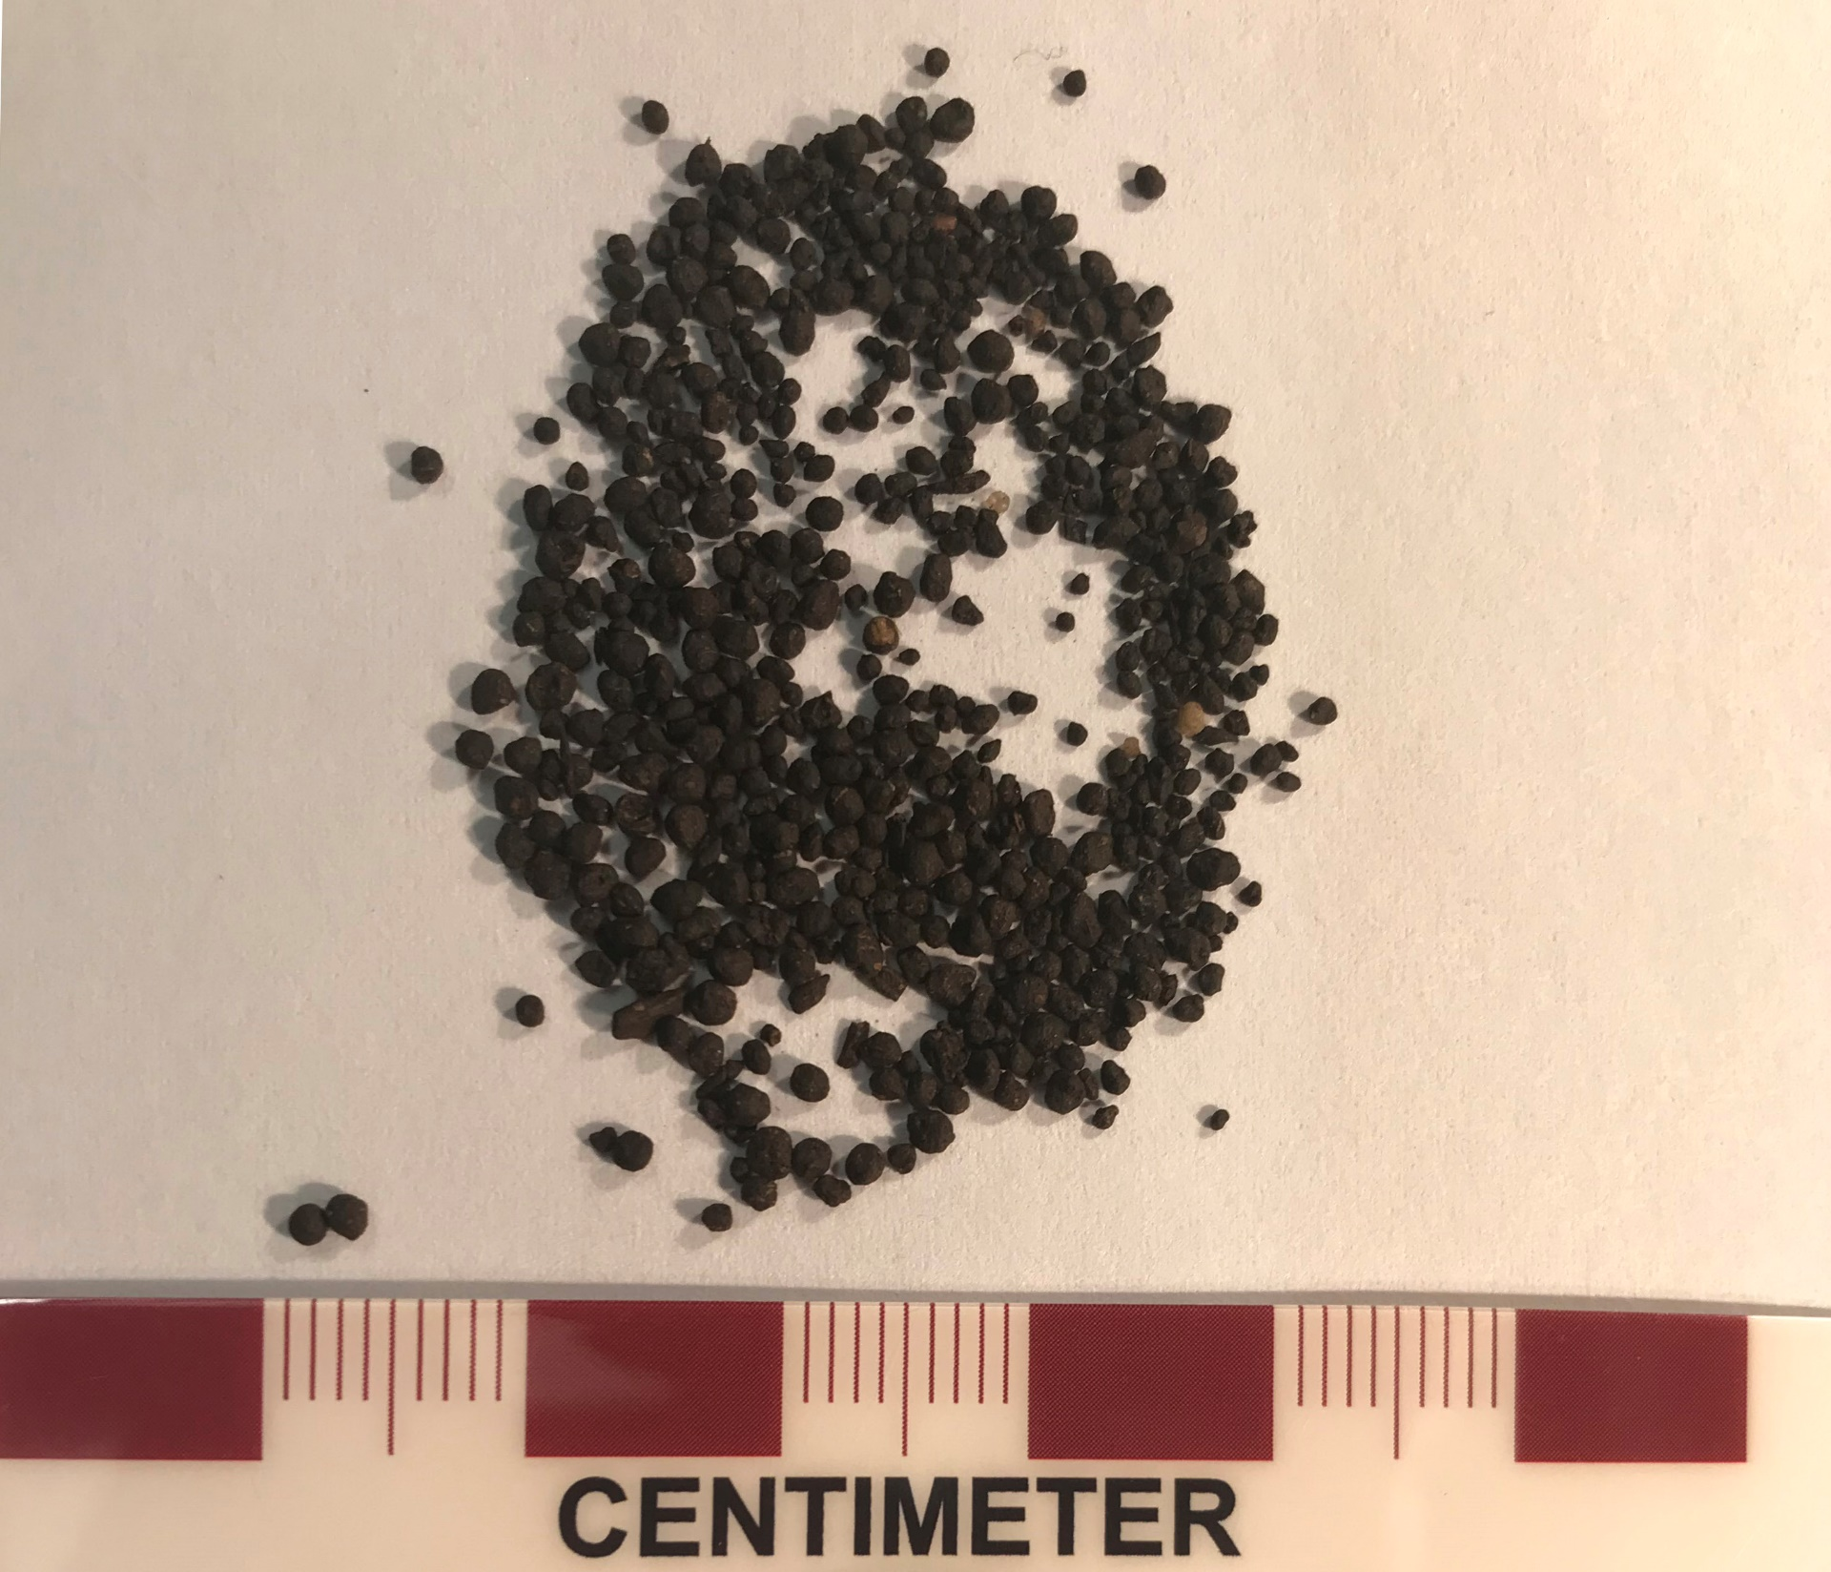

Slide 22
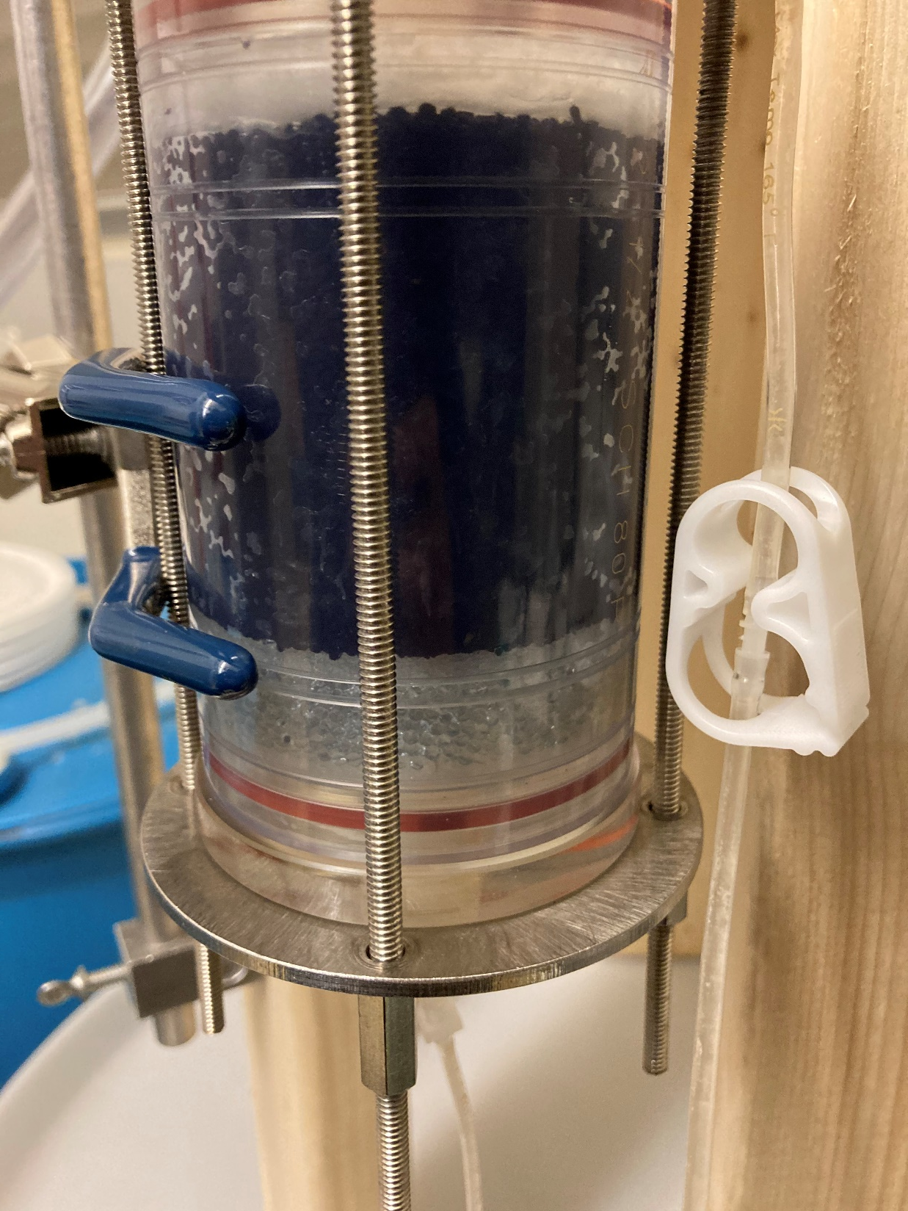

Slide 23
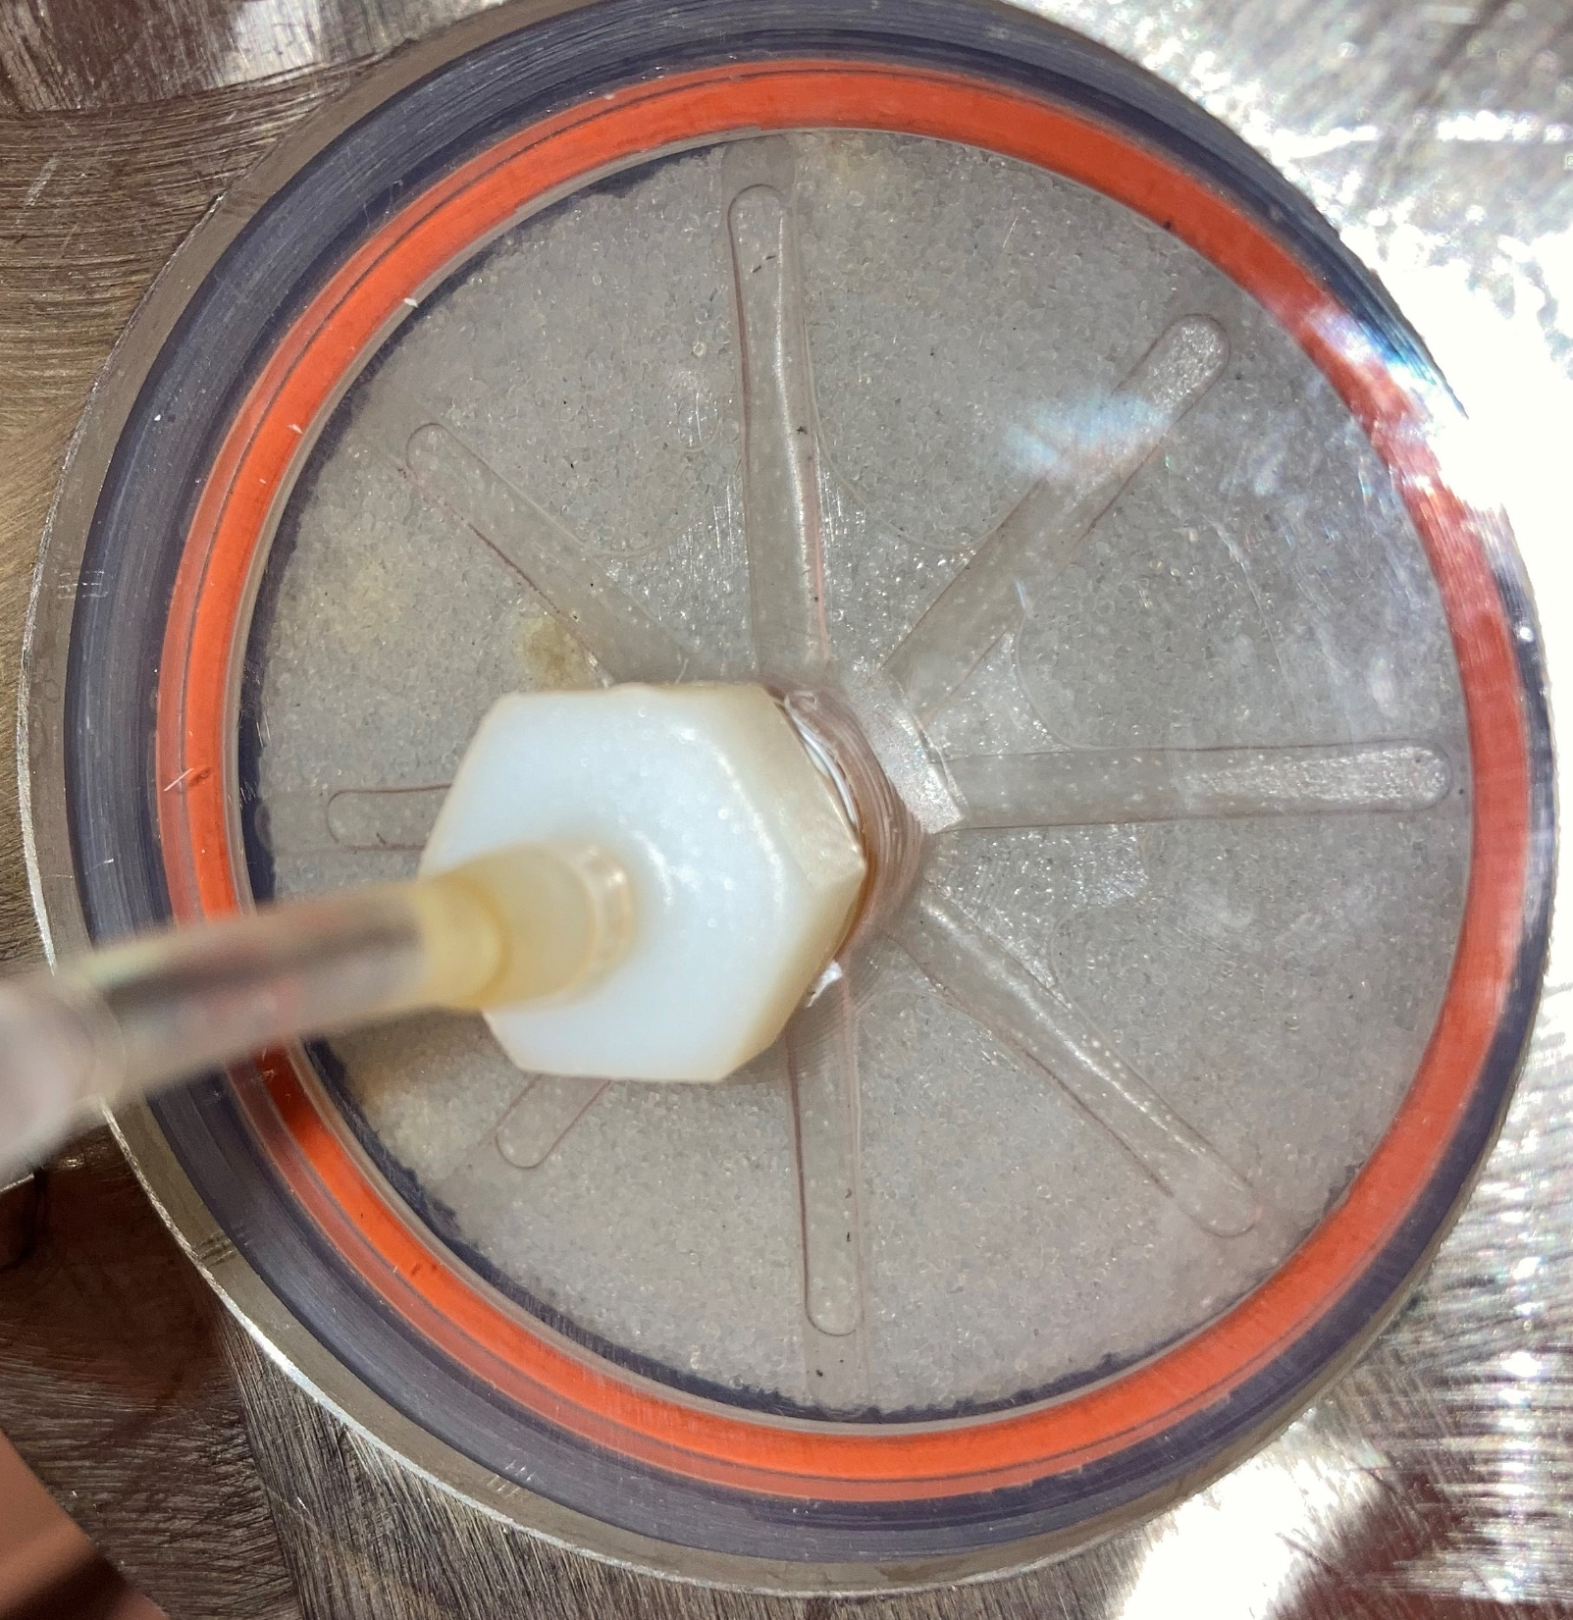

Slide 24
Column Test 3
APTivator

Slide 25
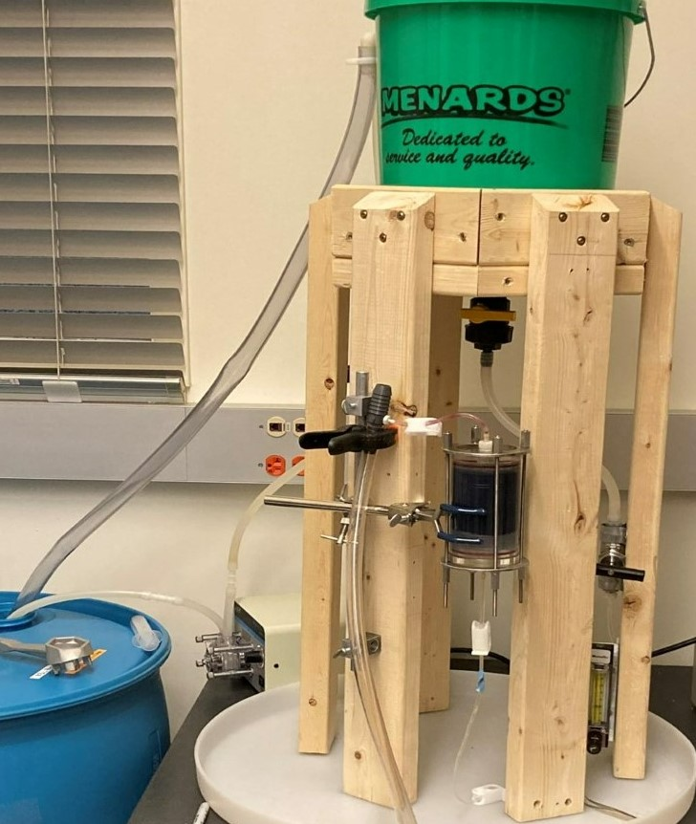

Slide 27
Column Test 4
Biochar

Slide 28
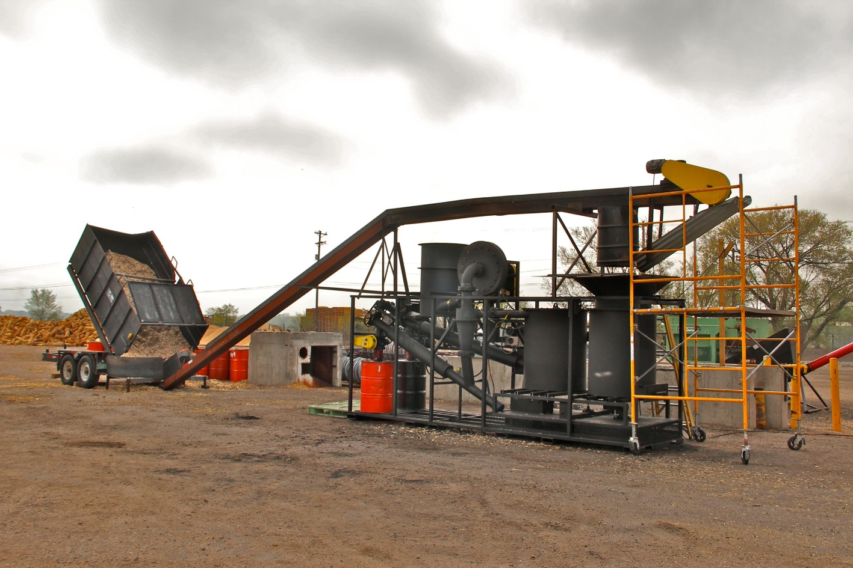
Biochar
Charcoal-like substance
Burn organic material in a controlled process
Biochar Solutions

Slide 29
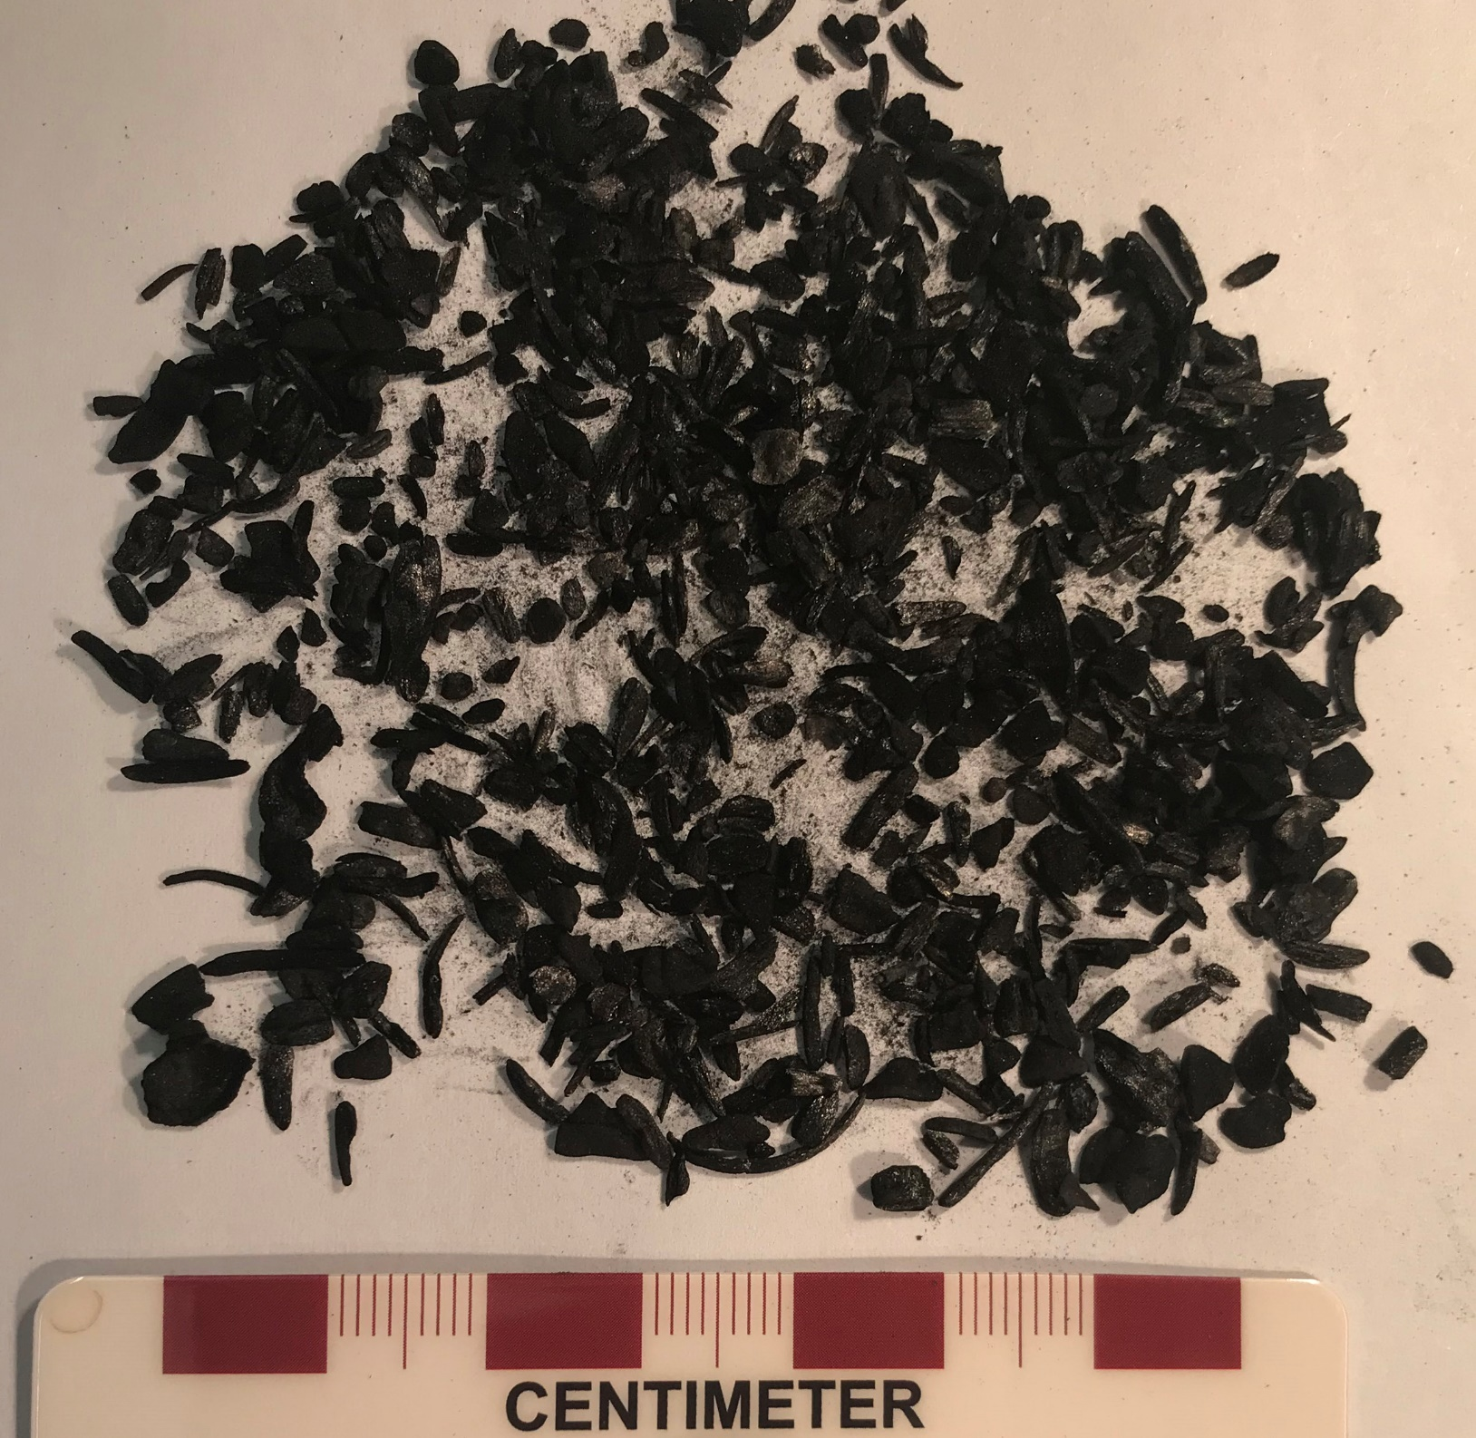
Column
14 grams

Slide 30
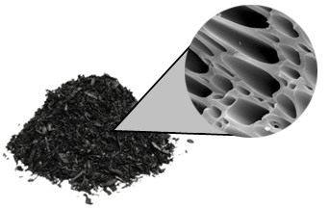
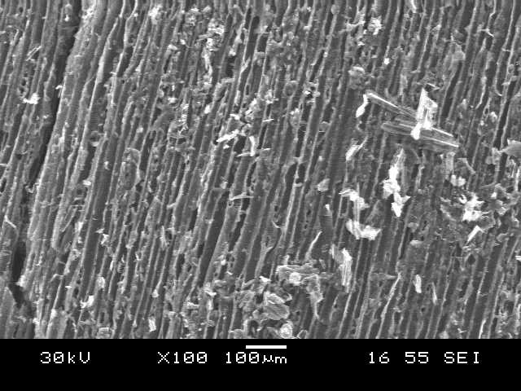

Slide 34

Conclusion
All products remove metals from water
Would require lead/lag approach
Better removal with peat

Slide 35
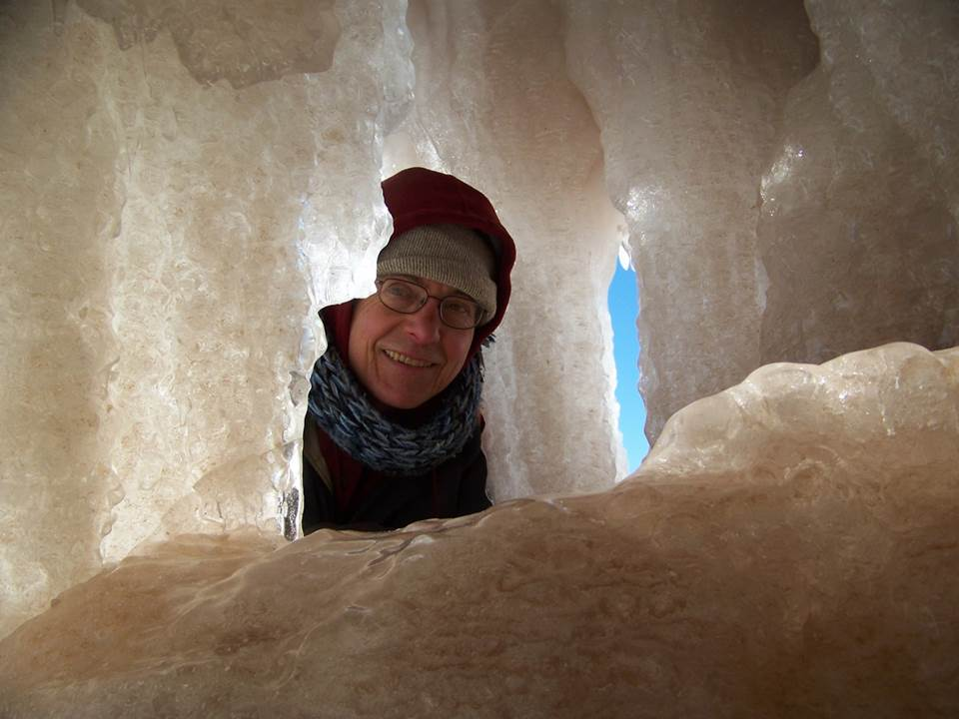
Looking for Answers?
Ask a question!
Thank you!

