Slide 1
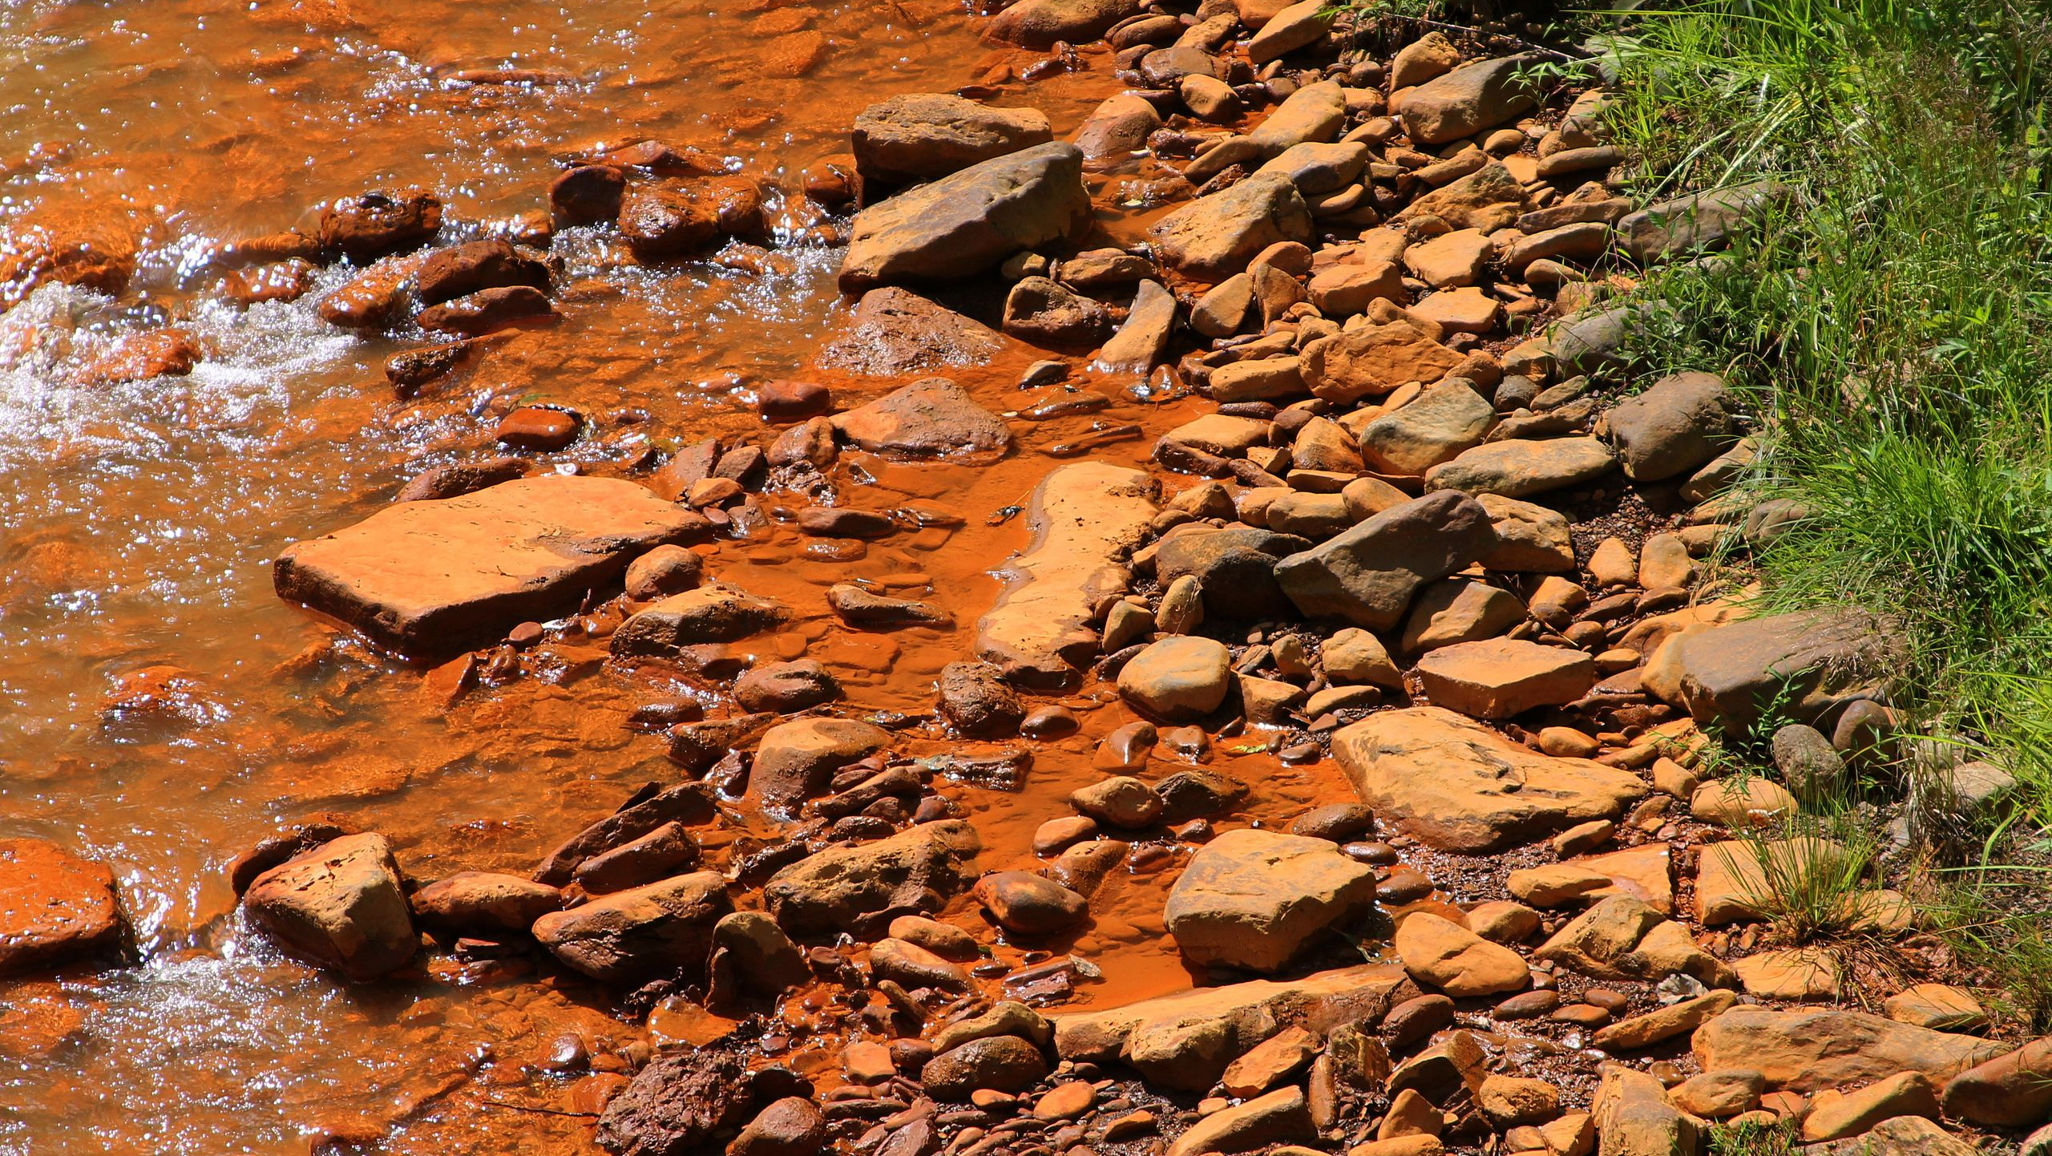
SORPTION OF METALS FROM WATER BODIES POLLUTED BY MINING AND REUSE OF HYDROCHAR IN LAND RECLAMATION
PRESENTED BY: BENJAMIN QUARDEY
COMMITTEE: PROFS. NATALIE KRUSE DANIELS, SARAH DAVIS, LEI WU
ASRS CONFERENCE 2022
MASTER OF SCEINCE IN ENVIRONMENTAL STUDIES (MSES)
OHIO UNIVERSITY ASRS 39TH ANNUAL CONFERENCE

Slide 2
INTRODUCTION
Acidic or alkaline drainage with high metals concentrations.
Mine water is the largest anthropogenetic activity associated with mining activity.
Single largest impediment to surface water and groundwater.
Large negative impacts on aquatic ecosystems.

Slide 3
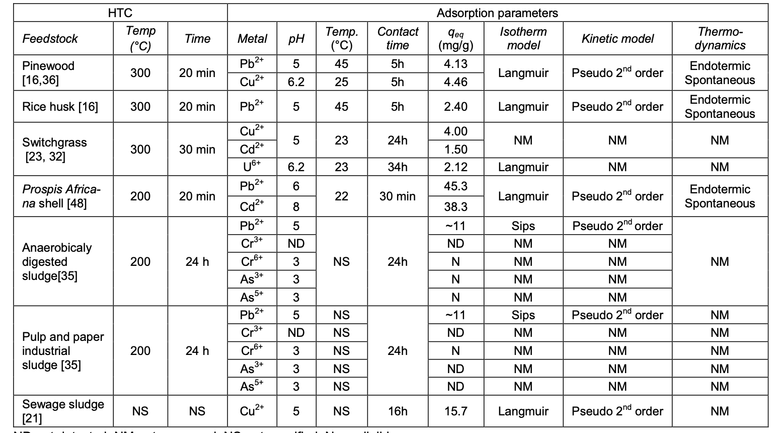
ADSORPTION PARAMETERS OF HYDROCHAR
ND-not detected, NM-not measured, NS-not specified, N- negligible
Table 1: hydrochar parameters

Slide 4
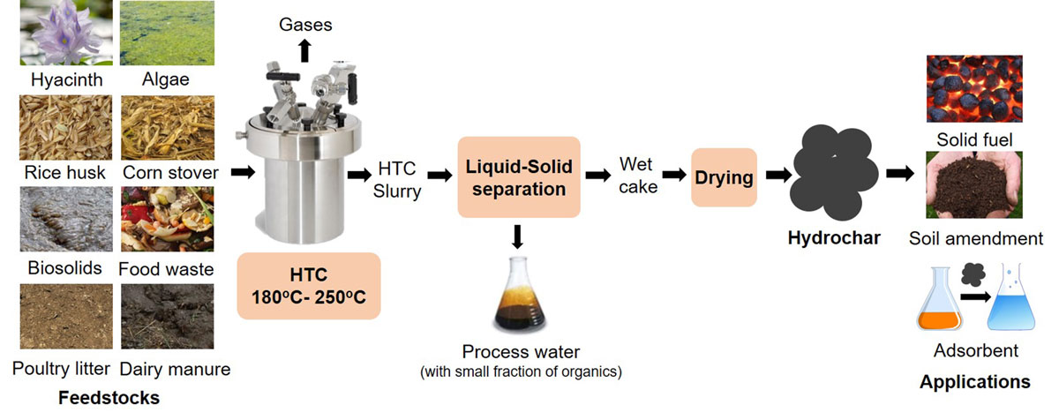
HYDROCHAR PRODUCTION
Fig 3.Hydrochar Production model

Slide 5
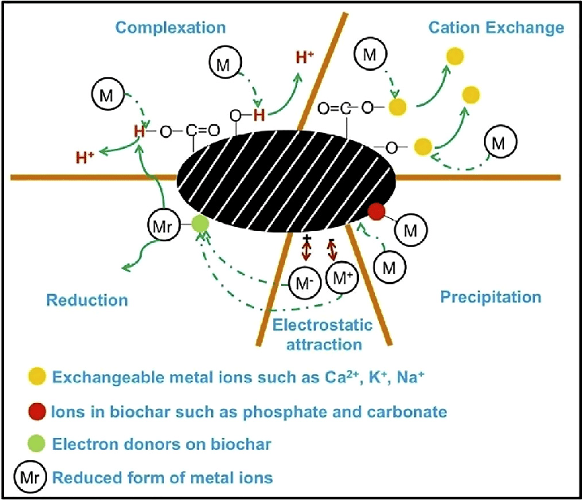
SORPTION MECHANISM
ION EXCHANGE: Hydrochar sample and heavy metals being examined exchange protons and ionized cations with dissolved salts.
ELECTROSTATIC ATTRACTION: Hydrochar sample interacts chemically by ion exchange with the heavy metals via the negative charge on the hydrochar surface.
SURFACE COMPLEXATION: Multi atom forms metal ligands forming oxygen and carboxyl bond with specific heavy metals.
Fig. 4. Sorption mechanism

Slide 6
OBJECTIVES
MAIN OBJECTIVE
SPECIFIC OBJECTIVES
Determine the capacity of hydrochar produced from anaerobic digestate for removing heavy metals (copper, cadmium, zinc) in mine water.
Study the adsorption kinetic of hydrochar at different reaction times.
Assess reuse of hydrochar for land amendment.
Test the capacity of hydrochar for sorption of metals.

Slide 7
METHODOLOGY
Preparation of synthetic mine water solution
Sorption capacity and contact ratio
Sorption kinetic test
Desorption test

Slide 8
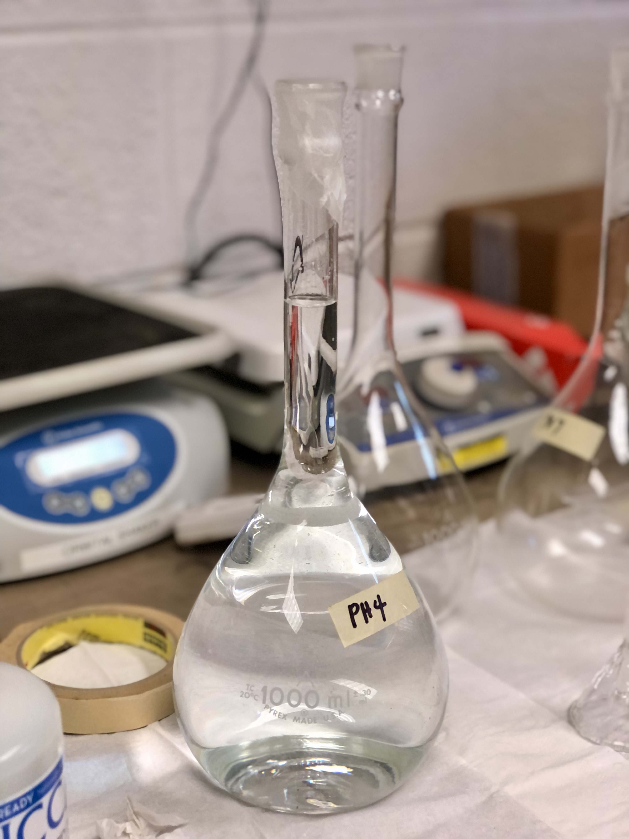
VOLUMES AND CONCETRATIONS
Stock solution | Concentrations (mg/L) | Volumes (mL) | Target concentrations mg/L
Zn | 65.38 | 1.53 | 10
Cu | 63.55 | 3.93 | 10
Cd | 112.41 | 13.71 | 3
Table 1: Concentrations of target metals
Fig 6: synthetic mine water

Slide 9
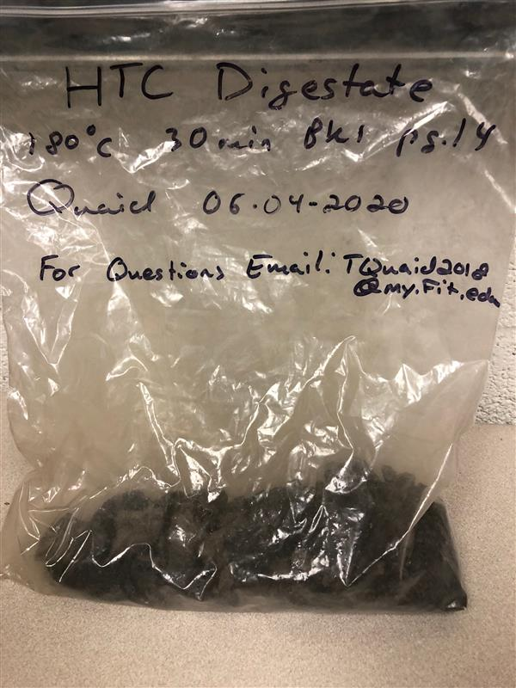
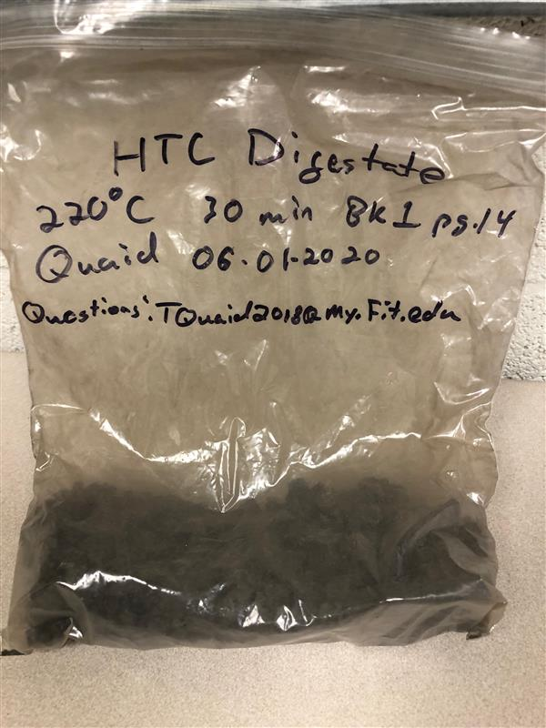
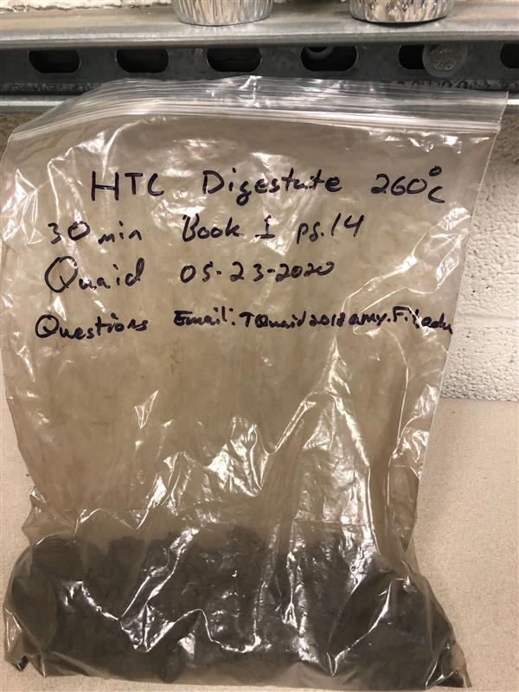
HYDROCHAR SAMPLES
A
B
C
Fig 4: A, B and C are hydrochar samples 180 $℃$ , 220 $℃$, and 260 $℃$ respectively derived from anaerobic
digestate produced at the Florida Institute of Technology.

Slide 10
SORPTION CAPACITY
 |  | pH 4 |  |  | pH 7
0.5 g | 1 g | 2 g | W/H | 0.5 g | 1 g | 2 g | W/H
5 g | 8 g | 10 g | Ctrl | 5 g | 8 g | 2 g | Ctrl
Table 2: triplicates of hydrochar samples

Slide 11
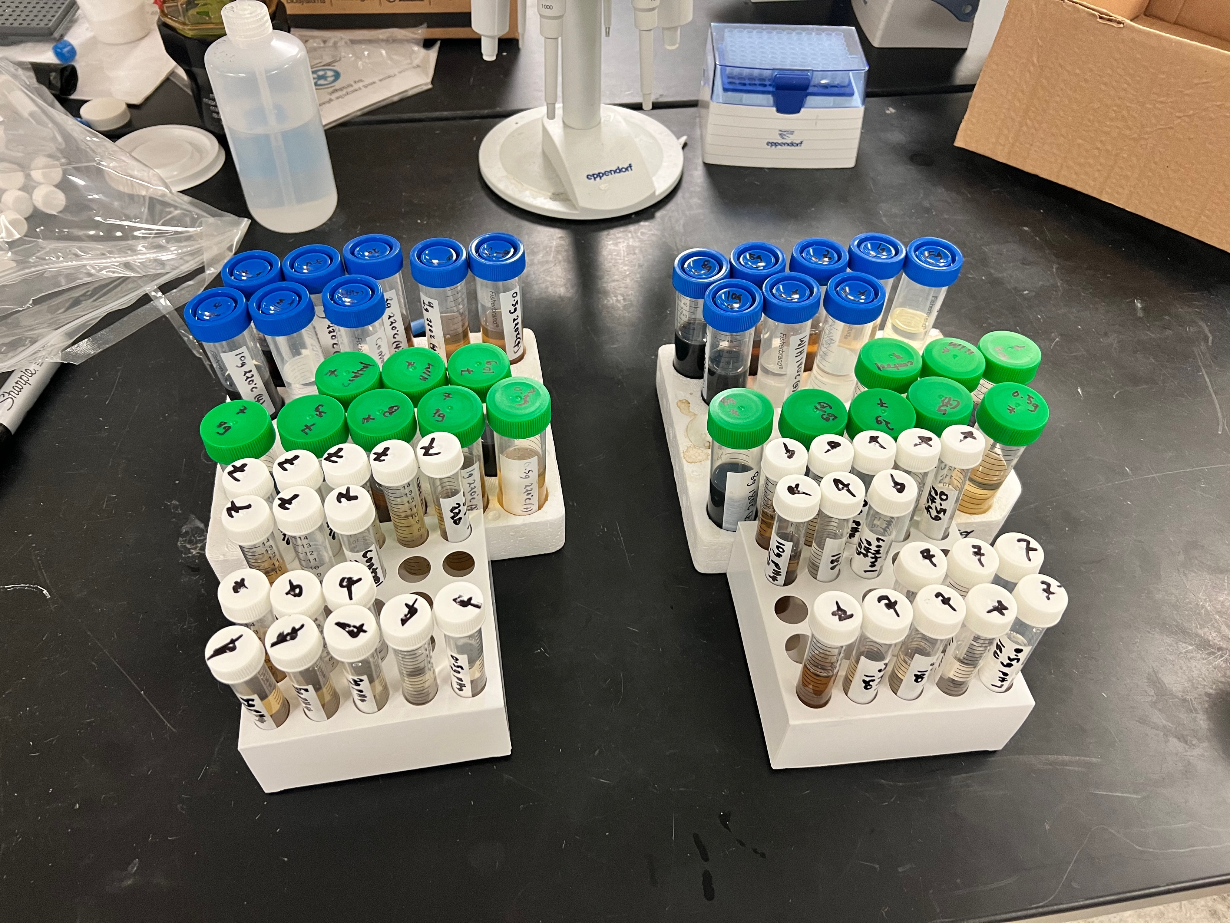
SORPTION CAPACITY
50 mL centrifuge tubes containing 35 mL of synthetic neutral mine water or synthetic acidic mine water.
The solution was mixed with hydrochar at 150 rpm on a shaker plate for 24 hours.
A 0.45 µm filter paper after the incubation period was used for filtration.
The effluent was analyzed using the ICP-OES for target metal concentration.
Fig 7: hydrochar sample after incubation period

Slide 12
RESULTS REMOVAL RATES
Fig 7: 180 $℃$ hydrochar sample for pH 4
Fig 8: 180 $℃$ hydrochar sample for pH 7

Slide 13
RESULTS SORPTION CAPACITY
Fig 9: 180 $℃$ hydrochar sample for pH 4
Fig 10: 180 $℃$ hydrochar sample for pH 7

Slide 14
RESULTS POST SORPTION CONCENTRATION
Fig 11: 180 $℃$ hydrochar sample for pH 4
Fig 12: 180 $℃$ hydrochar sample for pH 7

Slide 15
RESULTS REMOVAL RATES
Fig 13: 220 $℃$ hydrochar sample for pH 4
Fig 14: 220 $℃$ hydrochar sample for pH 7

Slide 16
RESULTS SORPTION CAPACITY
Fig 15: 220 $℃$ hydrochar sample for pH 4
Fig 16: 220 $℃$ hydrochar sample for pH 7

Slide 17
RESULTS POST SORPTION CONCENTRATION
Fig 17: 220 $℃$ hydrochar sample for pH 4
Fig 18: 220 $℃$ hydrochar sample for pH 7

Slide 18
RESULTS REMOVAL RATE
Fig 19: 260 $℃$ hydrochar sample for pH 4
Fig 20: 260 $℃$ hydrochar sample for pH 7

Slide 19
RESULTS SORPTION CAPACITY
Fig 21: 260 $℃$ hydrochar sample for pH 4
Fig 22: 260 $℃$ hydrochar sample for pH 4

Slide 20
RESULTS POST SORPTION CONCENTRATION
Fig 3: 260 $℃$ hydrochar sample for pH 4
Fig 24: 260 $℃$ hydrochar sample for pH 7

Slide 21
CONLCUSIONS
Synthetic mine water at pH 4 for 220 $℃$ hydrochar sample removed most Cd as compared to Cu and Zn.
Precipitation and filtering may explain high metal concentrations after ICP analysis.
Hydrochar sample may contain cd, therefore the variation in concentration after incubation and filtration.

Slide 22
CONCLUSIONS CLOSING THE LOOP
Food Production
Fig 25: Summary of the project
Food Waste
Anaerobic Digestion
Methane
Hydrothermal Processing
Wastewater from Mining Industry
Hydrochar
Mine Water Treatment
Treated Water
Land Amendment

Slide 23
REFERENCES
Deliyanni, E.A., Peleka, E.N., Matis, K.A., 2007. Removal of zinc ion from water by sorption onto iron-based nano adsorbent. J. Hazard. Mater. 141, 176–184.
Igwe, J.C., Ogunewe, D.N., Abia, A.A., 2005. Competitive adsorption of Zn (II), Cd (II) and Pb (II) ions from aqueous and non-aqueous solution by maize cob and husk. Afr. J. Biotechnol. 4 (10), 1113– 1116.
Gupta, V.K., Rastogi, A., Saini, V.K., Jain, N., 2006. Biosorption of copper (II) from aqueous solutions by Spirogyra species. J. Colloid In Bishnoi, N.R., Bajaj, M., Sharma, N., Gupta, A., 2003.

Slide 24
THANK YOU

