Slide 1
Passive removal of Mn from mine water by heterogeneous Mn oxidation
Robert Hedin, Neil Wolfe, Benjamin Hedin
Hedin Environmental, Pittsburgh PA
American Society of Reclamation Sciences
39th Annual Conference, Duluth MN
June 12-16, 2022

Slide 2
Manganese: origin
Acid dissolution of carbonate or silicate minerals
Reduction of Mn oxides

Slide 3
Mn: why is it regulated?
  Surrogate for other more hazardous metals (Kleinmann papers in the 1980s)
  Ecotoxicity at high instream concentrations
  “…At levels beyond those necessary to maintain adequate health, manganese has been identified as a nervous system toxin and has been specifically linked to negative impacts on fetal and childhood neurodevelopment.” (Pennsylvania Environmental Quality Board, Water Quality Standard for Manganese and Implementation, July 25, 2020)

Slide 4
Mn: effluent standards
SMCRA and most US mining programs
  2.0 mg/L monthly average
International hardrock mining sites
  0.5 mg/L
Proposed Pennsylvania standard
  0.3 mg/L

Slide 5
Mn: treatment
Potential solids
MnS (rare), MnCO₃ (uncommon), MnOOH (unstable)
MnO₂ (common)
pyrolusite, birnessite

Slide 6
MnO₂ formation
oxidation Mn²⁺ + ½O₂ + 2H⁺ → Mn⁴⁺ + H₂O
hydrolysis Mn⁴⁺ + 2H₂O → MnO₂ + 4H⁺
Sum Mn²⁺ + ½O₂ +H₂O → MnO₂ + 2H⁺
hydrolysis is very rapid
oxidation is limiting step

Slide 7
Mn²⁺ oxidation kinetics^{A}
At contant pH and dissolved O₂:
d[Mn²⁺]/dt = -k₀[Mn²⁺] – k₁[Mn²⁺] [MnO₂]
k₀ and k₁ are rate constants
[MnO₂] is surface area of Mn solids
^{A} Based on Stumm and Morgan (1996); Rose, Means and Shah (2003); Means and Rose (2005)

Slide 8
Homogeneous oxidation mechanism
d[Mn²⁺]/dt = -k₀[Mn²⁺] – k₁[Mn²⁺] [MnO₂]
Strongly pH dependent and requires pH >9
NaOH is commonly used in conventional treatment
Over-treatment will result in effluent pH >10 and formation of Mg solids
Many states provide high-pH waivers for NaOH treatment systems

Slide 9
Heterogeneous oxidation mechanism
d[Mn²⁺]/dt = -k₀[Mn²⁺] – k₁[Mn²⁺] [MnO₂]
Sorption of Mn²⁺ to solids, where oxidation can occur much more rapidly at lower pH
Means and Rose suggest that surface area of [MnO₂] is rate-limiting factor
Appropriate solids
  Wetland substrate
  Organic substrates (coconut coir)
  Inorganic substrates (carpet fibers)
  Mineral substrates (aggregate)
Microbial or fungal contribution

Slide 10
Requirements for heterogeneous Mn removal
Aerobic conditions (1 mg/L Mn → 0.3 mg/L O₂)
Low Fe²⁺
Substrate for MnO₂ accumulation: aggregate
  carbonate aggregate if water has low pH
  no preference is water has circumneutral pH
Development of enough MnO₂ to promote the heterogeneous reaction
Retention times vary with concentration and substrate size

Slide 11
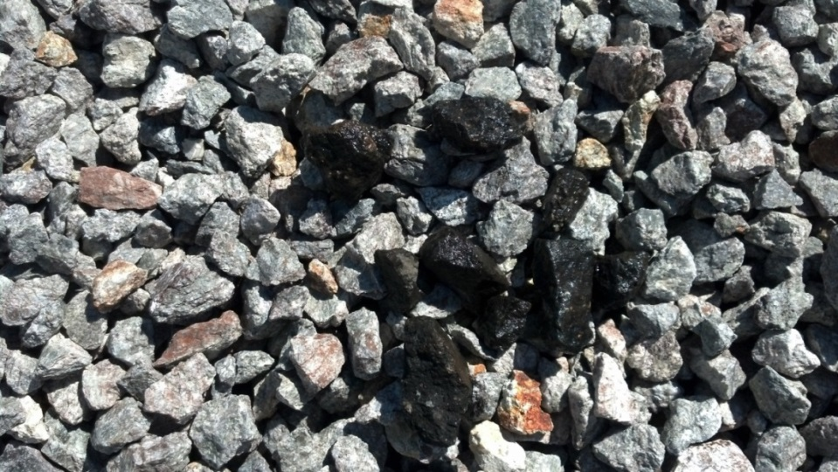
the right stuff

Slide 12
Case Studies
Unexpected Mn removal by aggregate systems

Slide 13
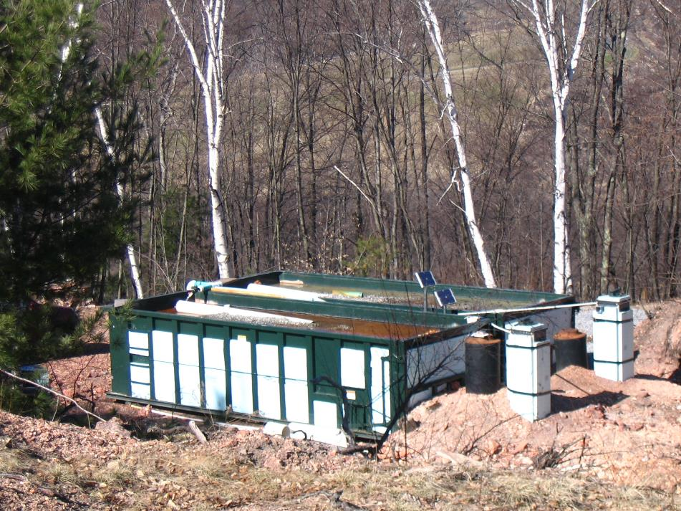
Mitchell limestone flushing project
2006-2008
AgriDrain
Smart Drainage System
30 CY roll off containers filled with limestone

Slide 14
Mitchell West Box, 2008-2020
 | pH | Alk | Acid | Mn | Fe | Al | SO4
 | s.u. | mg/L CaCO₃ |  | mg/L | mg/L | mg/L | mg/L
Influent | 3.0 | 0 | 200 | 11.9 | 6.8 | 21.5 | 523
effluent | 6.9 | 82 | -61 | 2.8 | 0.5 | 3.4 | 495

Slide 15
West Box (Tioga County, Pennsylvania)

Slide 16
West Box (Tioga County, Pennsylvania)
Effluent percentile
Concentrations
90th 5.8 mg/L
75th 3.7 mg/L
50th 2.7 mg/L
25th 1.0 mg/L
10th 0.4 mg/L

Slide 17
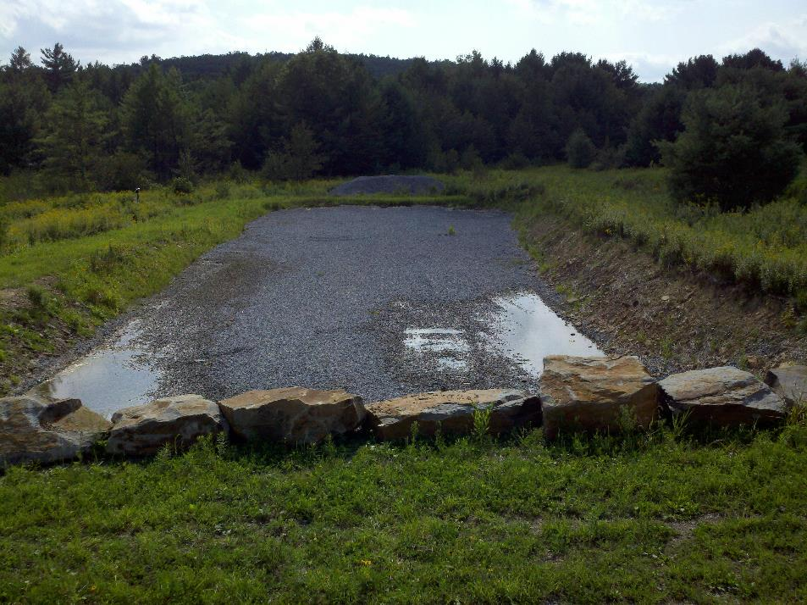
Scootac #1

Slide 18
Scootac #1, 2010-2020
 | pH | Alk | Acid | Mn | Fe | Al | SO4
 | s.u. | mg/L CaCO₃ |  | mg/L | mg/L | mg/L | mg/L
Influent | 4.0 | 0 | 86 | 23.5 | 0.2 | 10.3 | 889
effluent | 7.3 | 189 | -162 | 1.6 | 0.1 | 0.2 | 914

Slide 19
Scootac #1, (Clinton County, Pennsylvania)

Slide 20
Scootac #1, (Clinton County, Pennsylvania)

Slide 21
Case Studies
Targeted Mn removal by aggregate systems

Slide 22
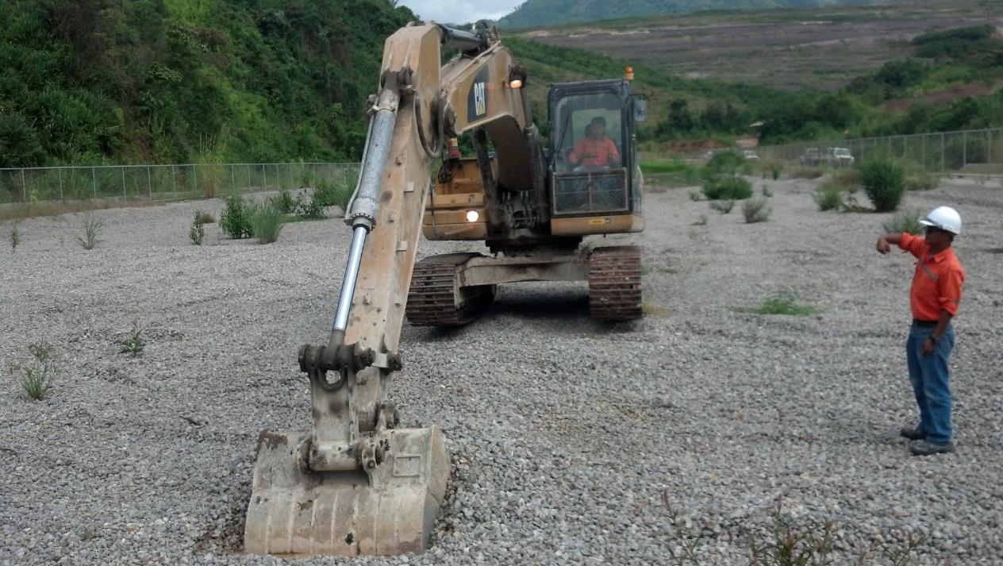
Phu Kham copper mine (Laos)

Slide 23
Phu Kham, 2013-2020
 | pH | Alk | Acid | Mn | Fe | Al | SO4
 | s.u. | mg/L CaCO₃ |  | mg/L | mg/L | mg/L | mg/L
Influent | 6.9 | 250 | na | 3.0 | 0.2 | <0.1 | 427
effluent | 7.2 | 251 | na | <0.1 | <0.1 | <0.1 | 466

Slide 24
Phu Kham (Lao People’s Democratic Republic)

Slide 25
Phu Kham (Lao People’s Democratic Republic)

Slide 26
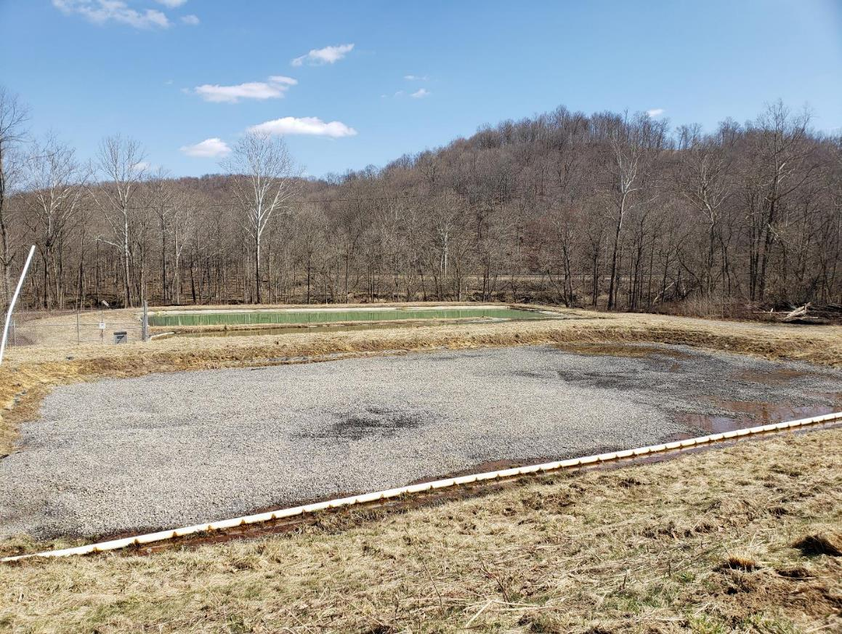
Tenmile

Slide 27
Tenmile, 2015-2022
 | pH | Alk | Acid | Mn | Fe | Al | SO4
 | s.u. | mg/L CaCO₃ |  | mg/L | mg/L | mg/L | mg/L
Influent | 3.2 | 0 | 146 | 30.8 | 2.7 | 3.1 | 1710
effluent | 7.7 | 105 | -59 | 1.1 | 0.8 | 0.1 | 1888

Slide 28
Tenmile (Greene County, Pennsylvania)

Slide 29
Tenmile (Greene County, Pennsylvania)

Slide 30
Conclusions
Passive removal of Mn at circumneutral pH is feasible
Treatment requires MnO₂-coated substrate that promotes the heterogeneous oxidation mechanism
The buildup of sufficient reactive solids takes 4-8 weeks
Very low effluent concentrations are possible
Periodic maintenance of the treatment bed is necessary to maintain treatment

Slide 31
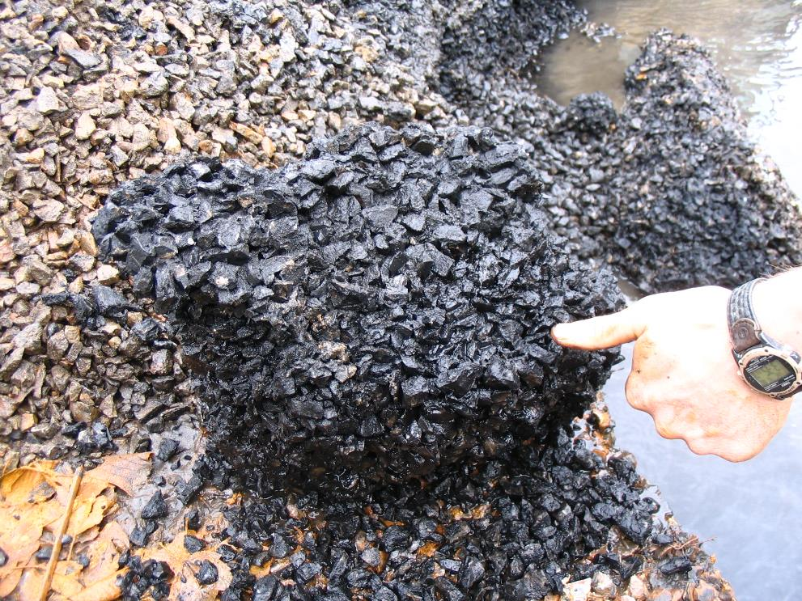
Questions?
Too much of the right stuff

Slide 33

Hedin Environmental is Hiring!!!
Diverse mine drainage and passive treatment projects
Field and design/engineering openings
Competitive pay and benefits
Pennsylvania is a happening place
Talk to Bob Hedin or email Ben Hedin, ben.hedin@hedinenv.com
The future is so bright, we have to wear shades

Slide 34
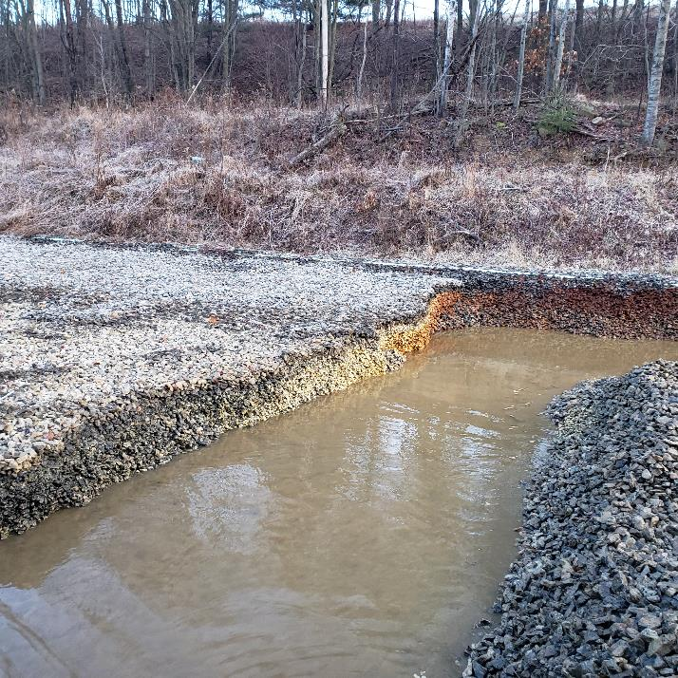
If other metals are involved, Mn removal is delayed

