Slide 1
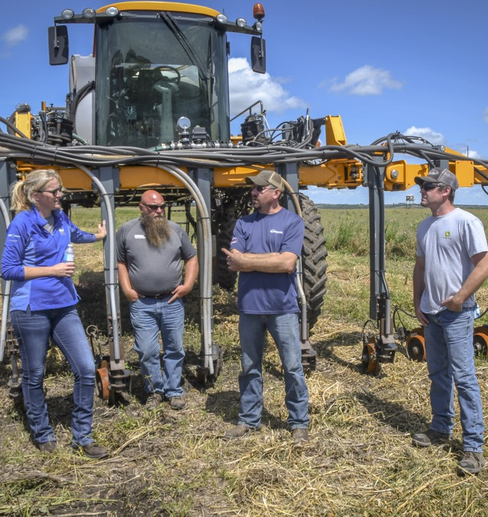
EXTENSION AIN’T YOUR GRANDPA’S PROGRAM ANYMORE
DR. ABBEY WICK
ASSOCIATE PROFESSOR OF SOIL HEALTH
EXTENSION SOIL HEALTH SPECIALIST
NORTH DAKOTA STATE UNIVERSITY

Slide 3
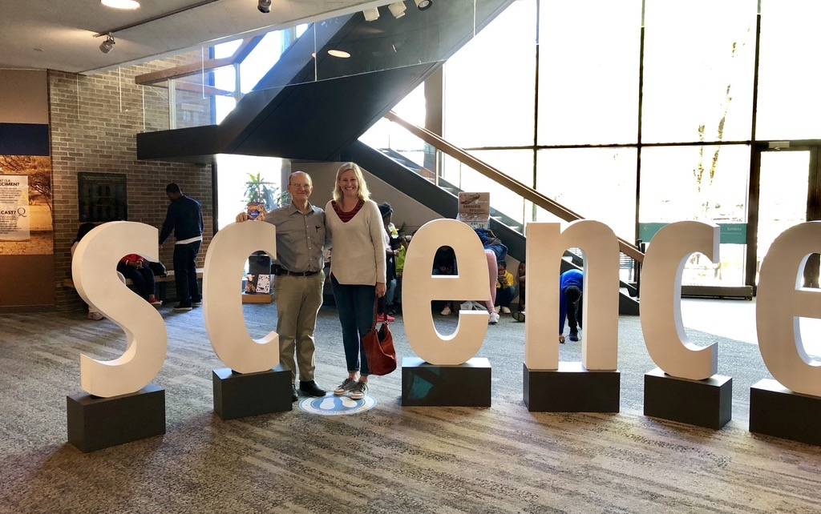


Slide 4
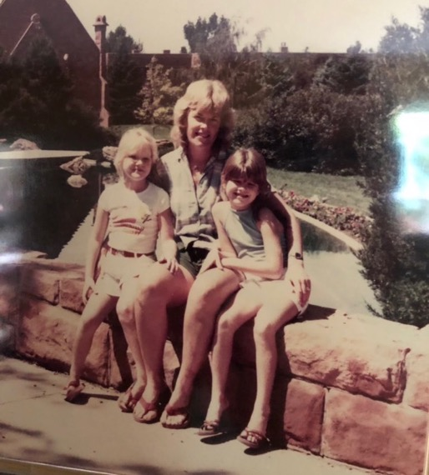
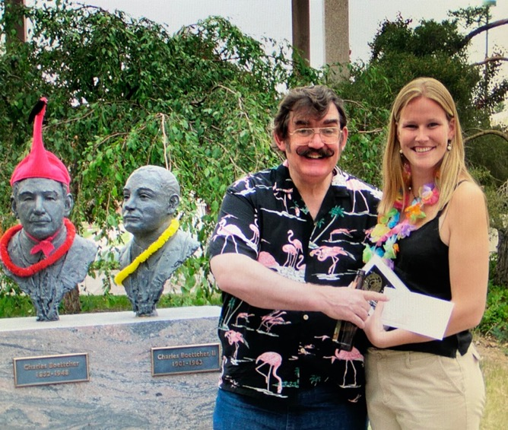
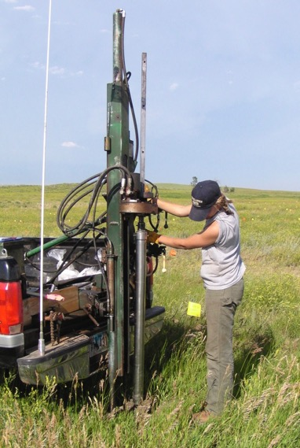

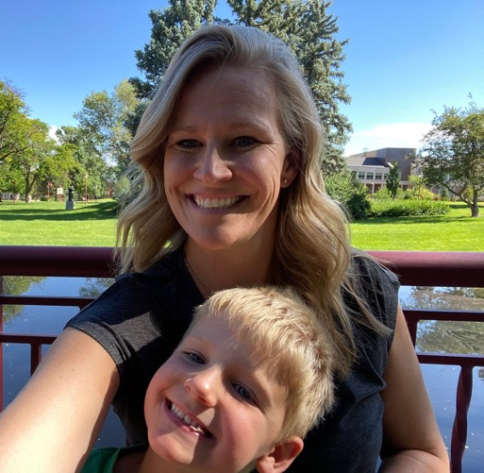
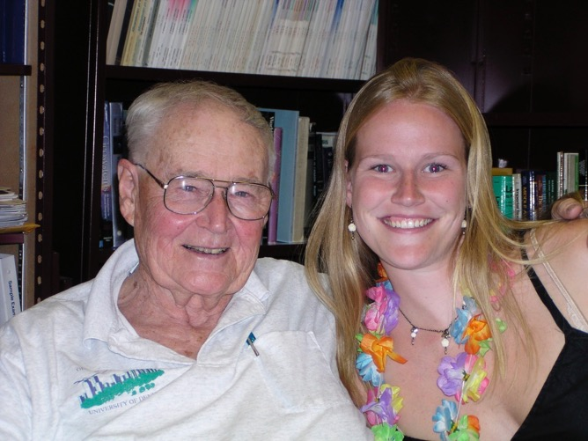
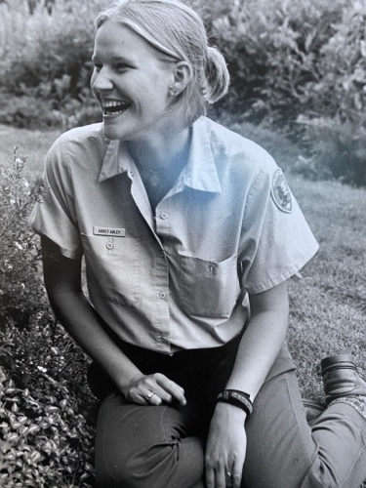

Slide 5


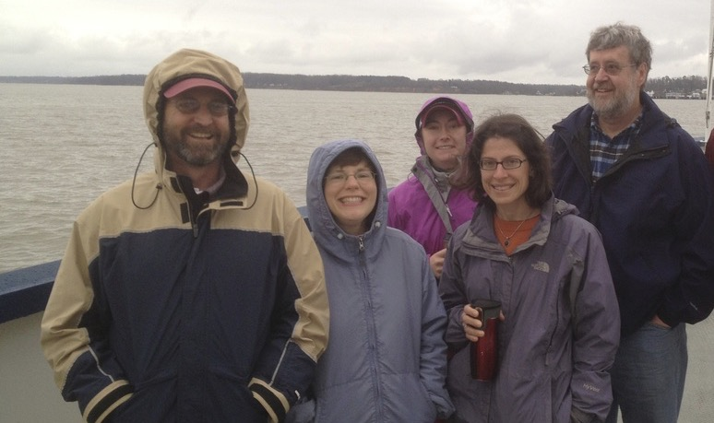
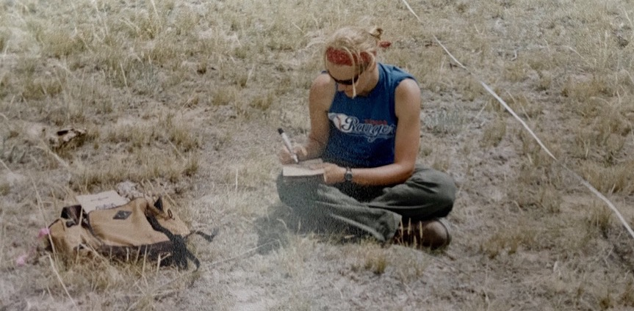
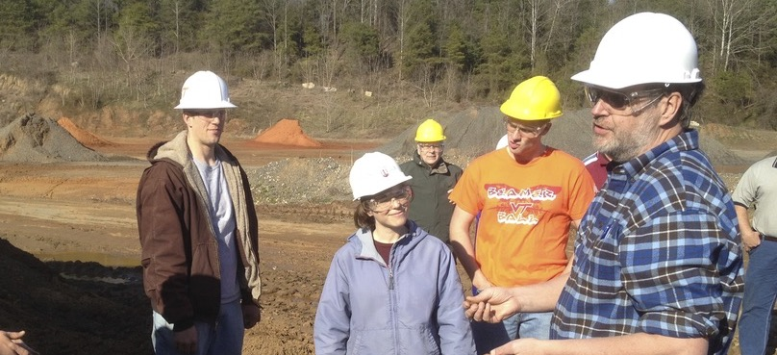

Slide 6
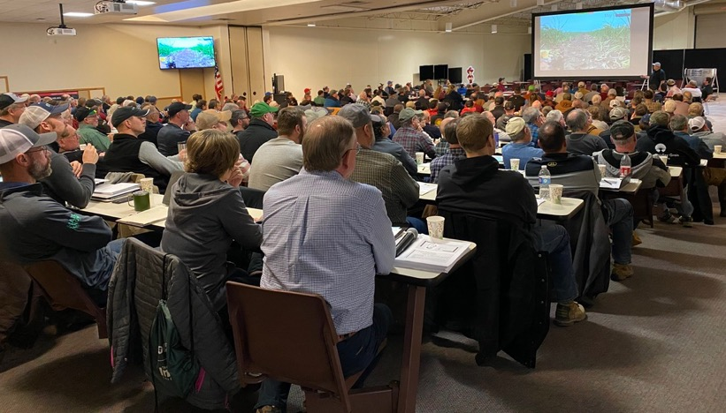
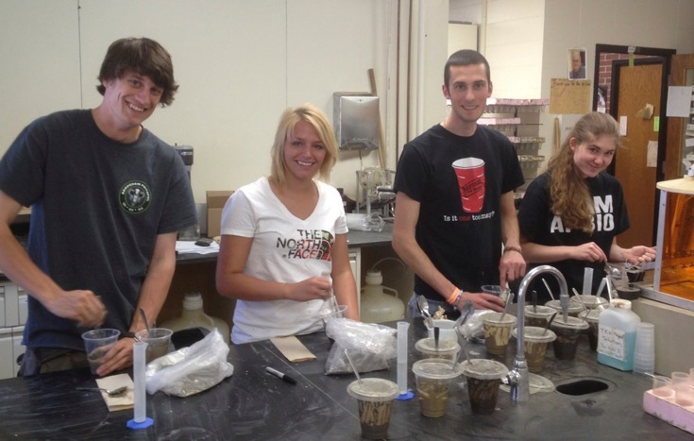

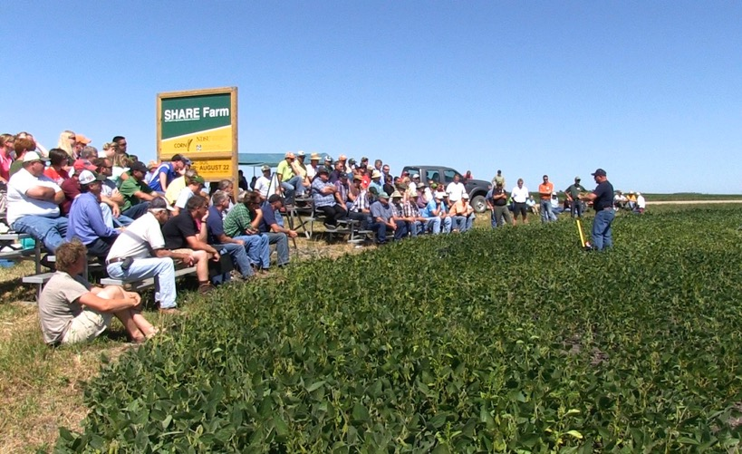
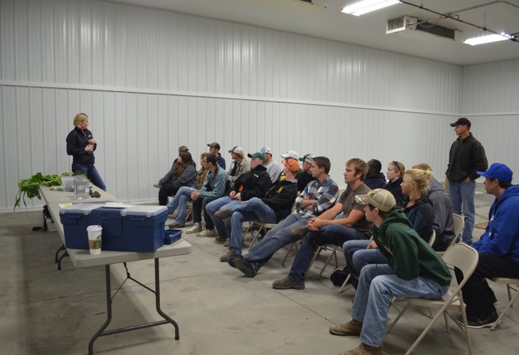

Slide 7
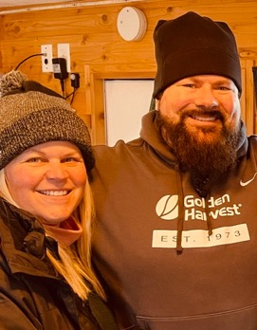
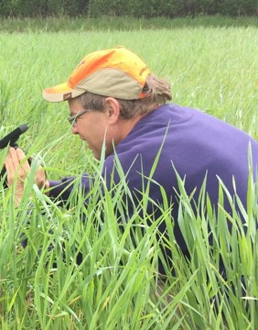
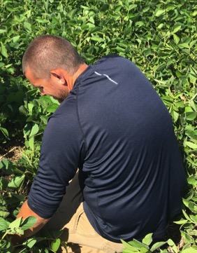
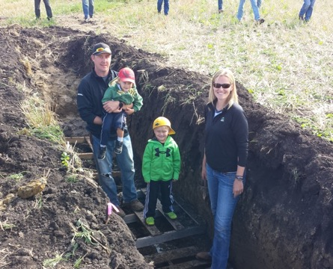

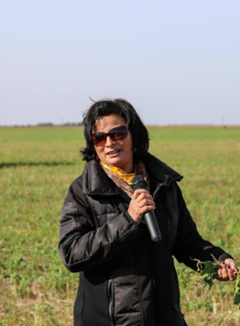
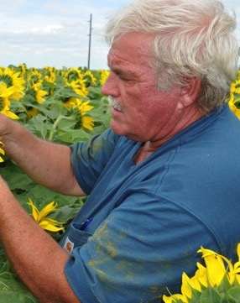
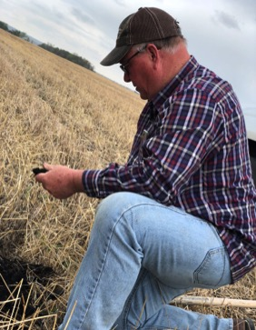
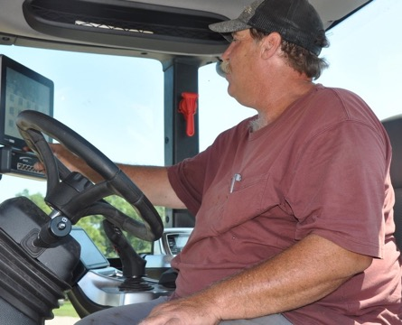
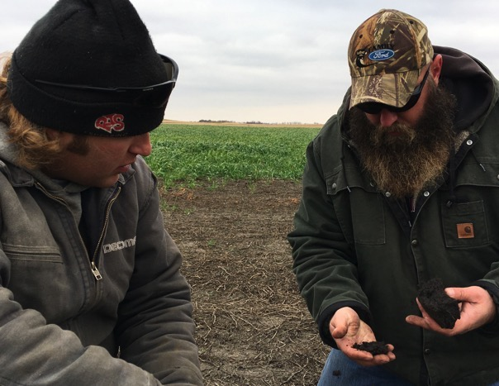
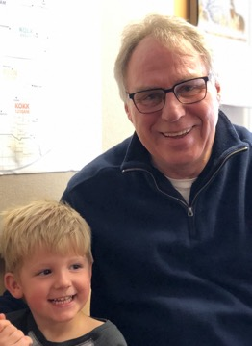
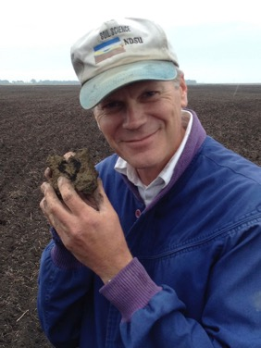
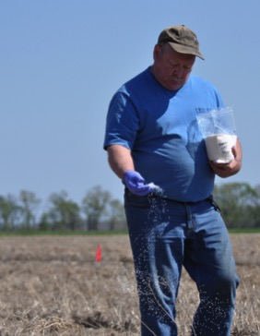
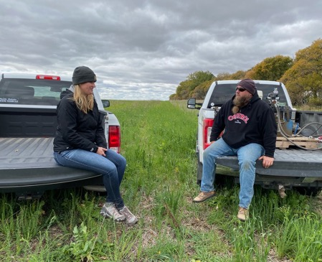
POWER OF A NETWORK

Slide 8
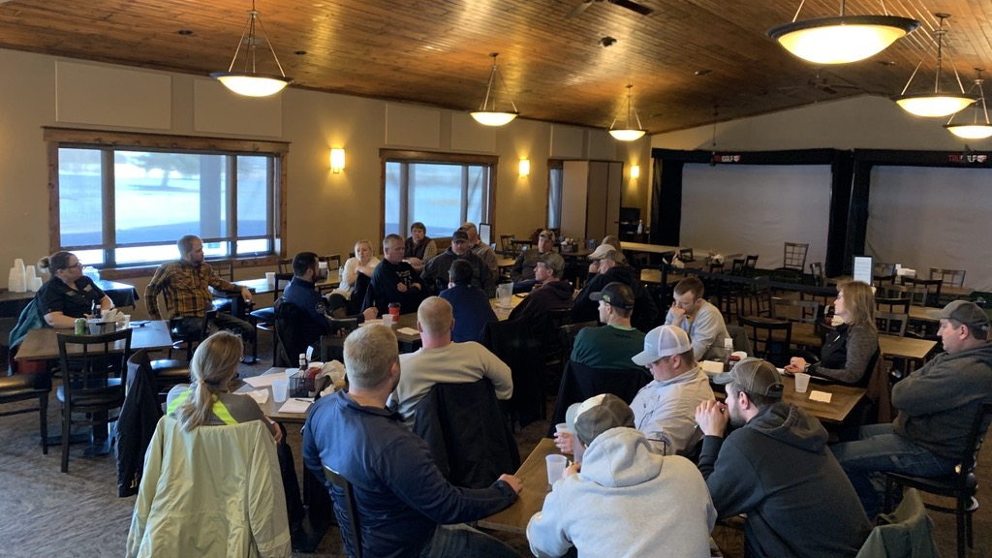
CAFÉ TALKS – OLD SCHOOL WITH A NEW SPIN

Slide 9
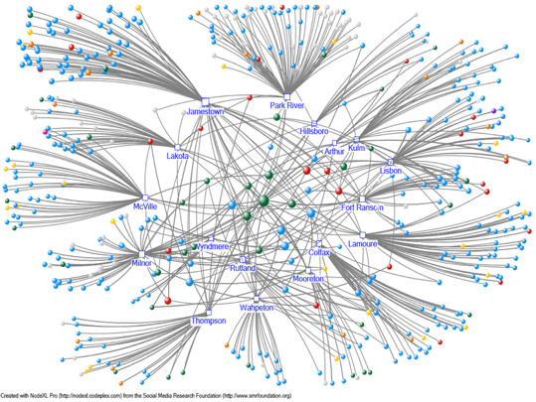

Slide 10
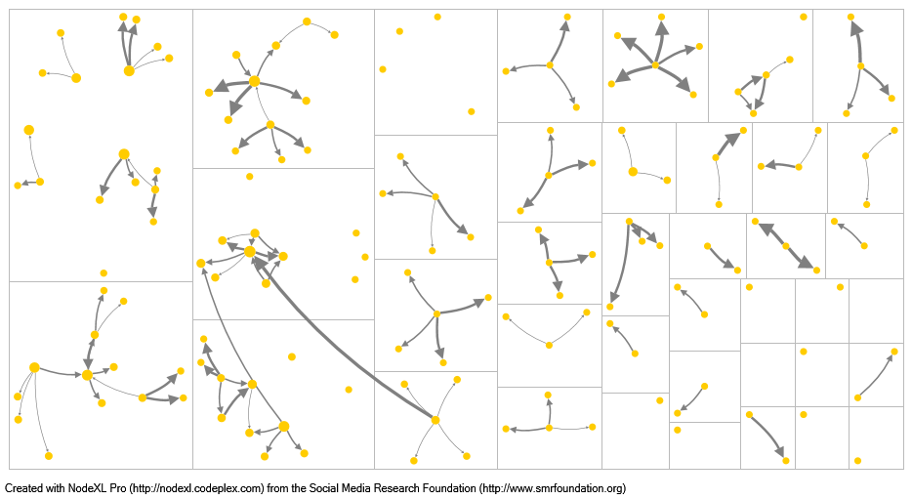
Network Maps – Farmers Only
2019 Farmers
Legend
Farmer
51 respondents identified up to 4 farmers that they communicate with regularly about soil health.
Individuals = 134
Connections = 111
Largest Connected Grp = 20
Average distance = 2.4*
*on average it takes 2.4 “hops” for one person to get to everyone else in the graph.
Node size based on Eigenvector centrality
Line thickness indicates frequency of communication
Notes:
NDSU = green: 0, 102, 51
Farmer = yellow: 255, 204, 0
Consultant = blue: 0, 0, 255
Financial = 0, 0, 0
Industry = 0, 217, 217
Government = 255, 0, 0
Other/unknown = 192, 192, 192

Slide 11
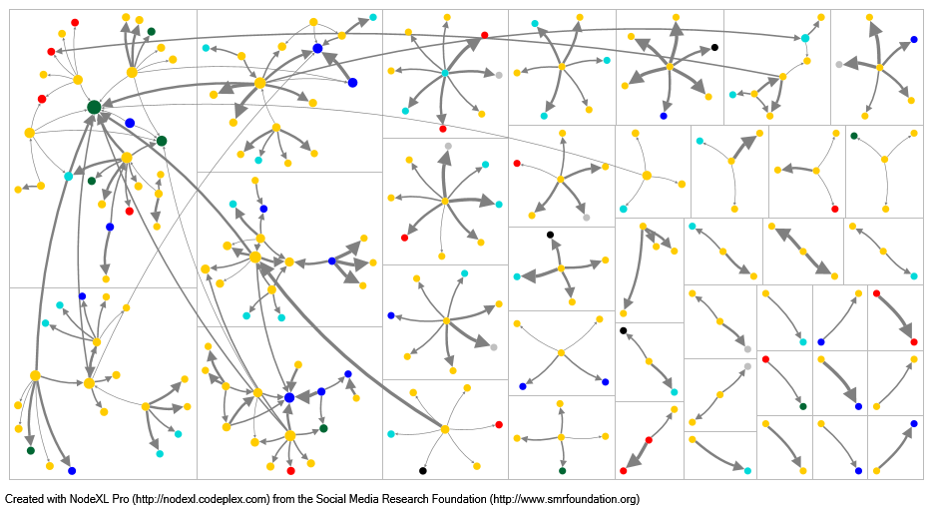
Network Maps - Complete
2019 Farmers
51 respondents identified up to 4 farmers and 4 non-farmers that they communicate with regularly about soil health.
Individuals = 240
Connections = 232
Largest Connected Grp = 116
Average distance = 4*
*on average it takes 4 “hops” for one person to get to everyone else in the graph.
Legend
Consultant
Farmer
Financial
Government
Industry
NDSU
Other/ unknown
Node size based on Eigenvector centrality
Line thickness indicates frequency of communication
Notes:
Connected group is called connected component in SNA lingo
NDSU = green: 0, 102, 51
Farmer = yellow: 255, 204, 0
Consultant = blue: 0, 0, 255
Financial = 0, 0, 0
Industry = 0, 217, 217
Government = 255, 0, 0
Other/unknown = 192, 192, 192

Slide 12

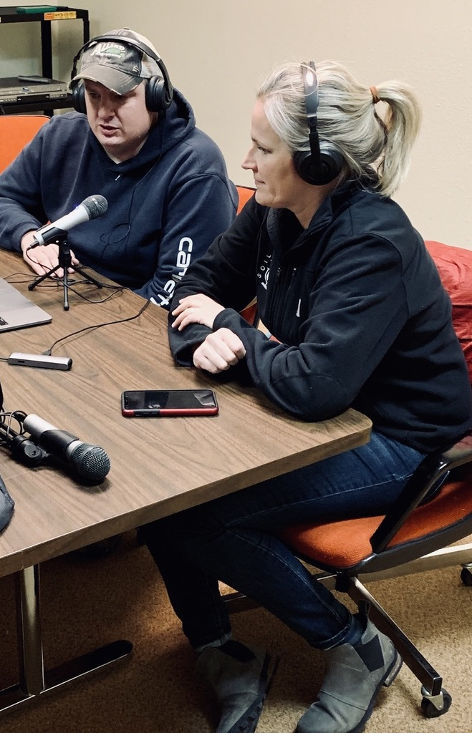

Slide 13
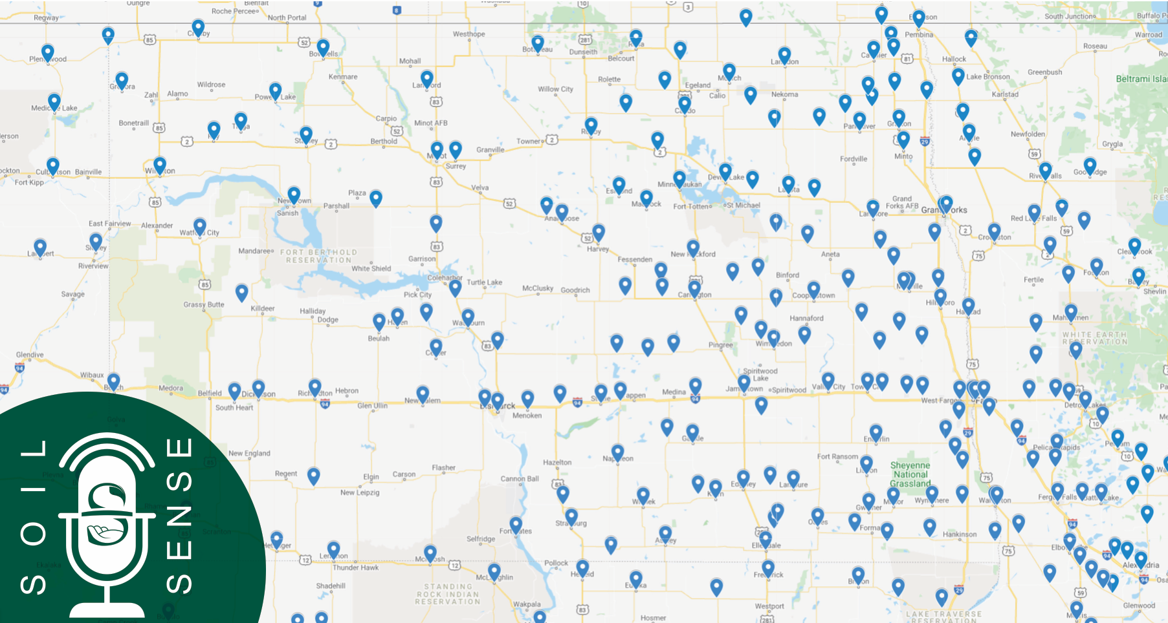
PLAY LOCATIONS - STATE
OVER 150,000 PLAYS

Slide 14
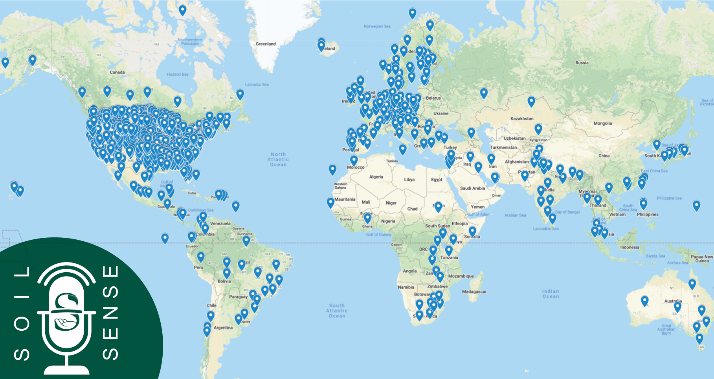
PLAY LOCATIONS - GLOBAL
OVER 100 COUNTRIES

Slide 15
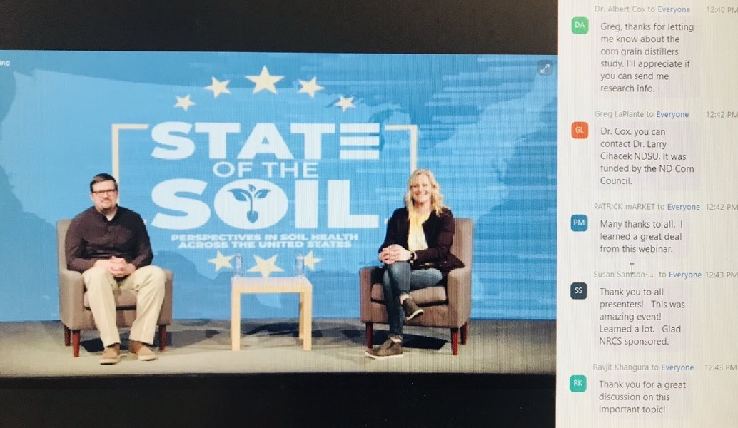

Slide 16

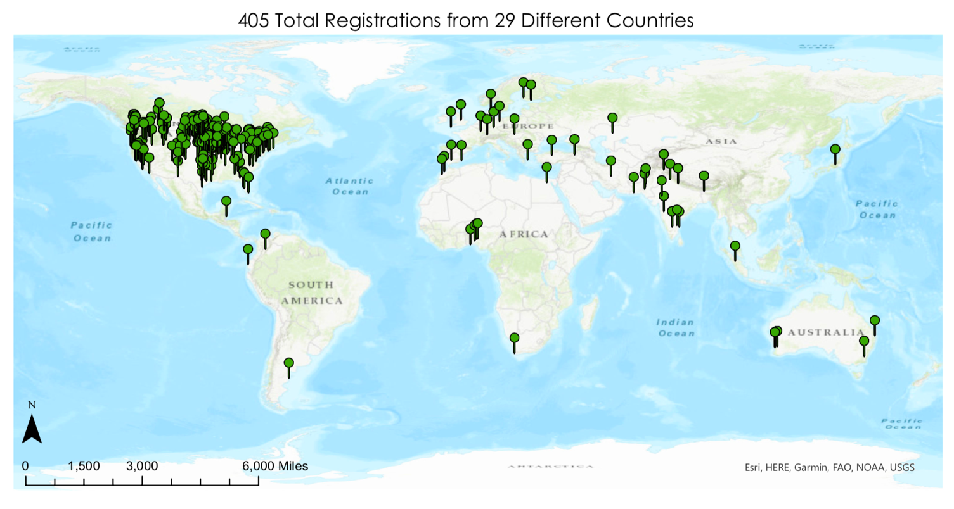

Slide 17
DIRT ATTENDEES
OVER 450 JOINED

Slide 18
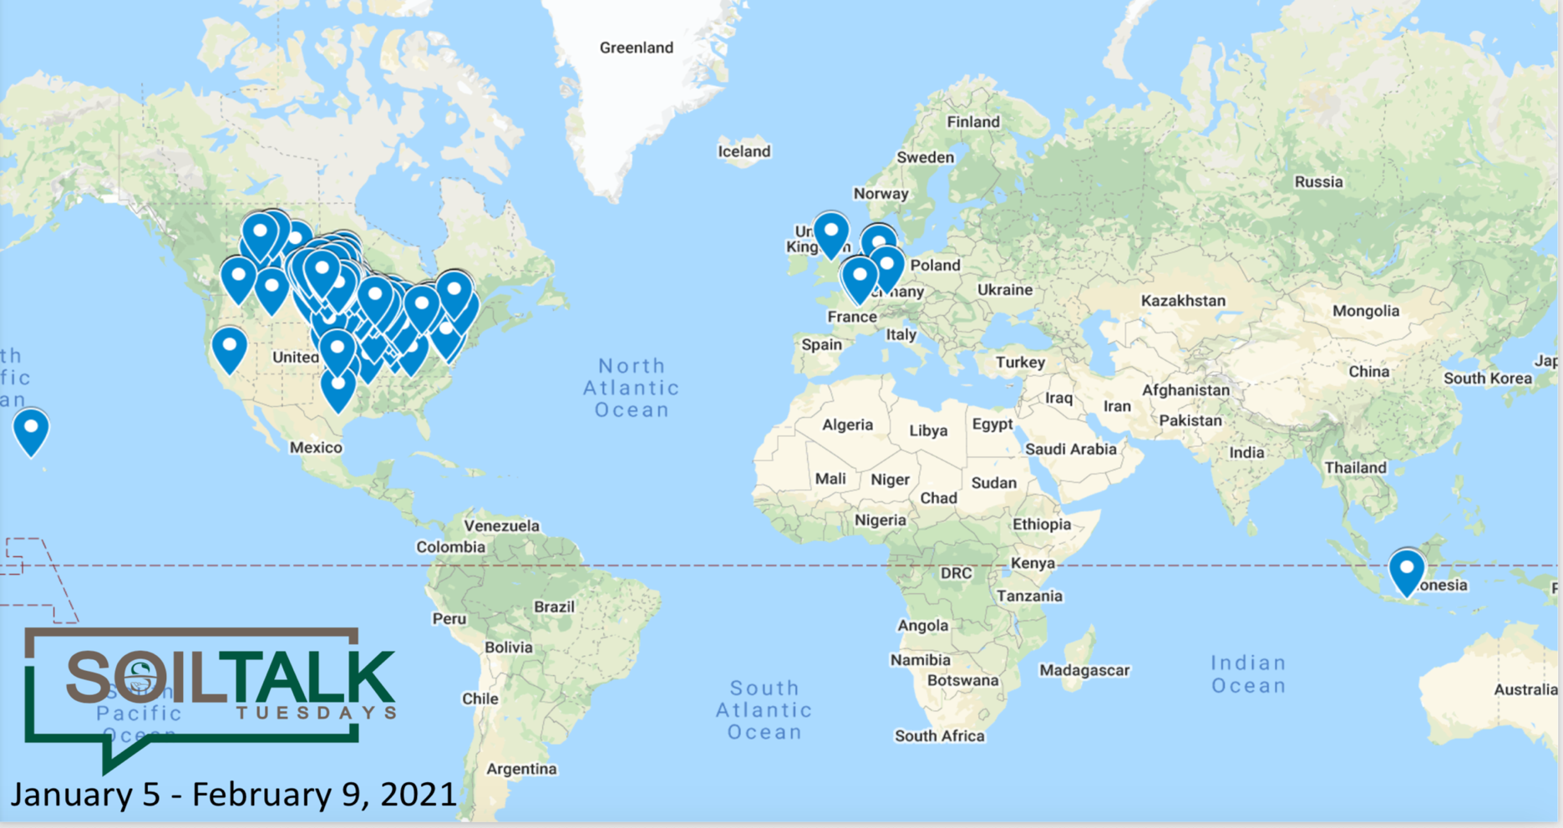
WINTER PROGRAM ATTENDEES
OVER 750 JOINED

Slide 19
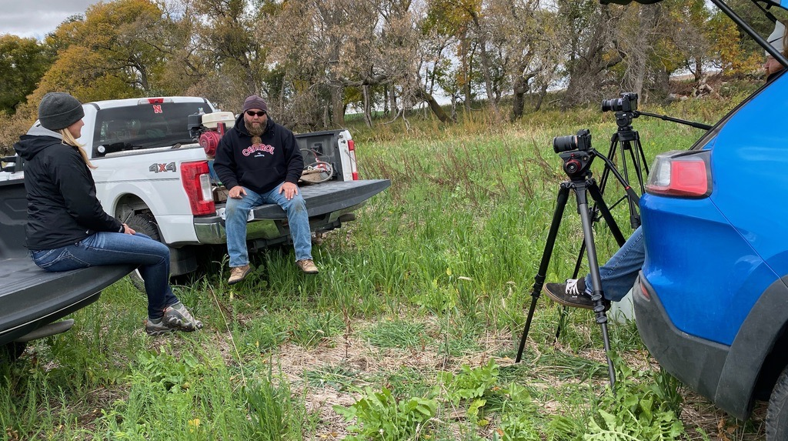

Slide 20



OVER 200 VIDEOS PRODUCED:
PLAYLISTS
HASHTAGS
3.5 MINUTES OR LESS

Slide 21
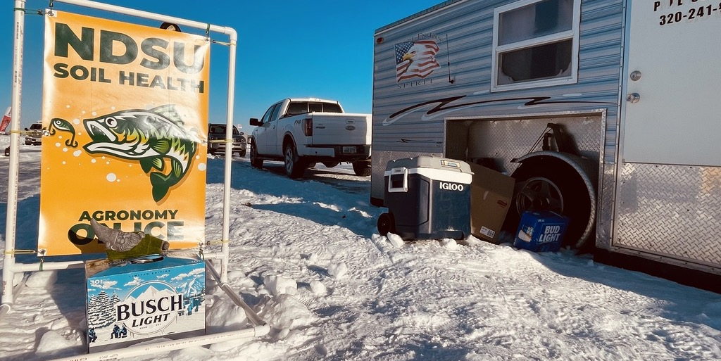
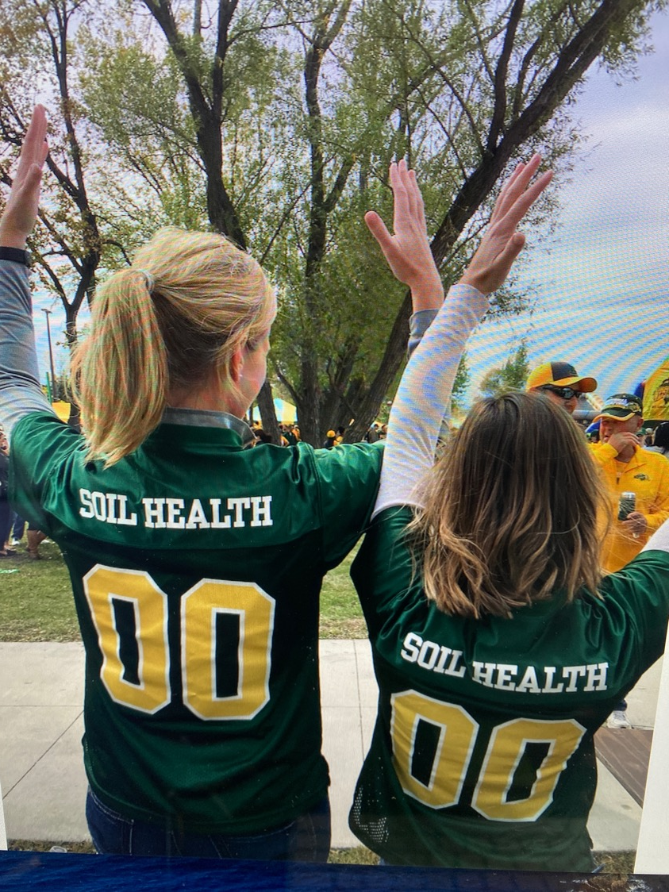
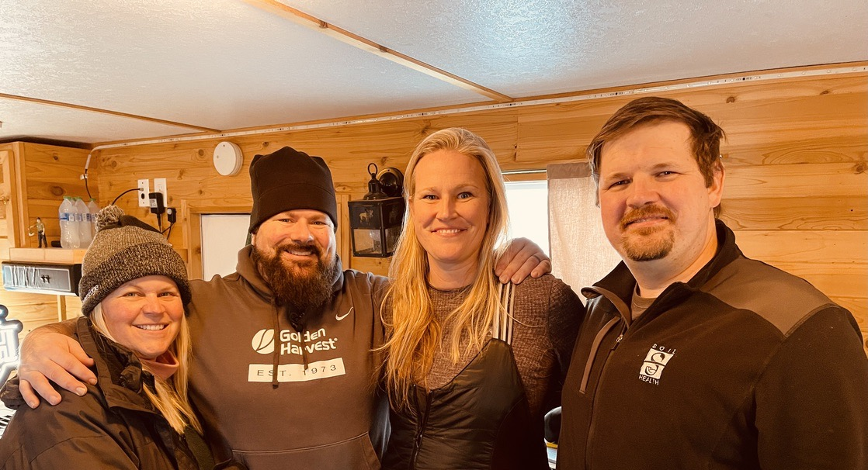

Slide 22
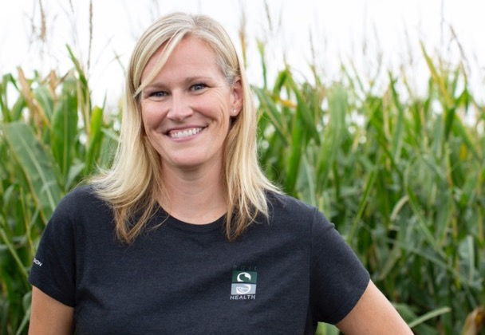





Dr. Abbey Wick
Soil Health Specialist
Associate Professor
NDSU SNRS
PO Box 6050, Dept 7680
Fargo, ND 58108
@NDSUsoilhealth
701-850-6458 (cell)
abbey.wick@ndsu.edu
ndsu.edu/soilhealth
NDsoilsense.com
NDfieldcheck.com

