Slide 1
Welcome to:
Partners in Reclamation
Teaching Young and Old
Pups New Tricks
Dr. Terry Toy
Notes:
Introductory slide to have on screen as people arrive to make sure they are in the right room

Slide 2
Game Plan
My route to reclamation
Partnerships in the classroom –
young pups
Partnerships in workshops and
consulting – old but wiser pups

Slide 3
My Route to Reclamation
A partnership might be described as a mutually beneficial relationship between individuals
My route to reclamation began with a partnership between the U.S. Geological Survey and myself
I arranged an internship/apprenticeship with the Public Lands Hydrology Program of the U.S.G.S. in Denver

Slide 4
U.S.G.S. Public Lands Hydrology
I was assigned to work with hydrologist Gregg Lusby to assess runoff and sedimentation from natural and reclaimed lands at coal mines in the Western United States using rainfall simulation

Slide 5
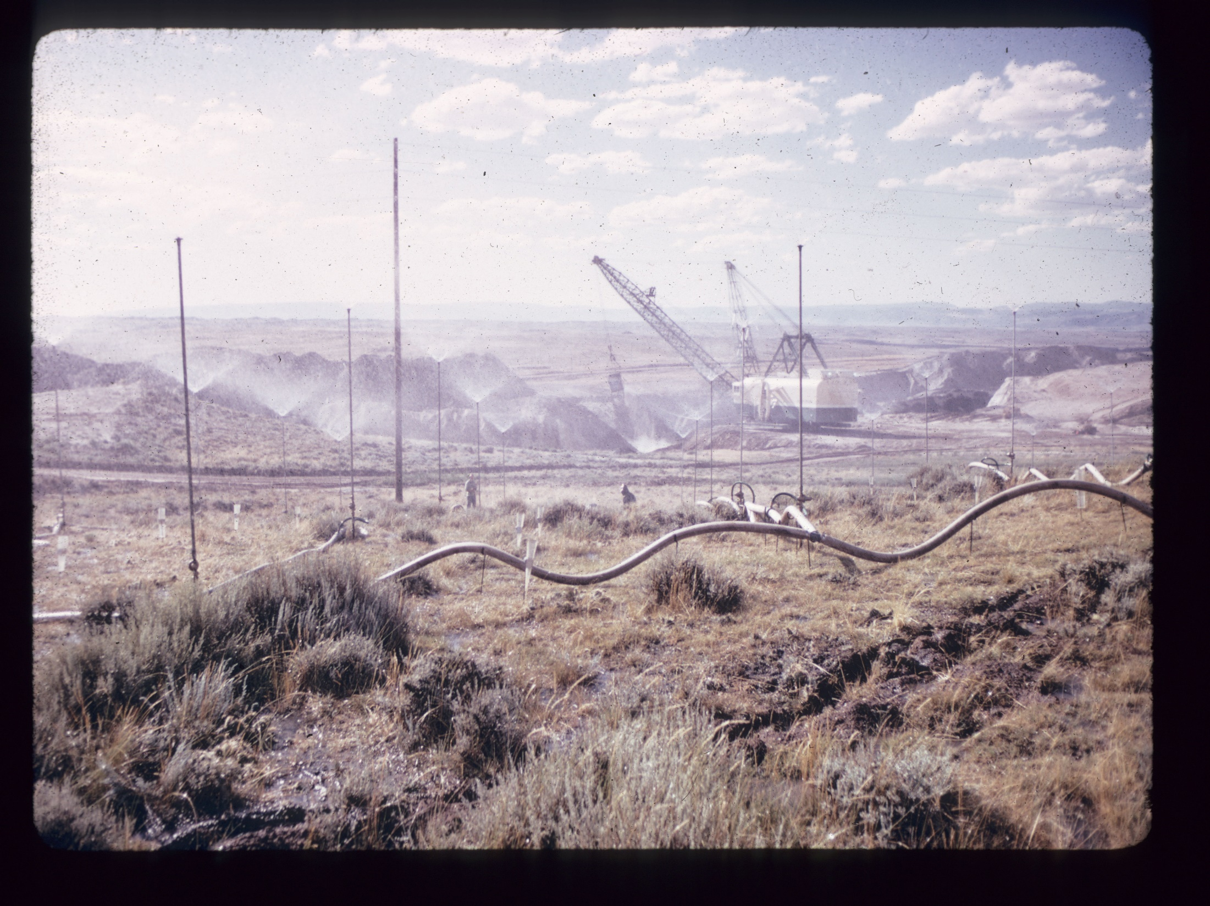

Slide 6
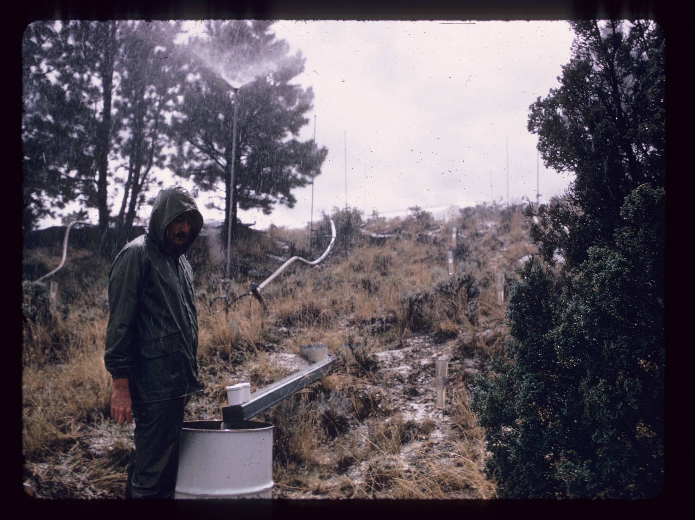

Slide 7
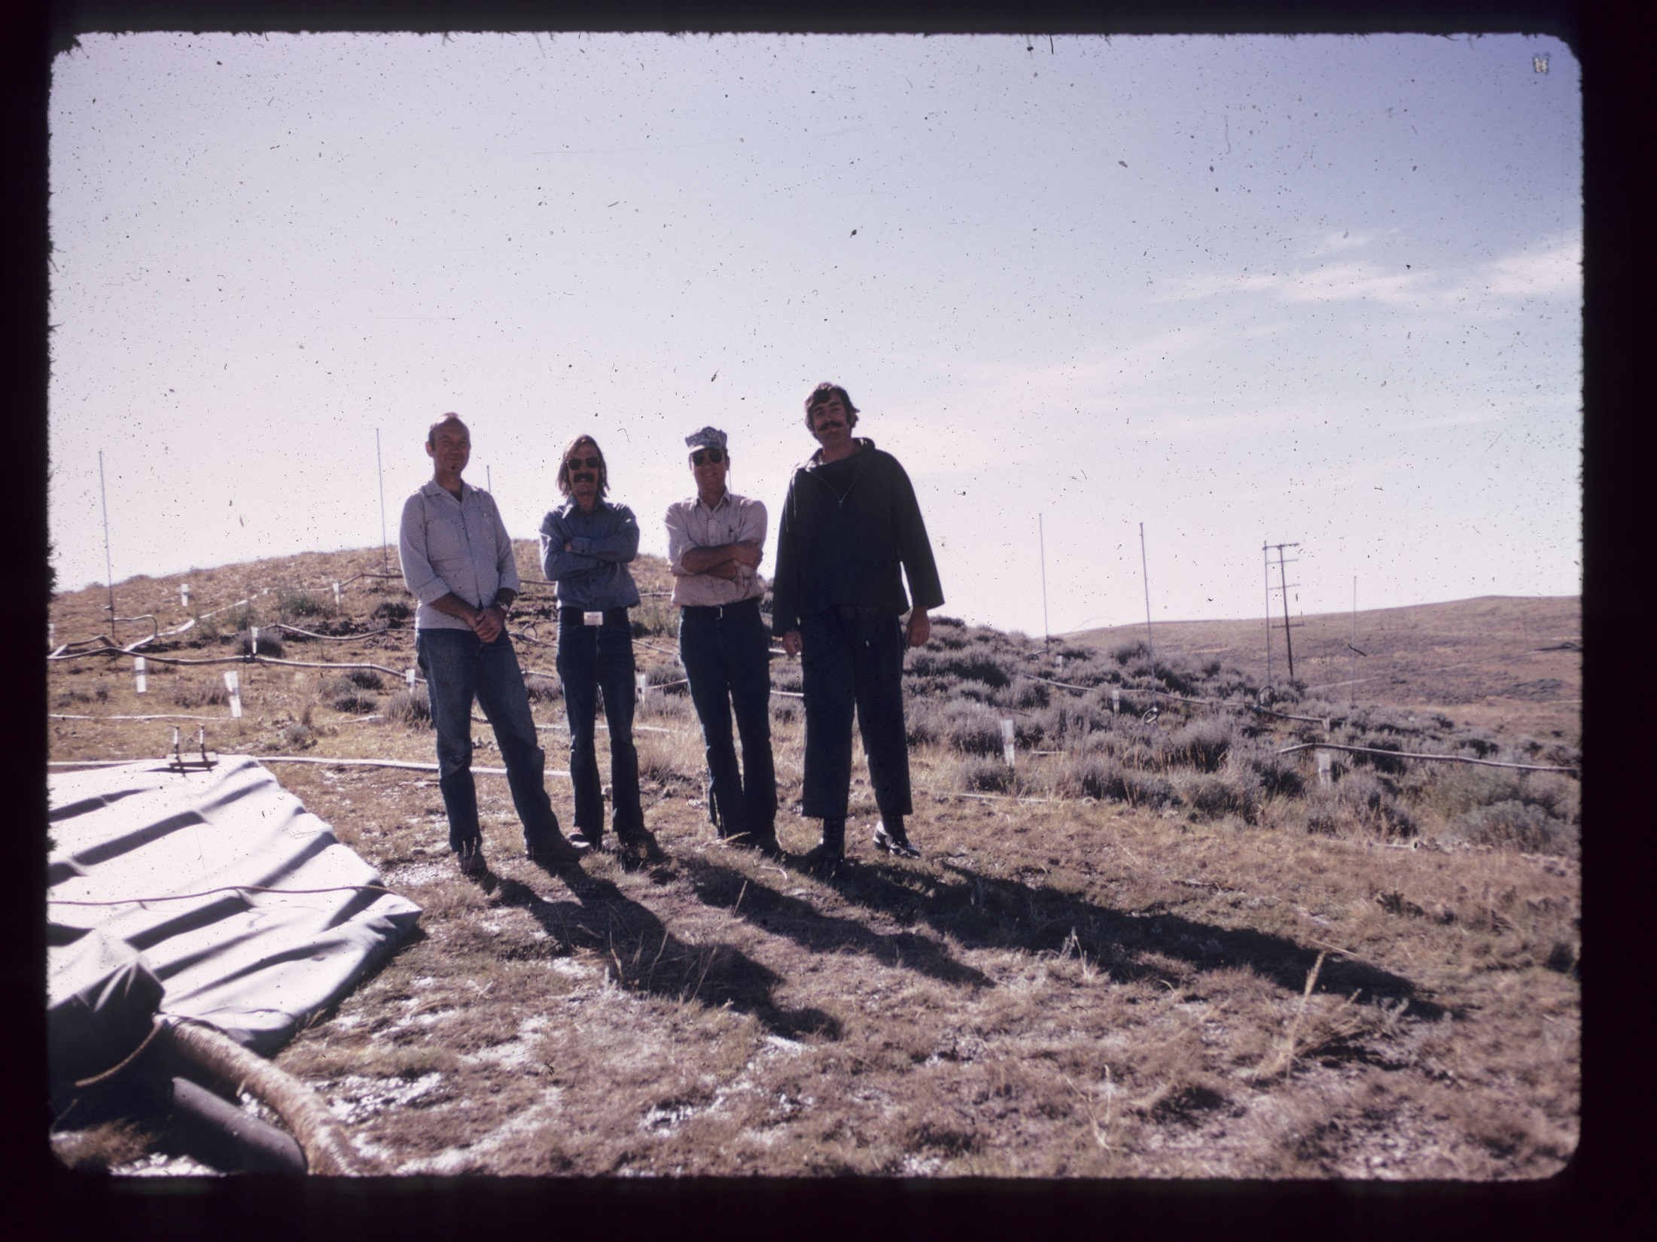

Slide 8
U.S.G.S. Public Lands Hydrology
    Led to my first publication in Reclamation:
  Lusby, G.C., and Toy. T.J., 1976, “An Evaluation of Surface-Mined Spoils Area Restoration in Wyoming Using Rainfall Simulation,” Earth Surface Processes and Landforms, V.1, No.4, pp. 375-386.
  And the rest is history, approaching ancient history

Slide 9
Partnerships In the Classroom –
Young Pups
The classroom is a partnership between the teacher (fountain of wisdom) and the student (sponge of knowledge).
As a new assistant professor I was given the opportunity to teach 6 quarter-long classes per year, most with laboratories, for a total of just about 300 student-contact hours per year. (later that changed to only 5 classes per year)
As a result, I taught 18 different classes during my academic career.

Slide 10
Eventually, I was given the opportunity to add courses that I thought were important for our students and were congruent with my interests
One of the first was the Reclamation of Disturbed Lands
A feature of almost all of my classes was a practical dimension, including guest speakers and field trips
Here’s where the partnerships came in.

Slide 11
Guest speakers in the reclamation class included such luminaries as:
  Dr. Jerry Schuman – from ARS, Cheyenne WY
  Mr. Dave Chenowith – Western States
  Reclamation
  Mr. David Berry – Office of Surface Mining
  Ms. Karen Dwyer-Kwon – private consultant,
    with Knight-Piesold

Slide 12
Field trips during the class included visits to:
  20-mile Creek Mine – Colorado
  Climax Molybdenum, Climax Colorado
  LaFarge North America - Wayne Erickson
  Colorado State Highways – Bill Agnew
  Housing Development – Denver Foothills,
  Wayne Erickson

Slide 13
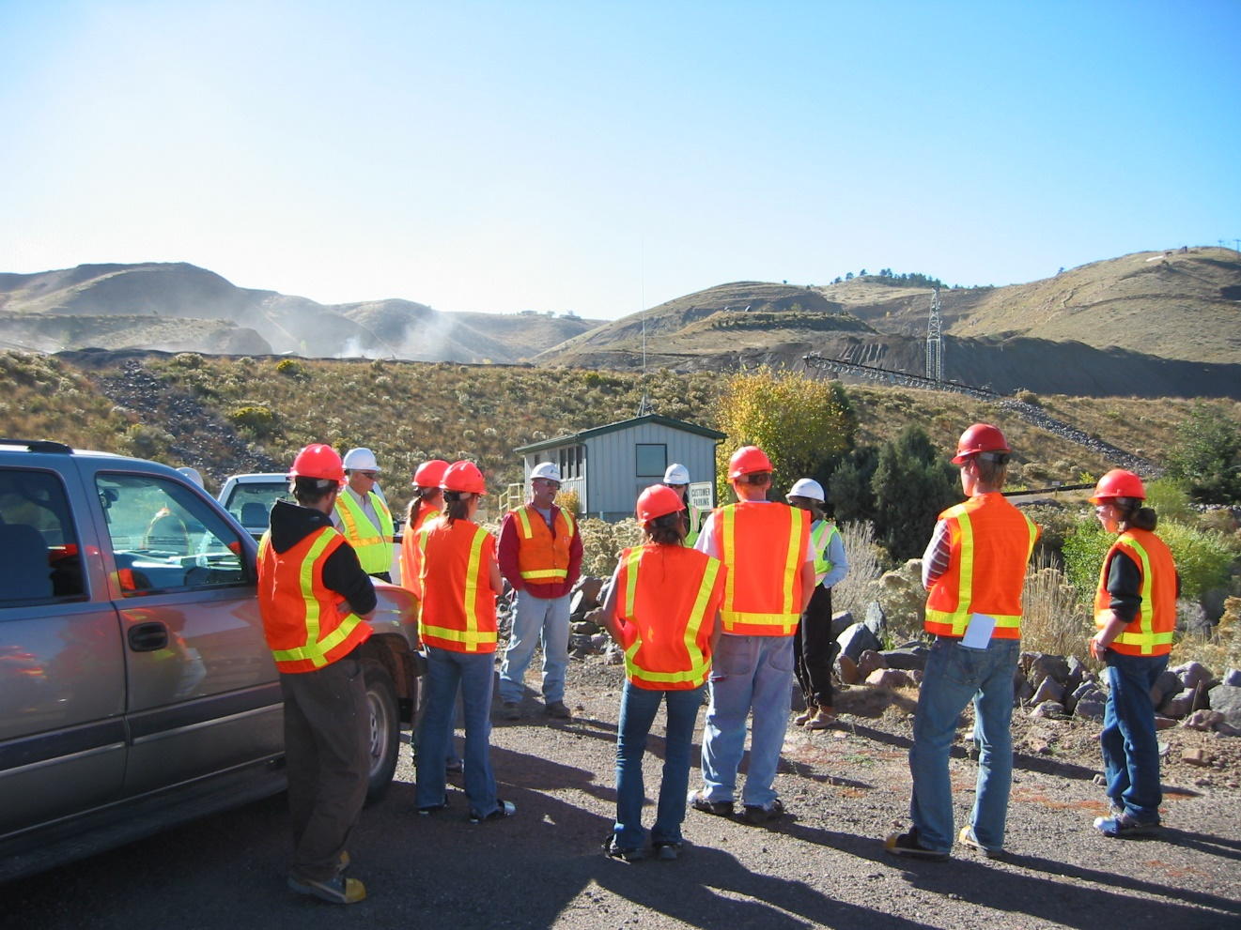
LaFarge with Wayne Erickson

Slide 14
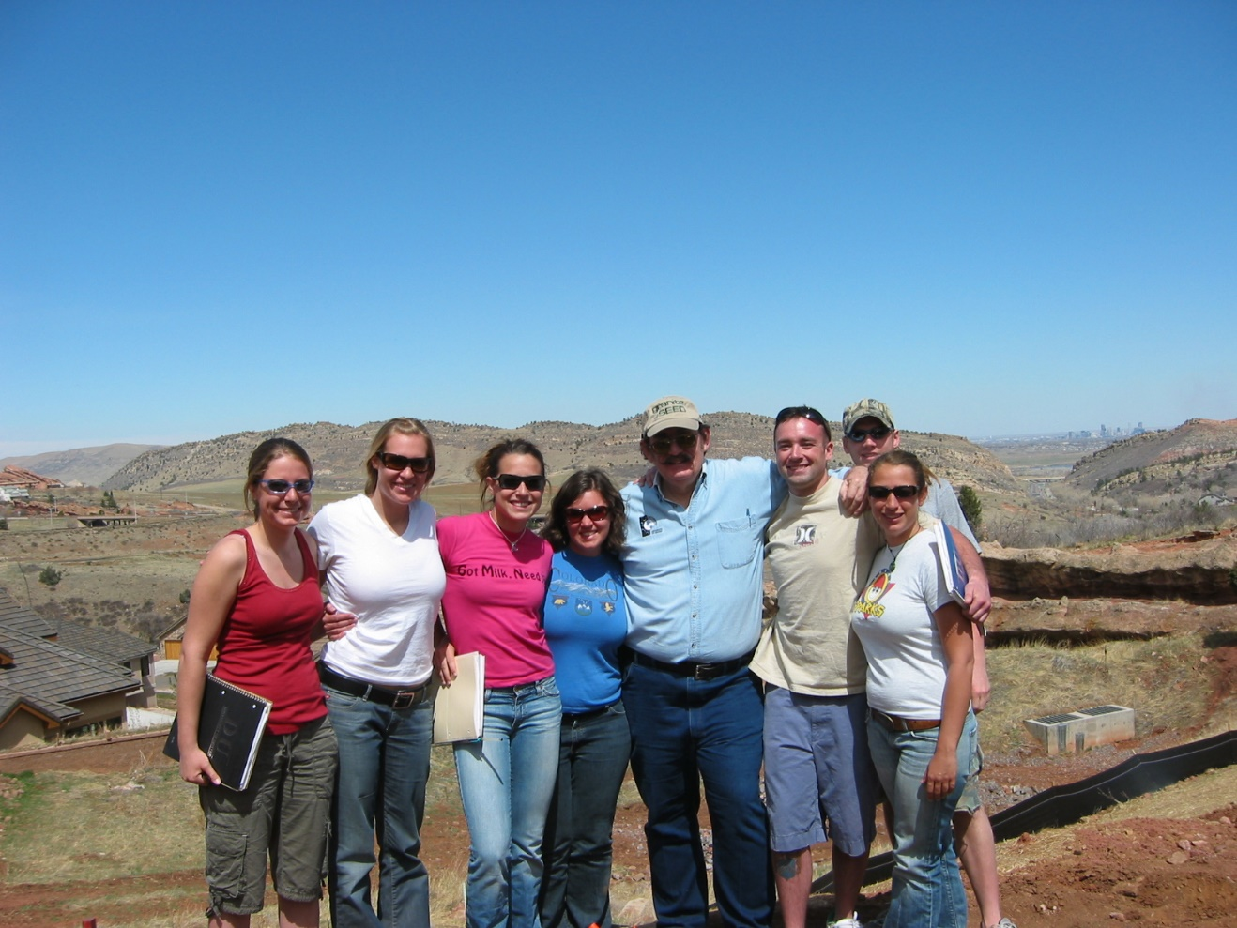
Housing Development – Denver Foothills

Slide 15
The students benefitted from the partnerships with the guest speakers and field-trip guides by learning that reclamation was real.
The guest speakers and field-trip guides learned that the University of Denver and our students were real. These contact occasionally led to job opportunities.
I enjoyed the partnerships with the guest speakers and the fieldtrip

Slide 16
For graduate students the experience was more intense
In addition to the classroom experience there often was the field-assistant experience associated with grant research
They learned field methods, data reduction and analyses methods, and gained some report-writing capability
Often this led to their theses or dissertation projects

Slide 17
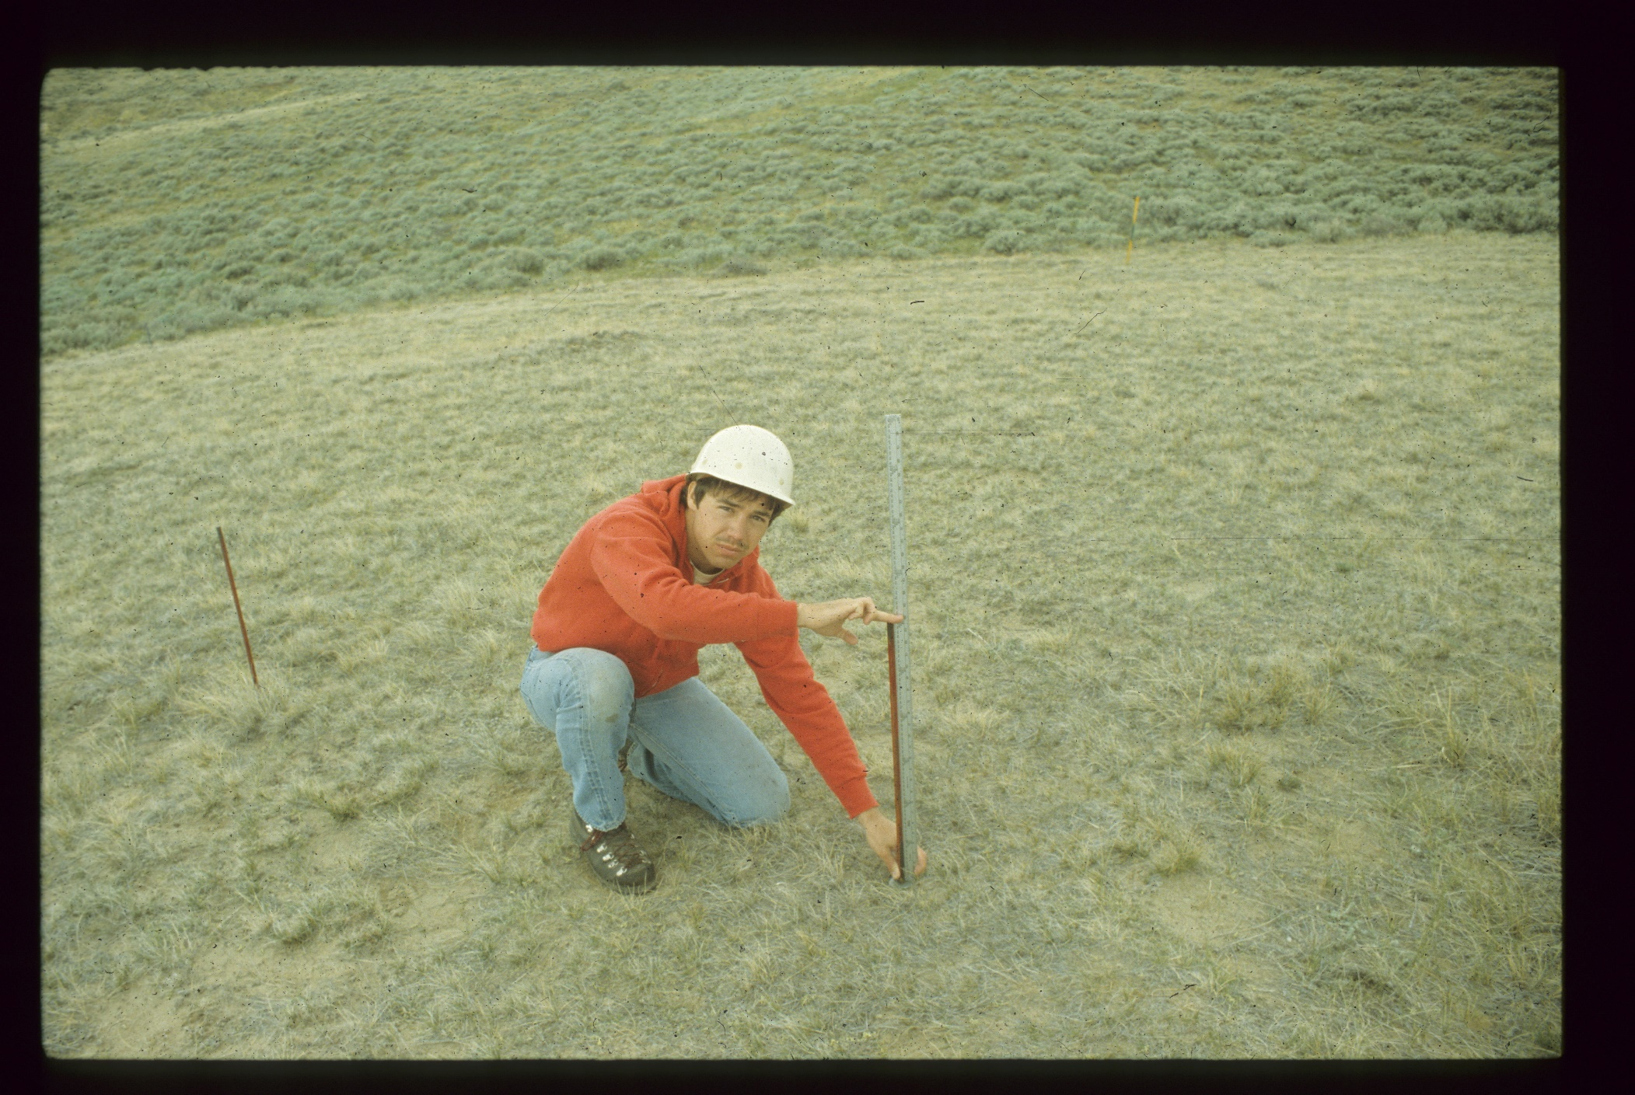
Dr. James Doerner, Professor, Dept. Geography, GIS and Sustainability
University of Northern Colorado

Slide 18
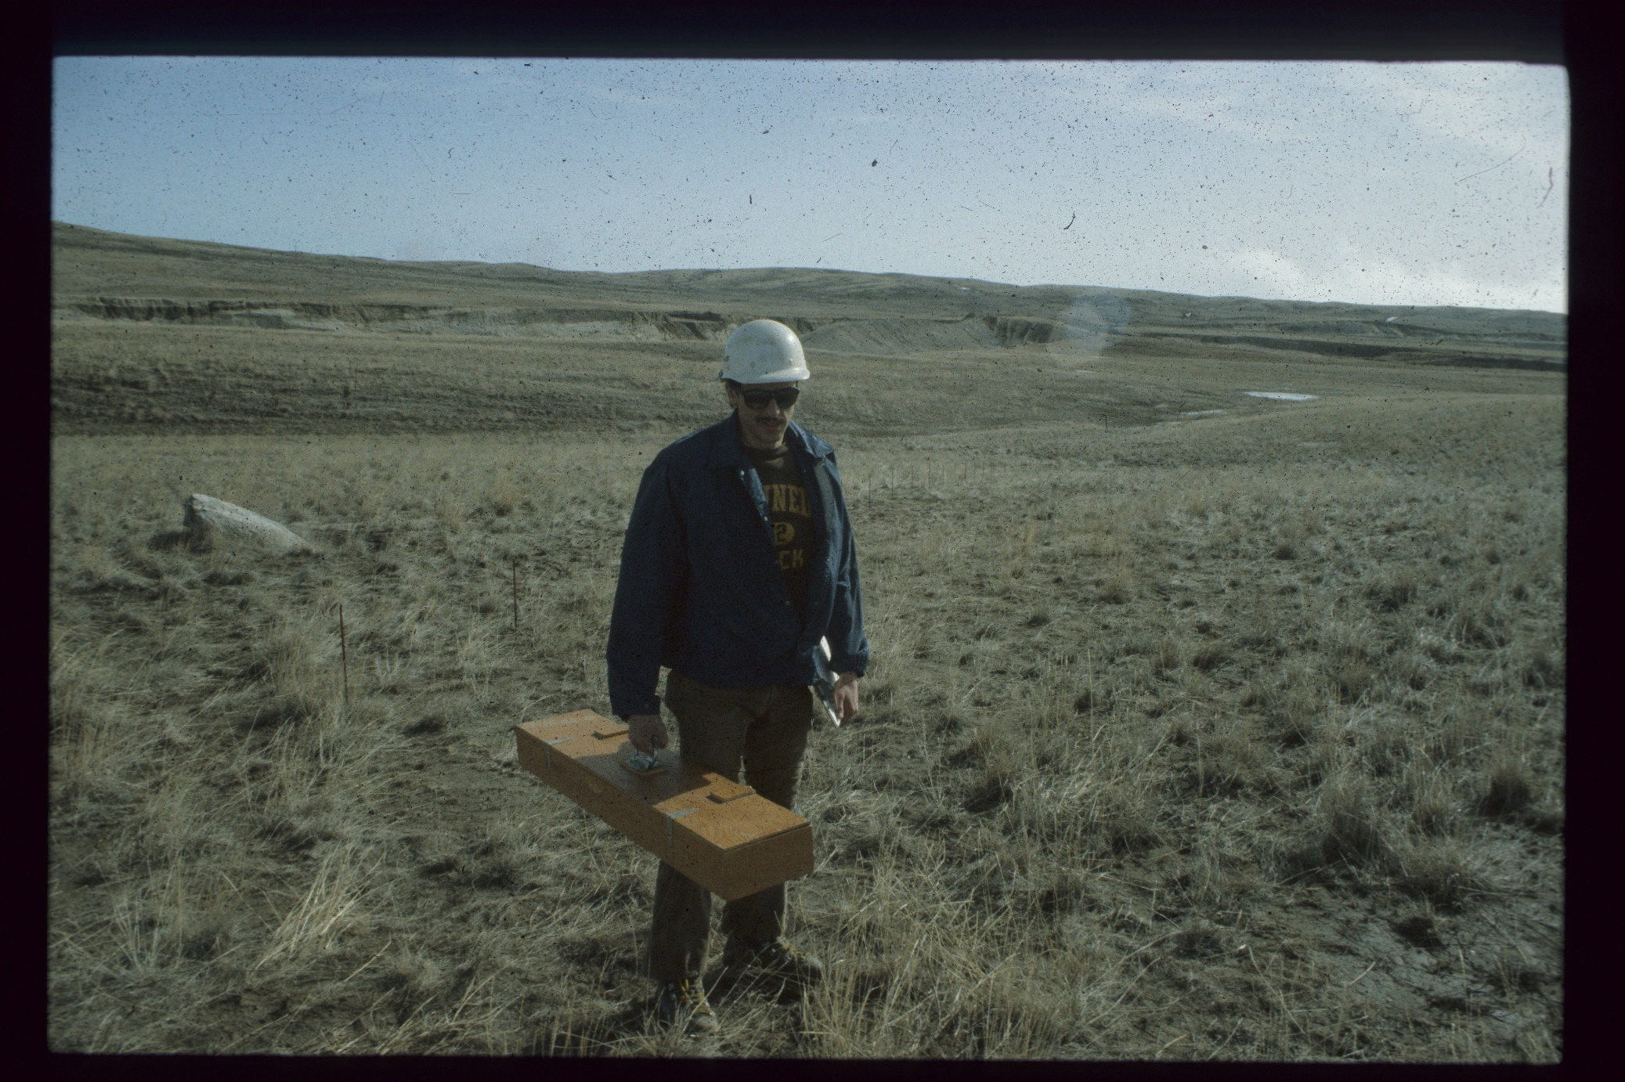
Mr. David Berry, Western Regional Director, Office of Surface Mining

Slide 19
Through these partnerships with their faculty advisors graduate students learned how to conduct research.
They also met reclamation professionals working on-site and the challenges that confronted these professionals in their work
Dr. Skousen will discuss the role of partnerships in research

Slide 20
Partnerships In Workshops and Consulting -
Older Pups
Partnerships with those engaged in reclamation includes workshops and consulting opportunities
Most of the workshops that I developed focused upon the Revised Universal Soil Loss Equation (RUSLE 1 & 2) and usually involved a partnership with a colleague – George Foster of ARS or Dave Lightle of the NRCS.

Slide 21
These workshops were presented throughout the United States, a couple in Canada and Brazil at International Erosion Control Association and American Society of Mining and Reclamation meetings or by special arrangement at universities or consulting firms, 2007 – 2017.
These workshops sometimes led to extended partnerships between the presenters and participants in the workshops m the form of consulting opportunities.

Slide 22
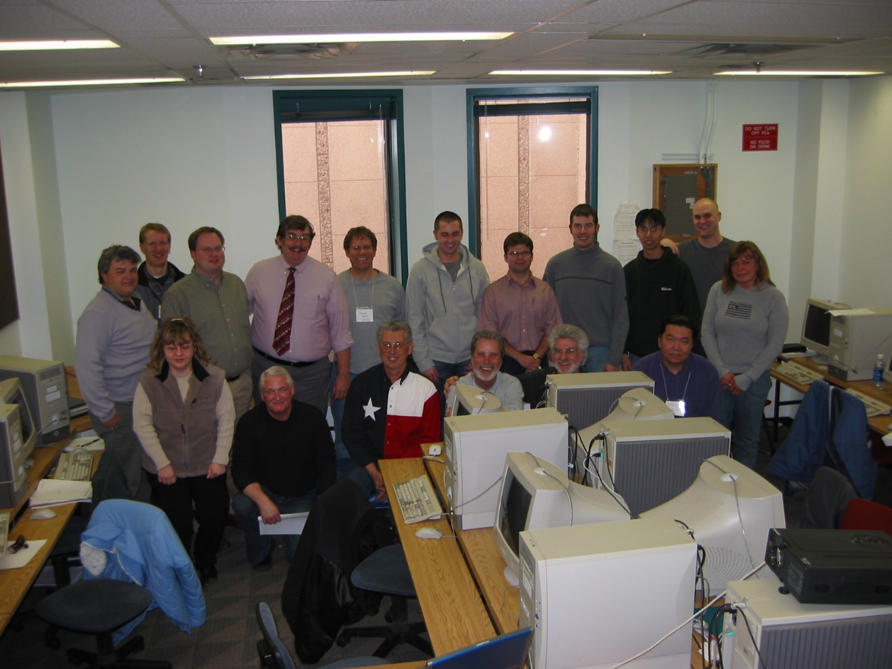
RUSLE workshop in Calgary, Alberta Canada

Slide 23
Occasionally, I was fortunate to participate in thematic workshops focusing on disturbed land reclamation or erosion issues, such as the workshops sponsored by the ASMR in Estonia and by North Dakota State University and a sabbatical in Brazil.
These teaching opportunities created partnerships between the participants and myself.
And I could bring the experiences back to the classroom for my students.

Slide 24
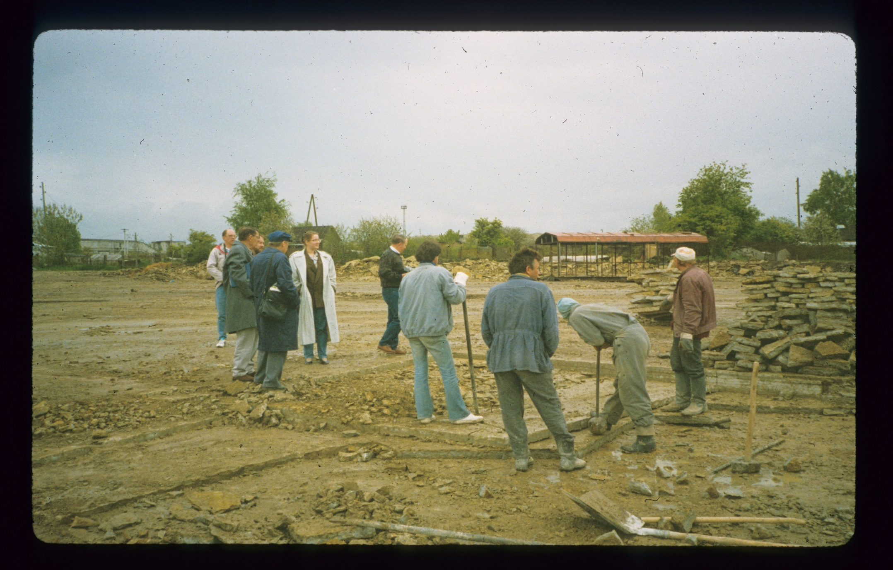
ASMR workshop field trip in Estonia

Slide 25
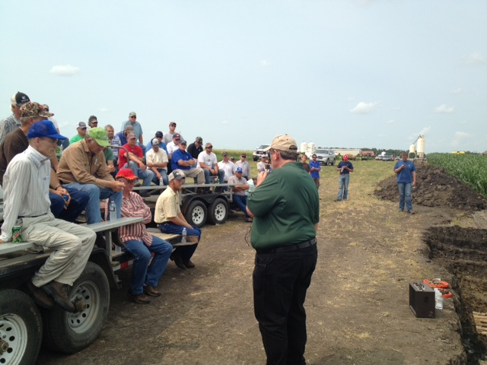
Soil Erosion Field Days in North Dakota

Slide 26
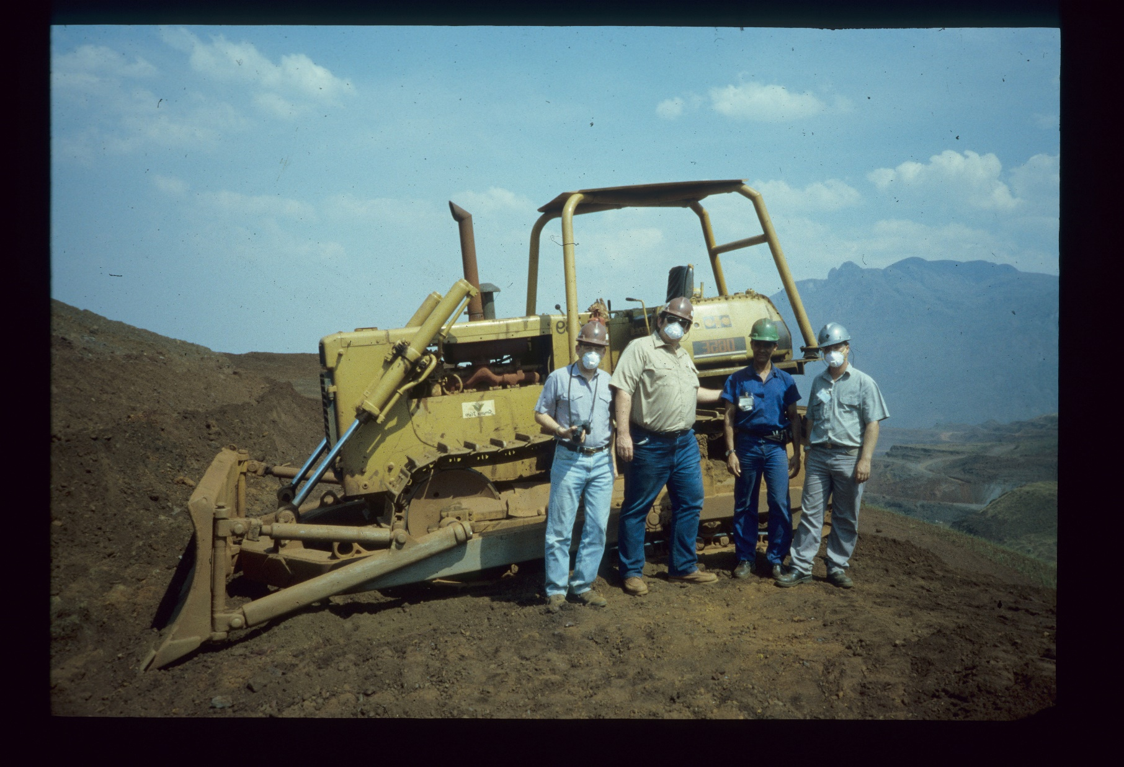
Sabbatical in Brazil working with mine reclamation personnel and my host, Dr. Jim Griffith, to evaluate reclamation practices.

Slide 27
Conclusion:
Partnerships in Reclamation
Teaching Young and Old
Partnerships come in many flavors
  Students, both graduate and undergraduates
  Professional reclamationists – colleagues, consultants
Teaching takes place in many ways
  Classrooms, fieldtrips, workshops, consulting
  All involve partnerships and the transfer of knowledge

Slide 28
Advantages
The advantages include:
  The opportunity to bring the knowledge and experiences back to the classroom for the students
  A dose of reclamation reality; what will and what is unlikely to work
  Experience with the latest methodologies and techniques
  Oftentimes, opportunities for students for continuing their education or obtaining jobs

Slide 29
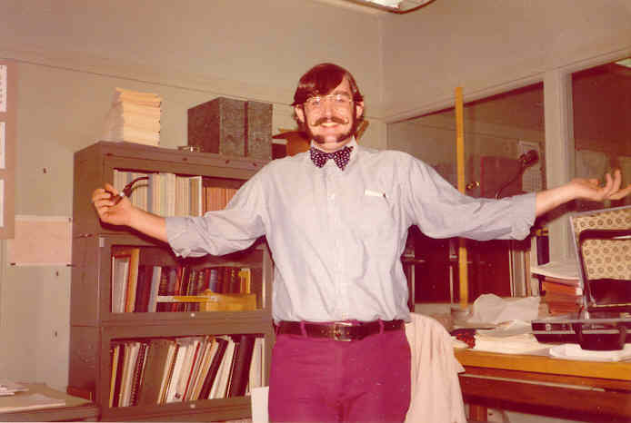
At the start: U.S. Geological Survey, Denver Offices, 1971 (51 years ago)
Thanks For Coming

