Slide 1
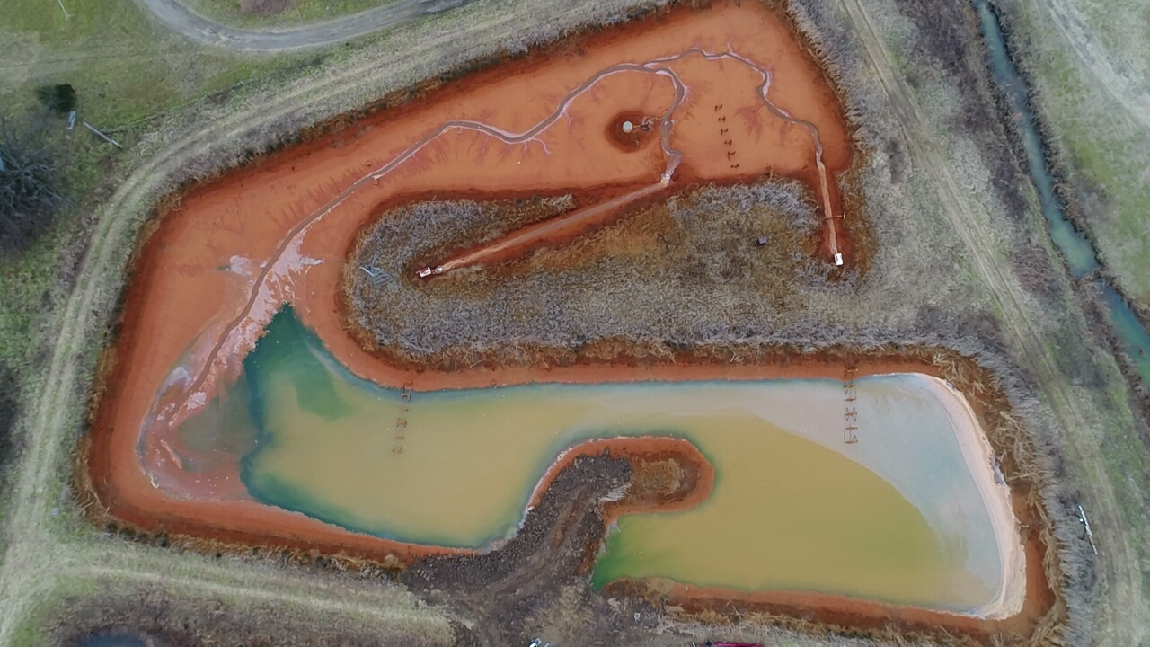
Using sUAS for the Development and Validation of Surface Water Quality Models in Optically Deep Mine Water
Brandon K. Holzbauer-Schweitzer, Ph.D.
And
Robert W. Nairn, Ph.D.
39th Annual ASRS Meeting
Tuesday June 14th, 2022

Slide 2
Acknowledgements
Center for Restoration of Ecosystems and Watersheds (CREW):
Dr. Juan Arango Calderon
Dillon Bruer
M’Kenzie Dorman
JD Ingendorf
Dr. Nicholas Shepherd
Harper Stanfield
Dr. Zepei (Maggie) Tang
Taylor Wall
David Wilcox
Duncan Wright
Earth Observation and Modeling Facility (EOMF):
Dr. Xiangming Xiao
Dr. Rajen Bajgain
Grand River Dam Authority:
Dustin Browning
Matthew Conrad
Steve Nikolai
Dr. Darrell Townsend
Landowners:
Martin Family
Fleming Family
Family and Friends
Notes:
I’d like to being by acknowledging several individuals who without this project would not have been possible. First nearly every individual apart of our research team CREW has participated in either collecting or analyzing samples. The individuals with Earth observation and modeling at OU who allowed me to use their spectral instruments. The Grand River dam authority for funding and allowing me access to their laboratory, the Martin and Fleming Families for access to their properties and my study location, and finally all of my family and friends that helped me through my stint in academia. You are all very much appreciated.

Slide 3
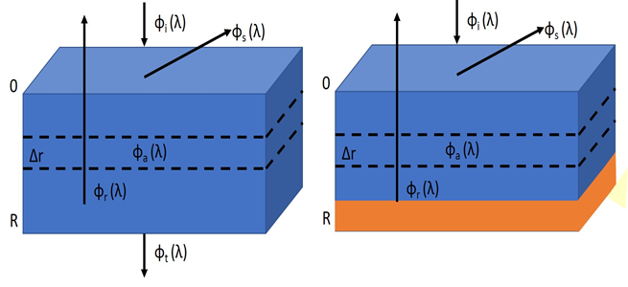
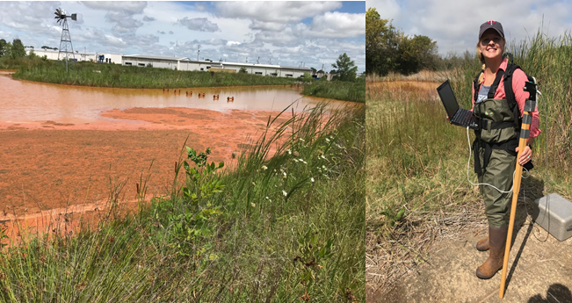
Background and Introduction
Methodology
Results and Conclusions
3
Notes:
We are going to begin with a brief mapping slide to outline today's presentation
We will start with a brief introduction to the science of remote sensing, I will then explain what was missing from the literature and why my studies were necessary, and
Then I will provide a generalized overview of the methods I employed.
From there we will dive into the meat of todays talk and wrap up with a series of concluding statements

Slide 4
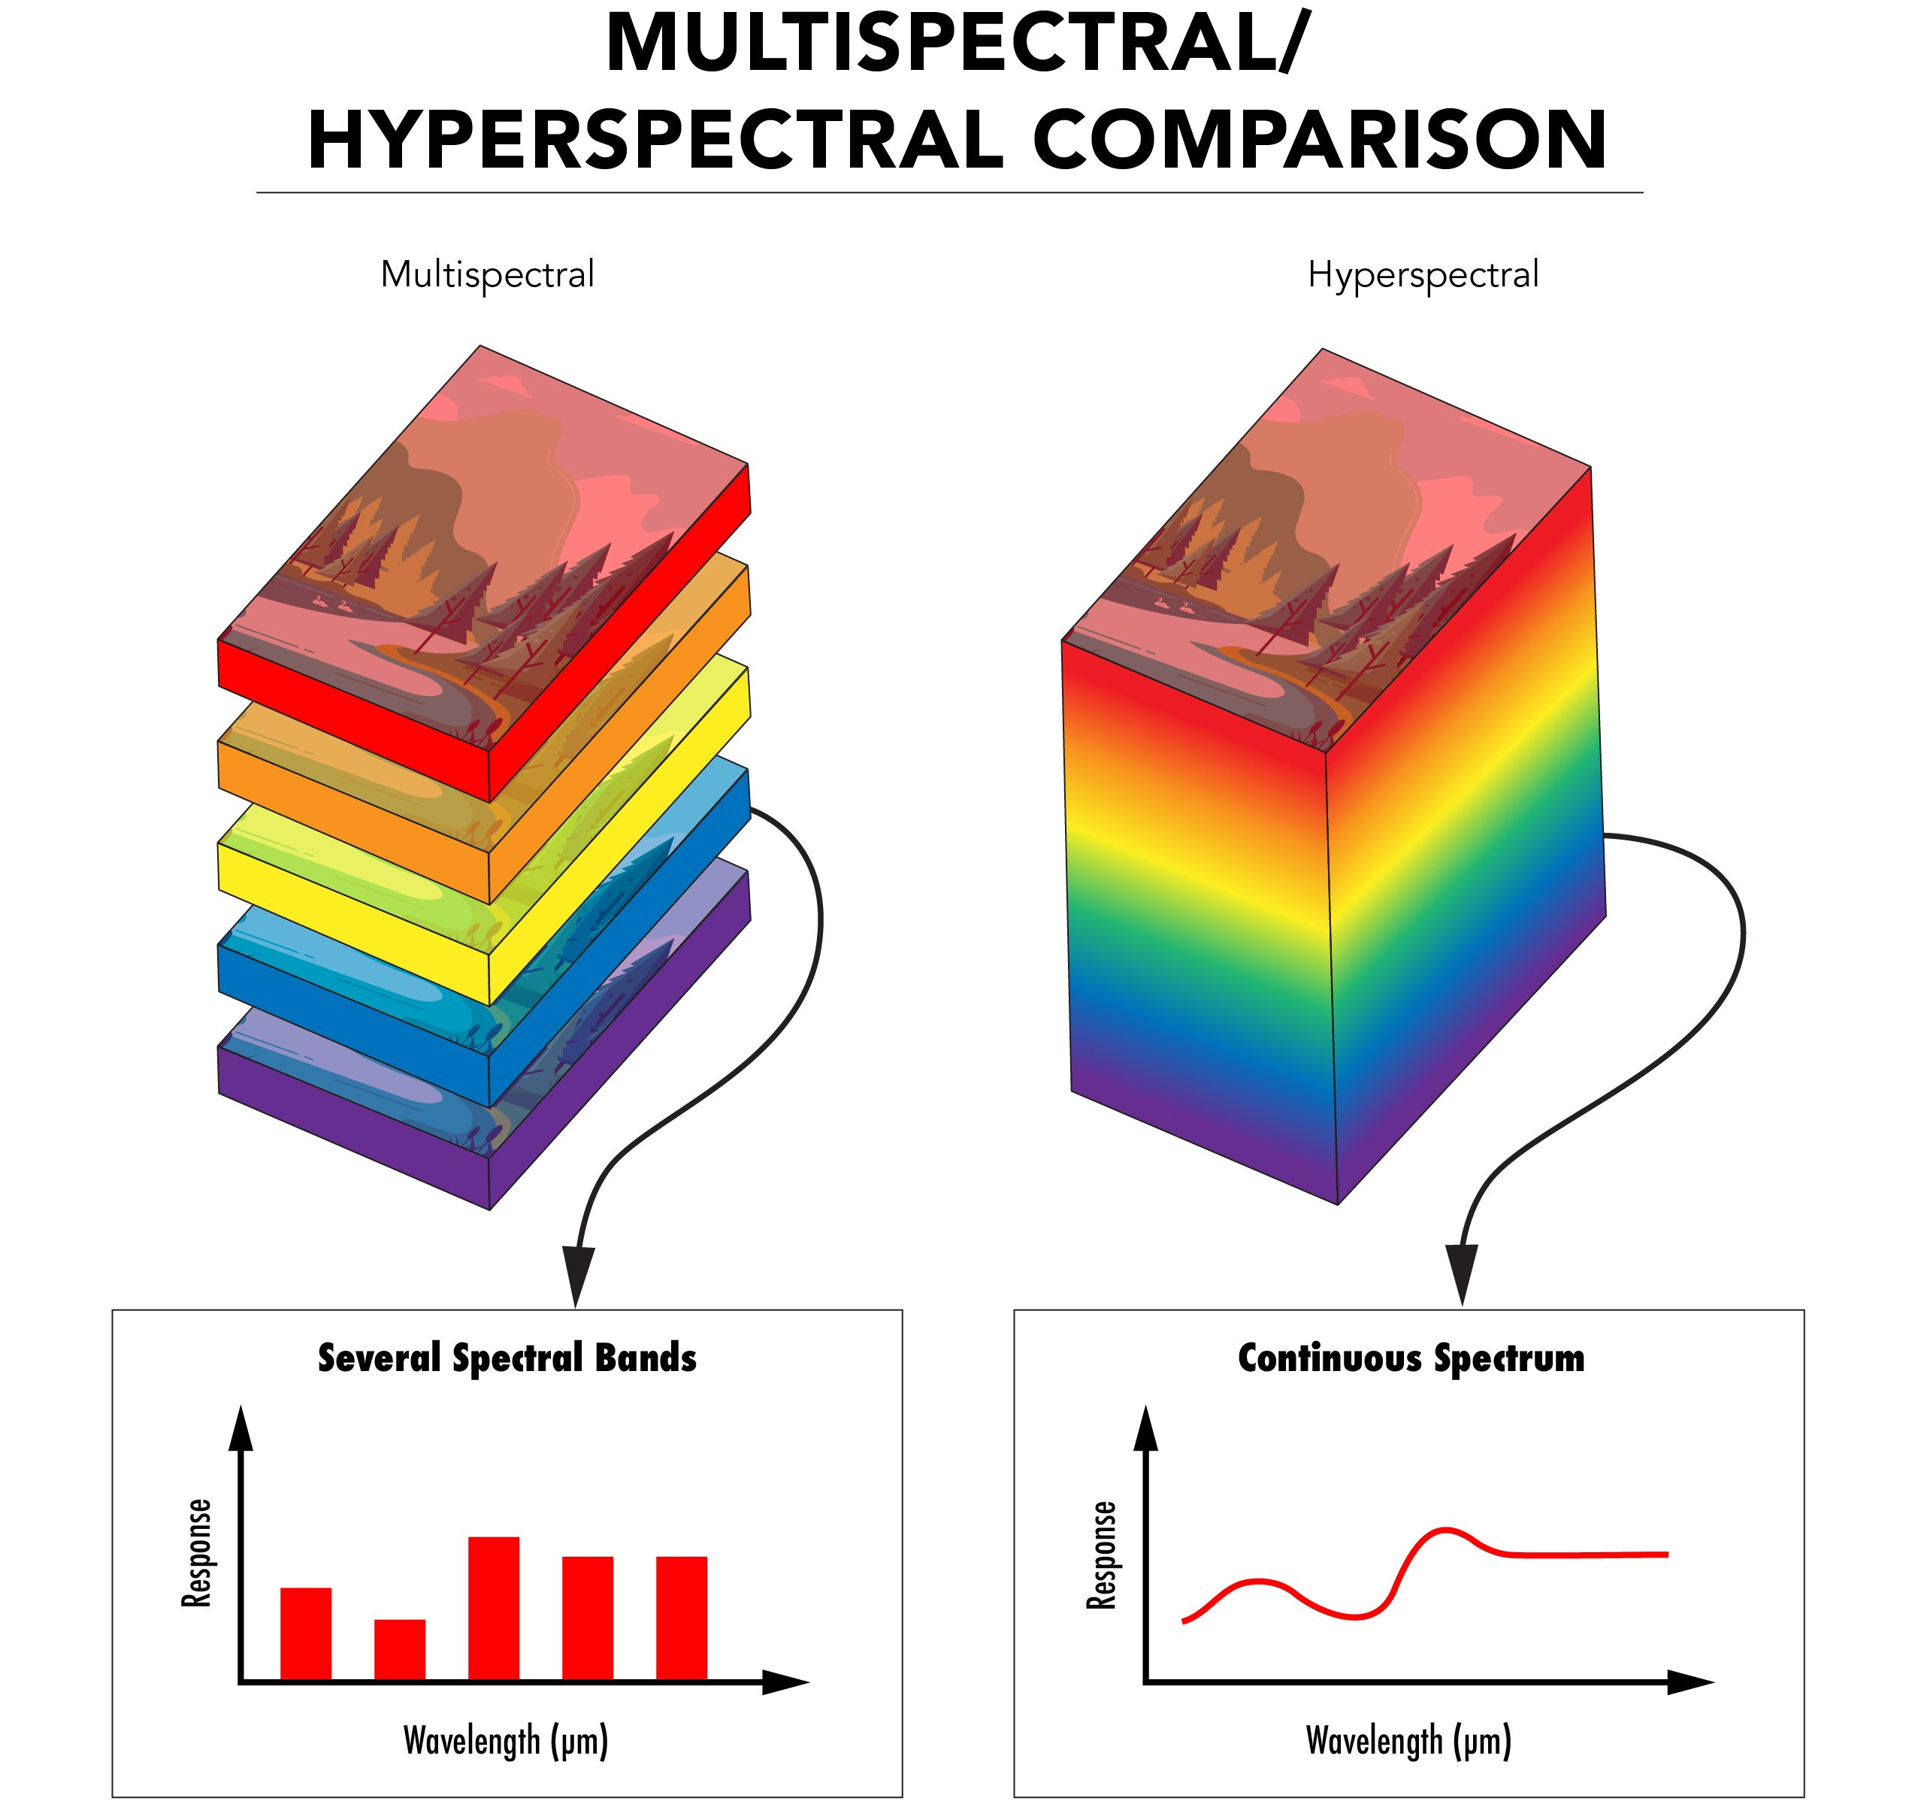
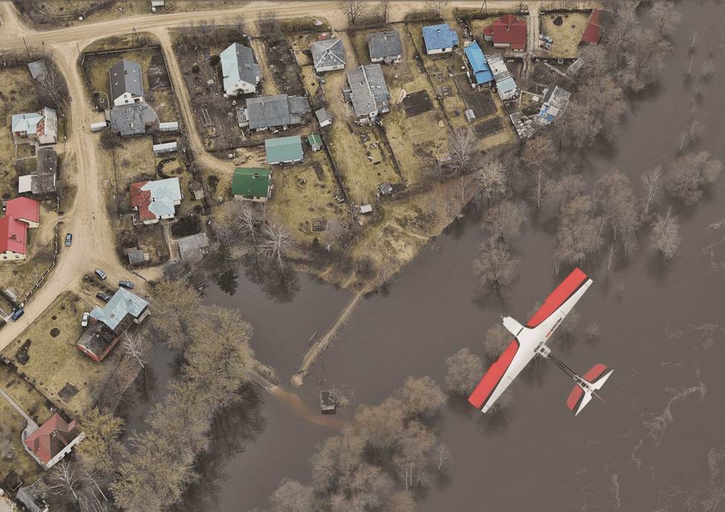
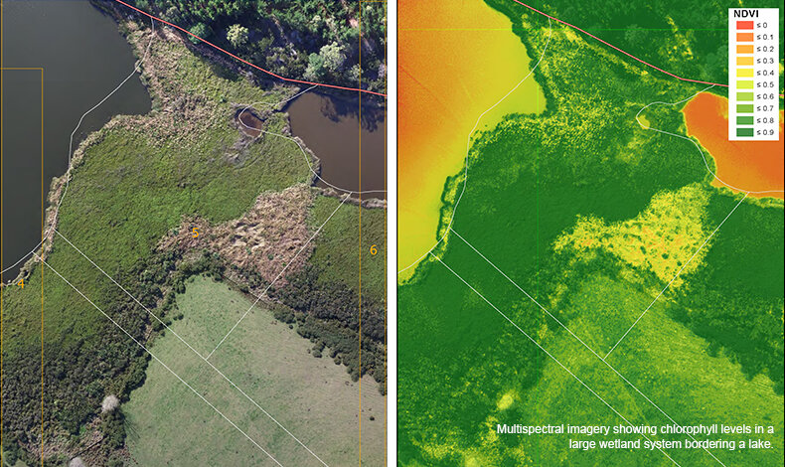
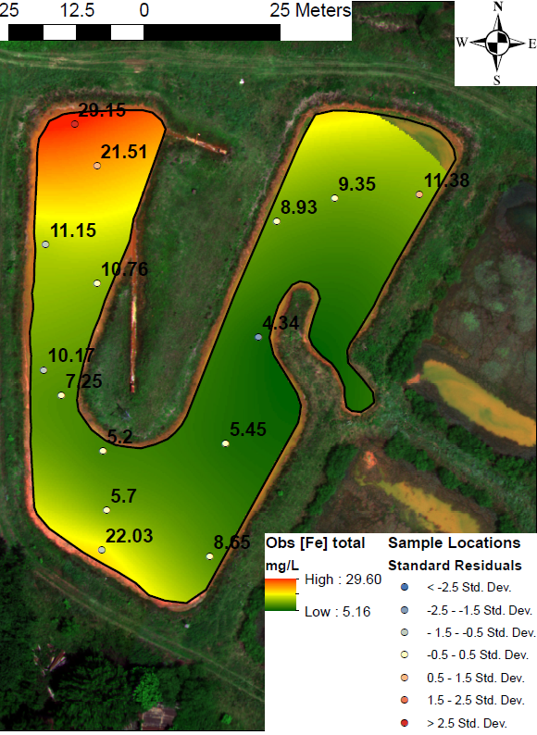
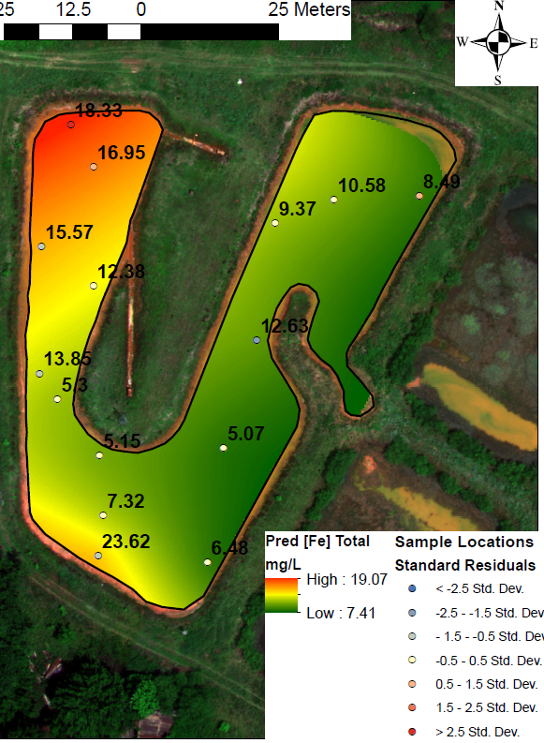
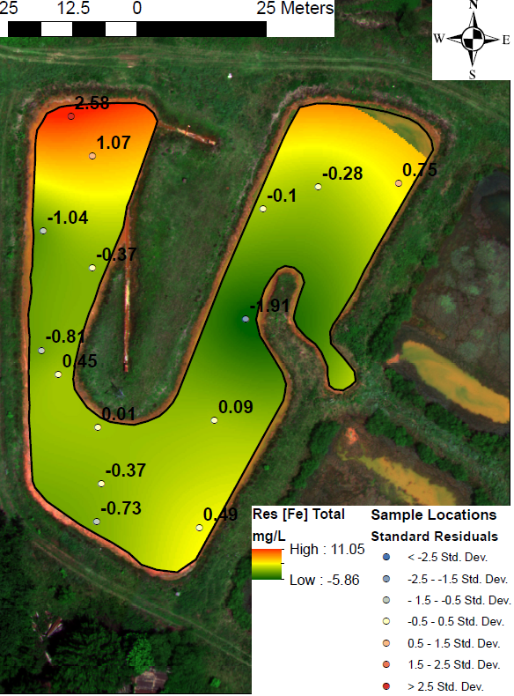
Environmental Remote Sensing
Continued wide-spread degradation of the natural environment
New observation and analysis tools
Assess natural disaster damage and recovery (true color)
Evaluate wetland health (NDVI), extent, type, and biodiversity (LiDAR and spectral)
Estimate surface water quality to advance traditional in-situ monitoring efforts (multi and hyperspectral)
4
Notes:
So, what is Environmental remote sensing.
With the continued degradation of the natural environment, humans have developed new observation and analysis tools to collect information from a target object without ever coming in contact with it.
Some applications of these technologies include assessments of natural disaster damage and recovery using true color imagery, evaluation of wetland health, extent, type, and biodiversity using LiDAR or a type of spectral data, and then what we are going to focus on today, which is the estimation of surface water quality to advance traditional monitoring efforts, using multi and hyperspectral data.
The difference between multi and hyperspectral data, both of which were used in this study was the spectral resolution –multispectral data incorporates a set number of several spectral bands, while hyperspectral provides a continuous profile across the electromagnetic spectrum.

Slide 5
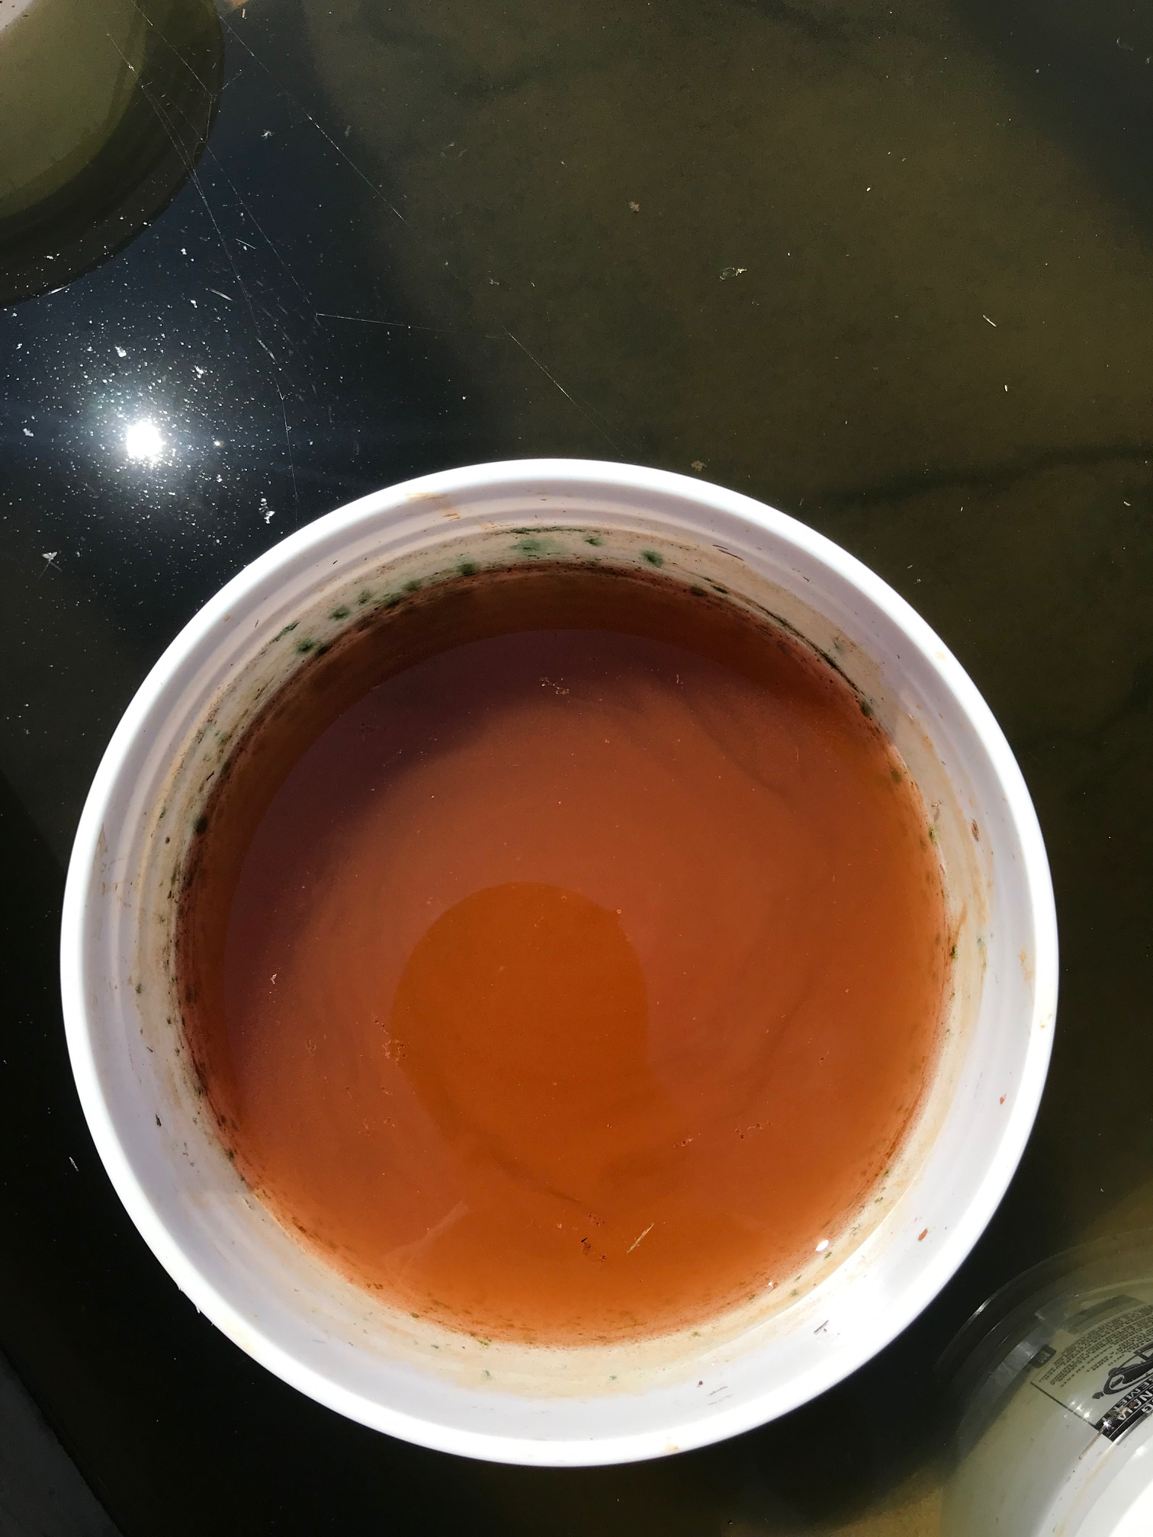
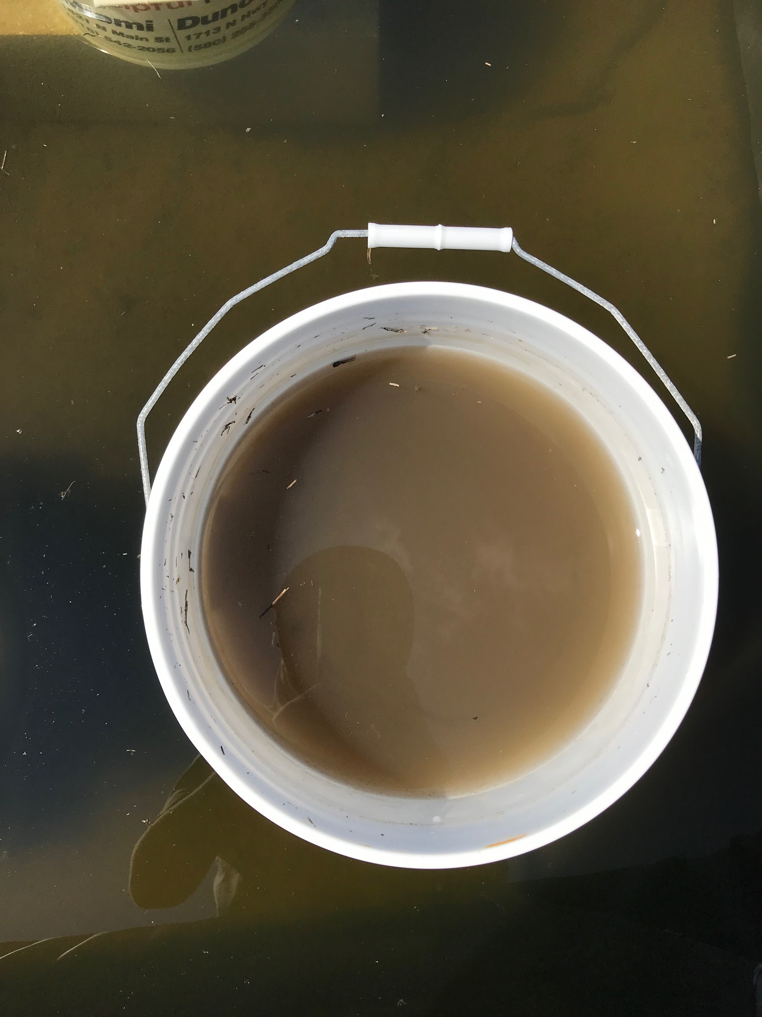
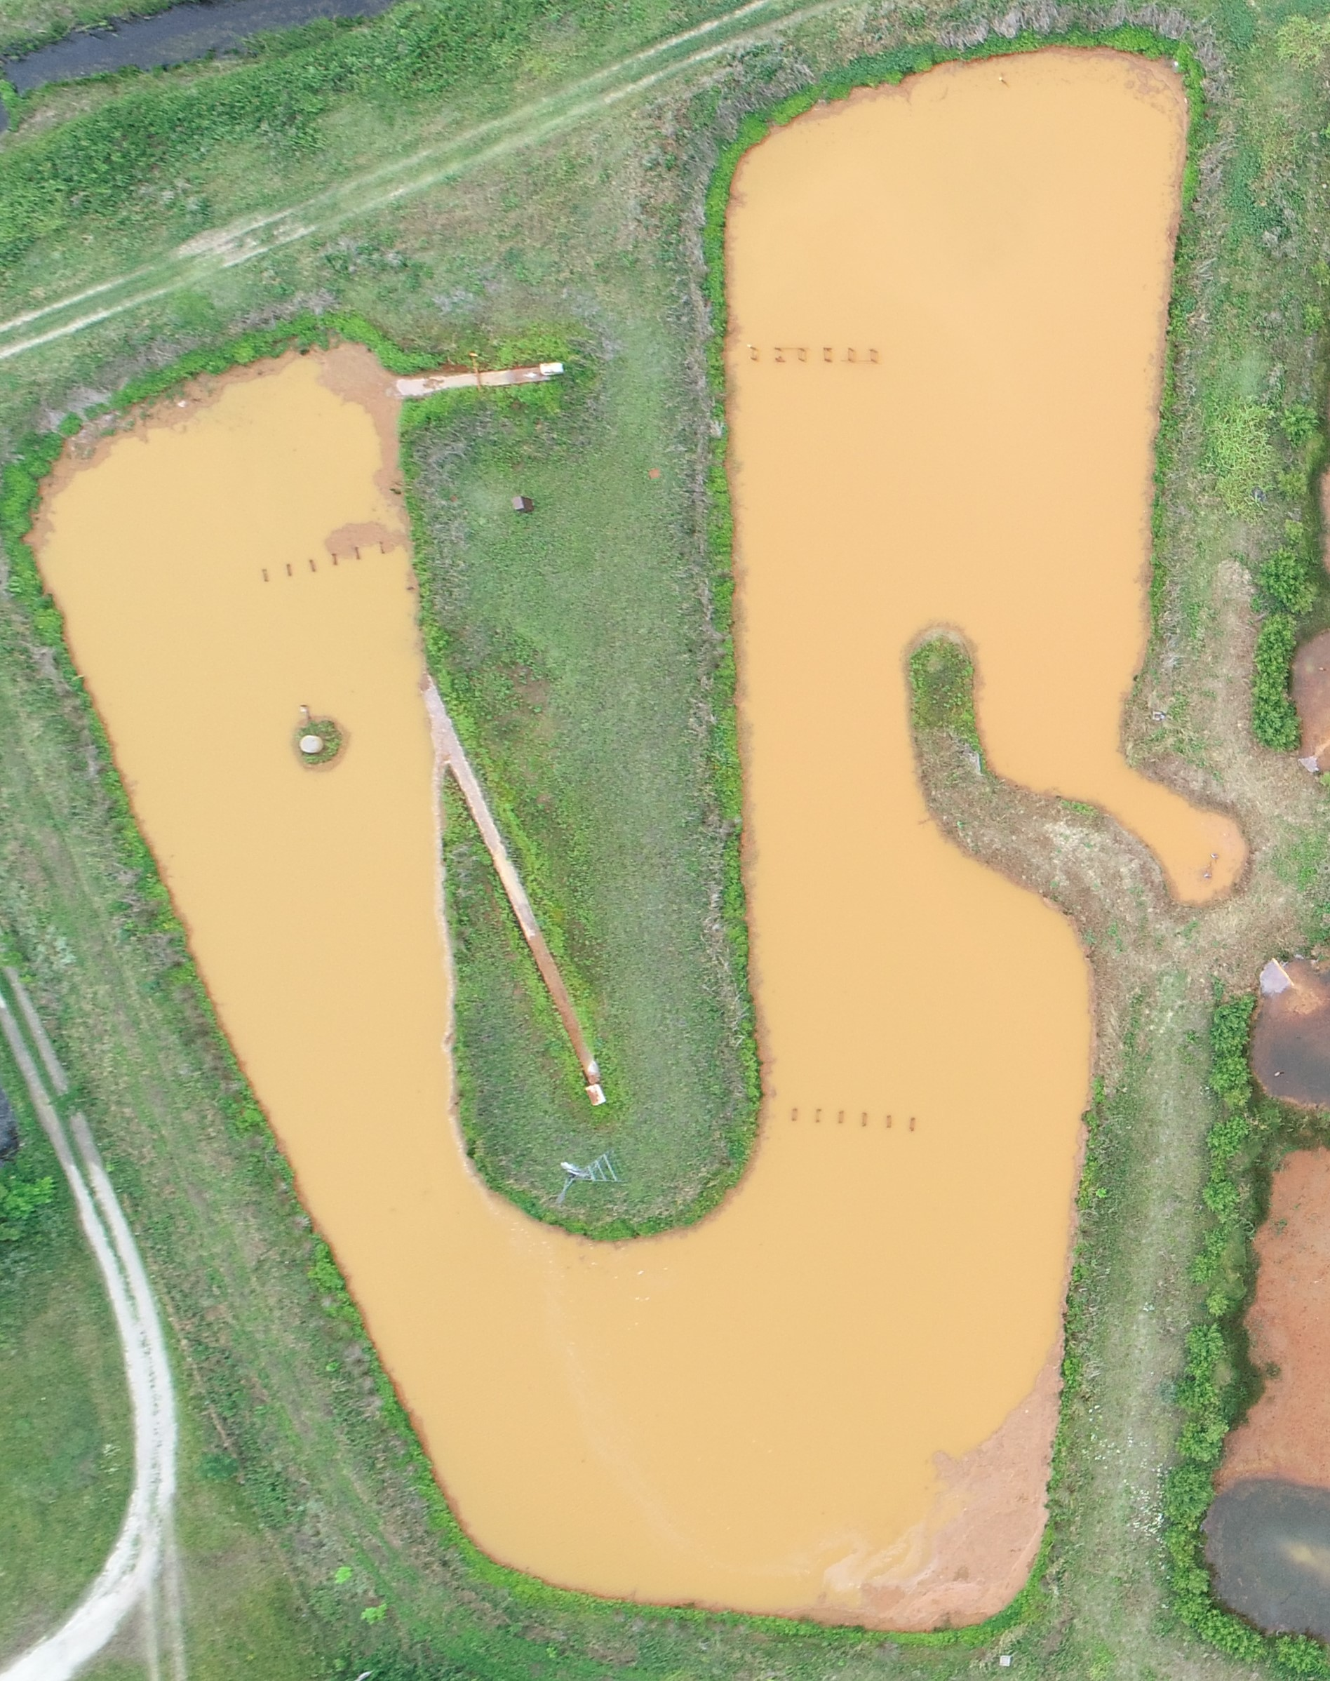
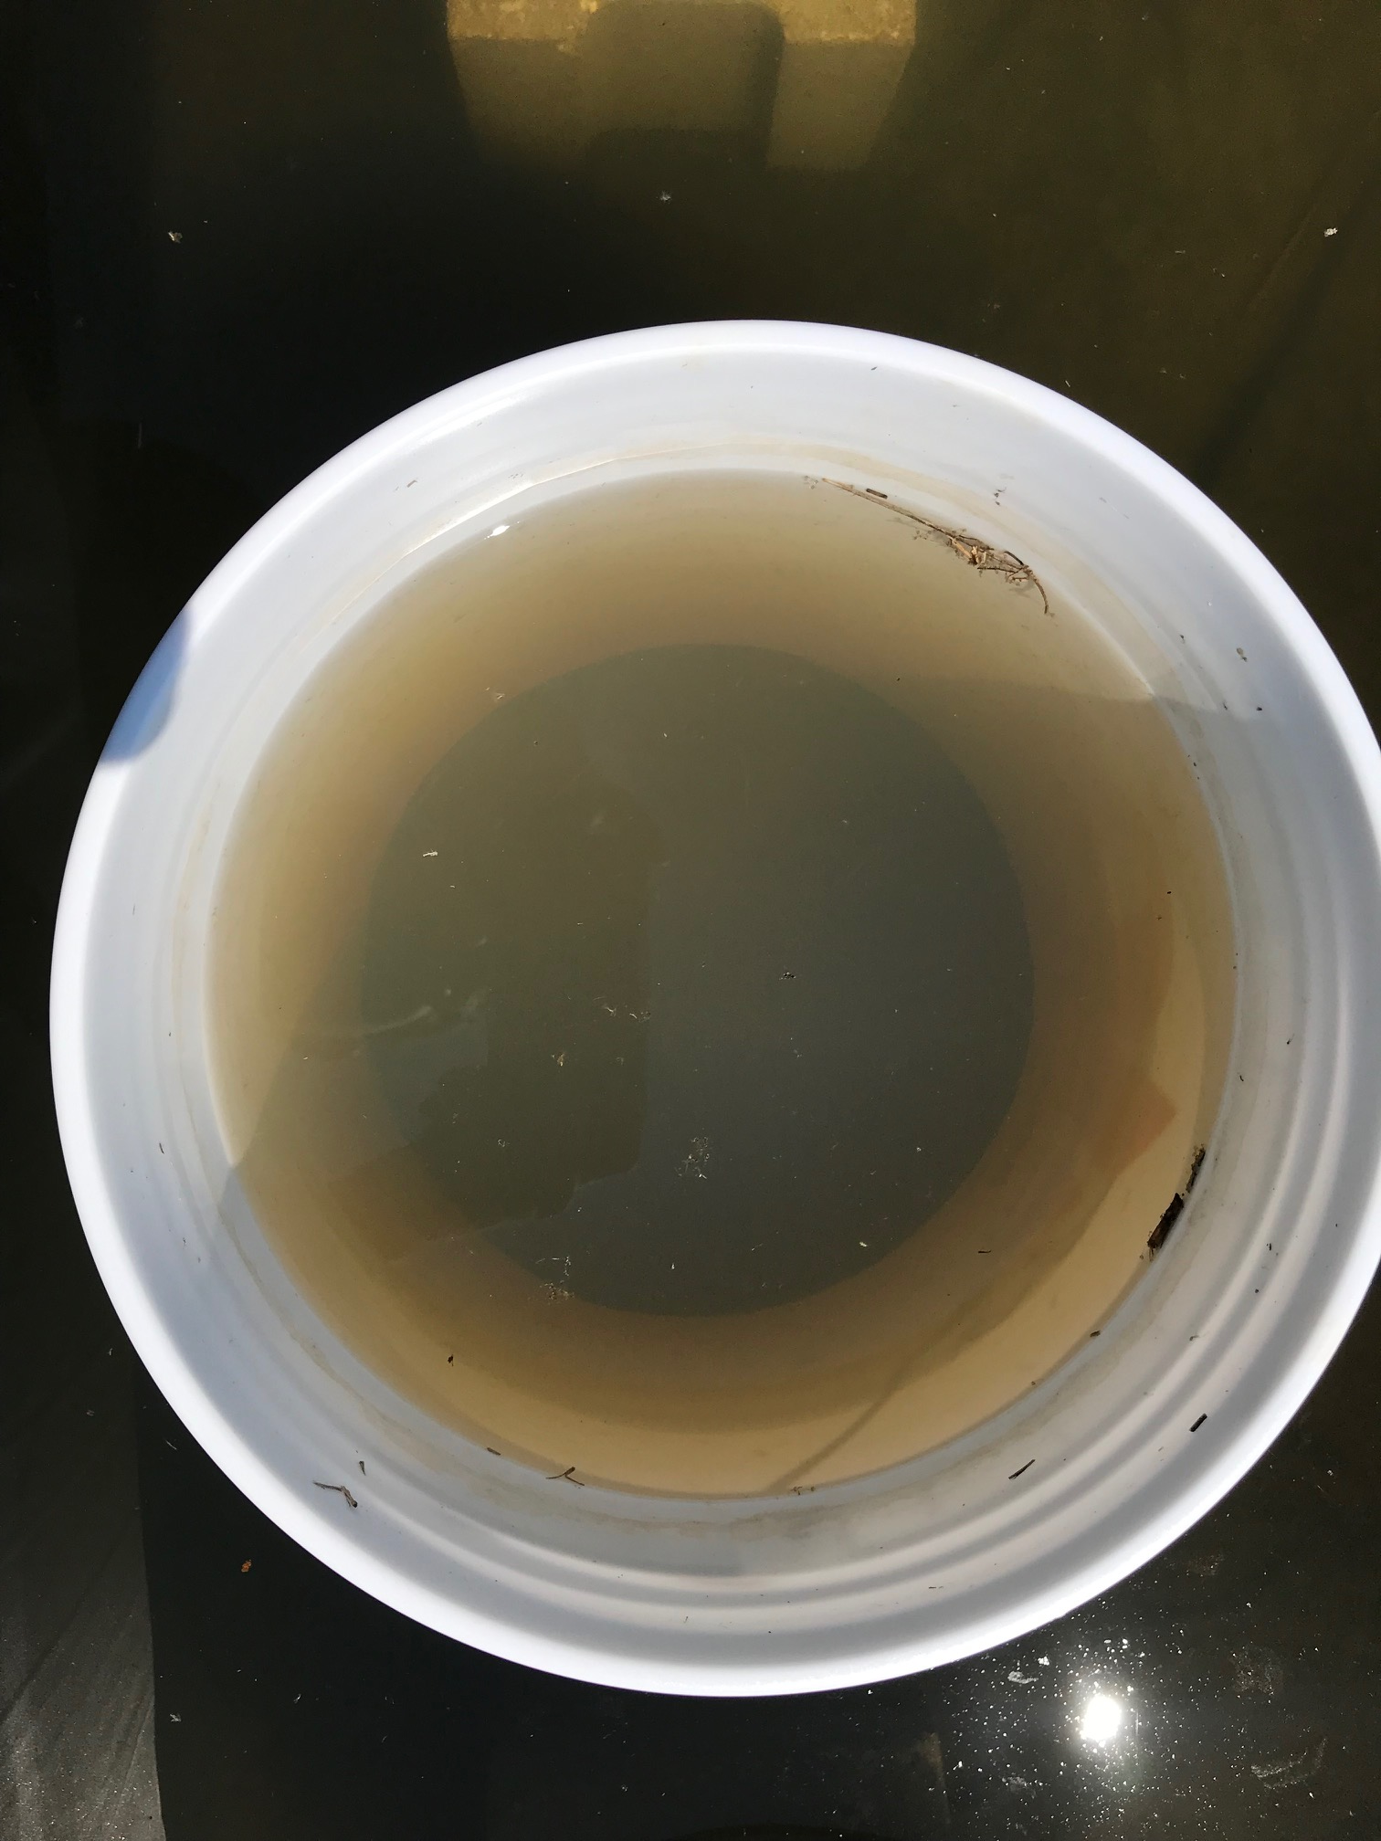
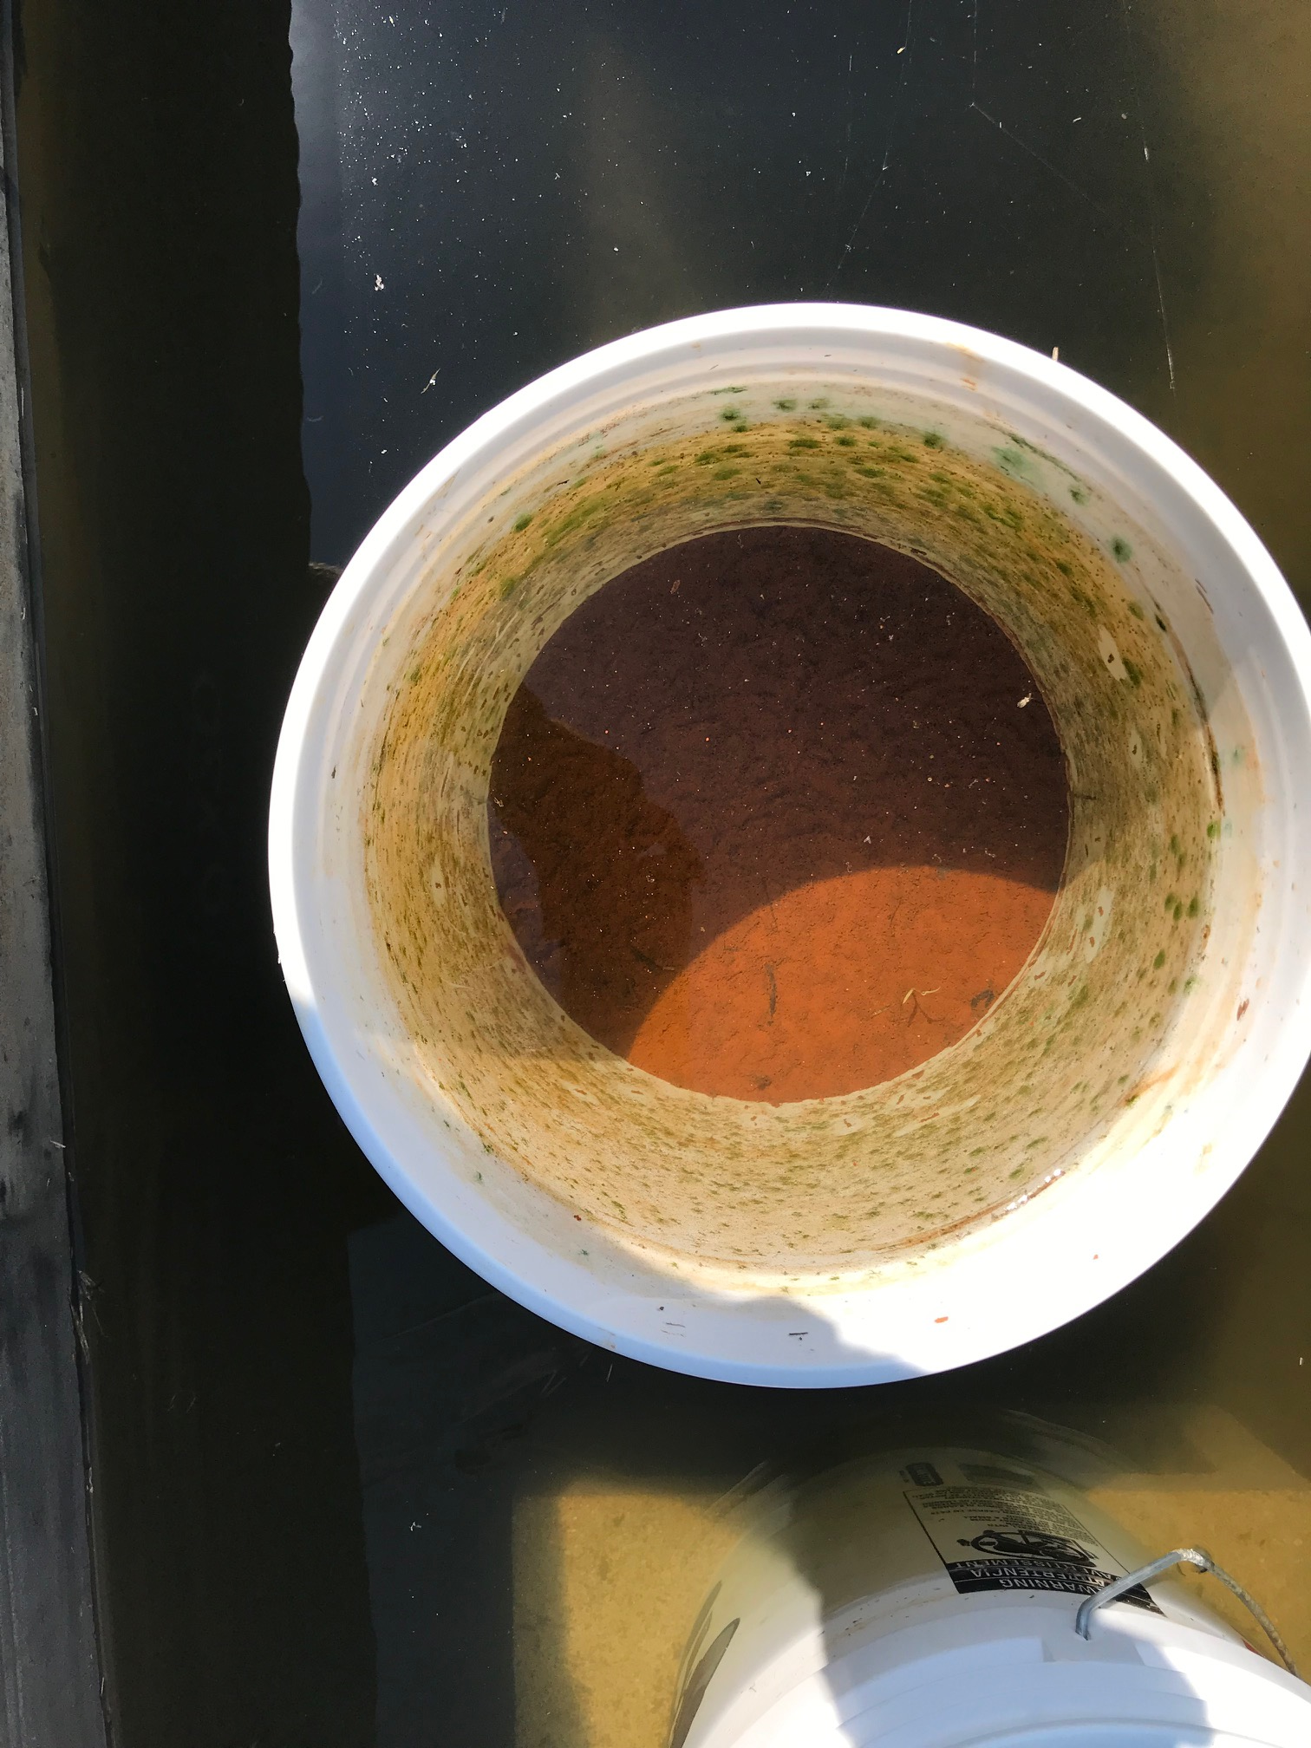
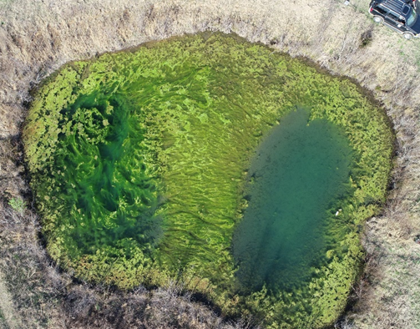
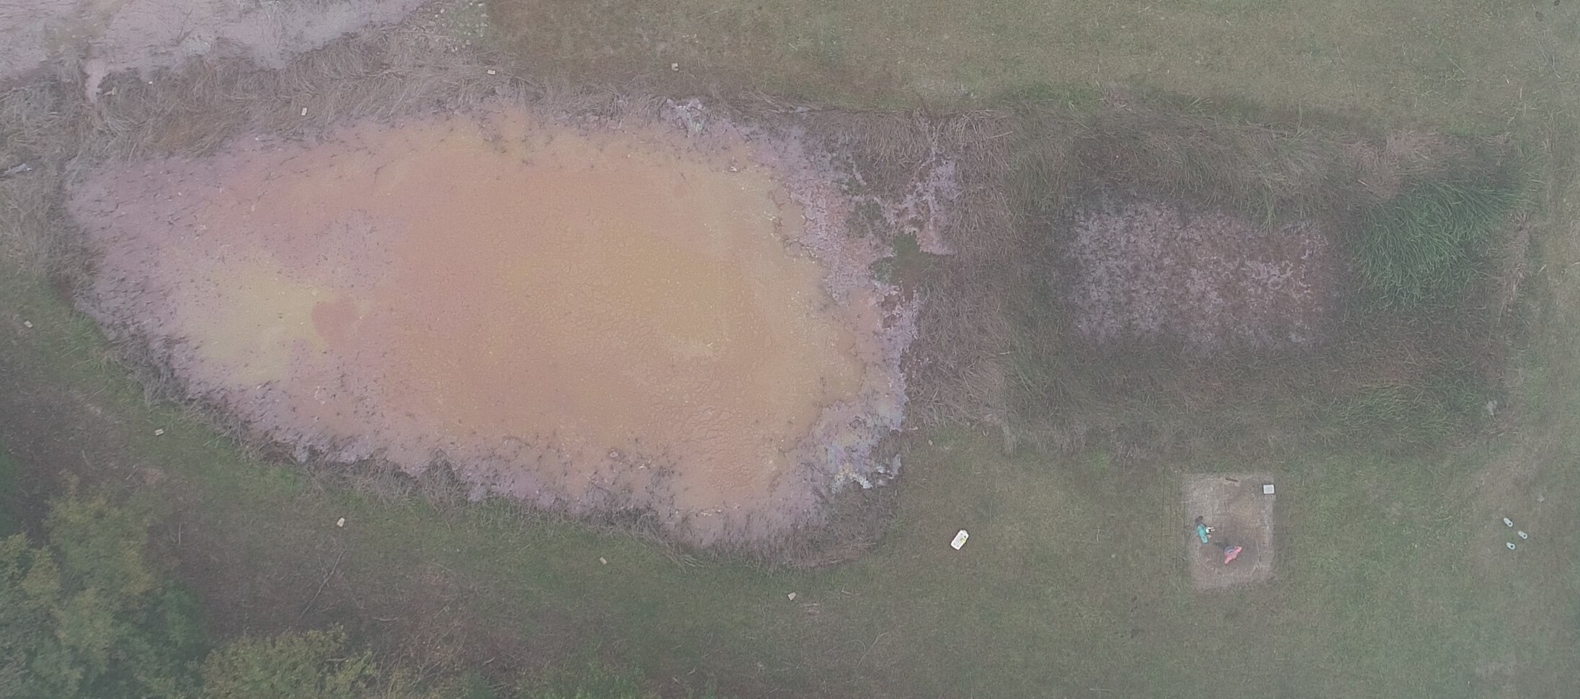
Optical Depth Impacting sUAS Spectra
Think photic zone… or Secchi disk depth (SDD)
ɸ_{i} (λ)
ɸ_{i} (λ)
ɸ_{s} (λ)
ɸ_{s} (λ)
0
0
ɸ_{a} (λ)
∆r
ɸ_{a} (λ)
∆r
ɸ_{r} (λ)
ɸ_{r} (λ)
R
Substrate
R
ɸ_{t} (λ)
Optically Deep Waters (ODWs)
Optically Shallow Waters (OSWs)
5
Notes:
So what happens when this energy or light interacts with a waterbody. Specifically, one where the substrate is visible through the water column or is considered optically shallow.
I have provided a theoretical example on the left, and examples from my work on the right.
Modeling surface water quality in these systems in complex because the energy can interact with the substrate and interfere with the measured reflectance. The substrate type, bathymetry, and overall surface properties all play a role, and can be detrimental to developing relationships between the reflected energy and the in-situ water quality
On the other hand, this interaction is minimized in waters that are sufficiently deep or turbid, and represent optically deep waters where a majority of the reflected energy signal is representative of the bulk of the waterbody

Slide 6
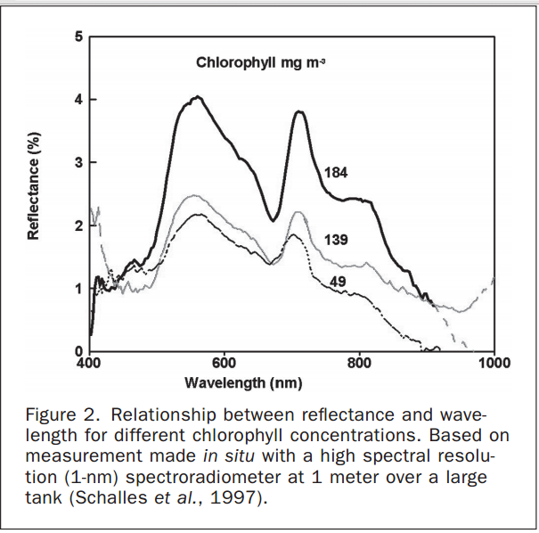
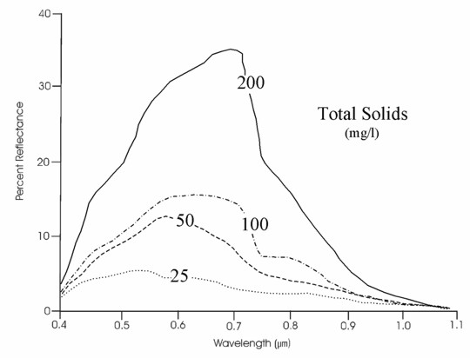
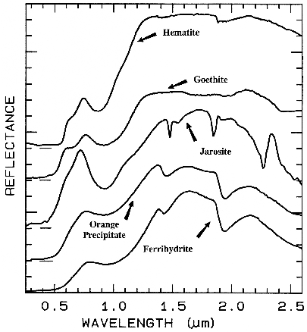
Spectral signatures of optically active constituents
6
Notes:
So what do the reflectance profiles look for water containing various concentrations of chlorophyll and suspended solids
Here are spectral profiles for waters containing only chlorophyll and TSS, and as we know it is not common for waters to only contain just these constituents
Pair that with various substrates common to passive systems and all other contaminants the problem quickly becomes tremendously more complicated

Slide 7
What was the motivation? Why these studies? What was missing from the literature?
Develop an additional innovative tool to assist environmental monitoring and restoration efforts
Cheaper, safer, and more efficient than traditional monitoring efforts
Minimal research efforts focused on developing statistical models capable of predicting surface water quality in mine drainage systems
Evaluate the tradeoffs and opportunities related to sUAS data quality, mission efficiency, and operational parameters
7
Notes:
What motivated this research
From a review of the literature and understanding status of sUAS around the world, a need exists to develop an additional innovative tool to assist environmental monitoring and restoration efforts, and if wide-spread implementation is achieved, sUAS will save money, time, person hours, while also decreasing risk and providing a more complete assessment of the issue

Slide 8
What was the motivation? Why these studies? What was missing from the literature?
Develop an additional innovative tool to assist environmental monitoring and restoration efforts
Cheaper, safer, and more efficient than traditional monitoring efforts
Minimal research efforts focused on developing statistical models capable of predicting surface water quality in mine drainage systems
Evaluate the tradeoffs and opportunities related to sUAS data quality, mission efficiency, and operational parameters
7
Notes:
What was missing from the literature?
Minimal research efforts have focused on developing statistical models capable of predicting surface water quality in mine drainage systems.

Slide 9
What was the motivation? Why these studies? What was missing from the literature?
Develop an additional innovative tool to assist environmental monitoring and restoration efforts
Cheaper, safer, and more efficient than traditional monitoring efforts
Minimal research efforts focused on developing statistical models capable of predicting surface water quality in mine drainage systems
Evaluate the tradeoffs and opportunities related to sUAS data quality, mission efficiency, and operational parameters
Present the opportunities (and limitations) of scaled-down traditional remote sensing technologies, in terms of, size, cost, and complexity (sUAS) for real-world monitoring applications to address the remote sensing limitations associated with shallow inland waters whose optical properties are unique and ever-changing.
7
Notes:
Then from my own research efforts, the lack of a clearly communicated standard methodology is a severe limitation to environmental remote sensing. Environmental scientists, monitors, and professionals rely on standard operating procedures for reliable, repeatable, accurate, and communicable results. Applying sUAS for remote environmental monitoring applications should be no different. Thus, the need for contributions to development of a standardized method was apparent.
The overall purpose of todays presentation is to present the opportunities and limitations of scaled down traditional remote sensing technologies, in terms of size, cost, and complexity for real-world monitoring applications to address the remote sensing limitations associated with shallow inlands waters whose optical properties are unique and ever changing

Slide 10
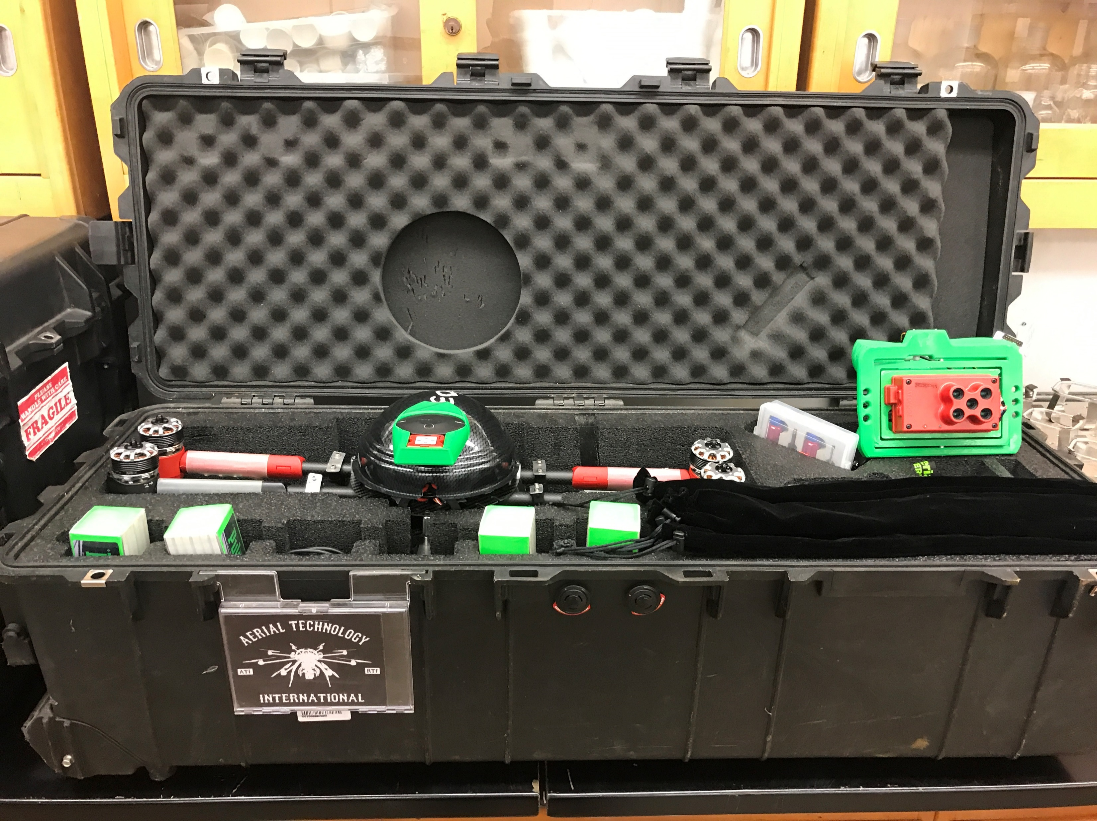
Experimental Hypotheses
- Various water quality parameters will be more readily estimated in optically deep compared to optically shallow waters with sUAS
- sUAS-derived imagery will be capable of describing water quality parameters typically not examined (e.g., metal concentrations) in remote sensing studies, and the models will not be site-specific
8
Notes:
Then to move to something completely new and different, I examined the utility of sUAS and statistics in mine drainage passive treatment systems.
The hypotheses of this study were, sUAS-derived imagery will be capable of describing water quality parameters not typically examined (metal concentrations) in remote sensing studies, and the developed models will not exhibit site-specificity

Slide 11
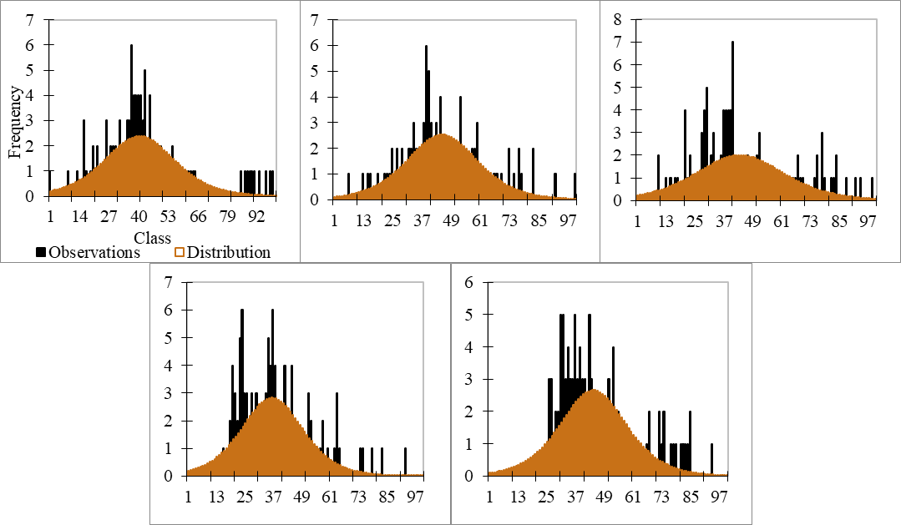
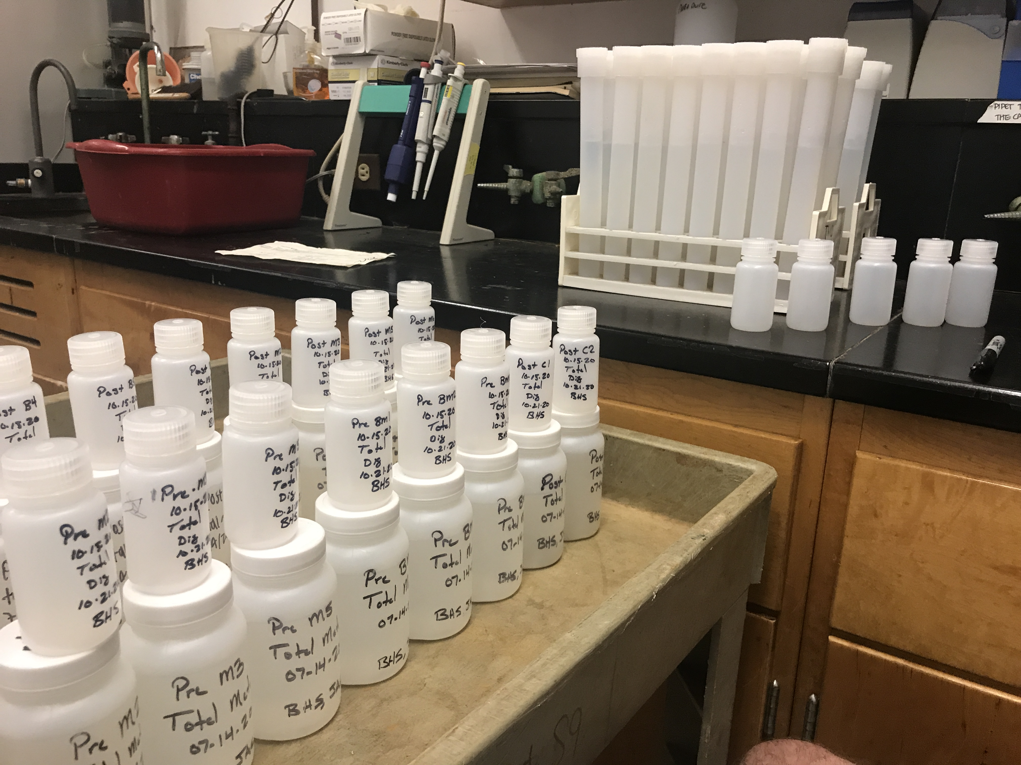
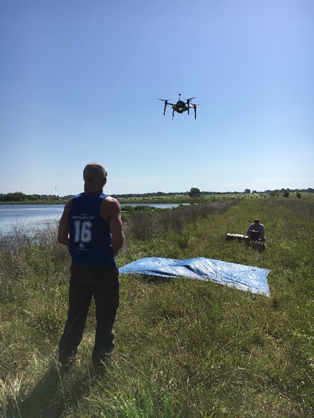
Generalized Dissertation Methodology
Spectral Data Processing:
- Digital number to reflectance
- Atmospheric corrections
- Georectification and mosaic
Reflectance Extraction:
- Pixel-by-pixel
- Buffer-by-buffer
- Composite buffer
Spectral Data:
- MS and HS
Model Development:
- Distributions
- Data transformations
- Band ratios
- OLS regression
Evaluation, Verification, and Validation:
- 50 percent of dataset
- R², Significance, RMSE
- Apply to different location
Laboratory WQ Analyses:
EPA 3015A/6010C,
EPA 445, EPA 147A,
APHA 2540D, APHA 2130B,
In-situ WQ Data:
- TM/FM, Chl, Color, TSS, Turbidity, SDD, AD
9
Notes:
Moving into a generalized dissertation methodology. A majority of the studies I completed began with collecting multi and hyperspectral data with the sUAS and a field spectroradiometer shown in the image. Then typically within +/- 1 hour of collecting the spectral data, in-situ water quality samples were also collected.
From there, both sets of data required processing. The spectral information had to be converted from raw digital number format to relative reflectance, and the sets of images had to be stitched together to generate an orthomosaic. Additionally, various laboratory water quality analyses were completed throughout the study quantifying constituents such as chlorophyll-a, color, total suspended solids, and various metal concentrations.
A final step before model development, was to extract the reflectance values from the sampling locations within the orthomosaic generated. I completed this task using several techniques throughout my dissertation, which will be touched on momentarily.
Bringing each data set together began with characterizing the information and evaluating which forms of regression best fit the dataset. I also explored various data transformations and band ratio combinations in attempts to improve the observed relationships
The final step was to evaluate the model outputs and attempt to validate the models with a portion of the dataset not used in model development or at a different location.

Slide 12
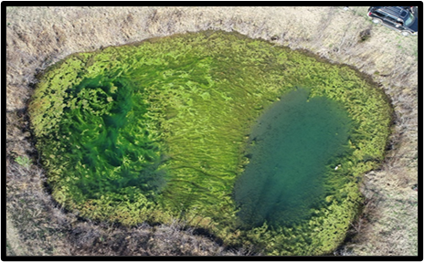
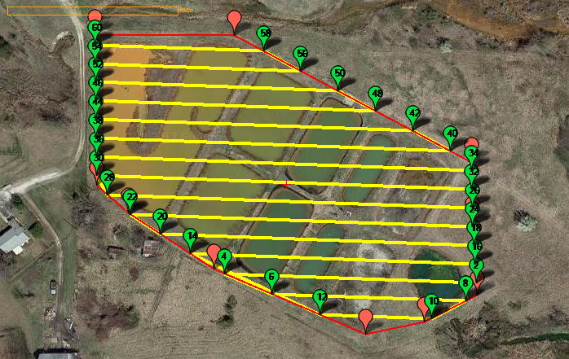
Identifying Sample and Pixel Locations
Autonomous sUAS Mission Parameters
Operations within ± 2 hr of local solar noon, ~60 m AGL, 75 percent image side and overlap and 6 m/s
Various extraction techniques applied
~5 cm
~5 cm
Approximate WQ Sample Location
10
Notes:
CLICK WITH EACH POINT

Slide 13
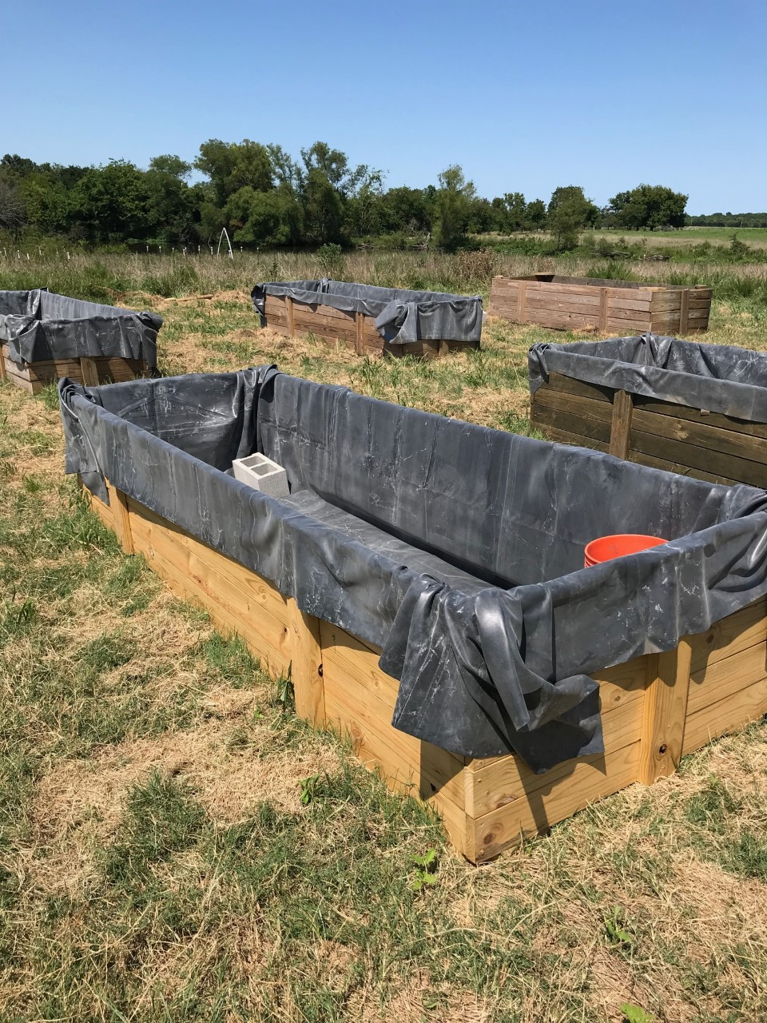
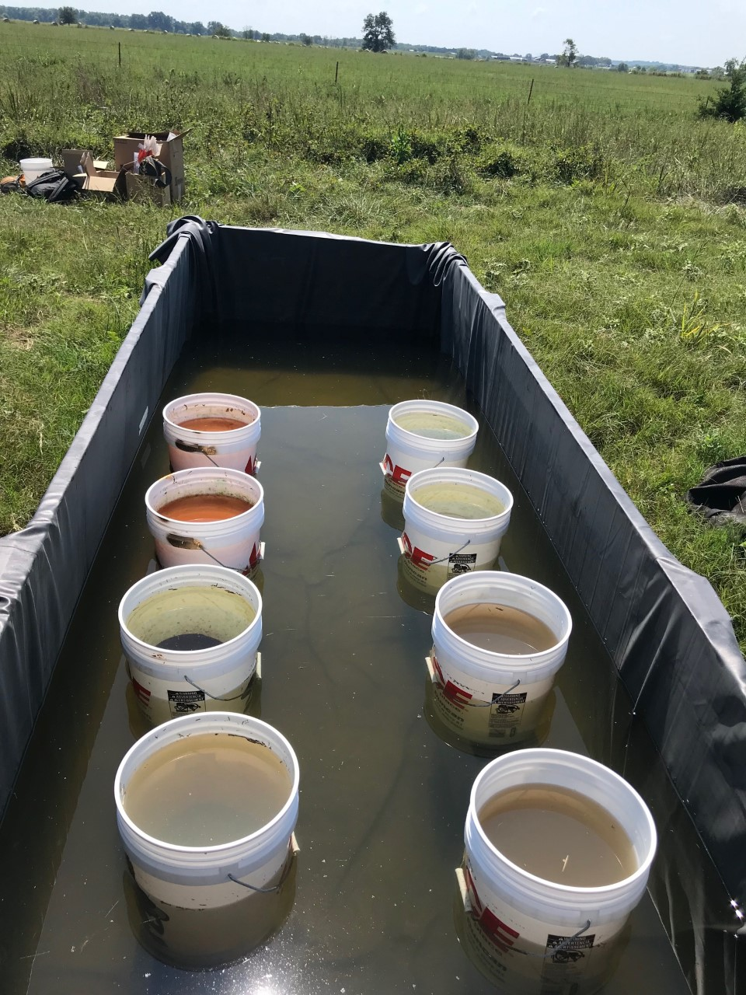
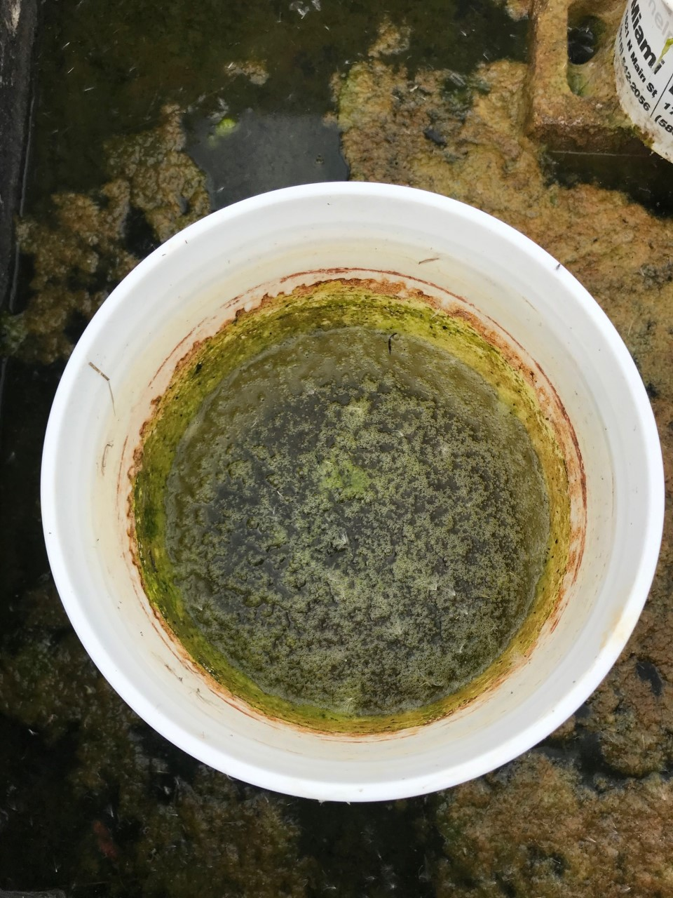
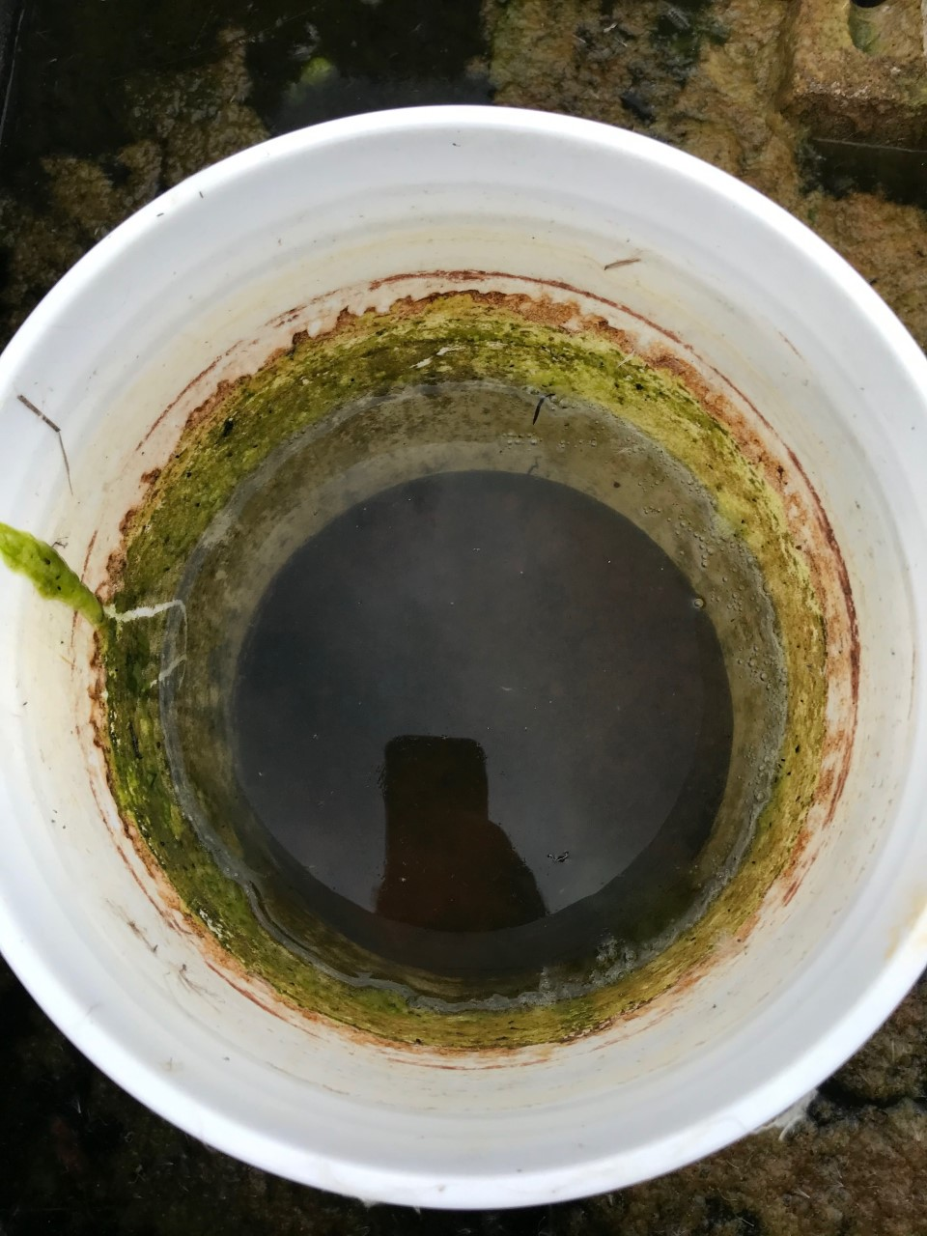
In-situ Manipulations of Aquatic Optical Depth
Purpose:
Document the effects that various optically complex mesocosm systems have on establishing accurate water quality models with sUAS-derived multispectral imagery
11
Notes:
This study examined in-situ manipulations of aquatic optical depth
With the purpose of documenting the effects that various optically complex mesocosm systems have on establishing accurate water quality models with sUAS-derived multispectral imagery and addressing hypothesis one

Slide 14
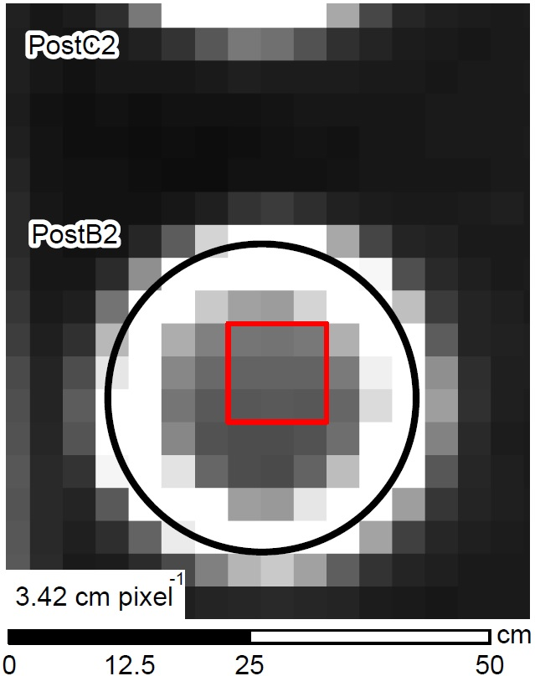
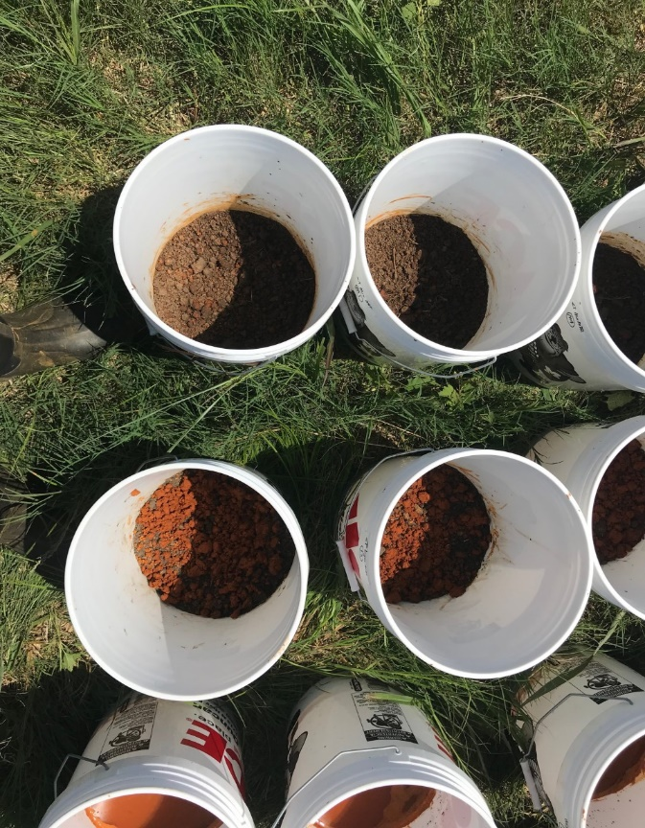
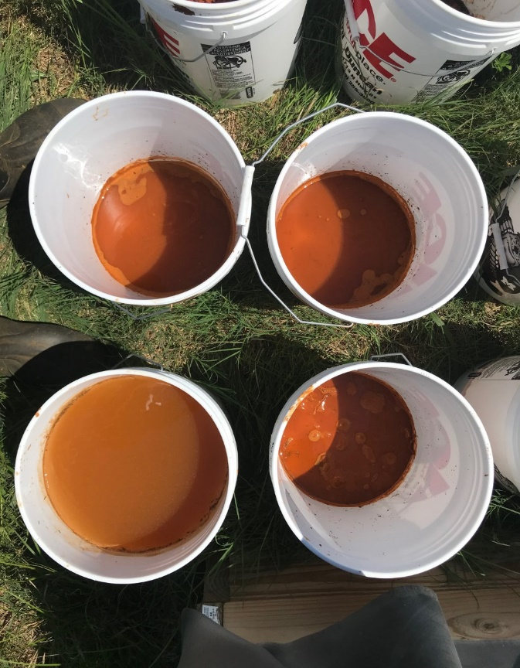
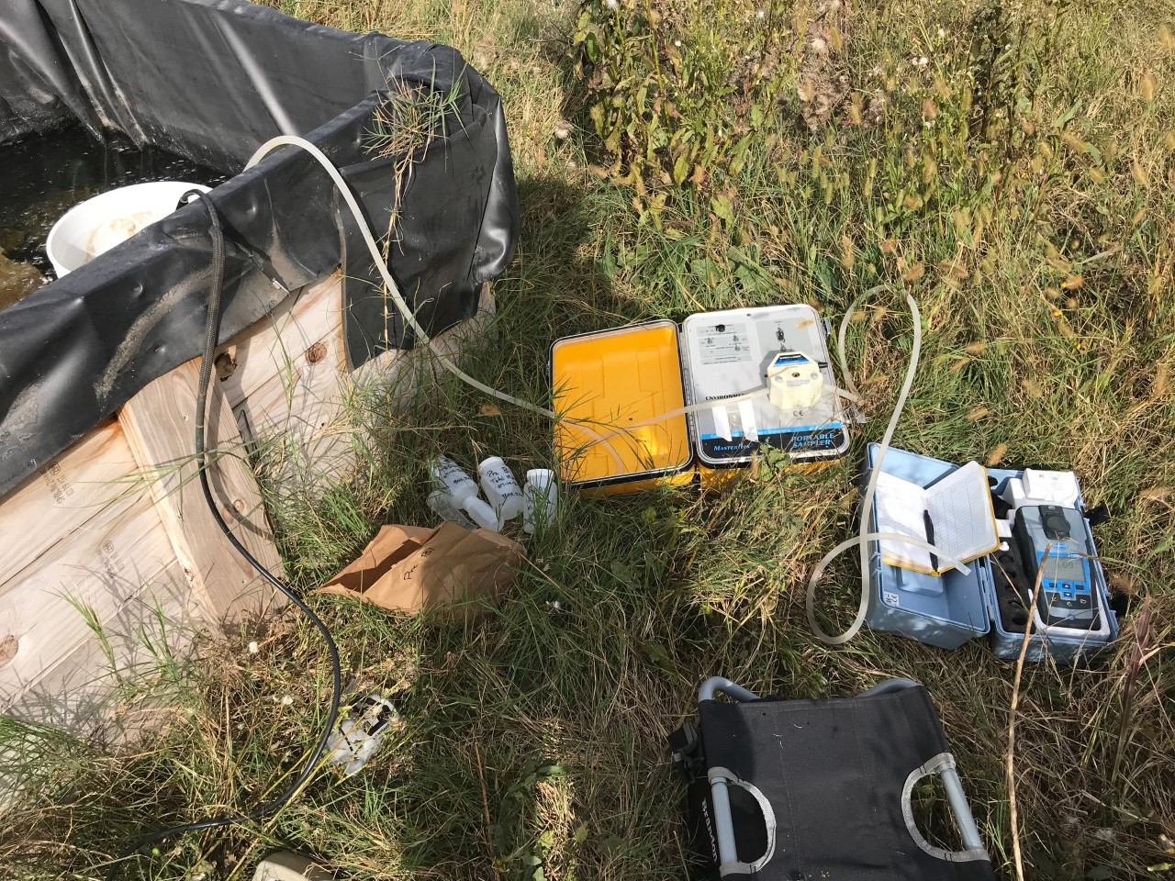
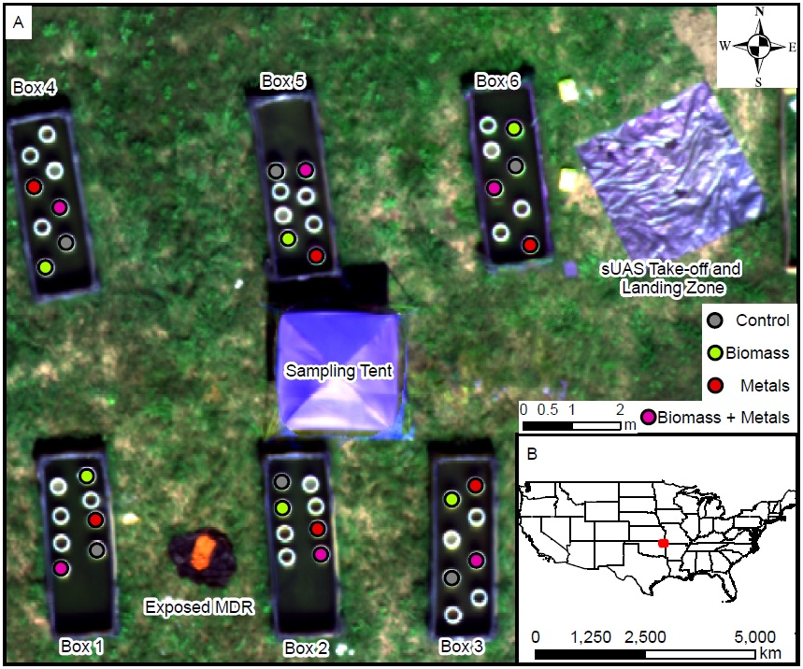
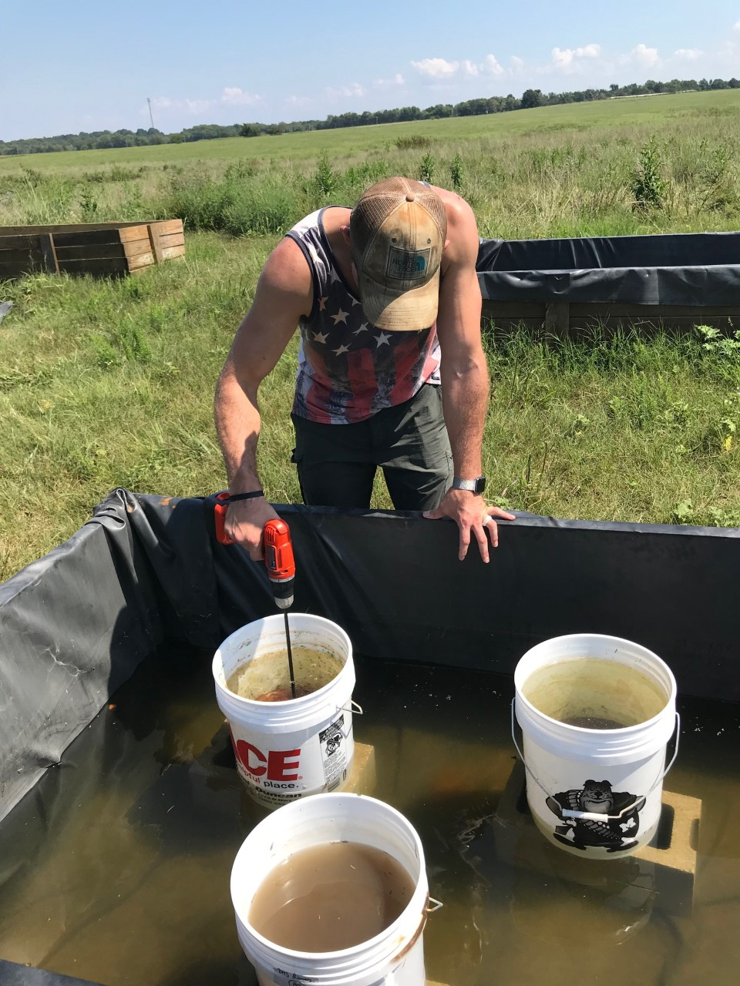
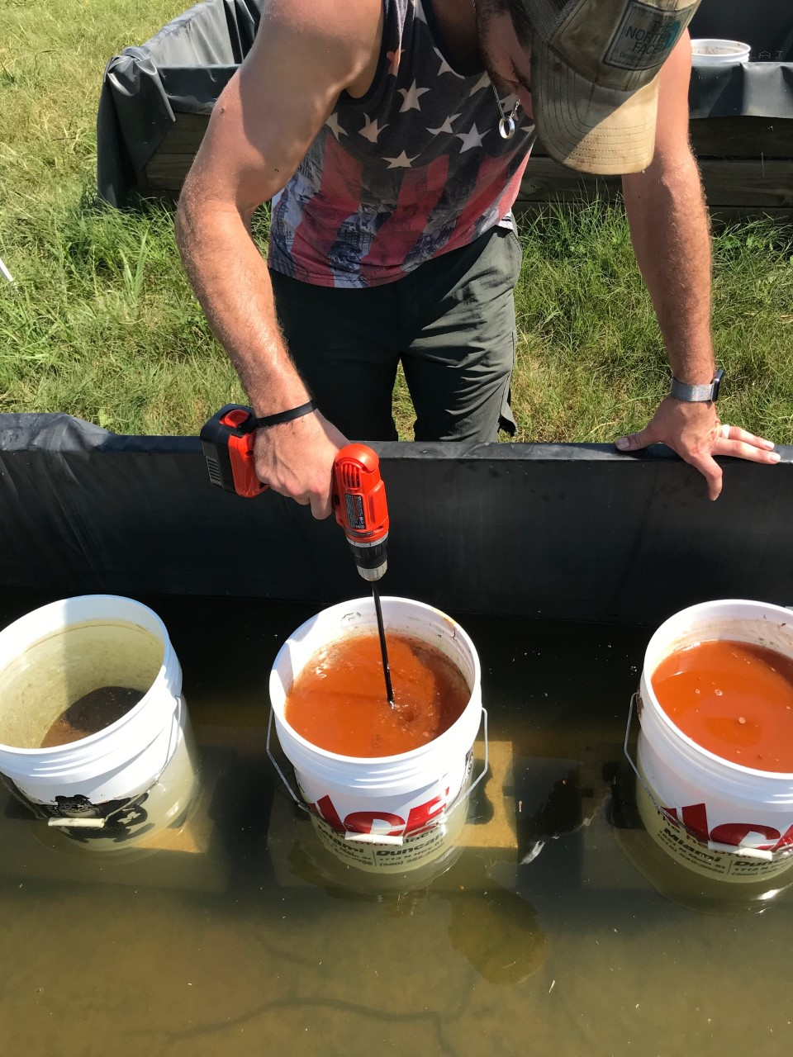
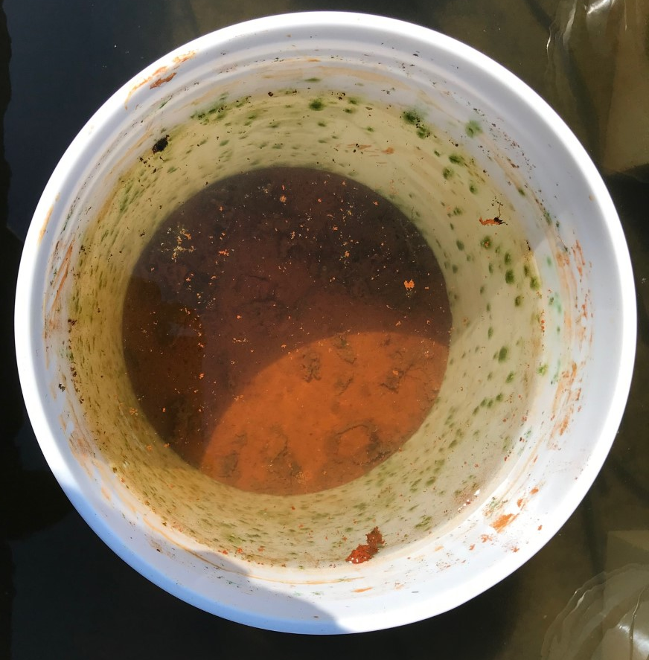
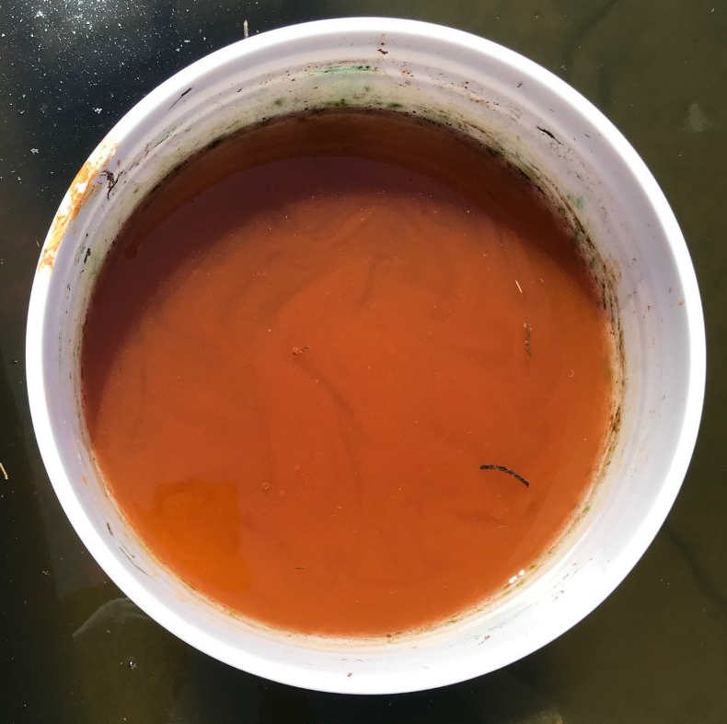
In-situ Manipulations
of Aquatic Optical Depth
Duck Creek Nursery – Four vessel types each with six replicates
Control (C), Biomass (B), Mine Drainage Residuals (M), and BM
Optical depth manipulated via mixing
Pre- and post-mixing sUAS and WQ
sUAS multispectral imagery
Pre- and post-mixing missions (n = 4 each)
Traditional and “novel” water quality parameters
Chlorophyll-a, TSS, turbidity, SDD, AD, color, and total, dissolved, and particulate (calc.) mine water contaminants
Pixels extracted manually
OSWs
ODWs
Pre-mixing
Post-mixing
20
Notes:
This study took place at the Duck Creek Nursery managed by the Grand River Dam Authority in NE Oklahoma.
The experimental vessels included a control, biomass, mine drainage residuals, and BM replicated six times – each type of vessel except the controls received a different type of amendment. The amendments were additions of MDR as substrate to the M and BM vessels, while the B and BM vessels received a dosing of algae rich water to ensure sufficient algal growth. Otherwise, the substrate and water was sourced from the site. With vessels of this size, in-situ manipulations of aquatic optical depth were possible via mixing the system with a drill and paint mixer. To examine the affect optical depth had on sUAS-derived multispectral reflectance, sUAS missions and WQ sampling occurred before mixing (PRE) and immediately after mixing (POST).
Each of these events were captured four times and included sampling of both the traditional and novel water quality parameters discussed earlier.
Reflectance values were manually extracted in this study – here is an example of a reflectance raster for post-mixing biomass vessel 2 (POSTB2). I have outlined the bucket edges in black and pixels I extracted in red. The reason each had to be manually extracted was because extreme care had to be taken to not sample pixels that had been mixed, particularly near the edges of the vessel

Slide 15
In-situ Manipulations of Aquatic Optical Depth
 |  | PreC | PostC | PreB | PostB | PreM | PostM | PreBM | PostBM
Chl-a (ug L⁻¹) | Min | 0.09 | 2.65 | 0.20 | 2.09 | 0.05 | 0.94 | 0.20 | 1.32
Chl-a (ug L⁻¹) | Med | 0.73 | 22.81 | 0.74 | 27.46 | 2.73 | 21.75 | 3.53 | 22.43
 | Max | 3.91 | 220.72 | 33.60 | 106.95 | 93.62 | 178.86 | 24.46 | 199.76
TSS (mg L⁻¹) | Min | 0.86 | 39.00 | 0.14 | 32.50 | 0.14 | 17.50 | 0.71 | 13.13
TSS (mg L⁻¹) | Med | 5.86 | 104.00 | 2.80 | 100.50 | 2.29 | 42.00 | 2.29 | 40.75
 | Max | 15.40 | 330.00 | 18.20 | 272.67 | 16.40 | 129.00 | 10.40 | 145.00
SDD (cm) | Min | 11.00 | 5.00 | 16.00 | 5.50 | 12.20 | 1.00 | 13.00 | 4.00
SDD (cm) | Med | 25.00 | 8.00 | 25.00 | 10.00 | 25.00 | 12.50 | 24.00 | 12.50
 | Max | 47.00 | 26.50 | 37.00 | 25.70 | 26.00 | 19.00 | 26.00 | 17.00
Color (HU) | Min | 9.60 | 75.30 | 7.10 | 35.10 | 4.90 | 52.20 | 4.50 | 56.90
Color (HU) | Med | 41.70 | 269.60 | 47.90 | 131.30 | 11.20 | 136.60 | 17.50 | 130.70
 | Max | 658.40 | 1021.30 | 356.50 | 815.90 | 144.10 | 353.60 | 121.40 | 237.80
Total Fe (mg L⁻¹) | Min | 0.02 | 0.83 | 0.04 | 0.53 | 0.03 | 5.17 | 0.04 | 3.90
Total Fe (mg L⁻¹) | Med | 0.16 | 2.41 | 0.21 | 1.71 | 0.18 | 15.64 | 0.19 | 16.95
 | Max | 3.24 | 8.22 | 2.18 | 4.93 | 3.23 | 104.68 | 2.19 | 37.03
Mixing produced significant differences in all WQ parameters, but not reflectance
Exploratory regression to identify candidate models and OLS to evaluate
Highly variable datasets required a more in-depth examination of R²
 |  | PreC | PostC | PreB | PostB | PreM | PostM | PreBM | PostBM
Blue | Min | 0.016 | 0.024 | 0.015 | 0.025 | 0.015 | 0.024 | 0.014 | 0.025
Blue | Med | 0.054 | 0.042 | 0.051 | 0.043 | 0.024 | 0.034 | 0.024 | 0.031
 | Max | 0.076 | 0.085 | 0.084 | 0.081 | 0.059 | 0.051 | 0.064 | 0.050
Green | Min | 0.022 | 0.026 | 0.023 | 0.029 | 0.026 | 0.031 | 0.024 | 0.033
Green | Med | 0.084 | 0.068 | 0.083 | 0.069 | 0.048 | 0.085 | 0.049 | 0.069
 | Max | 0.105 | 0.138 | 0.110 | 0.124 | 0.086 | 0.147 | 0.097 | 0.145
Red | Min | 0.024 | 0.032 | 0.022 | 0.017 | 0.026 | 0.042 | 0.030 | 0.047
Red | Med | 0.090 | 0.075 | 0.084 | 0.076 | 0.071 | 0.151 | 0.074 | 0.140
 | Max | 0.101 | 0.156 | 0.106 | 0.141 | 0.098 | 0.291 | 0.111 | 0.293
Rededge | Min | 0.037 | 0.042 | 0.043 | 0.049 | 0.060 | 0.058 | 0.049 | 0.074
Rededge | Med | 0.091 | 0.090 | 0.095 | 0.090 | 0.107 | 0.159 | 0.110 | 0.159
 | Max | 0.111 | 0.183 | 0.110 | 0.167 | 0.130 | 0.328 | 0.141 | 0.335
NIR | Min | 0.061 | 0.071 | 0.064 | 0.074 | 0.080 | 0.055 | 0.067 | 0.055
NIR | Med | 0.101 | 0.094 | 0.100 | 0.090 | 0.098 | 0.103 | 0.106 | 0.108
 | Max | 0.126 | 0.230 | 0.125 | 0.197 | 0.131 | 0.277 | 0.152 | 0.270
13
Notes:
As one would imagine, mixing significantly altered the observed water quality across all vessels and constituents (bolded values in table)
Models were developed and tested using the technique described earlier – exploratory regression to identify candidate models, and ordinary least squares regression to evaluate
Finally, due to the nature of R squared and the variability of the datasets a more in-depth examination was required.

Slide 16
In-situ Manipulations of Aquatic Optical Depth
Spectra from ODWs were more representative than OSWs
Greater R²_{adj.} with considerably higher variability
Significant Koenker (p-val < 0.05) indicates unequal scatter
Variance Inflation Factor (VIF) > 10 suggests significant redundancy
Post models with lower R²_{adj.} performed “better”
 | R²_{adj.} | Koenker p-val | VIF | RPD (%) | MAE | SE
PreCChl-a | 0.79 | 1.27E-01 | 47.78 | 41.82 | 0.30 | 0.45
PostCChl-a | 0.53 | 8.54E-02 | 4.90 | 80.70 | 26.00 | 36.31
PreBChl-a | 0.84 | 1.49E-01 | 4.62 | -126.74 | 2.22 | 3.40
PostBChl-a | 0.90 | 7.52E-01 | 5.20 | 26.22 | 0.12 | 0.39
PreBSDD | 0.74 | 2.74E-01 | 494.88 | 8.38 | 2.06 | 3.03
PostBSDD | 0.69 | 5.27E-02 | 3.79 | 18.27 | 2.04 | 3.18
PreBFe | 0.72 | 3.44E-01 | 4.82 | -67.99 | 0.30 | 0.43
PostBFe | 0.85 | 7.90E-02 | 3.41 | 15.82 | 0.31 | 0.47
PreMTSS | 0.89 | 1.16E-01 | 4.58 | 146.74 | 0.94 | 1.34
PostMTSS | 0.80 | 9.44E-01 | 5.96 | 24.50 | 0.14 | 0.84
PreMColor | 0.66 | 5.03E-01 | 3.12 | 78.28 | 14.47 | 22.92
PostMColor | 0.52 | 5.68E-01 | 5.28 | 27.75 | 0.13 | 0.41
PreMFe | 0.54 | 7.81E-01 | 4.74 | 63.03 | 0.50 | 1.56
PostMFe | 0.71 | 9.44E-01 | 3.14 | 32.35 | 0.15 | 0.58
PreBMChl-a | 0.70 | 1.12E-01 | 173.87 | -36.54 | 2.44 | 3.36
PostBMChl-a | 0.82 | 7.66E-01 | 4.81 | 34.27 | 0.19 | 0.93
PreBMFe | 0.74 | 9.78E-03 | 2.98 | 107.30 | 0.18 | 0.27
PostBMFe | 0.39 | 8.61E-02 | 2.26 | 45.07 | 6.34 | 8.38
47.78
PostCChl-a
PostBChl-a
0.90
494.88
PostBSDD
PostBFe
0.85
PostMTSS
24.50
0.14
0.84
PostMColor
27.75
0.13
0.41
PostMFe
0.71
PostBMChl-a
0.82
Spectra from ODWs represented WQ better than spectra from OSWs
9.78E-03
PostBMFe
14
Notes:
Overall, spectra from ODWs were more representative than OSWs, what does that mean?
Some post-mixing models exhibited greater adjusted R squared values than their pre-mixing counter part while accounting for significantly higher variability
Some pre-mixing models could not be identified that satisfied the regression criteria, suggesting because we could see the substrate interfered with the reflectance value measured
Finally, although some post-mixing models had weaker regression relationships, further evaluation of the outputs (relative percent difference, mean absolute error, and standard error of regression) were substantially lower than their pre-mixing counterpart
Thus, multispectral reflectance from optically deep waters represented water quality better than spectra measured from their optically shallow counter part.
-----------
Significance in Koenker indicates heteroscedasticity was present with the regression terms. Essentially, this means that the relationship (e.g., one unit increase v one unit increase) was not consistent across the range of the dependent variable, thus the model could not be properly specified

Slide 17
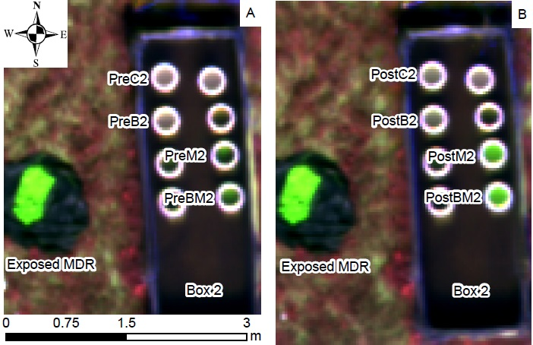
Qualitative Evaluation of Substrate Impacts
False-color composite
(G, B, R) V. (R, G, B) – symbolizes R as G to assist in feature identification
Pre-mixing Mission
Post-mixing Mission
RGB Composite
24
Notes:
Through digital image processing I was able to develop a qualitative evaluation of substrate impacts using a false color composite

Slide 18
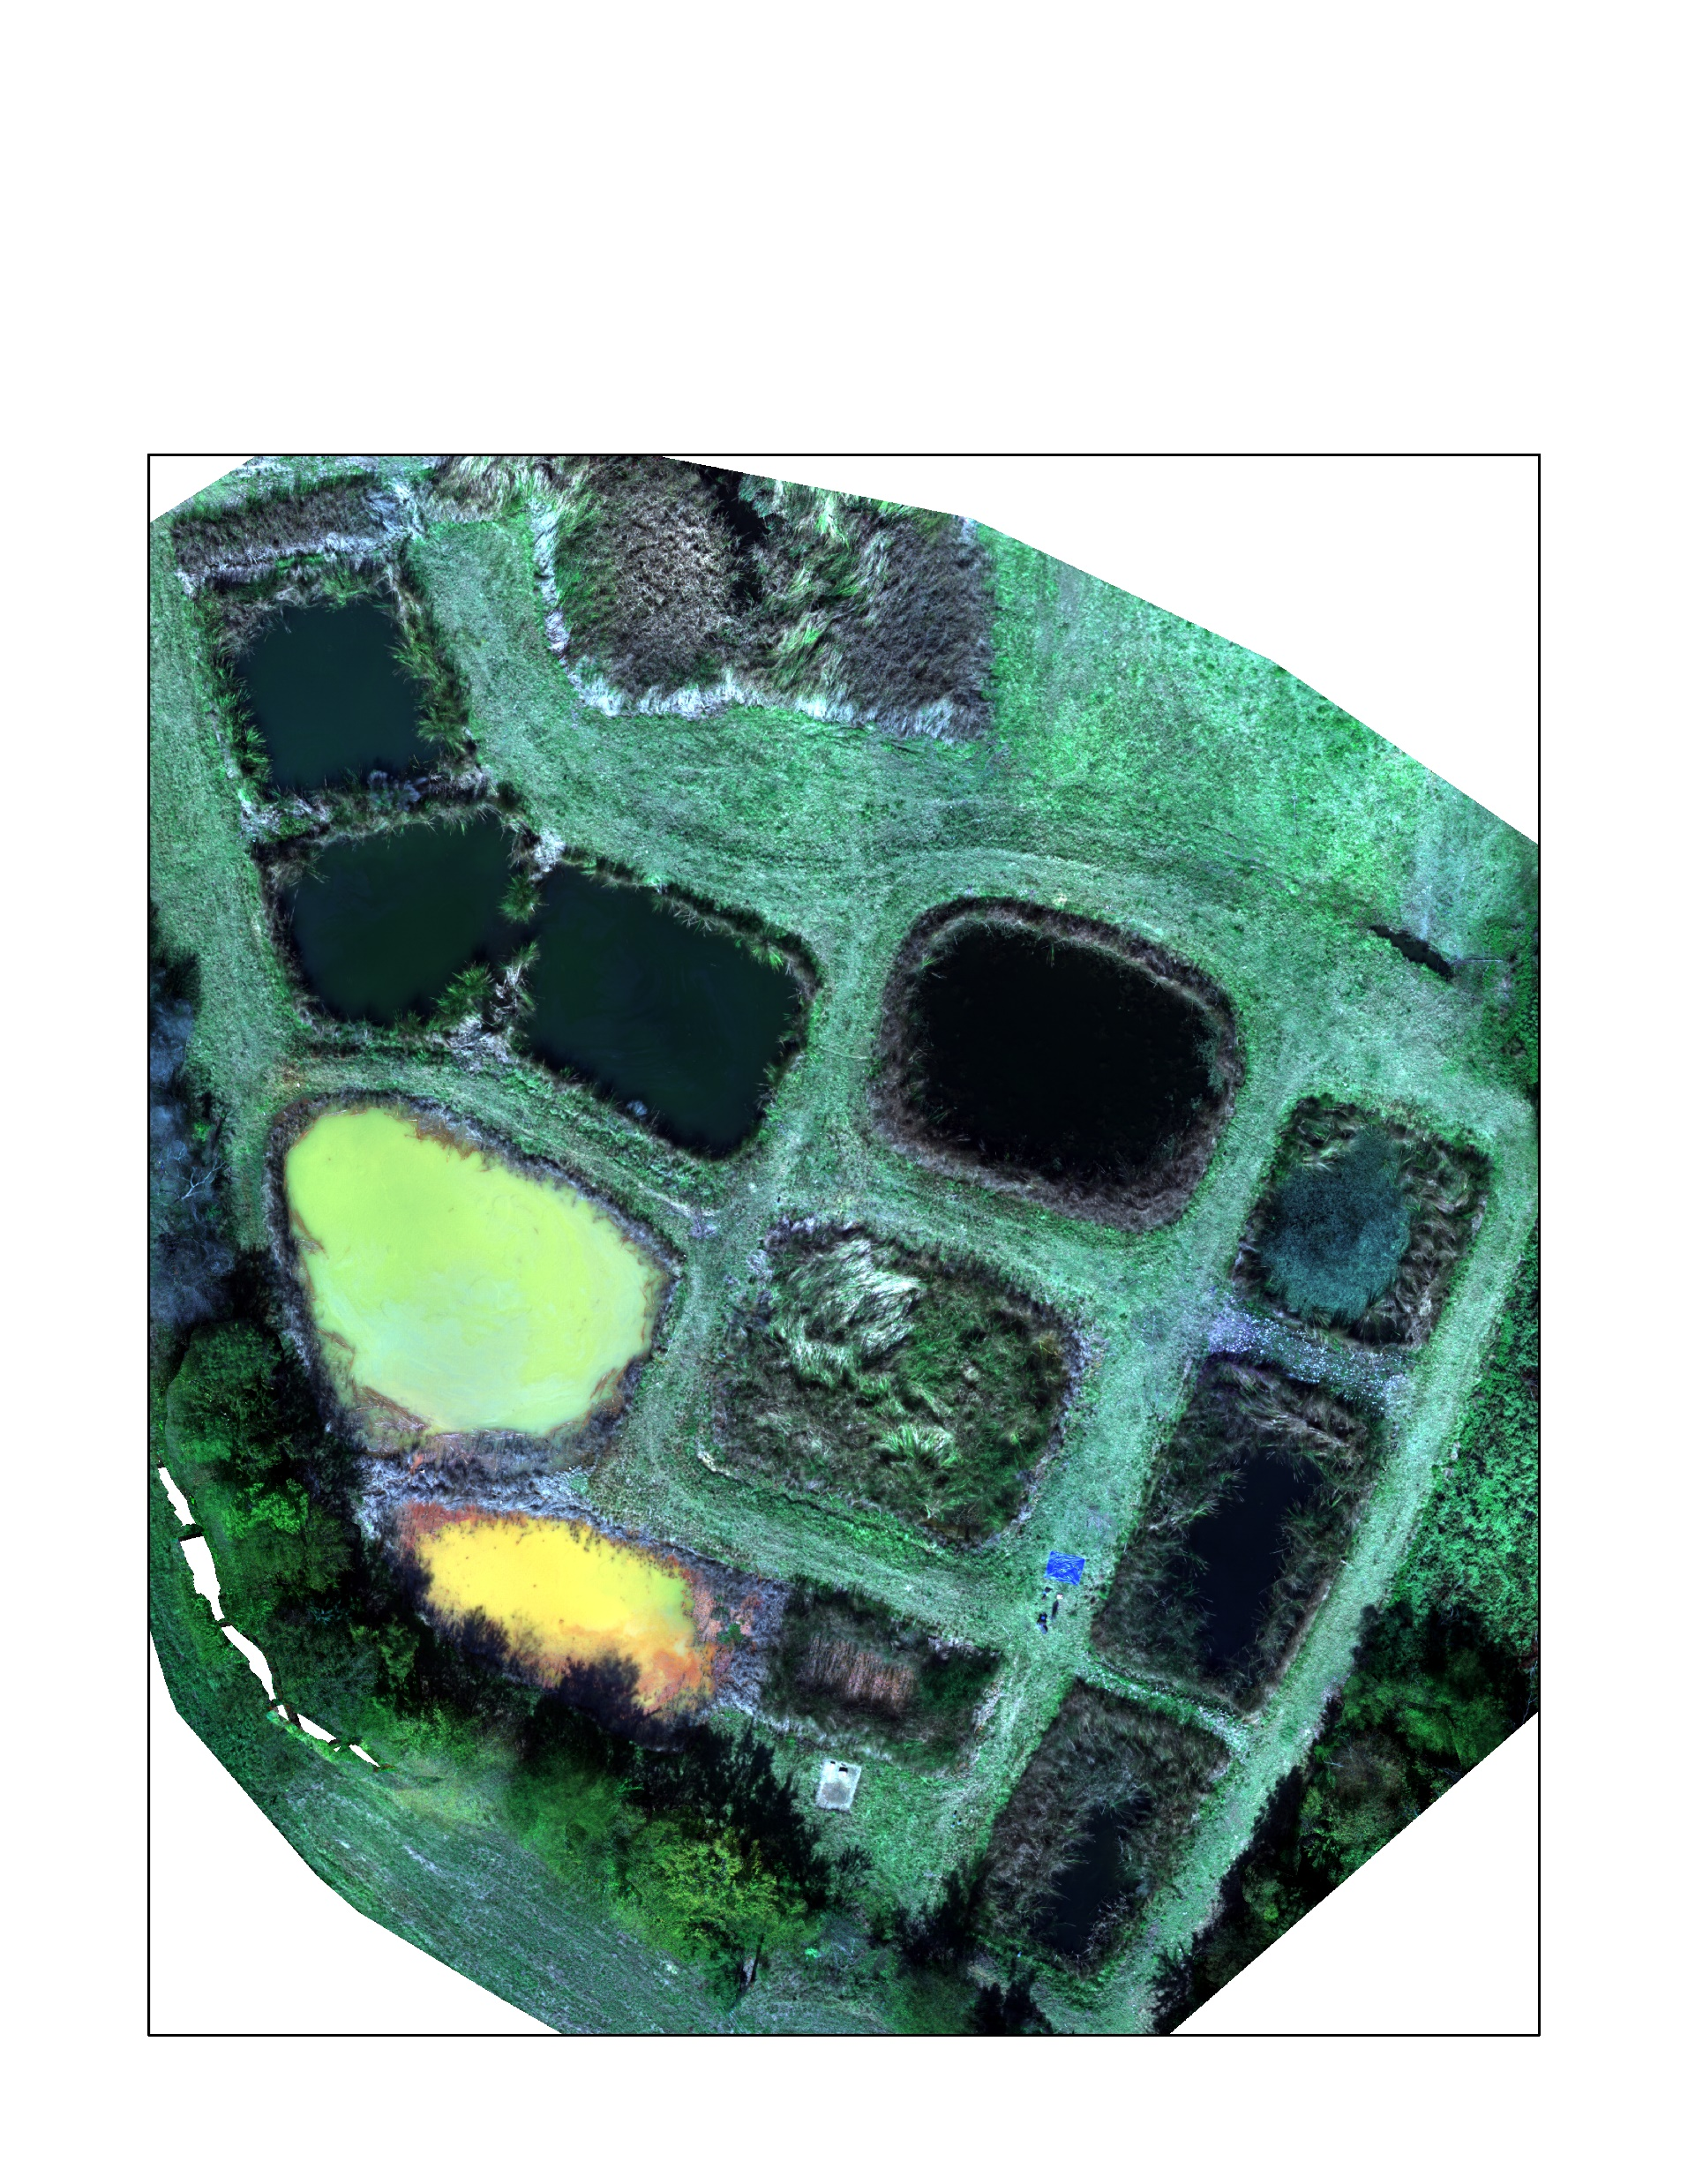
Spectral Monitoring Techniques for ODWs: Model Calibration and Verification
Purpose:
Examine the feasibility of utilizing sUAS-derived multispectral imagery to estimate in-situ concentrations of various mine drainage constituents and validate the models in waters of a different geologic origin.
16

Slide 19
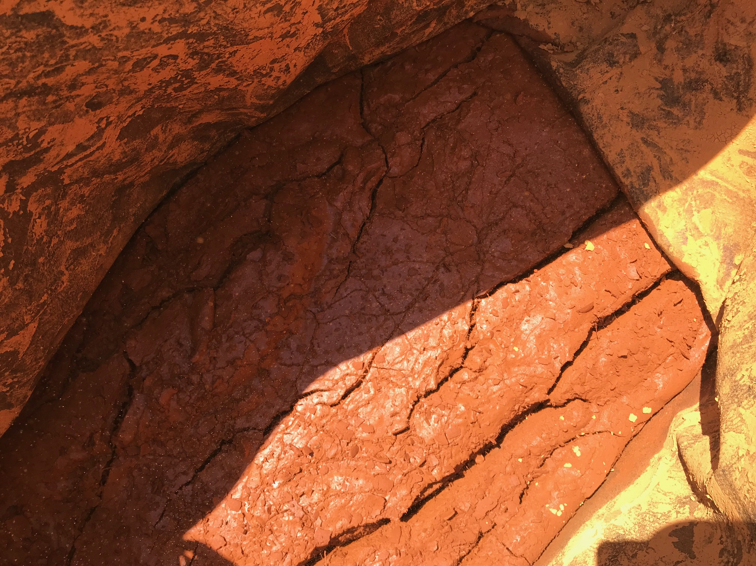
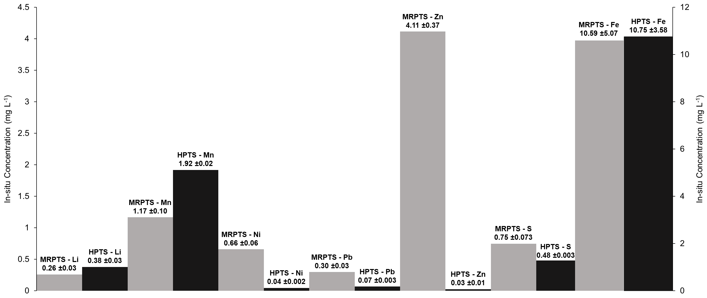
Spectral Monitoring Techniques for ODWs
MRPTS AND Hartshorne PTS
Oxidation Ponds (Study Ox. Pond)
sUAS multispectral imagery
MRPTS (n = 2)
HPTS (n = 1)
“Novel” water quality parameters
Total, filtered, and particulate (calc.) metals, turbidity, alkalinity, SDD, and actual depth (AD)
MRPTS (n = 30)
HPTS (n = 10)
Pixel-by-pixel extraction
Other extraction techniques tested
17
Notes:
All metals concentrations were significantly different aside from particulate Fe concentrations
The only reflectance bands that were significantly different were Red and NIR

Slide 20
Exploratory and Ordinary Least Squares (OLS) Regression
Exploratory regression techniques evaluated every possible combination of explanatory variables
Untransformed and log-transformed multispectral bands and band ratios
Evaluated models with R²_{adjusted} and AICc using OLS regression
 | Total Li | Total Mn | Total Ni | Total Pb | Total S | Total Zn | Particulate Fe
R²_{adjusted} | 0.76 | 0.76 | 0.77 | 0.78 | 0.76 | 0.74 | 0.81
Measured mean | 0.26 | 1.17 | 0.66 | 0.30 | 749.45 | 4.15 | 12.40
Predicted mean | 0.26 | 1.17 | 0.65 | 0.30 | 730.72 | 4.14 | 11.76
Mean residual | -3.45E-4 | 2.78E-3 | 1.58E-2 | 2.99E-4 | 1.87E+1 | 1.34E-2 | 6.36E-1
Mean difference | -0.13% | 0.24% | 2.39% | 0.10% | 2.50% | 0.32% | 5.13%
Upper CL | 0.27 | 1.18 | 0.66 | 0.30 | 745.96 | 4.20 | 12.75
Lower CL | 0.26 | 1.15 | 0.63 | 0.29 | 715.48 | 4.10 | 10.78
MRPTS
OLS
Metrics
 | Total Li | Total Mn | Total Ni | Total Pb | Total S | Total Zn | Particulate Fe
R²_{adjusted} | 0.01 | 0.04 | 0.05 | 0.06 | 0.07 | 0.14 | 0.78
Measured mean | 0.38 | 1.91 | 0.45 | 0.07 | 477.99 | 0.03 | 10.75
Predicted mean | 0.29 | 1.23 | 0.67 | 0.10 | 790.09 | 4.04 | 10.21
Mean residual | 0.09 | 0.68 | -0.22 | -0.03 | -312.09 | -4.01 | 0.54
Mean difference | -23.18% | -35.75% | 48.51% | 46.92% | 65.29% | 16582.46% | -0.53%
Upper CL | 0.30 | 1.26 | 0.69 | 0.11 | 814.34 | 4.16 | 11.96
Lower CL | 0.27 | 1.20 | 0.64 | 0.09 | 765.83 | 3.91 | 8.46
HPTS
OLS
Metrics
18
Notes:
Some of you may be asking why I am showing all of these statistical metrics, well due to the nature of R2 these metrics were required to full understand the relationships and their accuracy, because if you just look at the measured and predicted means these models appear to have performed well, and that is because of how the data was presented by averaging all observed and predicted measurements to more closely represent typical in-situ efforts.
In other words the models developed exhibited site specificity as noted by several papers throughout the literature
HAKA E KAY Information Criterion corrected for small sample sets

Slide 21
Something extra
Transects developed at each PTS
Hyperspectral reflectance (350 – 2500 nm)
SDD and AD
Exponential decay of EM energy in water (Beer-Lambert Law)
14

Slide 22
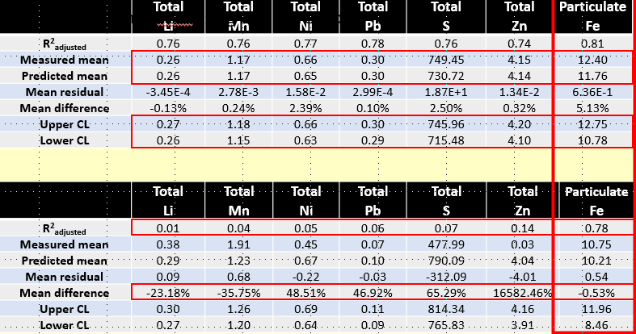
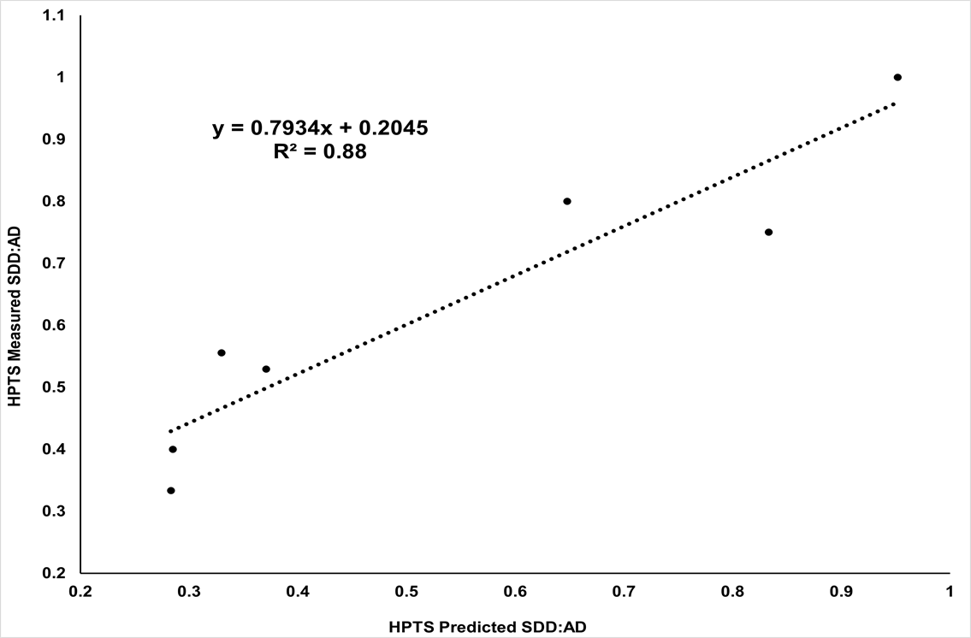
What do you conclude from your dissertation?
Optically active constituents were more accurately represented in ODWs compared to OSWs.
Accepted Hypothesis #1
- sUAS-derived multispectral imagery can be used to identify OSWs and discern the effect reflectance from bottom substrate had on the observed spectra.
Strong linear relationships (R²_{adj.} > 0.73) were observed with most estimates within the 75 percent confidence interval, and one percent of the observed value.
Partial Acceptance of Hypothesis #2
The dominant optical parameter (e.g., iron oxyhydroxides – particulate Fe – MDR) was readily estimated, however, most other parameters were more accurately estimated with site specific spectra.
Partial Rejection of Hypothesis #2
31
Notes:
Chapter 2:
2.1) In chapter two I observed strong linear relationships (R²_{adj.} > 0.74) with most mine water constituent models producing estimates within the 75 percent confidence interval, and one percent of the observed value.
2.2) The dominant optical parameter (e.g., iron oxyhydroxides – particulate Fe) in the studied mine drainage systems was readily estimated, however, most other parameters were more accurately estimated with site specific spectra.
2.3) The remote identification of OSWs and other remote sensing interferences was possible by developing a strong (R² = 0.73) exponential model relating sUAS-derived red band reflectance and the in-situ SDD AD ratio.

Slide 23
Thank You!
Questions, Comments, and/or Concerns?

Slide 24
Spatial Stats
Statistical Parameter | Selection Threshold
R²_{adjusted} | > 0.75
Minimum Jarque-Bera | p-value > 0.01
Minimum Koenker | p-value > 0.01
Minimum Moran's I | p-value > 0.05
Minimum Getis-Ord | p-value > 0.05
Maximum Joint-F | p-value < 0.01
Maximum VIF | < 7.5
An insignificant Jarque-Bera Statistic (p-value > 0.01) indicated the regression residuals (e.g., observed minus predicted value) were normally distributed, and the predictions displayed no significant bias. Non-normally distributed residuals suggest not all explanatory variables were accounted for, nonlinear relationships were modeled, or outliers significantly impacted the models.
The Koenker Studentized (Bruesch-Pagan) (BP) Statistic (e.g., Koenker) was used to assess the consistency of the relationship between the independent and dependent variables in geographic and dataspace. In other words, if the relationship (e.g., slope) was similar between the variables at all sampling locations (e.g., stationary) and that relationship did not change (e.g., linear to nonlinear) with changes in the magnitude of the explanatory variable (e.g., homoscedasticity) the models were specified correctly (e.g., a key variable was not missing).
Moran’s I and Getis-Ord Global G (Gi*) were used to assess spatial autocorrelation and clustering of the raw data and regression residuals. Evidence of significant spatial autocorrelation (p-value > 0.05) further suggests an explanatory variable was excluded from the model. Clustering was used to identify if any sampling location or region produced consistently higher or lower values (e.g., high-low clusters) which was considered significant at p-values > 0.05.
The Joint-F test Statistic (Joint-F) provided an assessment of multiple regression model significance (p-value < 0.01) compared to a model with no independent variables (e.g., intercept only model).
Finally, the Variance Inflation Factor (VIF) was a metric describing the redundancy among explanatory variables in the multiple regression model. VIF is the reciprocal of tolerance. Although no explicit rule exists, some authors have suggested VIF > 10 indicates severe collinearity, poor estimation of regression coefficients, and an inflated standard error of the regression (Marquardt 1970; Miles 2005). Again, all the statistical metrics and tools described in this paragraph were outputs from the OLS tool or analyzed separately in ArcMap V. 10.6.1 (ESRI 2018).
17
Notes:
The only pre-mixing vessel that was spectrally dissimilar was PreBM. BM was also the only vessel to contain a mixture of the two reference substrates – optical properties are not additive so each substrate was examined and the one producing the smallest difference (lowest angle) was selected for presentation, both were spectrally dissimilar. Thus it was likely the presence of both substrates that caused the dissimilarities observed with this figure supports because when the buckets were mixed red band reflectance increased by 100 %

Slide 25
Why Exploratory Regression
Exploratory regression is a data mining tool that evaluates all possible combinations of the explanatory variables and generates models that pass set “model criteria” satisfying all requirements and assumptions of Ordinary Least Squares Regression
Three Cautions
Overfitting – I evaluated 1 – 4 variable models; improvements were observed up to 3 var than collinearity and reducancy increased substantially with 4 variable models – The additional metrics included provide a more detailed view of the “fit”
Increased Chances of Type I Error – A 95% confidence probability indicates that approximately 1000 of the 20,000 or so models evaluated could have been false positives. However, because of all the other statistics computed and the experimental design (six replicates) I believe type I errors were minimized
Complex problem – Knowing all the factors that contribute to the real-world relationships was unattainable. These are complex natural relationships/problems that the literature has yet to fully describe.
Particularly, the lack information on some OACs (Fe) and mixed information for others (Chla estimated with nearly every band)
17
Notes:
Type I Error – Errors of commission – you conclude something is fact, when it occurred by chance
Type II Error – Errors of omission – you conclude something is fact (pre-models did not perform well), but it only occurred out of a random fluke because something was left out, the size of this error depends on the magnitude and direction of the missed determination – which is also further justification for not omitting outilers

