Slide 1
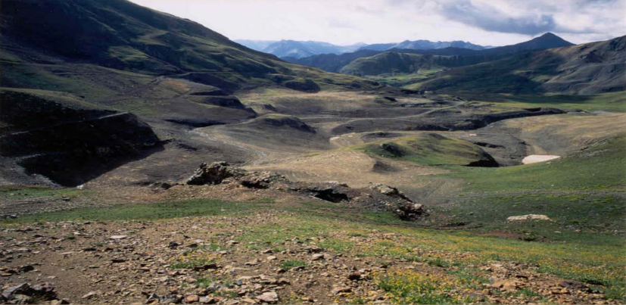
SGC Mining and Reclamation
Evaluating Animas River Water Quality
2019 ASMR Conference and 36th Annual Meeting
June 2019
Notes:
TITLE SLIDE – Replace the picture to fit overall presentation theme.
1

Slide 2
Overview
Metals loading adversely impacts the Animas River in the area around Silverton, San Juan County, Colorado
  as a result of natural mineralization producing acid rock drainage in the area,
  compounded by historic mining activities
SGC, with Agency concurrence, completed a comprehensive watershed approach to Sunnyside Mine’s reclamation
SGC’s actions resulted in reduced metals loading in the Animas River and reduced impacts on aquatic life
2

Slide 3
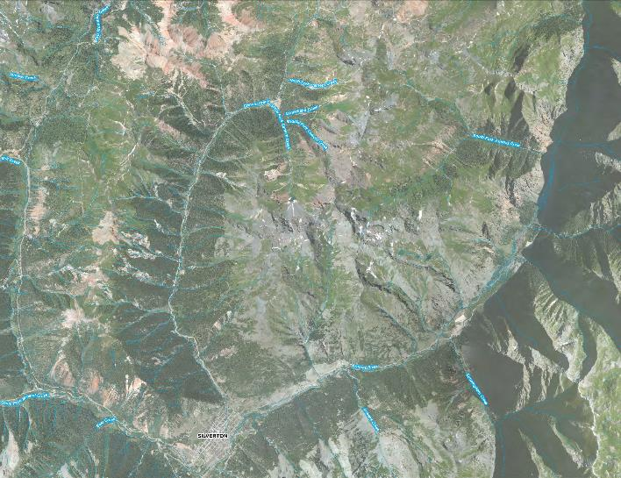
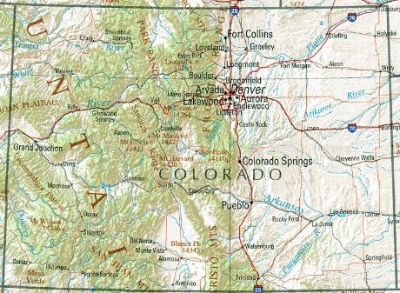
Site Location
Sunnyside Mine
Silverton
Cement Creek
Animas River
Mineral Creek
3

Slide 4
The Challenge
How to reclaim a mine site under current environmental regulations when:
  The mine began operation over 100 years ago under very different (or non-existent) regulatory requirements
  The surrounding rocks are highly altered and mineralized
  Massive metals loading of surface and groundwater existed pre-mining
  Hundreds of abandoned mining facilities are present in the watershed
4

Slide 5
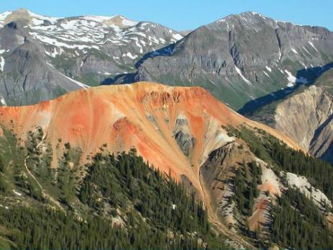
Geologic Setting
Sunnyside Mine is approximately 8 miles north of Silverton, San Juan County, CO
The area is naturally mineralized and has been for millions of years. It’s been naturally discharging heavy metals for thousands of years
As a result, acid rock drainage and poor water quality were prevalent long before the advent of mining
This natural metals loading in the Animas River has limited aquatic life, including trout populations downstream from Silverton
5

Slide 6
Historic Mining
Serious mineral exploration began in the area in the early 1870s
Gold, silver, lead and copper were the main metals mined
The Silverton Caldera hosted 1,500 mines and over 50 mill sites, 8 smelters and 35 aerial trams which contributed to poor water quality
An estimated 8.6 million short tons of mill tailings were discharged directly into surface streams between 1872-1935
In the 1970s, regulations were established to monitor and limit metals discharges and to require miners to reclaim their sites
6

Slide 7
History - Sunnyside Mine
The Sunnyside vein was discovered by George Howard and R. J. McNutt in 1873, and valid mining claims were staked in 1874
In November 1900, Judge John Terry obtained ownership of the mine
The U.S. Smelting and Refining Company purchased the mine and mill from the Terry family in 1917
In 1959, the Sunnyside mine was leased by Standard Metals
In June 1978, Lake Emma broke into the mine and emptied more than four million tons of water and mud into the workings
In 1985 Standard Metals was forced into bankruptcy and the mine was purchased by Sunnyside Gold Corporation (SGC), and put back into production
7

Slide 8
SGC History
“The mining operation exhibited some vast improvements over the last two years. The Division would like to commend Frank Bergstrom (SGC Environment Manager at the time) for his courteous, efficient and diligent manner with which he works with our office as well as in the field, as evidenced by the improvements noted, specifically at the Terry and American Tunnels.”
–Mining Land Reclamation Division, Oct. 1987
SGC was established in 1985
SGC operated Sunnyside from 1986 until 1991
Brought all discharge permits into compliance
Re-designed the mining operation
Completed a substantial mine-permit amendment in cooperation with the regulatory agencies
As a result, won the “Most Improved Site” award from the Colorado MLRD
American Tunnel, 1998
8

Slide 9
SGC’s 5 Years of Mining
All of SGC’s mining activities used modern techniques and were under the modern era of environmental regulation
SGC’s activities were regulated by the Federal and State governments, and all activities were permitted
SGC treated a significant amount of water, and as a result, substantially reduced metals loading in the Animas River
9

Slide 10
Reclamation Approach
Reclaim and restore the surface in the Sunnyside Basin
Reclaim and restore the surface at the American Tunnel Portal
Physically and chemically stabilize the Mayflower Tailings
Control and minimize mine discharge by installing bulkheads
Remediate a series of non-SGC sites in the Upper Animas Basin
Compliance determined by zinc concentration at USGS Gaging Station (A-72) below confluence of Animas River, Cement Creek, and Mineral Creek
10

Slide 11
Key Reclamation Dates
November 1993: Technical Revisions to the reclamation plan, including installation of bulkheads, approved by MLRB
Fall 1994: Animas River Stakeholders Group formed and SGC becomes member
May 1996: SGC and Colorado enter into a consent agreement which was approved by BLM and endorsed by EPA
January 2003: Colorado Department of Public Health and Environment (CDPHE) Determines Terms of Consent Decree met
11

Slide 12
SGC Reclamation and Remediation Activities
12

Slide 13
Reclamation - Surface Facilities
SGC placed 240,000 cubic yards of clean fill over the Lake Emma Subsidence area, contoured and reseeded area
SGC removed 80,000 tons of historic mine waste and tails from the American Tunnel, contoured and reseeded the area
SGC contoured the 4 Mayflower tailings piles to promote physical stability, covered with subsoil, and reseeded the area
In January 1999 added projects for additional hydrologic controls of Mayflower tailings pond #4 to divert upgradient surface and groundwater around the tailings
13

Slide 14
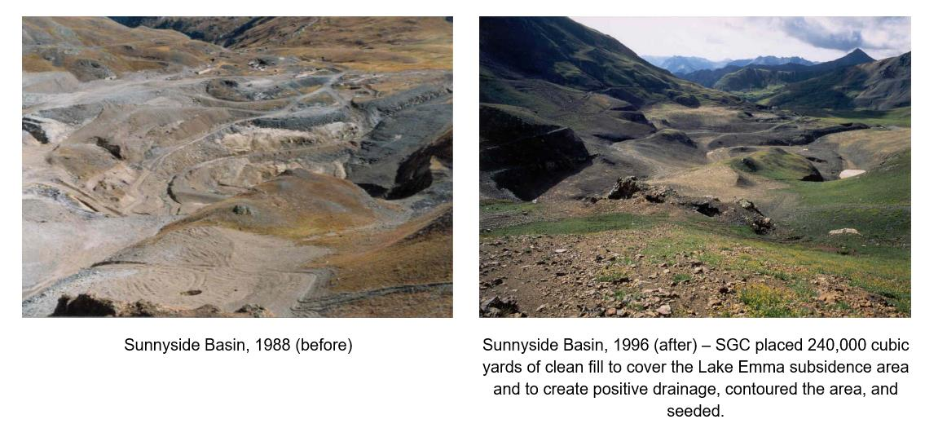
Reclamation - Before & After
14

Slide 15
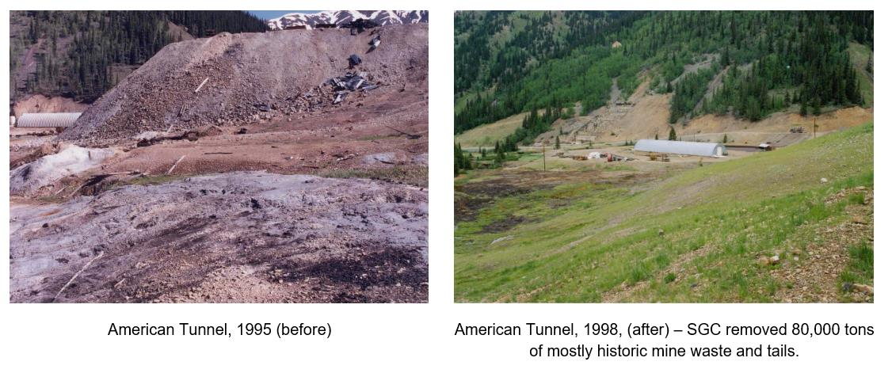
Reclamation - Before & After
15

Slide 16
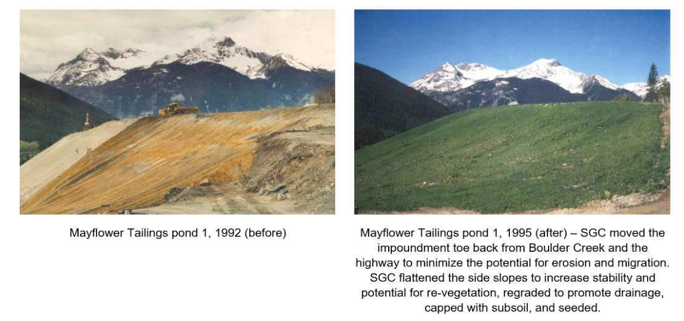
Reclamation - Before & After
16

Slide 17
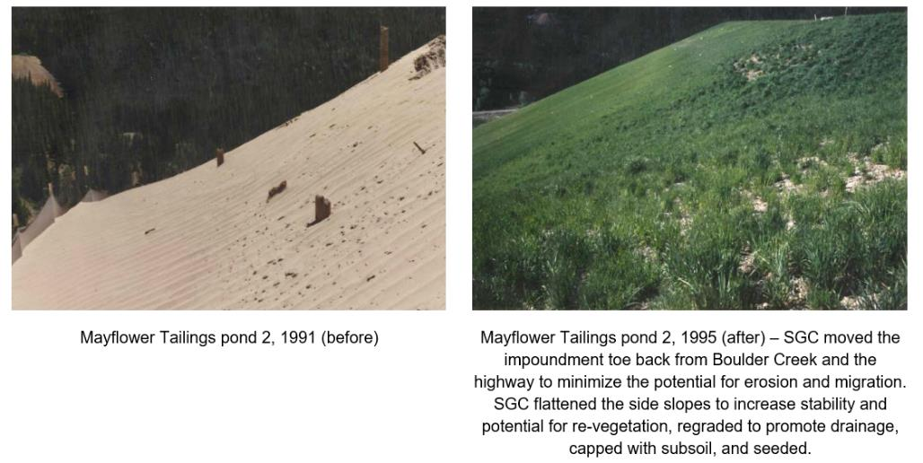
Reclamation - Before & After
17

Slide 18
Reclamation - Sunnyside Underground
Between 1992 and 2002, SGC installed a series of nine engineered concrete bulkheads in the Sunnyside Mine, including the Terry and American Tunnels
The primary purpose of the concrete bulkheads is to isolate the interior workings of the Sunnyside Mine, and prevent water flow from the interior workings to the surface
As expected, the installation of the bulkheads caused the local water table to return toward natural levels
Lime slurry was injected into the flooded Sunnyside mine workings
The engineered bulkheads are stable, performing as intended, and have isolated the interior workings of the mine
18

Slide 19
Reclamation - Water Treatment
SGC operated a plant to treat the discharge from the American Tunnel and used excess capacity to treat the flow in Cement Creek. SGC removed:
  Over 326,000 pounds of metal from Cement Creek between August 1996 and December 2002
  Over 290,000 pounds of metals from American Tunnel discharge between August 1996 and December 2002, preventing it from entering Cement Creek
  As a result of these efforts, Cement Creek below the treatment plant had less metals loading than it would have under baseline conditions
SGC also operated a treatment plant at the Terry Tunnel from 1986-1996 when SGC installed bulkheads in the Tunnel, removing thousands of additional pounds of potential contaminants
19

Slide 20
SGC Water Treatment System at Cement Creek
20

Slide 21
Reclamation - Other Projects
SGC and the State of Colorado agreed on a comprehensive watershed approach in which SGC would be released from further obligations in exchange for bulkheading various sources of mine drainage and completing several other projects in the region.
Bulkheads were installed at the Mogul, Gold Prince and Koehler mines
  Large quantities of mine waste and historic tailings were removed, relocated and stabilized
  Sites were contoured and reseeded to improve stability and promote revegetation to minimize erosion
21

Slide 22
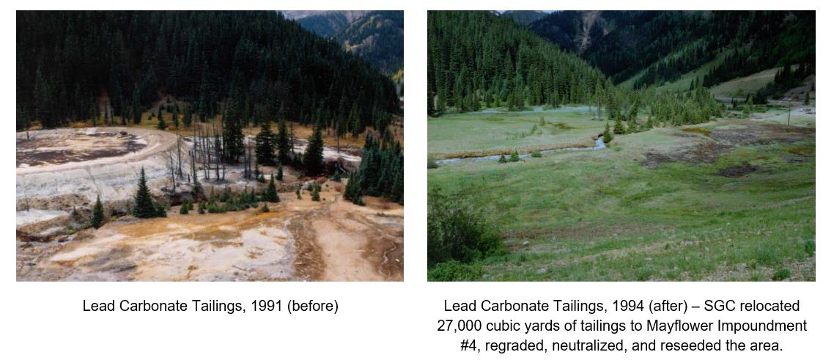
Other Projects - Before & After
22

Slide 23
Collaboration
SGC is a member and active participant of the Animas River Stakeholders Group (ARSG)
ARSG, working with state and federal agencies, identified 400 sites as priority contributing sources to the upper Animas River.
67 of these sources accounted for 90 percent of the metals contamination from all mining sources
ARSG’s study led CDPHE to implement 27 realistic Total Maximum Daily Load standards, based on partial remediation of the priority sites
ARSG has completed many of the identified projects utilizing 319 grants
SGC provided a portion of the in-kind match and a disposal site for one of the projects
23

Slide 24
Evaluation of SGC Activities
CDPHE evaluated the success of SGC’s actions based on the zinc concentrations measured at sample point A-72 (USGS Gaging Station)
A methodology based on a regression analysis of flow versus concentration was employed to account for seasonal fluctuations in concentrations in response to variation in stream flows
SGC met the criteria at A-72 and was released from further obligations in 2003
24

Slide 25
Methodology for Evaluating Zinc at A-72
Determine Zn concentration at A-72 monthly
Develop regression equation for flow and zinc concentration during reference period:
ln(Zn_{A-72}) = 8.30-0.462*ln(flow)+0.697*Rise
Zn_{A-72}=e^{[ln(ZnA-72)]}
StdE Rise 0 = 0.1460 StdE Rise 1 = 0.1533
Compute the standardized residual
StR = (ln[Zn_{A-72 Actual}] - ln[Zn_{A-72Pred}])/StdE
Evaluate the trends in the data using a running average of the standardized residual
25
Notes:
25

Slide 26
Regression Plot Reference Period
26

Slide 27
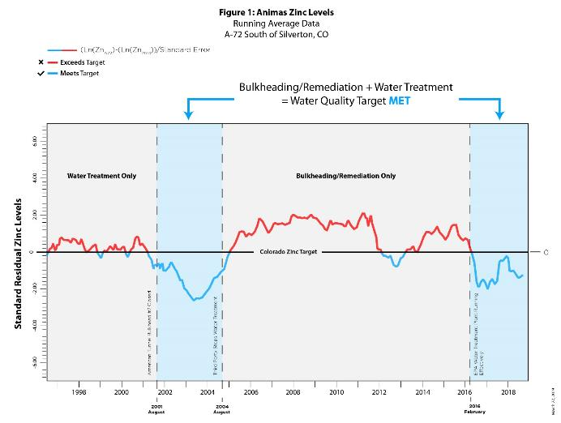
Zinc Standardized Residual Running Average
27

Slide 28
Ongoing Success of SGC’s Closure Method
Application of CDPHE’s methodology demonstrates the continued success of SGC’s bulkheading, remediation and reclamation activities.
The post closure plan included two independent aspects to maintain the zinc concentrations
    Successful completion of SGC’s bulkheading, remediation and reclamation
    Third party operation of the Gladstone treatment plant to treat water from various adits
When both aspects in place, zinc targets met
EPA commenced operation of the Gladstone plant at substantially less than its capacity in February 2016, and CDPHE’s zinc targets have been met since June 2017
28

Slide 29
Conclusions
The use of bulkheads to control discharges from the Sunnyside mine, and reclamation of associated surface facilities in conjunction with removing other sources of metals loading from facilities not owned by SGC have resulted in decreased loadings to the Animas River
SGC’s brief mining and extensive reclamation activities each substantially reduced metals loading in the Animas River
Without the actions of SGC, metal levels in the Animas River, and the resulting impacts on aquatic life and the trout fishery downstream of Silverton, would undoubtedly be more adverse
29

Slide 30
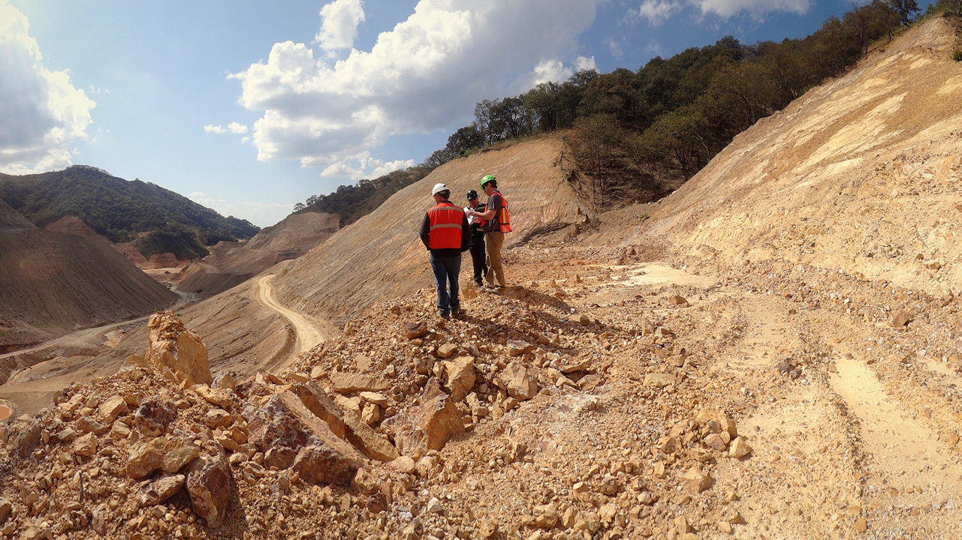
Q&A
Steven Lange
slange@knightpiesold.com
Notes:
EXIT SLIDE – Replace the picture and adjust elements on the Exit Slide as necessary.
30

