Slide 1




Laboratory Testing to Optimize Retention Time in Auto-Flushing Limestone Beds
Julie LaBar, Buck Neely, Cliff Denholm, Tim Danehy, and Bill Strosnider
Presented at the 36th Annual Meeting of the American Society of Mining and Reclamation
June 3-7, 2019 in Big Sky, MT

Slide 2
Outline
Site Background
Proposed Changes
Bucket Testing
Conclusions

Slide 3
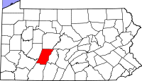
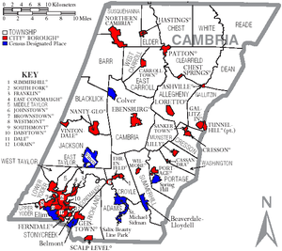
Site Background
Puritan discharge
  Portage, PA
Partially flooded underground mine
Discharges to Trout Run
Water quality (1997-2010)
  pH 3.0
  26 mg/L Fe
  21 mg/L Al
  4 mg/L Mn
  300 mg/L acidity

Slide 4
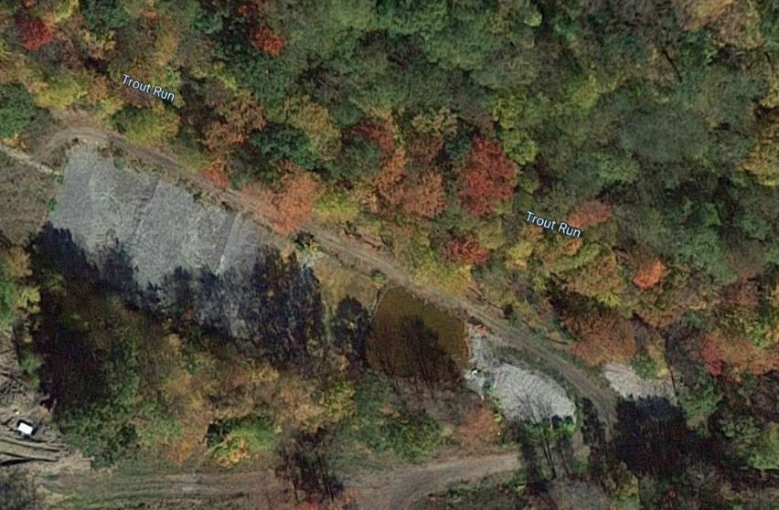
Site Background
Treatment system constructed in 2012
  3500-ton limestone bed
  4 over and 5 under baffles

Slide 5
Site Background
Flows as high as 1600 gpm
  Designed to treat 100 gpm
Moderately effective treatment
  pH 6.4
  1.5 mg/L Fe
  3.6 mg/L Al
  1.0 mg/L Mn
  -46 mg/L acidity
  >80 mg/L alkalinity

Slide 6
Site Background
Problems encountered quickly
First two cells clogged within months
  LS must be stirred/replaced frequently
20-50% of flow is lost
  System unlined
  Constructed in coal refuse

Slide 7
Proposed Changes
System needs more than maintenance
Growing Greener application in 2015
  SFU and SRI
  $540K
  Proposed to construct new system that would:
    Treat all of the water
    Eliminate leaking
    Reuse existing LS
  Awarded in 2016

Slide 8
Proposed Changes

Slide 9
Bucket Testing
Need to optimize retention time in AFVFP and settling ponds
Collected LS from existing system to perform tests
  Used water from site
Examined:
  Contact time with LS
  Whether to fill AFVFP all at once or gradually
  Settling time

Slide 10
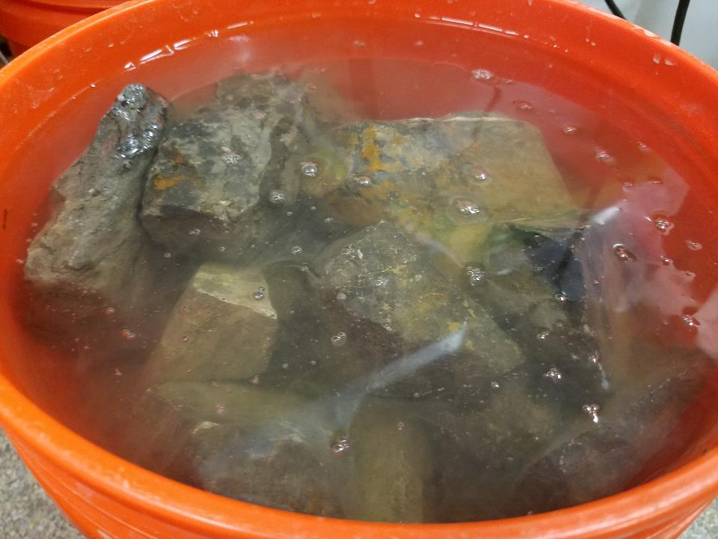

Slide 11
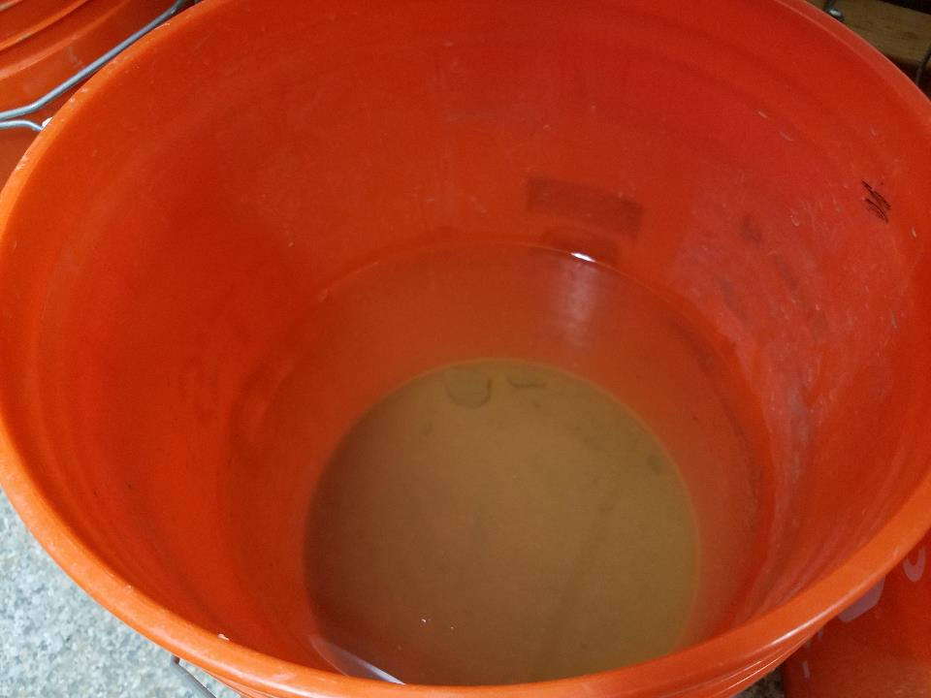

Slide 12
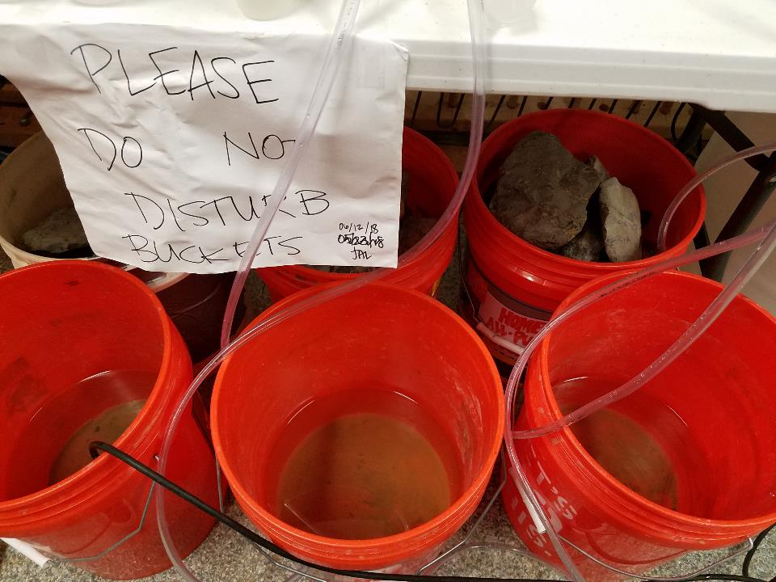

Slide 13
Mean influent water quality
pH | 3.03 ± 0.37
Acidity (mg/L) | 113 ± 3.3
DO (mg/L) | 5.50 ± 1.2
 | Total | Dissolved
Fe (mg/L) | 5.56 ± 1.09 | 5.29 ± 1.01
Al (mg/L) | 10.90 ± 1.94 | 10.68 ± 1.76
Mn (mg/L) | 1.39 ± 0.13 | 1.34 ± 0.08

Slide 14
Bucket Testing – Results
1A final metals
Fe: <0.1 mg/L
Al: 0.19 mg/L
Mn: 1.30 mg/L
1B final metals
Fe: <0.1 mg/L
Al: 0.11 mg/L
Mn: 1.18 mg/L

Slide 15
Bucket Testing - Results
All treatments removed Fe to <0.10 mg/L within first contact period (except for 2B)

Slide 16
Bucket Testing - Results
All treatments removed Al to <0.10 mg/L within first contact period (except for 2B)

Slide 17
Bucket Testing - Results

Slide 18
Bucket Testing - Results

Slide 19
Bucket Testing - Results

Slide 20
Bucket Testing - Results

Slide 21
Conclusions
Adding water gradually vs. all at once:
  Does can significantly impact pH, alkalinity, or acidity
  Can impact metals removal in first stage (still efficient for Fe and Al removal, overall)
When first stage is of shorter duration, adding water all at once provides better treatment

Slide 22
Questions?

