Slide 1




Finite element water balance modeling in a coal refuse pile cap and cover reclamation
Iuri Lira Santos, MSCE
Leslie Hopkinson, PhD
John Quaranta, PhD
Levi Cyphers, MSCE
ASMR 2019 – Big Sky, MT

Slide 2
Acknowledgements
Research supported by U.S. Department of Interior, Office of Surface Mining, Reclamation, and Enforcement (OSMRE) under Cooperative Agreement Number S15AC20020
Collaborators include:
West Virginia Water Research Institute: Paul Ziemkiewicz, Ph. D., Director
West Virginia Department of Environmental Protection: Mike Sheehan

Slide 3
Presentation Layout
Introduction and background
  Acid Mine Drainage
  Cap and covers
  Unsaturated soil mechanics
Project description
  Site description
  Project rationale
  Materials and methods
  Results
  Cost comparison
  Conclusions

Slide 4
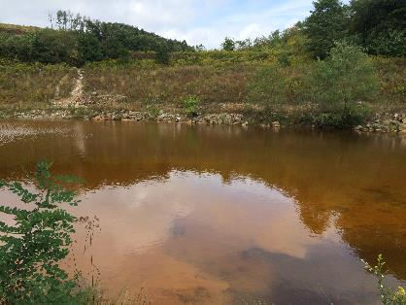
Acid Mine Drainage
Acid Mine Drainage (AMD) is formed when sulfide minerals in the Coarse Coal Refuse (CCR) are exposed to oxidizing conditions (water and oxygen), forming highly acidic solution.
2FeS₂ + 7O₂ + 2H₂O→2FeSO₄ + 2H₂SO₄
2Fe₂⁺ + 1/2 O₂ + 2H⁺ →2Fe₃⁺ + H₂O
Fe₃⁺ + 3H₂O →Fe(OH)₃ + 3H⁺
FeS₂ (s) + 15/4 O₂ + 7/2 H₂O↔4H⁺ + 2SO₄²⁻ +Fe(OH)₃ (s)
Source: Author

Slide 5
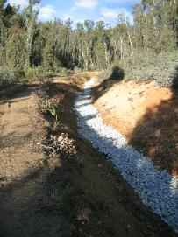
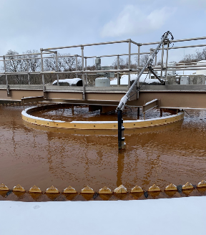
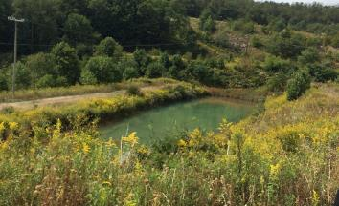
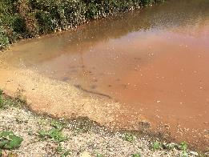
AMD treatment
Passive (low acidity and flow)
  Wetlands: aerobic and anaerobic
  Limestone drains, beds, channels,
  etc.
Active
  Treatment ponds,
  Clarifiers,
  etc.
Source: Author

Slide 6
Cap and Cover Systems
Minimize infiltration of precipitation into the subsurface and minimize gas venting to surface
Provide vegetative surface to produce an ecological and resistive layer to erosion and freeze / thaw

Slide 7
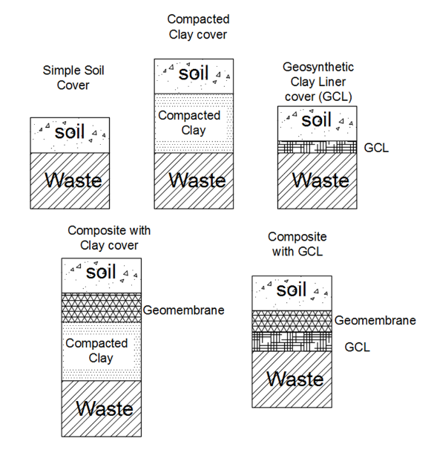
Examples
Low permeability layers
Seepage occurs on topsoil
Used in conventional (less hazardous waste) landfills
High permeability layers over impermeable layer
Function as a protection cap
Surface texture has to be carefully selected

Slide 8
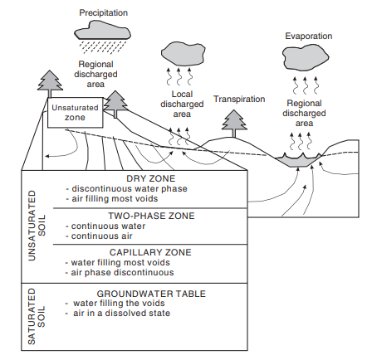
Unsaturated Soil Mechanics
Fredlund, Rahardjo and Fredlund (2012)

Slide 9
Unsaturated Soil Mechanics
Considers that the soil mass is conceived as a multi-stage system, composed of soil, water, air and a contractile skin
Interaction of the air influences the water flow through a soil, affects soil strength parameters, stress-strain and deformation behavior,
Soil-Water Characteristic Curve indicates soil-water interaction which correlates the water content and the soil suction

Slide 10
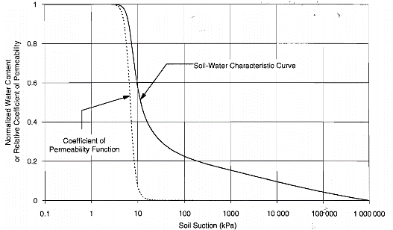
Soil Water Characteristic Curve (SWCC)
SWCC
Soil suction to water content drives permeability
SWCC reflects the soil texture and granulometry
Fredlund, Xing and Huang (1994)

Slide 11
Project Description

Slide 12
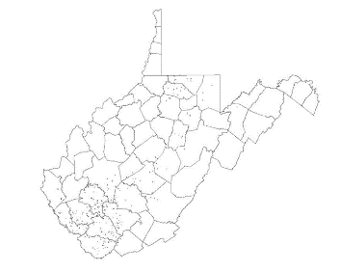
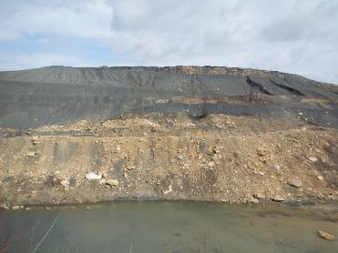
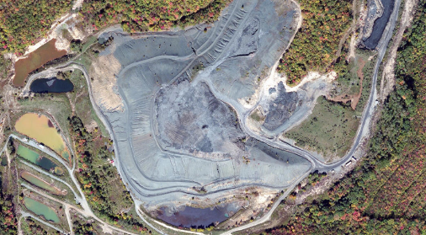
Royal Scot Demonstration Site
Located in Greenbrier County, WV
Coarse coal refuse disposal site
Abandoned in 2001
Ridge-top refuse disposal
Royal Scot Location
Adapted from Stevens, 2016
Source: Author
Source: Google earth

Slide 13
Project Drivers
The pile consists of pyritic coarse coal refuse shale producing acid mine drainage (AMD) to watershed,
The site was abandoned in 1999 and is constantly being treated with conventional settlement ponds for pH stabilization and metal removal (caustic soda).
Treatment cost averages on $220,000/ year
Highest cost AMD site for WV

Slide 14
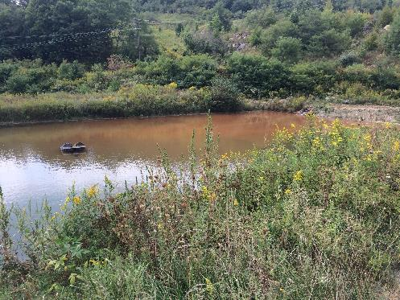
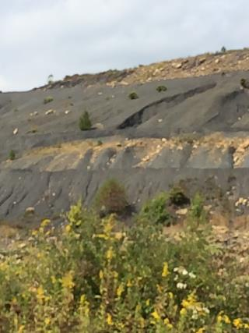
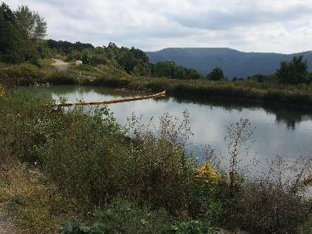
Site Conditions
Source: Author

Slide 15
Materials and Methods
Reclamation utilized Geomorphic Landform Design principles
Geotechnical material laboratory testing
Slope stability analysis and design
3D Seepage analysis and cap/cover system design

Slide 16
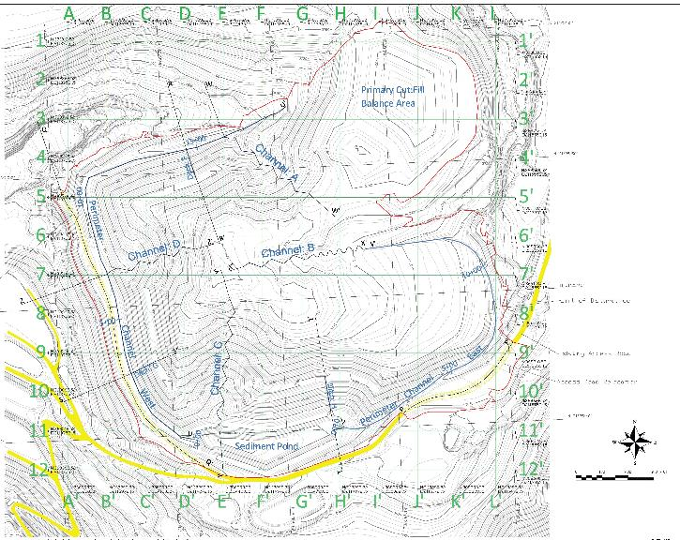
Proposed reclamation plan

Slide 17
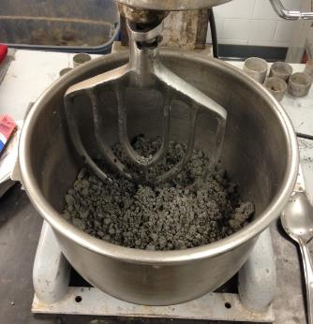
Soil Properties
Coarse coal refuse
  Sand-like material with gravel
Short paper fiber composition-
  Primary (~85%): Solids from primary clarification (wood fiber, lime, mineral additives)
  Secondary (~15%): Microbial biomass from biological wastewater
  Has been tested as an amendment for soil
  Benefits to refuse: adds organic matter and nutrients, lowers pH

Slide 18
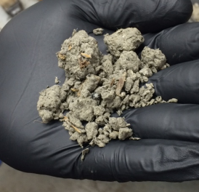
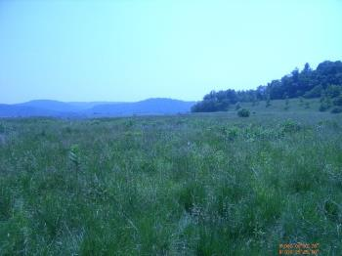
Background: Use of Paper Mill Residuals in reclamation
Compacted to form hydraulic barrier
  New England MSW landfills
Soil Amendment
  Has been successfully applied at WV sites
  Short paper fiber produced by WestRock’s Covington paper mill (marketed as MGro™)
  favorable characteristics for plant growth, acid-neutralization potential and suitable strength (internal angle of friction of approximately 30°)
  Visual examination shows clumped masses of fibrous material with wood chips and clay-like material. The material swells noticeably when wet.
Typical MGro™ sample
Martinka Mine site: Marion County

Slide 19
2 Layer Design
Growth Layer:
Mixture of shale and MGro™ in fixed volumetric ratio.
Initial results from the 60% shale :40% SPF blend have been favorable.
60/40 Mgro Geotechnical properties defined in laboratory testing
Proposed thickness = 1 feet
Impermeable Layer
Intended for seepage infiltration control
Compacted coarse coal refuse
Preliminary thickness ranges = 1 - 2 ft
Refuse pile material (Cut / Fill)
Homogeneous
Source of the acid mine drainage
Field self weight ranges 12.5 to 14.1 kN/m³ pcf.
Thickness varies 3 m to 45 m.
2 Layer Final Cover System
Growth
Growth Layer
Low permeability Layer
Site Coarse Coal Refuse
(CCR)
19

Slide 20
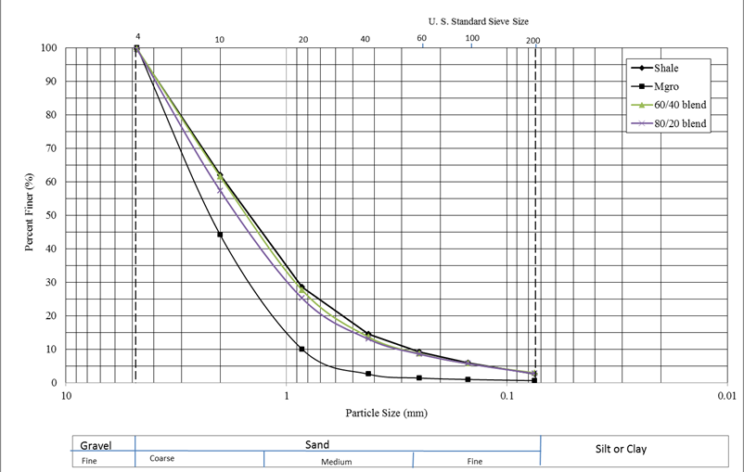
Final ASTM- USCS Grain Size Distribution & Classification
CCR Shale: SP - Poorly Graded Sand with Gravel (>15% gravel)
MGro: SP - Poorly Graded Sand with Gravel (>15% gravel)
60% CCR + 40% Mgro: SW -Well Graded Sand with Gravel
80% CCR + 20 % Mgro: SW – Well Graded Sand with Gravel
Shale GSD
MGro™ GSD

Slide 21
Materials Properties
Material | Saturated Hydraulic Conductivity (cm/s) | Porosity | Specific Gravity
Fill | 4 x 10⁻⁴ | 0.45 | 2.65
Low permeability layer | 2 x 10⁻⁶ | 0.18 | 2.31
Growth layer | 1 x 10⁻³ | 0.52 | 2.00
Compaction Energy | Optimum dry unit weight (kN/m³) | Optimum moisture content (%)
67.85 kJ/m³ (11% Proctor) | 14.6 | 17.5
203.58 kJ/m³ (34% Proctor) | 15.1 | 17.0
592.5 kJ/m³ (Standard Proctor) | 15.9 | 14.3

Slide 22
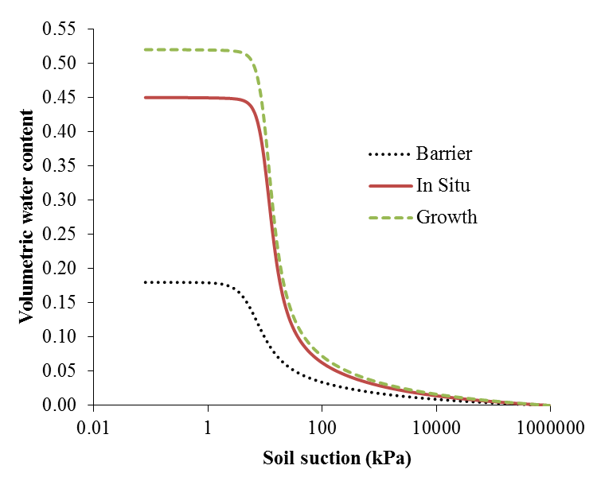
Calculated SWCC

Slide 23
FEM Analysis
Unsaturated soil mechanics
3D
Comparison between bare refuse to cap and cover
Transient analysis
Two topographical aspects evaluated:
Steep ( > 1V : 4H )
Flat ( < 1V : 4H )

Slide 24
Simulation Input Variables
Precipitation
  1-yr., 5-yr., 25-yr., 100-yr. 24 hour rainstorms
  59 mm, 82 mm, 112 mm, and 139 mm respectively.
  Precipitation applied at day 1 of modeling.
Environmental
  Evapotranspiration estimated by modified Wilson-Pennman (Wilson et al., 1994)
  Temperature 20ºC, 70% humidity, 20 Mj/m²/day, wind speed 1 m/s.

Slide 25
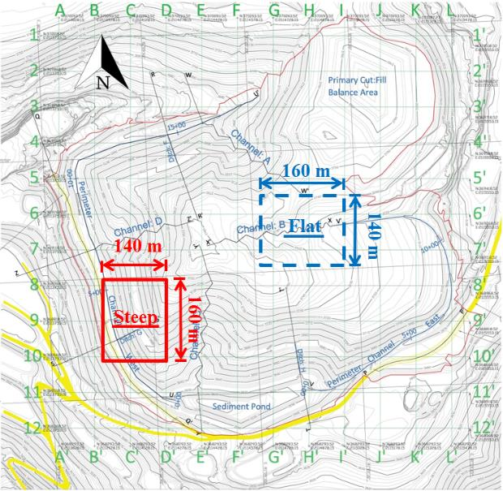

Slide 26
Steep slope model – relative coordinates

Slide 27
Flat slope model – relative coordinates
(160,140,15.44)

Slide 28
Results

Slide 29
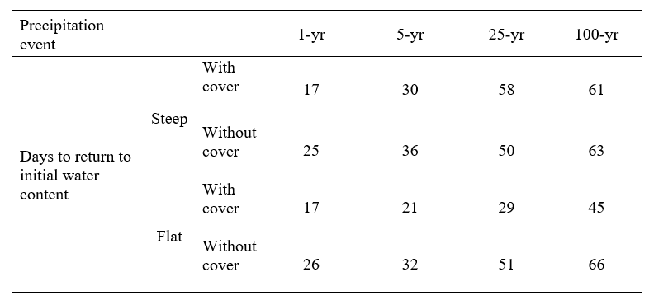
Seepage summary

Slide 30
a) Initial volumetric water (dry)
b) Day after precipitation; 60%-70% saturation
c) Saturation reduction by evapotranspiration and seepage
d) Desaturation progress
e) Almost dry
25-year storm
day 0
day 2
day 10
day 15
day 45

Slide 31
a) Initial volumetric water (dry)
b) Day after precipitation; 70%-80% saturation
c) Saturation reduction by evapotranspiration and seepage
d) Desaturation progress
e) Almost dry
25-year storm
day 0
day 2
day 10
day 15
day 45

Slide 32
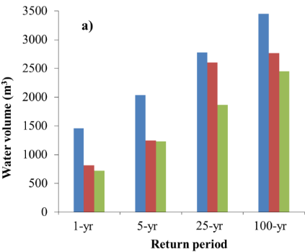
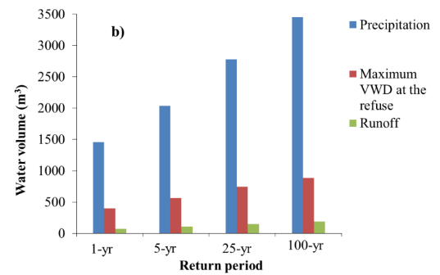
Steep slope water balance
Without cover
b) With cover

Slide 33
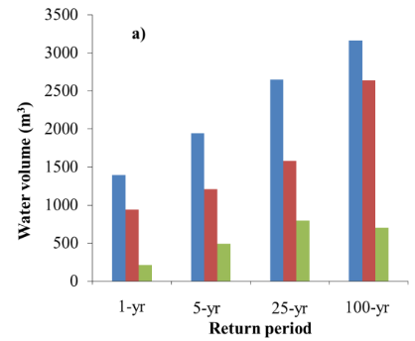
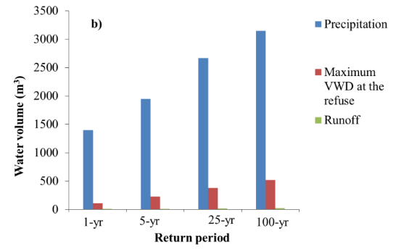
Flat slope water balance
Without cover
b) With cover

Slide 34
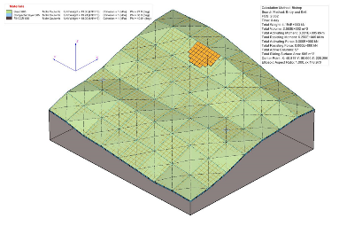
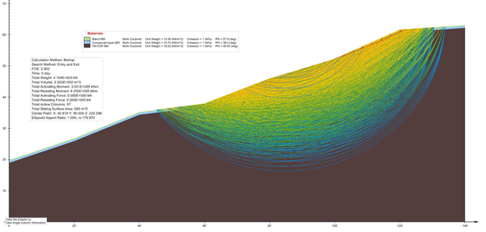
Slope stability analysis
Regrade to maximum 2H:1V slopes
Establish hydraulic barrier with compacted coal refuse
Develop growth layer composed of paper fiber and coal refuse manufactured topsoil
Factor of Safety of 2.3

Slide 35
Pilot Test

Slide 36
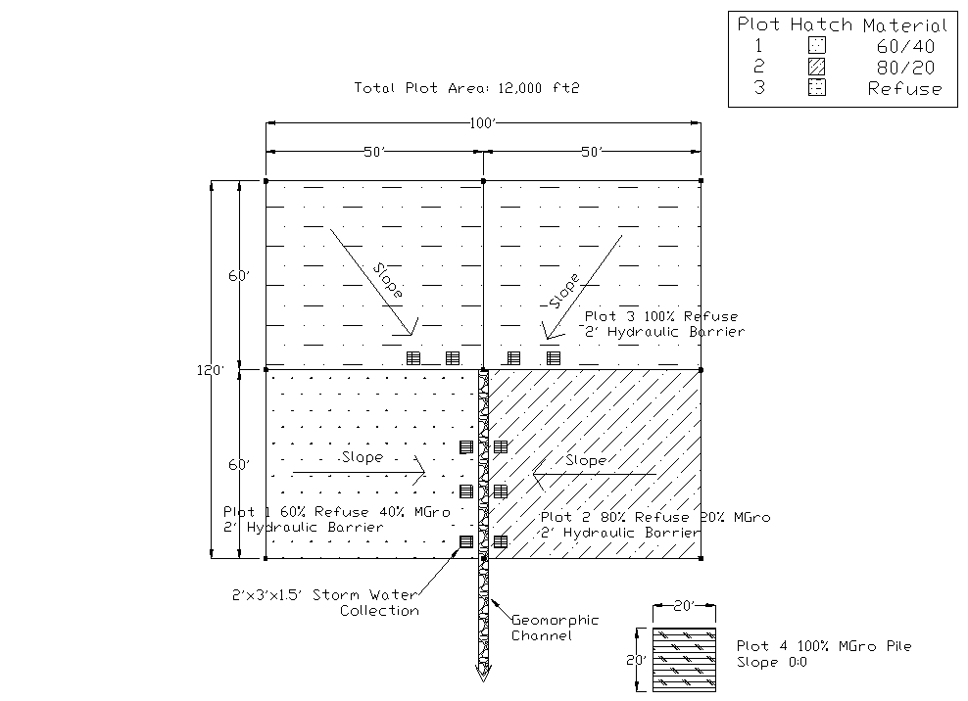
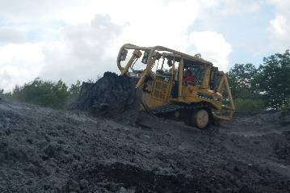
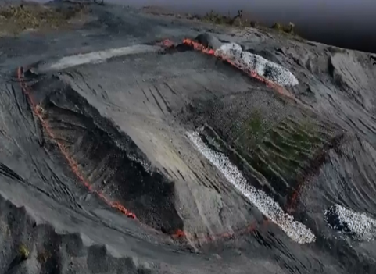
Test Plot Construction
Variety of Seed | Application Rate (lb/acre)
Orchardgrass | 15
Birdsfoot Trefoil | 15
Red Clover | 10
Annual Ryegrass | 15
Bicolor Lespedeza | 1
Winter Wheat | 20

Slide 37
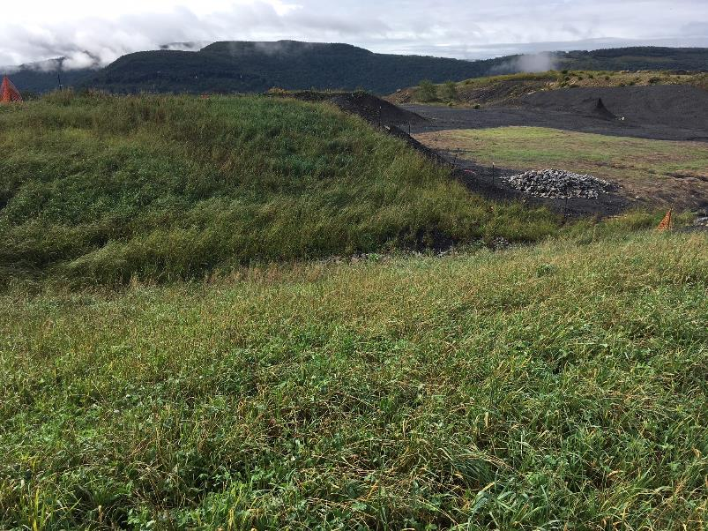
Test Plot Evaluation
Reseeded May 9th w/straw,
Paper fiber provided necessary nutrients and pH balance for grass to germinate,
Slope aspect (north facing) provided a large advantage,
70% ground cover was met for NPDES permit.
September 11, 2018

Slide 38
Conclusions
Implementation of cap and cover reduced water seepage into refuse for the different tested storms,
Different responses of the models for the simulated precipitations, with maximum volumetric water difference varying from 50% to 88%,
Slope stability analysis demonstrated safe slopes with FoS of 2.3,
Growth layer retains water, a benefit for vegetation,
Short paper fiber blend material utilization shows potential in surface mine reclamation.

