Slide 1
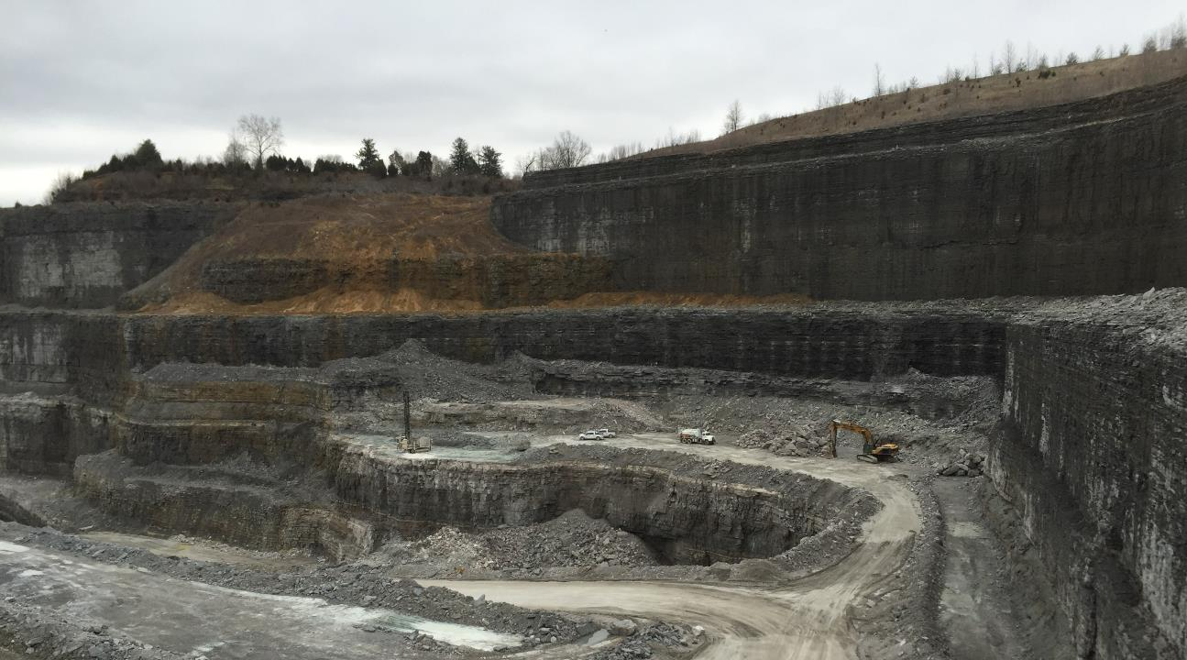
Cast Blasting as a Cost Saving Reclamation Tool

Slide 2
What is cast blasting?
Cast blasting is commonly used in surface coal mines for production
Use drilling and blasting methods to move as much material to a final location as safely possible
The amount of material that is blasted into it’s final placement location is typically referred to as cast-to-final.
Cast blasting is not commonly used in surface coal mines for reclamation purposes.
Reclamation design has a different profile geometry for material’s final resting location.
Cast blasting can be used, but with a slightly different take.

Slide 3
What is cast blasting?
https://www.youtube.com/watch?v=myqj_TCnIvA
Regular blasting (not a cast blast) on upper bench
Closer to a cast blast on lower bench
https://www.youtube.com/watch?v=I3xc53G331Q
First 1 minute of videos are cast blasts in coal mines
Notice controlled throw of material compared to first video
These videos show that cast blasting can move a large amount of material a distance that means we have to move much less material with shovels and trucks

Slide 4
Background
Using drilling and blasting methods to move material to a final location.
Cast blasting is common in surface coal mines for production
Shots are loaded into a hole and blasted in sequence
Move materials (interburden / overburden) off of the coal seam
Blasting for reclamation rarely considered
Most available blasting tools not designed for reclamation
Change to pay up front bonding instead of self bonding

Slide 5
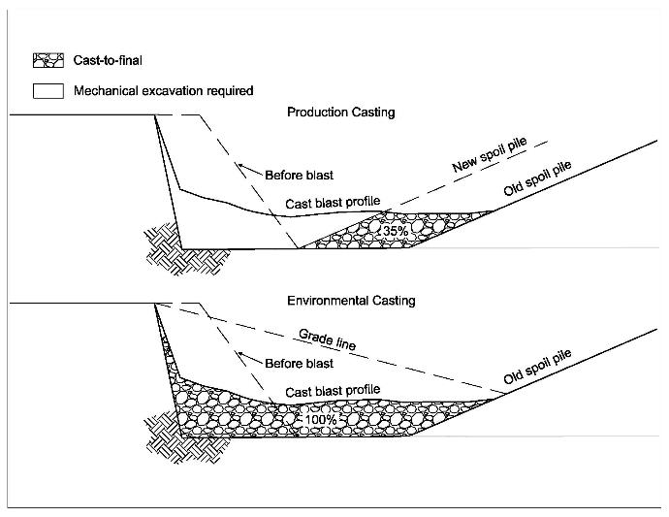
production vs reclamation casting
Cast-to-final Below the Grade Line
Reclamation casting blasts material below the grade line (final topography).
Mechanical excavation not required when 100% cast to final achieved
Must drill below grade line to achieve
*Favre et al. 2014

Slide 6
Why Cast Blast?
To Save Money!
Lower permit bonding requirements by reducing mechanical excavation and hauling

Slide 7
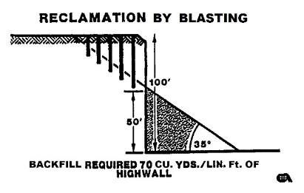
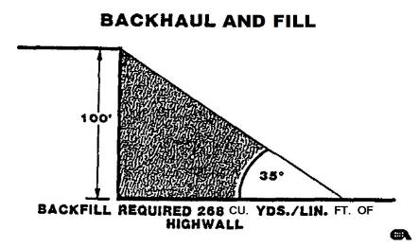
Reclamation by Blasting Compared to Backfilling
Reclamation by Blasting
Backhaul and fill
Backfill Required: 70 yds / linear ft of highwall
Backfill Required: 268 yds / linear ft of highwall
*Loop et al. 1994

Slide 8
No simple task
Contractors usually control:
Timing
Burden to spacing ratio
Burden velocities
Inclination
Detonator accuracy
Engineers can control:
Powder Factor (explosive energy(
Highwall height to pit width ratios
“Predicting cast-to-final percentage is difficult for a reclamation cast blasting site with no prior records in such application.” – Worsey et al.

Slide 9
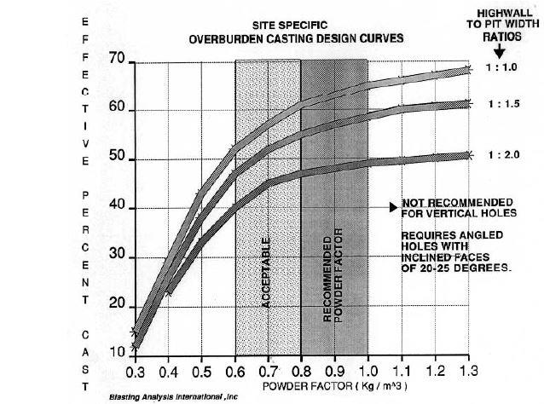
Powder Factor doesn’t have a significant influence above 1.0
Highwall to pit ratios continue to have strong influence at high powder factors
Matching this ratio is most important when matching a blast profile
* Chiappetta et al. 1990

Slide 10
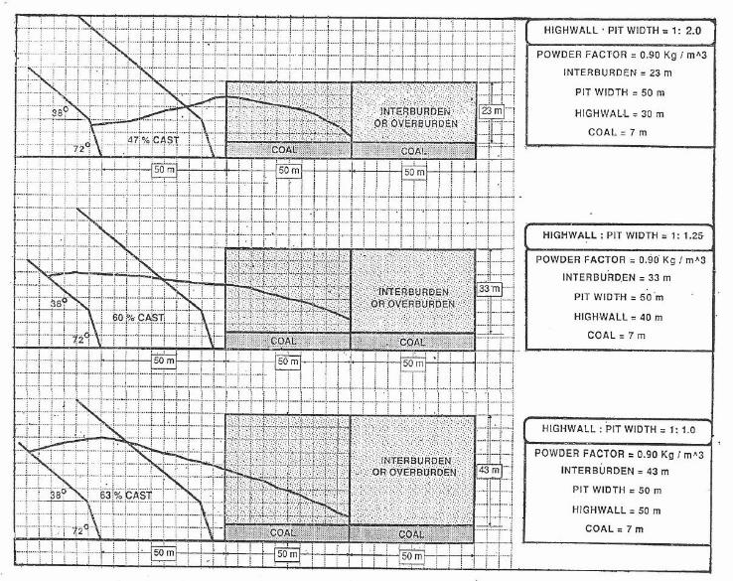
Increasing highwall height increases cast to final
Shape of pit has strong influence on cast to final %
Final highwall reclamation can achieve higher cast to final %
* Chiappetta et al. 1990

Slide 11
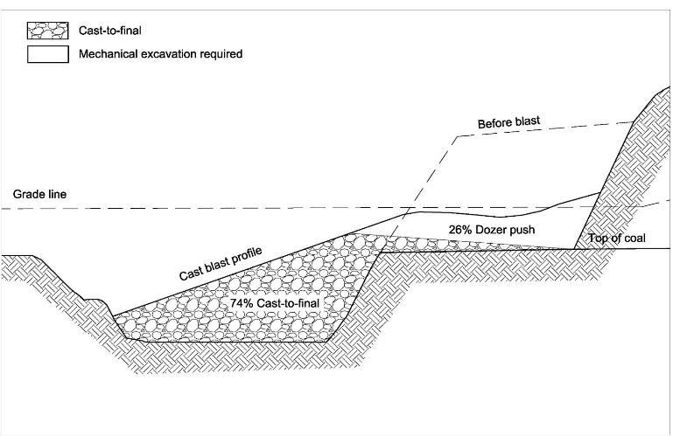
Example
This image shows an example of a post-blast cast blast profile.
74% of the material would be cast to final (based on results from production blasting)
26% of material would need dozer pushed into the pit to clear for a subsequent blast (or if no subsequent blasts, it could be left in that location.
There were a few assumptions used to create this example; detailed field-collected data by the authors has not yet occurred.
* Worsey et al. 2016

Slide 12
Limitations
When fill requirements are more than one blast into the bench some material has to be excavated to free the face and optimize the cast of the next blast
Cast-to-final percentages reduce as more cast blasts are used (2 to 3)
Mass balancing method has scenarios in which it could favor cast-to-final percentages

Slide 13
Conclusions
Cast blasting is a viable option for reclaiming highwalls to natural topography
Cast-to-final percentages of 60 to 100 percent are very achievable when cast blasting for reclamation in surface coal mines
Expensive modeling is not required to figure out cast-to-final percentages for permits using reclamation blasting
Using cast blasting can save money on the cost to reclaim highwalls

Slide 14
References
Chiappetta, F., Srihari, H., & Worsey, P. Design of Overburden Casting by Blasting – Recent Developments. India: Journal of Mines, Metals and Fuels, Vol. 38, No. 9, pp 194-208, 1990. Print.
Favreau, R., Mahan, D., & Favreau, P., Comparison of Field and Simulated Cast Blasts. Cleveland, OH: International Society of Explosives Engineer, 2014. Online Paper Database.
Loope, J., Petrunyak, J. & Postupack, C., The Use of Explosives To Backfill and Reclaim Former Quary Sites. Cleveland, OH: International Society of Explosives Engineer, 1994. Online Paper Database.

