Slide 1
Innovative Methods for Cost Effective Rehabilitation of Challenging Mining and Energy Sites
Andy Jung, President of Western GeoSystems
Marc Theisen, CPESC, CPSWQ, CESSWI, Vice President of Profile Products
Presented at ASMR Conference, Big Sky, MT
June 6, 2019
Notes:
Thanks for joining. Hopefully everyone isn’t in a food coma after lunch.
Independent rep for a variety of manufacturers.
Marc was the co-author. He couldn’t be here, so I am presenting on his behalf.

Slide 2
Overview
Quick Glance at “The 5 Fundamentals”
Overview of Soil Health
Summary of Biotic Soil Technologies
Three Project Examples
Cost Example
Q & A
Notes:
Marc presented the 5F’s at St. Louis last year.

Slide 3
The Five Fundamentals
Understand Your Substrate: Test the soil or substrate for agronomics
Plant Species Selection: Pick plant materials compatible with project goals
Erosion Control Materials: Select the most effective control measures for your site
Proper Installation: Ensure guidelines and specifications are followed
Inspection and Maintenance: Coordinate plan to ensure success
Fundamentals must be integrated into a process that entails proper planning and execution
Notes:
Test your soils. Free. No excuse not to do this. Cation exchange capacity, sodium absorption ratio in addition to pH, macro and micro nutrients
Especially in mountainous regions like Big Sky – elevation and aspect matter. If you have mine site with ARD spoils and a geosynthetic, avoid woody species, ET cover – plants with deep roots to promote transpiration
Protect the slope while you wait for grow in . Many western species take time to establish. Some products last up to 24 months..

Slide 4
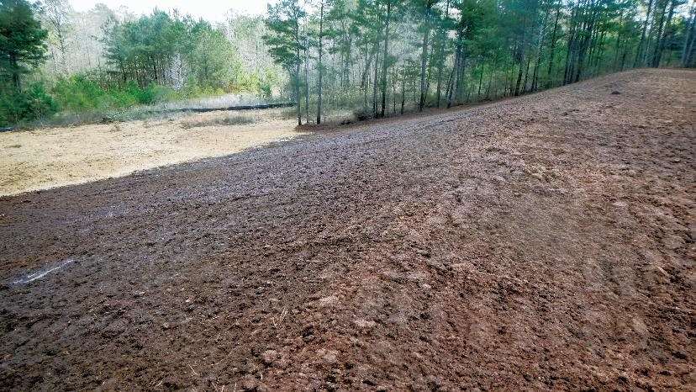
What is our ultimate site restoration goal?
Notes:
Lots of goals, but a main one we can all agree on is………….

Slide 5
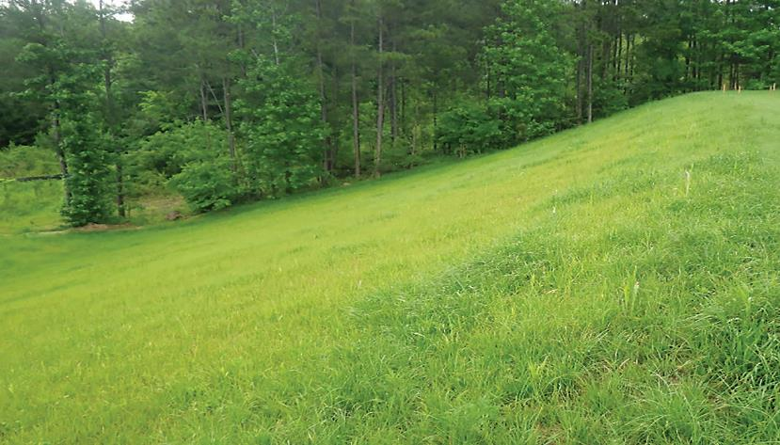
Sustainable Vegetation
Climax Community
Notes:
Set up conditions so we are on the trajectory to reach the ultimate Climax Community. In this photo, over time, the trees in the background will move into the grassed areas and we will ultimately reach the Climax Community over time.

Slide 6
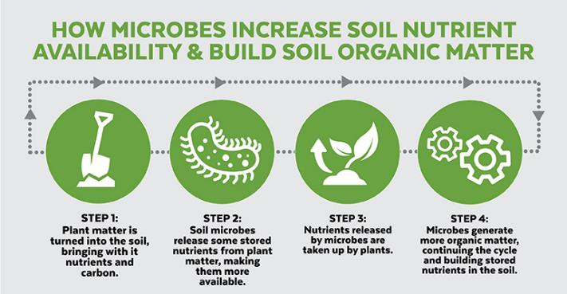
Sustainability Comes From Nutrient Cycling
Requires a healthy soil as the infrastructure to support and nurture vegetation
Nutrient Cycling
Notes:
Microbes convert the organic matter into mineralized nutrients that can then be taken up by plants

Slide 7
Why are We Talking About Soil Health?
It is the foundation of a successful project!
Healthy Soil
Alive with microbes
Storing water
Cycling nutrients
Attractive animal habitat
Sustainable Vegetation
Dense coverage
Diverse species
Prolific roots
Aesthetically appealing
Long-Term Erosion Control
Minimal cost
Low maintenance
Habitat enrichment
Water quality enhancement
Notes:
It all starts with healthy soil. Leading to sustainable vegetation and ultimately….

Slide 8
Key Elements of Healthy Soil
Minerals: Clay, sand and silt
Organic Matter: Needed for microorganisms to break down to humus
Biological Activity: Bacteria, fungi, protozoa, nematodes, worms, etc.
Water: Carrier of nutrients, all living things require water
Air: Critical for plant and microbiological activity
Notes:
All the living things that make their home in the soil
Good soil structure with void spaces for water and air components

Slide 9
Improving Soil Health
Ensuring adequate Organic Matter and Biological Activity are the keys to improving Soil Health
How do we do this?
Like all good engineers and consultants, if we want to track something and improve it, we measure it.
Sample and measure before and after the implementation of our solutions.
Notes:
Like all good engineers, if we want to track something, we measure it.
Tracking and measuring OM and Soil respiration are the key

Slide 10
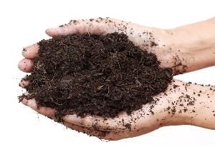
Organic Matter
Organic Matter (OM) is the foundation for all biological life in the soil
Target will vary based on region
Typical would be 2-5%
Improves soil structure to better accommodate drainage and increases water retention
For every 1% increase in organic matter, water-holding capacity increases by 16,500 to 27,000 gallons per acre – depending on soil type (USDA NRCS 2013)
Notes:
A parameter that has been tracked for a long time is Organic Matter
Closer to 2 in the arid west. Closer to 5 east of the Mississippi
Preventing runoff – reducing flooding potential – less water to treat in an ET cap

Slide 11
Biological Activity: Soil CO₂ Respiration
Measures soil respiration
Rate of CO₂ released from decomposition of Organic Matter by soil microbes
Indicates the level of microbial activity
Correlates to the nutrients contained in Organic Matter in forms available to plants
Notes:
A parameter that we’ve be tracking with our recent projects is Soil Respiration.
Respiration is the production of CO2 as a result of biological activity in the soil by microbes, live roots and macroorganisms (earthworms)
CO2 is colorless and odorless
Amount emitted annually by soil is greater than ALL human activities
Respiration is impacted by soil moisture and temperature
Inherent soil respiration rates depend on amount and quality of SOM, temperature, moisture, salinity, pH, and aeration.
Biological activity of soil organisms varies seasonally, as well as daily.
Microbial respiration more than doubles for every 10°C (18°F) soil temperatures rise up to a maximum of 35 to 40°C (95 to 104°F)
Beyond which soil temperature is too high, limiting plant growth, microbial activity and soil respiration

Slide 12
Soil Respiration Activity
The target Soil Respiration value is 1,000 mg CO₂ / kg soil / week
Deficient Soil Activity | Low Soil Activity | Medium Soil Activity | Ideal Soil Activity | High Soil Activity
mg CO₂ / kg soil / week
< 300 | 300 – 500 | 500 – 1000 | 1000 – 2000 | > 2000
Reference: USDA-NRCS, Soil Respiration – Soil Quality Kit – Guide for Educators

Slide 13
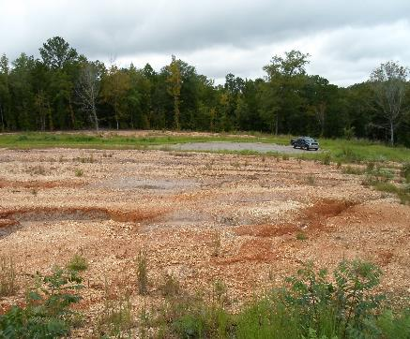
No Quality Topsoil — What Then?
Next best alternative?
Use subsoil and hope for the best? (One of the primary causes of project failures)
Haul in and spread topsoil or compost? (Common but often expensive)
Notes:
Moving forward… many abandoned mines no longer have topsoil

Slide 14
Topsoil and Compost
Many specifications for topsoil and compost do not call for specific agronomic requirements.
Neither topsoil or compost can be effectively placed on steep slopes and both can actually increase erosion potential.
Trucking in materials adds time and cost to projects and has a negative environmental impact.
Potential safety issues due to truck traffic.
Quality topsoil can be hard to find and can be expensive when you find it
Compost may contain harmful bacteria or pathogens
So what do you do?
Notes:
As Brent Hardy mentioned in his presentation, topsoil brought in cheat grass, so they just created more problems

Slide 15
What are Biotic Soil Technologies (BST)
Manufactured growth media or “engineered soils” containing recycled biodegradable fibers, biostimulants, biological inoculants and other amendments
Designed to promote regeneration of denuded soils and accelerate sustainable vegetative establishment
Why import topsoil when you can build a topsoil in place?
Notes:
My segue into the technology I’d like to focus on
The question we want to ask is “why import topsoil, when you can build a topsoil in place.”

Slide 16
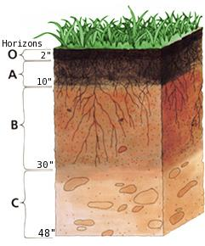
How Does BST Build Healthy Soils?
BST’s improves soil chemistry — which later improves soil structure / texture — with increased organic matter and biological activity
Helps O & A horizons to regenerate faster by creating a “revegetation platform”
While the soil chemistry is improving, the media provides a more ideal growing environment
Provides rapid growth establishment and sustains long-term vegetation
Jump starts the nutrient cycling process
Notes:
Improves soil chemistry, structure and texture
Provide rapid growth establishment
Essentially jump starts the nutrient cycling process

Slide 17
Some Common BST Components
Bark and Wood Fibers – phyto-sanitized to provide organic matter, erosion resistance and high moisture retention without weed seeds and pathogens
Soil Building Components:
Porous Ceramics and Biochar – stable, porous particles that demonstrate a high CEC, ability to hold water/nutrients & act as habitat (“coral reef”) for beneficial bacteria and fungi
Beneficial Bacteria – colonize “fresh” substrates and essential for soil processes, Nitrogen fixation, aggregation of soil particles, and maintenance of soil nutrients
Endomycorrhizae – symbiotic association of a fungus and plant roots to facilitate nutrient and water uptake that improves drought, disease and salinity resistance
Humic Acid – principal component of humic substances, which are the major organic constituents of soil (humus), peat and coal produced by biodegradation of dead organic matter
Seaweed Extract (cytokinins) – plant growth substances (phyto-hormones) that promote cell division or cytokinesis in plant roots and shoots
Cross-linked Polysaccharide Biopolymers/Flocculants – increase water-holding capacity, viscosity, bond strength and “shoot-ability” of the media matrix
Notes:
Coral reefs or condominiums
Tackifiers to shoot on steep slopes and increase the bond (or tensile strength) of the product

Slide 18
Compare: BST vs. Topsoil vs. Compost
Considerations | BST | Topsoil | Compost
Consistent Product | ✓ | ✗ | ✗
Decreased Hauling Costs | ✓ | ✗ | ✗
Readily Available / Easy Delivery | ✓ | ✗ | ✗
Easy On-Site Storage | ✓ | ✗ | ✗
Fast, Uniform Application | ✓ | ✗ | ✗
No Substrate Mixing Required | ✓ | ✗ | ✗
Steep Slope Applications | ✓ | ✗ | ✗
Introducing Concentrated OM | ✓ | ✗ | ✓
Readily Renewable | ✓ | ✗ | ✓
Application on Toxic Substrates | ✗ | ✓ | ✗
Notes:
Features and benefits comparison

Slide 19
Biotic Soil Technologies (BST)
Notes:
Mine site in SE Idaho from last fall. Added lime tilled into gypstack waste and direct seeding – rather than a separation layer.
This could be a great case study if we get grow in this summer – we are a couple weeks removed from the site being covered in snow.

Slide 20
Case Studies
Look at three case studies where we not only achieved success, but also tracked pre and post levels of organic matter, soil respiration, bacteria and fungi counts.
Oil & Gas Pad in Western Colorado
Mine Reclamation in SE USA
High Elevation Mine Site in SW Colorado
Notes:
The fun stuff!!
2 projects in the west (1 arid and 1 high elevation) / 1 in the east

Slide 21
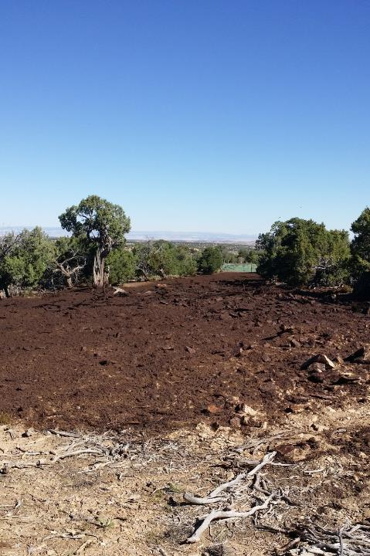
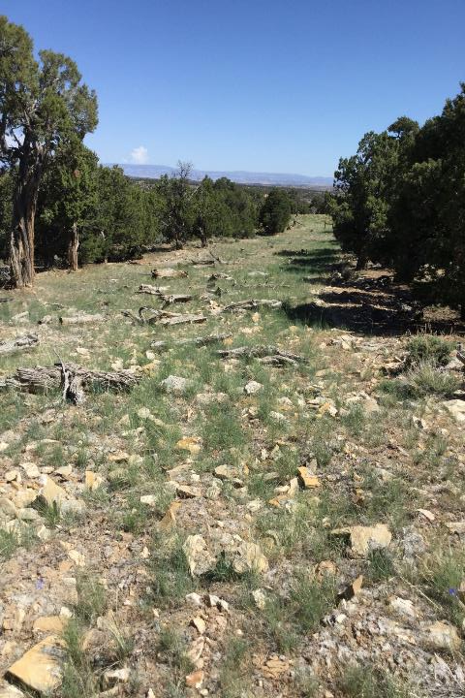
Oil & Gas Pad Site and Road Access – Western Colorado

Slide 22
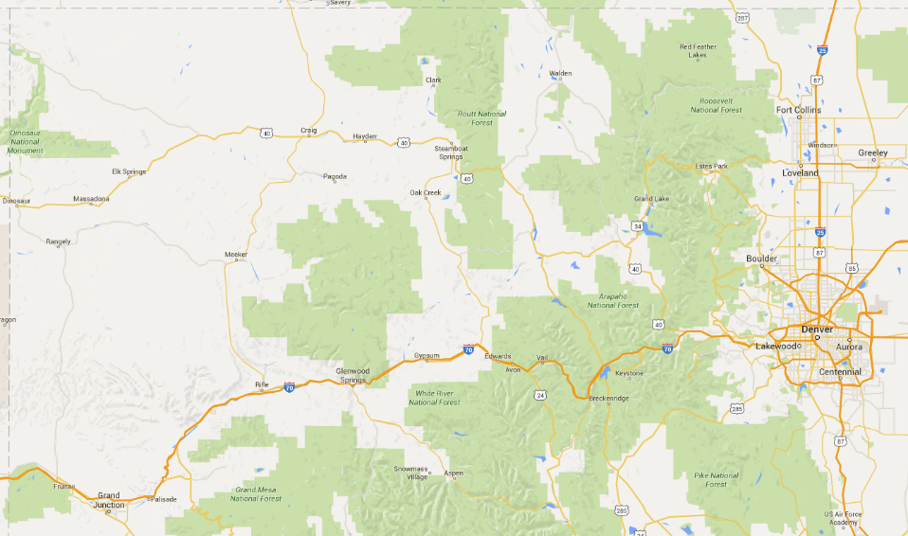
General Project Location
Notes:
Pretty much the middle of nowhere Colorado

Slide 23
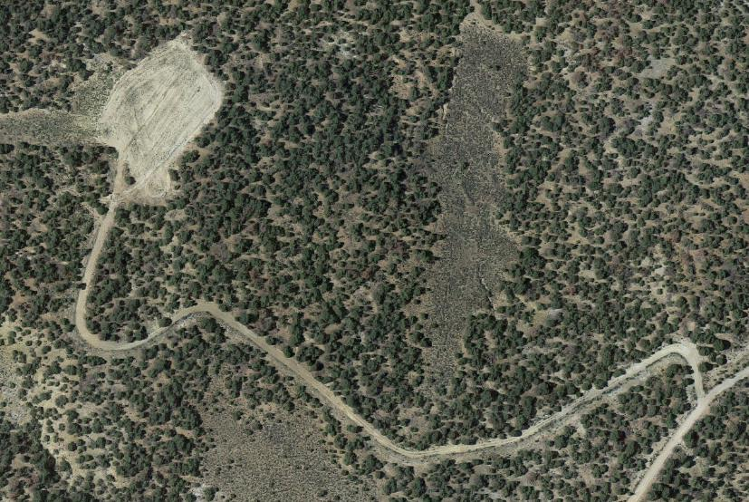
Site Pad and Road
Notes:
Aerial photo pre-reclamation

Slide 24
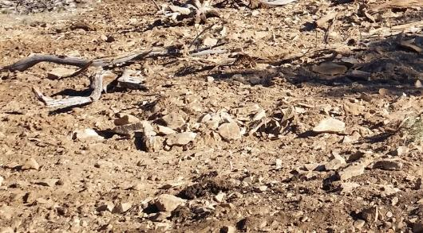
Pad & Road Site Soil Test Problems
 | pH | Organic Matter (OM)
Optimal Range | 6.3 – 7.4 | 3% – 5%
Site Values | 8.4 | 1.6%
Notes:
pH was high, OM was low

Slide 25
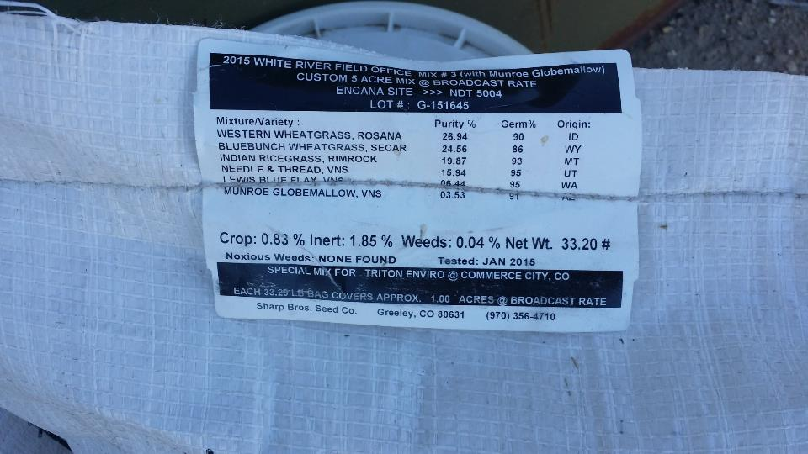
Custom Grass Seed Mix: 33.2 lb/acre
Notes:
Native grasses

Slide 26
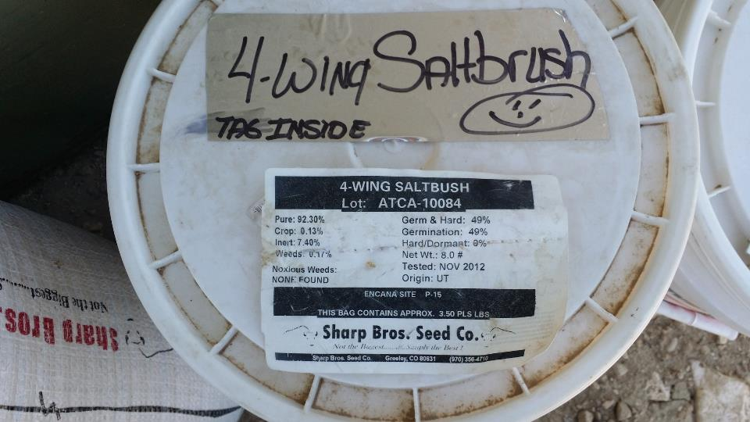
Saltbush: 4-Wing
Notes:
Native shrub species

Slide 27
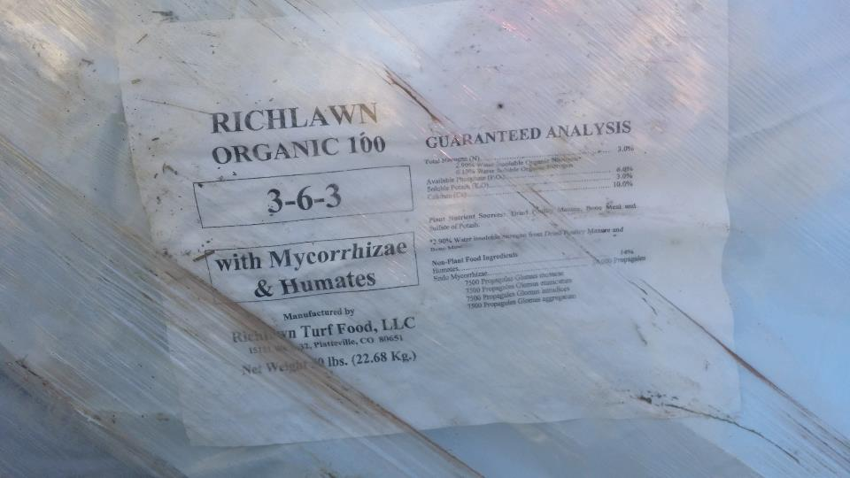
Fertilizer: 2,000 lb/acre

Slide 28
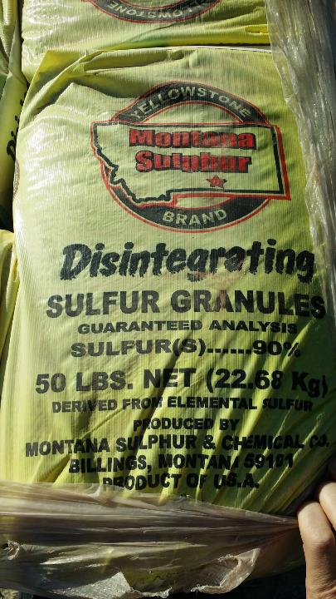
pH Modifier - Sulfur: 1,000 lb/acre for this site
Notes:
Added 1,000 lb/ acre to lower the pH and assist with germination

Slide 29
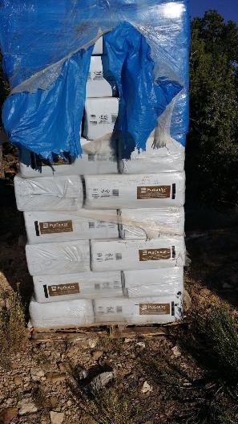
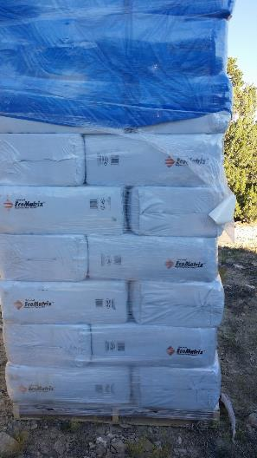
BST: 4,000 lb/acre
BFM: 2,500 lb/acre
Notes:
Biotic soil technology material
Bonded fiber matrix as erosion control material

Slide 30
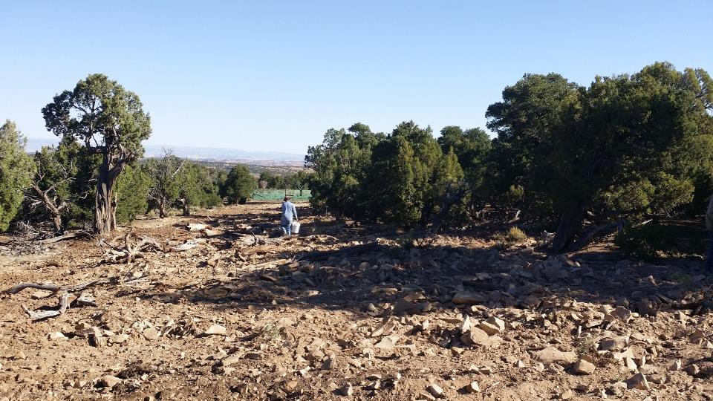
Road is prepared – Ripped with tractor, fairly rocky with log placement for more natural look
Notes:
Using some “rough and loose practices”
Also, trying to keep the 4-wheelers off the old road

Slide 31
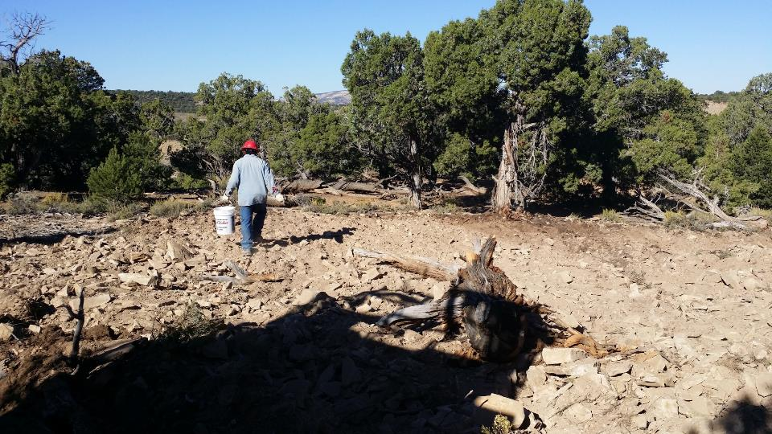
Applying Saltbush by hand

Slide 32
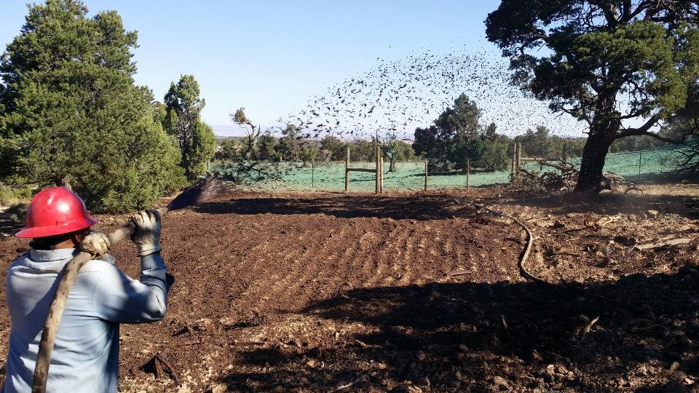

Slide 33
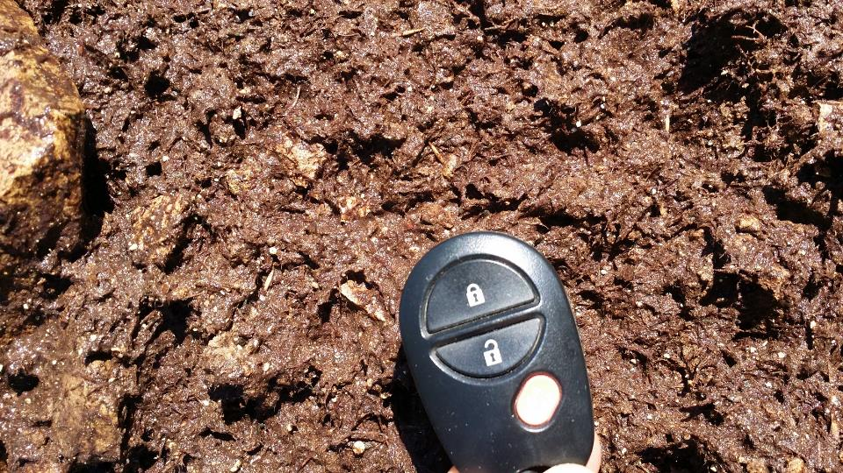

Slide 34
9/24/15 - Installation
5/21/18 – 32 Months Later
Notes:
Starting to fill in nicely despite some drought years.

Slide 35
Organic Matter Change
Notes:
Now, on to the data!
OM actually higher than the background and TRIPLE the untreated soil

Slide 36
Soil Respiration
Soil is on the right track for improved biological activity – Soil Health is at or above ideal for region
Significant increase in Soil Respiration (406% increase)
(mg CO₂/kg soil/week)
Notes:
Pretty much at the target of 1,000 mg CO2/kg/week!!!

Slide 37
Soil Bacteria Level
Significant increase in beneficial Bacteria (304% increase)
(cells/g soil)

Slide 38
Soil Fungi Level
Significant increase in Fungi (867% increase)
(cells/g soil)
Notes:
Soil fungi levels are much greater than both

Slide 39
Mine Reclamation – SE USA

Slide 40
Mine Location
“Failure is Not an Option”
Must gain bond release
Open up additional mining sites
Must be done in 2016
Consultants embraced “Five Fundamentals”
Site
Notes:
Need to get bond release in order to open up additional clay mines

Slide 41
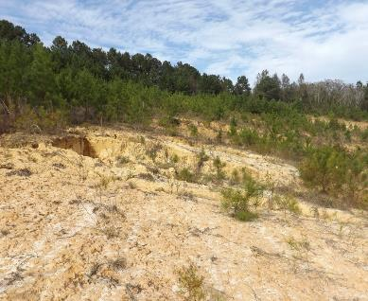
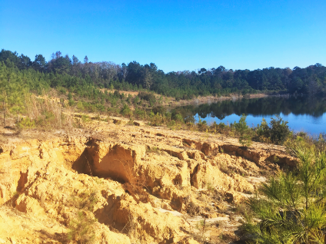
Mine Site Soil Test Problems
 | pH | Organic Matter (OM)
Optimal Range | 6.3 – 7.4 | 3% – 5%
Site Values | 5.0 | 0.6%
Notes:
In this one, the pH was low. Right on a lake so there was sediment going into the lake after every rain event.

Slide 42
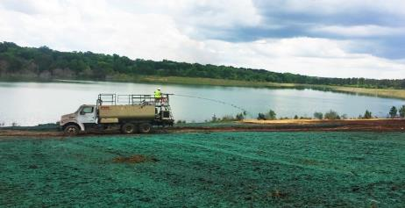
Installation – April, 2016
5,000 lbs/acre of BST™ applied
3,500 lbs/acre of HP-FGM
Lime to raise the pH
BioStimulants applied to promote germination

Slide 43
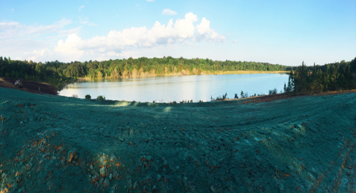
April 25, 2016
Drone shot of applications over 2 hectare (5 ac) site
Seed mix included:
Bermuda grass
Bahia grass
Millet – nurse crop
6 weeks later, Tropical Storm Colin dumped 150 mm (6 in) of rain on June 5-6
Notes:
Of course, Mother Nature threw a curve ball at us.

Slide 44
Day After Tropical Storm Colin
No soil loss into lake seen during inspection the next day
Notes:
Profile rep, Melanie Furhman drove to the site the next day expecting the worst, but all parties were happy that the site held up well with No soil loss into the lake.

Slide 45
Timeline — August
Site inspection mid-August 2016. Completed reclamation release on September 1, 2016. Six months!
Notes:
Six months from application to bond release!

Slide 46
Timeline — 18 Months after Installation
Follow-up inspection: sustainable vegetation/climax community.
Notes:
On trajectory to reach the Climax Community

Slide 47
Organic Matter Change
Notes:
Organic Matter more than tripled

Slide 48
Soil Respiration
Soil is on the right track for improved biological activity – Soil Health is improving
Significant increase in Soil Respiration (271% increase)
(mg CO₂/kg soil/week)
Notes:
While we still have a way to go to get to the Ideal USDA ideal value of 1,000 mg CO2/kg/week, we are almost triple the untreated value.

Slide 49
Soil Bacteria Level
Significant increase in beneficial Bacteria (345% increase)
(cells/g soil)

Slide 50
Soil Fungi Level
Significant increase in Fungi (142% increase)
(cells/g soil)
Notes:
We can safely say that we’ve taken the proper steps to build the soil to support sustainable vegetation at this site.

Slide 51
Mine Site – Ouray, CO

Slide 52
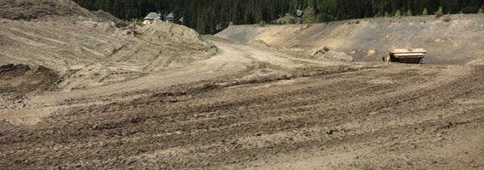
Mine Site Soil Test Results
 | pH | Organic Matter (OM)
Optimal Range | 6.3 – 7.4 | 3% – 5%
Site Values | 7.3 | 1.1%
Notes:
OM low as would be expected in a denuded and disturbed site

Slide 53
Initial Growth/Germination
Promising Start at almost 10,000’
Short growing season and very dry summer last year
South facing slope
Will continue to track over time
“Sleeps Year 1, then Creeps Year 2, then Leaps Year 3”
FGM holding strong
Notes:
I was discouraged that in the fall, we didn’t have much growth, but a partner who has been involved in many of these high altitude told me the expression – sleeps, then creeps. Flexible Growth Media – holding strong. Really good job of adding pockets for moisture retention.

Slide 54
Year 2 Snowpack is Looking Good Though!
Snowpack at 300% (and higher in some places)
Photo from late April in Silverton, just south of Ouray, CO
Will be a challenge for the FGM
Will see if the site “Leaps”
Notes:
Photo I took during a late April ski trip.
Flexible Growth Media hydraulically applied erosion control material used to protect the slope

Slide 55
Organic Matter Change
Notes:
I sampled the background OM up above the site in the trees. Maybe not indicative as there was a lot of litter on the forest floor.
Regardless, EXCITED that we are addressing the soil – the FOUNDATION of success.

Slide 56
Soil Respiration
Soil is on the right track for improved biological activity – Soil Health is at ideal for region
Significant increase in Soil Respiration (329% increase)
(mg CO₂/kg soil/week)
Notes:
Almost at the “Ideal” value of 1,000 mg CO2/kg/week

Slide 57
Soil Bacteria Level
Significant increase in beneficial Bacteria (240% increase)
(cells/g soil)

Slide 58
Soil Fungi Level
Significant increase in Fungi (1800% increase)
(cells/g soil)
Notes:
So, I feel like we’ve laid the foundation for success. The site might not be snow free until July 4th or even later however. This really speaks to how challenging reclamation is at 10,000’.

Slide 59
What’s the Cost of BST?
Cost of obtaining, hauling and placing topsoil can be significant
Compare the cost of BSTs to topsoil or compost for any project site
Online BST Calculator
Notes:
There are online calculators you can use with your own topsoil costs

Slide 60
BST Calculator
Site Example |  | Select Units | Acres | Square Feet
 |  | U.S. | 2.7 | 117,61
Traditional Volume-Based Topsoil and/or Compost
MATERIAL COST
Material | Depth in Inches | Cubic Yards Needed | Cost Per Cubic Yard | Total Cost
Topsoil | 4 | 1,452 | $16.00 | $23,232.00
Compost/Other | 0 | 0 | $20.00 | $0.00
Total Material | 4 | 1452 |  | $23,232.00
TRANSPORTATION & INSTALLATION COST
 | Cubic Yards |  |  | Total Truckloads
Truck Size | 22 |  |  | 66.0
Material Hauling | Number of Truckloads | Miles to Job Site | Cost Per Mile¹ | Total Cost
Topsoil | 66.0 | 10.0 | $4.00 | $5,280.00
Compost/Other | 0.0 | 0.0 | $0.00 | $0.00
Installation | Cubic Yards Material | Cost Per Cubic Yard
Topsoil | 1,452 | $8.00 |  | $11,616.00
Compost/Other | 0 | $8.00 |  | $0.00
Total Transportation & Installation Cost |  |  |  | $16,896.00
Total Cost |  |  |  | $40,128.00
Cost Per Mile based on a round trip from topsoil borrow pit or compost/other location to job site. Enter zeros in mileage and cost per mile if you have a delivered Cost. If you have a flat rate hauling cost per truckload, make sure you add it to your material cost.
Notes:
Cost per CY. Cost to transport. Cost to place.

Slide 61
BST Calculator
Site Example |  | Select Units | Acres | Square Feet
 |  | U.S. | 2.7 | 117,61
BST
Material | Application Rate (lb/ac) | # Bags Needed | Cost Per Bag | Total Cost
BST | 5,000 | 270 | $75.00 | $20,250.00
Transportation |  | Number of Pallets² | Cost per Pallet³
BST |  | 7 | $50.00 | $350.00
Installation⁴ | Acres | Cost per Acre
BST | 2.7 | $3,000.00 |  | $8,100.00
Total BST Cost |  |  |  | $28,700.00
BST Cost Savings |  |  | 28.5% | $11,428.00
Number of Pallets: Forty, 50lb bags of BST per pallet = 2,000 lb/pallet
Cost per Pallet: Based on LTl freight rates per 2,000 lb pallet or full truckload pricing for 22 pallets = 880 bags. If you have a delivered BST cost, enter zero in your freight cost per pallet.
Installation: BST is hydraulically applied with complementary soil amendments and seed in one convenient and time-saving application.
Notes:
Cost of bags. Freight per pallet. Costs to install.

Slide 62
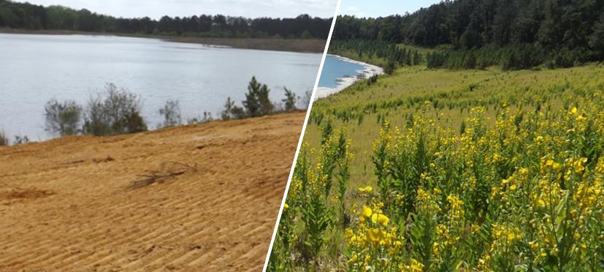
Summary & Conclusion
Confirmed with multiple project sites that utilizing the “5 Fundamentals” in conjunction with BST’s can rebuild soil health and allow for sustainable vegetation AND save money versus conventional techniques
Notes:
Biotic soil technologies

Slide 63
Questions?
Presenter: Andy Jung
Email: andy.jung@westerngeosystems.com
Phone: 303-518-2939

