Slide 1
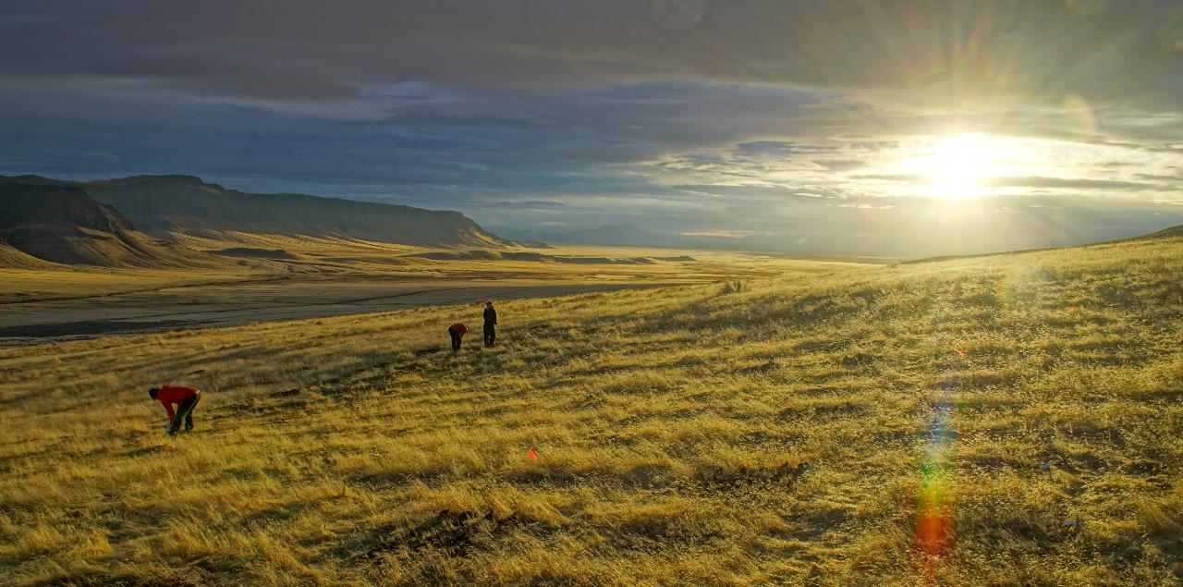
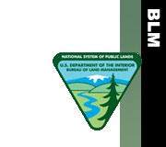
Seed Enhancement Technologies for Improving Native Plant Restoration on Reclaimed Mines
©Owen Baughman
Maggie Eshleman, Restoration Scientist
Corinna Riginos, Conservation Scientist
Notes:
Before I get started, I want to take the time to acknowledge that although I’m here presenting these ideas, most of them were in motion before I joined this team. Colleagues in Burns Oregon with TNC and also with the Agricultural Research Service have been working on this for a number of years. My colleague, Corinna Riginos, and I are attempting to use some of these technologies that are applicable to Wyoming, but we are not the originators of this work.

Slide 2
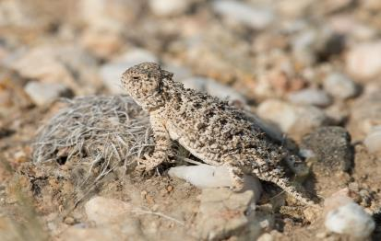
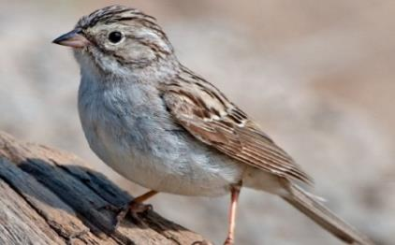
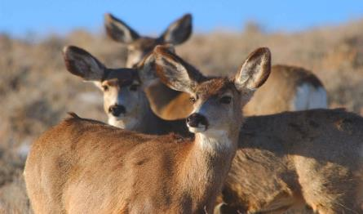
Why is restoration so important?
THE GREATER SAGE-GROUSE
Umbrella species over the Sagebrush Sea
Notes:
Although much of our focus for restoring the sagebrush sea is on the greater sage-grouse, there are over 350 vertebrate wildlife species that depend on the sagebrush ecosystem, not to mention the plants that are endemic to this region of the country. In order to maintain these wildlife populations, we need to be able to restore this ecosystem after disturbance.

Slide 3
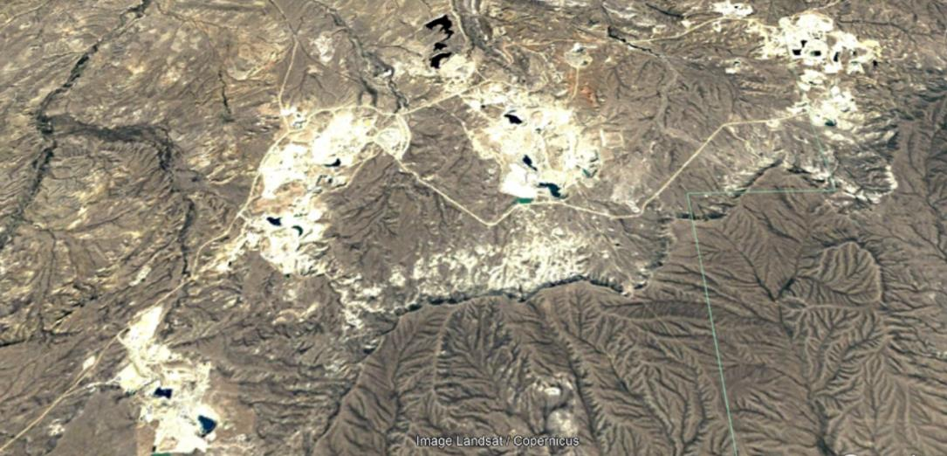
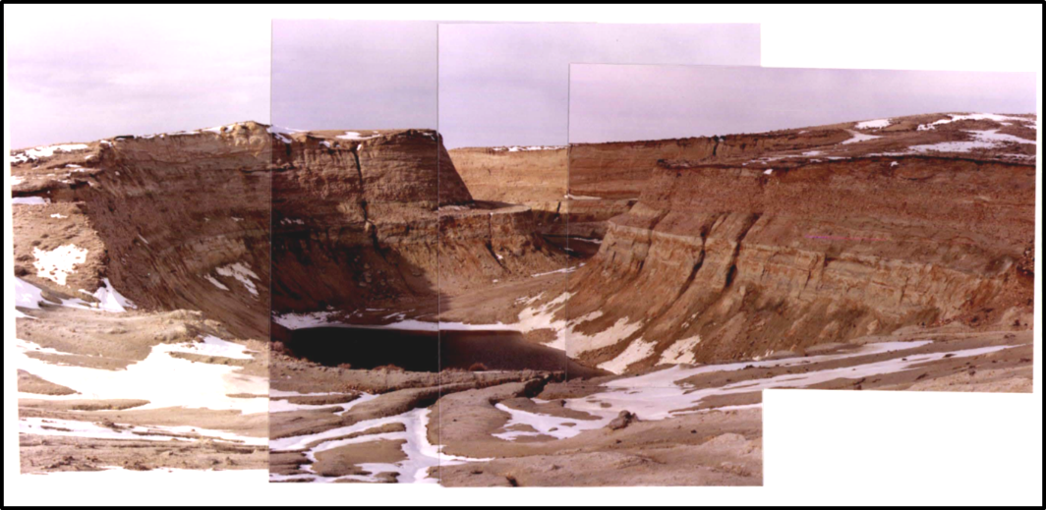
Disturbance from Historic Mining
Notes:
At a small scale historic mining may not seem like a big deal from a habitat standpoint. The open pit mining that was done in the 50’s usually isn’t to the same scale that it is done today. However when you zoom out to a large scale there is still a significant amount of habitat disturbance across the landscape. It’s a little over 12 miles from one end of this complex of mines to the other. All of this is amongst a patchwork of sage grouse core areas. The discontinuity of this landscape does have an impact on the species that live there.

Slide 4
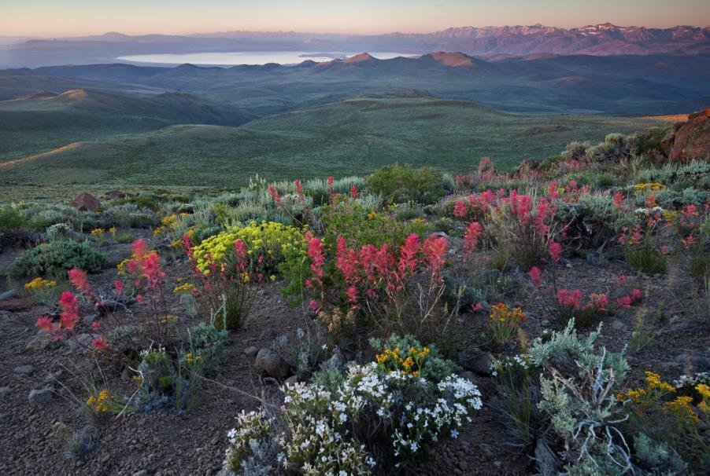
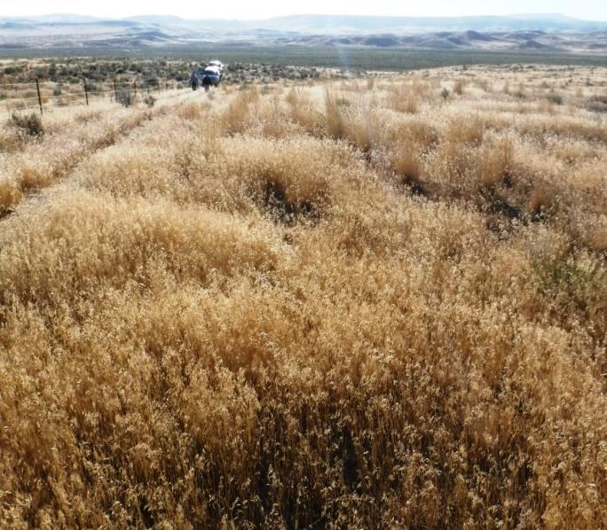
Results of Disturbance
Notes:
The results of these disturbances, when no restoration is attempted, often is going from a intact, diverse native plant community to the introduction of invasive annual grasses which don’t provide good wildlife habitat or grazing forage.

Slide 5
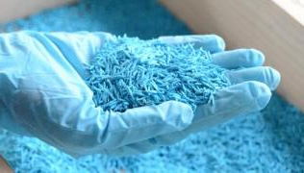
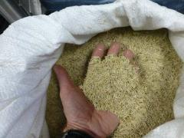
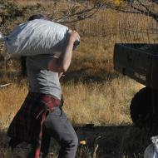
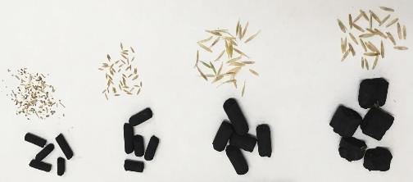
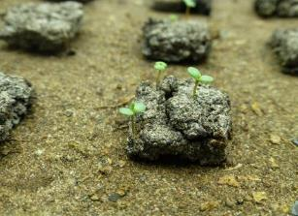
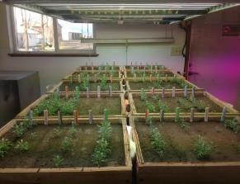
The Innovative Restoration Approach
Innovative Restoration
Notes:
One of our strategies to try to meet this goal is through innovative restoration. We are taking seed technologies that are prevalent today in agriculture and adapting them to the challenges of restoration. These include seed coatings, seed pods, delaying or speeding up germination. The ultimate goal is to be able to pair technologies with geospatial information about where they should be deployed or have the highest likelihood of success. I don’t think anyone expects that we will develop a silver bullet that works everywhere under all weather conditions. If we can develop different technologies that work against different establishment barriers then we can deploy them based on where those establishment barriers exist.

Slide 6
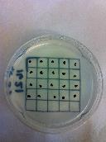
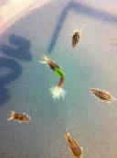
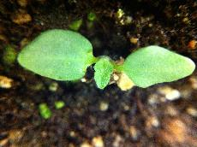
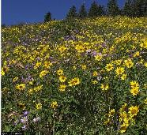
Barriers to Establishment
Invasive Species
Lack of Moisture
Pathogens
Competition
Weather
Bottleneck identified in popular restoration grass species
(James et al, 2011)
Notes:
James et al – bluebunch wheatgrass (late seral), squirreltail (early seral) and desert wheatgrass (introduced). The probability that any one seed established was <0.06.
This type of work is critical to determining what technologies will help improve restoration success. If we don’t know what is killing germinants, seedlings or plants, then we’re simply guessing at solutions which isn’t an effective way to address the problem. This information is lacking for other functional groups at this point. Madsen at BYU is working on doing a similar study with sagebrush, but that will only be in a limited geography and we know that sagebrush are locally adapted so there is a need for this type of work on a larger scale as well.
The technologies that we’re working on address the barriers to establish very early in the plants development, mainly the transition from a germinant to a seedlings and perhaps a little bit after the seedling emerges.

Slide 7
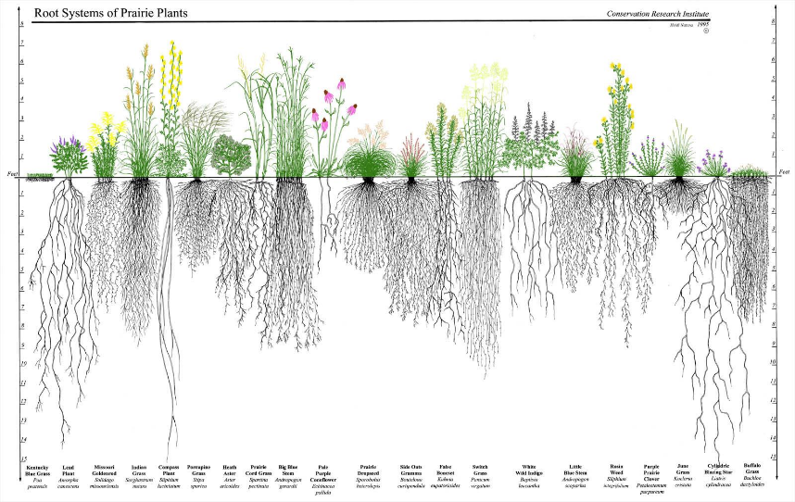
Competition
Light
Nutrients
Water

Slide 8
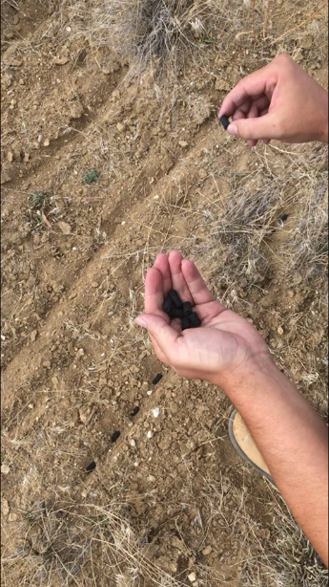
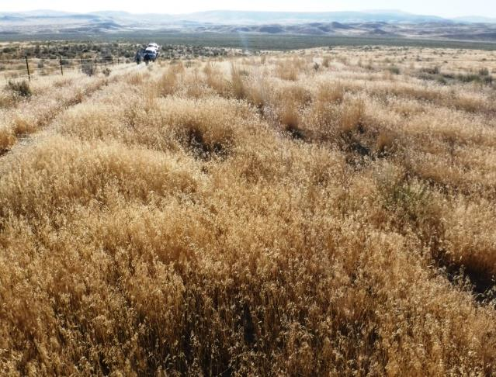
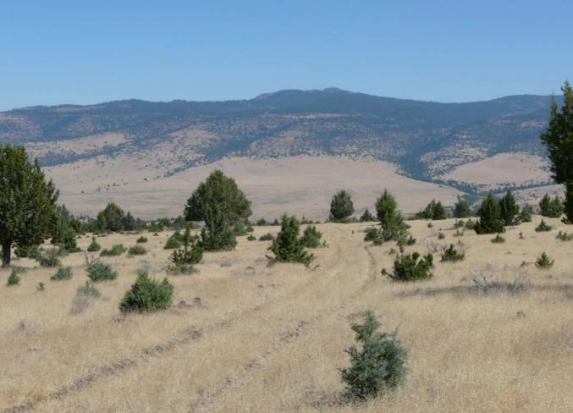
Competition
Credit: Mike Pellant
© David Bohnert
Herbicide Protection Pod
Notes:
Invasive species change the picture

Slide 9
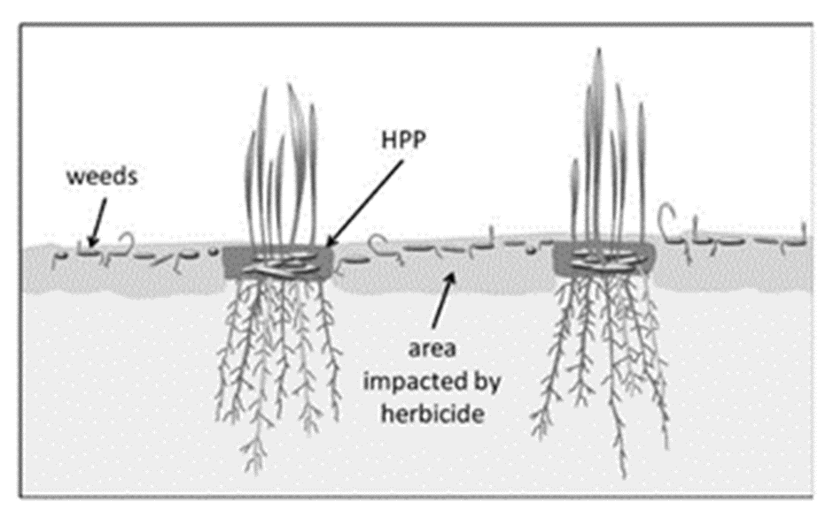
Herbicide Protection Pod

Slide 10
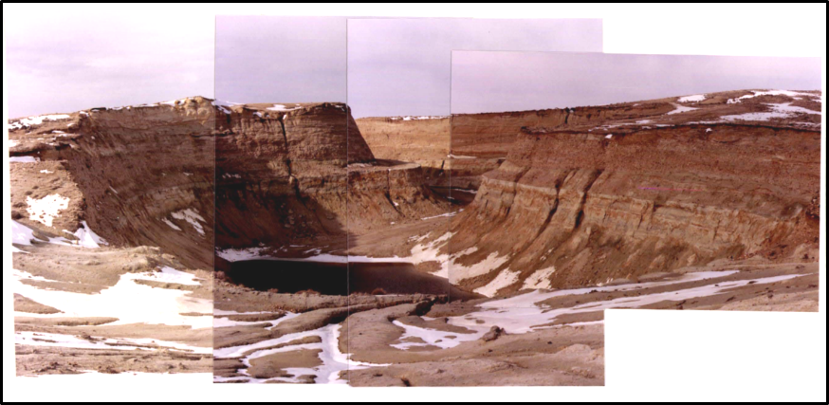
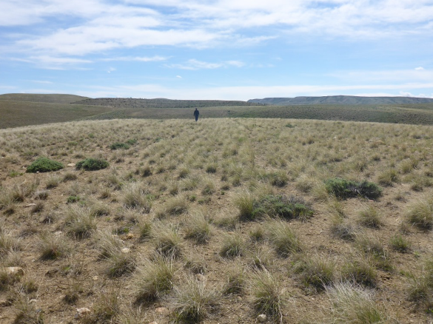
Reclaimed Uranium Mines
Notes:
At the reclaimed mine sites, there has been great earth work that bring the topography back to a more natural look, but we haven’t yet brought the vegetation back to a natural community. In the picture on the right you can see that there is a good stand of native bunch grasses, but shrub cover is lacking, and there is very little sagebrush in this picture. Based on the Ecological Site Description for this area, shrub cover should be around 10-15%. Here we are trying to establish sagebrush within an existing plant community.

Slide 11
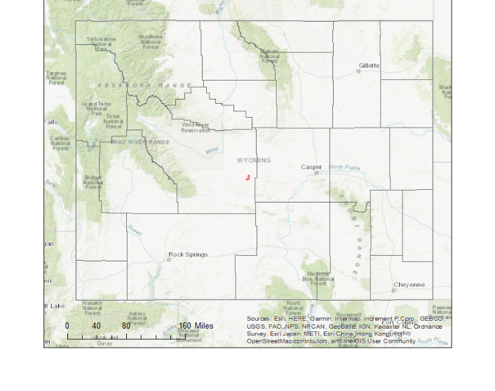
Gas Hills, Wyoming
Notes:
To locate us in the world, the experiment is located in the Gas Hills in central Wyoming. We are testing herbicide protection pods at three reclaimed mine sites in the Gas Hills. George Pit, the northern most site, was reclaimed in 2000 and 2002, Andria Hunter was reclaimed in 2006 and North Rex was reclaimed in 1990.

Slide 12
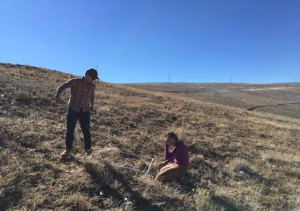
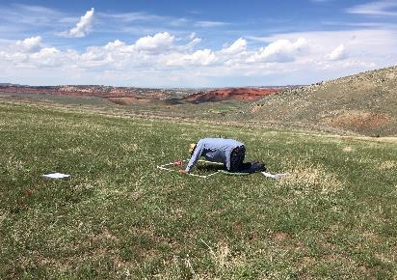
Experimental Design
2018 Experiment tests:
Bare seed vs HPPs
Wet aspect vs dry aspect
Herbicide vs no herbicide
Species: Wyoming big sagebrush and Indian ricegrass
5 replicates of each treatments
All plots raked and furrowed prior to seeding

Slide 13
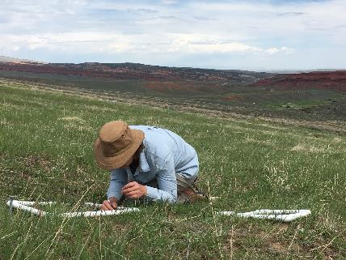
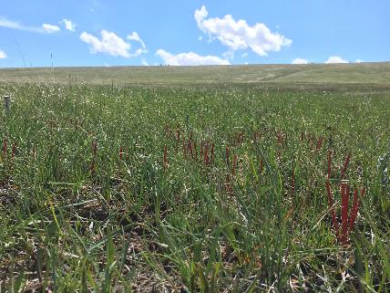
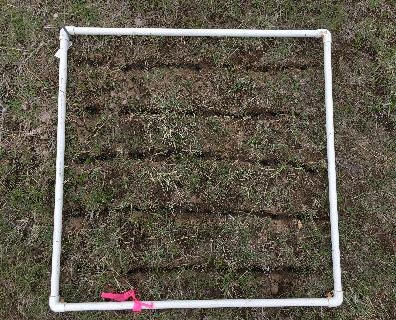
Peak Emergence
All sagebrush seedlings were counted in early May to determine peak emergence
Good year for sagebrush seedlings in central Wyoming
Greatest emergence = 70%

Slide 14
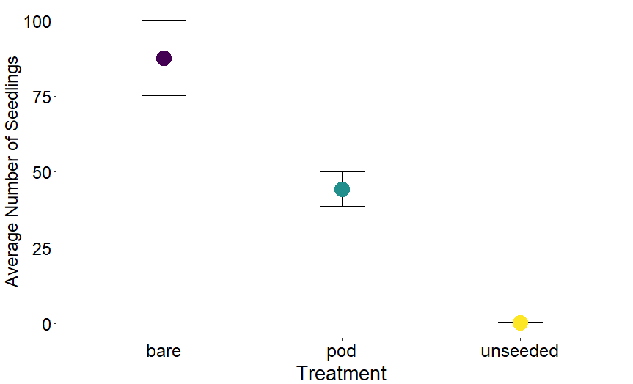
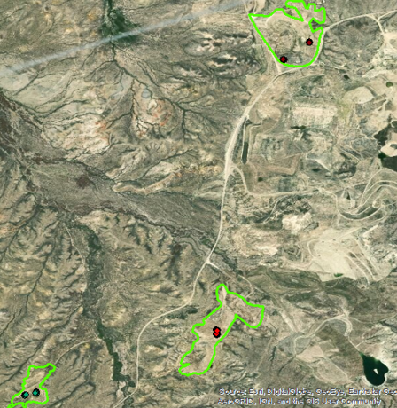
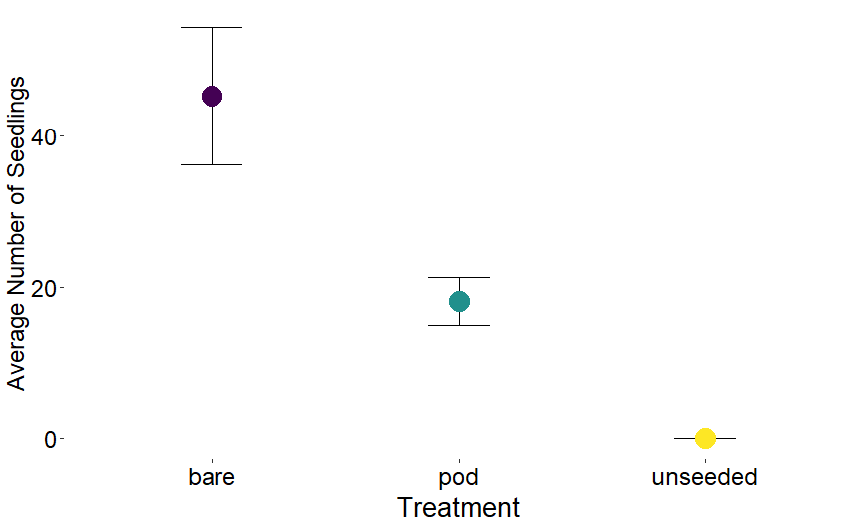
Notes:
This combines both the plots that were sprayed with herbicide and those not sprayed with herbicide for sagebrush only. A team in Oregon and Nevada testing the exact same seed pod recipe, but with sandberg’s bluegrass and squirrel tail have seen the opposite in their results this spring. They have had greater emergence from seeds in the herbicide protection pods than from the bare seed.

Slide 15
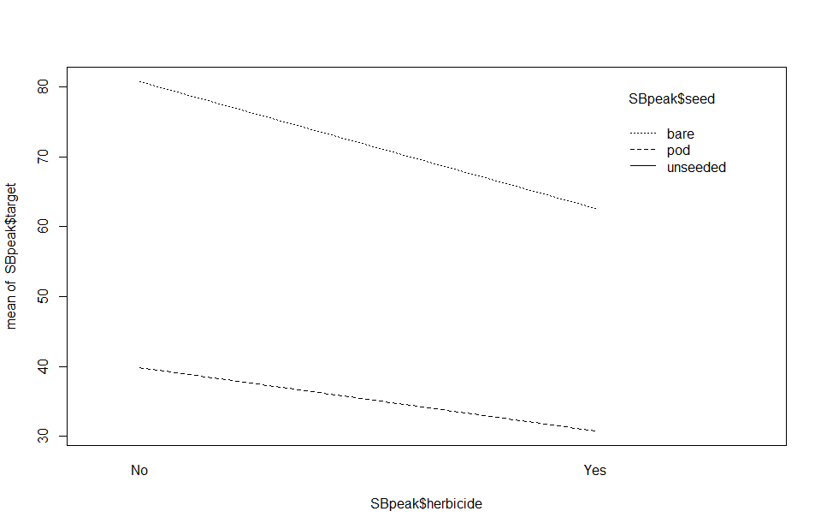
Impact of Herbicide
Bare
Pod
Average Number of Seedlings
No Herbicide
Herbicide

Slide 16
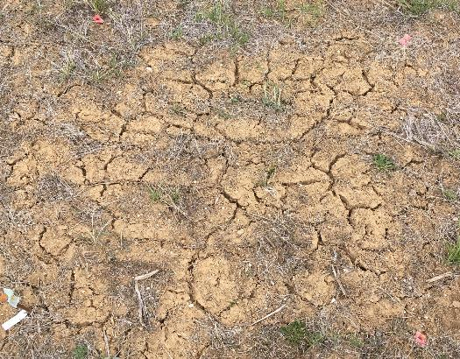
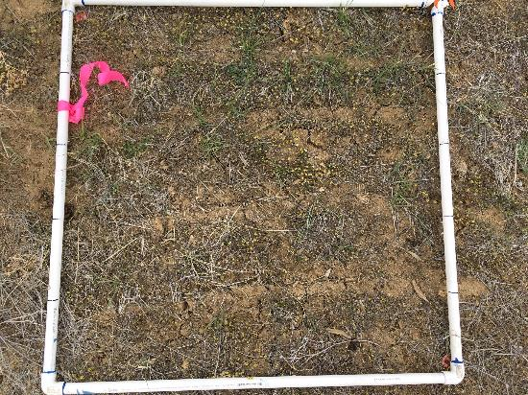
Impact of Herbicide
Herbicide
No Herbicide

Slide 17
Current vs Average Conditions
Notes:
Between 2.68 and 3.23 inches of rain in this area

Slide 18
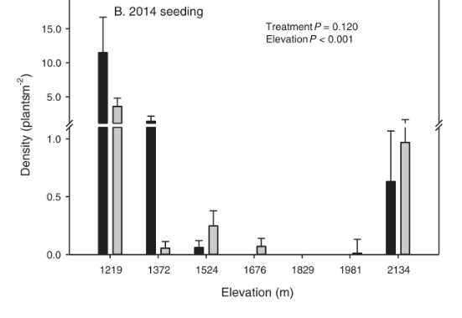
Current vs Average Conditions
Moisture may play a role in how seed pods perform in comparison to bare seeds
Less barriers to bare seed germination and emergence when there’s high spring moisture
May precipitation at these two low elevation sites was over 200% of long term average
Davies et al., 2018 – Rangeland Ecology and Management

Slide 19
Next Steps
Continue to track survival
Do seed pods incur some benefit later in the 1st growing season?
Test new seed pod recipes
Multiple years
Does spring precipitation amount and timing make a difference?
?

Slide 20
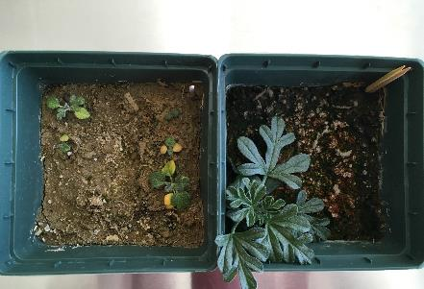
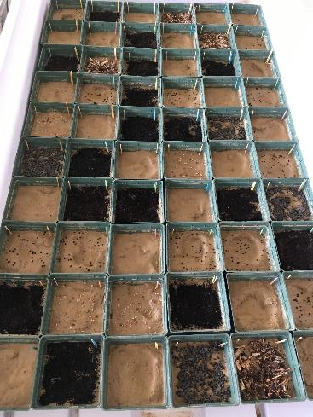
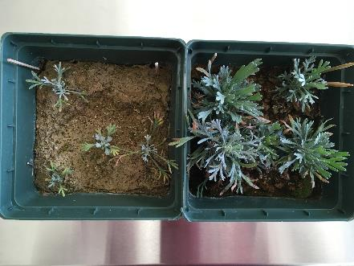
Potential Formulas
12 treatments:
Control
Humic acid
Seaweed extract
Humic acid + seaweed extract
10:10:10 fertilizer
Compost
Worm castings
Compost + worm castings
Aspen mulch
Iron Chelate
4:10:3 fertilizer
Biosol
Notes:
All hope for seed pods and sagebrush is not lost yet though. We currently have a lab trial going looking at different fertilizer options that could be incorporated into pods to see if they impact sagebrush growth.
12 different treatments including NPK, but also micronutrients. One is an aspen mulch because we heard from a donor that they had good luck growing sagebrush with aspen mulch in particular. Another is a byproduct of penicillin production called Biosol that is a slow release fertilizer, which is sometimes used as a soil additive in mine reclamation.
We’re excited to have our own seed lab in Lander where we can test different seed pod recipes.

Slide 21
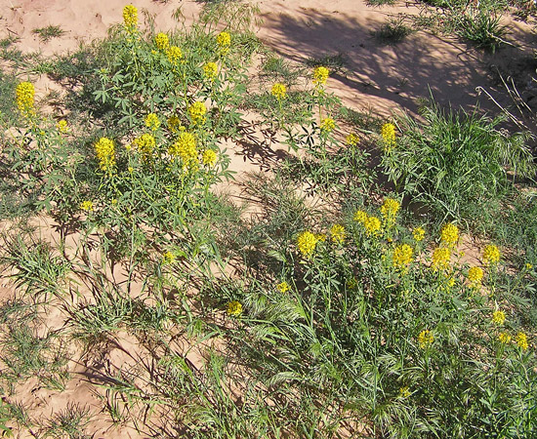
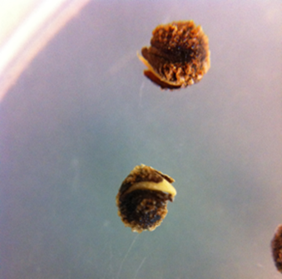
Conclusions
© Southwest Colorado Wildflowers
Notes:
The ultimate goal of seed technologies is to go from a germinating seed to an adult plant. Different technologies will address different barriers to establishment so it’s imperative that research goes into determining what those barriers are and how a particular species might be susceptible to them. Right now, we’re assuming that the bottleneck between germination and emergence applies broadly across the board for rangeland plants, but that hasn’t really been proven at this point. Knowing your site and species will be critical to success. Hopefully though pairing that knowledge with the appropriate technology will allow us to increase restoration success and reverse the trend of sagebrush habitat loss.

Slide 22
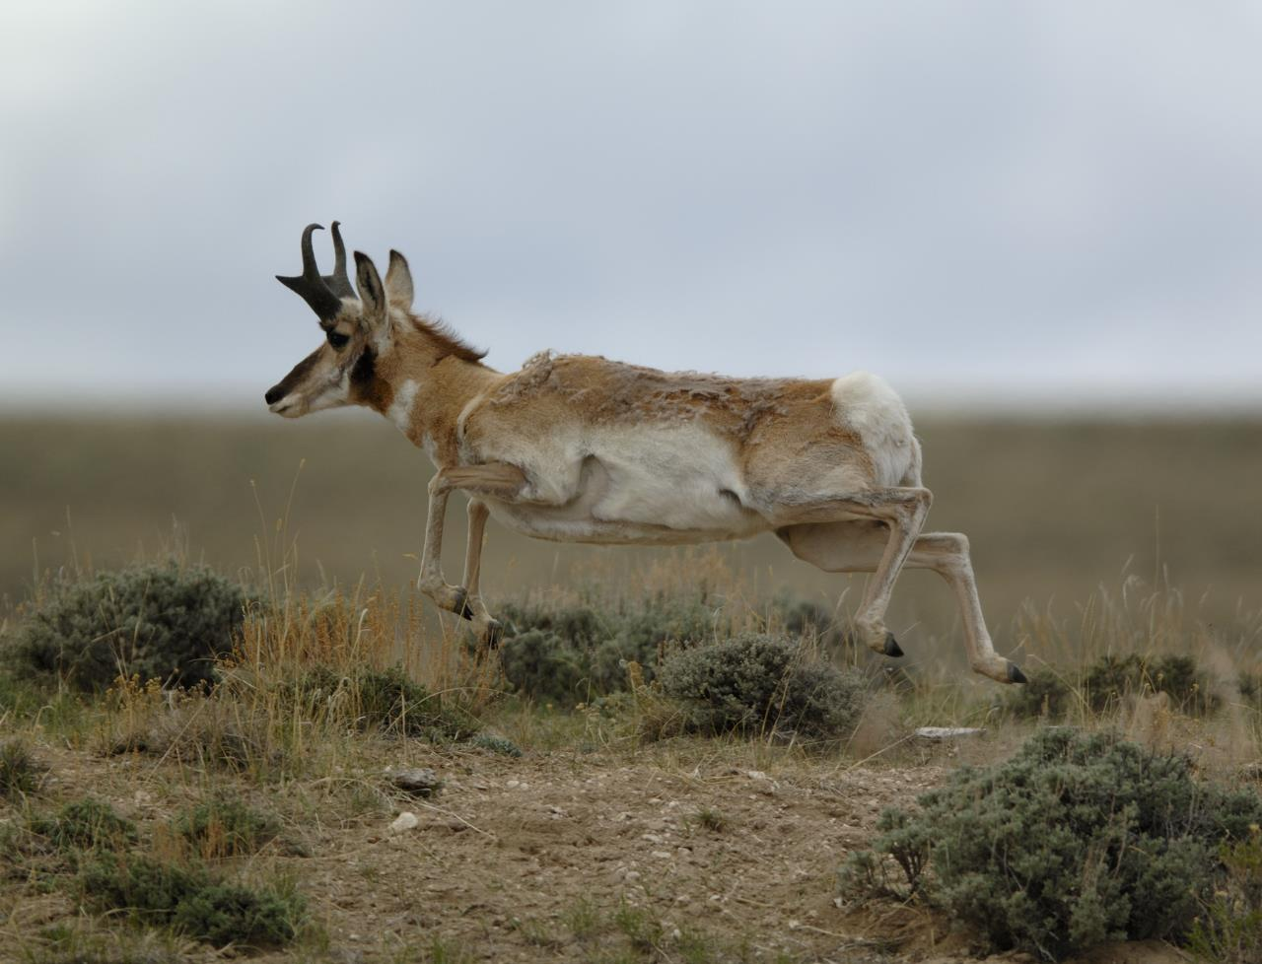
Questions?
Questions?
@ Scott Copeland
©Jared Lloyd

