Slide 1
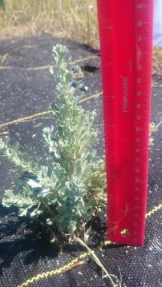
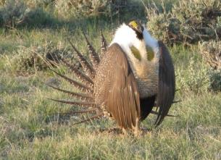
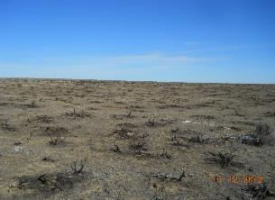
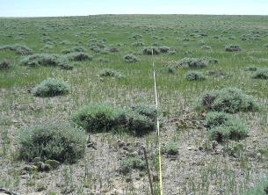
Restoration of Wyoming big sagebrush to intact rangelands within a Greater Sage-grouse Core Population Area, Converse County, Wyoming
American Society of Mining and Reclamation Annual Conference,
Big Sky, Montana
June 6, 2019
Jana Heisler White, PhD (Trihydro Corporation), On behalf of the Douglas Core Area Restoration Team
Notes:
Introduce self and role in supporting the DCA RT

Slide 2
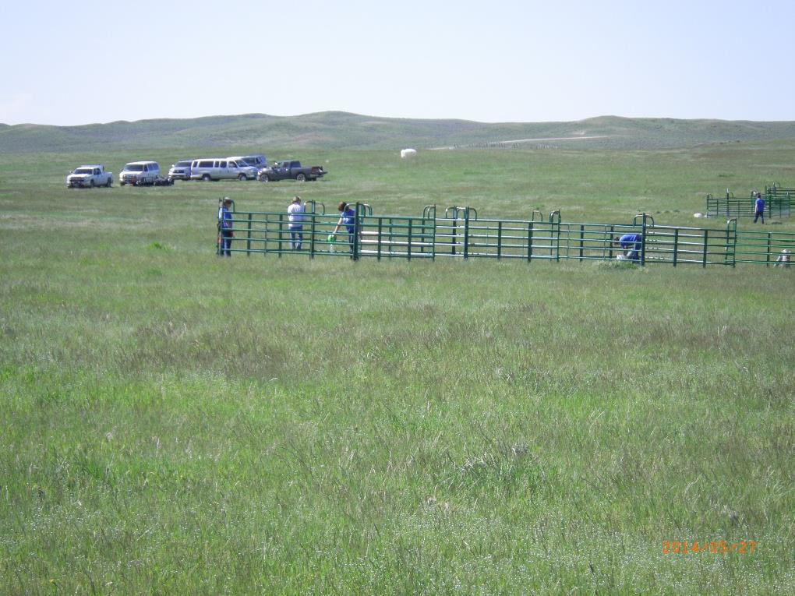
The Douglas Core Area Restoration Team A Multi-Stakeholder Team
Audubon Rockies
Bureau of Land Management
Chesapeake Energy
Converse County Conservation District
The Nature Conservancy
Thunder Basin Grasslands Prairie
Ecosystem Association
United States Fish and Wildlife Service
University of Wyoming
USDA-NRCS
Williams (formerly Access Midstream)
Wyoming Department of Agriculture
Wyoming Game and Fish Department
Wyoming Stockgrowers Land Trust
DCA RT Technical Support:
Trihydro Corporation and WEST Inc.
Team Funding: Wyoming Community Foundation
Notes:
-Multi-stakeholder driven conservation
-Groups that have contributed to the Team’s efforts
-Chesapeake and WGFD agreed upon a formula for establishing the amount of money to be set aside in an escrow account within the Wyoming Community Foundation. The amount was based upon Chesapeake’s existing and anticipated development within the DCA over the duration of the Plan.

Slide 3
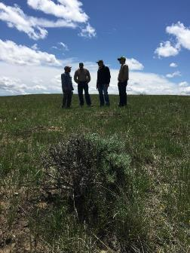
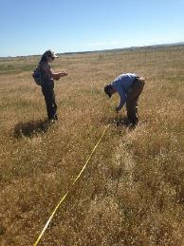
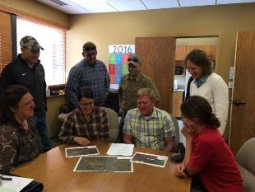
The Douglas Core Area Restoration Team Formed in 2013
Notes:
-Multi-stakeholder driven conservation
-Groups that have contributed to the Team’s efforts
-Chesapeake and WGFD agreed upon a formula for establishing the amount of money to be set aside in an escrow account within the Wyoming Community Foundation. The amount was based upon Chesapeake’s existing and anticipated development within the DCA over the duration of the Plan.

Slide 4
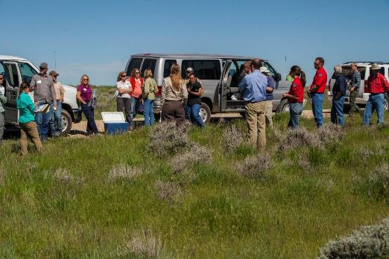
Collaborative Conservation
Collaborative conservation efforts have the potential to scale solutions across landscapes.
-biological landscapes (sagebrush ecosystem)
-human landscapes (diverse agencies, organizations (public and private), and communities)
Nelson and Parrish 2018
Restoration Plan development
Sagebrush seed collection
Seedling planting
Cheatgrass spraying
Wildfire burn management plan
West Nile Virus/mosquito larvae treatment
Graduate student assistantships/research support
Outreach – presentations, news series, technical documents
Supported water well development projects
Collaborated with private landowners
Secured additional project funding to support habitat enhancement
Implemented restoration projects
Projects monitoring
Notes:
-The Restoration Plan was drafted by the RT as a guidance document for project prioritization and selection. It specifies that each project will have a work plan, landowner agreement, focus on at least one of five objectives pertaining to sage-grouse habitat enhancement and/or conservation, and have a monitoring plan that guarantees data collection for five years post-implementation. In addition, the Restoration Plan highlights Key Success Indicators that are directly tied to Restoration Project Objectives and help to quantify project results.

Slide 5
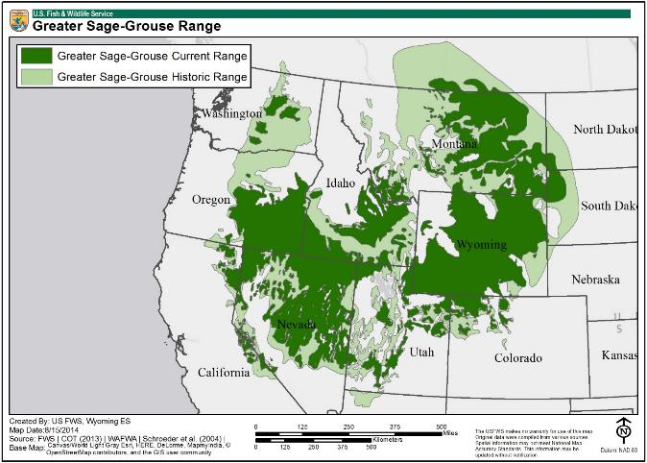
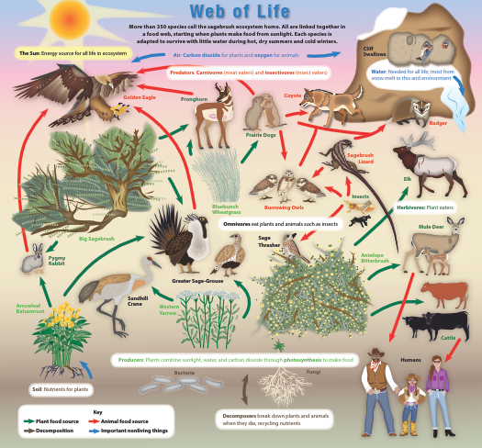
The Sagebrush Ecosystem…
…is one of the most imperiled ecosystems in North America.
USFWS 2014, 2016
Notes:
Small core Area – Current size – 66, 686 acres

Slide 6
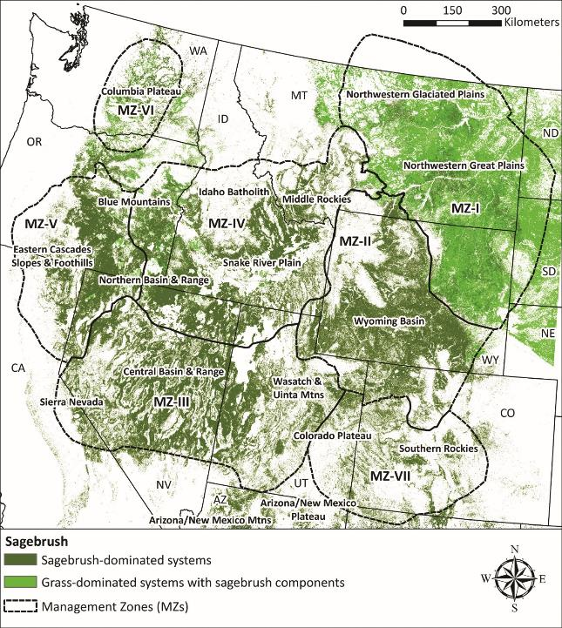
Sagebrush ecosystem
Pattern/frequency of wildfires have changed
Post-wildfire recovery differs across the ecosystem
In northeast Wyoming, perennial herbaceous species rapidly return
Recovery can take decades or centuries
USGS 2014
Notes:
Small core Area – Current size – 66, 686 acres

Slide 7
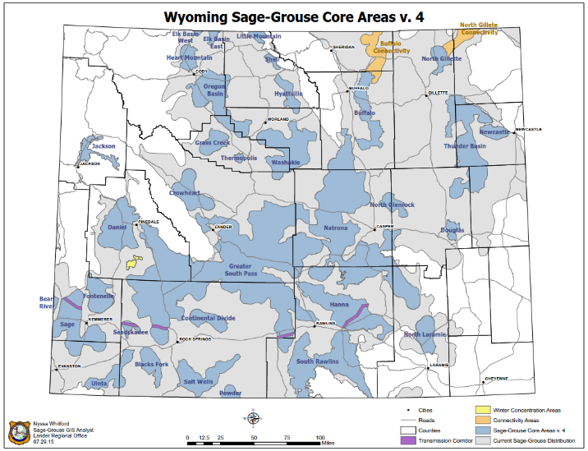
Greater Sage-Grouse Conservation in Wyoming
Wyoming has led the way in establishing policy to guide sage-grouse conservation
Key component: balancing species conservation with development
The Douglas Core Area (DCA) is a success story of a partnership between numerous stakeholders
The DCA Restoration Team (RT) has been integral to conservation within this core area
WGFD 2015
Notes:
Important context for the motivation behind the team’s work and general habitat conservation and restoration in WY
Small core Area – Current size – 66, 686 acres

Slide 8
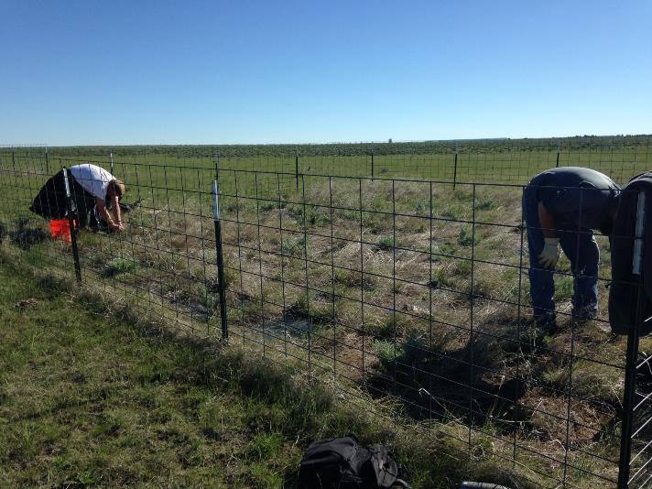
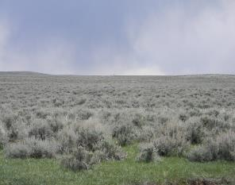
Sagebrush Restoration within Northeastern Wyoming – The Challenges
Eastern portion of sagebrush ecosystem – grass/shrub competition
Post-fire plant community is grass-dominated
Sagebrush seed is short-lived and dispersed short distances
Re-establishment from burn perimeter inward takes time
High herbivory – small and large mammals
Notes:
Explicit component of WY EO’s has been recognition of valid and existing rights
Chesapeake valid and existing rights – lease agreements pre-2008
The Plan covered a 3-year time period and is currently being rewritten so as to be extended for another 3 years.
Small number of birds and leks – only 4 occupied leks prior to the EO implementation; 15 year average lek attendance = 12 males/lek (high and low of 29 and 2 birds, respectively)
High level of disturbance prior to the EO – some sagebrush clearing (as was typical in NE WY), and considerable acreage burned in wildfires and not suitable habitat
2015 lek data – 6 occupied leks and 59 males observed; 2014 lek data – 31 males; 2007 peak – 76 males
CHK is primary leaseholder; predominantly private land

Slide 9
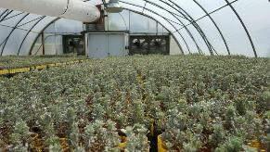
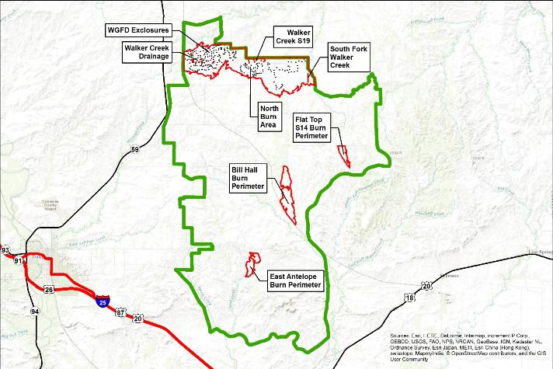
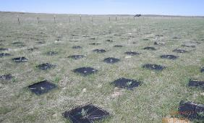
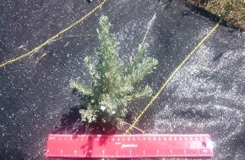
Habitat Enhancement & Restoration – Story with Data
Six project sites (2014-2018)
Approximately 100,000 sagebrush seedlings planted
992 acres in discrete project areas including a recent (2016) burn
5,280 acres in North Burn; projects complementing WGFD planting efforts

Slide 10
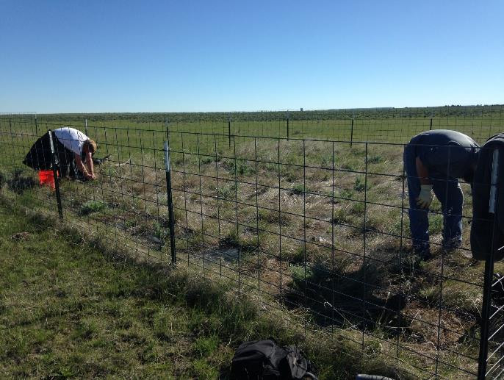
Sagebrush Restoration within the Douglas Core Area – Confronting the Challenges
Initial recruitment- outplanting/establishing seed source “islands”
Resource competition – fabric mulch
Herbivory – fencing
Facilitating future recruitment – current research
Goals: Survival, growth, persistence, reproductive maturity
Notes:
Explicit component of WY EO’s has been recognition of valid and existing rights
Chesapeake valid and existing rights – lease agreements pre-2008
The Plan covered a 3-year time period and is currently being rewritten so as to be extended for another 3 years.
Small number of birds and leks – only 4 occupied leks prior to the EO implementation; 15 year average lek attendance = 12 males/lek (high and low of 29 and 2 birds, respectively)
High level of disturbance prior to the EO – some sagebrush clearing (as was typical in NE WY), and considerable acreage burned in wildfires and not suitable habitat
2015 lek data – 6 occupied leks and 59 males observed; 2014 lek data – 31 males; 2007 peak – 76 males
CHK is primary leaseholder; predominantly private land

Slide 11
Seed source islands
Burn perimeter
Notes:
Team’s goal: making inroads into sagebrush restoration approaches, techniques that are cost-efficient/effective and bring about results as quickly as its practicable
-because wildfire can result in habitat loss in hours and days, whereas recovery can take centuries, decades (if at all)

Slide 12
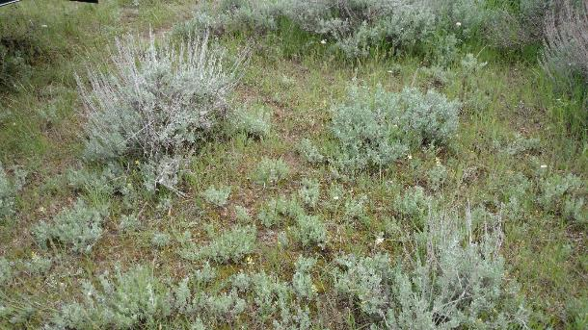
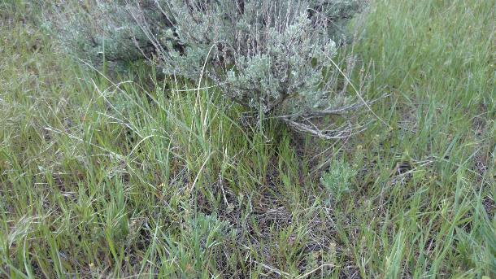
Seed Source Islands
Seedling recruitment within 1 meter of “mother plants”
Notes:
Images showing seedling recruitment within 1 meter of ‘mother plants’

Slide 13
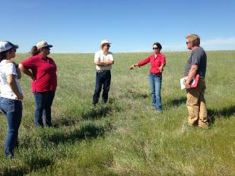
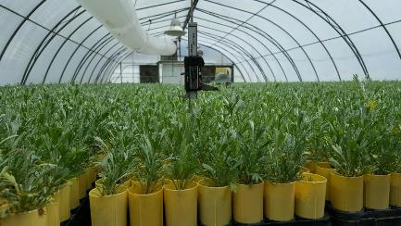
Research Questions
Is there a benefit to using locally collected seed?
Does fabric mulch enhance survival and growth?
What is the time frame from planting to reproductive maturity?
How does herbivory impact survival and growth over time?
Notes:
Team’s goal: making inroads into sagebrush restoration approaches, techniques that are cost-efficient/effective and bring about results as quickly as its practicable
-because wildfire can result in habitat loss in hours and days, whereas recovery can take centuries, decades (if at all)

Slide 14
Is there a benefit to using locally collected seed?
1-year post-planting
1-year post-planting
2-years post-planting
ID Seedlings
YES. Higher survival, higher growth rates, and a shorter time to reproductive maturity.

Slide 15
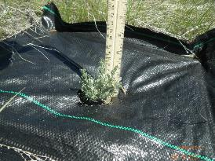
Does fabric mulch enhance survival and growth?
Survival
Growth
Reproduction
2018
2018
2018
YES. Higher survival, higher growth rates, and a shorter time to reproductive maturity.

Slide 16
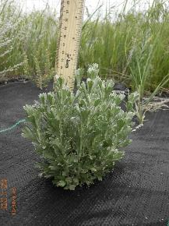
Soil water availability and dynamics
Control (no mulch)
1-m fabric mulch
0.25-m fabric mulch
1-m scalp
Control (no mulch)
Greater surface coverage → greater water availability → sustained growth
Reduced evaporation
Reduced competition

Slide 17
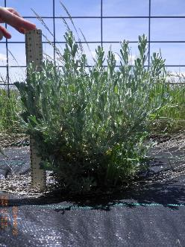
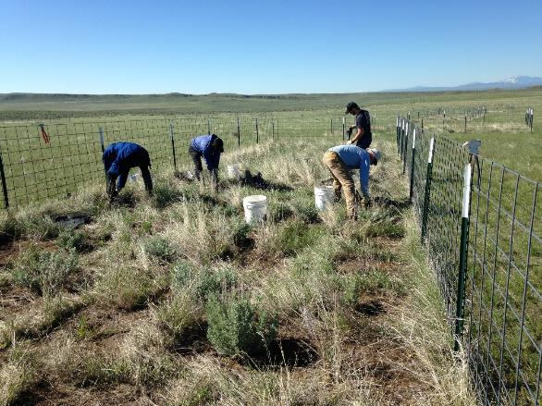
What happens when the exclosures are removed?

Slide 18
Does herbivory impact survival, growth, and reproduction over time?
YES. Large reduction in plant size and reproduction. Small reduction in survival.

Slide 19
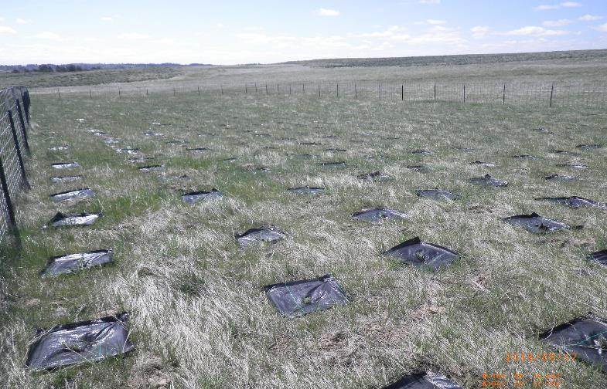
Acting as seed source islands….what next?
Successful restoration and reclassification of sites:
Cover – 5% sagebrush cover to be considered suitable habitat
Recruitment – critical to practical restoration of landscapes
?
Cover, Seed source →

Slide 20
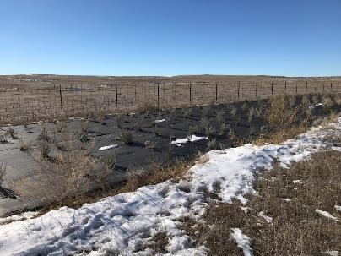
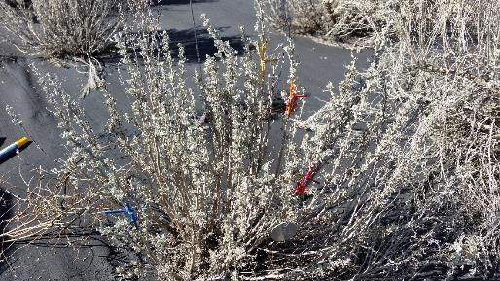
Acting as seed source islands….what next?
Ongoing Research
1. Quantification of winter herbivory and annual growth increment
2. Testing reduced seedling densities and “open spaces” for recruitment
3. Testing soil disturbance and grazing as facilitators for recruitment

Slide 21
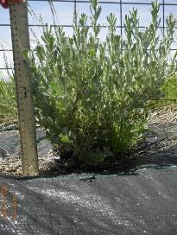
Conclusions – Sharing what we have learned
Evidence of use – If you build it, they will use it
Data supported practices for successfully re-establishing sagebrush
Making inroads into the longer term understanding of sagebrush restoration within fire-impacted landscapes
Private landowners and multi-stakeholder teams can be partners in conservation/restoration
Time and more research are needed to understand sagebrush recruitment and potential ways to facilitate it

Slide 22
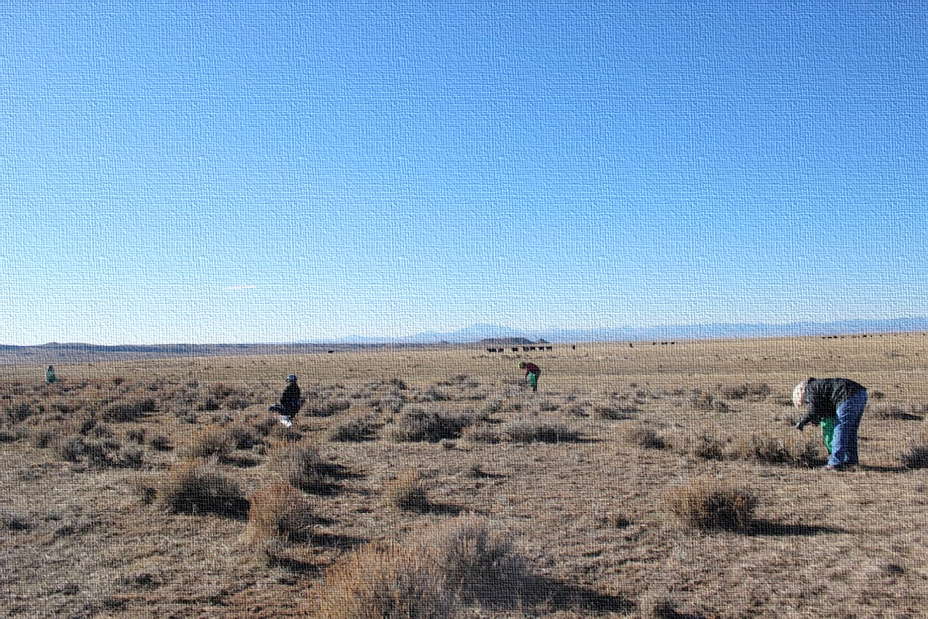
Questions?
Jana White, jwhite@trihydro.com
Sagebrush seed collection for growing seedlings, Fall 2013

