Slide 1


A River Runs Through It
Designing and Permitting the Stibnite Gold Project
Dale Kerner, P.G. - Permitting Manager
Midas Gold Idaho – Boise, Idaho
MAX.TSX
MDRPF.OTCQX
JUNE 2019

Slide 2
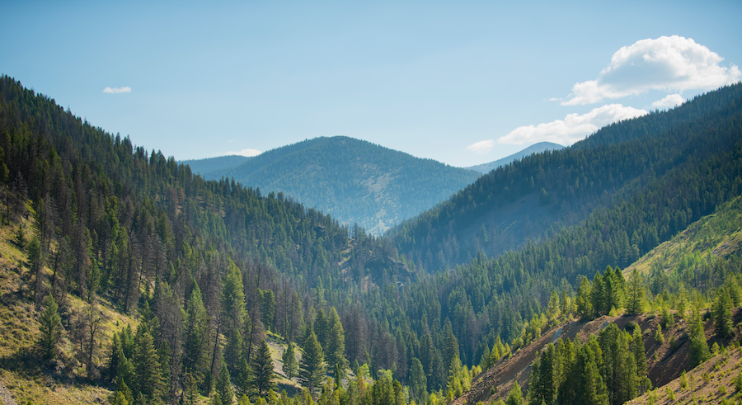

WHO WE ARE
Midas Gold Idaho is based right here in Idaho and we call Idaho home. We are dedicated to doing business the right way by caring for the environment, our community and our employees.
2
Notes:
VANDALS:
Angie, Tanya, Hayley, Chris, Kyle, Ryan, Melanie, Jordan=8
Broncos:
Dale, Kyle, Koda, Tanya=4 Ciara+Kaleb=6

Slide 3







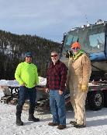

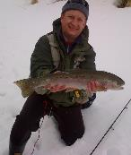

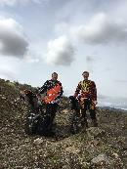

















OUR TEAM
MOST OF OUR 33+ EMPLOYEES CALL IDAHO HOME.
EXPERTS, DEDICATED TO IDAHO AND COMMITTED TO DOING THE RIGHT THING.

Slide 4
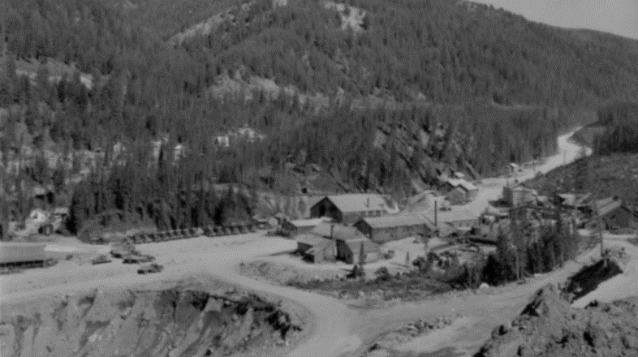
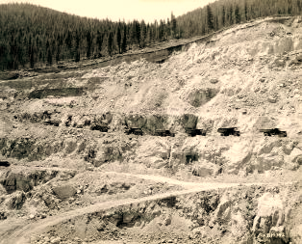
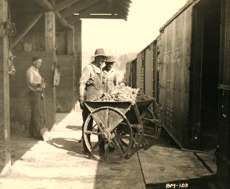
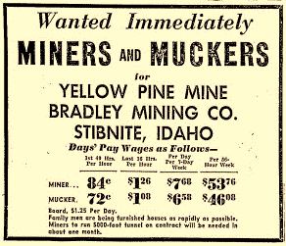
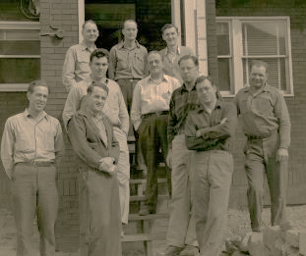
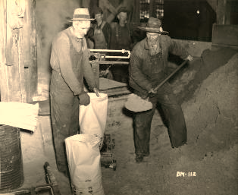
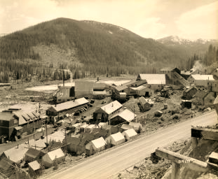
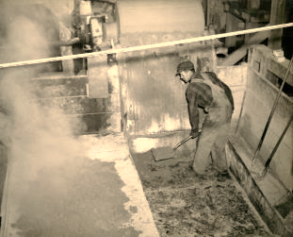
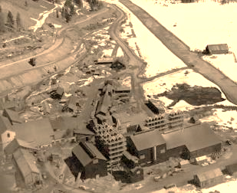
THE STIBNITE MINING DISTRICT
Notes:
HISTORY
The site is in a historic mining district. Starting in the 1890’s, mining occurred at stibnite for Antimony, Gold, Silver and Tungsten.
At one point, the town of Stibnite grew to nearly 1,000 residents.
In the 1950’s the town started to slowly disappear and by the1990’s the companies stopped operating.

Slide 5

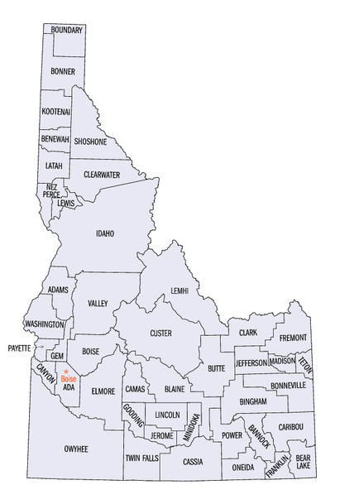
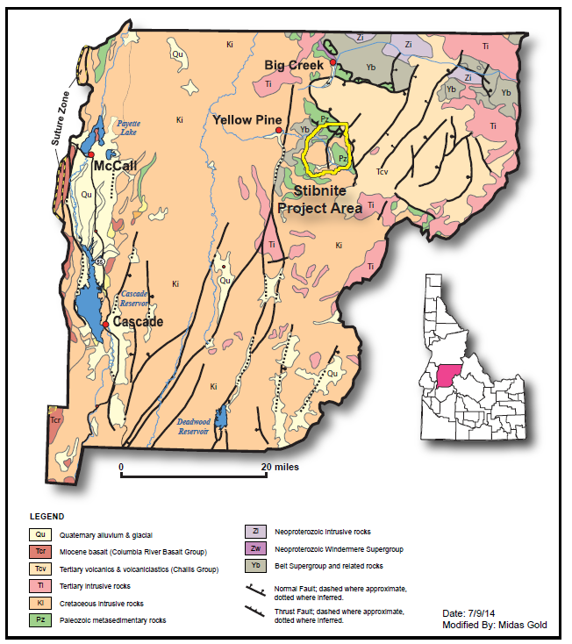
STIBNITE MINING DISTRICT
Valley County, Idaho
From Boise - 92 air miles, 144 miles by road
From Cascade - 44 air miles NE
From Yellow Pine - 12 miles east

Slide 6
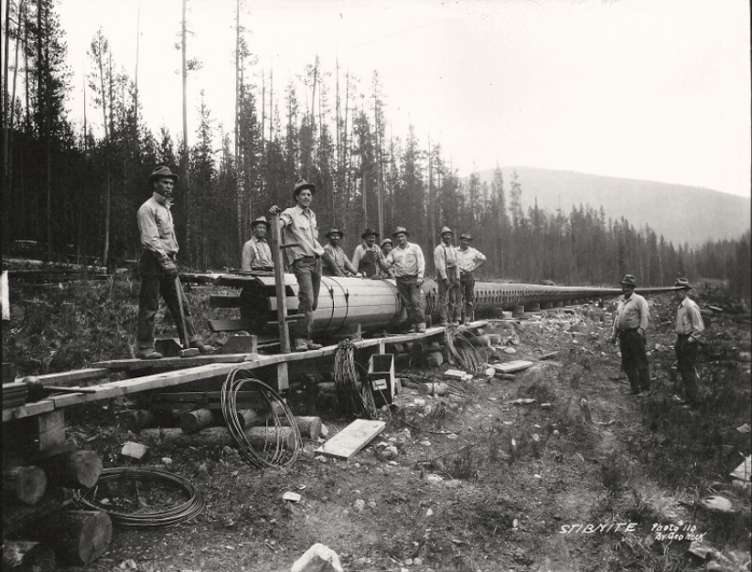
STIBNITE…A LONG HISTORY
Water Delivery Pipeline for Power Plant on Sugar Creek (circa 1930).
Notes:
Water Delivery Pipeline for Power Plant on Sugar Creek (circa 1930). 11,000 ft long 28-inch diameter redwood stave wire-wrapped pipe. Transported water from EF Meadow Creek to generator at Sugar Creek. Photo courtesy of the J. Nock Family

Slide 7
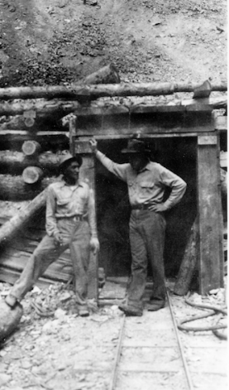
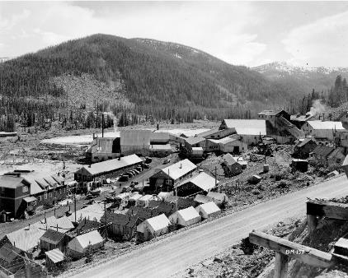
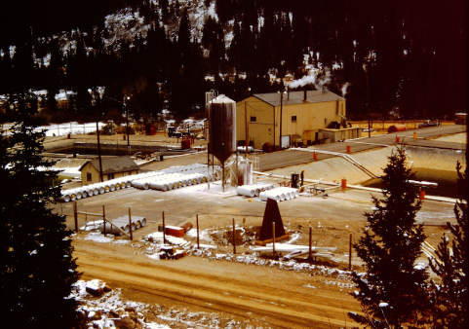
STIBNITE MINING DISTRICT
1940s & 1950s
WWII & Korean War
Antimony & Tungsten
1980’s & 1990’s
Gold & Silver
Late 1920s – 1930s
Underground Exploration and Mining
(Gold, Silver, Antimony)
Notes:
Much of the history of mining at the site occurred prior to meaningful environmental regulation.
The Stibnite Mining District Namesake
WWI - A military use also appeared in the 19th century when a brittle lead alloy hardened with 10 to13 percent antimony was used for the spherical bullets contained in a new antipersonnel artillery shell invented by British General Henry Shrapnel. “Shrapnel” was used so extensively in the trench warfare of World War I that world antimony production between 1915 and 1918 averaged 53,000 metric tons per year (t/yr) and peaked at 82,000 t in 1916 these figures were not approached again until World War II (Schrader, 1921, p. 298).
WWII - Antimony was again used in large quantities in World War II when world demand peaked at about 58,000 t/yr in 1942 and 1943 (Mote, 1948, p.128). With the abandonment of trench warfare in favor of maneuver and with an emphasis on mobile armored units, however, a much smaller fraction of military antimony went into fragmentation ammunition. Most of it was used in the LA batteries of military vehicles and in flame retardant compounds. The flame retardants were used primarily for heavy textiles, such as were made into tents and tarpaulins.
An Army Munitions Board Supply Department General noted that the materials mined from the Stibnite District likely cut a year off the war in the Pacific and saved over a million lives (Clark, 1951; Congressional Record, 1956). Clark, N.M., Want to Get Away From it All, Saturday Evening Post, December 8, 1951, p. 97-105.
Sb and W primarily in Yellow Pine Pit, some in hangar flats

Slide 8
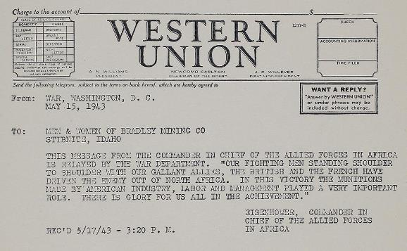




STIBNITE MINING DISTRICT
HISTORIC PRODUCTION
1M oz gold
2M oz silver
44K tons antimony
(1938-1952)
13M lbs tungsten
(1938-1952)
During WWII years, Stibnite produced approximately 40% of America’s tungsten and up to 90% of the antimony.
Notes:
The Stibnite Mining District Namesake
WWI - A military use also appeared in the 19th century when a brittle lead alloy hardened with 10 to13 percent antimony was used for the spherical bullets contained in a new antipersonnel artillery shell invented by British General Henry Shrapnel. “Shrapnel” was used so extensively in the trench warfare of World War I that world antimony production between 1915 and 1918 averaged 53,000 metric tons per year (t/yr) and peaked at 82,000 t in 1916 these figures were not approached again until World War II (Schrader, 1921, p. 298).
WWII - Antimony was again used in large quantities in World War II when world demand peaked at about 58,000 t/yr in 1942 and 1943 (Mote, 1948, p.128). With the abandonment of trench warfare in favor of maneuver and with an emphasis on mobile armored units, however, a much smaller fraction of military antimony went into fragmentation ammunition. Most of it was used in the LA batteries of military vehicles and in flame retardant compounds. The flame retardants were used primarily for heavy textiles, such as were made into tents and tarpaulins.
An Army Munitions Board Supply Department General noted that the materials mined from the Stibnite District likely cut a year off the war in the Pacific and saved over a million lives (Clark, 1951; Congressional Record, 1956). Clark, N.M., Want to Get Away From it All, Saturday Evening Post, December 8, 1951, p. 97-105.
Sb and W primarily in Yellow Pine Pit, some in hangar flats

Slide 9
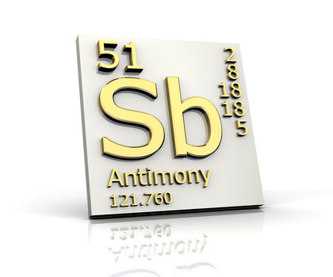
ANTIMONY
USGS Mineral Commodity Profile – 2018
In 2017, no marketable antimony was mined in the US
Sb consumption (2017) - 25,000 metric tons (55M lbs)
85% net import reliance
15% from recycled sources
Executive Order 13817 – December 2017
Sec. 3. Policy. It shall be the policy of the Federal Government to reduce the Nation's vulnerability to disruptions in the supply of critical minerals...The United States will further this policy…by:
(d) streamlining leasing and permitting processes to expedite exploration, production, processing, reprocessing, recycling, and domestic refining of critical minerals.
Notes:
Executive Order 13817 (12-20-2017)
Sec. 3. Policy. It shall be the policy of the Federal Government to reduce the Nation's vulnerability to disruptions in the supply of critical minerals, which constitutes a strategic vulnerability for the security and prosperity of the United States. The United States will further this policy for the benefit of the American people and in a safe and environmentally responsible manner, by:
(a) identifying new sources of critical minerals;
(b) increasing activity at all levels of the supply chain, including exploration, mining, concentration, separation, alloying, recycling, and reprocessing critical minerals;
(c) ensuring that our miners and producers have electronic access to the most advanced topographic, geologic, and geophysical data within U.S. territory to the extent permitted by law and subject to appropriate limitations for purposes of privacy and security, including appropriate limitations to protect critical infrastructure data such as those related to national security areas; andStart Printed Page 60836
(d) streamlining leasing and permitting processes to expedite exploration, production, processing, reprocessing, recycling, and domestic refining of critical minerals.

Slide 10
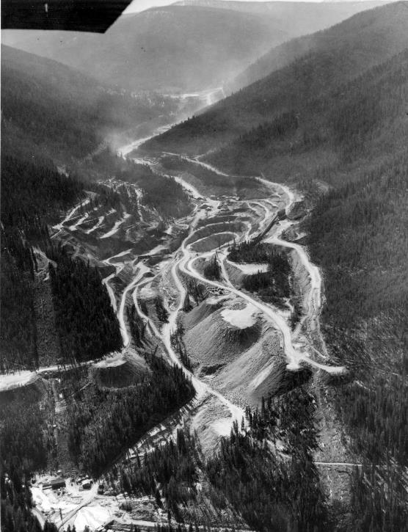

1899
The Thunder Mountain gold rush
brings mining to the area
HISTORIC STIBNITE MINING DISTRICT
1900-1930
The town of Stibnite is established
1938
Mining at Yellow Pine pit stops
salmon migration upstream
1943-1950
The town of Stibnite booms when
antimony is declared a critical mineral
1952-1960
With WWII & the Korean war over, mining slowed and Stibnite faded
1960s
Earthen dam failed, resulting in hundreds of tons of sediment
eroding into surrounding
streams & rivers, even to this day
1970-1990
Periodic mining by multiple
owners and operators
1990s
All mining stopped, U.S. Gov’t
conducts some limited clean-up
2009
Midas Gold consolidated land ownership & began evaluating the
geology & environment within the Stibnite Gold Project area
Notes:
1900 – Hg, Au and Ag discovered at Thunder Mtn.
1914 – Albert Hennessy, first claims at Stibnite for Au-Sb

Slide 11
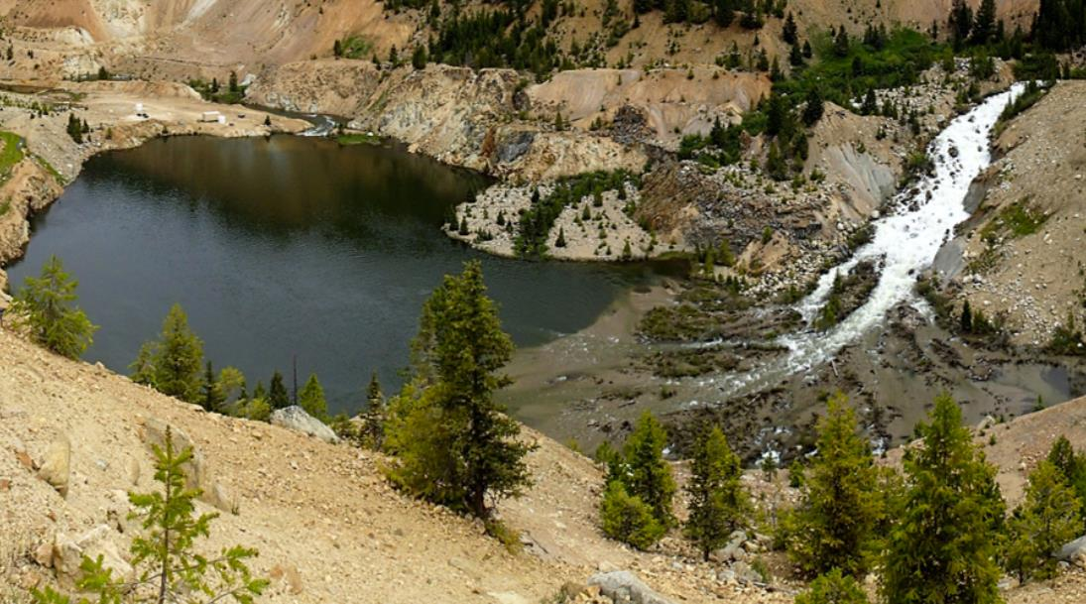

LEGACY IMPACTS

Slide 12
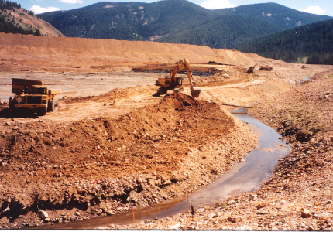
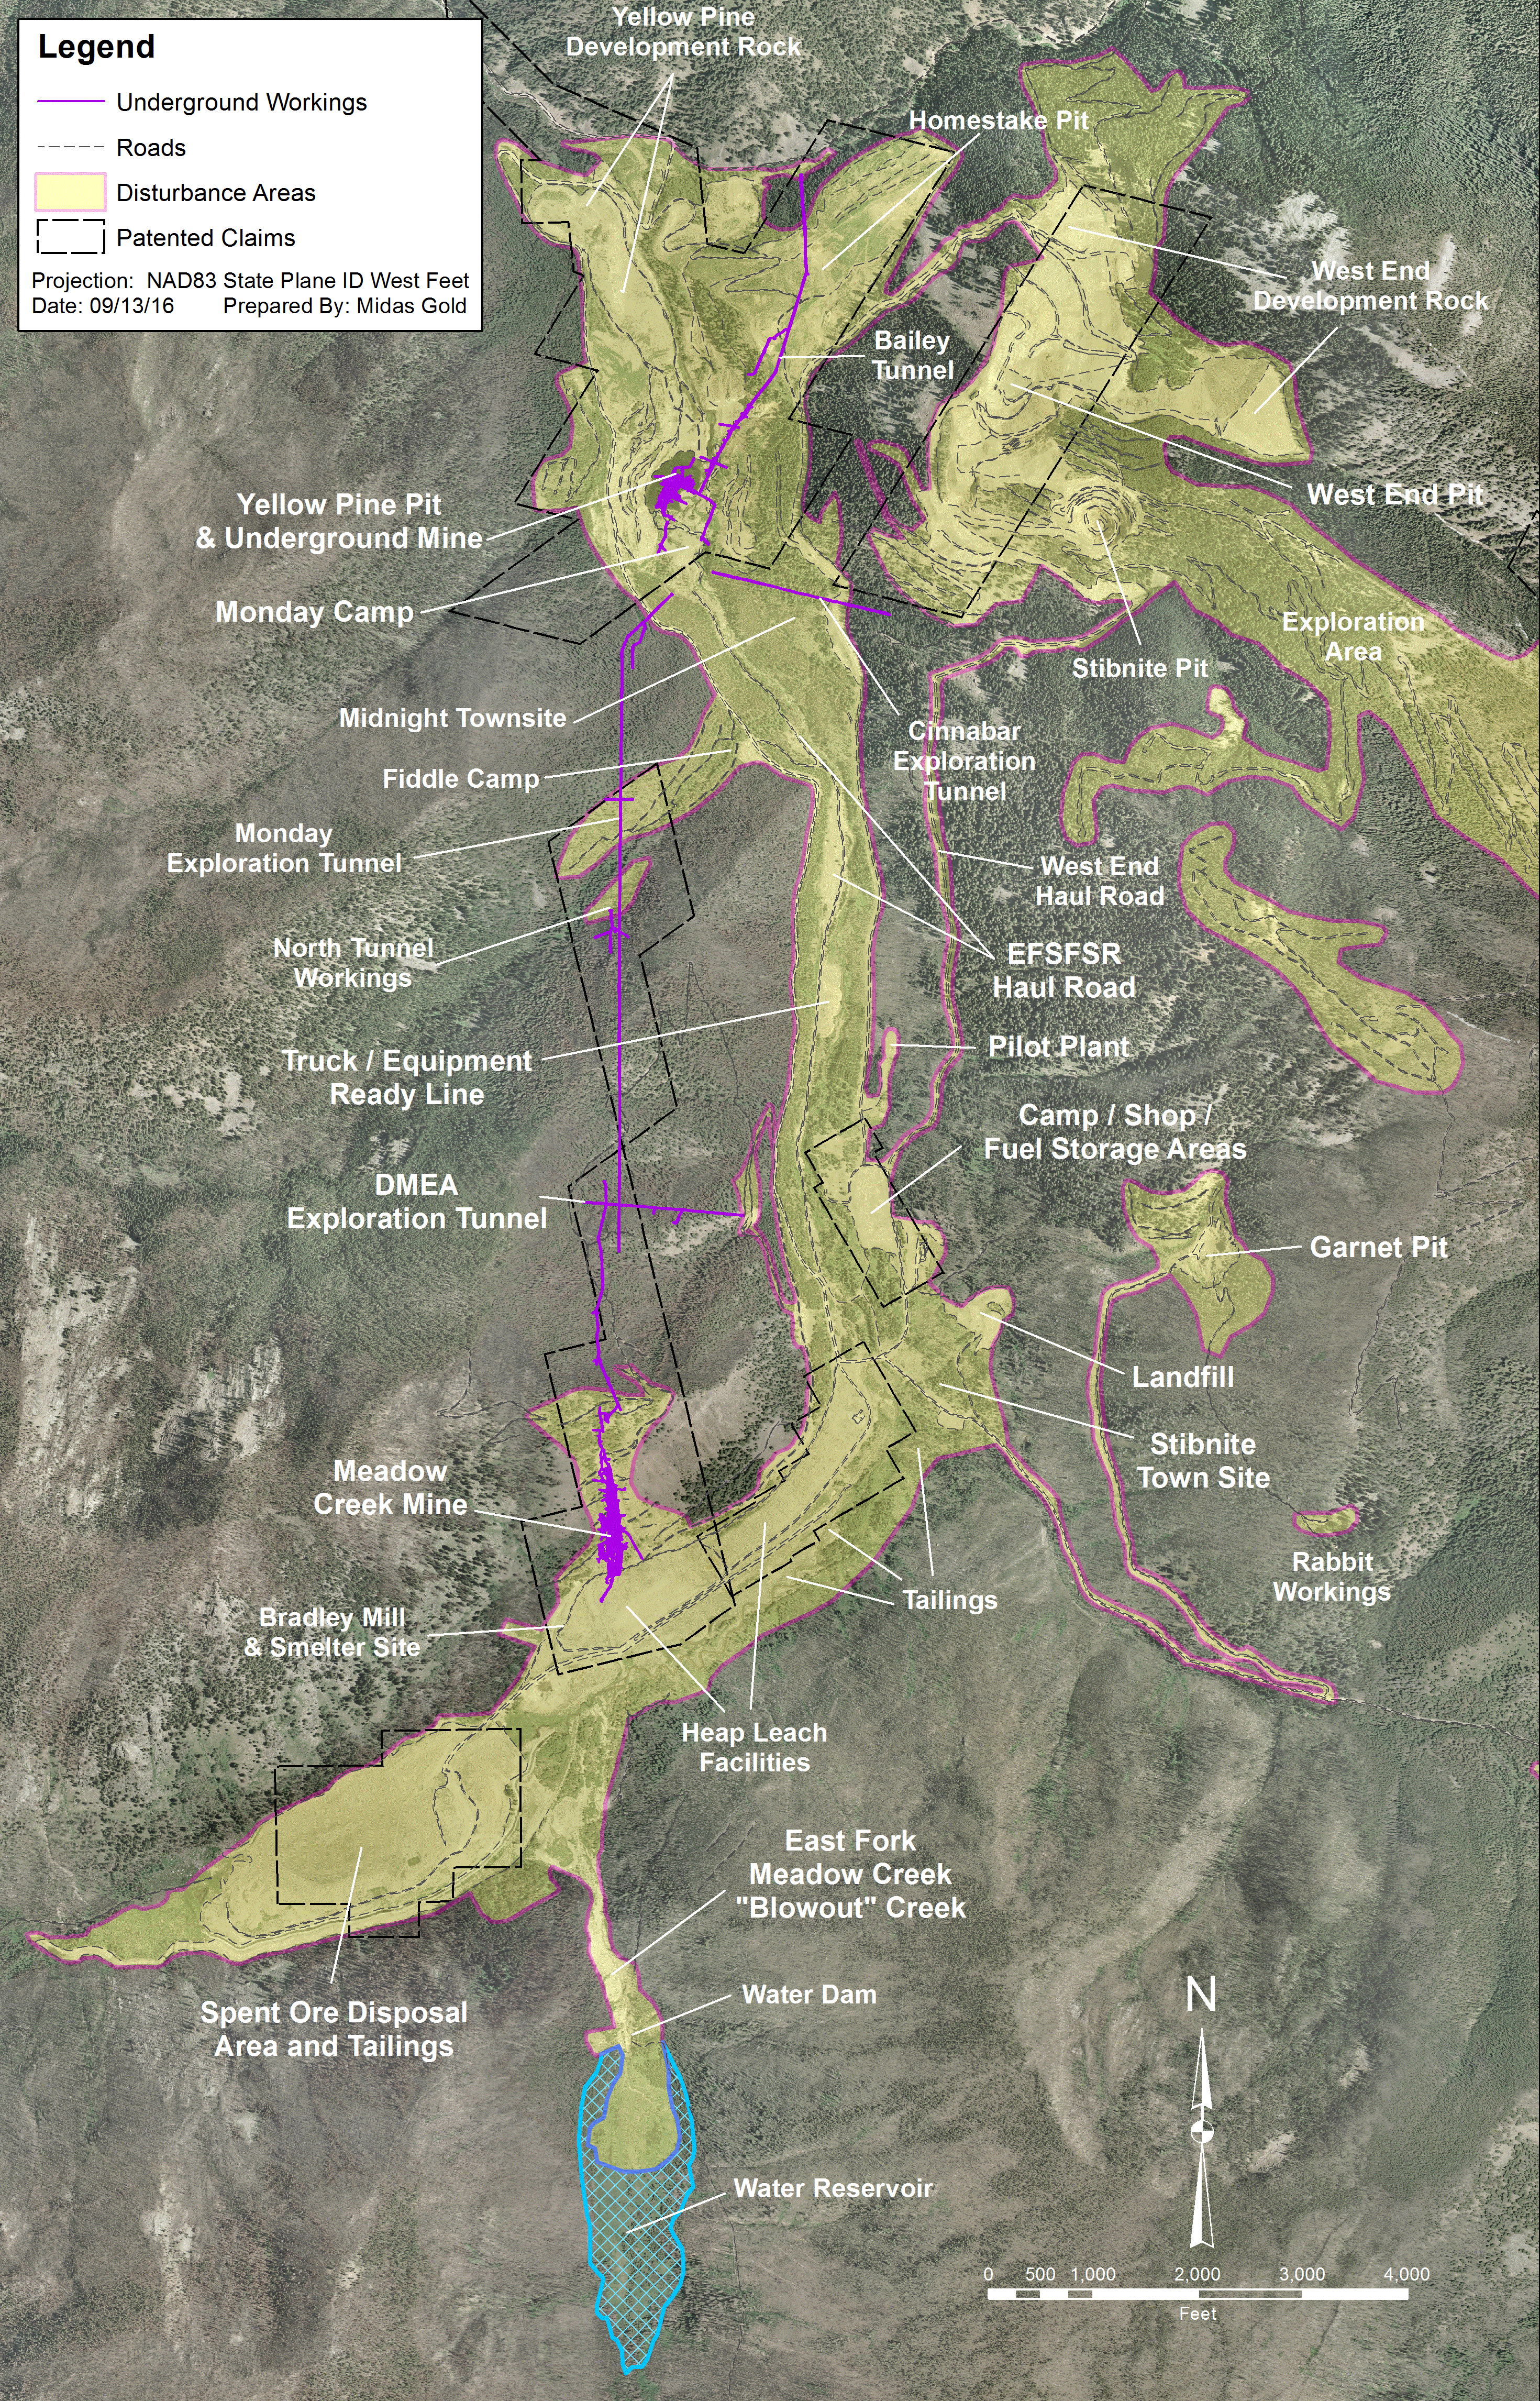
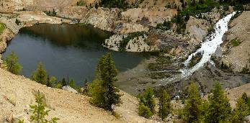
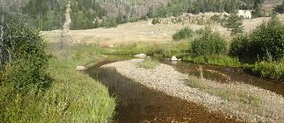
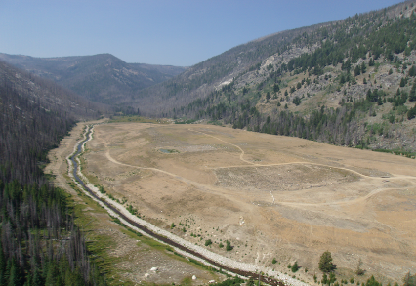
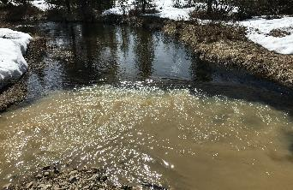
YELLOW PINE PIT
TAILINGS
HABITAT
BLOWOUT CREEK
SODA and re-channeled MEADOW CREEK
Notes:
TAILINGS
10.5 million tons of legacy spent ore and tailings, unlined, interact with water table
MEADOW CREEK
4,900 ft rock lined ditch with limited habitat function
YELLOW PINE PIT
The East Fork of the South Fork dumps in to a legacy mine pit. Currently, ~80 feet of sediment collected at the bottom
FISH PASSAGE
Fish migration is blocked by the Yellow Pine pit
HABITAT
13,500 ft poor
habitat quality
BLOWOUT CREEK
Largest source of sedimentation in the watershed14 foot drop in water table, loss of wetlands function

Slide 13
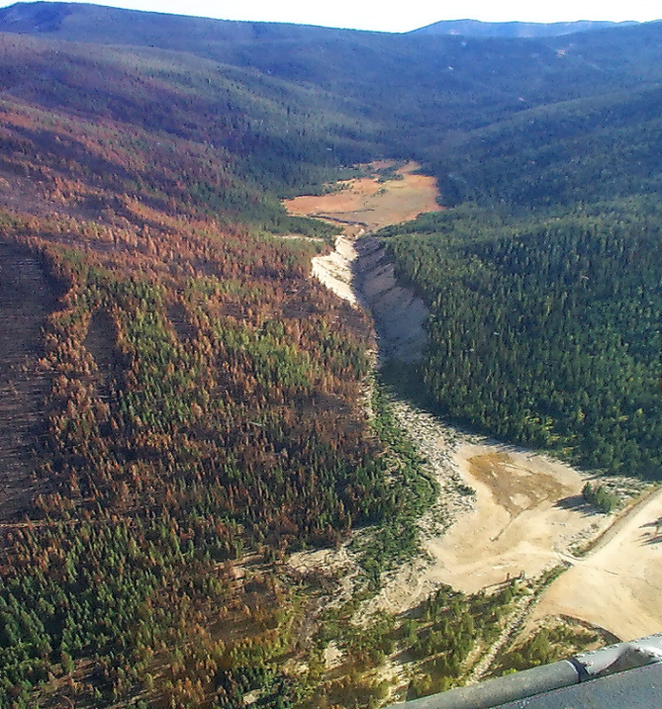
LEGACY
BLOWOUT CREEK
Water reservoir (1930s) developed to provide water and hydroelectric power to process plant on the East Fork of Meadow Creek; dam failed in 1965.
TODAY
The most significant source of sediment in the EFSFSR watershed, degrading water quality and fish habitat and diminishing wetlands functionality. GW table in upper meadow has dropped ~14 feet and incised channel.

Slide 14
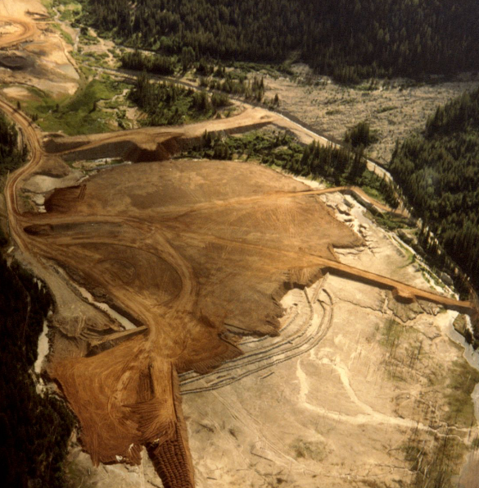
LEGACY
SPENT ORE DISPOSAL
Flotation and smelter tailings (grey) were covered with spent heap leach ore (brown) and deposited, unlined, in the Meadow Creek Valley.
TODAY
The area has been revegetated, however, legacy materials continue to degrade water quality and leach metals into the surface and groundwater.

Slide 15
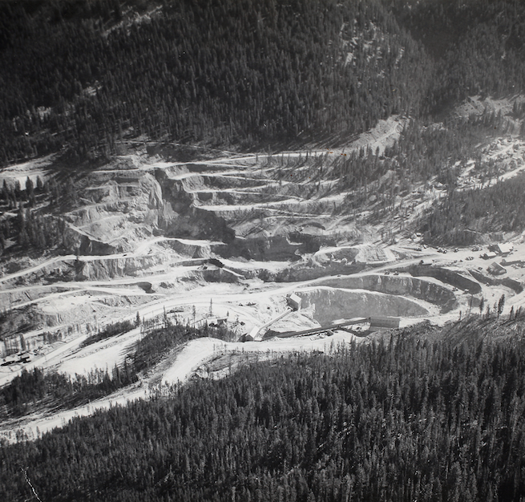
LEGACY
YELLOW PINE PIT
During the World War II era, the East Fork of the South Fork of the Salmon River (EFSFSR) was diverted to facilitate mining of the Yellow Pine pit, cutting off fish passage.
TODAY
The river flows directly into the Yellow Pine pit, blocking fish passage.

Slide 16
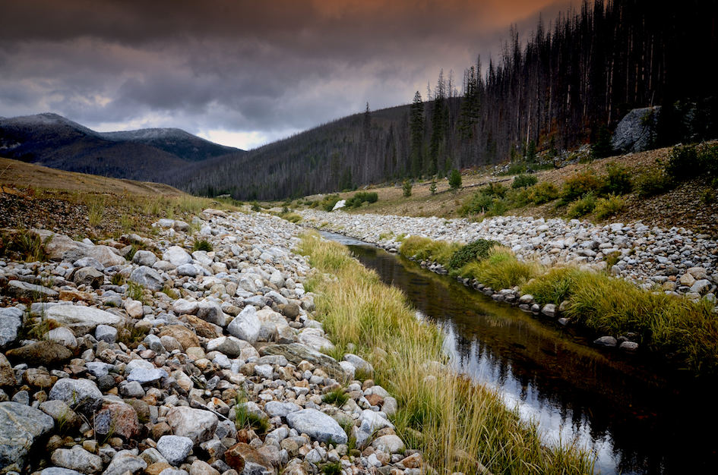
THE STIBNITE GOLD PROJECT
PLAN OF RESTORATION AND OPERATIONS (PRO)

Slide 17
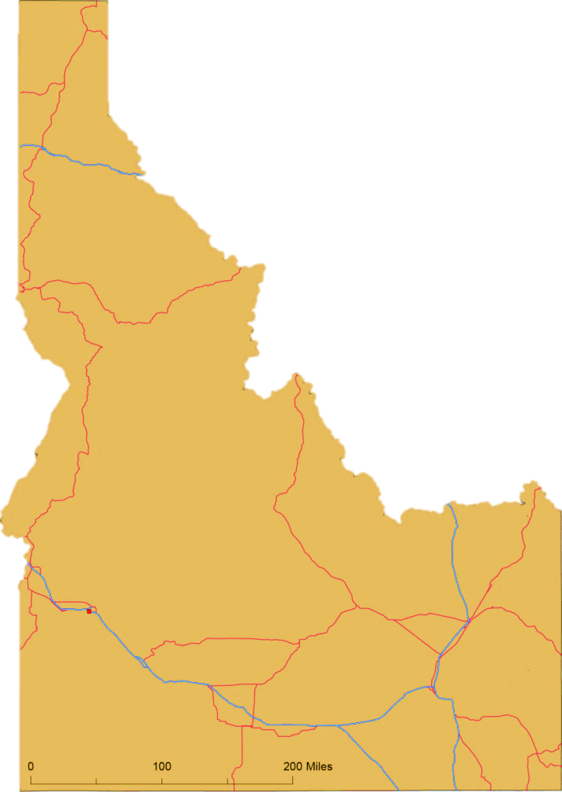
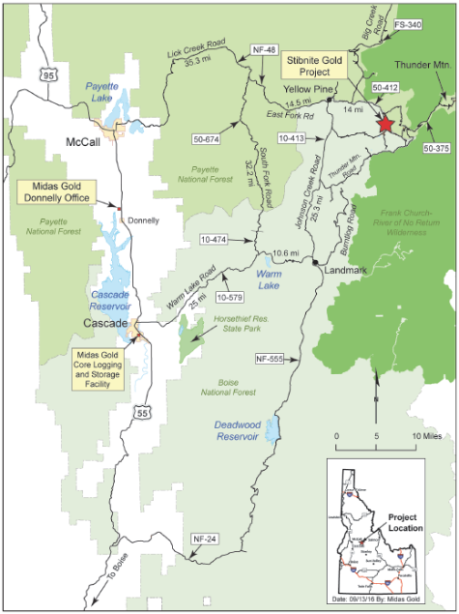
STIBNITE GOLD PROJECT
Coeur d’Alene
17
Stibnite Gold Project
Midas Gold Au-Sb
McCall
Cascade
BOISE
IDAHO
Notes:
LOCATION

Slide 18
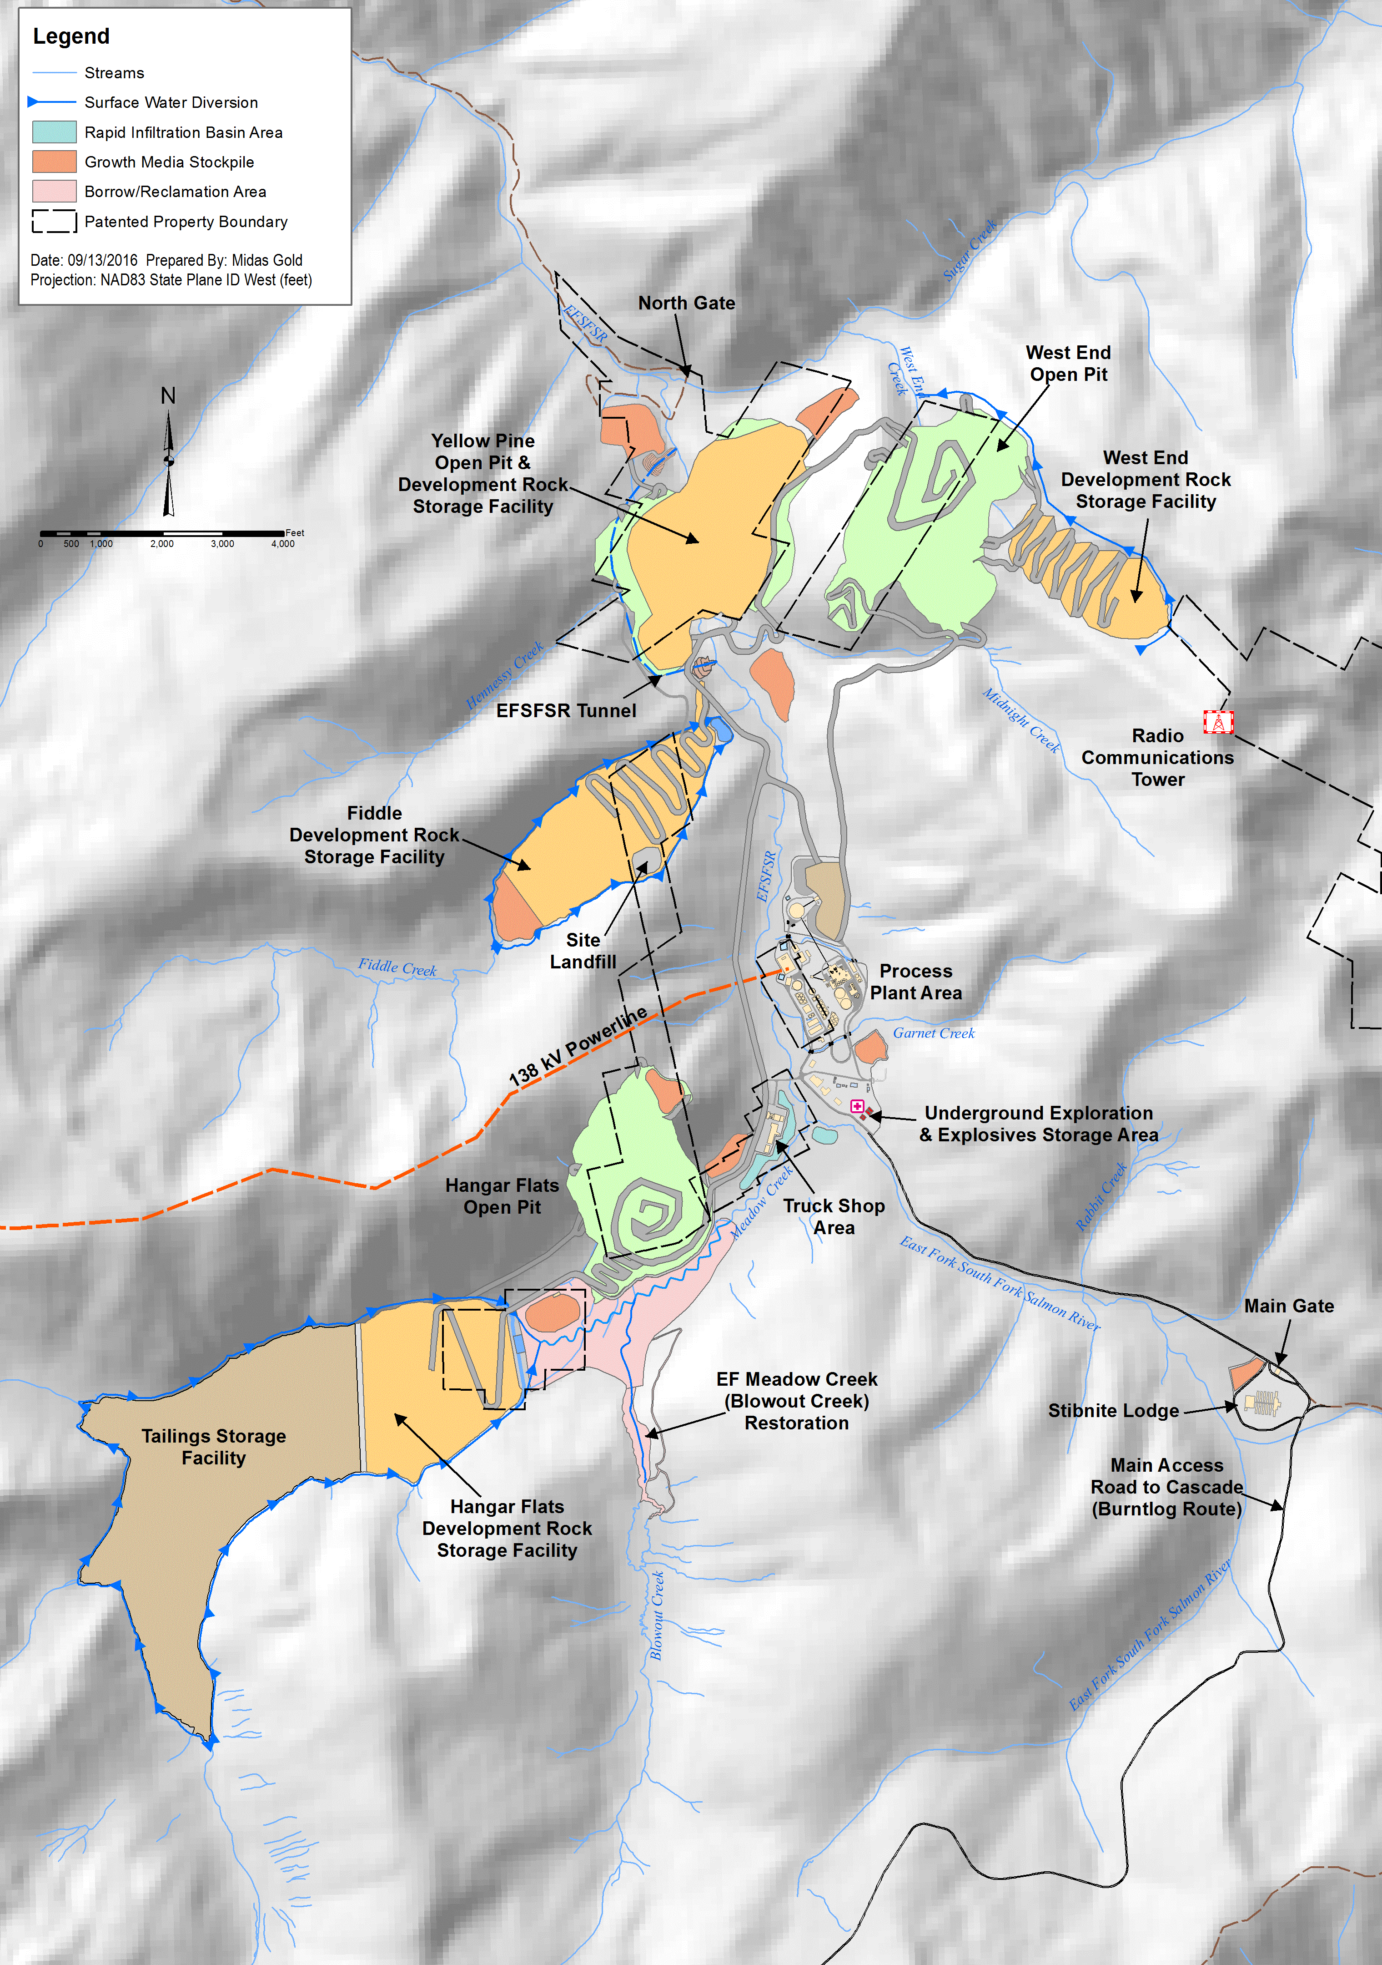

Slide 19
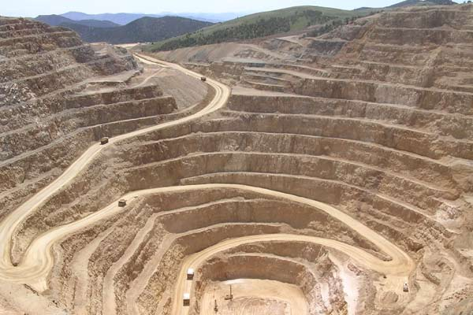
PROPOSED MINING
~100 MT ore
~300 MT development rock
20K-25K tons/day ore processing
4-5 million oz Au
2-3 million oz Ag
100-200 million lbs Sb
12-15 year mine life
~25-28 years: development to closure

Slide 20
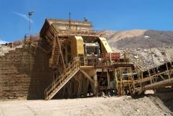
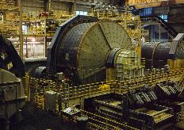

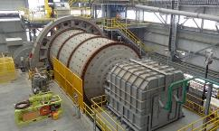

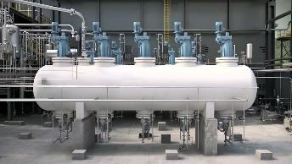
ORE PROCESSING
Jaw Crusher
SAG Mill
Ball Mill
High Sb Sulfides (~14%)
Stibnite Concentrate
Antimony Flotation
Jaw Crusher
SAG Mill
Gold Flotation
Low Sb Sulfides
(~72%)
Oxides
(~14%)
Pressure Oxidation
Ball Mill
Flotation
Neutralization
Tailings Storage
Tailings Detoxification
Gold Leach
& Recovery
  Gold Doré
Autoclave (Pressure Oxidation Vessel)
The PFS is intended to be read as a whole, sections should not be read or relied upon out of context. The information in this presentation is subject to the assumptions, exclusions and qualifications contained in the PFS. See “Regulatory Information” at the end of this presentation.
Notes:
Wherever possible, our footprint for operations stays limited to areas already disturbed.
After reprocessing legacy tailings we will mine Yellow Pine pit.
Currently, the EFSFSR dumps into the old Yellow Pine pit. We will temporarily re-route the river in order to mine and then back fill the Yellow Pine pit.
This allows us to begin the process of setting the river back to its pre-1930’s course.
We will then mine Hangar Flats and West End.

Slide 21
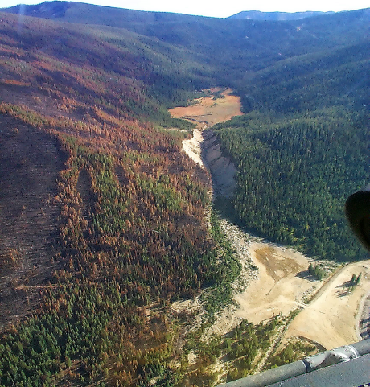
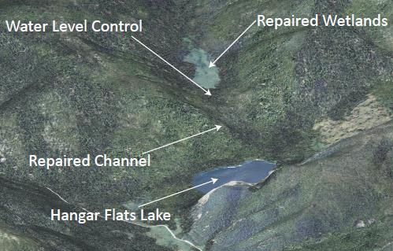
BLOWOUT CREEK RESTORATION
CURRENT
RESTORATION

Slide 22
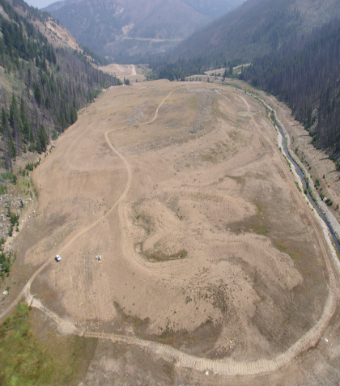
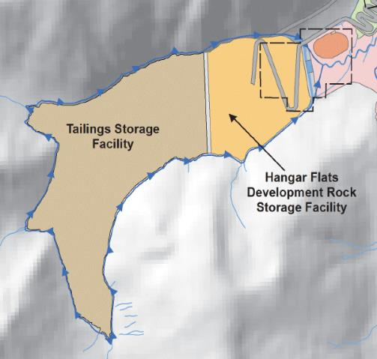
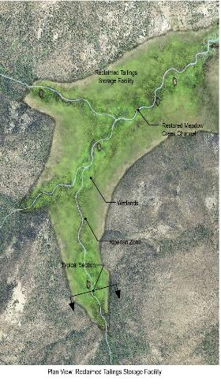
REMOVE & REPROCESS LEGACY TAILINGS
CURRENT
REPURPOSE, REPROCESS
RESTORE

Slide 23
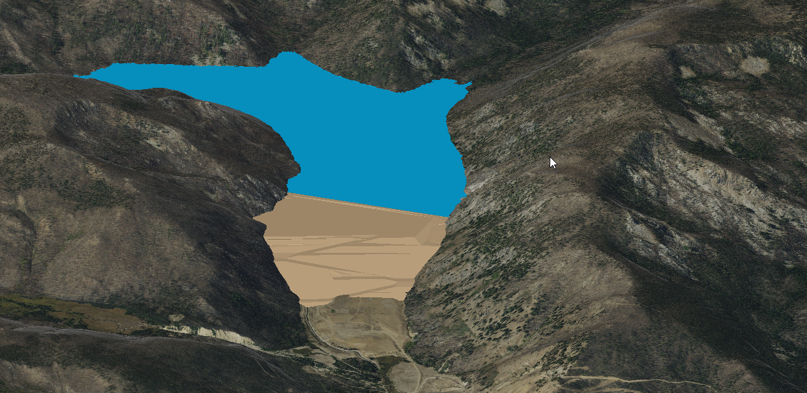
TAILINGS STORAGE
PRO TSF
Impoundment
Hangar Flats DRSF
SODA

Slide 24
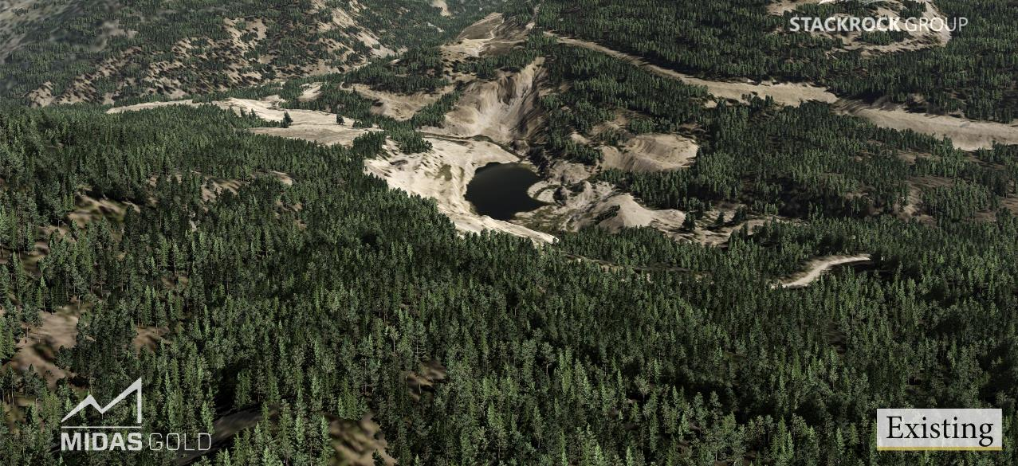
YELLOW PINE PIT - CURRENT

Slide 25
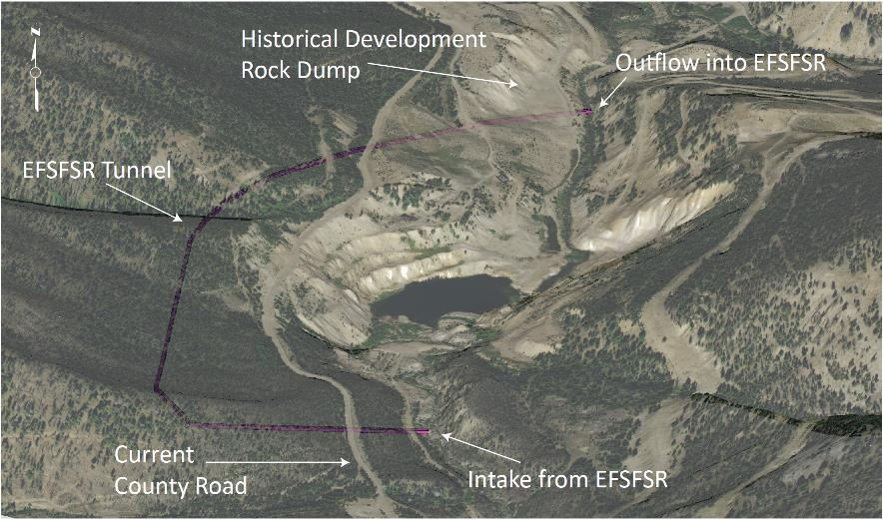
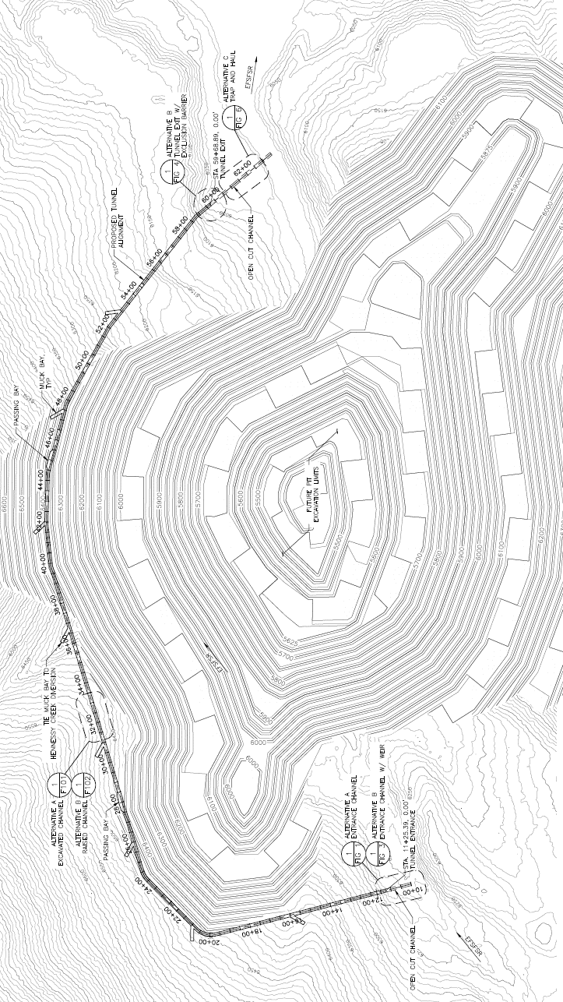
THE YPP AND THE EFSFSR

Slide 26

YELLOW PINE PIT - RESTORED

Slide 27


Slide 28


FISHERIES
GOALS
Fisheries Conservation & Protection Goals:
Restore volitional passage
Restore spawning and rearing habitat
Minimize incidental take of ESA-listed fish.
Results:
3-9 miles of additional habitat (species-dependent)
Net improvement in habitat
Support conservation and recovery
Notes:
Restore volitional passage early, during mine operations, through closure, and beyond
Restore spawning and rearing habitat in EFSFSR and Meadow Creek.
Minimize incidental take of ESA-listed fish.
Results:
Restoration of passage, accessing 3-9 miles of additional habitat (species-dependent)
Net improvement in habitat
Increased salmon production (+possible seeding other areas)
Support conservation and recovery

Slide 29


Reclaimed
Fiddle DRSF
Restored
EFSFSR
Reclaimed Tailings
Storage Facility
West End
Lake
Restored
Blowout
Creek
Hangar Flats
Lake
Post Closure
Notes:
Overall restoration view.
Note fisheries habitat opened up by facilitating passage at YPP

Slide 30

NEPA ANALYSIS
AND PERMITTING STATUS

Slide 31

Soooo…when are we going to be getting those permits?

Slide 32






PERMITTING
3+ years
of Regulatory Review
11 agencies
State and Federal Agencies
50+ permits
for Environmental, Safety and Regulatory Standards
$10s of millions
set aside for Reclamation

Slide 33



NEPA PROCESS
We are here
Submittal of PRO
9/2016
Administrative
Approval
12/2016
Pre-work & Planning
Q1/Q2 2017
NOI, EIS Project Initiation & Public Scoping
Q2/Q3 2017
Alternatives & Environmental Analysis
Q3 2017 – Q3 2019
Prepare
Draft EIS
NOA for
DEIS In Federal Register
Q4 2019
DEIS Comment
Period
Q1 2020
Engineering & Design
Project
Approved
Construction 2021
ROD
Dependent Permits
Publish Final ROD
Q4 2020
NOA for FEIS & Draft ROD in Federal Register
Q3 2020
Public Objection Period,
Objection Resolution
Respond to Comments on DEIS & Prepare
Final EIS & Draft ROD
Q1 2020 – Q3 2020
Ancillary Permits (CN, Dam Safety, Water Rights, NPDES, 404, Air PTC, WWTP, ROW, etc.)
Notes:
Wherever possible, our footprint for operations stays limited to areas already disturbed.
After reprocessing legacy tailings we will mine Yellow Pine pit.
Currently, the EFSFSR dumps into the old Yellow Pine pit. We will temporarily re-route the river in order to mine and then back fill the Yellow Pine pit.
This allows us to begin the process of setting the river back to its pre-1930’s course.
We will then mine Hangar Flats and West End.

Slide 34
ALTERNATIVES ANALYSIS
Federal agencies are required by NEPA to rigorously explore and objectively evaluate reasonable alternatives and to briefly discuss the reasons for eliminating any alternatives that were not analyzed in detail (40 Code of Federal Regulations [CFR] 1502.14).
MIDAS GOLD PRO | ALTERNATIVES UNDER CONSIDERATION
TSF in upper Meadow Creek | TSF in upper East Fork South Fork Salmon River drainage
Site access – Burntlog Route | Access via upgrade of existing roadways and through Village of Yellow Pine
Public access – OHV connector | Public access through mine site
Lime delivery to site | On-site lime production (lime kiln)
YPP pit backfill, DRSFs | YPP and partial Hangar Flats pit backfill
Support facilities and infrastructure as proposed | Modifications to location of support facilities, partial reroute of transmission line
Notes:
Wherever possible, our footprint for operations stays limited to areas already disturbed.
After reprocessing legacy tailings we will mine Yellow Pine pit.
Currently, the EFSFSR dumps into the old Yellow Pine pit. We will temporarily re-route the river in order to mine and then back fill the Yellow Pine pit.
This allows us to begin the process of setting the river back to its pre-1930’s course.
We will then mine Hangar Flats and West End.

Slide 35
ALTERNATIVES: TSF
PRO TSF
Embankment
Hangar Flats DRSF
SODA

Slide 36

ALTERNATIVES: TSF
EFSFSR TSF
Embankment
Housing Fac.
Hangar Flats DRSF
Mine Access
SODA (remains)
36
36

Slide 37

ALTERNATIVES: ACCESS
Agency-proposed access route via existing infrastructure (Johnson Creek Road, Stibnite Road)
Passes through Village of Yellow Pine
Adjacent to Johnson Creek and EFSFSR
Occurs in avalanche-prone drainage
2-year project delay due to construction
80% cost increase

Slide 38

ALTERNATIVES: PUBLIC ACCESS
2 Alternatives routing public access through the mine site

Slide 39


Slide 40


ALTERNATIVES: LIME KILN
Notes:
LS and lime required for neutralization in ore processing
(max: 52K ton/year)
Abundant Middle Marble in West End Pit
Lime kiln alternative reduces GHG transport round trips, increased kiln emissions

Slide 41






PERMITTING
  Additional Permitting Requirements
NPDES
Section 404 (Wetlands)
Stream Channel Alteration
Cyanidation
Water Rights
Air Quality
Dam Safety
Cultural, MSGP, SWPPP, WWTP, ROW encroachment, SUP, Reclamation
Notes:
Wherever possible, our footprint for operations stays limited to areas already disturbed.
After reprocessing legacy tailings we will mine Yellow Pine pit.
Currently, the EFSFSR dumps into the old Yellow Pine pit. We will temporarily re-route the river in order to mine and then back fill the Yellow Pine pit.
This allows us to begin the process of setting the river back to its pre-1930’s course.
We will then mine Hangar Flats and West End.

Slide 42

A LOOK AHEAD

Slide 43


ECONOMY
Invest $1 billion in Idaho
Provide well-paid jobs to Idahoans
Grow economic opportunity with an estimated $43 million in direct annual payroll during operations & $86 million in local and state taxes*
ENVIRONMENT
Reprocess historical tailings
Restore fish passage
Repair historically impacted waterways
Remediate areas contributing to water degradation
Rehabilitate habitat and natural vegetation
Reuse materials on site
*Based on 2014 Pre Feasibility Study
Notes:
This is the unique proposition we offer.
This project has the right economics to be the source of remediation and reclamation of a brownfield site.
(change photo?)

Slide 44

IDAHO JOBS
~ 2-3 year construction period*
Approx. 400 direct jobs in Idaho
Average wage: $70,000
Average annual payroll ~ $34 million
~ 12 year operating life*
Approx. 500 direct jobs in Idaho*
Average wage: $80,000*
Average annual payroll ~$42 million
~ 3-5 year final reclamation and closure*
Approx. 50-200 direct jobs in Idaho
Average wage: $60,000
MANY HUNDREDS MORE INDIRECT JOBS
* Based on Dec. 2014 PFS. The PFS is intended to be read as a whole, sections should not be read or relied upon out of context. The information in this presentation is subject to the assumptions, exclusions and qualifications contained in the PFS. See “Regulatory Information” at the end of this presentation.

Slide 45







SUPPORT STIBNITE
1,700+

Slide 46
COMPLIANCE WITH NI 43-101
The technical information in this presentation (the “Technical Information”) has been approved by Stephen P. Quin, P. Geo., President & CEO of Midas Gold Corp. (together with its subsidiaries, “Midas Gold”) and a Qualified Person. Midas Gold’s exploration activities at Stibnite Gold were carried out under the supervision of Christopher Dail, C.P.G., Qualified Person and Exploration Manager and Richard Moses, C.P.G., Qualified Person and Site Operations Manager. For readers to fully understand the information in this presentation, they should read the Pre-Feasibility Study Report (available on SEDAR or at www.midasgoldcorp.com) in its entirety (the “Technical Report”), including all qualifications, assumptions and exclusions that relate to the information set out in this presentation that qualifies the Technical Information. The Technical Report is intended to be read as a whole, and sections or summaries should not be read or relied upon out of context. The technical information in the Technical Report is subject to the assumptions and qualifications contained therein.
Mineral resources that are not mineral reserves do not have demonstrated economic viability. Mineral resource estimates do not account for mineability, selectivity, mining loss and dilution. These mineral resource estimates include inferred mineral resources that are considered too speculative geologically to have economic considerations applied to them that would enable them to be categorized as mineral reserves. There is also no certainty that these Inferred mineral resources will be converted to the Measured and Indicated categories through further drilling, or into mineral reserves, once economic considerations are applied.
Section 2.3 of NI 43-101 states that: Despite paragraph (1) (a), an issuer may disclose in writing the potential quantity and grade, expressed as ranges, of a target for further exploration if the disclosure
(a) states with equal prominence that the potential quantity and grade is conceptual in nature, that there has been insufficient exploration to define a mineral resource and that it is uncertain if further exploration will result in the target being delineated as a mineral resource; and
(b) states the basis on which the disclosed potential quantity and grade has been determined.
The mineral resources and mineral reserves at the Stibnite Gold Project are contained within areas that have seen historic disturbance resulting from prior mining activities. In order for Midas Gold to advance its interests at Stibnite, the Project will be subject to a number of federal, State and local laws and regulations and will require permits to conduct its activities. However, Midas Gold is not aware of any environmental, permitting, legal or other reasons that would prevent it from advancing the project.
The PFS was compiled by M3 Engineering & Technology Corp. (“M3”) which was engaged by Midas Gold Corp.’s wholly owned subsidiary, Midas Gold, Inc. (“MGI”), to evaluate potential options for the possible redevelopment of the Stibnite Gold Project based on information available up to the date of the PFS. Givens Pursley LLP (land tenure), Kirkham Geosystems Ltd. (mineral resources), Blue Coast Metallurgy Ltd. (metallurgy), Pieterse Consulting, Inc. (autoclave), Independent Mining Consultants Inc. (mine plan and mineral reserves), Allen R. Anderson Metallurgical Engineer Inc. (recovery methods), HDR Engineering Inc. (access road), SPF Water Engineering, LLC (water rights) and Tierra Group International Ltd. (tailings, water management infrastructure and closure) also contributed to the PFS. Additional details of responsibilities are provided in the technical report filed on SEDAR in December 2014. The PFS supersedes and replaces the technical report entitled ‘Preliminary Economic Assessment Technical Report for the Golden Meadows Project, Idaho’ prepared by SRK Consulting (Canada) Inc. and dated September 21, 2012 (PEA) and that PEA should no longer be relied upon.
NON-IFRS REPORTING MEASURES
"Cash Costs", “All-in Sustaining Costs” and “Total costs” are not Performance Measures reported in accordance with International Financial Reporting Standards (“IFRS”). These performance measures are included because these statistics are key performance measures that management uses to monitor performance. Management uses these statistics to assess how the Project ranks against its peer projects and to assess the overall effectiveness and efficiency of the contemplated mining operations. These performance measures do not have a meaning within IFRS and, therefore, amounts presented may not be comparable to similar data presented by other mining companies. These performance measures should not be considered in isolation as a substitute for measures of performance in accordance with IFRS.
46

Slide 47
FORWARD LOOKING STATEMENTS
Statements contained in this presentation that are not historical facts are "forward-looking information" or "forward-looking statements" (collectively, "Forward-Looking Information") within the meaning of applicable Canadian securities legislation and the United States Private Securities Litigation Reform Act of 1995. Forward-Looking Information includes, but is not limited to, disclosure regarding possible events, conditions or financial performance that is based on assumptions about future economic conditions and courses of action; and the plans for completion of the Offerings, expected use of proceeds and business objectives. In certain cases, Forward-Looking Information can be identified by the use of words and phrases such as "anticipates", "expects", "understanding", "has agreed to" or variations of such words and phrases or statements that certain actions, events or results "would", "occur" or "be achieved". Although Midas Gold has attempted to identify important factors that could affect Midas Gold and may cause actual actions, events or results to differ materially from those described in Forward-Looking Information, there may be other factors that cause actions, events or results not to be as anticipated, estimated or intended. There can be no assurance that Forward-Looking Information will prove to be accurate, as actual results and future events could differ materially from those anticipated in such statements. Accordingly, readers should not place undue reliance on Forward-Looking Information. Except as required by law, Midas Gold does not assume any obligation to release publicly any revisions to Forward-Looking Information contained in this news release to reflect events or circumstances after the date hereof or to reflect the occurrence of unanticipated events.
Forward-Looking Information involves known and unknown risks, uncertainties and other factors which may cause the actual results, performance or achievements of the Corporation to be materially different from any future results, performance or achievements expressed or implied by the Forward-Looking Information. Such risks and other factors include, among others, the industry-wide risks and project-specific risks identified in the 2014 prefeasibility study and summarized above; risks related to the availability of financing on commercially reasonable terms and the expected use of proceeds; operations and contractual obligations; changes in exploration programs based upon results of exploration; changes in estimated mineral reserves or mineral resources; future prices of metals; availability of third party contractors; availability of equipment; failure of equipment to operate as anticipated; accidents, effects of weather and other natural phenomena and other risks associated with the mineral exploration industry; environmental risks, including environmental matters under US federal and Idaho rules and regulations; impact of environmental remediation requirements and the terms of existing and potential consent decrees on the Corporation‘s planned exploration and development activities on the Stibnite Gold Project; certainty of mineral title; community relations; delays in obtaining governmental approvals or financing; fluctuations in mineral prices; the Corporation‘s dependence on one mineral project; the nature of mineral exploration and mining and the uncertain commercial viability of certain mineral deposits; the Corporation‘s lack of operating revenues; governmental regulations and the ability to obtain necessary licences and permits; risks related to mineral properties being subject to prior unregistered agreements, transfers or claims and other defects in title; currency fluctuations; changes in environmental laws and regulations and changes in the application of standards pursuant to existing laws and regulations which may increase costs of doing business and restrict operations; risks related to dependence on key personnel; and estimates used in financial statements proving to be incorrect; as well as those factors discussed in the Corporation's public disclosure record. Although the Corporation has attempted to identify important factors that could affect the Corporation and may cause actual actions, events or results to differ materially from those described in Forward-Looking Information, there may be other factors that cause actions, events or results not to be as anticipated, estimated or intended. There can be no assurance that Forward-Looking Information will prove to be accurate, as actual results and future events could differ materially from those anticipated in such statements. Accordingly, readers should not place undue reliance on Forward-Looking Information. Except as required by law, the Corporation does not assume any obligation to release publicly any revisions to Forward-Looking Information contained in this presentation to reflect events or circumstances after the date hereof or to reflect the occurrence of unanticipated events.
Cautionary Note
The presentation has been prepared by Midas Gold management and does not represent a recommendation to buy or sell these securities. Investors should always consult their investment advisors prior to making any investment decisions.
All references to “dollars” or “$” shall mean United States dollars unless otherwise specified. Exchange rates and share prices used, where appropriate, are based on the spot prices as of Feb. 19th, 2016.
47

Slide 48


WWW.MIDASGOLDIDAHO.COM
WWW.SUPPORTSTIBNITE.COM
EMAIL: info@midasgoldinc.com PHONE: (208) 901-3060

Slide 49



THE STIBNITE GOLD PROJECT
WWW.MIDASGOLDIDAHO.COM
EMAIL: info@midasgoldinc.com PHONE: (208) 901-3060

