Slide 1


Navigating Regulation to Promote Reclamation
Notes:
My name is Jon Staldine, I work with Montana’s DEQ in the Coal Section.
Today I’d like to share some thoughts on integrating permitting processes, and using existing regulation to promote reclamation.

Slide 2

THINK OF A COAL MINE
What does it look like?
Notes:
Mining is an interesting industry; an industry which offers numerous social benefits, produces a range of products, utilizes a multitude of technologies, and is often not well understood by the public. If you asked a group of people what they thought a mine looked like, you’d likely receive an answer that it is a big hole in the ground, or a picture of miners with hard hats and picks walking into an adit single file. Maybe some folks think of the quarry Fred Flintstone worked in.

Slide 3
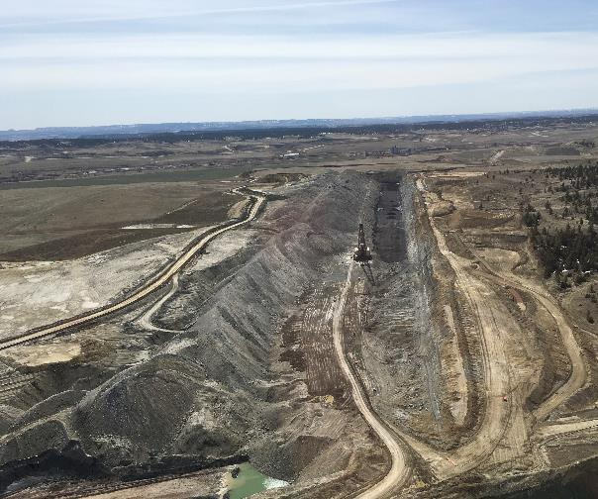
PERSPECTIVE
Something like this?

Slide 4
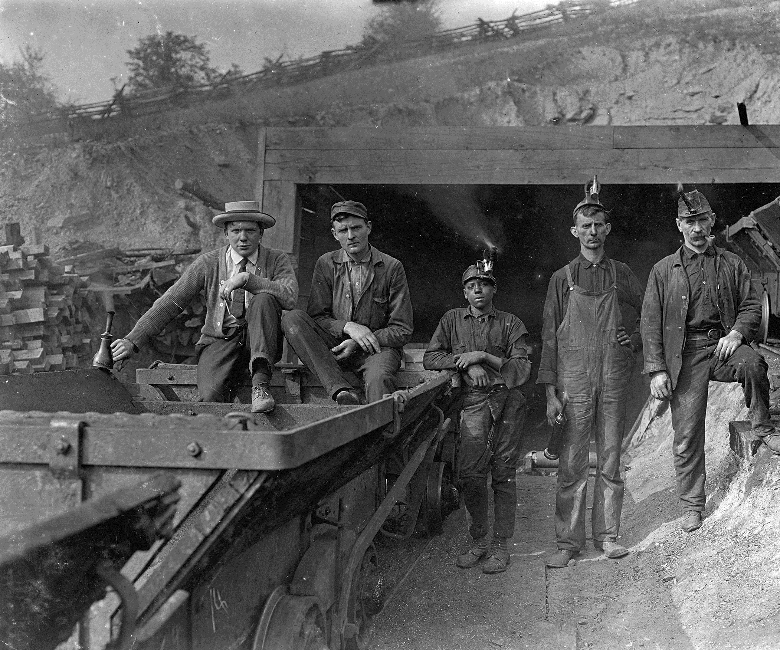
PERSPECTIVE
Or maybe like this?

Slide 5
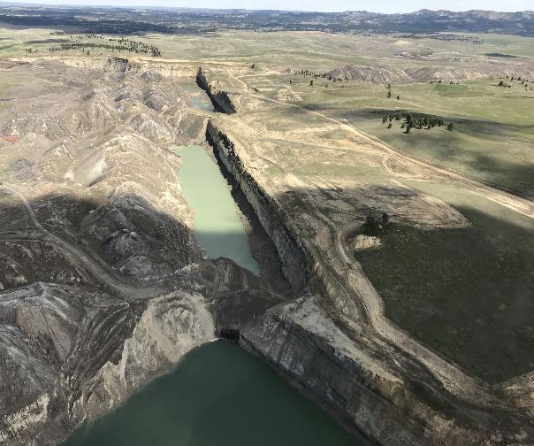
PERSPECTIVE
They actually fill the holes?
Notes:
When I started working with Montana DEQ two years ago, I was surprised to learn how little some of my coworkers in another division knew about coal strip mining and reclamation. At one point during a meeting, several people were surprised to hear that the mines are reclaimed and “the holes are filled”.

Slide 6
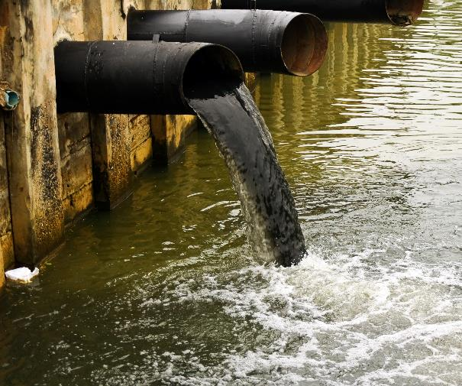
PERSPECTIVE
Outfalls are not all the same…
Notes:
I certainly do not mean to disparage my colleagues with this anecdote, but I think it is important to point out that the permit to mine coal is only one of the permits required by DEQ in Montana. The outfalls that my coworkers are more familiar with are mostly a temporary part of the mine’s life cycle. They can certainly provide useful information, but that data does not tell the story of what water quality looked like pre-disturbance, and then there is always the question of what happens when the mine is gone?

Slide 7

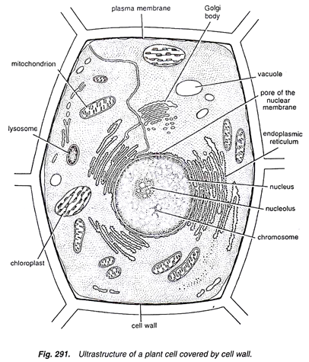
PART OF A BIGGER PICTURE
Notes:
Alone, a plant cell consists of many of the important parts that make the cell work. The bigger picture is how the cells work as part of a larger organism. There are different types of cells which perform very different functions. Some move water and minerals from the roots while others process water, specific portions of the light spectrum and CO₂ creating energy. In a sense this is how permitting should work, cooperatively – seamlessly – efficiently. Then there are bureaucratic realities, DEQ likes to refer to this as working in silos, which lead away from the permitting programs functioning cooperatively.

Slide 8
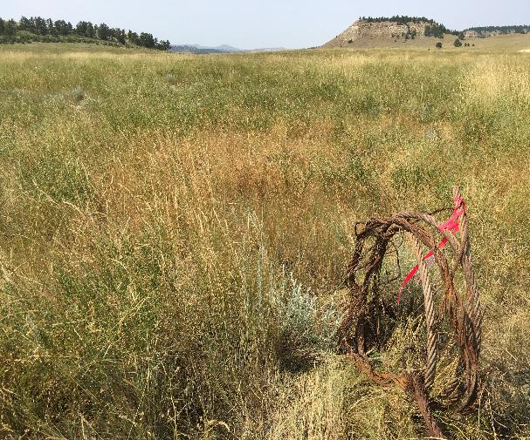
COAL PERMITTING
Surface Mining Control and RECLAMATION Act
Montana Strip and Underground Mine RECLAMATION Act
“… capable of supporting the uses that those lands were capable of supporting prior to any mining or to higher and better uses.”
Notes:
While DEQ regulates coal mining, the other important aspect is reclamation. The title of the Montana Strip and Underground Reclamation Act which forms the basis of our permitting makes this clear. The purpose of reclamation is to support a post-mine landscape which is “… capable of supporting the uses that those lands were capable of supporting prior to supporting prior to any mining or to higher and better uses.”

Slide 9
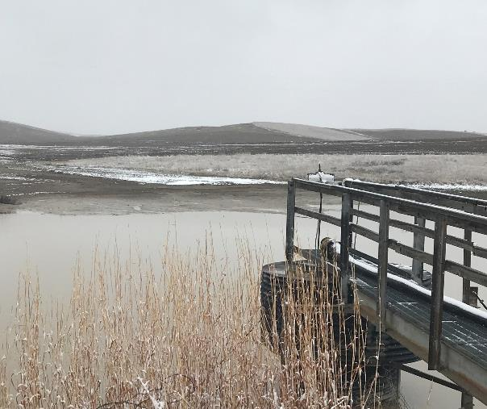
MPDES (NPDES)
Point Source Regulation
Water Quality Protection
Technology-based
Water Quality-based
Notes:
At the same time DEQ also regulates point source discharges at the mines, with the goal of being protective to downstream water quality. These discharges are regulated through MPDES permitting, with effluent limits developed through technology based guidelines and water quality based limits.

Slide 10
PERMITTING
NPDES Permitting
Coal Permitting
Reclamation Plan
Point Source Regulation
PHC Development
Material Damage
  H₂O Quality
  Sediment
  H₂O Quantity
BMP/BTCA
Conventional
Priority
Non-conventional
State Standards
Reflect Operation
Hydrologic Balance
OPERATION
Focus of permitting
RECLAMATION

Slide 11
PERMITTING
NPDES Permitting
Coal Permitting
Reclamation Plan
Point Source Regulation
PHC Development
Material Damage
  H₂O Quality
  Sediment
  H₂O Quantity
BMP/BTCA
Conventional
Priority
Non-conventional
State Standards
Reflect Operation
Hydrologic Balance
OPERATION
Focus of permitting
RECLAMATION

Slide 12
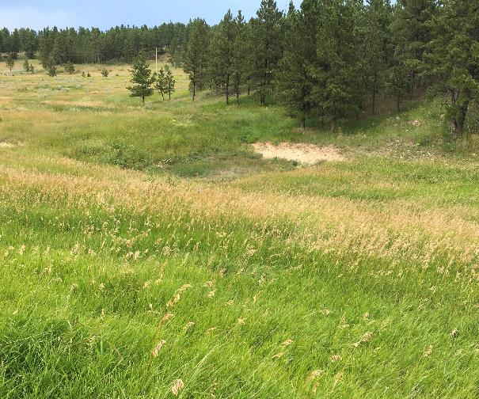
PERMITTING CONFLICT
Effects on Reclamation
Legacy Permitting
Notes:
This creates a bit of permitting conflict, where the permittee could have monitoring requirements up to or beyond mine permit life, or, discharge permitting could delay reclamation.
Important to note that sediment loss, transport and deposition is an important aspect of large area or watershed scale hydrology

Slide 13

RECLAMATION ORIENTED REGULATION?
Yep!

Slide 14
REGULATORY TIMELINE
CWA 1972
WPCA 1972
MT WQA 1974
CWA Am. 1977
ASCM considered 1981
Coal ELGs 1985
ELG revisions 1998
WCMWG 2001
40 CFR 434, H 2002
SMCRA 1977
MSUMRA 1978
ASCM considered 1981
ASCM/BTCA 1985
WA MPDES 2006
WA and MSUMRA 2018
Outfall Removal 2019?

Slide 15
ENVIRONMENTAL BENEFITS
9 Benefits Identified in 2001 development document:
Source Control
Minimizes Disturbance to the Hydrologic Balance
Maintains Natural Sediment Yield
Minimizes Surface Disturbance
Encourages Vegetation
Improves Soil and Promotes Soil Conservation
Addresses Site-Specific Environmental Conditions
Stabilizes Landforms
Minimizes Disruptions to Flow Regime and ET Losses

Slide 16
ENVIRONMENTAL BENEFITS
Source Control
  Top – down watershed approach
  Sediment content equilibrium focus
  Decentralized implementation of BMPs
Minimizes Disturbance to the Hydrologic Balance
Maintains Natural Sediment Yield
Minimizes Surface Disturbance
Encourages Vegetation
Improves Soil and Promotes Soil Conservation
Addresses Site-Specific Environmental Conditions
Stabilizes Landforms
Minimizes Disruptions to Flow Regime and ET Losses
Notes:
A top-down watershed approach to sediment management promotes the use of BMPs to manage the sediment content equilibrium by using site-specific technologies rather than an outfall-based engineered control at the bottom of a drainage.

Slide 17
ENVIRONMENTAL BENEFITS
Source Control
Minimizes Disturbance to the Hydrologic Balance
  Designed to function similarly to premine conditions
  Design reflects hydrologic processes
  Supports postmine land use(s)
Maintains Natural Sediment Yield
Minimizes Surface Disturbance
Encourages Vegetation
Improves Soil and Promotes Soil Conservation
Addresses Site-Specific Environmental Conditions
Stabilizes Landforms
Minimizes Disruptions to Flow Regime and ET Losses
Notes:
Water has the benefit of interacting with the site in a manner which reflects hydrologic processes and supports the post-mine landuse.

Slide 18
ENVIRONMENTAL BENEFITS
Source Control
Minimizes Disturbance to the Hydrologic Balance
Maintains Natural Sediment Yield
  Sediment yield and transport functions
  Prevents exaggerated erosion
  Sediment content equilibrium
Minimizes Surface Disturbance
Encourages Vegetation
Improves Soil and Promotes Soil Conservation
Addresses Site-Specific Environmental Conditions
Stabilizes Landforms
Minimizes Disruptions to Flow Regime and ET Losses
Notes:
Sedimentation happens, blame erosion. Reclamation hydrology has to consider sediment yield and transport in addition to water.
This sediment helps shape channels, develops deposition areas as well as incised areas that support diverse vegetation and wildlife habitat. Likewise, starving water of sediment just means the sediment will be recruited downstream. This can result in off permit headcuts, scour, and exaggerated lateral migration off the permit boundary. There is a site-specific sediment equilibrium that needs to be attained, and this cannot be supported through end of drainage area sedimentation ponds.

Slide 19
ENVIRONMENTAL BENEFITS
Source Control
Minimizes Disturbance to the Hydrologic Balance
Maintains Natural Sediment Yield
Minimizes Surface Disturbance
  Minimizes disturbance footprint for treatment
  Especially true in large drainages
  Does not create a sediment content equilibrium issue
Encourages Vegetation
Improves Soil and Promotes Soil Conservation
Addresses Site-Specific Environmental Conditions
Stabilizes Landforms
Minimizes Disruptions to Flow Regime and ET Losses
Notes:
Particularly true in large catchments, end of drainage sedimentation ponds require an extensive area. As reclamation in a drainage with a sedimentation pond progresses, the pond ultimately is the last piece to be reclaimed, and leaves its own sediment content equilibrium issue. The use of BMPs supports source control, while maintaining a small footprint by comparison.

Slide 20
ENVIRONMENTAL BENEFITS
Source Control
Minimizes Disturbance to the Hydrologic Balance
Maintains Natural Sediment Yield
Minimizes Surface Disturbance
Encourages Vegetation
Promotes infiltration/precipitation retention
Develops microhabitat
Aids diverse vegetation establishment
Improves Soil and Promotes Soil Conservation
Addresses Site-Specific Environmental Conditions
Stabilizes Landforms
Minimizes Disruptions to Flow Regime and ET Losses
Notes:
The use of BMPs encourages infiltration/precipitation retention, development of deposition (aggradation) areas as well as incised features with unique microclimates. BMPs let the landscape behave in a manner which is more consistent with pre-mine conditions, which promotes development of diverse vegetation.

Slide 21
ENVIRONMENTAL BENEFITS
Source Control
Minimizes Disturbance to the Hydrologic Balance
Maintains Natural Sediment Yield
Minimizes Surface Disturbance
Encourages Vegetation
Improves Soil and Promotes Soil Conservation
Nutrient & organic matter poor soils (typ.)
Increased water retention
Improved veg. establishment, biomass, soil biota
Improved surface stability
Addresses Site-Specific Environmental Conditions
Stabilizes Landforms
Minimizes Disruptions to Flow Regime and ET Losses
Notes:
Findings from the Western Coal Mining Work Group show that typical western topsoils are poorly developed, poor in nutrients, and generally low in organic matter. Through the use of BMPs instead of sediment ponds the work group identified increased water retention in upper portions of drainage, improving levels of organic matter, and generally improved the soil. These benefits were also found to promote stability, soil biota content, and improve soil formation processes.

Slide 22
ENVIRONMENTAL BENEFITS
Source Control
Minimizes Disturbance to the Hydrologic Balance
Maintains Natural Sediment Yield
Minimizes Surface Disturbance
Encourages Vegetation
Improves Soil and Promotes Soil Conservation
Addresses Site-Specific Environmental Conditions
Adaptive management
Minimize shock from pond removal
Stabilizes Landforms
Minimizes Disruptions to Flow Regime and ET Losses
Notes:
Implementation of appropriate BMPs leaves operator flexibility to respond as necessary to environmental conditions in kind of an adaptive management feedback loop approach. If an issue is discovered, abatement is localized and requires less disturbance then would be required for an end of contributing drainage sedimentation pond. There is also reduced risk of off permit impacts. Furthermore, the use of BMPs largely avoid shock attributed to removal of water (and sediment) impounding structures like ponds and traps.

Slide 23
ENVIRONMENTAL BENEFITS
Source Control
Minimizes Disturbance to the Hydrologic Balance
Maintains Natural Sediment Yield
Minimizes Surface Disturbance
Encourages Vegetation
Improves Soil and Promotes Soil Conservation
Addresses Site-Specific Environmental Conditions
Stabilizes Landforms
Promotes infiltration
Promotes vegetation establishment
Improves channel stability
Minimizes Disruptions to Flow Regime and ET Losses
Notes:
Most of the environmental benefits identified in the Western Alkaline subcategory development document focused on infiltration, increased vegetation, and improved channel stability. The idea of landscape stability is pretty site specific however. The landscape of eastern Montana is quite variable, some of the mines feature sandstone outcrops, badlands-type erosive features, and some were very flat pre-mine. We push for operators to consider the landscape context, and our rules state that the postmining must approximate the premining natural slopes. Soil physical/chemical properties, slope, aspect, accumulation/storage/duration/intensity of precipitation, vegetative cover, and landuse are important variables in landscape stability.

Slide 24
ENVIRONMENTAL BENEFITS
Source Control
Minimizes Disturbance to the Hydrologic Balance
Maintains Natural Sediment Yield
Minimizes Surface Disturbance
Encourages Vegetation
Improves Soil and Promotes Soil Conservation
Addresses Site-Specific Environmental Conditions
Stabilizes Landforms
Minimizes Disruptions to Flow Regime and ET Losses
Reduces impact to downstream water uses
Aids establishment of riparian/wetland vegetation
Reflects premine flow regime
Notes:
Sedimentation ponds offer an effective treatment methodology for wastewater during active mining. The majority of the sediment settles out during treatment along with some other pollutants of concern, and they work with changing upstream conditions. They also disrupt the surface flow regime, particularly in drier parts of the country. Evaporation/evapotranspiration losses in arid and semi-arid regions can often outweigh precipitation rates, and these effects are pronounced in shallow sedimentation ponds and traps. This can be a concern for downstream water users, establishment of riparian and wetland vegetation, and wildlife. Utilizing BMPs during reclamation ameliorates most of these concerns through establishing a flow regime that reflects the premine conditions, and encourages alluvial storage and transport in ephemeral drainages, conserving downstream water resources.

Slide 25
ENVIRONMENTAL BENEFITS

Slide 26
Sounds great. How do you tell if it fits?

Slide 27
WHAT QUALIFIES FOR A WESTERN ALKALINE OUTFALL?
40 CFR 434.81 Applicability
(a) This subpart applies to alkaline mine drainage at western coal mining operations from reclamation areas, brushing and grubbing areas, topsoil stockpiling areas, and regraded areas.
(b) This subpart applies to drainage at western coal mining operations from reclamation areas, brushing and grubbing areas, topsoil stockpiling areas, and regraded areas where the discharge, before any treatment, meets all the following requirements:
  (1) pH is equal to or greater than 6.0;
  (2) Dissolved iron concentration is less than 10 mg/L; and
  (3) Net alkalinity is greater than zero.
(c) The effluent limitations in this subpart apply until the appropriate SMCRA authority has authorized bond release.

Slide 28
WHAT QUALIFIES FOR A WESTERN ALKALINE OUTFALL?
40 CFR 434.81 Applicability
(a) This subpart applies to alkaline mine drainage at western coal mining operations from reclamation areas, brushing and grubbing areas, topsoil stockpiling areas, and regraded areas.
(b) This subpart applies to drainage at western coal mining operations from reclamation areas, brushing and grubbing areas, topsoil stockpiling areas, and regraded areas where the discharge, before any treatment, meets all the following requirements:
  (1) pH is equal to or greater than 6.0;
  (2) Dissolved iron concentration is less than 10 mg/L; and
  (3) Net alkalinity is greater than zero.
(c) The effluent limitations in this subpart apply until the appropriate SMCRA authority has authorized bond release.

Slide 29
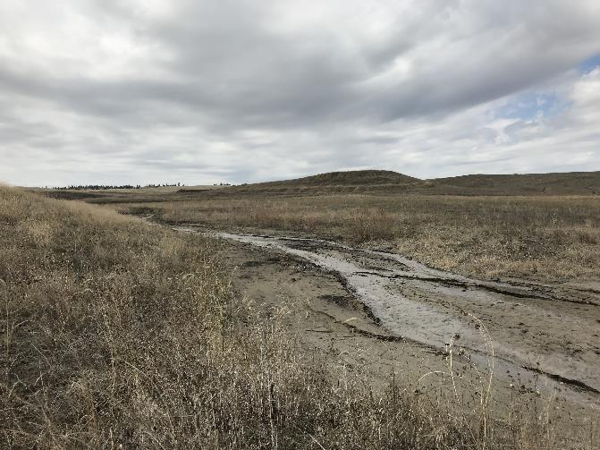
IMPLEMENTATION
Observations:
Inconsistently applied
Compliance coordination
Regraded spoil, is still spoil
High runoff coefficient
High sediment load
Clunky w/permanent ponds
Lacking clarity for operators and regulators
Not always a smooth transition

Slide 30
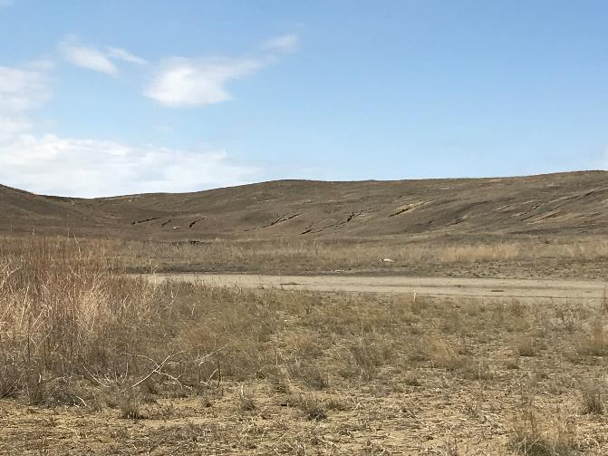
IMPLEMENTATION
Opportunities:
Established vegetation/BMPs
Encompassing entire drainage
Relate to bond release phasing
Streamline WA conversion

Slide 31
RECLAMATION REQUIREMENTS

Slide 32
BONDING
Bond Issued
Permit Issued
≥ Cost of reclamation
Relative to disturbance
Phase I
Phase II
Surety adjustments:
60% Phase I
Relative, Phase II, III
Phase III
Phase IV
Released
MCA 82-4-223, 82-4-232, 82-4-235
How does it work?

Slide 33
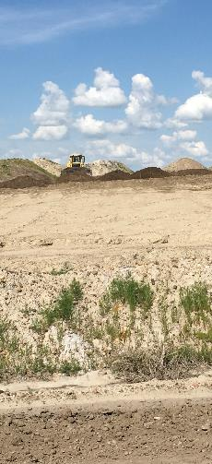
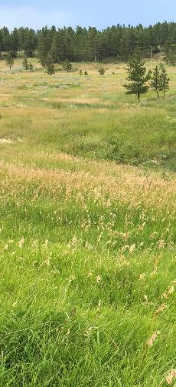
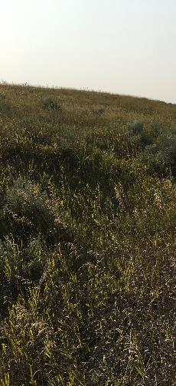
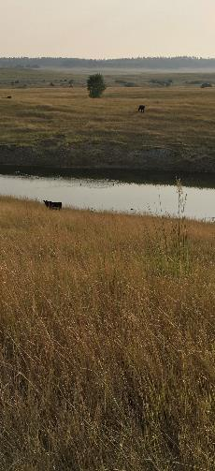
RECLAMATION PHASES

Slide 34
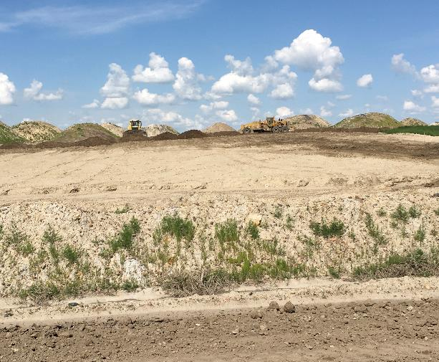
Phase I Bond Release
Mined areas are backfilled and graded to an approved post-mine topography (PMT).
Drainage control in the PMT is an integral part of an approved reclamation plan.
Notes:
Offsite water discharges are regulated by the facility MPDES permit and MSUMRA requirements. PMT does not include streams to nowhere, or convex drainage profiles among other requirements.

Slide 35
Phase II Bond Release
Soil replacement and seeding have been completed.
Two growing seasons (minimum) have elapsed, demonstrating the area:
meets revegetation regulations
soil is protected from accelerated erosion
control of noxious weeds
Notes:
Important to note that sediment loss, transport and deposition is an important aspect of large area or watershed scale hydrology

Slide 36
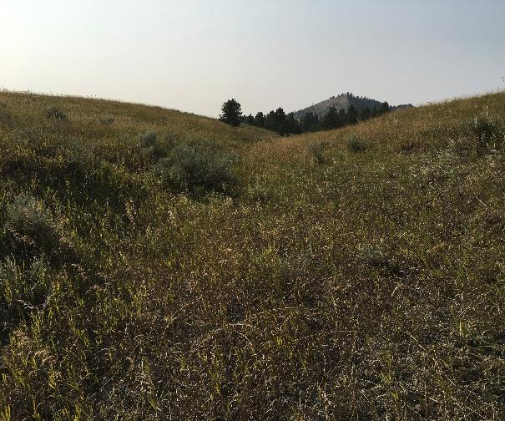
Phase III Bond Release
A responsibility period (10 years) has passed since phase II release, demonstrating:
The drainage basin is stable consistent with an approved post-mine land-use
Lands are not contributing sediment in excess of pre-mine yields
Permanent ponds include a mgmt. plan
OR MCA 82-4-235(4)(a) applies to the lands
Notes:
MCA 82-4-235(4)(a) is applicable to disturbance prior to May 2, 1978 (but after 1973 to the best of my understanding)

Slide 37
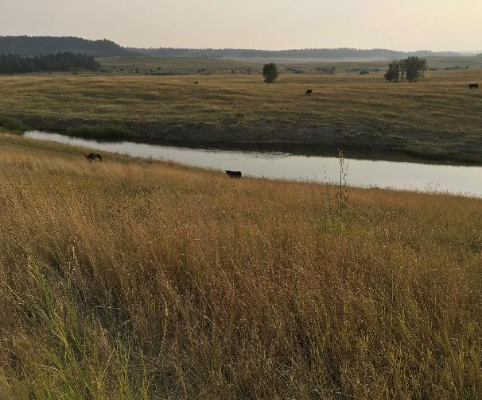
Phase IV (FINAL) Bond Release
Phase IV Bond Requires:
Ph. III release in the whole drainage basin
Fish & wildlife value has been reclaimed
Disturbance to the hydrologic balance has been minimized and off-site material damage prevented
Water supplies adversely affected have been replaced
AVF hydrologic function and productivity has been re-established
Notes:
Important to note that sediment loss, transport and deposition is an important aspect of large area or watershed scale hydrology

Slide 38
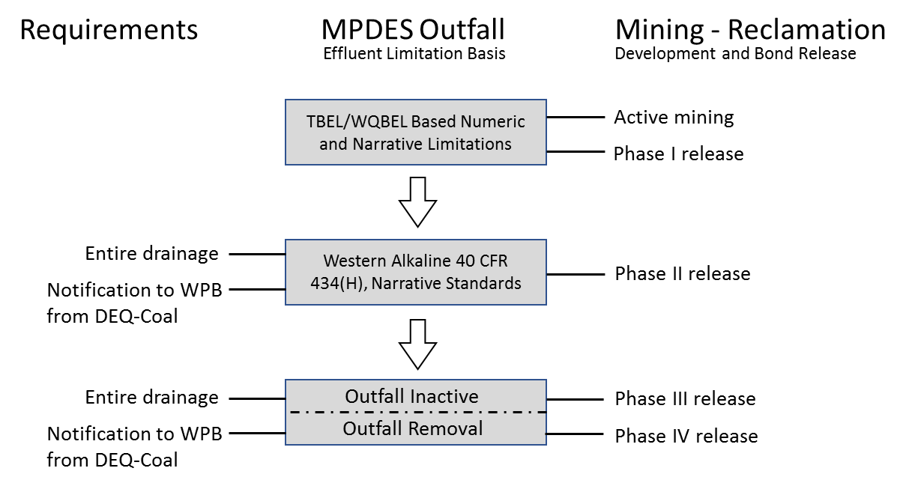
BRIDGING THE GAP
Notes:
Important to note that sediment loss, transport and deposition is an important aspect of large area or watershed scale hydrology

Slide 39
CONCLUSIONS
Look for opportunities to link regulation
Development documents are invaluable
Try to anticipate your hurdles
Learn from the mistakes, don’t repeat
Communication is everything

Slide 40
QUESTIONS, COMMENTS, THOUGHTS?
Jon Staldine
Env. Science Specialist
MT DEQ Coal Section
jon.staldine@mt.gov
444-2885

