Slide 1
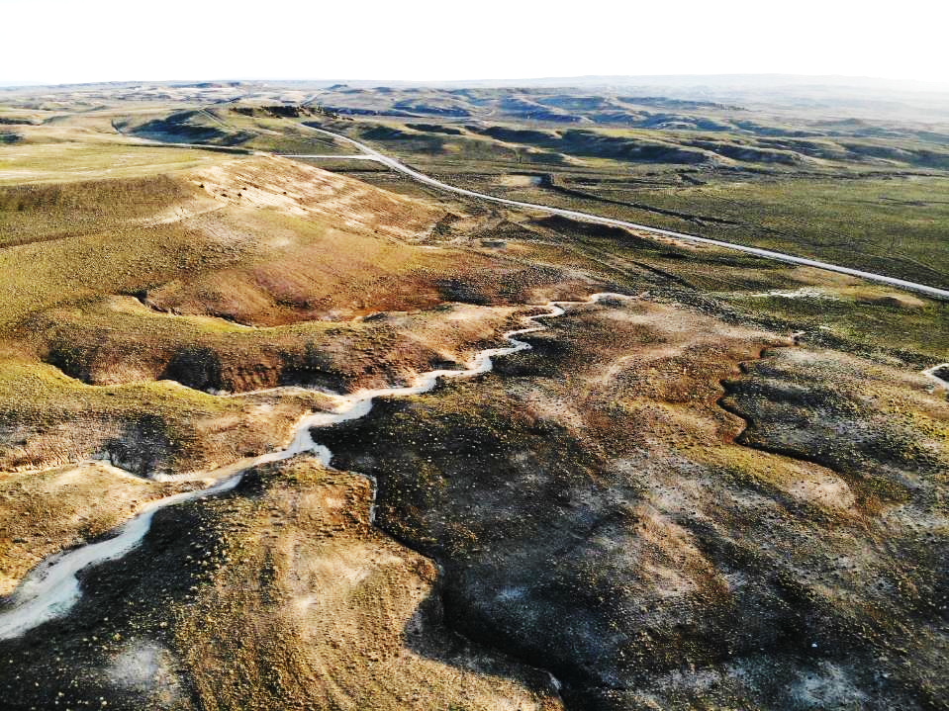
Assessing physiographic controls on snow accumulation and vegetation cover in mineland reclamation using airborne LIDAR and high-resolution imagery
Edward A. Gage, Kurt R. Fleisher, and Kristina M. Hufford
Department of Ecosystem Science and Management
University of Wyoming
Notes:
Physiographic variables drive landscape differences in pedogenic and ecological development in both natural and reclaimed landscapes by affecting the basic energy balance of sites. Simple variables like slope and aspect, as well as more integrative metrics derived from elevation data such as solar insolation can provide insights into hydrologic and ecological function important for successional development and reclamation performance. This analysis quantifies physiographic characteristics of mineland reclamation sites in central Wyoming³ using digital elevation models derived from airborne lidar, comparing landscapes reclaimed using traditional and geomorphic reclamation techniques and relatively undisturbed landscapes. We quantify landscape heterogeneity, as driven by reclamation technique, and evaluate the consequences of physiographic differences on snow accumulation and post-reclamation vegetation cover as derived from analyses of high-resolution satellite imagery. Supervised image classification and machine learning algorithms are used to derive snow and vegetation cover data. These are then statistically compared between reclamation treatments, undisturbed controls and field measurements of vegetation cover and functional type. Results provide inferences on post-reclamation ecological trajectories. More than a decade after reclamation, we found clear differences in treatments that were influenced by differences in landscape physiography and heterogeneity.

Slide 2
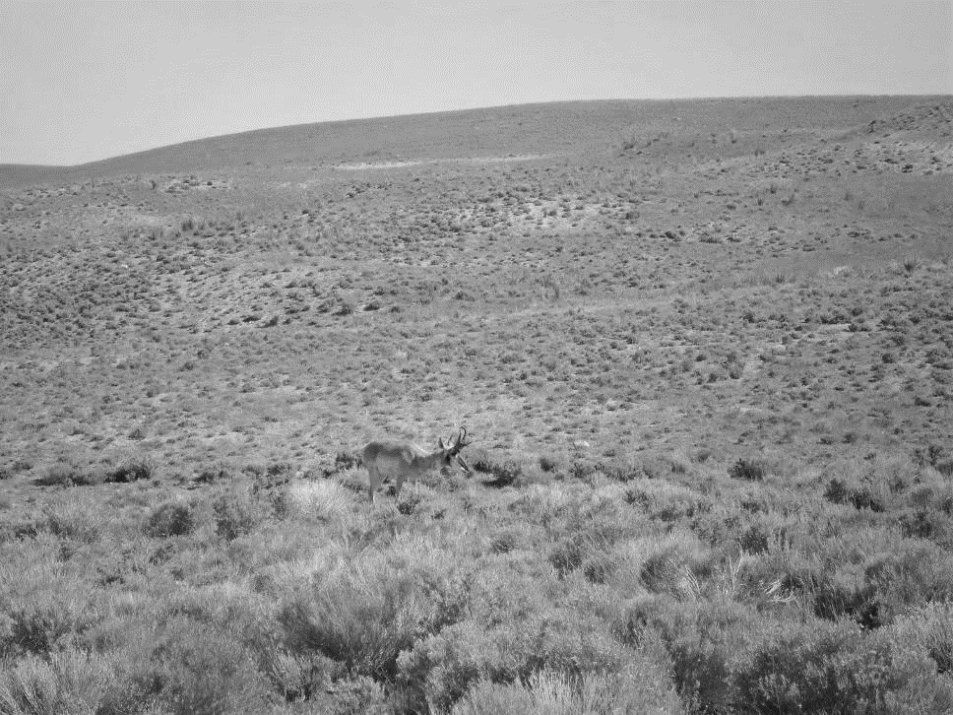
Background
Surface mining widespread in Wyoming
>90,000 acres disturbed
>285,000 acres permitted
Represents a severe land disturbance
Loss of public utility and pollution issues
Habitat loss and fragmentation
Challenging to reclaim
WY AML has been actively working to reclaim many of these areas using two basic approaches: “Traditional” and “Geomorphic”
What methods work best (and why)?

Slide 3
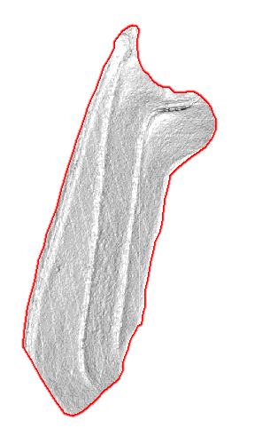
Traditional
Reclamation Practices
Geomorphic
landform homogeneity
uniform linear slopes
susceptible to erosion
benches or terraces
landform heterogeneity
slope-aspect variety
create erosional stability
provide aesthetic value
50
slope (degrees)
0
Carlson Natural RegradeTM
Notes:
traditional methods create:
In contrast Geo methods create:
These figures show variation in slope between the two methods

Slide 4
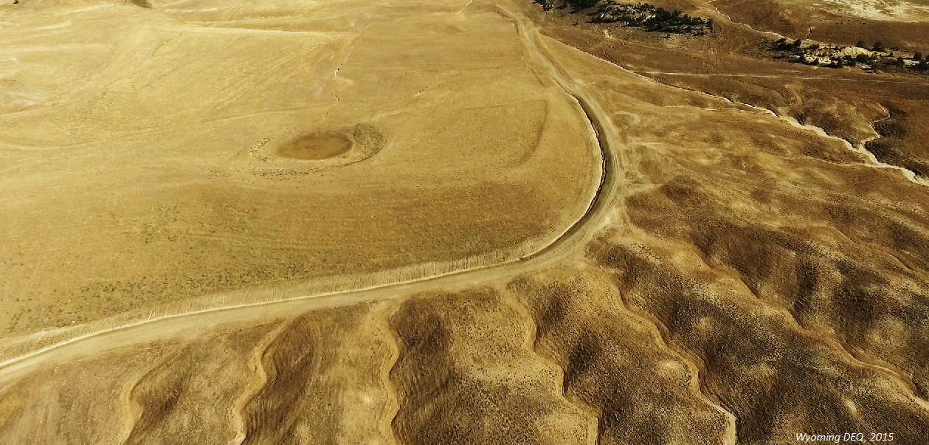
Traditional
Geomorphic
Notes:
Drone flight of reclamation treatments, seen in the figures on the last slide
Traditional rec on the left and panning to geomorphic
Notice the differences in topography seen between the two methods

Slide 5
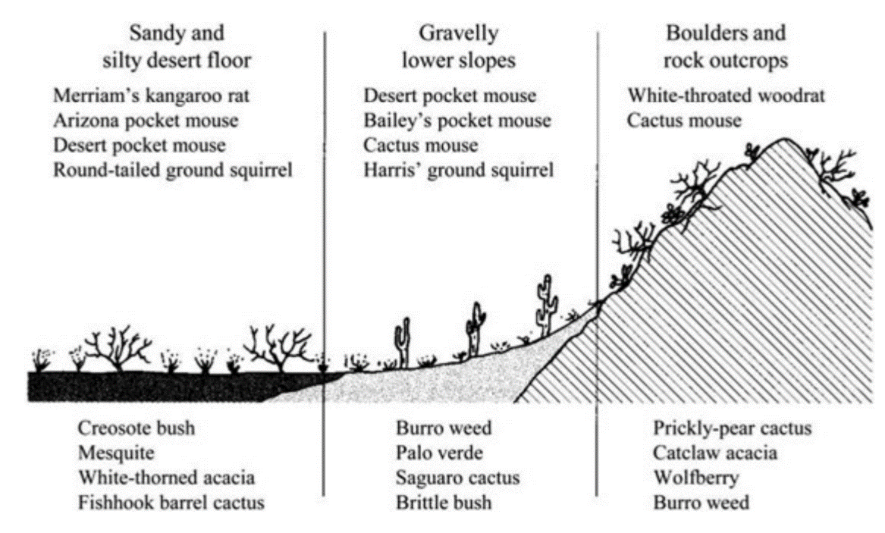
Distribution of biota is not random…
Hugget, R. J. 2004. Fundamentals of biogeography. 2nd edition. Routledge, London

Slide 6
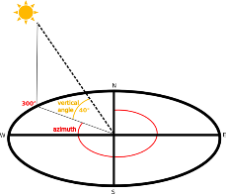
Physiography key to site functioning
Terrain affects physical environment…
Soil development
Energy balance and insolation
Water balance
Terrain affects ecological processes
Vegetation community composition
Successional trajectories
Terrain may affect reclamation performance…

Slide 7
Topographic heterogeneity creates environmental heterogeneity
Aspect a key control
Correlation between topographic heterogeneity and plant diversity
Heterogeneity results in more niche space, thus more diversity
Vegetation diversity linked to increased resilience and resistance
Can contribute to greater ecosystem resiliency
Notes:
What are the important implications of topographic heterogeneity?
Heterogeneity linked to plant species diversity
Based on simple principle, more environmental heterogeneity result in more niche space, thus more diversity
Vegetation diversity is correlated with increased resilience and resistance, leading to a more autonomous ecosystem
When we restore a landscape we want to restore natural trajectories towards native autonomous ecosystems

Slide 8
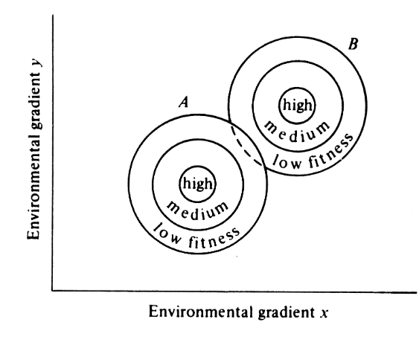
“The riches are in the niches”
Hutchison's n-dimensional hypervolume

Slide 9
Research questions
How does physiography differ between areas reclaimed using traditional and geomorphic reclamation techniques and reference landscapes?
Do physical and ecological heterogeneity differ in response to reclamation technique?
Do patterns of snow cover visible in remote sensing and post-reclamation vegetation cover

Slide 10
Study objectives
Quantify physiographic characteristics of reclamation sites
Compare terrain in landscapes reclaimed using traditional and geomorphic techniques and undisturbed landscapes
Develop flexible sampling approaches for multiple assessment goals
Evaluate the consequences of physiographic differences on snow accumulation and post-reclamation vegetation cover as derived from analyses of satellite imagery

Slide 11
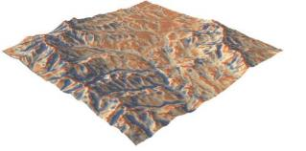
Assessing terrain
Digital elevation data
NED
LiDAR
Structure from Motion (SfM)
Derived elevation models can be used to assess:
Simple variables: e.g., slope
Integrative indices
Notes:
Can provide insights into hydrologic and ecological function important for successional development and reclamation performance

Slide 12
Terrain indices
TRI (Terrain Ruggedness Index): mean of the absolute differences between the value of a cell and the value of its 8 surrounding cells
TPI (Topographic Position Index): difference between the value of a cell and the mean value of its 8 surrounding cells
Roughness: difference between the maximum and the minimum value of a cell and its 8 surrounding cells
Heat load index (HLI): "folds" aspect so that the highest values are southwest and the lowest values are northeast HLI values range from 0 (coolest) to 1 (hottest)
Curvature: second derivative of the surface. Positive curvature indicates the upwardly convex surface; negative indicates upwardly concave at that cell. A value of 0 indicates the surface is flat

Slide 13
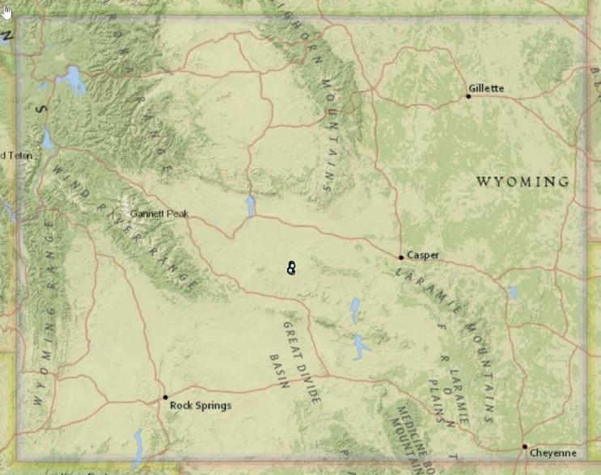
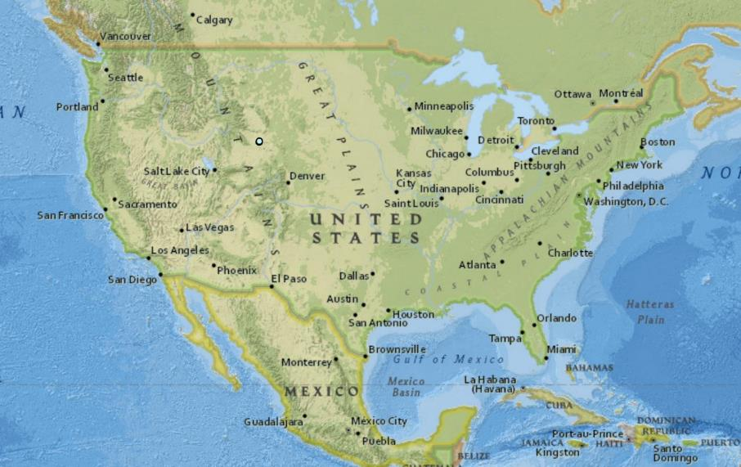
Study areas

Slide 14
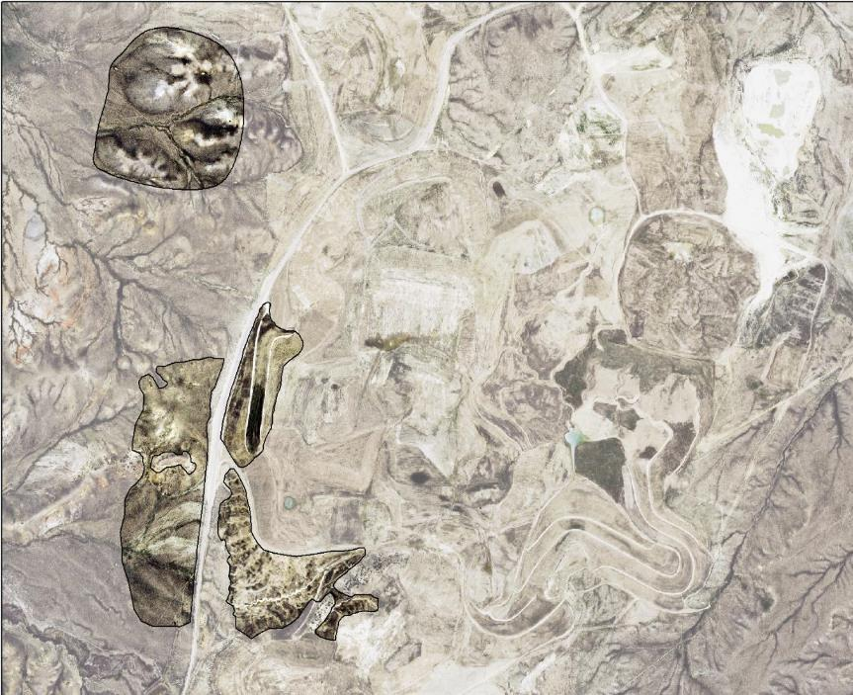
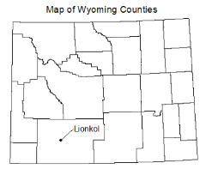
Gas Hills Central Spoils (AML Project 16N)
U
T
U
Former uranium mine
AML project
G
Notes:
To answer these questions, we conducted field surveys at two reclaimed surface mines
First is called GH the sites pictured here were part of the drone flight seen previously
U, G, T correspond to und, geo, and trad Elevation 6500 ft, precipitation 12 inches, growing season 125 daysSagebrush steppe dominated by Wyoming big sagebrush and perennial grasses

Slide 15
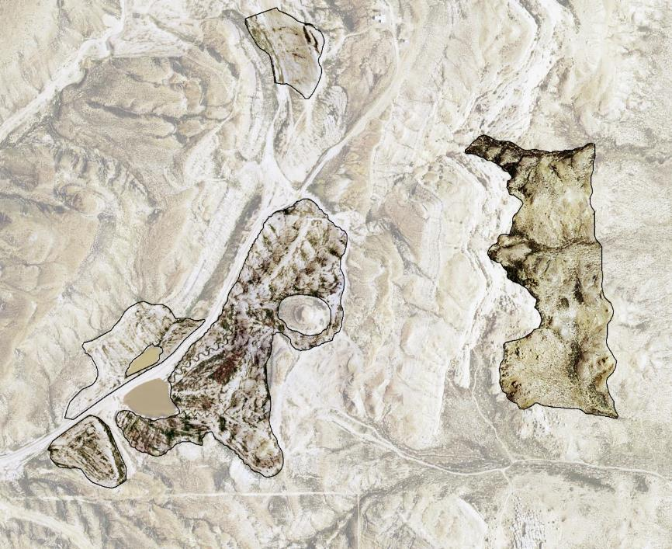
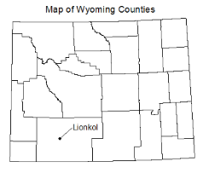
Lionkol (AML Project 17H)
T
U
G
T
Former coal mine
AML project
T
Notes:
Second is called Lionkol
Here we have an Undisturbed control, geo, and three separate traditional treatments
Elevation 7000 ft, precipitation 9 inches, growing season 125 days
High desert shrubland dominated by basin big sagebrush and perennial grasses

Slide 16
Day Loma (chronosequence)
Day Loma
(chronosequence)

Slide 17
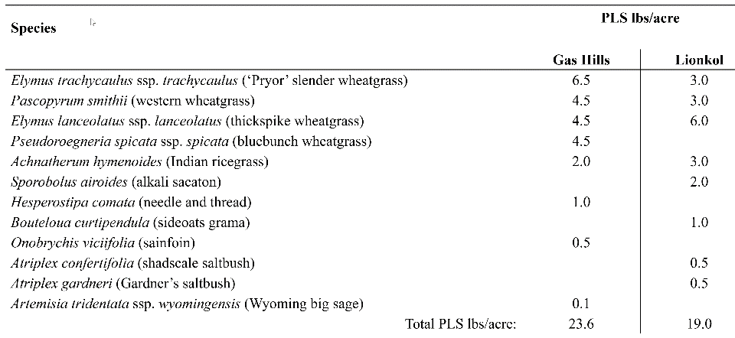
Reclamation seed mixes
Notes:
Here are the reclamation seed mixes for GH and Lionkol
seed mixes are identical within site for reclamation methods, but different between sites
Native seed mix dominated by perennial grasses
Shrubs seeded at both sites, but Wyoming big sagebrush, an important species for wildlife was only seeded at GH
seed mix is a product of limitations in a realistic world, seed is expensive and unavailable in large quantity for some species
All native except one introduced forb

Slide 18
Spatial sampling design
Created spatially balanced sampling of study area polygons using GRTS algorithm
Flexible design: can be used to sample variety of resources
Each sample point represents roughly the same proportion of the total study area
Extracted pixel values to points
Buffered points to 100m² and extracted zonal statistics for different explanatory layers in GIS

Slide 20
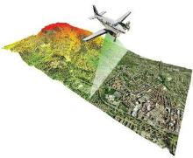
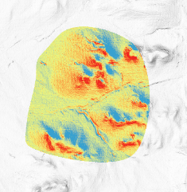
Terrain analysis
Source data: LAS airborne LiDAR point cloud data from 2015
Used to derive DEM
Functions in R and ArcGIS Pro used to calculate:
Slope and aspect
Heat Load Index (HLI)
Topographic Position Index (TPI)
Topographic Wetness Index (TWI)
Topographic Roughness
Slope curvature (McNab)

Slide 21
Multivariate terrain analyses
Goal:
Identify similar physiographic settings across study sites
Distill terrain complexity
Approach:
Input variables: LiDAR-derived terrain variables
Analytical methods:
Hierarchical cluster analysis
Principal Component Analysis (PCA)

Slide 22
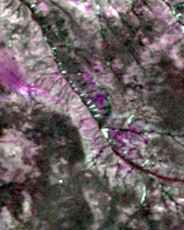
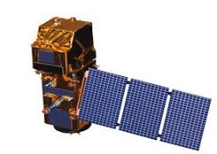
Data: snow cover analysis
RapidEye
5 m resolution
5 spectral bands
Sentinel 2
10 to 20m spatial resolution (band dependent)
Multi-spectral data with 13 bands in the visible, near infrared, and short wave infrared part of the spectrum

Slide 23
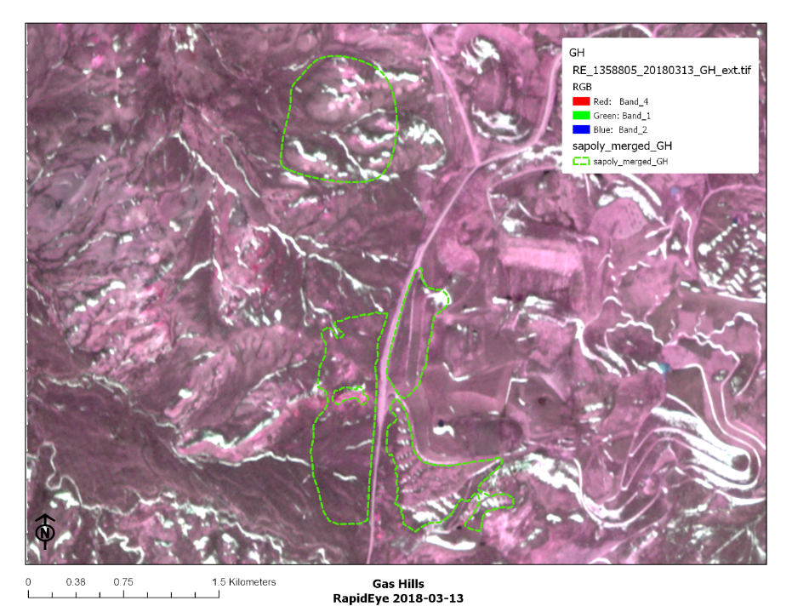
Motivation
Geomorphic and traditional reclamation produce sites with distinct physiography.
What are the consequences for mineland reclamation?
How do physiographic characteristics, as shaped by reclamation treatment, influence snow cover and persistence?
How do physiographic characteristics influence vegetation cover and composition?

Slide 24
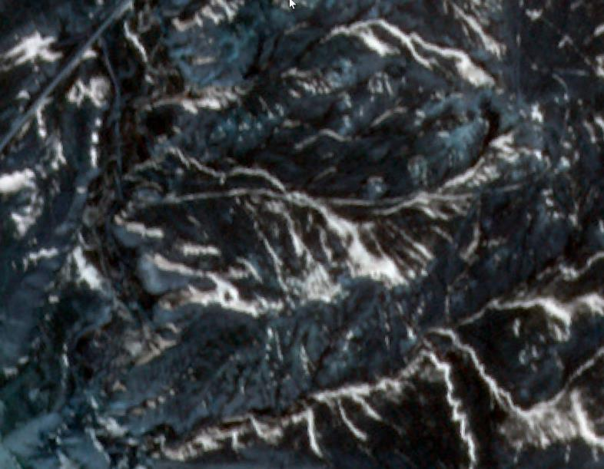

Slide 25
Data: vegetation cover
Sentinel 2 and Landsat
10-30m pixel size
Collection frequency: various
Response: NDVI
NAIP (1m pixel size)
Collected: 2015 (1x), 2017 (1x)
Collection frequency: various
UAS (<1in pixel size)
Inspire 2 UAS
Pix4D for flight planning and post processing
Notes:
Course spatial scale – high temporal resolution data
30m spatial resolution
8 spectral bands
Surface Reflectance (SR)

Slide 26
Analysis: vegetation
Image processing: pixel-based approach
Development of training (ground-truthed dataset)
Thresholding
Error analysis (e.g., confusion matrix)
Image processing: object oriented approach
Segmentation
Development of training/testing set - segment based
Classification of image segments
Error analysis (e.g., confusion matrix)

Slide 27
Raw UAS image

Slide 28
Segmented image

Slide 29
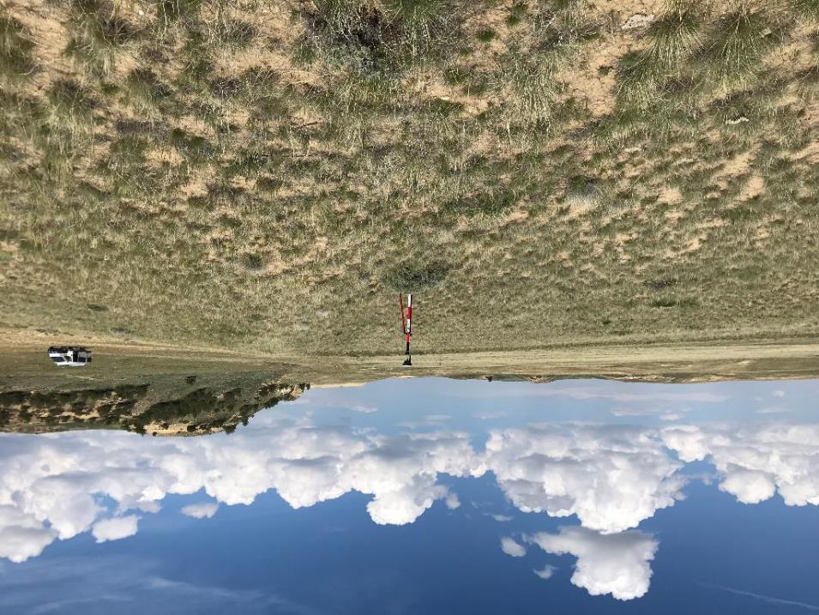
Results

Slide 30
Aspect

Slide 31
Topographic Position Index

Slide 32
Hierarchical Slope Position

Slide 33
Topographic Roughness

Slide 34
Heat Load Index (HLI)
McCune & Keon (2002)
Notes:
McCune & Keon (2002) Heat Load Index

Slide 35
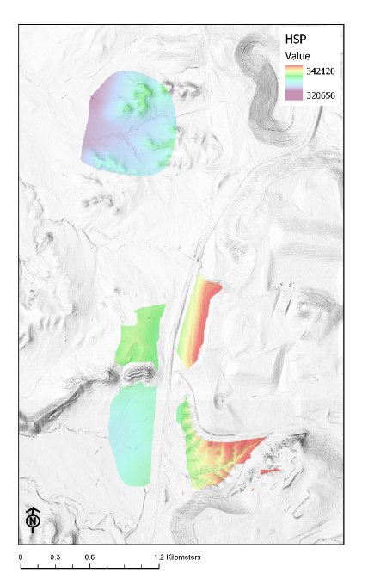
HLI
HSP

Slide 36
Curvature
Negative values in the profile curvature indicate the surface is upwardly convex Positive values indicate that the surface is upwardly concave
Notes:
The planform and profile curvatures are the second derivative(s) of the elevation surface, or the slope of the slope. Profile curvature is in the direction of the maximum slope, and the planform curvature is perpendicular to the direction of the maximum slope. Negative values in the profile curvature indicate the surface is upwardly convex whereas, positive values indicate that the surface is upwardly concave. Positive values in the planform curvature indicate an that the surface is laterally convex whereas, negative values indicate that the surface is laterally concave. Total curvature is the sigma of the profile and planform curvatures. A value of 0 in profile, planform or total curvature, indicates the surface is flat. The planform, profile and total curvatures are derived using Zevenbergen & Thorne (1987) via a quadratic equation fit to eight neighbors as such, the s (focal window size) argument is ignored.
McNab's and Bolstad's variants of the surface curvature (concavity/convexity) index (McNab 1993; Bolstad & Lillesand 1992; McNab 1989). The index is based on features that confine the view from the center of a 3x3 window. In the Bolstad equation, edge correction is addressed by dividing by the radius distance to the outermost cell (36.2m).

Slide 37
PCA of terrain attributes

Slide 38
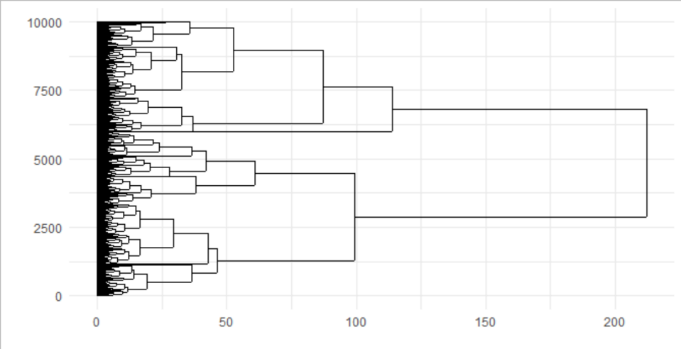
Cluster analysis

Slide 39
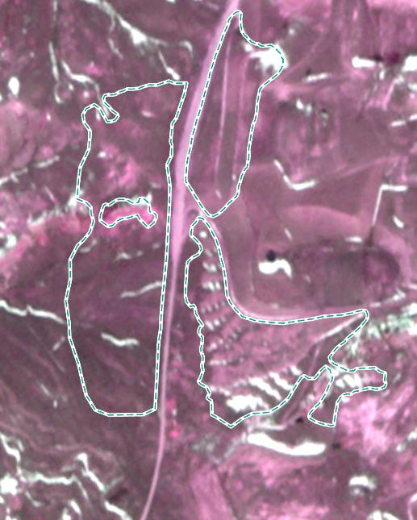
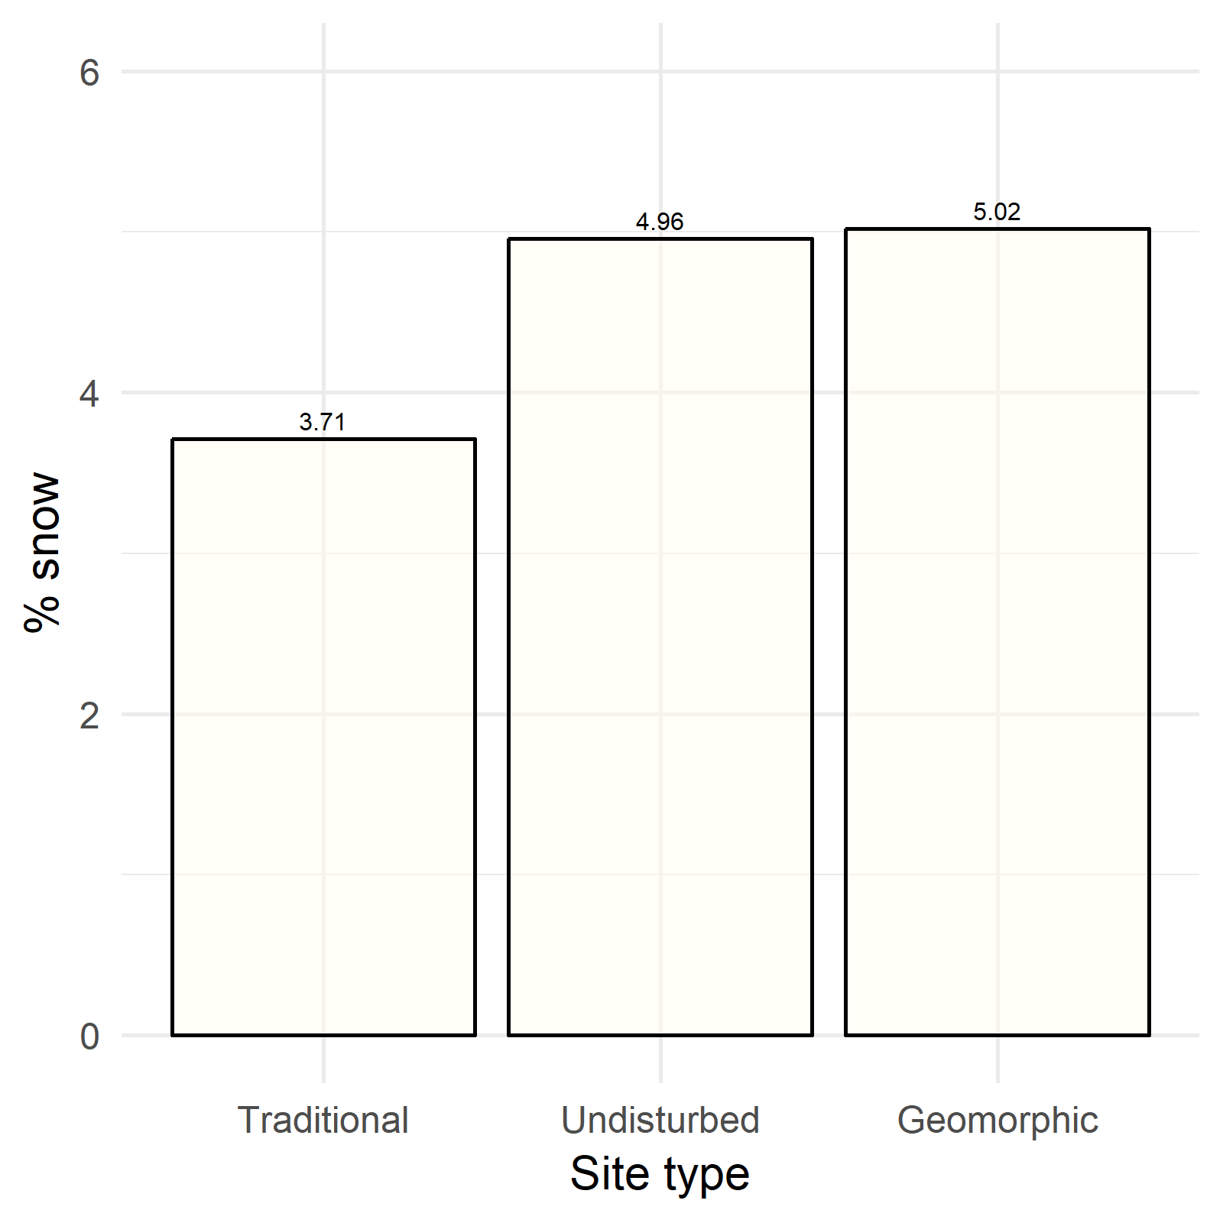
Snow cover: RapidEye 2018-03-13

Slide 40
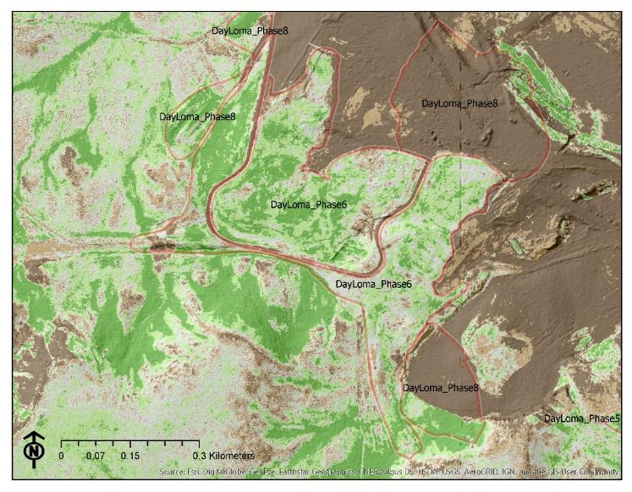
NAIP 2017: NDVI

Slide 41
Vegetation: NDVI

Slide 42
Discussion
Approach can provide useful inferences for evaluating post-reclamation ecological trajectories
Field data indicate that 10+ years after reclamation, there are clear differences between treatments in vegetation
Physiographic characteristics are important drivers of differences in physical and ecological environment

Slide 43
Ongoing/future analyses
Acquire and process UAS along chronosequence of geomorphic reclamation sites (Day Loma)
Assess vegetation cover by functional type from UAS imagery
Develop SfM-derived canopy height models to assess vegetation structure
Compare vegetation data from field assessments to estimates derived from remote sensing data
Use GRTS sampling design to guide sampling of wind born sediment

Slide 44
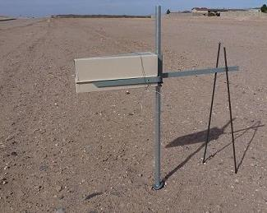
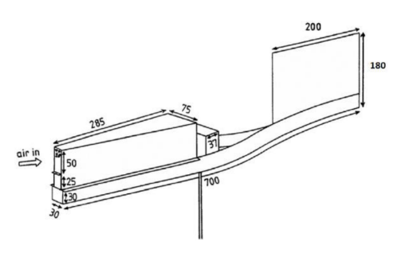
Erosion
BSNE samples
Marble dust collectors (MDC)

Slide 45
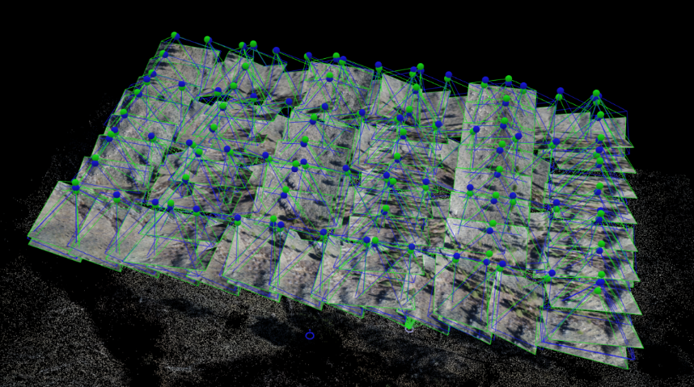
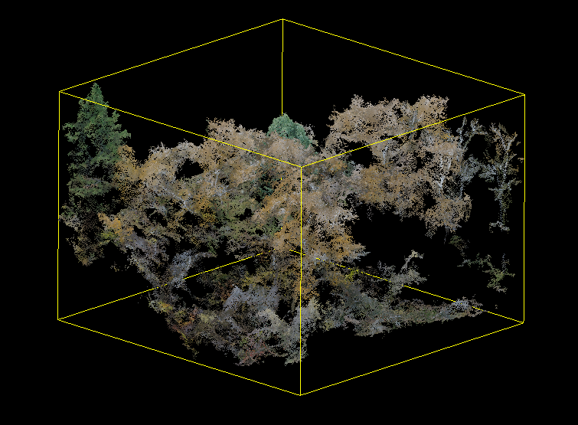
Canopy height model

Slide 46
Implications
Results support idea that different post-reclamation ecological trajectories for methods
More than a decade after reclamation, we found clear differences in treatments
Influenced by differences in landscape physiography and heterogeneity
Diversity of landscape facets may contribute to greater ecological diversity and improved habitat

Slide 47
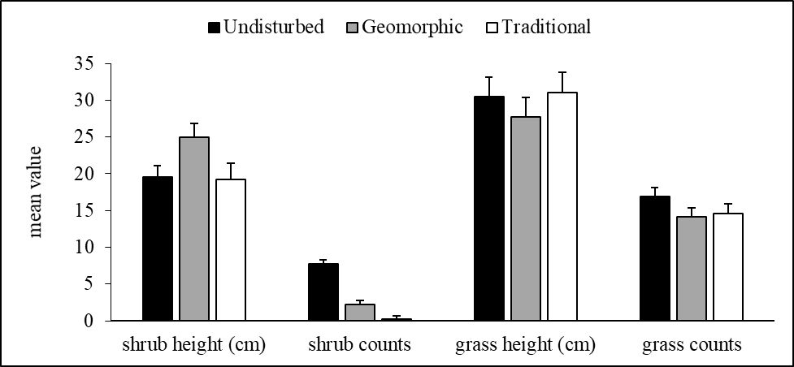
Implications for habitat quality
Shrub height requirements
Connelly et al. 2000
Notes:
One of the major findings of this study is that geomorphic methods at GAS HILLS, combined with active sagebrush seeding practices NOT ONLY resulted in greater sagebrush abundance but also greater sagebrush height
On these figures are sage grouse habitat requirements, and we see that geomorphic methods have the potential to meet these requirements much more so than traditional methods
Sage grouse habitat is important to restore because this species is on the cusp of becoming listed as a federally endangered species
The potential for listing has huge implications of the energy industry, where listing sage grouse as an endangered species would result in legislation changes
In addition, sagebrush presence is linked to lower invasibility by introduced species

Slide 48
Caveats: limitations of remote sensing
Analyst can only see what the sensor sees
Spatial resolution
Spectral resolution
Temporal resolution
Seasonality of acquisition key
Spectral properties of vegetation
Phenological changes in vegetation
Limitations for assessing composition

Slide 49
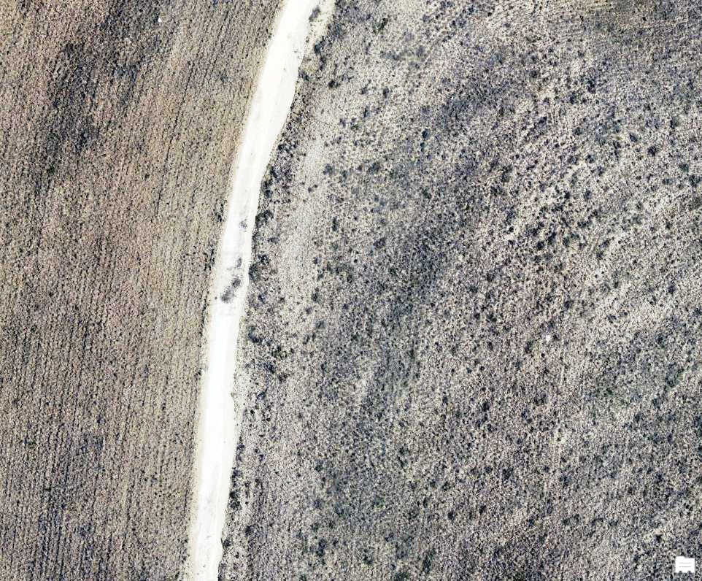
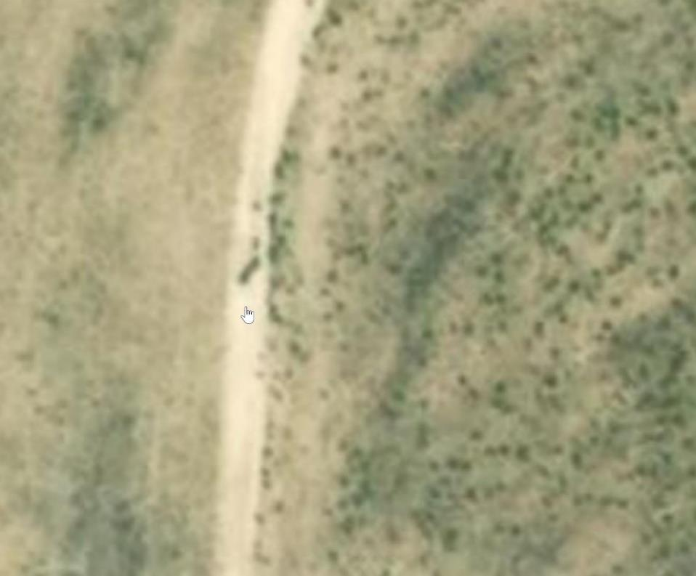
UAS imagery

Slide 50
Conclusions
Geomorphic and traditional reclamation approaches produce landscapes with distinct physiographic characteristics
Geomorphic reclamation produces greater terrain variability…
Leads to greater environmental heterogeneity
Leads to greater biotic diversity*
May contribute to greater ecological resiliency
May lead to better performance
Notes:
protecting biodiversity in a changing climate is to protect the diversity of the geophysical landscape that influences patterns of biodiversity. Species distributions, communities, ecosystems, and broader patterns of biodiversity are influenced by landscape characteristics such as soils, geology, topography, and climate. Although climates will change relatively rapidly over the coming century, soils, geology, and topography will not. By protecting a diversity of geophysical landscape components (referred to here as land facets), it may be possible to protect areas that will foster a diversity of biota in the future —albeit different biota than those areas harbor today.

Slide 51
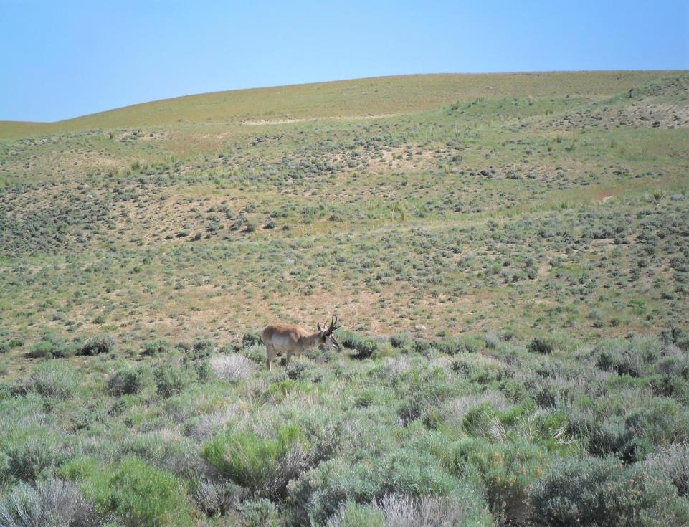
Acknowledgements
Hutson, Harold
Bautz, Melissa
Schumann, Gerald
Schumann, Gerald
Locke, Bill
Vance, George
Vaughan, Karen
Gary Gavin
Questions?
American Society of Mining & Reclamation
Notes:
I’d like to thank first and foremost Kristina Hufford, YOUR diligence and guidance was invaluable.
Thanks to my committee for meeting and reading my entire thesis
A huge thanks to Ernie Nelson of the Rocky Mountain Herbarium, who helped ID species
Josh and John provided their statistical guidance and wisdom
Thanks to Melissa (BLM) and Harold (BRS) who helped in project planning and site access
Thanks to all of the folks providing mental and physical support in fieldwork, Kayla, Amanda, Taylor, and Colin
I want to thank the team who helped with the grant and project planning (Karen, Pete, George Vance, Jerry Schumann, Kristina)
Lastly, a big to the Wyoming DEQ who provided funding for this research.

