Slide 1
Geomorphic Reclamation: Economic and Risk anaysis
Roger Coupal, Professor
Karsyn Lamb, Research Associate
Agricultural and Applied Economics
University of Wyoming
Presented at the ASMR 2019 Conference in Big Sky, Montana
DEQ Contract, Thanks to BRS Consulting and Melissa Bautz, WY DEQ Abandoned Mine Lands steering committee

Slide 2
Objective
Evaluate the economics of innovation in reclamation development: Geomorphic Reclamation techniques compared to traditional methods
Perceived need for economic values of the results of reclamation beyond jobs and income generated (some of my first forays into this area).
Includes a risk based analytical framework
Reclamation Challenges
Next Steps

Slide 3
Perceived Need
Evaluate the economics of innovation in reclamation approach development:
Perceived need for economic values of the results of reclamation beyond jobs and income generated (some of my first forays into this area). Supporting services are intermediate and therefore are often impossible to value or valued final services (cultural, provisioning, etc.)
Values can be high but jobs can be low. Reasons include
Regulatory (e.g. ESA)
Cultural/historical (e.g. wild horses burro protection) – natives and “charismatic mega invasives”
Values can be challenging and expensive estimate: “Isn’t the value of sage grouse habitat in the West dictated by sage grouse hunters and wildlife watchers?”
Ecosystems and climate are dynamic and stochastic. Point estimate are limited in measuring value

Slide 4
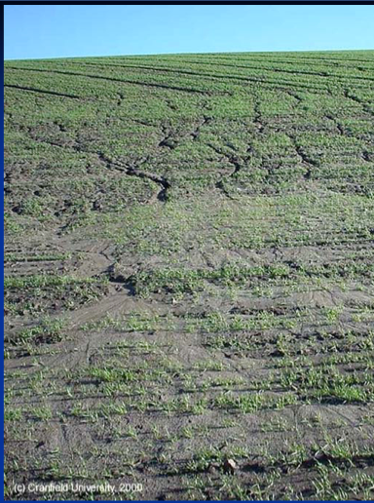
Reclamation Challenges
Reclamation design challenges - Excessive rill and gully creation leading to re-remediation
Ecological targeting
Habitat Equivalency Analysis approach
Recovery curves and chrono-sequences
Cost effectiveness Analysis approach
Transdisciplinary frameworks
If these are problems then it will cost someone something

Slide 5
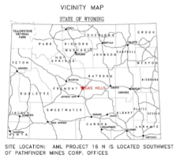
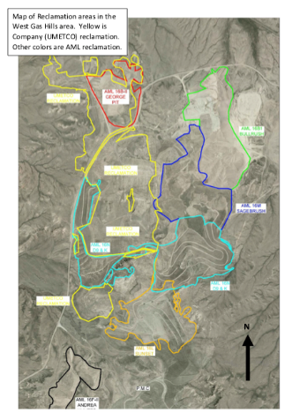
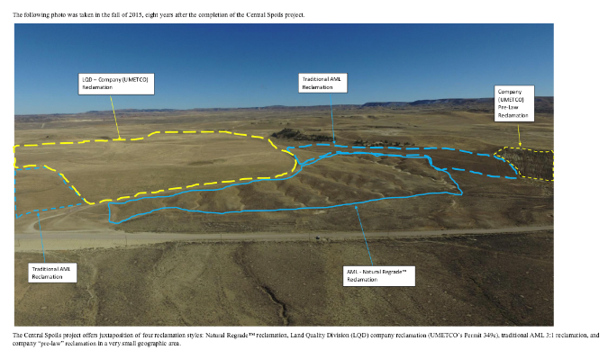
Central Wyoming
Source: BRS, Inc.

Slide 6
Erosion management
Both designs generate erosion but which technique has a propensity for more destructive erosion?
What is the incidence rate of erosion?
How extensive is it?
How much does it cost to re-remediate?
Anecdotal evidence suggests that traditional has more of a probability of destructive erosion than geomorphic

Slide 7
Erosion minimization
Operating Costs
Supplies & Materials | 30%
Labor | 48%
Administration | 14%
Sundry Items | 9%
Capital Costs
Equipment | 48%
Haul Roads | 4%
Pre-production Stripping | 2%
Buildings | 20%
Electrical System | 0%
Working Capital | 5%
Engineering & Management | 11%
Sundry Items | 9%
Source: Bureau of Mines, 1997
Smooth hilly surfaces versus
Small topological variation surfaces
Fixing these problems generates costs that firms and agencies incur: re-remediation costs.
Used @Risk software to assess risk
Assumptions:
Rill erosion is continuous/acre
Significant gully (blow-out) 1 in ten years / acre
Estimated cost: 15% of the final grading costs (guess)

Slide 8
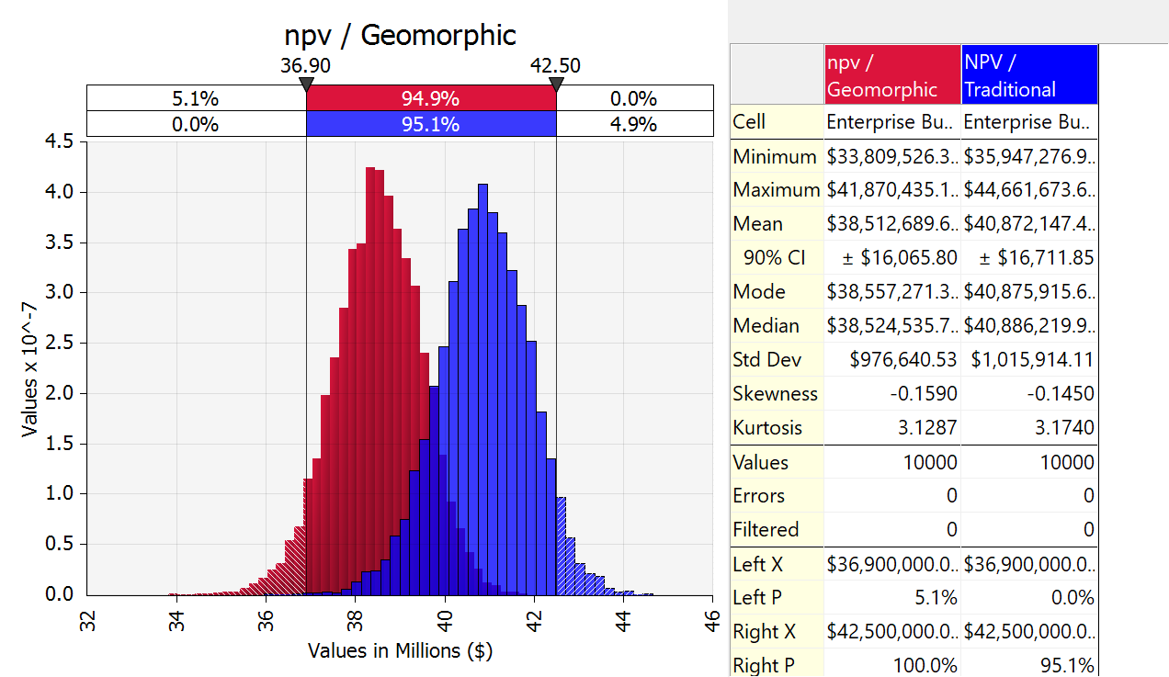
NPV of costs over 20 years, Geomorphic versus Traditional
Source: Palisade.com

Slide 9
Potential Recovery acres over a period using an Habitat Equivalency Analysis framework
HEA approach:
Loss of Services as a result of use
Recovery begins as one prepares the damaged site
Ultimately returns the site to the base
Mitigation offsets using HEA are measured by the size of the loss
Typically not stochastic
Baseline
Loss
Resource Services
Recovery Function
Incident
Recovery begins
Return to Baseline
Time

Slide 10
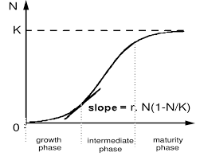
Modeling a growth curve
$$S=−\sum_{1}^{n}{p_{i}\ln{p_{i}}}$$
Used a logistic growth function and calibrated it
e = the natural logarithm base
s₀ = the s-value of the sigmoid's midpoint,
L = the curve's maximum value, and
k = the logistic growth rate or steepness of the curve
Used literature and Kurt Fleisher’s MS Thesis (2019).
Assumption: we assume that the Biodiversity Index changes mimics a population change
$$f\left(s\right)= \frac{\hat{L}}{\left(1+e^{−k(s−s_{0}}\right)}$$

Slide 11
Hypothetical Shannon diversity index convergence to a control site in the Day Loma Mine area
Logistic growth curve
Control site index level assigns the equivalent of a carrying capacity
Here modeled so that the variation approaches but does not exceed control
That may be an empirical question.
It could exceed control since there is little in the Rocky Mountain West where some direct or indirect affect of human use on the ecosystem is apparent (e.g. grazing levels , recreation, human fire, invasives – plant and animal, et al.
For every year changes in conditions affect both the control and the reclaimed sites independently to account for broad based climate changes.

Slide 12
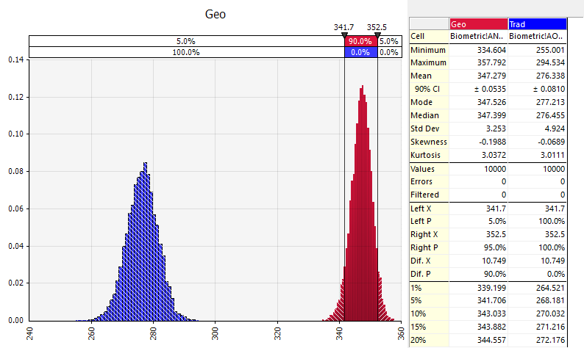
Adjusted Acres on a 488 acre site: Average over final 10 years
Constructed a logistic growth function for progression over the planning time frame.
Assumed Normal Distribution:
Min value truncation = 0
Max value truncation = Control average Shannon
Calculated the difference between the terminal value of the Shannon index – Control site Shannon for each
monte carlo simulation
-----------------------
Did not put the distribution spread of the control site but the distribution overlaps
Ultimate difference in the two simulations provide a beginning for the cost effectiveness analysis.

Slide 13
Hypothetical Shannon diversity index convergence to a control site in the Day Loma Mine area
Following HEA the figure shows recovery acres.
Functional range?

Slide 14
Conclusions
In both design and biodiversity comparisons geomorphic appeared to perform better than traditional
Geomorphic costs improvements in design are slightly more expensive but lower re-construction costs from surface erosion
Geomorphic becomes more expensive if the costs are more 12 pct more than traditional (would be very much location dependent)
Regulatory standards for erosion could make traditional approach more cost effective or less cost effective: How much are regulatory agencies willing to accept?
Other parameters could make difference

Slide 15
Conclusions
Biodiversity recovery rates appears to be higher and closer to the control site than traditional, Fleischer (2019)
Calibration of the stochastic logistic recovery function is dependent upon the indices means and s.d.
Comparison with a control site might also be bias depending upon the control site history.
Continuing work
Cost effectiveness analysis (based upon medical CE)
Use the methodology to evaluate the other sites.

