Slide 1


AN ANALYSIS OF COST FACTORS IN GEOMORPHIC MINE RECLAMATION
Harold Hutson, P.E., P.G.
BRS, Inc. Project Manager
1130 Major Ave.
Riverton, Wyoming 82501
307.857.3079
brs@brsengineering.com

Slide 2
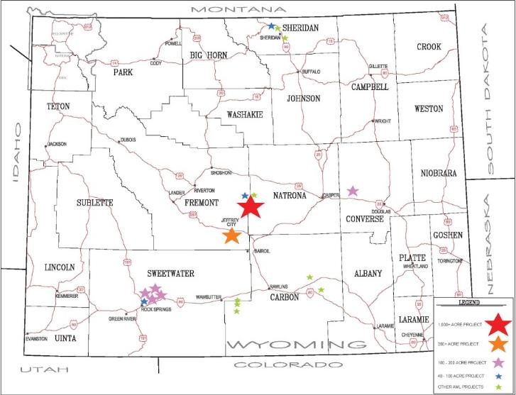
Wyoming Abandoned Mine Lands Geomorphic Reclamation Sites

Slide 3
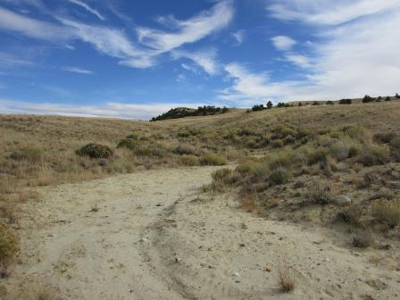
AML/BRS Geomorphic Reclamation Cost Data Dataset
First Project Completed 2007
21 Projects/Phases Completed to Date
Mixture of Project Sizes, Types, Challenges, and Configurations
$50 Million Construction Costs
27.5 Million Cubic Yards Earthwork
1,558 Acres Geomorphic Reclamation

Slide 4
General Project Groupings
Large Open Pit Uranium Mine Reclamation
Multiphase projects
Large volume / moderate acreage sites
High vertical , steep gradients
Open Pit Coal Mine Projects
Single phase projects
Moderate volume / larger acreage sites
Moderate vertical and gradients
Coal Mine Impacted Drainage Reclamation
Single phase projects
Low volume / moderate acreage
Minimal vertical, low gradients

Slide 5
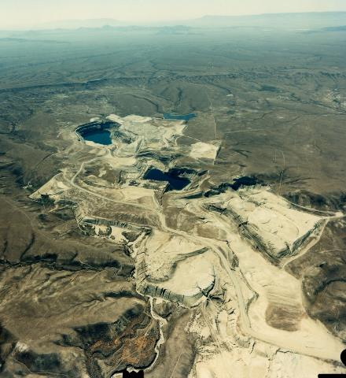
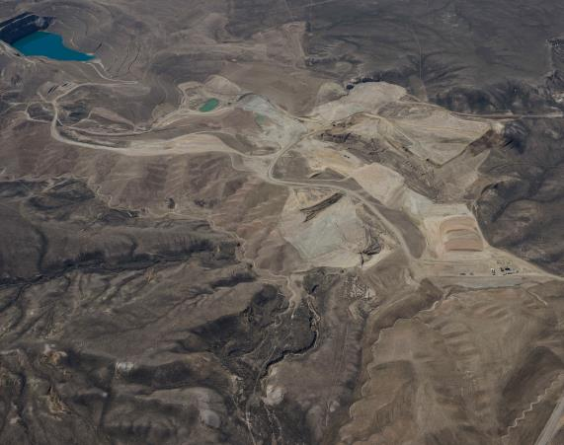
Large Open Pit Uranium Mine Reclamation
Day Loma Progress 2016
Day Loma District 1996

Slide 6
Large Open Pit Uranium Mine Reclamation
DAY LOMA AND CLYDE PITS COST DATA
Total Project Size >27 Million Cubic Yards
Total Area to Reclaim: 1,008 Acres
9,637’ of Dangerous Highwalls (DH)
575 Acres of Dangerous Piles and Embankments (DPE)
9 out of 15 Phases Completed to Date
Average Phase Cost: $2.7 Million
Average Earthworks Quantity per Phase: 1.8 Million Cubic Yards
Avg. Earthwork Cost: $1.47 per Cubic Yard
Average Phase Final Grading Area: 86 Acres

Slide 7
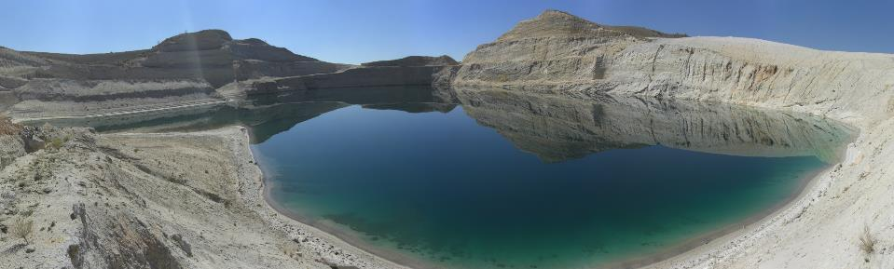
Large Open Pit Uranium Mine Reclamation
McINTOSH PIT RECLAMATION
3 out of 6 Phases Completed to Date
Average Phase Cost: $3.1 Million
Average Earthworks Quantity per Phase: 1.5 Million Cubic Yards
Avg. Earthwork Cost: $1.59 per Cubic Yard
Average Phase Final Grading Area: 39 Acres
McIntosh Pit 2013

Slide 8
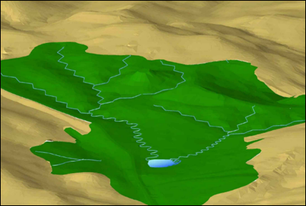
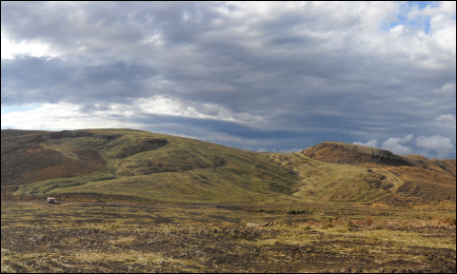
Open Pit Coal Mine Reclamation
LIONKOL PITS AND DAVE JOHNSTON SPOILS
Three Distinct Projects
Average Phase Cost: $2.0 Million
Average Earthworks Quantity per Project: 1.0 Million Cubic Yards
Avg. Earthwork Cost: $1.56 per Cubic Yard
Avg. Phase Final Grading Area: 141 Acres

Slide 9
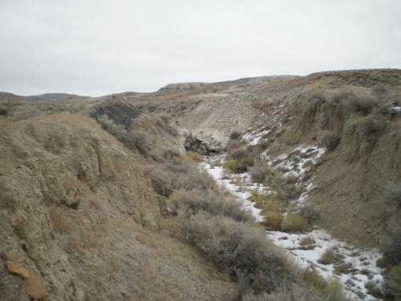
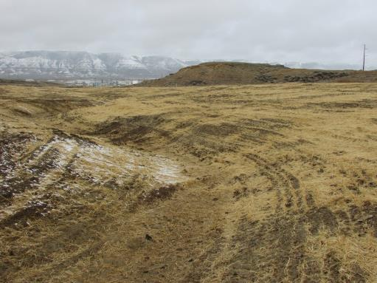
Coal Mine Impacted Drainage Reclamation
Five Distinct Projects
Average Phase Cost: $1.2 Million
Average Earthworks Quantity per Project: 0.3 Million Cubic Yards
Avg. Earthwork Cost: $4.38 per Cubic Yard
Avg. Phase Final Grading Area: 75 Acres

Slide 10
Earthwork Cost Factors
Size of Project -Economy of Scale
Scope of Project - Bulk Haulage v. Finish Grading
Equipment Type and Costs
Haulage or Push Distance and Gradient
Material Types – Favorable or Difficult
Unique Site Conditions
Ancillary Costs – Ripping, Blasting, Dewatering
Special Material Handling Requirements

Slide 11
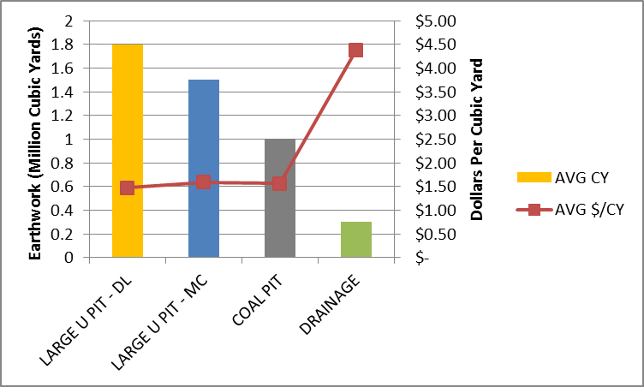
Project Size

Slide 12
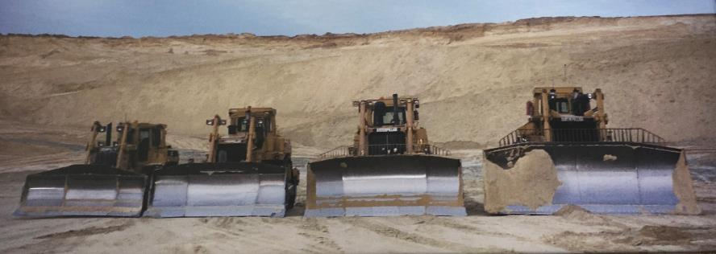
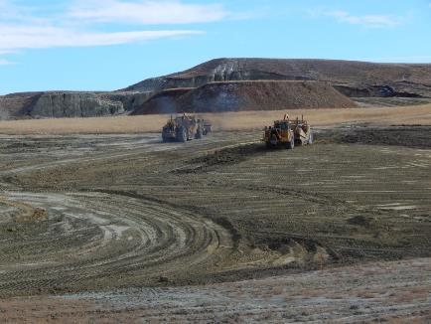
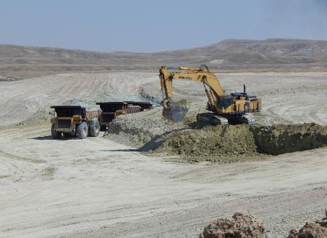
Equipment Type and Size

Slide 13
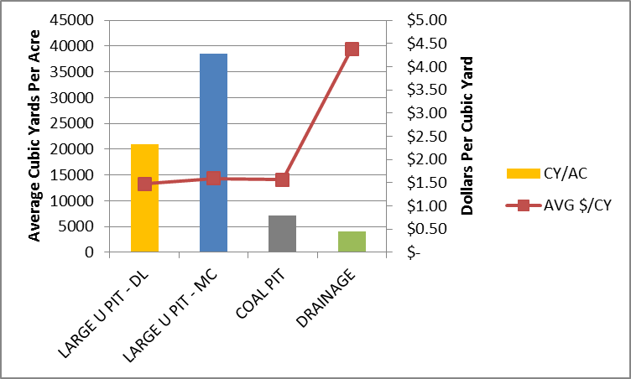
Project Scope – Bulk Haulage v. Finish Grading

Slide 14
Typical Earthwork Cost Estimation
Determine Haulage Distance and Profile
Select Appropriate Equipment
Calculate Cycle Times
Apply Availability Factor – 0.83 Typical
Estimate Production by Applying Load Factor to Number of Cycles
Calculate Number of Required Units to Meet Production Requirements Safely
Estimate Support Equipment Needs
Divide Operated Equipment Costs by Production Rate to Determine Cost Per CY
Apply Factor for Overhead and Profit

Slide 15
Day Loma Project Example – Unadjusted Data

Slide 16
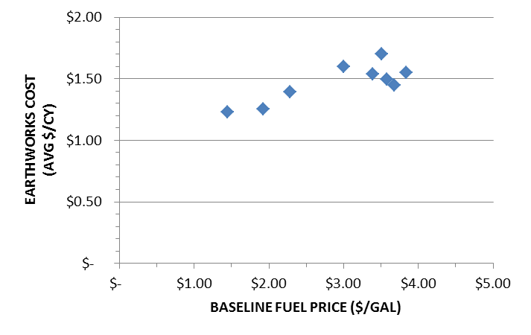
Earthwork Cost v. Fuel Price

Slide 17
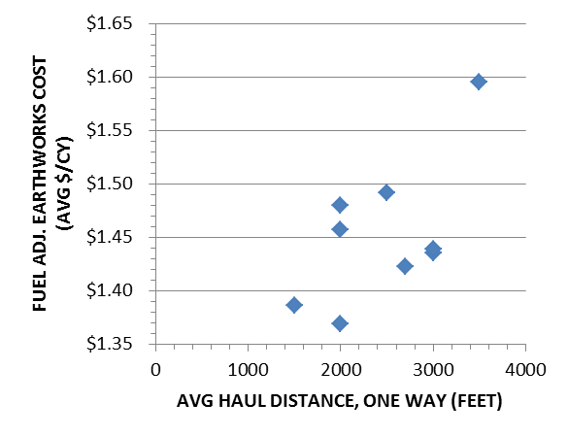
Earthwork Cost v. Distance – Fuel Price Adjusted

Slide 18
McIntosh Pit Example –
Material Types

Slide 19
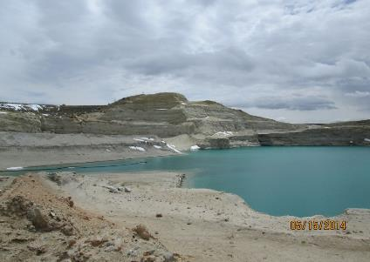
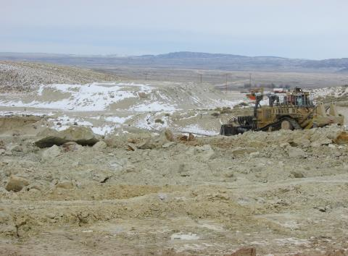
McIntosh Highwall Reduction – Unfavorable Ripping Conditions

Slide 20
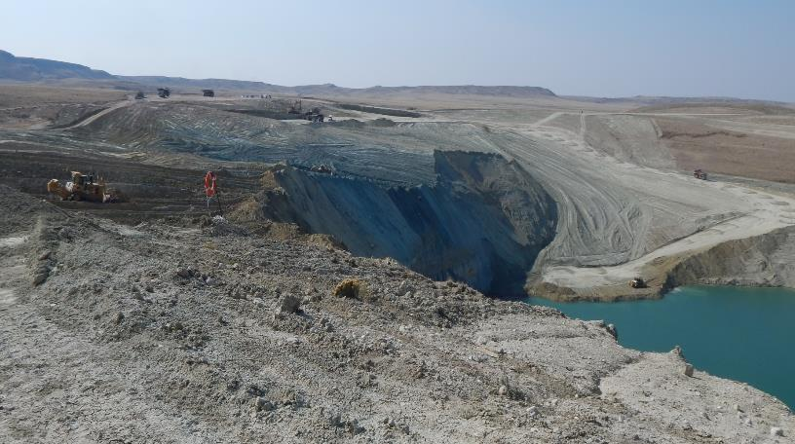
Day Loma Highwall Reduction – Moderate Ripping

Slide 21
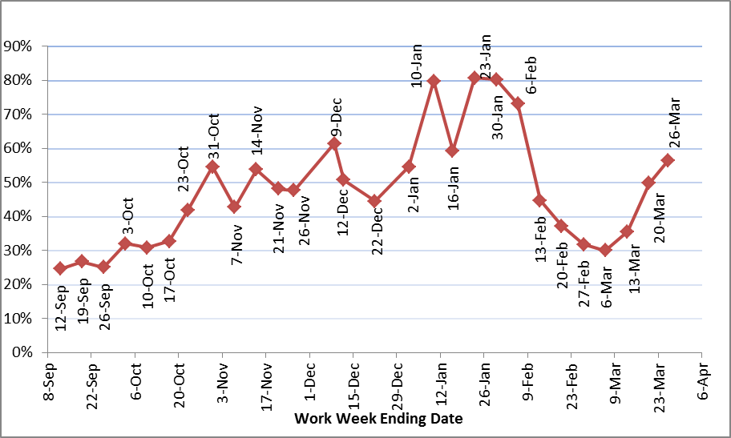
Ancillary Costs - Ripping
ACTUAL PERCENT TIME SPENT RIPPING AML 160-1
27% cost increase to unit rates prior to initiation of blasting

Slide 22
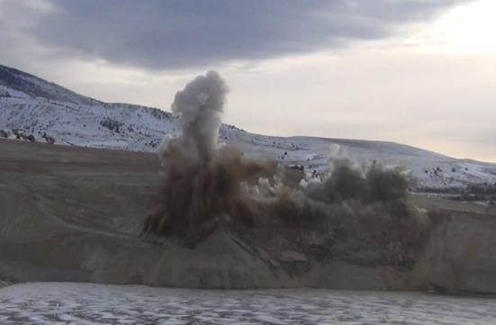
Ancillary Costs - Blasting
Blasting costs vary with project size, material type, powder factor, equipment availability, and many other factors.
WY DEQ/LQD uses $0.19/cubic yard for large mine shots, and $0.35 per cubic yard for small mines and quarries.
Actual McIntosh highwall blasting cost was $0.66 per cubic yard including drilling, materials, and labor.

Slide 23
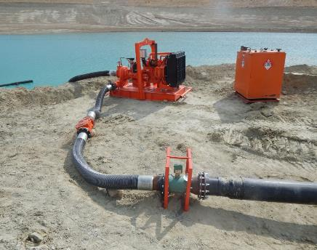
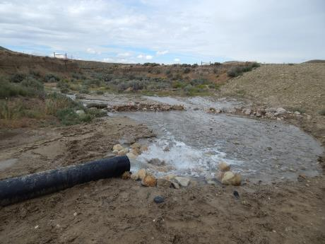
Ancillary Costs - Dewatering
Offsite Discharge

Slide 24
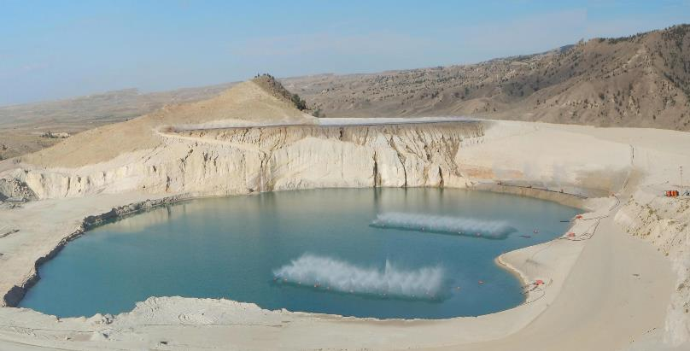
Ancillary Costs - Dewatering
Evaporative Dewatering

Slide 25
Ancillary Costs - Dewatering

Slide 26
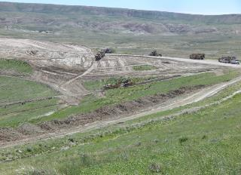
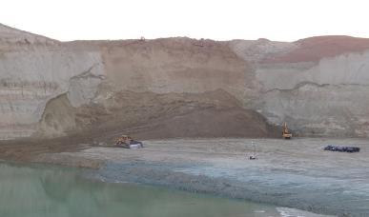
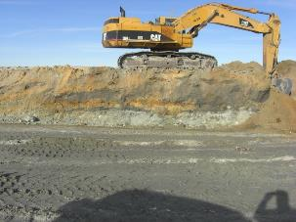
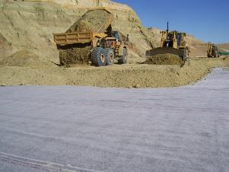
Special Requirements
Coversoil Salvage
Reworking Dozed Slough
Unsuitable Materials
Liners, Riprap, Ponds, Etc.

Slide 27
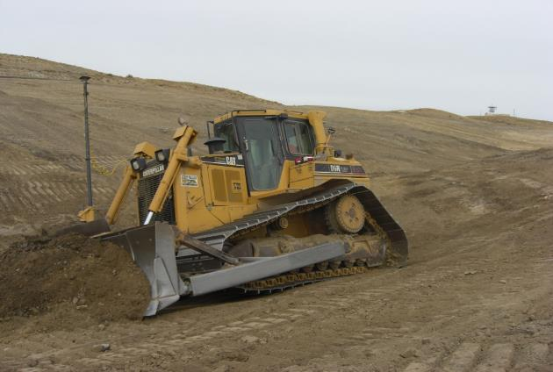
What About the Cost of Geomorphic Reclamation?
GPS Equipped Dozer Constructing an Uplands Channel

Slide 28
Final Grading Cost Data

Slide 29
Final Grading Cost Data Summary

Slide 30
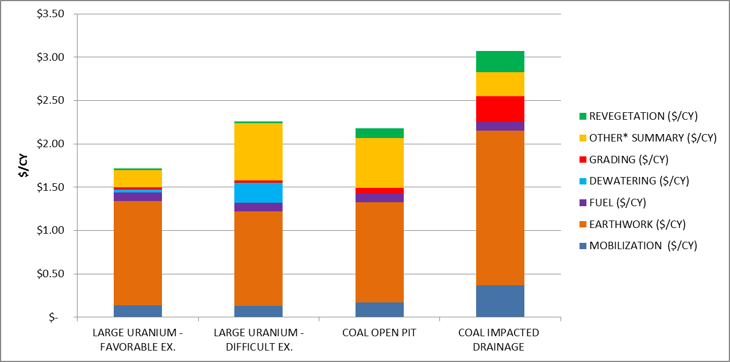
Relative Cost of Geomorphic Reclamation to Other Cost Factors
*Includes site-specific work requirements such as ripping, blasting, special handling, long haulage of material, and revegetation amendments

Slide 31
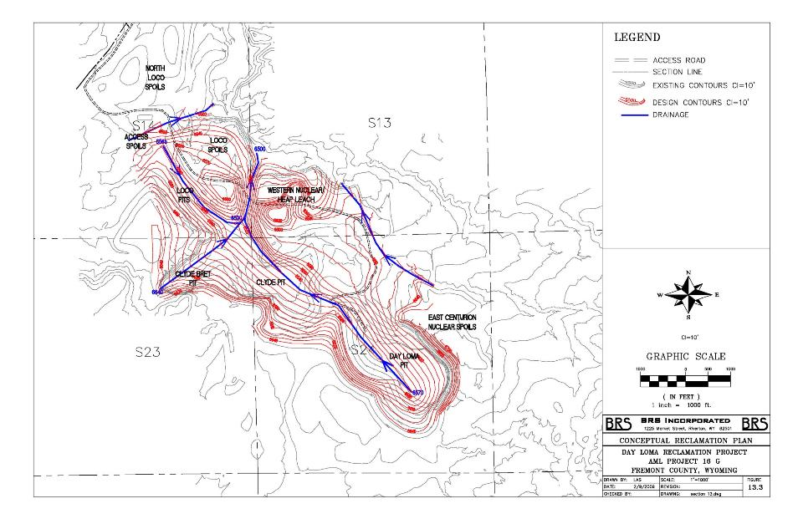
Day Loma 2009 Traditional Design

Slide 32
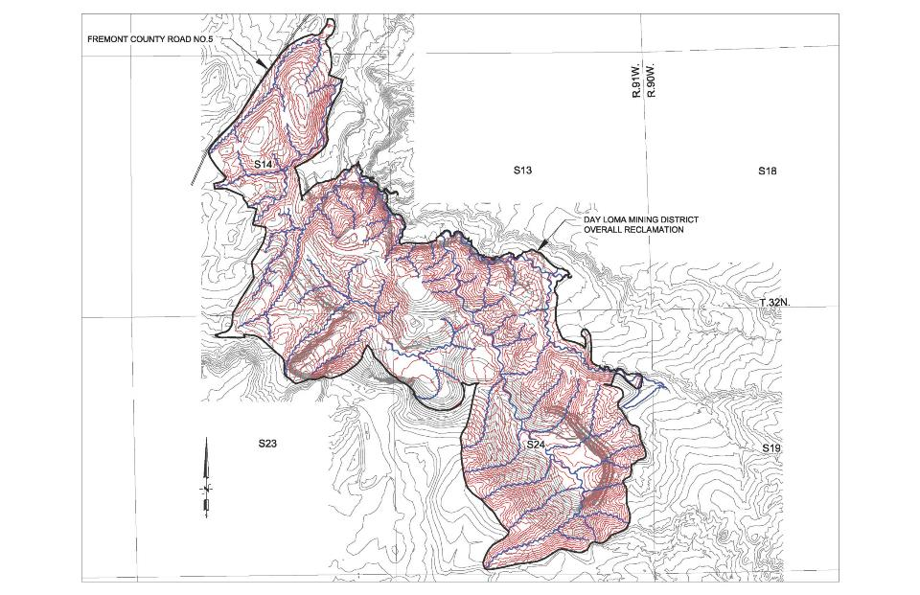
Day Loma 2018 Geomorphic Design

Slide 33
Day Loma 2009 Traditional v.
2018 Geomorphic Cost Comparison
Increased excavation volume after adjustments approximately 9%
Added 3 phases of construction
Increased total acreage reclaimed
Increased coversoil thickness
Required additional double handling of coversoil
Experienced savings in geomorphic reclamation grading costs per acre due to competitive bidding
Inflation adjusted rates
TOTAL COST INCREASE AFTER ADJUSTMENTS: 4%

Slide 34
Traditional Reclamation
Initial Project Costs
AML Site | Initial Project Quantity CY | Total Project Acres | Initial Project Cost (2019) | Initial Project Cost/CY | Initial Project Cost/Acre
16B - George Pit | 2,390,082 | 167 | $3,537,240.94 | $1.48 | $21,181.08
16J - 4X and H&I | 6,204,796 | 378 | $8,288,925.52 | $1.34 | $21,928.37
16L - Sunset | 3,939,321 | 167 | $4,494,108.00 | $1.14 | $26,910.83
16N - D9 & K Pit | 7,039,058 | 197 | $13,370,381.00 | $1.90 | $67,869.95
 |  |  | Average total | $1.46 | $34,472.56
$1.46/CY initial project average compared to $1.52/CY at the Day Loma project to date.
Closely matches the previous 4% cost increase calculation, or $0.05/CY
$34,472.56 average cost per acre compared to $41,063.62 per acre on the Day Loma project.

Slide 35
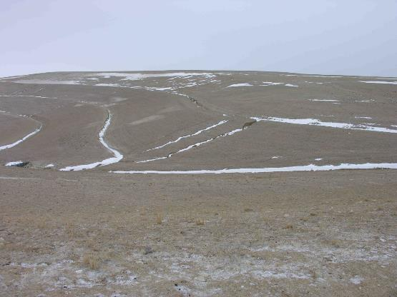
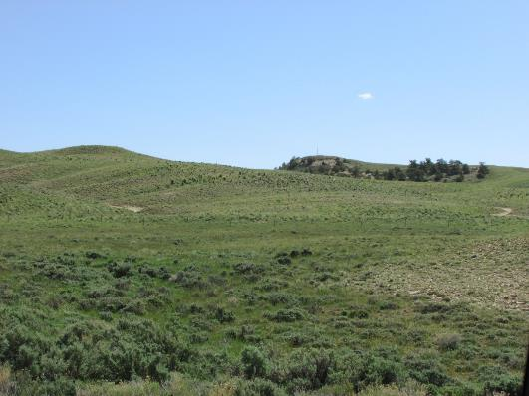
Decreased Maintenance
Increased Vegetative Diversity, Improved Aesthetics and Habitat Value

Slide 36
Traditional Reclamation Estimated
Repair Costs
AML Site | Initial Project Cost (2019) | Repair Cost | Repair vs Initial Cost | Repair Cost/Initial Project Quantity (CY) | Repair Cost/ Total Project Acres
16B - George Pit | $3,537,240.94 | $60,420.00 | 2% | $0.03 | $361.80
16J - 4X and H&I | $8,288,925.52 | $293,490.00 | 4% | $0.05 | $776.43
16L - Sunset | $4,494,108.00 | $69,920.00 | 2% | $0.02 | $418.68
16N - D9 & K Pit | $13,370,381.00 | $170,360.00 | 1% | $0.02 | $864.77
 |  | Average total | 2% | $0.03 | $605.42
Cost of repairs ranging from 1-4% of the initial project construction costs.
Age of projects from 23 to 11 years old. Most recent site has lowest repair costs.
Cost per acre for the repairs is similar to the $625.58/acre Final Grading costs at Day Loma.

Slide 37
Summary and Conclusions
Competitive bidding and increased use and acceptance of GPS equipment have lowered the cost of geomorphic reclamation projects in WY.
Geomorphic reclamation costs are comparable to fluctuations in fuel, revegetation costs, and other minor cost factors.
Project costs are dominated by earthwork requirements including project size and type, materials, and special conditions.
Geomorphic reclamation projects may require an increase in earthwork volume.
Stable final surfaces and decreased maintenance may offset construction cost increases.
Additional aesthetic and environmental benefits result from geomorphic reclamation.

Slide 38
Harold Hutson, P.E., P.G. – Project Manager
1130 Major Ave.
Riverton, Wyoming 82501
307.857.3079
brs@brsengineering.com

