Slide 1


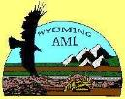



2019 American Society of Mining
& Reclamation
Challenges to Mine Backfilling in Poor Rock Formation with High Artesian Mine Water Pressure
Brierley Associates
June 6th, 2019
Mohamed Gamal, PhD, PE
David Hibbard, Engineering Geologist
Acknowledgements:

Slide 2
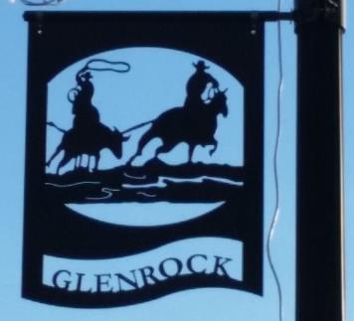
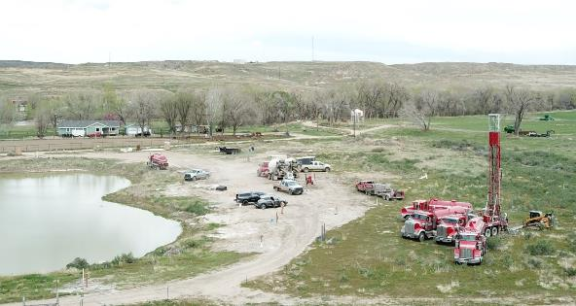
Presentation Outline
Mining and Mitigation History of Glenrock
Subsidence History in Glenrock
Study Pilot Area
Localized Groundwater Conditions
Monitoring and Analyses
Risks (Subsidence/Mitigation)
Backfilling Challenges
Alternative Grouting Approach
Questions and Answers

Slide 3
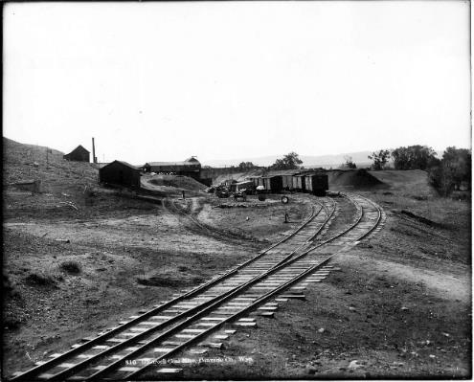
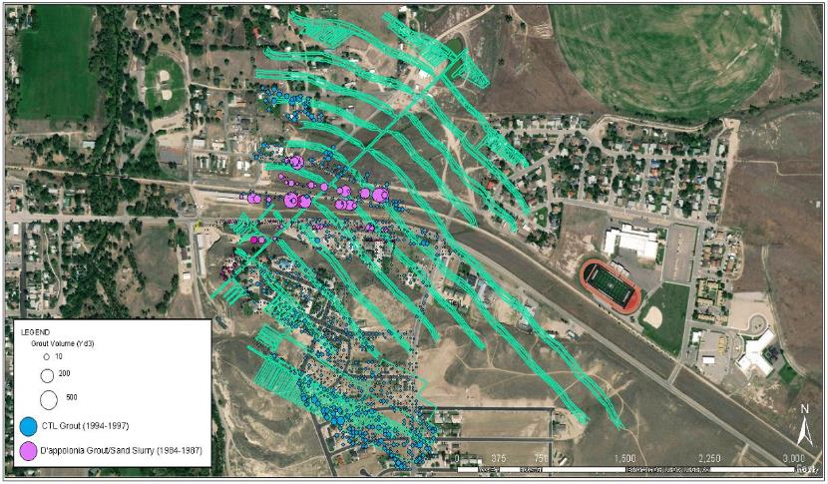
Glenrock Mining History
1847: First documented coal production near Glenrock
1888: Increase in commercial production. Coal used for domestic purposes
  Over 855,000 Tons mined
1909: Glenrock Mines closed due to poor roof and excessive flooding
Total undermined area in Glenrock
No. 1 and No. 2 Mines = 217 acres
McDonald Mine = 22 acres
Two Historic Mitigation Programs Launched
  D’Appolonia: 1984 – 1987
  CTL/Thompson: 1994 – 1997

Slide 4
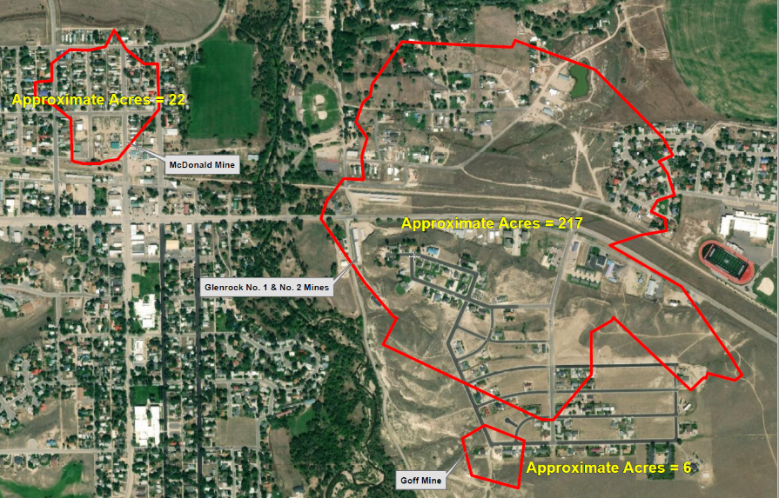
Mines in Glenrock and Undermined Areas
No. 1 and No. 2 Mines
Area = 217 acres
McDonald Mine
Area = 22 acres
Goff Mine
Area = 6 acres

Slide 5
Background - Why We Are Here
AML response to Spring/Summer 2016 Subsidence Events
Sinkhole in Glenrock at the intersection of Millar Lane and the Highway 20-26-87 (May 2016) following heavy precipitation.
3 additional events due east, north of the Glenrock Birch Street Apartments (June 2016).
Investigations confirmed they are mine-related.
Similar events recorded after 2016 - current with additional pubic awareness.
Millar Lane & Hwy 20-26; outside of known mining extent

Slide 6
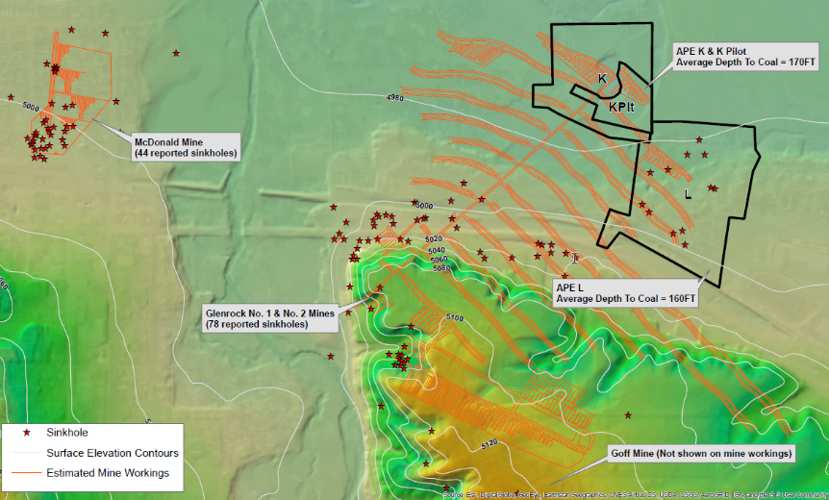
Subsidence Events and Topography
APE (Area of Potential Effect
  APE K & L, focus of study area
Dipping northeast
Approximately 150’ of hydraulic head pressure
165’ average depth to coal in study area

Slide 7
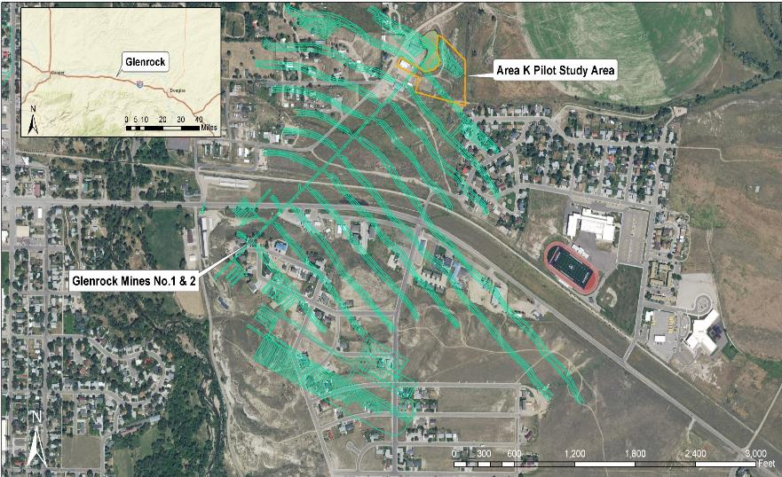
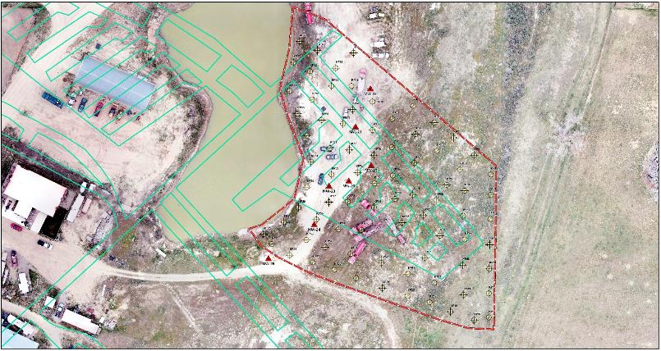
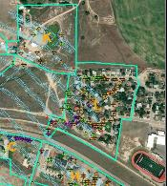
Area K Pilot Program
Purpose: To test the feasibility of mitigation under artesian conditions within a heavily developed suburb
7 monitoring wells in Pilot area.
Total of 23 all over the city
Approximately 100 proposed injection borings for grouting.
Grout barrier to prohibit and isolate groundwater and grout flow.
Surcharge loads to simulate footing loads
One well is equipped with a valve to release pressure when needed.
Loading & Settlement Testing

Slide 8
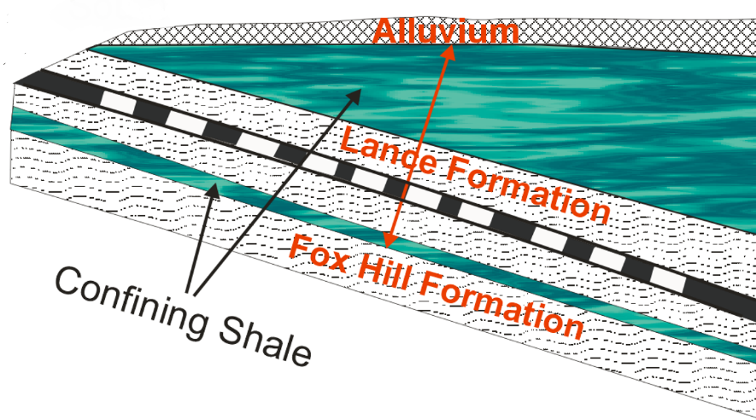
Localized Aquifer System in Glenrock
Southwest
Northeast
Aquifer 1
Mined Interval
(Room/Void)
Shale/SltSt
Ss
Aquifer 2
Ss
Aquifer 3
Shale/SltSt
Ss
Aquifer 4

Slide 9
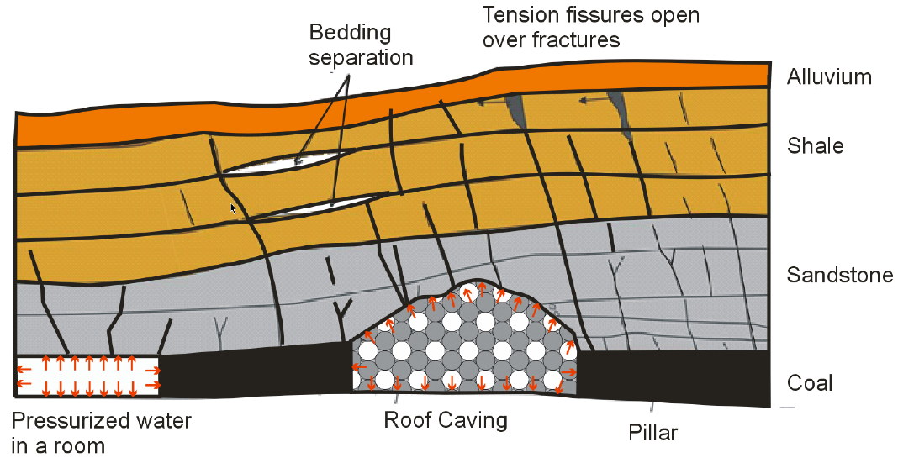
Mining Impact on Local Hydrogeology

Slide 10
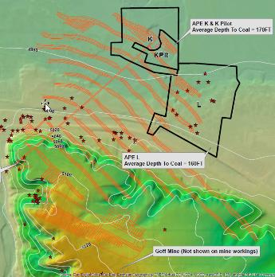
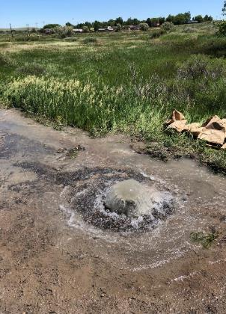

Formation of Artesian Condition
Southwest
Northeast
Shale/SltSt
Ss
Ss
Ss
Localized confining layers. Four hydraulic systems created
Hydraulic Head; northeast down dip
Artesian Conditions; Mined interval

Slide 11
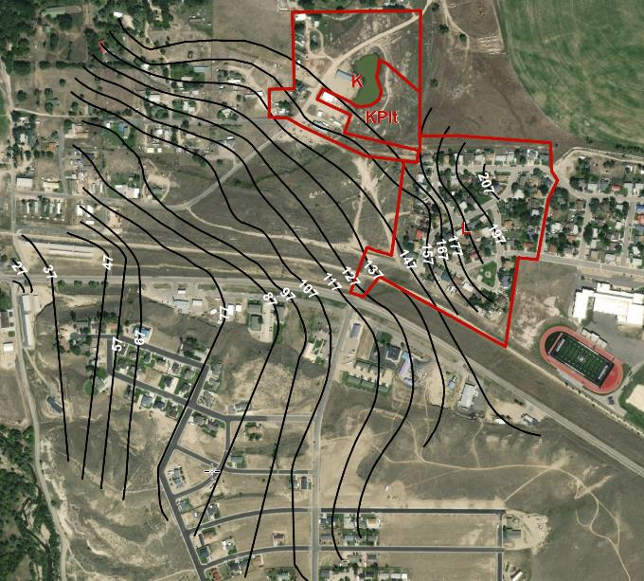
Prelim. Chemical Analyses Findings
Adjacent North Platte River:
SO4: 803 mg/L
TDS: 1840 mg/L
Water quality in Lance Formation, Mine, Coal, Pond and Platte River is very similar
Quality degrades downdip
SO4: 860-930 mg/L
TDS: 1870-2290 mg/L
SO4: 400-450 mg/L
TDS: 1100-1150 mg/L
Glenrock Area K Field Parameter Readings
Well ID | Sample Date | pH | Temperature (°C) | Specific Conductivity (µS/cm)
BA-GM12-MW-20 | 4/10/19 | 8.10 | 11.9 | 3280
BA-GM12-MW-21 | 4/4/19 | 9.58 | 11.2 | 1721
BA-GM12-MW-22 | 4/4/19 | 9.26 | 11.7 | 1562
 | 4/9/19 | 9.76 | 13.1 | 1525
BA-GM12-MW-23 | 4/5/19 | 9.30 | 13.3 | 2370
BA-GM12-MW-24 | 4/8/19 | 8.77 | 12.1 | 3480
 | 4/9/19 | 7.80 | 12.3 | 3450

Slide 12
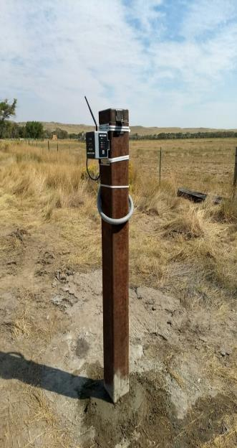
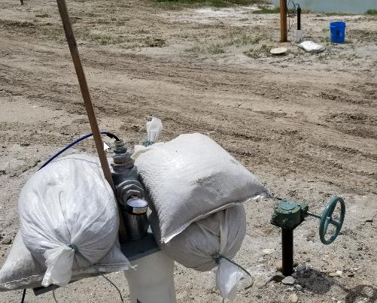
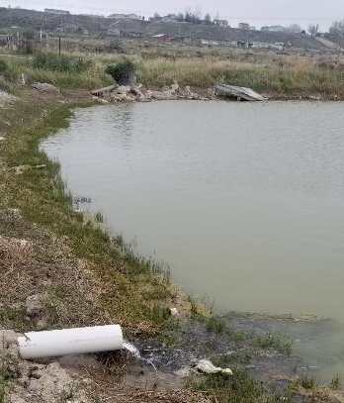
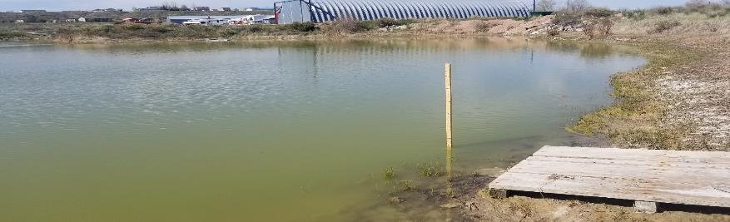

Slide 13

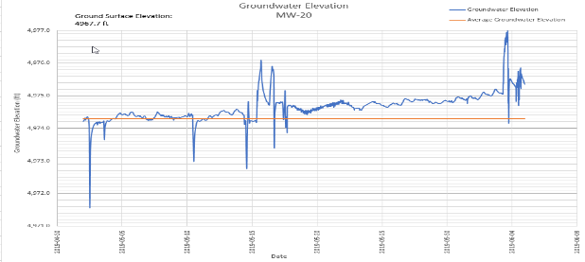
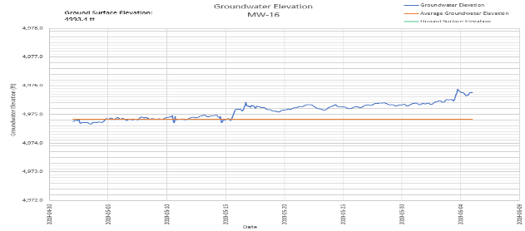
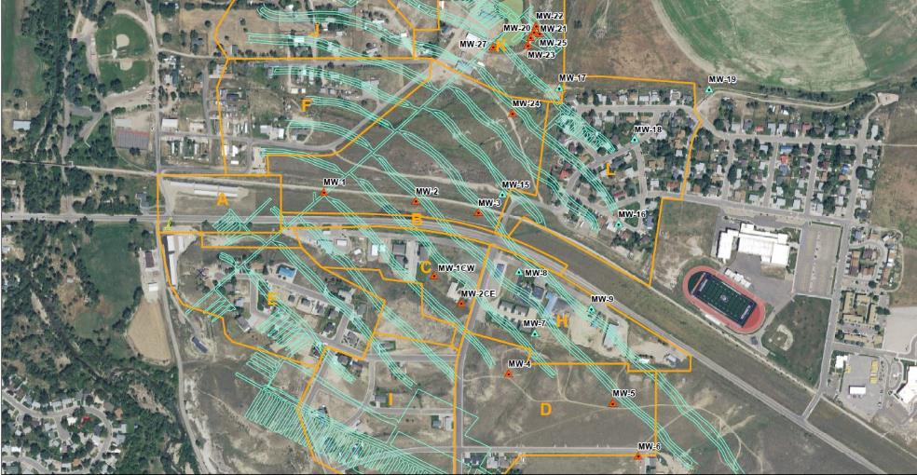
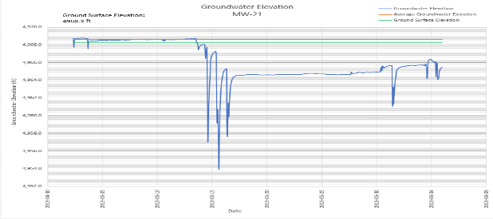
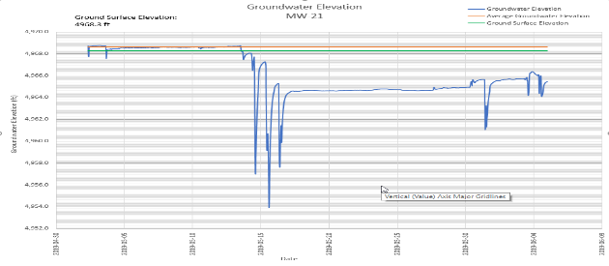
Groundwater Response While Grouting
MW-20 (MI)
MW-16 (MI)
MW-21 (Ss)
MW-22 (Ss)
Change date range

Slide 14
Risks of Current Condition?
Mine subsidence
Extended periods of drought –increase subsidence risk due to loss of confinement and increase of effective stress
Communication of water in mine with overlaying strata
Flooded basements and crawl spaces
One house condemned
Impact on pavement
Indications of sulphates attack to concrete elements
Possible degradation of groundwater quality

Slide 15
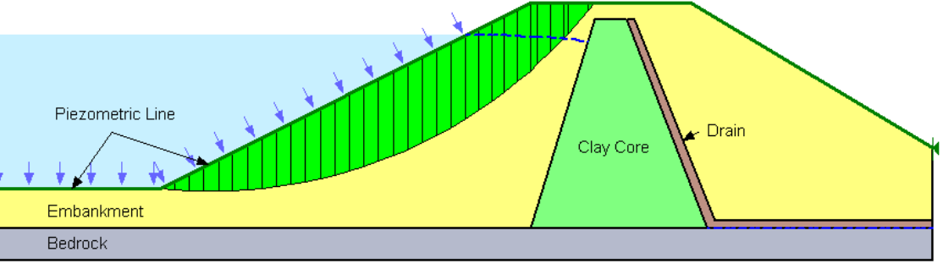
What Are The Risks of Mitigation in Artesian Condition?
Grouting injection could increase potential of flooding if no discharge of mine water
Trigger settlement if pumping out is done improperly
What is proper rate of mine water pumping for given Injection rate
Lag time between change in stress condition in soil/rock and change in water pressure

Slide 16
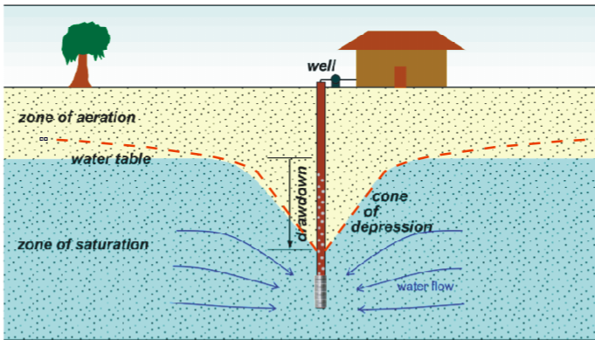
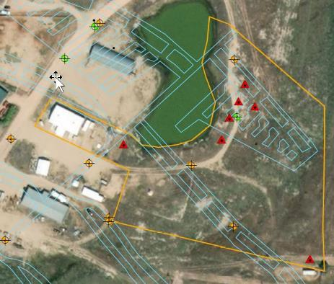
What Are The Risks of Mitigation – Cont.
Local VS. global variation of water pressure regime
  Locally upon injection the water table dropped.
  At a distance the ground water table rose

Slide 17
Backfilling Challenges in Glenrock
Very weak rock – voids are not limited to mine interval Staged grouting
The mine is highly rubblized and flooded – less rubble in artesian areas
Two previous mitigation programs Initial high injection pressure (300-400 psi)
          Sand slurry – mostly gone
          Stiff grout with 2” to 6” slump – left of lot voids in the rubble
          Inaccurate utilities locations Daylighting utilities Disturbance to loose soil
          Artesian Sealing of Injection hole

Slide 18
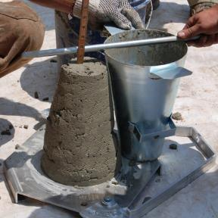
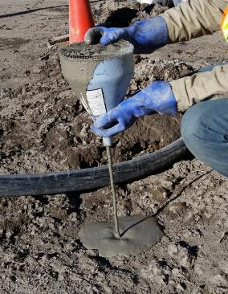
Alternative Grouting Approach
Design Criteria
  Focus on filling voids, not on strength of grout
  Compression Strength 200 psi (Cores showed 1200 to 8000 psi)
  Heavier than water
  Fill mine voids, joints and fractures in rock overburden
  Grout is stable under pressure as high as 1,000 psi
  Assign refusal criteria as function of depth
Traditional Approach
Modern Approach

Slide 19
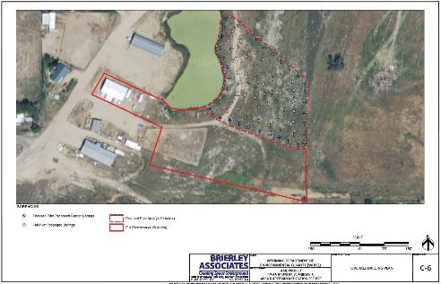
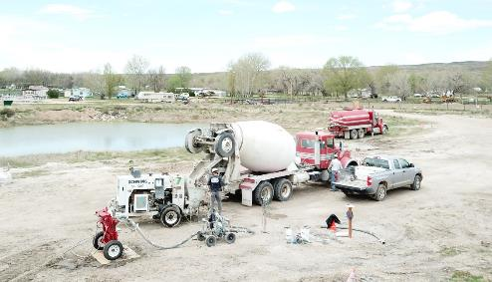
Alternative Grouting Approach – Cont.
Use 3 different Mixes
  High mobility Mix A
  Medium mobility Mix B (8” – 10” slump)
  Low mobility Mix C (4” – 6” slump)
Mix Selection Depends on…
  Mine condition (Open Void vs. Rubblized)
  Purpose of usage (Barrier vs. Void infilling)

Slide 20
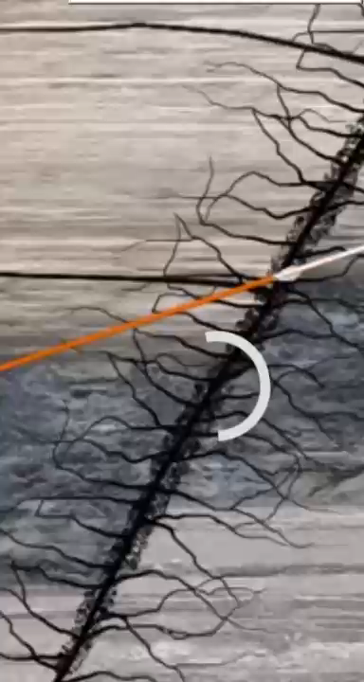
Alternative Grouting Approach – Cont.

Slide 21
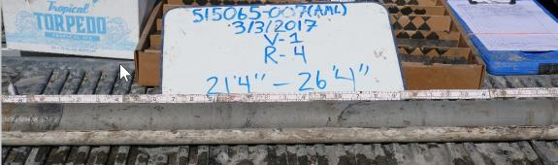
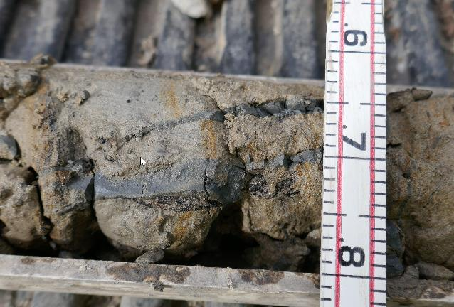
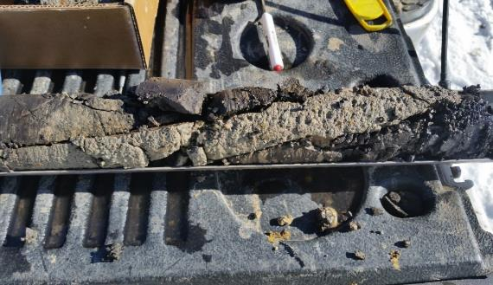
Alternative Grouting Approach – Cont.

Slide 22
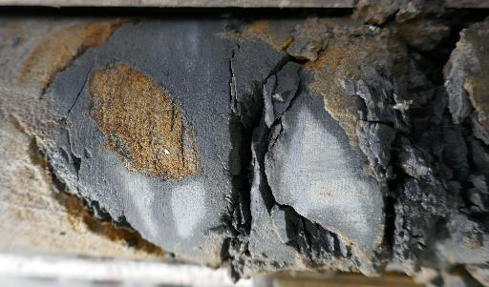
Brierley’s Current Grouting Approach – Cont.

Slide 23
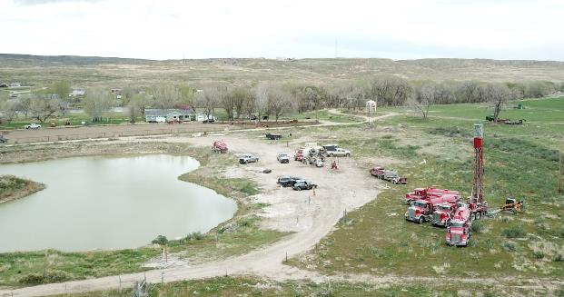
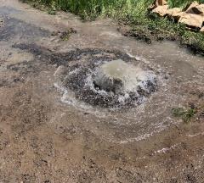
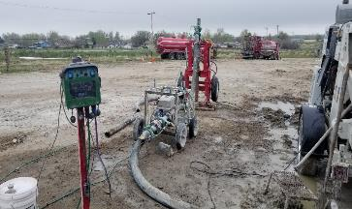
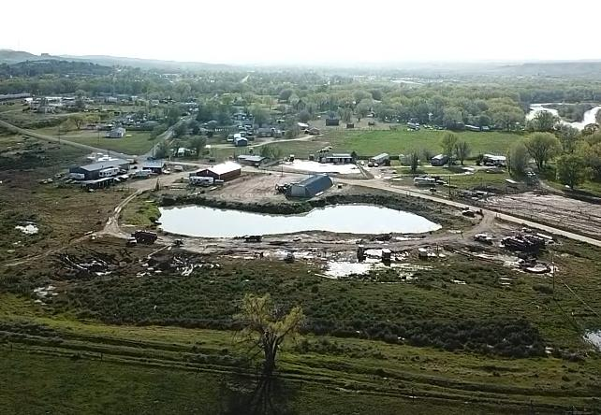
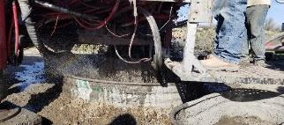

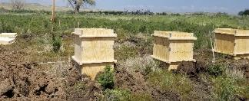
Q & A

