Slide 1
Industrial Hemp as a Potential Crop for reclaiming disturbed and contaminated soils
Louis M. McDonald
Professor, Environmental Soil Chemistry and Soil Fertility West Virginia University

Slide 2
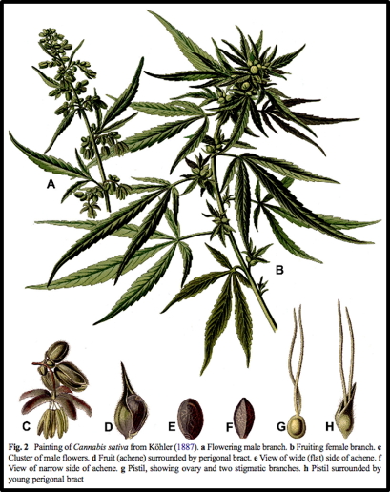
Is it industrial hemp or Marijuana?
It’s the same plant (Cannabis sativa) but
Bred for a different purpose
Different production practices
Industrial hemp is NOT marijuana
2014 USDA Farm Bill definition <0.3% THC
2018 USDA Farm Bill removed hemp from Schedule 1 Drug List

Slide 3
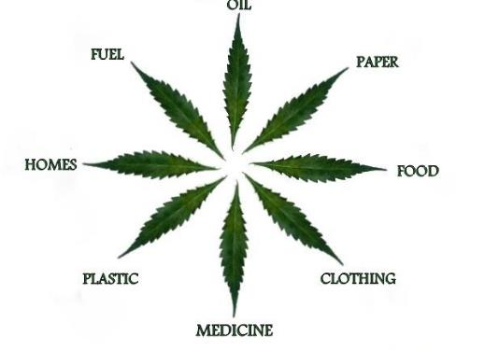
What good is industrial hemp?
Over 50,000 products
Fiber → high-quality textile, plastics, building materials, etc.
Grain
Human & animal feed (protein, eight amino acids, omega-3 fatty acid)
High quality oil for food, cosmetics and industrial applications
Flowers → extracts for the supplement, nutraceutical market, CBD
From: gospelofhemp.com

Slide 4
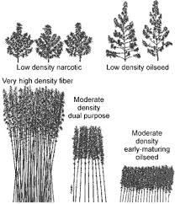
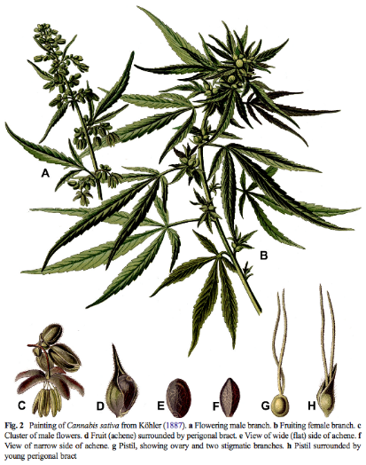
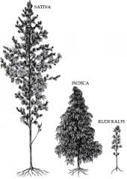
Notes:
Cannabaceae family, hops are in there too. Annual plant that grows quickly in vegetative state, and is induced to flower via photoperiod, They are predominately dioecious with pistillate female and staminate male flowers. Males will die after anthesis.
The main stalk is erect and can be furrowed when large with a somewhat woody interior. It may be hollow at the internodes.Eventhoug woody it is referred to as an herb. It has a branched taproot.
Typically it will be between 1-5m. Depending on its variety or use. Go to first diagram. Low density for increased lateral branching and preponderance for female flowers. Generally they use moderate density oilseed.
Cannabis often has been called weed as a common or generally identification. This is representative of cannabis range of phenotypic plasticity and ability to grow in many different climates, soils, and altitudes.
Last diagram different species of cannabis that is currently being studied. Two species or gene pools (C. sativa and C. indica) are widely used in describing the pedigree or appearance of cultivated Cannabis plants. Sativa for hemp and marijuana and indica for marijuana. They genotyped 81 marijuana and 43 hemp samples, we show that marijuana and hemp are significantly differentiated at a genome-wide level, demonstrating that the distinction between these populations is not limited to genes underlying THC production. There is some evidence that c. sativa hemp varieties share more genetic lineage single-nucleotide polymorphisms (SNPs) with c. indica than c. sativa. The difference between marijuana and hemp plants has considerable legal implications in many countries, and to date forensic applications have largely focused on determining whether a plant should be classified as drug or non-drug.

Slide 5
THC and CBd
THC = tetrahydrocannabinol
One of at least 120 known cannabinoids
Δ⁹-tetrahydrocannabinol
Federally illegal if plant-derived
Synthetic THC → Dronabinol
Appetite stimulant, by prescription
CBD = Cannabidiol
Readily available
Legally in a gray area; illegal at Federal level (FDA)
Epidiolex – approved for epilepsy

Slide 6
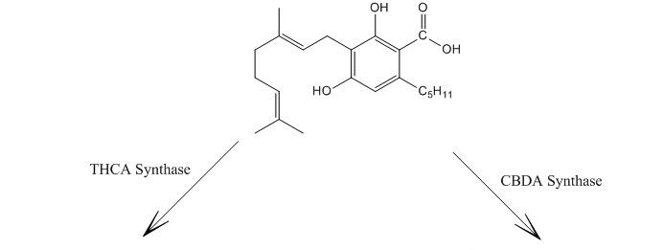
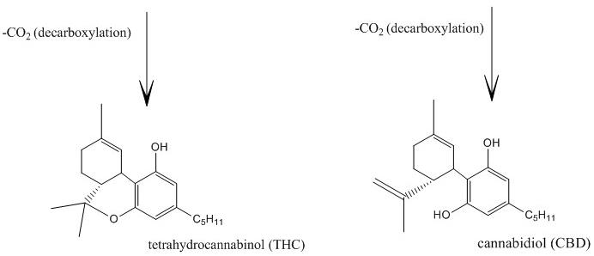
CBGA
THCA
CBDA
THC
CBD

Slide 7
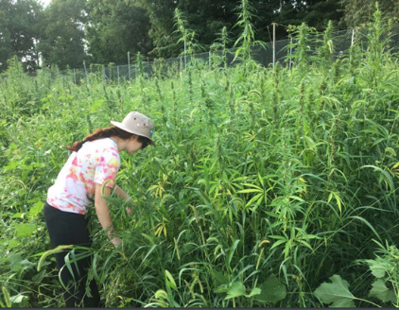
What are the challenges?
The 2018 Farm Bill changed a lot – but not everything
CBD is not a legal additive/supplement according to FDA - fines
Still no agreed upon regulatory definition of THC
A lot of people want to grow hemp –
Lack of knowledge
Quality seed
Processing facilities
Markets still emerging

Slide 8
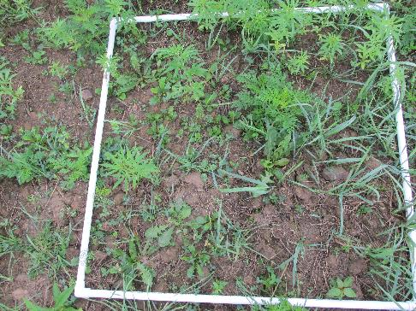
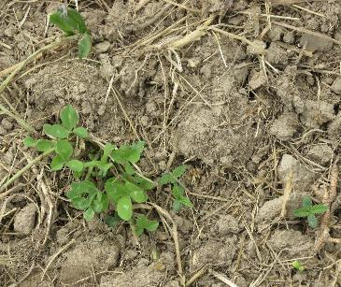
Myths, Rumors, and outright lies
Hemp will grow anywhere
Hemp does not require fertilizer
Hemp does not need herbicide

Slide 9
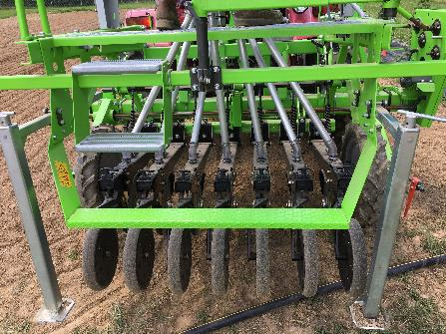
Challenges for reclamation: Part 1
Annual
Needs a finely prepared seed bed to compete against weeds
Machinery
Soil preparation
Grain drill to plant – not broadcast!
Harvesting
Drying

Slide 10
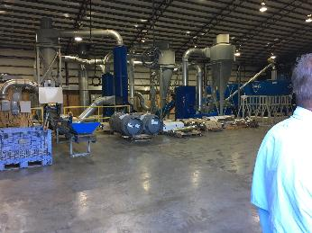
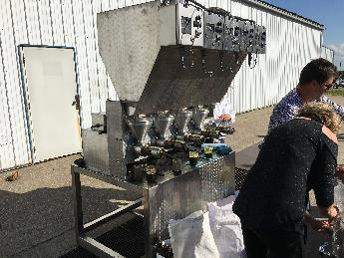
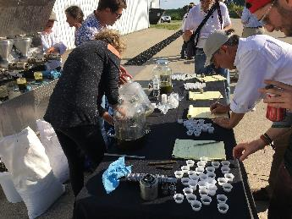
Challenges Part 2
Seed can expensive (up to $50/lb); minimum orders; High CBD >$1/seed
Seed is not very uniform
Seed from Europe (Poland, France, Italy) is old by the time it gets to farm – poor germination and vigor – somewhat resolved with 2018 Farm Bill
Processing infrastructure
Two & four-legged and winged pests

Slide 11
Potential and Concerns for reclamation
Known to be salt-tolerant
Some evidence for metal accumulation – phytoremediation
Question/Concern:
If THC concentration exceeds 0.3% then it’s marijuana – may forfeit crop
THC is a secondary plant metabolite
Some secondary plant metabolites are produced as stress response (N?)
What role does biotic and abiotic stress play in hemp growth and THC production? Preliminary results

Slide 12
Salt tolerance
Simple Petri dish experiment & NaCl solutions
Five varieties, many salt concentrations
USDA Salinity Classification
Class | Category | Salinity (EC) | Plant Growth
0 | Non-saline | 0-2 | Negligible effects
1 | Very slightly saline | 2-4 | Yield decrease only for very sensitive crops
2 | Slightly saline | 4-8 | Yield decrease for many crops
3 | Moderately saline | 8-16 | Tolerant crops only
4 | Strongly saline | >16 | Very-tolerant crops only

Slide 13
Salt tolerance 1

Slide 14
Salt Tolerance 2

Slide 15
Salt Tolerance 2
Variety = Tygra
Germinated in mist bed
Salt treatments: NaCl to achieve range in EC

Slide 16
Salt Tolerance 2

Slide 17
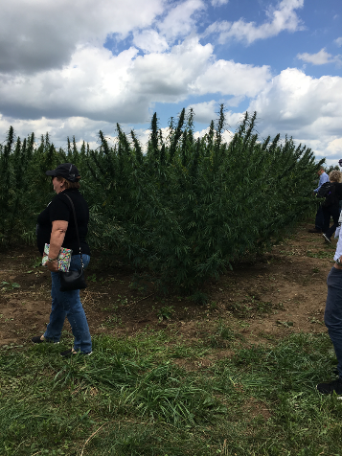
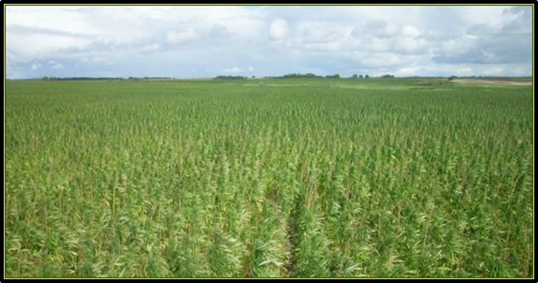
Metal Accumulation: Incomplete Case study
Background
Commercial industrial hemp grower for CBD
No known history of metal contamination
Processor detected Pb in biomass and oil

Slide 18
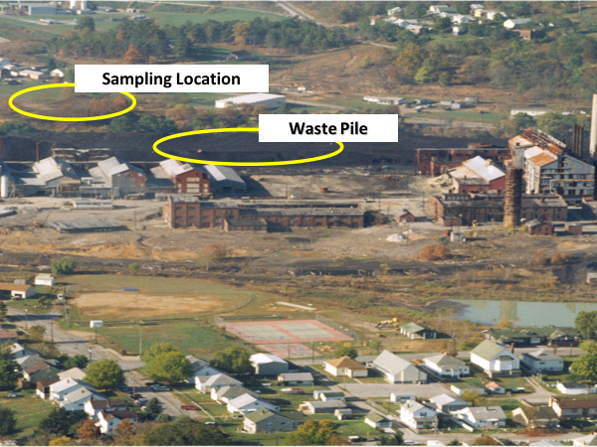
Metal Accumulation: Greenhouse Study 1
Zn Smelter contaminated soil
Zn = 3,100 ppm total
Pb = 600 ppm total
Cd = 60 ppm total
Mixed with sand at 25, 50, and 75% (w/w) contaminated soil (pH ~6.5)
Variety = Canda

Slide 19
Metal Accumulation: Greenhouse Study 1

Slide 20
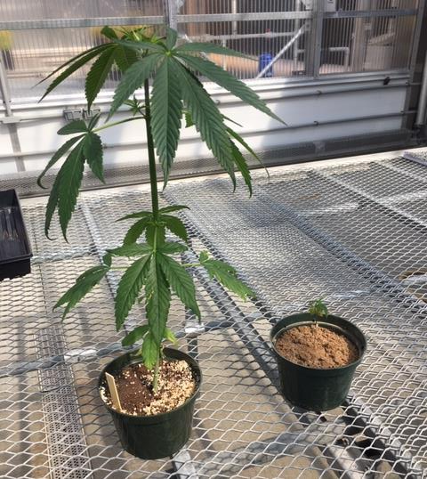
Metal Accumulation: Case study

Slide 21
Metal Accumulation: Greenhouse Study 2
Zn Smelter contaminated soil
Zn = 3,100 ppm total
Pb = 600 ppm total
Cd = 60 ppm total
Mixed with potting media at 0, 1, 2, 4, and 8% (w/v) contaminated soil (pH ~6.5)
Variety = Tygra

Slide 22
Metal Accumulation: Greenhouse Study 2

Slide 23
Metal Accumulation: Greenhouse Study 2
You must have done it wrong.

Slide 24
Mycorrhizal influences
International Culture Collection of (Vesicular) Arbuscular Mycorrhizal Fungi
WVU-INVAM

Slide 25
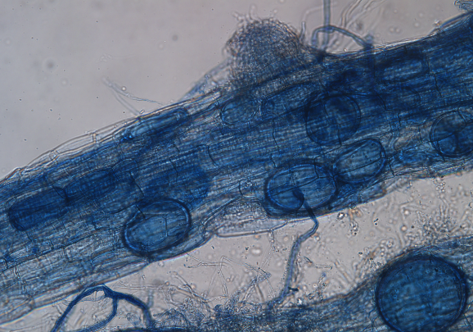
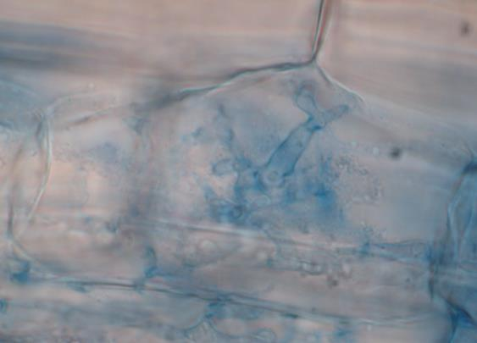
Mycorrhizal influences
A B
sp
ves
sp
sp
arb
ves
sp
sp
sp

Slide 26
Mycorrhizal influences - THC
Variety = Tygra

Slide 27
Mycorrhizal influences - CBD
Variety = Tygra

Slide 28
Mycorrhizal influences - CBG
Variety = Tygra

Slide 29
Summary
Still early days for production and processing
Potential to produce biomass, but . . .
Your State has to have a pilot program
You need a permit from that program
Need a secure location, open to inspection
You have to pass an FBI & State Police background check
Nail down your seed source & processing facility!

Slide 30
