Slide 1
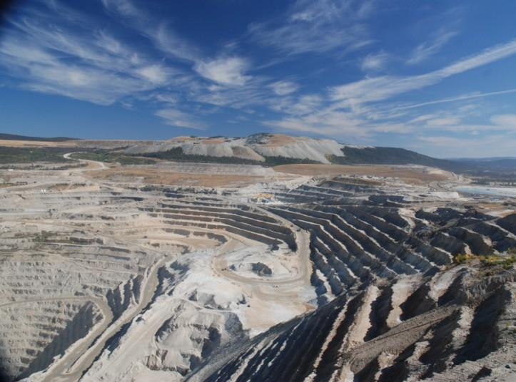
Cost-effective Strategies for the Restoration of Drastically Disturbed Sites
200 ton trucks
David F. Polster, M.Sc., R.P.Bio., CERP Polster Environmental Services Ltd.

Slide 2
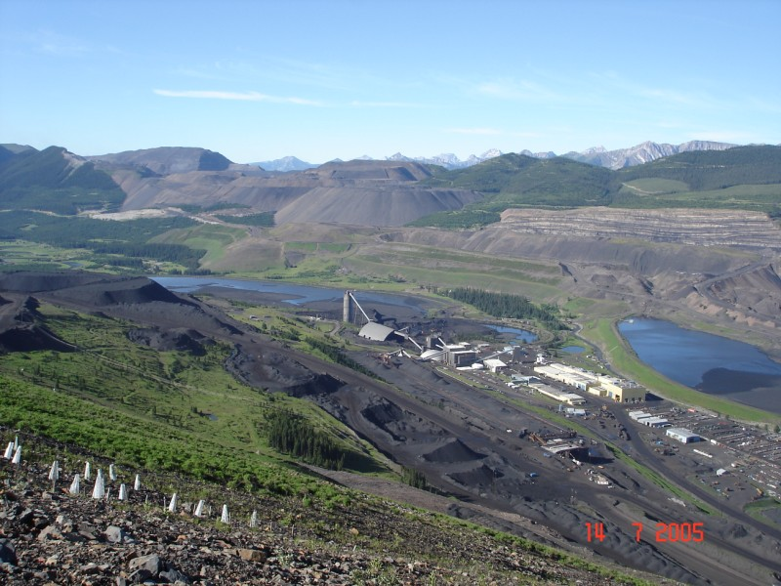
Ecological restoration is the process of assisting the recovery of an ecosystem that has been degraded, damaged, or destroyed.

Slide 3
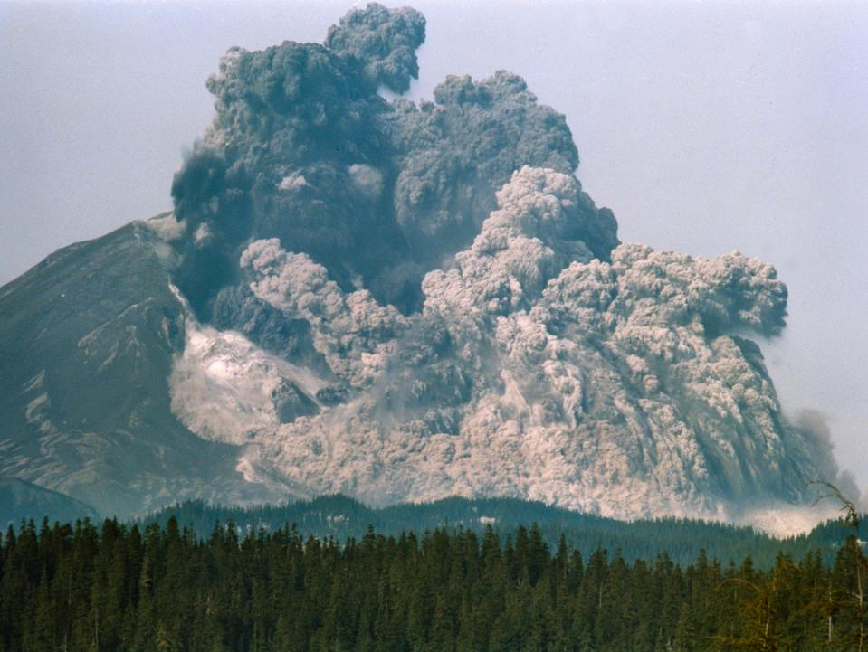
Natural disturbances have occurred since the beginning of earth.

Slide 4
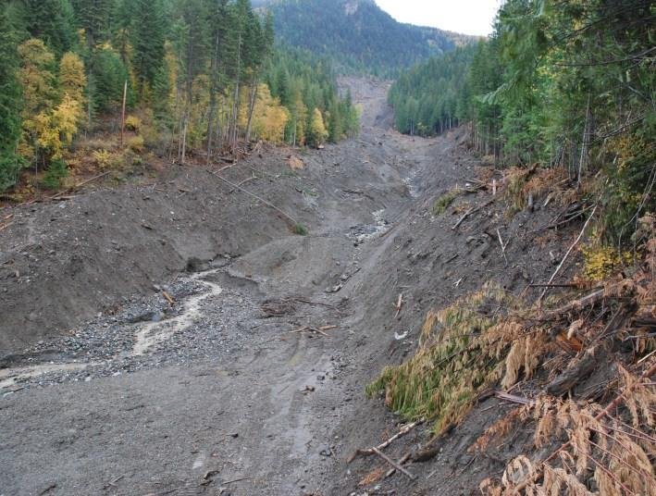
By looking at how natural processes restore these disturbances, we can gain insights in the restoration of sites we disturb.

Slide 5
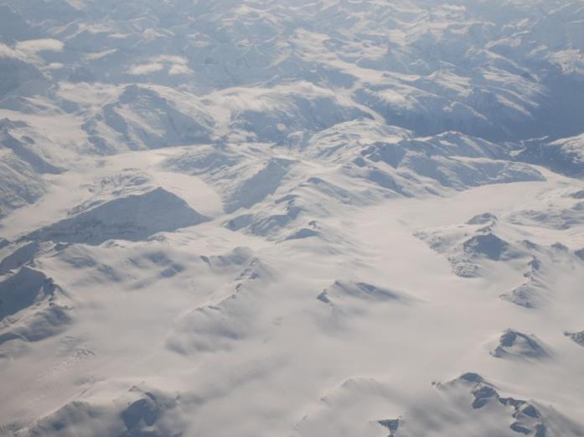
At one point not long ago most of the northern hemisphere was covered by ice.

Slide 6
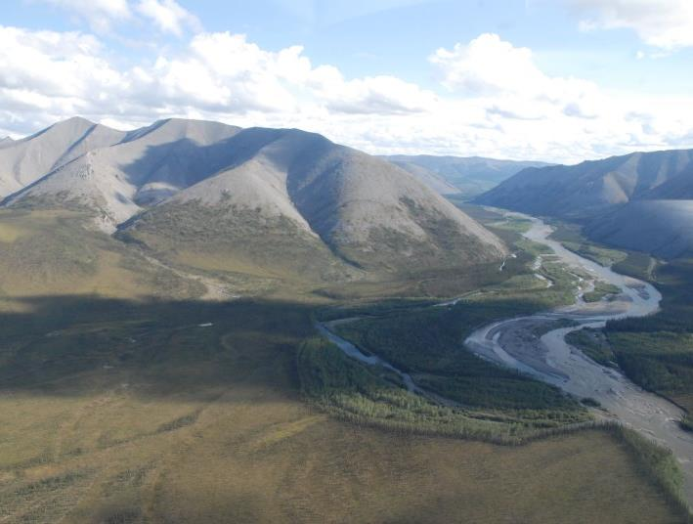
Now we have a diversity of ecosystems,

Slide 7
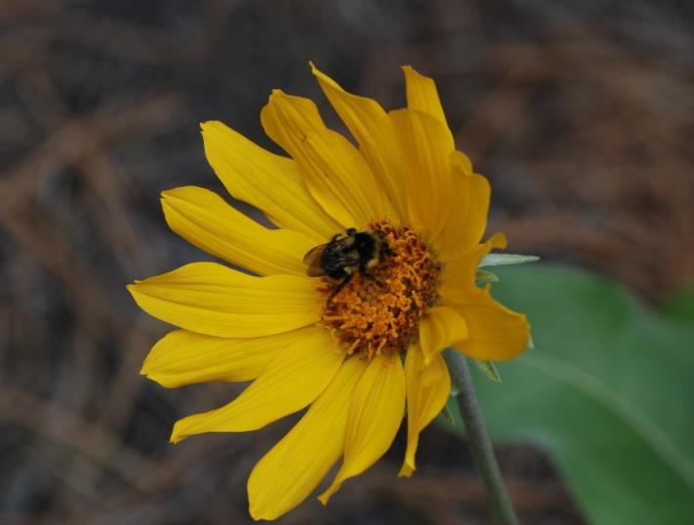
with all sorts of fancy interactions and connections.
Natural processes made this happen.

Slide 8
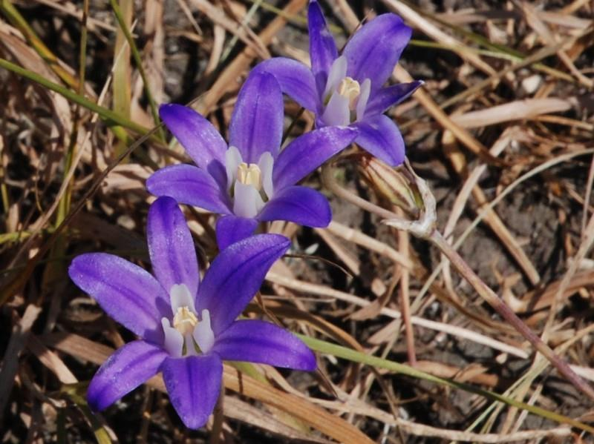
Natural processes ensure that the right species are established in the right places at the right times.
How does this happen?

Slide 9
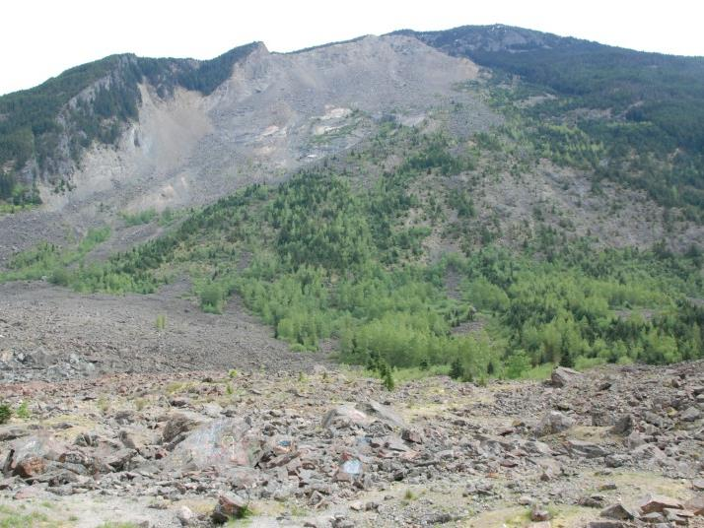
Hope Slide
How can we define strategies for the restoration of drastically disturbed sites?

Slide 10
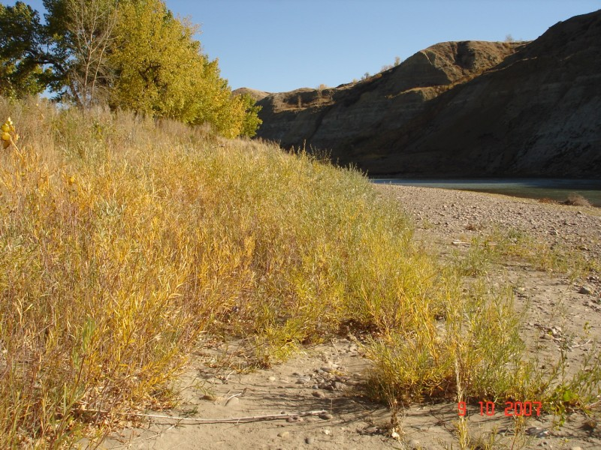
Milk River, AB
What are the species that establish naturally on disturbed sites?

Slide 11
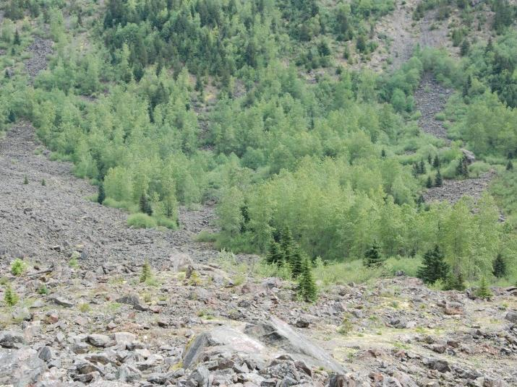
What characteristics do these species have?

Slide 12
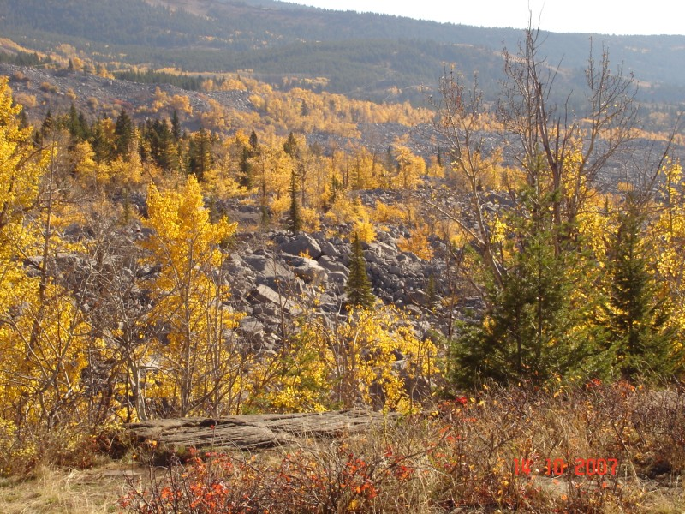
Frank Slide
What are the mechanisms of establishment?

Slide 13
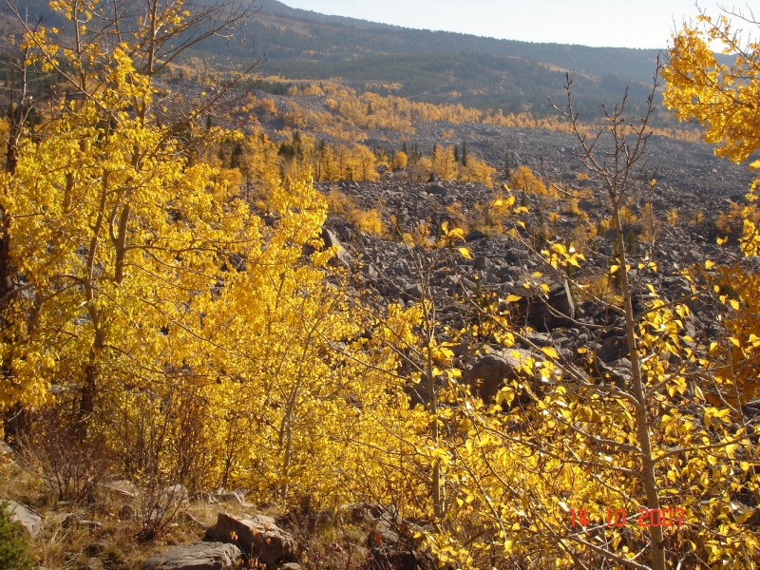
Frank Slide
How do pioneering species build soils on sites with no soil?

Slide 14
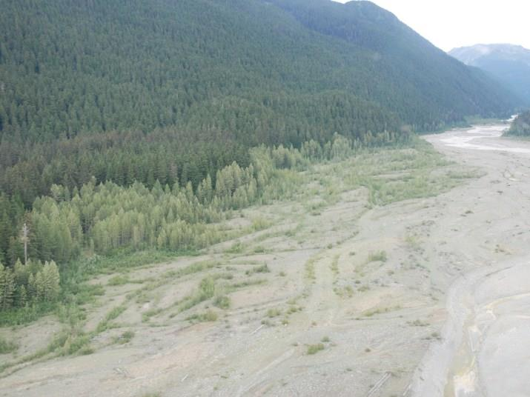
On gravel bars?

Slide 15
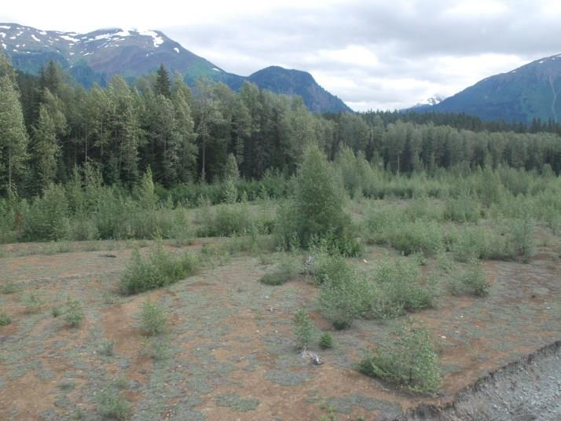
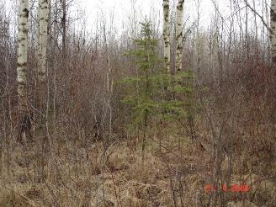
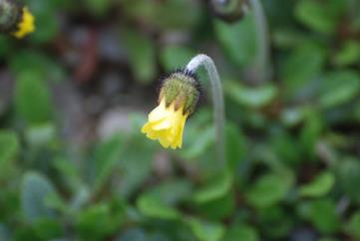
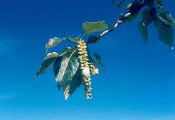
Develops soil horizons
Starts soil building, N fixing
Adds organic matter
Ecosystems in motion.

Slide 16
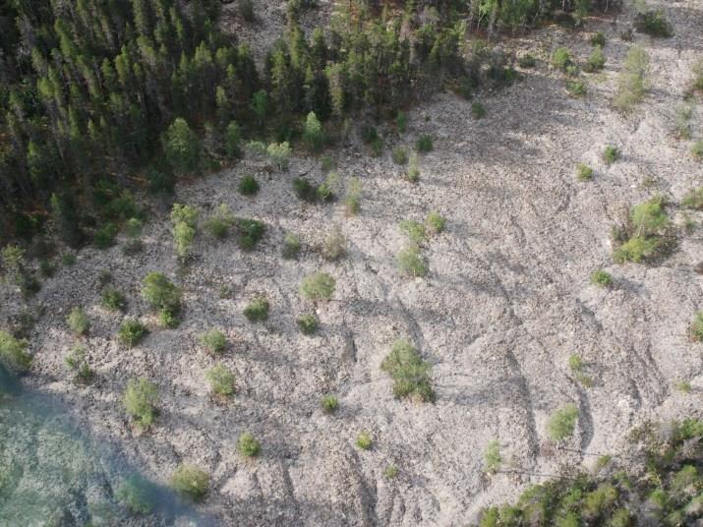
On lava flows?

Slide 17
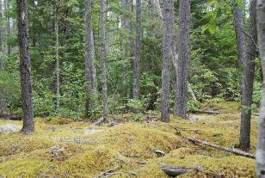
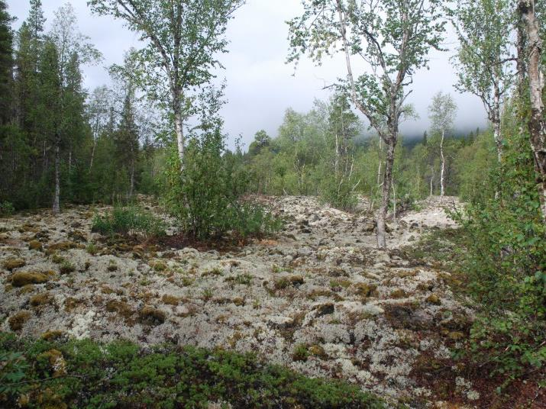
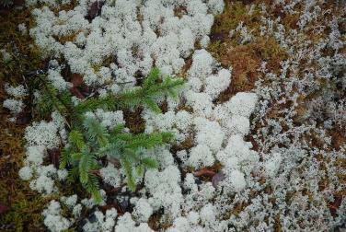
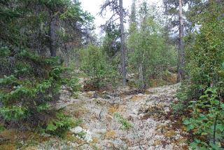
Develops soil horizons
Lichens fix Nitrogen, start soil building
Adds organic matter
Ecosystems in motion.

Slide 18
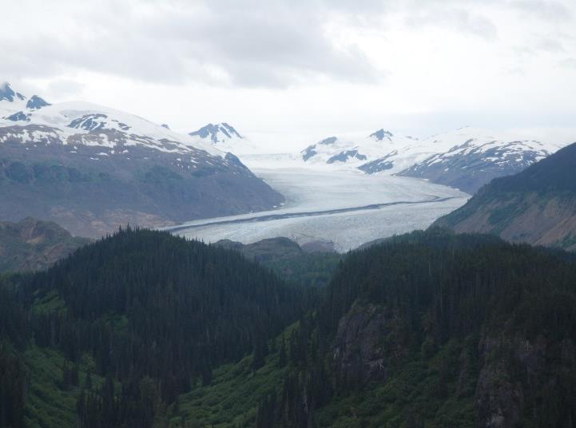
Behind retreating glaciers?

Slide 19
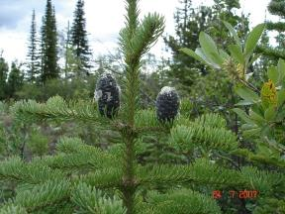
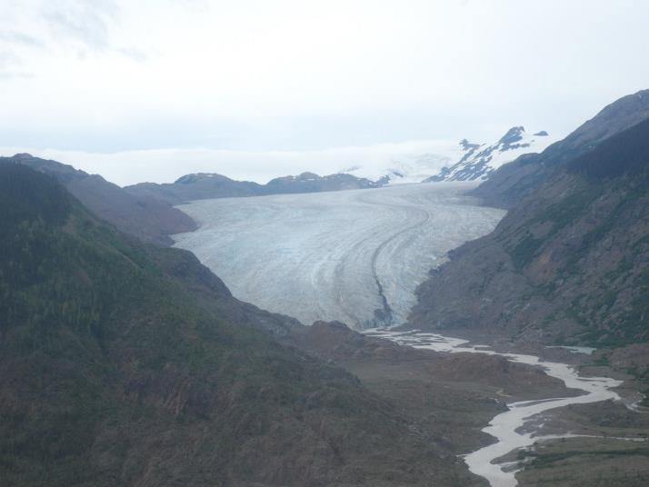
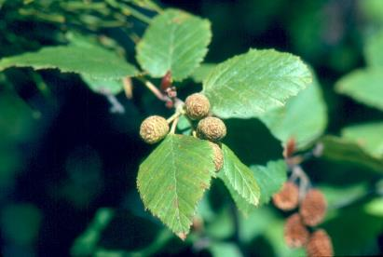
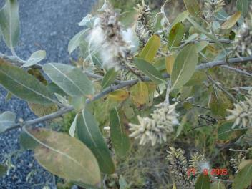
Conifers develop soil horizons
Alders fix Nitrogen, start soil building
Willows add organic matter
Ecosystems in motion.

Slide 20
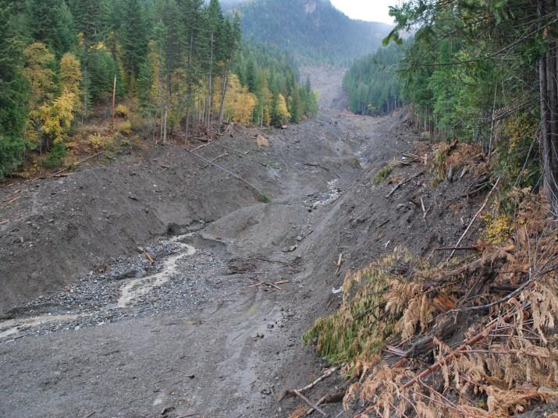
On landslides?

Slide 21
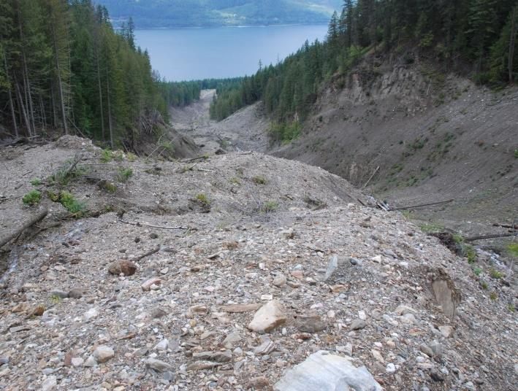
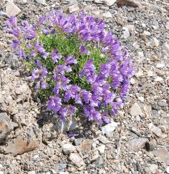
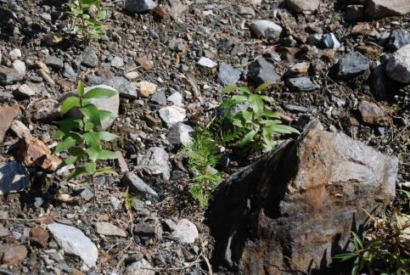
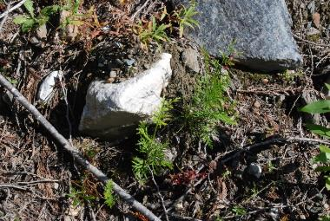
Showy plants add diversity
Pioneering plants start rebuilding the ecosystem
Conifers move in
Ecosystems in motion.

Slide 22
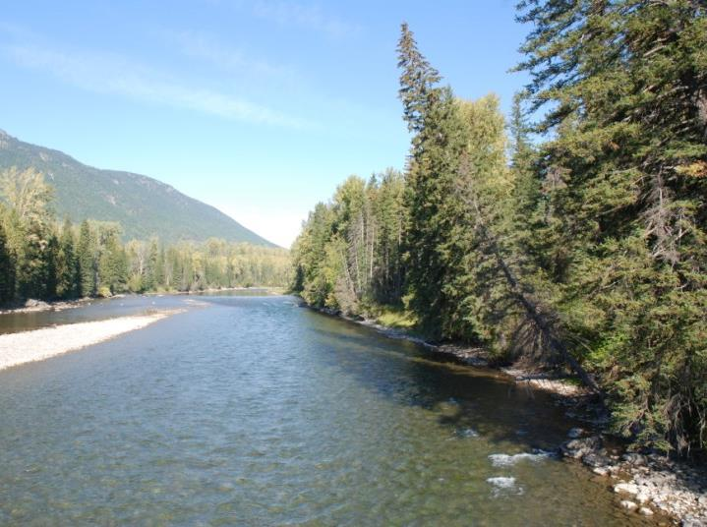
Natural processes build ecosystems from scratch.

Slide 23
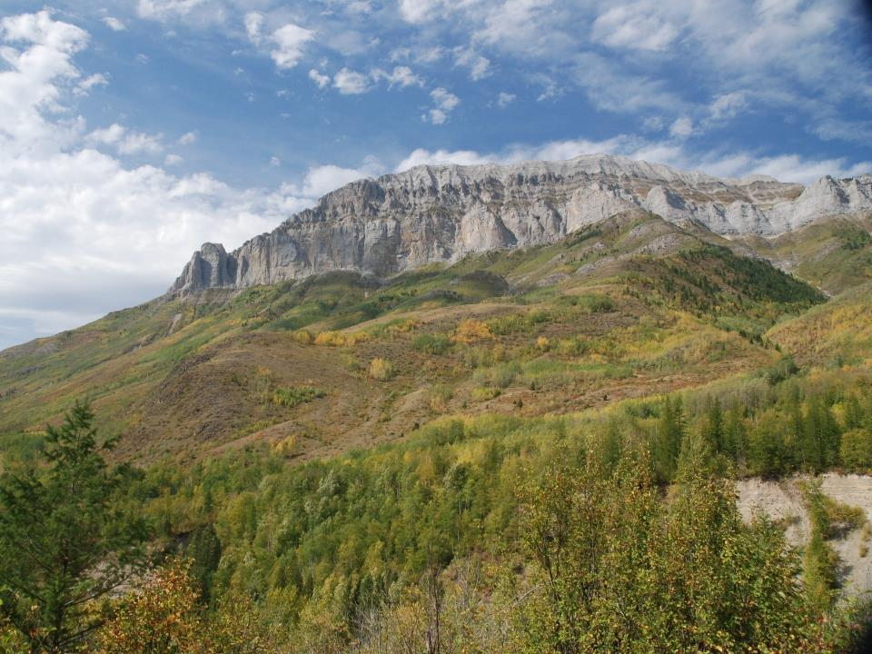
So how can we use these natural processes to restore ecosystems?
What are the “filters” that are preventing recovery, and how can we “assist” that recovery?

Slide 24
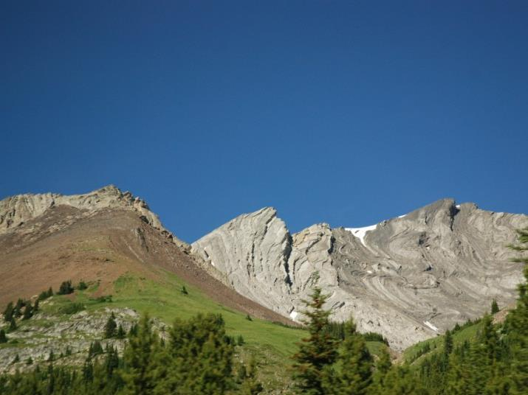
Common abiotic filters:
Steep slopes
Adverse texture
Nutrient status (+/-)
Adverse chemical properties
Soil temperature extremes
Compaction
Adverse micro-climatic conditions
Excessive erosion

Slide 25
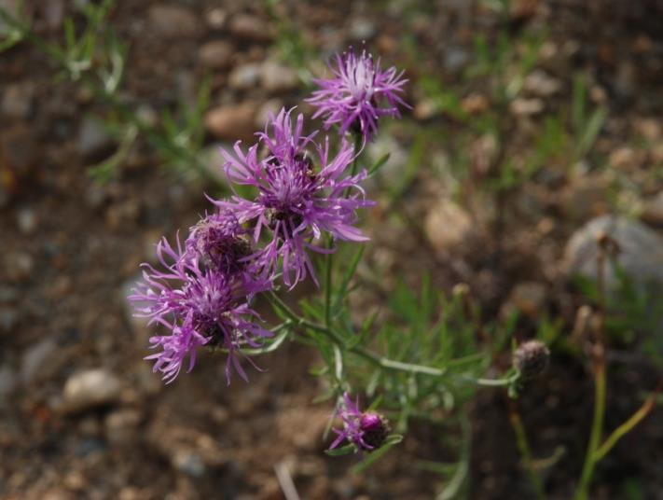
Common biotic filters:
Herbivory
Competition
Propagule availability
Phytotoxic exudates
Facilitation
Species interactions
Spotted Knapweed
Centaurea maculosa

Slide 26
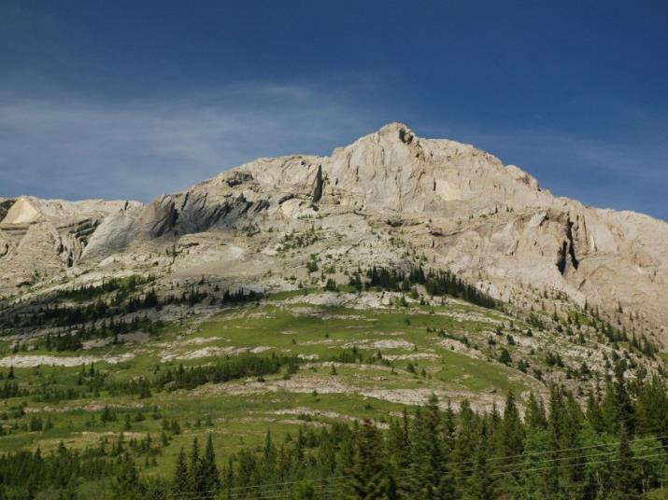
So let’s look at how natural processes address these filters…
…so we will have some ideas when we cause a disturbance.

Slide 27
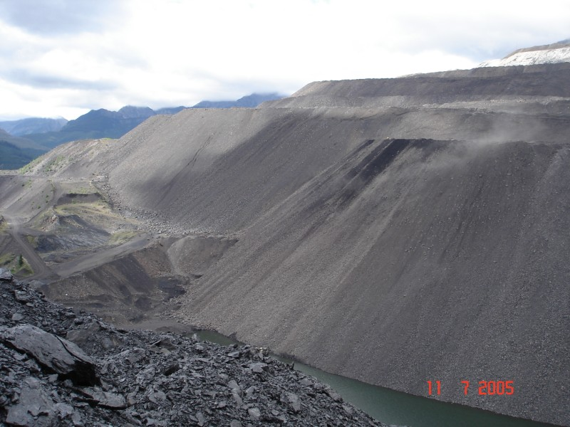
What about steep slopes and adverse textures?

Slide 28
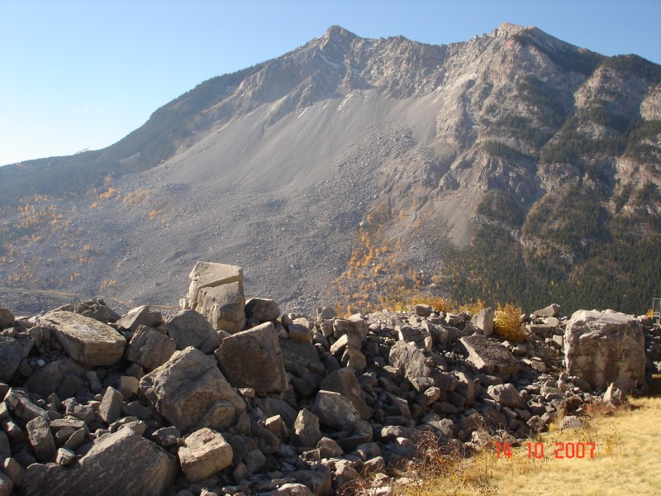
Frank Slide
Over time natural processes “restore” these sites.

Slide 29
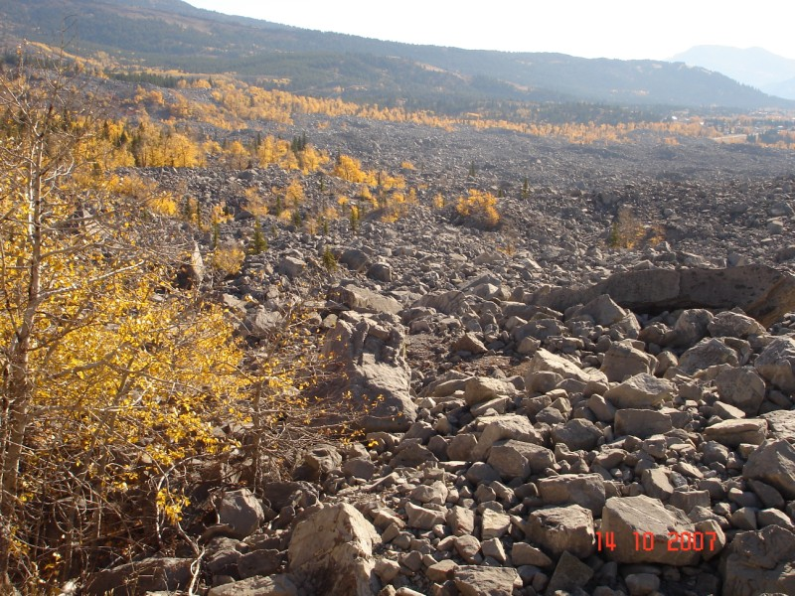
Studying how this happens provides a foundation for the design of restoration programs for our largest disturbances

Slide 30
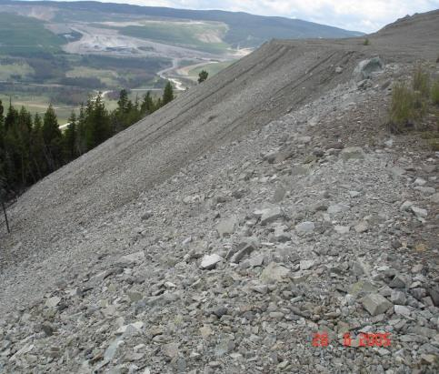
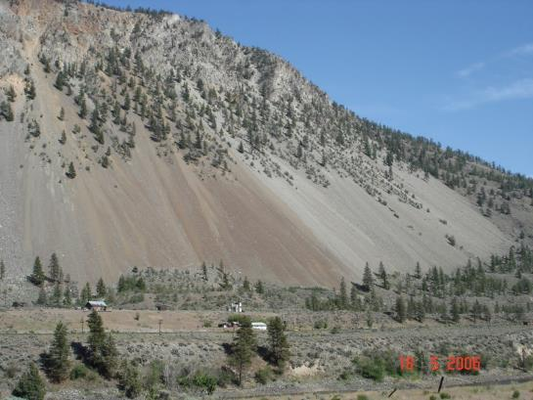
See any similarities???

Slide 31
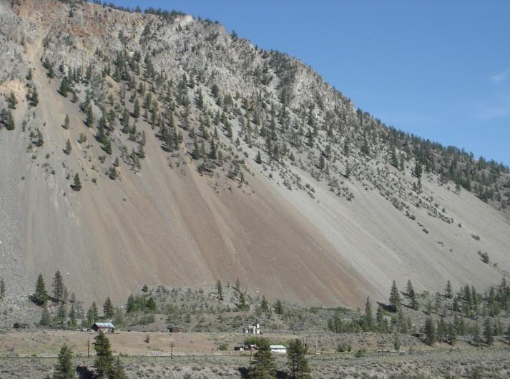
By looking at natural solutions to revegetation we can develop effective restoration systems

Slide 32
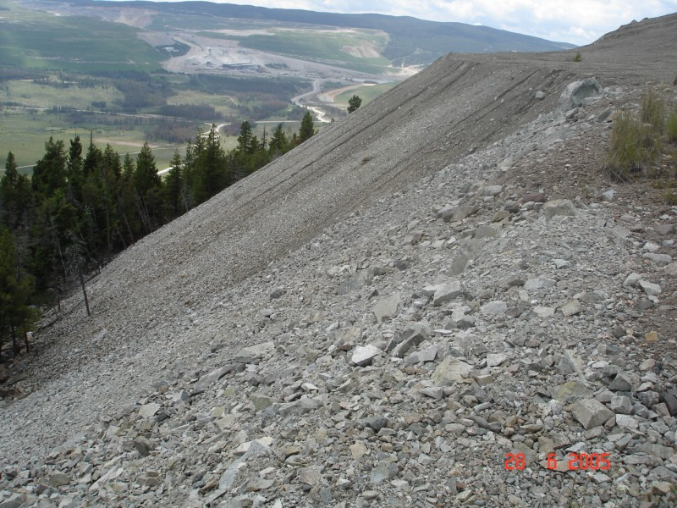
Fine textures at the top, free draining in the middle, larger rock at the bottom.

Slide 33
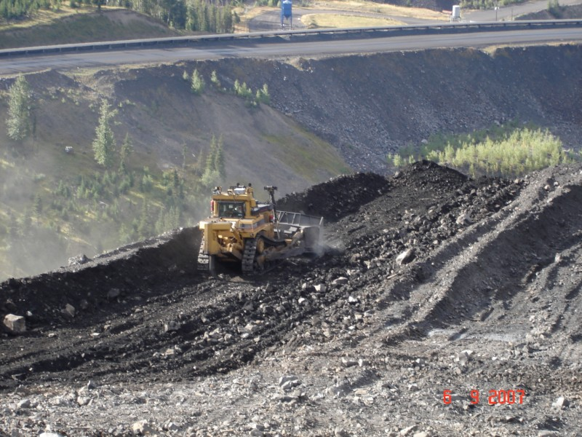
By pushing the fine textured materials over the face we can eliminate the limitations of the coarse substrate.

Slide 34
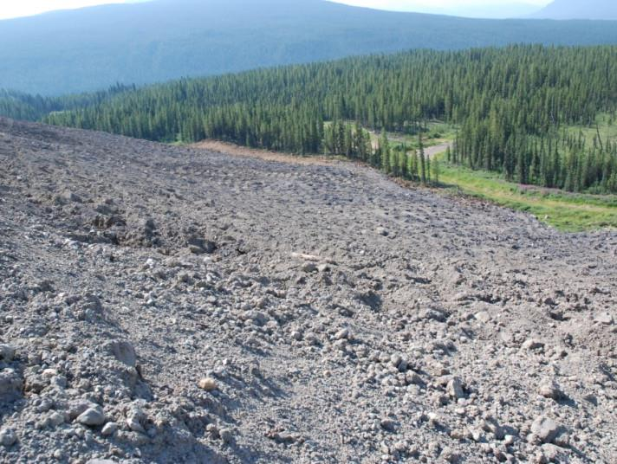
By making the surface rough and loose we can control erosion.
No seeding, topsoil or planting is needed to re-grow a forest on this site using natural processes.

Slide 35
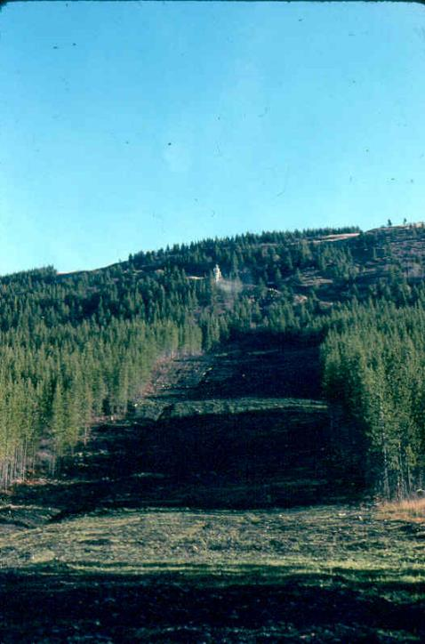
Helicopter seeding exploration trench in the Upper Elk Valley in the fall of 1977

Slide 36
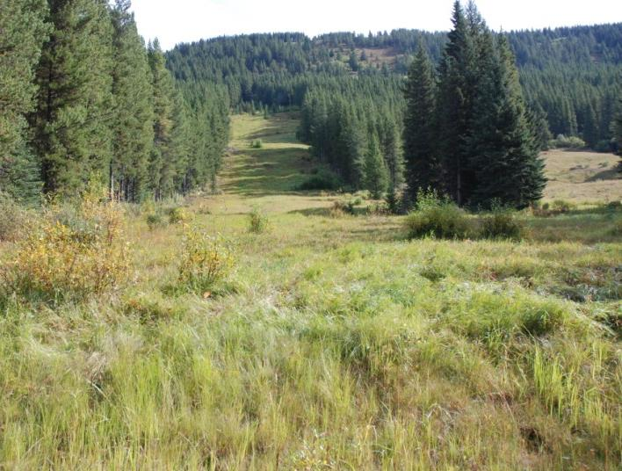
Upper Elk Valley
2009.
Notes:
However, 32 years later, this trench is still grass and legume covered. It should be covered with trees.

Slide 37
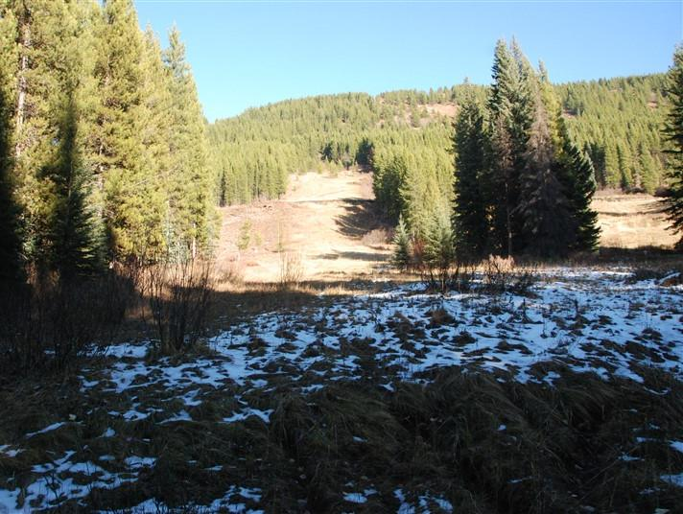
Upper Elk Valley
Seeded with agronomic grasses and legumes in 1977, photographed on October 26, 2017, 40 years later.

Slide 38
Upper Elk Valley
The agronomic grasses and legumes we have been using for erosion control and reclamation prevent effective recovery of these sites.

Slide 39
Natural Processes for the Reduction of Runoff
One of nature’s solution to heavy fall rains on the West Coast

Slide 40
Another solution to heavy rain

Slide 41
Swordferns
Note funnel-like shape that channels rainfall directly into the ground.

Slide 42
It is not surprising that Salal is one of the main plants on the outer West Coast where rainfall is high.
Notice how Salal takes rain water and channels it to the stem to run down the stem into the ground.
Notes:
Simple plants like Salal, one of our most common forest plants, move enormous quantities of rainfall directly into the groundwater system. Think of the West Coast of Vancouver Island where the salal is over your head and impossible to walk through.

Slide 43
Even pretty flowers perform this important ecological service.
Notes:
Even pretty flowers like this pink Easter lily catch rainfall with their broad leaves, channeling it into the groundwater system.

Slide 44
Water does not run across the ground in natural forests except in streams.
Notes:
Understanding how forest hydrology operates allows us to design systems that restore these important aspects of forested watersheds.

Slide 45
Water absorbing features of the forest floor create conditions that prevents run-off.
Notes:
Mossy rocks stockpile water allowing it to slowly seep into adjacent soil.

Slide 46
The mossy ground protects the soil surface from erosion and allows rainfall to soak in.
Notes:
In addition, the mossy covering in most forests prevents raindrop erosion and allows rainfall to soak into the ground.

Slide 47
The shape of the leaves and stems of this willow channel rainfall into the ground.

Slide 48
Many native grasses have a funnel like shape and deep roots.
Bluebunch Wheatgrass (Pseudoroegneria spicata (Pursh) A. Love)

Slide 49
Many prairie species have this structure.
Prairie Dropseed (Sporobolus heterolepis (A. Gray) A. Gray )

Slide 50
Plant shape helps capture moisture
Prevents rainfall from running off
Festuca altaica

Slide 51
How do natural processes operate in a forest to prevent runoff?

Slide 52
Natural forest processes

Slide 53
How are trees turning up in a forest connected with runoff prevention

Slide 54
Trees turn up large clumps of soil, leaving pits in the forest floor

Slide 55
As the old root mass weathers and breaks down

Slide 56
The mound of soil starts to attract vegetation

Slide 57
Until it becomes a mound on the forest floor.

Slide 58
How can we deal with erosion without grass and legume seeding?
“D 10” Bulldozer
July 21, 2008
Notes:
This was a project I was involved in a few years ago.

Slide 59
Spreading soil material…
“D 10” Bulldozer
Notes:
They were spreading soil (actually an oxidized till material) on the face of their tailings dam and they ended up with erosion before they were even done spreading the soil…

Slide 60
Erosion starting on smooth surface before spreading is even completed.
Notes:
The issue with the smooth slope was erosion. Water running down the slope would reach a point where the soils would saturate and slough away causing these erosion rills. Notice the tailings sand piling up on the bench. Any time you see sediments showing up like this there is erosion happening somewhere. The same is true for cloudy water. If the water is cloudy running off a site then there is erosion happening on the site.

Slide 61
Making the surface rough and loose
July 22, 2008
Notes:
In any case, the solution to sheet erosion is to stop the overland flow of water. Making the surface rough and loose so the water soaks in rather than flowing across the surface is a simple, cost-effective way of solving this problem.

Slide 62
Roughened the whole surface
Notes:
Here is the whole slope roughened.

Slide 63
Cost of rough and loose treatment at a northern mine was $715/ha while hydroseeding costs over $3,500/ha
Making surfaces rough and loose controls erosion and enhances native species establishment.
Notes:
In this way, the rough and loose terrain controls erosion and encourages native species establishment. The other nice thing is that it is about 1/3 the cost of normal hydroseeding, the traditional erosion control treatment.

Slide 64
Northern BC, September 22, 2014
Rough and Loose Restoration Treatments

Slide 65
Creating ideal conditions for vegetation growth.
Notes:
The rough and loose treatments were applied on the flat dump platforms, creating conditions that will support the growth of a variety of species.

Slide 66
West Portal, Planting in 1989
Rough and loose
Notes:
Notice rough and loose substrate (tunnel muck) and the general lack of a seeded cover.

Slide 67
West Portal, 1989
Notes:
Looking towards the Mount Macdonald Tunnel portal

Slide 68
West Portal July 15, 1999
Notes:
Conifers starting to dominate the canopy

Slide 69
West Portal August 3, 2003
Notes:
Note the healthy growth rates on the confers (internode length – length between main whorls of branches). The red arrow shows the portal while the yellow arrows show the internode growth.

Slide 70
West Portal July 8, 2005
Notes:
Portal almost obscured by tree growth

Slide 71
West Portal July 27, 2008

Slide 72
West Portal September 17, 2011

Slide 73
West Portal September 17, 2011

Slide 74
West Portal September 17, 2011

Slide 75
West Portal July 25, 2018, 29 years after planting.

Slide 76
Access management and erosion control, Ghost River, AB

Slide 77
Ghost tributary, Lesueur Creek, July 22, 2015

Slide 78
Rough and loose slope, Ghost River

Slide 79
Rough and loose road, Ghost River

Slide 80
Ghost tributary, Lesueur Creek, September 30, 2018

Slide 81
Balsam Poplar trees, Sept. 30, 2018

Slide 82
Making the site rough and loose has solved the un-authorized access problem and initiated recovery of the area.

Slide 83
NE Alberta
August 27, 2012
Notes:
At Foster Creek a number of temporary soil stockpiles were made rough and loose to control erosion and encourage woody species growth.

Slide 84
Happy willows…
NE Alberta,
September 10, 2014
Notes:
The rough and loose surface provides ideal conditions for the growth of willow cuttings.

Slide 85
Former gas plant near Edmonton.
Contaminated conditions remediated, February 1, 2010
Notes:
The contaminants were removed and the site remediated.

Slide 86
Gas plant site near Edmonton to be restored, March 11, 2010
Notes:
A former gas plant just south of Edmonton was remediated to remove contaminants. Note the osprey nest in the background.

Slide 87
Rough and loose, April 14, 2010
Notes:
The rough and loose treatment was applied.

Slide 88
Planting pioneering vegetation,
April 14, 2010
Notes:
Pioneering species, willows, Balsam Poplar and Red-osier Dogwood were planted as live stakes.

Slide 89
Planting pioneering vegetation,
April 14, 2010, note fence.
Notes:
Two meter long dormant cuttings were inserted one meter into the soil.

Slide 90
August 19, 2011
Two growing seasons
Notes:
But some of the Balsam Poplar cuttings were well above the Sweet Clover by the end of the growing season.

Slide 91
Happy Balsam Poplar…
August 17, 2013
Notes:
The forest that was established by the live staking continues to grow.

Slide 92
September 25, 2015

Slide 93
September 25, 2015
Six growing seasons after planting and we have 25 ft. high trees!

Slide 94
Pioneering forest established,
October 27, 2016.

Slide 95
Conifers coming in around the edges for free, October 27, 2016

Slide 96
Lots of Balsam Poplar seedlings moving into bare areas, October 27, 2016

Slide 97
Lots of Prickly Rose found in many areas, October 27, 2016

Slide 98
A diverse forest has a diversity of organisms, October 27, 2016

Slide 99
As the forest matures, additional species will establish, October 27, 2016

Slide 100
The forest continues to mature, September 18, 2017
The use of natural processes can provide cost-effective solutions for the restoration of drastically disturbed sites.
Notes:
By using natural processes for the recovery of this former industrial site we can provide effective restoration that rebuilds the natural ecosystems of the area.

Slide 101
Rough and loose gravel pit slopes,
NE Alberta

Slide 102
Control of erosion and enhancement of native species growth

Slide 103
Enhancement of recovery

Slide 104
Adding woody debris improves the recovery.

Slide 105
Tree planting as required by Alberta regulations (2,000 stems/ha planted).

Slide 106
Creating conditions for establishment of pioneering species allows a diversity of species to grow.

Slide 107
The trees grow really well on the rough and loose ground.

Slide 108
But in addition to the 2,000 planted species, a total of 13,000 stems/ha of pioneering species were found, including alder, willow and Balsam Poplar.

Slide 109
Making the ground rough and loose creates a diversity of ecological conditions so a diversity of species can establish.

Slide 110
Failing Slope – Using plants to perform stability functions rather than expensive engineering solutions.
June 18, 2014

Slide 111
Shallowly rooted grasses provide no support for slope

Slide 112
…the hill was re-sloped.
September 6, 2014

Slide 113
The steep, smooth slope was prone to erosion, so…
September 6, 2014

Slide 114
…we made it rough and loose and scattered some woody debris, and…
November 18, 2014

Slide 115
…installed 2,500 2 m long live stakes with 1 m in the ground.
November 18, 2014

Slide 116
A fence was installed to keep out the deer.

Slide 117
By March 16th, 2015, the cuttings were starting to sprout.

Slide 118
August 13, 2015

Slide 119
September 23, 2015

Slide 120
September 27, 2016

Slide 121
August 1, 2017

Slide 122
August 1, 2017

Slide 123
September 8, 2018
This site is sequestering 20 to 25 tonnes/ha of CO₂ annually

Slide 124
September 8, 2018

Slide 125
January 11, 2019

Slide 126
Alder Seeding
Sitka Alder Seed collection, September 25th, northern BC

Slide 127
Sitka Alder Seed collection, October 4th, Interior BC

Slide 128
Seeding steep slopes (0.8 : 1 or 51.3º) Roger’s Pass Project

Slide 129
Seeding Sitka alder, October 30, 1986

Slide 130
Alder seedlings from seeding
Notes:
Seedlings of Red alder from Clayoquot, not Roger’s Pass

Slide 131
Alder seeded slope, May 23, 1994

Slide 132
Alder seeded slope, July 16, 1999

Slide 133
Alder seeded slope, July 16, 1999
Notes:
Arrows show location of conifers that have seeded in naturally

Slide 134
Alder seeded slope, July 9, 2005
Notes:
Arrows show location of conifers that have seeded in naturally

Slide 135
Alder seeded slope, August 1, 2009
Conifers moving in…
Notes:
23 years after the slope was seeded with alder…

Slide 136
Alder seeded slope, July 26, 2018
Conifers continue to move in 32 years after the alder seeding.

Slide 137
Small slumps under straw blanket

Slide 138
Moisture sensitive soils treated with “Soil Guard”

Slide 139
Soil slumps under spray on blanket

Slide 140
Moisture sensitive soils treated next with coco-fiber matting

Slide 141
… with a similar result.

Slide 142
As the winter progressed, the slope continued to unravel.

Slide 143
Repairs initiated

Slide 144
Wattle fences hold the mud but let the water out.

Slide 145
The cuttings love the wet soil…

Slide 146
… and grow well.

Slide 147
May 21, 2008

Slide 148
May 21, 2008

Slide 149
March 23, 2010

Slide 150
August 19, 2016

Slide 151
Soil bioengineering solutions for the Point Grey Cliffs
Notes:
The Point Grey cliffs were part of a much larger outwash plain from continental glaciation 25,000 years ago called Quadra Sediments. The small grey band at the top of the slope is Vashon Till, a 12,000 year old deposit that resulted from the most recent glacial advance and pushed most of the Quadra sediment out of the Georgia Basin, leaving little bits in various places around the basin.

Slide 152
UBC Slopes, Winter 1988/89
Notes:
UBC was looking for a solution to erosion of the cliffs. Their engineers said that it would cost $500,000 to do the studies and drilling required to design the $20 million retaining walls that were going to be needed. We fixed the slope for $223,000 with 4.5 km of wattle fencing. This brief PowerPoint segment shows this process and how it all worked out.

Slide 153
UBC Slopes, March 6, 1989
70º Slope
Notes:
The slopes are very steep and are composed of weakly cemented (CaCO2) sands.

Slide 154
Doesn’t change slope (70 degrees)
Changes conditions for vegetation growth
1989
Notes:
Soil bioengineering uses living plant materials to treat problem sites. It doesn’t change the actual slope, as you can see from the untreated slope behind the worker, but it changes the conditions of the slope to allow vegetation to grow. The work on this slope was conducted over the winter of 1988/89.

Slide 155
UBC slopes initial test planted winter of 1987/88, May 7, 1988
Notes:
The materials (willows) used to build the retaining walls (wattle fences) sprout and grow.

Slide 156
Wattle Fences
Notes:
The steeper the slope the narrower the benches become.

Slide 157
UBC Slopes, May 28, 1990
Notes:
The whole slope turns green.

Slide 158
UBC Slopes, January 18, 1990
Notes:
Although the original slope can still be seen in this winter photo.

Slide 159
UBC Slopes, 1996
Notes:
Over the years the willows grow up and support the slope with their roots.

Slide 160
UBC Slopes, March 25, 1999
Notes:
Eventually (10 years) alder moves in and starts building soils.

Slide 161
UBC Slopes, March 25, 1999
Notes:
Conifers also move in under the alder. Soils continue to build. All on the 70º slope.

Slide 162
UBC Slopes, July 4, 2012
Notes:
As the forest grows, other species move in.

Slide 163
UBC Slopes, July 4, 2012
Notes:
Soils continue to build on top of the sand.

Slide 164
UBC Slopes, November 26, 2012
Notes:
We now have a forest of alder, Western Hemlock, Salmonberry, Swordferns and a diversity of other species.

Slide 165
UBC Slopes, January 21, 2016
Notes:
Some English Ivy has moved in and should be dealt with.

Slide 166
UBC Slopes, February 3, 2017
Notes:
This wintery view of the slope shows how the vegetation continues to deal with the steep slope.

Slide 167
UBC Slopes, February 3, 2017
Notes:
Soils continue to develop.

Slide 168
UBC Slopes, January 24, 2019

Slide 169
What will happen in this ditch when it starts raining?

Slide 170
So now it is raining and sediment is washing into a sensitive wetland

Slide 171
Is this an effective erosion control system???

Slide 172
What about this?

Slide 173
…or this???

Slide 174
Live silt fencing slows flows and allows sediments to drop out

Slide 175
A high-tech solution, live silt fences, February 20, 1992
Notes:
Live silt fencing is a soil bioengineering technique that slows the flow and allows sediment to drop out. The cuttings grow into a willowy wetland that is perfect for controlling sediment and enhancing the biodiversity of the watercourse.

Slide 176
February 20, 1992
Notes:
Dense rows of live stakes slow the velocity of the water and allow sediments to be deposited. This site is on the Vancouver Island Gas Pipeline just above the Qualicum River fish hatchery.

Slide 177
May 11, 1992
Notes:
The cuttings sprout and grow.

Slide 178
January 30, 1993
Notes:
As leaves and other detritus collects against the bands of cuttings, small settling ponds are formed, further encouraging the further deposition of sediment.

Slide 179
April 9, 1997
Notes:
Eventually a willowy wetland is formed.

Slide 180
April 9, 1997
Notes:
Complete with skunk cabbage and other wetland plants and animals.

Slide 181
Vancouver Island Gas Pipeline RoW
May 25, 2018

Slide 182
Disturbed streambank prior to treatment, October 12, 2005

Slide 183
Cuttings ready to go

Slide 184
Disturbed streambank after treatment, December 18, 2005

Slide 185
Disturbed streambank growing,
July 14, 2006

Slide 186
May 1, 2010

Slide 187
Natural processes can provide significant advantages.
Notes:
Even large mining operations can make sites rough and loose. This is at the Greenhills mine in SE BC.

Slide 188
At this coal mine site, the rough and loose surface creates North and South exposures.
Notes:
They also added woody debris. In addition to controlling erosion, the creation of the large irregularities has created slopes with different exposures within a few meters of each other so heat, another filter on dark substrates, is ameliorated on the north facing parts of these slopes.

Slide 189
We can use natural processes as a model for the restoration of large mines.

Slide 190
These are very cost-effective strategies for the restoration of large disturbances

Slide 191
We have learned about how natural systems (rough and loose) can control erosion and foster recovery.

Slide 192
And about how these systems can deal with the filters that prevent recovery, like compaction,

Slide 193
And about how the cost of these systems is a fraction of the cost of traditional treatments ($715/ha vs. $3,500/ha) but what are some of the other advantages?

Slide 194
Plants grow well on rough and loose substrates, and do so for free.

Slide 195
So let’s look at how we can use these restoration systems to restore major disturbances.
BC Hydro removed the Heber River Dam and was faced with the need to restore the disturbed sites
Notes:
BC Hydro has removed the Heber River Dam and associated infrastructure. I was asked to develop a restoration plan for the project disturbances. As this site is located within Strathcona Provincial Park, the primary project goal is to return disturbed sites to a natural condition that will allow full recovery with species assemblages appropriate to the ecological conditions of the site. The restoration target in this case is a diversity of successional ecosystems that will re-establish the disturbed sites on the natural successional trajectories that will lead to a diversity of vegetation types, depending on the specific conditions of the site that was treated.

Slide 196
There was a 3 km penstock that was also removed.
Notes:
This photo shows the penstock pipe. I want you to notice a couple of things here – the relatively narrow right-of-way and the abundance of vegetation that has established naturally with no help along the pipe. So we know that even in a relatively narrow right-of-way, native pioneering vegetation will establish, even on an unprepared site. If, once the pipe is removed, we make the site rough and loose to provide opportunities for seed capture, I suspect the area will recover nicely within a few years. Of course this is the essence of ecological restoration – doing what we need to do to assist in the recovery of a site that has been damaged, degraded or destroyed.

Slide 197
What are the constraints or filters preventing natural recovery?
Notes:
The key to finding appropriate restoration treatments is to identify what factors (filters) are preventing the natural recovery of disturbed sites. As you can see on this old logging road in the dam area, compaction is preventing vegetation from establishing. The vegetation is slowly moving in from the edges where compaction is reduced. Eventually natural de-compaction processes and/or covering the site with organic detritus from the adjacent forests will allow vegetation to cover this site.

Slide 198
What are the successional patterns that operate in the region?
Notes:
Successional processes revolve around pioneering species including red alder (Alnus rubra), cottonwood (Populus balsamifera) and willows – mainly Scouler’s (Salix scouleriana). Red-osier dogwood (Cornus stolonifera) shows up in some areas. As you can see in this photo, alder establishes very quickly on any sites that are suitable.

Slide 199
So we made project sites rough and loose (= increased topographic heterogeneity) and covered them with woody debris (October 7, 2012).
Notes:
This controls erosion and provides sites for seed capture and seedling growth. This creates conditions for recovery.

Slide 200
Dam area, October 7, 2012
Notes:
The rough and loose dam area with woody debris starts the natural recovery processes.

Slide 201
Dam area, July 16, 2017

Slide 202
By November 13th, 2012 the project sites were ready for winter.
Notes:
The river was rising and the ground was being covered by snow when the site was visited in mid-November.

Slide 203
Monitoring transects were established at 5 project locations.
Dam area, July 16, 2013
Notes:
Transects were established at 5 locations throughout the project area, including the dam area shown here. Each transect consists of 10 plots that are circular with an area of 1/100th of a hectare. The transects were established on July 16th and 17th, 2013. The relatively early fall completion of the large dam area site allowed the 2012 alder seed crop to establish on the freshly prepared soils.

Slide 204
Woody debris is an important natural process for bringing in other species.
Notes:
Using woody debris in the restoration of the dam area promotes recovery. Birds land on the woody debris, bringing the seeds of Black Raspberry (Rubus leucodermis Dougl. ex T. & G.) that is growing beside the stump. The small photo on the left shows a detail of the seed containing bird poop that can be seen on the stump. This photo was taken on July 8, 2015 on Transect 4. Woody debris should be applied at a rate of 100 m³ / ha.

Slide 205
In 2017, fruit bearing plants were found in 98 % of the 50 plots.

Slide 206
An average of 5,410 Red Alder seedlings/hectare were found in 2013
Notes:
The number of alder seedlings in each plot were counted. In some cases where numbers exceeded several hundred an estimate was made. An average of 5,410 alder seedlings per hectare were found. Although many of these will die, new seedlings will establish. It is clear that natural establishment of a suitable cover of pioneering species is assured.

Slide 207
Including between the rocks of the rip-rap
Notes:
As the alder forest develops, other species will move in with the conifers of the Coastal Western Hemlock zone eventually replacing the alder. The alder will have provided a nitrogen rich humus layer into which the seeds of forest species can establish. As the woody debris that was scattered on the sites softens, species such as Red Huckleberry will move in. Similarly, birds perching on the growing alder will bring in seeds of Salmonberry and other fruit bearing species. Eventually the full compliment of native species will be established on the disturbed sites with species favouring wet areas growing in the wet spots and those favouring dry sites growing in the dry areas. The application of natural processes will ensure the appropriate species establish in the appropriate locations.

Slide 208
The alder that naturally established in the rip-rap will grow to lock the rocks in place providing a powerful tool in the maintenance of the rip-rap for free.
Notes:
Trees growing in rip-rap help to lock the rock in place.

Slide 209
In 2017 these trees are growing up between the rip-rap.

Slide 210
By 2014 an average of 8,554 Red Alder seedlings/hectare (and 67 other species) were found
Notes:
The 2014 inspection revealed an average of 8,554 Alder seedlings (and 67 other species) growing on project sites including seedlings of Hemlock and Douglas-fir.

Slide 211
In 2015 an average of 5,392 Red Alder seedlings/hectare were found along with 80 other species
Notes:
The alder trees are starting to thin out while other species move in.

Slide 212
By 2016 an average of 6,162 Red Alder seedlings/hectare were found.
Notes:
By 2016 the count was up to 6,162 alder with conifers in most of the plots.

Slide 213
In July 2017 an average of 6,963 Red Alder seedlings/hectare were found along with conifers in 98% of the plots.

Slide 214
The growth of conifers under a canopy of deciduous species is enhanced.
Notes:
On June 19, 2017 this happy little Douglas-fir tree was noted under the alder.

Slide 215
July 16, 2013
Notes:
The rough and loose ground and woody debris provides ideal habitat for establishing alder. The red arrow shows a tree that can be seen in the repeat photos of this site.

Slide 216
July 23, 2014
Notes:
The sprouting alder is turning the project sites green.

Slide 217
July 6, 2015
Notes:
There is now a carpet of happy alder.

Slide 218
July 20, 2016
Notes:
Now that the alder have leafed out, the cover provided by the naturally seeded in alder is obvious. Note that none of these were planted, they all came in on their own as the habitat for them was created by making the areas rough and loose and scattering woody debris.

Slide 219
July 16, 2017

Slide 220
In addition, the diversity of species that have established (over 80 different species) means that the restored ecosystems have a high degree of ecological resilience.
None of these plants were purchased and planted saving on the order of $15,000/ha.

Slide 221
Including a bunch of showy species,
All planted in the right spots.

Slide 222
Year | No. of Alder / ha | Cover of Alder | No. of Other Spp. | No. of Conifer Occurrences out of 50 plots | Total Cover
2013 | 5,412 | Less than 1% | 32 | 3 (1 spp.) | 1.10%
2014 | 8,550 | 2.60% | 68 | 31 (2 spp.) | 9.20%
2015 | 5,392 | 17.72% | 80 | 30 (4 spp.) | 36.30%
2016 | 6,162 | 27.04% | 75 | 40 (3 spp.) | 46.40%
2017 | 6,963 | 34.58% | 84 | 49 (5 spp.) | 54.00%
Salient features of 5 years of monitoring at the former Heber Dam
Notes:
This table shows how the vegetation has responded over the 5 growing seasons since the dam was removed. The vegetation that has established on the site for free is estimated to be valued at about $15,000/ha.

Slide 223
Crossing site, October 29, 2018

Slide 225
Questions???
July 15, 2017

Slide 226
Consider applying to become a Certified Ecological Restoration Practitioner

