Slide 1
Land Application Disposal System Design for Biochemical Reactor Treated Effluent
N.R. Anton
D.T. Shanight
C.S. Storrar
M.J. Fischer
E.M. Janoviak
B. Lala
American Society of Mining and Reclamation Conference
June 6, 2019

Slide 2
Outline
Tenmile Site Background
Luttrell Repository Components
Pre-Design Investigation Activities
Full-Scale Passive Treatment Design Overview
LAD Design and Operation

Slide 3
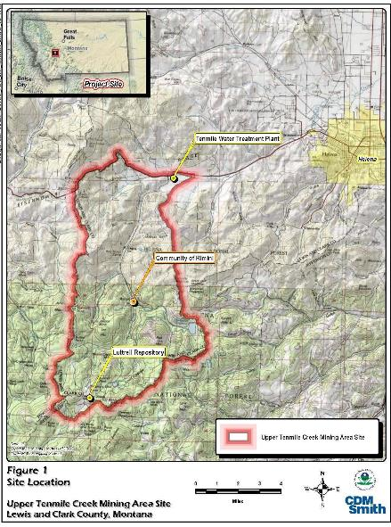
General Site Background
Location: Upper Tenmile Creek Mining Area Superfund Site
Contaminants of Concern: Al, As, Cd, Cu, Fe, Pb, Mn, and Zn
Currently addressing priority abandoned mine sites
28 remediated to date (after 2015)
54 mine sites remaining
Waste from contaminated residential yards and abandoned mines moved to Luttrell Repository

Slide 4
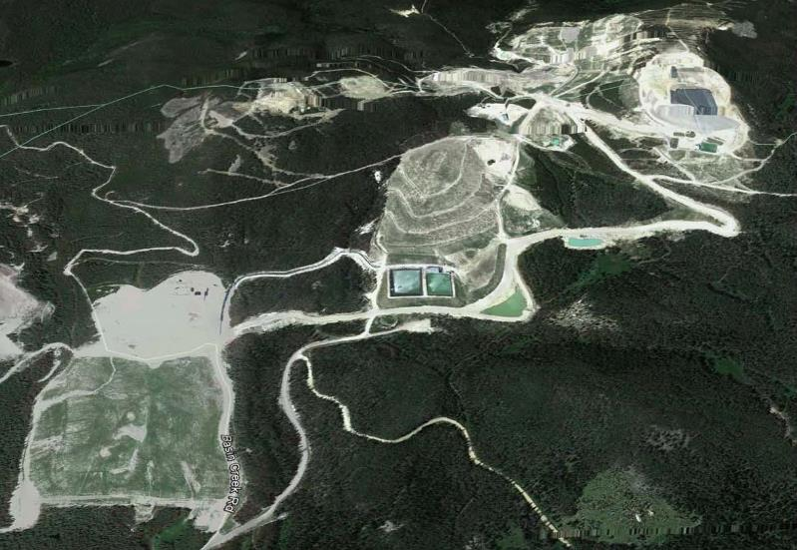
Luttrell Repository
Regional repository
Former Basin Creek Mine – Luttrell Mine Pit
Serves Tenmile Creek, Basin Creek Superfund sites, and other high priority mine cleanups
Long-term leachate treatment approach

Slide 5
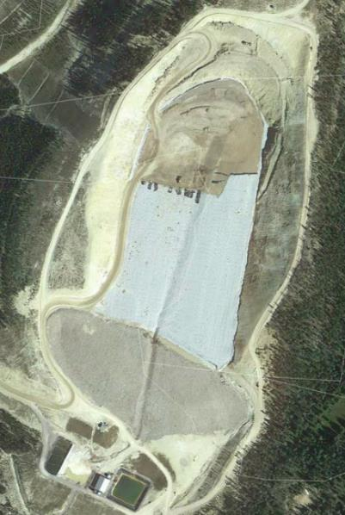
Luttrell Components
Luttrell Repository
Full liner system with leachate collection and treatment
~1 million CY capacity
Leachate Collection Pond
~750,000 gal capacity
Water Treatment Plant
Up to ~50 gpm
BCR Pilot
Existing Land application disposal (LAD) system
2015 Waste Placement Area
Winter Cover
LAD area
BCR Pilot Pond
Storm Water Pond
Water Treatment Plant
Leachate Collection Pond

Slide 6
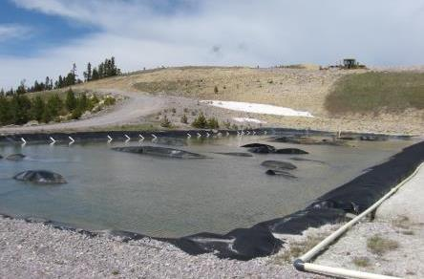
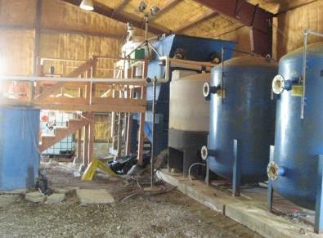
Leachate Water Treatment Systems
Active conventional water treatment plant using sodium hydroxide
Pilot BCR - sulfate reducing bacteria (SRB) to reduce sulfate to sulfide and form metal sulfide precipitates
Systems are aging and require diesel generator power - long-term treatment solution needed
Existing Leachate pond undersized to accommodate spring melt
Pilot BCR
Active Treatment Plant

Slide 7
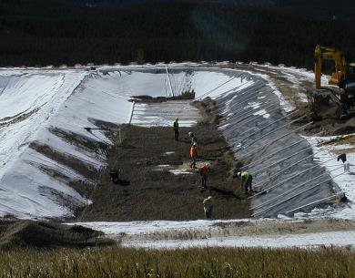
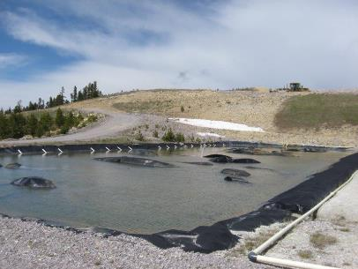
Pilot-scale Biochemical Reactor
Startup in 2003
Operated through 2017 season
Design parameters:
Max influent flow rate: 6 gpm
Sulfate reduction rate: 300 mmol/m³-day
Retention-time: 5.4 days
Substrate: straw, manure, wood chips, coarse limestone gravel
Adequate metal removal - Can use same sizing principles for scale-up system

Slide 8
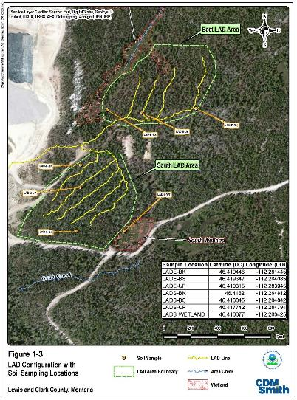
Land Application Disposal System
Existing System
Diesel generator and pump operated from WTP and BCR
Two LAD areas covering 16.7 acres
~2 acres of wetted surface area
Site-specific discharge standards based on soil adsorption capacity
Not ideal location for long-term application of treated water

Slide 9
Land Application Disposal System
LAD benefits
Avoids direct surface water discharge and required standards
Utilizes sorption capacity of soils to remove residual metals and ions
Provides supplement watering of forest or other type of ecosystem
Site-specific sorption-based standards and/or GW-based standards
Can be gravity operated for passive systems
LAD challenges
Requires regulatory approval and coordination
Could mimic or trigger ‘groundwater injection’ regulations
Requires careful soil evaluation of proposed LAD area to ensure:
Effective water retention
Adequate sorption capacity
Safe distance from wetland areas and near-surface groundwater

Slide 10
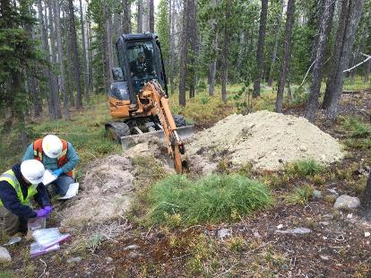
Pre-Design Field Investigation
LAD field assessment
Evaluate evapotranspiration and permeability of area soils using USDA and Montana resources
Identify overall LAD areas
Test pits in new potential LAD areas
Lithologic logging
Forest and wetland evaluation
Soil analysis
Total metals
Agronomic properties
Grain size analysis
Remolded permeability
Sand cone field density
Metal sorption capacity testing

Slide 11
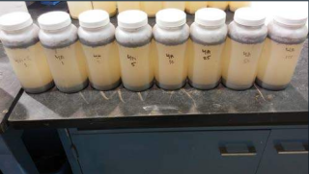
LAD Soil Metal Sorption Study
Soil from 2 test pits in new potential LAD areas, A and B horizons
7 ratios of stock BCR effluent water to spiked BCR effluent water
(10%, 5%, 2.5%, 1%, 0.5%, 0.2%, 0.1%)
Spiked BCR effluent (As₂O₅, CdCl₂, CuCl₂, PbCl₂, ZnCl₂)
Post-treatment aeration simulated
28 batch tests plus 2 replicates
Batch tests tumbled for 24 hours
Samples analyzed for metals analyses
Subsample of soil from each location
Stock BCR effluent water
Batch tests

Slide 12
LAD Soil Metal Sorption Study
LAD system metal sorption capacity
Plotted data for each metal and sample
Langmuir isotherm linear regressions to calculate sorption capacity
Soil Location | Source | Sorption Capacity (Qm) (mg/kg)
 |  | Arsenic | Cadmium | Copper | Lead | Manganese | Zinc
T4A | Calculated¹ | 28.33 | 15.92 | 61.35 | 28.01 | 48.54 | 285.71
 | Estimated² | 28.8 | 5 | 45 | 40 | N/A | 250
T4B | Calculated | 1.12 | 2.18 | N/A | 34.72 | N/A | 212.77
 | Estimated | 1.2 | 10 | 18 | 40 | N/A | 200
T7A | Calculated | 8.10 | 1.80 | 27.10 | 26.88 | N/A | 69.44
 | Estimated | 8.1 | 1.2 | 30 | 35 | N/A | 65
T7B | Calculated | 20.92 | 0.84 | 31.15 | 97.09 | 36.50 | 80.65
 | Estimated | 2.1 | 0.8 | 30 | 100 | N/A | 90

Slide 13
LAD Area Sorption Capacity
Mass of each metal over operational period
92-day treatment season x 12.5 gpm = 1.6 Mgal
Average 2015 effluent metals concentrations
Volume of soil in proposed LAD area
6.3 acres x 8 ft = 62,000 m³
Use sorption capacity from tests
Calculate sorption life in years
Lifespan = 22 years (conservative)
Partial removal Mn in post-treatment
Fluctuation of Mn concentrations year to year
Precipitation of Mn-oxides (rather than sorption)

Slide 14
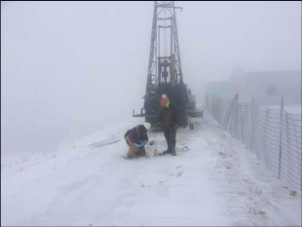
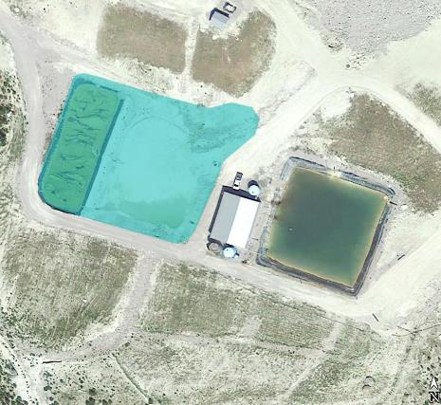
Pre-Design Field Investigation
Leachate pond stability evaluation
Hollow-stem auger drilling at existing pond areas
Geotechnical properties
Inclinometer installation to evaluate embankment movement
Geotechnical calculations
Area fill evaluation
Excavation of test pits in proposed construction areas
Identification of available fill/excavation depths
Estimation of oversize rock content
Expanded Leachate Pond
Existing Fill Slope
~60 feet high
Boring Locations

Slide 15
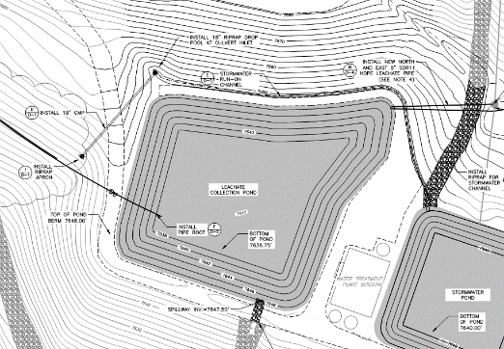
Full-Scale Passive Treatment Design Overview
Leachate collection pond
1.8 Mil gallon - built in current pilot BCR and stormwater pond area
Pre-treatment oxidation – windmill powered aerator
Size based on maximum runoff, direct precipitation inflows, leachate inflows, and repository construction inflows
Treatment only
July – September
New Stormwater Pond
Unlined
Built in existing leachate pond area – smaller capacity

Slide 16
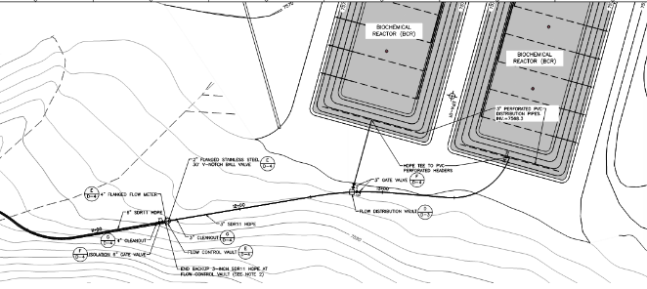
Full-Scale Passive Treatment Design Overview
Leachate transfer
~1300 feet long, gravity flow
6-inch HDPE primary, 3-inch HDPE backup
Cleanouts ~ every 300 ft
Flow control vault and splitter basin to BCRs
V-notch stainless flow control valve
Mag flow meter
Concrete splitter basin to
send equal flow to each BCR

Slide 17
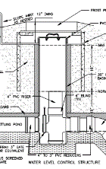
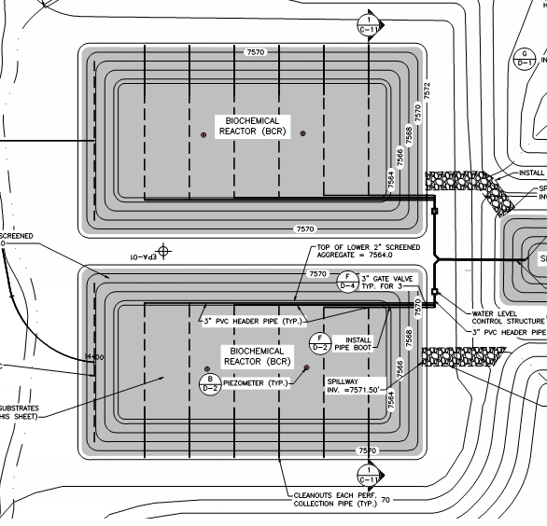
Full-Scale Passive Treatment Design Overview
Biochemical Reactor
12.5 GPM design flow based on water volume and treatment season
Two parallel BCRs 2X design flow (25 GPM)
Down-flow
Limited surficial piping (flooded)
3 effluent perf pipe zones with isolation valves
Cleanouts on each lateral
Level control structure
Allows drain to substrate top surface for winterization
Freeze insulated vault

Slide 18
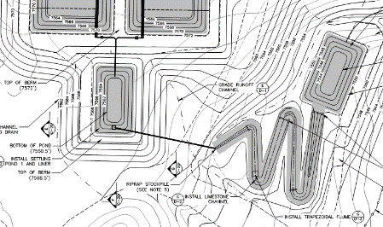
Full-Scale Passive Treatment Design Overview
Post-treatment
Anaerobic settling pond
Quiescent settling of organic matter and sulfides
Minimizes metal sulfide oxidation
Drop structure/aeration at outfall
Limestone-lined aeration channel and cascades
Provides alkalinity and aeration/oxidation
Manganese removal and
additional trace metal polishing
Aerobic settling pond
Windmill-powered aerator
Outlet to LAD pipeline
~300 ft long, 3-inch HDPE

Slide 19
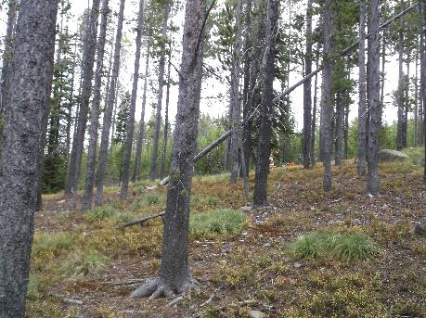
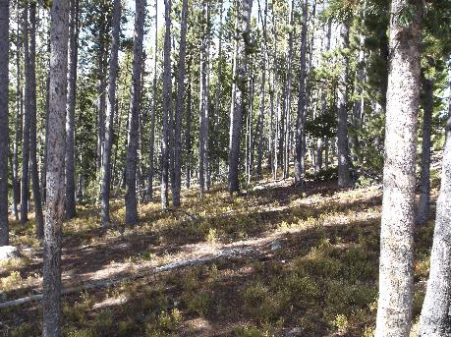
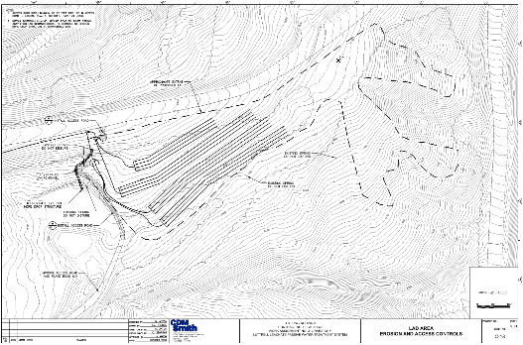
Full-Scale LAD Design Basis
No power available – no pumping
Low available head
Current LAD sprinkler approach would not function
Need even flow distribution
24/7 unattended operation
Notes:
Unattended operation, meaning it has to function by itself and so not able to use a large (10,000+ gal) holding tank that is drained periodically like the current system.

Slide 20
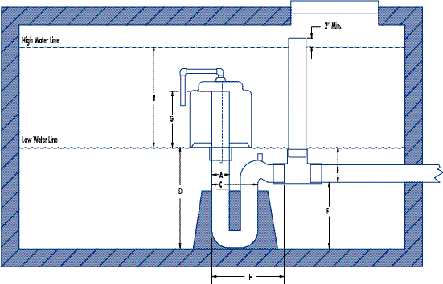
Full-Scale LAD Design Basis
Dosing Siphons
Dosing siphons provide high flow rate to pressurize system
Gravity flow system
Design Flow
Flowrates determined by siphon size
Design = 4” Siphon = 170 gpm flowrate
Copyright 2013 ©Fluid Dynamic Siphons, Inc.
Siphons.com
Notes:
For the dosing siphon, we can talk about the fact that we can’t just run 12.5 gpm out to the LAD because basically only the last few holes in the pipe would be flowing and it would overload that section of the LAD soils

Slide 21
Full-Scale LAD Sizing
Distribution area determined by soil infiltration rate – no runoff
Soil Infiltration Rate (e.g., percolation rate)
Remolded permeability measurements using sand-cone field density
Assumed 20% of permeability was available for infiltration
Calculated available hydraulic loading rate for the soils
Calculated required LAD area based on hydraulic loading rate
LAD size ~ 1 acre for 12.5 GPM

Slide 22
Full-Scale LAD Sizing
Design flow: 170 gpm) LAD area too large when calculated using hydraulic loading – 14 acres!
Calculation assumes continuous flow and not pulsed flow – Not Correct
Design check - assume pulsed flow is rainfall and use curve number hydrologic calculation method
CN = 70 (Woods, Good Condition, HSG – C)
Set volume of pulse equal to initial abstraction for no runoff
Back calculate required area to absorb dose volume
0.11 acre required area – much smaller than available area to account for antecedent moisture
Final design LAD area = 6.25 acres
More than adequate space available based on hydraulic loading
Notes:
Also checked the required area for 12.5 gpm and 25 gpm continuous flowrates using the SCS CN method. Results compared favorably to the method using permeability and hydraulic loading rate

Slide 23
Full-Scale LAD Design Overview
Dosing Siphon and Tank Design
Commonly used in septic drainfields
Perforated pipelines distribute flow
Distributes flow into the entire piping system and receiving soil
Dual siphons in one tank provide flow to two LAD zones
Hydraulics
4 individual LAD zones with isolation valves
4 Perforated pipelines within each zone laid on contour – 16 pipelines
Available head for each pipe determined
Orifice size and spacing calculated based on pressure and flowrates in each lateral

Slide 24
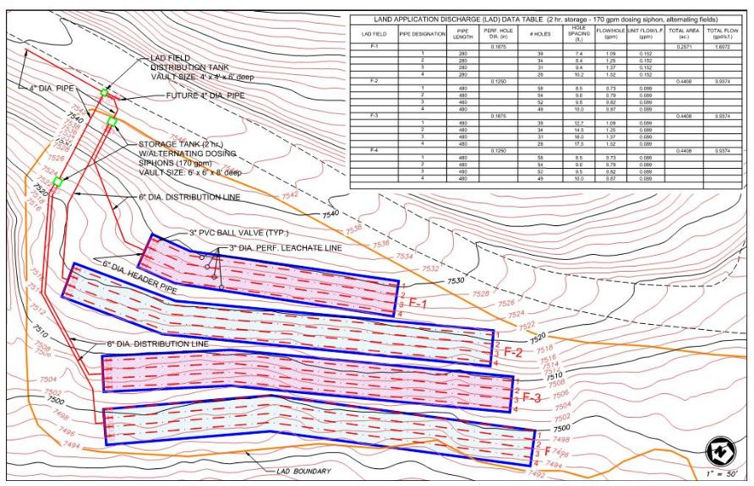
Full-Scale LAD Design Overview
Notes:
Valves on laterals will allow for adjustments to ensure even flow distribution once system is operational. Calculations and real-world sometimes don’t match up.

Slide 25
Full-Scale LAD Design Overview
Siphon Operation Parameters
1,500 gallon dose volume
~10 minute dose time
2 hour fill time between doses (12.5 gpm fill rate – 1 BCR)
Dual siphons – 4 hours between doses to a single LAD zone
Available head 7 – 22 feet
Valving will allow adjustments to laterals as necessary
Can isolate one zone or use all zones, and portions of laterals within each zone

Slide 26
Questions

