Slide 1
Performance Evaluation of the North Fork Montour Run Passive Treatment System
36th Annual Meeting of the American Society of Mining and Reclamation June 3-7, 2019 Big Sky Montana
Presented by Tim Danehy, QEP, BioMost, Inc.
Co-Authors: Rich Beam PG, PA Dept. of Env. Protection, Bureau of Abandoned Mine Reclamation
Ryan M. Mahony, Cody “Buck” A. Neely PE, Clifford F. Denholm III, & Daniel A. Guy, PG, BioMost, Inc.

Slide 2
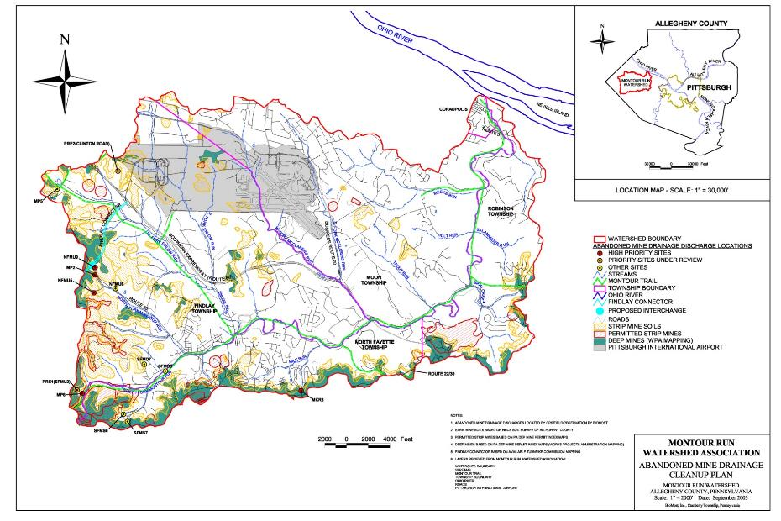
Montour Run Watershed

Slide 3
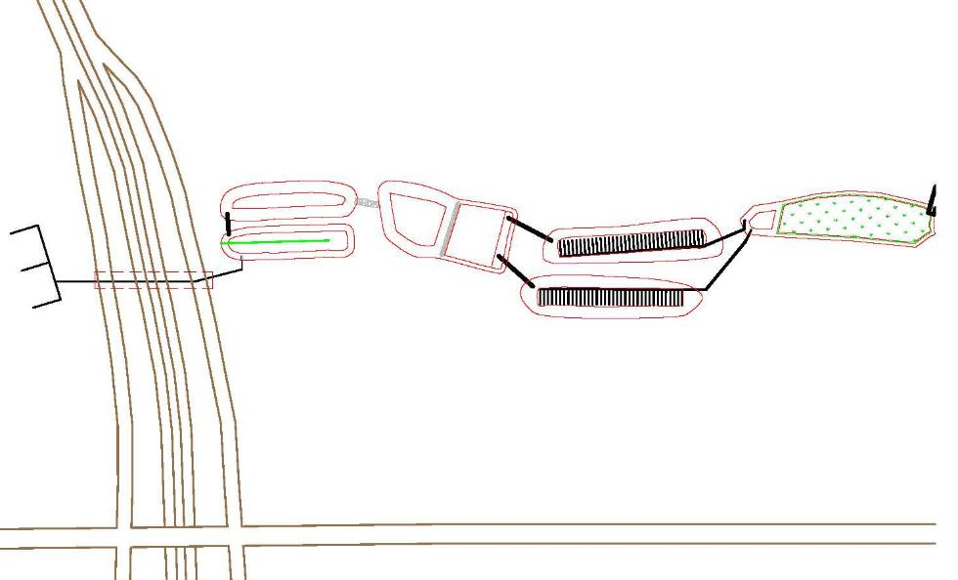
North Fork Montour Run Passive Treatment System
North
Pond 2
Pond 3
Wetland
ALD (under highway)
VFP-East
Pond 1
Pond 3A
Collection System
(UG Pgh. Coal Mine)
VFP-West
Route 576
“Findlay Connector”
ALD Outlet/Pond 1 Inlet: FC Raw
(outlet of 18” concrete pipe)
US Route 30

Slide 4
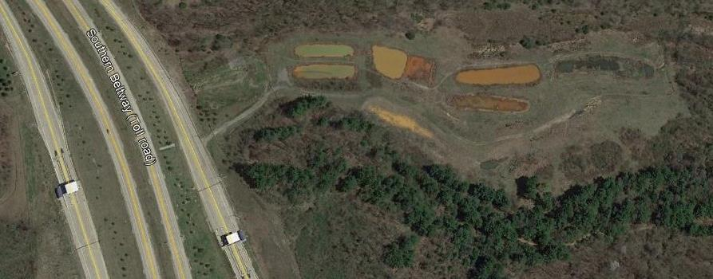
North Fork Montour Run Passive Treatment System

Slide 5
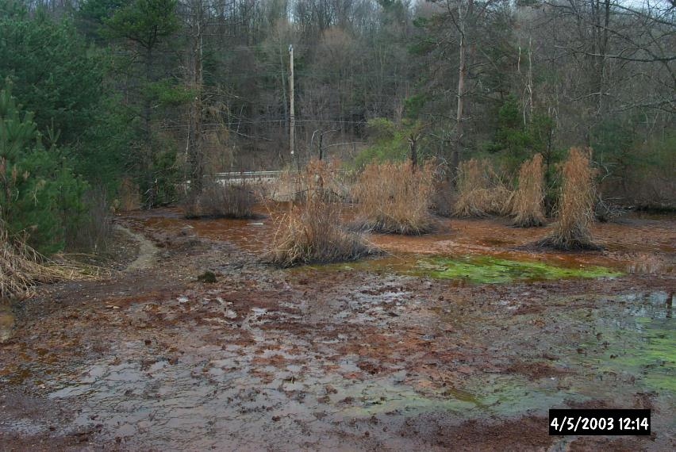
NFMU9: 2003 - Pre Findlay Connector

Slide 6
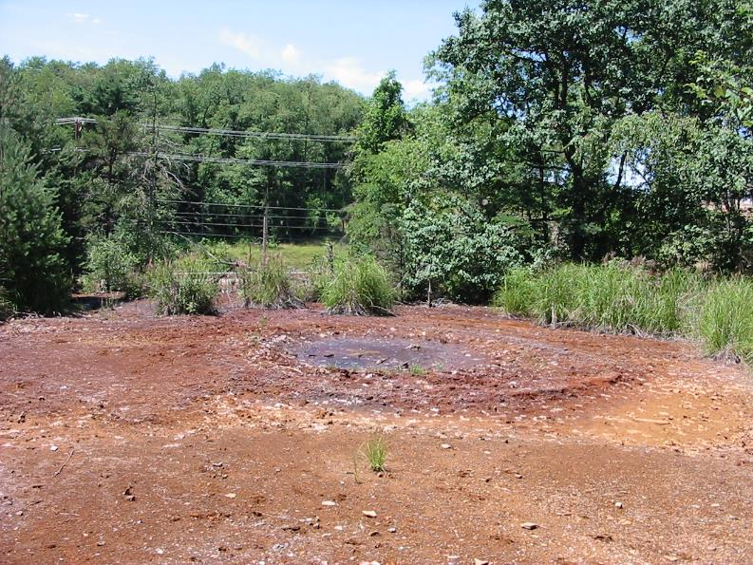
NFMU9: 2005 - Post Findlay Connector

Slide 7
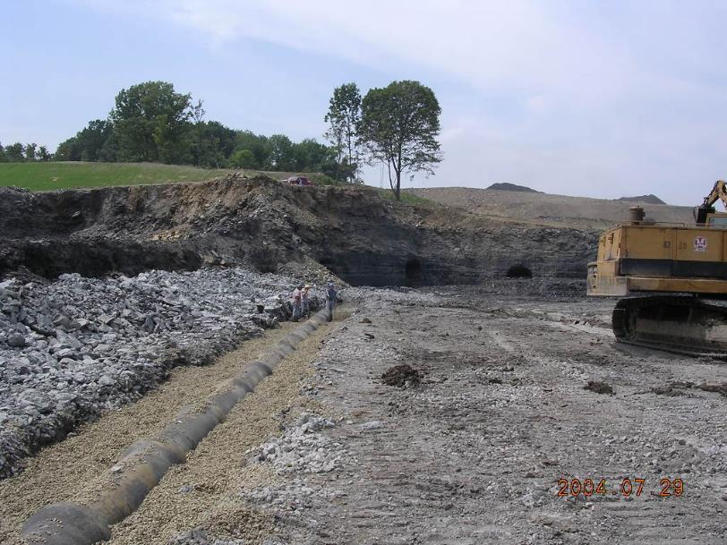
PA Turnpike & PADEP-BAMR Collection and ALD
Looking north towards “Clinton Block Mine”
ALD under 18” RCP Culvert

Slide 8
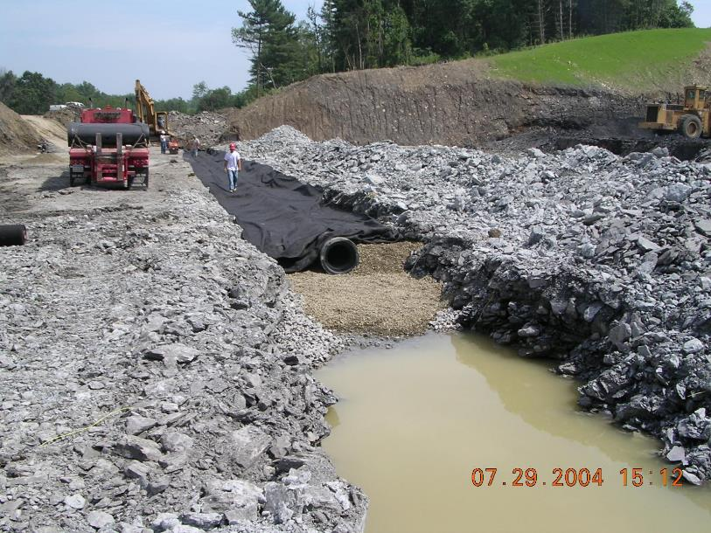
PA Turnpike & PADEP-BAMR Collection and ALD
Looking south towards future treatment expansion area
ALD under 18” open joint RCP Culvert bedded in non-calcareous river gravel overlain by geotextile

Slide 9
PA Turnpike & PADEP – ALD Detail (~640 Tons LS)

Slide 10
System Design & 2008 Installation
Pre 2004 – Findlay Connector highway design
2004 Collection system & ALD built during highway construction
2005 – 2007 Monitoring
FC Raw Worse than NFMU9 (better collection of drainage)
2006 – 2007 Design & Permitting
2007 – 2008 Additional grant from OSM
2008 Construction
Placed on-line April 2008

Slide 11
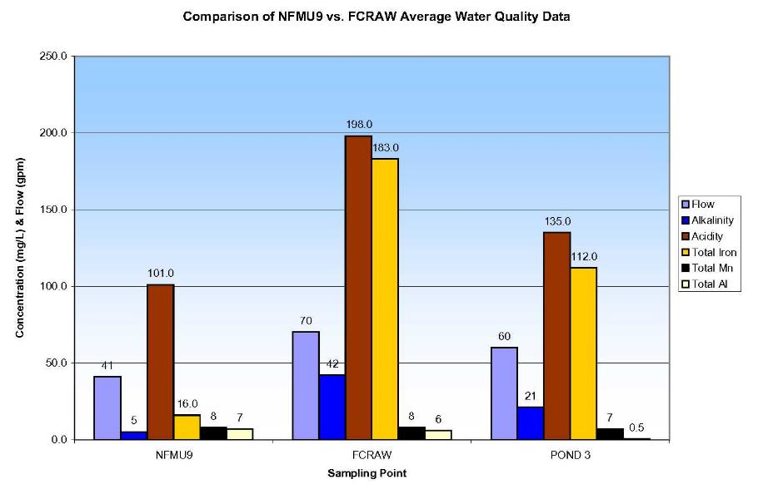
NFMU9 vs. FCRAW Monitoring

Slide 12
Pond 3 (Pre-Expansion) Monitoring Summary
Date | Flow gpm | Field pH s.u. | Lab pH s.u. | Field Alk. mg/L | Lab Alk. mg/L | (Hot) Acidity mg/LCaCO₃ | Calc. Acidity mg/LCaCO₃ | D.Fe mg/L | D.Mn mg/L | D.Al mg/L | (Hot) Acid Load lb/d | Calc. Acid Load lb/d | D.Fe Load lb/d
09/22/05 | 45 | 4.6 | 3.5 | 0 | 0 | 135 | 163 | 81 | 9 | 0 | 73 | 88 | 44
10/28/05 | 30 | 3.9 | 3.6 | 0 | 0 | 48 | 101 | 46 | 7 | 0 | 17 | 36 | 16
11/23/05 | 26 | 4.2 | 4.0 | 0 | 0 | 51 | 56 | 22 | 7 | 0 | 16 | 17 | 7
12/26/05 | 45 | 6.1 | 5.1 | 61 | 7 | 110 | 176 | 90 | 7 | 0 | 59 | 95 | 49
01/31/06 | 70 | 5.7 | 5.6 | 56 | 7 | 223 | 266 | 140 | 7 | 0 | 189 | 225 | 118
02/21/06 | 103 | 6.1 | 5.8 | 18 | 10 | 250 | 285 | 151 | 7 | 0 | 309 | 353 | 187
03/15/06 | 70 | 6.5 | 5.6 | NM | 12 | 186 | 250 | 134 | 6 | 0 | 157 | 212 | 113
05/25/06 | 76 | 4.8 | 3.8 | NM | 0 | 118 | 114 | 57 | 6 | 0 | 109 | 104 | 52
08/02/06 | 19 | 4.2 | 3.8 | 0 | 0 | 99 | 91 | 43 | 6 | 0 | 23 | 21 | 10
01/18/07 | 103 | 6.4 | 5.6 | 50 | 9 | 31 | 91 | 45 | 9 | 0 | 38 | 112 | 56
Minimum | 19 | 3.9 | 3.0 | 0 | 7 | 31 | 56 | 22 | 6 | 0 | 16 | 17 | 7
Average | 59 | 5.2 | 4.6 | 23 | 9 | 125 | 159 | 81 | 7 | 0 | 99 | 126 | 65
Median | 58 | 5.2 | 4.6 | 9 | 9 | 114 | 138 | 69 | 7 | 0 | 66 | 100 | 50
Maximum | 103 | 6.5 | 5.8 | 61 | 12 | 250 | 285 | 151 | 9 | 0 | 309 | 353 | 187
“Design” | 70/110 |  | 3.0 | 0 | 0 | 285 |  | 80 | N/A | 1 | 100/353 |  | 100 +/-
Calculated acidity assumes all Ferrous iron. Design parameters average/maximum. Average pH not calculated from H-ion concentrations. Design Fe load is what was expected discharge from VFPs; It was assumed that about 1/2 of the iron load would be retained within the VFPs as either oxides or sulfides; wetland size was limited by budgetary and site constraints.

Slide 13
North Fork Montour Run Passive Treatment System
North
Pond 2
Pond 3
Wetland
ALD (under highway)
VFP-East
Pond 1
Pond 3A
Collection System
(UG Pgh. Coal Mine)
VFP-West
Route 576
“Findlay Connector”
ALD Outlet/Pond 1 Inlet: FC Raw
(outlet of 18” concrete pipe)
US Route 30

Slide 14
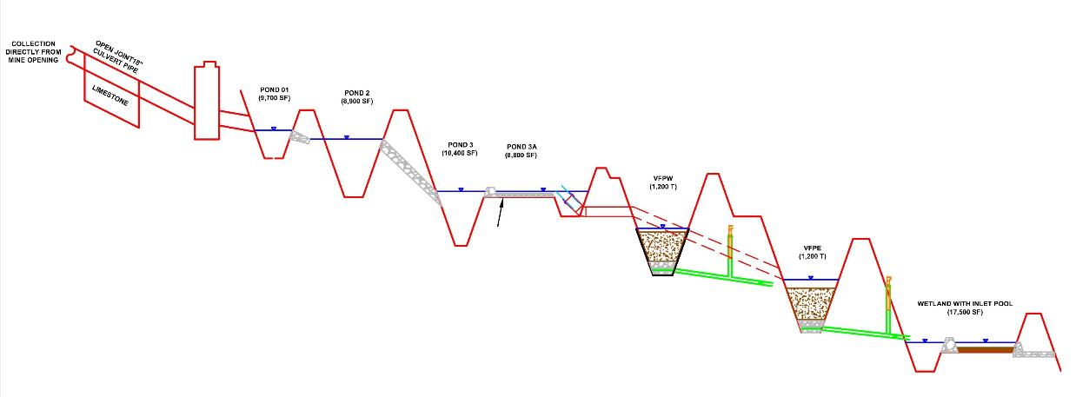
North Fork Passive Treatment System
Looking south towards future treatment expansion area
ALD under 18” open joint RCP Culvert bedded in non-calcareous river gravel overlain by geotextile
Not shown: 3 trompes below wetland with aerator in Pond 2

Slide 15
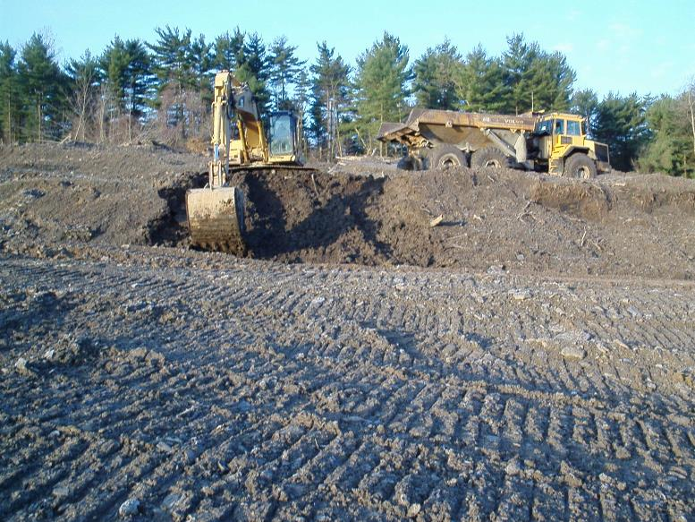
North Fork Passive Treatment System

Slide 16
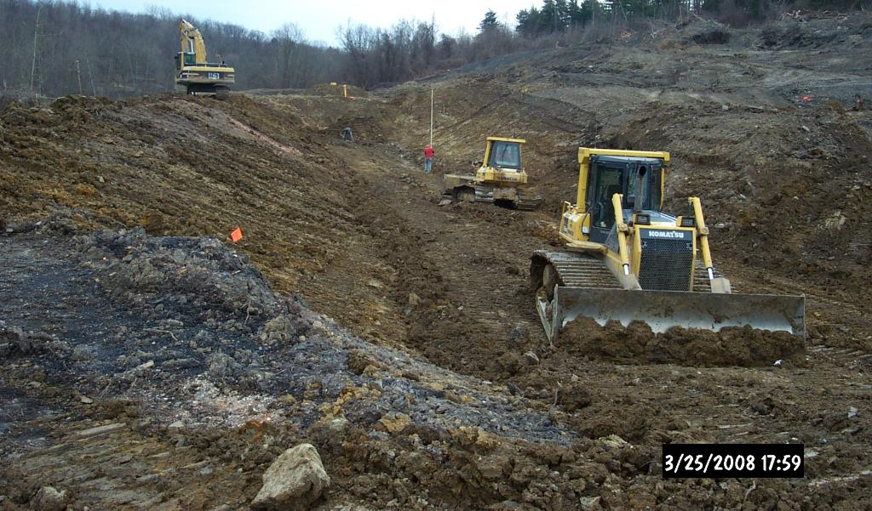
North Fork Passive Treatment System

Slide 17
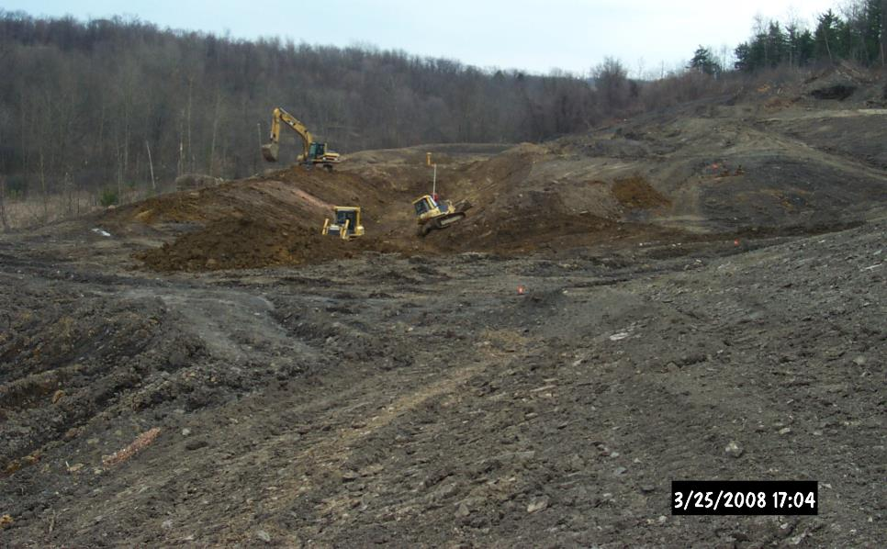
North Fork Passive Treatment System

Slide 18
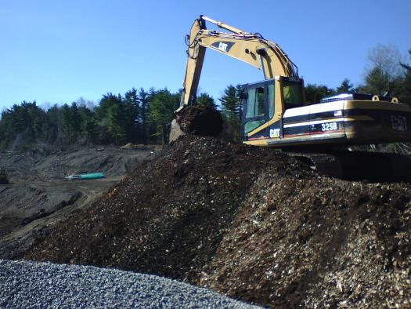
Vertical Flow Pond As-Built
System put on-line 04/28/08
Quantities Per Pond (Flow to be SPLIT EQUALLY)
1200 tons AASHTO #67 limestone (90% CaCO3)
440 CY wood chips
440 CY spent mushroom compost
888 CY limestone + 880 CY organic = 1768 CY mixture
As-built
VFPW ~1130 CY ~3’ thick (36% reduction due to mixing)
VFPE ~1160 CY ~3’ thick (34 % reduction due to mixing)
~8” PADOT #3 limestone aggregate above 4” pipes (~1’ total)
VFPW: 300 CY = ~400 Tons
VFPE 300 CY = ~400 Tons
4-Cell 4” SDR35 PVC underdrain (laterals perforated, solid headers)
~3” PADOT #3 aggregate pipe bedding
Woven geotextile on pond bottom & up sides to top of treatment media
(As-Built Information available on datashed.org: https://www.datashed.org/north-fork-montour-run/downloads)

Slide 19
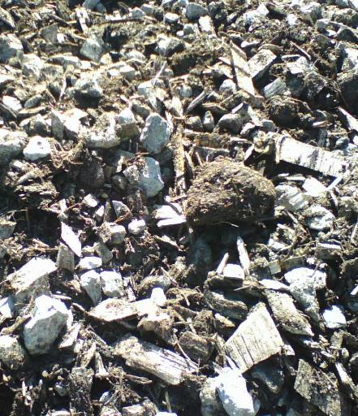
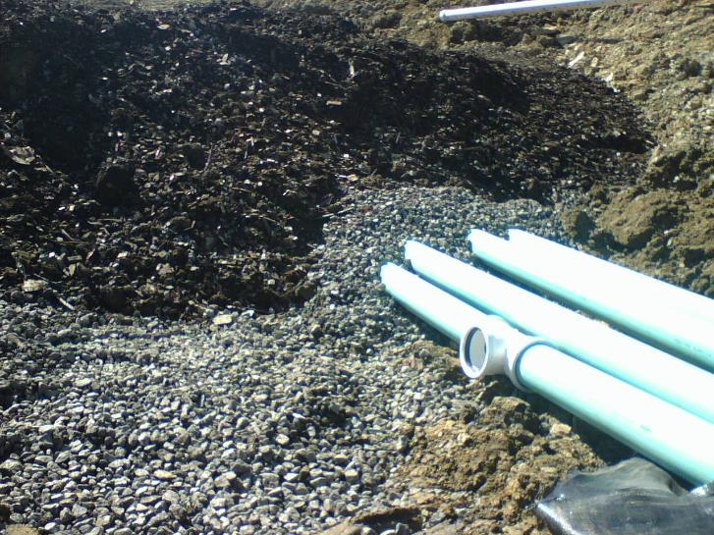
Vertical Flow Pond Treatment Media & Underdrain

Slide 20
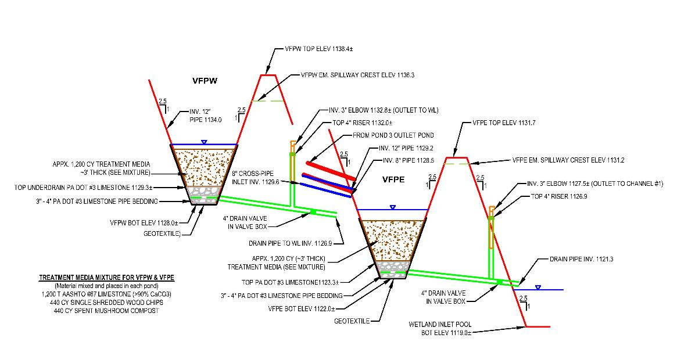
Vertical Flow Pond Detail

Slide 21
VFP Performance Pre-2018
VFP | Flow gpm | Lab pH s.u. | Lab Alk. mg/L | (Hot) Acidity mg/LCaCO₃ | T.Fe mg/L | T.Mn mg/L | T.Al mg/L
WEST – Minimum | 3 | 6.6 | 90 | -373 | <0.1 | 4.7 | <0.1
WEST – Average | 19 | 7.0 | 234 | -172 | 4.5 | 6.0 | 0.1
WEST – Median | 20 | 6.9 | 140 | -93 | 5.1 | 6.2 | <0.1
WEST – Maximum | 56 | 7.7 | 580 | -72 | 10.9 | 6.9 | 0.2
EAST – Minimum | 12 | 6.7 | 76 | -192 | 0.2 | 4.8 | <0.1
EAST – Average | 30 | 7.1 | 149 | -121 | 5.4 | 5.9 | 0.1
EAST - Median | 32 | 7.2 | 151 | -121 | 3.3 | 5.9 | <0.1
EAST – Maximum | 44 | 7.5 | 234 | -54 | 18.7 | 7.2 | 0.2
Six samples collected: 06/01/09, 9/24/09, 11/28/09, 03/27/10, 05/15/12, 06/09/15. 580 mg/L lab alkalinity taken 9/24/09 with 3 gpm flow, field alk. was 582 mg/L. Additional data available on www.datashed.org (https://www.datashed.org/north-fork-montour-run/reports)
AT/BELOW DESIGN
CONSITENTLY ALKALINE

Slide 22
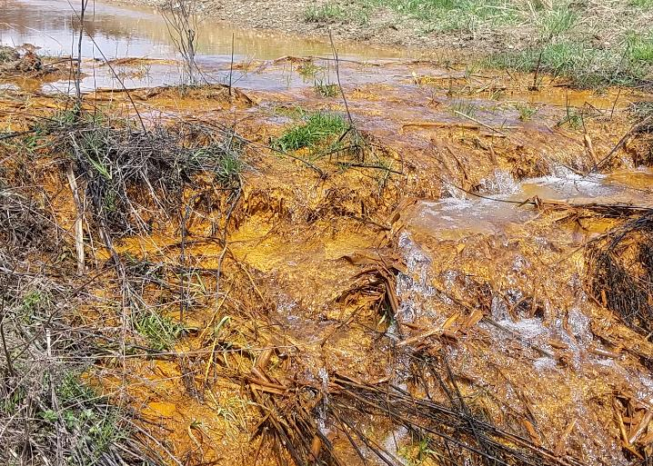
10 Years Later: The Discharge is Bad!
04/26/18 Wetland
5 pH
96 mg/L acid
56 mg/L Fe
6 mg/L Al

Slide 23
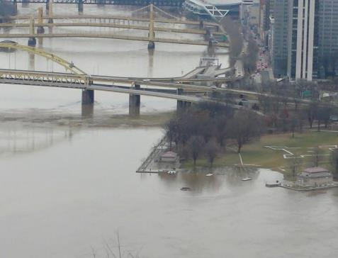
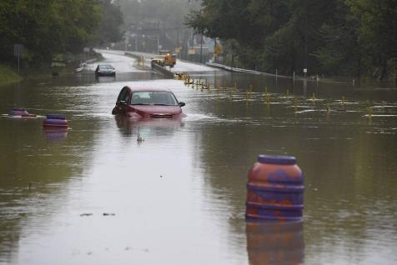
2018 – THE. WETTEST. YEAR. EVER.
57.83 inches of rain in Pittsburgh
19.64 inches above normal
51% higher than normal
174 days with >0.01 inches of rain
Rained every other day on average
15% higher than normal
83 days with >0.1 inches of rain
38% higher than normal

Slide 24
What is the System Expected to Do?
04/26/18
“Combined” Measurements (both VFPs)
Design Flow: 110 gpm
Actual Flow: 228 gpm (207%)
Design Acid: 353 lb/day (max)
Design Acid: ~100 lb/day (avg)
Actual Acid In: 778 lb/day (220%) (Pond 3A)
Actual Acid Out: 263 lb/day (Wetland)
Acid Removed: 515 lb/day (Pond 3A to Wetland)
SYSTEM OVER PERFORMING MAX DESIGN BY 45%

Slide 25
Monitoring Data: 04/26/18
Point | Flow gpm | Field pH s.u. | Lab pH s.u. | Field Alk. mg/L | Lab Alk. mg/L | (Hot) Acidity mg/LCaCO₃ | T.Fe mg/L | T.Mn mg/L | T.Al mg/L | Acid Load lb/d CaCO₃ | Δ Acid Load lb/d CaCO₃ | Fe Load lb/d | Δ Fe Load lb/d
FC Raw | 228 | 4.4 | 3.95 | 0 | 0 | 316 | 121 | 7 | 27 | 865 | - | 332 | -
Pond 2 | 228 | 4.5 | 3.91 | 3 | 0 | 295 | 107 | 7 | 23 | 809 | -56 | 293 | -38
Pond 3A | 228 | 4.2 | 3.88 | 0 | 0 | 284 | 125 | 7 | 21 | 778 | -31 | 343 | +48
VFP-West | 61 | 6.5 | 5.77 | 108 | 53 | -4 | 44 | 7 | 2 | -3 | -211 | 32 | -60
VFP-East | 81 | 6.7 | 5.67 | 121 | 43 | 2 | 54 | 7 | 2 | 2 | -275 | 53 | -69
VFP-East Overflow | ~86 | 4.1 | N.M. | N.M. | N.M. | N.M. | N.M. | N.M. | N.M. | N.M. | N.M. | N.M. | N.M.
Wetland | 228 | 6.2 | 5.08 | 33 | 3 | 96 | 56 | 7 | 6 | 263 | -515 | 154 | -188
Pond 2 acid and iron change from FC Raw (Pond 1 not sampled). Wetland acid and iron change calculated from Pond 3A (Inflow to VFPs). VFP-East Overflow drains to Wetland.

Slide 26
Bases for Evaluation
USED TO CALCULATE THEORETICAL HRT
VFP-West: 1130 CY Mix + 300 CY LS Underdrain
VFP-East: 1160 CY Mix + 300 CY LS Underdrain
VFP-West Assumed Void Volumes:
45,600 gal in LS/organic mixture + 29,700 gal in limestone underdrain
VFP-East Assumed Void Volumes:
46,900 gal in LS/organic mixture + 30,300 gal in limestone underdrain
VFP-West Water Surface Area: 14,300 SF (1330 SM)
VFP-East Water Surface Area: 14,600 SF (1160 SM)
*Very limited data available regarding void volume in mixed media, 20% effective void space assumed from 03/05/99 specific
yield test performed on a 3:1 organic:limestone by volume pilot-scale system installed at Jennings Environmental Education
Center by BioMost, Inc. that showed an initial 19% void (rounded to 20%).
50% void assumed in limestone (LS) underdrain.
Water surface area estimated halfway between the top of the treatment media mixture and the emergency spillway
elevation and will vary with actual water elevation.

Slide 27
VFP Performance: 04/26/18
Component | Flow Through Media gpm | Acid Neutralized lb/d | Theoretical LS/Organic Mixture HRT hr | LS/Organic Mixture Acid Neutralization Rate lb/d/CY | Theoretical Limestone Underdrain HRT hr | Total Theoretical HRT hr | Total Acid Neutralization Rate lb/d/CY | *Areal Acid Neutralization Rate g/sm/d
VFP-West | 61 | 211 | 12.5 | 0.19 | 8.3 | 20.8 | 0.15 | 72
VFP-East | 81 | 275 | 9.7 | 0.24 | 6.2 | 15.9 | 0.19 | 92
Note: Total VFP-East overflow was 167 gpm with 86 gpm overflowing to wetland
HRT = Hydraulic Retention Time
“Total” HRT and Acid Neutralization Rate based on total volume of LS/Organic mixture and limestone underdrain.
*Areal Acid Neutralization Rate follows procedure described by Dr. Art Rose where a typical removal rate was found to be about 34 g/sm/d. Ref: Vertical Flow Systems Effects of Time and Acidity Relations, Proceedings of American Society of Mining and Reclamation, 2004. (https://doi.org/10.21000/JASMR04011595)

Slide 28
System Performance: 04/26/18
“You don’t know how small you can build something until you break it.”
-Dr. Bob Nairn
VFP-West effluent acidity: -4 mg/L
VFP-East effluent acidity: 2 mg/L
Both VFPs effluents are almost exactly “neutral”
(i.e. 0 mg/L acidity)
(Is this the breaking point?)

Slide 29
System Performance: 04/26/18
VFP-West Acid Load In/Out lb/d 208 to -3 = 211 lb/d
VFP-East Acid Load In/Out lb/d 276 to 2 = 274 lb/d
Total Acid Neutralized in VFPs = 485 lb/d
Max pre-construction calculated acid load: 353 lb/d
37% over “design” maximum load (based on only VFPs)
System put on-line 04/29/08 (10 years)
Design life is 15 years
TAKE AWAY: Even with “bad” effluent the system did not fail…
…it is doing more than what it was designed to do.

Slide 30
But Will We Ever See Good Water Again…?

Slide 31
Monitoring Data: 06/06/18
Point | Flow gpm | Field pH s.u. | Lab pH s.u. | Field Alk. mg/L | Lab Alk. mg/L | (Hot) Acidity mg/LCaCO₃ | T.Fe mg/L | T.Mn mg/L | T.Al mg/L | Acid Load lb/d CaCO₃ | Δ Acid Load lb/d CaCO₃ | Fe Load lb/d | Δ Fe Load lb/d
FC Raw | 149 | 5.4 | 5.27 | 49 | 27 | 230 | 124 | 7 | 9 | 412 | - | 222 | -
Pond 1 | 149 | 5.3 | 5.17 | 23 | 16 | 220 | 117 | 7 | 5 | 394 | -18 | 210 | -13
Pond 2 | 149 | 5.4 | 4.68 | 8 | 2 | 222 | 102 | 7 | 3 | 398 | +4 | 183 | -27
Pond 3A West | 75 | 4.1 | 3.61 | 0 | 0 | 217 | 92 | 7 | 4 | 196 | -5 | 83 | -9
Pond 3A East | 74 | 4.0 | 3.64 | 0 | 0 | 224 | 96 | 7 | 4 | 199 | +2 | 85 | -5
VFP-West | 75 | 6.7 | 6.21 | 92 | 59 | 13 | 47 | 7 | 1 | 11 | -184 | 42 | -41
VFP-East | 74 | 6.5 | 6.55 | 183 | 136 | -98 | 44 | 7 | 0 | -87 | -287 | 40 | -46
Wetland | 149 | 6.5 | 6.55 | 63 | 48 | -20 | 17 | 7 | 0 | -36 | +40 | 31 | -51
Wetland acid and iron load change calculated from mathematically combined VFP-West and VFP-East loads (-76 lb/d acid & 82 lb/d Fe) used as the inflow to the wetland (not shown above).

Slide 32
Monitoring Data: 10/23/18
Point | Flow gpm | Field pH s.u. | Lab pH s.u. | Field Alk. mg/L | Lab Alk. mg/L | (Hot) Acidity mg/LCaCO₃ | T.Fe mg/L | T.Mn mg/L | T.Al mg/L | Acid Load lb/d CaCO₃ | Δ Acid Load lb/d CaCO₃ | Fe Load lb/d | Δ Fe Load lb/d
FC Raw | 83 | 5.2 | 5.77 | 96 | 76 | 105 | 86 | 5 | 3 | 105 | - | 86 | -
Pond 3A | 83 | 6.1 | 5.86 | 36 | 10 | 111 | 60 | 5 | 0 | 111 | +6 | 60 | -26
VFP-West | 71 | 6.7 | 6.59 | 91 | 62 | -44 | 13 | 5 | 0 | -38 | -133 | 11 | -40
VFP-East | 12 | 7.4 | 6.71 | 115 | 78 | -61 | 16 | 4 | 0 | -9 | -25 | 2 | -7
Wetland | 83 | 7.0 | 6.78 | 74 | 58 | -44 | 4 | 4 | 0 | -43 | +4 | 4 | -10
VFP-West & East acid and iron load reductions calculated from the mathematically divided load from Pond 3A: VFP-West 95 lb/d acid & 51 lb/d Fe; VFP-East 16 lb/d acid & 9 lb/d Fe. Wetland acid and iron load reductions calculated from mathematically combined VFP-West and VFP-East loads (-47 lb/d acid & 14 lb/d Fe) used as the inflow to the wetland (not shown above).

Slide 33
2018 VFP Performance
VFP | Flow Through Media gpm | Acid Neutralized lb/d | Theoretical LS/Organic Mixture HRT hr | LS/Organic Mixture Acid Neutralization Rate lb/d/CY | Theoretical Limestone Underdrain HRT hr | Total Theoretical HRT hr | Total Acid Neutralization Rate lb/d/CY | Areal Acid Neutralization Rate g/sm/d
04/26/18 (Total Inflow = 228 gpm - 200% of Max Design Flow – 86 gpm overflow from VFPE; Pond 3A 778 lb/d acid)
VFP-West | 61 | 211 | 12.5 | 0.19 | 8.3 | 20.8 | 0.15 | 72
VFP-East | 81 | 275 | 9.7 | 0.24 | 6.2 | 15.9 | 0.19 | 92
06/06/18 (Total Inflow = 149 gpm - 135% of Max Design Flow; Pond 3A 395 lb/d acid)
VFP-West | 75 | 184 | 10.1 | 0.16 | 6.7 | 16.8 | 0.13 | 63
VFP-East | 74 | 287 | 10.6 | 0.25 | 6.8 | 17.4 | 0.20 | 96
10/23/18 (Total Inflow = 86 gpm - 78% of Max Design Flow; Pond 3A 11 lb/d acid)
VFP-West | 71 | 133 | 10.7 | 0.12 | 7.1 | 17.8 | 0.09 | 45
VFP-East | 12 | 25 | 65.1 | 0.02 | 42.1 | 107.2 | 0.02 | 8

Slide 34
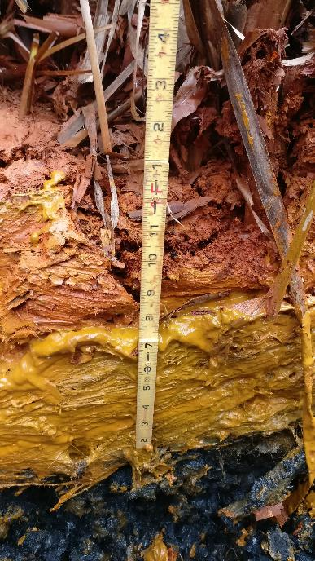
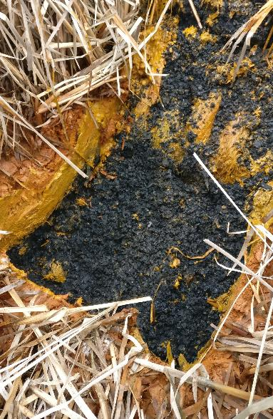
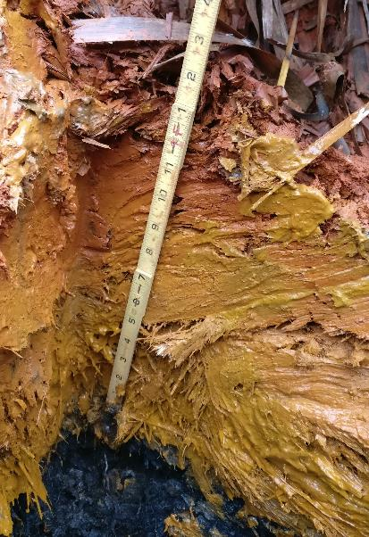
Test Pit (VFP-West) 2-15-18

Slide 35
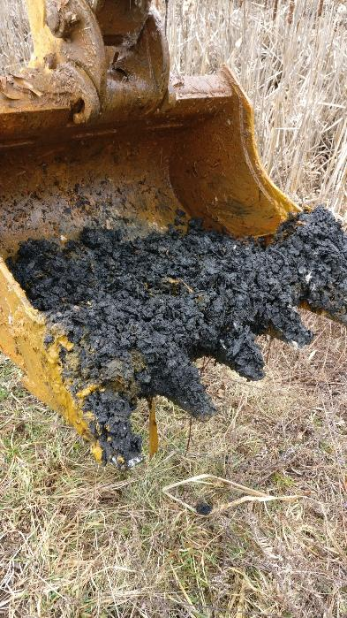
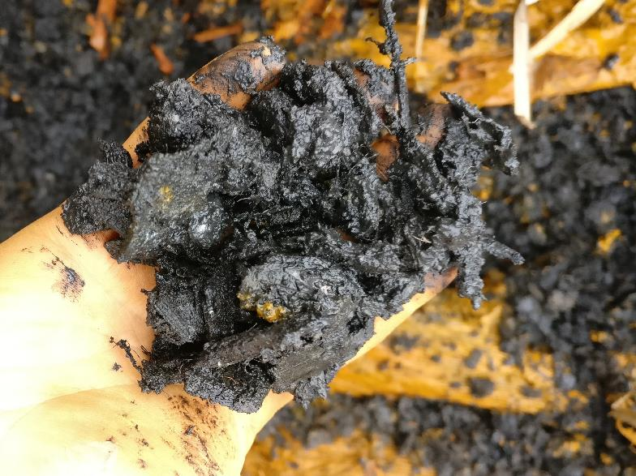
Test Pit (VFP-West) 2-15-18

Slide 36
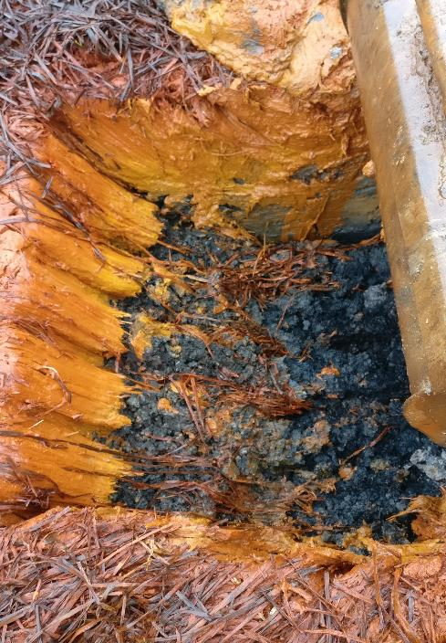
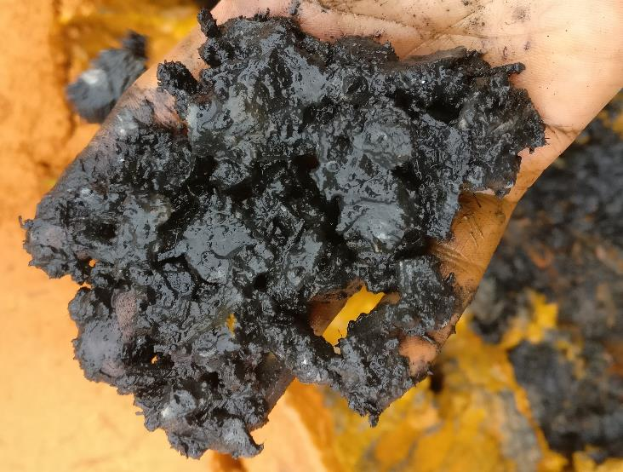
Test Pit (VFP-East) 2-22-18

Slide 37
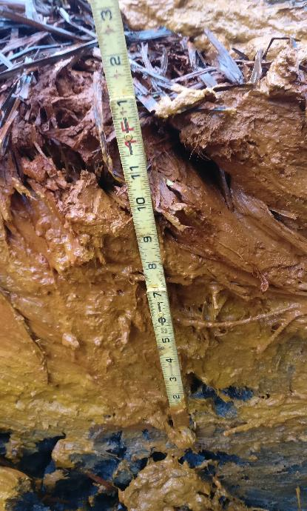
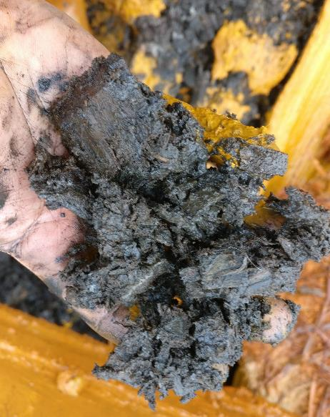
Test Pit (VFP-East) 2-22-18

Slide 38
VFP Hydraulic Performance
Date | Total Flow gpm | Component | Inflow gpm | Overflow gpm | Flow Through Media gpm | Driving Head ft | Areal Flow Load gpm/1000 sf | Comments (Daily High Temp)
02/28/18 | 434 | VFP-West | 235 | 0 | 235 | 3.24 | 19.75 | (64 F)
 |  | VFP-East | 199 | 10 | 189 | 3.06 | 15.49
03/09/18 | 238 | VFP-West | 128 | 0 | 128 | 2.41 | 10.76 | (28 F)
 |  | VFP-East | 110 | 20 | 90 | 3.25 | 7.38
04/26/18 | 228 | VFP-West | 61 | 0 | 61 | 1.26 | 5.13 | (61 F)
 |  | VFP-East | 167 | 86 | 81 | 3.68 | 6.64
05/01/18 (@1430) | 199 | VFP-West | 148 | 0 | 148 | 3.02 | 12.41 | “Burped” VFPE @1440 for ~45 Minutes. Water level dropped 0.22’ (79 F)
 |  | VFP-East | 51 | 6 | 45 | 3.49 | 3.70
05/01/18 (@1634) | 199 | VFP-West | Not Measured (assumed to be unchanged)
 |  | VFP-East | 51 | 0 | 154 | 3.27 | 12.61
06/06/18 | 149 | VFP-West | 75 | 0 | 75 | No data | 6.30 | (59 F)
 |  | VFP-East | 74 | 0 | 74 | No data | 6.07
10/23/18 | 83 | VFP-West | 71 | 0 | 61 | 1.61 | 5.13 | (57 F)
 |  | VFP-East | 12 | 0 | 12 | 1.04 | 0.98
VFP Surface Area Top of Treatment Media (square feet): West 11,900, East 12,200; Driving Head: Water Level in VFP to Invert Outlet Risers. Flow load based on water passing through media.

Slide 39
Operation & Maintenance (First 10 years)
2012
Install Trompe #1 aeration demonstration with minor cleaning of part of Pond 2
Install pipe from Pond 1 to Pond 2 and move baffle curtain from Pond 2 to Pond 1
2013
Pump sludge from Pond 2 to Pond 3 & Install Trompes #2 & #3
Construct Sludge Pond & pump Ponds 1 & 2 to Sludge Pond
2018
Pump Ponds 1, 2, & 3
Replace baffle curtain in Pond 1
Clean vegetation from Pond 3A
Test pits in VFP-West and VFP-East
Adjust VFP-East berm and lower emergency spillway
Remove select vegetation around ponds
Repair diversion ditch
On-going (periodic/occassional)
monitoring, trompe cleaning, VFP riser adjustment, VFP “burping”

Slide 40
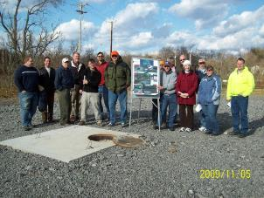
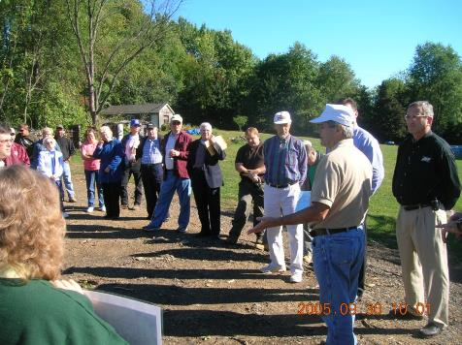
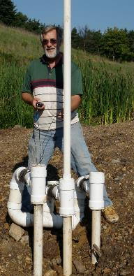
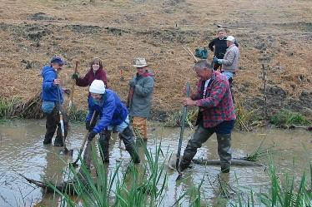
Thank you!
Much thanks to the great folks at the Montour Run Watershed Association
Thanks to OSM for Funding the Trompe Project
Thanks to PADEP for O&M Funds/Assistance
Thanks to the Rockwell Foundation for O&M Funds
Thanks to Allegheny County Airport Authority (landowner)
In memory of Bruce Leavitt, Inventor & Trompemaster

