Slide 1
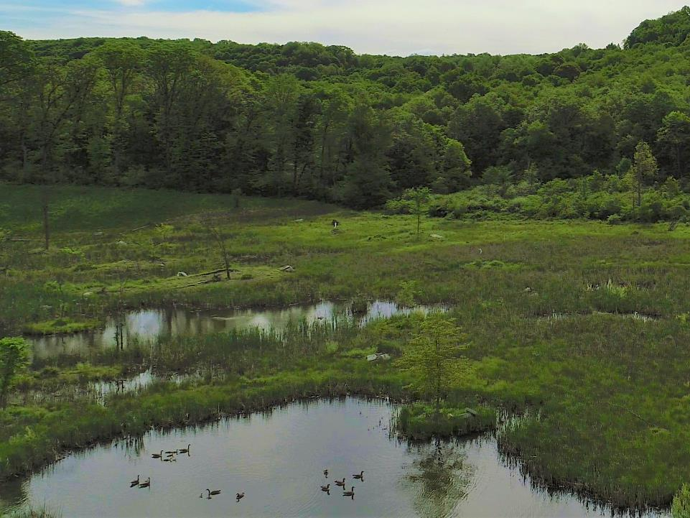
Case Study: Baird Wetland Mitigation 3rd Year Update
Presented by: Shaun L. Busler, GISP, Biologist
BioMost, Inc.
Contributors: Yan Sheykhet, Allegheny Mineral Corporation
Dan Guy, Tim Danehy, Ryan Mahony, Cliff Denholm,
and Cody Neely, BioMost, Inc.
36th Annual Meeting of the American Society of Mining & Reclamation
Big Sky, Montana
Notes:
I want to thank the other contributors to this project.

Slide 2
Site Location
Notes:
Located in the Slippery Rock Creek Watershed, which is a tributary to the Beaver and Ohio River. About 40 miles north of Pittsburgh.

Slide 3
History
Site was previously mined for coal within a portion of the permit area in the mid 1950’s to early 1960’s
Several mine discharges formed
Unreclaimed highwalls
Oil wells
6 oils wells were onsite along with related facilities (pipelines, tanks, etc.)
Plugged prior to mining
Notes:
I always like to look at the history of sites because I think it provides a better perspective of the current conditions.

Slide 4
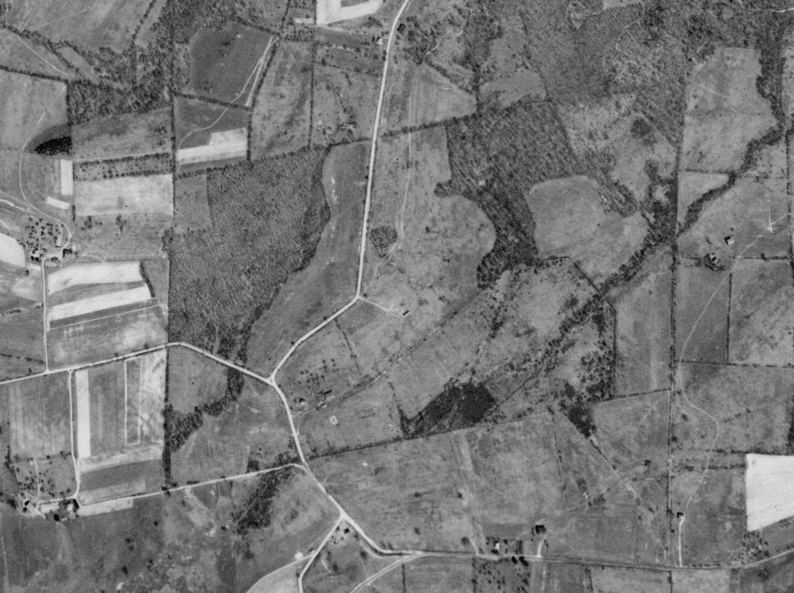
1939
Notes:
Whenever I work on a project I want to know the history of the land. This aerial photograph was from 1939…

Slide 5
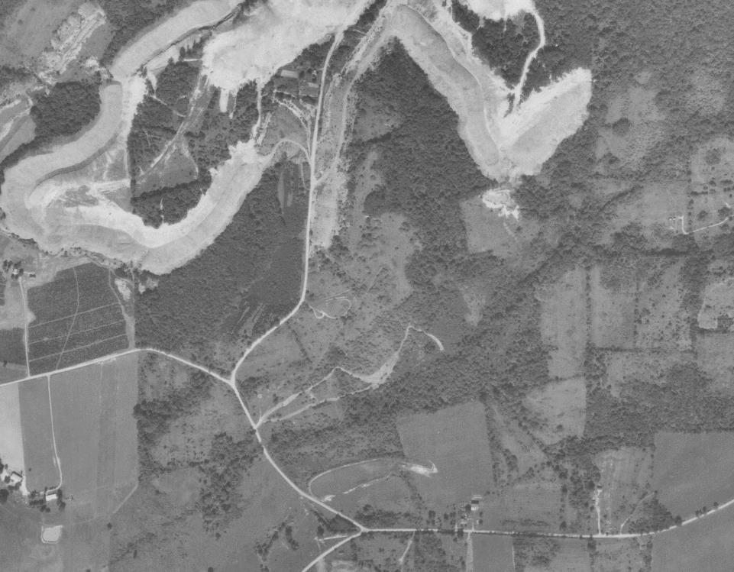
1967
Notes:
Property primarily pasture land with a homestead near the Y intersection. Point out sediment pond.

Slide 6
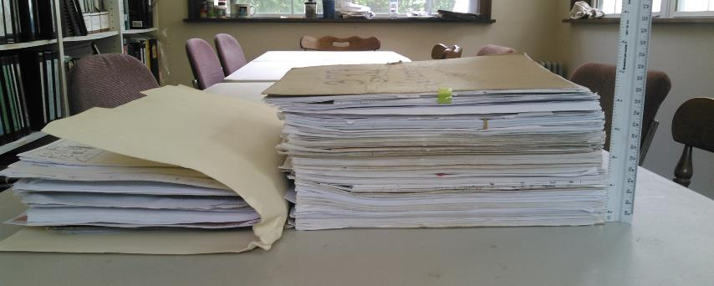
Permitting
Permit was originally issued in 1997.
Required 13.6 acres of mitigation.
Notes:
Sophomore in college.

Slide 7
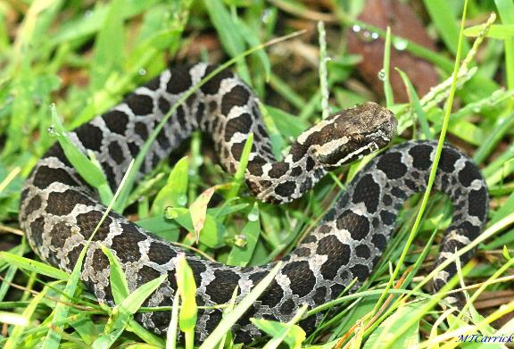
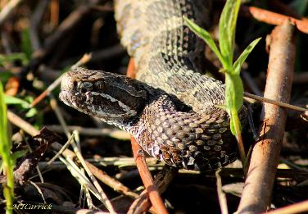
Massasauga Rattlesnake
Notes:
There was a lot of permitting associated with the mine and one of the concerns was the Massasauga Rattlesnake. Massasauga Rattlesnake belongs to the pygmy rattlesnake family. Full size adult rattlesnakes only reach 2-3’ long. Also known as swamp rattler. Not really a PA species. PA is at the edge of its range. Prefers prairies of the midwest. One known site is located about a mile to the west of the mine.

Slide 8
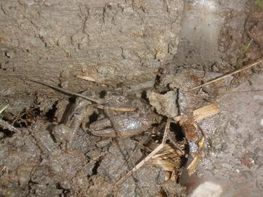
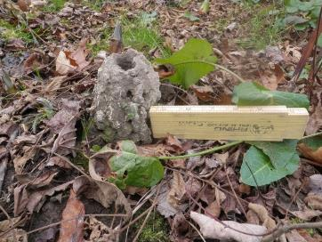
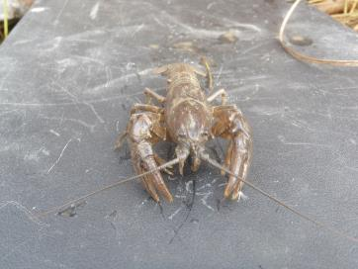
Symbiotic Relationship
Hibernates in crayfish burrows
Cambarus thomai (Little Brown Mudbug)
Roger Thoma, OSU
Notes:
Ohio State University; Burrowing or terrestrial crayfish

Slide 9
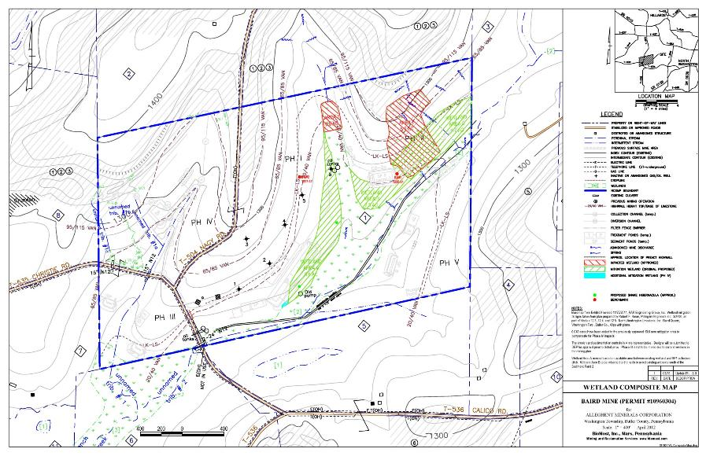
Permit Map
Notes:
Show different phases, mining area, discharges, and impacted wetlands. About 7 acres of wetland impact but required 2:1 mitigation.

Slide 10
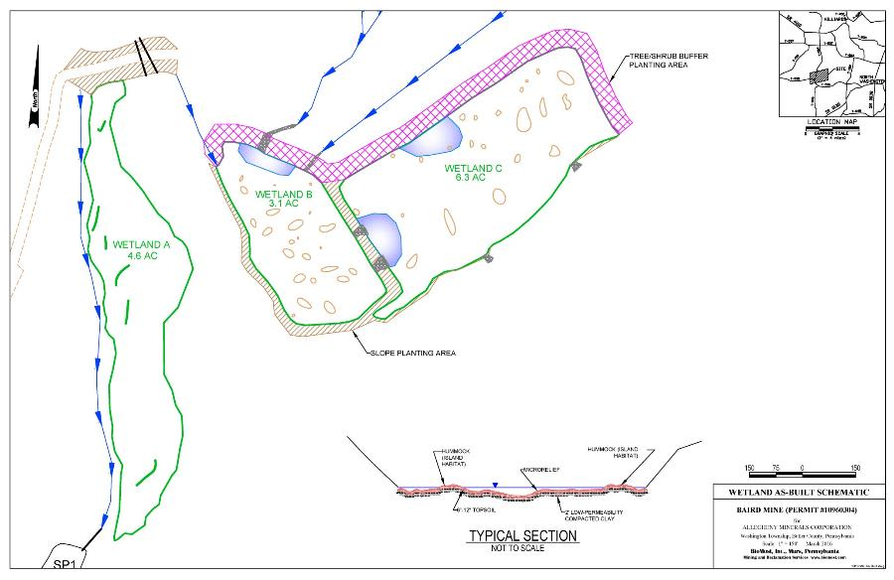
As-Built Schematic
Notes:
Sediment Pond overlap. Mention discharge locations, existing wetland,

Slide 11
Wetland A Construction
Constructed in 2012
Created 4.6 acres of wetland
Constructed outside of mining area
Proposed a different type of wetland construction
Minimize disturbance
Encourage terrestrial crayfish
Construction
Area
Existing Wetland
Notes:
We proposed a different type of wetland construction than what was originally included in the mitigation plan completed in 2000. Since it was outside of the mining area we wanted to minimize disturbance, utilize what was available, to encourage the terrestrial crayfish.

Slide 12
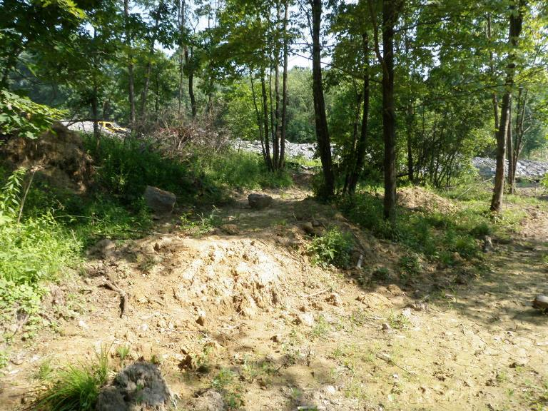
Wetland A Construction
Notes:
Here is a picture of WL A under construction. We left a lot of trees standing and created a series of check dams, terraces, and pools.

Slide 13
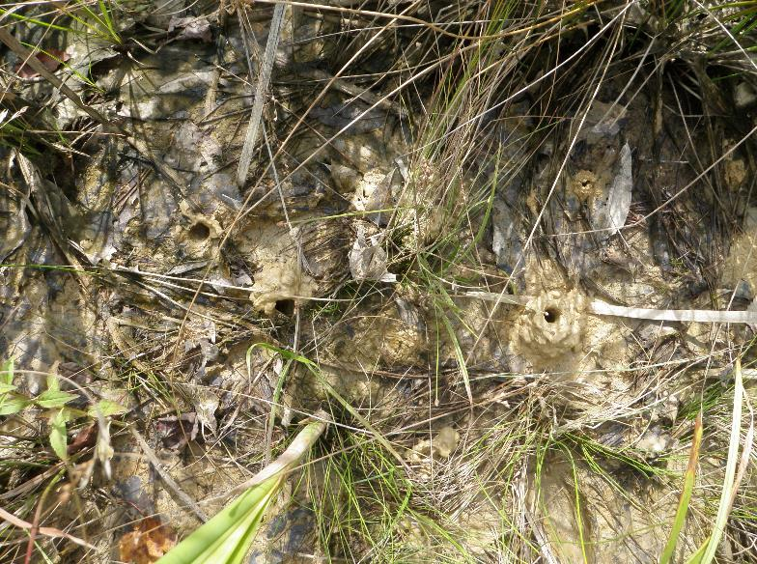
Wetland A Post-Construction

Slide 14
As-Built Schematic
Notes:
Sediment Pond overlap

Slide 15
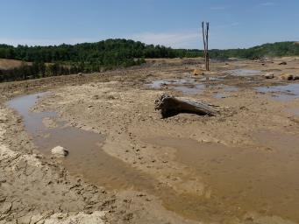
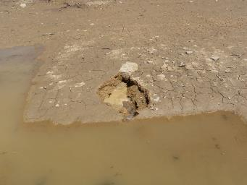
Wetland B & C Construction
Constructed within the mining area in 2015
Took precautions:
Spoil tends to settle
2’ layer of onsite clay compacted with a roller
Another 1-2’ of “wetland substrate” over compacted clay
Notes:
This photo is what can hapeen if you do not have an adequate liner.

Slide 16
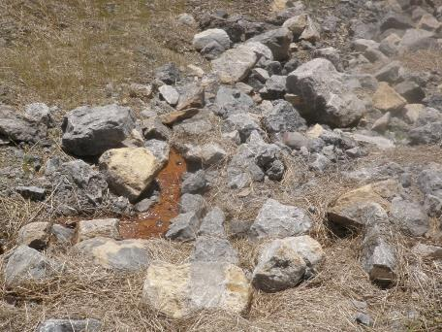
Wetland B & C Construction
Water Sources
Surface runoff
Abandoned mine discharge
Previously fed a majority of wetlands at the site
Flows through limestone ditch

Slide 17
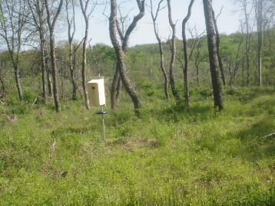
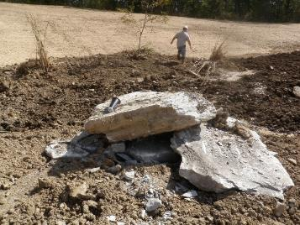
Wetland Habitat Creation
Microtopography/ Hummocks
Deep Pools
Snags
Woody Debris
Rock Piles
Crevices sometimes used by Massasauga Rattlesnakes
Notes:
Whenever I am involved in wetland delineation, I include a few different restoration techniques to create habitat. Snags, dead upright trees-become homes for cavity nesters, perches for birds

Slide 18
Planting
Used a combination of seed, live stakes, and bare root
Seeded in fall of 2015
Ernst Obligate Wetland Seed Mix
Supplemented with additional seed from a small supplier
Reduce costs
Increased diversity
Scirpus acutus (Hardstem Bulrush)
28 species in seed mix
Spread at rate of 12 Lbs/acre (Ernst recommends 20 Lbs/acre)
Experiment – Only seeded Wetland C. No seed used within Wetland B.
Spent >$6,500 on seed for Wetland C
Planted 2400 livestakes in both wetlands

Slide 19
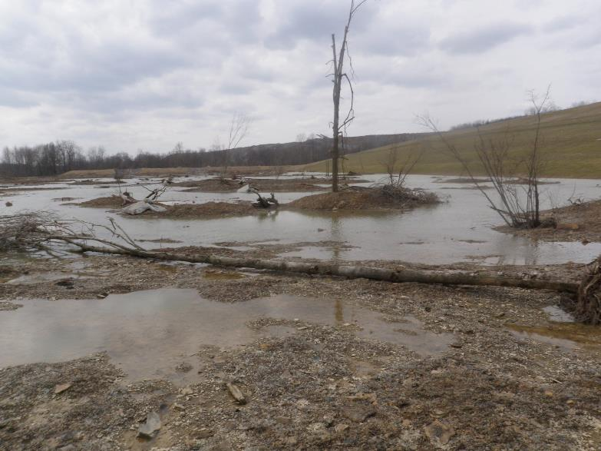
Wetland B Construction

Slide 20
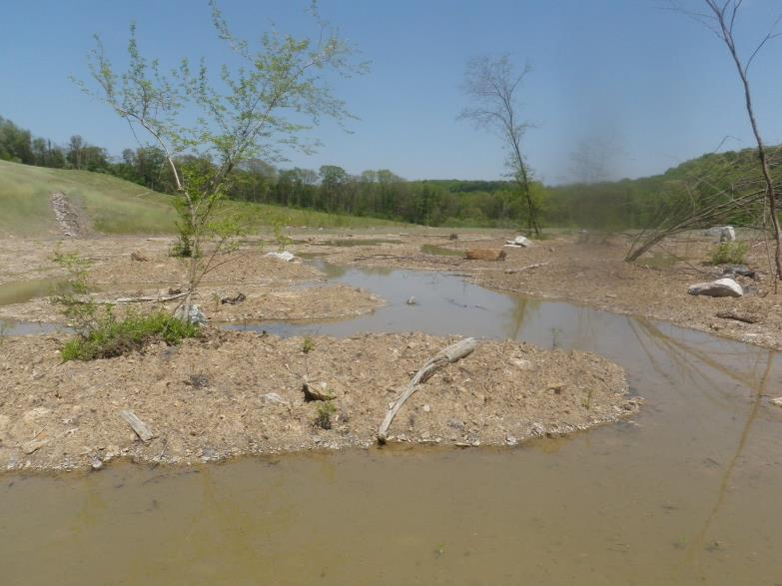
Wetland B Construction

Slide 21
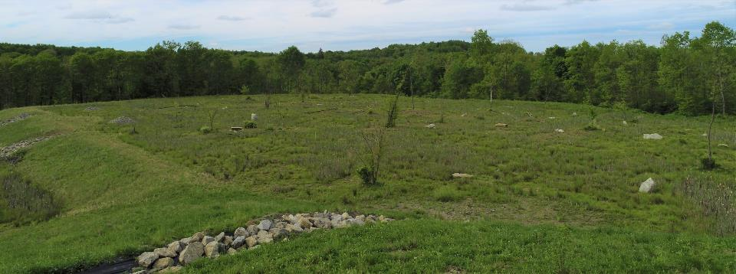
Wetland B – May 2019

Slide 22
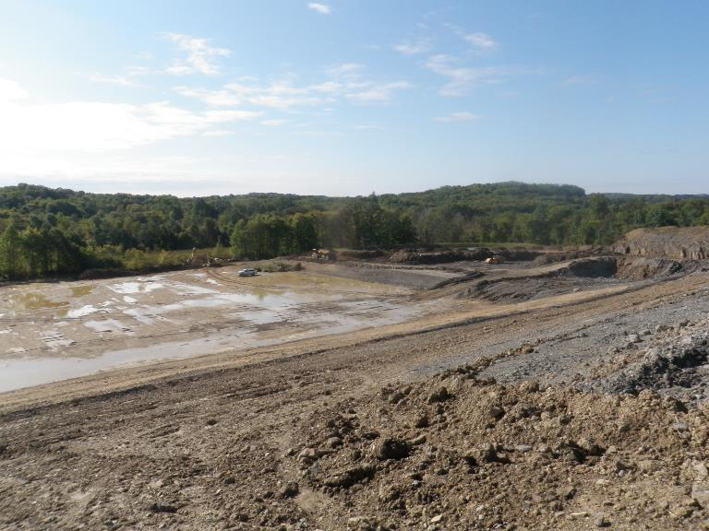
Wetland C Construction

Slide 23
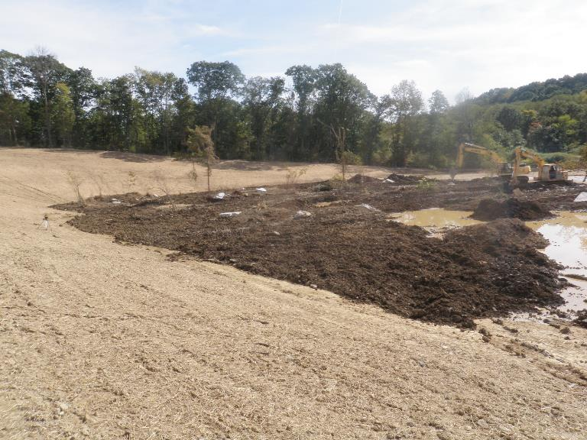
Wetland C Construction

Slide 24
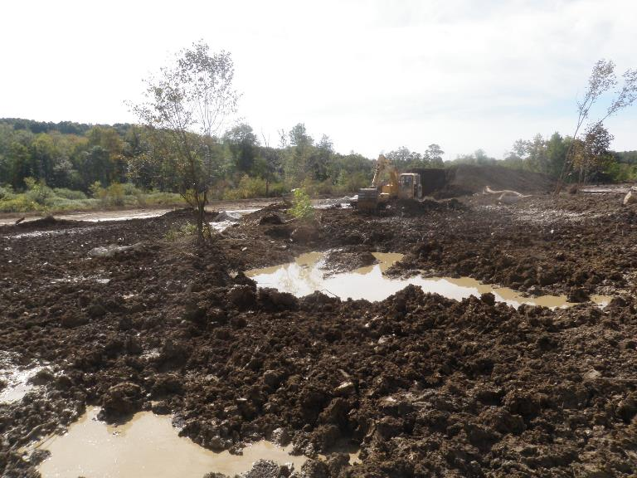
Wetland C Construction

Slide 25
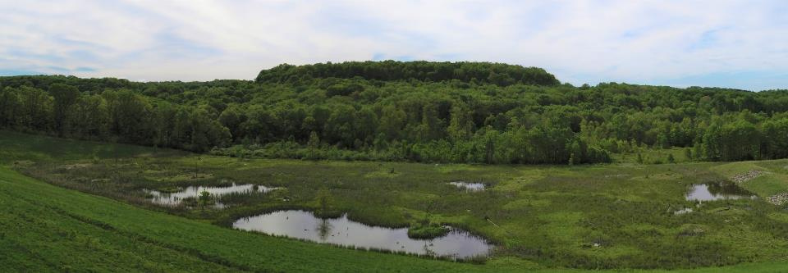
Wetland C – May 2019

Slide 26
Issues
Some erosion prior to revegetation upgradient of wetlands
Eroding collection ditch
Added limestone riprap to channels
Invasive plants
Spillway

Slide 27
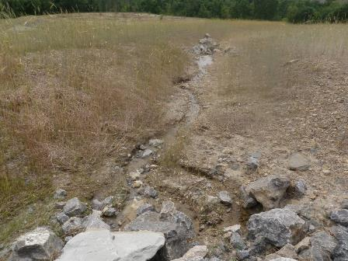
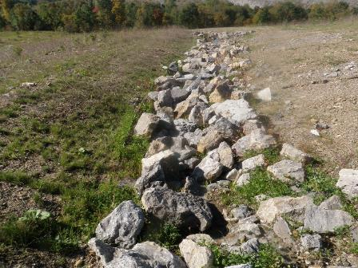
Ditch Repairs
BEFORE
AFTER

Slide 28
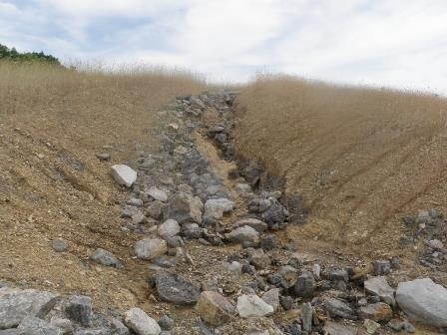
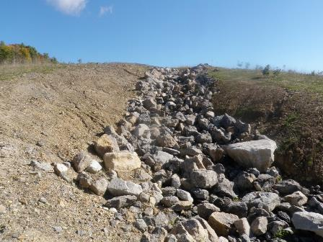
Ditch Repairs
BEFORE
AFTER

Slide 29
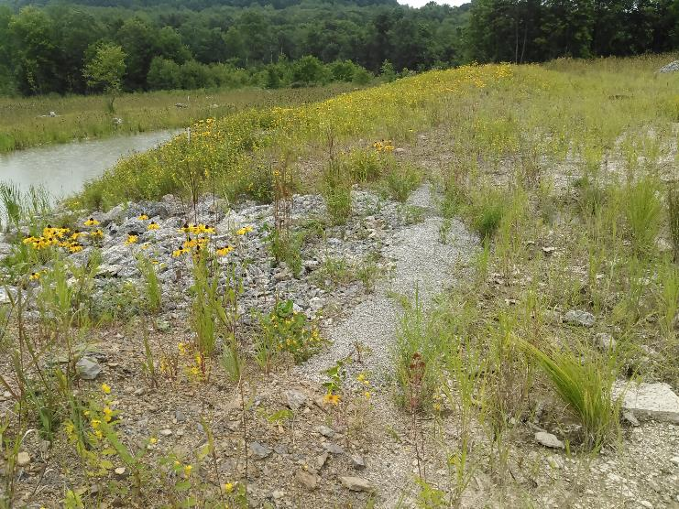
Wetland B Spillway Plugging

Slide 30
Monitoring
Monitoring will began in June 2016
Photo points have been established throughout the wetlands.
Establish quadrats in each of the wetlands
2 monitoring events for 3 years
Comprehensive vegetative survey in 2nd year
Last two years of monitoring not required since wetland successfully met goals.
Notes:
First time that I have been able to take the time to look at the monitoring that has been done over the years.

Slide 31
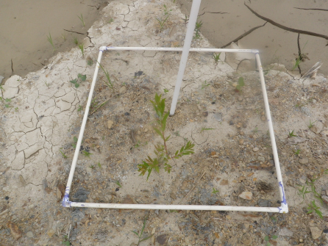
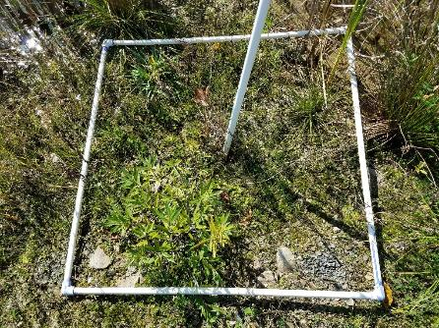
Monitoring Point Photos
6/2016
10/2018
MP 5

Slide 32
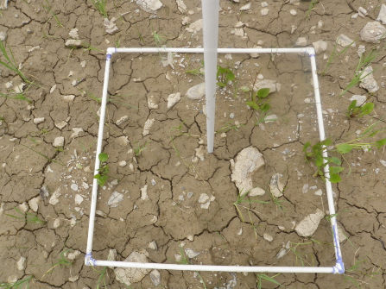
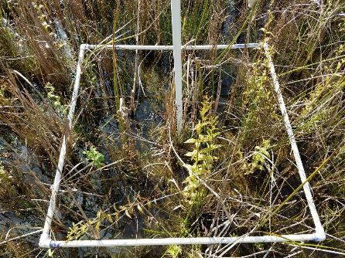
Monitoring Point Photos
6/2016
10/2018
MP 8

Slide 33
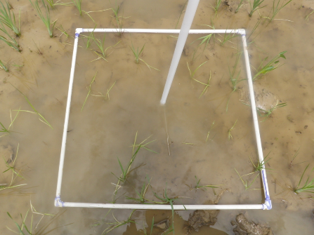
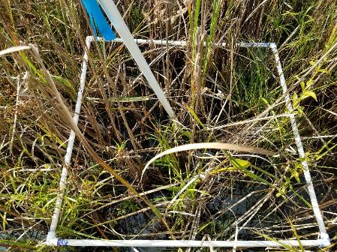
Monitoring Point Photos
6/2016
10/2018
MP 9

Slide 34
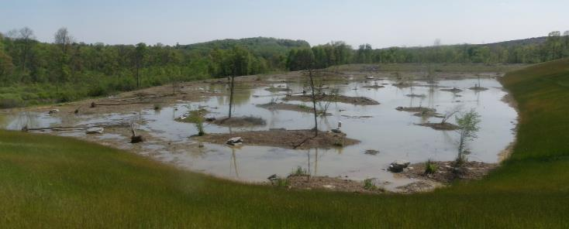
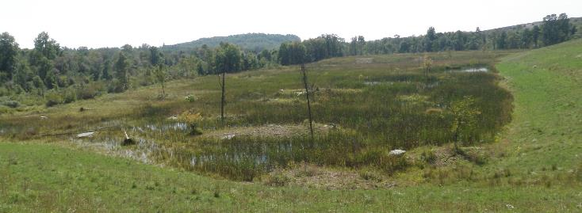
Photopoint 11

Slide 35
UAV Monitoring
Allegheny Mineral using drone for the last 3 years
Stockpile volume calculations
Increased frequency of estimations
Also help with monitoring efforts

Slide 36
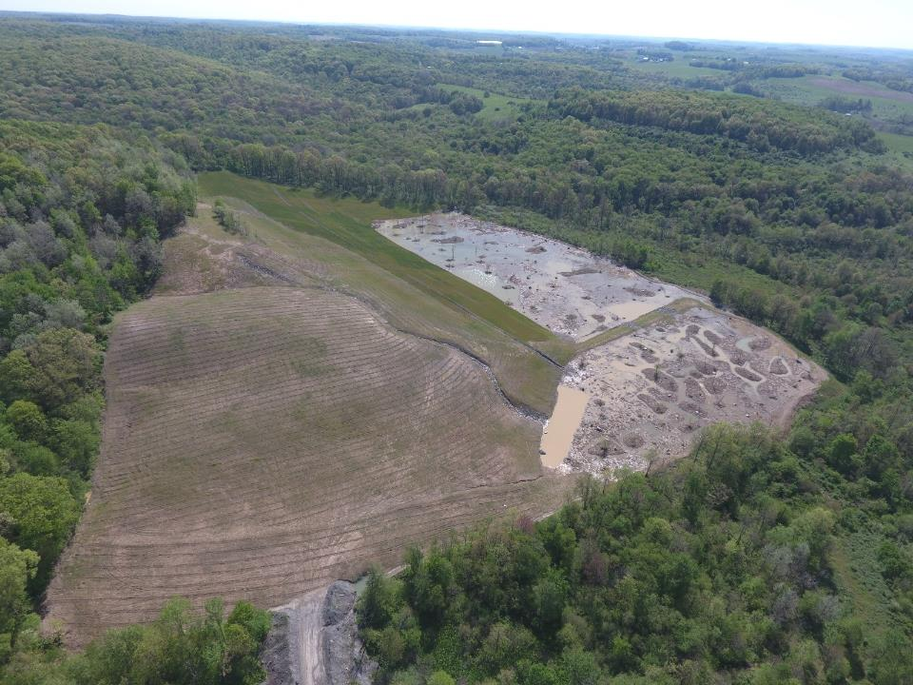
2016
Notes:
The mining operator is nice enough to use their drone to help with monitoring efforts.

Slide 37
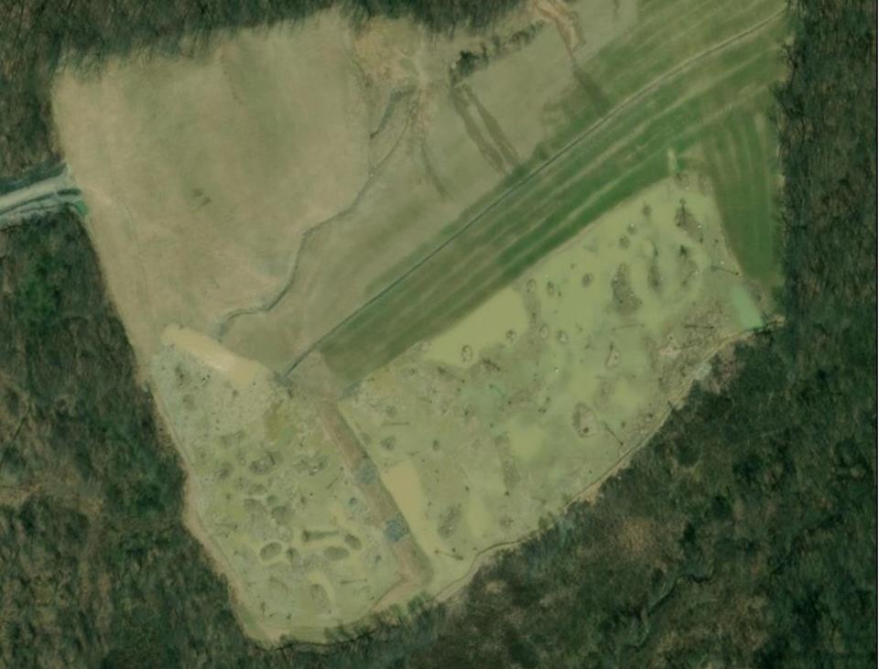
2016

Slide 38
2016

Slide 39
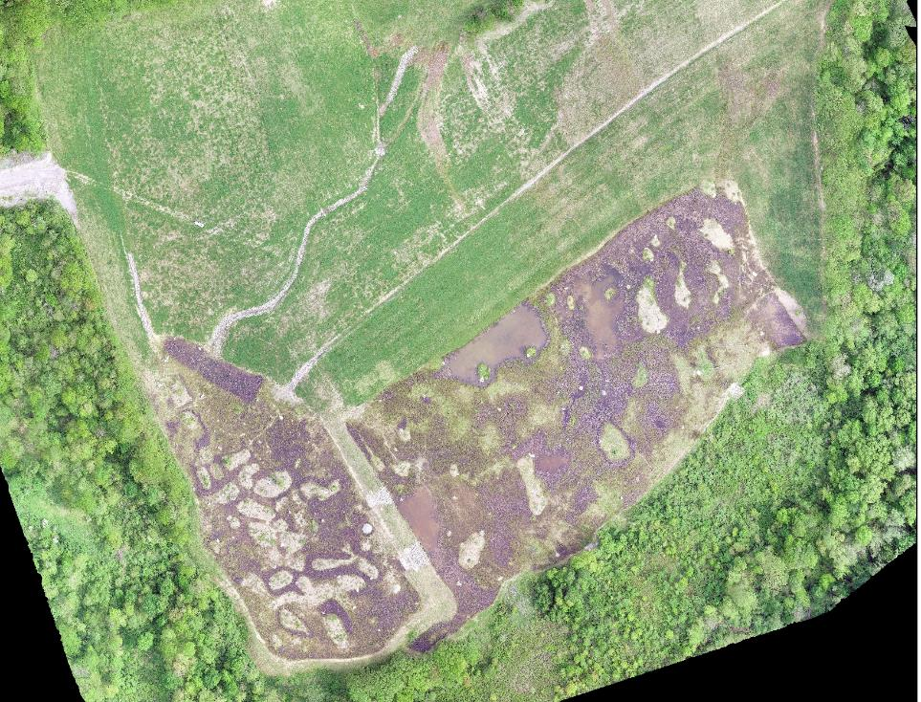
2019

Slide 40
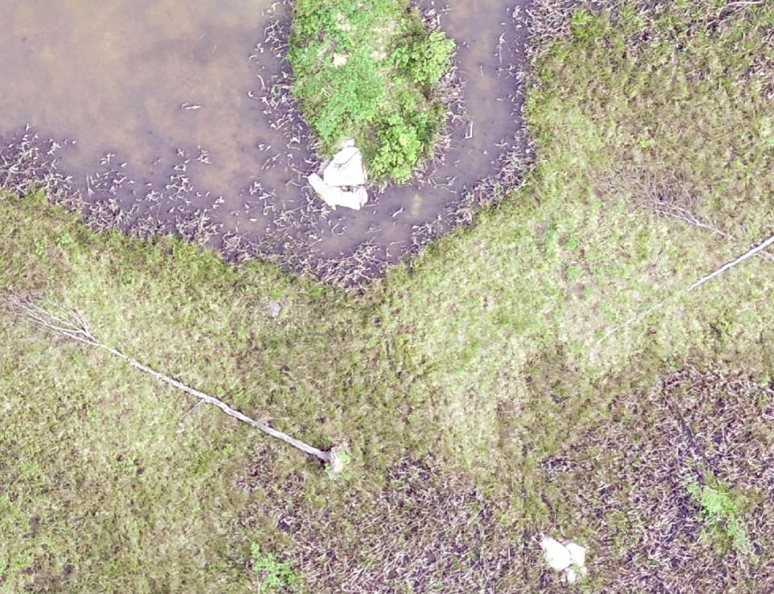
2019

Slide 41
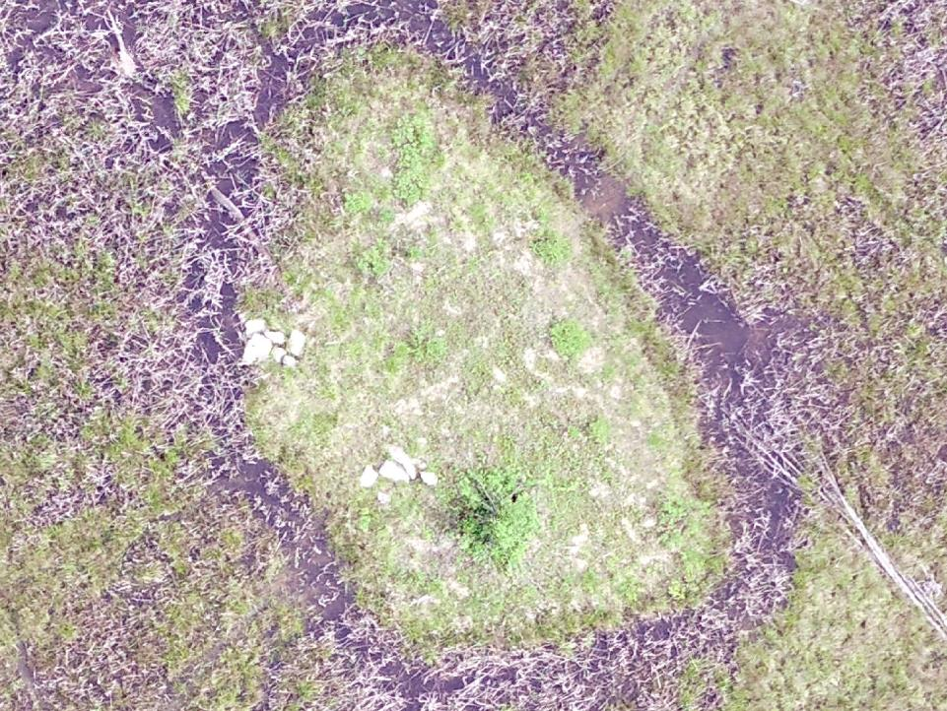
2019

Slide 42
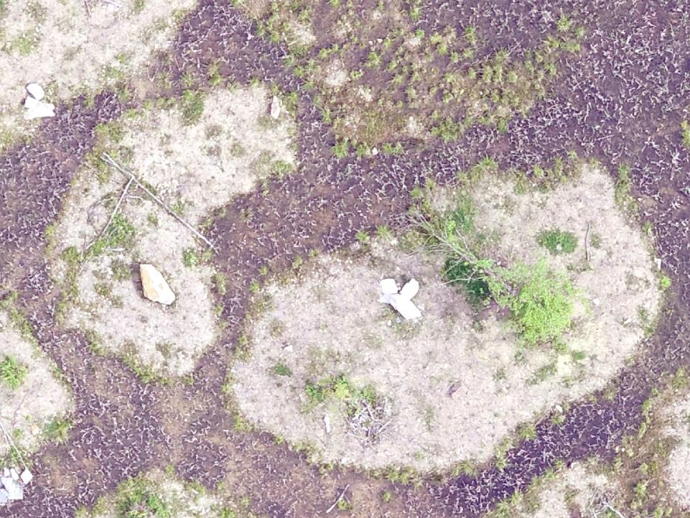
2019

Slide 43
Comparison of Wetland C with Seed Mix
After 3 years, 19 of the 28 species within the seed mix/livestakes remained in the wetland.
Bidens cernua – annual
Never saw Sparganium sp.
Increased from 28 introduced species to 39 in the 3rd year of monitoring.
Botantical Name | Common Name
Alisma subcordatum | Mud Plantain (Water Plantain)
Asclepias incarnata | Swamp Milkweed
Bidens cernua | Nodding Bur Marigold
Carex crinita | Fringed (Nodding) Sedge
Carex lupulina | Hop Sedge
Carex lurida | Lurid Sedge
Carex scoparia | Blunt Broom Sedge
Carex vulpinoidea | Fox Sedge
Eupatorium fistulosum | Joe Pye Weed
Eupatorium perfoliatum | Boneset
Glyceria canadensis | Rattlesnake Grass
Iris versicolor | Blueflag
Juncus effusus | Soft Rush
Ludwigia alternifolia | Seedbox
Mimulus ringens | Square-Stemmed Monkeyflower
Onoclea sensibilis | Sensitive Fern
Penthorum sedoides | Ditch Stonecrop
Pontenderia cordata | Pickerelweed
Salix nigra | Black Willow
Salix sericea | Silky Willow
Schoenoplectus acutus | Hardstem Bulrush
Scirpus atrovirens | Green Bulrush
Scirpus cyperinus | Woolgrass
Scirpus validus | Softstem Bulrush
Solidago patula | Roughleaf Goldenrod
Sparganium americanum | Eastern Bur-Reed
Sparganium eurycarpum | Giant Bur-Reed
Verbena hastata | Blue Vervain
Notes:
Burreed has a really tough seed coat. Usually don’t see it the first year. 12 additional species has naturally colonized from the surrounding area.

Slide 44
Vegetation Analysis

Slide 45
Vegetation Analysis
Notes:
MP3 is beneath a shingle oak, which doubles its vegetative cover. If the shingle oak was removed from the calculation it would roughly be the same as the others. There are slight fluctuations in the cover, but it remains very constant.

Slide 46
Vegetation Analysis

Slide 47
Vegetation Analysis
Notes:
Large increase in October 2016 due to an annual at MP11 (PA Smartweed). Slight decrease in October 2018 most likely due to seasonal fluctuations. Species such as Pickerelweed and Water Plantain die back earlier than other species. The general trend is higher vegetative coverage.

Slide 48
Vegetation Analysis
Hydrologic Conditions of Wetlands B & C
 | Water Depth/Soil Saturation of Constructed Wetlands (inches)
Date | MP5 | MP6 | MP7 | MP8 | MP9 | MP10 | MP11 | MP12
Jun-16 | 0 | 0 | 0 | M | 5 | 1.5 | 0 | M
Oct-16 | S | 0.25 | S | 2.25 | 5.5 | 3 | S | 1
Jun-17 | M | 1 | M | 3 | 6 | 4.25 | M | 1
Sep-17 | M | 0 | 0 | S | 3 | 2 | 0 | S
Jun-18 | M | 1 | 0 | 4 | 7 | 5 | S | 1.25
Oct-18 | S | 1 | 0.5 | 3.25 | 6.75 | 4.5 | S | 0.75
Average | 0.0 | 0.5 | 0.1 | 3.1 | 5.5 | 3.4 | 0.0 | 1.0
M – moist soil; S – Saturated Soil
Species Richness of Monitoring Points
Date | MP5 | MP6 | MP7 | MP8 | MP9 | MP10 | MP11 | MP12
Jun-16 | 6 | 5 | 6 | 4 | 3 | 4 | 5 | 3
Oct-16 | 10 | 6 | 6 | 5 | 6 | 6 | 6 | 7
Jun-17 | 9 | 6 | 7 | 8 | 8 | 4 | 5 | 8
Sep-17 | 9 | 6 | 8 | 6 | 8 | 3 | 7 | 8
Jun-18 | 8 | 6 | 7 | 7 | 6 | 5 | 6 | 7
Oct-18 | 11 | 5 | 6 | 7 | 7 | 4 | 10 | 6
Average | 8.8 | 5.7 | 6.7 | 6.2 | 6.3 | 4.3 | 6.5 | 6.5
Notes:
Highest number of species occurred at monitoring points with lower water levels. When looking at the data, those points had a few FACU species.

Slide 49
Vegetation Analysis
Notes:
Invasive species were actively targeted during monitoring events. Invasives within Wetland B were scattered throughout the wetland, but Wetland C invasives were mainly found around the edges.

Slide 50
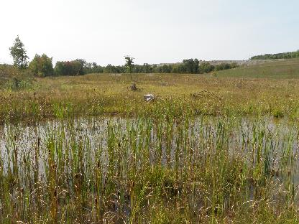
Schoenoplectus acutus
State Endangered Species
Seeded in Wetland C
Successfully established throughout the wetland

Slide 51
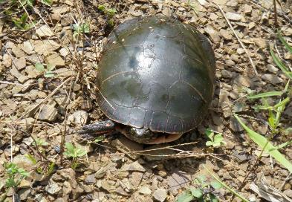
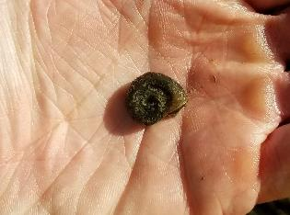
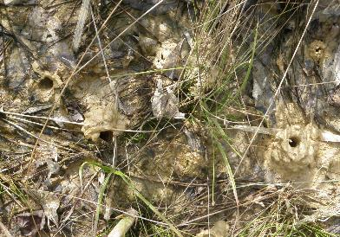
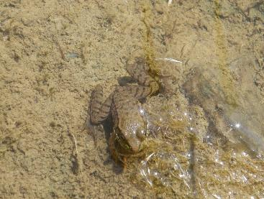
Wetland Visitors
Notes:
Painted turtle, orb snails, wood duck, green frog, black bear

Slide 52
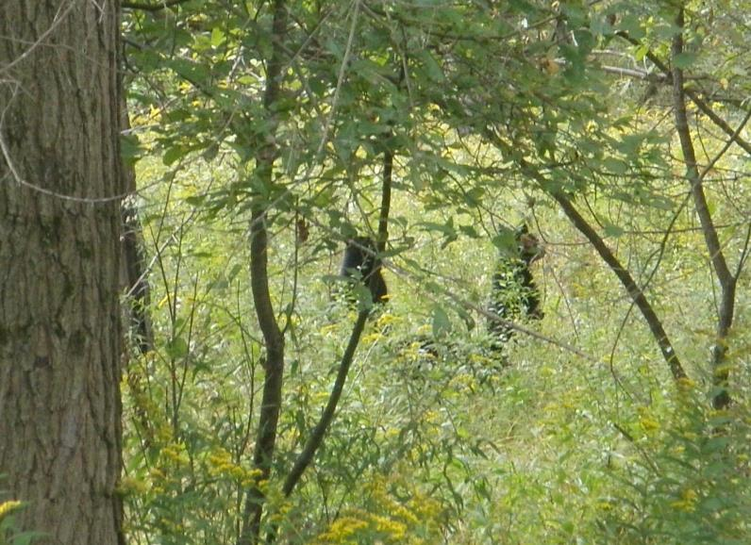
Unwelcome Visitor?
Notes:
Wood duck boxes found destroyed in June 2018.

Slide 53
Recommendations
Cut the seeding rate
Only 60% of the recommendation was used for Wetland C
Seeding may not be necessary
Maybe only applies to areas with adjacent wetlands
Seeding appears to help prevent invasive species from establishing
Focus on unique or endangered species
Seed islands/hummocks
Supplement seed with livestakes/bareroot trees and shrubs
Notes:
I should qualify that a totally isolated wetland may not do well without some sort of seeding. I am not sure how some of the seed was introduced into Wetland B. Some like purple leaf willow herb and cattails can blow by the wind. Many of the species disperse by gravity.

Slide 54
Questions

