Slide 1
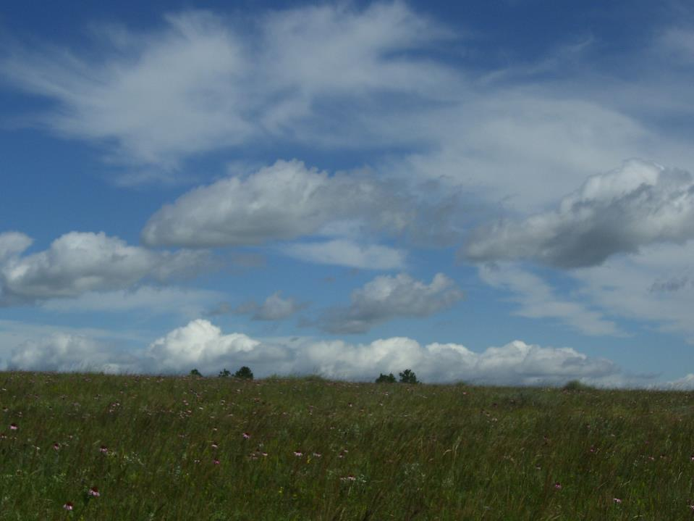
Riley Pass Uranium Mine Site –
Restoring the Hydrologic Function
Mary Beth Marks - USDA Forest Service
Mark Donner – TriHydro
Mike Hatten – Tetra Tech

Slide 2
Acknowledgements
Geomorphic Reclamation Concepts
Dustin Wasley – GeoEngineers
Harold Hutson – BSR Engineering
Tyrel Hulet – Trihydro Corporation
Peter Werner – USDA Forest Service
Design Engineers
Tetra Tech, LT Leon and TriHydro
Construction
NorthWind Construction Services

Slide 3
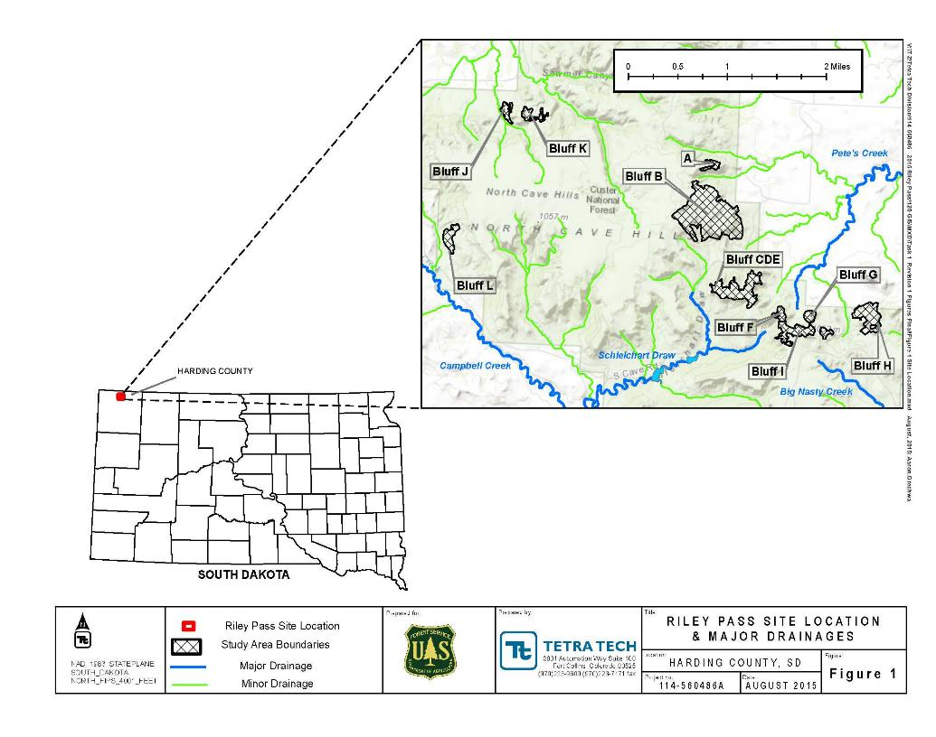
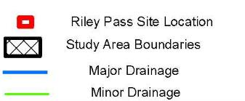

Slide 4
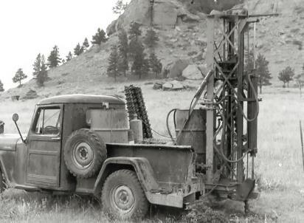
RILEY PASS URANIUM MINES
Prospecting Activities – as early as 1950
Uranium mining operations in 1962
Mining ceased in 1965
Overburden pushed off the outer edges of the pits, highwalls and spoils material with exposed radioactive material

Slide 5
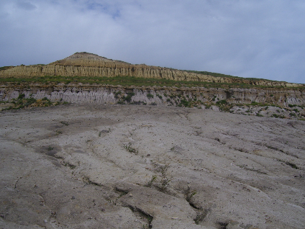
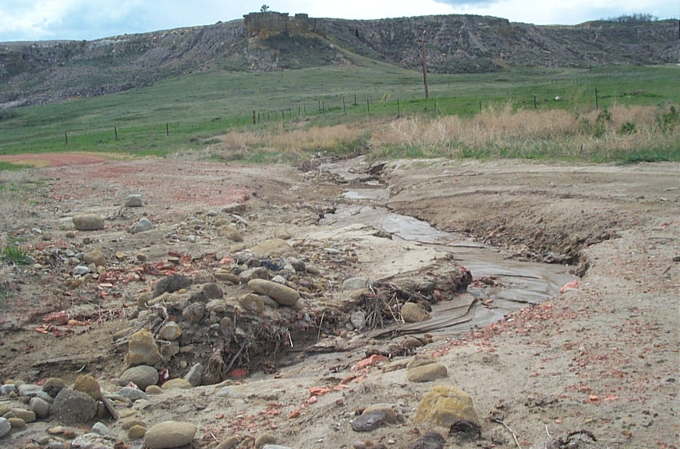
EROSION
  Physical characteristics of the soils,
  Relatively steep terrain
  Climate conditions – high frequency of storm events
  Primary transport of contaminants is erosion

Slide 6
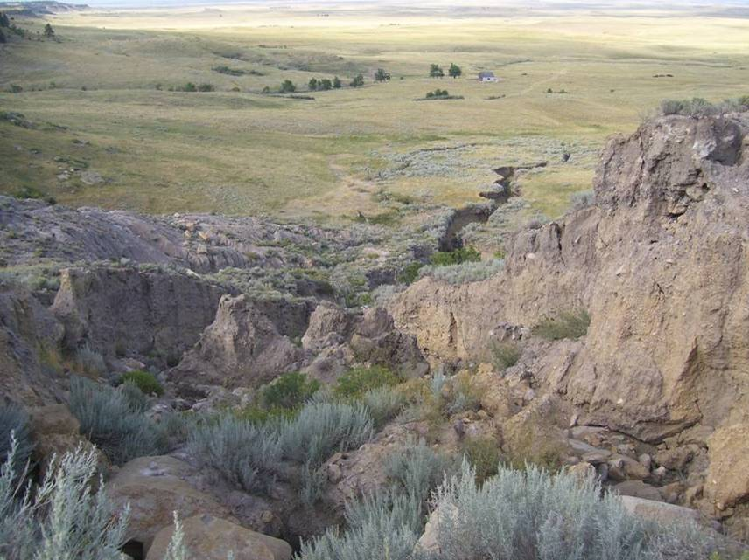
Northeast Drainage Channel – Bluff B

Slide 7
Hydrology
No surface water at site, except runoff during snowmelt and rain events
Springs and seeps surface at the base of the sandstone

Slide 8
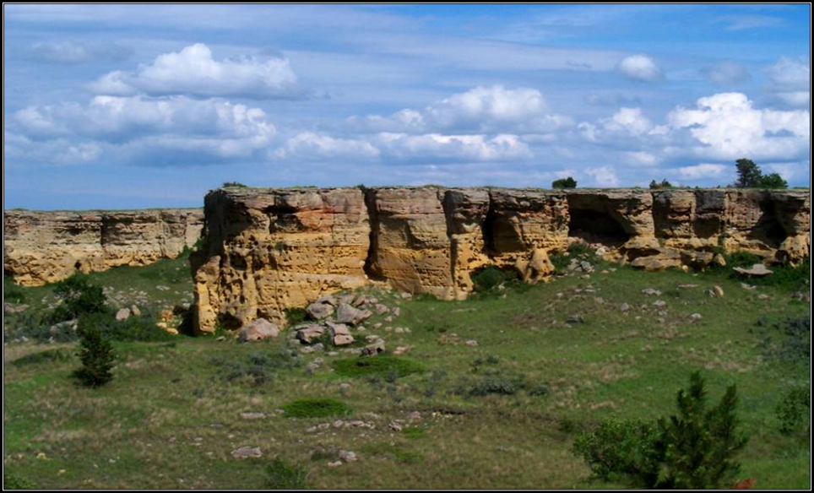
What are the Natural Landforms at Riley Pass?

Slide 9
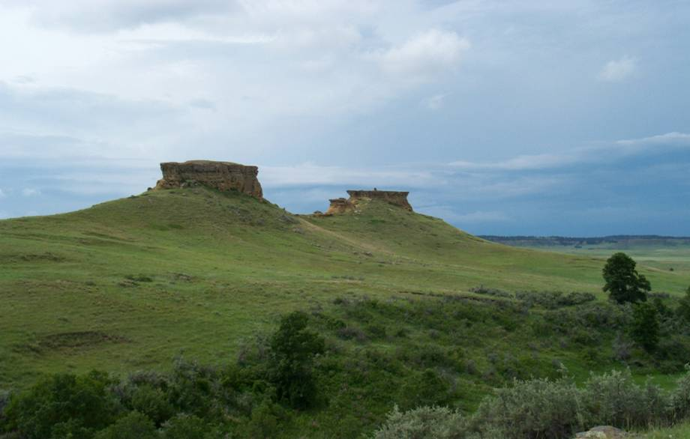

Slide 10
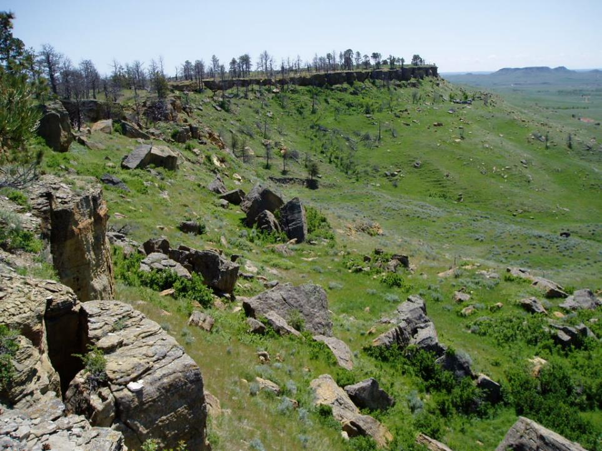

Slide 11
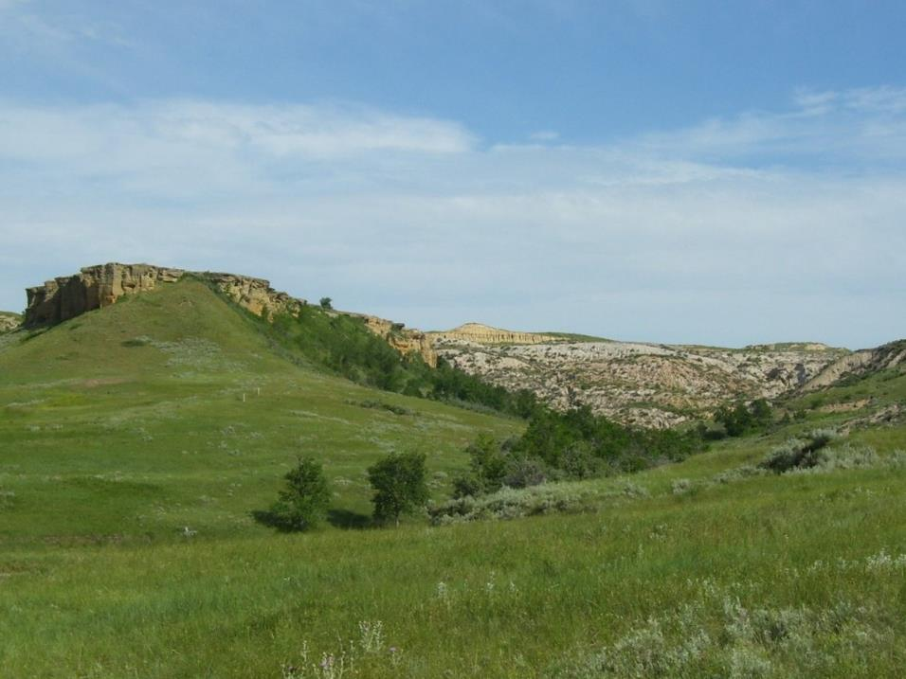

Slide 12
Geomorphic Reclamation
Restoring the Hydrologic Function
Natural channel morphology
Small drainage basins
Increased diversity of slope aspects and habitat
Stable configuration of slopes

Slide 13
Geomorphic Reclamation at Riley Pass Mine Site
Starting with Carlson’s Natural Regrade™ on bluff tops and slopes
Placement of large rocks and tree and shrub planting
Reclamation approach will evolve as we observe surface runoff and gain experience with Natural Regrade™
Isolation of waste, sandstone bluff cliff edges and groundwater flow will likely present challenges

Slide 14
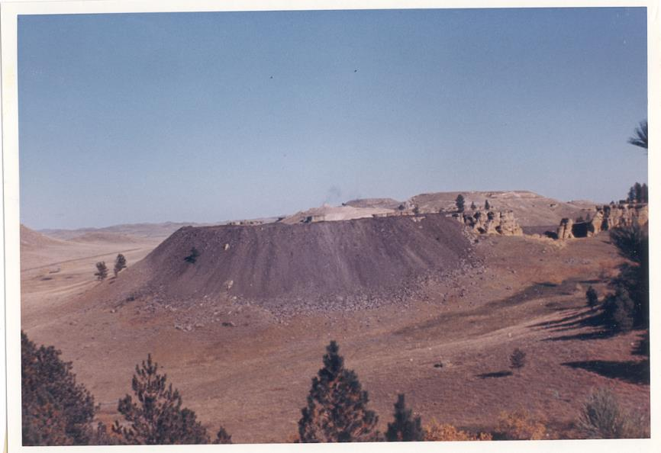
Bluff G – During Mining - 1964

Slide 15
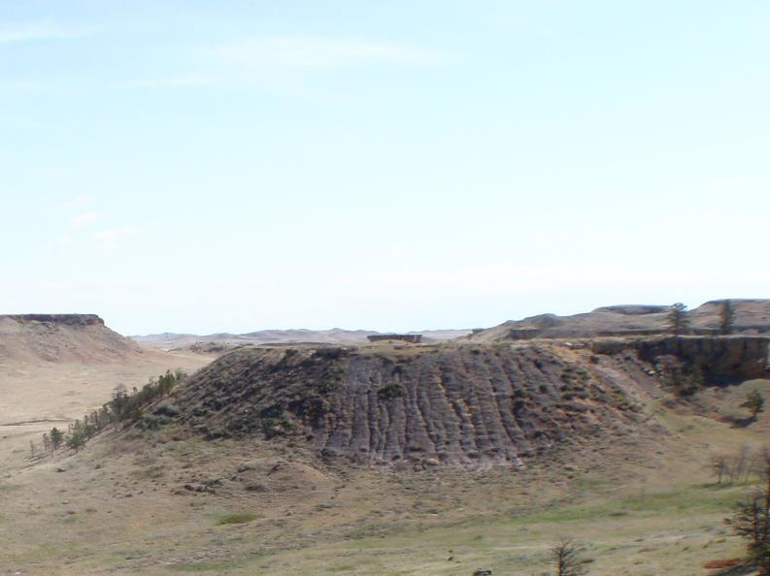
Bluff G – Post Mining - 2012

Slide 17
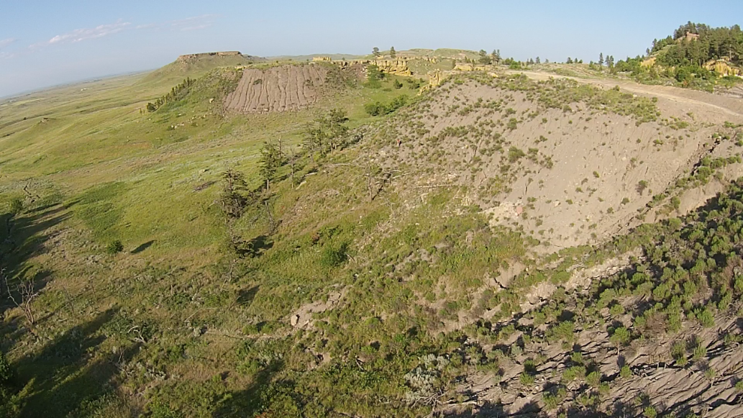
Reclamation of Bluffs F, G and I
Bluff G
Bluff I

Slide 18
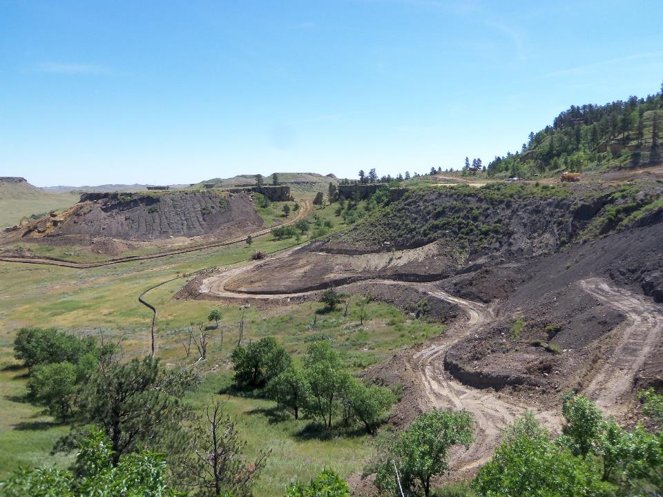

Slide 19
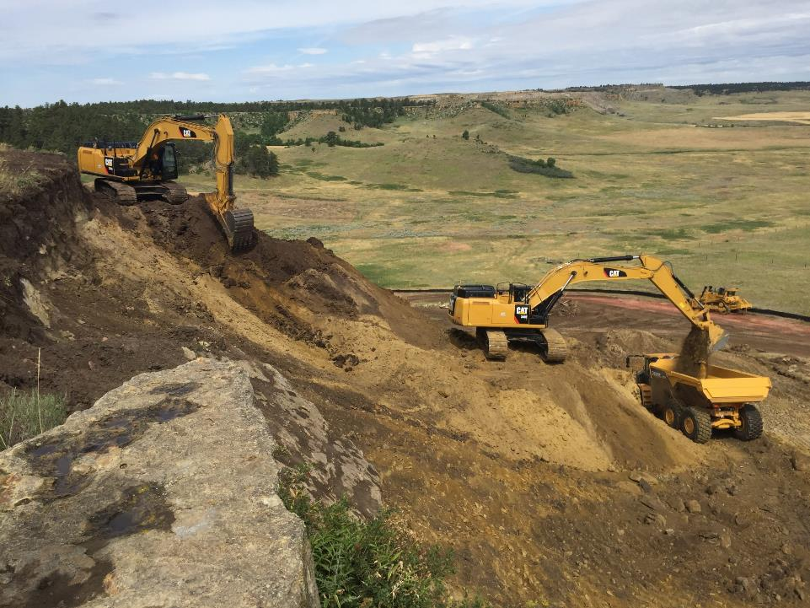

Slide 20
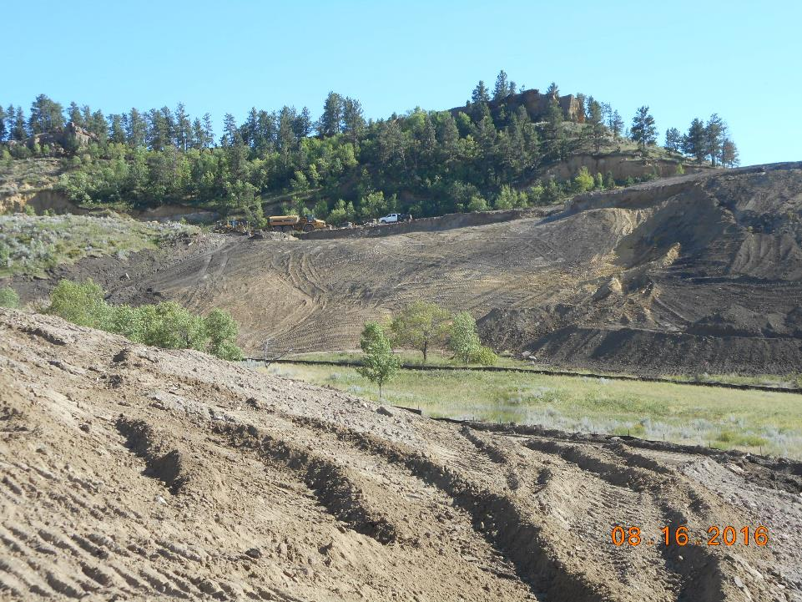

Slide 21
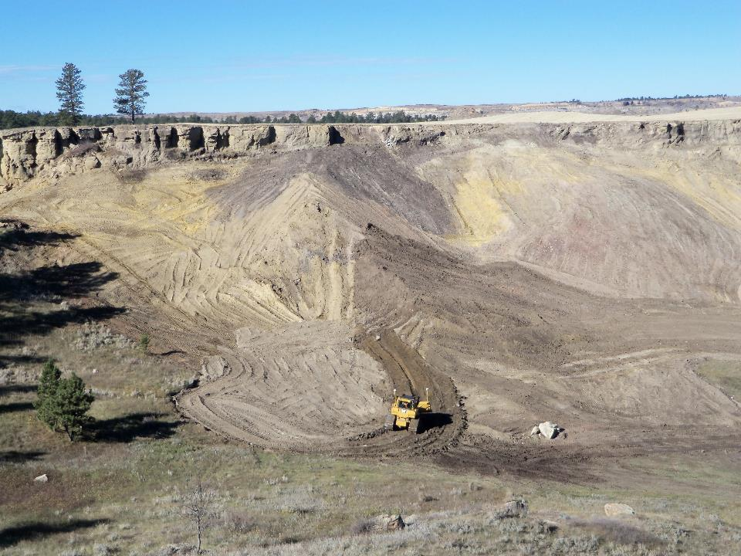

Slide 22
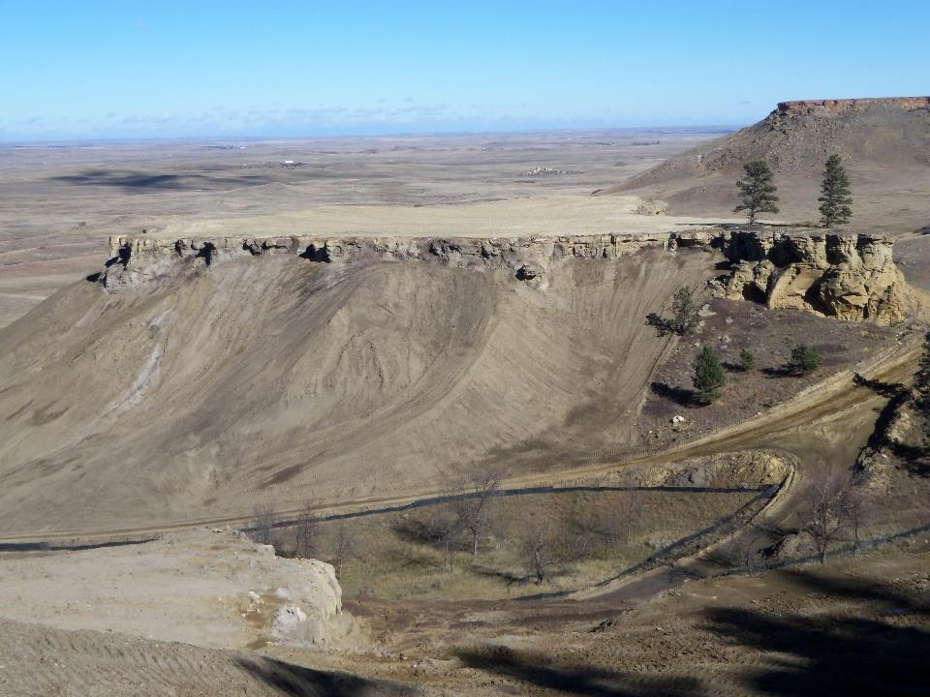

Slide 23
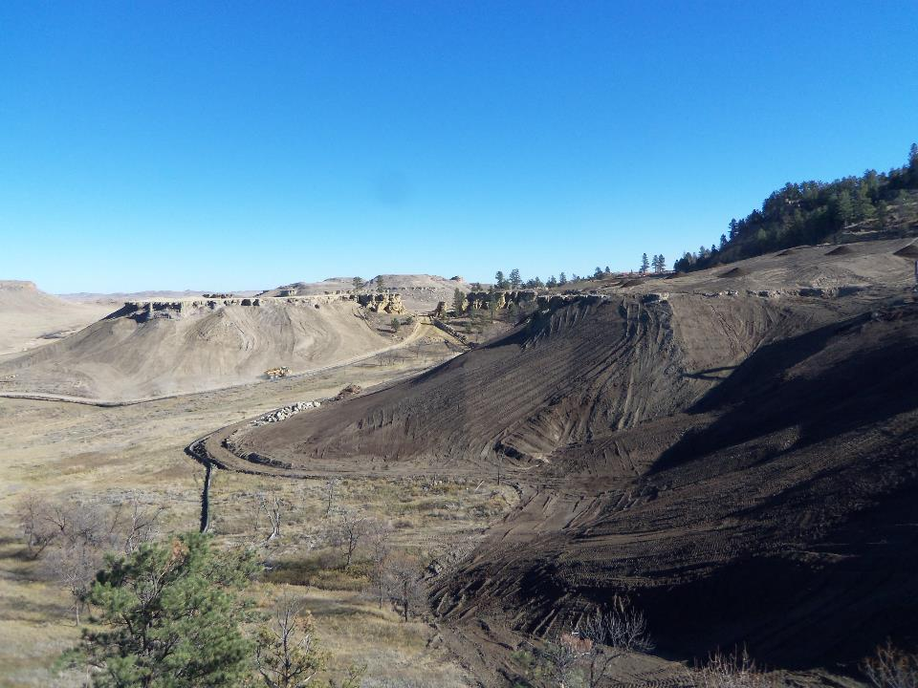

Slide 24
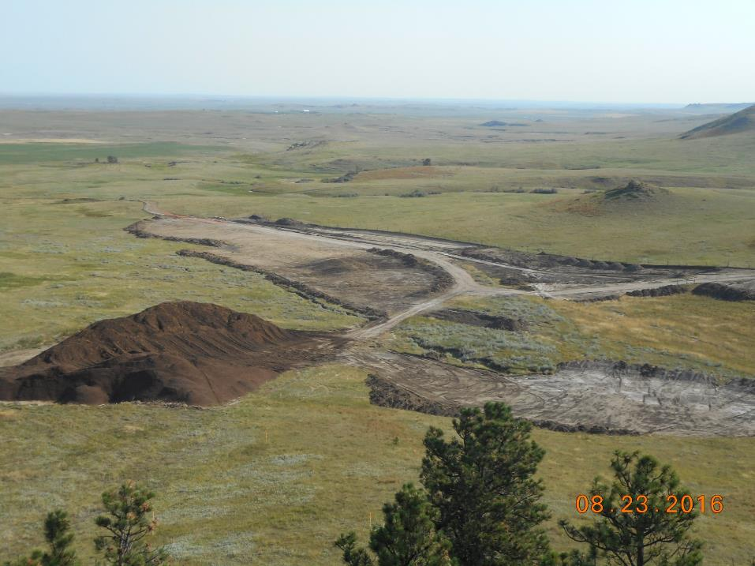

Slide 25
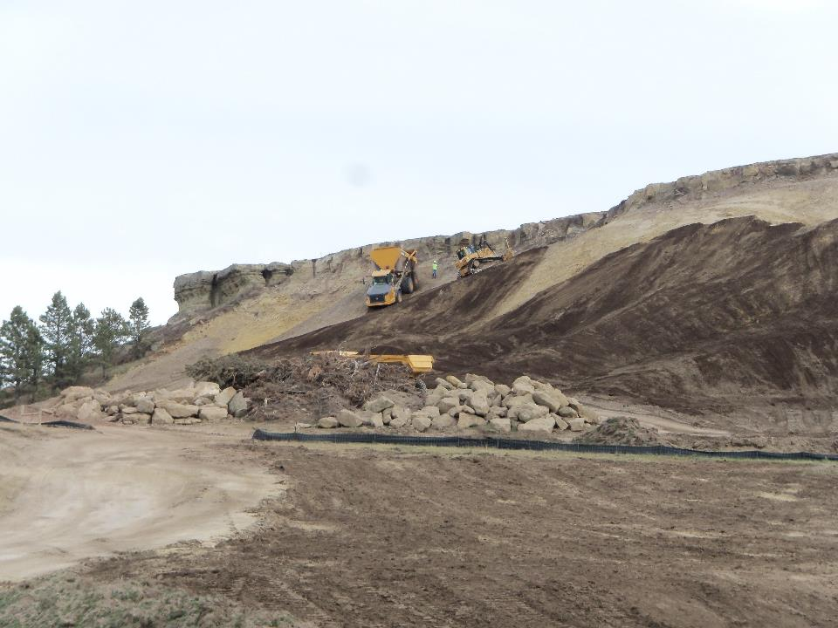

Slide 26
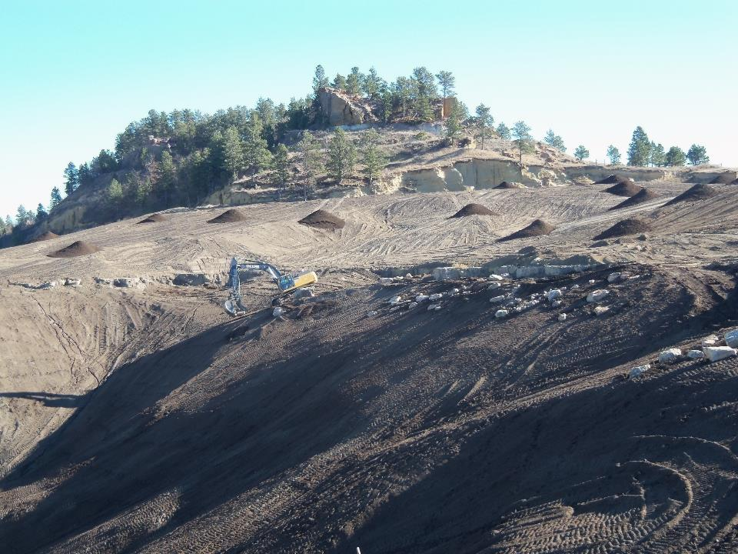

Slide 27
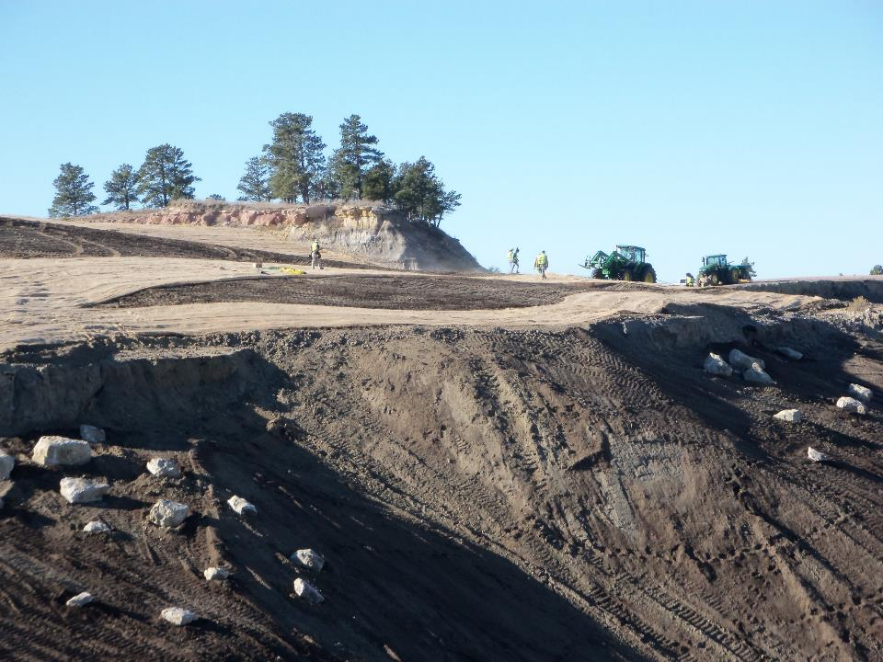

Slide 28
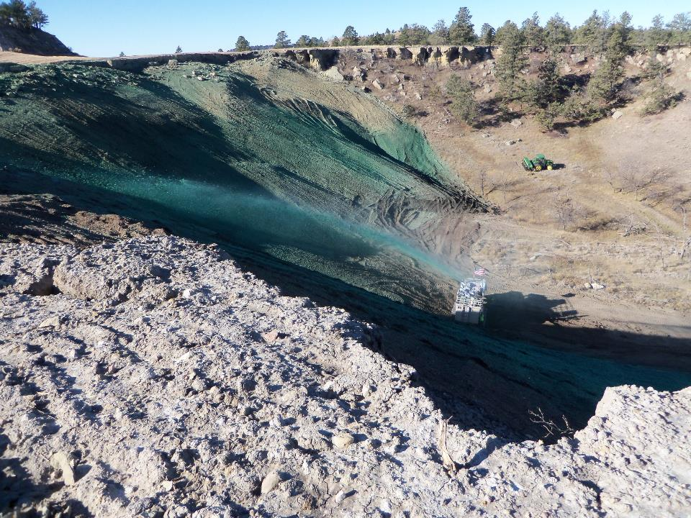

Slide 29
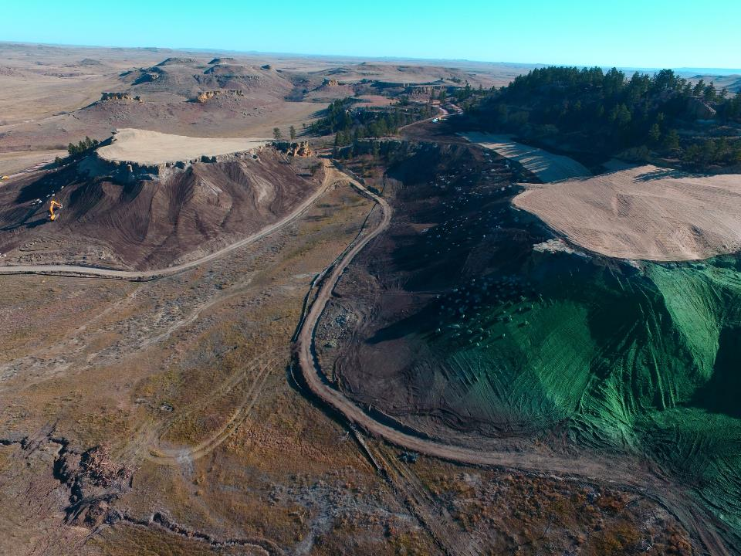

Slide 30
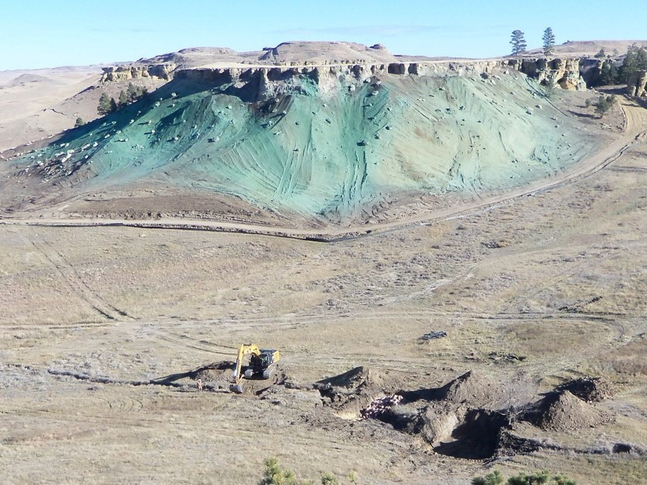

Slide 31
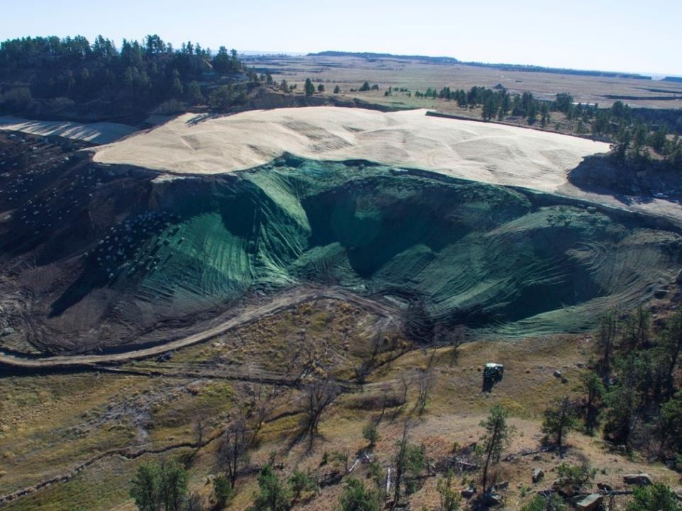

Slide 32
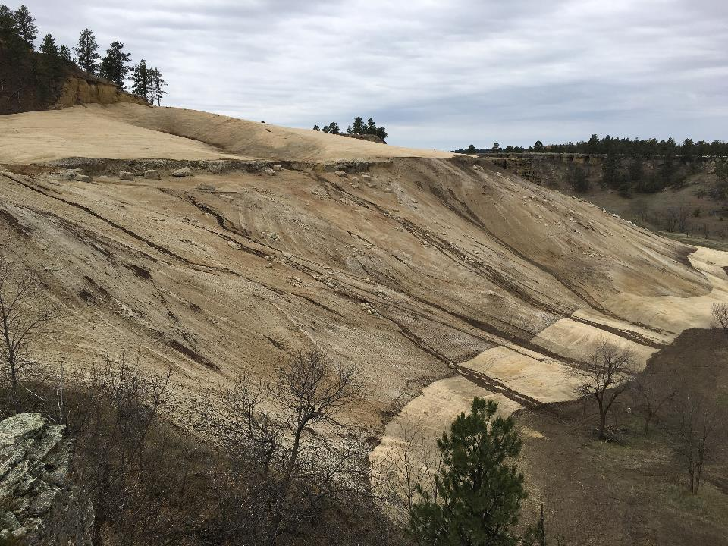
April 2017

Slide 33
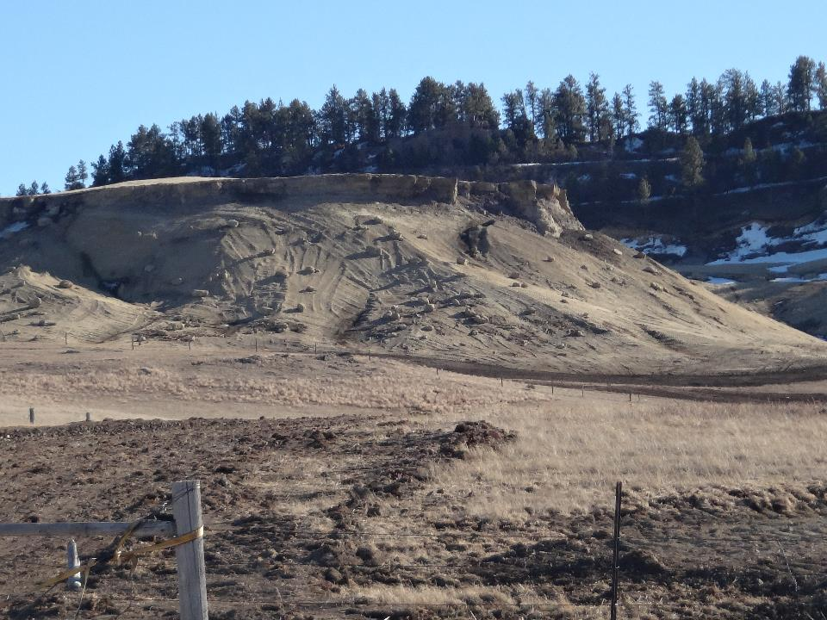

Slide 34
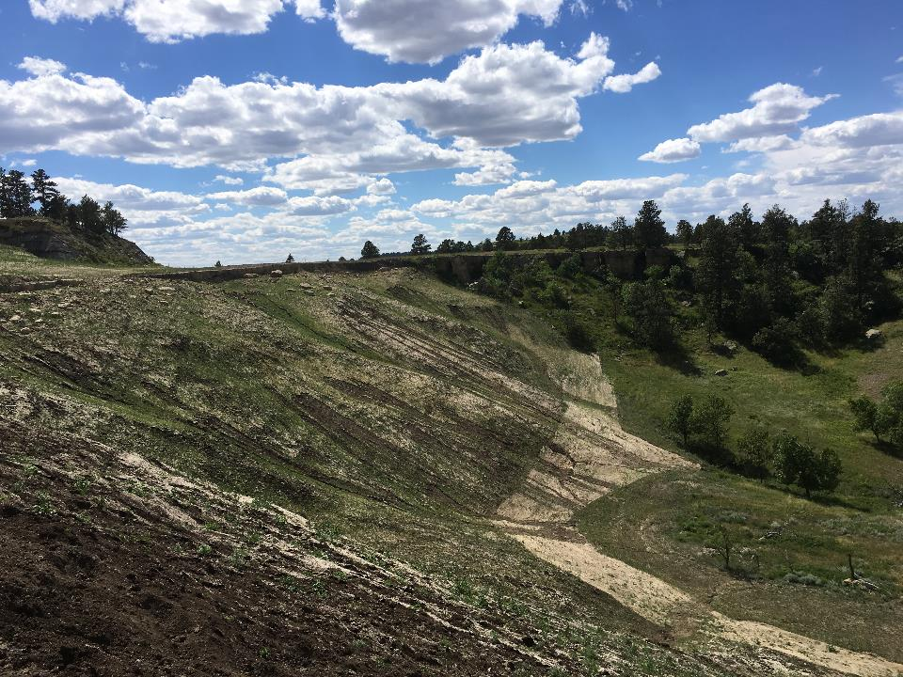
June 2017

Slide 35
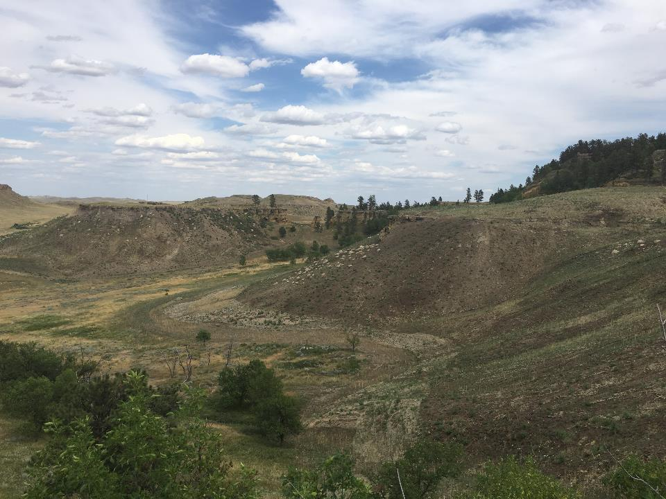
July 2017

Slide 36
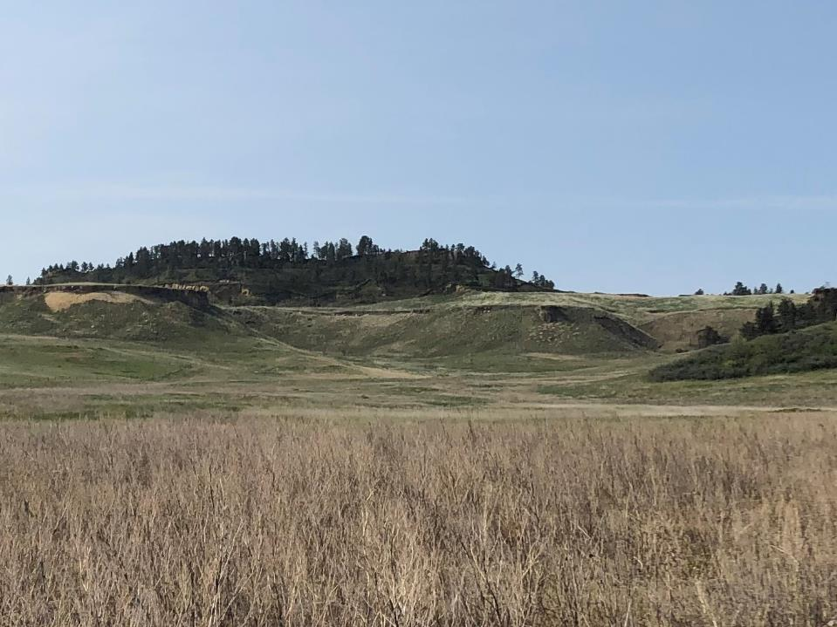
May 2019

Slide 37
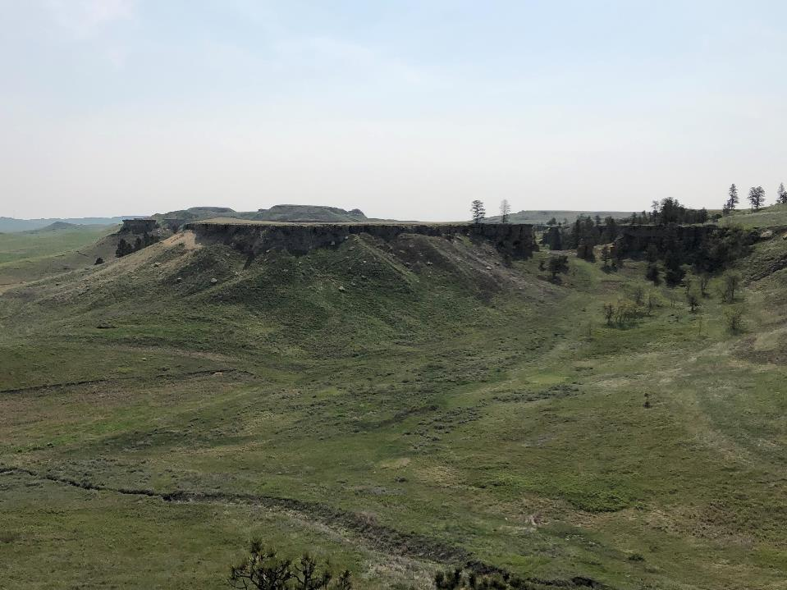

Slide 38
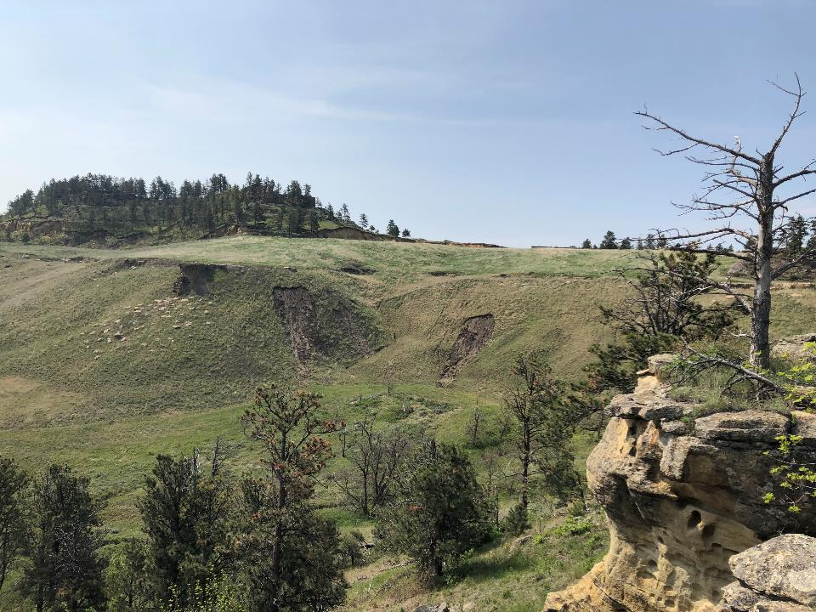

Slide 39
Reclamation of Bluff CDE
Isolate waste onsite
Construct Natural Landforms
  Natural Regrade ©
  AutoCAD design
Low landforms on top of sandstone bluff

Slide 40

Natural Regrade
AutoCAD

Slide 42
Construction Challenges
GPS Control Construction
  Format of files loaded into Heavy Equipment
  Assistance to load design files into equipment
  Operator experience with GPS contouring
  Difficult to verify construction on the ground
  Surveying
  Survey checks of LiDAR survey
  Need good surveying control from the beginning
  Construction area is not staked for construction

Slide 43
Lessons Learned
Keep design files as small as possible
Keep separate grading areas in separate files
Quantity estimates
  Pre-construction baseline – LiDAR surface check
  Depth of excavation (bedrock) may vary from assumption in design
  Consider shrinkage factor of material
  Surveying for final quantities is completed at the end of the work
  Important to keep load counts during construction
Carlson’s Natural Regrade™ Design
  Designs are difficult to modify for conceptual changes, such as differing cover thicknesses
  Difficult to get an estimate of quantities without doing the design
  Making changes to design during construction is time consuming

Slide 44
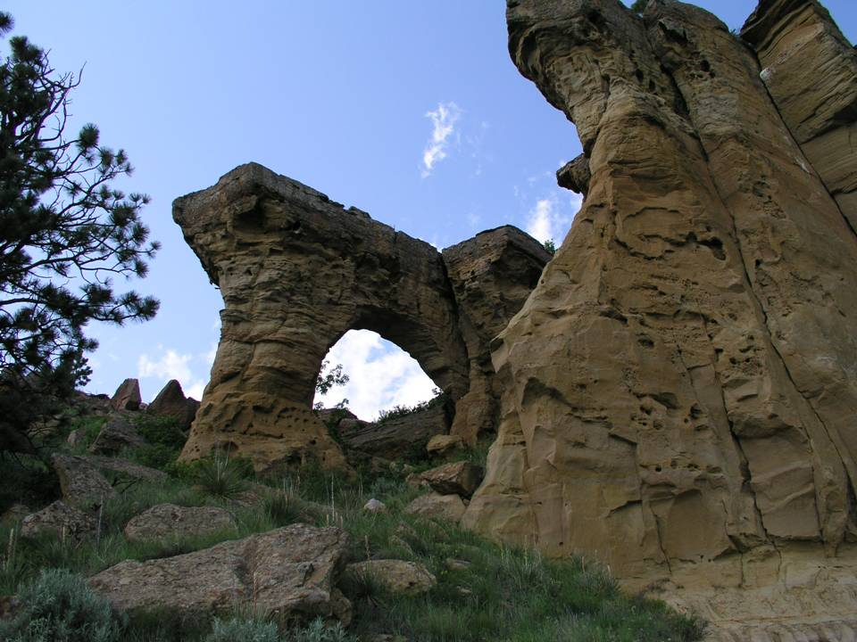
Any Questions?

Slide 45
Project Seed Mix (common names)
Black Eyed Susan
Lead Plant
Maximillan Sunflower
Purple Coneflower
Prairie Coneflower
Prairie Sage
Purple Prairie Clover
Wester Yarrow
Winterfat
Bluebunch Wheatgrass
Canada Wildrye
Green Needlegrass
Little Bluestem
Prairie Sandreed
Sideoats Grama-Pierre
Slender Wheatgrass
Western Wheatgrass

Slide 46
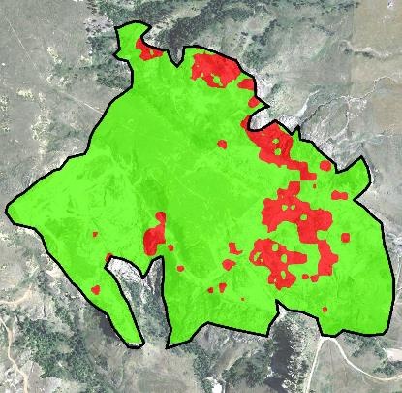

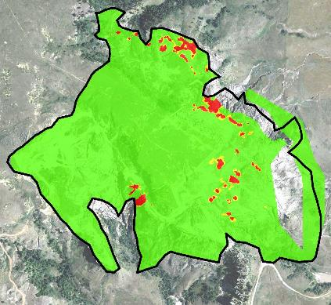

Bluff B
Arsenic
Radium-226

Slide 47
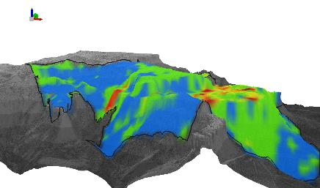
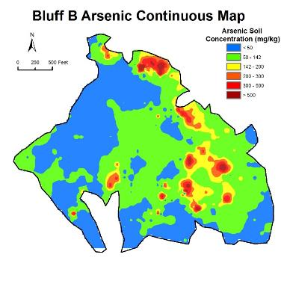
Arsenic Mapping

Slide 48
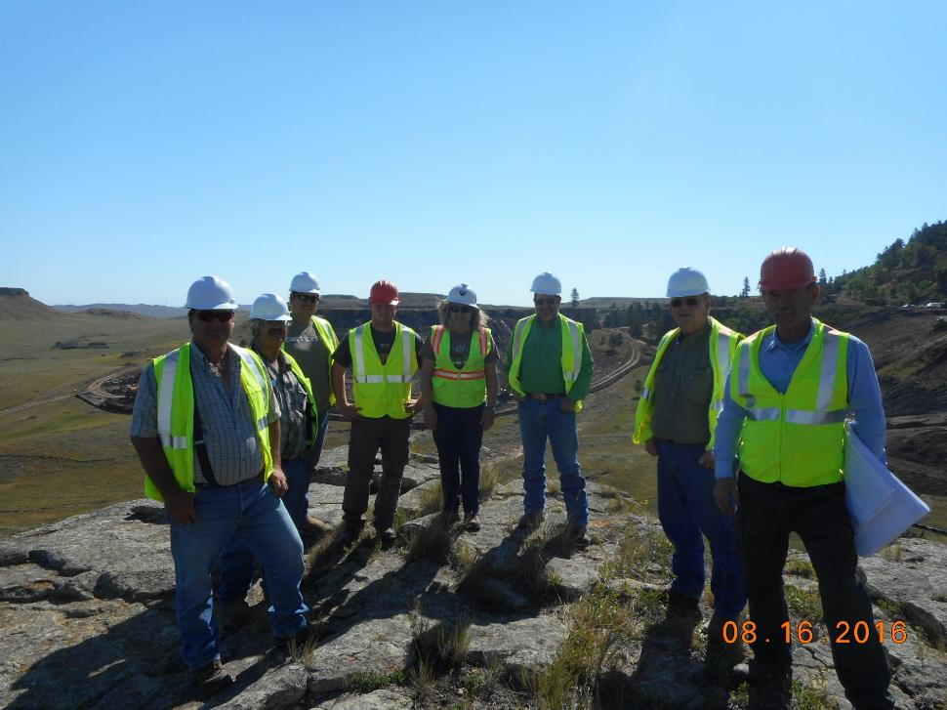
Community Relations

Slide 49
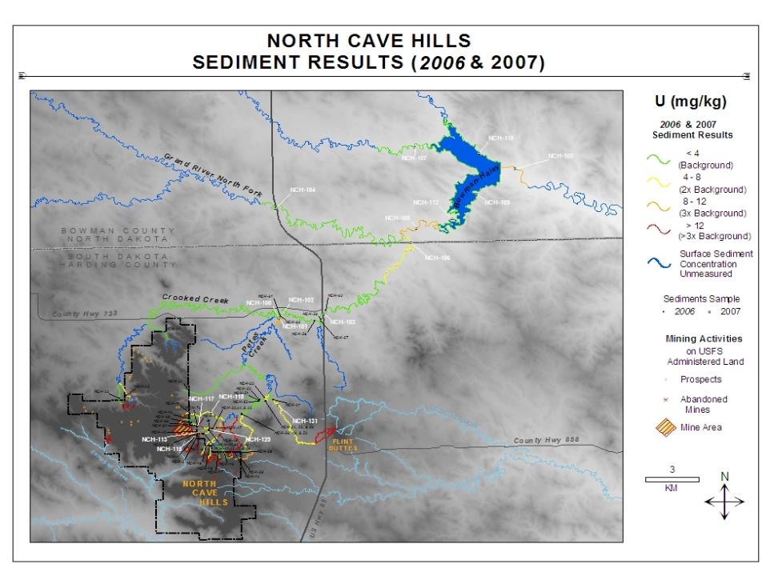

Slide 50
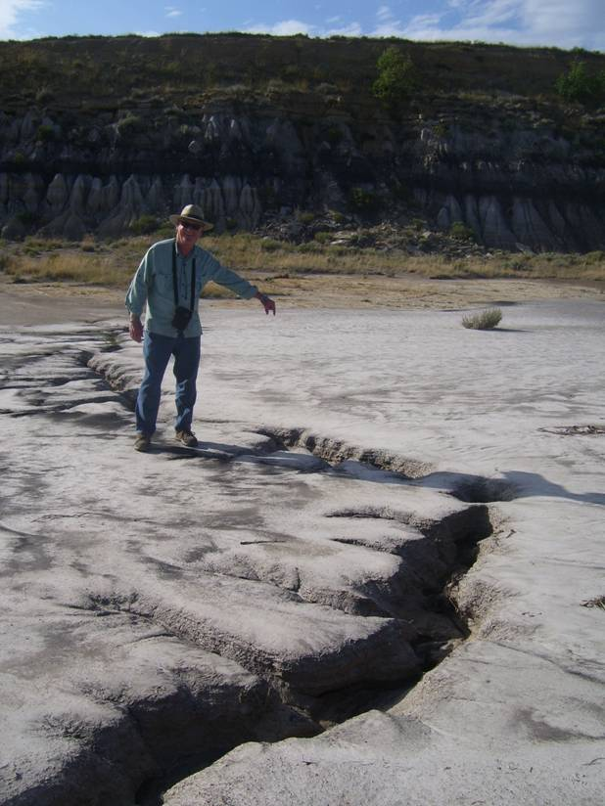
Fractures in Basal Sandstone

Slide 51
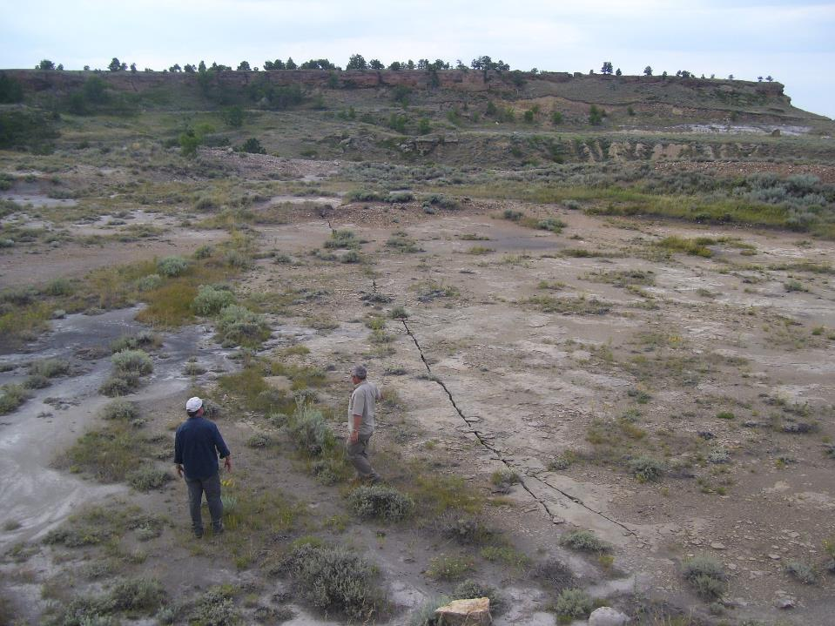
Bluff E

Slide 52
