Slide 1
Lessons About Geomorphic Reclamation From Sediment Yield Quantification and Erosion Modeling Studies
Nicholas Bugosh
and
Edward G. Epp
ASMR 36th Annual Meeting
Big Sky, Montana

Slide 2
Geomorphic reclamation for reestablishment of landform stability at a watershed scale in mined sites: The Alto Tajo Natural Park, Spain Ignacio Zapico, et al. in Ecological Engineering 111 (2018) 100-116
geomorphic reclamation (GeoFluv method) project at El Machorro mine from 2012 to 2017
sediment yield, runoﬀ and suspended sediment concentration monitoring spanned ﬁve years
stable landscape reference area used for Natural Regrade inputs to make CAD for two ﬁrst-order stream watersheds
design was constructed, but base level elevation and slope grading errors aﬀected one sub-watershed (2012GF)

Slide 3
Location of the mined areas at the edge of the Alto Tajo Natural Park, Spain

Slide 4
Oblique aerial view of El Machorro Mine in 2014
Fluvial geomorphic reclamation project area
pond

Slide 5
Oblique aerial view of the El Machorro fluvial geomorphic reclamation site Photo by DGDRONE (2015)
2012GF constructed September 2012
2014GF constructed September 2014

Slide 6
Sediment monitoring
2012 GF project
Partially filled outlet pond and suspended sediment monitoring station
Empty pond in September 2013
Suspended sediment close-up views:
4-ISCO sampler
5-solar panel, batteries, data logger and telemetry
6-turbidimeter
7-strainer that took the ISCO samples
8-pressure sensor
(6, 7 and 8 installed at the H-ﬂume)

Slide 7
Erosive 2012GF landform details
black 0.2 m contour reconstructed September 2012 topography
white 0.2 m contour April 2015
contours overlain on a Triangular Irregular Network (TIN) ﬁle made from the April 2015 point cloud scan
point cloud view showing the incision in the main channel
point cloud view showing swale rilling

Slide 8
Higher than expected September 2012 to April 2015 sediment yield values from 2012GF were the result of main channel incision and swale rilling. Analyses show:
Initial 71 Mg ha⁻¹ yr⁻¹ yield; 55% from channel incision and 45% from swale rilling (SEPT 2012 to APR 2015)
Interim 18.4 Mg ha⁻¹ yr⁻¹ yield can be attributed to attenuated channel incision and minor swale rilling (APR 2015 to JUL 2016)
Final 4.02 Mg ha⁻¹ yr⁻¹ yield was conﬁrmed by no further channel incision nor swale rilling (JUL 2016 to AUG 2017)
Final values support the conclusion that grading errors caused high initial value

Slide 9
Initial and interim period adjustments were to:
i) the local base level (mostly), and
(ii) Improved vegetation growth (less critical).
Once the local base level underwent the needed adjustment, and vegetation cover exceeded about 30 percent:
sediment yield reached 18.4 Mg ha⁻¹ yr⁻¹ from APR 2015 to JUL 2016
sediment yield decreased to 4.02 Mg ha⁻¹ yr⁻¹ from JUL 2016 to AUG 2017

Slide 10
Study sediment yield values can be considered reliable and representative because:
i) they were from direct sediment quantiﬁcation: ﬁlling of the outlet pond, and
(ii) they are from two entire sub-watersheds, rather than from a single plot or slope, and are more representative of what a reclaimed mined site yields.

Slide 11
El Machorro Study Sediment Yield Conclusions
Very low 4.02 Mg ha⁻¹ yr⁻¹ sediment yield after initial grading error adjustment with no on-site or oﬀ-site environmental degradation
geomorphically reclaimed areas can be hydrologically connected with the natural ﬂuvial system (even critical areas like the Alto Tajo)
site stabilized to background in three growing seasons with 2012 GF construction-grading errors
2014GF without grading errors indicates that ﬁnal low sediment yield, steady-state equilibrium can occur in a growing season

Slide 12
More learnings from the El Machorro study
need to specify and agree on proper construction tolerances
freshly-graded reclamation surface will have high and low spots within construction tolerances; adjustment during initial storms
after the initial adjustments, surface was closer to design and remained ‘stable’
permanent sediment traps can be integrated into correct stream longitudinal proﬁle
advisable to construct temporary sediment traps
temporary traps can be breached when stability is achieved and low sediment yield runoﬀ can flow to natural streams

Slide 13
Geomorphic design and modelling at catchment scale for best mine rehabilitation –The Drayton mine example (New South Wales, Australia) - G.R. Hancock, J.F. Martín Duque, and G.R. Willgoose in Environmental Modeling and Software 114 (2019) 140-151
Used the SIBERIA erosion modelling software to predict sediment yield from four reclamation designs:
As-built GeoFluv demonstration project
As-built fluvial geomorphic design adjusted using SIBERIA
Traditional contour bank (gradient terrace)
“Natural Contour”

Slide 14
SIBERIA applied to fluvial geomorphic as-built (Australia)
3D model of demonstration project waste pile at end of mining
Photo of demonstration project waste pile at end of mining
A draft fluvial geomorphic design for the demonstration project

Slide 15
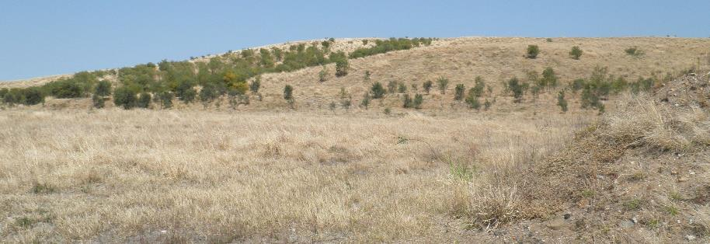
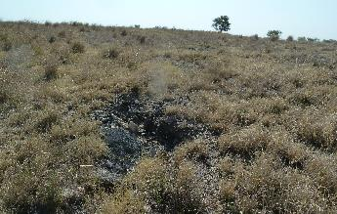
Drayton demonstration project
Panoramic verdant view
Panoramic dormant view
Example gully, average 20cm

Slide 16
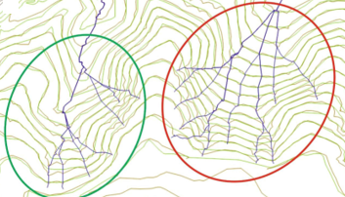
Sub-parallel contours indicating ‘flat’, long, constant-gradient slopes subject to rill and gully formation
Correct runoff tracking
Imposing spatial predictability for the erosion lines
Decrease in erosion rates
Wrong runoff tracking
Unpredictability of erosion lines
Increase in erosion rates

Slide 17
SIBERIA erosion modeling on four surface designs
SIBERIA-adjusted fluvial geomorphic
as-built fluvial geomorphic
contour bank (gradient terrace)
‘natural contour’

Slide 18
Landscape design | SIBERIA erosion rate (t⁻¹ha⁻¹yr)
fluvial geomorphic as-built | 23.4
Adjusted fluvial geomorphic | 13.9
Gradient terrace / contour banks | 25.6
‘Natural contouring’ | 21.7

Slide 19
The ‘Natural Contour’ design had a 21.7t⁻¹ha⁻¹yr erosion rate and developed gullies.
This suggests the unsuitability of arbitrarily trying to imitate the pre-mine topography or that of the surrounding terrain .
This approach can be well intentioned but lacks geomorphic basis . . . Unfortunately, the authors have seen an increasing use of ‘Natural Contour’ approaches.
A geomorphic approach to mine rehabilitation should not be a matter of simply looking like a natural landform – it must be functionally stable.
Hancock, et al, 2019.

Slide 20
SIBERIA-adjusted fluvial geomorphic design 100-year prediction
SIBERIA-adjusted fluvial geomorphic design
SIBERIA-adjusted fluvial geomorphic design after 100 years of erosion

Slide 21
SIBERIA study findings
Correcting errors in the fluvial geomorphic designs produced successively lower erosion rates for each landscape iteration
Improved fluvial geomorphic design using SIBERIA modelling reduced erosion by half
Able to store 7% more mine waste volume than contour banks

Slide 22
Evaluating sediment production from native and ﬂuvial geomorphic reclamation watersheds at La Plata Mine - N. Bugosh and E. Epp, in Catena 174 (2019) 383-398
Quantified sediment yield from three sub-watersheds in highly erosive area
Matched physical characteristics of three sub-watersheds:
Native, un-disturbed site
Constructed GeoFluv reclamation with little vegetation
Constructed fluvial geomorphic reclamation with robust vegetation
Captured sediment yield behind temporary sediment dams
Sediment yield measure from 2012 – 2014
Studied precipitation events and their effect on sediment yield

Slide 23
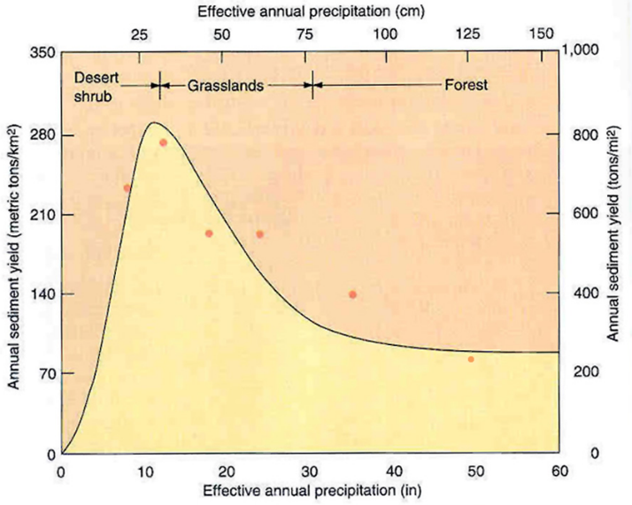
Overland Flow Dominates
(Poor Soils, Low Veg. Cover)
Sediment Yield DECREASES With Increasing Precipitation, Because:
Throughflow Dominates
(Well-Developed Soils, High Veg. Cover)
Langbein and Schumm (1958)
Graph Derived From 94 Stream Monitoring Stations Grouped in Precipitation Classes. Similar Results from 163 Sediment Pond Surveys

Slide 24
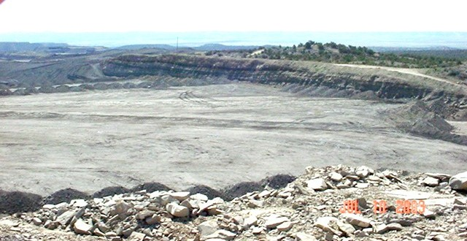
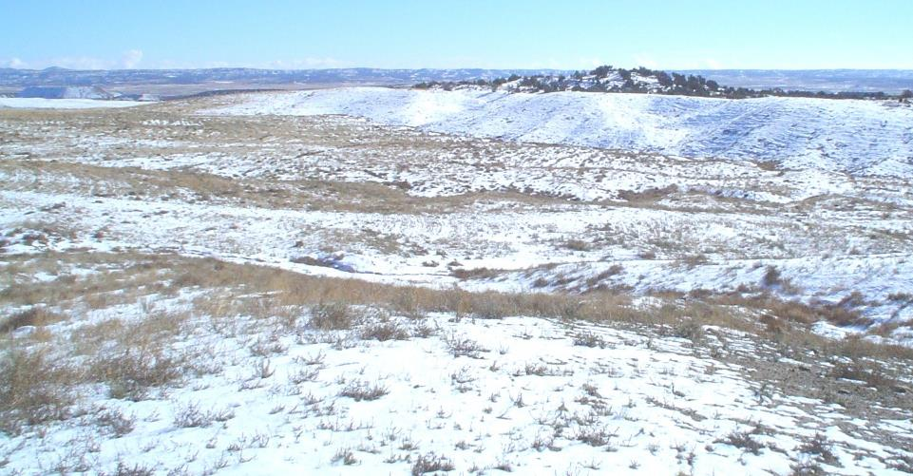
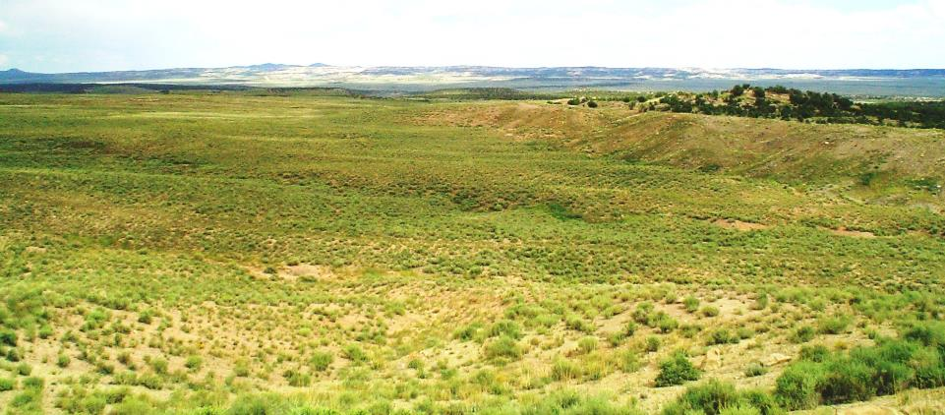
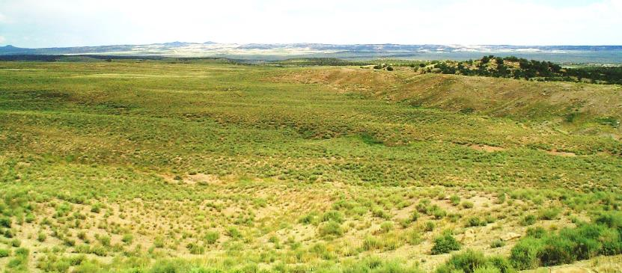
Mine highwall and pit to functional landform – 743 ha fluvial geomorphic reclamation at La Plata Mine

Slide 25
Looking across a new fluvial geomorphic reclamation project

Slide 26
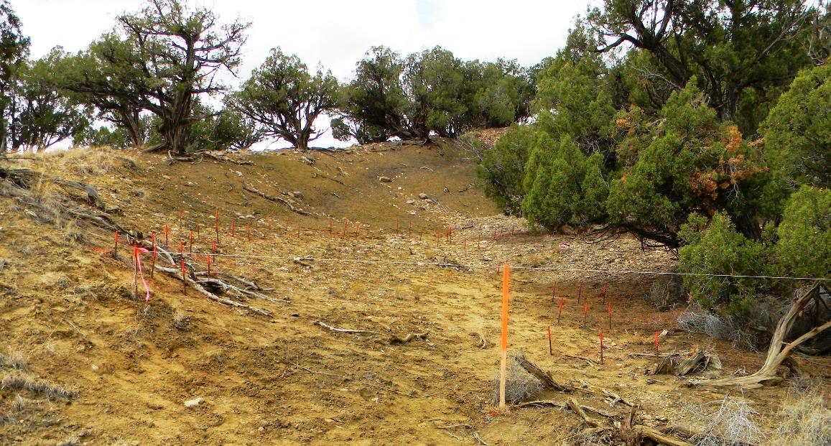
Site Layout sediment pins surveyed, string is bankfull elevation for top of dam

Slide 27
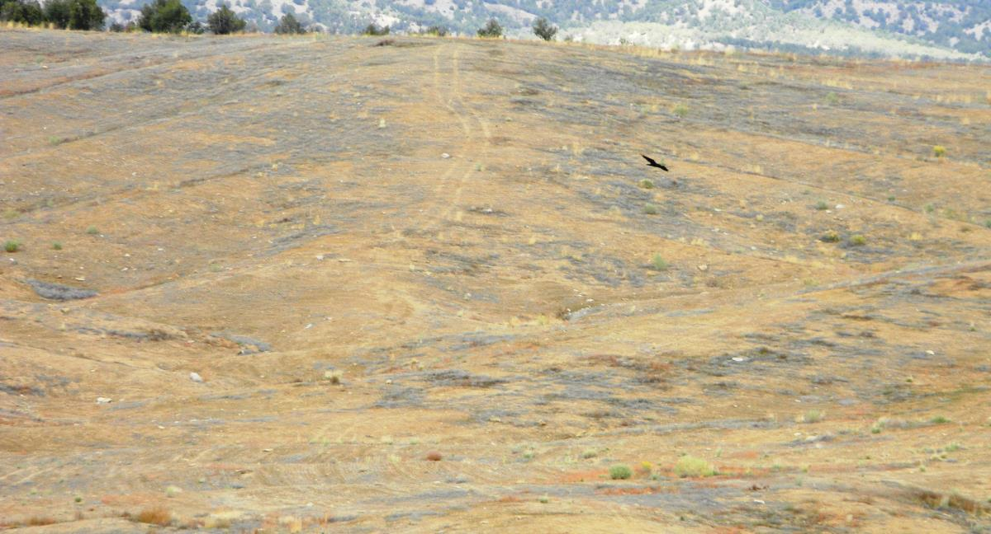
Constructed fluvial geomorphic design with topdressing and little vegetation

Slide 28
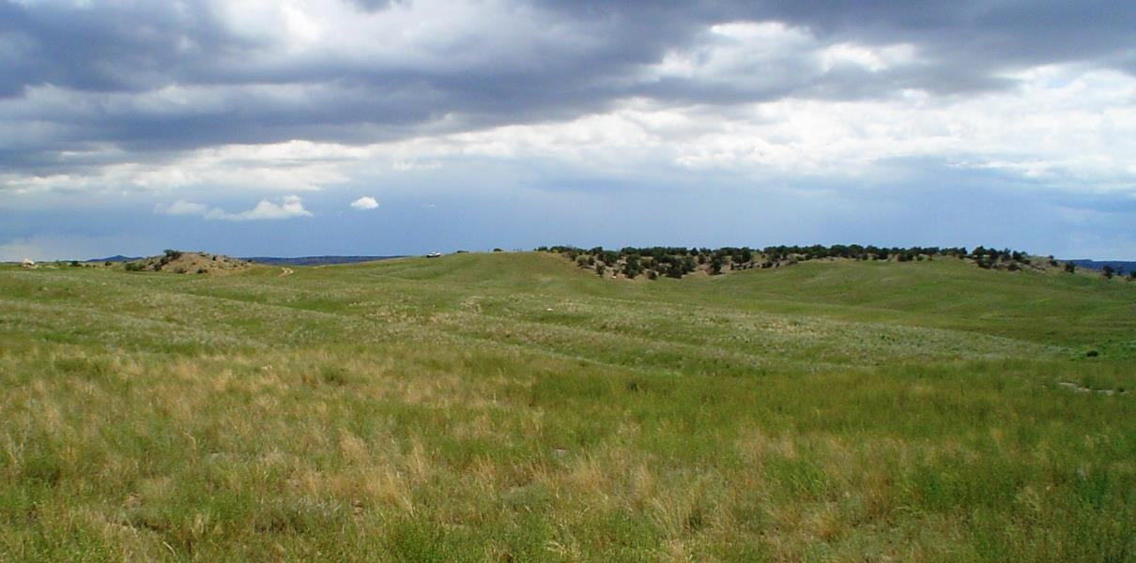
Constructed fluvial geomorphic design with topdressing and robust vegetation

Slide 29
A temporary sediment dam used in the study

Slide 30
Sediment yield results for six periods during study
N7 is native, undisturbed
MV5 is fluvial geomorphic with little vegetation
WV3 is fluvial geomorphic with robust vegetation
Fluvial geomorphic sites’ sediment yield similar to or less than native for all events

Slide 31
Cumulative sediment yield
Left is representative of 2013 water year
Right is entire study period
Properly designed and constructed fluvial geomorphic reclamation without good vegetation is similar to native, lower when vegetation is established

Slide 32
El Machorro Study Sediment Yield Conclusions
Very low sediment yield after initial grading error adjustment with no on-site or oﬀ-site environmental degradation
geomorphically reclaimed areas can be hydrologically connected with the natural ﬂuvial system (even critical areas like the Alto Tajo)
site stabilized to background in three growing seasons with 2012 GF construction-grading errors
2014GF without grading errors indicates ﬁnal low sediment yield, steady-state equilibrium can occur in a growing season) following proper construction

Slide 33
SIBERIA study:
Correcting errors in the fluvial geomorphic designs produced successively lower erosion rates for each landscape iteration
Improved fluvial geomorphic design using SIBERIA modelling reduced erosion by half
Able to store 7% more mine waste volume than contour banks

Slide 34
SIBERIA study:
The ‘Natural Contour’ design 21.7t⁻¹ha⁻¹yr erosion rate suggests the unsuitability of arbitrarily imitating the pre-mine or surrounding terrain topography
“approach can be well intentioned but lacks geomorphic basis . . . Unfortunately, the authors have seen an increasing use of ‘Natural Contour’ approaches.”
geomorphic approach to mine rehabilitation should not be a matter of simply looking like a natural landform – it must be functionally stable.
Hancock, et al, 2019.

Slide 35
Evaluating sediment production from native and ﬂuvial geomorphic reclamation watersheds at La Plata Mine conclusions
Properly designed and constructed fluvial geomorphic reclamation can achieve sediment yield similar to undisturbed, native ground in extremely erosion lands even without vegetation
Good vegetation can further reduce sediment yield from fluvial geomorphic in extremely erosive lands by up to 19%
Sediment yield varies with the monitoring period and shorter or longer periods can vary actual yield – use a representative period

Slide 36
Major Conclusions
Just having a ‘natural appearance’ does not make a functional fluvial geomorphic landform; the science must be in the design
A proper fluvial geomorphic design must be constructed as designed to provide desired performance
Properly designed and constructed fluvial geomorphic reclamation can provide sediment yield comparable to ‘stable’ natural lands and discharge can flow into high quality streams without problems

