Slide 1
Modeling Water Balance of Geomorphic Evapotranspiration Covers for Reclamation of Mine Land
Z. Fred Zhang*, Yilin Fang, Nicholas Bugosh, Chang Liao, Teklu Tesfa
* Presenter, Environment Engineer
National Meeting of the American Society of Mining and Reclamation, Big Sky, MT
June 3–7, 2019

Slide 2
Background
Conventional 3:1 slope
Conventional reclamation
  Constant-gradient slopes with benches.
  Combined with elements to redirect and slow runoff
  Give little consideration for proper hydrologic function for balanced conveyance of water and sediment
Geomorphic reclamation
  Provide analogues for post-mining landscapes
  More functional, cost-effective, long-lasting, and more visually attractive
  The landform is hydrologically, geomorphologically, and visually compatible with the surrounding area
  Remain stable for the long term
Geomorphic grading

Slide 3
Evapotranspiration Cover
Layer | Primary Function
Erosion-control layer | Resist wind and water erosion
Storage layer | Medium for vegetation growth and stores infiltration water
Drainage layer | Remove excessive water from the storage layer and improve slope stability; deter intrusion of roots, animal burrowing, and/or human digging
Barrier layer | Minimizes percolation of water through the underlying waste; restricts upward movement of any gases or volatile constituents
Foundation layer | Supports upper layers and heavy construction equipment

Slide 4
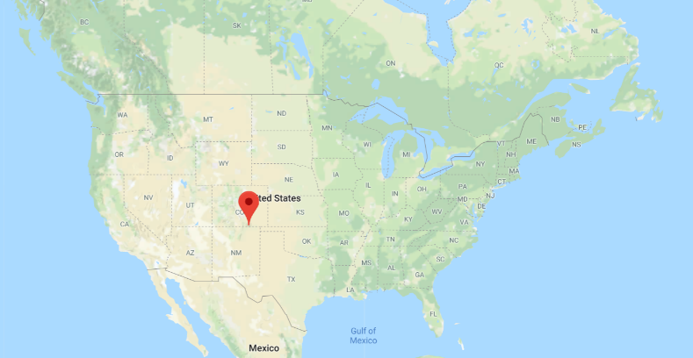
Objectives
Introduce a new capability of simulating ET using the eSTOMP simulator
Demonstrate the capability by simulating the ET process at the Tin Pan coal mine site near Raton, NM

Slide 5
Methods to Simulate ET
Plant roots are treated as sinks
The potential ET (PET) is determined by the user as inputs
The actual ET (AET) is determined by modifying PET:
α is scaled leaf area index;
w is the water stress factor
All the factors range between 0 and 1.

Slide 6
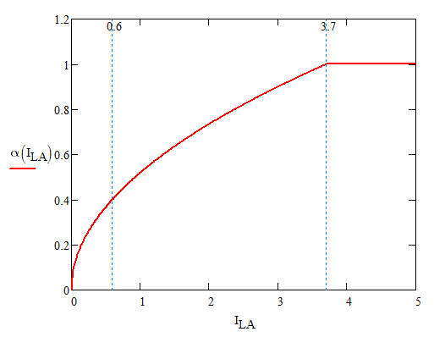
Scaled Leaf Area Index
I_{LA} is leaf area index

Slide 7
Soil Water Stress
ψ is soil matric potential
ψ_{c} is the value when stomata are fully closed
ψ_{o} is the value when stomata are fully open

Slide 8
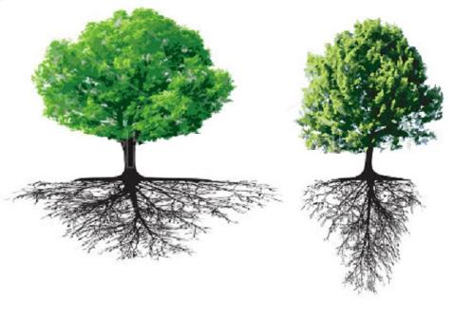
Locations of Consumed Water
The cumulative root distribution (Y) is described using
where z is depth; a and b are coefficients

Slide 9
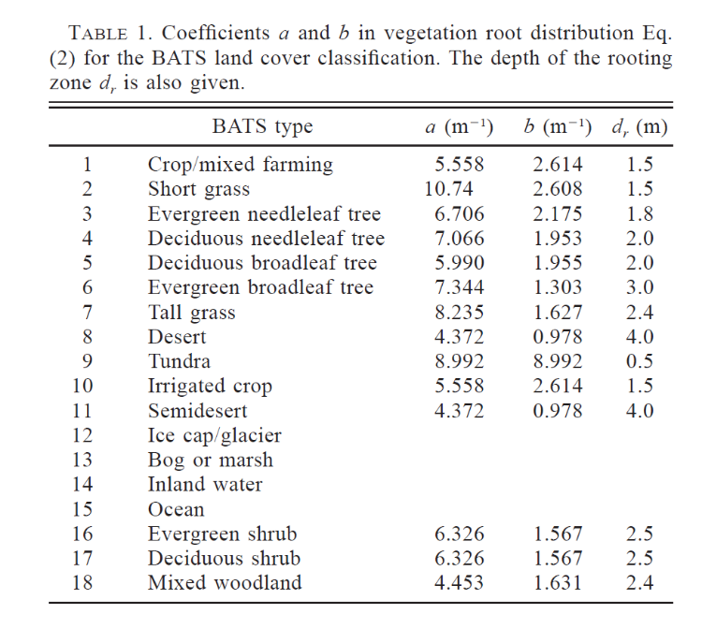
Typical root distribution parameters
After Table 1 of Zeng (2001)

Slide 10
Cumulative Root Distribution

Slide 11
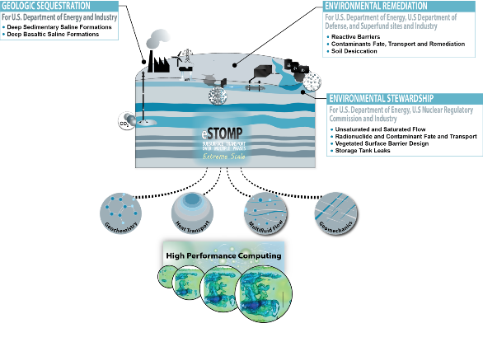
eSTOMP Simulator
eSTOMP: exascale Subsurface Transport Over Multiple Phases
Is an analytical tool for investigating coupled processes involving multifluid flow, heat transport and geochemistry in the subsurface
Parallelization is achieved through domain decomposition using the Global Arrays toolkit (GA)
It is suited for simulation with very large domain and/or run time
An ET module has been added to eSTOMP to simulate the flow and transport process involving plant water use

Slide 12
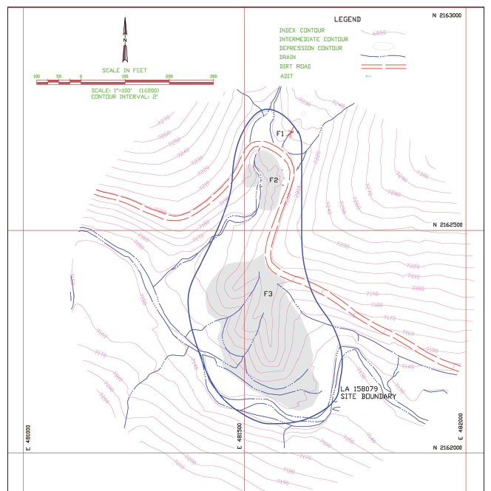
Demonstration at the Tin Pan Mine Site at NM
Actual mining of the coal may have started in 1906 and ceased operations before 1949.
The waste site consists of two gob piles of mine waste
The Tin Pan Canyon stream flows by the large pile

Slide 13
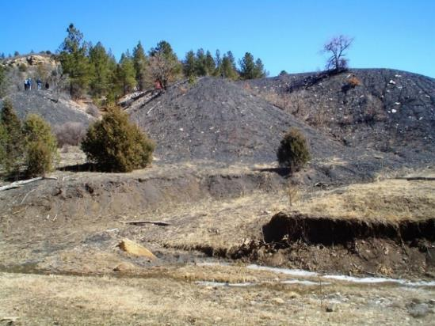
Site Characteristics
The stream meandering is controlled by a thick, competent sandstone
Thin soils over this bedrock combined with short-duration, high-intensity storms
The tributary channel discharges have eroded a gully along the west valley wall.
Steep slope that could contribute to rill and gully erosion.
Rock Exposure
Gob Pile
Sandstone Ledge
(a)
Tin Pan Canyon Stream

Slide 14
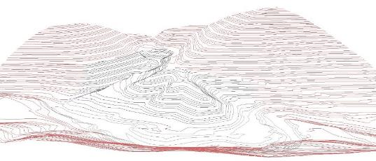
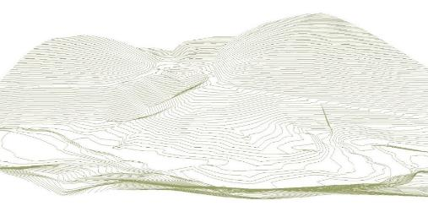
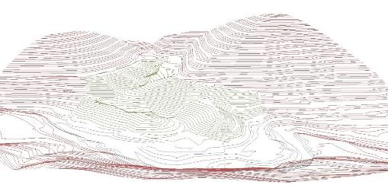




Geomorphic Grading (GG) at the Tin Pan Site
Existing
Stable reference site
  drainage density: 83 m/ha; 110 ft/acre)
  ridge to head of channel distance: 27 m; 90 feet
  ‘A-channel’ reach length: 15 m/ha; 20 feet/acre
Two GG design alternatives
  Alternative #1
  Alternative #2
GG Alternative #1
Tin Pan Valley
Tin Pan Canyon Stream
GG Alternative #2
Tin Pan Valley
Tin Pan Canyon Stream

Slide 15
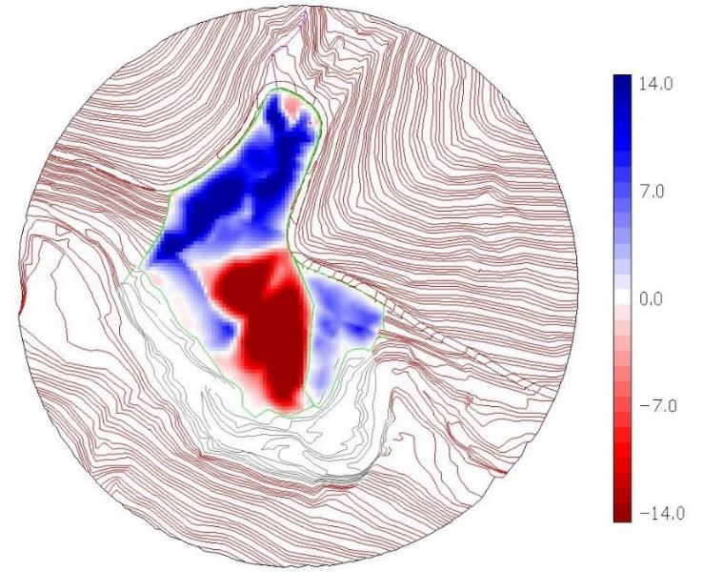
Cut Fill Color Map (Alternative #2)

Slide 16
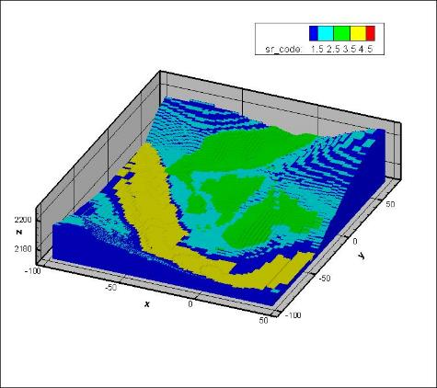
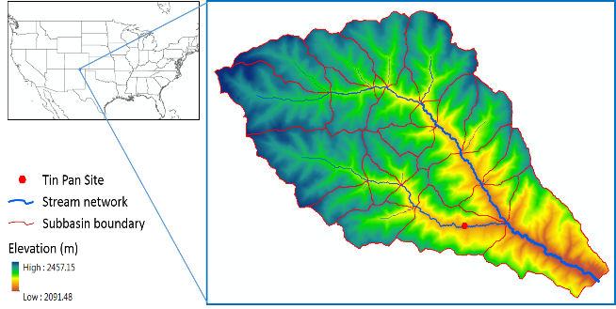
Integrated Watershed (WS) and Site-Scale (SS) Models
The WS model provides for the SS the boundary conditions
  GW level
  PET
The SS model provides for the WS model flux rates of water and contaminants when different reclamation is used

Slide 17

Simulation of Flow and Transport
Components
  Rock
  Soil
  Gob pile
  Surface barrier
  River
  Vegetation
    Shallow roots
    Deep roots
Domain
  200x200x38 m
  64x85x76 = 413,440 cells
  x,y spacing: 2 to 5 m
  z spacing: 0.2 to 2 m

Slide 18
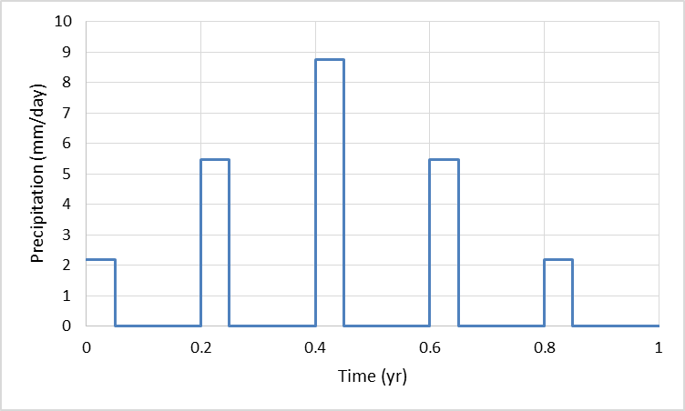
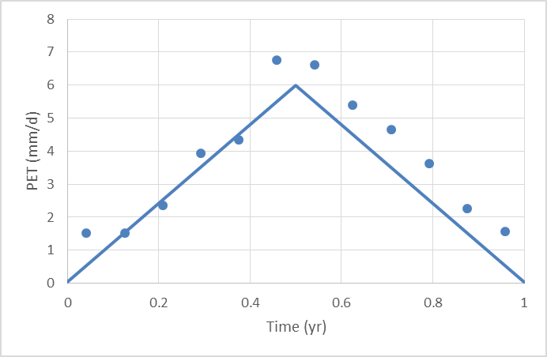
Inputs for Flow Simulation
Precipitation at Raton, NM
SWAT calculated average PET
Groundwater condition boundary condition: MODFLOW simulated average conditions

Slide 19
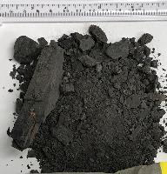
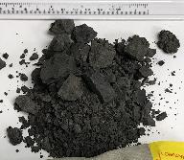
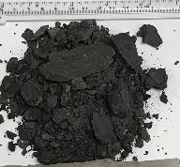
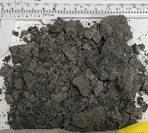
Inputs for Flow Simulation
Physical parameters:
Hydraulic Properties
Sand | 40 | %
Silt | 29 | %
Clay | 32 | %
Texture | CL
Material | Porosity | Ks (m/s)
Mine Waste | 0.35 | 2.37E-6
Soil | 0.35 | 8.39E-5
Rock | 0.15 | 1.00E-4

Slide 20
Simulation Scenarios
Simulation of flow process on the conceptual grading alternative #2.
Case NO. | Case Name | LAI | Root Distribution | Precipitation Level
1 | DR | 3.7 | a = b = 5 m⁻¹ Depth = 0.9 m | Average (P_{avg})
2 | SR | 3.7 | a = b = 20 m⁻¹ Depth = 0.2 m | Average (P_{avg} = 440 mm/yr)
3 | DR High P | 3.7 | Depth = 0.9 m | High (1.5P_{avg})
4 | SR High P | 3.7 | Depth = 0.2 m | High (1.5P_{avg})
5 | SR Low LAI | 0.6 | Depth = 0.2 m | P_{avg}

Slide 21
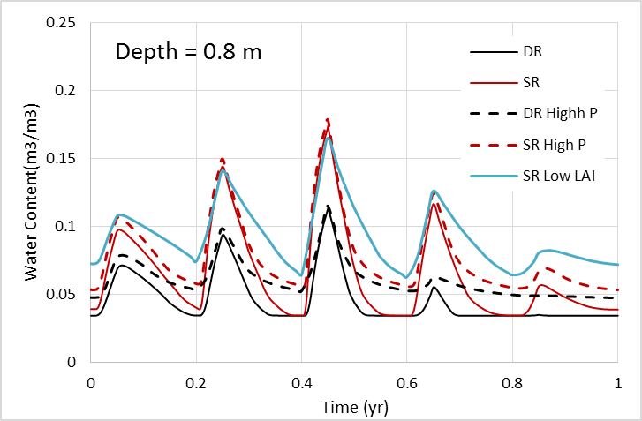
Time Course of Water Content
Water content varies with time
Water content was higher when roots are shallower
The minimum water content was higher when P was higher
Shallow roots

Slide 22
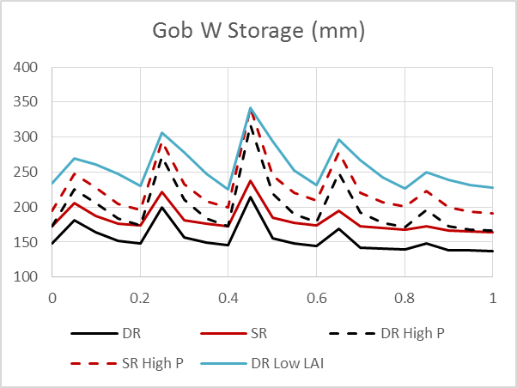
Simulated Water Storage in the Gob Pile
Water storage was higher when the
  vegetation had shallower roots
  or the precipitation was higher

Slide 23
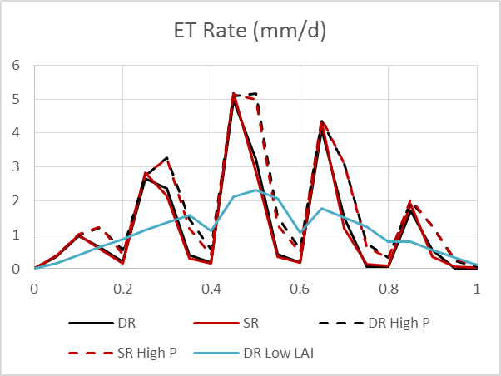
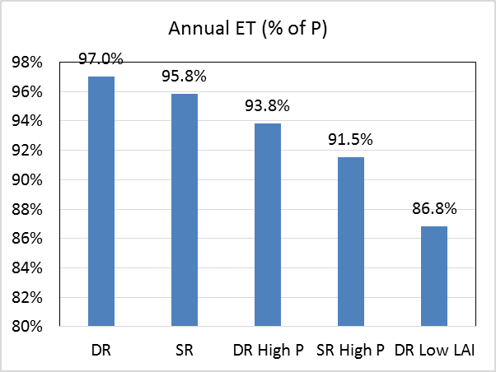
Simulated ET
There weren’t much difference in ET between the shallow and deep rooted vegetation
ET was higher when P was higher

Slide 24
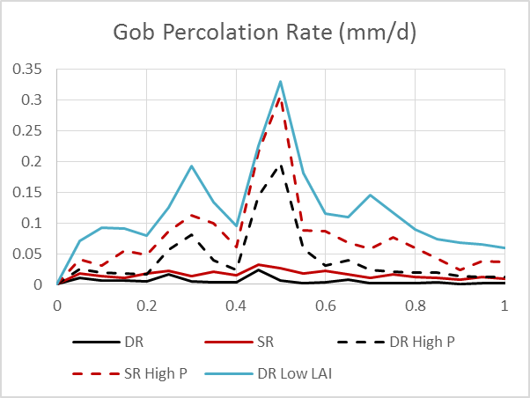
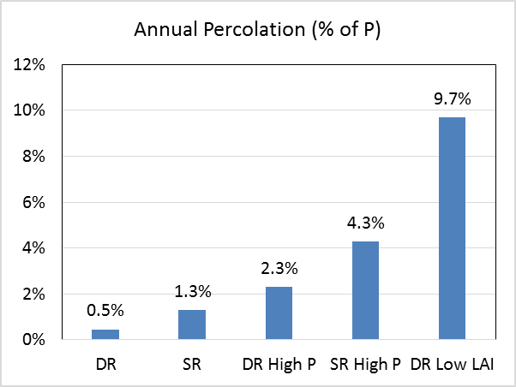
Simulated Percolation
Slightly more percolation occurred when
  roots were shallower
  or P was higher

Slide 25
Summary
An ET module has been added to eSTOMP so that plant water use can be simulated, in addition to the existing simulation capabilities
A demonstration at the Tin Pan mine showed that the eSTOMP with the ET module can reasonably simulate the flow and ET process
The water condition in waste mine piles and percolation from the piles are affected by the precipitation level, vegetation type, and vegetation coverage.

Slide 26
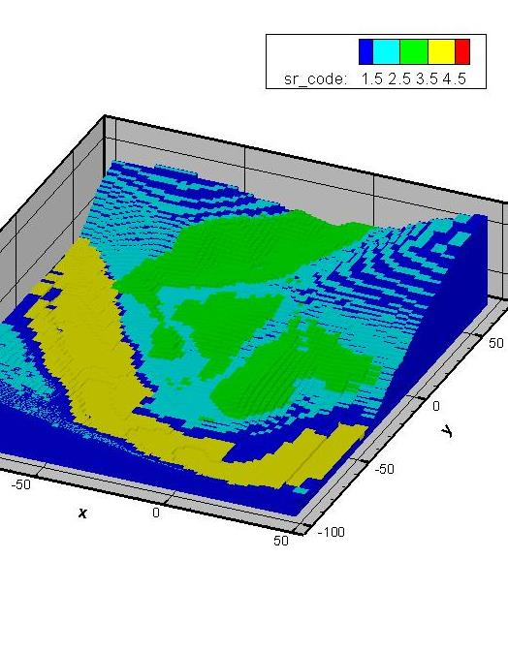
Acknowledgement
This work was supported by interagency agreement S17PG00002 between Department of the Interior, Office of Surface Mining Reclamation and Enforcement and Department of Energy, Pacific Northwest National Laboratory.
Thank you

Slide 27
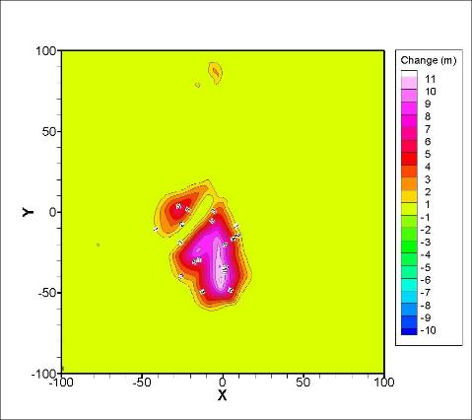
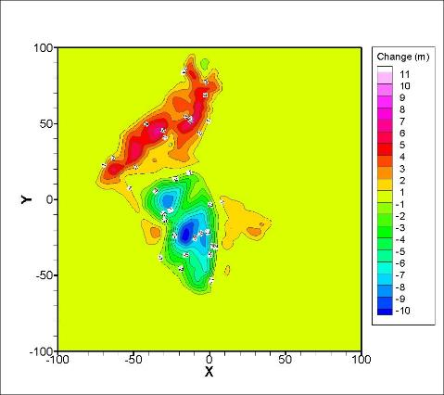
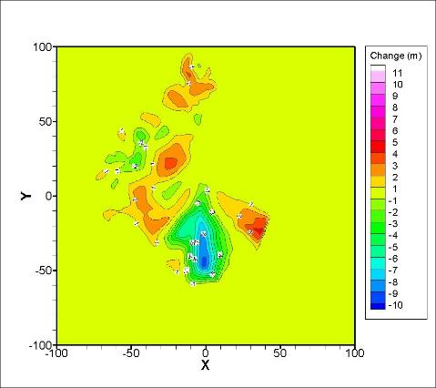
Geomorphic Grading
Gob Piles
Alternative #2
Alternative #1

