Slide 1
BIRD RECOVERY FOLLOWING RIPARIAN REMEDIATION

Slide 2
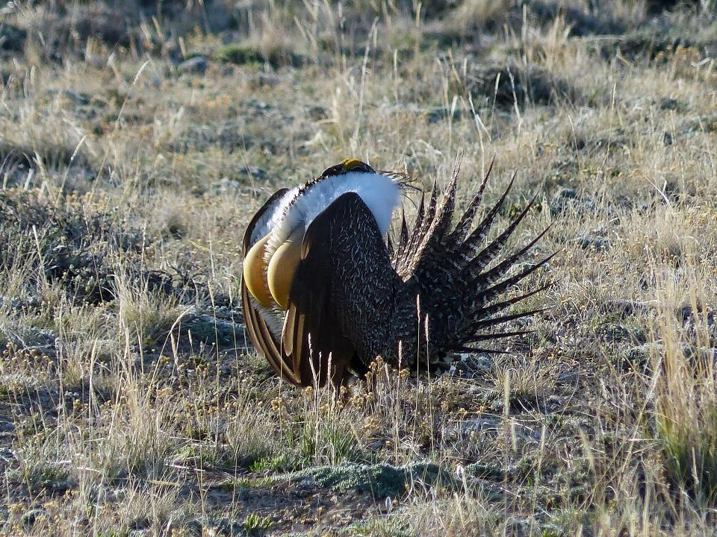
YOUR FAVORITE BIRD?

Slide 3
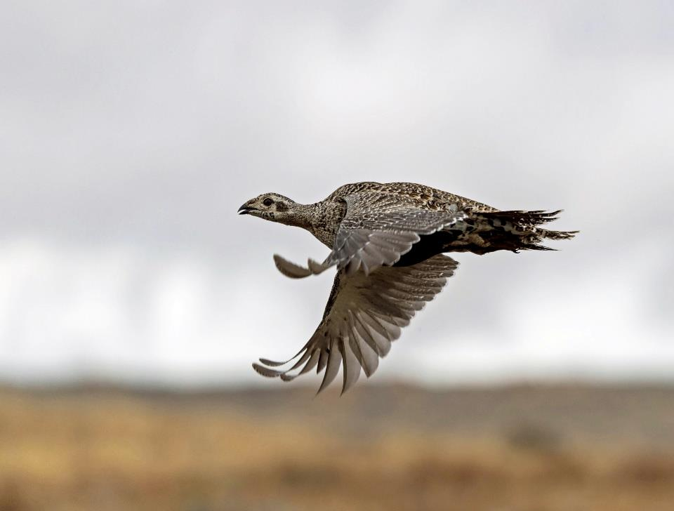
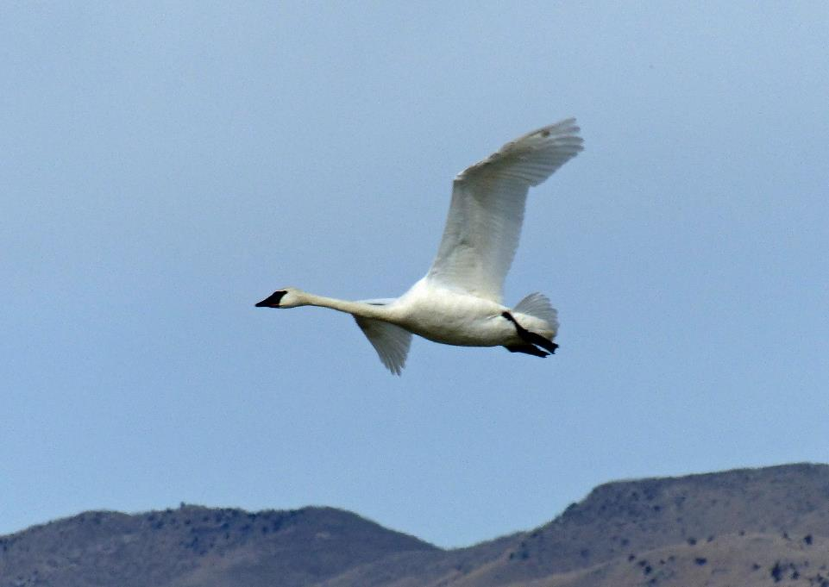
FLIGHT
Joel Maes

Slide 4
FLOOD AT THE TURN OF THE 19TH CENTURY DEPOSITED BUTTE MINE WASTE IN THE SILVER BOW CREEK FLOODPLAIN.

Slide 5
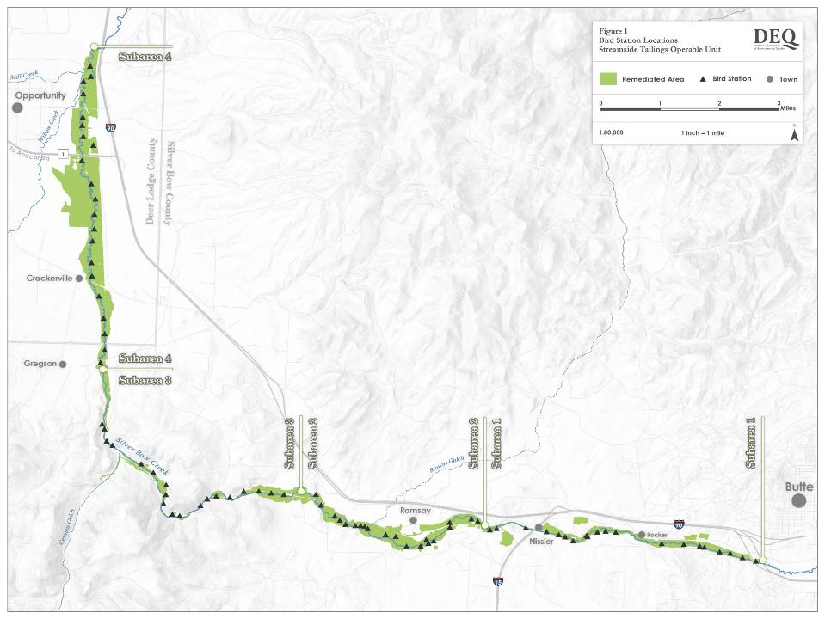

Slide 6
SILVER BOW CREEK REMEDIATION Remove 6.1 MM CY Mine Waste Relocate stream Coversoil to grade Revegetate 2000-2014

Slide 7
ONE ASPECT OF THE RECOVERY PROCCESS BIRD USE IN A RESTORED RIPARIAN CORRIDOR, SOUTHWEST MONTANA

Slide 8
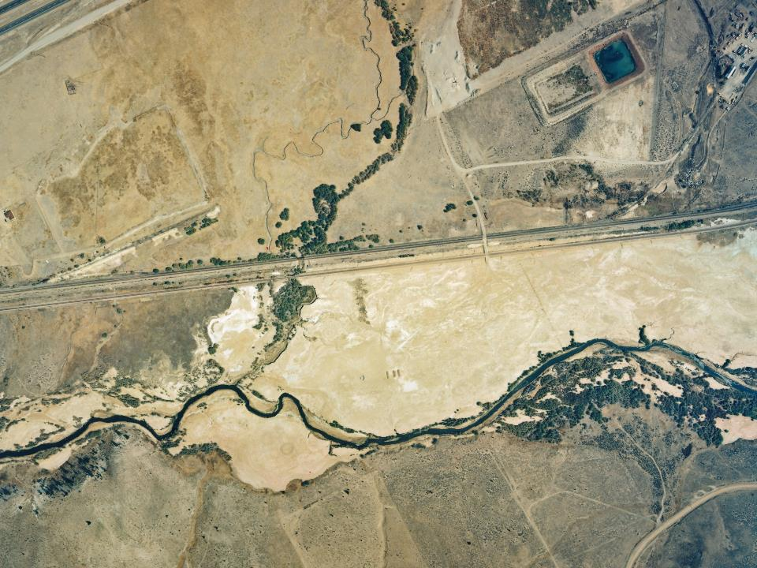
9-1998

Slide 9
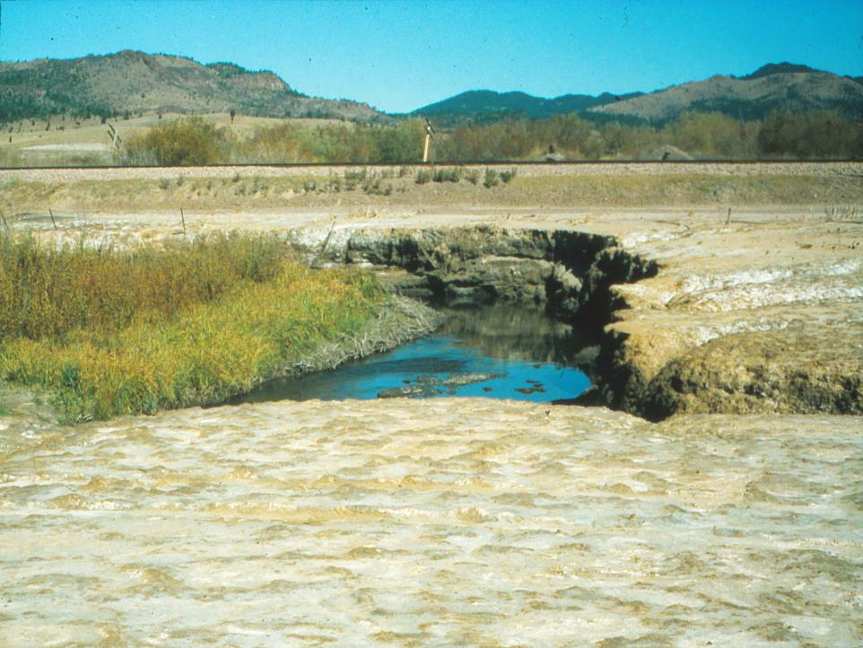

Slide 10
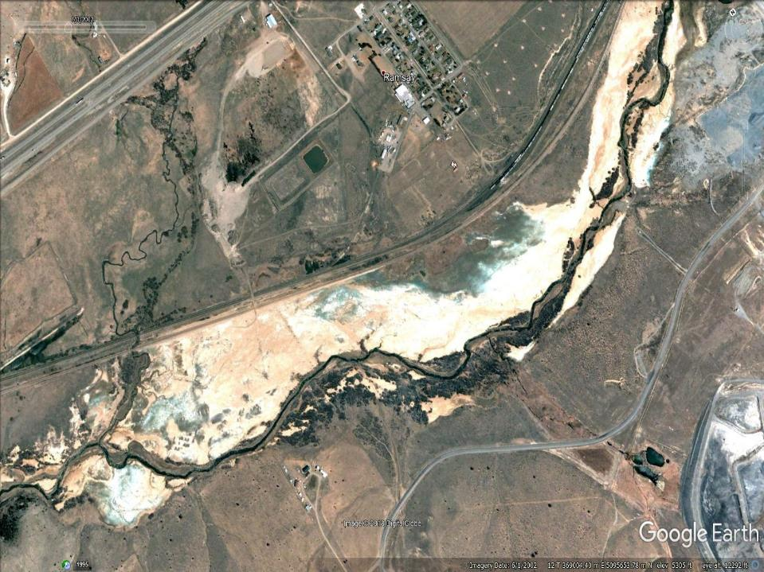
RAMSAY
2002

Slide 11
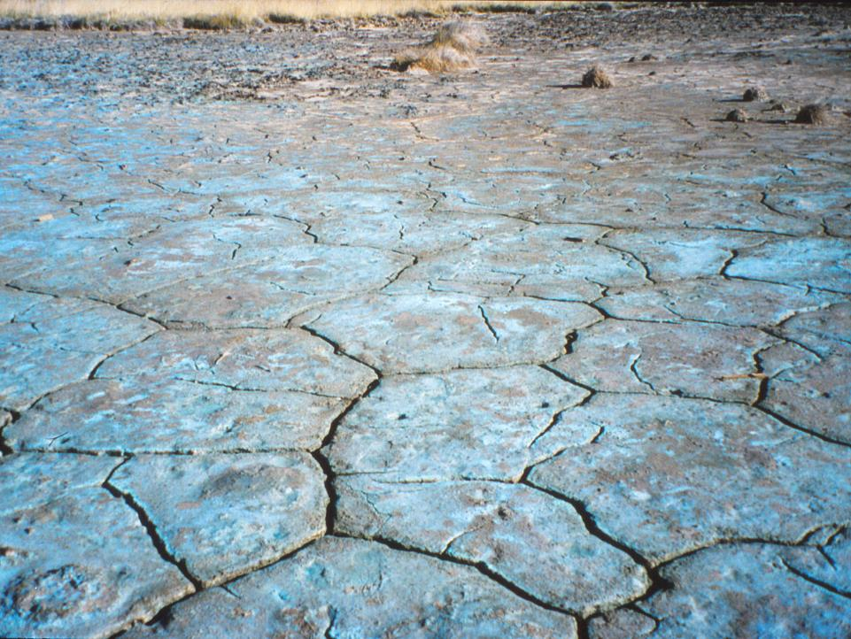

Slide 12
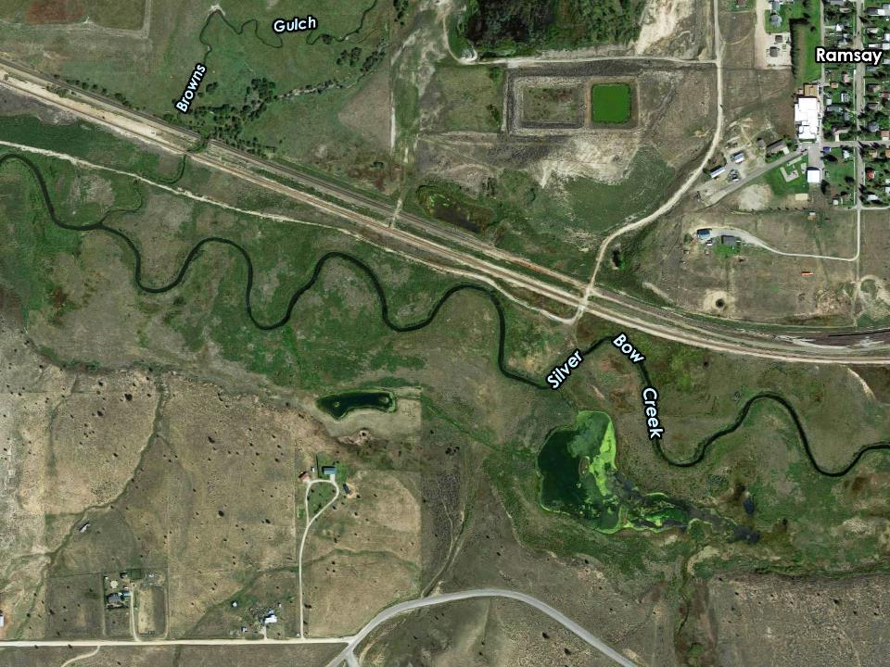

Slide 13
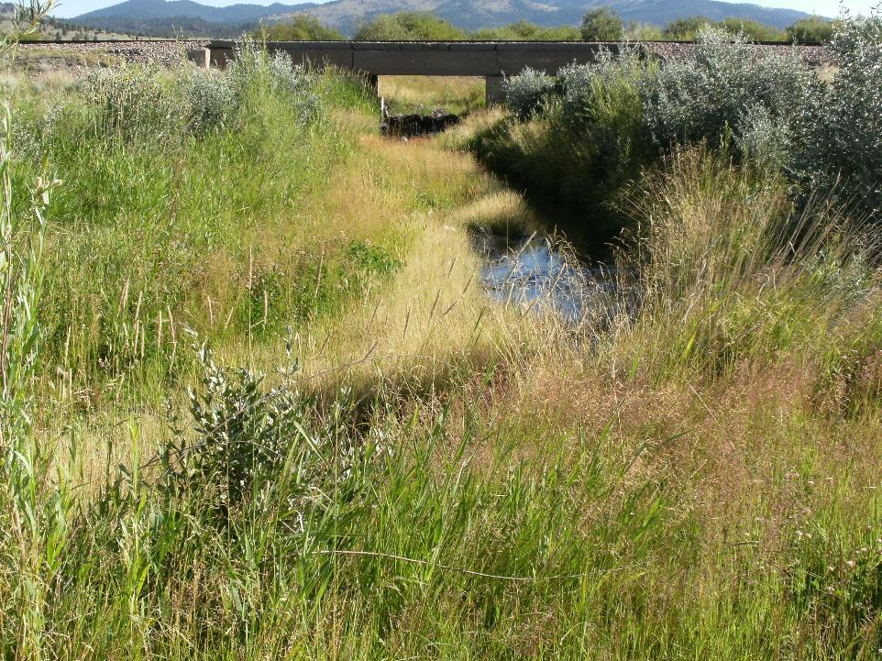

Slide 14
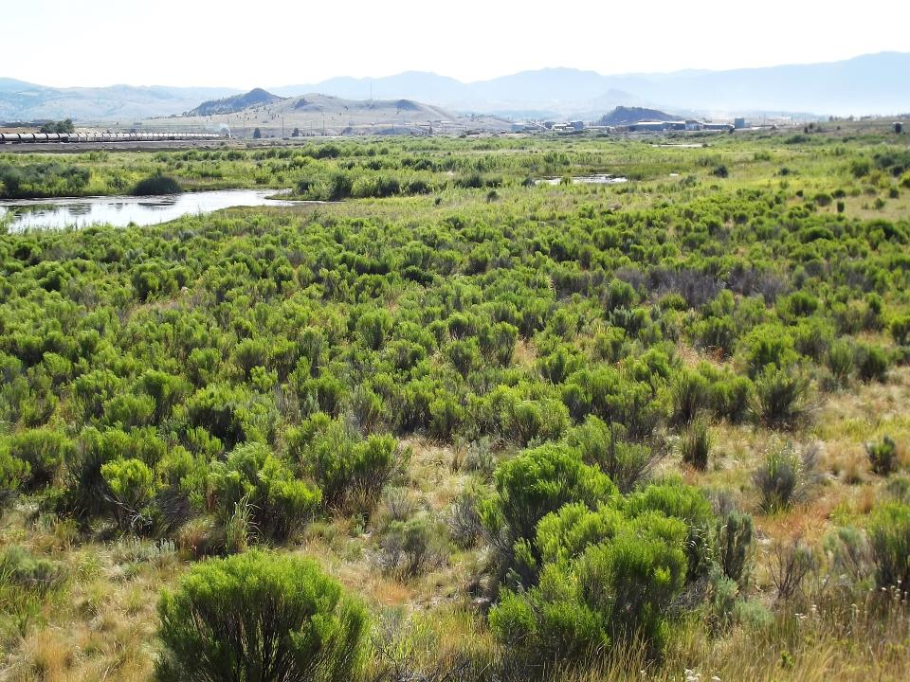

Slide 15
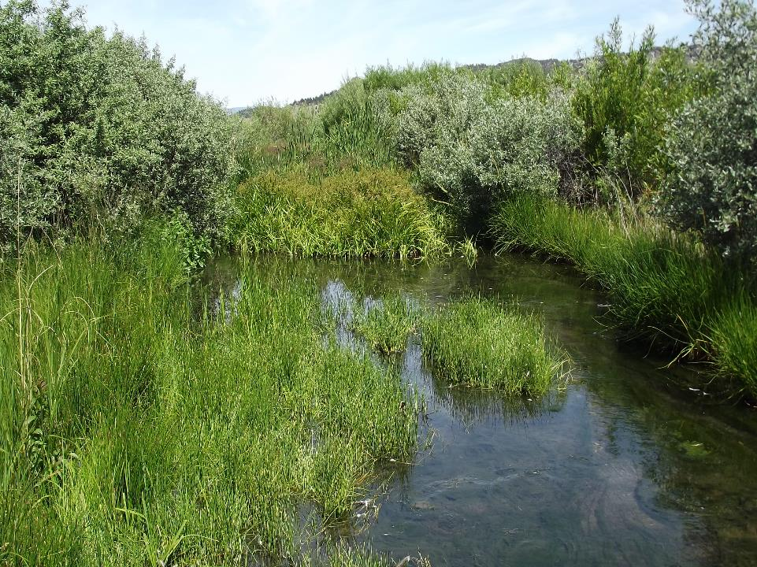

Slide 16
SAMPLE SUBAREAS IN ROTATION – NOT EACH ONE EACH YEAR. START AT DAWN. SAMPLE EACH STATION (20/SUBAREA) FOR FIVE MEASURED MINUTES. RECORDS BIRDS BY SIGHT AND SOUND

Slide 17
4 MONTHS. LATE MARCH, APRIL, MAY, AND JUNE. CAPTURES MIGRATORY BIRDS AND SUMMER RESIDENTS TAKES <4 HRS. PER SUBAREA

Slide 18
SAMPLED 15 YEARS SAME METHODS SAME APPROXIMATE DATES SAME OBSERVER

Slide 19
CLSW 13% MALL 12% RBGU 8% CAGO 6% ------- 39%

Slide 20
BIRD HABITAT USE VARIES– MOBILITY…. MAY MOVE SEASONALLY OR DAILY EVEN HOURLY TO MEET HABITAT PREFERENCES

Slide 21
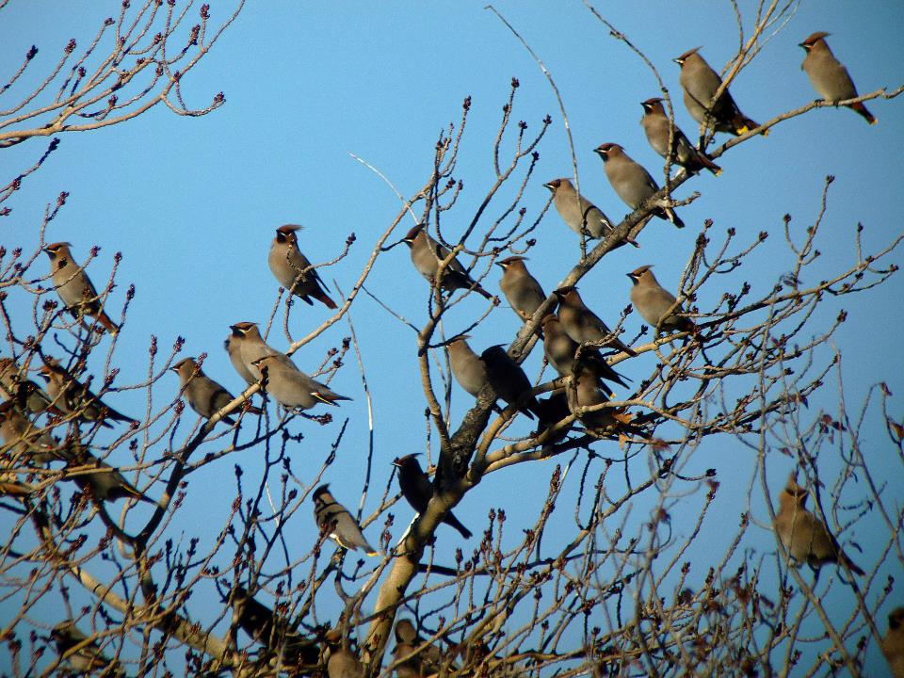
Passeriformes
120 count SA 2 April 2009

Slide 22
FOOD, WATER COVER (THERMAL, SECURITY) SPECIAL HABITATS: NESTING, SLEEPING, MATING. HUMAN AND DOG VISITS

Slide 23
PARAMETERS BIRD COUNTS OR DENSITY SPECIES RICHNESS SPECIES DENSITY SPECIES EQUITABILITY OR EVENNESS TROPHIC CLASSES HABITATS

Slide 24
SPECIES FUNDAMENTAL UNIT OF TAXONOMY AND INVENTORY BUT NOT DIVERSITY

Slide 25
DIVERSITY Traditional measures of species diversity treat all species as being equal in all respects except their abundance.

Slide 26
RICHNESS: MERE # OF SPP. SHANNON INDEX: EVENESS OR EQUITABILITY _{S} H' (Shannon Index) = -∑ p_{i} ln p_{i} ^{i=1} Where: p_{i} is the relative abundance of entity P expressed as a decimal. Lower bound 0; upper bound Ln S.

Slide 27
100 BIRDS 5 SPECIES 96,1,1,1,1 SHANNON = 0.22 20,20,20,20,20 SHANNON = 1.61

Slide 28
145 bird species comprising 19,152 birds were tallied sampling. 38% Breed Locally

Slide 29
28% Yearlong Residents; 56% Summer Residents; 3% Winter Residents; and 13% Migrants.

Slide 30
TROPHIC SPECIES BIRDS % % Herbivores 10 10 Omnivores 38 54 Invertebrates 35 34 Vertebrates 17 2

Slide 31
WHAT IS A SUBAREA? We focus on the oldest revegetation to track temporal trends.

Slide 32
COMPARING TEMPORAL DATA SETS Sorenson (1948) 2C Similarity Index = ----------- A + B

Slide 33
SUBAREA 1 µ = 66% 2005 100 2006 66 100 2010 86 61 100 2013 60 56 64 100 2017 60 50 82 71 100 2005 2006 2010 2013 2017

Slide 34
SUBAREA 2 µ = 66% 2009 100 2012 60 100 2014 81 72 100 2016 56 64 63 100 2009 2012 2014 2016

Slide 35
#1. SIMILARITIES ARE RATHER LOW, NO PATTERN FORETELLS WEAK TEMPORAL RELATIONS IN SPECIES COMPOSITION

Slide 36
IS SAMPLING ADEQUATE TO REVEAL TEMPORAL TRENDS?

Slide 40
FOR SIGNIFICANT DIFFERENCES: MORE IN MARCH AND APRIL LESS IN MAY AND JUNE FOR POOLED MONTHS, NO DIFFERENCE TO 10% DUE DIFFERENCES IN SAMPLE DATE.

Slide 41
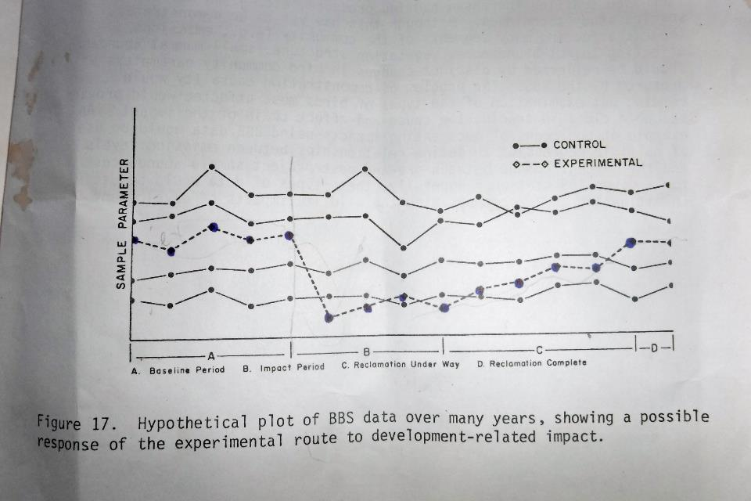

Slide 42
TRENDS IN BIRD QUANTITY

Slide 45
LESSON #2. IF YOU BUILD IT, BIRDS COME QUICKLY AND NOT MANY MORE COME LATER.

Slide 46
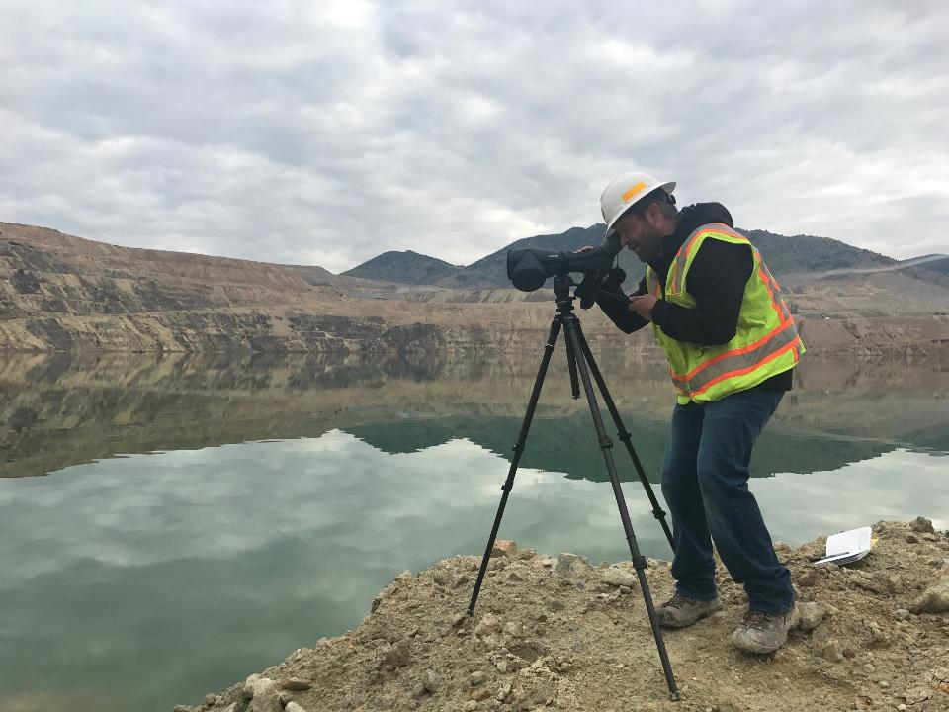

Slide 47
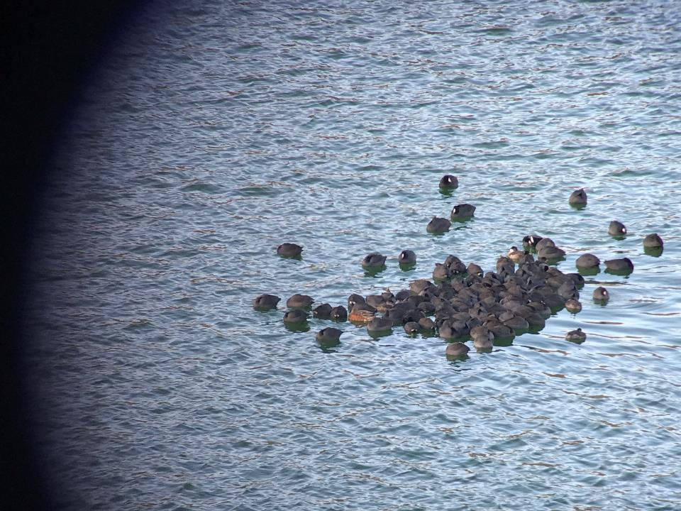

Slide 49
TRENDS IN SPECIES RICHNESS AND EQUITABILITY

Slide 57
LESSON #3. BIRD DIVERSITY INCREASES OVER TIME ESPECIALLY IN MAY AND JUNE.

Slide 58
TRENDS IN HABITAT USE AND HABITAT HETEROGENEITY

Slide 61
LESSON #4 HUGE HABITAT DIFFERENTIAL WITHIN SUBAREAS HABITAT USE PATTERN IS PRETTY CONSTANT OVER TIME

Slide 62
SPECIAL HABITATS FLUVIAL TALL SHRUB TYPE #1 HABITAT 46% OF STATIONS

Slide 63
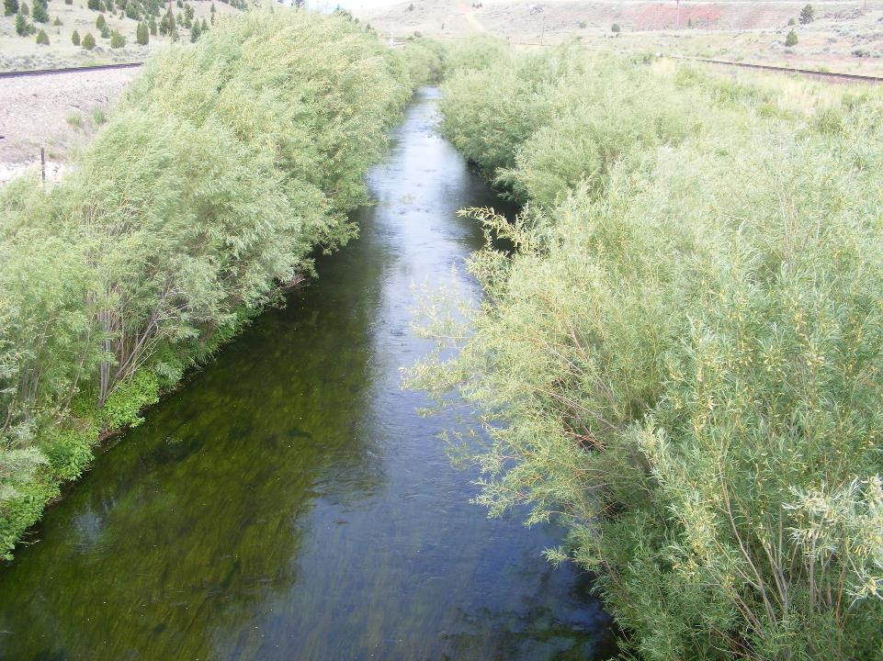
10 YEARS OLD

Slide 64
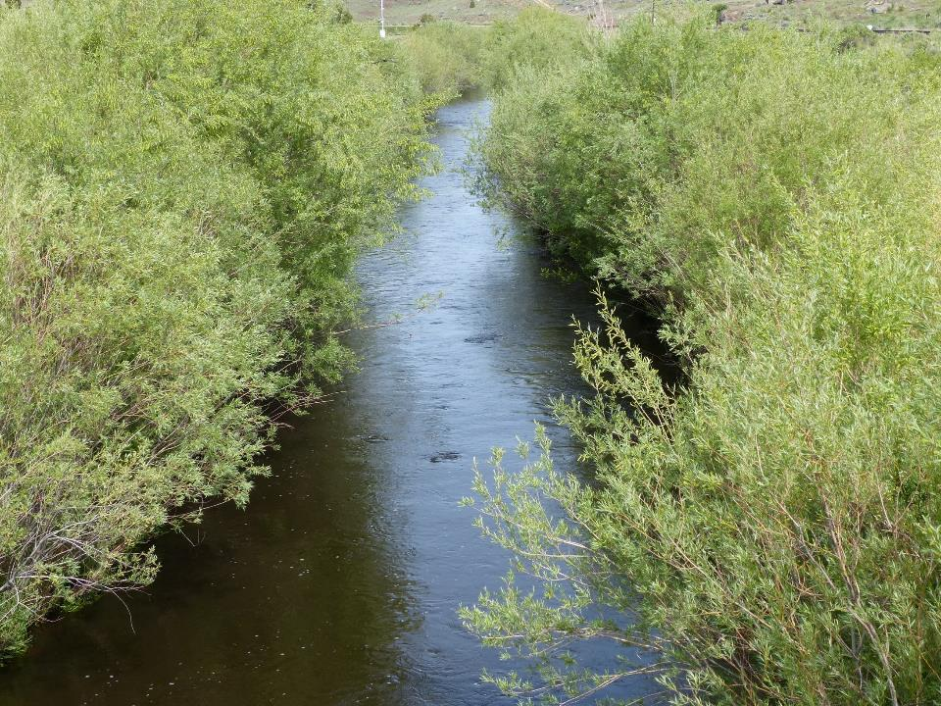
12 YEARS

Slide 67
SO FAR BIRDS ARE MERE NUMBERS The cumulative summaries provided so far blend sometimes contrary trends for different species and can mask differential use by habitat specialists.

Slide 68
WE SEE ONLY THE NET EFFECT FROM COUNTING

Slide 69
LOOK AT THREE HABITAT SPECIALISTS 1. WILLOW FLYCATCHTER

Slide 70
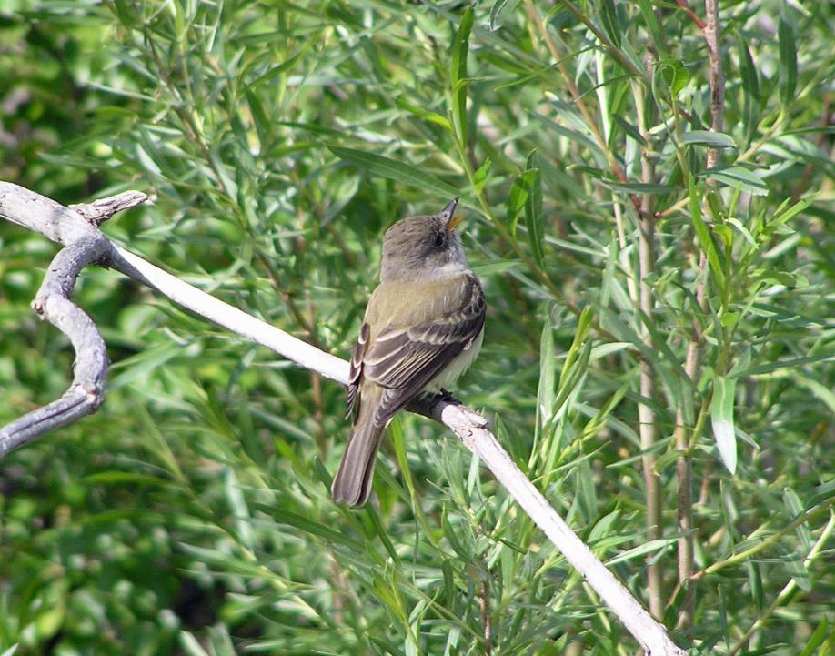

Slide 71
INSECTIVOROUS – AERIAL FORAGER DARTS OUT FROM ELEVATED PERCHES SOUTHWESTERN SSP. ENDANGERED

Slide 72
WILLOW AGE YEARS 6-10 7-13 11-17 ----------------------------------- WIFL COUNTS IN JUNE SA 1 2 14 18 SA 2 2 9 12

Slide 73
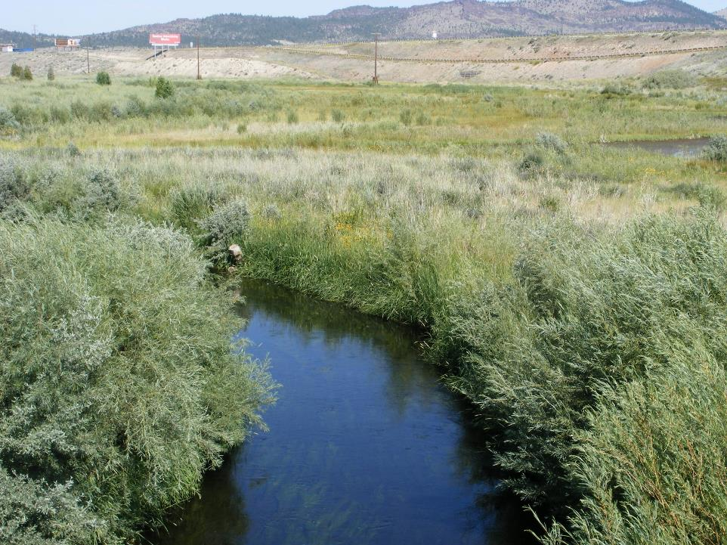
FIRST WILLOW FLYCATCHER SEEN
7 YRS. AFTER WILLOW PLANTING

Slide 74
PALUSTRINE WETLANDS #2 HABITAT 21% OF STATIONS

Slide 75
EMERGENT PLANTS: cattails, spike rush, bulrushes, water sedge, tufted hairgrass, American speedwell. Some woody plants, e.g., certain willows and buffaloberry.

Slide 76
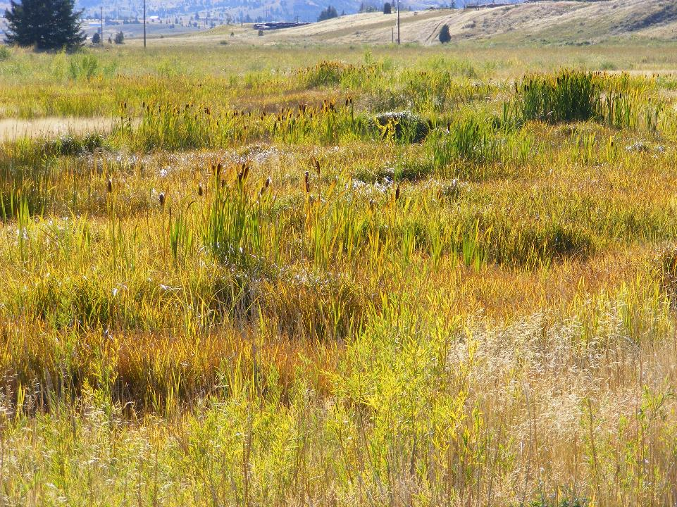
Reach F SA 2

Slide 79
2. MARSH WREN – INSECTIVORE SUMMER VISITOR Their abundance tracks the succession of tall herbaceous plants such as cattails and bulrush and their spread in wetlands.

Slide 80
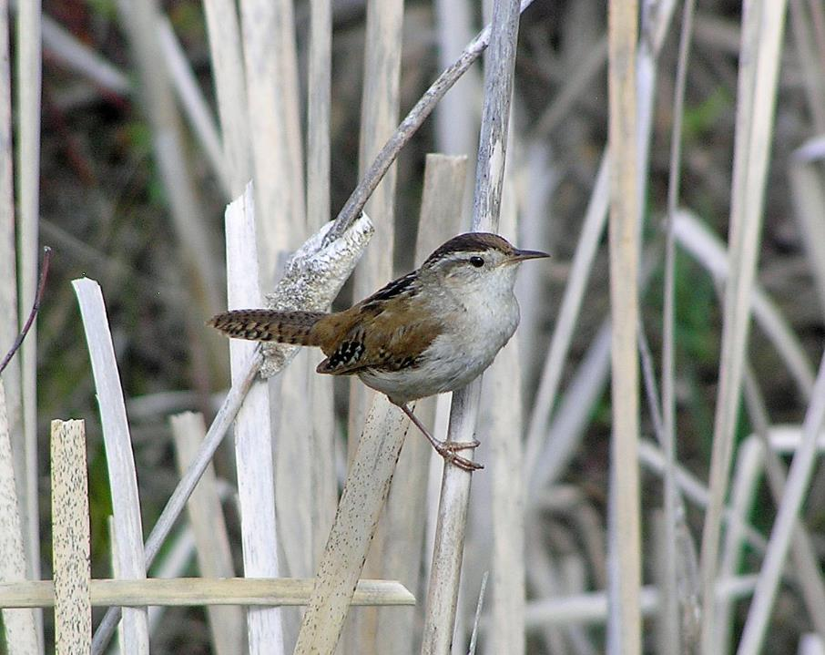

Slide 81
SA 2 MAWR COUNTS 2014 2016 APRIL 0 3 MAY 0 7 JUNE 0 10

Slide 82
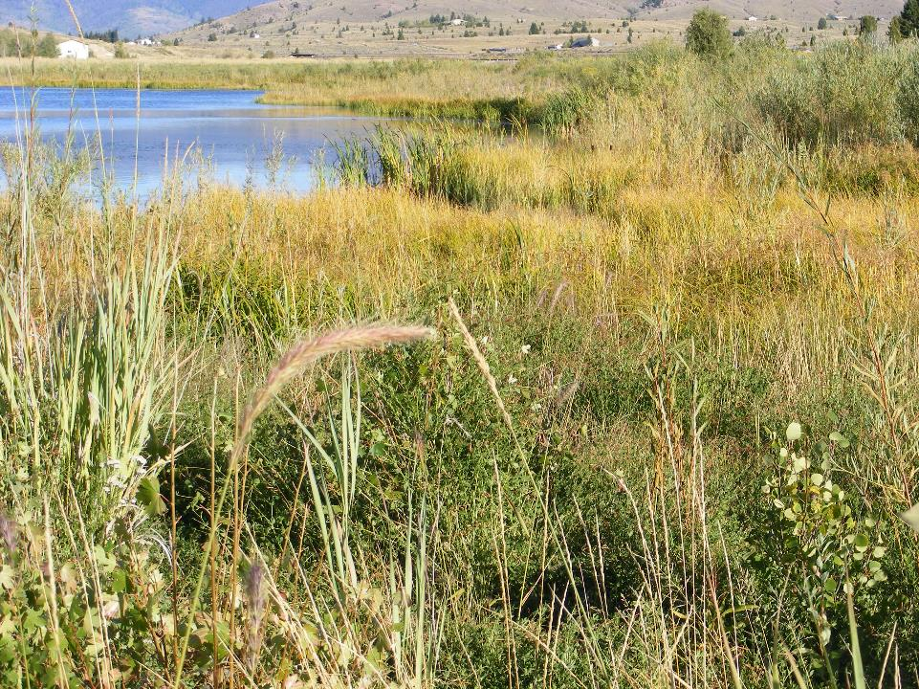
Reach E SA 1

Slide 83
SOME HABITAT SPECIALISTS PREFER MORE OPEN HABITATS 3. SPOTTED SANDPIPER SUMMER SHOREBIRD FEEDS ON INVERTEBRATES

Slide 84
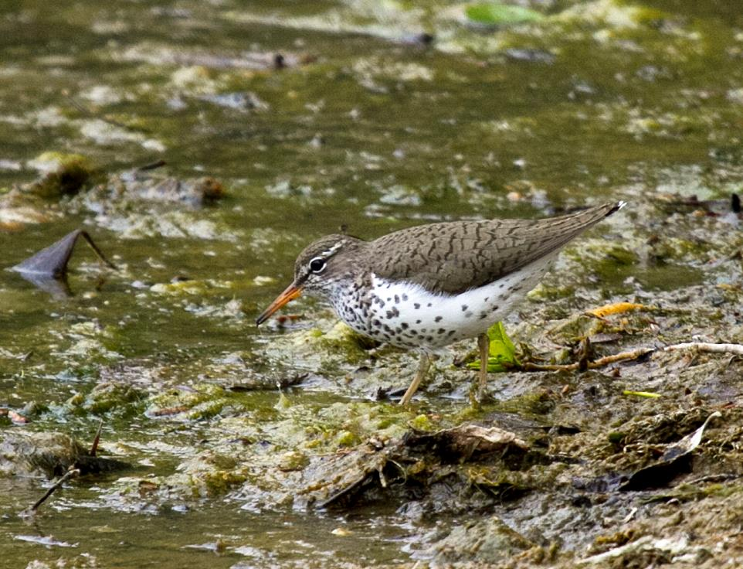
Bob Martinka

Slide 85
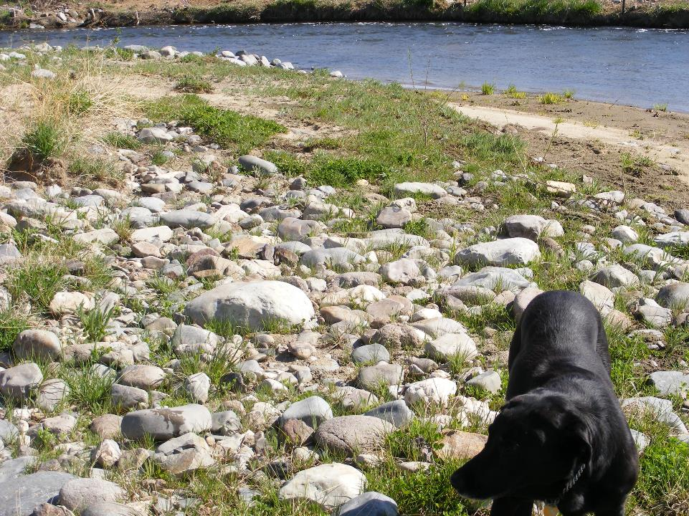

Slide 86
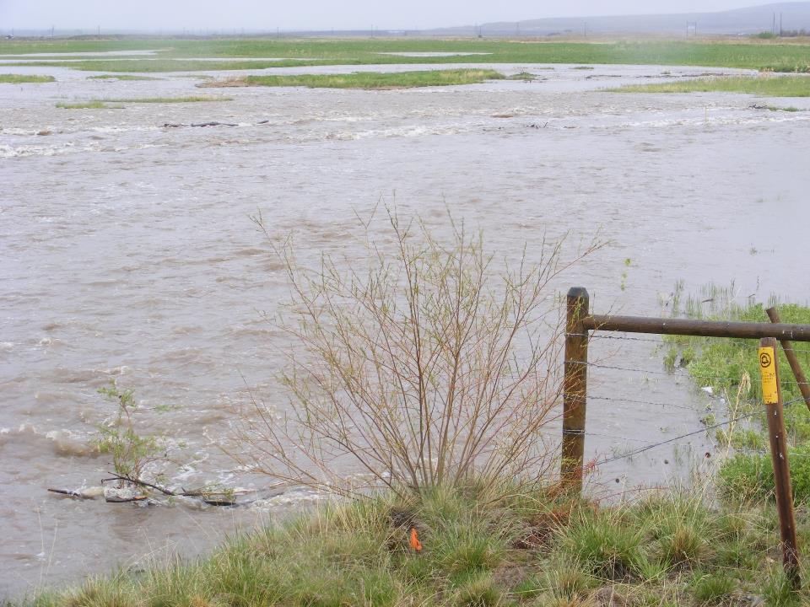

Slide 87
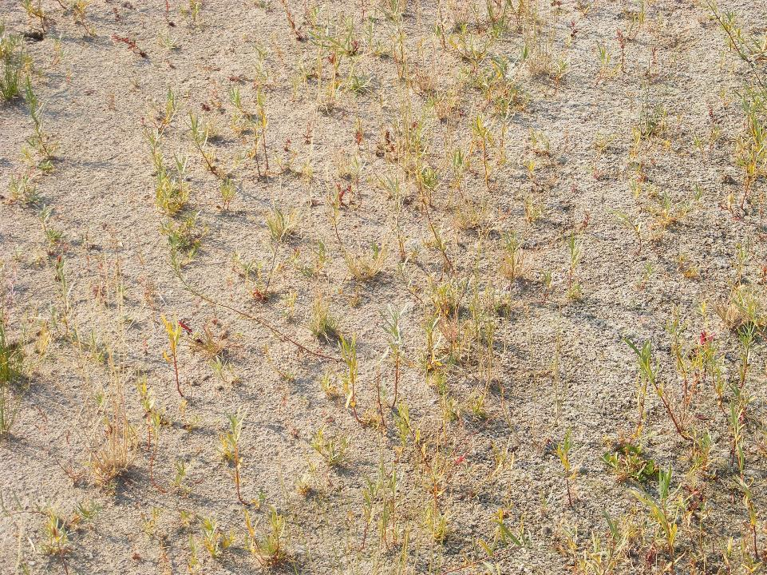

Slide 88
SUBAREA 4 LOTS OF POND MARGINS SPSA COUNTED JUNE JUNE 2014 2016 ---------------------------- 38 27

Slide 89
SA 1 2005 2006 2010 2013 2017 ------------------------------------------------------------------ 17 13 4 4 4

Slide 90
SA 2 2009 2012 2014 2016 -------------------------------------------------- 27 28 6 14

Slide 91
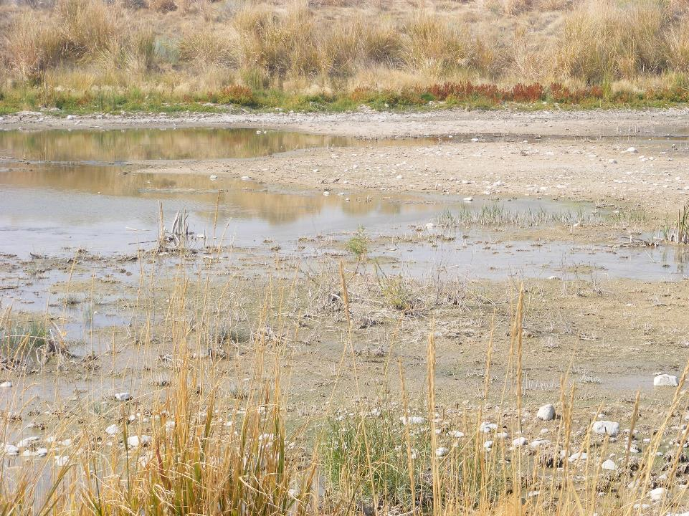
EARLY SERAL HABITAT

Slide 92
SUMMING UP: Birds instantly colonize fresh habitat with no discernible increase in the following decade.

Slide 93
SUMMING UP: Bird species composition is rather dissimilar among even consecutive years. Temporal trends are weak.

Slide 94
SUMMING UP: All used measures of species diversity increased modestly over the ensuing 15 years, but mainly in the second half.

Slide 95
SUMMING UP: As habitats change through vegetational development or disturbance, bird habitat specialists wax and wane.

Slide 96
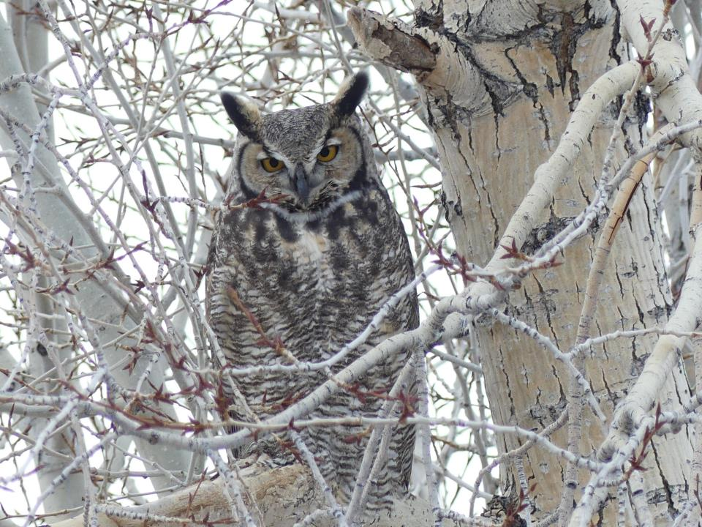
SPONSORED BY MONTANA NATURAL
RESOURCES DAMAGES PROGRAM

