Slide 1
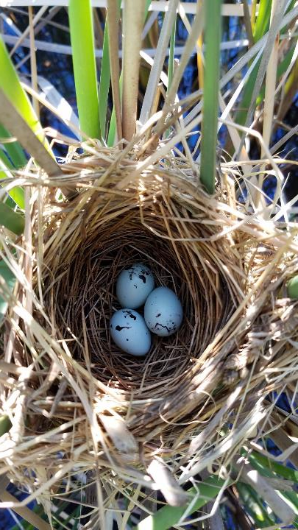
Bird Community Response to Remediation at Tar Creek
Christine Rega-Brodsky, Summer King, Kelly Mallatt
Pittsburg State University
Quapaw Nation Environmental Office

Slide 2
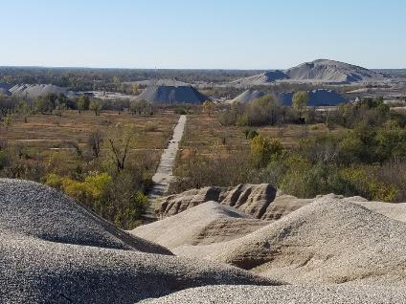
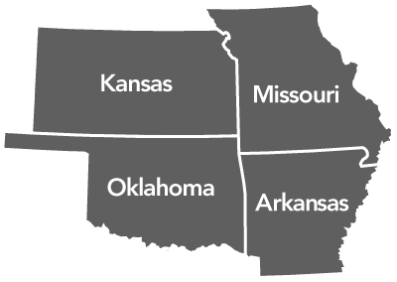
Tar Creek Superfund Site
Picher and Cardin, OK
Lead and zinc mining (1900 – 1970s)
Superfund designation in 1983
Chat piles

Slide 3
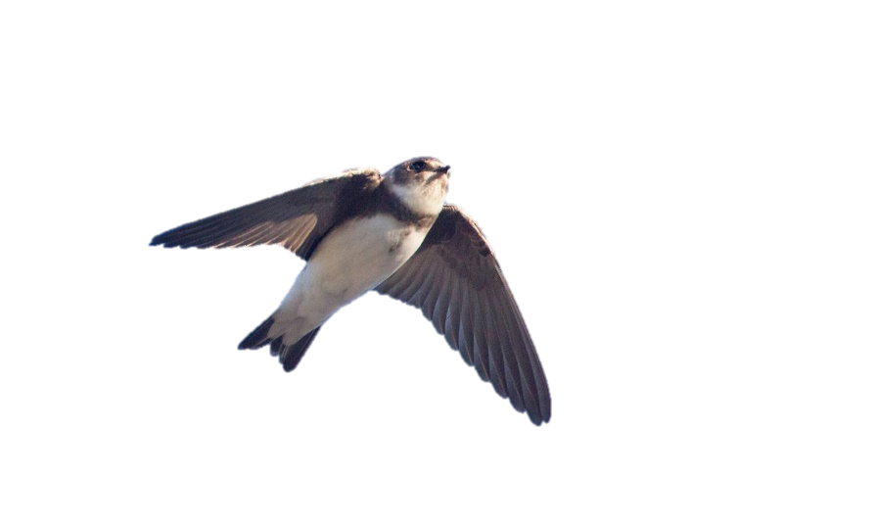
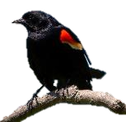
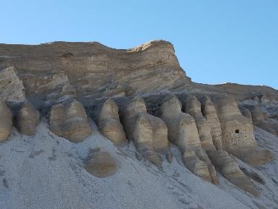
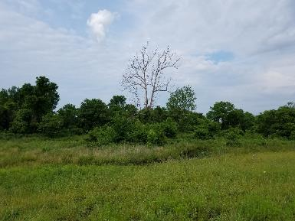
Tar Creek Superfund Site
Large scale changes in habitat with remediation efforts
Habitat removal, change → Impacts on bird community?
?
Bank swallow nests in chat pile
Remediated site – Nesting red-winged blackbirds

Slide 4
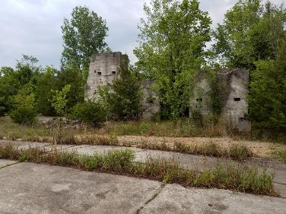
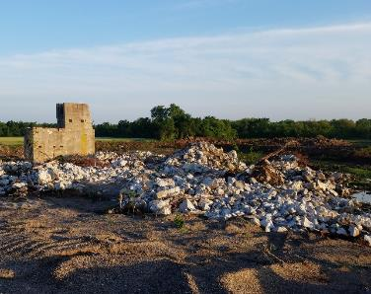
Project Objectives
Determine how the bird community changes throughout the remediation process:
Removing habitat = removing birds?
Richness (number of birds)?
Composition (species present)?
Habitat features impacting change?
Offer recommendations for how to maintain bird diversity throughout remediation process
?
Distal 12 CB096 - 2017
2018

Slide 5
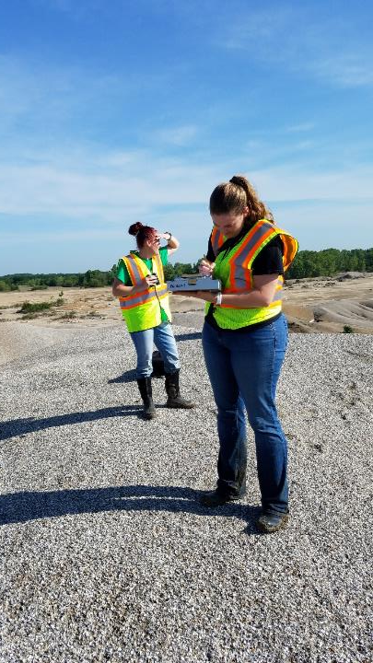
Methods
2017 – 2019
3, 5-minute point count surveys
All birds seen, heard
Account for detection variables (e.g. wind, temp)
Vegetation survey
Ground cover classes & cover
Grass, forbs, bare, litter, rock
Tree size, species
Canopy cover, height
Dominant shrub cover

Slide 6
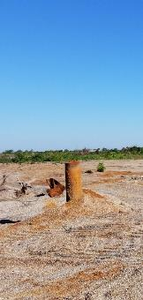
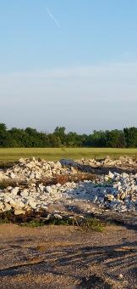
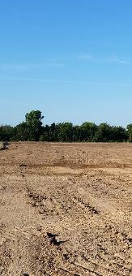
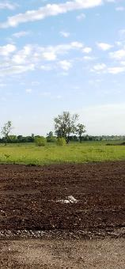
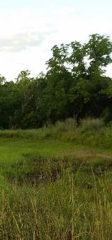
Methods
Selected sites across Tar Creek (> 250m apart)
Categorized each site by remediation status
Under
Construction
None
Bare
Seeded
Complete

Slide 7
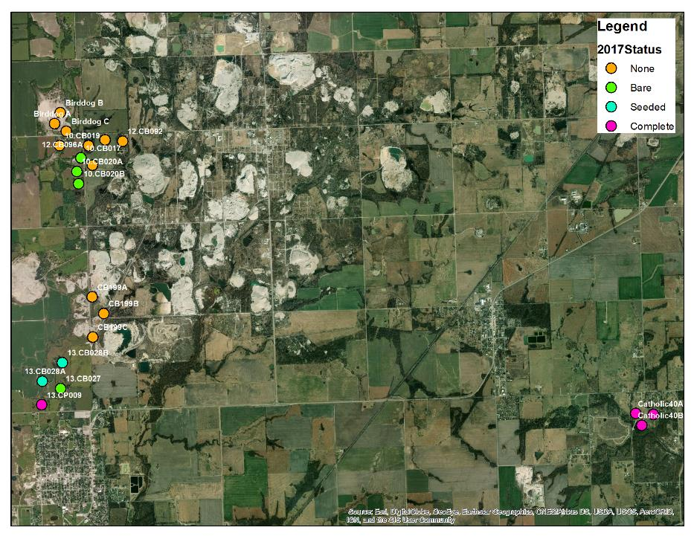
2017
21 sites
(Did not sample Elm Creek)

Slide 8
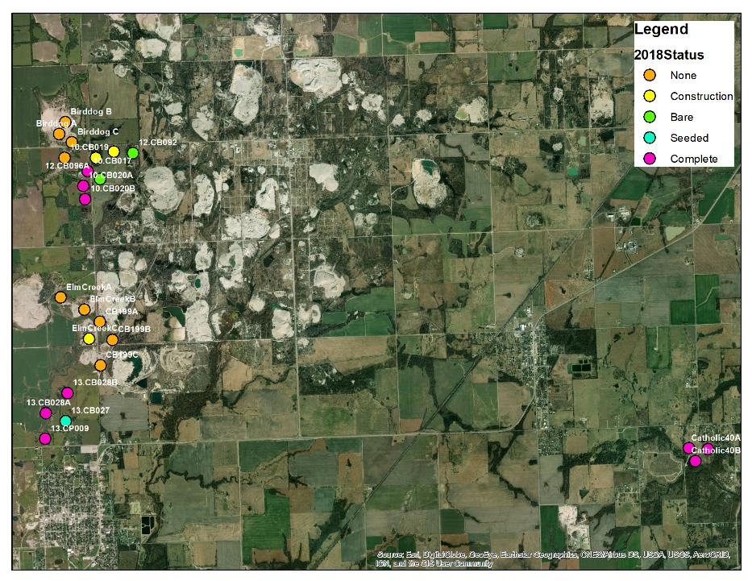
2018
24 sites
(Added Elm Creek)

Slide 9
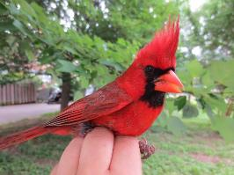
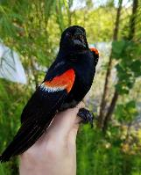
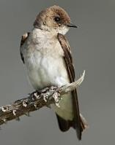
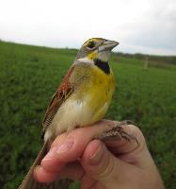
Results
 | 2017 | 2018
Birds Observed | 957 | 1317
Bird Species | 58 | 62
Species per Site | 14.7 (Range 9 – 23) | 16.8 (Range 12 – 26)
Dominant Species | Northern Cardinal Red-winged Blackbird Bank Swallow Indigo Bunting Brown-headed Cowbird | Red-winged Blackbird Dickcissel Bank Swallow Northern Cardinal American Crow
Cardinal
Red-winged blackbird
Bank swallow
Dickcissel
Notes:
No difference across two years in species richness

Slide 10
Results - Abundance
Note: No construction sites were assessed in 2017
More bird were found in seeded and completely remediated sites (ANOVA: F = 11.2, P < 0.001), specifically compared against sites without remediation and bare sites.
We observed significantly more birds in 2018 (ANOVA: F = 6.5, P = 0.017).

Slide 11
Results – Species Richness
Note: No construction sites were assessed in 2017
a
a
a
ab
b
More bird species were found in completely remediated sites (ANOVA: F = 7.2, P < 0.001), specifically compared against sites without remediation, construction, and bare sites.
No difference in richness across years (ANOVA: F = 1.1, P = 0.29).

Slide 12
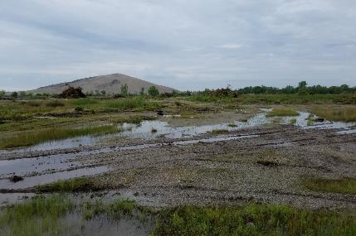
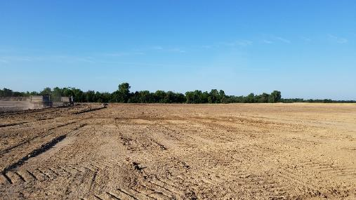
Results
Some sites without remediation may provide habitat, so remediation at those sites may initially reduce the number of bird species during construction, seeding.
2017
2018
Distal 12
CB092
No remediation (2017) = 22 species
Bare ground (2018) = 15 species

Slide 13
Results
 | 2017 | 2018
Birds Observed | 957 | 1317
Bird Species | 58 | 62
Avg Species per Site | 14.7 (Range 9 – 23) | 16.8 (Range 12 – 26)
Dominant Species | Northern Cardinal Red-winged Blackbird Bank Swallow Indigo Bunting Brown-headed Cowbird | Red-winged Blackbird Dickcissel Bank Swallow Northern Cardinal American crow
Already see a shift from a bird community with remediation efforts after 1 year

Slide 14
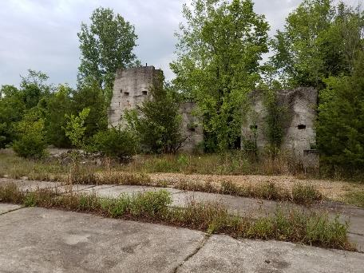
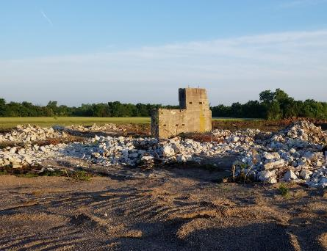
Results
Distal 12
CB096
Site A
Shift from forest → grassland birds with remediation
2017
2018
0. None
1. Construction
In this time…

Slide 15
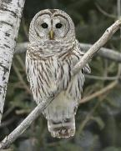
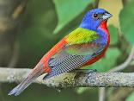
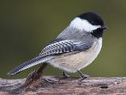
Results
Distal 12
CB096
Site A
Shift from forest → grassland birds with remediation
2017
2018
Lost these forest species…
Painted bunting
Barred owl
Carolina chickadee

Slide 16
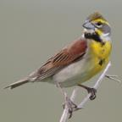
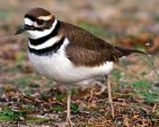
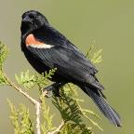
Results
Distal 12
CB096
Site A
Shift from forest → grassland birds with remediation
2017
2018
Gained these grassland/field species…
Dickcissel
Killdeer
Red-winged Blackbird

Slide 17
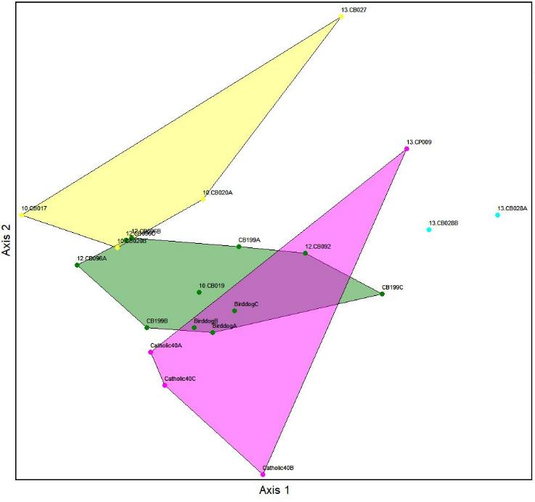
2017
2018
All Years

Slide 18
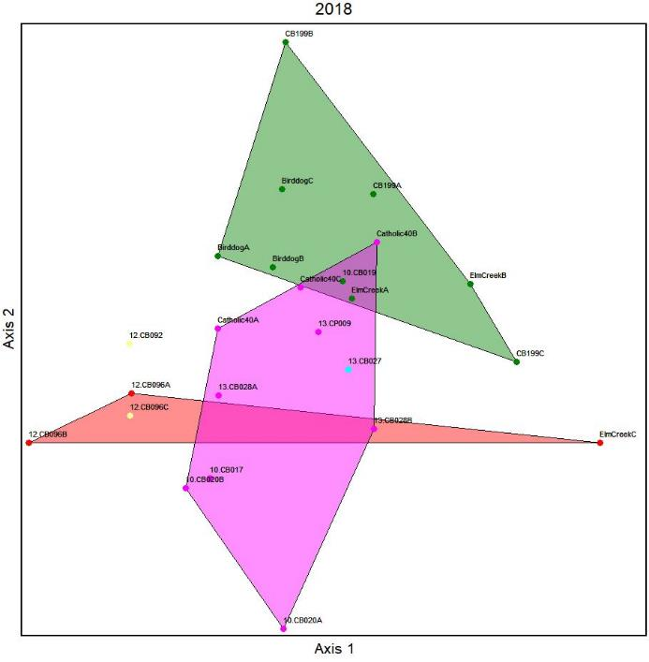
2017
2018
All Years

Slide 19
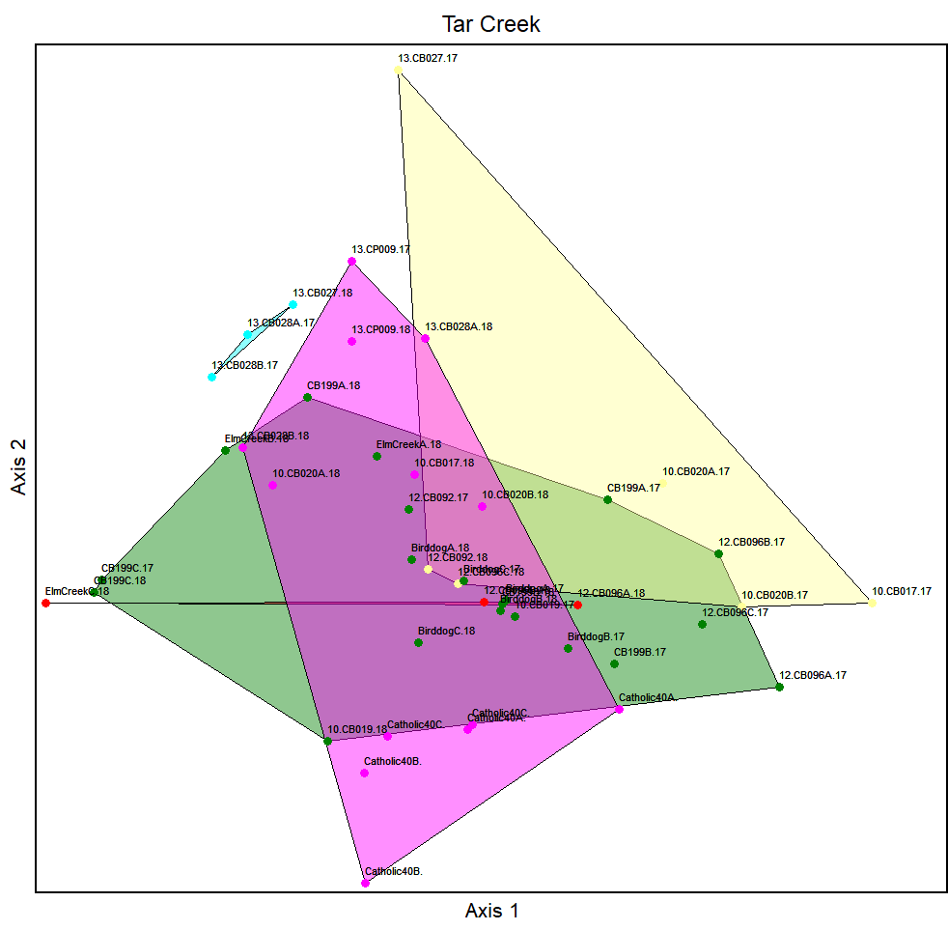
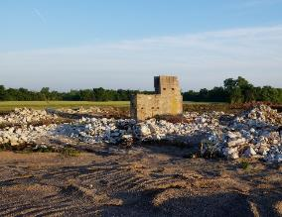
2017
2018
All Years
2018
2017
Site 12.CB096A

Slide 20
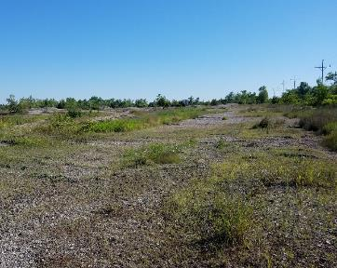
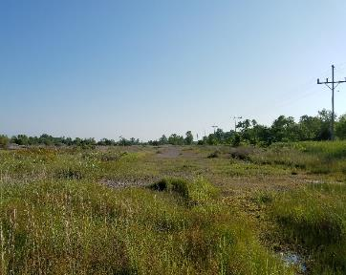
2017
2018
All Years
2018
2017
Site CB199C

Slide 21
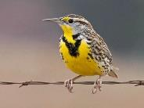
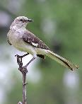
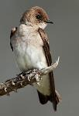
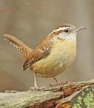
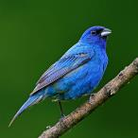
Open Fields, Grassland
2017
2018
All Years
Edge Habitats, Wetlands
Edge Habitats, Forested

Slide 22
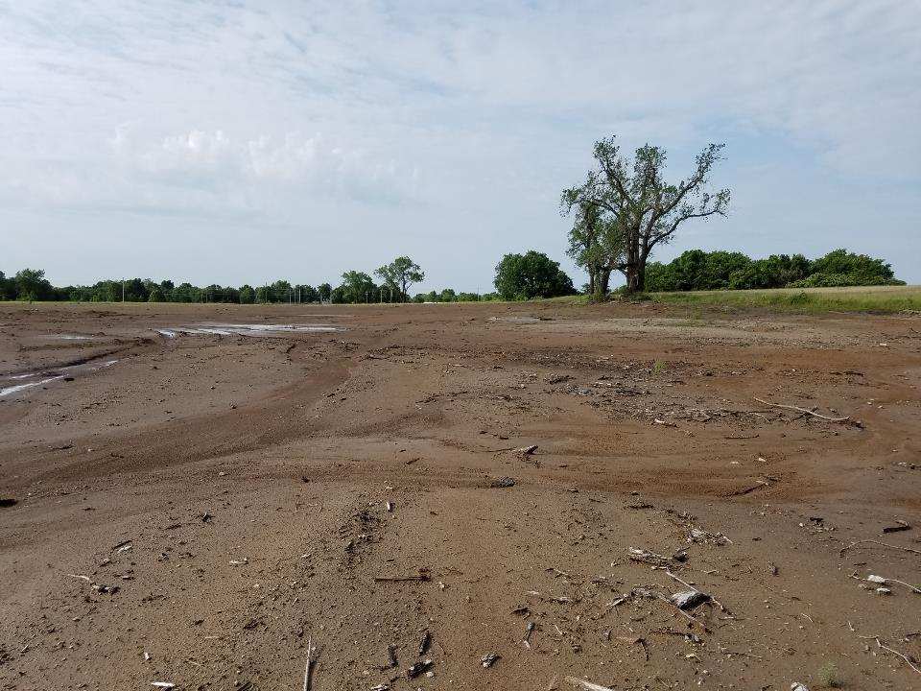
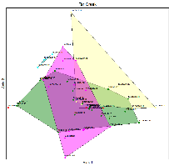
Distal 13
CB027
2017
Status: Bare
Open Fields, Grassland

Slide 23
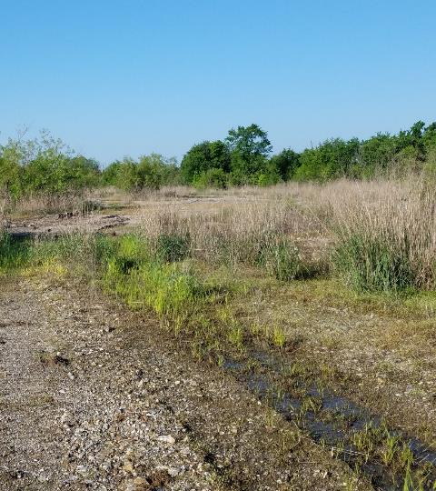
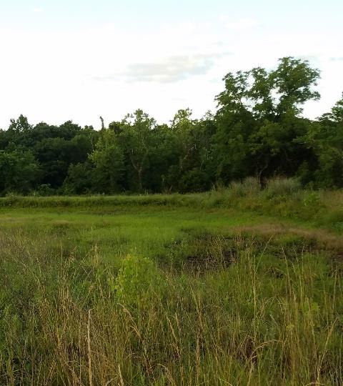
Distal 10
CB019
2018
Status: No Remediation
Edge Habitats, Wetlands
Catholic 40
Site B
2018
Status: Complete

Slide 24
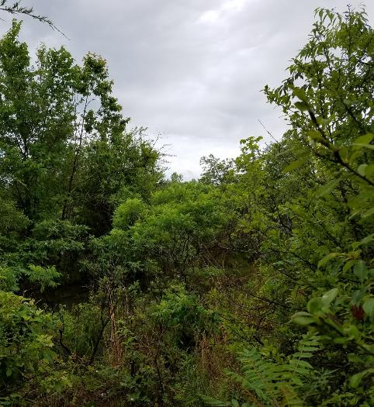
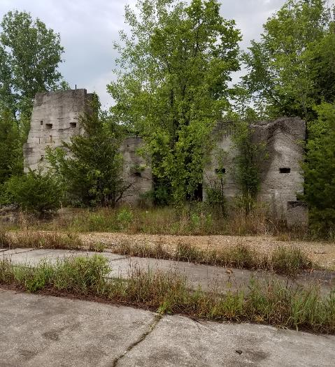
Edge Habitats, Forested
CB199
Site B
2017
Status: No Remediation
Distal 12
CB096
2017
Status: No Remediation
Notes:
Most sites within this category are “No remediation” → Overall loss of trees and conversion to more open field habitats

Slide 25
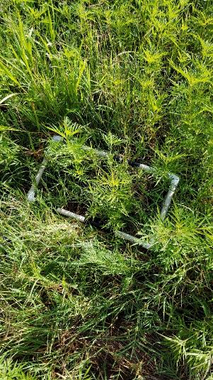
Results – Habitat Features
Few habitat variables correlated with bird richness and abundance
Grass and forbs key driver of the bird community

Slide 26
Results – Habitat Features
Bird species richness (number of bird species at the site) driven by grass and forb habitat availability (R² = 0.19, P = 0.032).

Slide 27
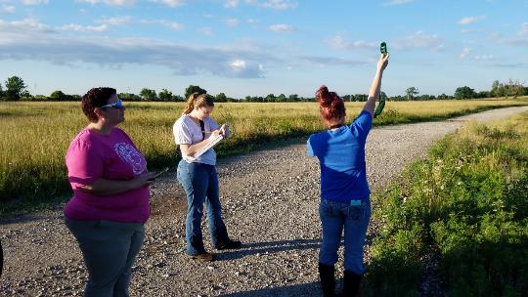
Key Preliminary Findings
These results are from only two years of data,
But we’re already seeing some patterns emerge…

Slide 28
Key Preliminary Findings
Remediation efforts have attracted more species to the sites
Construction and bare ground provides the least amount of habitat for birds
Leave the ground bare for as little time as possible!
Planting and maintaining grassland habitat is beneficial for the bird community

Slide 29
Revisiting Hypotheses
Determine how the bird community changes throughout the remediation process:
Removing habitat = removing birds? → No
Richness? → Increases
Composition? Shifts from forest → grassland community
Habitat features impacting change? Grass, forb cover

Slide 30
Future Goals and Plans
Repeat sampling to track long term changes
Broaden scope to include:
Nesting success rates
Trends in mammal community
Create models for the abundance of key species as related to habitat variables
Recommend habitat management actions to increase overall species diversity

Slide 31
Acknowledgements
Funding
Kansas INBRE, IDeA Program of the National Institute of General Medical Sciences of the National Institutes of Health (NIH). Grant #P20 GM103418
Pittsburg State University
Many thanks to…
Craig Kreman
Quapaw Nation Environmental Office
Our amazing Pitt State student interns/ researchers!
Ashlyn Parmley
Robin Goodreau
Kylie Carnahan
Morgan Smith
Questions?
Please email me at cbrodsky@pittstate.edu

