Slide 1
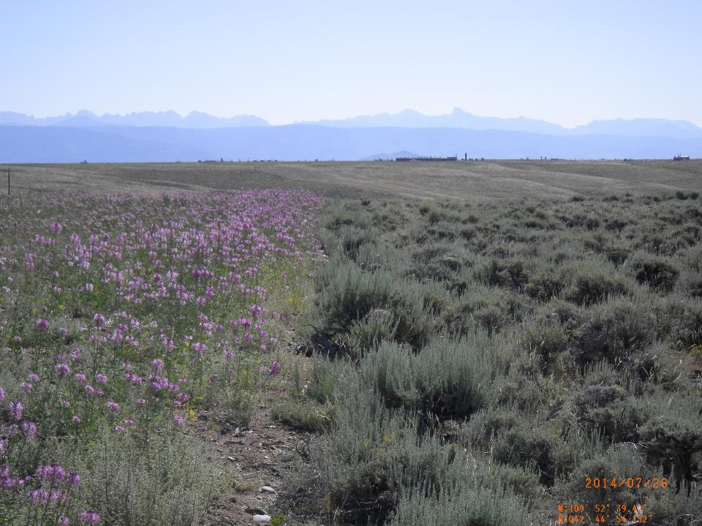
j
Insect response and dispersal within a semi-natural natural gas field undergoing restoration activities
Michael Curran (University of Wyoming, Program in Ecology)
Collaborators:
Dr. Douglas Smith and Dr. Peter Stahl (UW Ecosystem Science & Management)

Slide 3
Land Reclamation and Ecosystem Restoration in Oil and Gas Fields
May be viewed as ‘assisted succession’ (McCann 2007, Walker et al. 2007)
Typically focused on structural, not functional, end points
Regulatory Criteria – Roll Over/Bond Release
Lack of attention on native annual forbs (Prasser 2015)
Based on vegetation structure and composition
Reclaimed sites compared to adjacent, undisturbed reference sites (BLM Gold Book 2007)

Slide 6
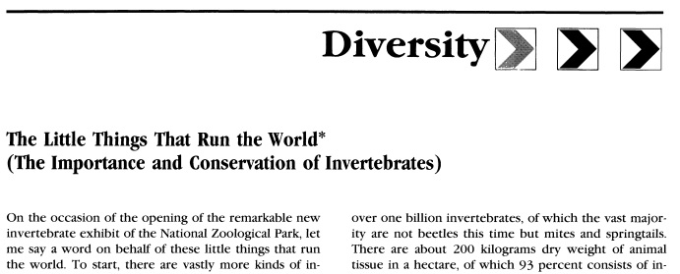

Slide 7
Insects and Ecosystem Services
Provisioning Services
Food, raw materials, fresh water, medicinal resources
Regulating Services
Local climate and air quality, carbon sequestration and storage, moderation of extreme events, waste-water treatment, erosion control/soil fertility, pollination, biological control
Habitat or Supporting Services
Habitat for species (food, shelter, water), maintenance of genetic diversity (high species diversity often means high genetic diversity), nutrient cycling
Cultural Services
Recreation (mental & physical health), tourism, aesthetic appreciation and inspiration for culture, art, and design, spiritual experience
www.teebweb.org

Slide 8
Insects and Restoration Ecology
Few studies have examined how insects respond to vegetation communities at different successional stages (especially in high altitude/arid environments)
Have been used as indicators of restoration success in natural/semi-natural ecosystems (e.g., Longcore 2003)
Large amounts (i.e., statistically valid numbers) of insects can be collected in short time periods
Pollinator habitat restoration very well studied in crop-agriculture
5 of 22,137 published articles on pollinator habitat restoration are in non-crop systems (Menz et al. 2011 – only a few since)

Slide 9
Information about Insects from previous literature
Plant-vigor hypothesis (Price 1991) – if given choice, insects prefer young, vigorous plants over old, decadent plants (this has been shown with domestic livestock and other herbivorous animals, as well)
Mass-flowering hypothesis (Westphal et al. 2003) – in non-diverse ecosystems (agriculture based), patches of dense flowers increase pollinator diversity and abundance
Many insects avoid terpenoids (produced by old sagebrush) and very few insect families eat wood
Not many studies have been conducted to see how grazing impacts insects, but most show negative impact (Fleischer 1994)
Not much is known about wild pollinators in rangelands (Harmon 2011)

Slide 10
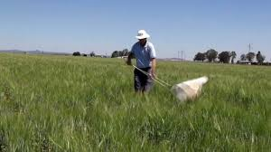
Benefits of insect studies
High numbers (statistically valid samples) collected in short times
Relatively inexpensive to study
Indicators of ecosystem recovery (e.g. Longcore 2003)

Slide 11
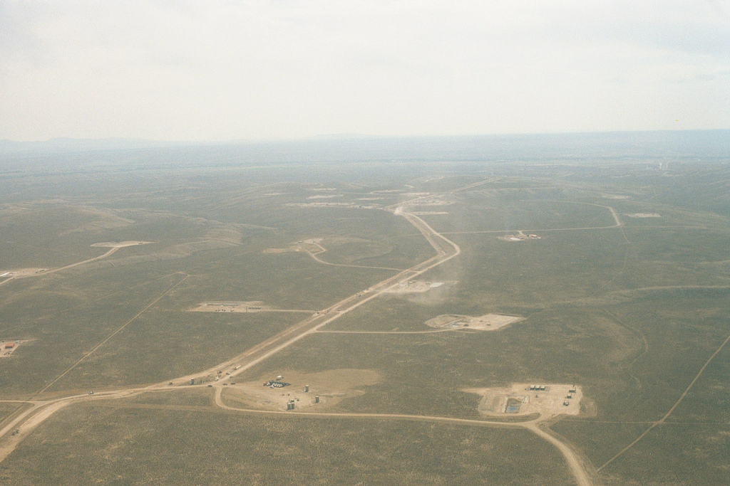
Study Area
Pinedale Anticline natural gas field (Pinedale, WY, USA)
High daily and annual temperature fluctuations
~2,100 m elevation
42 day frost-free period
Low (254-356 mm) and unpredictable precipitation
Highly fragmented
5,289 acres of initial disturbance with 3,668 acres undergoing active reclamation (69.3%)
Subject to domestic livestock grazing possibly dating back to 1871
All sites selected in study fall in ESD R034AY222WY
Historic climax plant community of mixed grass, big sage

Slide 12
Study Area

Slide 13
a. b.

Slide 14
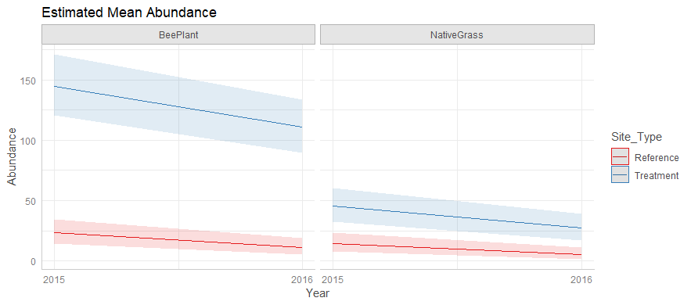
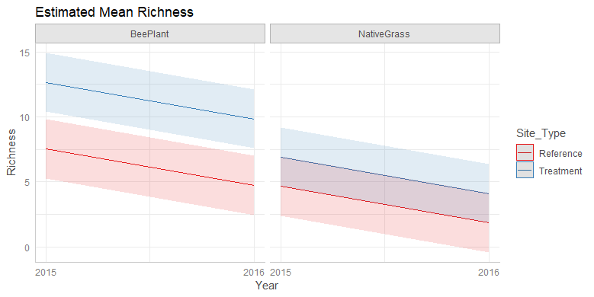

Slide 15
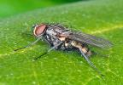
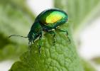
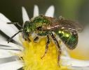
2015 Whittaker Plot

Slide 16
2015 Ecological Role

Slide 17
2016 Whittaker Plot

Slide 18
2016 Ecological Role

Slide 19
Drawbacks of Pinedale Study
Unsure if reclaimed sites provide suitable nesting habitat
Unsure if reclaimed sites are acting as resource islands or sinks
Limited to one time of year (generally the case in mass-flowering studies)

Slide 20
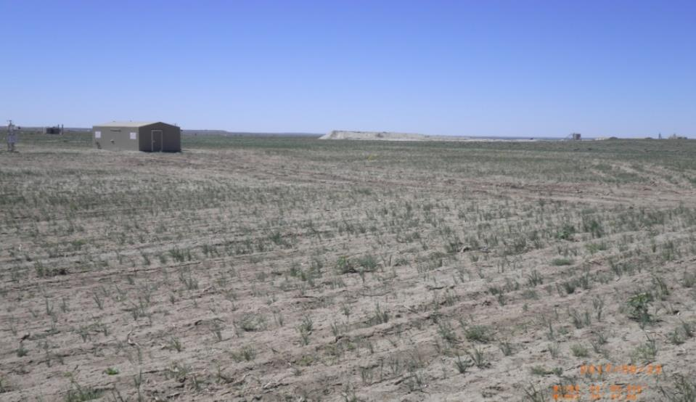
Jonah Infill Study

Slide 24
Insect Abundance (sweep nets)

Slide 25
Early/mid-season families (Yarrow sites)

Slide 26
Late season sites (Rocky Mountain bee plant)

Slide 27
Late season

Slide 28
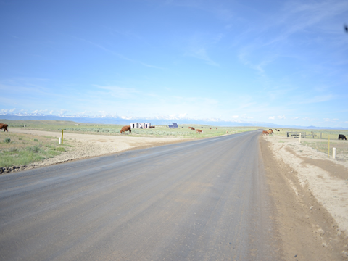
Preliminary Results/Challenges
Insect densities are higher on sticky traps located on and near reclaimed well pads (~4,000;~6,000 insects per each study area)
Identifying beyond Order difficult for many insects on sticky traps
Zero values and count data not traditional in spatial analysis
Generally, continuous data used for this study design
Unable to determine if insects are coming from areas outside of specific study area

Slide 29
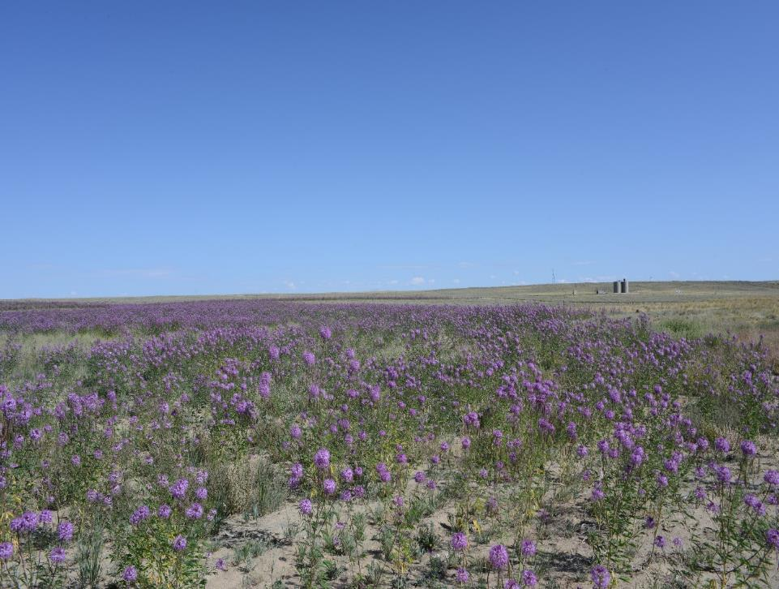
Expected Outcomes
Provide a baseline for insect groups in this environment
Determine whether insects which are utilizing well pads are moving away from well pads and across well pads
Map insect abundance and movement patterns
Heat map
Subjective
Kriging

Slide 30
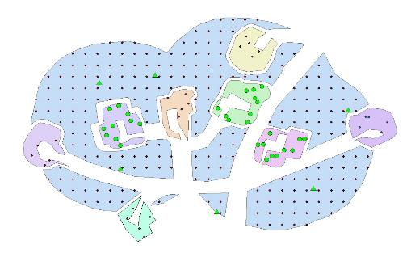
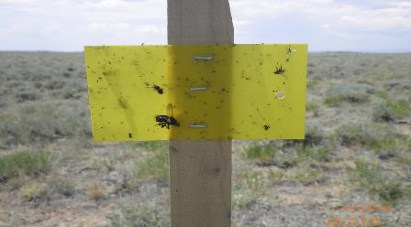
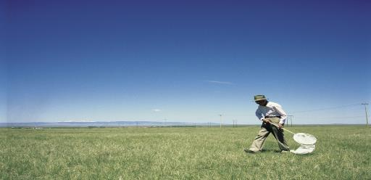
Current Research: combine sticky traps, protein marking, and sweep netting at different points in the year

Slide 31
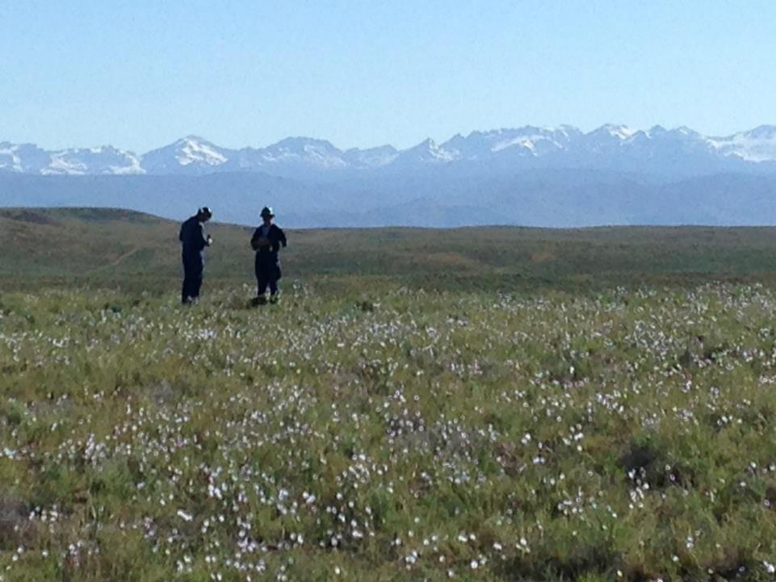
Thank you!
Jonah Energy
Wyoming Reclamation and Restoration Center
Collaborators
Smith, Hagler, Machtley, Robinson, Anderson-Sprecher, Stahl
Pinedale Bureau of Land Management

