Slide 1
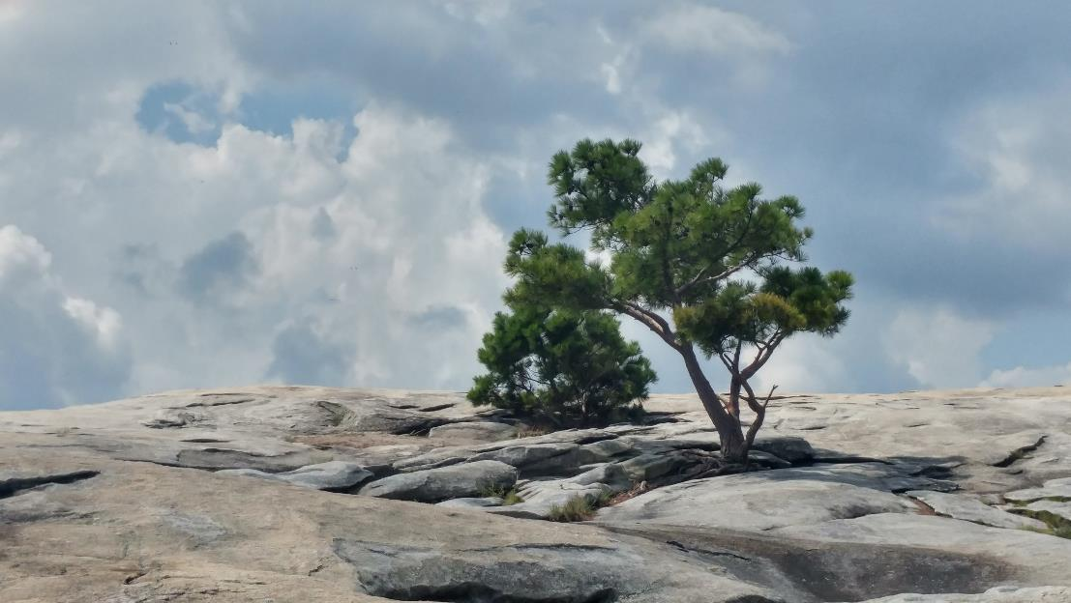
Tree Response to Soil Treatments on Quarry Overburden
J.A. Franklin and D.S. Buckley
Dept. of Forestry, Wildlife and Fisheries
University of Tennessee
Presented at ASMR, June 6, 2019
Big Sky, MT

Slide 2
Forestry Reclamation Approach
1. Create a suitable rooting medium for good tree growth that is no less than 4 feet deep and comprised of topsoil, weathered sandstone, and/or the best available material
2. Loosely grade the topsoil or topsoil substitutes established in step one to create a non-compacted growth medium
3. Use ground covers that are compatible with growing trees
4. Plant two types of trees – 1) early succession species for wildlife and soil stability, and 2) commercially valuable crop trees
5. Use proper tree planting techniques

Slide 3
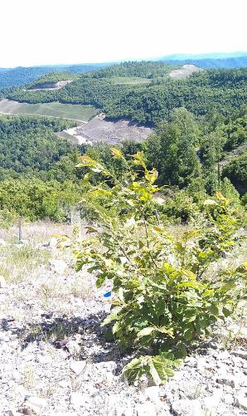
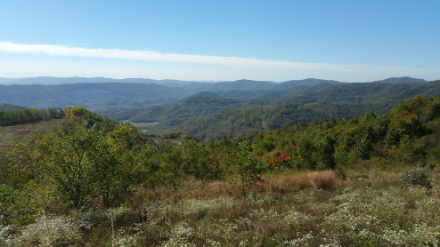
Forestry Reclamation Approach
Recommends seeding tree-compatible ground cover, and creating soil conditions that promote the establishment of trees and native vegetation.

Slide 4
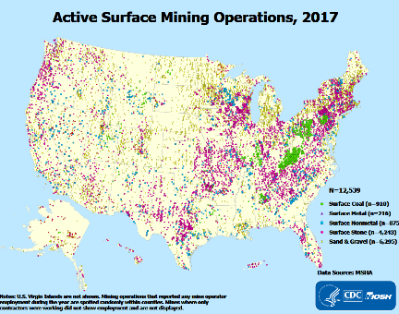
Forestry Reclamation Approach
Tested extensively on reclaimed coal mines in the eastern US for establishing forest.
Aggregate industry in 2019 (USGS):
$8.7 billion in construction products
$6.2 billion in industrial products
9,350 active quarries in US
Concentrated in populated areas

Slide 5
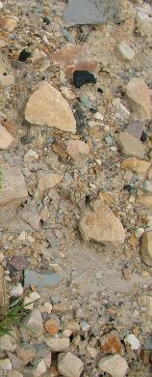
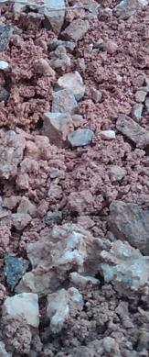
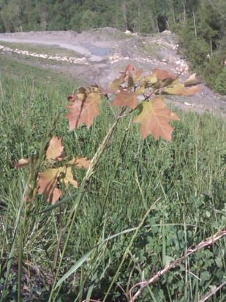
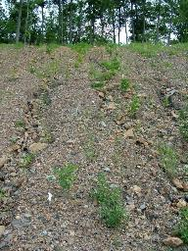
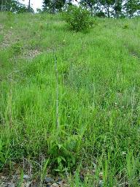
Challenges in applying the FRA in different situations:
coal mine quarry
Lime application effects
Differences in soil pH, soil texture, available nutrients
Fertilization effects

Slide 6
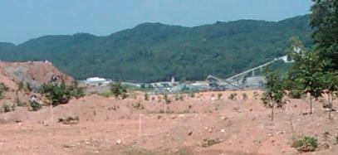
Project objectives:
Demonstrate the use of the FRA for the reclamation of quarry overburden
Test the influence of reclamation treatments on the establishment of planted trees:
Treatments:
Grading
Fertilization
Lime application

Slide 7
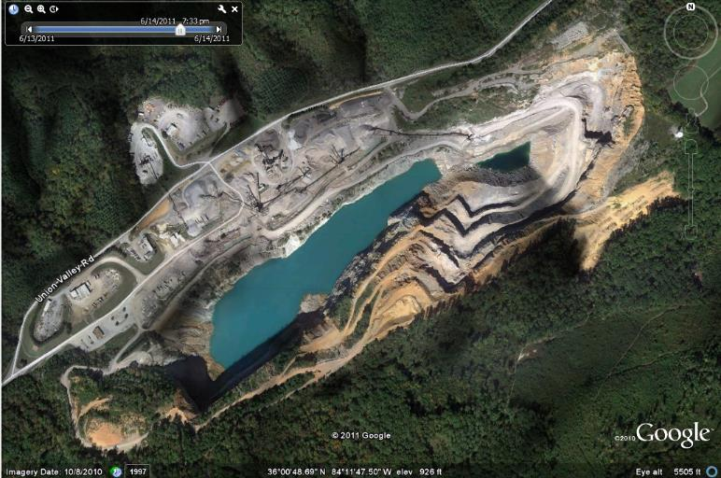
Study site: Roger’s Quarry, Oak Ridge, TN

Slide 8
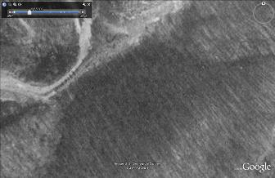
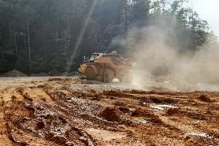
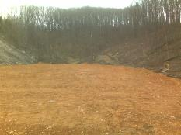
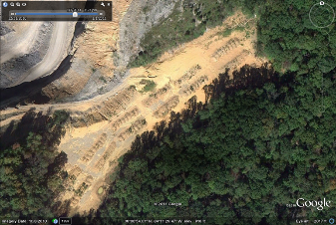
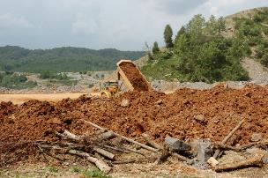
Site construction: 2007-2008
Valley filled with overburden
Pre-disturbance
Compacted base
Feb. ‘09
Ready for planting May ‘09
Plot placement Mar. ‘09

Slide 9
Soil properties
P 0.4 %
K 54.2 ppm
Ca 3626
Mg 1854
Zn 17.3
Cu 0.4
Fe 3.7
Mn 29.5
Na 18.7
N BDL
pH 5.1-5.6
66% > 2mm
26% sand
2% silt
6% clay
0.7% organic

Slide 10
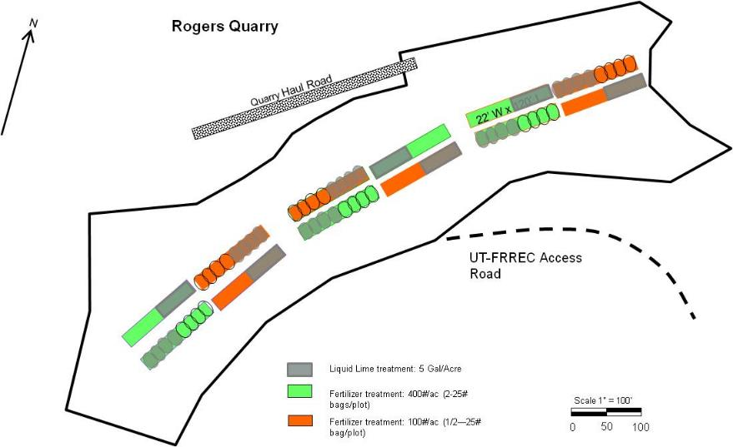
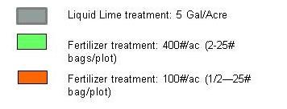
Graded
Un-graded
(46.78 L/Ha)
400 Kg/Ha N from 20:20:20
100 Kg/Ha N from 20:20:20
3 blocks, based on shading from adjacent forest

Slide 11
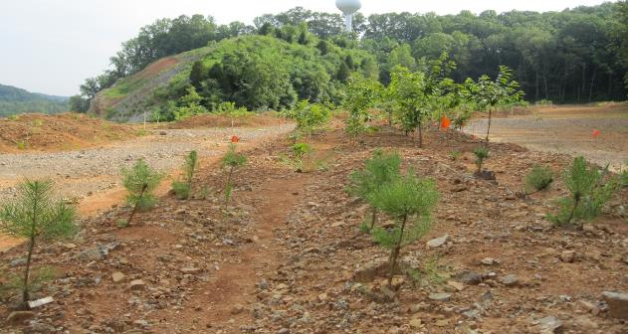
Trees were planted 1 species per sub-plot
white oak shortleaf pine American Chestnut
(Quercus alba) (Pinus echinata) (Castanea dentata)
No ground cover was seeded

Slide 12
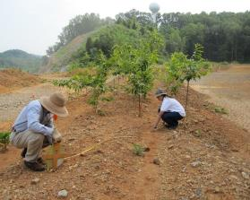
Measurements
Soil pH of each plot was tested two times per year in 2009, 2010, and 2011. After 1 year there was no longer an effect of lime on pH, and it was re-applied in May 2010.
Soil temperature and soil moisture at 15 mm depth were measured twice per month during the 2009, 2010 and 2011 growing seasons.
Tree height and root collar diameter (RCD) were measured in May 2009, Dec. 2009, and during the summers of 2011, 2014, and 2016.
On un-graded plots, topographic position of each tree was noted.

Slide 13
2013

Slide 14
2016

Slide 15
2016

Slide 16
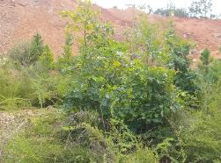
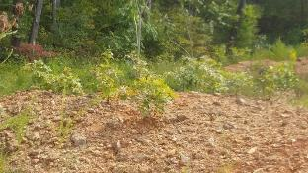
Results Main effects - fertilizer
*
*
*
*
*
*
*indicates a significant effect of treatment for the species at p> 0.05

Slide 17
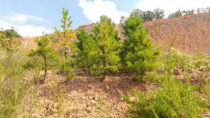
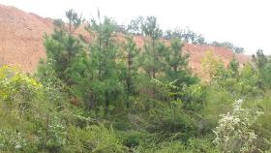
Results Main effects - fertilizer
*
*indicates a significant effect of treatment for the species at p> 0.05

Slide 18
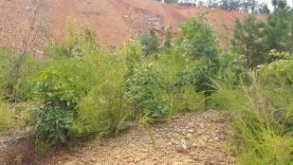
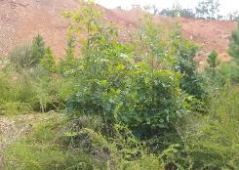
Results Main effects – lime application
*
*
*indicates a significant effect of treatment for the species at p> 0.05
No effect on growth

Slide 19
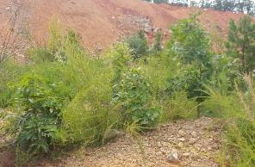
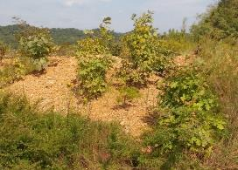
Results Main effects – grading
*
*indicates a significant effect of treatment for the species at p> 0.05
Mean volumetric soil moisture was significantly greater (16.06 % ± 0.37 SE) in graded plots than in ungraded plots with mounds (15.25 ± 0.41 SE).

Slide 20
Results Influence of microtopography - aspect
A
B
B
B
C
No clear pattern for soil moisture

Slide 21
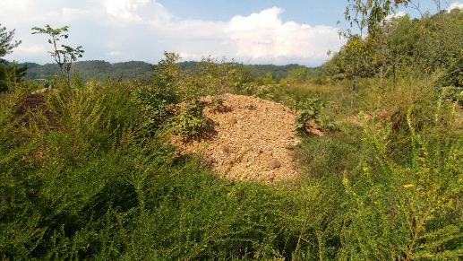
Results Influence of microtopography – slope position
Temperature – hotter on top
Soil moisture – no pattern
Organic matter – lower on top
Fertilizer – likely lower on top
Competition – lower on top
*

Slide 22
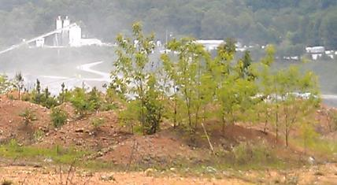
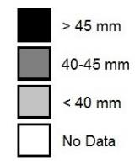
Results Influence of microtopography
North
Species did not differ in response, combined for analysis of 2016 data.
Clear gradient on northern aspect, not on southern.
Mid-slope position had more consistent growth.
Mean RCD in 2019

Slide 23
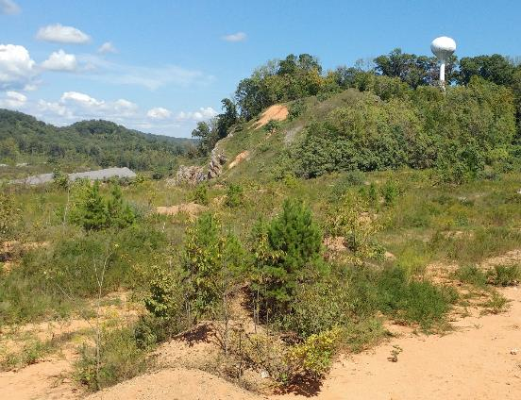
Conclusions
FRA techniques applied to quarry restoration resulted in successful tree establishment, similar to results seen on reclaimed coal mines.
Site preparation and soil amendments at the time of stand establishment can have a significant influence on tree survival and long-lasting effects on tree growth.
Microtopography has an influence on tree growth.

Slide 24
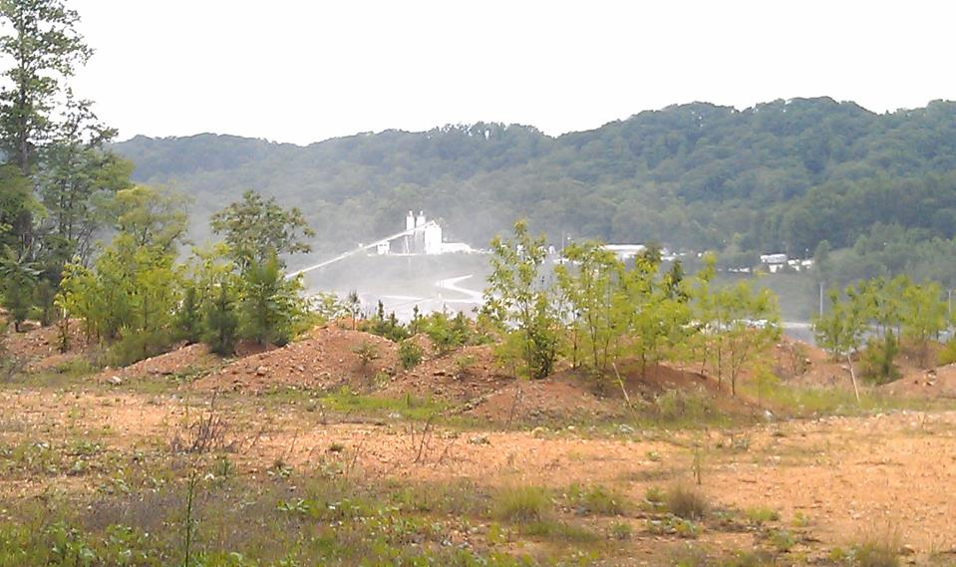
Acknowledgements
Richard Evans and Kevin Hoyt, UT-FRREC
Roger’s Group – funding and site prep
UTIA and USDA McIntire-Stennis – funding
USFS and ACF – Chestnut seedlings
Technical assistance: Beth Aubuchon, Adam Klobucar, Aju Sahadevan, Veronica de Lima Neibles, Joslyn Knox, Brien Ostby

