Slide 1
Techniques to refine initial amendment selection for dispersed mine tailings reclamation
Jason Willis, PE | Andrew Harley, PhD
Colorado AML Program Manager | Principal Geochemist/Soil Scientist
Trout Unlimited | Duraroot, LLC
jwillis@tu.org 719.221.0411 | aharley@duraroot.com 720.840.4703

Slide 2
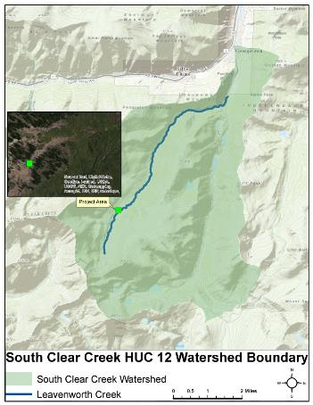
Waldorf mine – project location
Project Site: 6 miles SW of Georgetown, CO on east side of continental divide.
Adjacent to historic Waldorf Mine/Mill site
Footprint includes: Former town/mill site
Waldorf Mine adit (Wilcox tunnel)
Waste rock pile
Dispersed mill tailings area (DTA) (Focus of this study)

Slide 3
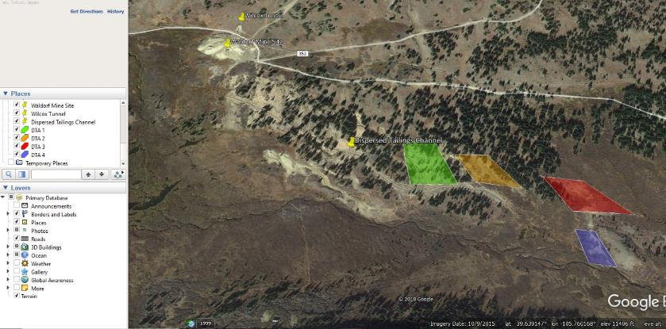
Site Description
Site situated 0.25 miles NW of Leavenworth Creek at 11,600 ft amsl
TMDL – Segment 3b – Non-attainment of aquatic life Cu chronic standard : Cd, Mn added to M&E list
Past 2011-2013 WQ sampling at 27 watershed sites showed Cd, Pb, Zn, and Cu above benchmark screening levels
Zinc loading rates increased from 8.2 tons/yr upstream of DTA to 12.5 tons/yr below DTA

Slide 4
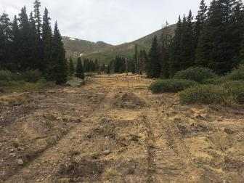
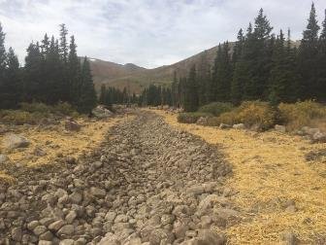
Timeline of events
2014 Project Planning
2015 DTA Channel construction and consolidation
~ 3,000 ft. of locally harvested riprap channel construction
5,400 CY of tailings consolidated and capped from channel floodplain
4 acres revegetated along floodplain
Evaluation of In-situ Design (KC Harvey, 2015a,b) and EE/CA (Sovereign, 2017)
Spring 2017 RFP released for DTA work
H-2 Enterprises and Duraroot won the competitive bid process
Soil sampling in July 2017 to refine amendments
Final amendment calculations/scope determined in August 2017
Construction took place from September through October 2017
KC Harvey (2015a) Evaluation of In-situ Design for Abandoned Mine Reclamation in Central Colorado, 2015. KC Harvey Environmental, LLC report dated December 31, 2015
KC Harvey (2015b) Deliverables #4, Memo Style Report for sites included in Task 5; recommendations for amendment materials, rates, application methods. KC Harvey Technical Memorandum dated December 29, 2015.
Sovereign (2017) Maintenance Action Memorandum, Waldorf Mine Dispersed Tailings, Leavenworth Creek, Clear Creek County, Colorado. Sovereign Consulting Inc report dated May, 2017.

Slide 5
In-Situ phytostablization
Gao, Z., van Zweiten, L., Zhu, Q., Yan, T., Xue, J., Wu, Y. (2019) Soil microbial community structure shifts induced by biochar and biochar-based fertilizer amendment to karst calcareous soil. Soil Science Society of America 83 398-408.
Li, M., Wang, Y., Liu, M., Liu, Q., Xie, Z., Li, Z., Uchimiya, M. and Chen, Y. (2019) Three-Year field observation of biochar-mediated changes in soil organic carbon and microbial activity. Journal of Environmental Quality 48 717-726.
Valentin-Vargas, A., J. Neilson, R. Root, J. Chorover and R. Maier (2018). Treatment impacts on temporal microbial community dynamics during phytostablization of acid-generating mine tailings in semiarid regions. Science of the Total Environment 618: 357-368.
Yang, T., J. Liu, W. Chen, H. Shu, P. Jia, B. Liao, W. Shu and J. Li (2017). Changes in microbial community composition following phytostabilization of an extremely acidic Cu mine tailings. Soil Biology & Biochemistry 114: 25-58.
You, F., R. Dalal and L. Huang (2018a). Initiation of soil formation in weathered sulfidic Cu-Pb-Zn tailings under subtropical and semi-arid climatic conditions. Chemosphere 204: 318-326.
You, F., R. Dalal and L. Huang (2018b). Biochar and biomass organic amendments shaped different dominance of lithoautotrphs and organoheterotrophs in microbial communities colonizing neutral copper (Cu)-molybdenum (Mo)-gold (Au) tailings. Geoderma 309: 110-110.
Valentin-Vargas, A., J. Neilson, R. Root, J. Chorover and R. Maier (2018). Treatment impacts on temporal microbial community dynamics during phytostablization of acid-generating mine tailings in semiarid regions. Science of the Total Environment 618: 357-368.

Slide 6
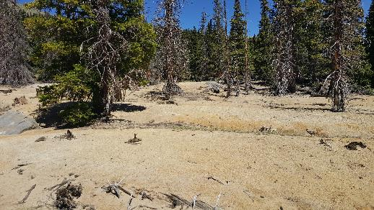
Original estimates
Liming rates
pH 3.5
ABA -36 t/kt
SMP 32 t/kt
Lime Rate 70 ton lime/acre - 24”
Organic Matter Application
OM% = 4.9
Compost Rate 80 yards/acre – 6”

Slide 7
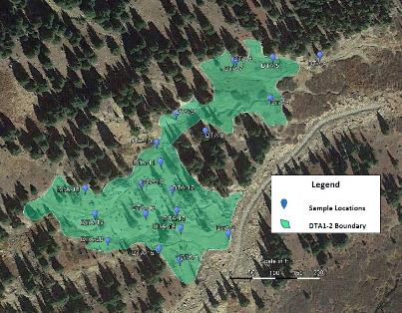
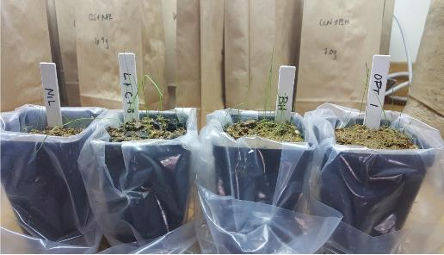
soil sampling breakdown
Due to heterogeneity of former mill tailings, prelim geochemical tests were necessary to determine proper rates at DTA 1, 2, & 3
Phytostabilization proposed for DTA 1, 2, & 3
Composite samples taken at each area for pH, sulfate/sulfur, metals, nutrients, etc.
Composite sample of 30 samples for each DTA as per Smith et al., 2000¹
Based on soil sample results, germination tests performed using ryegrass seeds and various amendment rates
Lime rate testing to achieve pH 5.5-7.5
Intervals of 10 from 0-60 tons/acre
^{1.}Smith, K., Ramsey, C. and Hageman, P. (2000) Sampling strategy for the rapid screening of mine-waste dumps on abandoned mine-waste dumps on abandoned mine lands. USGS Open-File Report 00-016

Slide 8
Amendment refinement phase 2 – lime addition trials

Slide 9
Amendment refinement phase 1 – plant growth tests
Composite sample of 30 samples for each DTA as per Smith et al., 2000^{1.}
Evaluate various amendments for in-situ phytostabilization
No Amendments (NIL)
As per EE/CA (L+C+B)
5% v/v Composed Forest Product (BH)
Seaweed + humate liquid (OPT-1)

Slide 10
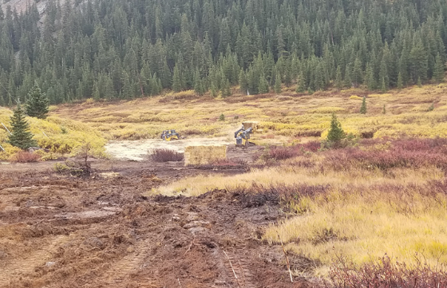
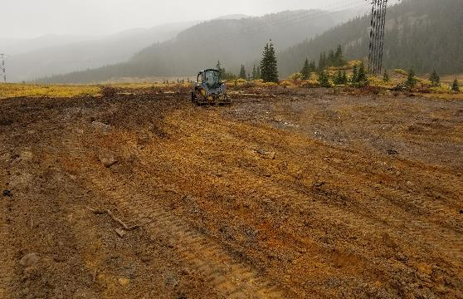
Proposed 2017 project plan
Work completed fully on USFS lands following time-critical removal action process under CERCLA authority
An addendum to a 2015 Action Memorandum was written approving and justifying work between USFS and TU.
Multi-faceted approach
DTA 4 – Due to shallow GW, repository construction and clean-fill placement in floodplain with biochar, lime, and 3-6-3 fertilizer. Approximate 880 CY of waste to be removed and consolidated per this approach.
DTA 3 – 300 ft of Run-on earthen ditch construction followed by in-situ phytostabilization using lime, compost, biochar and 3-6-3 fertilizer into top 18-24 inches. Run-on ditch lined with Coir matting and staked with live willows.
DTA 1&2 – In-situ phyto of both areas using calculated rates of lime, compost, biochar, and 3-6-3 fertilizer into top 18-24 inches. Also installed several drainage channels using local trees to connect with 2015 channel.
Native seed, woodstraw and ag straw mix spread throughout entire site and access road.
Total Construction Costs: $380,000

Slide 11
Post construction testing
pH of Amended Disturbed Tailings DTA-1-2
pH of Amended Disturbed Tailings DTA-3

Slide 12
Post construction testing kinetic nag
A variation of the common single addition NAG test, the Kinetic NAG continuously measuring temperature and pH throughout sequential testing intervals.
Can provide indication of acidic lag times and oxidation rates similar to long-term column tests
Quick, simple and inexpensive
Use to assess active, exchangeable and residual acidity and buffering controls towards efficacy of reduced lime application relative to single-addition kinetic NAG testing

Slide 14
Post construction testing Acid Buffering Characterization curve
Slow Acid titration with continuously pH monitoring
The acid buffering of a sample to pH 4 estimate of readily available ANC.
Identification of neutralizing minerals based on reference mineral database (based on Stewart, 2006)

Slide 15
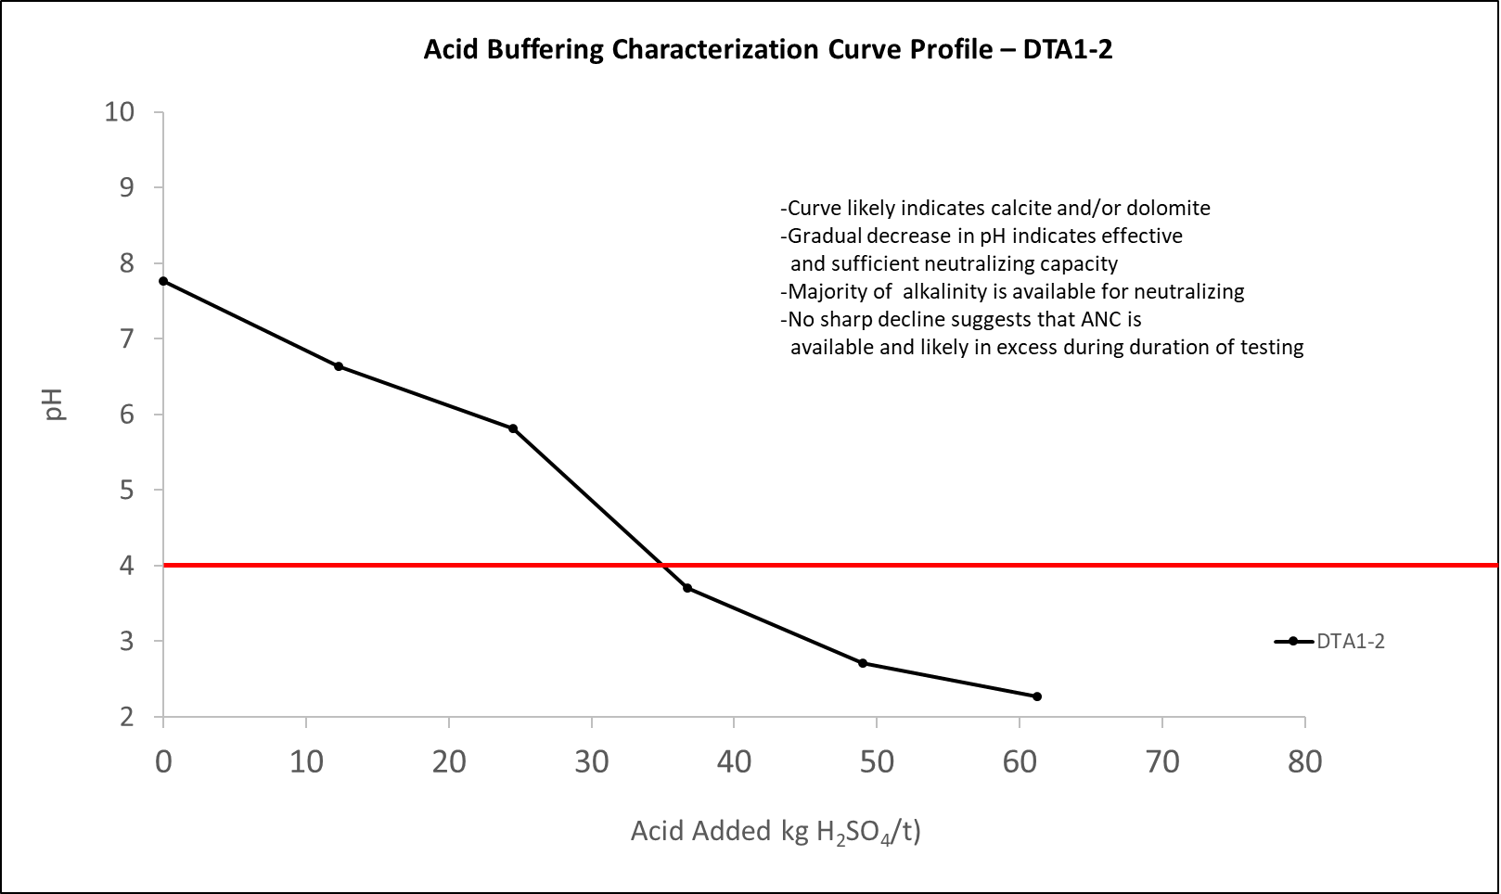
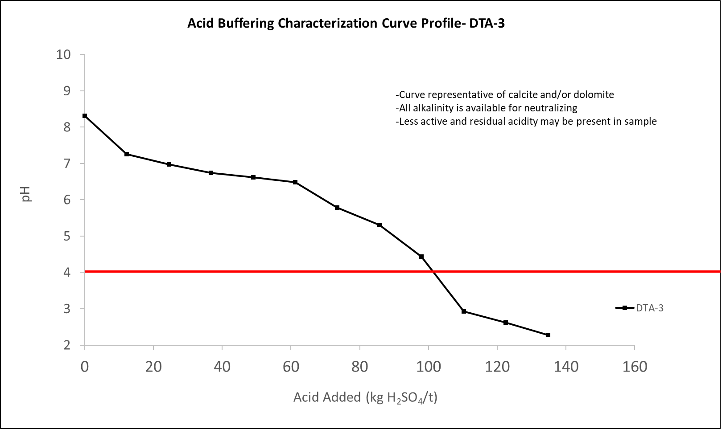

Slide 16
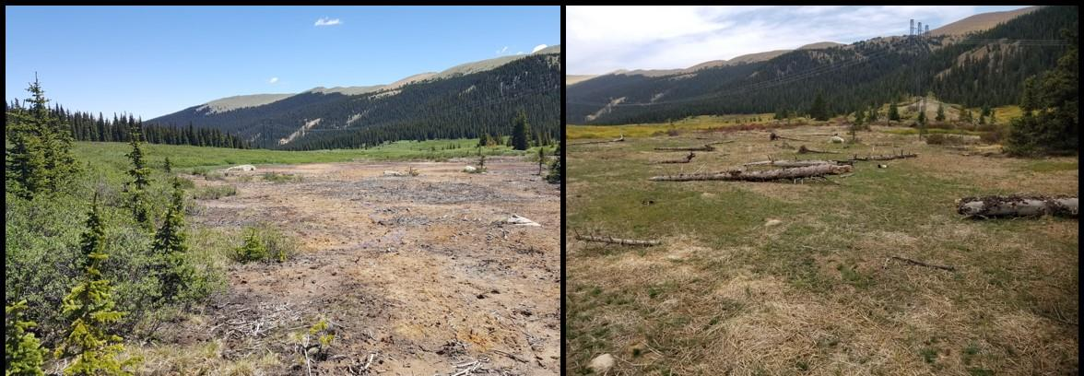
Pre and Post (Year 1) conditions

Slide 17
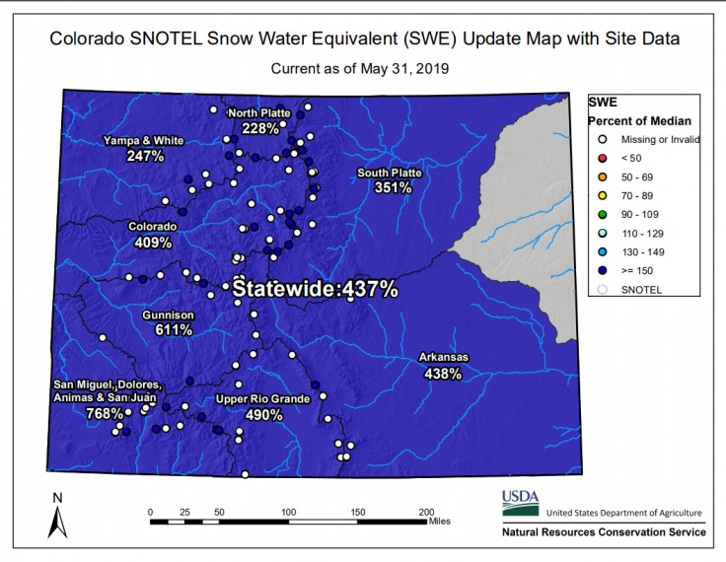

Slide 18
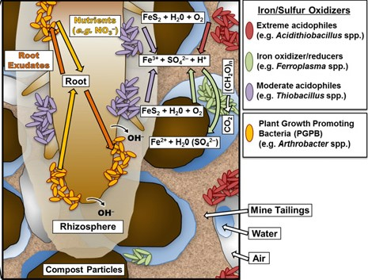

Slide 19
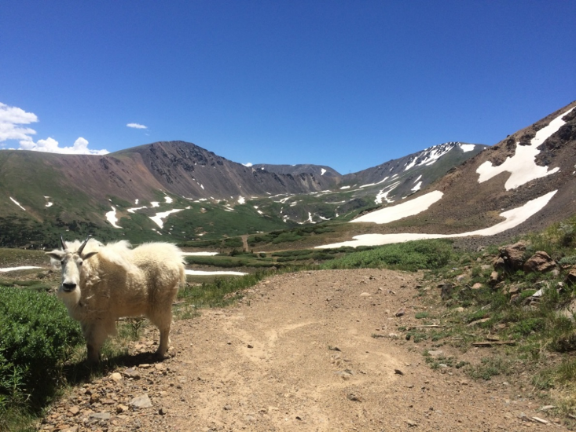
acknowledgements
Stuart Jennings for discussions and review of liming rates
ACZ Laboratories for help with Kinetic NAG protocols
Kelley House and Doc Richardson for help with data analysis

