Slide 1
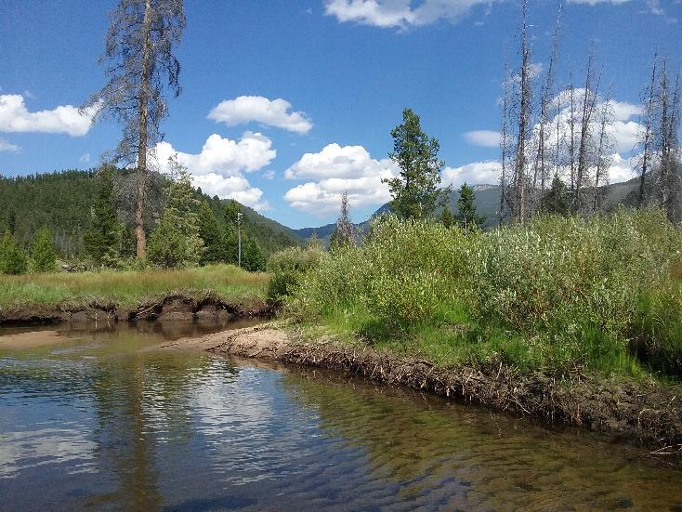
Rumsey Mill & Fred Burr Creek Site Characterization

Slide 2
Project Members
Granite Headwaters Watershed Group
DNRC Grant
Trout Unlimited
Project Coordination
Landowners
KC Harvey Environmental
Natural Resource and Technical Lead

Slide 3
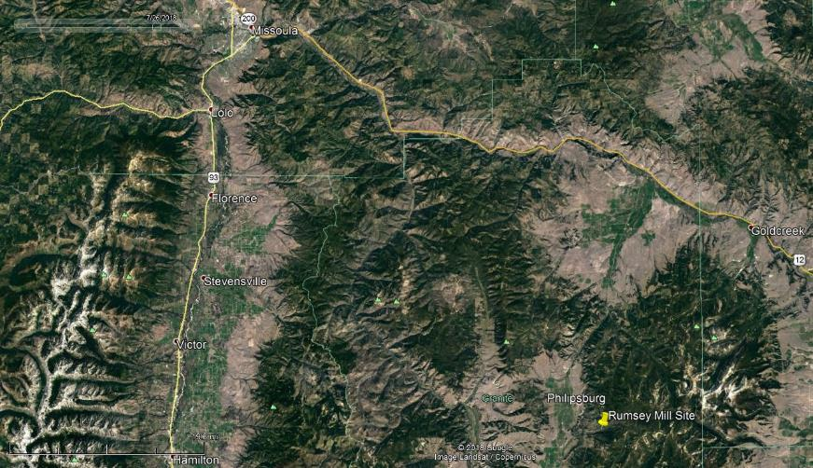
Rumsey Mill & Fred Burr Creek Site Characterization
Project Location

Slide 4
Site Background
Mill History
Milling silver circa 1890’s
Mercury and metals in tailings
Substantial Site Disturbance
Off site Re-processing (historic; 1930’s – 1950’s)
Pond and ditch construction (circa 1996/97)
Pond site reclamation (circa 2002/03)
Subdivision and Development (current)
Recent fire
Natural erosion of mill site area and streambanks

Slide 5
Site Background
Key Previous Investigations
Focused on Mill Site area and SW/Sediments
MDEQ
AML program (circa 1995)
SW and Sediments (circa 2015/16)
EPA (1997 – 2001)
In response to 404 violation/pond construction
SW, Sediments, Soils/Tailings
Ecological Risk Assessment
Montana FWP (2014)
BMI’s Private (2002)
Reclamation of pond construction site
University of Montana (2014)
Sediment Sampling

Slide 6
Existing Data Review (Pre-2018 Field Investigation)
Summary
Elevated mercury, arsenic and lead in surface water and sediments in Fred Burr Creek below mill site to Flint Creek
Elevated mercury, arsenic and lead in floodplain soils of Fred Burr Creek around mill site
Elevated mercury in BMI and fish in Flint Creek
Eco Risk Assessment - Benthic and terrestrial invertebrates and reference plants impacted
Mill site area disturbed/reclaimed in some areas of sampling; no post-reclamation confirmation sampling of soils
Unknown level of soil contamination below historic mill/tailings location on Fred Burr Creek floodplain

Slide 7
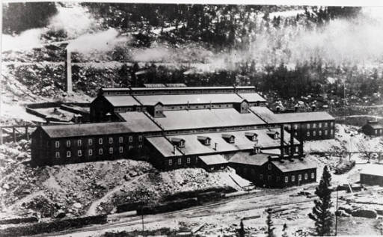
Rumsey Mill circa 1890’s

Slide 8
Historic Rumsey Mill Site (MBMG)

Slide 9
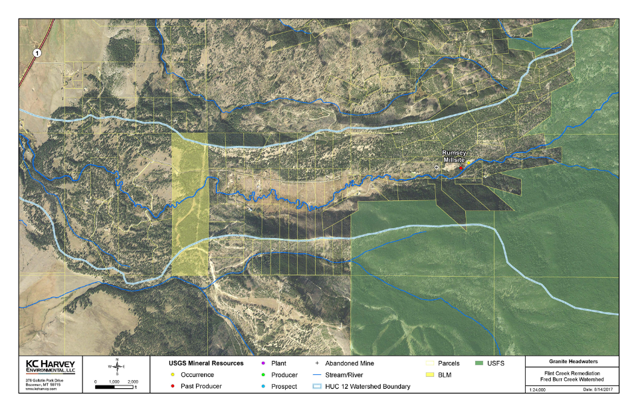
Parcel Map of Upper Fred Burr Creek

Slide 10
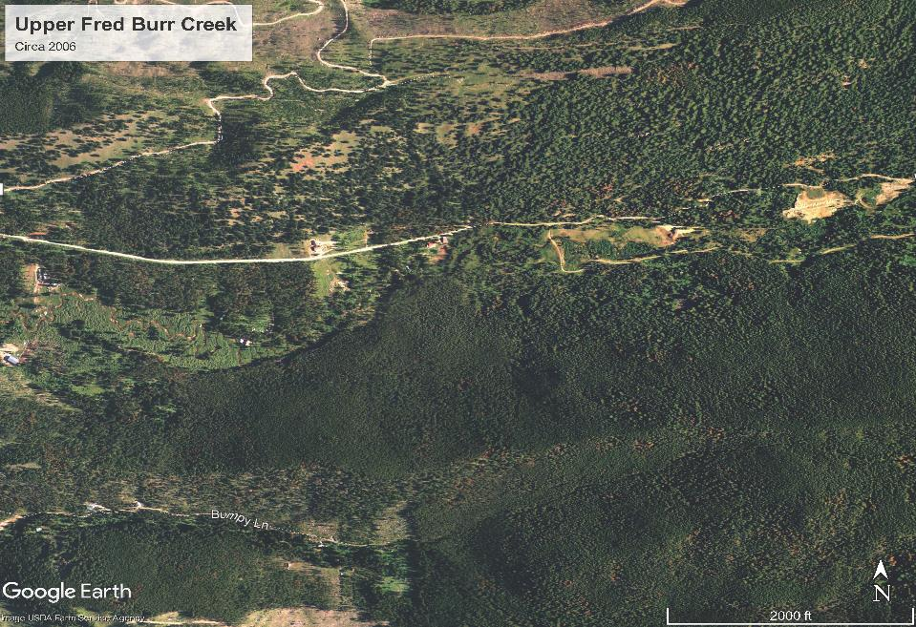

Slide 11
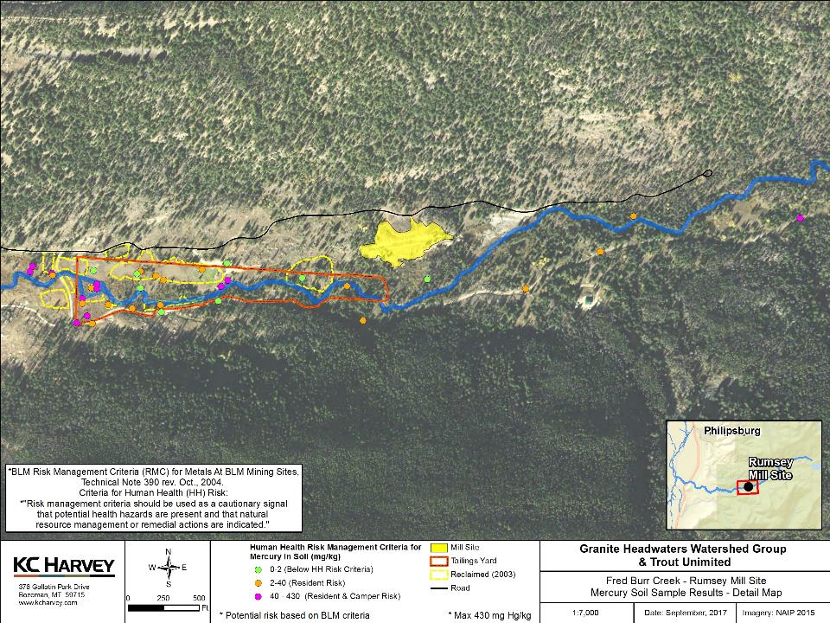
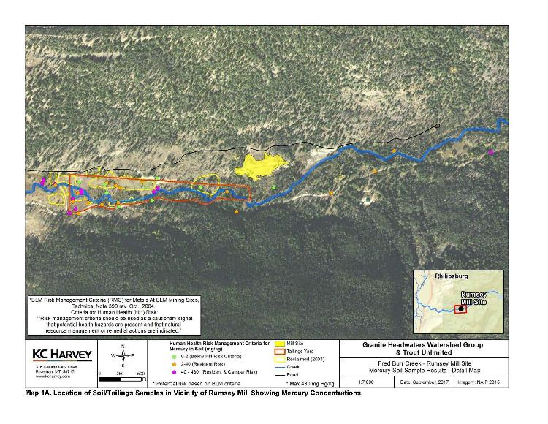
Historic Soil Data in Vicinity of Mill and Reclaimed Areas

Slide 12
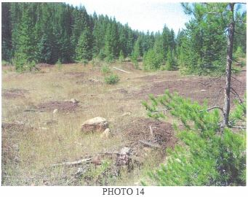
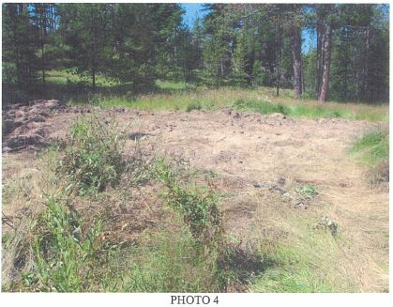
Reclaimed Bare/Tailings Areas (left) and Repository (right) (From LMRC and WET, 2003)

Slide 14
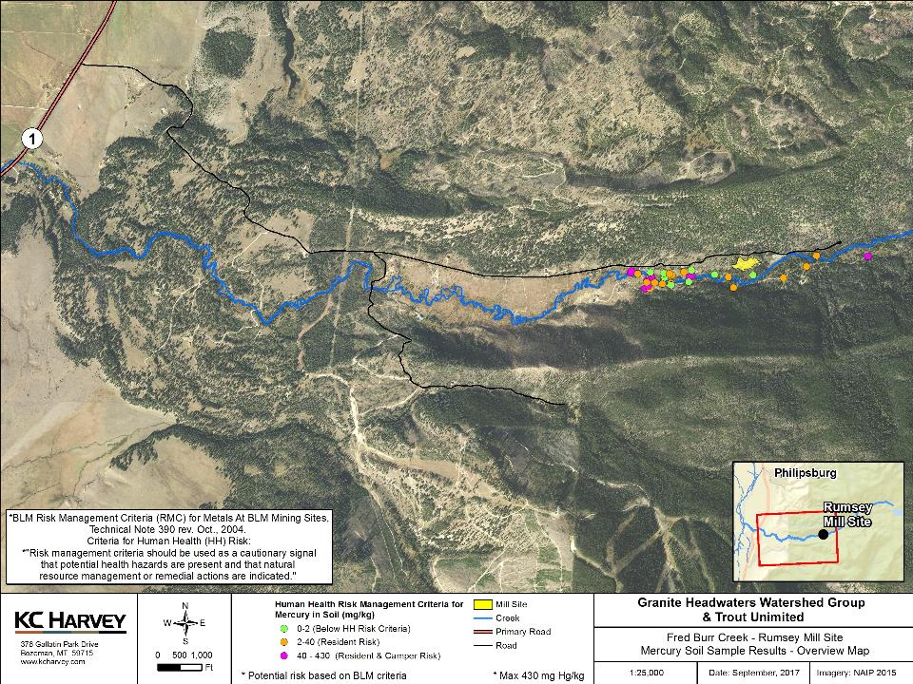
b

Slide 15
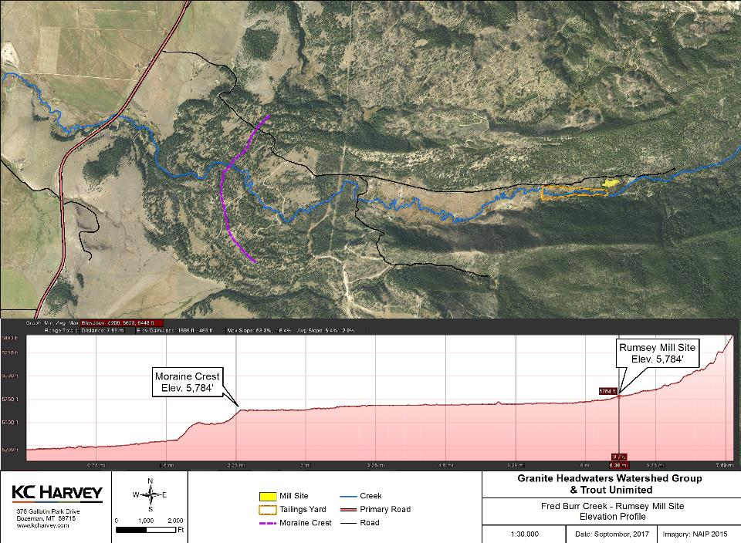

Slide 16
2017 Data Gaps
Extent (lateral and depth) of contamination
Limited to historic mill site area
Many historic land disturbances
Sediment source to Creek
Groundwater Quality and effects on Fred Burr Creek
Roads/Construction materials
Effect of recent flood flows on stream sediment chemistry

Slide 17
Field Investigation
Objective: Define extent and degree of milling contamination in upper FBC
Sampling and Analysis Plan
Focused soil/tailings sampling from soil pits in the upper (mill area) FBC floodplain (no access)
Soil/Tailings sampling from soil pits along transects between mill site and moraine crest
XRF analysis permits real time decision making and saves $
Laboratory confirmation samples
Sediment sampling at select locations (similar to previous efforts)
Limited co-located surface water samples to correlate to stream sediment results
Groundwater observations/sampling to:
Note depth to GW in soil pits
Install piezometers for seasonal measurements of GW levels

Slide 18
Sampling Methods
Soil
11 Hand-dug pits
39 Mini excavator (larger)
147 XRF samples from various depths
Sediment
5 samples from low-energy sections of FBC channel
Surface Water (SW)
4 samples co-located with sediment samples
Groundwater (GW)
6 piezometers installed in soil pits

Slide 19
QA/QC
Soil
Daily accuracy and precision using NIST Hg standards
Daily cross-contamination blanks
11 Field Duplicates
20 sample splits for lab physical & chemical analyses
Sediment
1 Field Duplicate
All samples for lab analyses
All samples split for fine fraction (< 63um) analysis of Hg
Surface Water (SW)
1 Field Duplicate

Slide 20
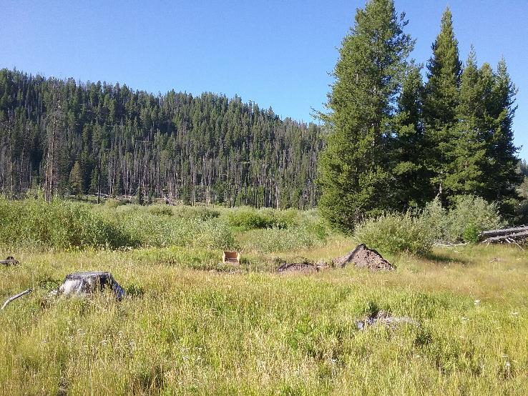
Fred Burr Creek bench (foreground) and floodplain looking SE

Slide 21
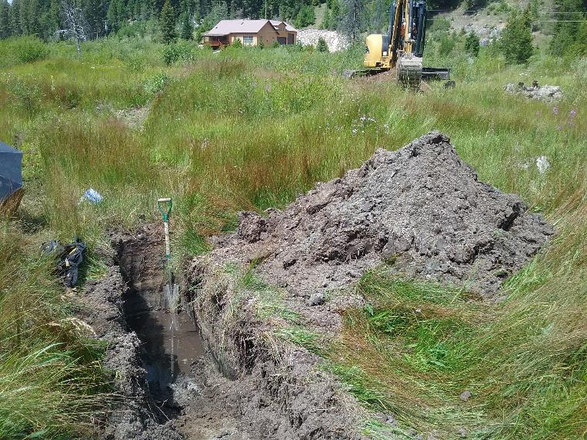
Typical excavator-dug soil pit during the July 23rd to 26th 2018 field investigation at Fred Burr Creek.

Slide 22
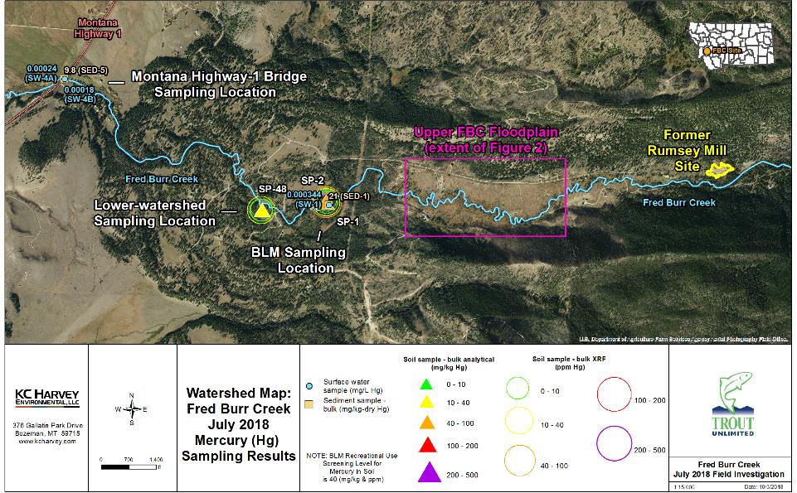
Watershed-scale site map and sampling locations for the July 2018 field investigation at Fred Burr Creek.
FBC Data Summary Presentation
6/17/2019

Slide 23
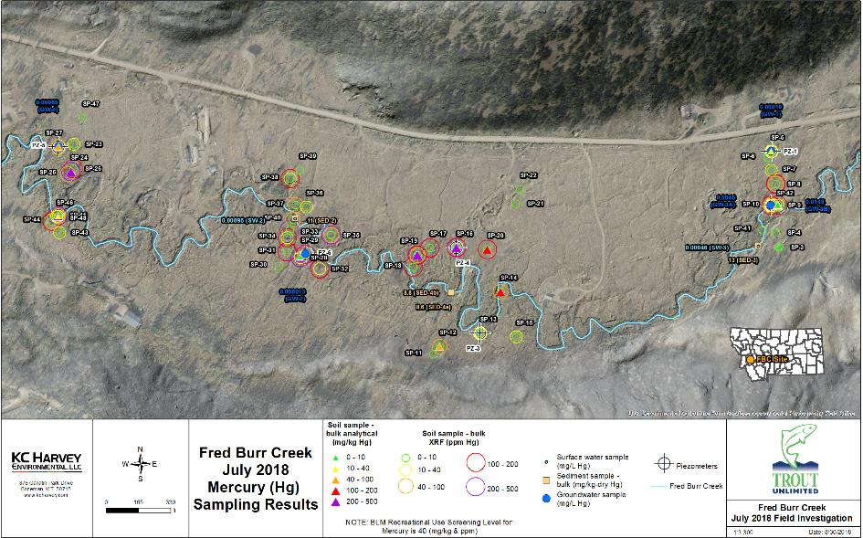
Sampling locations and results summary for July 2018 field investigation in upper Fred Burr Creek.
FBC Data Summary Presentation
6/17/2019

Slide 24
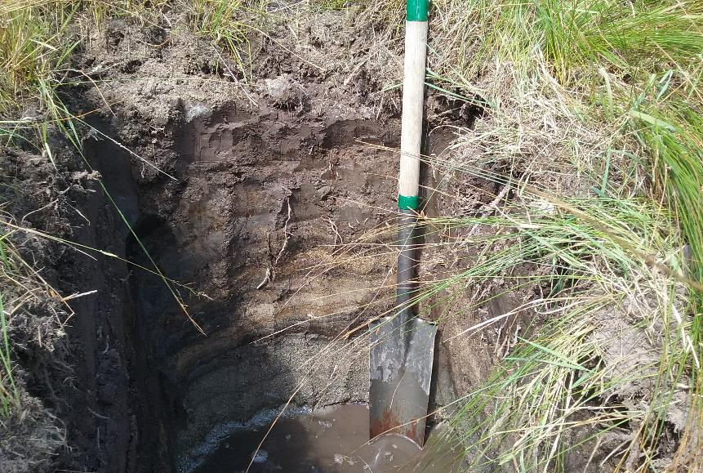
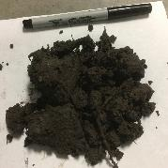
Representative FBC soil profile and descriptions at sampling pit SP-8 (sharpshooter spade for scale). Inset, lower left: close-up of tailings layer (2-8” BGS) found throughout FBC.
0-2” BGS: silty loam; roots/OM
(mg/kg: 90 Hg / 2,593 As / 1,254 Pb)
0”
2”
2-8” BGS: Medium brown very fine (v.f.) sand to silt, no mica (tailings layer— mg/kg: 226 Hg / 8,425 As / 3,084 Pb)
8”
8-16” BGS: Dark brown micaceous v.f. sand to silt (mg/kg: ND<1.8 Hg /
85.0 As / 9.5 Pb)
16”
16-23” BGS: Interbedded fine to medium sand with black v.f. sand lenses (0-1”)
(mg/kg: ND<2.7 Hg /
21.5 As / 8.3 Pb)
23”
23-32” BGS: Light gray coarse sand with black organic matter interbeds (<1”)
32”
FBC Data Summary Presentation
6/17/2019

Slide 25
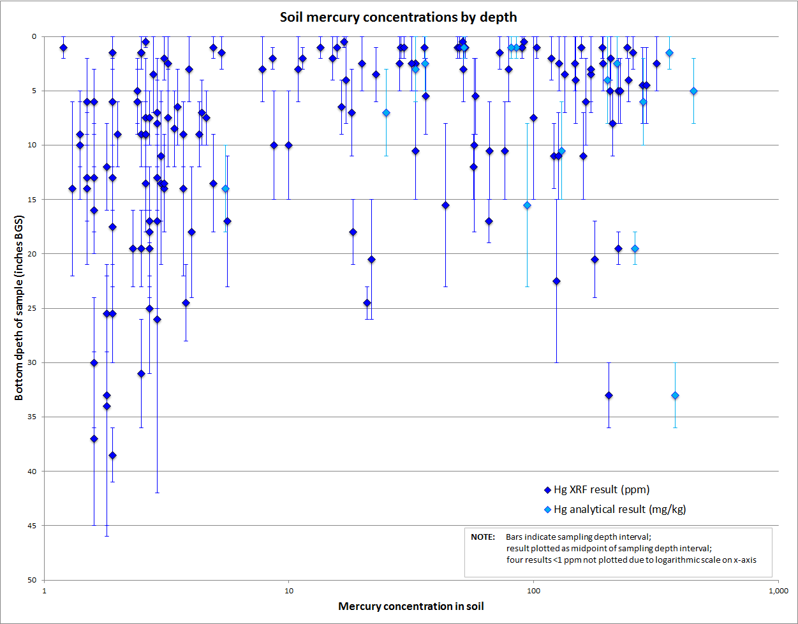
Mercury concentrations for laboratory and XRF analyses of soil samples collected in upper FBC watershed
FBC Data Summary Presentation
6/17/2019

Slide 26
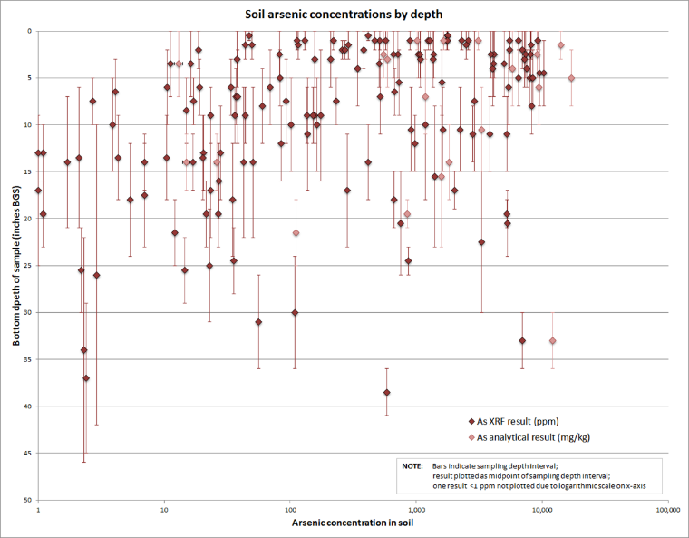
Arsenic concentrations for laboratory and XRF analyses of soil samples collected in upper FBC watershed
FBC Data Summary Presentation
6/17/2019

Slide 27
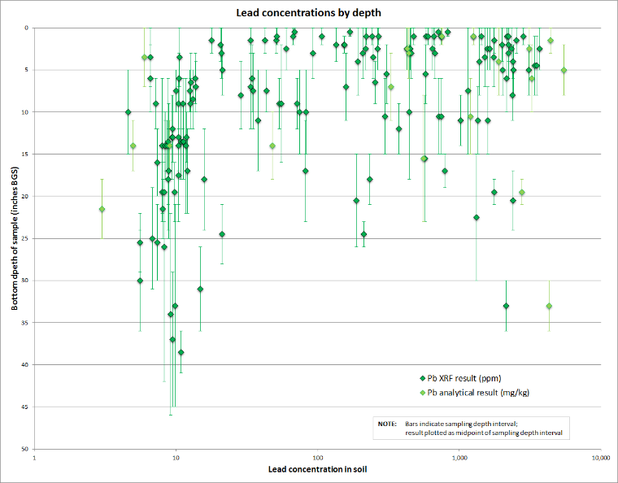
Lead concentrations for laboratory and XRF analyses of soil samples collected in upper FBC watershed
FBC Data Summary Presentation
6/17/2019

Slide 28
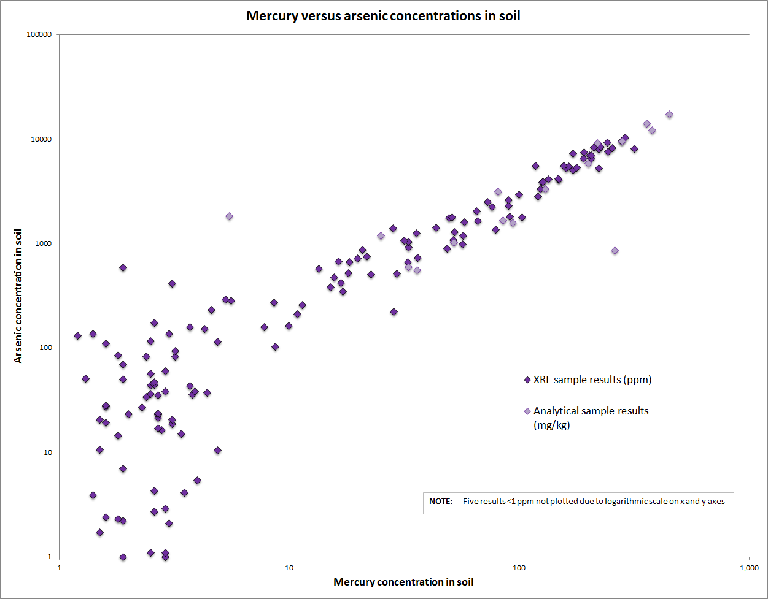
Mercury and arsenic concentrations for XRF and laboratory splits of soil samples collected in upper FBC watershed
FBC Data Summary Presentation
6/17/2019

Slide 29
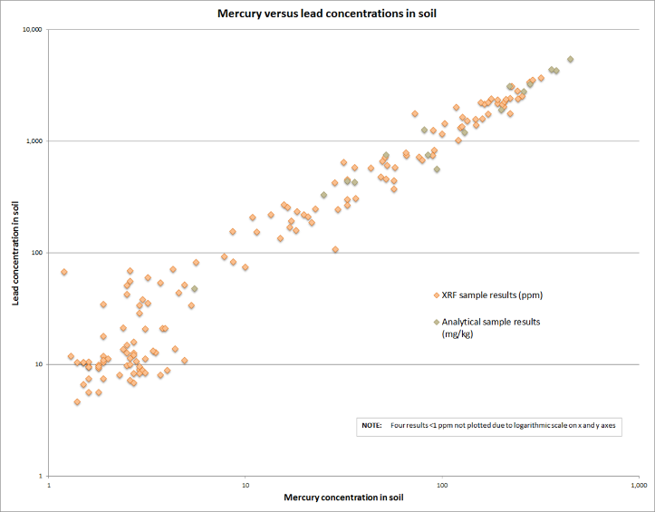
Mercury and lead concentrations for XRF and laboratory splits of soil samples collected in upper FBC watershed
6/17/2019

Slide 30
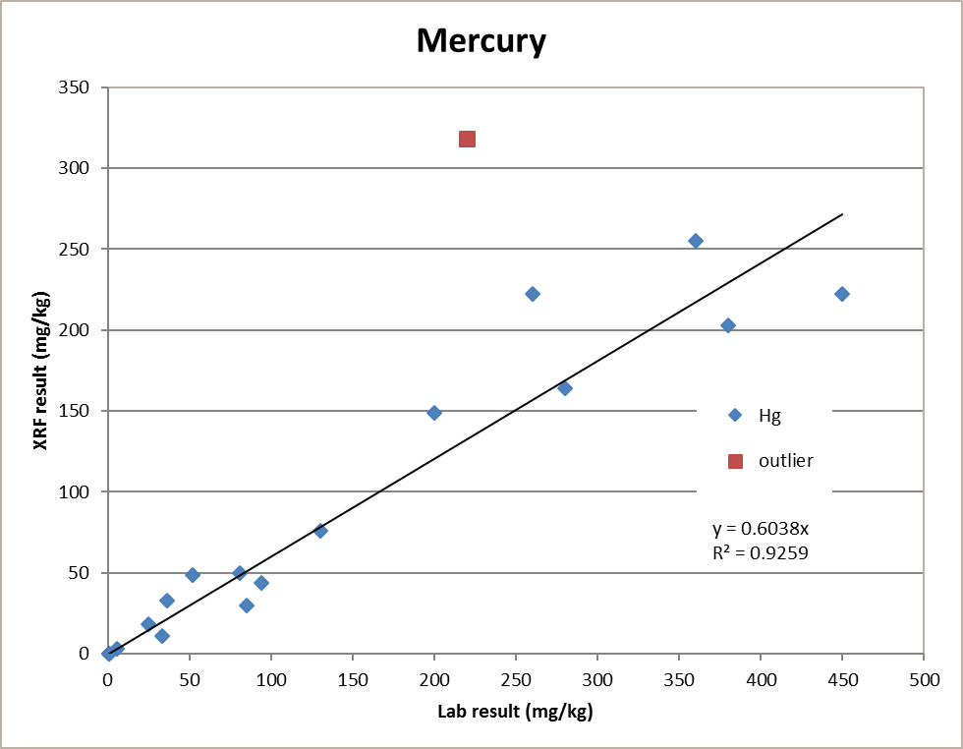
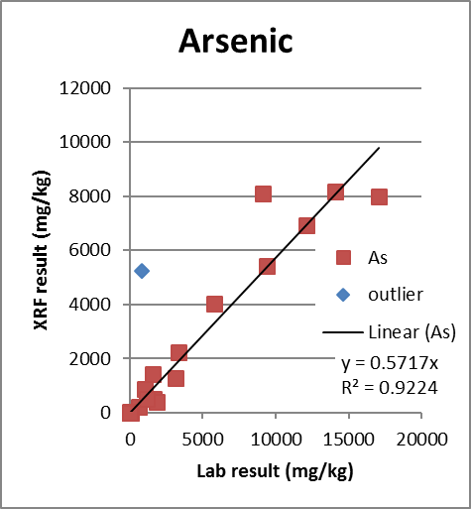
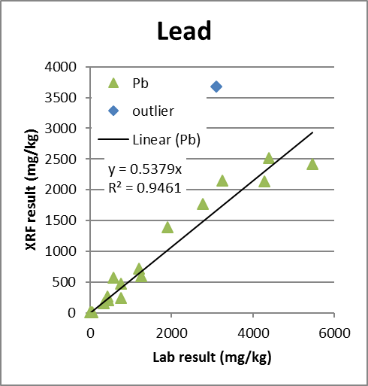
Sample Split Lab vs XRF Total Concentrations
FBC Data Summary Presentation
6/17/2019

Slide 31
Results
Soil
Presence of tailings/impacted soils are primarily limited to the riparian corridor and lower terraces of the floodplain (average width approximately 250 feet)
Impacted material ranged between approximately 0 and 25 inches BGS
Most impacts observed within the upper 12 to 15 inches
Total mercury (Hg), arsenic (As) and lead (Pb) concentrations correlate strongly
Mercury (Hg) and arsenic (As) are elevated, particularly in “tailings” layer
Mercury ranged between below detection to 450 mg/kg
Arsenic and lead ranged between below instrument detection and 17,100 mg/kg and 5,460, respectively
Antimony concentrations (only 20 lab samples) were also elevated
Antimony ranged between below detection to 530 mg/kg
Soils and sands immediately beneath tailings/impacted soils and above groundwater in most locations had relatively low to below detection limits for mercury, arsenic and lead

Slide 32
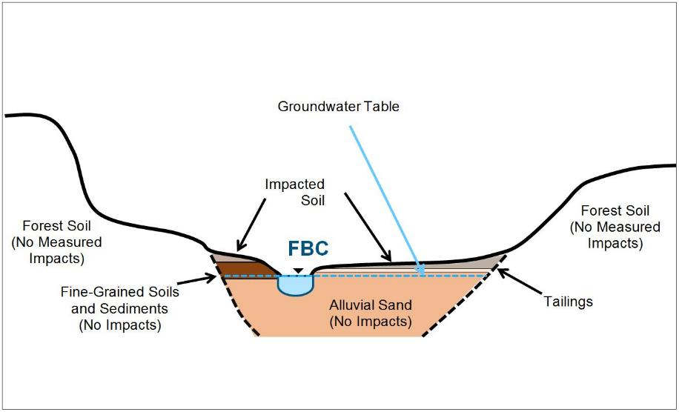
FBC floodplain cross-section schematic showing tailings, impacted, and non-impacted sediments and soils (not to scale).
FBC Data Summary Presentation
6/17/2019

Slide 33
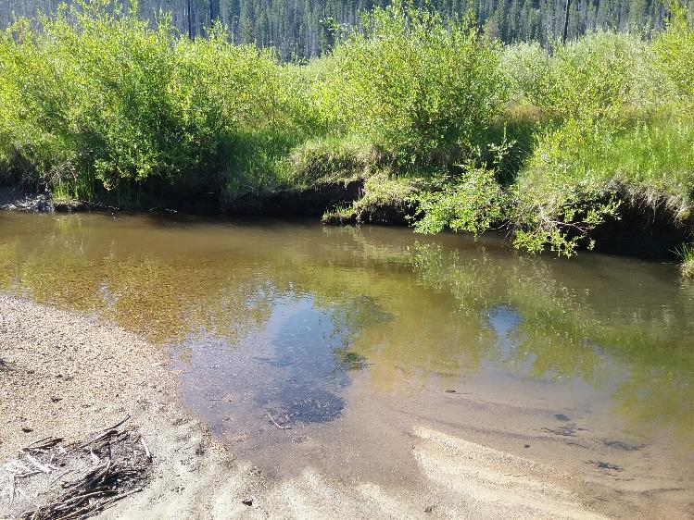
Typical sediment sample location on Fred Burr Creek

Slide 34
Results
Sediment
Mercury, arsenic and lead concentrations were comparable with values observed in the recent MDEQ sediment sampling
Splits of the fine fraction (silt <63um) of samples had mercury, arsenic, lead and antimony concentrations between 2 to 3, 4 to 10, 4 to 6 and 2 to 6 times greater than bulk samples, respectively.
Recent overbank flood deposits similar to sediment Hg and metal concentrations
Implications for long-term impacts
COC | Bulk Sample Range (mg/kg) | Fine (<63um) Fraction Range (mg/kg)
Mercury | 8.6 - 21 | 25 - 64
Arsenic | 78 - 398 | 401 – 1,840
Lead | 36 - 132 | 172 - 572
Antimony | 4 - 19 | 11 - 78

Slide 35
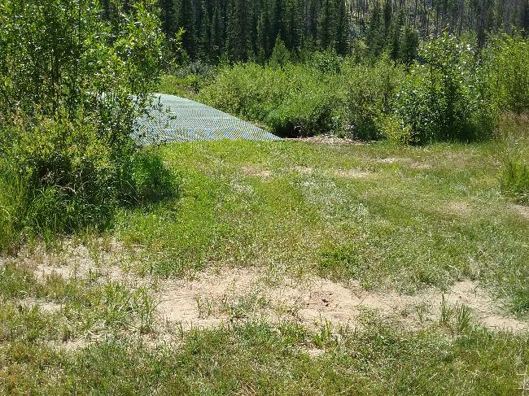
Recent (2017) flood overbank deposits on Fred Burr floodplain
Hg, As and Pb concentrations similar in overbank deposits and stream sediment

Slide 36
Results
Surface Water
Generally within the range observed in recent MDEQ sampling at similar locations
COC | Sample Range | MDEQ Aquatic Standard (chronic/acute) | MDEQ Human Health Standard
 | (ug/l) (lead @ hardness = 25 mg/l)
Mercury | 0.18 – 0.95 | 0.91/1.7 | 0.05
Arsenic | 13 - 25 | 150/340 | 10
Lead | 0.8 – 3.7 | 0.545/13.98 | 15
Antimony | 1.0 – 1.6 | NA/NA | 5.6
FBC Data Summary Presentation
6/17/2019

Slide 37
Results
Groundwater
Depth to GW ranged from 24-56” BGS in floodplain
Analytical results are not conclusive, as groundwater was highly turbid at the time of sampling from piezometers
FBC Data Summary Presentation
6/17/2019

Slide 38
Select Agency Soil Screening and Risk Levels
COC | Receptor (*) | Soil Concentration (mg/kg) |  |  |  | # and % sample locations with 1 or more samples > EPA removal criteria | # and % surface sample locations with 1 or more samples > EPA removal criteria | # and % of total samples > EPA removal criteria
 |  | BLM (1) | MDEQ (2) | EPA (3) | EPA (4)
Mercury | Residential | 2 | 1 | 11 | 33 | 27 (56%) | 24 (50%) | 52 (35%)
 | Rec/Commercial (*) | 40 |  | 46 | 140 | 17 (35%) | 10 (21%) | 23 (16%)
Arsenic | Residential | 3 | 40 | 0.68 | 68 | 40 (83%) | 39 (81%) | 94 (64%)
 | Rec/Commercial (*) | 20 |  | 3 | 300 | 39 (81 %) | 37 (77%) | 70 (48%)
Lead | Residential | 400 | 400 | 400 | 400 | 29 (60%) | 26 (54%) | 51 (35%)
 | Rec/Commercial (*) | 1000 |  | 800 | 800 | 21 (44%) | 17 (35%) | 34 (23%)
Antimony** | Residential | 1 | -- | 31 | 94 | 9 (45%) | 4 (20%) | 9 (45%)
 | Rec/Commercial (*) | 50 | -- | 470 | 1400 | 0 (0%) | 0 (0%) | 0 (0%)
* - BLM Receptor is for recreational camper; EPA receptor is industrial/commercial worker
(1) - Bureau of Land Management - Risk Management Criteria for Metals at BLM Mining Sites (Tech note 390 October 2004)
(2) - Montana Department of Environmental Quality - Tier 1 Risk Based Corrective Actions for Petroleum Releases (2009)
(3) - EPA - Regional Soil Screening Levels at Superfund Sites - Generic SSL's (November 2018); TR (carcinogenic)=1E-6;THQ (non-carcinogenic)=1
(4) - EPA - Regional Removal Management Levels - Generic Values (November 2018); TR (carcinogenic)=1E-4;THQ (non-carcinogenic)=3
FBC Data Summary Presentation
6/17/2019

Slide 39
Screening Levels
Sediment
Mercury
All samples exceeded EPA BTAG freshwater benchmarks (0.18 mg/kg)
Arsenic
All samples exceeded EPA BTAG freshwater benchmarks (1.8 mg/kg)
Lead
All samples exceeded EPA BTAG freshwater benchmarks (35.8 mg/kg)
Antimony
All samples exceeded EPA BTAG freshwater benchmarks (2 mg/kg)
FBC Data Summary Presentation
6/17/2019

Slide 40
Screening/Regulatory Levels
Surface Water
Mercury
All samples exceeded MDEQ human health standard
A single sample exceeded MDEQ chronic aquatic standard
Arsenic
All samples exceeded MDEQ human health standard
Lead
All samples exceeded MDEQ chronic aquatic standard
FBC Data Summary Presentation
6/17/2019

Slide 41
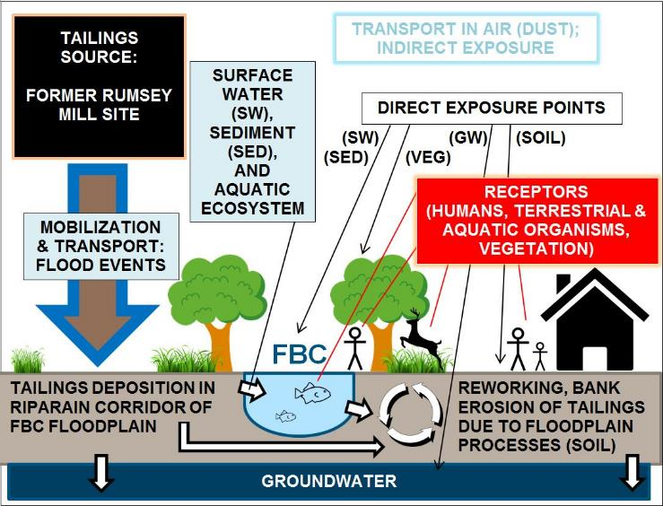
Conceptual Site Model schematic for potential tailings impacts and exposure pathways in the FBC floodplain.
?
?
FBC Data Summary Presentation
6/17/2019

Slide 42
Contaminant Transport/ Exposure Pathways
Streambank erosion and fluvial processes
Likely substantial source of elevated Hg and metals in sediment and SW
Groundwater
Large decrease (2 orders of magnitude) in Hg and metal concentrations in underlying soil/seds Suggests limited movement via infiltration to GW
Floodplain surface runoff is likely minimal
Floodplain has a low slope
Floodplain also well-vegetated, minimizing runoff/erosion
Exposure due to ingestion or airborne soils likely minimal
Well-vegetated floodplain
Roads near mill site unknown
Mill site characteristics are the primary unknowns
How much source material remains and where is it located?
What does runoff regime look like?
What is extent/degree of impacts in FBC floodplain near mill site?
Effect of disturbance on distribution
Road material contamination

Slide 43
Contaminant Transport/ Exposure Pathways

Slide 44
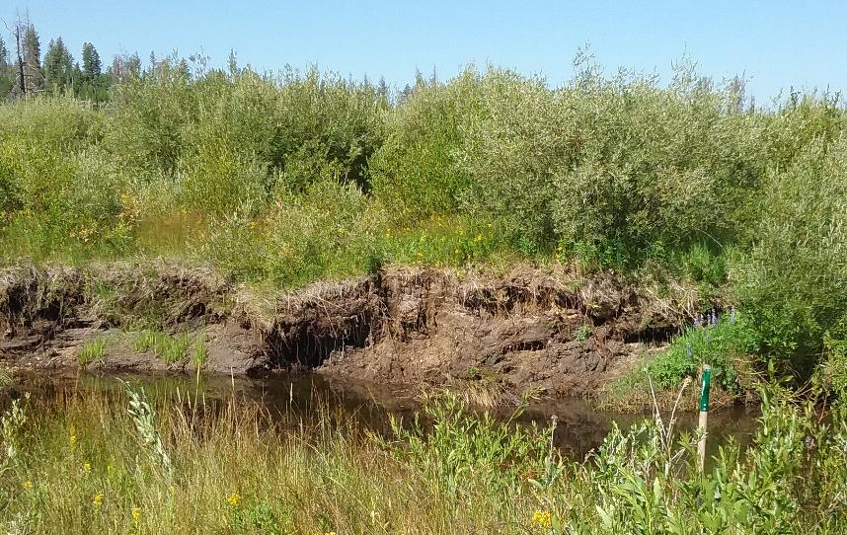
Soil (A) slumping into FBC channel as a result of streambank erosion and undercutting near SP-37. Also note red top and willows on top of the river bank—the vegetation assemblage observed with tailings impacts in the FBC floodplain.
A
FBC Data Summary Presentation
6/17/2019

Slide 45
Next Steps What We Are Doing Now
Develop volume estimate of tailings/impacted soils in floodplain using LiDAR, GIS and existing analytical data
Sample domestic wells for Hg and metals
Analyze sediments/soils for methylmercury
Begin Preliminary Risk Assessment
Refine Hg/metal source loading to FBC
Estimate bank migration rates and develop estimate of sediment input and Hg/metal loading to FBC
If warranted, install a few shallow monitoring wells to characterize floodplain GW quality

