Slide 1
Proposed Skill Sets for Effective Natural Resource Managers of the Future
S. E. Williams & Associates
Environmental & Educational
Consulting
Steve Williams and Stan Bellgard

Slide 2
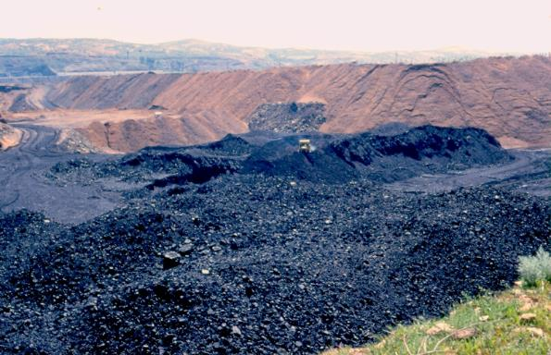
EXTRACTIVE INDUSTRY RESOURCE MANAGER’S OBJECTIVES
PLAN PROJECT WITH FINAL RESTORATION IN MIND.
COSTS OF ACTIVITIES ARE KEY TO RESTORATION SUCCESS.
FINAL RESULT SHOULD BE
A RESILIENT COVERING OF
APPROVED PLANT COVER
ON STABLE SOIL SUBSTRATES
THAT APPROXIMATES THE
PRE-MINING ECOSYSTEM.

Slide 3
NATURAL RESOURCE MANAGERS ULTIMATE CHALLENGE
TO MAKE DURABLE, INCLUSIVE, JUST DECISIONS THAT ANTICIPATE AND WEIGH NEGATIVE CONSEQUENCES AND EXCEEDS EXPECTATIONS OF ALL STAKEHOLDERS, REGULATORS AND END-USERS.
THESE INCLUDE SEEMINGLY SMALL DECISIONS LIKE CHOOSING A PARTICULAR SEED MIX IN A RESTORATION ACTIVITY (E.G. WESTERN WHEATGRASS OR INDIAN RICE GRASS?)
INCLUDE MODERATE DECISIONS LIKE DETERMINING WHERE TO SITE A DRILL PAD AND WHERE NOT TO (E.G. ON SALINE SOILS OR ON NON-SALINE SOILS?)
INCLUDE DECISIONS HAVING LARGER CONSEQUENCES LIKE WHERE, HOW AND WHEN TO CONSTRUCT A MAJOR PIPELINE FROM PRODUCTION ZONES TO SHIPPING PORTS (E.G. FROM CANADA TO LOUISIANA).

Slide 4
DERIVATION OF SKILL SETS NEEDED BY NATURAL RESOURCE DECISION MAKERS
WE EXAMINED FIVE (5) HISTORICAL NATURAL RESOURCE DECISION CASES AND EXTRACTED SKILLS NEEDED TO MAKE THESE DECISIONS.
WE ALSO EXAMINED THREE (3) TRAINING EVENT CASES TO DERIVE POSSIBLE WAYS TO MOVE THESE SKILLS FROM TRAINERS TO TRAINEES.
WE INCLUDED ONE (1) CASE ILLUSTRATING A HUMAN DIMENSION OFTEN OVER-LOOKED IN DECISION MAKING. THIS IS IDENTIFIED HERE AS THE NOSTALGIA-EUTOPIA PARADIGM.

Slide 5
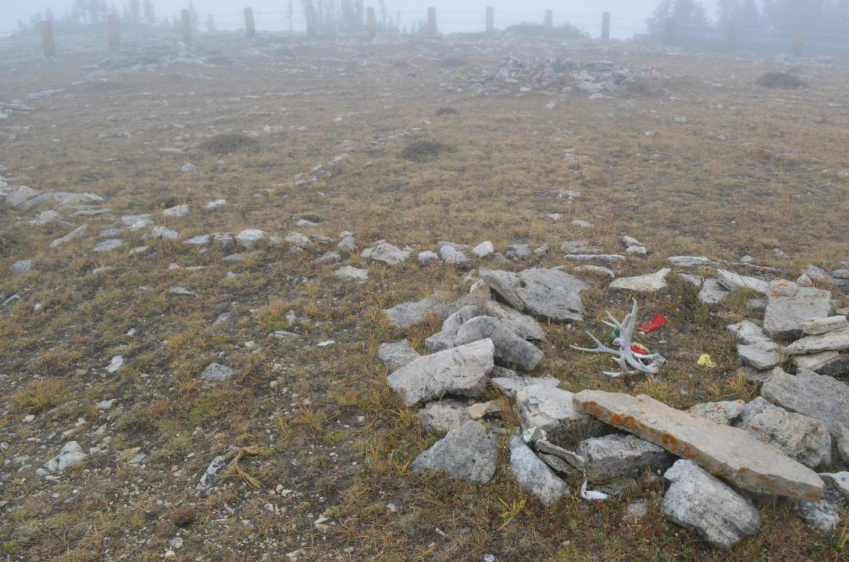
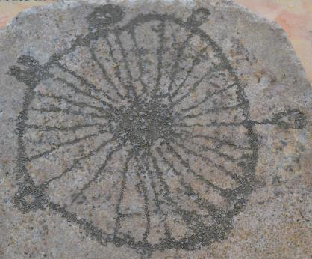
MEDICINE
WHEEL
NORTHERN
BIGHORN MTNS., WY
ELEVATION:
2,940 METERS
(9,643 FEET)
DIAMETER
24.4 METERS
(80 FEET)

Slide 6
RESULTS OF META-ANALYSIS
FROM THESE NINE CASE STUDIES, WE HAVE EXTRACTED 21 SKILLS WE PERCEIVE AS CRUCIAL IN THE DECISION MAKING PROCESS.
WE HAVE GROUPED THESES 21 SKILLS INTO SEVEN SKILL SETS WE SEE AS ESSENTIAL CHARACTERISTICS OF DECISION MAKERS
1. AWARENESS AND INCORPORATION OF LAND ETHICS.
2. HISTORICAL AND POLITICAL KNOWLEDGE (LEGAL)
3. TRUST BUILDING ABILITY.
4. CULTURAL AWARENESS INCLUDING CONTRASTING WORLD VIEWS
5. INFORMATION/DATA GENERATION AND SCREENING CAPACITY
6. USE OF INSTRUCTIONAL AND DECISION MAKING ENVIRONMENTS
7. AWARENESS AND USE OF THE DECISION MAKING PROCESS.

Slide 7
TRUST
LEGAL
INFORMATION
CULTURAL
ETHICS
DECISION MAKING

Slide 8
TRUST
LEGAL
INFORMATION
E N V I R O N M E N T
CULTURAL
ETHICS
DECISION MAKING

Slide 9
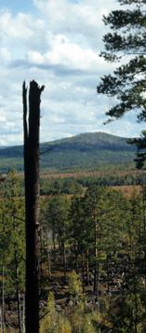
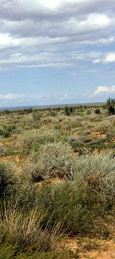
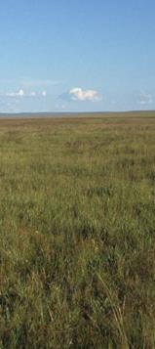
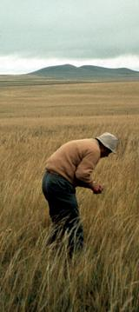
MONGOLIA: AN EXAMPLE OF TRAINING AND DECISION MAKING
Steppe Desert
Ppt <100 mm/Yr
Forest Steppe
Ppt > 400 mm/Yr
Desert Steppe
PPt 170 mm/Yr
Meadow Steppe
Ppt 350 mm/Yr
Typical Steppe
Ppt 270 mm/Yr
Cultural and ecological transect through the Asian Steppe in China and Mongolia

Slide 10
MONGOLIA’S ADVANTAGE LIES IN VAST RESOURCES
COAL
ANTHRICITE
BITUMINOUS
GOLD
SILVER
TUNGSTON
COPPER

Slide 11
CHALLENGED BY
PUSH FROM OUTSIDE TO IGNORE ENVIRONENTAL ISSUES.
ILLEGAL MINING (NINJA MINERS).
ARID TO HYPERARID CLIMATE
SHORT GROWING SEASON

Slide 12
REPUBLIC OF MONGOLIA
TRAINING OF NATURAL RESOURCE MANAGERS
NATION-WIDE LAND USE MANAGEMENT PLAN (DEVELOPMENT BY DESIGN).

