Slide 1
Do we really know the next generation of reclamation researchers?
S. E. Williams & Associates
Environmental & Educational Consulting
Stan Bellgard¹, Steve Williams² and Pete Stahl^{2,3}.

Slide 2
Outline
Technology advancement time-line
Characterising Generation “We”
Changing attitudes towards fossil fuels
Evidence of a disconnect between government and industry
Reconnecting at an early age
Participatory learning platforms
Conclusions. 2

Slide 3
Main characteristics of industrial advancements
Period | Energy resource | Technical achievement | Developed industry | Mode of transport
I: 1760-1900 | Coal | Steam engine | Textile, steel | Train
II: 1900-1960 | Oil, Electricity | Internal combustion engine | Metallurgy, auto, machine / “other” assembly lines | Train, car
III: 1960-2000 | Oil, electricity, Nuclear energy natural gas | Computers, robots | Auto, Chemistry | Train, car, plane
IV: 2000- | Green energies | Internet, 3D printer, GMO | Higher / tertiary industries | Electric car, high speed train, auto-drive 3

Slide 4
Characteristics of the 4th Industrial revolution
“A fusion of technologies that is blurring the lines between physical, digital and biological spheres”
Characterised by pace, scope and impact
Affecting our lives and re-shaping economic, social, cultural and human environments
“Disruption” is the new “normal”
Giving rise to a Person-centric / client-centric, community-level empowerment, because of the immediacy of evidence. 4
Industry 4.0
Autonomous robots
Simulation
Cybersecurity
Big Data
Internet of Things
Cloud Computing
System Integration
Additive Manufacturing

Slide 5
Generational profile: Major consumer groups in USA (2016)
Years born | <1945 “Matures” | 1946-64 “Boomers” | 1965-77 “Gen X” | 1978-95 “Millennials” “Gen Y” | 1996-2016 “Gen. ‘Z’ / ‘We’”
Ages in 2019 | +74 | 52-73 | 39-54 | 21-41 | 0-23
Cultural ethos / value-set | Uncertainty; Conformity | Prosperity; Counter-culture | Disillusioned; Information | Globalised; Social responsibility | War on terror; Social justice
Population | 31,7 million | 72,9 million | 63,4 million | 87,2 million | 82,1 million
Median income | $37K | $60K | $67K | $54K | $21K (Ages 16-19)*
Outlook | Pragmatic | Optimistic | Sceptical | Hopeful | Savvy
Generational profile

Slide 6
Values of “Generation Z / We”
New generation of children moving through teen years right now; it’s the generation after the “Millennials”, “Gen We”. Often referred to as “Gen Z” is constantly connected to their digital and offline friends and in 5-7 years will be entering the industry
This demographic value diversity and social justice within a new global context and they’ve been raised to learn in teams and work as a collective.
From an early age “Gen We”, has been raised to be empathetic, to spot and stamp out bullying. The most ethically and gender aware cohort, teens are exposed to more, and to understand more, and driven to fight for more.
Many teens report feeling stressed by demands of school. The pressure is on to do well and get into a good college. Social pressures are exacerbated by social media, the increased divorce rate and the general change in people’s sense of safety and security.
“Gen Z” appears to be more entrepreneurial, loyal, open-minded and less motivated by money than Gen Y.
Young women understand the options available to them now and intend to make use of them. 6

Slide 7
The nexus between fossil fuels, climate change and food security
Carbon dioxide and Nitrous oxides, are ecological driver of climate change
Disruption of climatic patterns will impact upon rainfall distribution
Changes in rainfall will undermine primary productivity of pastures and crops
Primary productivity is the basis of our food security.
7

Slide 8
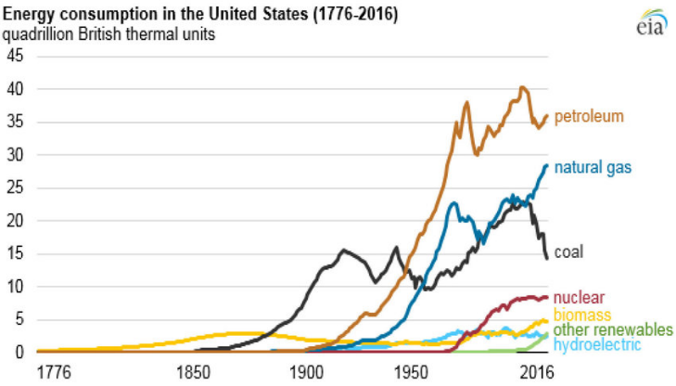
Trends in US Energy consumption
8

Slide 9
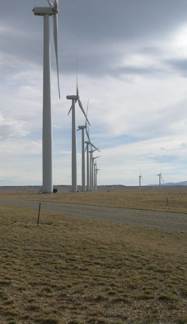
Evidence of a disconnect
Judge temporarily blocks drilling on 300,000 acres in Wyoming, citing climate change
In 2018, the Interior Dept. offered >12,8 M acres of public land to oil and gas companies
In Wyoming, the number of drilling rigs doubled from 2016 to 2018.
Now in US District Court, DC, has ruled that the Interior Dept. BLM violated the National Environmental Policy, for “Not taking into account the effect of drilling on greenhouse gas and climate change”
BLM must demonstrate “due diligence” assessment of greenhouse gas emissions before any new permits to drill on Wyoming Land. 9
Dis-connect

Slide 10
Eight Intelligences and benefits from hands-on learning
Eight intelligences and modes of learning
Traditional teaching methods focussed on logical-mathematical and verbal-linguistic approaches
Potentially dis-advantaging scholars with “other” elite talents e.g. artistic, musical, athletic, social, introverted, out-doors-type.
10

Slide 11
Reconnecting at an early age
Early engagement at the primary school-level increases the efficiency of knowledge up-take
Introducing concepts of restoration initiatives and pro-active leadership towards conservation objectives will inspire the next generation
Highlighting values that mirror the value-set of Gen Z
Communicate and delivery via their media platforms. 11

Slide 12
“Unlocking a nation of curious minds” funding model
A contestable fund supporting innovative projects that excite and engage New Zealander’s, especially young people, with fewer opportunities to get involved with science and technology;
Pasifika (Polynesian culture)
Women into STEAM
Two types of grants to fund their projects;
$30,000 for projects with a localised focus
Up to $150,000 for regional- or national scaled projects
12

Slide 13
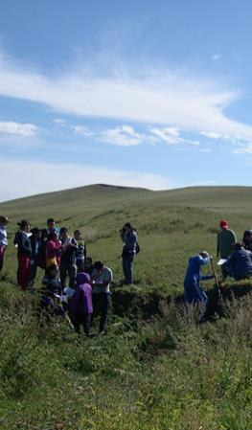
Industry-community partnerships: engaging citizen scientists to be part of the solution (not part of the problem)
Early inclusion of the community can add significant value to a project; e.g. BioBlitz, Fungal Foray.
It enables you to use stakeholder opinions / perceptions to shape the scope and vison of the project and gain early support.
It enables you to become aware of the communities’ issues, fears and doubts at the start, so they do not derail the project at the delivery-phase.
It enables you gain an appreciation of the community’s reaction and minimise the risks by identifying threats and problems early in the project life cycle.
Mechanisms to monitor the health of the relationships and re-calibrate personal / company performance in terms of the communities’ / stakeholders’ / end-users’ values and expectations.
13

Slide 14
Embracing diversity
Diversity is the range of human differences, including but not limited to;
Race
Ethnicity
Gender
Gender identity
Sexual orientation
Age
Social class
Physical ability or attributes
Religious or ethical value systems
National origin
Political beliefs 14
“A strong diversity and inclusion strategy can help your industry attract top talent and drive innovative results – and inspire change into other sectors as you achieve market differentiation.”

Slide 15
Conclusions
Only 14% of US adults had access to the internet in 1995. By 2014 that number was 87%.
“Gen Z / We” grew up during the most accelerated and game-changing periods of technological advancements in human history.
Gen Z doesn’t know a world where a smart device had been outside of arm’s reach;
Spending 3 hours 38 minutes / day online on smart phones
Value social justice and aware of global phenomena.
They bring to the industry their tech- and socially-aware “savvy”.
Early engagement in schools, where we can advocate for “connecting with the real world and dis-connecting from the digital-world”.
Long-term, citizen-science projects can help build community-industry partnerships.
Embrace diversity as a rule for the new employees of the future, and recognise, that sometimes, “our mentors are not all older than us!”

Slide 16
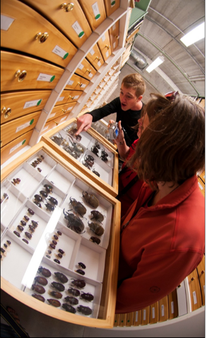
Acknowledgments
The people, the people, the people”
Students; Dawson Primary School, Rongomai Primary School, Mercury Bay Wide Area School
Students; University of Wyoming, USA
Participants; Mongolia
MW-LR; Biodiversity and Conservation Team, and Portfolio for Managing Invasives.
Auckland University of Technology, Computer Sciences
Fisher and Paykel – “Women in Engineering Program”
Ministry of Business Industry and Employment for funding support via “Unlocking a Naiton of Curious Minds
New Zealand Royal Society Teaching Fellow – N. Pattison
K. Schwab “The 4th Industrial Revolution”
Emeritus Prof. KC Williams
Prof. M. Bellgard, Foundation Professor of e-Research, Queensland University of Technology.
16

