Slide 1
University of Wyoming Extension Reclamation Workshops
Jay Norton
University of Wyoming
36th Annual Meeting of the American Society of Mining & Reclamation
Big Sky, Montana, June 5, 2019

Slide 2
Land ethic: Participants are in this field because they have one; Successful education activities should integrate perspectives and knowledge of this experienced target group.
Challenge is to balance teaching, listening, and integrating experiences on the fly, all in a reasonable timeframe.

Slide 3
Gas drilling and weather: Evolving needs for reclamation knowledge
High prices stimulate both production and conservation
Low prices shift interest to other things
Long-term mean
Low rainfall stimulates need for help.
Higher rainfall makes it easy.

Slide 4
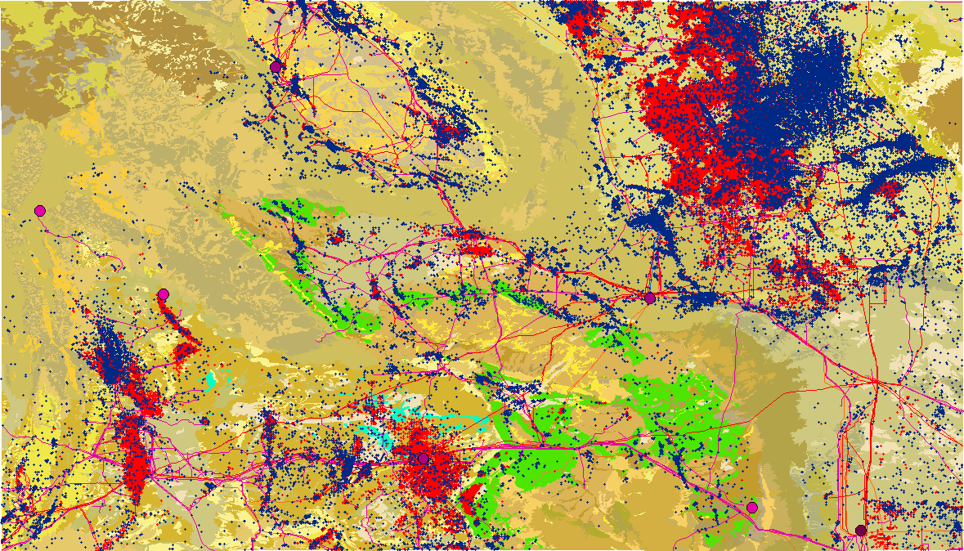
Pipelines + P&A + Active wells
25,841 Currently Producing Wells On File
158,500 Total Wells On File
(DrillingEdge.com)

Slide 5
Soil Property | U | D
SOC (g C kg soil-1) | 5.8 | 2.0
TN (mg N kg soil-1) | 0.68 | 0.45
Sand, % | 29.8 | 25.0
Silt, % | 37.0 | 38.5
Clay, % | 25.0 | 36.5
Base Saturation, % | 44.9 | 51.3
pH | 7.71 | 7.64
EC, dS m-1 | 1.14 | 5.79
Ca, mmolc kg-1 | 6.65 | 20.1
Mg, mmolc kg-1 | 1.68 | 16.1
Na, mmolc kg-1 | 3.94 | 27.9
SAR | 3.95 | 7.85
Lime, % | 4.16 | 4.25
Exchangeable Na, % | 4.96 | 9.51

Slide 7
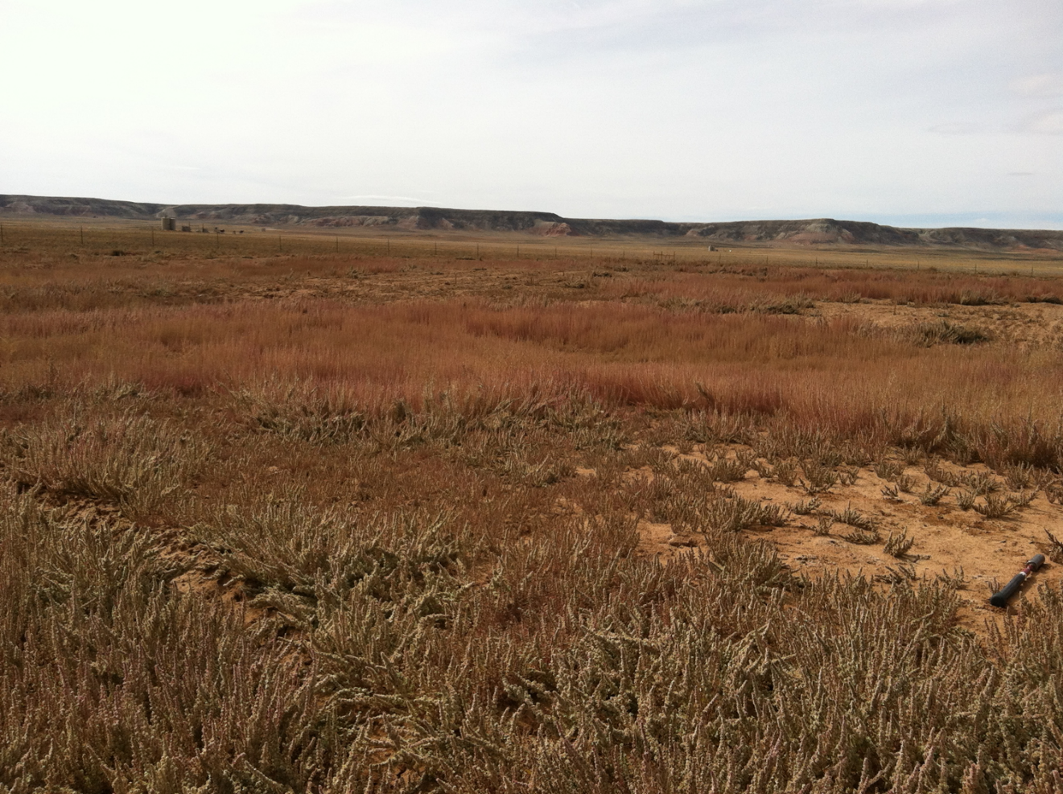

Slide 8
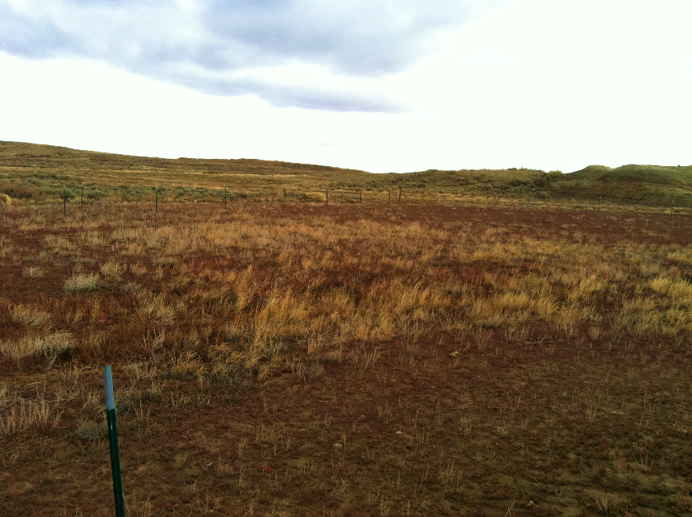
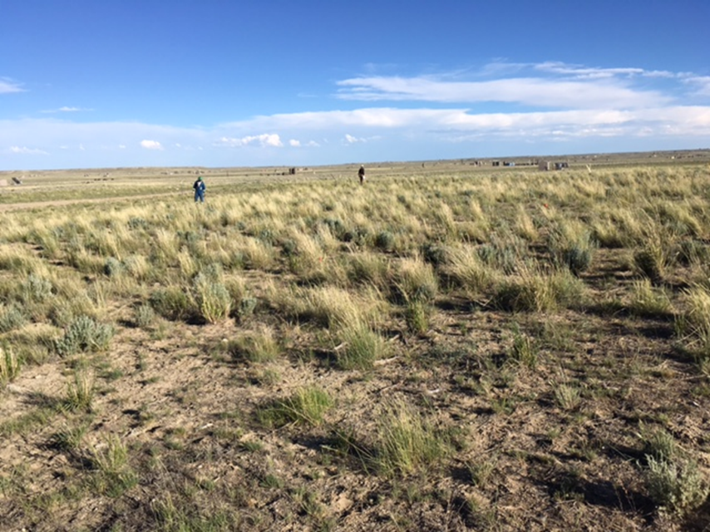
Jonah, 2011
Jonah, 2016

Slide 9
Timeline
2008: Kick-off meeting for UW Reclamation Extension project
2009-2011: Reclamation 101 & Bulletin writing
2011: Barriers to Successful Reclamation survey and roundtable
2012-2016: Regional field-based workshops

Slide 10
2008: Kick-off meeting for UW Reclamation Extension project
Need driven by University of Wyoming Extension educators
Fielding reclamation questions and addressing concerns;
Funded by grant from UW Extension
Developed a Reclamation Issue Team;
~50 participants from Wyoming & federal agencies, production companies, consultants, and UW
Facilitated discussion: brainstorming – grouping – prioritizing;
Breakout groups led by UW Extension educators & specialists.
Outputs:
List of bulletins topics, preliminary outlines, and writing team assignments;
Framework for Reclamation 101 and 201 workshops.

Slide 12
Reclamation 101
Classroom-style presentations;
Reclamation planning;
Soil management;
Weed control;
Seeding;
Erosion control;
Wildlife considerations;
Others.
Good evals, but requests for field component;
Death by Powerpoint?

Slide 13
Reclamation 201
Morning classroom and afternoon field sessions;
Stations led by AM instructors on field site identified by
Good evals but requests for more hands-on.

Slide 14
Lessons learned
Writing team approach was too ambitious:
Educators are pulled in many directions;
Excitement at the meeting cause over-volunteerism;
Finger pointing led to deterioration of issue team;
Difficulties of maintaining large-group effort: the team shrunk;
Too many topics and too little field time: diluted impact;
Not enough discussion/reflection time: experienced professionals need to learn from each other.

Slide 15
2011: Barriers to Successful Reclamation survey and roundtable
Effort to refocus reclamation needs and the extension education effort;
Modeled after BLM Stream Team “Barriers to Success” survey;
Survey administered by WySAC with funding from UW Extension;
Followed by invited roundtable to consider results and plan action.

Slide 16
Barriers Survey
Questions about:
Knowledge gaps;
Education gaps;
Policy gaps;
Market/logistical gaps.
And about effectiveness of reclamation workshops and bulletins;
105 respondents

Slide 17
Federal, Industry, and Reclamation Employees

Slide 18
Knowledge/Research

Slide 19
Knowledge/Research

Slide 20
Knowledge/Research
Percent of responses
Proportion of all F, I, and R responses
Not a problem Extreme

Slide 21
Knowledge/Research

Slide 22
Policies/Regulations

Slide 23
Education/Extension

Slide 24
Education/Extension

Slide 25
Logistics

Slide 26
Roundtable Discussion
May 24, 2012, in Laramie;
University
Jay Norton, Associate Professor, Soil Fertility Specialist
Calvin Strom, Research Scientist, Wyoming Reclamation & Restoration Center
Kristina Hufford, Assistant Professor of Ecological Restoration
Industry
Gary Austin, BP
Vanessa Cameron, District Surface Landman, Samson, Denver
Colleen Faber, Senior Reclamation and Regulatory Analyst, Anadarko Petroleum
Peter Guernsey, QEP Energy Company, Pinedale
Steve Paulsen, Conservation Seeding & Restoration, Inc., Kimberly, Idaho
BLM
Marty Griffith, Deputy State Director for Natural Resources, State Office, Cheyenne
Merry Gamper, Physical Scientist, State Office, Cheyenne
Rick Schuler, State Office, Cheyenne
Janelle Gonzales, Powder River Basin Restoration Coordinator, High Plains District
Jodi Camrud, Assistant District Manager, High Desert District, Rock Springs
Alexandra Kienker, Planning & Environmental Coordinator, High Desert District

Slide 27
Roundtable outcomes
Research:
Large-scale data compilation and analysis;
Development of standardized monitoring method;
Soils: BMP development for stockpiling, ID of suitable soil for salvage, Amendments: when remediation is needed;
Shrubs: Guidelines for staggered seeding, multiple species, ecotype selection.
Education: More hands-on workshops, target small operators
Policy: Improved communication, planning ahead
Workload issues: last-minute requests result in frustration;
Logistics:
Need for more trained personnel: difficult with declining reclamation $$;
Availability of seed for required species.

Slide 28
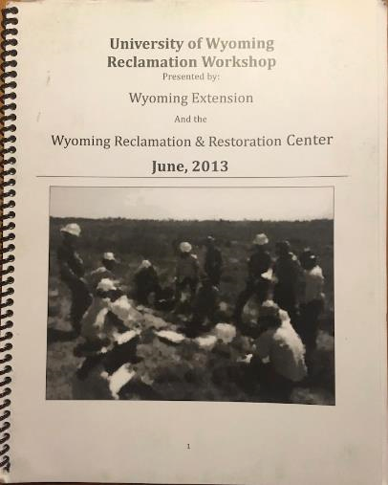
Regional Field Workshops: Reclamation plan activity
Field-based; integrates concepts;
Return to same field sites so we have site info;
Interdisciplinary groups: “count-off” method;
Day 1: intro and travel to hypothetical well-pad site, form groups and train in two areas:
Plant inventory: ID native plant community, weeds, wildlife habitat;
Suitable soil and erosion control;
Day 2: Groups complete info and develop reclamation plans:
Inventory in field (2-3 hours);
Develop plans in classroom using template (2-3 hours);
Present and discuss plans.

Slide 29
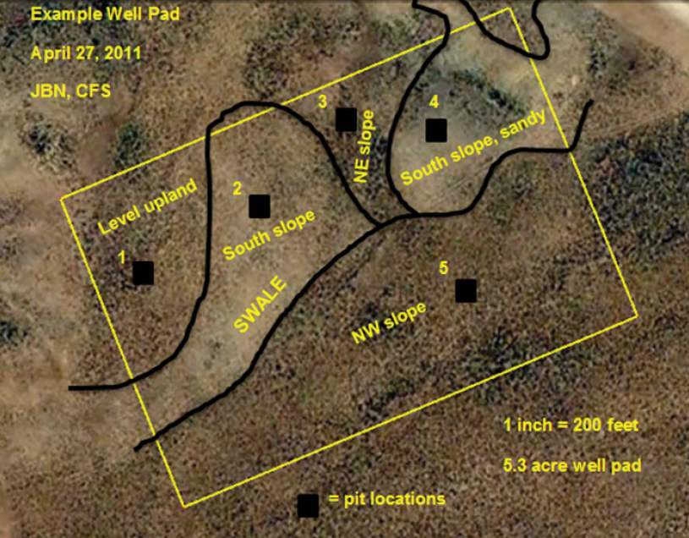

Slide 30
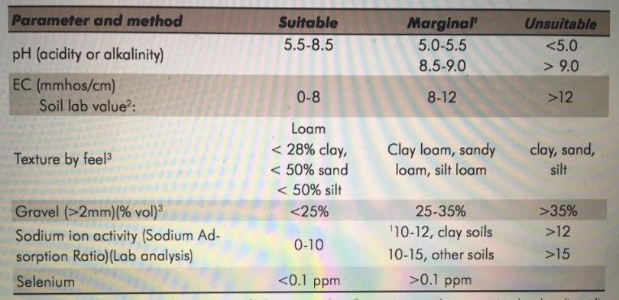
Suitable soil
Color and structure to identify “topsoil” depth;
Hand texture;
pH/EC meter;
Gravel sieve.

Slide 31
Lessons learned
Working with professional conservationists from diverse backgrounds is rewarding and challenging;
Focused activities with multi-disciplinary teams allow time for discussion and valuable group learning (you can’t teach everything in one day);
Developing a hypothetical reclamation plan integrates concepts and draws on participant experience;
Structured, facilitated planning meetings engaged reclamation stakeholders for effective approach.
Draw on practioners’ experience to define systems, identify problems, and “redesign”.

