Slide 1
Development of Mine Soils in a Chronosequence of FRA-reclaimed sites in Eastern Kentucky
Kenton Sena, Kevin Yeager, John Lhotka, and Chris Barton

Slide 2
Introduction
Native soils are frequently not retained for use in reclamation in Appalachia.
Conventionally reclaimed sites are typically reclaimed with high-compaction grading and mine-run spoils
FRA-reclaimed sites should be reclaimed with low-compaction techniques and weathered brown sandstone
Little to no organic matter
Low microbial activity
High levels of dissolved solids

Slide 3
Context
Development of soil structure and function is critical to ecosystem restoration
Soil microbial community assembly
Formation of soil structure, aggregates
Accumulation of soil organic matter
Nutrient and moisture retention

Slide 4
Project Goals
Using a chronosequence of mine sites (0, 10, 12, 15, 18 yrs after reclamation) and a ~90 yr unmined forested stand (Robinson Forest), assess changes in soil chemistry and texture over depth and time

Slide 5
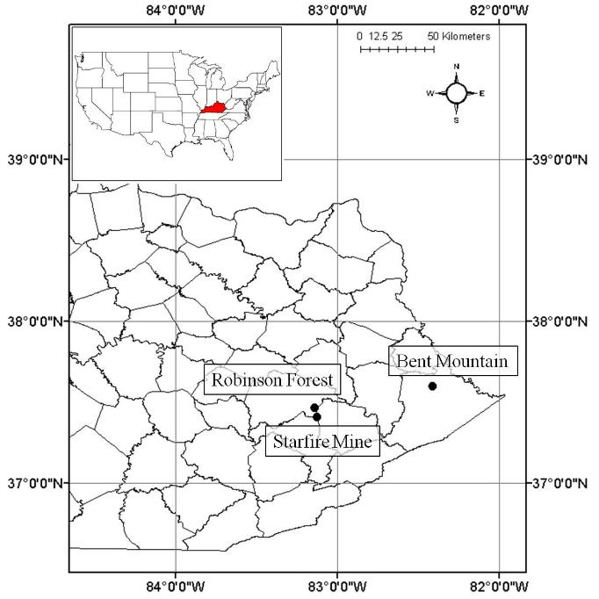
Study sites
10, 12 yr (Bent Mountain. Pike County, KY) and 15, 18 yr (Starfire Mine, Breathitt County, KY)
Controls (Robinson Forest, fresh mine spoil from Starfire Mine)
Figure credit: Sena et al. 2018

Slide 6
Methods
Samples for “high resolution” analysis (2 cm increments from 0 – 20 cm; 5 cm increments from 20 – 50 cm) collected from soil pits
Three cores for “low resolution” (0-10 cm, 10-40 cm, 40-50 cm) collected using soil auger
Analyzed for Al, Mn, Fe, Mg, K, Ca, Na, d15N, d13C, %N, %C, %OC, texture

Slide 7
Results
Notes:
One of the most critical soil formation processes on these sites—formation of soil fines, which can improve soil moisture and nutrient relations, and lend toward the development of soil aggregates

Slide 8
a
b
Sand (%)
Silt (%)
y = -1.6184x + 71.695
R² = 0.5909
p = 0.0021
y = 1.7852x + 19.502
R² = 0.6931
p = 0.0004
Figure credit: Sena et al. 2018
Notes:
(includes data from previous studies on these sites, where available…) Demonstrates strong trends in decreasing % sand and increasing % silt—accumulation of soil fine particles over time.

Slide 9
Notes:
Depletion of Ca over time is consistent with the literature on rapid initial weathering of mine spoils: concentrations are initially very high as the previously isolated spoils are exposed to water and air. However, they typically decline over time as they are leached out by interflow.
In the forested site, concentration of Ca near the surface is consistent with leaf litter being the primary source of Ca in this system—roots mine Ca from deeper soils and Ca is returned to surface soils by decaying litter.

Slide 10
Notes:
Consistent with the previous slide, demonstrates weathering of mine soils over time, releasing dissolved solids (such as Calcium). As these are leached and soil minerals stabilize with respect to weathering, concentrations of calcium are expected to decline to near-forest levels.

Slide 11
Notes:
Depletion of d13C is associated with enrichment of organic carbon (vs. inorganic carbon). Carbon on fresh mine spoils is primarily in the form of carbonate minerals; however, as these are leached out and organic matter is contributed to the soil, d13C becomes more depleted, reaching a maximum in the mature forest.
The trend toward greater d13C depletion in near-surface soils is consistent with concentration of organic matter in these soils.

Slide 12
δ¹³C (‰)
Robinson Forest (± SE)
y = 0.0314x² – 0.872x – 21.455
R² = 0.9517
p = 0.0005
Figure credit: Sena et al. 2018
Notes:
(Includes data from previous studies on these sites) Again, demonstrates strong trend toward d13C depletion over time, approximating levels in unmined forest by ~10 years

Slide 13
Notes:
Similarly to the previous slide, Organic Carbon accumulates over time, with highest values in the near surface soils in the unmined forest. The

Slide 14
Figure credit: Sena et al. 2018
Notes:
Exhibits some variation, likely attributable to some regional variation in spoil chemistry. But demonstrates generally increasing soil organic matter stocks over time

Slide 15
White Oak C (kg ha⁻¹)
Years since reclamation
Notes:
When considered with aboveground biomass (in this case, white oak), these sites demonstrate remarkable carbon sequestration rates—here 1.44 Mg C/ha/yr in aboveground biomass and

Slide 16
Discussion
Depletion of base cations over time and nearer the surface is consistent with generally observed weathering patterns. Fresh mine spoil rapidly weathers, releasing higher concentrations of dissolved solids in the first few years after placement.
Accumulation of organic matter is evidenced best by δ¹³C depletion, which is more sensitive to the differences between inorganic and organic carbon than some other measurements.
In general, site effects are apparent. This is consistent with previous studies, and is thought to be related to regional variation in mine spoil properties.

Slide 17
Questions?

