Slide 1
Pennsylvania & Indiana Gulch Road Decommissioning
Habitat Management Inc.
Anthony Matthews & Jesse Feeback

Slide 2
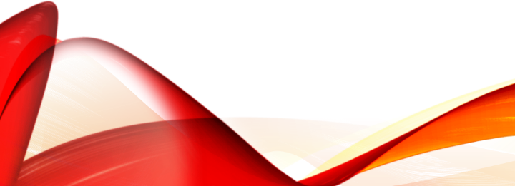
Overview
2017-Present Partnership between US Forest Service, National Forest Foundation, & Habitat Management
Decommissioned/reclaimed 3.6 miles of roads & trails near Breckenridge, CO.
Indiana & Pennsylvania Gulch
Addressed severe erosion & soil compaction.
Defragmented & restored 3 acres of wildlife habitat including critical Canada lynx habitat.
Used a holistic reclamation approach which considered vegetation, hyrdrology, soils, & wildlife.

Slide 3
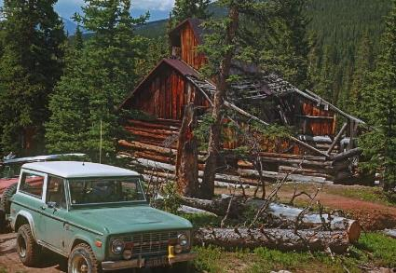
History of the area
Breckenridge was founded to serve miners working rich placer gold deposits discovered along the Blue River.
The Breckenridge mining district produced about 31,000 kilograms of gold. (US Geologic Survey)
A small mining town named Dyersville was formed in the upper reaches of Indiana Gulch.
The area had an extensive road system that continued to be used by hunters and recreationists after mining had ceased.
Dyersville, Colorado

Slide 4
Indiana & Pennsylvania Gulch
Ecosystem
High Altitude Lodgepole Pine & Spruce/Fir Forest
Elevation 9,500 ft – 11,000 ft.

Slide 5
Soil Decompaction
All compacted soils were ripped & decompacted using a mini excavator.
Rocks & drainage structures were placed in high erosion areas.
Undamaged soils were left undisturbed.
The road was regraded to match the original topography.

Slide 6
Seeding
Developed a seed mix of grasses & forbs that were identified in the area prior to construction.
Hand crews raked the area after decompaction to fine grade the soil & prepare the seed bed for planting.
The seed mix was hand broadcasted & lightly raked into the ground to ensure good seed to soil contact.

Slide 7
Slope Stabilization
Slope stabilization was achieved using a mix of rock & log fill, erosion control fabric, & woodstraw mulch.
Rock fill was used to stabilize drainages & erosional issues.
Biodegradable erosion fabric was used in steep & eroding areas in order to prevent further erosion & protect the seed that had been spread.
In areas where the fabric could not be transported, woodstraw mulch was used to prevent erosion & protect the seed bed.

Slide 8
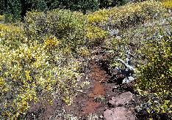
Willow Staking & Transplanting
Willow stakes & large transplants were planted in riparian areas to stabilize the soil & restore a continuous willow cover.
Large willow transplants were collected and installed by the mini excavator.
Willow stakes were harvested and installed using dig bars and hammers.

Slide 9
Final Steps
The former road was made to look as natural and undisturbed as possible.
Achieved by placing large boulders, logs, & debris across the trail & transplanting shrubs & trees from the surrounding areas.
A further 300 saplings provided by the USFS were also planted in the previously established road.
Visual barriers were installed which involved placing dead trees & logs in upright positions. (Tank traps)
These blocked the sight of the trail and made the reclamation hard for recreationists to access.

Slide 10
Before & After

Slide 11
Before & after

Slide 12
Before & After

Slide 13
Before & After

Slide 14
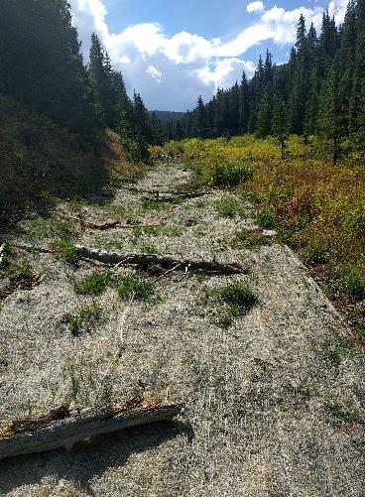
Results After 1 Year

Slide 15
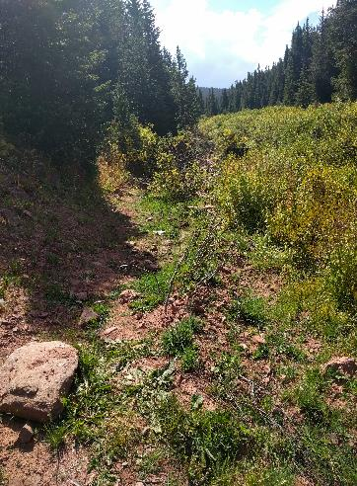
Results After 1 Year

Slide 16
Questions?

