Slide 1
TAILINGS BASIN RECLAMATION ATLANTIC CITY IRON MINE, WYOMING
WYOMING AML PROJECT 9A-II
J. J. Gusek P.E., Linkan Engineering, Golden, CO
&
B.K. Schladweiler, BKS Environmental, Gillette, WY

Slide 2
Site Location
Southern end of the Wind River Mountains
35 mi south of Lander WY on South Pass (WY Highway 28)

Slide 3
SITE HISTORY
Iron resource recognized during Cold War
This mine and the Sharon Steel Mill in SLC were located out of range of ICBMs at the time.
US Steel operated mine 1962 to 1983
Salvage operator acquired property in about 1985 for railroad rails but later sold
WY AML assumed some of reclamation responsibility in late 1980’s

Slide 4
Site Environment
Site elevation – 8,100 ft (2,470 m)
Strong winds
Short growing season
Semi-arid/high altitude climate

Slide 5
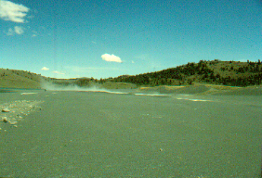
SITE SPECIFIC PROBLEMS Prior to Reclamation
A tailings basin cap installed in 1985 was being eroded by uncontrolled ground water seeps
Wind-blown dust from the tailings basin was causing zero visibility on adjacent state highway to the south

Slide 6
Challenges
Site conditions described previously
On-going drought during construction and reclamation
8-year drought
Most intense period August 2002
No topsoil originally salvaged/source of borrow topsoil

Slide 7
SITE LAYOUT
Relocated HWY 28 (2003?)

Slide 8
Seeps eroding vegetative cover soil
SEEPAGE FROM PIT LAKE

Slide 9
Mill and Tailings Basin 1994
Partly Revegetated
Seeps
Exposed Tailings
Tailings Pond discharging through decant tower

Slide 10
WY AML’s Responsibilities
Reclaim lands not covered by owner obligations
Tailings Basin Reclamation
Portions of Waste Rock Dumps
Railroad Bridge Abutments
Railroad Fill Removal/Breaching
Notes:
DELETE?

Slide 11
INITIAL PROJECT GOALS
Provide a stable reclaimed surface to prevent blowing dust and develop habitat for wildlife and cattle grazing
Preserve or improve the stormwater protection the mine pit and tailings basin provided to downstream communities, especially during construction

Slide 12
PRE-DESIGN INVESTIGATIONS
Geotechnical - 2 tailings dams (North and South)
Site geochemistry
Surface water hydrology
Feasibility of compost use
Soils and revegetation
Threatened & endangered species
Notes:
DELETE?

Slide 13
General Reclamation

Slide 14
RECLAMATION PLAN

Slide 15
Site Features prior to Fall 1997 Seeding

Slide 16
Reclamation Plan Specifics
Rock wall snow fences substituted for vertical slat snow fences
Fertil Fiber/Kiwi-Power amendments with nearby White River overburden substituted for organic compost or imported topsoil
Based on historical research of taconite tailings
WRF low fertility but no chemical limitations (neutral pH; As <2 mg/kg)
Broadcast seed
Plant adapted species @ 40 kg/ha PLS (35-36 lbs/ac)

Slide 17
SOIL AMENDMENTS
(DRY) Fertil Fibers/Biosol applied in two doses @2.2 t/ha (1.0 st/ac) with dry inorganic fertilizer supplement
(WET) Kiwi Power bacterial inoculum applied at 47 liters/ha (5 gallons/acre) applied with “crop duster” airplane.

Slide 18
Fertilizer
Diammonium phosphate fertilizer 250 lb/acre
45 lbs elemental N
115 lbs elemental P
Potash 36 lb/acre
30 lbs elemental K

Slide 19
Mulching
Other than hydroseeded/hydromulched areas, no mulching was used

Slide 20
Seed Mix – Drill Rate
Critana Thickspike 3.0 PLS/ac
Rosana Western 3.0 PLS/ac
Secar Bluebunch 3.0 PLS/ac
Bromar Mountain Brome 4.0 PLS/ac
Trailhead Basin Wildrye 2.0 PLS/ac
Joseph Idaho Fescue 2.0 PLS/ac
Appar Blue Flax 0.5 PLS/ac
Eski Sanfoin 2.0 PLS/ac
Mountain Big Sagebrush 1.0 PLS/ac
TOTAL 17.5 PLS/ac

Slide 21
Fencing
Cattle grazing excluded for two growing seasons
Wildlife grazing could not be economically excluded

Slide 22
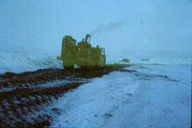
CONSTRUCTION SCHEDULE
Dec, 1996 - Winter startup/regrading of initial tailings basin
Nov, 1997 - Winter weather suspends revegetation work
Spring, 1998 – revegetation work complete, regrade other sites in project
Notes:
DELETE?

Slide 23
Tree Planting
Conducted in 2001
Two tree species in wind shadows of rock berms and rock boulder snow fences (15,000 trees)
Used 2’ x 2’ black matting
Lodgepole and limber pines – seeds harvested from forest within 500 feet of the mine and grown in containers in a CO nursery
Installed browse protection sleeves

Slide 24
Reclamation Sequence

Slide 25
Reclamation Project Areas/Phases
Tailings Storage Facility (TSF) (impoundment) including tree planting – Phase 1
RR bridge abutment removal – Phase 1A
Waste rock dumps – Phase 2
Railroad fill breaching – Phase 3

Slide 26
SITE LAYOUT
Relocated HWY 28 (2003?)

Slide 27
Challenges
New spillway 10 ft lower than the normal Iron Lake level.
Constructing the spillway without creating a flood was a challenge.
However, as excavation occurred closer to the Lake, the “seepage” encountered increased so that the lake level dropped in a controlled fashion.
Seep flow on the north end of the TSF managed with French Drains that daylighted at the tailings pond shoreline

Slide 28
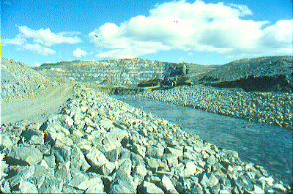
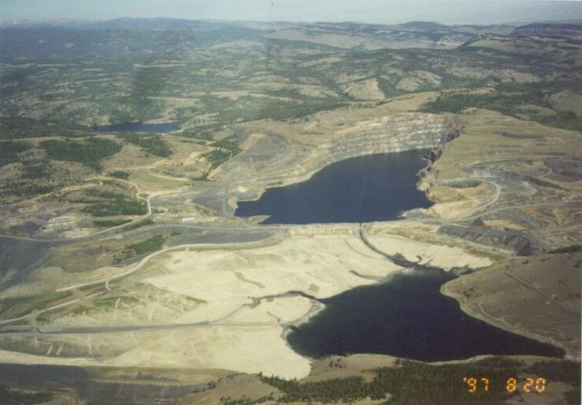
Iron Lake to Tailings Pond Spillway
Iron Lake
New Spillway
Iron Lake water level 10 ft. lower to eliminate seeps)
Tailings Pond

Slide 29
French Drains (more seep control)

Slide 30
Closure of Lower Diversion Canal/Old Spillway
Lower Diversion Canal Alignment
Iron Lake
French Drains
Old Spillway
Tailings Pond
Tailings Dam

Slide 31
New Tailings Basin Spillway
Iron Lake
French Drains
New Spillway
Tailings Pond
Tailings Dam

Slide 32
Tailings Basin Post-Construction
Iron Lake Spillway
Tailings Pond
Rock Boulder Snow Fence
Buried French Drains in this area

Slide 33
Tailings Basin + 2 yrs.
Iron Lake Spillway
Tailings Pond
Buried French Drains in this area

Slide 34
Tree Planting Assessment on Tailings Basin
Used Google Earth Imagery to count trees around 36 rock boulder snow fences
Used to determine tree survival rate
Lowest survival rate at a rock boulder snow fence was 11%
Highest survival rate at a rock boulder snow fence was 80%
Average survival rate at a rock boulder snow fence was 41%

Slide 36
Overall Statistics
 | Tree Count |  | Tree Mats |  | Survival Rate
Minimum | 4 |  | 28 |  | 11.4%
Average | 48.9 |  | 116.7 |  | 41.4%
Maximum | 145 |  | 333 |  | 79.7%
*Total | 1,760 |  | 4,201 |  | 41.9%
36 structures/polygons sampled * All trees and tree mats sampled. Accounts for the difference between the average and total survival rates. Reportedly, 15,000 trees were planted so the overall survival rate would be about 12%
What happend?
Notes:
Average was calculated by taking the average survival rate of each polygon. The Total was the sum of all trees counted, all tree mats counted, and the difference for the average (Average=total trees counted divided by total tree mats counted.
What happened? Here’s a theory…

Slide 37
Big Sagebrush – NE of tailings basin
NE of tailings basin
Simultaneously broadcasted shrub seed within drill seeded grasses

Slide 38
Reclamation Project Areas/Phases
Tailings Storage Facility (TSF) (impoundment) – Phase 1
RR bridge abutment removal – Phase 1A
Waste rock dumps – Phase 2
Railroad fill breaching – Phase 3

Slide 39
Bridge Abutment (Highway Hazard) Removal
Phase 1A

Slide 40
Hazards
Long considered a “choke point” on a long downhill stretch of highway that, under wintery conditions, could have resulted in a fatality if a vehicle hit the abutments.
The abutments were also considered a hazard to snowmobilers who routinely used the railroad right of way.
WY AML elected to have them removed.

Slide 41
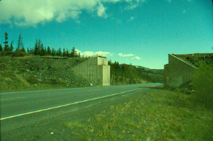
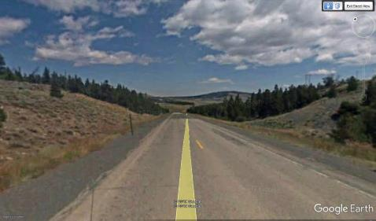
Bridge Abutment Removal
Photos courtesy of Tim Richmond, WY AML (retired)
Phase 1A
Notes:
The bridge abutment removal involved the use of explosives and the demolition contractor’s blaster was a bit trigger happy on the first few shots and the highway was closed for six hours! People weren’t very happy. Eventually, the blaster got the hang of it and the closures were less than 45 minutes. The Google Earth street view shows very mature vegetation – you’d never know what had been there.

Slide 42
Reclamation Project Areas/Phases
Tailings Storage Facility (TSF) (impoundment) – Phase 1
RR bridge abutment removal – Phase 1A
Waste rock dumps – Phase 2
Railroad fill breaching – Phase 3

Slide 43
SITE LAYOUT
Relocated HWY 28 (2003?)

Slide 44
Considerations
While the un-reclaimed waste rock areas presented no physical hazards, their reclamation was within AML’s mission statement.
Some of the advancements on the tailings project were transferred to the waste rock projects (e.g., rock snow fences)

Slide 45
Waste Rock Reclamation (Phase 2)
Ripping and Final Shaping

Slide 46
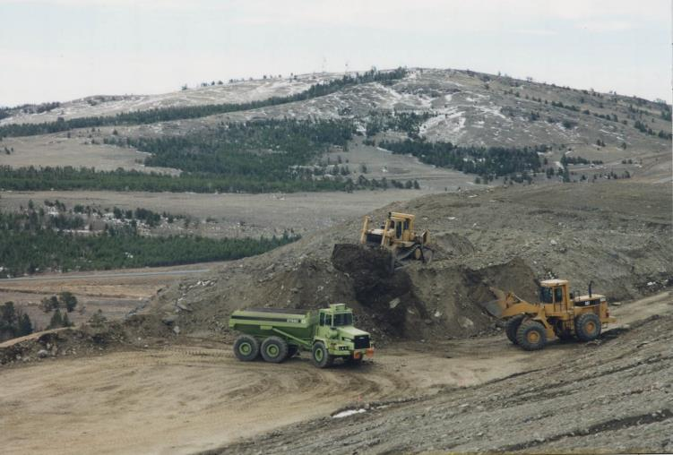
Atlantic City: Phase 2 (con’t)
Placing Cover Materials on Waste Dumps

Slide 47
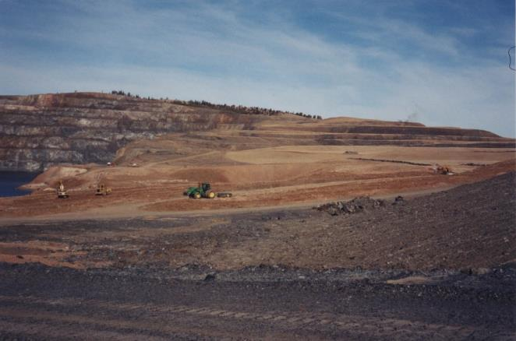
Incorporating Soil Amendments and Fertilizers
Atlantic City: Phase 2 (con’t)
Notes:
Soil amendments included a combination of slow-release fertilizer and a soluble liquid fertilizer for immediate plant utilization.

Slide 48
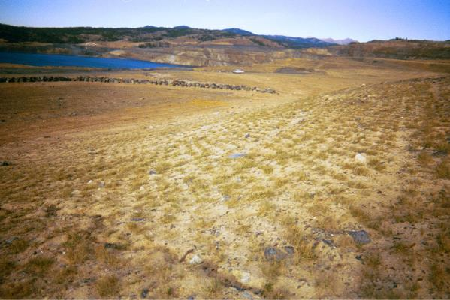
Pitted Surface on Slopes
Improves soils moisture capture and retention
Reduces wind erosion and abrasion of young seedlings

Slide 49
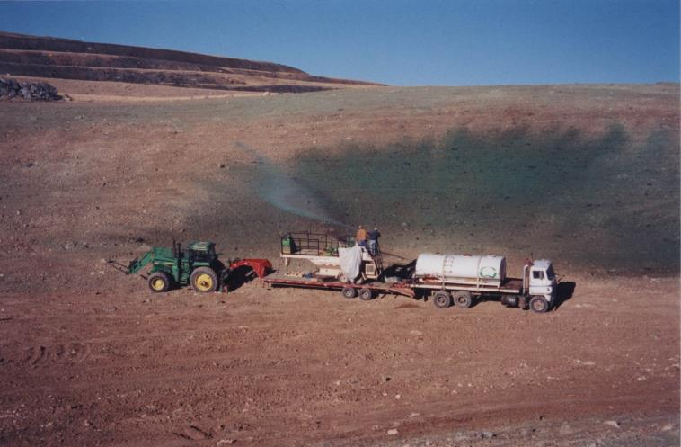
Atlantic City: Phase 2 (con’t)
Hydroseeding

Slide 50
Reclamation Project Areas/Phases
Tailings Storage Facility (TSF) (impoundment) – Phase 1
RR bridge abutment removal – Phase 1A
Waste rock dumps – Phase 2
Railroad fill breaching – Phase 3

Slide 51
SITE LAYOUT
Relocated HWY 28 (2003?)

Slide 52
Railroad Fills Removed/Breached
Notes:
The railroad fills presented potential flooding hazards if the steel culverts ever failed and water ponded up behind them to eventually fail catastrophically, resulting in loss of life and property. Removing them was a no-brainer for WY AML. (please don’t point out the lack of a hard hat on one of the workers – LOL).

Slide 53
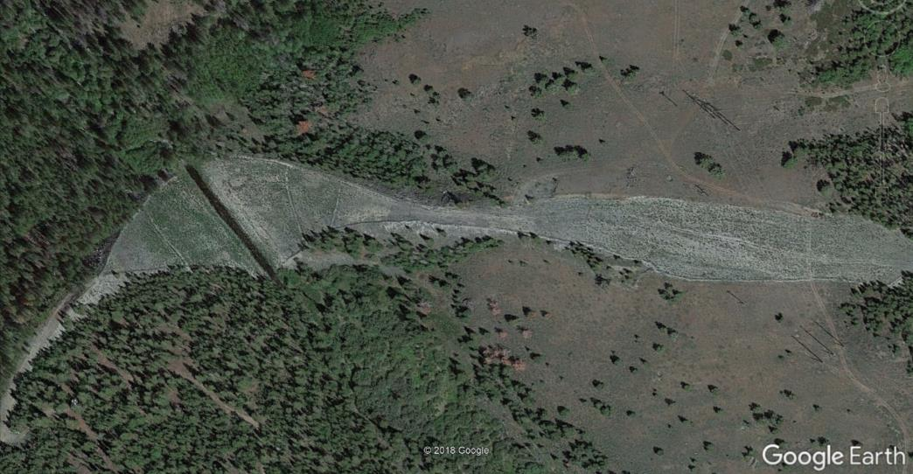
Railroad Fills Removed/Breached
Railroad Fill Removed
Fill Material Placed to Approximate
Original Contour
Slate Creek
0.25 miles to
Hwy 28 RR Abutments (removed earlier)
Notes:
The excavated materials were transported into the cut adjacent to the fill that probably provided the original fill materials.

Slide 54
Post Seeding Followup

Slide 55
AML Site Monitoring
2007
Noted:
Limited success of conifers behind rock habitat structures due to marmot activity
Main drainage out of Rock Creek blocked by overburden
Trash and debris in creek
Loose, resilient weed mats
Sanfolin, wheatgrass, flax and sagebrush noted
No noxious weeds

Slide 56
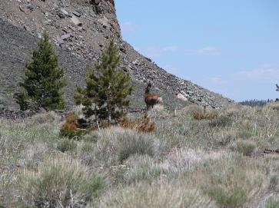
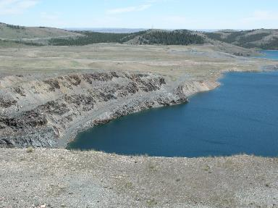
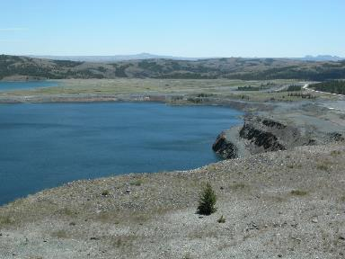
Near Remaining High Wall
(view south on lower photos)

Slide 57
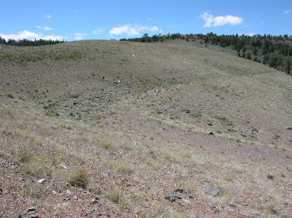
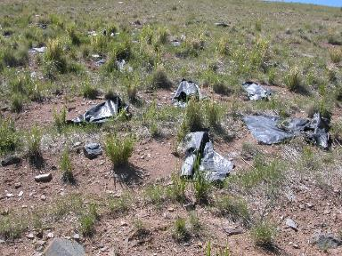
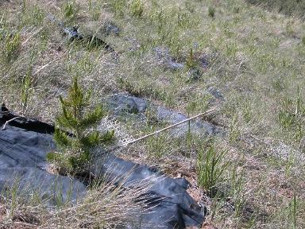
Reclaimed Waste Rock Dumps – Note Loose Weed Matting

Slide 58
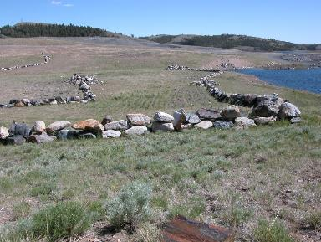
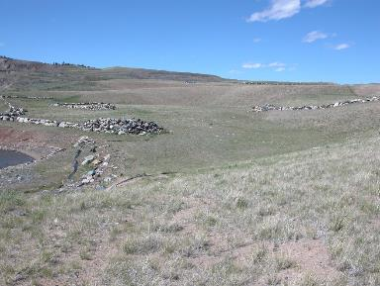
East Edge of Main Pit, View South
East Edge of Main Pit, View North

Slide 59
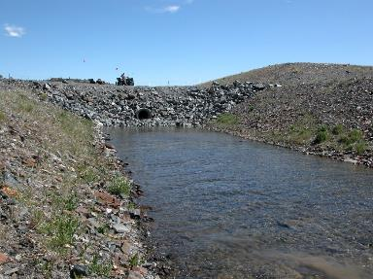
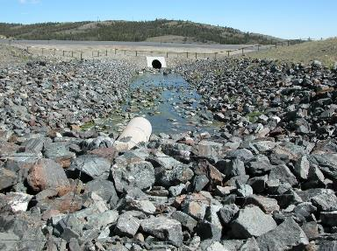
Downstream From The Outlet Of The Main Pit Pond

Slide 60
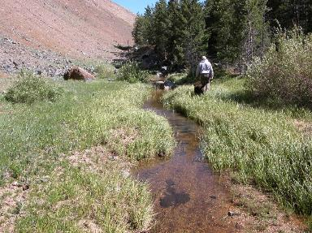
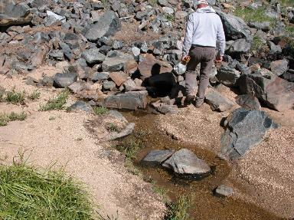
Interrupted Flow from the Rock Creek Reservoir

Slide 61
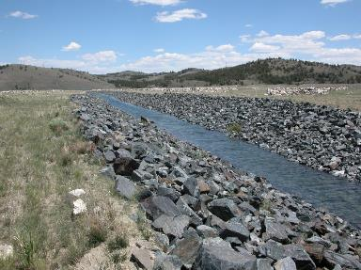
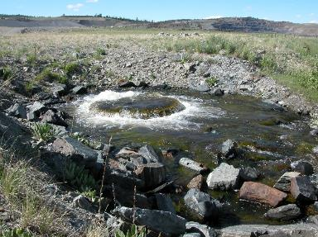
Channel structure flowing out of the pond from the previous photo
Flow of water coming up just above the old highway on the southeast side of the site

Slide 62
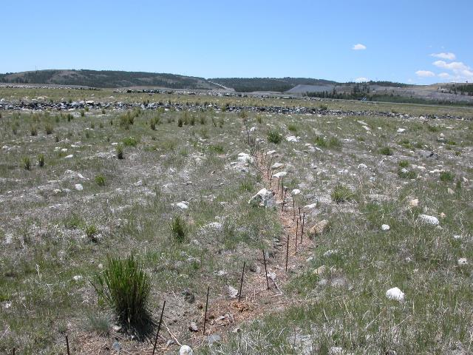
Stakes left after the straw bales were likely consumed by livestock

Slide 63
Contractor Monitoring

Slide 64
Summary – Observations and Lessons Learned
Dust problem on tailings under control
Stable landforms on tailings, waste rock dumps, railroad fills established
Relocated Highway 28 seems to blend into the landscape
Lessons learned (trees)
consider small wildlife browsing even with browse protection
reconsider strategic placement behind rock structures
were there more conducive areas to tree establishment
Skip the trees? Plant other species?
Overall, was it worth it?
Notes:
Summarize each bullet

Slide 65
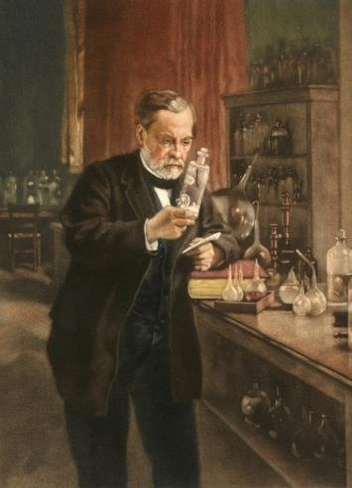
Questions?
Chance favors the prepared mind.
Louis Pasteur
Special thanks to J.R. Simplot, current mine owner, for permission to visit the site in 2018 and to share this success story.
BSchladweiler@bksenvironmental.com
jim.gusek@linkan.biz
Notes:
If there are questions I can’t answer, please feel free to contact Jim at his email address.

