Slide 1
Richard Spang Sr. Scientific Specialist

Slide 2
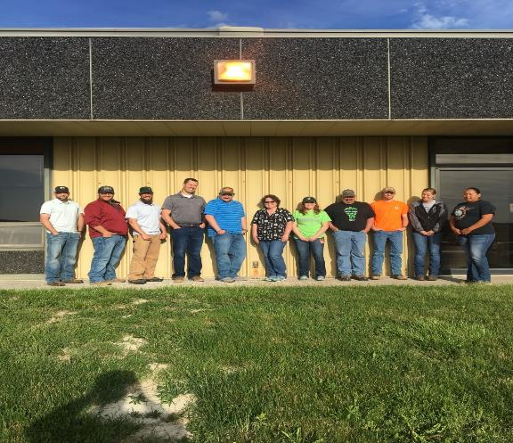
Area C Environmental & Engineering Office
Notes:
Area C Office Rosebud Mine 2019

Slide 3
History
Colstrip was founded in 1923
Mining started in 1924
Coal used for rail locomotives
Mining ceased in 1958 (diesel locomotives)
Montana Power purchased reserves/town in 1966
WECO started mining in 1968
Westmoreland Mining bought WECO April 2001

Slide 4
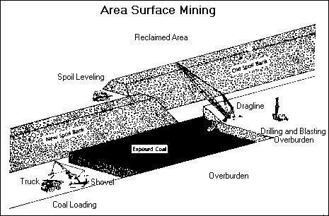

Slide 6
What is successful reclamation?
Vegetation Diversity
Post Mine Land Use
Post-Mine Topography (PMT)
Incorporating Micro Features
Wildlife features
Managing Reclamation Grazing
Bond Release

Slide 7
Reclamation History
Pre Law Pit 6
Area E (Final Bond Release May 8, 2019)
High Wall Reclamation
Special Projects after reclamation
Notes:
Area E permitted in Mid 1970’s, mining completed in late 80’s and final reclamation completed in 2004.

Slide 8
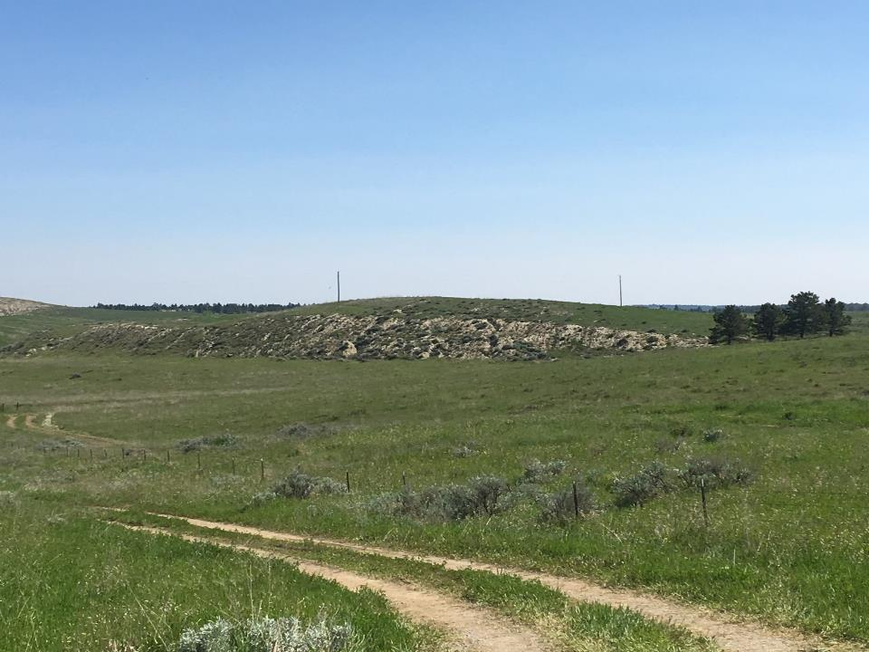
Notes:
Pre Law

Slide 9
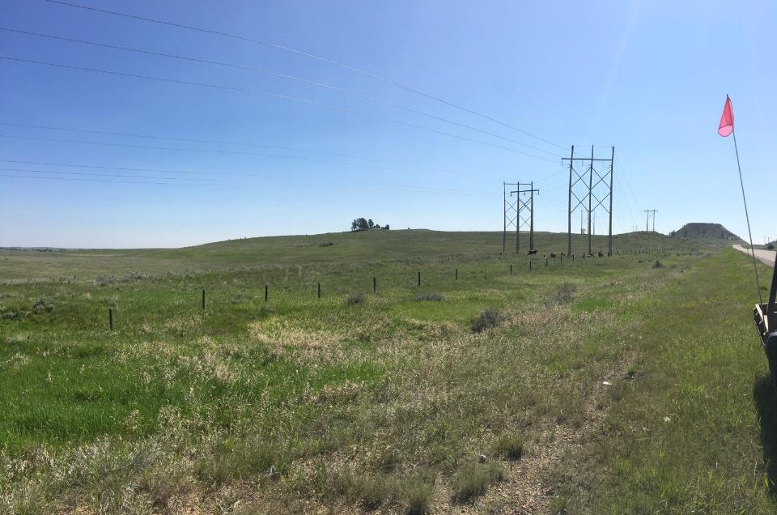
Notes:
Uniform slope on high wall tie in.

Slide 10
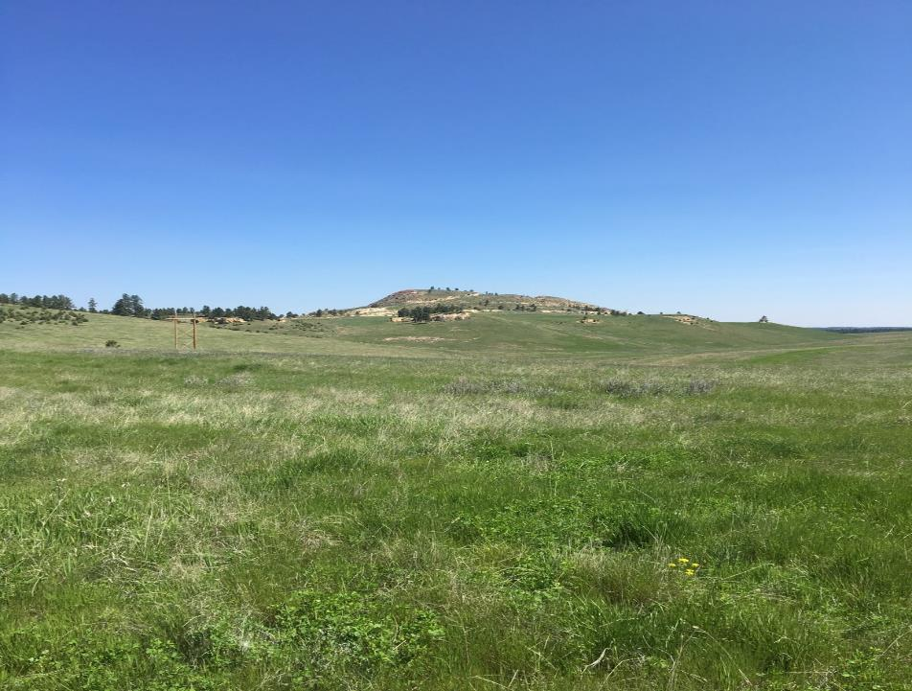
Notes:
Area E diversity in High Wall tie in.

Slide 11
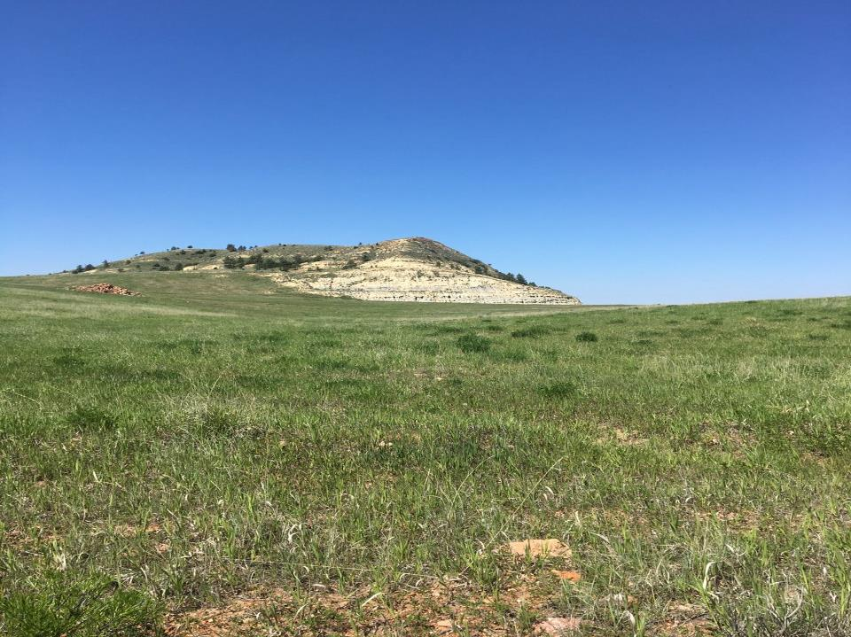
Notes:
Area E vertical high wall. View from east.

Slide 12
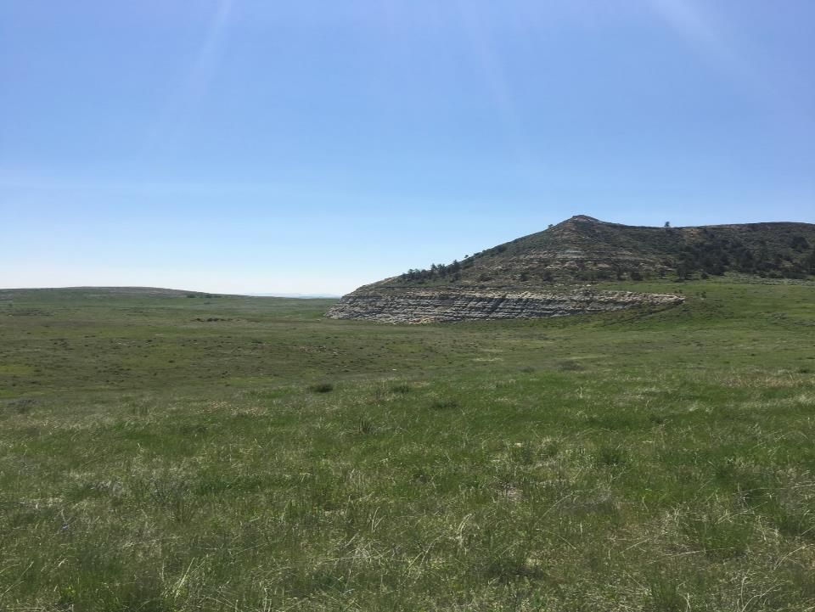
Notes:
Area E high wall reclamation. View from the north.

Slide 13
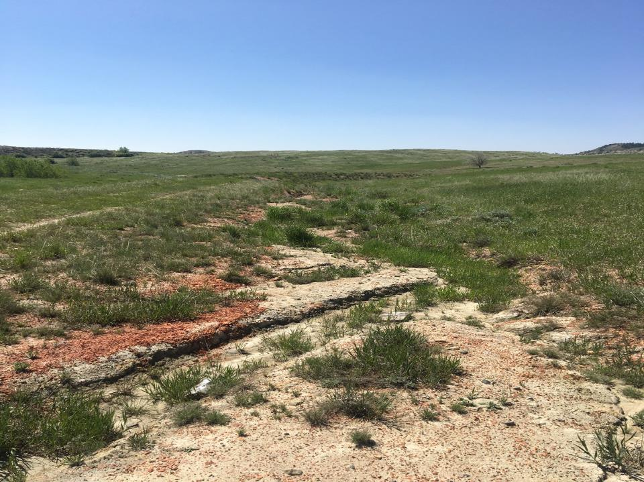
Notes:
Rill/Gully next to two track. Came up with plan while on DEQ insp with Julian Calabrease.

Slide 14
Area C North
Time Lapse Video
Tributaries
High Wall Reclamation
Shrub Establishment
Special Projects

Slide 15
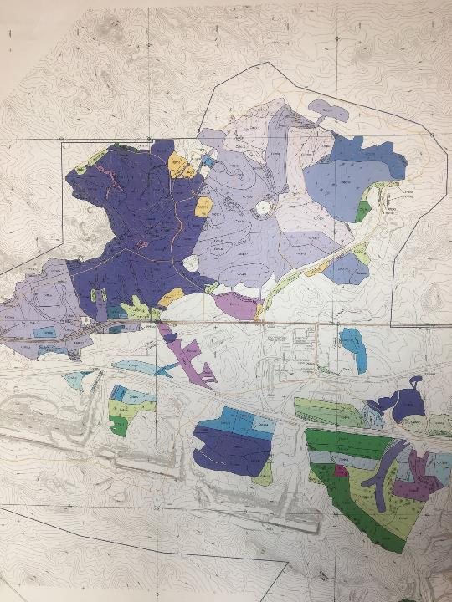

Slide 16
Notes:
Area C North Time Lapse Video. Bulk of Reclamation completed 2005-2010.

Slide 17
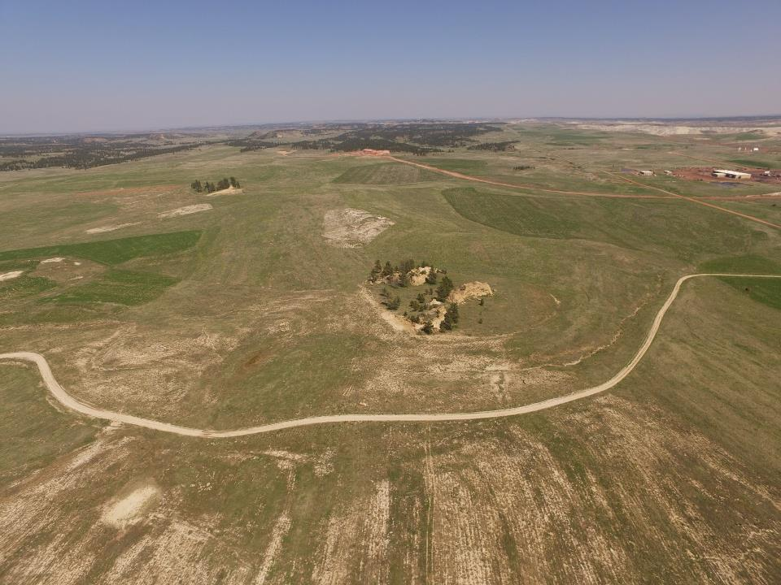
Notes:
Area C north May 2019. Note Love Lace Rock and Petro City and no soil field for shrub establishment. Note county road and c complex. View from the west.

Slide 18
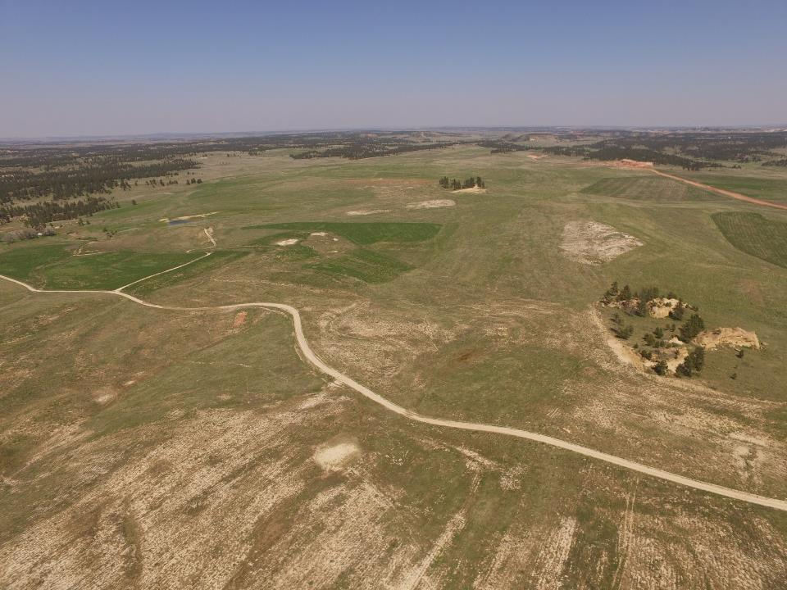
Notes:
View toward NE. Note crop land (alfalfa).

Slide 19
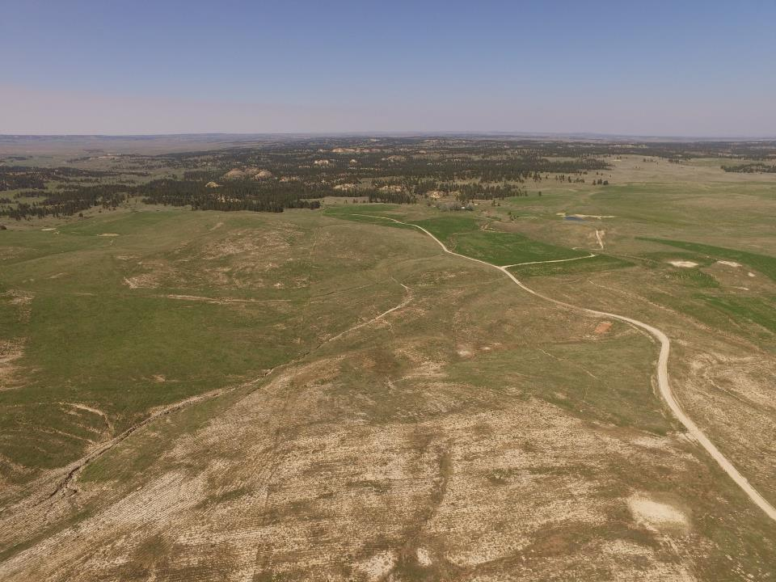
Notes:
View to the North. Note Love Lace Homestead. One thing in common on home steads in surrounding area?

Slide 20
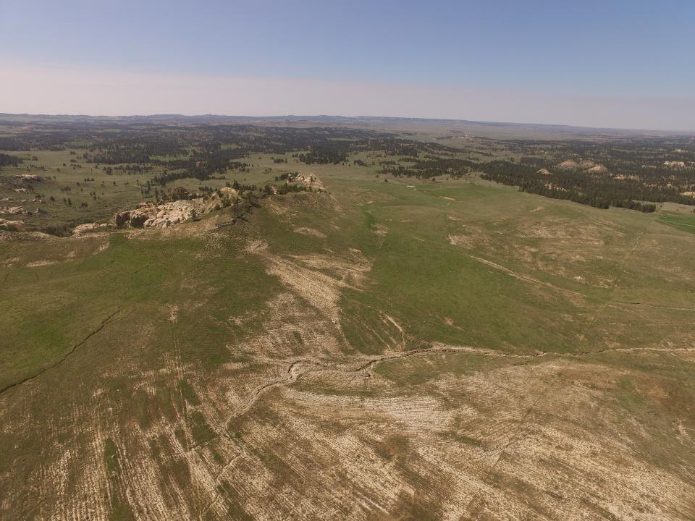
Notes:
View north west. Tribs forming.

Slide 21
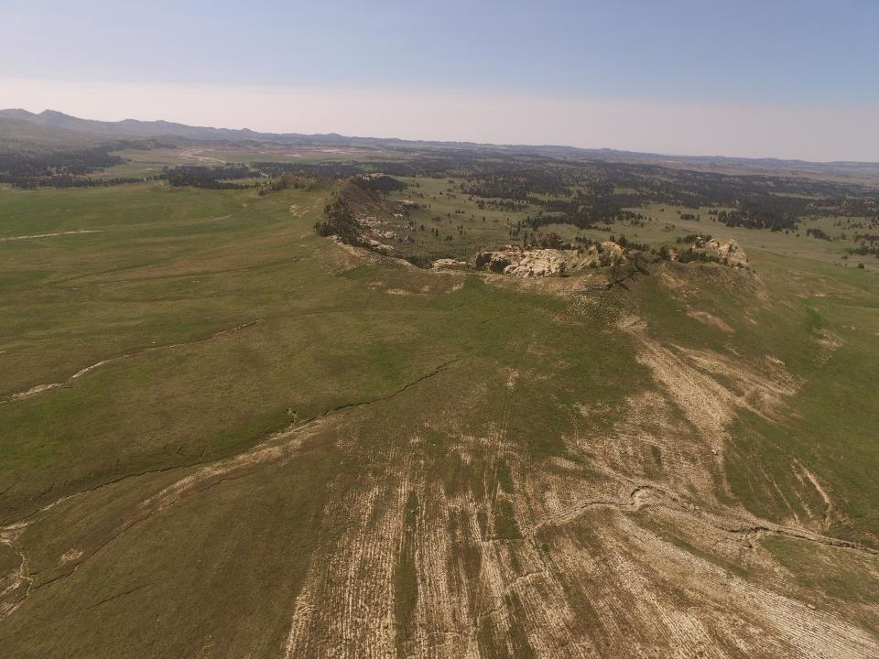
Notes:
View west. Tribs and high wall tie in.

Slide 22
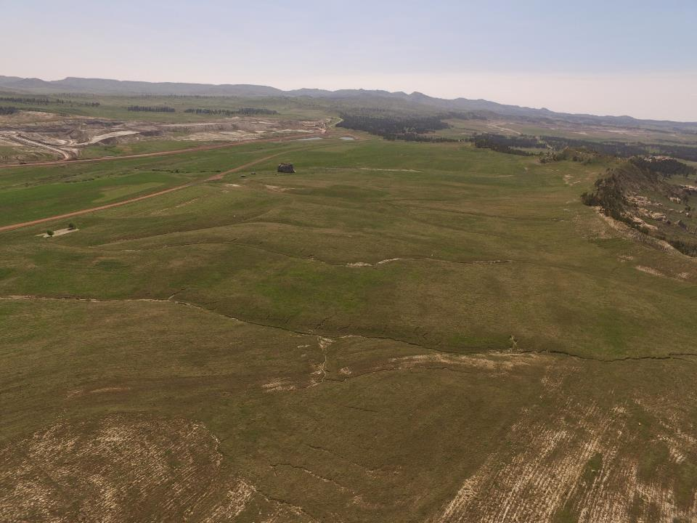
Notes:
View SW. Tribs forming. County Road.

Slide 23
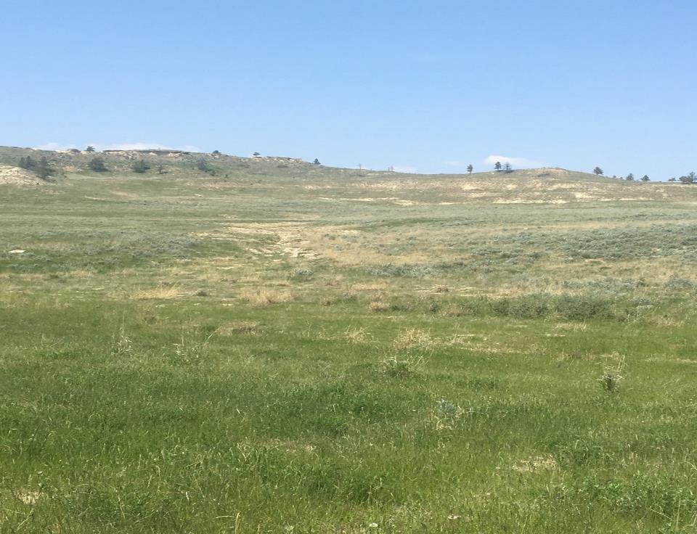
Notes:
CN swale with no soil and sage brush establishment from seed mix. Luck?

Slide 24
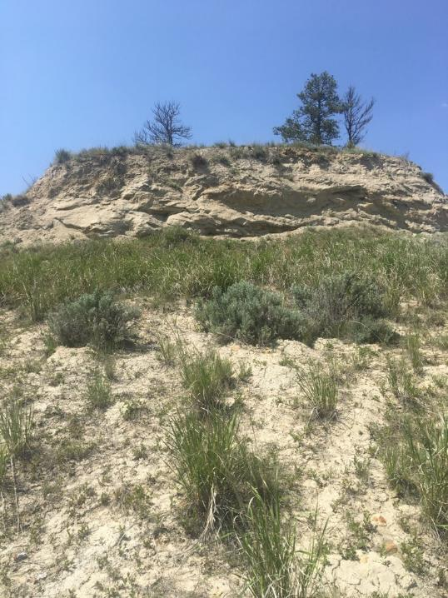
Notes:
Vertical walls in HW reduction. In our area C permit we can leave these steep features.

Slide 25
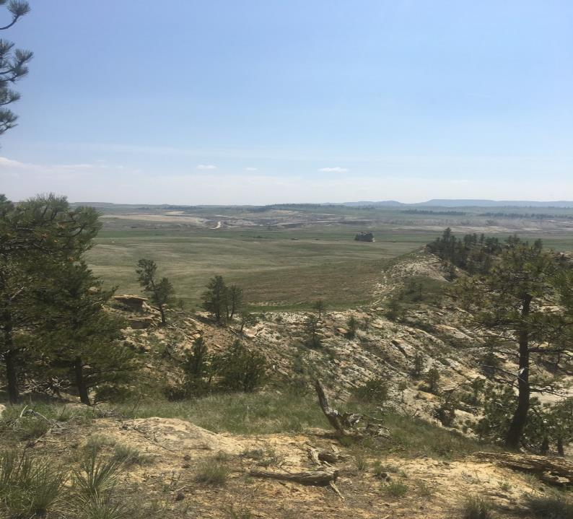
Notes:
View of tie in to undisturbed.

Slide 26
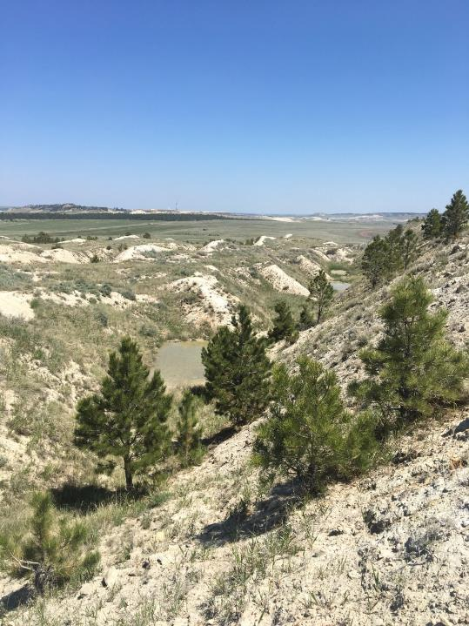
Notes:
Area C thin breaks. Replica feature. Ridge tops with thin soils in SE MT.

Slide 27
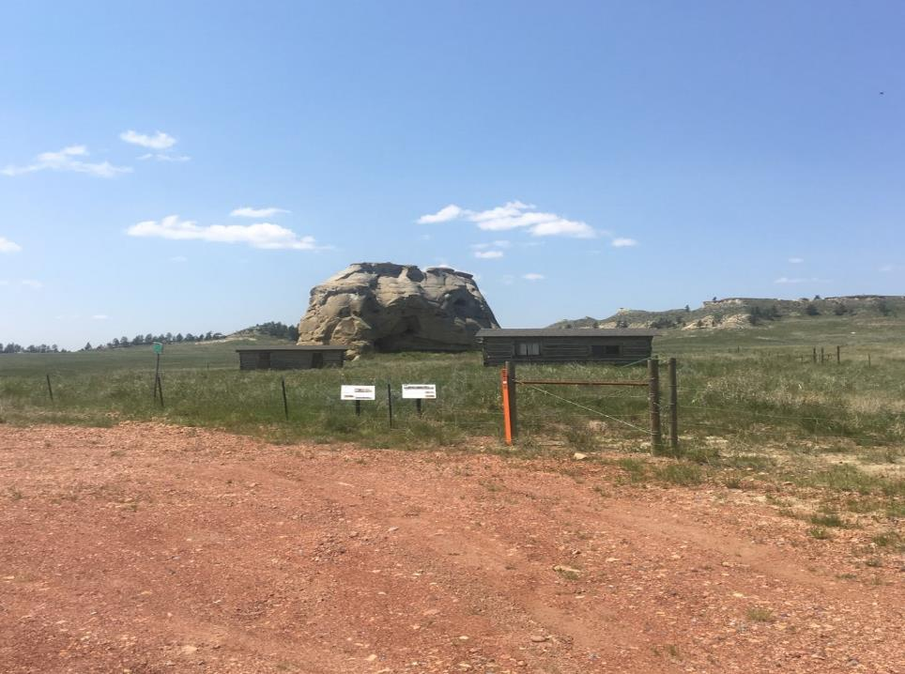
Notes:
Castle Rock Post Office/Rec Hall. Worked with regulatory agencies BLM , DEQ , Land owner GNP. Listed as historical site.

Slide 28
Area D
Time Lapse Video
Special Project Area
Incised Drainages
Soil Deficit
Notes:
Area Mined out. High over burden and diverse topography.

Slide 29
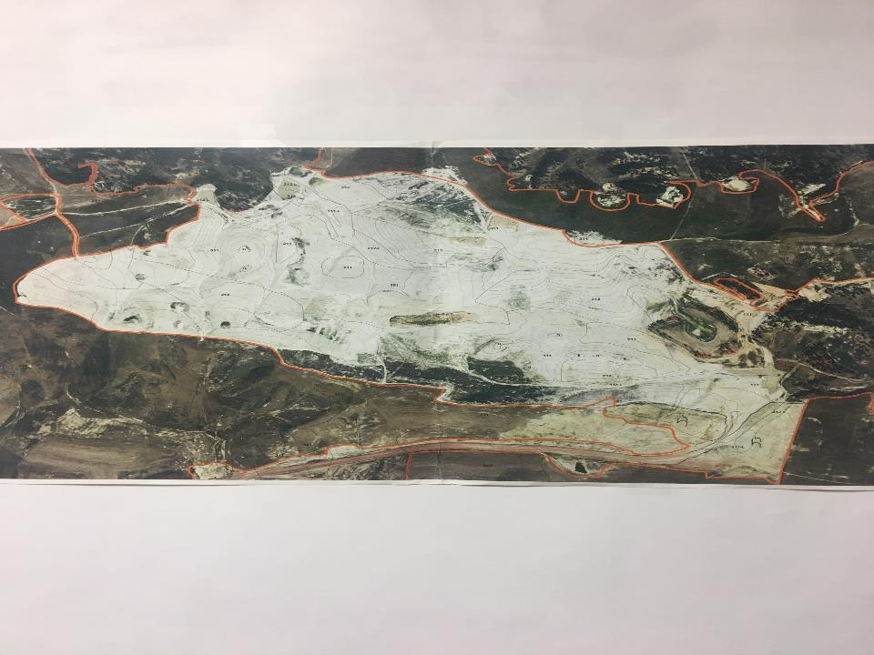
Notes:
Area D Special Project Field Map. Final pit reclamation.
Explain soil deficit solution. Single lift, haul road scoria, sub-soil

Slide 30
Notes:
Area D Time Lapse Video 1998-2013

Slide 31
Notes:
Drone Footage by Chris Oswald-apologies for first time footage.
2016 reclaimed and planted. View from east to west.

Slide 32
Notes:
Area D Drone by Seth May 2019. Special project area. View from west.

Slide 33
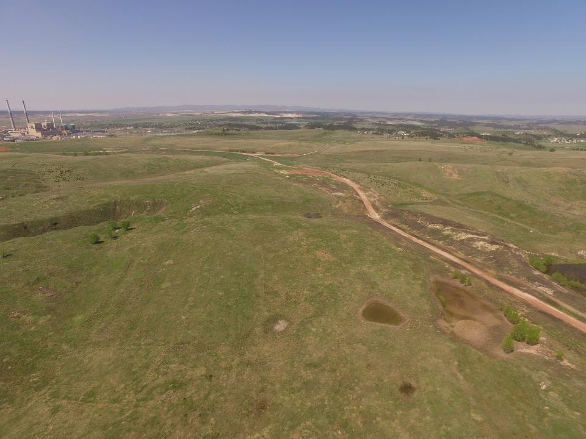
Notes:
Area D haul road rec and post mine 2 track. Note Pre law features on left.

Slide 34
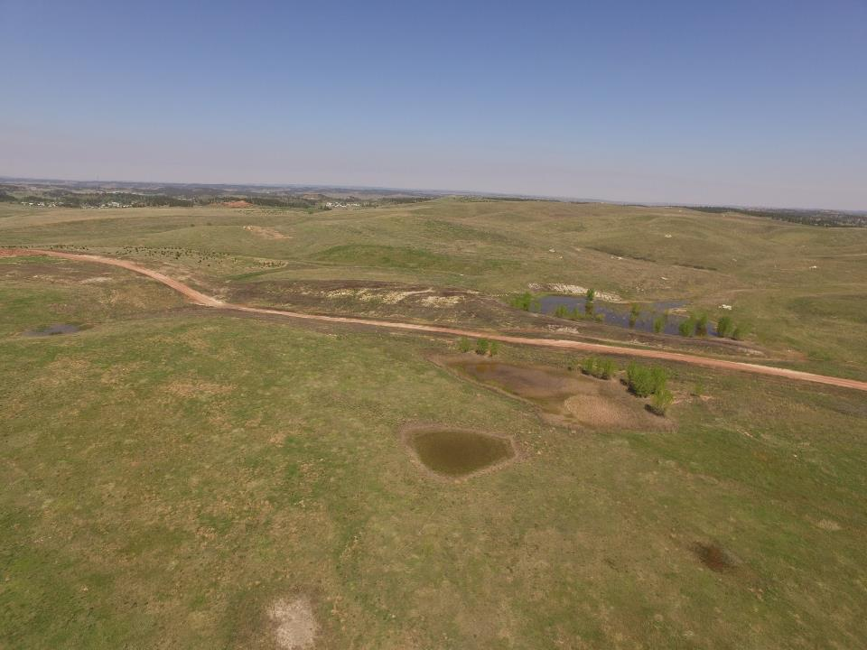
Notes:
Area D. Note small depressions and pond with over flow drainage.

Slide 35
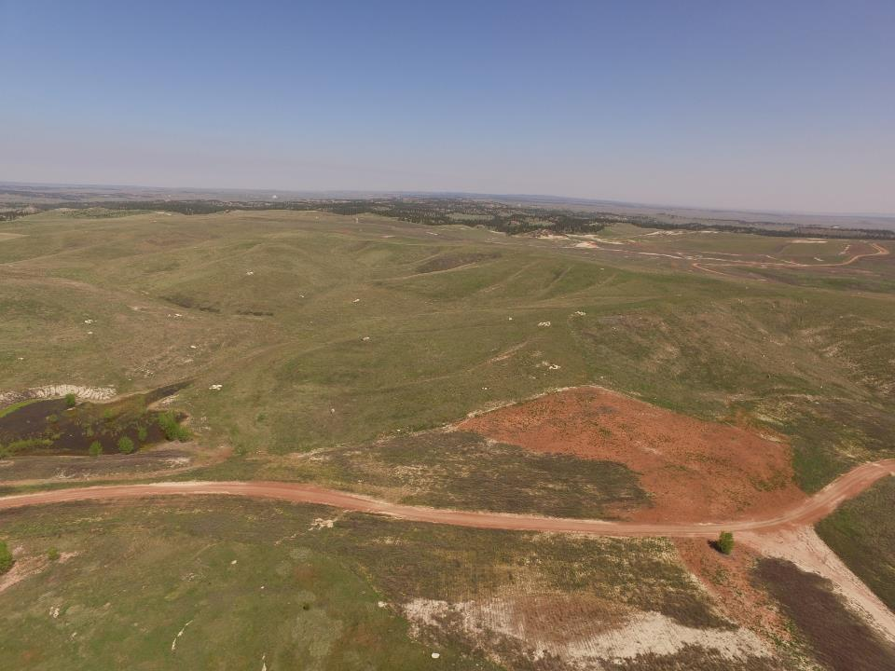
Notes:
Area D significant drainages. DEQ had input.

Slide 36
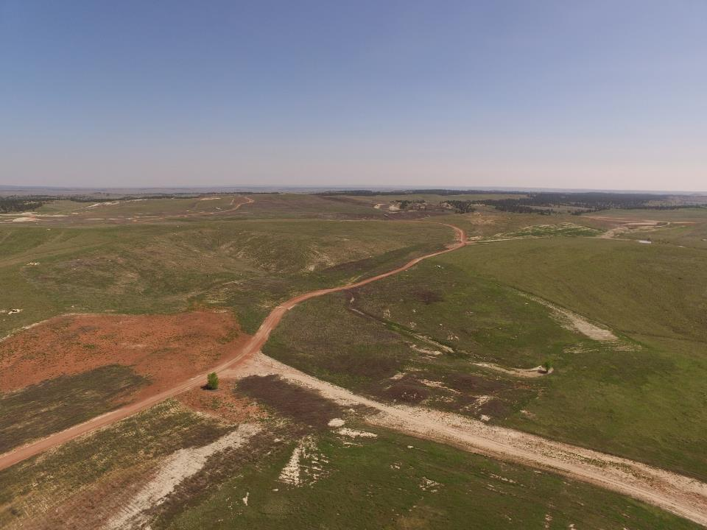
Notes:
Note scoria field from haul road.

Slide 37
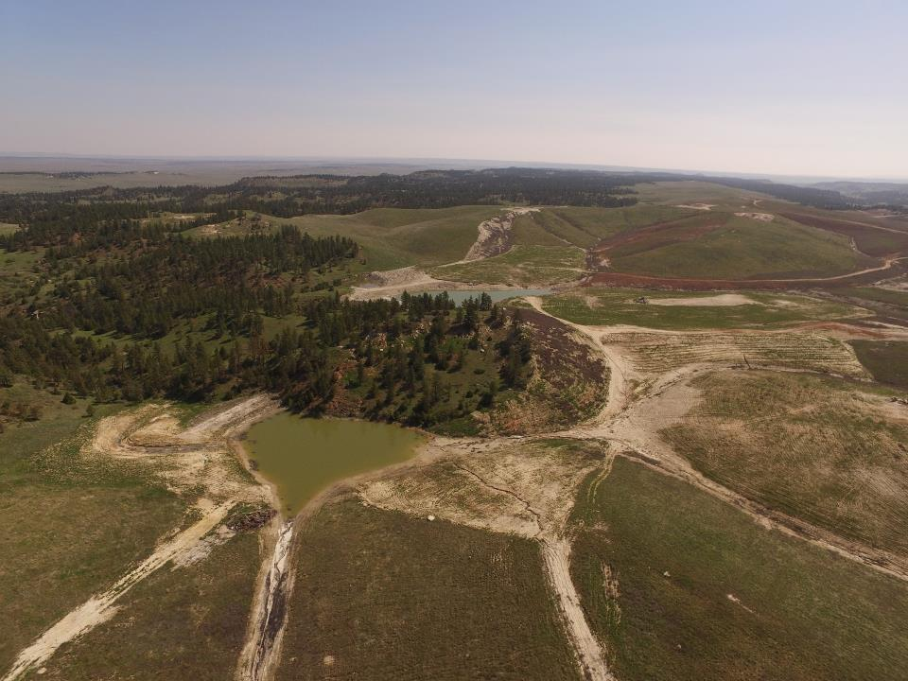
Notes:
Reclamation tie in with permanent ponds. Great for post mine land use wildlife and grazing.

Slide 38
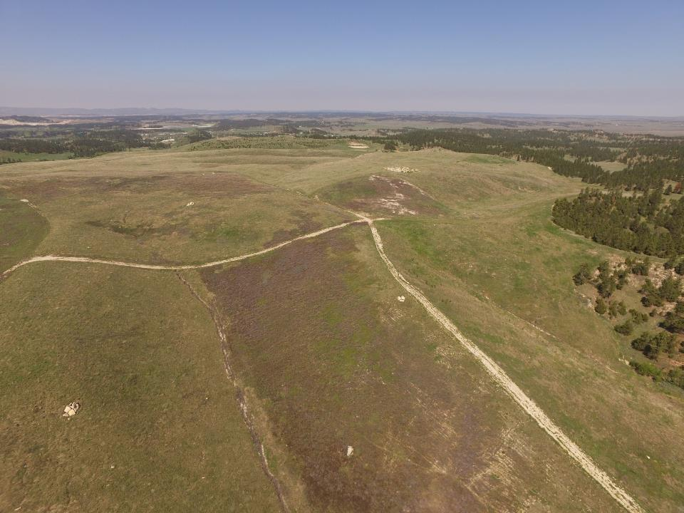
Notes:
Reclamation tie in to steeper slopes. Note topo diversity.

Slide 39
Post-Mining Land Use

Slide 40
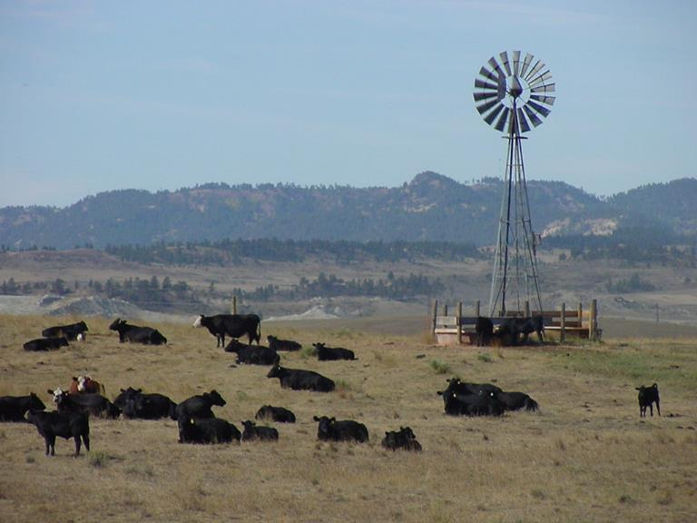
Livestock Production

Slide 41
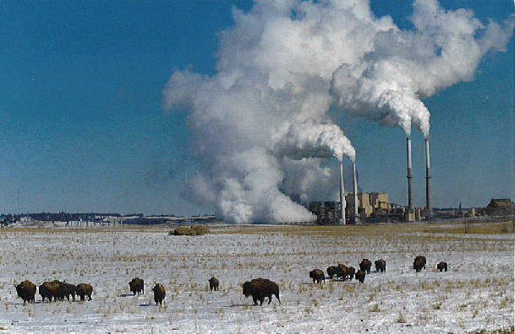
WECO Buffalo Herd

Slide 42
Crop Production

Slide 43
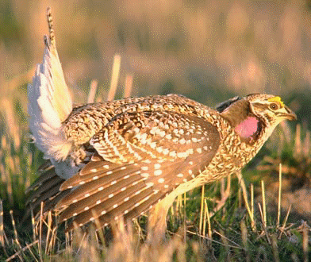
Wildlife

Slide 44
Reclamation Awards

Slide 45
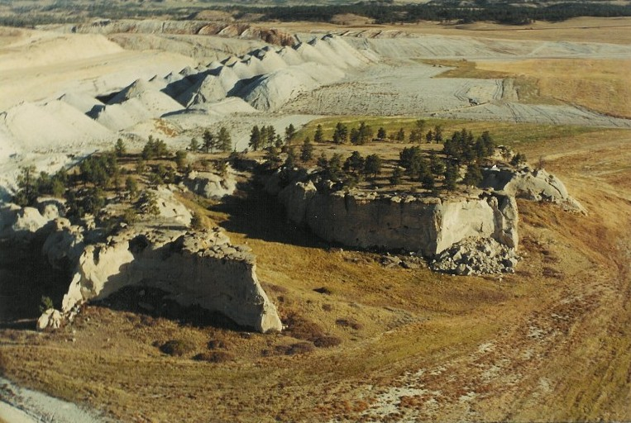
Eagle Rock

Slide 46
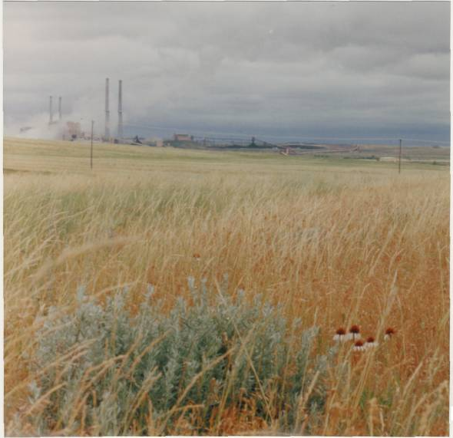
Rangeland

Slide 47
Thank You
Questions & Answers

